Slide 1
Two FPGA Case Studies Comparing High Level Synthesis and
Manual HDL for HEP applications
Marc-André Tétrault
IEEE NPSS Real Time Conference 2018
Williamsburg

Slide 2
Overview
What/why High Level Synthesis (HLS)
First contact account
  Signal processing design
  Flow-through event sorting engine
Take home message

Slide 3
What is High Level Synthesis
Hardware Description Language (VHDL)
High Level Synthesis (C/C++)
Example process:
Average of first 4 samples
process(clk)
begin
if (clk'event and clk = '1')then
q_ResetBLine <= Control(1) xor Control(2);
q_MeanBLine <= Control(2) xor Control(c_Size - 1);
if(q_ResetBaseline = '1')then
q_MeanAcc <= "00" & i_EventStream;
elsif(q_MeanBaseline = '1') then
q_MeanAcc <= q_MeanAcc + i_EventStream;
end if;
end if;
end process;
int BaseLineMean(int Samples[], int ReturnSamples[])
{
int Mean = 0;
for(int x= 0 ; x < SAMPLE_COUNT; x++)
{
if(x < 4) Mean += Samples[x];
ReturnSamples[x] = Samples[x];
}
Mean >>= 2; // divide by 4
return Mean;
}
Flow Control
Sample Stream
10 bit
8 bit MSB
Additional declarations and
flow control sections
Additional directives to HLS compiler

Slide 4
Appropriate for HEP designs?
Tutorial examples sound like a yes
  What about real designs?
  Compare with manual HDL?
Recreate parts of past designs
  Extensive logs, reports and code available
    Design time in man-hours
    Logic resource usage
    Throughput
First contact account
  Good prior FPGA/VHDL experience
  No prior HLS experience whatsoever (only tutorials)

Slide 5
Project 1 : Crystal Identification for PET
Detector
ADC
Lv1 Trigger
Sample Processing
Lv2 Trigger
Downstream consumers…
Tetrault et al, TNS 2010

Slide 6
Design Methodology
Verification
Divergence Evaluation
Matlab
Algorithm
High Level Model
Logic Friendly Model
Fixed point fine tuning
VHDL
VHDL
Test Bench
~2-3 weeks
14 man-days

Slide 7
Design Methodology
Verification
Divergence Evaluation
Verification
Divergence Evaluation
Matlab
C/C++
Algorithm
High Level Model
Logic Friendly Model
Fixed point fine tuning
HLS
Test Bench?
Algorithm
High Level Model
Logic Friendly Model
Fixed point fine tuning
VHDL
VHDL
Test Bench
8 man days to rewrite from original
Synthesis
Likely same 2-3 weeks in real situation

Slide 8
Project 1: Results
 | Manual HDL |  | HLS
 | Virtex-II Pro | Zynq 7000 | Zynq 7000
Flip Flops | 1762 | 1736 | 3910
LUT | 1816 | 1438 | 3542
RAM Blocks | 3 | 3 | 2
Multipliers | 23 | 23 | 24
Event Interval | 36 clocks | 36 clocks | 36 clocks
Latency | 252 clocks | 252 clocks | 300 clocks
Clock period | 6.78 ns | 5.3 ns | 10.7 ns

Slide 9
Project 1:Lessons learned
Timing not reached, larger design, but…
  Learned new strategies at the workshop, to be attempted
Time saving
  Hard to do exact comparison, but still consider HLS faster
  No duplicate test bench to write
  First HLS design, learned on the fly, some trial and error
Prior FPGA experience very advantageous
  Existing intuition about synthesis-friendly design entry
  Easier to identify and fix bottlenecks and poor synthesis attempts

Slide 10
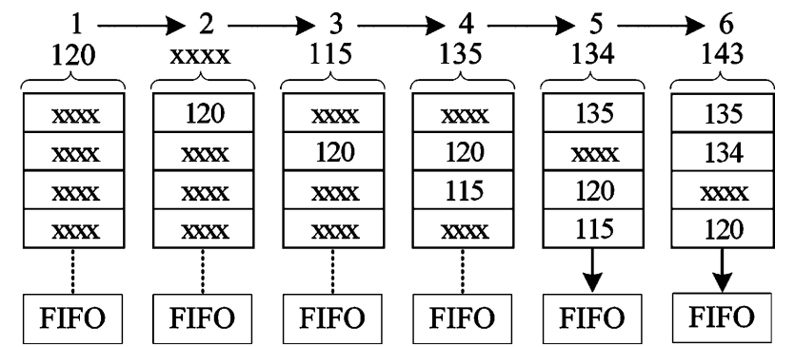
Project 2: Flow-Through Event Sorter
Shift list and insert when smaller
First version in 2005
  Virtex2 Pro
  100 MHz
  700k events/sec, list depth of 112 events
  5 man-days
Second version in 2008
  Virtex-5/6/7
  300 MHz
  1M events/sec, memory depth of 290 events
  5 man-days (pipeline re-alignment)
Tetrault et al, TNS 2010

Slide 11
Project 2: Flow-Through Event Sorter
Circular memory list
3-stage Pipeline
  One special case when event leaving sorter at bottom of the list
Comp N-2 | Write in N-3
Read N-1 | Comp N-1 | Write in N-2
 | Read N | Comp N | Write in N-1
 |  | Read 0 | Pass to Next | Write in N
 |  |  | Read 1 | Comp 1 | Write in 0
 |  |  |  | Read 2 | Comp 2 | Write in 1

Slide 12
Project 2: results
Items to improve
  Explicit pipeline in C code ☹
    Harder to read intent
  How to wrap loop on itself without reinitialization?
    Needs 8 clocks to start the pipeline every time
  Still looking for potential directives
But…
 | Manual HDL | HLS
 | Zynq 7000 | Zynq 7000
Flip Flops | 187 | 522
LUT | 75 | 471
RAM Blocks | 1 | 2
Sorting Cycle | 100 clocks | 108 clocks
Max Frequency | 300 MHz | 300 MHz
Man days | 5 days | 1-2 days

Slide 13
Project 2: Lessons Learned
Virtex-2 Pro to Virtex-5/6/7 Migration
  135 MHz to 300 MHz
  Multiplier primitive change (register stages)
  5 days with debug (same as initial design!)
With HLS, tool adjusts the pipeline automatically
  From 135 MHz to 300 MHz in one setting change
  No modifications to the code
  Expect easier migration between generations/technology

Slide 14
Conclusion
HLS workflow is compatible with the two use cases
Strong code reuse potential
Optimization : prior FPGA experience is very helpful
  Understanding the reports and implications is crucial
HLS designs have larger logic footprint
  … but better experience with the tool have good chances to improve this

Slide 15
Thank you!
Questions?

