Slide 1

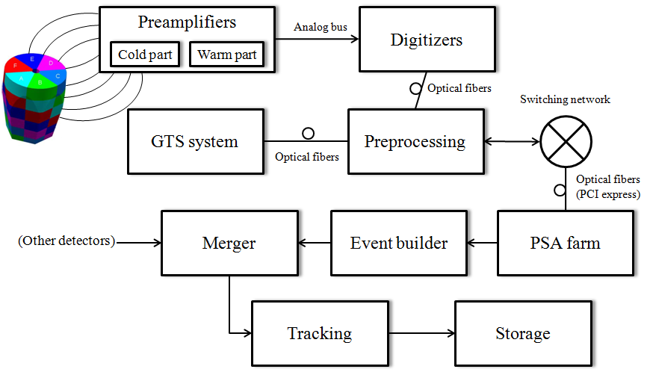
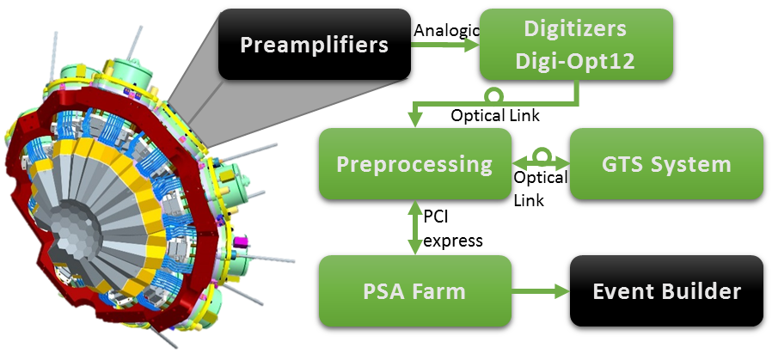
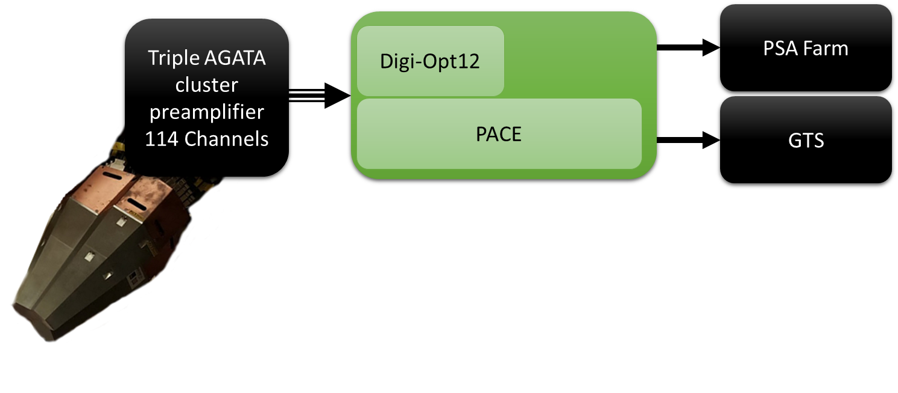
First Generation Electronics
25 Crystal
Second Generation Electronics
60 Crystal
Third Generation Electronics
Beyond 60 Crystal

Slide 2
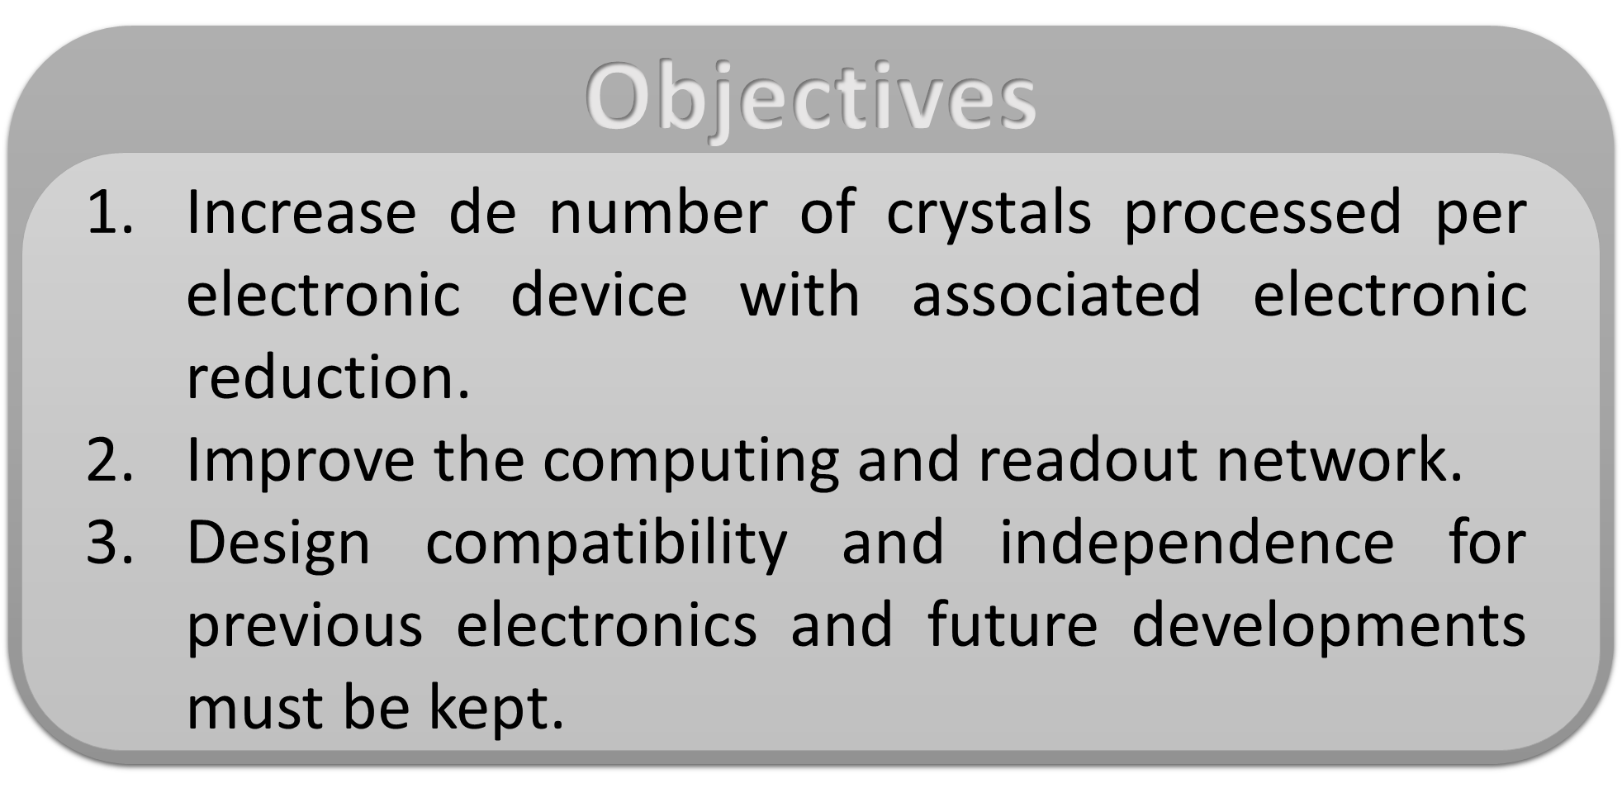
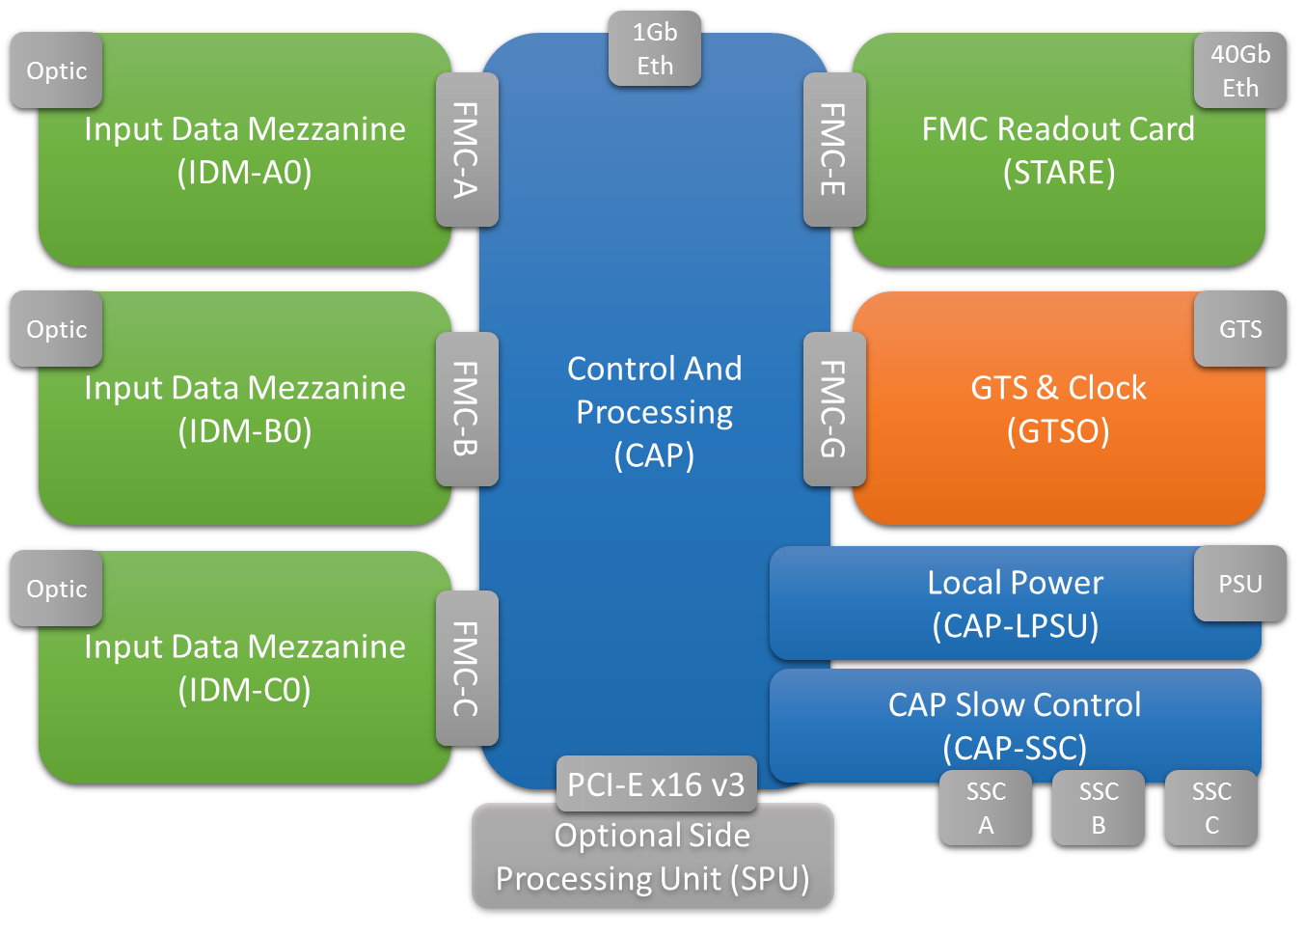
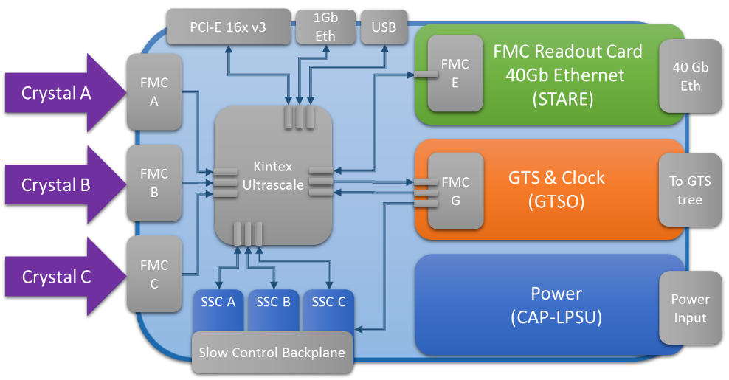
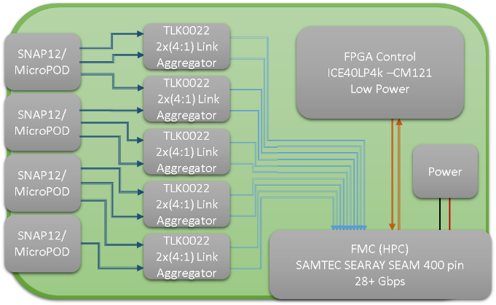
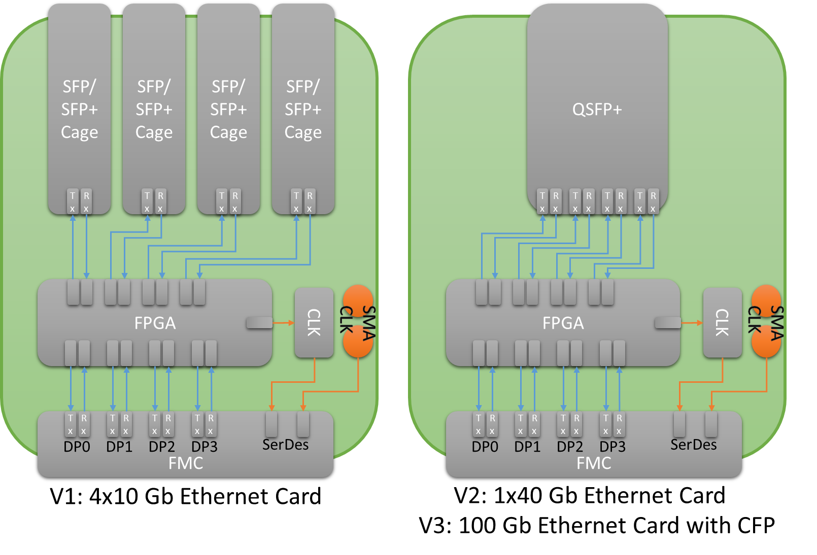
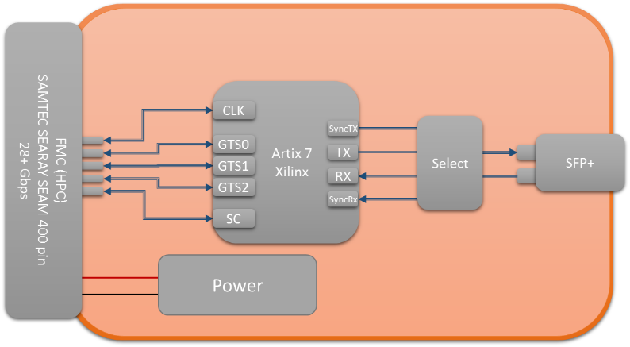

PACE Process and Control over Ethernet system
CAP
Control And
Processing
STARE
Serial Transfer Acquisition over Ethernet
IDM – Input Data Mezzanine
GTSO – Global Trigger System Output

