Slide 1
PLAS: A 32-channel, dead time-less analog memory ASIC for the TRACE detector
R. J. Aliaga, V. Herrero, S. Capra, J. A. Dueñas, A. Pullia, A. Gadea, D. Mengoni
Contact: raalva@ific.uv.es
20th Real Time Conference – Padova, Italy

Slide 2
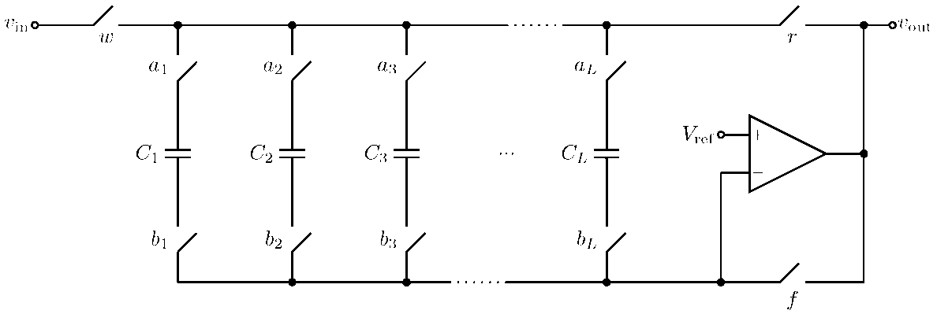
Classical Analog Memory:
SCA (Switched Capacitor Array)
a₁, b₁
a₂, b₂
a₃, b₃
a₄, b₄
Write: close w and f. Read: close r.
Capacitors charged consecutively, high write frequency
On trigger, SCA is stopped and contents are held
Slow read frequency, voltage is digitized externally
SCA is replicated for each input channel

Slide 3
Classical Analog Memory:
SCA (Switched Capacitor Array)
a₁, b₁
a₂, b₂
a₃, b₃
a₄, b₄
Write: close w and f. Read: close r.
Problem: SCA cannot be rewritten until read out.
Low read frequency implies very long dead time.
Existing solutions: partial readout, replication

Slide 4
New Analog Memory Structure:
PLAS (PipeLined Asymmetric SCA)
Proposed solution: Split the memory into two sequential SCA stages
No deadtime
Decreased number of capacitor cells

Slide 5
New Analog Memory Structure:
PLAS (PipeLined Asymmetric SCA)
Stage 1: Many short SCAs for pre-trigger samples
One per input channel
Continuous capture until trigger, then stop

Slide 6
New Analog Memory Structure:
PLAS (PipeLined Asymmetric SCA)
Stage 2: Few long SCAs for post-trigger samples
Shared between all inputs
Idle until trigger, then start capturing
Include buffer SCA where contents of stage 1 are copied

Slide 7
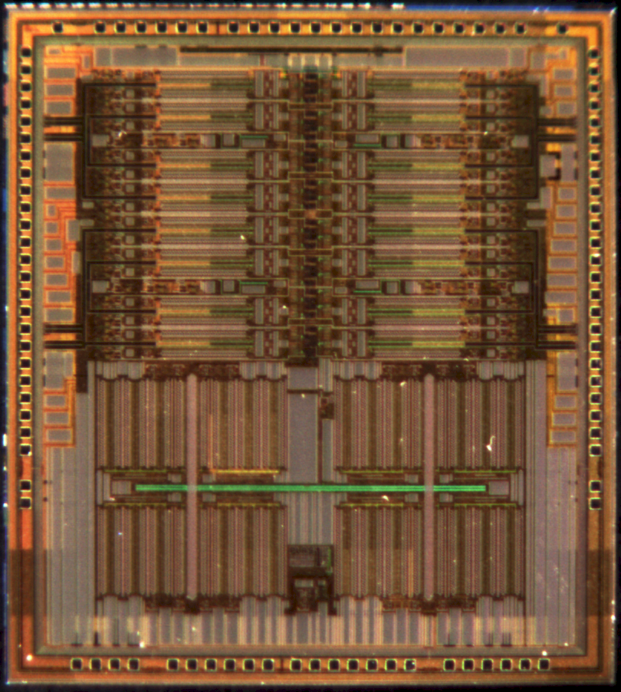
Come and see!
2nd poster session
Poster no. 42
Friday 10 Jun
11:00 – 12:30

