Slide 1

The State Key Laboratory of Particle Detection and Electronics,
Institute of High Energy Physics, CAS
A High Frame Rate Test System for the HEPS-BPIX based on NI-sbRIO Board
Jingzi Gu

Slide 2
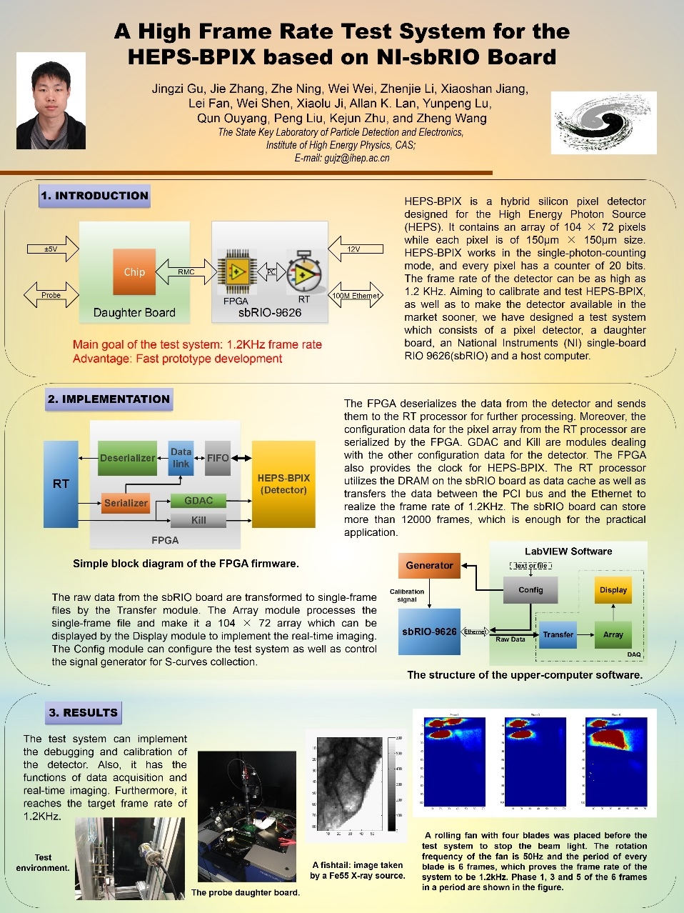
Poster
Motivation
Details of the design
Results
Jingzi Gu

