Slide 1
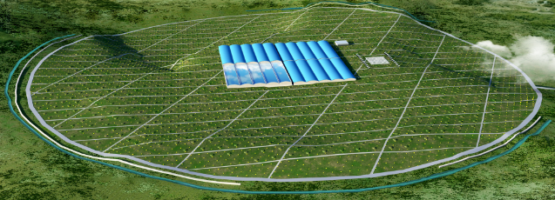
LHAASO WCDA Experiment
Extensive Air Shower
1) precise time and charge measurement over a large dynamic range from 1 to 4000 Photo Electrons (P.E.);
2) high quality clock distribution and automatic compensation with varying ambient temperature;
3) high bandwidth and reliability data transmission technology for the “trigger-less” electronics;
4) mixed transmission over the same fiber for data, commands, and the clock signal, in order to simplify the system architecture considering the large scale of detector node distribution;

Slide 2
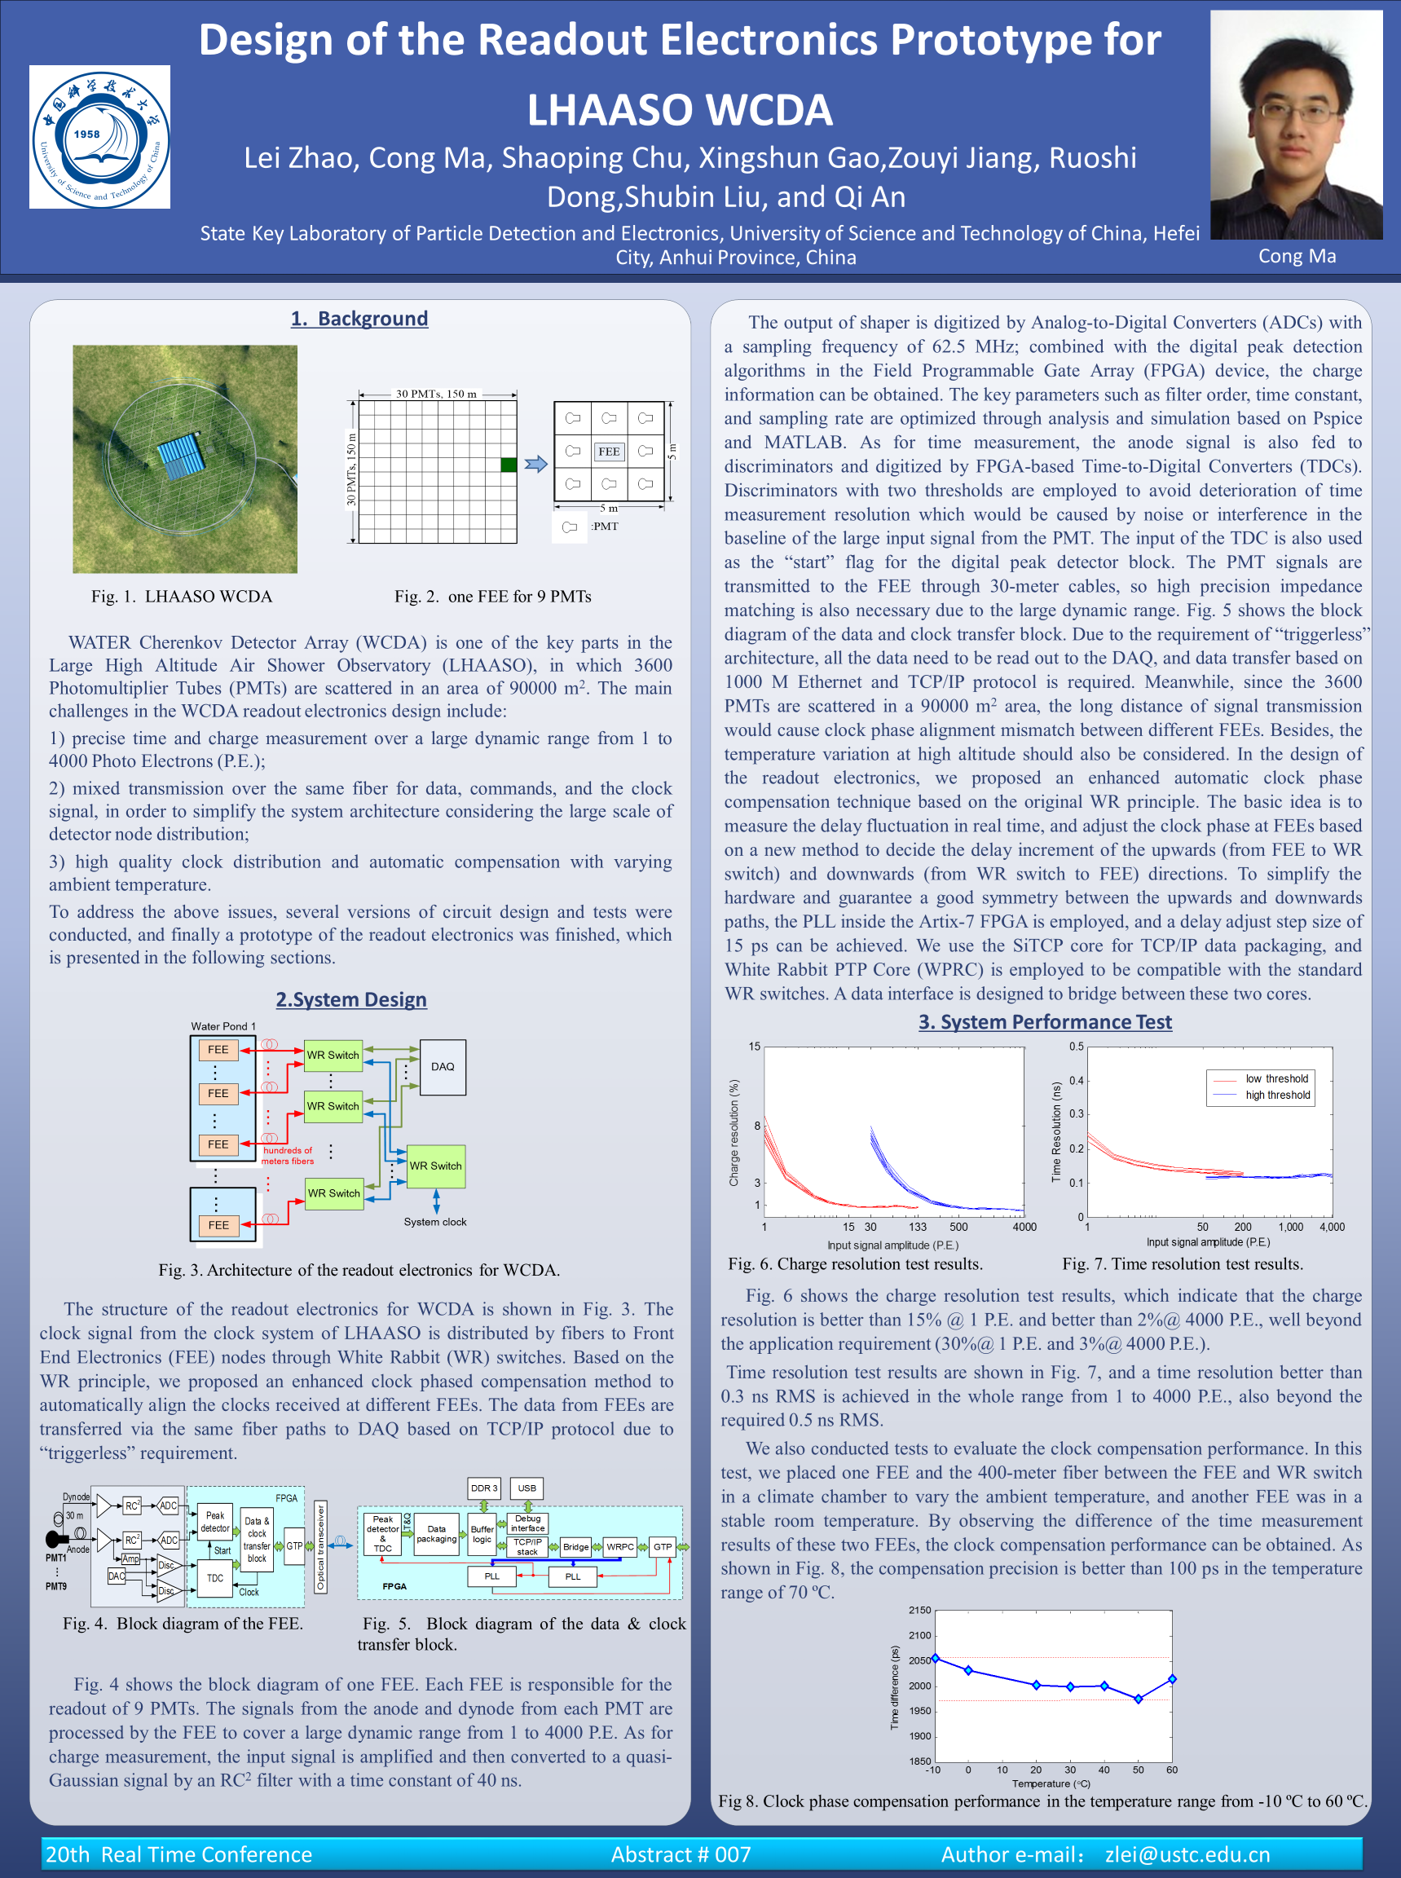
Poster
Background
System Design
Experiment and Results

