Slide 1
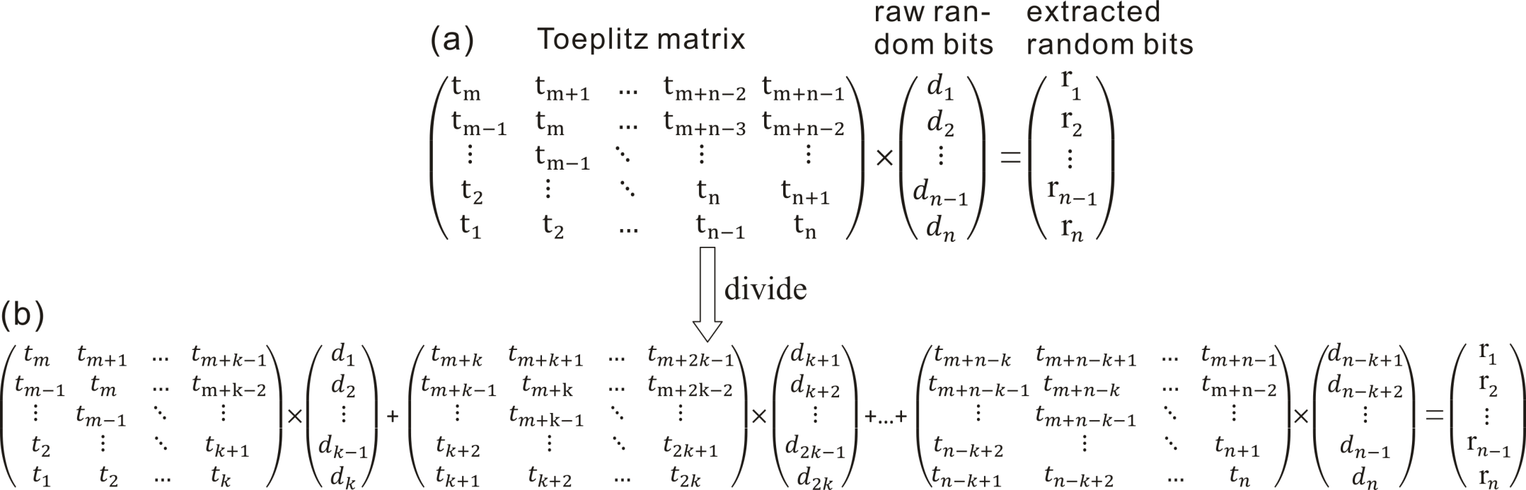
FPGA Implementation of Toeplitz Hashing Extractor for Real Time Post-processing of Raw Random Numbers
Xiaoguang Zhang, You-Qi Nie, Hao Liang, Jun Zhang
Department of Modern Physics, University of Science and Technology of China
State Key Laboratory of Technologies of Particle Detection & Electronics, Hefei, China
The way to transplant Teoplitz hashing extractor from computer to a resource limited FPGA.

Slide 2
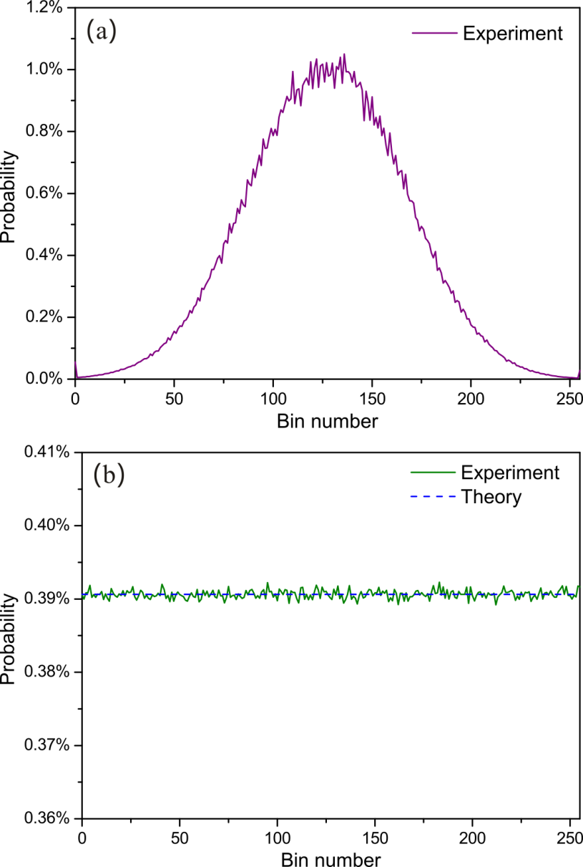
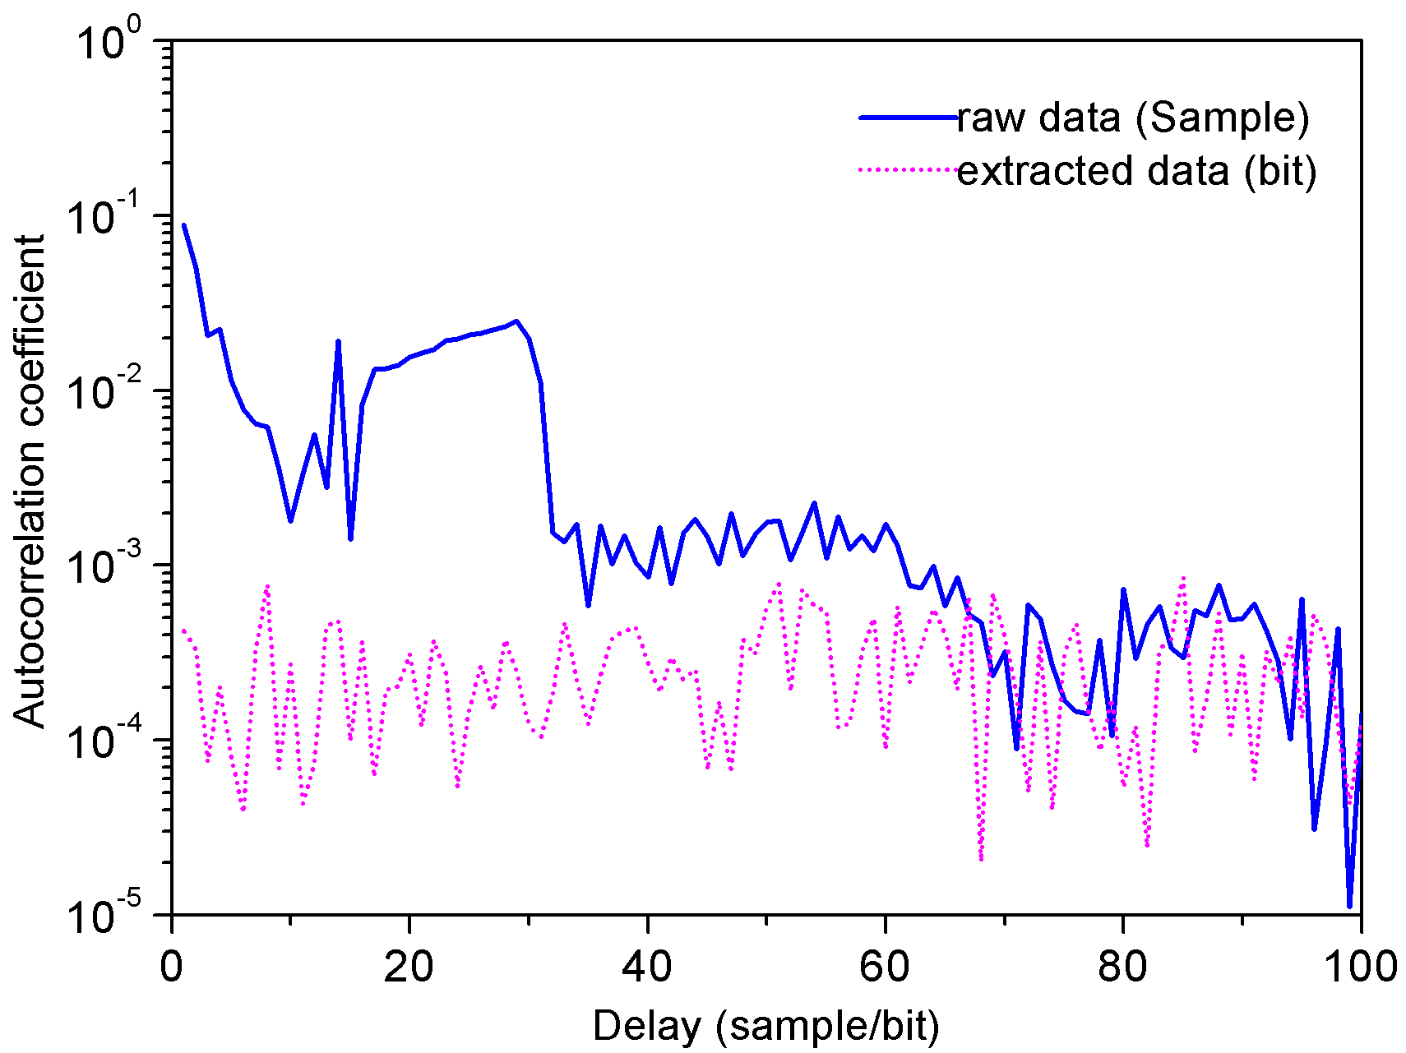
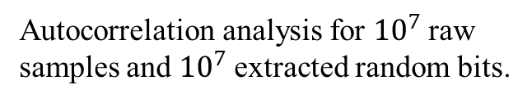
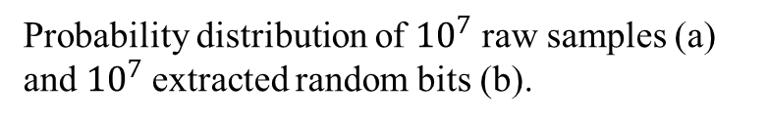
Experimental Results
The real time post-processing speed reaches above 3.36 Gbps
Autocorrelation analysis for ${10}^{7}$raw samples and ${10}^{7}$extracted random bits.
Probability distribution of ${10}^{7}$ raw samples (a) and ${10}^{7}$extracted random bits (b).

Slide 3
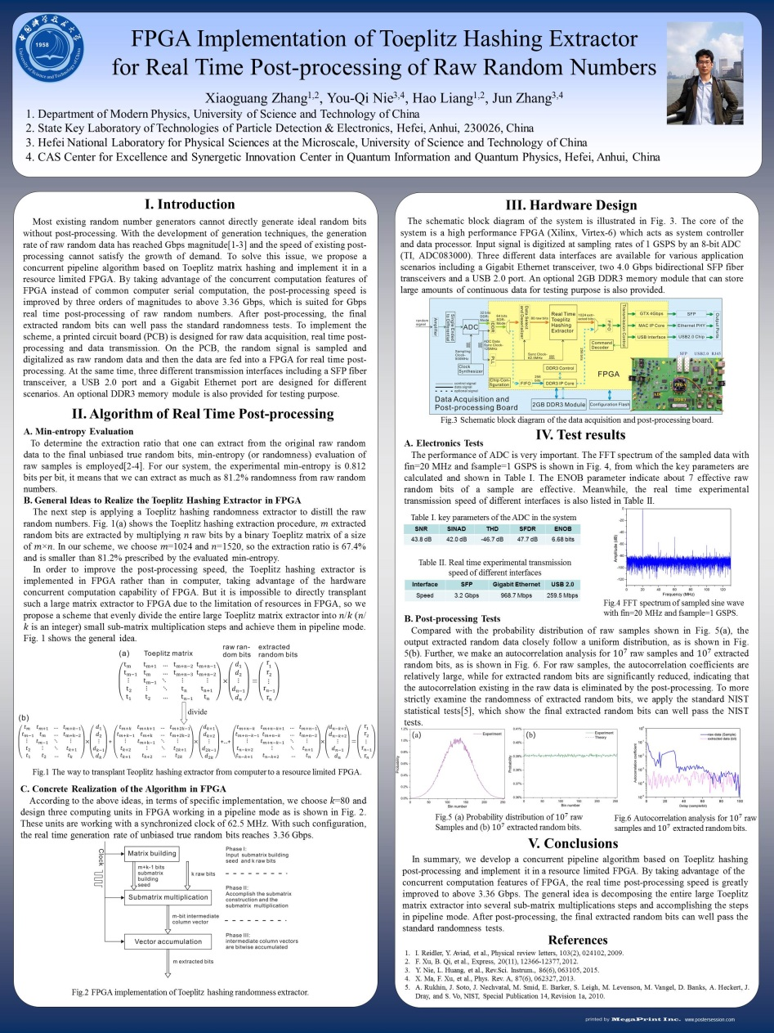
Poster
Hardware design
Ideas to realize the Toeplitz Hashing extractor in FPGA
Results

