Slide 1
High Speed Ethernet Application for the Trigger Electronics of the New Small Wheel
Houbing Lu, Kun Hu, Xu Wang, Feng Li, Liang Han, and Ge Jin
Modern Physics Department, University of Science and Technology of China
State Key Laboratory of Particle Detection and Electronics, USTC, Hefei, 230026
The GEM (gigabit Ethernet module) provides a test platform for the Ethernet.
The core of the GEM is based on a Kintex-7 FPGA. The Ethernet transceiver with the 1000BASE-T standard is operated at the physical layer.

Slide 2
FPGA Ethernet
The Ethernet MAC core is embedded in the FPGA for implementa-tion of Ethernet data link layer.
The design includes a basic glue logic brings up the external PHY and MAC to allow basic frame transfer or receive.

Slide 3
GEM Test
Linear data correctness test.
Transfer speed and stability test. Measure the transfer rate for 150 minutes, sample interval is 1 minute.

Slide 4
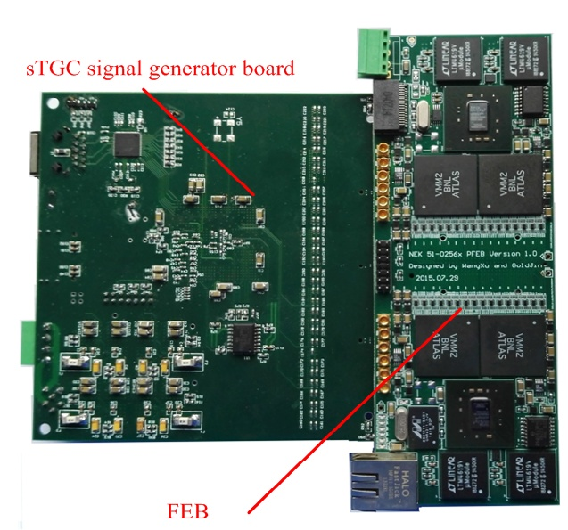
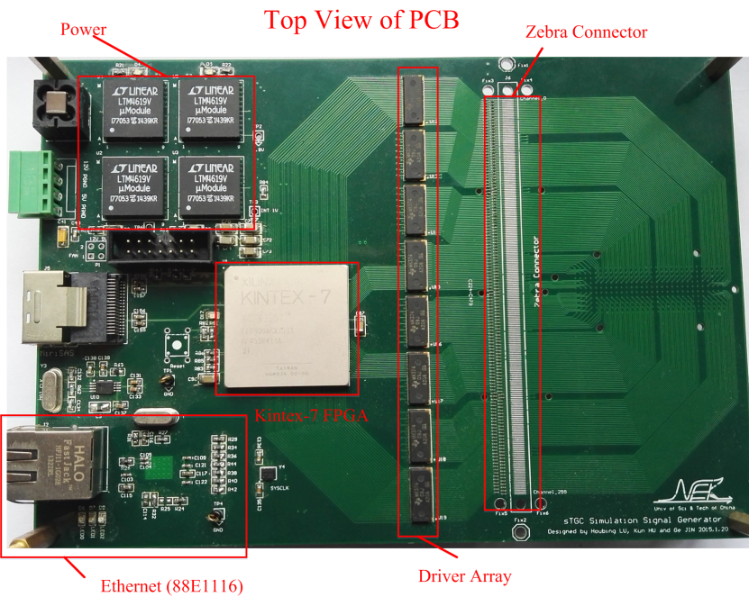
GEM Application
The GEM prototype has been applied in pFEB (pad frond end board) and SG (signal generator). The Ethernet interface is response for the communication between pFEB and PC or SG and PC.

Slide 5
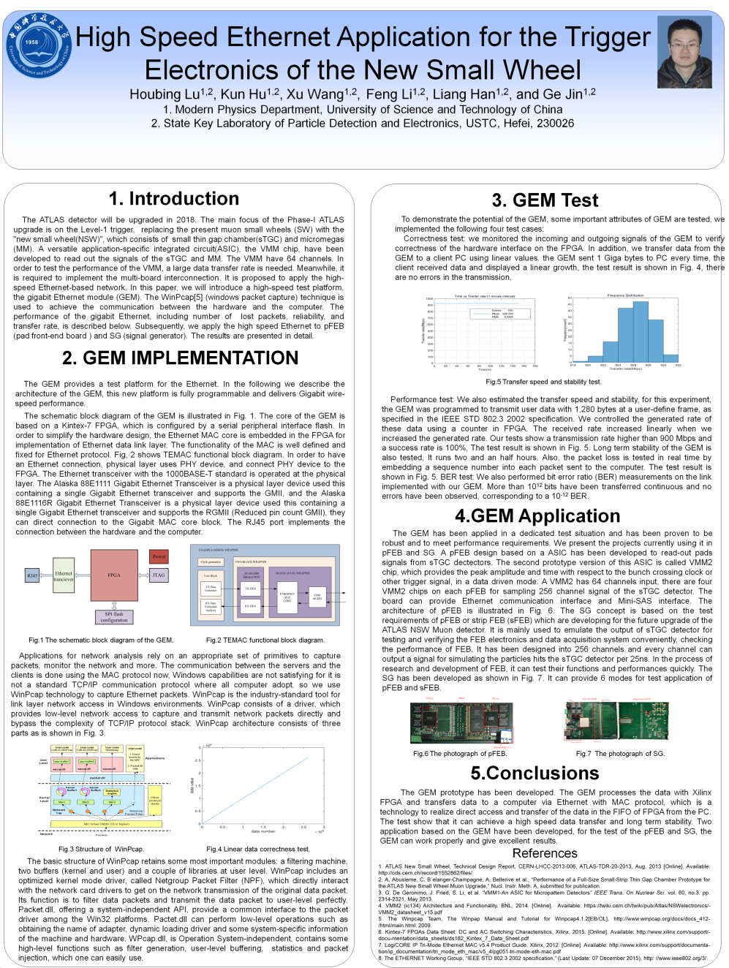
Poster
GEM Test
Introduction
GEM Application
GEM Implementation

