Slide 1


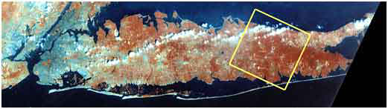
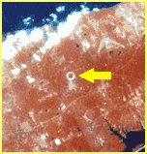
The Readout and Data Acquisition Design
of the sPHENIX Detector at RHIC
Martin L. Purschke
Manhattan
Long Island, NY
RHIC from space

Slide 2
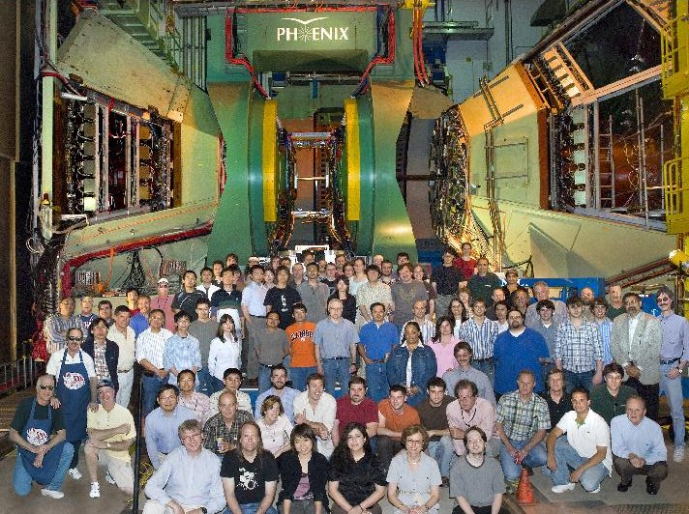
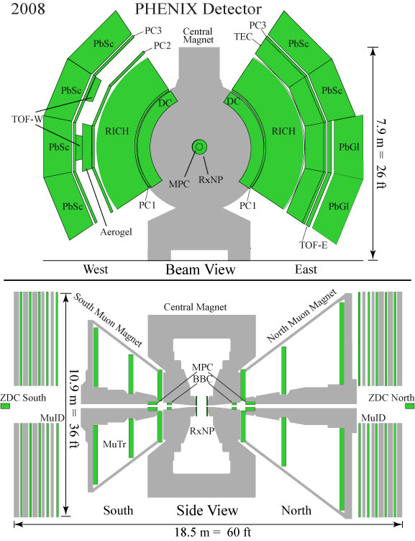
PHENIX 2000 - 2016
Quite a number of different detectors
4 Arms and central detectors
No hermetic coverage

Slide 3
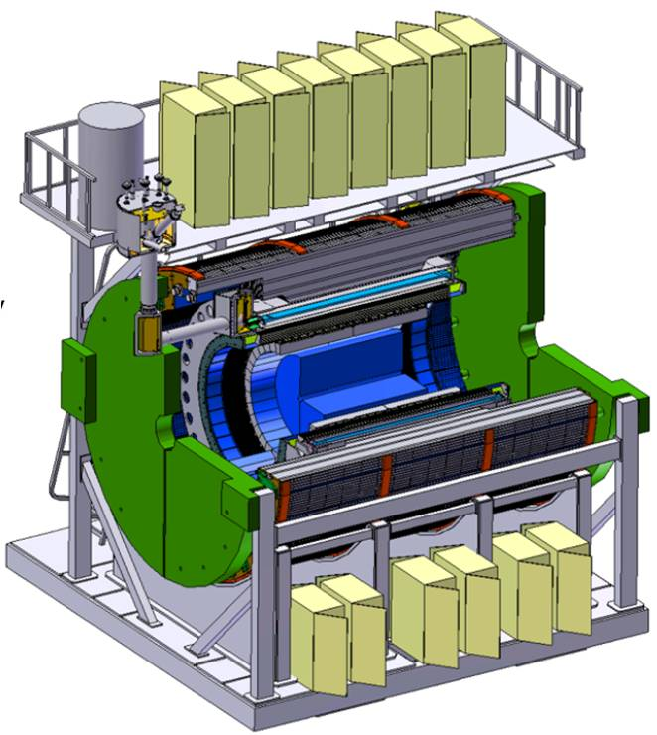
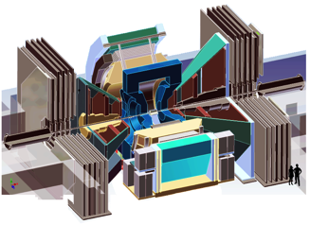
PHENIX -> sPHENIX
PHENIX has been around since the early 90’s
Started taking data in 2000, first Physics Run in 2001 – Run 16 is ongoing
400+ people collaboration, 200-ish publications, some “famous” ones among them
Still, the experiment is showing its age – much older than the cars most of us drive
The missing hermetic coverage is an issue for today’s analyses
Limitations of the 90’s designs look strange to us today
A wealth of new insights guides us what to look for next, how to build the next-gen detector

Slide 4
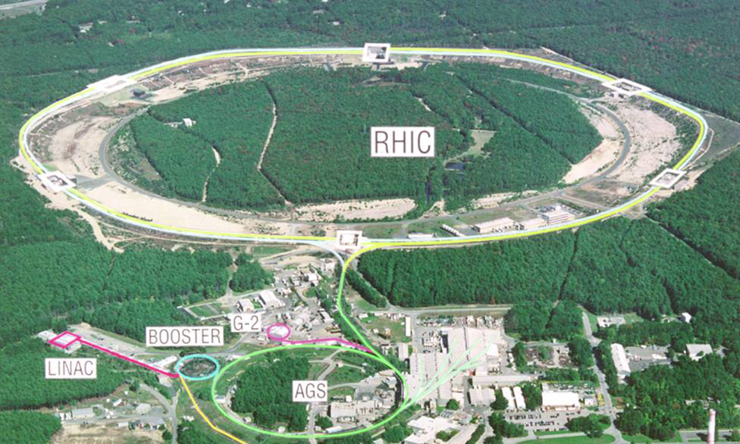
RHIC and (s)PHENIX
The Relativistic Heavy Ion Collider
Huge variety of ions possible - Au, Cu, ³He, ²³⁸U so far, but pretty much anything is possible
Polarized protons – a unique facility
500GeV/proton -> 200GeV/N for Au
Dedicated HI and polarized proton facility
PHENIX – high-rate heavy-ion experiment
Electromagnetic probes - Photons, electrons, muons
Heavy quarks & quarkonia

Slide 5
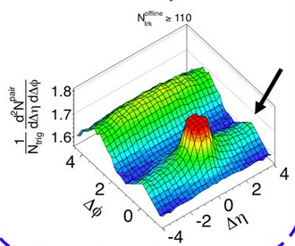
sPHENIX from a Physics Perspective… Jets!
The days of measuring single particles, in however a comprehensive way, are largely over
Most analyses look for some form of correlations between particles in individual events
Reaction planes, the now-famous long-range correlation ”ridge”, jets
Jets in particular is what carries the physics these days – probing the medium
The “Ridge”

Slide 6
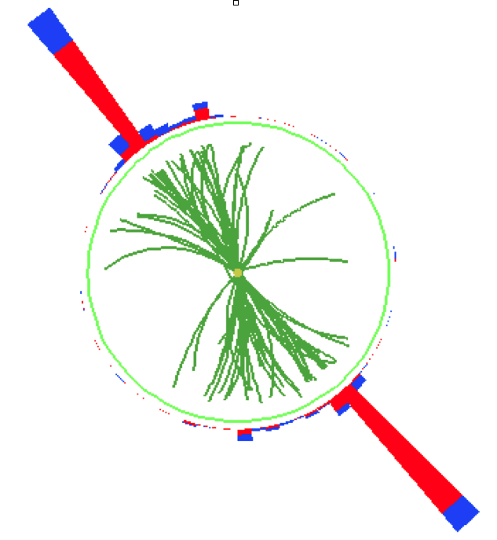
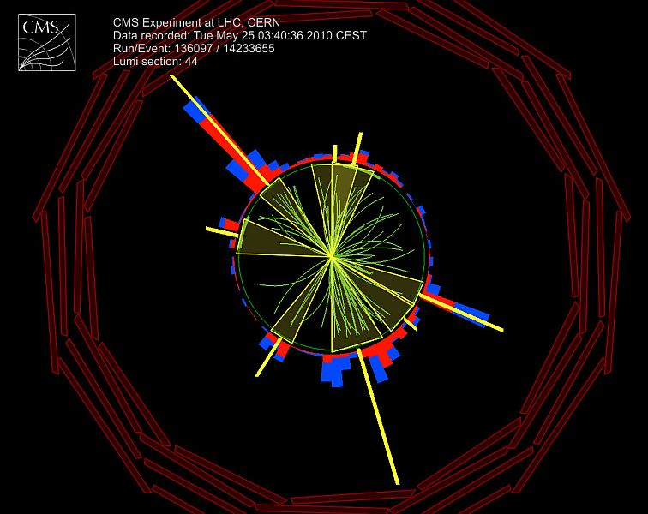
Jets
Jets are made in hard QCD scattering of quarks or gluons
You get an initial pair of quarks with (mostly) opposite momentum
Quarks hadronize – they produce a “spray” of particles in narrow cone, the “jets”
So we are looking for those back-to-back cones of particles

Slide 7
So, what do we want?
While we have a number of jet measurements, the PHENIX acceptance is too small (and has too many holes) to be a good jet detector
So what we want is:
full azimuthal coverage, large coverage in rapidity ( +- one unit)
decent tracking
electromagnetic and hadronic calorimetry
compact
So let’s go and upgrade the experiment!

Slide 8
Why didn’t we build PHENIX like that in the first place?
Crane clearance
The available materials at the time were such that a full-azimuth detector would not fit into the experimental hall
Only new techniques and materials make this possible, 20+ years later
“Lake PHENIX” level
If one digs just a few inches, there’s water…
Water table

Slide 9
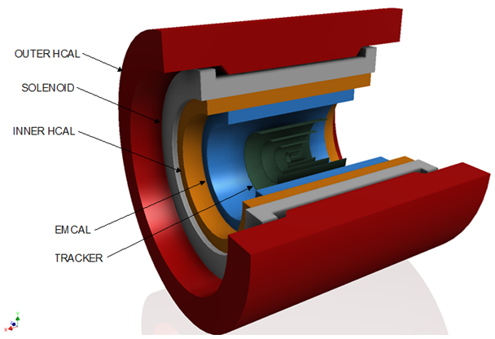
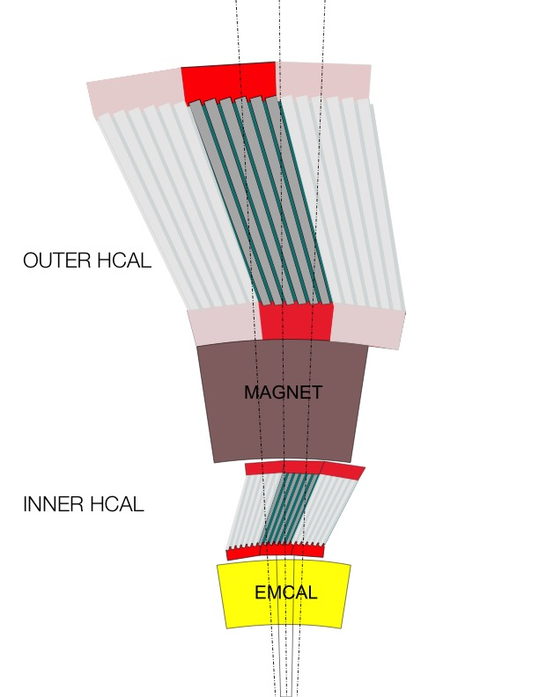
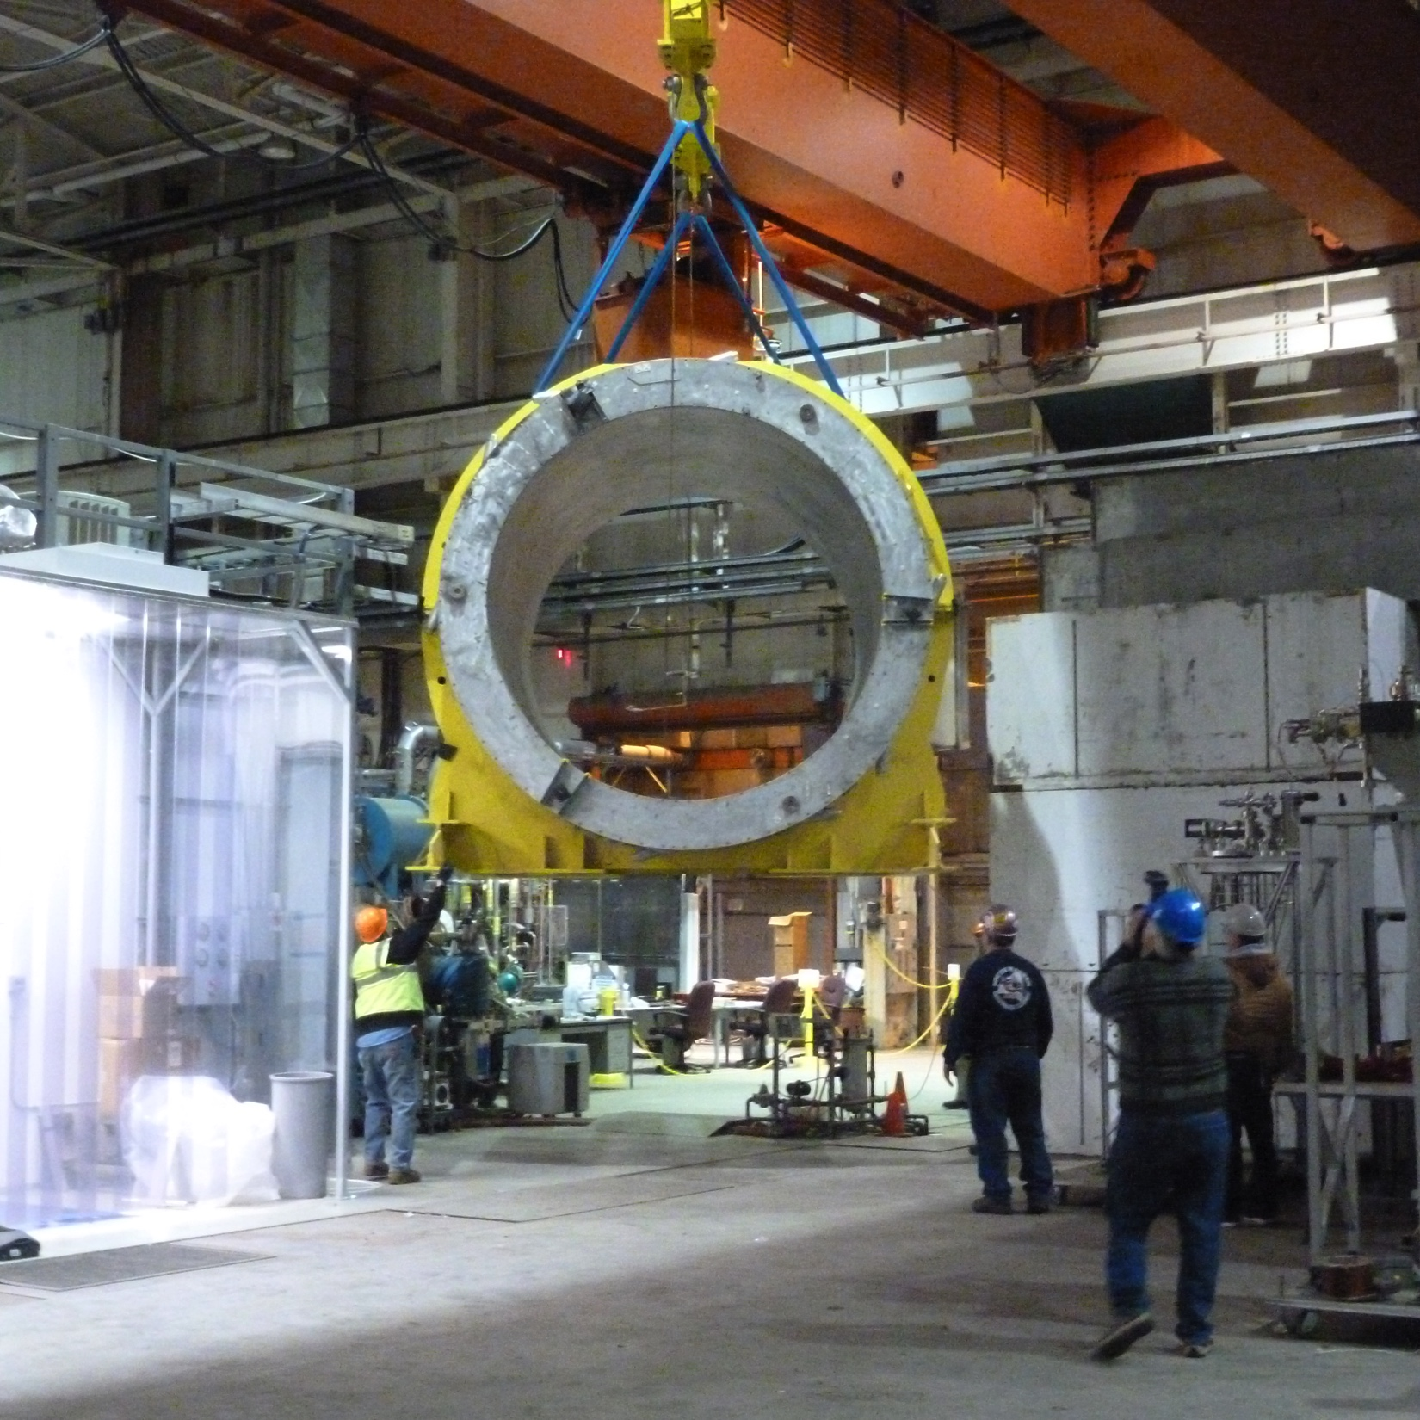
sPHENIX – the Concept
HCAL steel and scintillating tiles with wavelength shifting fiber
  2 longitudinal segments.
  An Inner HCal inside the solenoid.
  An Outer HCal outside the solenoid.
  Δη x Δφ ≈ 0.1 x 0.1
  2 x 24 x 64 readout channels
  σ_{E}/E < 100%/√E (single particle)
SiPM Readout
Outer HCAL ≈3.5λ_{I}
Magnet ≈1.4X₀
Inner HCAL ≈1λ_{I}
EMCAL ≈18X₀≈1λ_{I}
Tracker
The BaBar Magnet

Slide 10
The EmCal (this is is really the special item…)
A lot of the space savings (compared to PHENIX) are found in the Emcal
In the 90’s, the standard EmCal was Lead Scintillator or Lead glass
Comparable radiation lengths and Moliere radii for both – 28mm and 37mm
Metallic tungsten would be cool, X₀= 3.5mm!
But impossible to machine, melt, form…
Then a solution came from the most unlikely place – a golf club manufacturer
Instead of using metallic tungsten, use a paste of tungsten powder and epoxy
Not as dense as pure tungsten, but good enough – X₀ ~ 7mm
Can be shaped in any form (e.g. golf club heads), is cheap (uses “scrap” tungsten)
So we build the EmCal out of that!

Slide 11
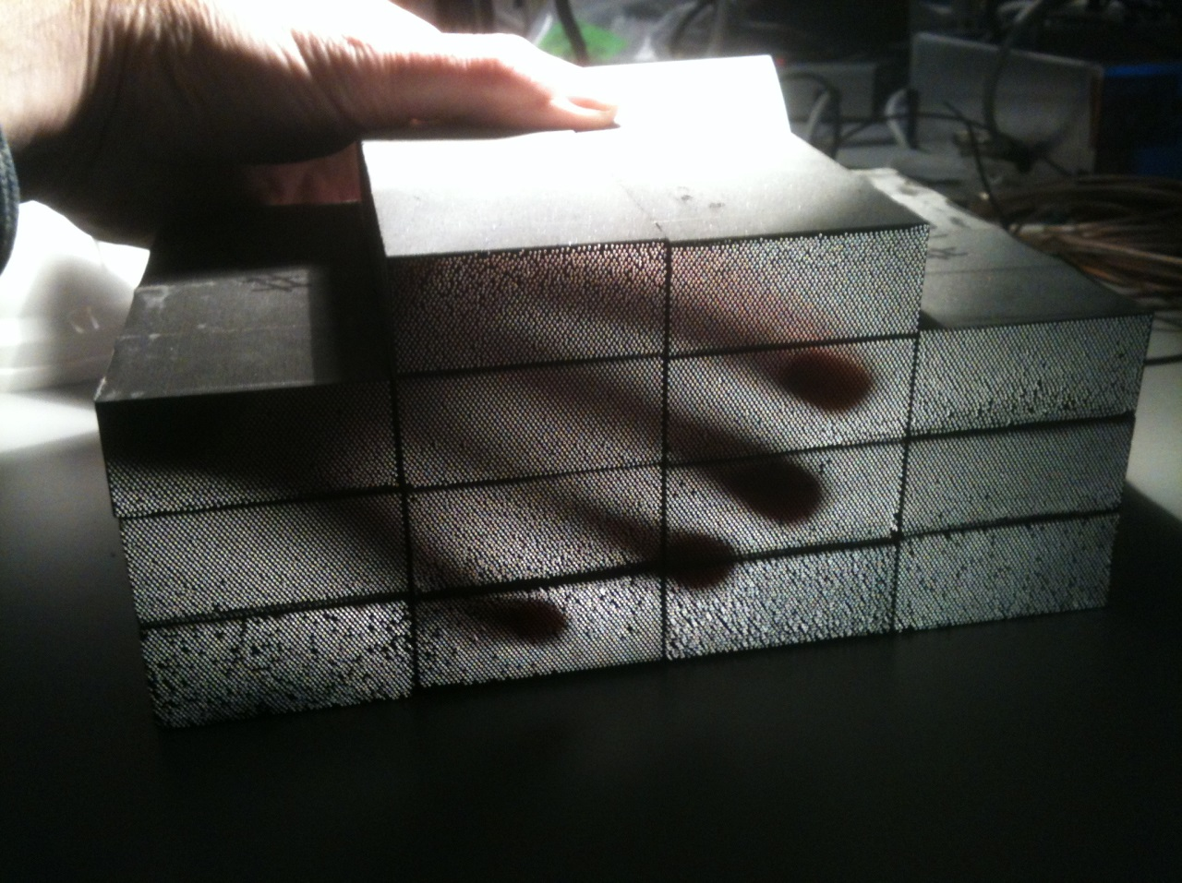
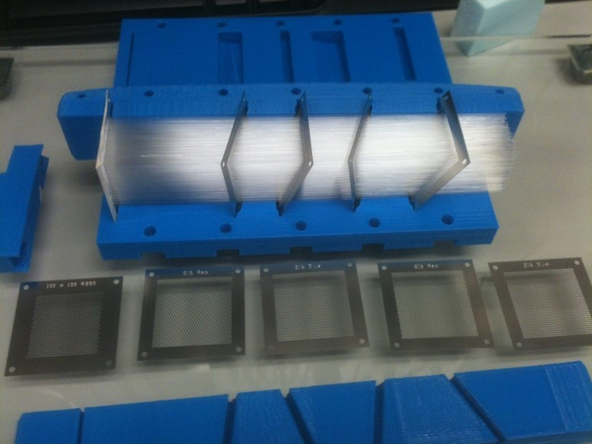
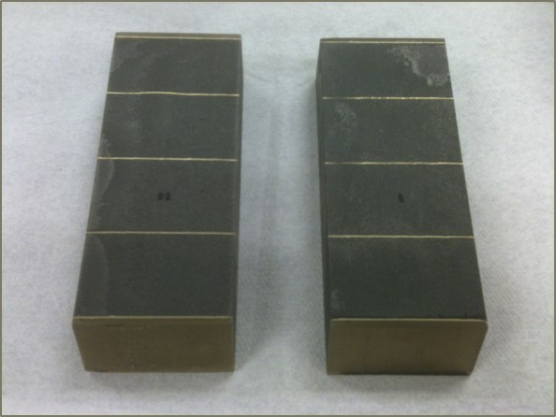
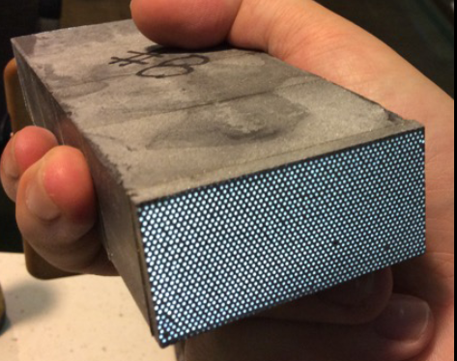
Tungsten Powder EmCal Modules
We are producing Emcal modules in-house (UIUC), and at a company called THP
Avg density ~ 9.3 g/cm³ ± ~ 0.1 g/cm³
Heavier than solid Lead
#8
The mold with scintillating fibers
All calorimeters are read out with SiPMs

Slide 12

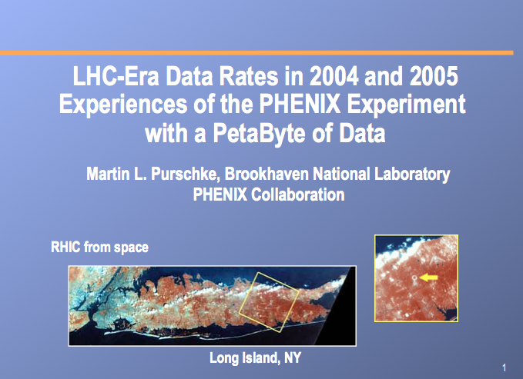
Talking about the Readout of all that…
PHENIX has never been afraid of high data rates and volumes
I personally claim a portion of that fame…
We fully intend not to sacrifice data and “take all we can”
Current design goal is 15KHz of event rate
This is possible right now, but will be less of an issue in 2020+
sPHENIX will have an estimated 15-25 GByte/s fully compressed data stream
My opening slide from the CHEP in 2006

Slide 13
The sPHENIX DAQ
As much as possible, we will re-use the existing PHENIX DAQ
We have been asked by review committee members why we wouldn’t want to upgrade a 15yr old DAQ
Answer: We already did that, we have just the system that we would build today
At least for the front-end!
Legacy gear from older detectors goes out the window
Working and very modern front-end, lots of experience
We have traditionally taken the highest data rates in the field
15KHz event rate envisioned, 14 have been demonstrated
Most of the work is in the back-end, event builder, etc
Test beam setup used an improved DAQ system already

Slide 14
Much less variety
PHENIX had 14 different detector system, each with its assorted front-end electronics
Herculean integration efforts early on
sPHENIX, by conscious design, has only a few and common technologies
Concentrate on uptime

Slide 15
DAQ Overview
Event Builder
FEM
DCM2
10+ Gigabit
Crossbar
Switch
ATP
DCM
DCM
SEB
Buffer Box
DCM
DCM
DCM
DCM
ATP
FEM
SEB
DCM
ATP
Buffer Box
DCM
DCM2
SEB
DCM
DCM
ATP
DCM
Buffer Box
FEM
DCM
SEB
DCM
ATP
Buffer Box
DCM
SEB
To
HPSS
DCM
DCM2
ATP
DCM
SEB
Buffer Box
FEM
DCM
DCM
DCM
ATP
Buffer Box
DCM
SEB
DCM
DCM2
ATP
FEM
DCM
SEB
DCM
DCM
DCM
DCM
SEB
ATP
Buffer Box
DCM
ATP
FEM
DCM2
SEB
DCM
DCM
DCM
DCM
DCM
DCM
Data Concentration
Computing
Facility
Interaction Region
Rack Room
Rack Room
Rack Room
DCM-2 receives data from digitizer, zero-suppresses and packages
SEB collects data from a DCM group (~35)
ATP Assembles events and compresses data (~60)
Buffer Box data interim storage before sending to the computing center (7)

Slide 16
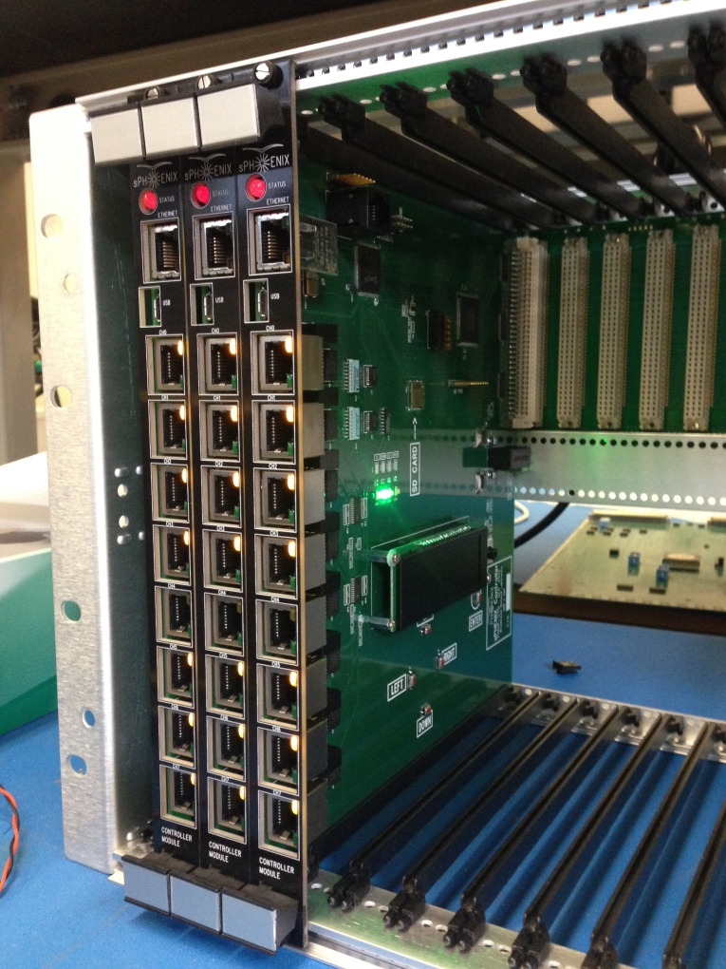
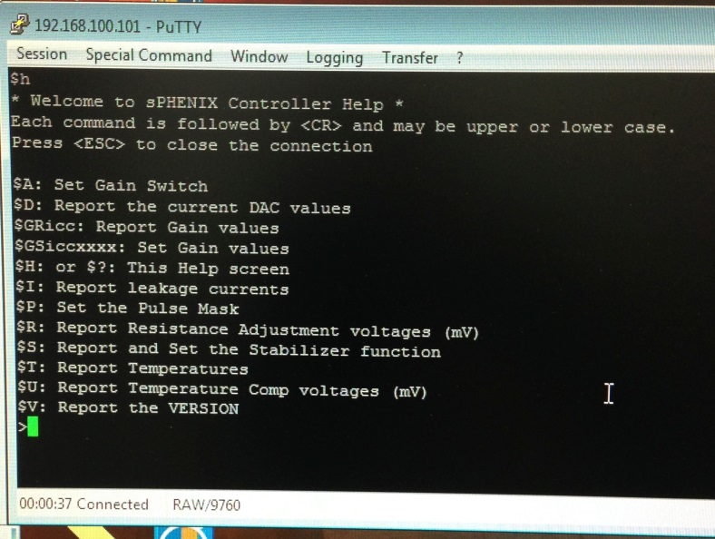
Slot Controllers
Provide monitoring and control for EmCal and HCal Interfaces.
Temperature and leakage stabilizer functions.
Temperature gain correction critical for SiPMs
Near-prodution boards used for EmCal and Hcal during beam test.

Slide 17
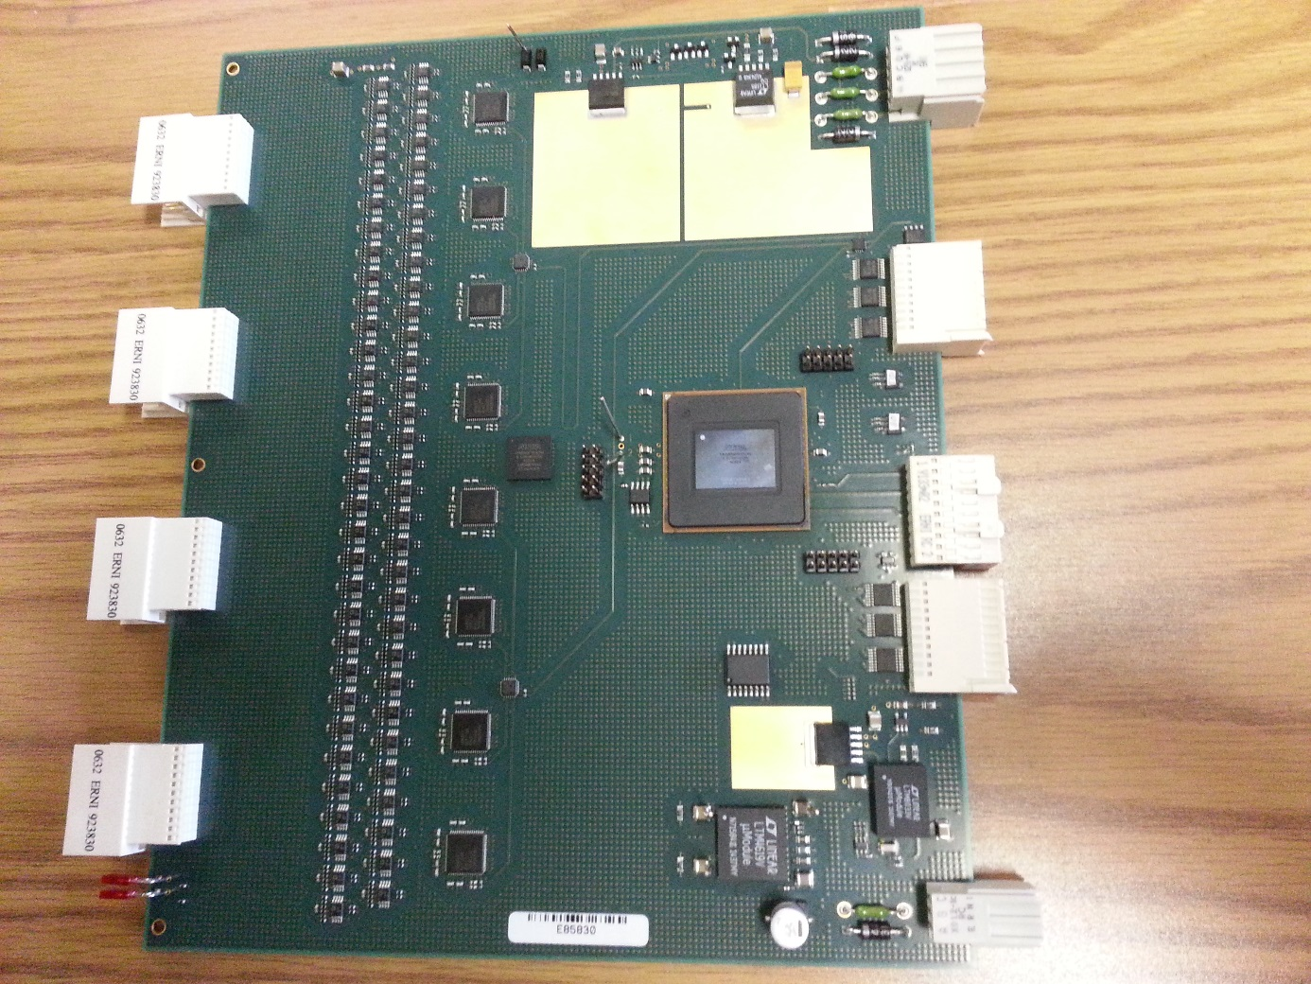
Digitizer/ADC Boards, XMIT, Controller
Goal is to run the next test beam (January 2017) with new digitizer electronics
64 channels per board
14 bit ADC
60 MHz sampling frequency
XMIT board interfaces 4 ADC
boards to DCM-II
Controller board interfaces
to SEB
Analog Powers
clock input
Slow readback
8 8-channels ADC
Altera
Arria 5GX
FPGA
2mm Hard Metric connectors
Trigger out/
Data link ports
64 channels Differential receiver
L0 timing in
Slow control/
download
Digital Powers
Signal Flow

Slide 18
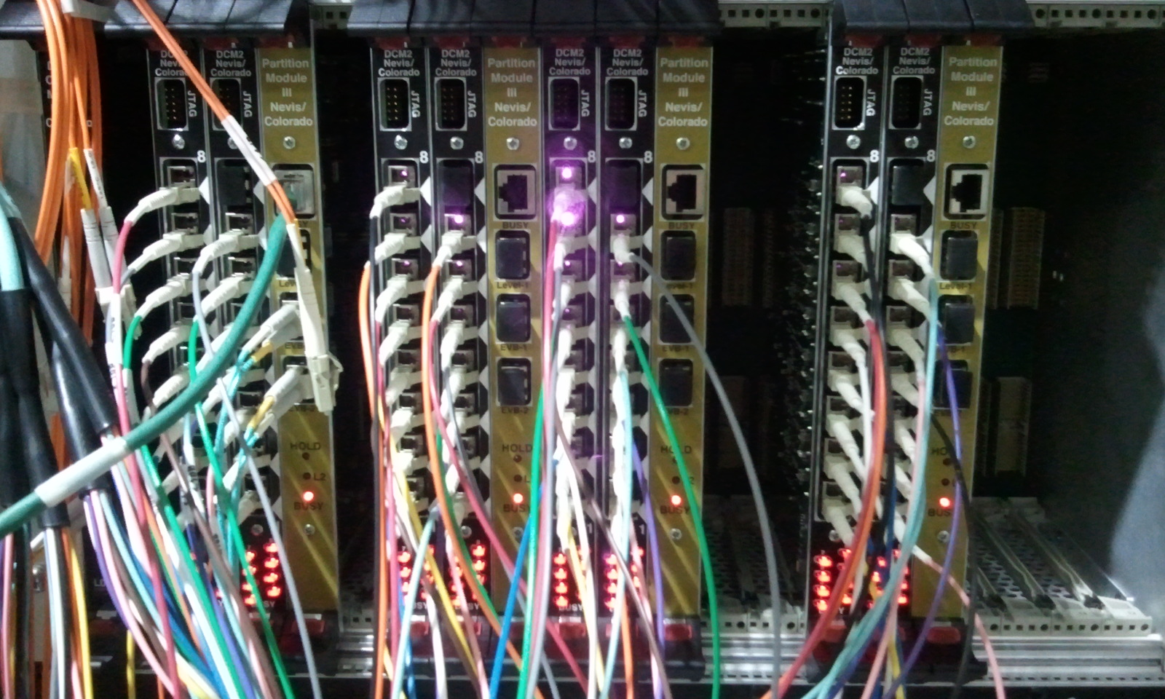
DAQ Components – DCM2
The Data Collection Module V2 is a modern, mature board commissioned in PHENIX Runs 14,15
“just as we would have built it” for sPHENIX
FPGA code, tools, existing configurations to draw from
Configuration tools / description language in place
O(200) units
Production-grade boards in hand for test beams, R&D, etc as soon as the PHENIX Run ends (end of June)

Slide 19
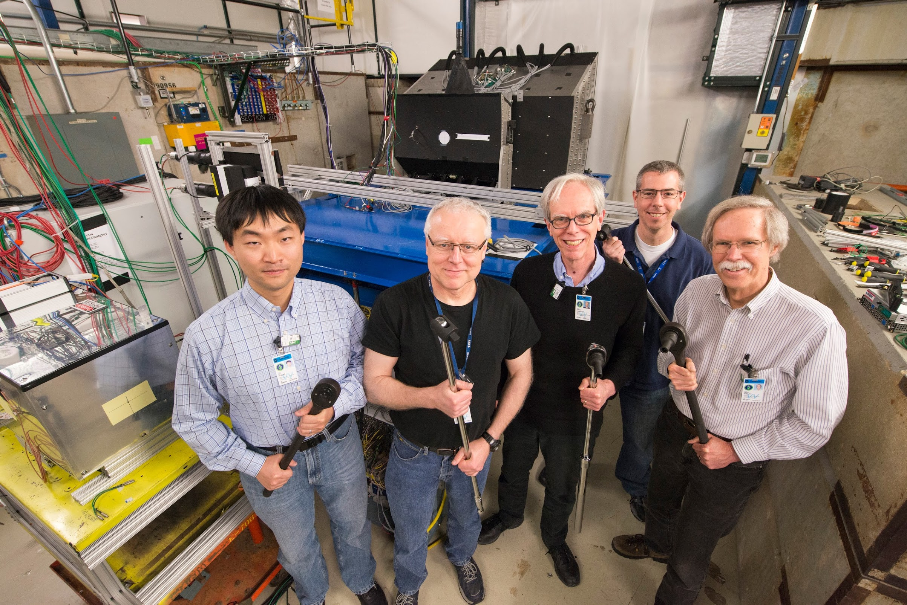
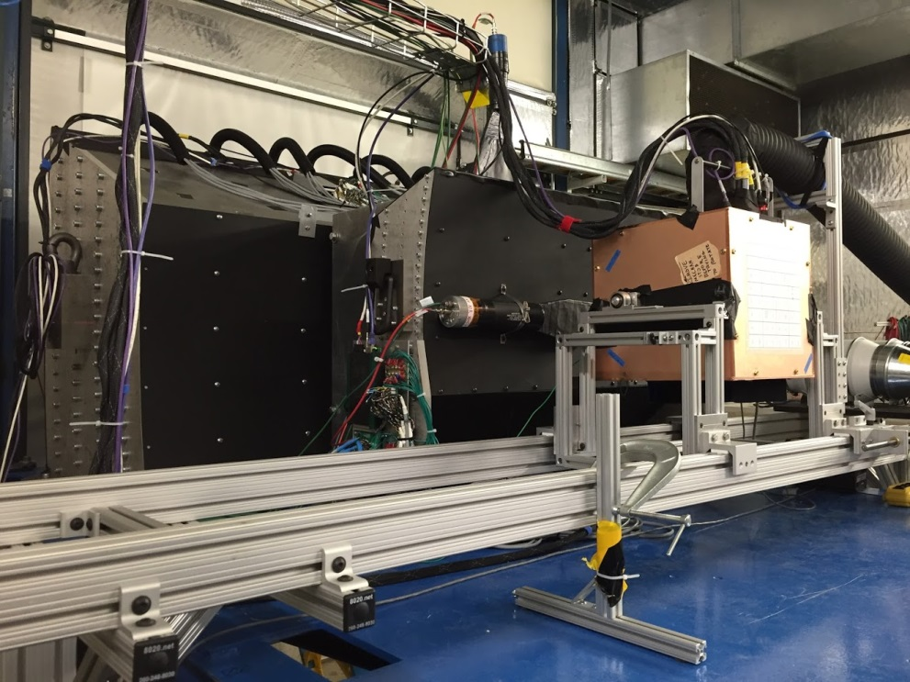
FNAL Testbeam Impressions
Simulated Magnet
IHCAL
EMCAL
OHCAL
Beam
Need to verify our simulation results with test beams before production
Had a really good run with few problems
Unified data taking for all (or at least most) projects with RCDAQ
Rcdaq is in use in sPHENIX and the EIC orbit (BNL, UIUC, SBU, Yale, GSU, even ATLAS ZDC test beam/calibration)
Produces the eventual sPHENIX data format (PRDF)
Ideal to get students to be proficient working with the raw data

Slide 20
Metadata Logging
Martin says: “Log everything you can think of. And then log some more.”
Log automatically. Do not rely on human input.
How was the DAQ configured? What was the HV? Were the lights on? What was the ambient temperature? Was something upstream in the beamline?
Many things just for “forensics” purposes in case something doesn’t make sense
I truly believe in taking pictures – a pic captures everything
Metadata captured in a database, but also in the raw data
Info cannot get lost, easy to access if you have the raw data file

Slide 21
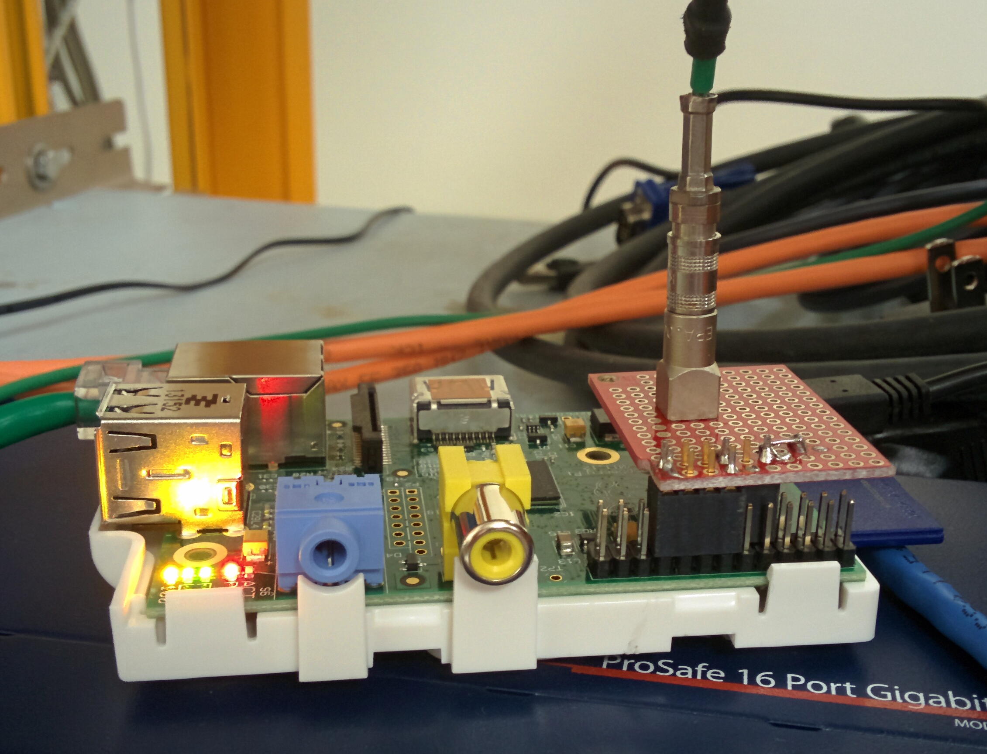
Metadata Logging Example – FTBF beam params
We had a RPi that was aware of the spill end – we fed it a copy of the spill signal into a high-tech board
Energy
Beamline
Counters
Emcal table
h/v position
Ambient temp
& humidity
Cher. pressures
S:MTNRG = -16 GeV
F:MT6SC1 = 10129 Cnts
F:MT6SC2 = 9013 Cnts
F:MT6SC3 = 7829 Cnts
F:MT6SC4 = 0 Cnts
F:MT6SC5 = 158725 Cnts
E:2CH = 248.3 mm
E:2CV = 11.33 mm
E:2CMT6T = 73.44 F
E:2CMT6H = 39.7 %Hum
F:MT5CP2 = 1.242 Psia
F:MT6CP2 = 1.492 Psia

Slide 22
Very useful for “forensics”
“It appears that the distributions change for Cherenkov1 at 1,8,12,and 16 GeV compared to the other energies. It seems that the pressure is changed. […] Any help on understanding this would be appreciated.”
Martin: “Look at the info in the data files”:
$ ddump -t 9 -p 910 beam_00002298-0000.prdf
S:MTNRG = -1 GeV
F:MT6SC1 = 5790 Cnts
F:MT6SC2 = 3533 Cnts
F:MT6SC3 = 1780 Cnts
F:MT6SC4 = 0 Cnts
F:MT6SC5 = 73316 Cnts
E:2CH = 1058 mm
E:2CV = 133.1 mm
E:2CMT6T = 73.84 F
E:2CMT6H = 32.86 %Hum
F:MT5CP2 = .4589 Psia
F:MT6CP2 = .6794 Psia
$ ddump -t 9 -p 910 beam_00002268-0000.prdf
S:MTNRG = -2 GeV
F:MT6SC1 = 11846 Cnts
F:MT6SC2 = 7069 Cnts
F:MT6SC3 = 3883 Cnts
F:MT6SC4 = 0 Cnts
F:MT6SC5 = 283048 Cnts
E:2CH = 1058 mm
E:2CV = 133 mm
E:2CMT6T = 74.13 F
E:2CMT6H = 37.26 %Hum
F:MT5CP2 = 12.95 Psia
F:MT6CP2 = 14.03 Psia

Slide 23
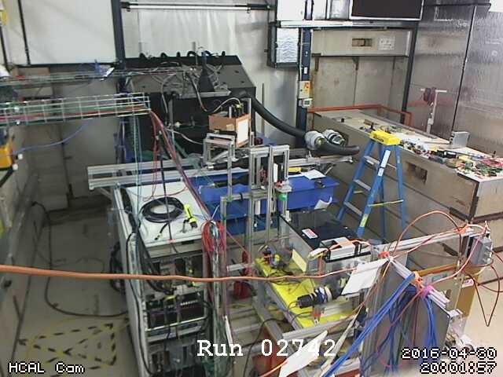
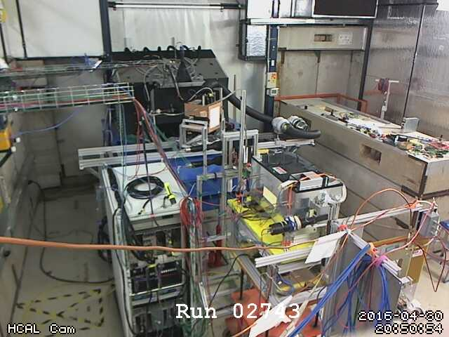
More Forensics
“Was the scintillator test contraption in the beam in run 2743? There is a higher fraction of showering than before.”
Look at the cam pictures we automatically captured for each run:
$ ddump -t 9 -p 940 beam_00002742-0000.prdf > 2742.jpg
$ ddump -t 9 -p 940 beam_00002743-0000.prdf > 2743.jpg

Slide 24
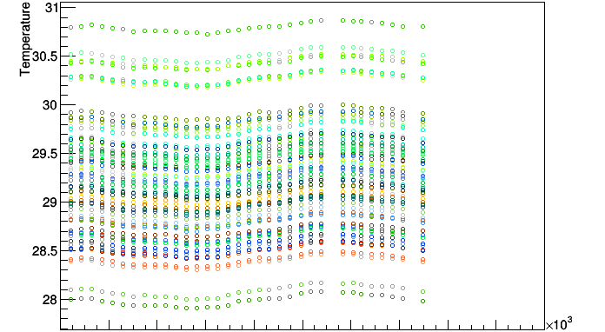
Example: Temperature compensation
The FTBF A/C was hard at work – temperature cycles at the 30 mins level
Estimated -3.6%/⁰C gain variation in the SiPMs
Need to see the effect of offline temperature change compensation
Periodic temperature readings embedded in the raw data
No need to correlate database entries with run/event numbers

Slide 25
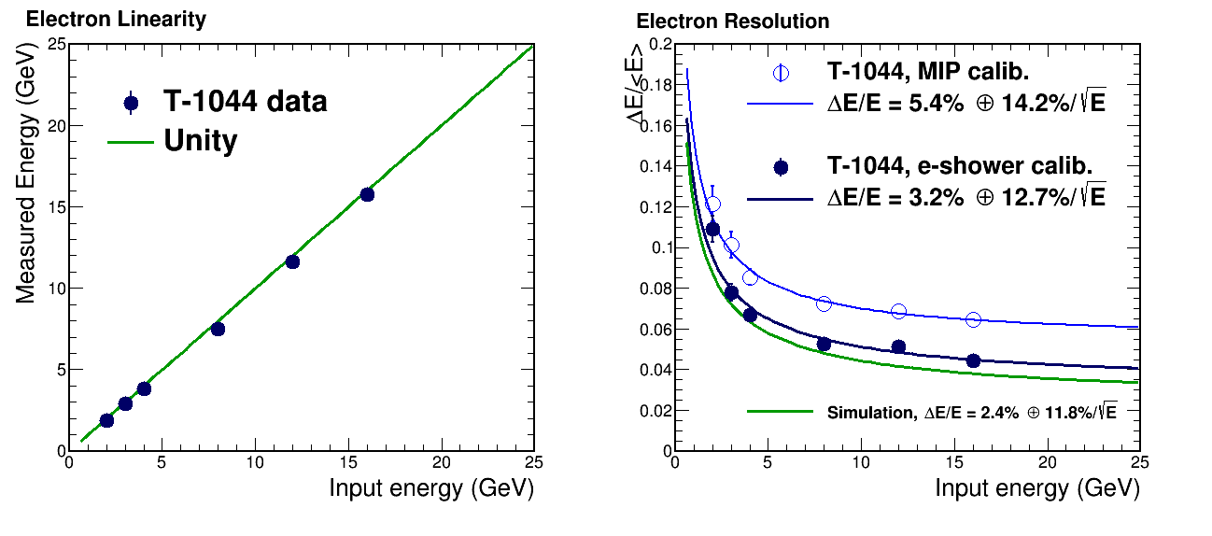
Flashing just one test beam result
EMCAL Energy Resolution and Linearity
Preliminary !
Preliminary !

Slide 26
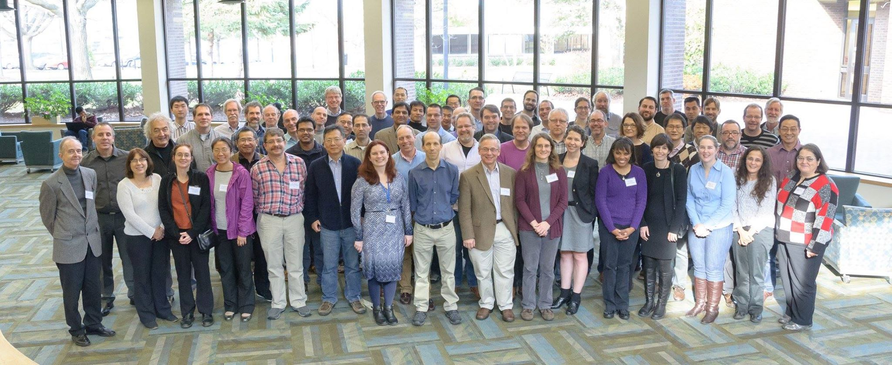
Summary
sPHENIX will re-use the really modern parts of the PHENIX DAQ
A workhorse “lean” DAQ system in hand to get us through all R&D
Uses the actual sPHENIX electronics but can also read out standard devices, CAEN, the SRS, DRS4, etc
Rich set of metadata logging features (“anything your computer knows”) for lab setups, test beams, R&D in general
Test bed for new electronics to come
SiPM automated temperature compensation in progress
SPHENIX envisioned to see first beam in 2022

Slide 27
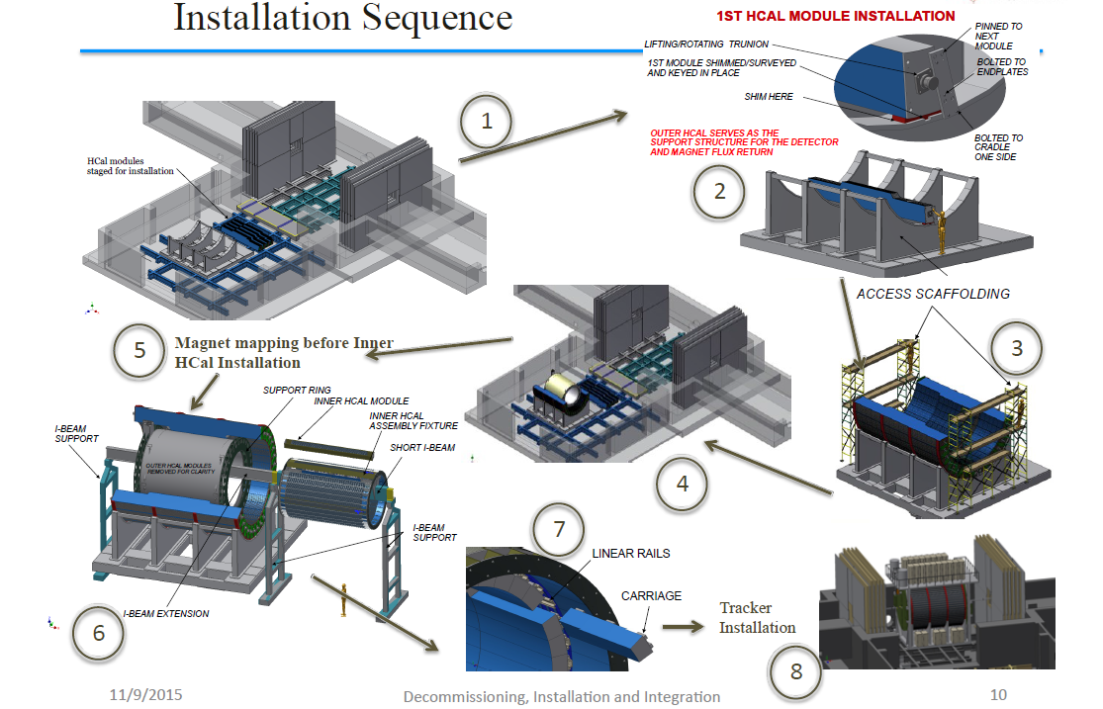
Taking a hint from Ikea
sPHENIX Monteringsföljd
Första HCal-modulinstallationen
Lyftande svängtapp
Första modulen shimsad
undersökt och injusterad.
Fastsatt med
nästa modul
Bultad till
ändplattorna
Yttre HCal fungerar som stödstruktur för detektorn och retur av magnetiskt flöde
Bultad till
hållaren en sida
HCal-moduler
förberedda
för installation
Byggnadsställningar
Kartläggning av magnetflöden
innan inre HCal-installationen
Stödring
Inre HCal-modul
I-balkstöd
monteringsfixtur
Kort I-balk
I-balkstöd
Linjärskenor
Vagn
I-balkförlängning
Detektorinstallation
Notes:
Taking a hint from Ikea – Att låta Ikea ge en vink (better: Vi låter Ikea ge en vink..)
1. HCal modules staged för installation – HCal-moduler förberedda för installation
2. 1st hcal module.. - Första HCal-modulinstallationen
Lifting/rotating trunion – lyftande/roterande .. (trunnion = svängtapp, justerstycke, höjdriktningstapp)
1 st module shimmed .. – Första modulen shimsad/undersökt och injusterad.
Shim here – mellanlager här or shim här
Pinned to the next module – Fastsatt med nästa modul
Bolted to endplates – Bultad till ändplattorna
Bolted to cradle one side – Bultad till hållaren, en sida or Bultad till hållare ett:s sida (depending on if it’s bolted to cradle 1’s side och bolted to cradle, one side ☺ )
Outer hcal .. – Yttre HCal fungerar som stödstruktur för detektorn och retur av magnetiskt flöde
3. Access scaffolding - Byggnadsställningar
5. Magnet mapping .. – Kartläggning av magnetflöden innan inre HCal-installationen (guessing that magnet mapping was measuring the magnetic fluxes? Otherwise this is wrong. ;) I couldn’t see the need for mapping an actual magnet (in my understanding of the word mapping))
6. Support ring – Stödring
Inner HCal module – Inre HCal-modul
Inner Hcal assembly fixture – Inre hcal monteringsfixtur
Short I-beam & I-beam support & I-beam extension – Kort I-balk & I-balkstöd & I-balkförlängning
7. Linear rails – Linjärskenor
Carriage – Vagn
8. Tracker installation - Detektorinstallation

Slide 28
This page is intentionally left blank

Slide 29

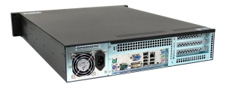
DAQ Components – jSEB2 and SEB
SEB
= +
jSEB2
A “Sub-Event Buffer” refers to a Linux PC with a “jSEB2” interface card
Card receives data from the DCM2’s via another board
First time data are seen in a standard PC
jSEB2 is a 4-lane PCI-Express card, 500MByte/s-capable
Code, tools, experience from Runs 14 & 15
Production-grade cards in hand
SEB is basis for test beam, R&D-type, small DAQs

Slide 30
Data compression
Buffer Boxes (7)
After all data reduction techniques (zero-suppression, bit-packing, etc) are applied, you typically find that your raw data are still gzip-compressible to a significant amount
Introduced a compressed raw data format that supports a late-stage compression
This is what a file normally looks like
buffer
buffer
buffer
buffer
buffer
buffer
LZO
algorithm
Add new
buffer hdr
New buffer with the
compressed one as payload
This is what a file then looks like
On readback:
LZO
Unpack
Original uncompressed buffer restored
All this is handled completely in the I/O layer, the higher-level routines just receive a buffer as before.

Slide 31
Data compression load
Buffer Boxes (7)
This compression buys you a lot spare bandwidth and nice features (e.g, your analysis runs faster!)
However:
A late-stage compression (think: in your tape drive in the extreme case) doesn’t really help you
The compression has to kick in before the data hit your storage system for the first time
No single machine can keep up with compressing a >2GByte/s rate

Slide 32
Switch to distributed compression
The compression is handled in the “Assembly and Trigger Processors” (ATP’s) and can so be distributed over many CPU’s -- that was the breakthrough
The Event builder has to cope with the uncompressed data flow, e.g. 1200MB/s … 2500MB/s
Event Builder
Buffer Box
10Gigabit
Crossbar
Switch
ATP
The buffer boxes and storage system see the compressed data stream, 700MB/s … 1300MB/s
SEB
Buffer Box
SEB
ATP
SEB
ATP
Buffer Box
SEB
ATP
SEB
ATP
Buffer Box
To
HPSS
SEB
ATP
SEB
ATP
Buffer Box
SEB
ATP
Current compression levels:
100G become ~55G
→ 45%
SEB
ATP
Buffer Box
SEB
ATP
Buffer Box

Slide 33
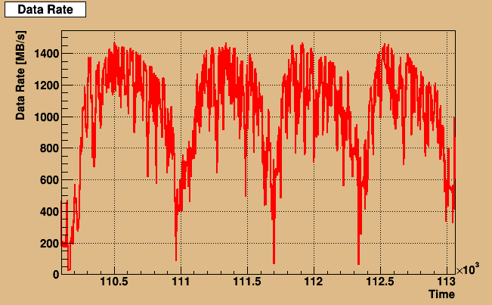
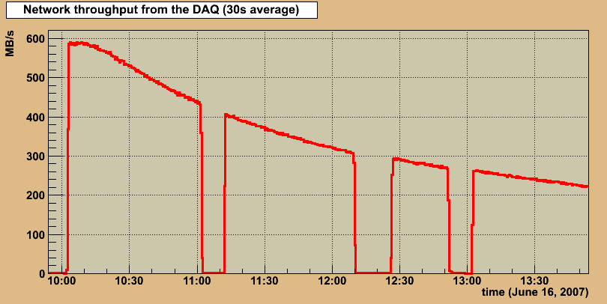
Data Rates (Run14)
Store
2007

Slide 34
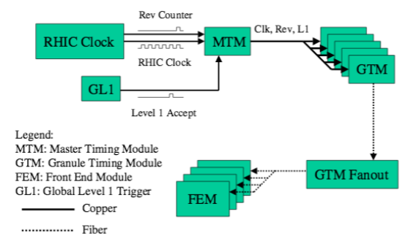
Trigger Electronics & Timing system
Trigger interface
Front-end modules aka “Digitizers”

Slide 35
Local-Level 1 (LL1) Boards
LL1’s generate a trigger signal from trigger primitives generated in the front-end for a given detector
new LL1 boards for calorimeter triggers
Potential new triggers for p+p, p+A need LL1 boards.

Slide 36
Trigger & Timing system
Trigger
GL1
MTM
L1
Busy
RHIC
Clock
Trigger Primitives
Clock/Trigger/Mode Bits
GTM
Event
Builder
DCM-2
SEB
HPSS
Digital Front End
Detector
Analog Front End
Monitoring
DCM-2
IR
Counting House

Slide 37
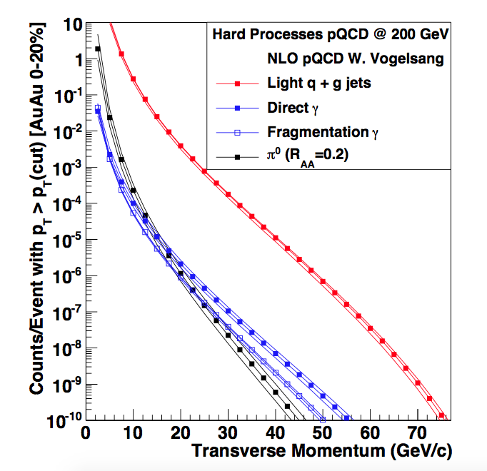
Some envisioned performance plots
The yield of hard processes in a typical RHIC year (22 weeks of running)
The lowest count in the plot correponds to 10 billion events
(We expect to get 20)

Slide 38
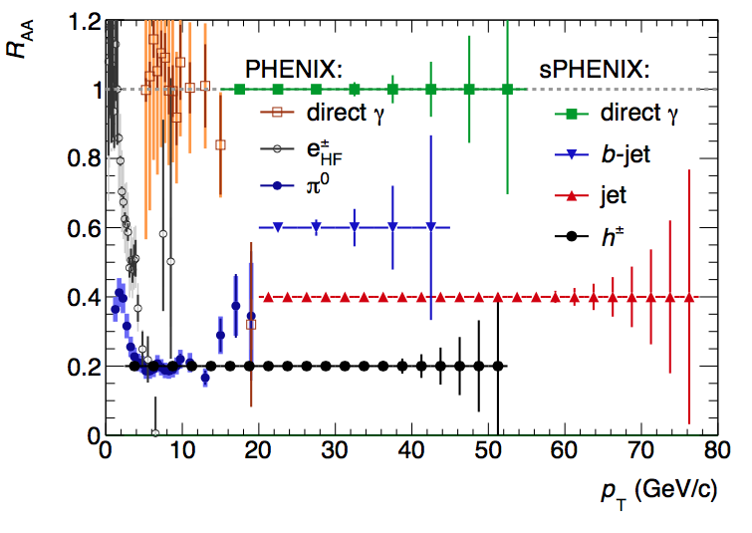
Statistical reach for some probes
The way PHENIX gets to high PT is through π0s
That reaches to ~20GeV/c
In sPHENIX, we can get to
4x that with jets

Slide 39
sPHENIX – the Collaboration

Slide 40
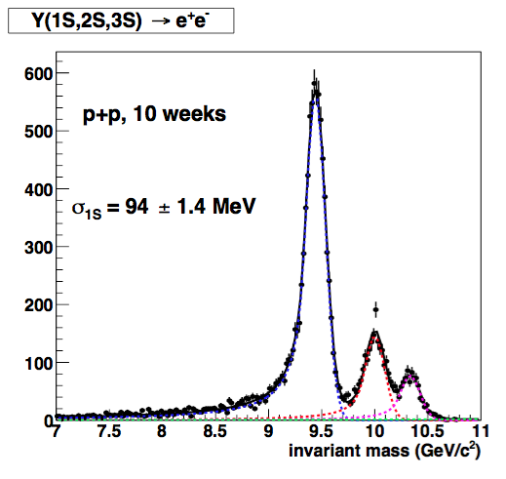
Upsilons
Just shy of 100 MeV/c resulution, enough to resolve the Upsilon states

Slide 41
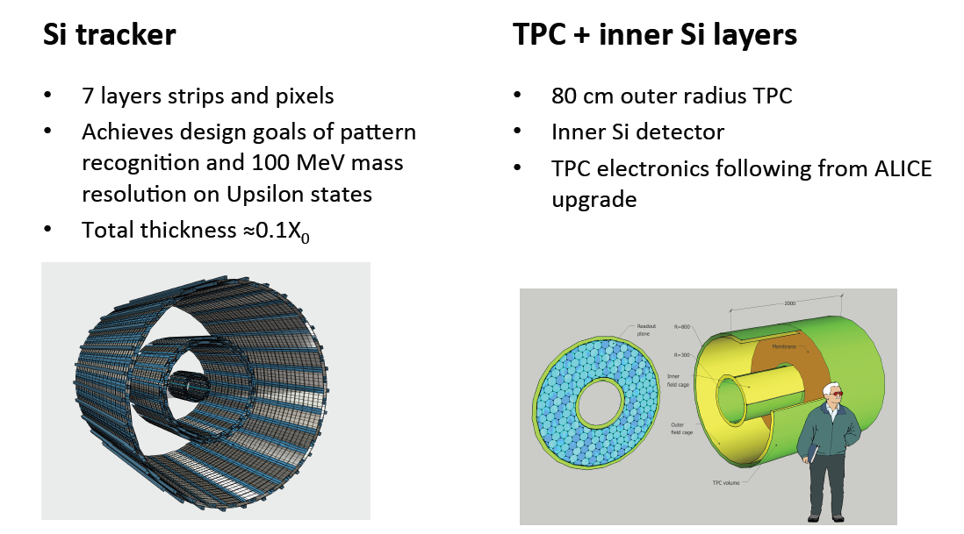
Tracking – 2 options, still very much under discussion
All Si Tracker option
2 Pixel Layers + Compact TPC option

Slide 42
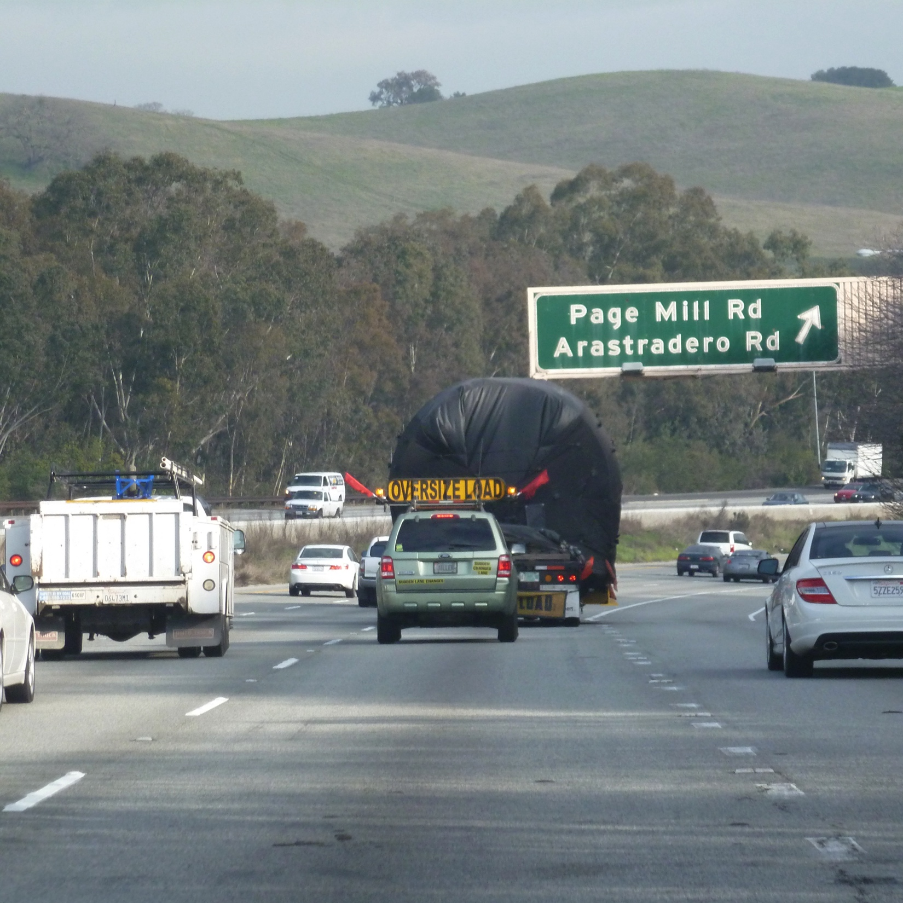
The BaBar Magnet
We had looked at magnets, but none of the available ones were quite right, then --
The BaBar magnet secured from SLAC after SuperB canceled, arrived at BNL in February 2015
Considerable additional equipment also acquired (power supplies, dump resistor, quench protection, cryogenic equipment)
SMD and CAD preparing it for low power cold test
Well suited to our needs without compromises
  1.5 T central field
  2.8 m diameter bore
  3.8 m long
  1.4X₀ coil+cryostat
This really gave a tremendous boost to this project!

Slide 43
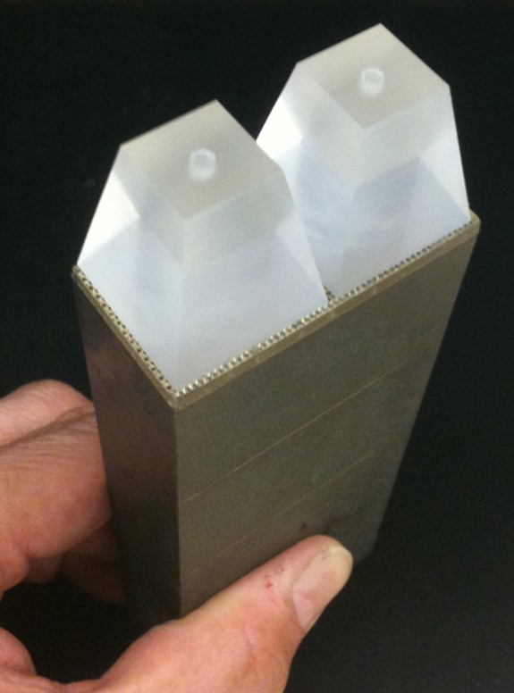
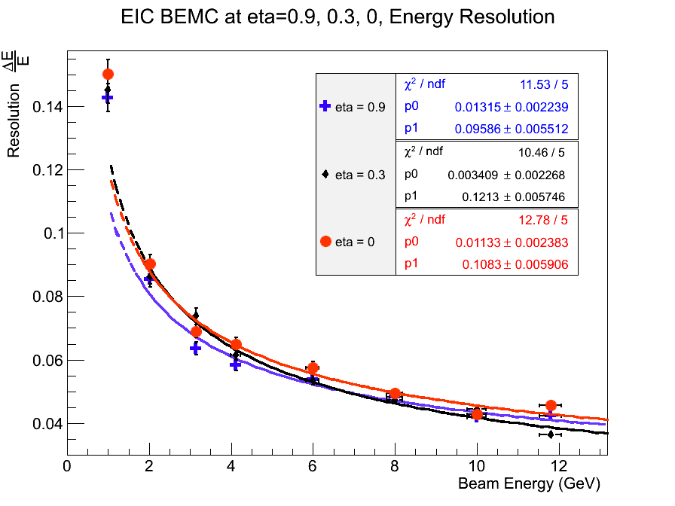
EmCal Modules
Tungsten-scintillating fiber SPACAL
Radiation length of ≈7 mm allows it to be inside the solenoid where only the material of the tracker is in front of it
Beam tested by UCLA group
Development of projective geometry which could improve e/π separation needed for the Upsilon measurements
Readout on inner radius of EMCAL with 4 3x3 mm SiPM’s
On-detector electronics limited to preamps, bias control and temperature monitoring

Slide 44
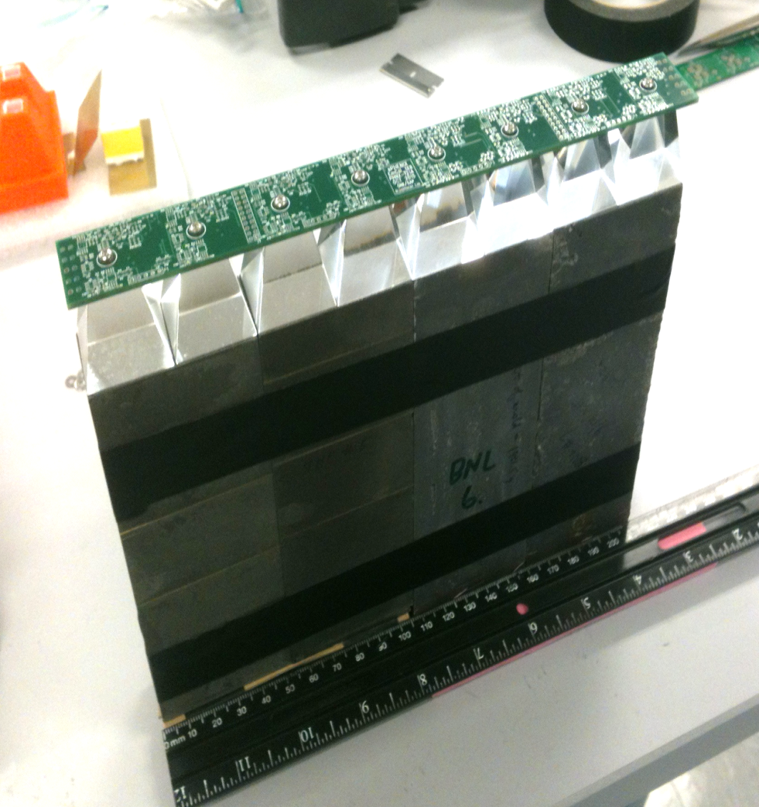
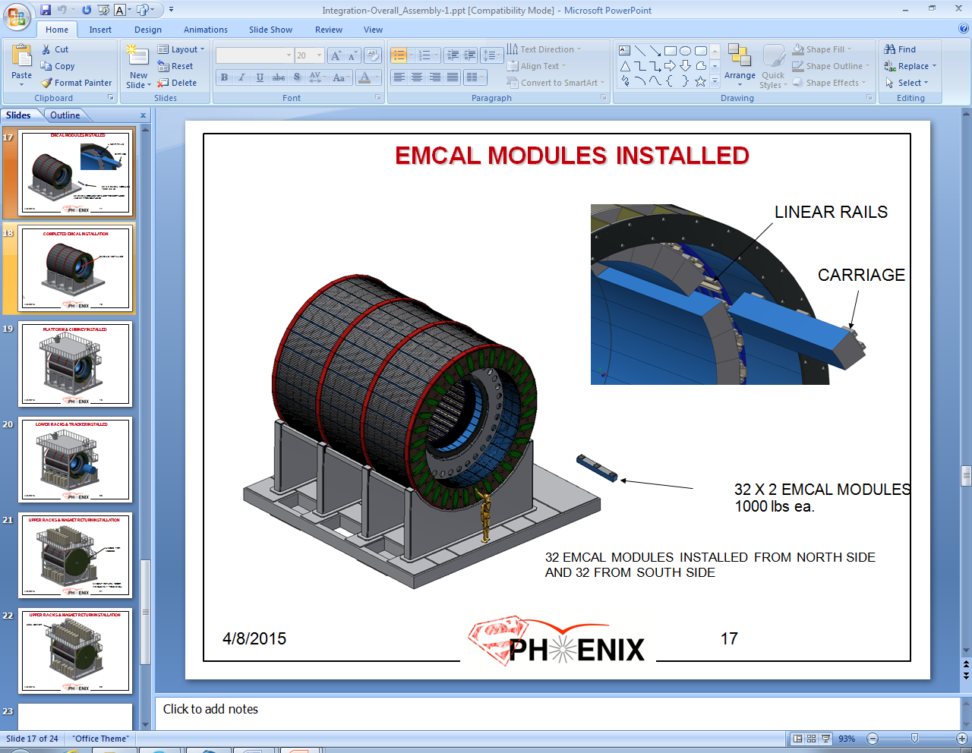
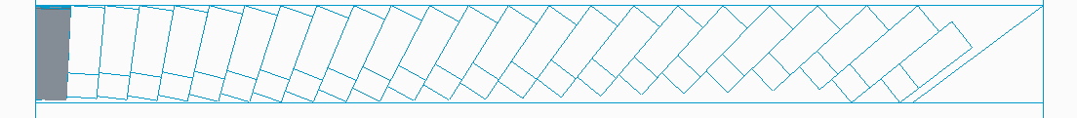
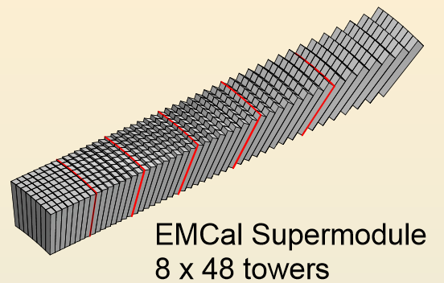
Projective Geometry
We want to make the EmCal projective, this is, each eta ring “looks” straight at the collision point
Superior over a “pineapple slice” design, angle of incidence is limited
That requires double-tapered modules to do it right
It is an engineering challenge though
Ultimately want to build ~25k towers

Slide 45
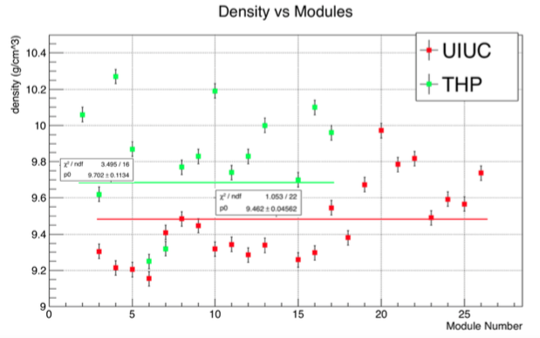
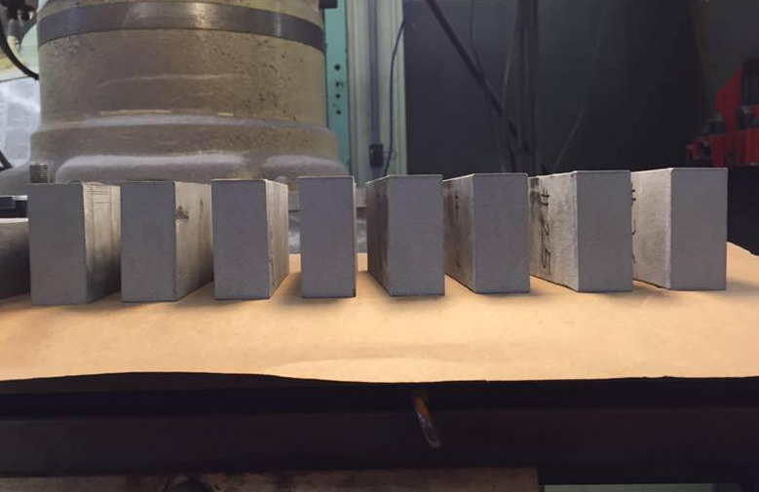
Density Uniformity, Sampling Fraction
The tapered design makes the sampling fraction change over the depth of the module – we need to test the energy reconstruction carefully
The production process is not “industrial-grade” yet, still at the level of prototypes
Still a good amount of density variation module by module – we are still learning the production process.
The latest batch of modules from Illinois

Slide 46
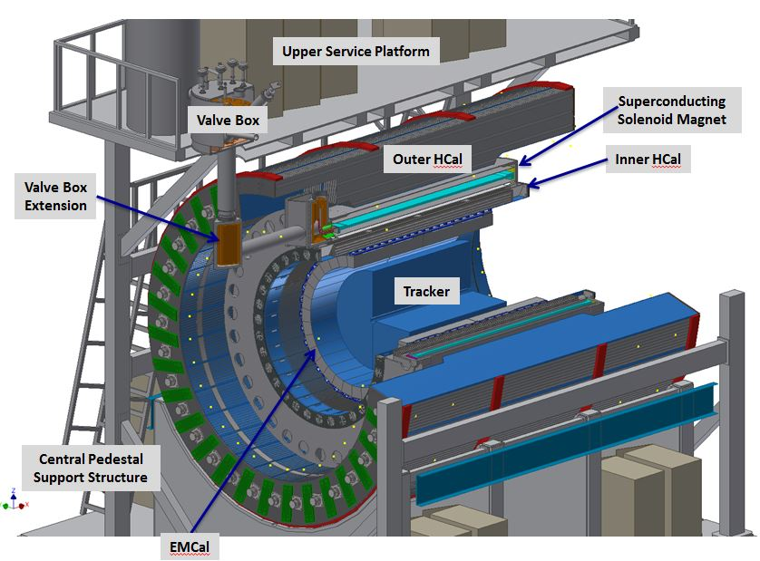
sPHENIX – step by step

Slide 47
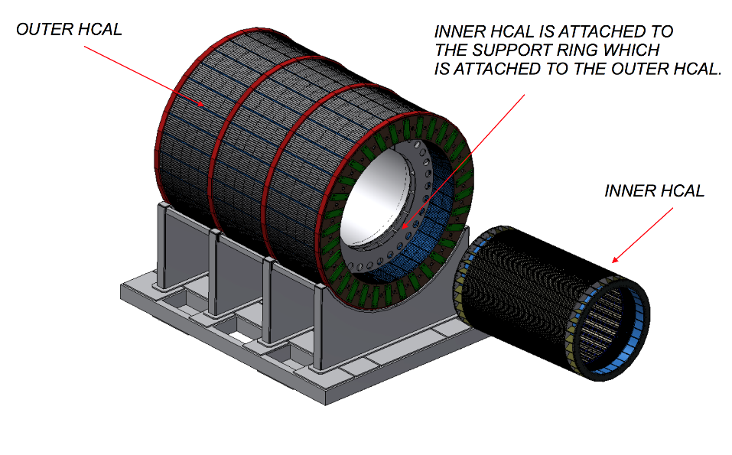


Inner HCal
32 sectors - 1.16m inner radius, 1.37m
outer radius
10 rows of 7mm scintillator tiles (24 tiles
per row)
32º tilt angle, tapered stainless steel plates ~10.2mm - ~14.7mm
Completed sector is 4.3m long, weighs ~ 1 ton
24

Slide 48

Outer HCal
32 sectors - 1.9m inner radius, 2.6m outer radius
10 rows of 7mm scint. tiles (24 tiles per row), 12º tilt angle
Tapered 1006 steel plates ~26.1mm - ~42.4mm
6.3 m long, 13.5 tons
The drawing looks at the Hcal from “the back”
Just because of the weight, the outer HCal tends to dominate our engineering discussions!
Scintillator tile

Slide 49



What we stick into the Test Beams…
A “sector” of the HCals, plus a small EmCal portion

Slide 50
Multi-Event buffering
This is what makes the DAQ as fast as it is
Or, in other words: that keeps the dead time in the low 90%’s
Comes down to dealing with your data from various events in parallel

Slide 51

An another-world example
A Volkswagen assembly line
A given car takes about 28 hours from starting as a naked chassis to being an assembled vehicle
One station adds the “skin”, another the engine, another installs the defeat devices – about 340 “stations”
Single-Event buffering – next car enters the assembly line once the previous car is done → one car every 28 hours
Multi-Event Buffering – car moves forward as soon as the next station is free → one car about every 5 minutes

Slide 52

Multi-Event buffering effect in the DAQ
single-event buffered runs

Slide 53
Multi-Event buffering effect in the DAQ
In a rare-event experiment, you do not want to go down this path
single-event buffered runs

Slide 54

Multi-Event buffering effect in the DAQ
Plus multi-event buffered runs

