Slide 1
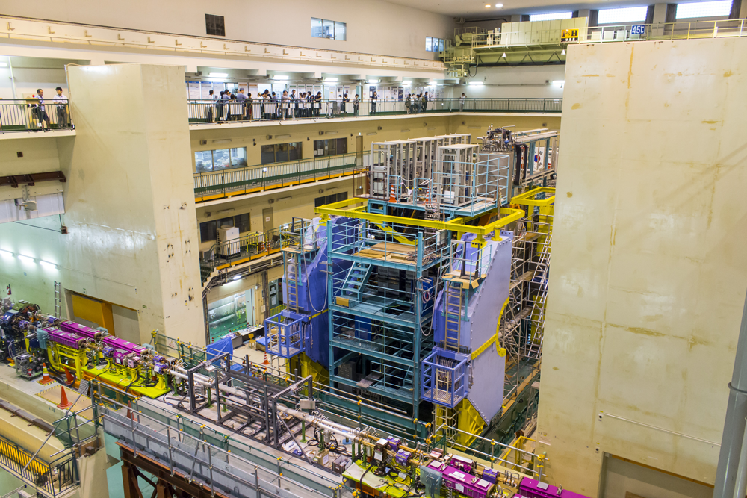


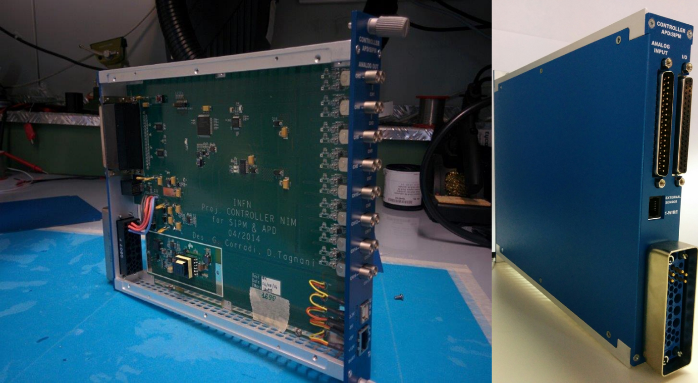
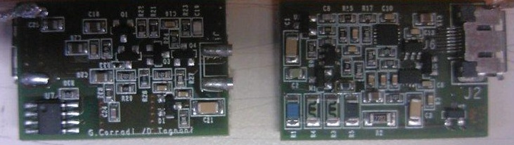
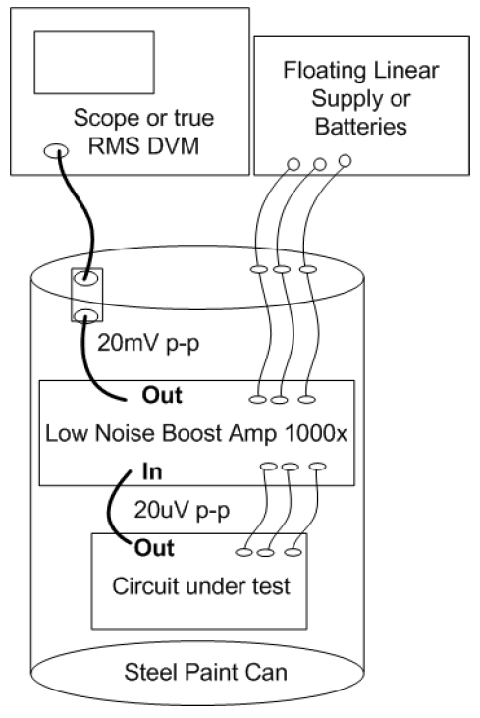
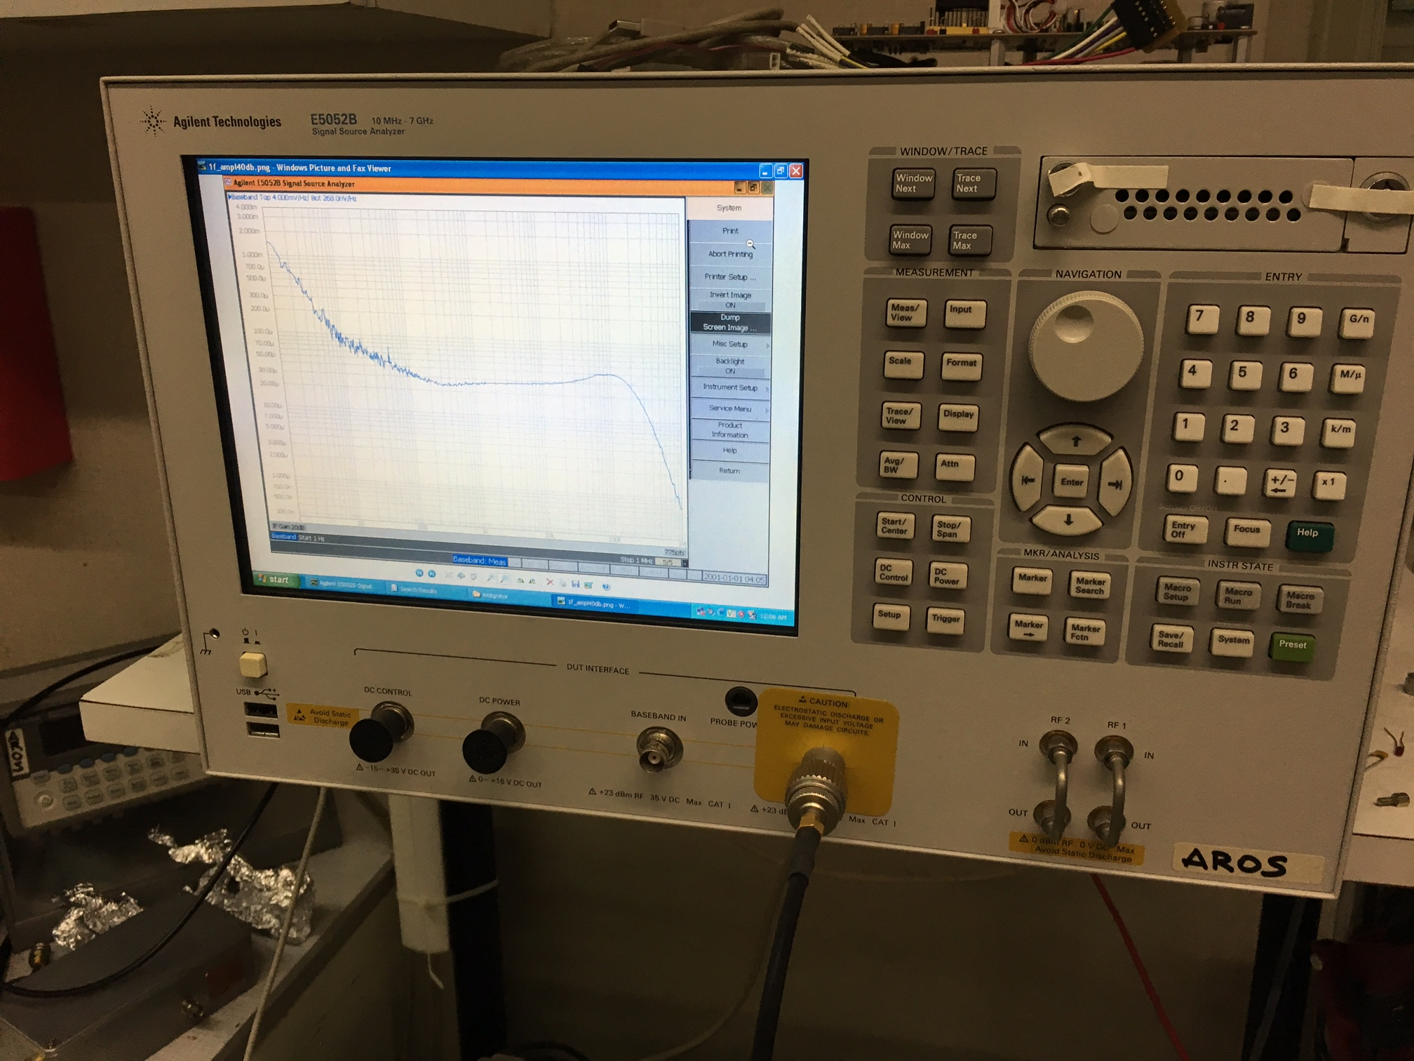
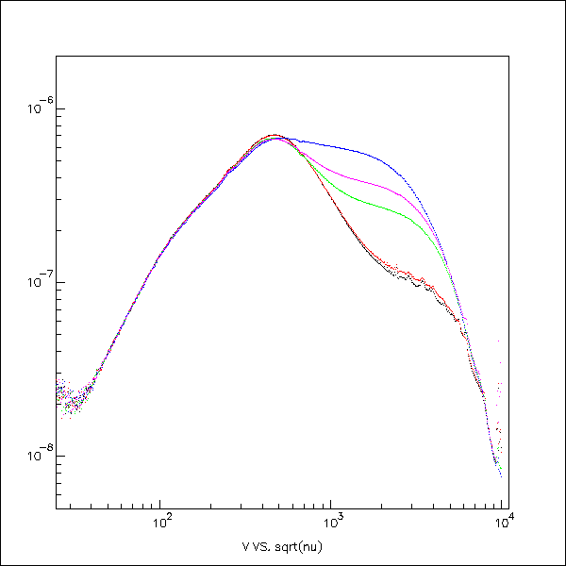
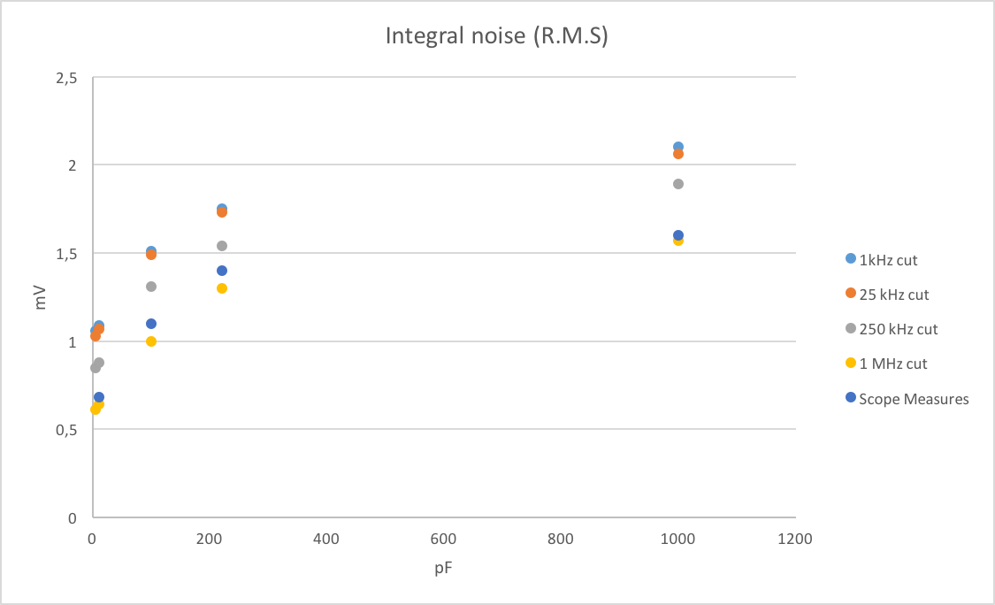
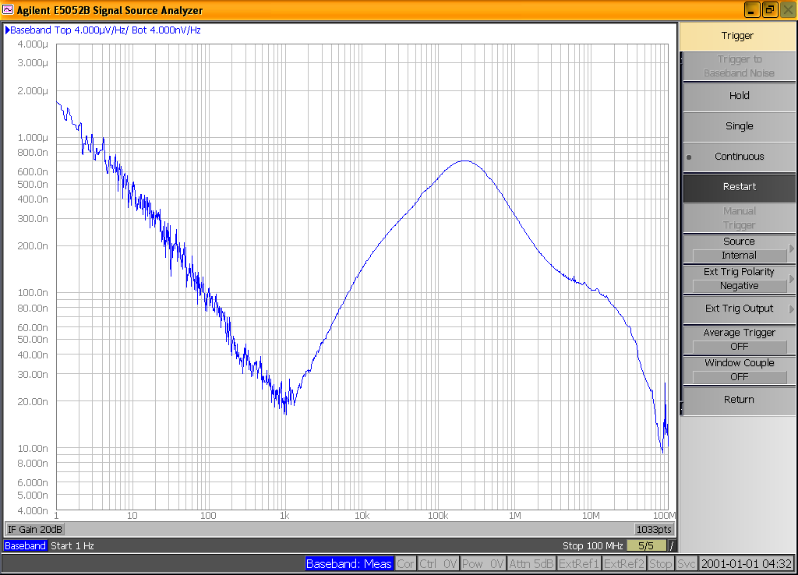


A low noise front-end for the Belle II forward electromagnetic calorimeter upgrade
A. Aloisioª, P. Branchini^{b}, A. Budano^{b}, G. Corradi^{c}, M. Galasso^{b} and D. Tagnani^{b}
ª INFN Sezione di Napoli, Napoli, Italy
^{b} INFN Sezione di Roma Tre, Roma, Italy
^{c} INFN Laboratori Nazionali di Frascati , Roma, Italy
20th Real Time Conference 5-10 June 2016 - Padova, Italy
INTRODUCTION
The Belle II experiment will operate at the SuperKEKB e+ e- collider, designed to reach a top luminosity 8x10³⁵ at the Y(4s) resonance. The high background environment of the accelerator poses serious challenges to the design of the detector. In particular the Belle2 collaboration is studying a major upgrade program which involves the forward electromagnetic calorimeter. The original calorimeter consisted of CsI (Tl) doped crystals. We are evaluating pure CsI crystals, since they have lower time constant but unfortunately with a much lower light yield. The electromagnetic calorimeter upgrade inherits detector constrains from the old one therefore an R&D program on photon-detectors and front end electronic has also been carried out by the Italian collaboration. Different APD and SiPM have been tested and qualified for this purpose. In this paper, we present the design of the read out front-end chain for the upgrade of the electromagnetic calorimeter of the BelleII experiment.
The power supply scheme follows a two-step approach: the main HV power unit is a step-up DC-DC converter which outputs 600V from 24 V input. Its accuracy is better than 10 mV over 600 V. The HV is distributed in parallel to remote programmable power units, which can be fine tuned via a I2C field bus. The main power unit is programmed via Ethernet and it can handle up to 16 I2C buses, each connecting up to 16 remote power units. This point-of-load power approach guarantees extremely low noise, local fine tuning and high fan-out.
Figure 1: power distribution cards (above) and pre-amp card (below)
Figure 1 shows the main HV APD custom made control system. The board hosts the HV main generator 16 I2C each coupled with one HV channel and one 6V low voltage channel to power the front-end amplifier . A CPU is in charge to drive the system which is interfaced to the BelleII slow control system via epics. The control system allows us to set the single APD voltage bias, distribute power to the front-end pre-amplifier and to read signals via a dedicated line from the front-end amplifier.
The front-end card hosts both a low noise charge pre-amplifier on one side and an HV regulator on the opposite side. Figure 1 shows the HV distribution card and the front-end card. The amplifier is a low noise charge amplifier based on bjt transistors. The charge amplifier gain is 1.4 V/pC, its power dissipation is 16 mW it is powered by the 6 V single power LV line its dynamic range is 2.2 V while its noise is about 6000 e- when loaded by the 280 pF of the APD capacitance.
The HV power supply is remotely controlled via ethernet by the usop system (these proceedings) which is also in charge to monitor enviromental variables. The setup has been used to collect data at test beams done at BTF (Beam test facility in Frascati) and Mainz.
Figure 2: noise measurement setup
V/$\sqrt{ν}$
black 5 pF
red 10 pF
green 100 pF
purple 220 pF
blue 1000 pF
Figure 4b: integrated noise spectra compared to the noise
mesured by the scope.
Figure 3: noise distribution spectrum
$$\sqrt{ν}$$
Figure 4a: the pre-amp has been loaded with different capacitance
The noise figure of the pre-amp has been measured with the setup described in figure 2. Figure 3 shows the noise distribution spectral density as measured by the E50052 used in base band. Data after processing are showed in Figure 4a and 4b as a function of the detector capacitance.

