Slide 1
MicroTCA
Development and Status
Kay Rehlich
DESY
Real Time Conference 2016
June 9 2016
Notes:
How to edit the title slide
Upper area: Title of your talk, max. 2 rows of the defined size (55 pt)
Lower area (subtitle): Conference/meeting/workshop, location, date,
your name and affiliation,
max. 4 rows of the defined size (32 pt)
Change the partner logos or add others in the last row.

Slide 2
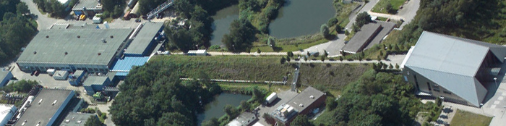
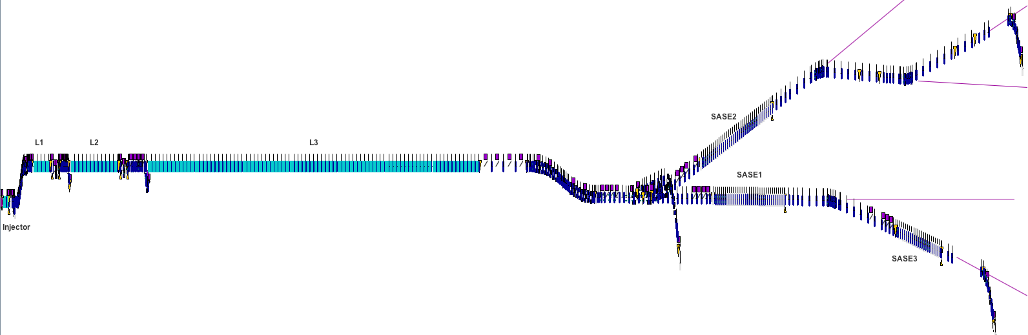
Motivation and Outline
1993
2016
FLASH
+ FLASH 2
XFEL start
The used standard
Architecture
  Hardware
  Software
1.6 km cold accelerator

Slide 3
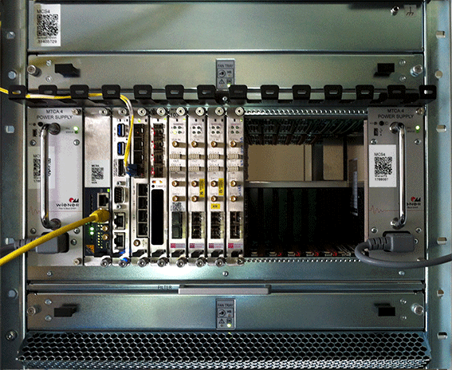


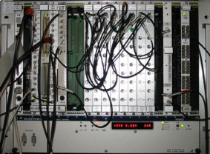
From VME to MicroTCA
Since 1993
Most cables from rear
Interne Clock & Trigger distribution
Redundant fans
Redundant power supply optional
Modern, high-speed data transfer
Excellent signal quality

Slide 4


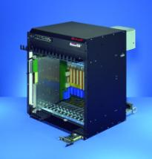




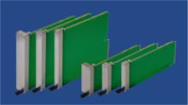




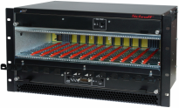


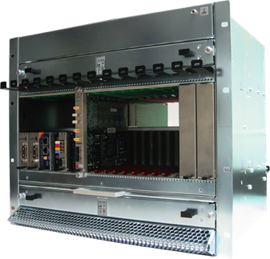

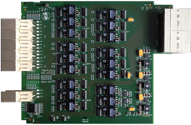
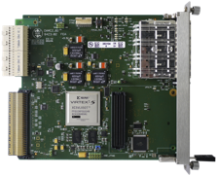








PICMG Standards “Telecom Computing Architecture”
Double
AMC.0
Single
MTCA.0
> 150 Mitglieder
MTCA.4

Slide 5
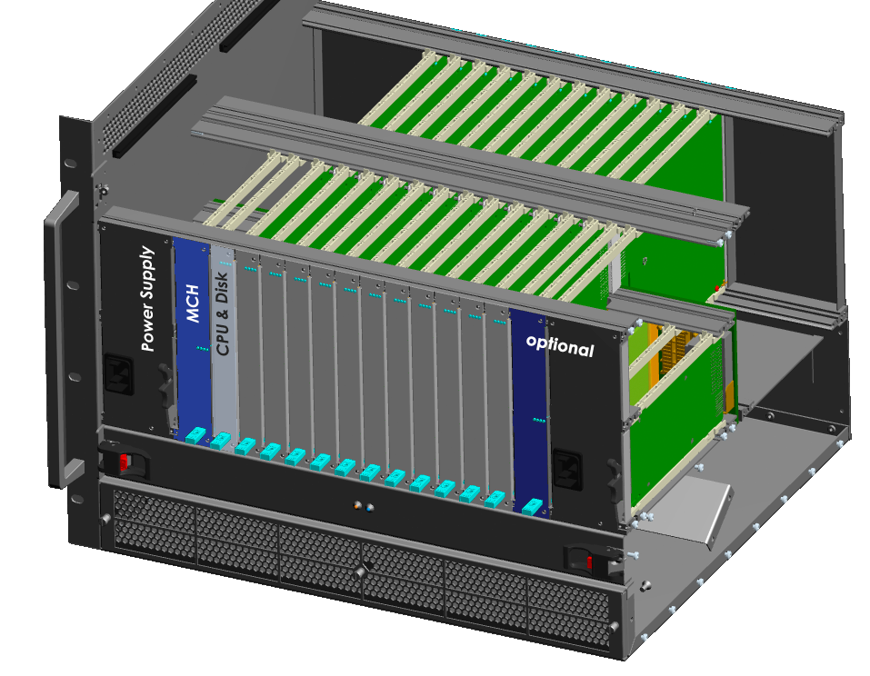
MicroTCA.4: Compact and Modular Design
Cables from rear side
Space for ….
See MTCA.4.1
Redundant:
Power
Fan
© Elma

Slide 6
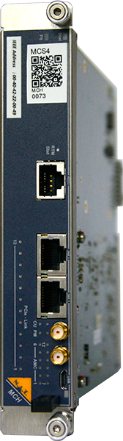
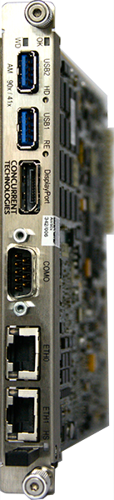
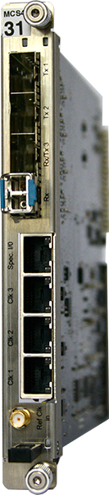
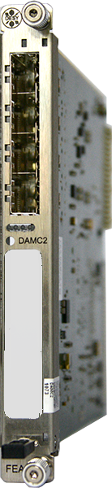
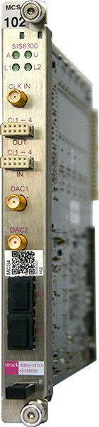


MTCA.4: Clocks, Triggers und Interlocks
Common modules
Application modules
ADC
Digi. IO
Controller
….
LLRF
Diagnostics
Cpl. Interlocks
Laser
…
Machine
Protection
System
MCH
CPU
Timing
From central timing
Ethernet
Clock
Clock
Clock
MTCA.4 Backplane
Trigger
Trigger
Interlock
Interlock

Slide 7
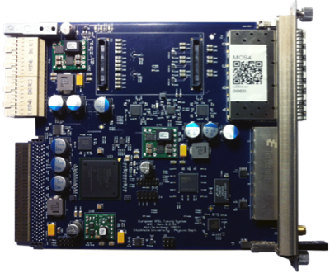
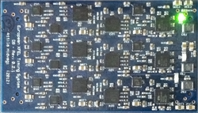

Timing System: Synchronization of all Subsystems
Fiber IO
Transmitter Piggyback with 3 channels of
link drift compensation
RJ45
LVDS
x2timer /
NAMC-psTimer
receiver / transmitter / repeater

Slide 8
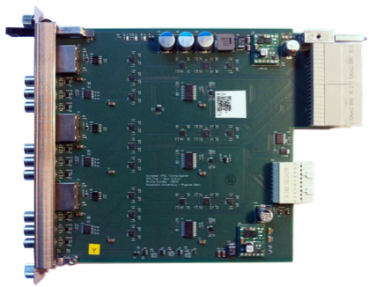
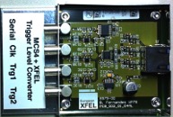
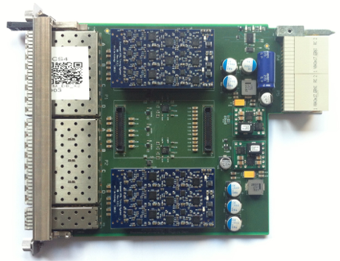
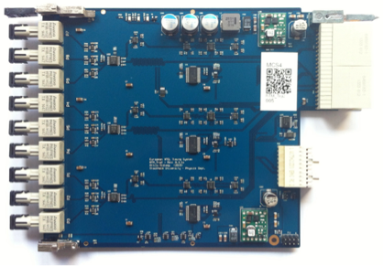
Timing System: Versatile IO
9 Lemo outputs (50 Ohm):
Triggers, Clocks, Data
3 channels with 5ps resolution
Optional RTM
backplane
AMC
RJ45
LVDS
> 100 m
x2timer /
NAMC-psTimer
receiver / transmitter
9 SFP outputs:
with length compensated fiber links
9 Fiber outputs (ST):
Triggers, Clocks, Data
used for modulators

Slide 9
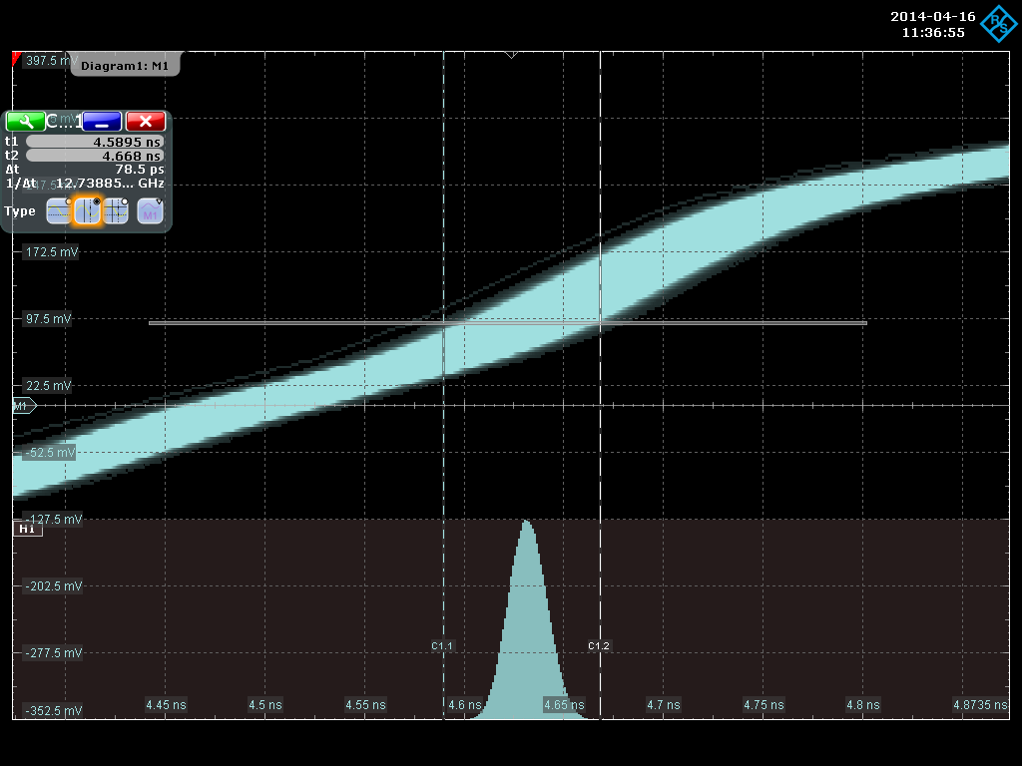
Timing System: Principle of Operation
Distributes:
  Triggers, gates, clocks (10ns … 5ps resolution)
  Bunch information (charge, destination,…), unique ID
Link drift compensation:
Jitter ~10ps RMS
Transmitter
Receiver
∿∿∿∿
1.3 GHz
Fiber Cable
4 km
Clock
Trigger
Data
Generation
Delay
Clock
& Data
Recovery
Clock
Trigger
Data
Controller
∿
50 Hz
Delay
Trigger

Slide 10
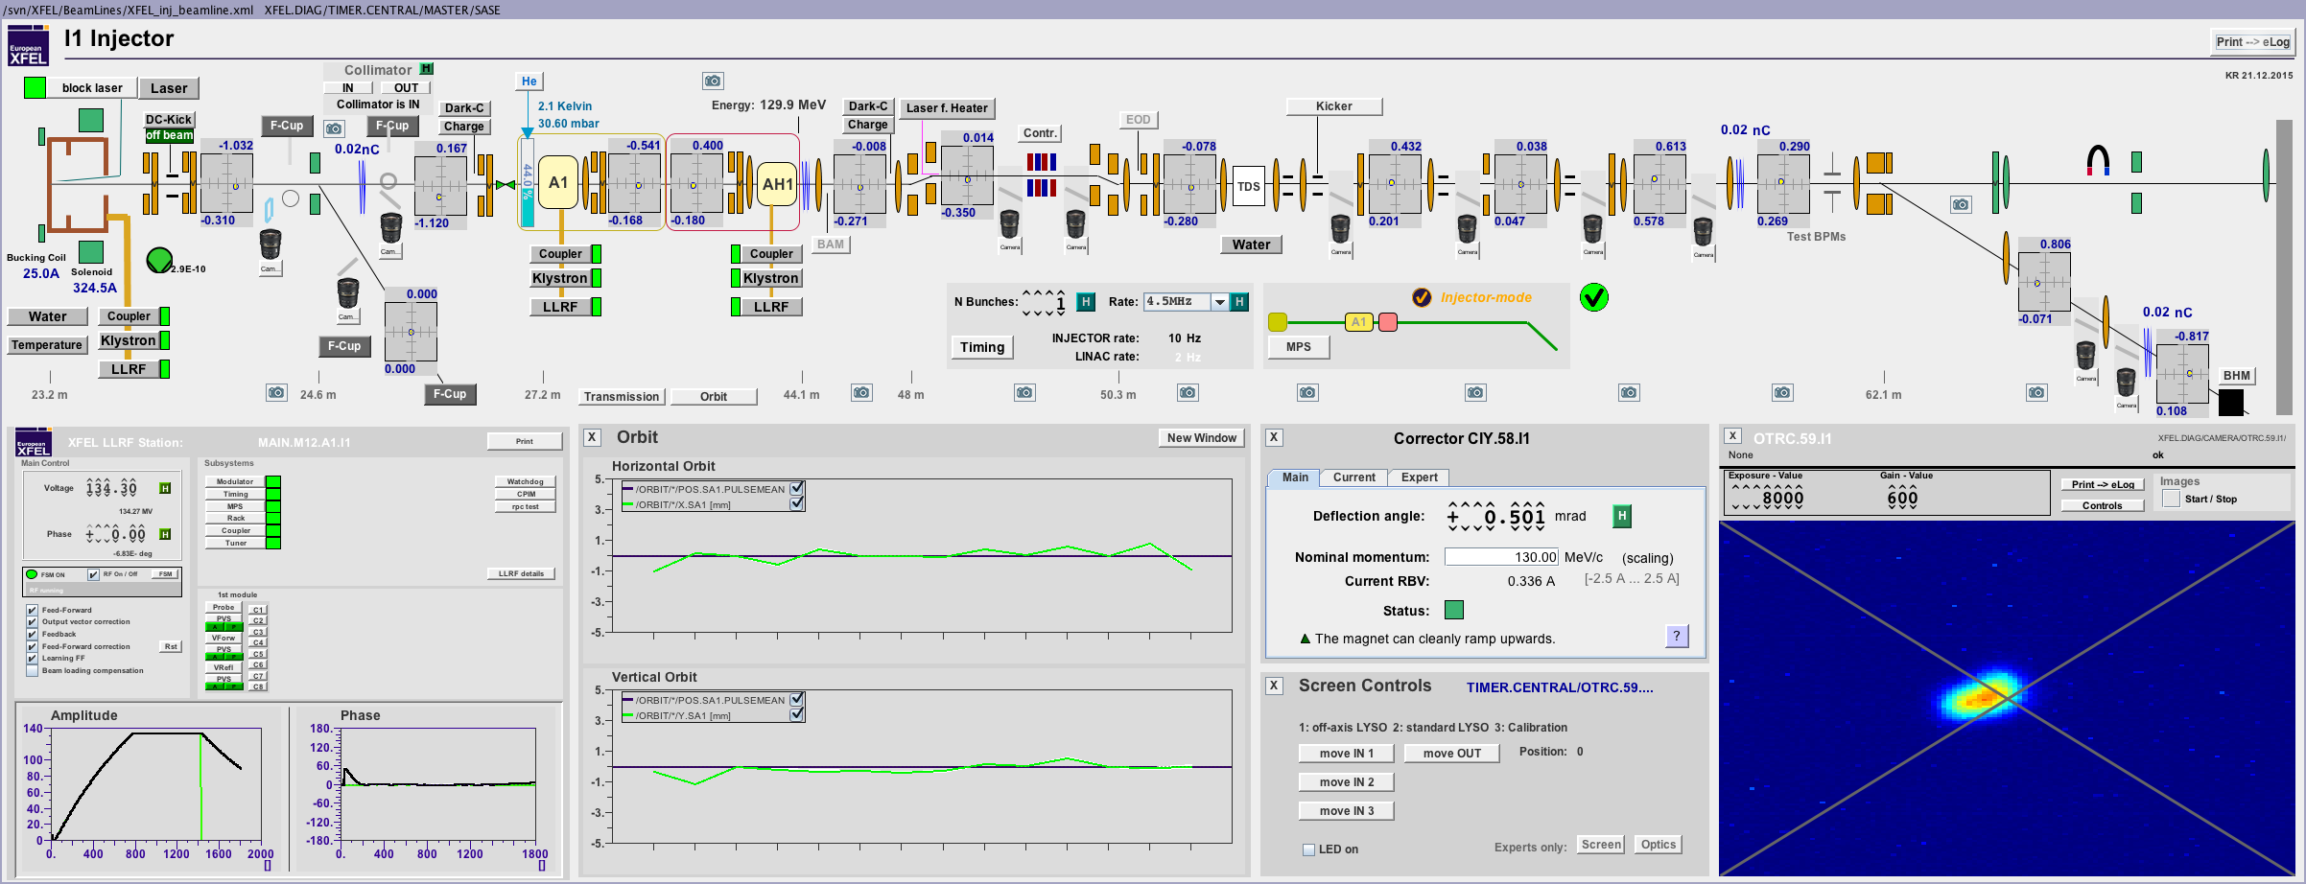
XFEL Injector Operation
Photo Gun 2 superconducting acceleration modules (1.3 and 3.9 GHz) length: 45m
In operation since Dec. 2015
Implements most of the XFEL subsystems:
  Klystron, Modulator, LLRF, BPM, Toroid, Magnet, Laser, Undulator, Vacuum, Water, Camera, Motor, Cryo, Timing, Protection, Dump, …
  DAQ system, middle layer servers, GUI programs and tools, …
> 3.3・10⁶ control system properties online now (270 000 channels with history)

Slide 11
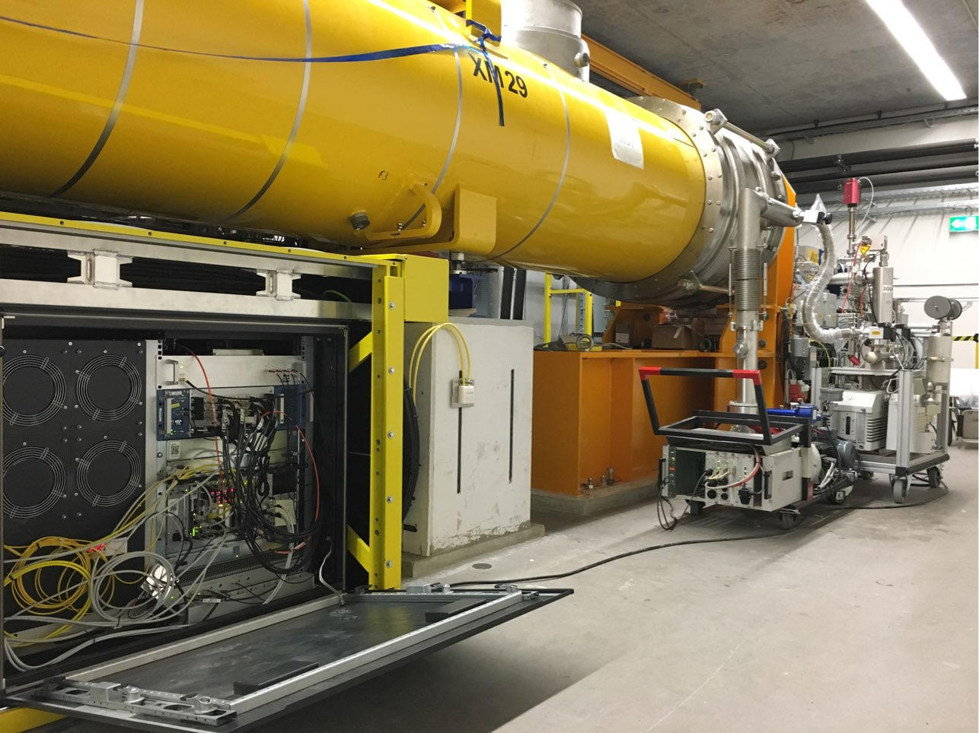
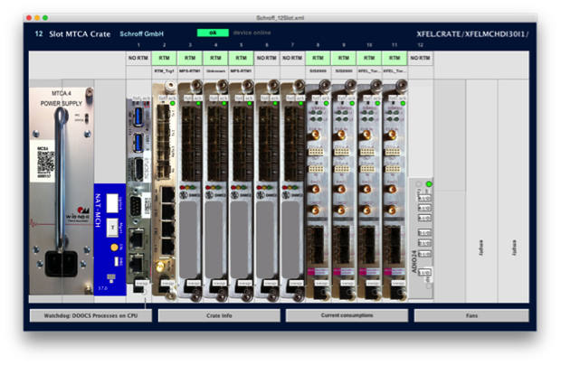
XFEL Injector: 1. Diagnostics Crate
Gun
Rack Cooling

Slide 12
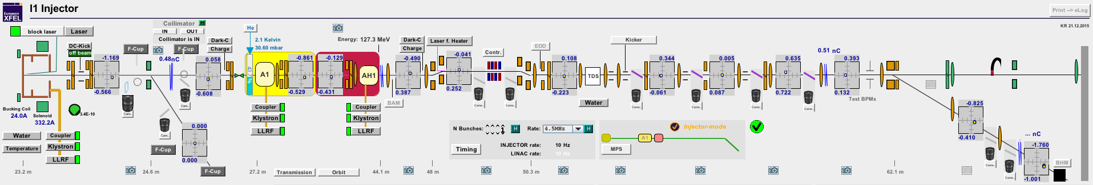
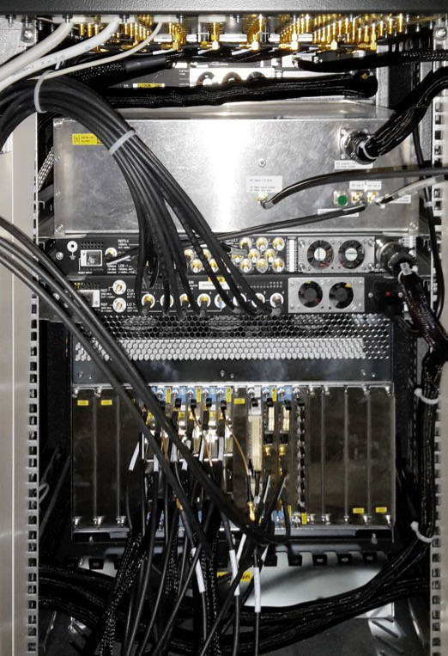
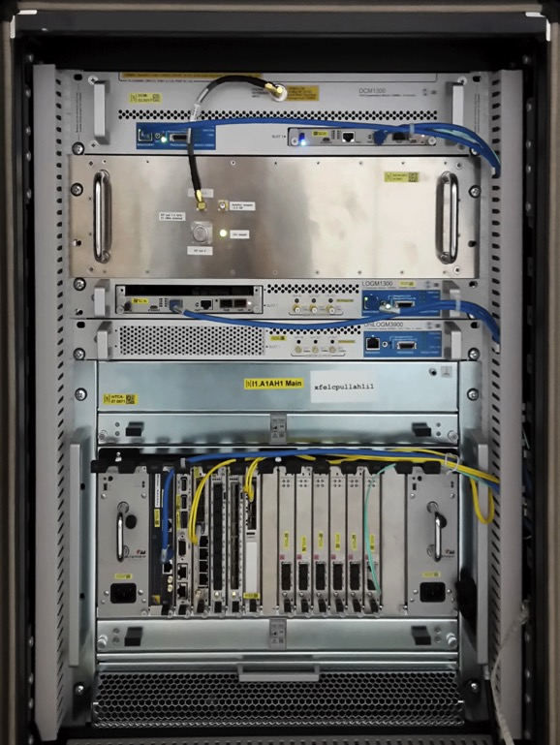
XFEL Injector: Regelung der Hochfrequenz
Rear
Front

Slide 13
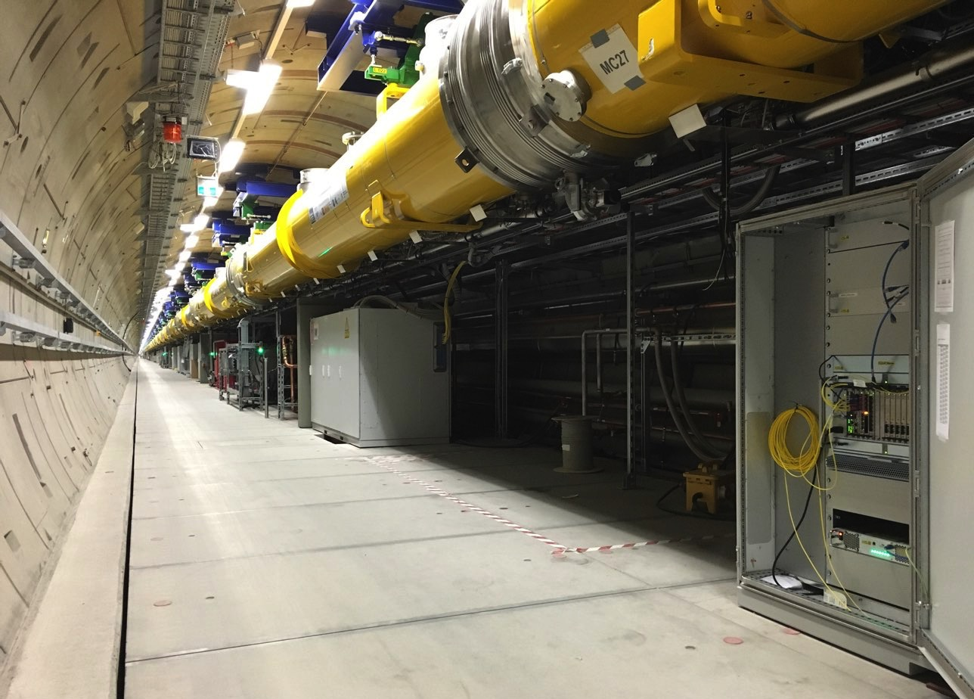
MicroTCA Crate Inside the XFEL Tunnel
1 von 100
Superconducting
Accelerator Modules
1 Klystron
drives 4 Modules
MicroTCA Crates:
2 LLRF
2 Coupler Interlocks
1 Diagnostics
LLRF MicroTCA Crate

Slide 14
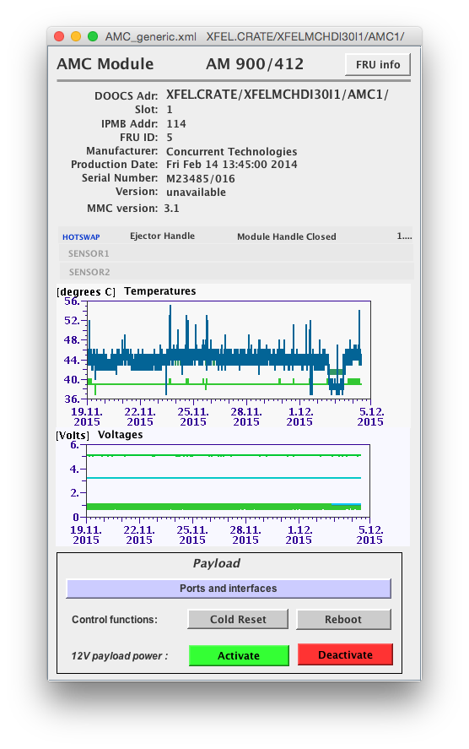
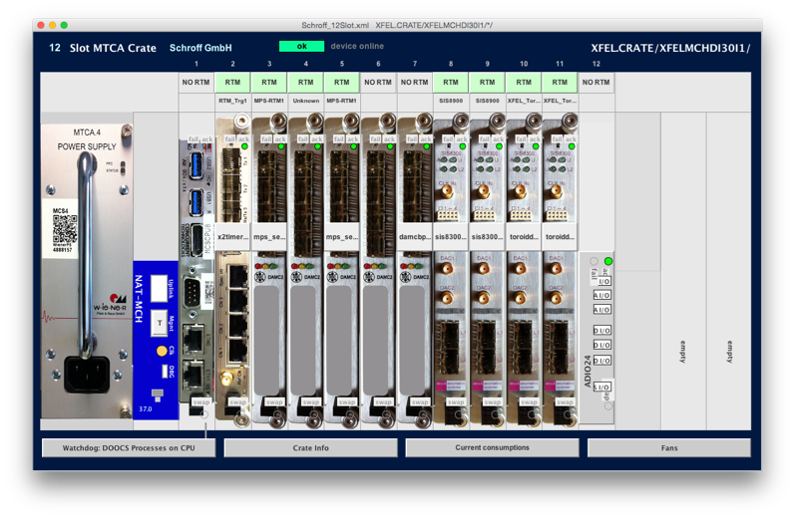
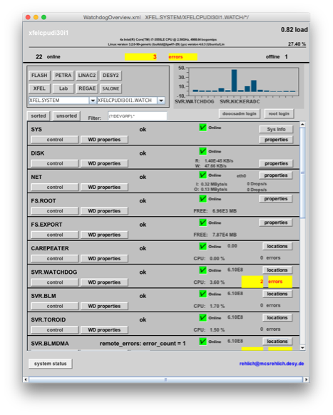
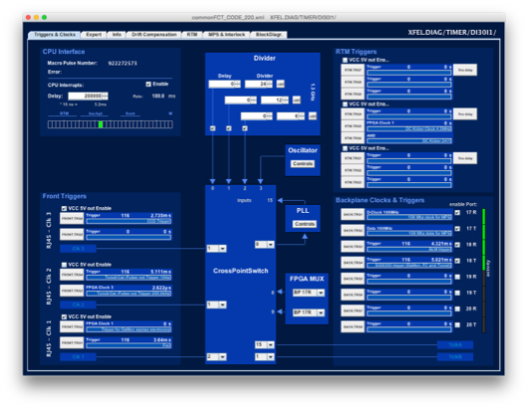
MicroTCA Remote Management
Display by standard controls tool jddd
Management
View
DOOCS
Control System
View
14

Slide 15
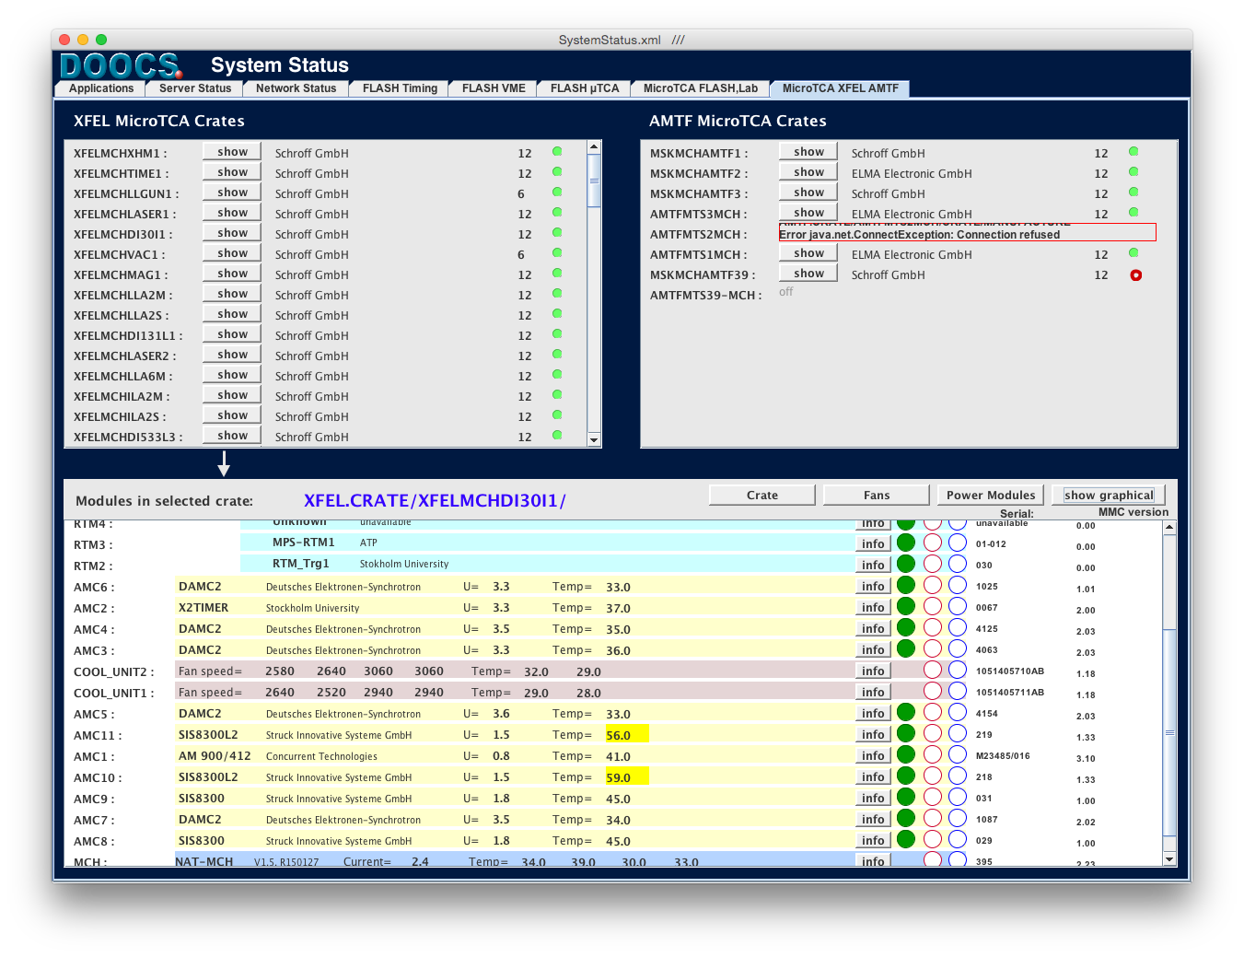
MicroTCA Crate Management View
Shows all Crates in XFEL
Shows all Modules in
selected Crate

Slide 16
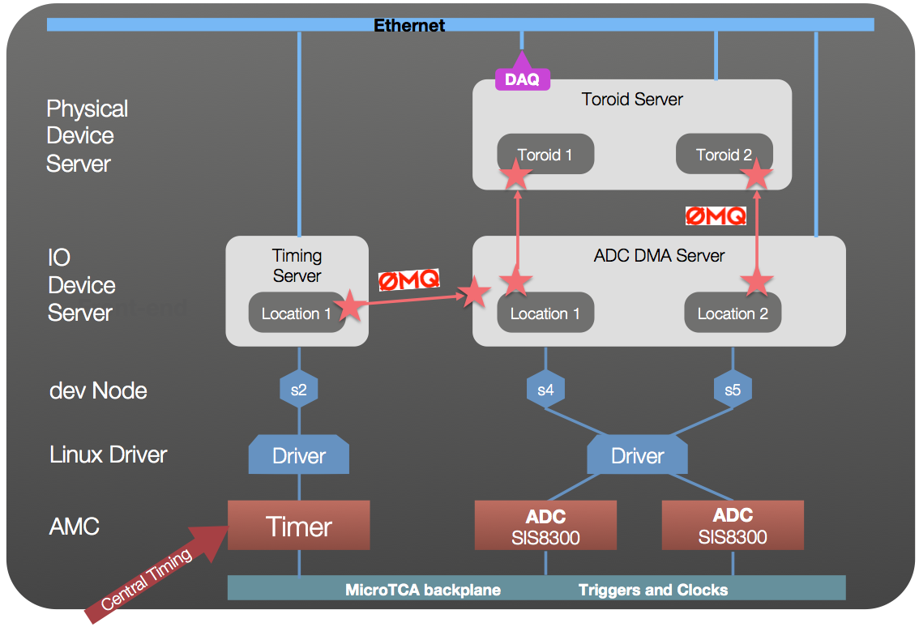
DOOCS Control System Data Flow

Slide 17
DOOCS Data Acquisition System
Orbit
Server
Energy
Server
Other
Server
Feedback
Server
Writer
Buffer Manager
Shared Memory
Disk
Tape
Configuration
Controller
Fast Collector
Slow Collector
      Front-end
Ethernet
  Multicast to several
  DAQ instances
DAQ
Toroid Server
Toroid 1
Toroid 2

Slide 18
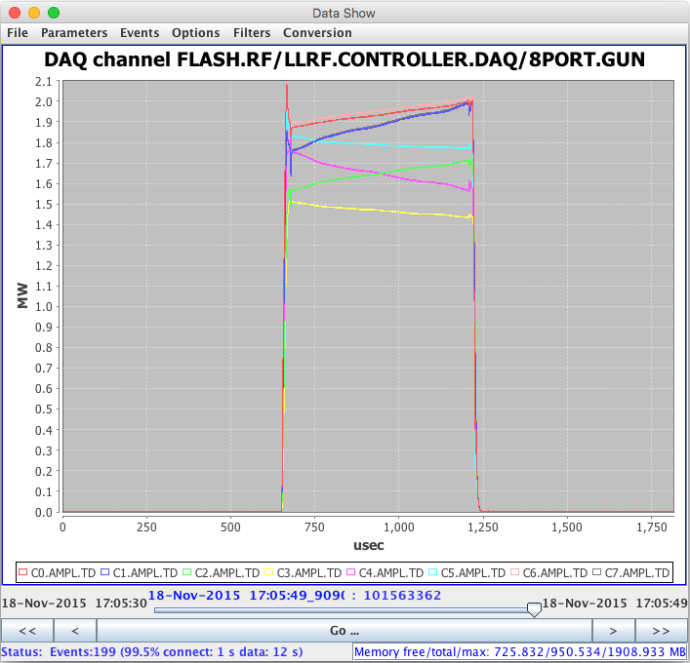
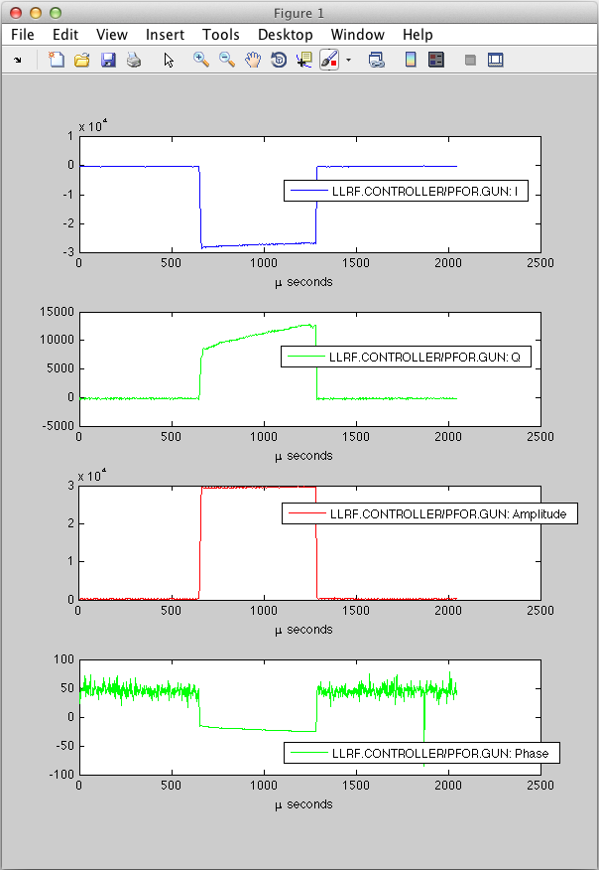
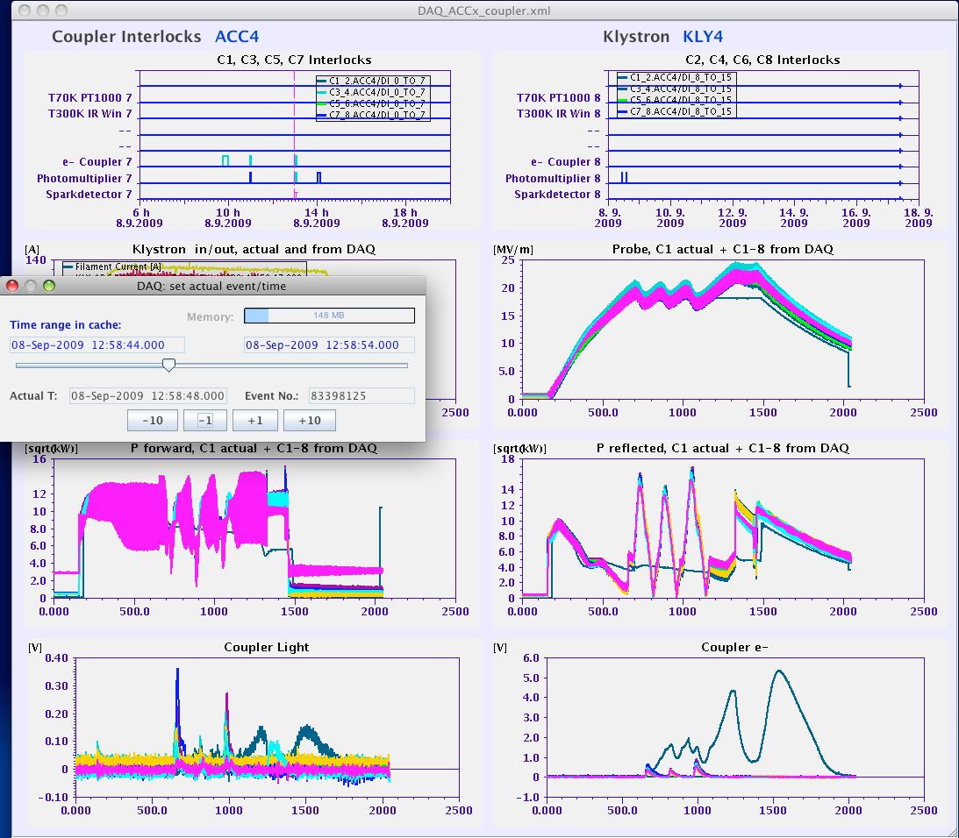
Analyze all Shots with Bunch Resolution
Jddd: GUI editor
DAQ GUI
MATLAB
Orbit
Server
Energy
Server
Other
Server
Writer
Buffer Manager Shared Memory
Fast Collector
Slow
Collector

Slide 19
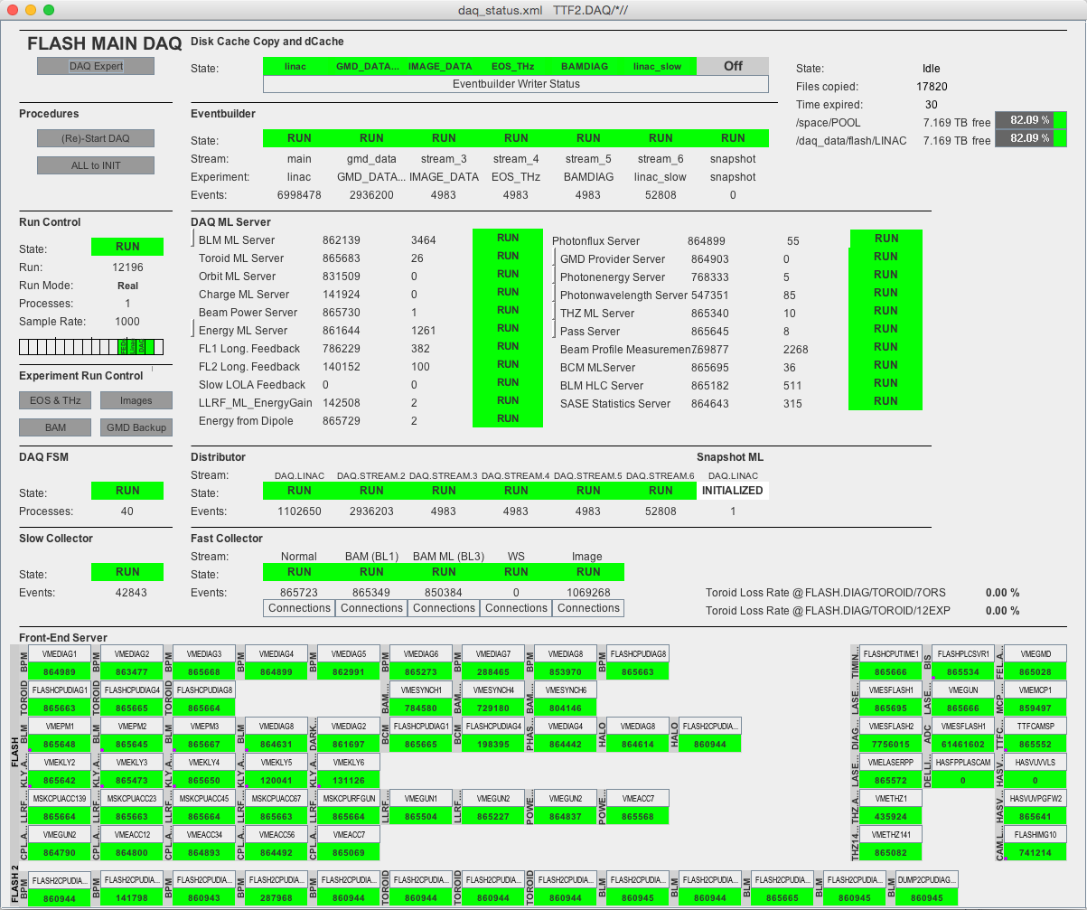
DAQ Maintenance Panel (Example: FLASH)
Storage
Streams
Attached
Processes
Data
Collectors
Distributed
Front-ends

Slide 20

Summary
PICMG Standard
  Started 2009 → MTCA.4 published 2011
    Q2 2016: MTCA.4.1 extensions
  Other projects can benefit from the standard
XFEL fast Diagnostics and Controls platform is
  Final installation > 200 MicroTCA.4 Crates
  Injector is fully operational since Dec. 2015
  Linac cool-down will start Oct. 2016
Critical Hardware and Software is successful in operation

Slide 21

Thank you!
More info: doocs.desy.de

