Slide 1

Real-time implementation in JET of the SPAD disruption predictor using MARTe
20th Real Time Conference
5-10 June 2016
Padova, Italy
S. Esquembri¹, J. Vega², A. Murari³, M. Ruiz¹, E. Barrera¹, S. Dormido-Canto⁴, R. Felton⁵, M. Tsalas⁵, D. Valcarcel⁶, and JET Contributors*
¹Instrumentation and Applied Acoustic Research Group (I2A2), Universidad Politécnica de Madrid, Madrid, Spain
²Laboratorio Nacional de Fusión, CIEMAT, Madrid, Spain
³Consorzio RFX (CNR, ENEA, INFN, Universitá di Padova, Acciaierie Venete SpA), Padova, Italy
⁴Dpto. Informática y Automática - UNED, Madrid, Spain
⁵EUROfusion Consortium, JET, Culham Science Centre, Abingdon, UK
*See the Appendix of F. Romanelli et al., Proceedings of the 25th IAEA Fusion Energy Conference 2014, Saint Petersburg, Russia.
Acknowledgements
This work was partially funded by the Spanish Ministry of Economy and Competitiveness under the Projects No ENE2012-38970-C04-01, ENE2012-38970-C04-03, ENE2012-38970-C04-04, predoctoral fellowship BES-2013-064875, and the grant for predoctoral short-term stays in R&D centers (2014)

Slide 2
Outline
Introduction
  Disruption Predictors
  MARTe & JET
SPAD Disruption predictor
  Algorithm
  Real-time Implementation
Results
Conclusions
Future Work
Q&A

Slide 3
Introduction
Context: Current (and future) Tokamak devices
Plasma disruptions are unavoidable and damage the machine
  Electro-Magnetic Forces
  Thermal Loads
  Runaway Electrons
Mitigation techniques must be applied before the disruption occurs -> Disruption Predictors
Notes:
In present tokamaks disruptions are unavoidable and can induce severe damage to the machine. Various mitigation techniques has been developed, but in order to be effective they must be applied before the disruption occurs, therefore disruptions predictors are needed for triggering the mitigation systems.

Slide 4
Introduction: Disruption Predictors
Several approaches already exist:
  Threshold based predictor -> Limit set manually based on the risk
    Using Locked Mode, Plasma Current, or Restraint Ring Loop
    Optimal/Universal threshold?
  APODIS -> Machine Learning (SVM).
    Using seven signals (including Locked Mode and Plasma Current)
    Need training based on disruptive and
    non-disruptive discharges
    Machine dependant?
    New/Upgraded machines?
    Big changes in plasma parameters?
    Difficult to find physics explanation
    justifying the detector classification
Notes:
In JET there are currently two kind of disruption predictors implemented. One based only in a threshold cross detection of signals like the locked mode signal, but there is no universal criteria for the threshold, and its set lower or higher depending on the potential damage produced by a disruption.
APODIS is the other disruption predictor implemented. This predictor is based on machine learning. This approach offers much better detection results but it also has inconveniences: needs a big set of discharges to be trained (that aren’t always available), the training is computationally expensive, might not be portable in terms of different machines or big changes in plasma parameters, and its really difficult to understand de underlying criteria applied for detecting a disruption

Slide 5
Introduction: MARTe
MARTe : Multi-threaded Application Real-Time executor
  Multiplatform framework for implementing real-time applications
  Isolation
    From PC hardware & OS
    From system I/O software
  Modularity
Already used in several tokamaks (RFX,COMPASS, ISTTOk, FTU)
  Also in JET: Interface with JPF/RTDN already implemented
Code reuse + maintainability
Notes:
MARTe it’s a widely used framework for implementing real time applications in tokamaks.
JET Vertical Stabilization system, Real Time Application Interface (RTAI) operating system on Intel multi-core processors;
JET error field correction coils based on VME, PowerPC and VxWorks;
COMPASS plasma control system, driven by Linux RT also on Intel multi-core processors;
ISTTOK real-time tomography equilibrium reconstruction which shares the same support configuration of COMPASS;
FTU LH reflected power system running on VME, Intel with RTAI.

Slide 6
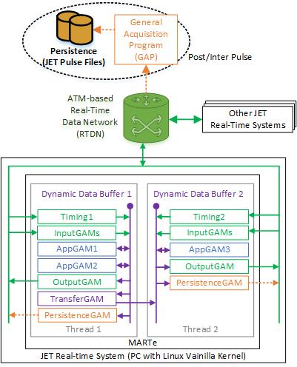
Introduction: MARTe
MARTe applications consist of Threads periodically executing GAMs (Generic Application Modules)
GAMs are interconnected using Dynamic Data Buffer (DDB)
Typical GAMs:
  Timing (Thread clock)
  System I/O
    (JETs: Read/Write from/to RTDN/JPFs)
  Process GAMs
  Thread-to-Thread communication (DDB-to-DDB)
Notes:
MARTe applications consist of threads executing modules called GAMS in a periodic basis. GAMS read and write values to the Dynamic Data Buffer, which interconnects all the GAMs in a thread. There are multiple GAMs already developed solving common problems, like timing GAMs to control the execution frequency of a thread, GAMs to perform I/O operations (in the JET case, input/output to JPF or RTDN), and GAMs to send/receive data from another thread. To implement an application in MARTe you could use this GAMs together with custom developed ones performing the operations required over the data.

Slide 7
SPAD Disruption Predictor
SPAD: Single signal Predictor based on Anomaly Detection
Objectives:
  No use of data from past discharges -> No training needed
Method
  Use Locked Mode signal -> Highly related with disruptions
  Detect abnormal behavior in the signal
    Normal behavior is learnt from the beginning of the discharge
  Predict disruptions using only one signal
  Easy to understand explanation for detection
Notes:
The objective of this work was to develop a disruption predictor based on a single signal, with no training or data from past discharges required, like the LMPT, but without a variable user-defined threshold, and using a more sophisticated criteria. The signal chosen was the LockedMode, as is closely related with the disruptions, and the method is to detect abnormal behaviour on the signal. The normal behaviour will be learnt from the beginning of the discharge, as discharges starts in a safe state.

Slide 8
SPAD Disruption Predictor
Already presented
  J. Vega et al. “Advanced disruption predictor based on the locked mode signal: application to JET”. 1st EPS Conference on Plasma Diagnostics. April 14-17, 2015. Book of abstracts. Frascati, Italy.
  J. Vega et al. “Disruption Precursor Detection: Combining the Time and Frequency Domains”. 26th Symposium on Fusion Engineering (SOFE 2015). May 31st-June 4th, 2015.Austin (TX), USA.
  J. Vega et al. “Real-time anomaly detection for disruption prediction: the JET case“. Nuclear Fusion (submitted).
Implemented in MATLAB and not suitable for real-time.
Notes:
This algorithm is described in previous publications and was provided as a MatLab program.

Slide 9
SPAD: Algorithm
Notes:
This a diagram of the steps in the algorithm.

Slide 10
SPAD: Real-time Implementation
Each step is performed in a different GAM
  + GAM to signal start based on Plasma current threshold
One single thread executing all the GAMS
Thread execution period = 1ms
Problems
  Covariance Matrix
  Standard Deviation
  Mean
Of a set growing with each iteration
Execution time not bounded
“Update” the values, no recalculate
Notes:
The work presented here is modification and codification of this algorithm in MARTe in a way that gives the same results than the original MatLab implementation. Each one of the previous steps will be performed in a different GAM (and one more to select what it’s the plasma current threshold to start the operation).
The algorithm will sample the LockedMode signal at 1 kS/s, therefore the thread execution period and maximum cycle execution time is 1ms.
This implies some problems with the original algorithm, as it performs some operations, specifically the calculation of means, standard deviation and covariance matrix, related with all the data collected since the beginning of the discharge. In principle, if we calculated from scratch this statistics, the execution time will be increased with every data added to the set. To solve this, we will update this statistics, instead of recalculating.

Slide 11
SPAD: Real-time Implementation
SlidingWindowGAM
Provide the latest 32 values (window) of Locked Mode signal
Update the window every 2 thread cycles (2 ms) (slide)
Signals when the window has been updated
Parameters:
  Input signal
  Window size
  Window slide
Notes:
The first of all is sample the LockedMode signal and create windows of 32 samples. This GAM will provide the latests 32 samples of the LockedMode signal, updating the window every 2 ms, but of course, the window size and updating rate are customizable.

Slide 12

SPAD: Real-time Implementation
HaarApp1DCoefGAM
Calculate the Haar Wavelet Transform Approximation Coefficients (for SPAD Level 2 $H_{L2}:ℝ^{32}→ℝ^{8}$)
Optimizations
  Coefficients not calculated by iteration
Parameters:
  Input signal
  Level applied
Notes:
These windows will be the output of the next GAM, that will calculate the approximation coefficients of the haar wavelet transform. As the detail coefficients won’t be used, they are not calculated. In SPAD, the best results are achieved using the level 2 transform, obtaining 8 coefficients from the 32 sample window, but the level applied is configurable.

Slide 13
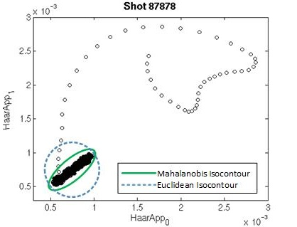

SPAD: Real-time Implementation
MahalanobisGAM
$H_{App}$ used as feature vector
Calculate distance between current vector and centroid of the cluster formed by all past vectors in the discharge.
Optimizations
  Covariance Matrix (S) and mean vector (μ) “updated”
    Store partial sums and products
  LUP method used for inverse product
    Can be done better!
Notes:
Once we got the haar approximation coefficients, we will used them as a feature vector, possibly represented as a point in a 8-dimensional space. This GAM will calculate the distance between the current point and the centroid formed by the all previous feature vectors in the discharge using the Mahalanobis distance method. Here we face for the first time the problem of a statistic using all the date since the discharge, as the Mahalanobis distance requires calculate the Covariance matrix and the mean vector. To solve the problem, partial sums and products are stored in a way that the distance can be calculated in a constant time, only depending on the number of features in the vector, and not of the number of samples to be considered.

Slide 14
SPAD: Real-time Implementation
OutlierFactorGAM
Is the current vector anomalously far from the cluster?
Factor given by an equation using mean(μ) and standard deviation(σ) from all past distances in the discharge.
Optimizations
  Update mean and standard deviation storing partial sums and products
Notes:
The Mahalanobis distance value will be used in the next GAM to calculate the outlier factor of the current window, or what it’s the same, how anomalous is the current distance considering the history of the discharge. Again, we have some statistical involved that will be calculated using partial sums and products in order to maintain the execution time constant during the whole discharge.

Slide 15
SPAD: Real-time Implementation
SPADAlarmGAM
Trigger the disruption alarm if the conditions are met
  Outlier factor surpasses a configurable threshold
  Current value of Locked Mode is a global maxima
Analysis over all ILW campaigns shows that K=10 works fine
Parameters
  Outlier Factor Threshold
Notes:
Finally, the last GAM, the one triggering the disruption alarm. The alarm will be triggered when current value of the lockedMode is a local maxima and the outlier factor is more than 10. This value was obtained as best value from the analysis of all ILW campaings, but it’s configurable.

Slide 16
Results
Same detection results than non-optimized MatLAB reference application.
Execution time bounded during the whole discharge.
Tested using JETs JPF data from all safe and unintentional disruptive discharges with ILW from 2011 to 2014 (C28-C34)
  1738 safe discharges
  566 unintentional disruptive discharges
Notes:
This are the results obtained. The most important is that we obtained the same results than the reference program even with the optimizations enabling the real-time execution independently of the length of the discharge. In the table we can observe the comparison among the three predictors. As in JET the mitigation system should be triggered at least 10ms before the disruptions, all the predictions with less anticipation time are considered “Tardy detections”. Also, predictions with more than 1.5 s are not considered valid predictions and are classified as Premature alarms. Only the predictions with anticipation time between 10ms and 1.5s are considered valid alarms. In the graphic is shown the accumulative detection rate with regard to the time. We can see, for example, that 60% of the disruptions are predicted by SPAD with at least 100ms.

Slide 17
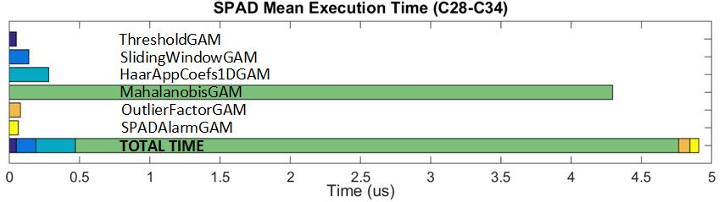
Results
Execution time in a no-Real Time platform
4 cores, 2 threads/core, 3.6 GHz, 16 GB RAM, RHEL 6.5
Confidence Level 97% (Mean Time + 3·Standard Deviation)
Max execution time 26.9280 us (OS interruptions?)
Notes:
Here we can observe the Mean execution time of the different GAMS with a confidence level of 97%. The test system was a computer with the specs described in the slide, similar to the final target system. The maximum execution time was near the 25 ms., more than 5 times the mean execution time. This could be caused by OS interruptions, but also to the calculation of the inverse matrix needed by the Mahalanobis distance. The results expected in the final system are a mean slightly greater but with less standard deviation.

Slide 18
Conclusions
Implemented real-time disruption predictor in MARTe
Execution time per cycle << 1ms (even in no-RT platforms)
Optimizations for the calculation of Covariance Matrix, Standard Deviation and mean
  Execution time bounded for the whole discharge
  Depends only on the size of the feature vector (not on the duration of the discharge!!)
Identical detection results for MatLAB reference application and MARTe implemented predictor.

Slide 19
Future Work
Predictor:
  Reduce false alarms
  Improve detection ratio
  Study behavior with other/more signals
    Related with root of disruption
Implementation
  Real-time implementation of the improvements in the predictor
  Improve inverse matrix and vector-matrix-vector product performance (Not really important due to current performance)

Slide 20

Q&A
Thanks for your attention

