Slide 1
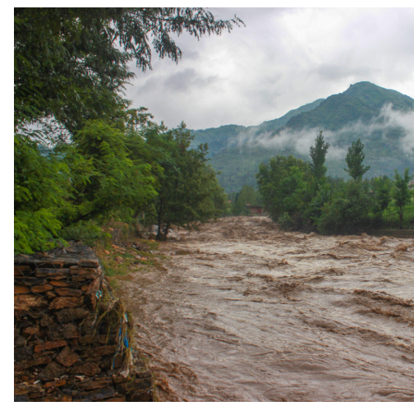

Impact of Climate Change on Glacial lake outburst (GLOF) in Northern Pakistan
Author : Rabia Mir

Slide 2
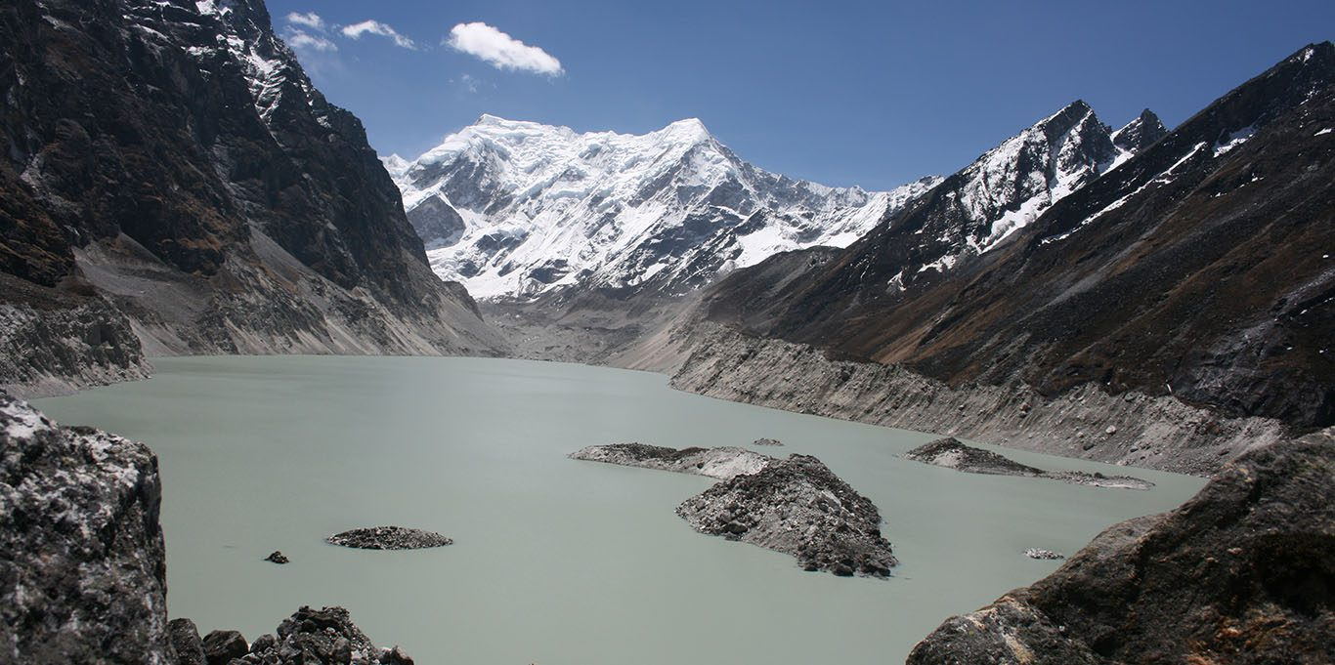
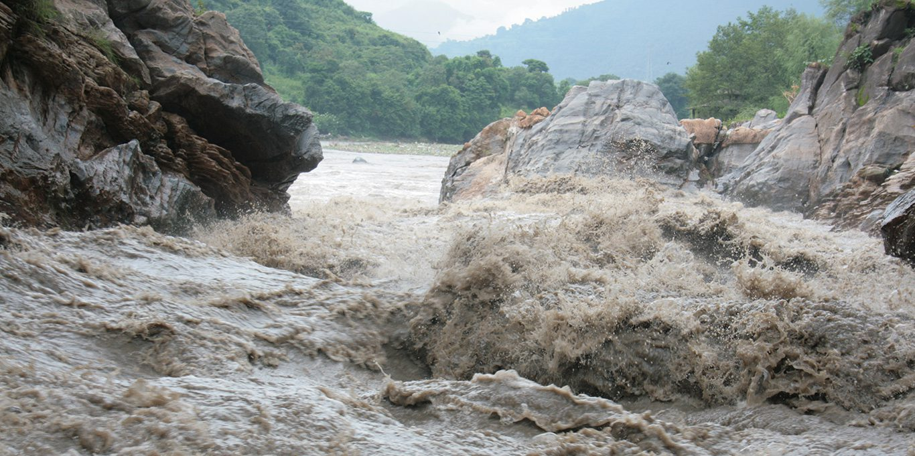
What is a Glacial Lake Outburst Flood?
A Glacial Lake Outburst Flood, or GLOF, is a sudden release of water from a lake fed by glacier melt that has formed at the side, in front, within, beneath, or on the surface of a glacier.

Slide 3
Increased Risk of GLOFs:
Northern Pakistan, including the Hindu Kush, Himalayas, and Karakoram ranges, is experiencing accelerated glacier retreat.
the primary reason for GLOFs is accelerated glacier melt driven by global warming.
GLOFs pose significant threats to local communities, infrastructure, and ecosystems.

Slide 4
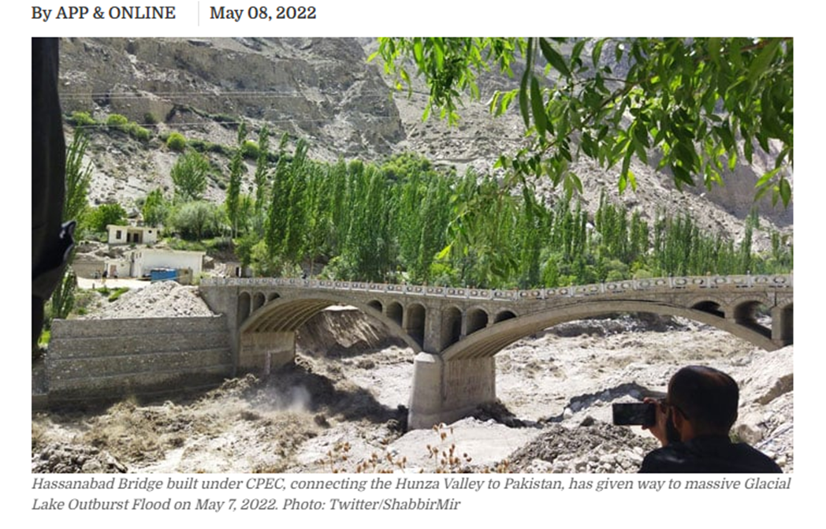
GLOF: A serious Threat to Pakistan Northern Areas
Pakistan faced 33 glacial lake outburst floods, with 16 linked to heatwaves.
In May-2022, GLOF in Hassanabad, Hunza, destroyed homes, hydro-plants, and a key bridge.

Slide 5
STUDY FOCUS
GLOFs from two specific lakes
Chitral-GL2
Swat-G31
AIM:
Assess the probability and potential magnitude of GLOF events.
Predict the spatial extent and impact of flooding on the surrounding areas.
Inform the development of effective early warning systems and mitigation strategies.

Slide 6
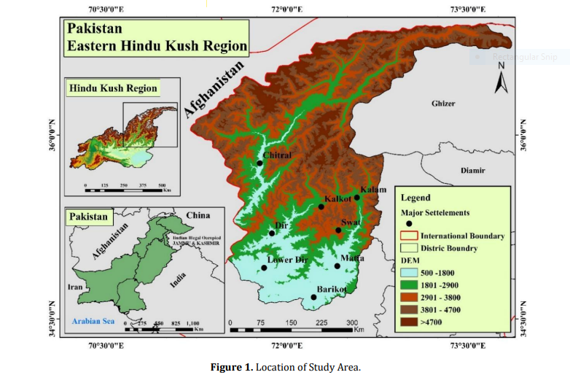
LOCATION
Eastern Hindu Kush is in northwestern Pakistan.
Includes Chitral, Upper Dir, Lower Dir, and Swat districts.

Slide 7
METHODOLOGY/APPROACH
Remote sensing and GIS were used to map glacial lakes, gathering data on their area, volume, and depth.
Empirical equations were developed to assess GLOF risk.
Hydrological modeling with HEC-RAS and HEC-GeoRAS (evaluating the spatial extent and depth of potential flooding)

Slide 8
DATA SOURCES
All data from the United States Geological Survey (USGS) open-source geospatial database.
ASTER GDEM
Landsat Imagery
Sentinel-2
Additional Data:
Meteorological Data: Collected from 1991 to 2019 by the Regional Meteorological Center, Lahore.
Population Data: Sourced from Pakistan Bureau of Statistics.

Slide 9
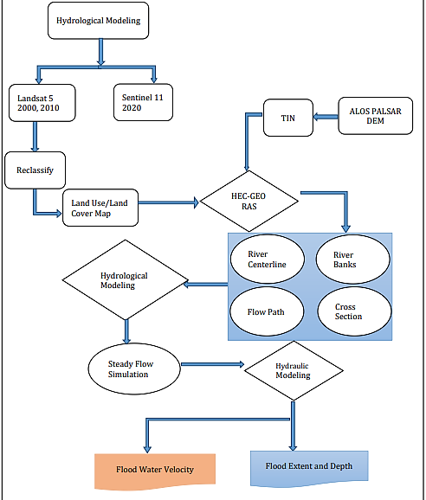
Spatial Hydrological Modeling

Slide 10
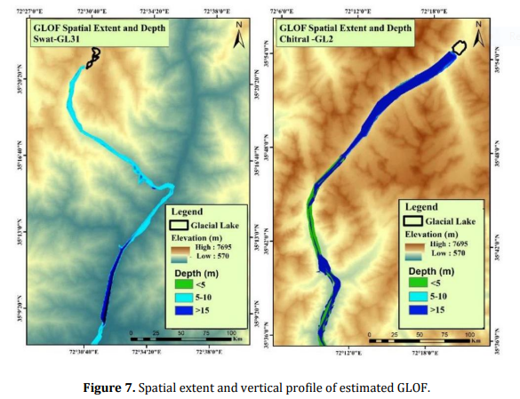
Flood Extent and Depth
Chitral-GL2:
Flood extent decreases downstream.
Flood depth for Chitral-GL2 ranges from 5 to 15 meters.
14.86 km² submerged
Swat-GL31:
Flood depth ranges from 5–10 m.
5.79 km² submerged

Slide 11
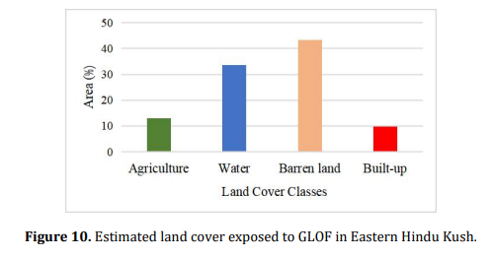
Flood Impact Assessment
Total area susceptible to flooding: 20.56 km².
Flood impacts by land type:
  Built-up and agricultural land: 2.7 km².
  Barren land: 8.93 km².
Flood depths range from less than 5 m to over 15 m.

Slide 12
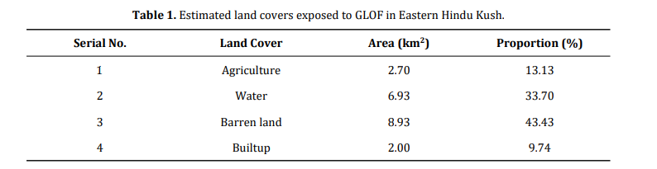

Slide 13
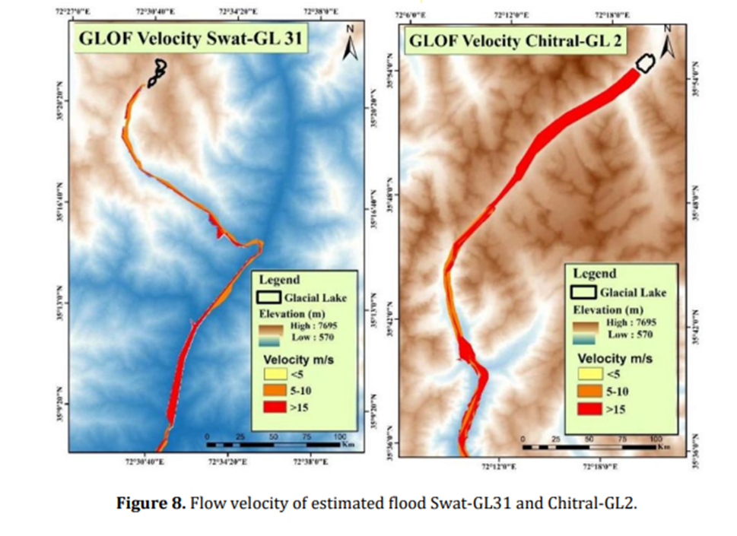
Flood water Velocity
The peak flood velocity map shows high-intensity flooding near the channel
Lower-intensity flooding downstream due to the channel's width

Slide 14
CONCLUSION
The study finds 20.56 km² vulnerable to GLOFs.
Chitral-GL2 is at greater risk than Swat-GL31 due to a steeper gradient.
Chitral-GL2 faces 14.80 km² of flooding, while Swat-GL31 sees 5.79 km² affected.
Flood depth impacts 2.7 km² of built-up and agricultural land, and 8.93 km² of barren land.

Slide 15
RECOMMENDATIONS
Implement early warning systems in GLOF-prone areas.
Monitor glaciers and glacial lakes regularly to assess risks.
Reduce global greenhouse gas emissions to mitigate global warming and subsequently slow glacial melting
Build controlled water release systems (dams) to reduce flood damage.

Slide 16
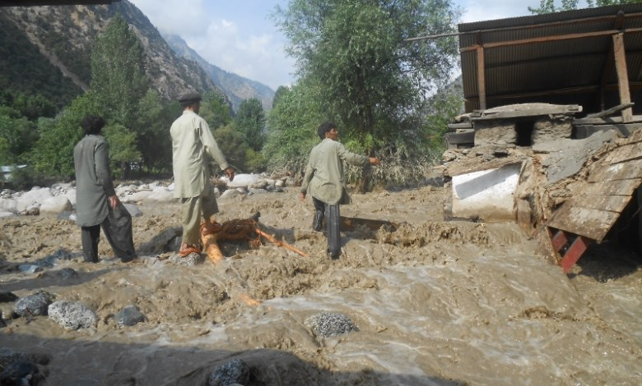
Significance
Identifies high-risk flood zones.
Guides flood management and resource allocation.
Supports safer urban planning in flood-prone areas.
Informs climate adaptation strategies.
Enhances community preparedness and safety.
Explains the role of natural features in flood dynamics.
Provides data for policy and decision-making.

Slide 17
References
Sarwar, M., & Mahmood, S. (2024). Assessing the Impact of Climate Change on Glacial Lake Outburst Flood (GLOF) in Eastern Hindu Kush Region Using Integrated Geo-Statistical and Spatial Hydrological Approach. Prevention and Treatment of Natural Disasters, 3(2).
Shah, A., Naveed, R., Khalid, I., & Khan, A. (2021). A review on consequences of climate change in Pakistan. International Journal of Engineering Research Updates, 1(01), 026-042.

