Slide 1
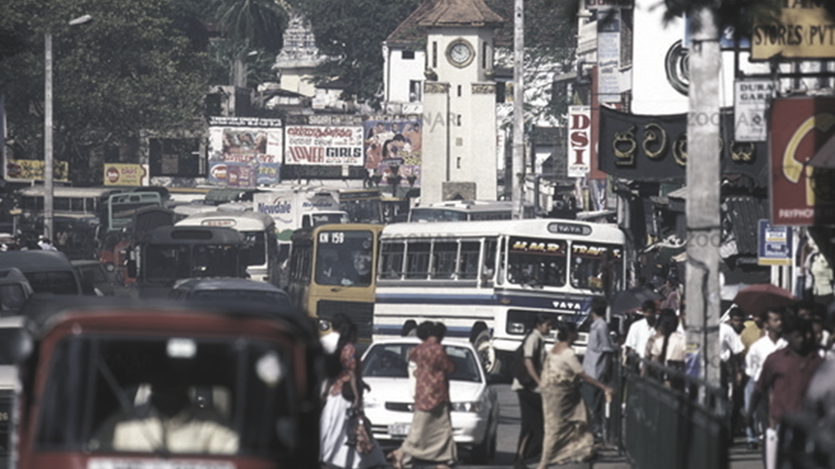
Microorganisms and heavy metals associated with atmospheric deposition in a congested urban environment of a developing country: Sri Lanka
Lakshika Weerasundara, R.W.K. Amarasekara, D.N. Magana-Arachchi, Abdul M. Ziyath,
D.G.G.P. Karunaratne, Ashantha Goonetilleke, Meththika Vithanage
Claudia Fernando (speaker)

Slide 2
Introduction – background & objective
Atmospheric deposition and pollutants
Heavy metals (HMs)
PAHs
Processes of deposition
Dry deposition (DD)
Wet deposition (WD)
Sources of pollutants
Natural sources
Bacteria
Impacts of heavy metals
Limited research
Study objective
Non-biodegradable
mobile
Anthropogenic activities

Slide 3

Materials & methods
Study area - Kandy
Thermal inversions in the atmosphere
26 km² land area
No significant industrial activities
Daytime relative humidity 63 – 83%
Average daytime temperature 28 – 32 °C
Daily traffic flow >100,000 vehicles
Daily transient population ~ 100,000
Monthly rainfall 52 – 398 mm

Slide 4
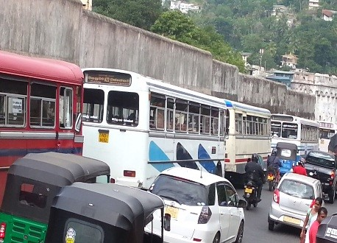
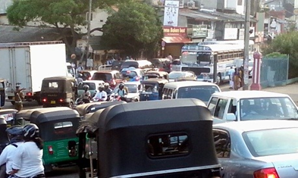
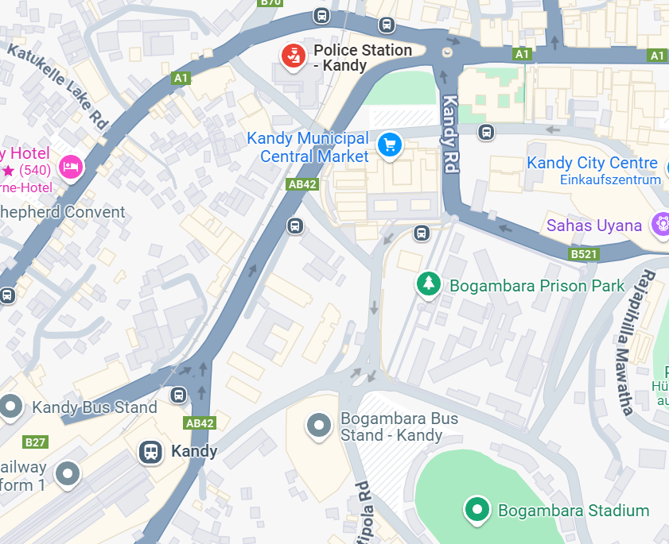
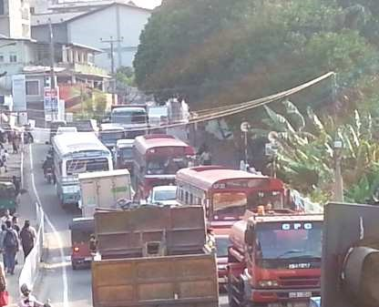
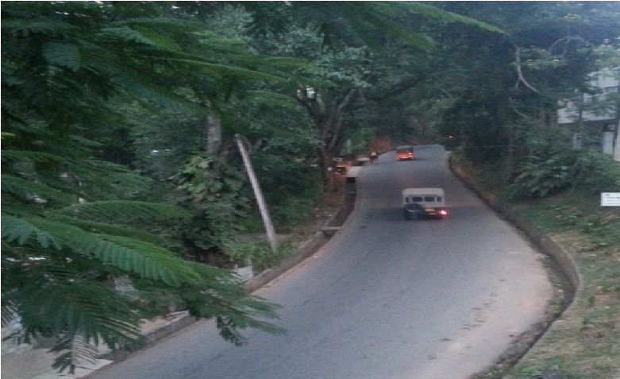
Sampling sites
Site P (Police Station)
Site F (Fire Brigade)
Site R (Railway Station)
Site I (NIFS)

Slide 5
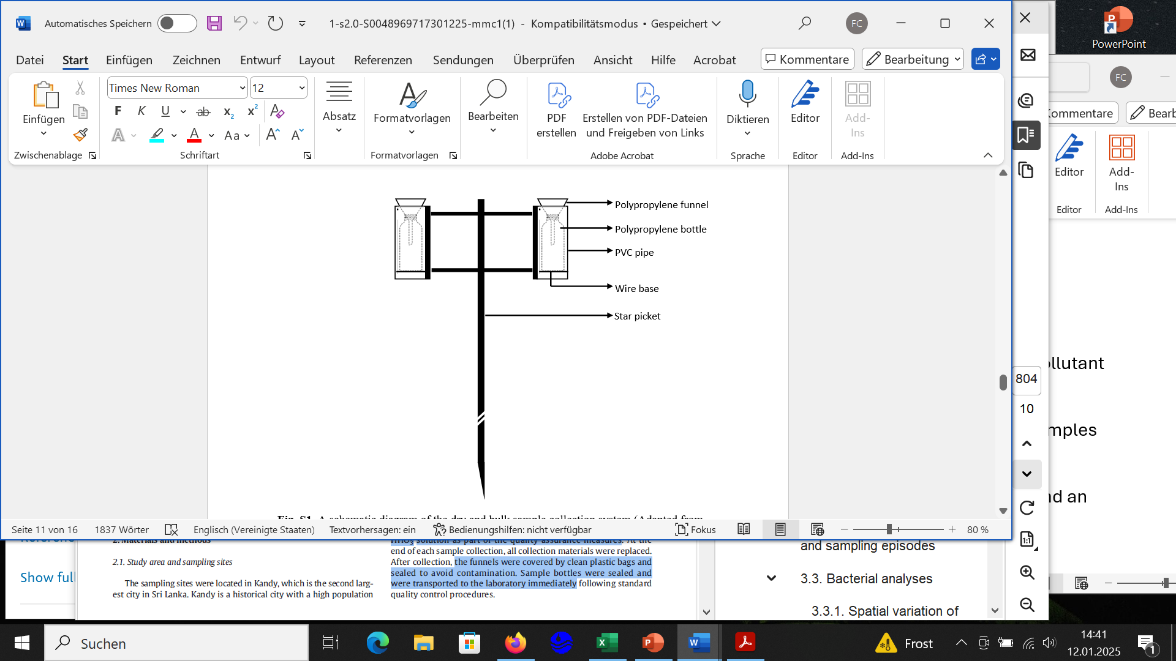
Sample collection
Sampling method
Sample collection process
  Three consecutive rainfall events
  Antecedent dry periods
  HDPE bottles & PE funnels
  Before and after rainfall
  Quality control (deionized water + acid wash)
Sampling setup
Sample handling
  1.5 m above ground
  Two sampling heads
    > Bulk deposition (BD)
    > DD
Prevent contamination
Transport

Slide 6
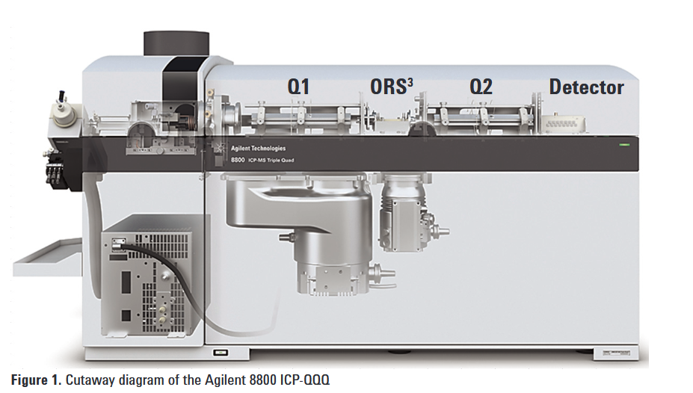
Laboratory analysis
Heavy metal analysis
Al, Cr, Mn, Fe, Ni, Cu, Zn, Cd, Pb
identifier for geogenic meatls
US EPA Method 200.8.
Agilent 8800 Triple Quadrupole ICP-MS
Quality control → testing calibration blanks, standards, and certified reference materials (CRM)
Calibration and Standards
→ calibration standards 0, 1, 10, 100, 1000, and 3000 ppb
→ internal standards, including Indium, Rhodium, and Rhenium, were spiked

Slide 7
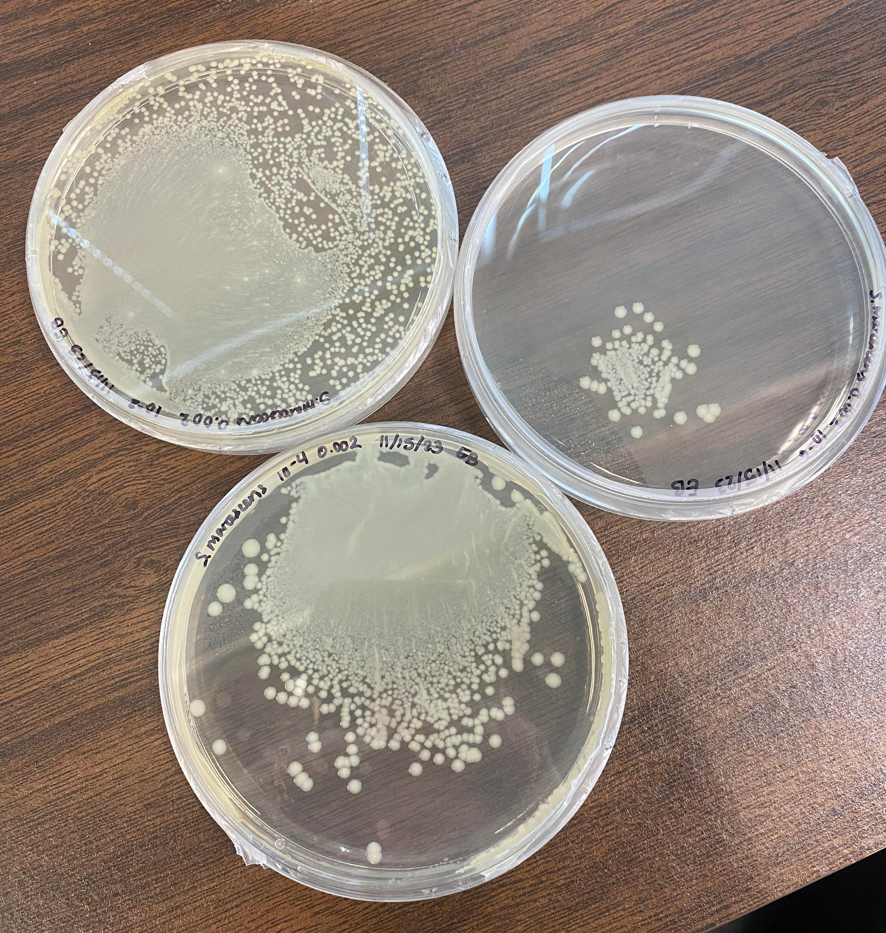
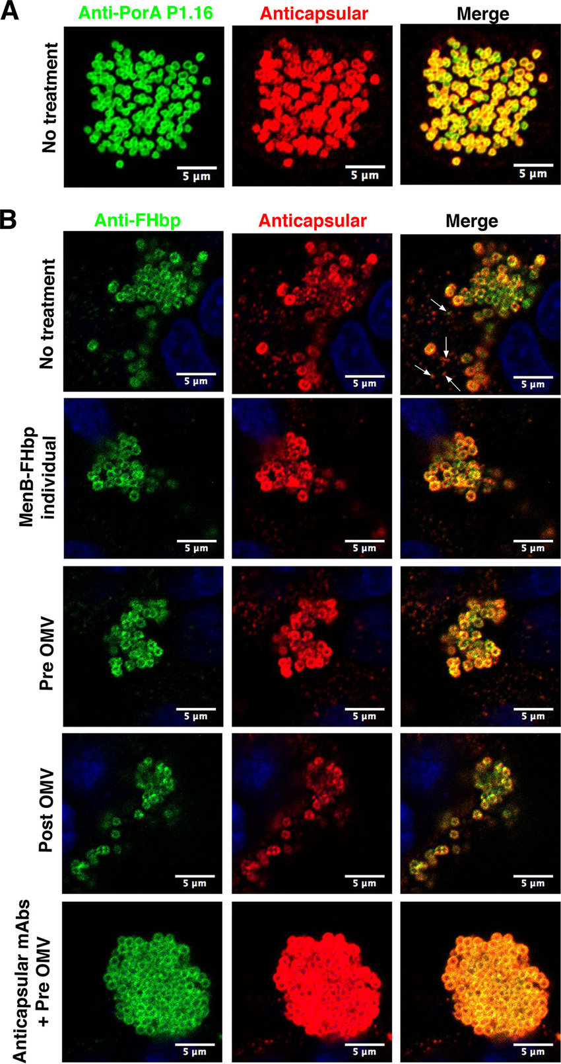
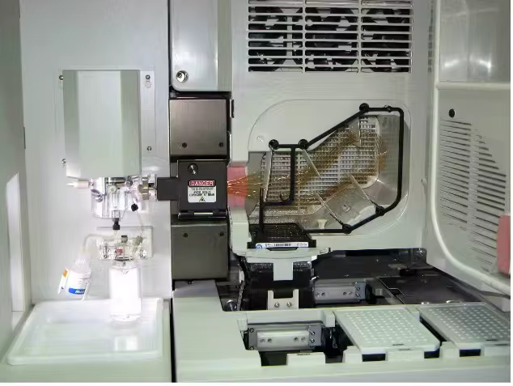
Bacterial analysis
Culturable Bacteria
→ spread plate technique on LB agar plates
→ colony-forming units (CFU/mL)
Total Bacterial Abundance
→ epifluorescence microscopy
→ cells/mL, considering dilution
CTAB method → DNA from cultured bacterial isolates
PCR and DNA Sequencing
→ PCR to amplify 16S rDNA
→ visualization via
gel electrophoresis
→ bacterial identification using
ABI 3730XL sequencers

Slide 8
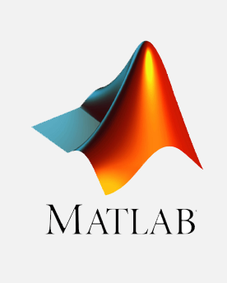

Data analysis
Statistical Analysis of Metal & Bacterial Data
metal data matrix
→ Q-Q probability distribution plots
→ Shapiro-Wilk test
variations in metal loads and bacterial data
→ Kruskal-Wallis one-way analysis of variance
→ Tukey's honest significance difference
Software → Matlab
Pollution Ranking and Analysis
→ PROMETHEE (Preference Ranking Organization Method for Enrichment Evaluation)
→ GAIA (Graphical Analysis for Interactive Assistance)

Slide 9
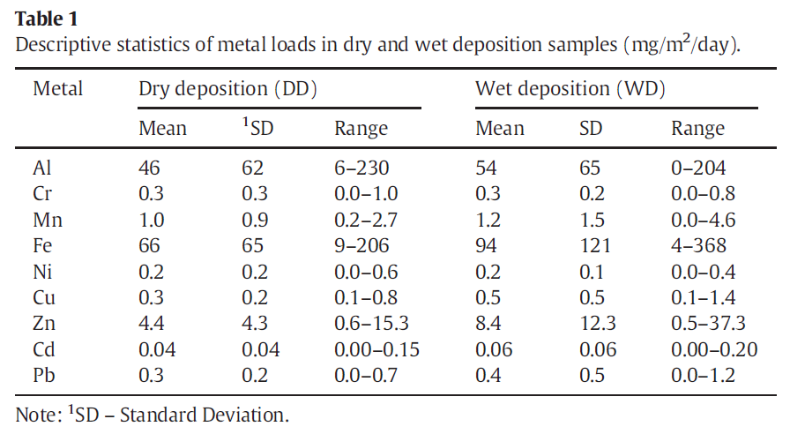
Results & disscusion
Metal load in deposited samples
Metal loads in wet samples (WD) > metal loads in dry samples (DD)
variability in metal composition across the study sites → local anthropogenic activities?
DD → generally a major contributor to total metal deposition

Slide 10
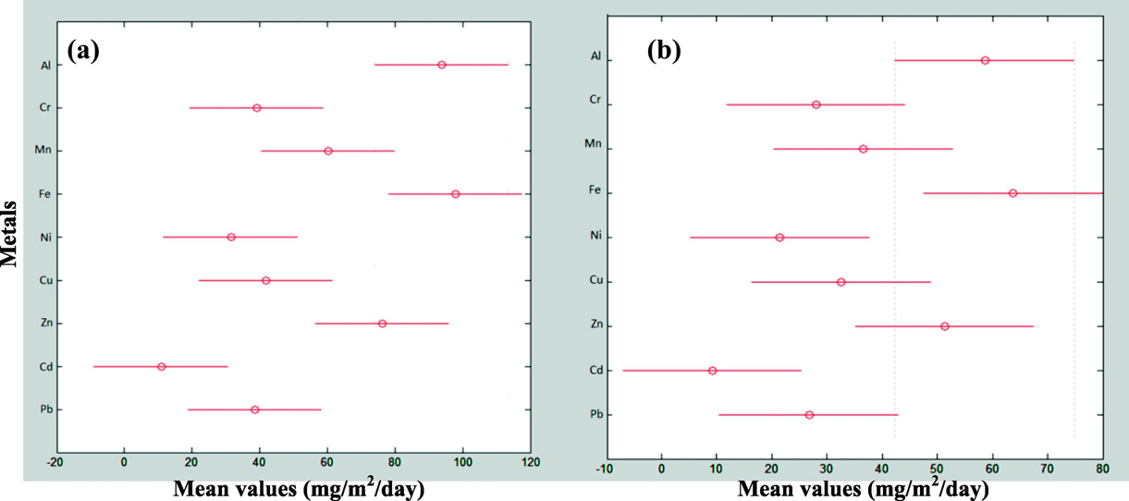
Post-hoc Tukey's honest significant test results for: (a) Dry deposition and (b)Wet deposition
Al and Fe are the major components in geogenic materials – disturbed soil, anthropogenic activities (e.g., traffic)
Zn in relatively higher quantity – vehicle emissions, tire wear, brake dust, and zinc-coated roofing
Other metal species investigated – commonly related to traffic activities, but present in relatively low quantity

Slide 11
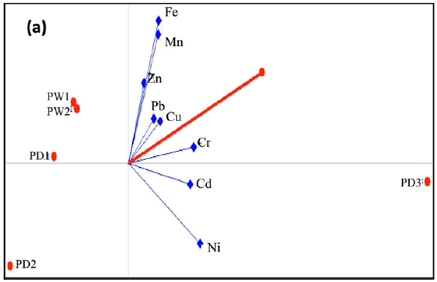
Ranking of study sites and sampling episodes
PROMETHEE Analysis – rank sampling episodes (9 metal loads, 20 objects, 5 sampling episodes)
→ FW1 the highest, RD2 the lowest (the first letter represents the study location, the second letter specifies whether DD or WD)
→ inconsistent pattern of ranking – multiple pollution sources?
GAIA analyses – deposition characteristics and mitigation strategies
→ Al and Fe
- minimal influence on pollution levels
→ higher amount of Zn at site P
→ anthropogenic influence
- higher variability of other species
→ mitigation approaches?
- other HMs
- Zn-pollution

Slide 12
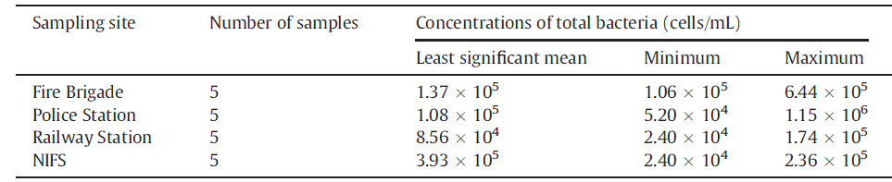
Bacterial analyses
Concentrations of total bacteria associated with deposition at the four sampling sites
Culturable bacterial survival = 1.00 × 10¹ to 2.27 × 10⁴ CFU/mL → only 0.01 to 10% of the total bacterial cells
Gram-negative rods were the most abundant
→ often pathogenic
→ more resilient
→ human health implications
Identified species?
six Gram (-) : e.g., Sphingomonas, Pseudomonas aeruginosa
three Gram (+) : e.g., Bacillus pumilus
Main sources?
soil → anthropogenic activities
vegetation → resuspension via dust

Slide 13
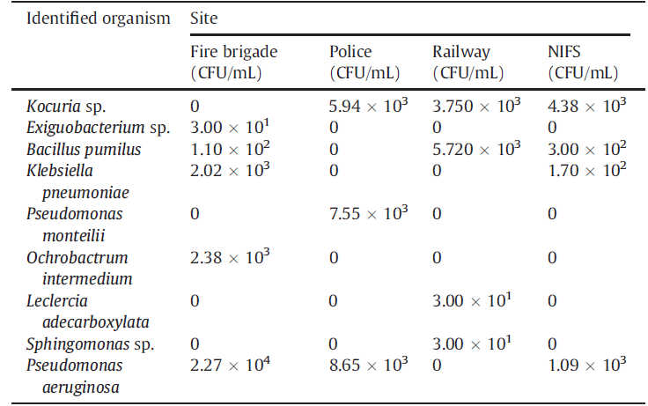
Concentrations of identified bacteria at the sampling sites
Ochrobactrum intermedium, Exiguobacterium sp. → only at site F
Pseudomonas monteilii
→ only at site P (vegetation, highest Zn-concentration)
Leclercia adecarboxylata, Sphingomonas sp. → only at site R
higher concentrations of culturable bacteria in BD than DD → moisture levels influence?
Increased bacterial viability → public health risk!

Slide 14
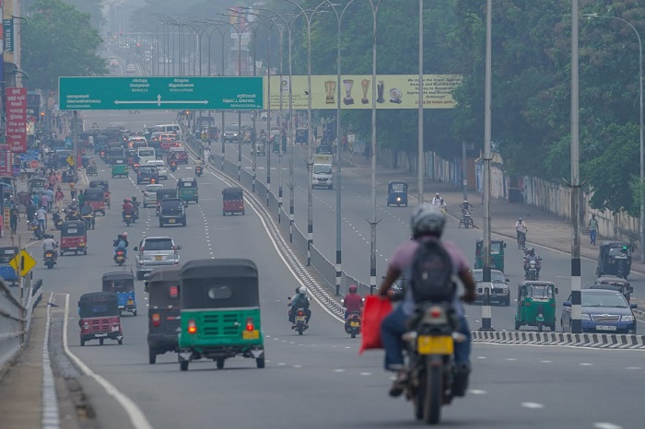
Conclusion
Heavy Metal Analysis
Al and Fe → higher
other metals = traffic sources
metal loads WD > DD
Mitigation Strategies for Metal Pollution
reducing traffic
fuel quality
cease the usage of Zn-coated roofs
Bacterial Contamination
opportunistic pathogens
airborne transmission
BD > DD
Health and Environmental Risks
potential health risks to,
humans
ecosystems

