Slide 1
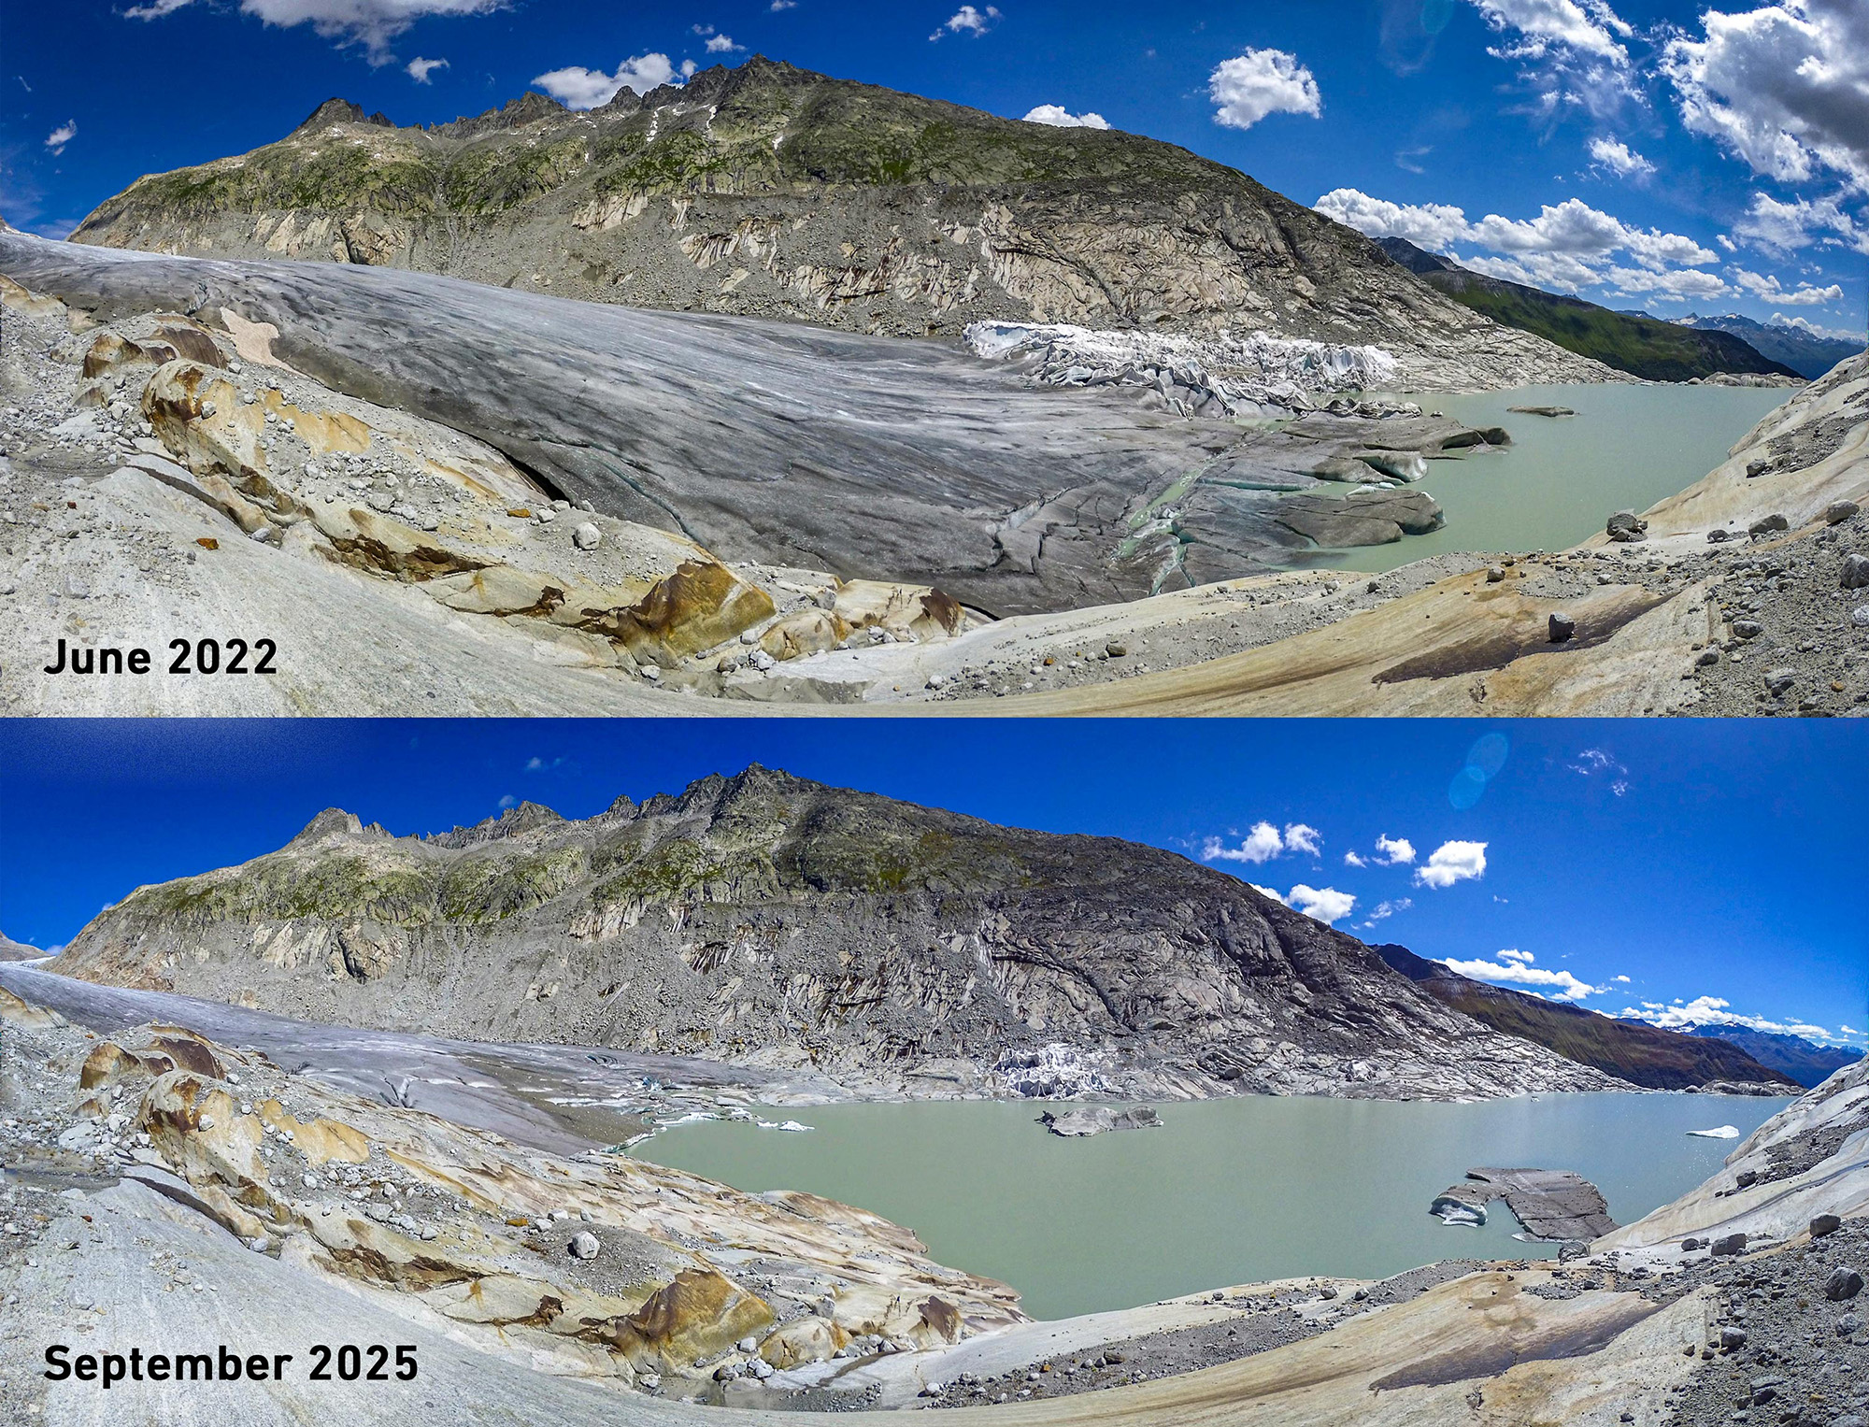
Global environmental Challenges
Release of Polychlorinated Biphenyls (PCB) from melting alpine glaciers to downstream ecosystems in a warming climate
Carina Freudling
(ETH Zürich, Chair of Glaciology)

Slide 2
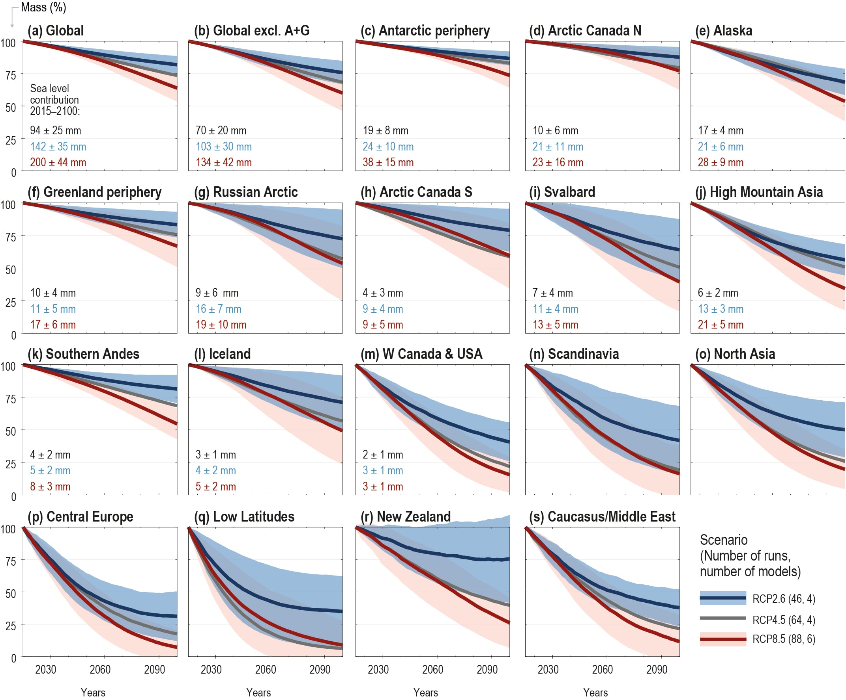
Glaciers & Climate Change
Largest global freshwater reservoir
Europe: fastest warming continent
Small, highly sensitive glaciers
~ 19% already disappeared
~ 50% loss within next 2 decades
(IPCC, 2022)
Notes:
75% of earth freshwater is contained within glaciers
Warming rate twice that of the rest of the world

Slide 3
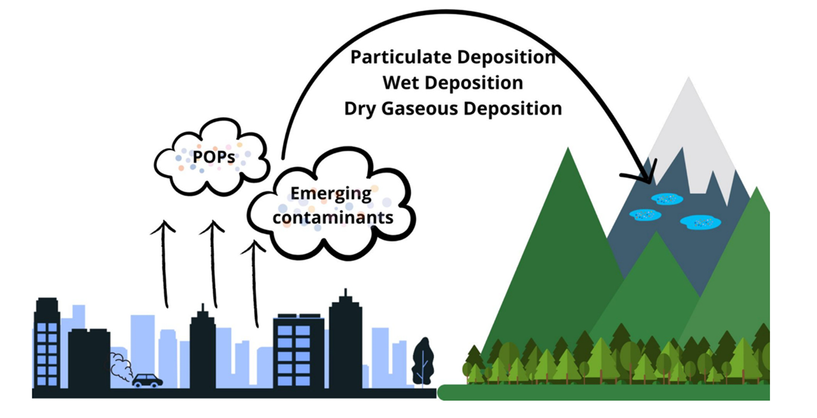
Glaciers as cold traps
Atmospheric transport to remote areas
High precipitation and low temperatures
→ Deposition on glaciers
Storage, release, degradation
Global warming
Accelerated release of pollutants
Impacts on human and environment
Global warming
Accelerated release of pollutants
Impacts on human and environment
(Pastorino et al., 2024)

Slide 4
Polychlorinated Biphenyls (PCBs)
1940s
Introduction
1960s-70s
Increased use
Partly banned
2001
International ban (Stockholm convention POPs)
Since 1970s
Group of persistent, bioaccumulative and toxic compounds
Used for dielectric fluids, plasticizers in sealing materials, flame retardants

Slide 5
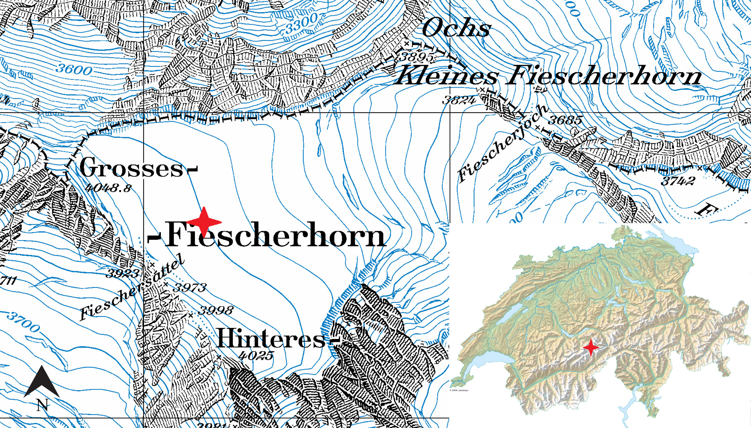
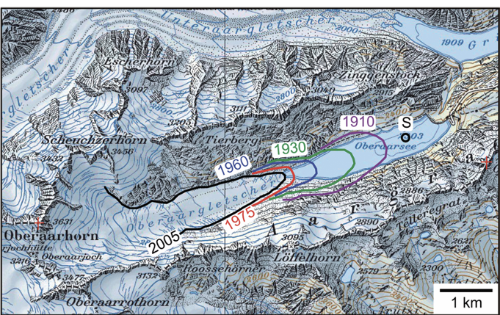
Storage in ice and release into lakes
Ice cores from Fiescherhorn glacier at 3900 m
Establishment of age-depth relation
GC/EI-HRMS
Sediment samples from Lake Oberaar (glacier fed)
Spiked with isotope-lables internal standards
GC/EI-HRMS
(Bogdal et al., 2009; Pavlova et al., 2014)

Slide 6
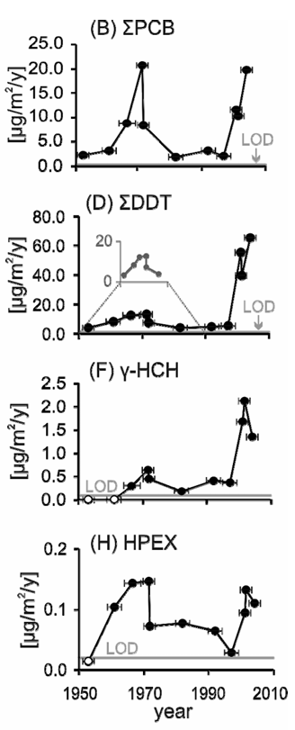
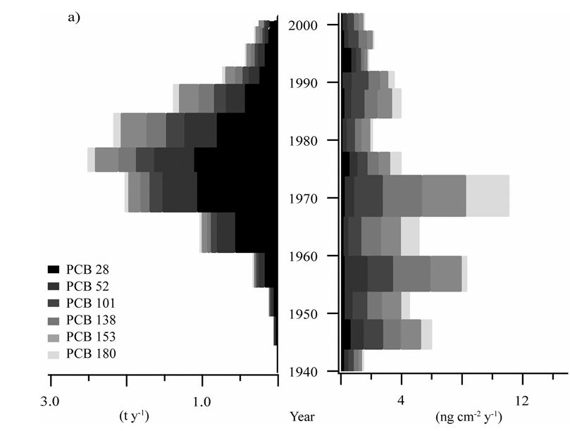
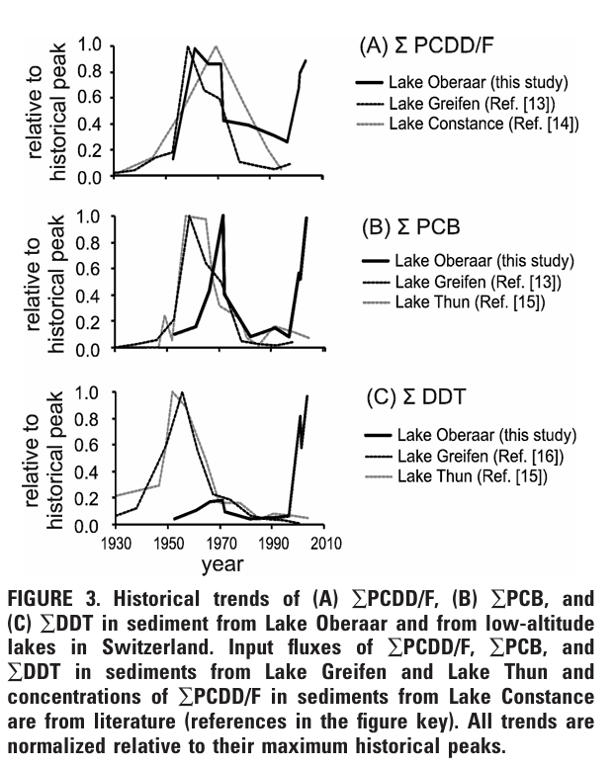
Ice cores
Lake sediments
Emission data
from Switzerland
Annual PCB
concentration
(Bogdal et al., 2009; Pavlova et al., 2014)
Notes:
most abundant PCB with higher chlorine content
-> less volatile
already above LOD
Low in 1980-90s -> ban in Switzerland in 1972 for open application
Through atmespheric deposition is unlikely
-> release from glacier

Slide 7
Glaciers as secondary source for PCBs
Glacier retreat remobilizes pollutants
Accelerated by climate change
Impacts on water quality downstream, possible contamination of ecosystems
Unknown effects on human health
Coupling of glacier dynamics and pollutant
Impacts of PCBs in the environment and for humans
Notes:
high-altitude ecosystems are already vulnerable to environmental stressors
PCBs found in fish tissues
Possible biomagnification along food chains

Slide 8
References
Bogdal, C. et al (2009). Blast from the Past: Melting Glaciers as a Relevant Source for Persistent Organic Pollutants. Environmental Science & Technology, 43(21), 8173–8177.
Dumont, M. et al (2025). The European Alps in a changing climate: Physical trends and impacts. Comptes Rendus. Géoscience, 357(G1), 25–42.
IPCC (2022). High Mountain Areas. In The Ocean and Cryosphere in a Changing Climate: Special Report of the Intergovernmental Panel on Climate Change (S. 131–202). Cambridge University Press.
Meyer, F. (2025), The Alps to lose a record number of glaciers in the next decade. ETH Zürich. https://ethz.ch/en/news-and-events/eth-news/news/2025/12/the-alps-to-lose-record-number-of-glaciers-in-the-next-decade.html
Pastorino, P. et al (2024). Alps at risk: High-mountain lakes as reservoirs of persistent and emerging contaminants. Journal of Contaminant Hydrology, 264, 104361.
Pastorino, P. et al (2025). Potential ecotoxicological effects of global change on organisms inhabiting high-mountain lakes in the Alps. Science of The Total Environment, 975, 179180.
Pavlova, P. A. et al (2014). Polychlorinated Biphenyls in Glaciers. 1. Deposition History from an Alpine Ice Core. Environmental Science & Technology, 48(14), 7842–7848.
Van Tricht, L. et al (2025). Peak glacier extinction in the mid-twenty-first century. Nature Climate Change, 1–5.

Slide 9
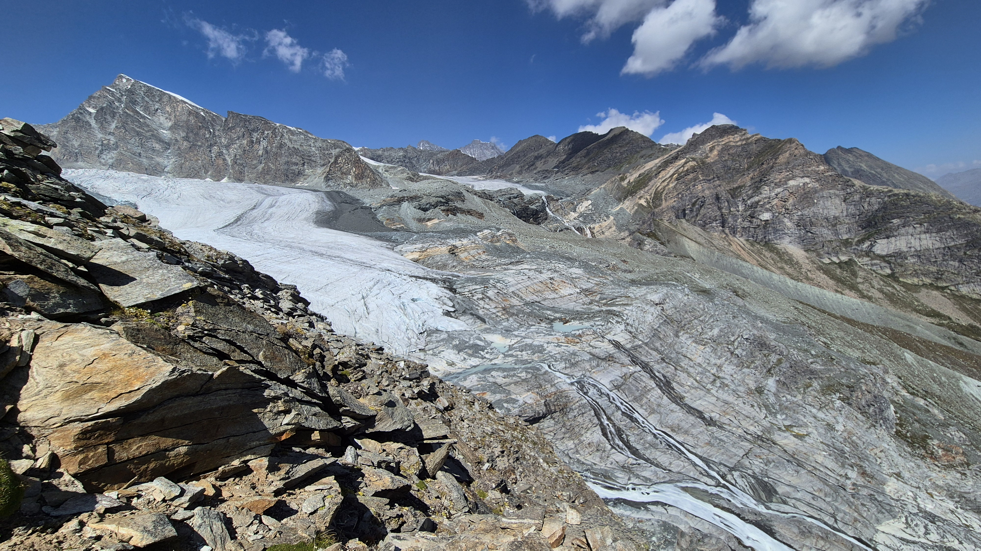
Questions?
(own picture)

