Slide 1



Persistence of Endosulfan in Kasaragod Soils and Its Health Implications
A Case Study from Kerala, India
Shashank Nagabhushan
M.Sc. Environmental Chemistry
University of Bayreuth, Germany
Global Environmental Challenges Symposium 2026
January 2026
Notes:
Good morning/afternoon everyone. My name is Shashank Nagabhushan. I'm a first semester master's student in Environmental Chemistry here at Bayreuth. Today I'll be talking about the endosulfan contamination case from Kasaragod, Kerala — that's in southern India. This is one of the worst pesticide disasters in Indian history. And the effects are still being felt today, in 2026. So let's start with the basics.

Slide 2
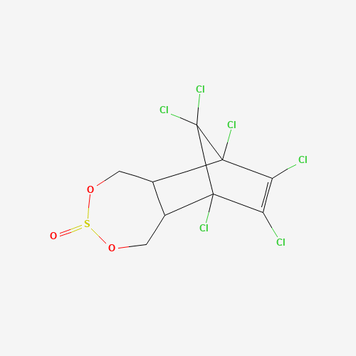
What is Endosulfan?
Organochlorine insecticide used worldwide on crops like cotton, cashew, tea, and vegetables
Highly effective against pests but very persistent in the environment
Classified as a Persistent Organic Pollutant (POP) under the Stockholm Convention (2011)
Known to cause neurological, reproductive, and developmental problems
Banned in over 80 countries including India (2011)
Chemical Structure
C₉H₆Cl₆O₃S
Molecular Weight: 406.9 g/mol
Source: PubChem, Stockholm Convention
Notes:
"First — what is endosulfan? It's an organochlorine insecticide. You can see the chemical structure here. It was used worldwide on crops like cotton, cashew, tea, and vegetables. Very effective against pests. But here's the problem — it's highly toxic and it doesn't break down easily. It stays in the environment for a long time. Because of this, in 2011, it was added to the Stockholm Convention as a Persistent Organic Pollutant — a POP. That same year, India banned it. Today it's banned in over 80 countries. It affects the nervous system and it's an endocrine disruptor — meaning it interferes with hormones. This is important for understanding what happened in Kasaragod.

Slide 3
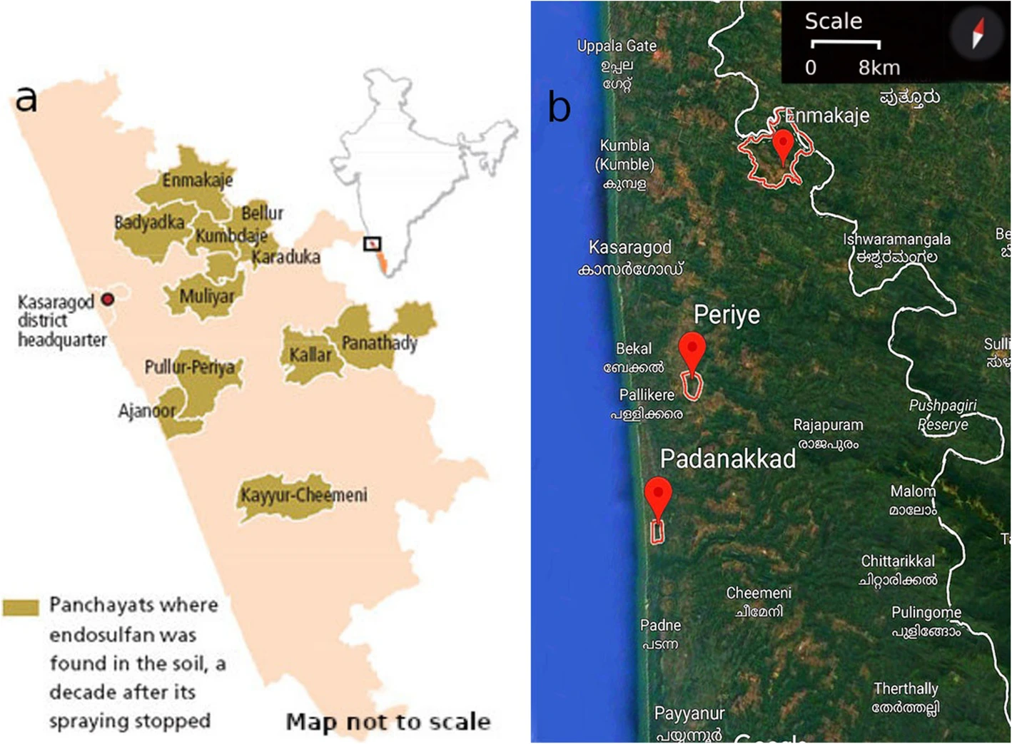
Study Area: Kasaragod District
Location: Northernmost district of Kerala, southern India
Key Facts:
11 panchayats officially recognized as affected areas
4,500+ hectares of cashew plantations sprayed
Plantations were on hilltops
Rain washed contamination into valleys where people lived
6,728 registered victims as of 2025
Map showing 11 affected panchayats including Enmakaje, Bellur, Padre, Pullur-Periya
Map source: Sony et al. 2020 (CC BY 4.0)
Notes:
So where did this happen? Kasaragod is the northernmost district of Kerala state in southern India. You can see it on this map. From 1978 to 2001 — that's 23 years — endosulfan was sprayed by helicopters over cashew plantations. The plantations covered more than 4,500 hectares. Now here's what made it worse. The plantations were on hilltops. When it rained, the contaminated water flowed downhill into the valleys. And that's exactly where people lived. So the geography concentrated the exposure. Families in the lowland areas got hit the hardest. Today, 11 panchayats — that means villages — are officially recognized as affected areas. As of 2025, there are 6,728 registered victims.

Slide 4
Timeline: From Spraying to Present
1978
1981
2001
2002
2011
2017
Aerial spraying begins on cashew plantations
First reports of deformed animals
Spraying stopped after health crisis
NIOH study confirms contamination
India bans endosulfan; Stockholm Convention lists as POP
Supreme Court orders ₹5 lakh per victim
2022
2024
2026
IISc Bangalore publishes transgenerational effects study
IISc challenges government's intrauterine exposure criteria
6,728 victims registered; 779 deaths; protests continue
23 years of spraying → 25 years since ban → effects still ongoing
Notes:
Let me walk you through the timeline. 1978 — aerial spraying begins on cashew plantations. By 1981, farmers started noticing something strange. Animals were being born deformed. Calves with twisted legs, that kind of thing. But spraying continued. In 2001, after years of complaints and protests, spraying was finally stopped. In 2002, the National Institute of Occupational Health — NIOH — conducted a study. They confirmed contamination in blood, water, and soil. 2011 was a big year. India banned endosulfan nationally, and the Stockholm Convention added it to the global ban list. In 2017, the Supreme Court of India ordered compensation of 5 lakh rupees — that's about 5,500 euros — for each victim. In 2022, researchers at IISc Bangalore published a study showing transgenerational effects. I'll explain that later. And today, in 2026? 6,728 victims registered, 779 deaths, and people are still protesting because many haven't received their compensation.

Slide 5
How Were People Exposed?
1
2
3
4
Direct Contact
Water
Food Chain
Soil Contact
Spray drift during aerial application reached nearby homes
Runoff from hilltop plantations polluted drinking water and streams
Residues found in vegetables, fruits, fish, and cow's milk
Agricultural workers exposed through contaminated fields
Key point: Geography made it worse — hilltop spraying → rain → valley contamination → concentrated exposure where families lived
NIOH 2002 confirmed multi-pathway exposure
Notes:
So how were people actually exposed to this chemical? There were four main pathways. First — direct contact. When helicopters sprayed, the wind carried droplets to nearby homes. People breathed it in, it landed on their skin. Second — water. Rain washed the residues from hilltop plantations into streams and wells. People drank contaminated water for years. Third — food chain. Researchers found endosulfan residues in vegetables, fruits, fish, even cow's milk from affected areas. So people ate it every day. Fourth — soil contact. Farm workers and children touched contaminated soil. The chemical can absorb through skin. The NIOH study in 2002 confirmed this multi-pathway exposure. They found endosulfan in blood samples, water samples, soil samples, and food samples. It was everywhere.

Slide 6
Environmental Persistence
Key Findings (Harikumar et al. 2014):
Combined toxic residues persist in soil for 1.5-2 years
Persistence depends on soil pH, organic matter, and clay content
Endosulfan sulfate (breakdown product) is MORE persistent than parent compound
Groundwater in Padre village: 7-51× above safe limits
Why this matters: The breakdown product degrades more slowly than the original chemical — explains why residues kept appearing years after spraying stopped
Data: Harikumar et al. (2014), Current Science
Notes:
Now let's talk about persistence — how long does this chemical stay in the environment? This chart shows data from Harikumar and colleagues, published in 2014 in Current Science. You can see alpha-endosulfan breaks down relatively fast — about 50 days in aerobic soil. But beta-endosulfan? That takes 185 days in lab conditions. And in actual field conditions? Up to 800 days. That's more than two years. The combined toxic residues persist for about 730 days — roughly two years. And here's the real problem. When endosulfan breaks down, it forms endosulfan sulfate. This breakdown product is actually MORE persistent than the original chemical. So even after spraying stopped, new toxic residues kept forming. They also found groundwater contamination in Padre village — 7 to 51 times above safe limits. Years after spraying stopped.

Slide 7
Blood Contamination Levels
NIOH Study (2002) Findings:
Blood tests in 2001 compared affected villages with control areas:
Affected Areas:
85% of women had detectable endosulfan
78% of men had detectable endosulfan
Control Areas:
~30% had detectable endosulfan
Data: National Institute of Occupational Health (NIOH), 2002
Notes:
The NIOH study in 2002 also tested people's blood. Look at these numbers. In affected areas, 85% of women had detectable endosulfan in their blood. For men, it was 78%. Compare that to control areas — villages that weren't sprayed. Only about 30% had detectable levels. So people in the sprayed areas had almost three times higher contamination rates. This is direct evidence that the spraying affected the population.

Slide 8
Documented Health Effects
Developmental
Neurological
Other
Congenital abnormalities
Physical deformities
Delayed sexual development (boys)
Growth retardation
Limb deformities
Mental retardation
Learning disabilities
Developmental delays
Cerebral palsy
Epilepsy
Elevated cancer rates
Skin disorders
Hormonal disruption
Reproductive issues
Immune system effects
Note: These conditions are documented as more common in affected areas. The causal link to endosulfan is supported by many studies but debated by some researchers.
Sources: NIOH 2002, Embrandiri et al. 2012
Notes:
What health effects were documented? The problems fall into three categories. Developmental effects — congenital abnormalities, physical deformities, delayed development in children, growth problems. Neurological effects — mental retardation, learning disabilities, cerebral palsy, epilepsy. And other effects — higher cancer rates, skin disorders, hormonal problems, reproductive issues. Now I want to be clear here. These conditions are documented as more common in affected areas. Many studies support the link to endosulfan. But some researchers still debate the exact causation. I'll talk about that debate later.

Slide 9
Health Statistics from Affected Areas
Embrandiri et al. (2012) Survey:
Survey of 1,000 people in 5 affected panchayats, conducted 7 years after spraying stopped:
Mental Retardation (ages 0-30):
Males: 74.5% | Females: 74.1%
Congenital Abnormalities (ages 0-14):
Males: 46% | Females: 42.5%
Physical Disabilities:
Males: 35.5% | Females: 12.8%
Data: Embrandiri et al. (2012), Asian Journal of Epidemiology
Notes:
"Let me show you some specific numbers. This data comes from Embrandiri and colleagues, published in 2012. They surveyed 1,000 people in 5 affected panchayats. This was 7 years after spraying had stopped. Mental retardation — in the 0 to 30 age group — was found in 74.5% of males and 74.1% of females surveyed. Congenital abnormalities — in children 0 to 14 — were found in 46% of males and 42.5% of females. Physical disabilities — 35.5% of males, 12.8% of females. The difference might be because more males worked directly in the fields. And cancer cases — 39.2% of males, 35.4% of females. These are very high numbers. And remember, this was seven years after spraying stopped. The effects kept showing up.

Slide 10
Transgenerational Effects
New Research from IISc Bangalore (2022)
What they found (mice study):
Why this matters for Kasaragod:
Exposure levels similar to what Kasaragod residents experienced
55-67% infertility rates in exposed animals
DNA damage in offspring even when only one parent was exposed
Effects lasted 8 months after exposure stopped
Organ defects in offspring who were never directly exposed
Effects can pass to children who were never exposed themselves
Government criteria requiring "intrauterine exposure" may exclude legitimate victims
The problem may continue for generations
2024 update: IISc researchers challenged government's victim criteria based on these findings
Source: Sharma, Raghavan et al. (2022), Frontiers in Genetics - IISc Bangalore
Notes:
Now this is really important — transgenerational effects. In 2022, researchers at IISc Bangalore — that's the Indian Institute of Science — published a study in Frontiers in Genetics. They exposed mice to endosulfan at levels similar to what Kasaragod residents experienced. What they found was shocking. 55 to 67% infertility in exposed animals. DNA damage. Organ defects in liver, kidney, and spleen. But here's the key finding — these effects appeared in offspring who were never directly exposed. Just the parents were exposed, but the damage passed to the next generation. The effects lasted 8 months after exposure stopped. Why does this matter for Kasaragod? Because the government's criteria for victims requires proof of 'intrauterine exposure' — meaning exposure in the womb. But this research suggests that even people born after spraying stopped could be affected through their parents. In 2024, IISc researchers actually challenged the government's criteria based on these findings.

Slide 11
The Causation Debate
✓ What is NOT disputed
? What is debated
Endosulfan was sprayed for 23 years
Residues found in soil, water, blood, food
Higher health problem rates in sprayed areas
Endosulfan is toxic and an endocrine disruptor
6,728+ registered victims
Whether exposure levels were high enough
Criticism of early study designs
Role of other factors (genetics, nutrition)
Proving direct causation is difficult
My position: Strong correlation exists. Government and courts have accepted the link. But scientific debate on exact causation continues — this is normal in environmental health research.
Notes:
I want to be honest about the scientific debate here. What is NOT disputed? Endosulfan was sprayed for 23 years. Residues were found in soil, water, blood, and food. Health problem rates are higher in sprayed areas. Endosulfan is toxic and an endocrine disruptor. And there are over 6,700 registered victims. What IS debated? Whether the exposure levels were high enough to cause all these effects. Some researchers criticized the methodology of early studies. Others point to possible confounding factors — genetics, nutrition, other environmental factors. My position? There's a strong correlation. The Indian government accepted the link. The courts accepted it. The Stockholm Convention banned the chemical globally. But yes, proving exact causation in environmental health is always difficult. That's just how science works. The victims are real. The suffering is real. The scientific debate continues, but it shouldn't stop us from helping affected communities.

Slide 12
Current Situation (January 2026)
6,728
779
1,031
Registered Victims
Recorded Deaths
Excluded from Aid
Unfulfilled Promises:
Government Response:
Only 2,665 of 6,212 victims received compensation
No medical camps since 2017
Supreme Court criticized Kerala government's inaction
Victims still protesting for promised benefits
₹281 crore spent by Kerala government
Sahajeevanam rehabilitation village built
₹5 lakh per victim ordered by Supreme Court (2017)
But implementation remains incomplete
Data: Kerala Health Department (2019, updated 2025)
Notes:
So where are we today, in January 2026? 6,728 registered victims. 779 recorded deaths. And 1,031 people who are eligible but still excluded from aid lists. The Supreme Court ordered 5 lakh rupees per victim back in 2017. That's almost 9 years ago. But only 2,665 out of 6,212 victims have actually received this compensation. There have been no medical camps since 2017. Health monitoring has basically stopped. The Supreme Court has criticized the Kerala state government for delays and inaction. Victims are still protesting. To be fair, the government has spent 281 crore rupees on relief. They built a rehabilitation village called Sahajeevanam for severely affected people. But implementation remains incomplete. 25 years after spraying stopped, the fight for justice continues.

Slide 13
Why Does This Case Matter?
Lessons beyond Kasaragod
1. Banning is not enough
4. Long-term monitoring needed
Toxic chemicals persist in environment long after bans. Residues keep reaching people for years or decades.
Effects are still being counted 25 years after spraying stopped. One-time studies are not enough.
2. Geography concentrates risk
5. Justice is slow
Hilltop application + rain + valleys = concentrated exposure in residential areas. Location planning matters.
Compensation ordered in 2017, still incomplete in 2026. Affected communities need sustained advocacy.
3. Transgenerational effects
6. Global relevance
Damage can pass to children who were never directly exposed. Risk assessment must consider this.
Similar POPs used worldwide. Other communities may face same issues. Kasaragod is a case study for environmental policy.
Notes:
Why should we care about this case? What lessons can we learn? First — banning is not enough. Toxic chemicals persist in the environment long after bans. The residues keep reaching people for years. Second — geography matters. Hilltop application plus rain plus valleys equals concentrated exposure. When planning pesticide use, location matters. Third — transgenerational effects. Damage can pass to children who were never directly exposed. Our risk assessments need to consider this. Fourth — long-term monitoring is essential. Effects are still being counted 25 years later. One-time studies are not enough. Fifth — justice is slow. Compensation ordered in 2017, still incomplete in 2026. Affected communities need sustained advocacy. And sixth — this has global relevance. Similar persistent organic pollutants were used worldwide. Other communities may face the same issues. Kasaragod is a case study for environmental policy everywhere.

Slide 14
Conclusions
Environmental:
Health:
Residues persist 1.5-2+ years in soil
Breakdown product even more persistent
Groundwater contamination years after spraying
6,728 victims, 779 deaths (2025)
Developmental and neurological conditions
Transgenerational effects in lab studies
Key Takeaway:
Banning a pesticide is not the end. Persistent chemicals continue affecting communities for decades. This case highlights the need for:
Long-term environmental monitoring of banned substances
Transgenerational health assessment in risk evaluation
Continued support for affected communities even decades later
Notes:
Let me summarize. Environmental findings: Residues persist 1.5 to 2 years in soil. The breakdown product is even more persistent. Groundwater was contaminated years after spraying. Health findings: 6,728 victims, 779 deaths. Developmental and neurological conditions documented. Lab studies show transgenerational effects. The key takeaway? Banning a pesticide is not the end. Persistent chemicals continue affecting communities for decades. We need long-term environmental monitoring of banned substances. We need to include transgenerational effects in risk assessment. And we need to continue supporting affected communities even decades after the initial exposure.

Slide 15
References
Harikumar, P.S., Jesitha, K., Megha, T., & Kokkal, K. (2014). Persistence of endosulfan in selected areas of Kasaragod district, Kerala. Current Science, 106(10), 1421-1429.
National Institute of Occupational Health (NIOH). (2002). Investigation of unusual illnesses allegedly produced by exposure to endosulfan in Padre Village of Kasaragod District. Ahmedabad, India.
Embrandiri, A., Singh, R.P., Ibrahim, H.M., & Khan, A.B. (2012). An epidemiological study on the health effects of endosulfan spraying on cashew plantations in Kasaragod. Asian Journal of Epidemiology, 5(1), 22-31.
Sharma, A., Raghavan, S.C., et al. (2022). Exposure to endosulfan can cause long term effects on general biology, including the reproductive system. Frontiers in Genetics, 13, 1047746. [IISc Bangalore]
Sony, R.K., et al. (2020). Endosulfan tragedy of Kasaragod, Kerala, India. Journal of Basic and Applied Zoology, 81, 24. [CC BY 4.0]
Additional: Kerala Health Department statistics, Stockholm Convention documentation, PubChem (chemical structure)
Notes:
Here are my main references. The Harikumar study for persistence data. The NIOH study for blood contamination. Embrandiri for health statistics. The Sharma study from IISc for transgenerational effects. And Sony for the map. All of these are peer-reviewed sources.

Slide 16
Thank You
Questions?
Shashank Nagabhushan
M.Sc. Environmental Chemistry
University of Bayreuth
bt730882@uni-bayreuth.de
Global Environmental Challenges Symposium 2026
Notes:
And that's my presentation. Thank you for listening. I'm happy to take any questions.

