Slide 1
The Agia Zoni II tanker accident: A case of oil spill affecting the marine environment of Saronikos Gulf, Greece
„Global Environmental Challenges 2026“
Theo Schönhoff

Slide 2
Structure
Research Questions
Modeled Oil Distribution
The Accident
Methods
Hydrocarbon Concentrations
Effects on Microbial Communities
Conclusions

Slide 3
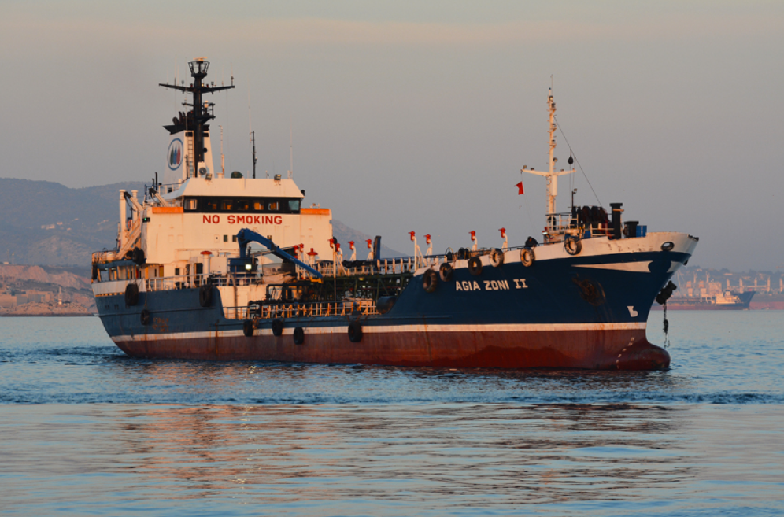
The Ship
Type: Oil Tanker
Construction year: 1972
Summer Deadweight Tonnage: 3205 tons (The maximum weight a ship can carry in Summer, shipspotting.com)
Figure 1: The tanker Agia Zoni II in the area of Piraeus (2016)

Slide 4
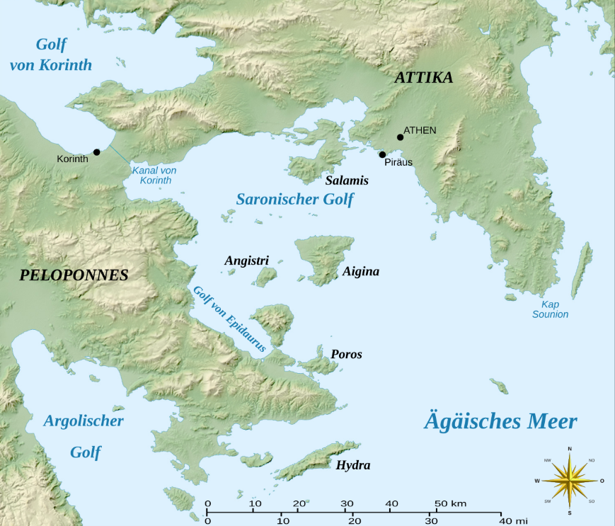
The Accident
Date: 10th September 2017
Location: Close to Atalanti Isle in Saronikos Gulf
Cargo: 2,194 tons fuel oil and 370 tons gas oil (ITOPF)
Reason: unclear
Release of approximately 500 tons of fuel oil into the sea
Figure 2: Map of Saronicos Gulf, the red star indicates the location of the shipwreck
Source of Figures: wikimedia.org, image edited

Slide 5
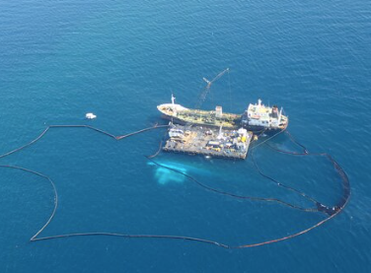
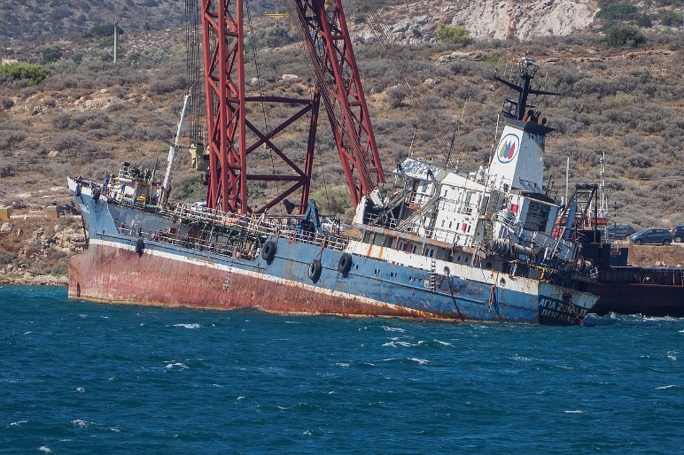
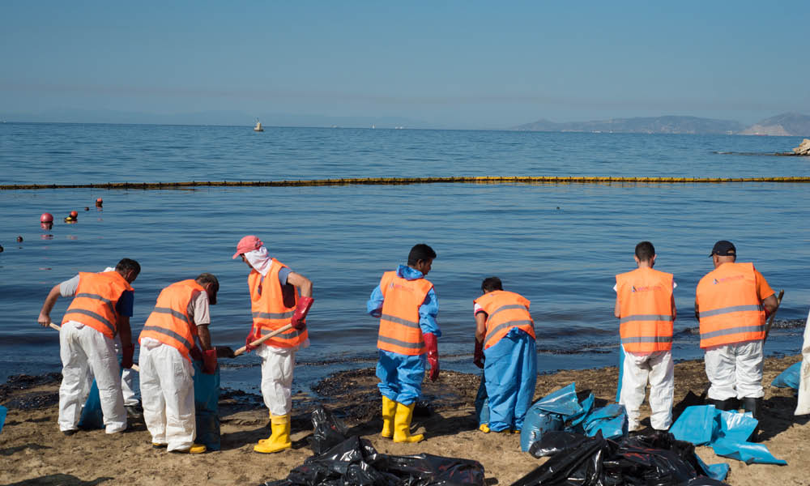
Human Response
© ITOPF
Figure 3: Shipwreck before (left) and after (middle) salvage and clean up-activities at a contaminated beach (right)
Sealing of the ship on 12th September
Pumping out the oil from from the tanks
Salvage of the sunken vessel
Oil booms
Absorbents
Flushing of Contaminated Sites/Material
High Powered Washing
Removal of Tar Balls and Contaminated Sediments
Sources of the pictures: ITOPF (left), wikipedia (middle), Antipollution Emergency Response Services (rigth)

Slide 6
Research Questions
1. How extensive was the oil spill?
2. How did the microbial community react at contaminated
sites?
3. Where the natural degradation processes and human clean-up operations sufficient enough?

Slide 7
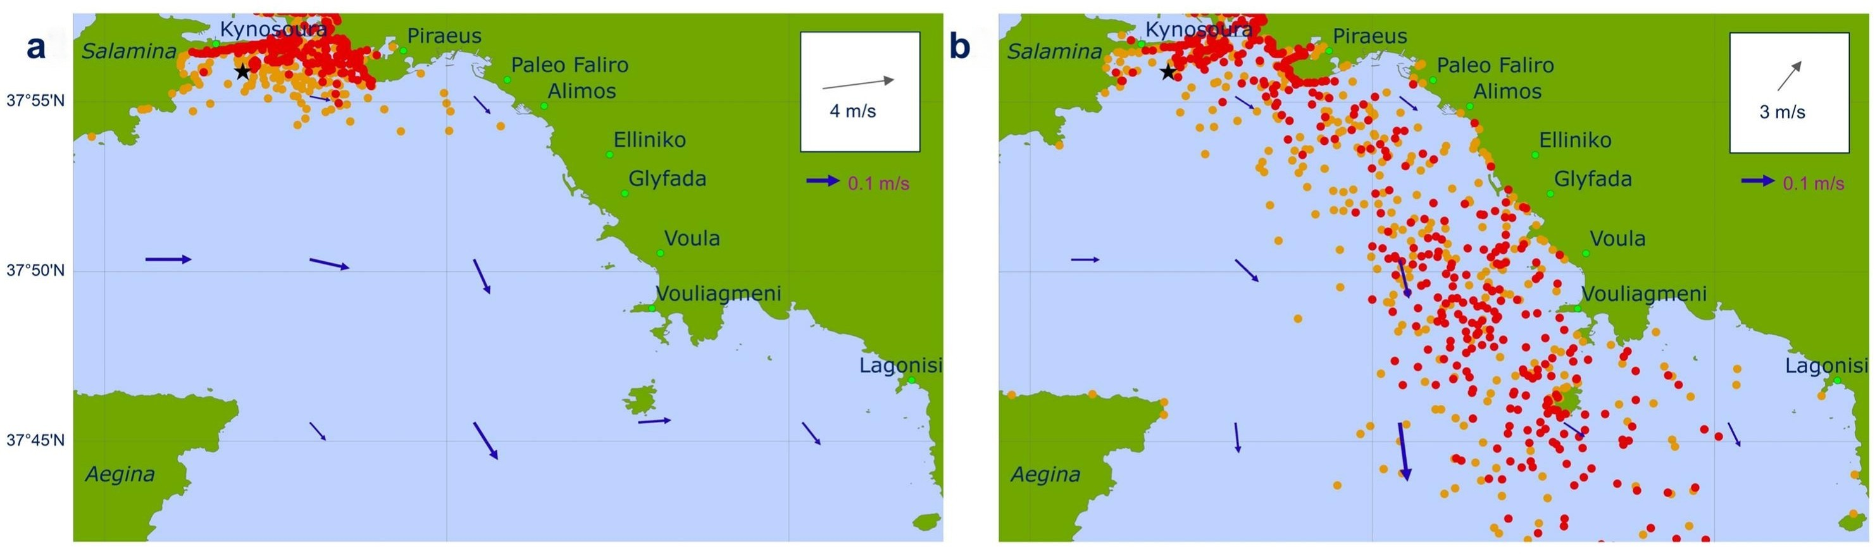
Modeled Oil Distribution
Figure 4: Modeled Oil Spill 3 (a) and 6 (b) days after the ship sank. Blue arrows represent current velocities; orange dots consider errors in the models input data whereas red don‘t. Deployment of floating boom could not be considered.
A large share (47.4%) of the released oil accumulated at the coast (Makatounis et al.2023)
Approximately 4 km of Salaminas and 25 km of Athens coastline were affected (Thomas et al. 2020)
Source of Figure: Makatounis et al. 2023

Slide 8
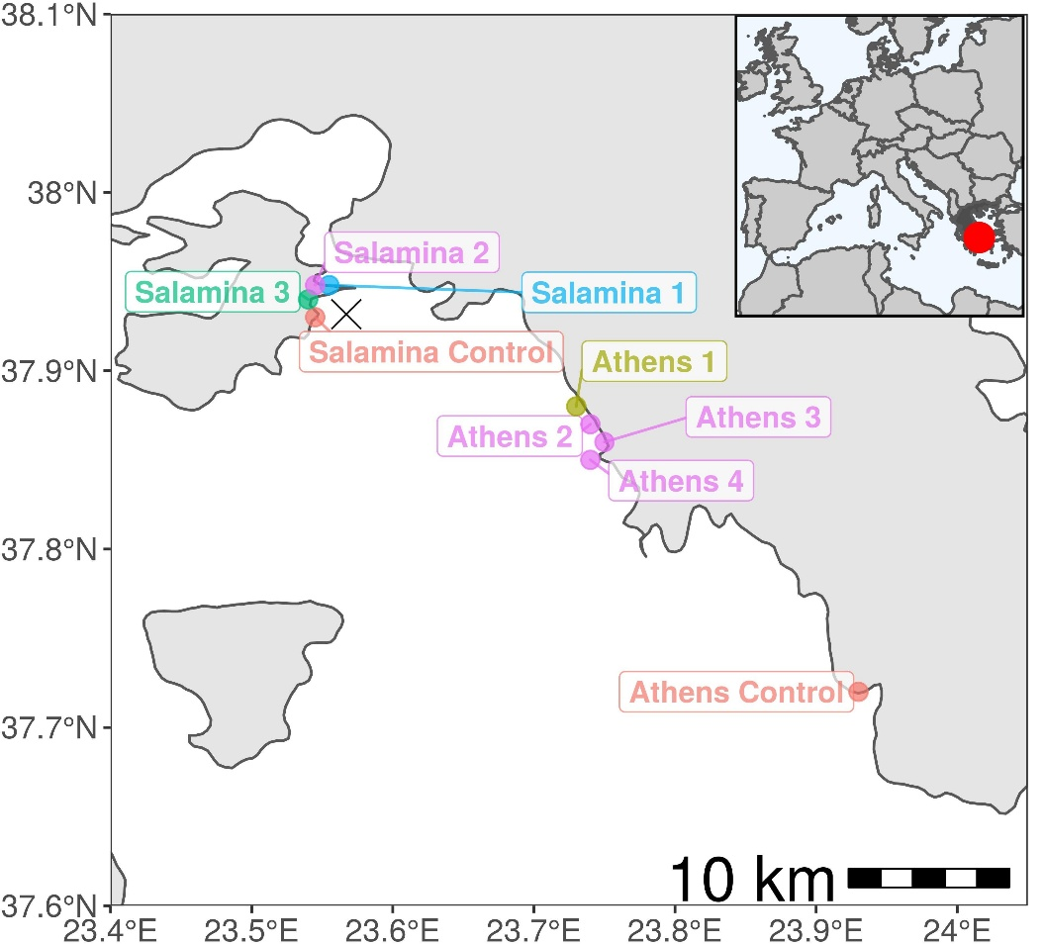
Methods
Samples were taken and 7 contaminated and 2 uncontaminated sites
First samples were taken only 5 days post-spill
Hydrocarbon concentrations were determined
Applying qPCR and sequencing of the 16 sRNA allowed conclusions about abundance and diversity of oil degrading bacteria
Figure 5: Locations of the sampling and control sites
Source of figure: Thomas et al. 2020

Slide 9
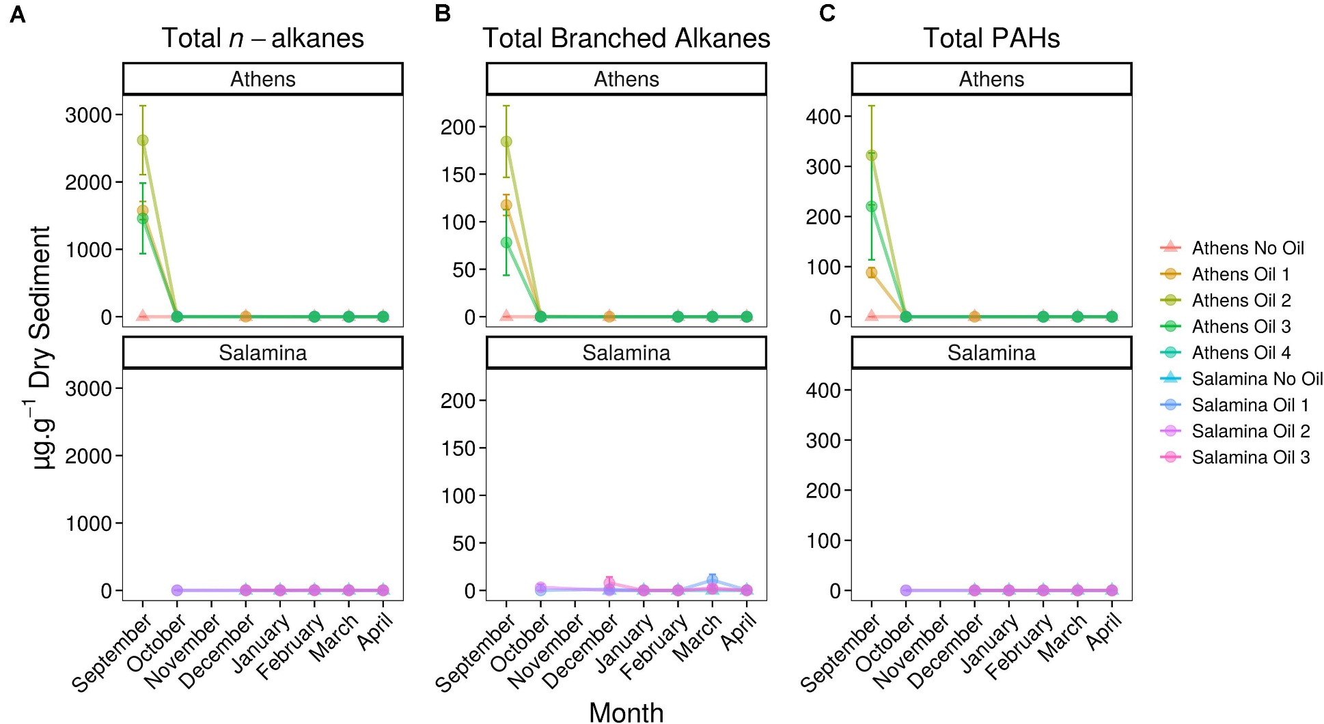
Hydrocarbon Concentrations
Figure 6: Concentration of hydrocarbons in surface sediments from contaminated sites at the Athen‘s and Salamina‘s coastline. Controls, unaffected by the oil spill, are provided (No Oil). A distinction is made between the groups n-alkanes, total branched alkanes and total PAHs (Polycyclic Aromatic Hydrocarbons)
Source of figure: Thomas et al. 2020

Slide 10
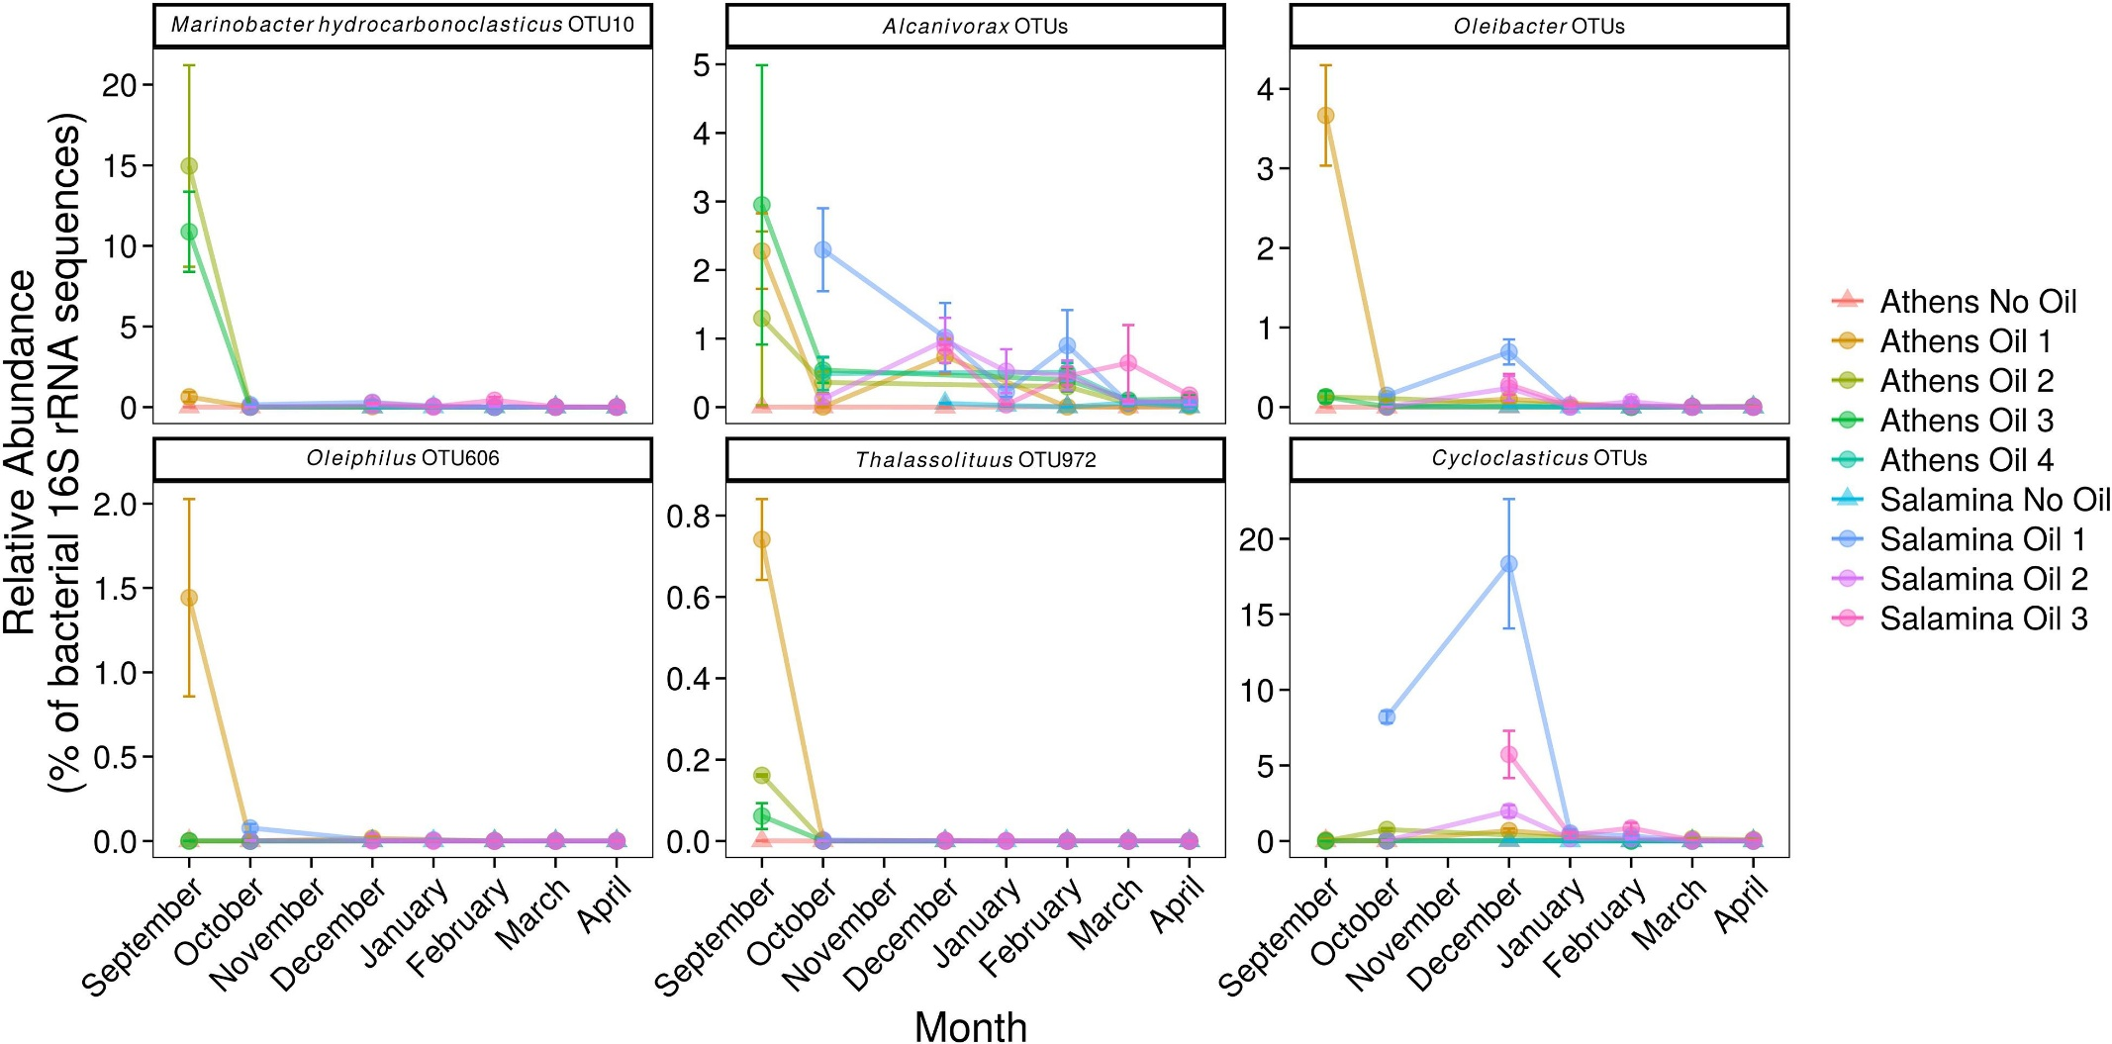
Microbial Response
Figure 7: Relative Abundance of 16 rRNA gene operational taxonomic units which are assigned to presumably obligate hydrocarbonoclastic bacteria in 5 contaminated and 2 uncontaminated sites at Athen’s and Salamina’s coastline
Source of Figure: Thomas et al. 2020

Slide 11
Discussion/Conclusions
The petroleum hydrocarbon concentrations are characterized high in comparison with other similar oil spills (Parinos et al. 2019)
Higher hydrocarbon concentrations immediately after the accident
Growth and dominance of certain oil degrading bacteria after the accident
Natural degradation processes and clean-up operations were quite efficient

Slide 12
References
Figure 1: Dennis Mortimer (2016), https://www.shipspotting.com/photos/2433890?navList=gallery&shipName=Agia+Zoni+II&shipNameSearchMode=begins&page=5&viewType=normal&sortBy=newest, Date of last access 14.01.2026
Figure 2: https://commons.wikimedia.org/wiki/File:Saronic_Gulf_map-de.svg, Date of last access: 14.01.2026
Figure 3 (left): ITOPF Limited, Dashwood, 69 Old Broad Street, London, https://www.itopf.org/in-action/case-studies/agia-zoni-ii-greece-2017/, Date of last access 14.01.2026
Figure 3 (middle): https://el.wikipedia.org/wiki/Πετρελαιοκηλίδα_στον_κόλπο_του_Σαρονικού_(2017), Date of last access 14.01.2026
Figure 3 (right): Antipollution Emergency Response Services, https://antipollutionemergencyresponse.com/case_studies/m-t-agia-zoni-ii-fighting-against-sea-surface-shoreline-oil-pollution/ ), Date of last access 14.01.2026
Figure 4: Makatounis PEZ, Stamou A, Ventikos N (2023) Modeling the Agia Zoni II tanker oil spill in Saronic Gulf, Greece. Marine Pollution Bulletin. 194 B. doi: 10.1016/j.marpolbul.2023.115275
Figure 5, 6 and 7: Thomas GE, Cameron TC, Campo P, Clark DR, Coulon F, Gregson BH, Hepburn LJ, McGenity TJ, Miliou A, Whitby C and McKew BA (2020) Bacterial Community Legacy Effects Following the Agia Zoni II Oil-Spill, Greece. Front. Microbiol. 11:1706. doi: 10.3389/fmicb.2020.01706
Conclusion: Parinos C, Hatzianestis I, Chourdaki S, Plakidi E, Gogou A (2019) Imprint and short-term fate of the Agia Zoni II tanker oil spill on the marine ecosystem of Saronikos Gulf. Science of the Total Environment. 693 . doi: 10.1016/j.scitotenv.2019.07.374

