Slide 1

Environmental Deregulation as intentional sabatage
Daniel Holder

Slide 2

The current American administration has given many concerning headlines
However, many of its policies has gone unrepresented in the media.
Specifically, those causing long-term damage as opposed to short term emergency.
Environmental deregulation is one such topic that is not a short-term emergency but will cause long-term damage

Slide 3
Deregulation as a political cudgel
The current administration accepted 445 million dollars from Oil and Gas during the 2024 election cycle.
This is the reported figure; more is likely from unregulated super pacs and dark money.
A clear pattern of pay for play has emerged from donations to this administration. Whether for pardons, contracts or policy.

Slide 4

Current efforts
While an initial 30% overall cut to the EPA was suggested on X by the president but fortunately a livable cut of only 4% was implemented for the 2025 physical year.
However this cut is not overall but targeted. It leaves much of the popular short term work the EPA does untouched such as testing for know toxins.

Slide 5
Introducing The EPAs ORD
The Offices of Research and development was founded with the EPA in 1970.
Its job was to be the primary future laboratory for the EPA.
Testing the unknowns, looking for pollutants that are not known to cause problems, devope new technology for the EPA, ect.
It is a small but incredibly important part of the EPA mission.

Slide 6
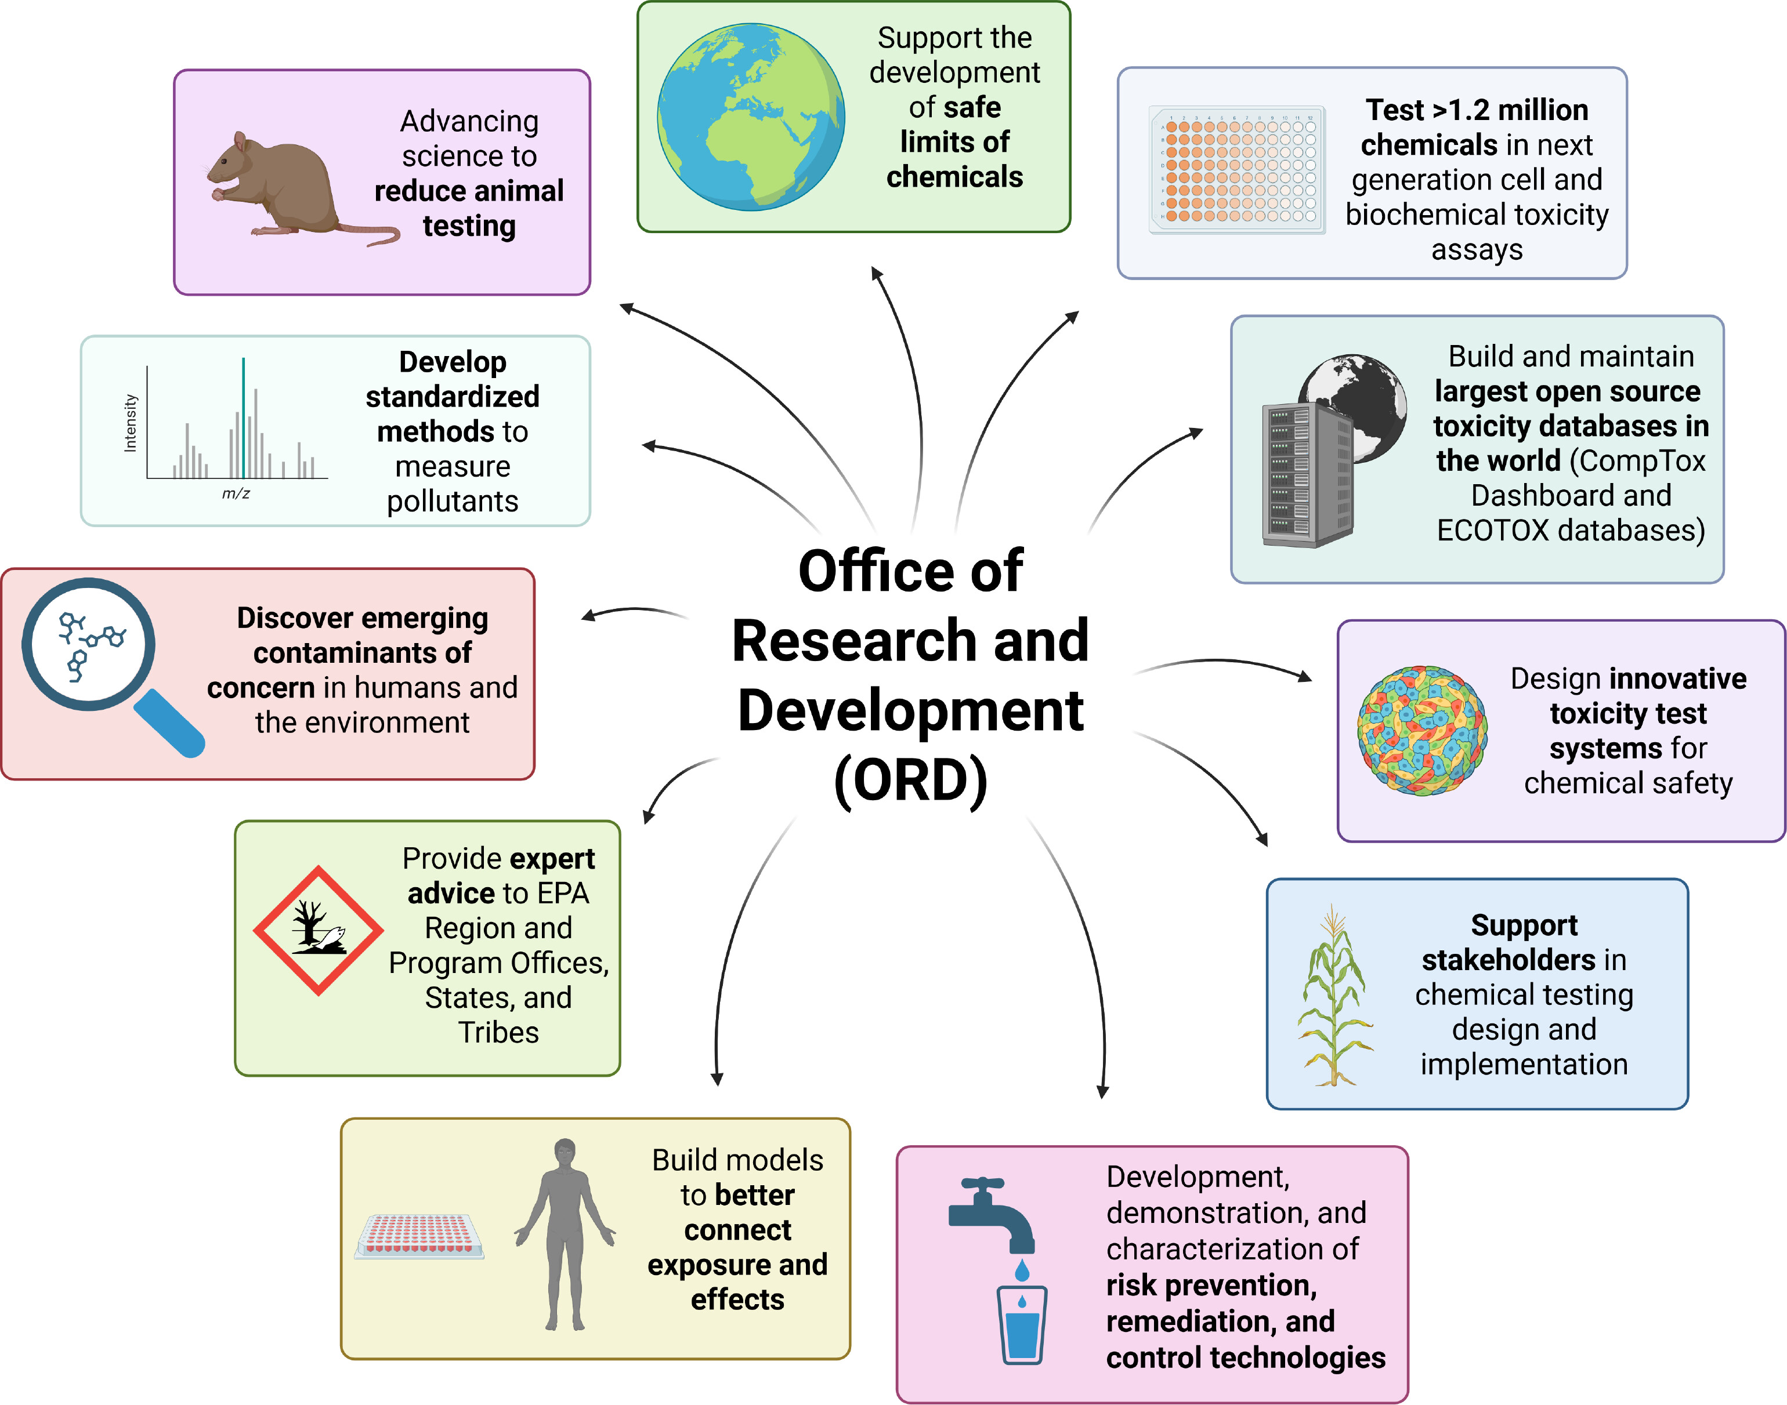

Slide 7
Past achievements of the ORD
Instrumental in developing the tools to meet the mandates of the Clean Water and Clean Air acts
Developing chemical safety and exposure procedures to o environmental cleanup and emergency response.
Studying chemicals through their entire lifecycle, developing methods to detect pollutants, track their movement, model human exposure, assess toxicity, and design technologies for prevention and remediation

Slide 8
Recent work
Before its closure on 18 July 2025 one of its many projects was to study per- and polyfluoroalkyl substances (PFAS).
A recent success story is a project in Cape Fear River Basin, a drinking water source for 1.5 million North Carolinians.
Previous studies targeted one PFAS compound at a time.
ORD deployed a cutting-edge approach called nontargeted analysis to broadly search for fluorinated chemicals in the water supply

Slide 9
Without the ORD
No other part of the EPA has the mandate, funding or practice to push the envelope in its study of unusual.
The EPA will become more reactive than proactive.
The EPA will have to reliant on external and industry funded research, which could lead to incentives misallied with the public and faulty research
It will erode the evidence base for regulation, delay responses to emerging threats, exacerbate environmental injustice, and weaken public confidence in environmental governance

Slide 10

Global perspective
Here in Germany the closure of ORB is not of immediate concern but will have consequences.
The EPA has been a leader in environmental research often through the ORB.
Many Environmental laws in other nations have been inspired by the EPA.
The environmental consequences will not stop at the American border

Slide 11

Thank you
Questions, comments or concerns?

Slide 12
References
Tollefson, J. (2025). US EPA HALTS FUNDING FOR ITS MAIN SCIENCE DIVISION. Nature, 641, 831.
Glaberman, S., Frey, H. C., & Tal, T. (2025). Dismantling EPA’s research office jeopardizes environmental safety, public health, and US competitiveness. Proceedings of the National Academy of Sciences, 122(24), e2508060122.
US EPA, “About Our Research.” https://www.epa.gov/research/about-our-research
Colgan, J., & Genovese, F. (2025). Global Climate Politics after the Return of President Trump. International Organization, 79(S1), S88-S102.

