Slide 1
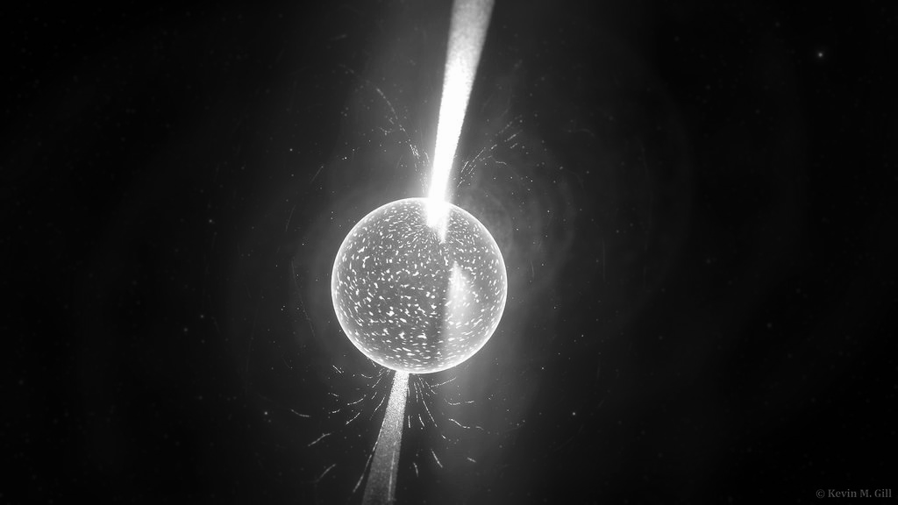
ECOs from the Dark: Properties
Adrien Hopkins¹, Jack MacArthur², Sergiy Kernytsky¹
¹York University, ²University of Alberta
EXPLORE III Workshop: Messengers from the Extreme & Ancient Universe
2023 April 11

Slide 2
Outline
Motivation
Theory
  Natural Units
  Newtonian Hydrostatic Equilibrium Equation
  Equation of State
Dark Matter Accretion
  Calculation of Accretion Rate
  Accretion Graphs
TOV Equation
  Generalizing Group Exercise 3
  Results
  Mass-K₀ Relation
Summary
Notes:
Explain every line in detail (don’t go too fast)

Slide 3
Theory and Motivation

Slide 4
Motivation
Why are we doing this?
As part of the ECOs from the Dark: Properties team, our goal was to understand and study the properties of:
ECOs
Dark matter
What are ECOs?
Compact objects include:
White dwarfs
Neutron stars
Black holes
Whereas ECOs or Exotic Compact Objects include:
Similar dense bodies that are for now hypothetical
What did we do?
Compared dark matter accretion of typical neutron stars with different dark matter profiles
Calculated dark matter accretion
Solved the TOV equation with different equations of state and different values of K₀

Slide 5

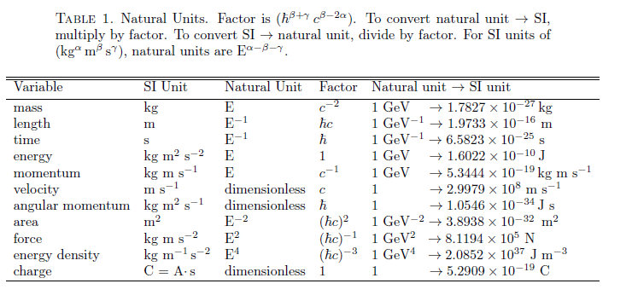

Natural Units
What are Natural Units?
Natural units are a system of units used extensively in astrophysics where:
Implications:
Conversion rates of natural units
Important information about Natural Units:
Different systems of units G=1 G≠1
Do not need to include missing factors of c
Source: Myers, A. L.
Notes:
Add bullet points on what they are and why they are needed - each slide should have a take home message, add more text

Slide 6





Invisible Factors when using Natural Units
The accretion rate of the dark matter WIMPs onto a neutron star, having taken into account relativistic effects is:
Let’s take a look at one of the factors of this equation:
The units of the factor are:
=
Source: Kouvaris, C. and Tinyakov, P.
Notes:
Change the sources**
Include another example
And change equations to make it look better
THis equation describe in detail, but on this slide say that “we will go over this eqn later, but I wanted to use it as an example of natural units”

Slide 7



Newtonian Hydrostatic Equilibrium Equation
A sphere in hydrostatic equilibrium has its internal forces from pressure equal to the external forces namely gravity
Thus, we derive the Newtonian Hydrostatic Equilibrium Equation
Where:
Source: Schaffner-Bielich, J.
Notes:
Use bullet points, and label each equation with a description
-include images
Dont derive, explain the set of Differential equations needed

Slide 8


Relativistic Hydrostatic Equilibrium Equation
The Einstein equations are being given by the following equations:
By making a few assumptions such as the radius of a star R being larger than the Schwarzschild radius
The equations provided by the Einstein equations, which when combined create the TOV equations
Where:
What about ε?
Source: Schaffner-Bielich, J.
Notes:
From einstein equations only two diff equations are independent
\left( \right) for brackets

Slide 9








Equation of State
The equation of state describes the relation between pressure and energy density determines the properties of bulk matter and how it reacts
The equation of state can be described as functions of energy density ε or number density n
In the nonrelativistic limit, the power coefficients are given by:
In the relativistic limit for a composite fermion gas, the power coefficients are given by:
In the ultra-relativistic limit for a single fermion gas,the power coefficients are given by:
In group assignment 3, we see the following EOS:
Source: Schaffner-Bielich, J.
Notes:
Don’t need to intrude polytropic index

Slide 10
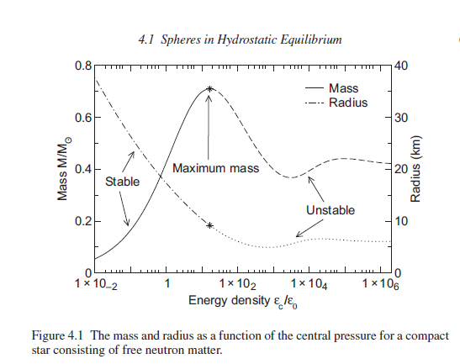
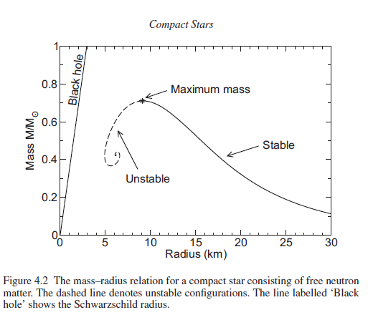
Stability of a Sphere of Free Gas of Fermions
The following are Mass-Energy Density and Mass-Radius Graphs for spheres of free gas of fermions (neutron matter):
Starting from the left and right sides of the graph respectively, the sphere is stable until it reaches a maximum mass
Source: Schaffner-Bielich, J.
Notes:
Stability of

Slide 11




Dark Matter Density Profiles
Navarro-Frenk-White
Einasto
Burkert
ρ_{s} = 0.06 GeV/cm3,
α = 0.17, and r_{s} = 20 kpc
ρ_{s} = 3.15 GeV/cm3, and r_{s} = 5 kpc
ρ_{s} = 0.26 GeV/cm3, and r_{s} = 20 kpc
Spike
ρ_{s} = 0.26 GeV/cm3, r_{sp} = 20 pc, and γ = 7/3
Source: Kouvaris, C. and Tinyakov, P.
Notes:
Show an image
Explain the equations in detail & split this slide in 2 1) density profiles 2) other eqn
Adrien will go in detail about F
Density profile before natural units and explain each variable (make the presentation a story) 1) profiles and spike 2) accretion rate

Slide 12

Equations that use the Dark Matter Density Profiles
The photon emission and heating due to dark matter annihilation equilibrium equation is:
The accretion rate of the dark matter WIMPs onto a neutron star, having taken into account relativistic effects is:

Slide 13
Dark Matter Accretion Graphs
Notes:
ADRIEN
Mention motivations here maybe
The task? Determine how dark matter accretes onto neutron stars within the Milky Way

Slide 14
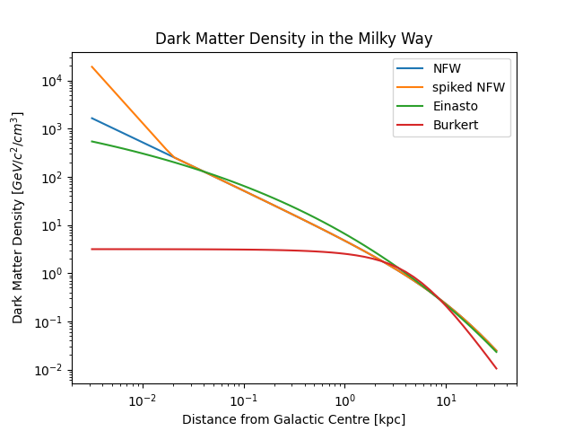




Estimating the Density of Dark Matter
all except sNFW are from Kouvaris, C. and Tinyakov, P., arXiv:1004.0586
Notes:
What are they?
They are equations modelling the density of dark matter at a certain distance /r/ from the Milky Way.
How did we get them? (read paper)
They were obtained via different simulations of dark matter. Each one is an approximation of the real world.
Spiked NFW estimates the dark matter density caused by the supermassive black hole

Slide 15
Calculating Dark Matter Accretion
source: Kouvaris, C. and Tinyakov, P., arXiv:1004.0586
Notes:
Equation from the paper
Accretion graph script
All I need is rho_dm, since m is assumed to be 100 GeV/c^2 while f is assumed to be 1
What are the variables? Mention both the stuff I deleted, and the stuff I’m keeping!

Slide 16
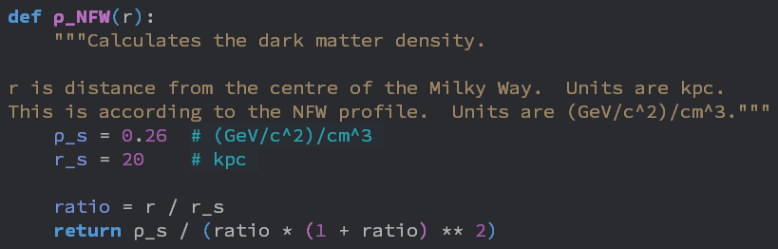
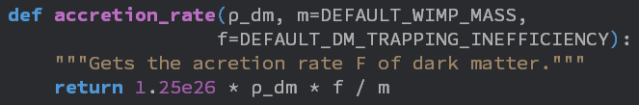
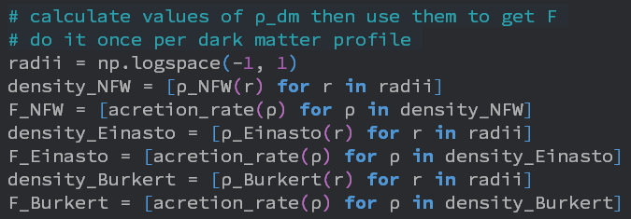
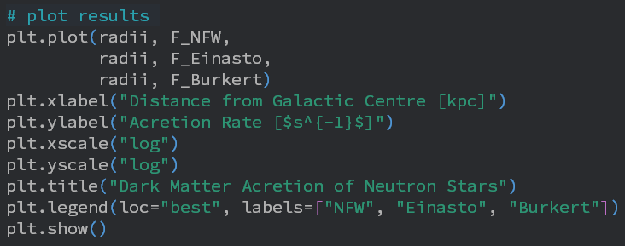
Graphing Accretion Rates with Python
Notes:
Explain the script, how I made it, the progress it’s gone through, there’s lots to talk about!
Mention I’m showing an early version?

Slide 17
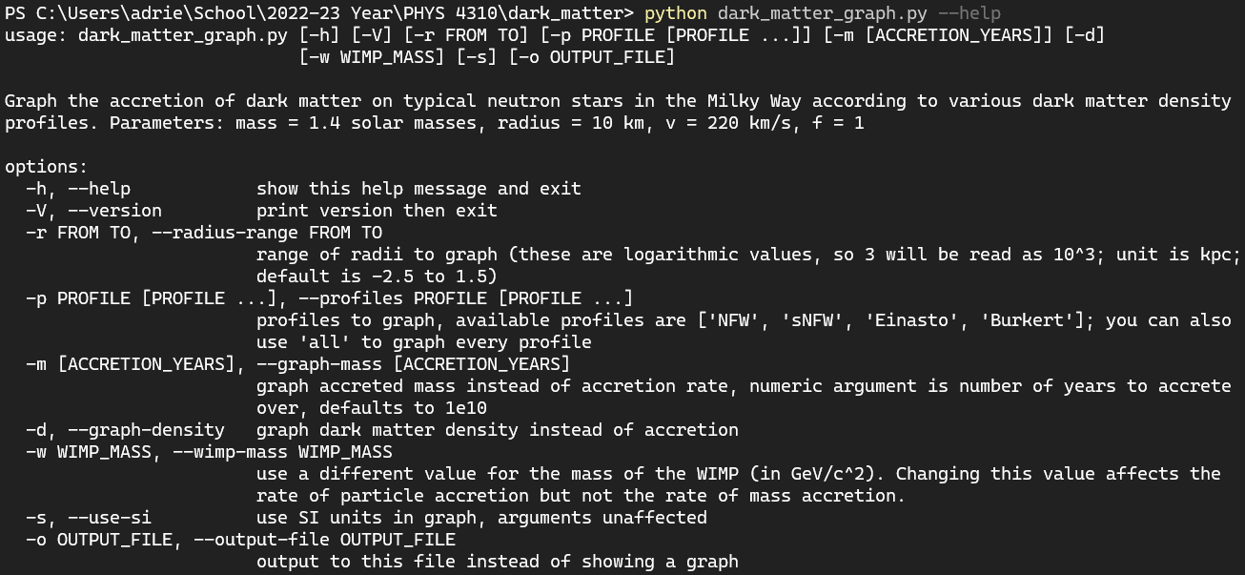
Different Kinds of Graphs

Slide 18

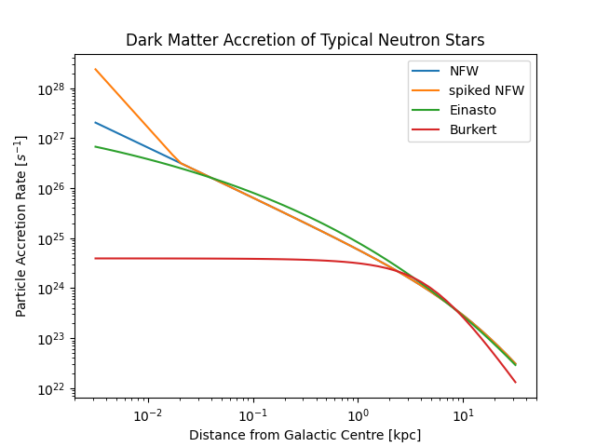
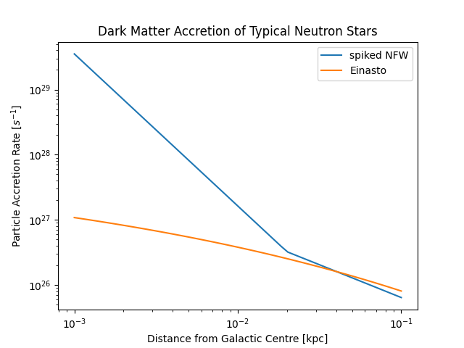
Graphs of the Accretion Rate
> python dark_matter_graph.py -p all
> python dark_matter_graph.py -r -3 -1 -p sNFW Einasto
Notes:
Show some graphs
Ask which graphs to show!
Spike caused by supermassive black hole accreting more dark matter than usual

Slide 19

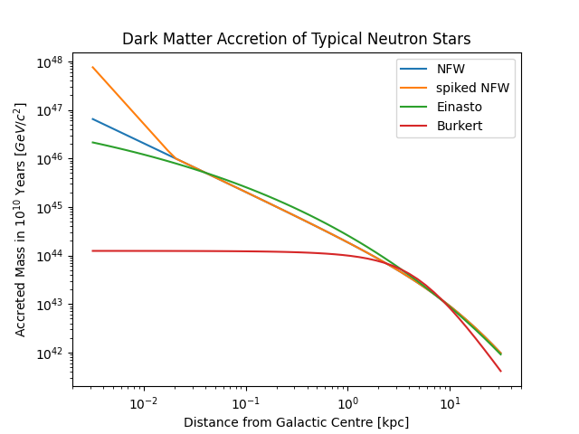
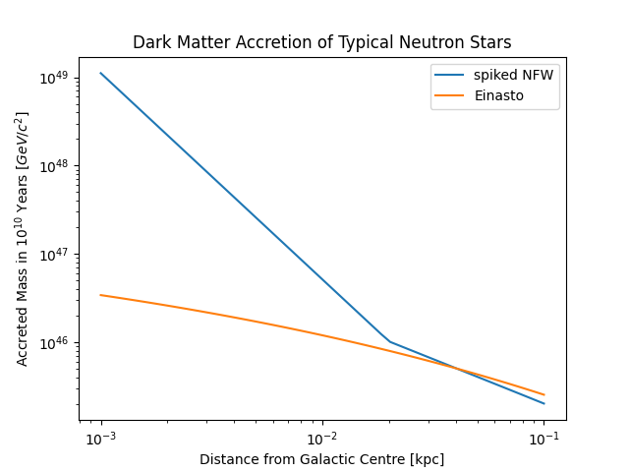
Graphs of the Accreted Mass
Same commands as before, but add -m
Notes:
Here’s graphs of the accreted mass!
This does not depend on the WIMP mass! (explain why)

Slide 20
Solving the TOV Equation

Slide 21
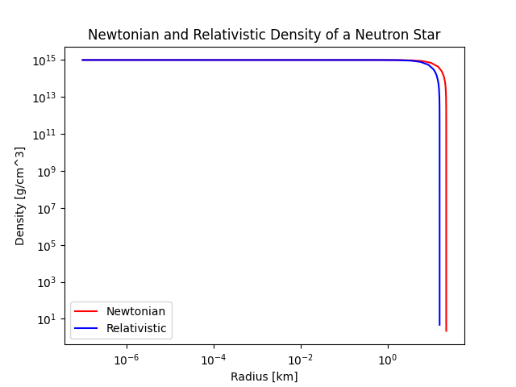
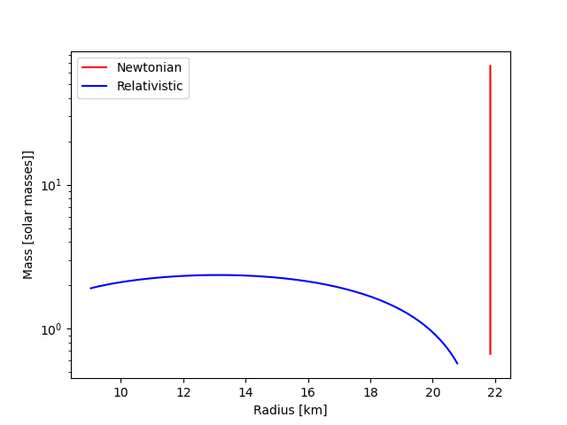

Recalling Python Group Project #3
In Group Exercise 3 we were asked to solve the TOV equation.
We needed an equation of state, as well as an initial density at the center of the star.
EOS:
Results from Group Exercise 3 courtesy of Adrien –>

Slide 22
Motivation
We expect the effect of the K₀ changing should be to scale the mass-radius curve by some amount.
Thus, one goal is to demonstrate this scaling effect, and to quantify it.
We want to generalizing this process to arbitrary equations of state.
Results from Group Exercise 3 courtesy of Adrien –>

Slide 23

Different Equations of State
In Python Group Exercise 3 we already solved the TOV equation using the following equation of state:
For our research project, we used a slightly modified version of this equation of state; called a polytropic equation of state:

Slide 24
Resolutions
Challenges
We resolved the issue of using the wrong equation of state. The ‘m’ is constant.
Numerical instability was fixed with a shorter step size. Essentially a brute force approach.
I had many issues with the conversions into and out of natural units. Careful calculation, and collaboration resolved them.
Initial difficulty, due to misinterpretation of the form of the polytropic equation of state.
Numerical instability
Using natural units

Slide 25
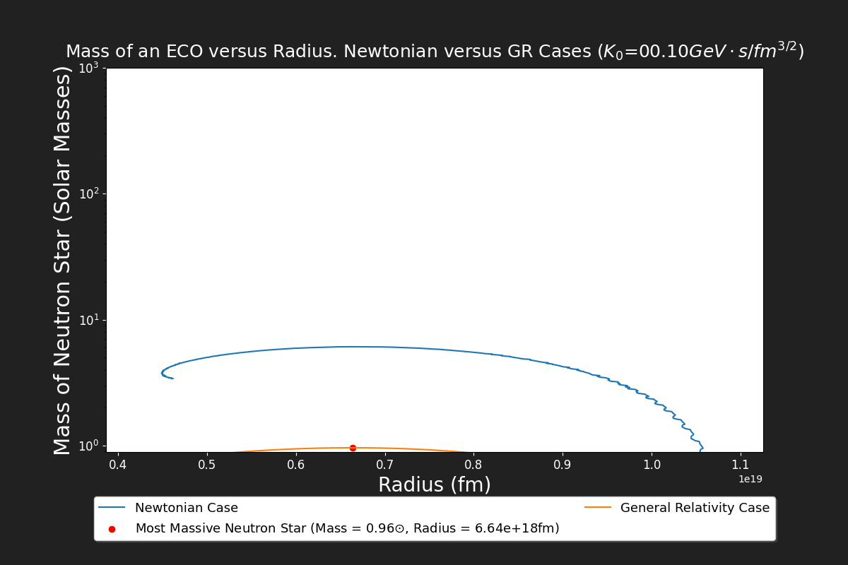


Plot of mass-radius relation for multiple values of K₀
This is a great visualization of the scaling effect the K₀ constant has

Slide 26
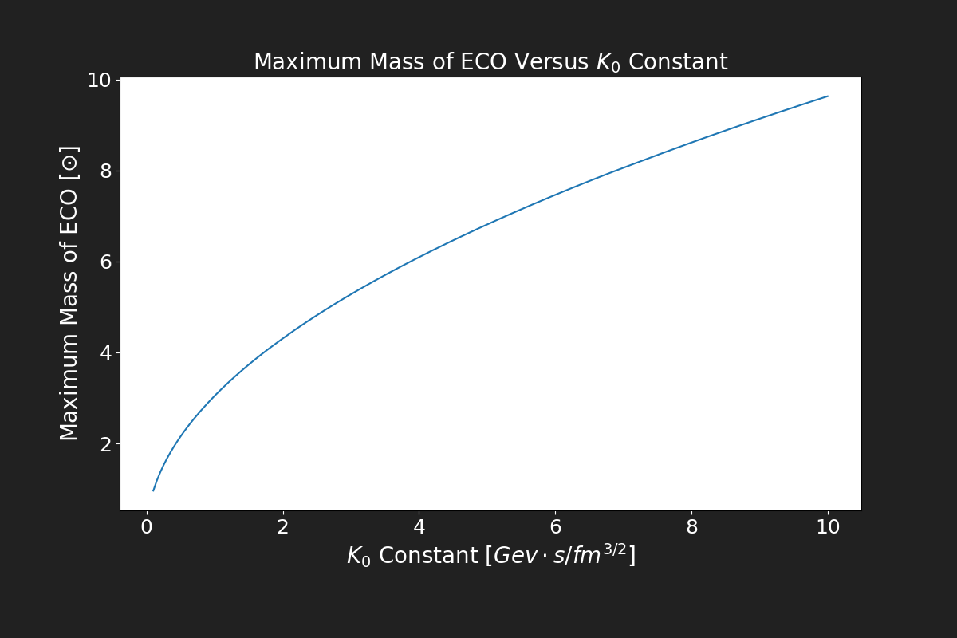
Plot of the relationship between K₀ and the maximum mass.

Slide 27

Looking Closer at the Maximum Mass versus K₀ Relationship
By plotting the logarithm of the K₀ value versus the logarithm of the maximum mass from before; we find there is a simple mathematical relationship between the two quantities of the form:
For unknown constants C₁ and C₂
To determine these constants, we simply calculate the slope and intercept of the loglog plot.

Slide 28
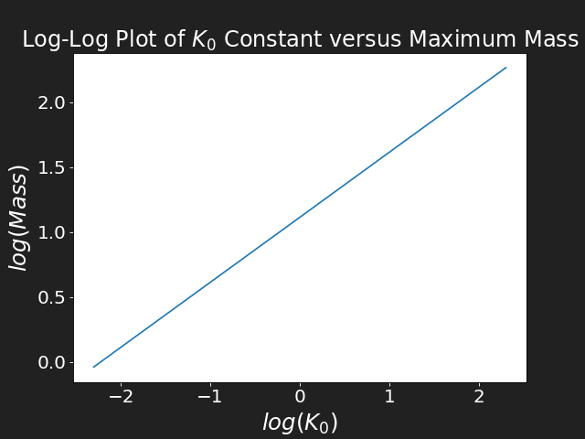
The loglog Plot
The plot is qualitatively a straight line.
The slope will give the exponent C₂
Exponentiating the intercept gives the coefficient C₁

Slide 29
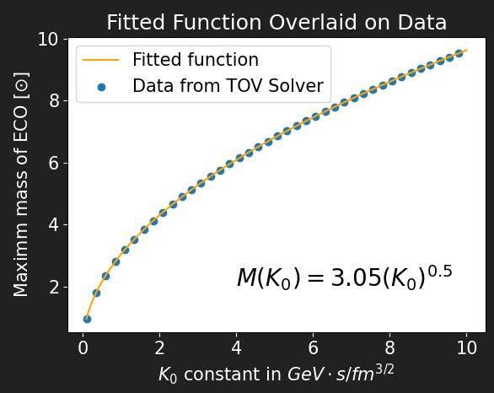
Plot of the relationship between K₀ and the maximum Neutron star mass, including the fitted equation. We see the relationship ship is exactly quadratic.

Slide 30
Summary
Motivation was to explore how Dark Matter accretes on Compact Objects
  DM Profiles
  TOV Equation
  Accretion Graphs
Dark Matter Accretion
  DM Profiles
  Python Graphing Tool
TOV Equation
  Generalized Group Exercise 3
  Quantified Mass-K₀ Relation
Natural Units
  Important Constants are Units
Notes:
All three of us make a combined summary

Slide 31
Bibliography
[1] C. Kouvaris and P. Tinyakov, “Can neutron stars constrain dark matter?,” Physical Review D, vol. 82, no. 6, 2010.
[2] Del Popolo, A., Le Delliou, M., &amp; Deliyergiyev, M. (2020). Neutron stars and dark matter. Universe, 6(12), 222. https://doi.org/10.3390/universe6120222
[3] Myers, A. L. (n.d.). Natural System of Units in General Relativity. University of Pennsylvania.
[4] Schaffner-Bielich, J. (2020). Compact Star Physics. Cambridge: Cambridge University Press. doi:10.1017/9781316848357
Notes:
Cite not using the numbers, but use the last names and the archive number Example: Kouvaris & Tinyakov, arXiv:2012.1234 make citations light green

