Slide 1
Considerations & issues in the radius extraction
Douglas Higinbotham
Jefferson Lab
Low Q Workshop: 17 May 2023

Slide 2
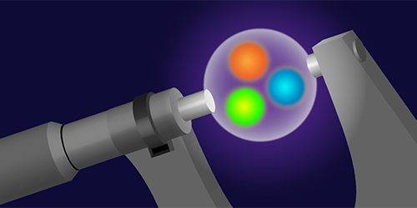
A Puzzle Caused By Tenacious Graduate Students
Randolf Pohl, Aldo Antognini, et al., Nature 466 (2010) 213–216.
The signal was nearly not found as they had been scanning frequencies assuming a large radius.
Figure by APS/Alan Stonebraker
2

Slide 3
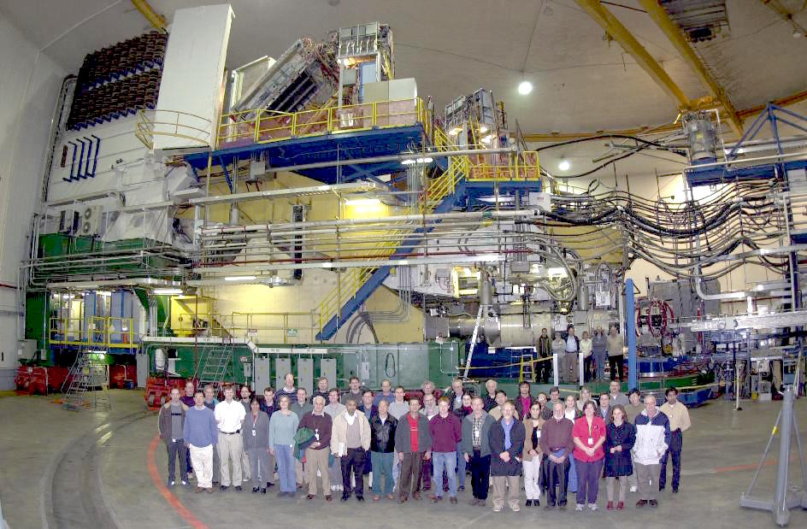
How do we typically do elastic electron scattering measurements?
Beam of electrons from an accelerator (E)
Place target material in the beam
  Foils are easy, nearly point (typically thin) targets and thickness is easy to determine
  Cryo-targets are challenging (e.g. boiling effects, energy loss)
  Since target thickness cannot be exactly determined, floating normalizations are often used.
For elastic measurement can measure scattered electron (E’) and/or proton.
  Over determined reaction
Spectrometers are typically used
  Magnetic fields, wire-chambers, reconstructed tracks, sieve data, etc.
Low Q Workshop 2023
and in Hall A 2002:
Jian-Ping Chen
Zein-Eddine Meziani
Ron Gilman
Douglas Higinbotham
Eric Voutier

Slide 4
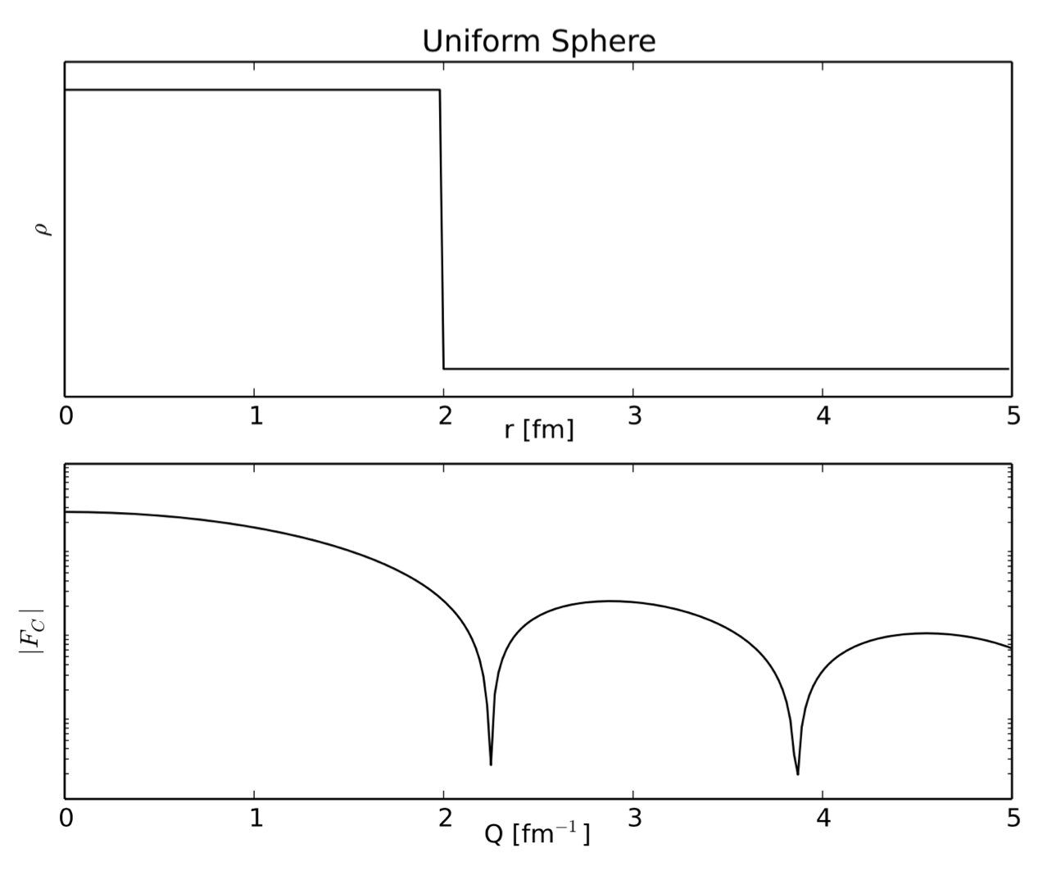
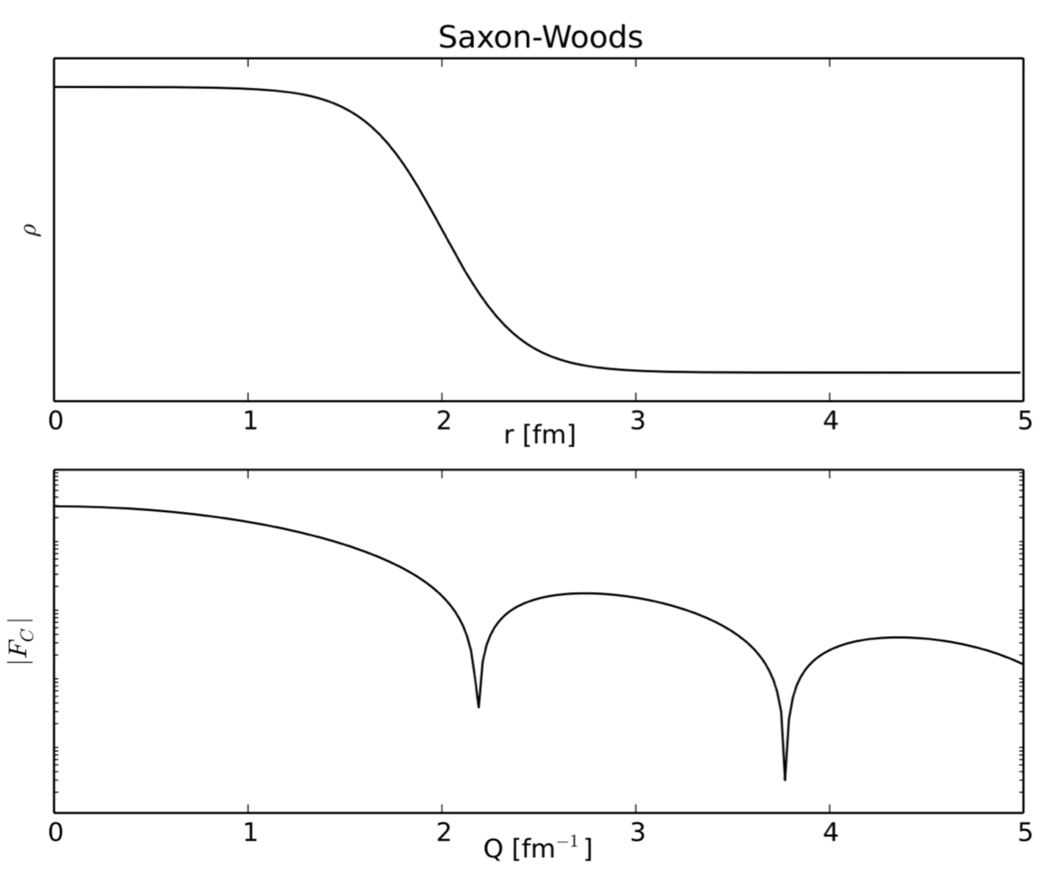
Electron Scattering Charge Radii from Nuclei
Fourier Transformation of Ideal Charge Distributions.
Example Plots Made By R. Evan McClellan while Jefferson Lab Postdoc now Professor at Pensacola State College)
e.g. for Carbon: Stanford high Q² data from I. Sick and J.S. McCarthy, Nucl. Phys. A150 (1970) 631.
National Bureau of Standards low Q² data from L. Cardman et. al., Phys. Lett. B91 (1980) 203.
4

Slide 5
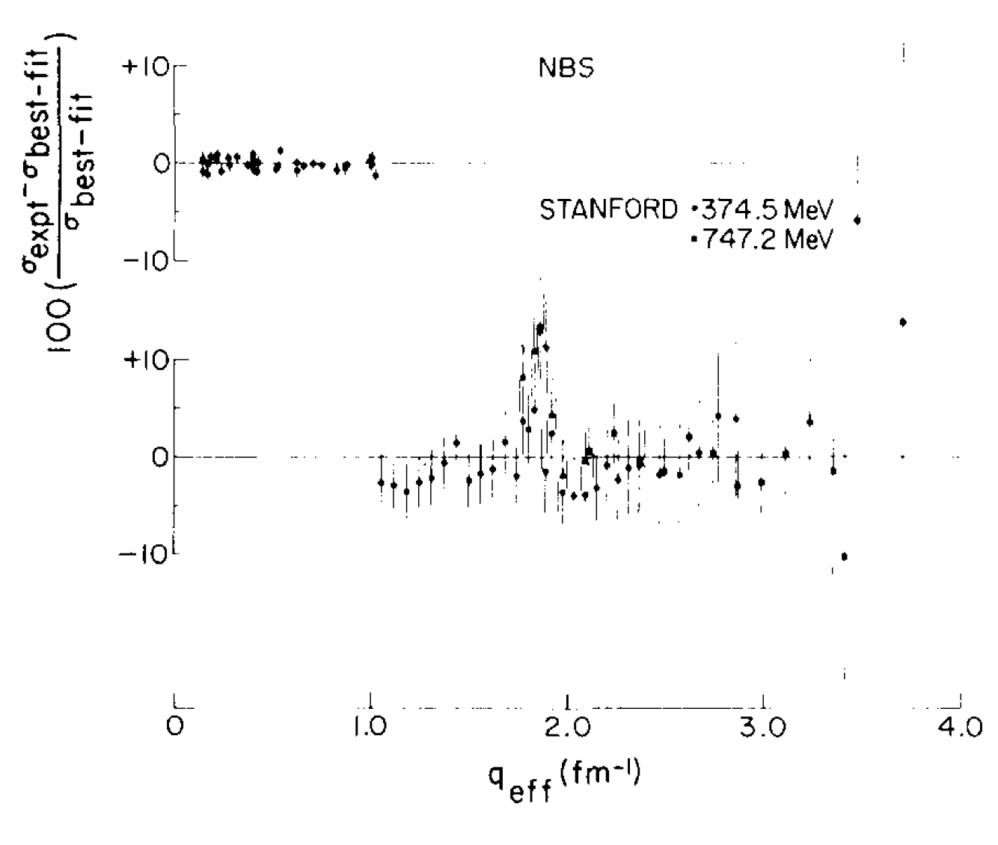
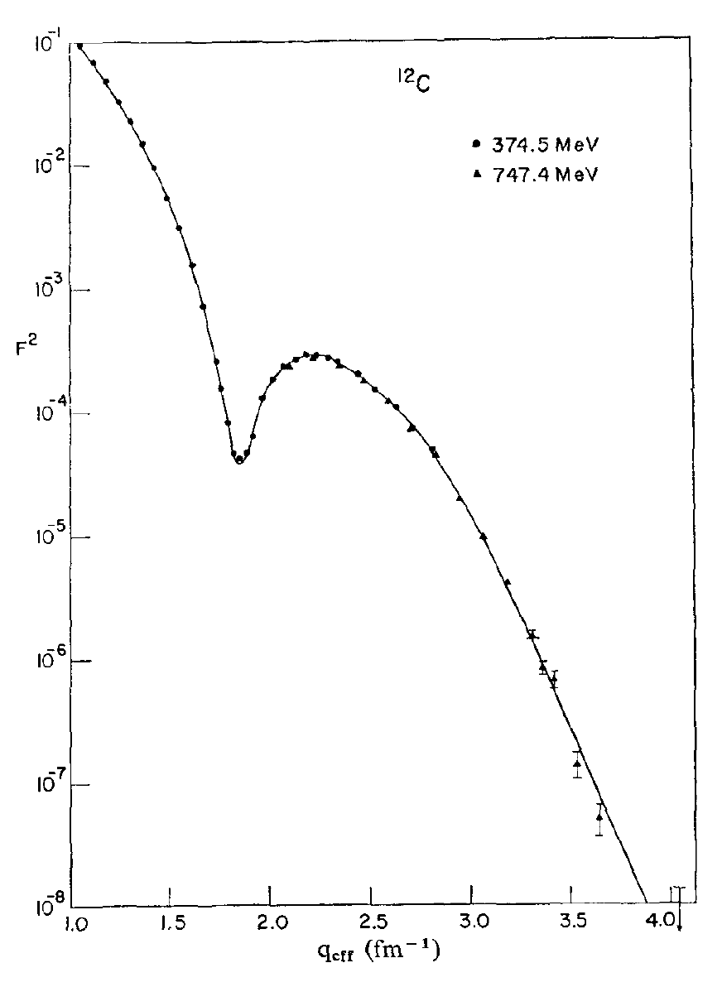
Determining the Charge Radius of Carbon
High Q² data from I. Sick and J.S. McCarthy, Nucl. Phys. A150 (1970) 631.
National Bureau of Standards low Q² data from L. Cardman et. al., Phys. Lett. B91 (1980) 203.
See the L. Cardman’s paper for details of the carbon radius ( 2.46 fm ) analysis.
5

Slide 6
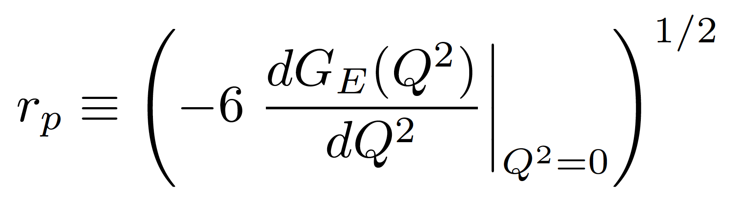
Charge Radius of the Proton
Proton G_{E} has no measured minima and is far too light for the Fourier transformation to work in a model independent way.
Thus for the proton we make use of the fact that as Q² goes to zero the charge radius is proportional to the slope of G_{E}
This definition of r_{P} has been shown to be consistent with the radius extracted from the muonic hydrogen data.
M. I. Eides, H. Grotch and V. A. Shelyuto, Phys. Rept.342 (2001) 63. http://doi.org/10.1016/S0370-1573(00)00077-6
Gerald A. Miller, Phys. Rev. C 99 (2019) 035202. https://doi.org/10.1103/PhysRevC.99.035202
As we cannot measure at exactly Q²=0 this will be an extrapolation problem.
6

Slide 7
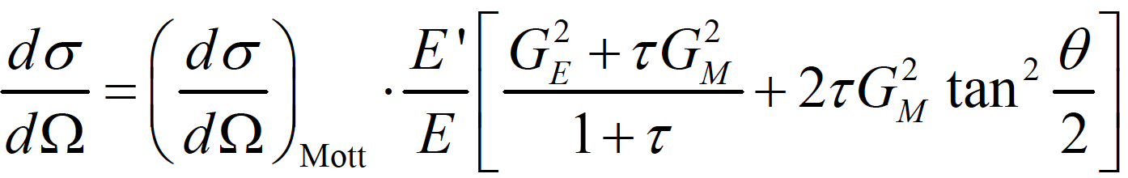
Elastic Electron Scattering from Spin-1/2 Particles
From relativistic quantum mechanics one can derive the formula for electron-proton
scattering where one has assumed the exchange of a single virtual photon.
where G_{E} and G_{M} form factors take into account the finite size of the proton.
G_{E} = G_{E}(Q²), G_{M} = G_{M} (Q²); G_{E}(0)=1, G_{M}(0) = μ_{p}
Q² = 4 E E’ sin²(θ/2) and τ = Q² /4m_{p}²
Elastic cross sections at small angles and small Q²’s are dominated by G_{E} ( JLab PRad Hall B )
Elastic cross sections at large angles and large Q²’s are dominated by G_{M} ( JLab GMP Hall A )
For moderate Q^{2’}s one can separate G_{E} and G_{M} with the Rosenbluth technique (same Q² different E,θ).
7

Slide 8
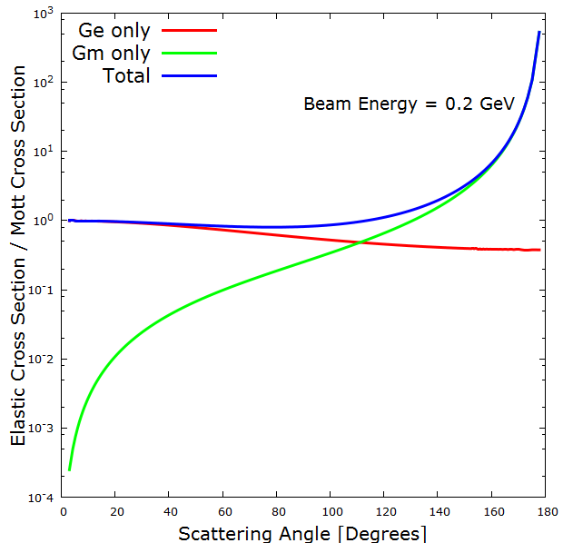
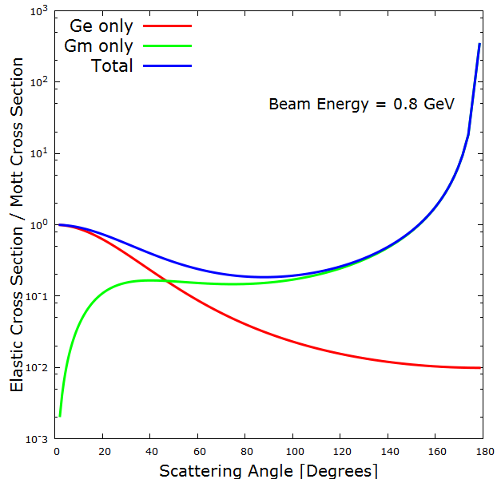
G_{E} and G_{M} Contributions To The Cross Section
Plots by Ethan Buck (Jefferson Lab SULI Student and W&M undergraduate)
Experiments like PRad (Hall B) go to small angle to maximize G_{E} and minimize G_{M} contribution..
Global fits, like typically done with the Mainz 2010 data, need several normalization, G_{E} and G_{M}

Slide 9
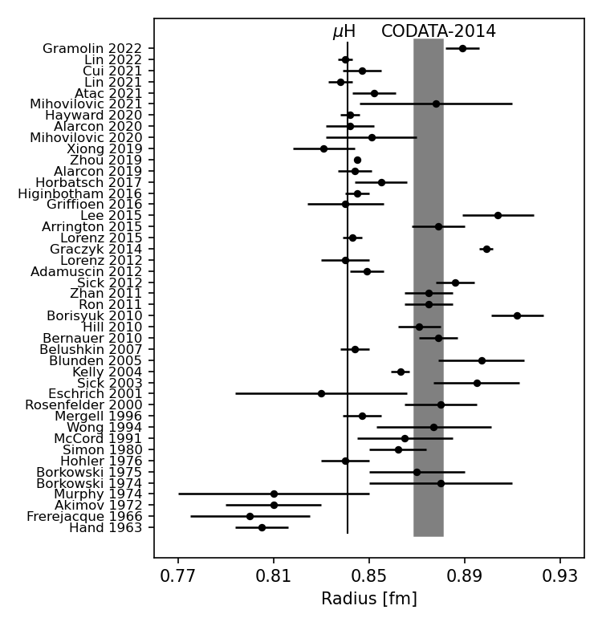
Radii from Electron Scattering Is A Story Of Many Results
Gramolin 2022: https://doi.org/10.1103/PhysRevD.105.054004
Lin 2022: https://doi.org/10.1103/PhysRevLett.128.052002
Cui 2021: https://doi.org/10.1103/PhysRevLett.127.092001
Lin 2021: https://doi.org/10.1016/j.physletb.2021.136254
Atac 2021: https://doi.org/10.1140/epja/s10050-021-00389-9
Mihovilovic 2021: https://doi.org/10.1140/epja/s10050-021-00414-x
Hayward 2020: https://doi.org/10.1016/j.nuclphysa.2020.121767
Alarcon 2020: https://doi.org/10.1103/PhysRevC.102.035203
Mihovilovic 2020: https://doi.org/10.3389/fphy.2020.00036
Xiong 2019: https://doi.org/10.1038/s41586-019-1721-2
Zhou 2019: https://doi.org/10.1103/PhysRevC.99.055202
Alarcon 2019: https://doi.org/10.1103/PhysRevC.99.044303
Horbatsch 2017: https://doi.org/10.1103/PhysRevC.95.035203
Higinbotham 2016: https://doi.org/10.1103/PhysRevC.93.055207
Griffioen 2016: https://doi.org/10.1103/PhysRevC.93.065207
Lee 2015: https://doi.org/10.1103/PhysRevD.92.013013
Arrington 2015: https://doi.org/10.1063/1.4921430
Lorenz 2015: https://doi.org/10.1103/PhysRevD.91.014023
Graczky 2014: https://doi.org/10.1103/PhysRevC.90.054334
Lorenz 2012: https://doi.org/10.1140/epja/i2012-12151-1
Adamuscin 2012: https://doi.org/10.1016/j.ppnp.2012.01.014
Sick 2012: https://doi.org/10.1016/j.ppnp.2012.01.013
Zhan 2011: https://doi.org/10.1016/j.physletb.2011.10.002
Ron 2011: https://doi.org/10.1103/PhysRevC.84.055204
Borisyuk 2010: https://doi.org/10.1016/j.nuclphysa.2010.05.054
Hill 2010: https://doi.org/10.1103/PhysRevD.82.113005
Bernauer 2010: https://doi.org/10.1103/PhysRevLett.105.242001
Belushkin 2007: https://doi.org/10.1103/PhysRevC.75.035202
Blunden 2005: https://doi.org/10.1103/PhysRevC.72.057601
Kelly 2004: https://doi.org/10.1103/PhysRevC.70.068202
Sick 2003: https://doi.org/10.1016/j.physletb.2003.09.092
Eschrich 2001: https://doi.org/10.1016/S0370-2693(01)01285-0
Rosenfelder 2000: https://doi.org/10.1016/S0370-2693(00)00316-6
Mergell 1996: https://doi.org/10.1016/0375-9474(95)00339-8
Wong 1994: https://doi.org/10.1142/S0218301394000255
McCord 1991: https://doi.org/10.1016/0168-583X(91)96079-Z
Simon 1980: https://doi.org/10.1016/0375-9474(80)90104-9
Hohler 1976: https://doi.org/10.1016/0550-3213(76)90449-1
Borkowski 1975: https://doi.org/10.1007/BF01409496
Borkowski 1974: https://doi.org/10.1016/0550-3213(75)90514-3
Murphy 1974: https://doi.org/10.1103/PhysRevC.9.2125
Akimov 1972: http://www.jetp.ac.ru/cgi-bin/dn/e_035_04_0651.pdf
Frerejacque 1966: https://doi.org/10.1103/PhysRev.141.1308
Hand 1963: https://doi.org/10.1103/RevModPhys.35.335
CODATA 2014: Proton Radius 0.8751(61)fm and Rydberg Constant 10 973 731.568 508(65)m⁻¹
CODATA 2018: Proton Radius 0.8414(19)fm and Rydberg Constant 10 973 731.568 160(21)m⁻¹

Slide 10
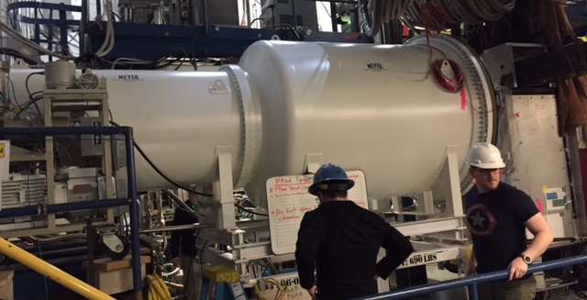
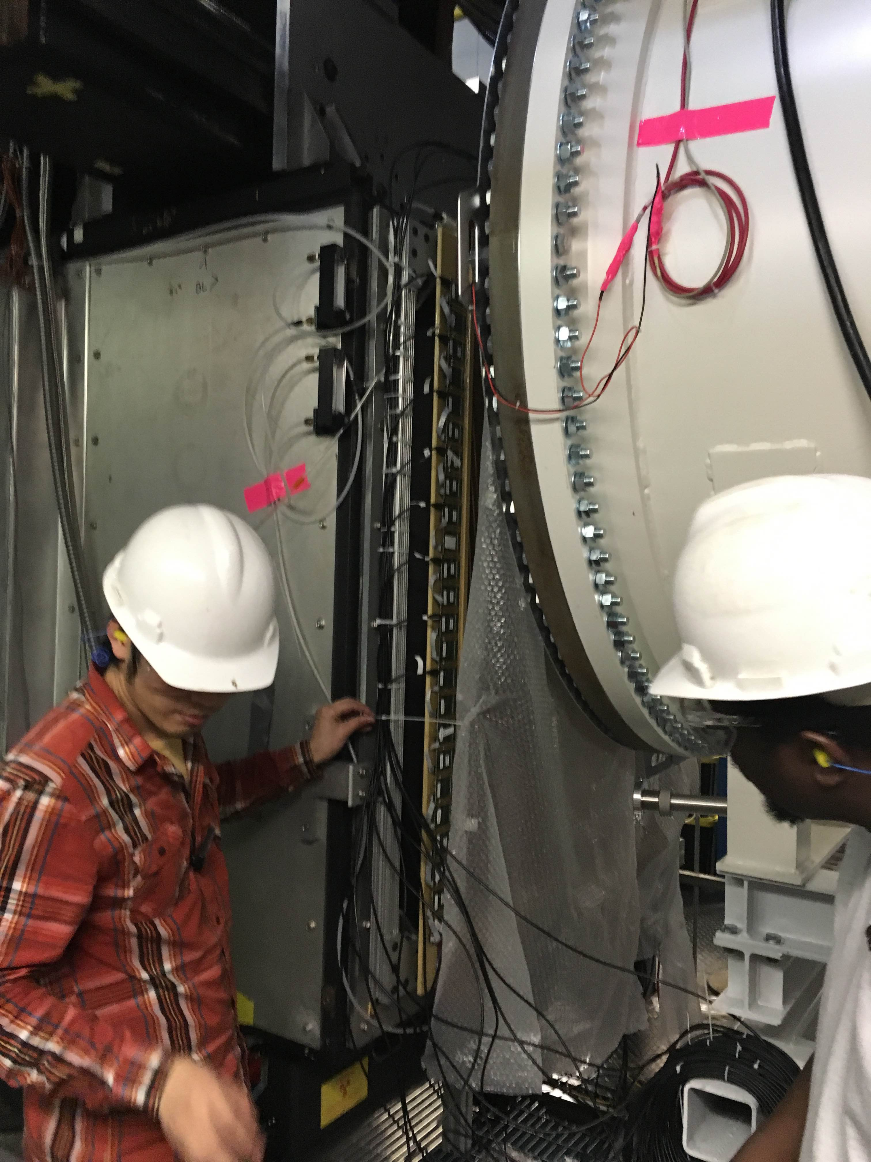
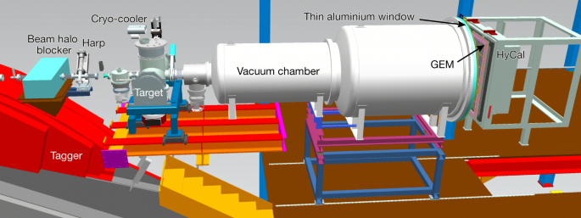
PRad: Hall B Proton Radius Experiment
Small angle and small Q² to minimize the effects of G_{M} and provide best measurement of G_{E}
Gas Target (the proton), GEM Detectors (scattering angles), Calorimeter (energy & position)
10

Slide 11
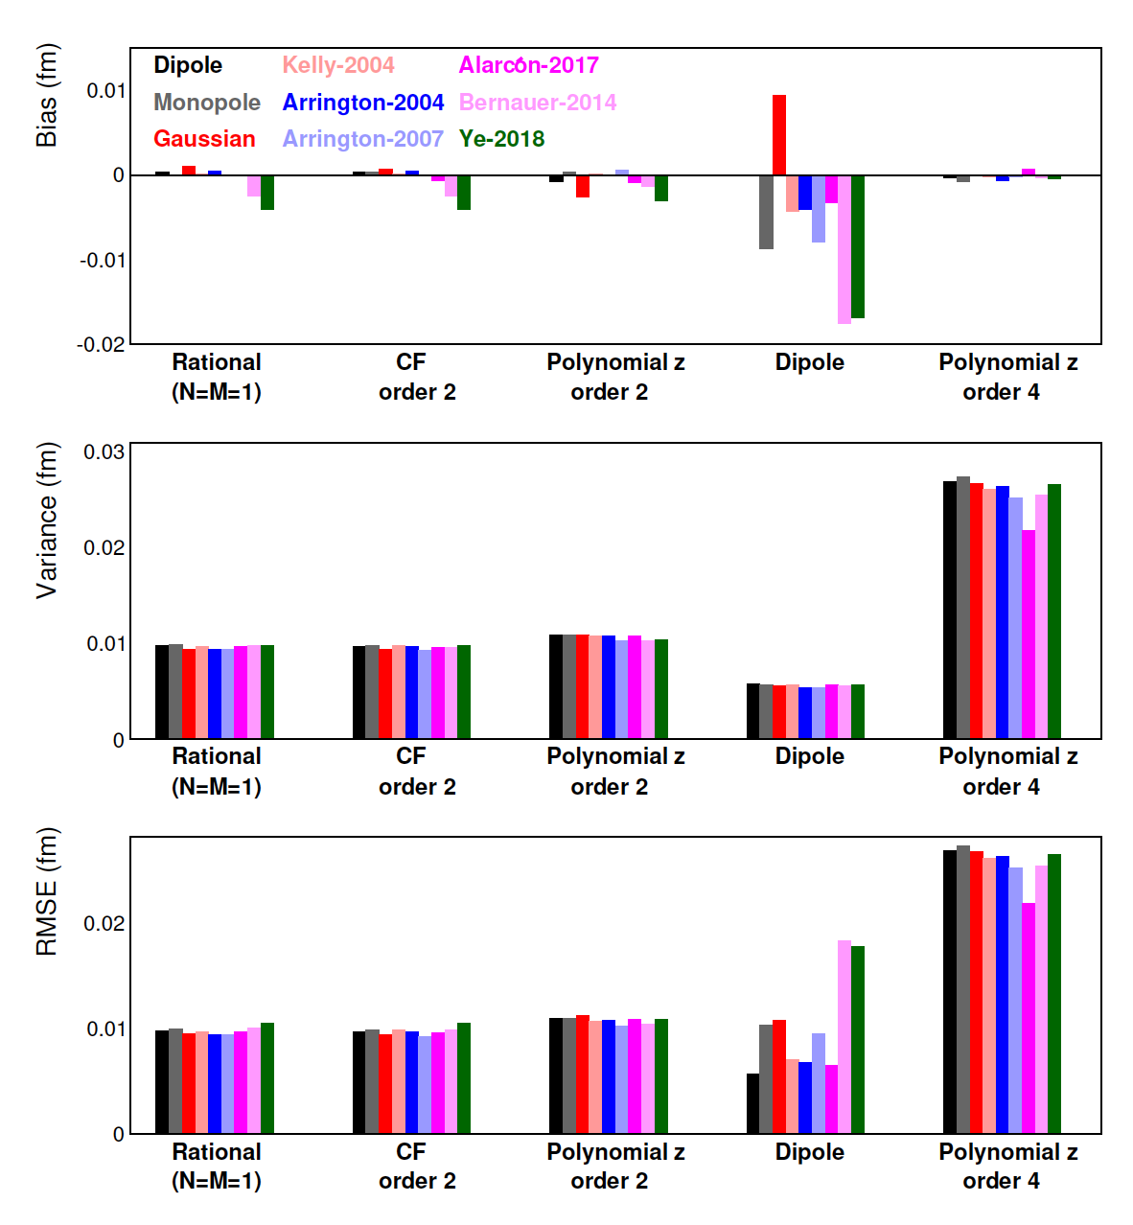
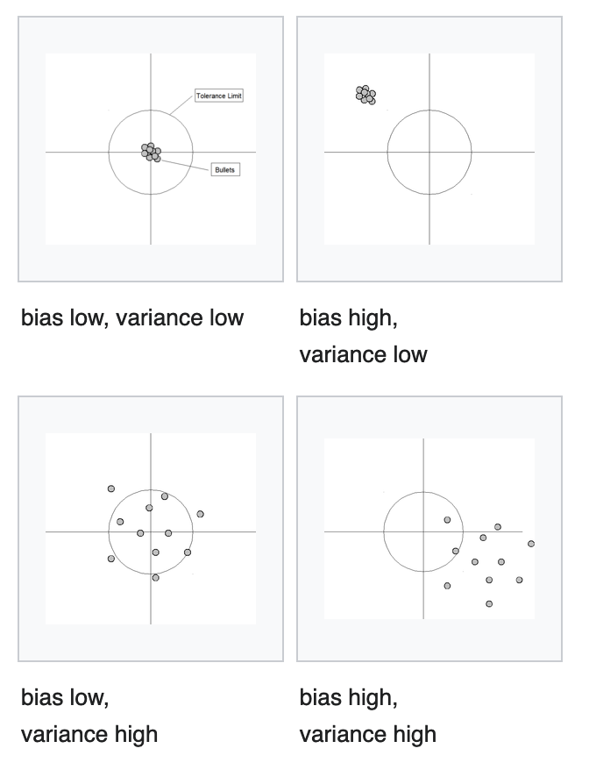
Model Selection For PRad BEFORE Seeing The Data
Z. Yan, DH, et al., Phys. Rev. C 98 (2018) 025204; https://doi.org/10.1103/PhysRevC.98.025204
Shown are a subset of the results of fitting the full range of expected data with lots of different charge form factor functions and radii.
Since we know the true radius for these functions we can calculation the bias: the offset from the true value.

Slide 12
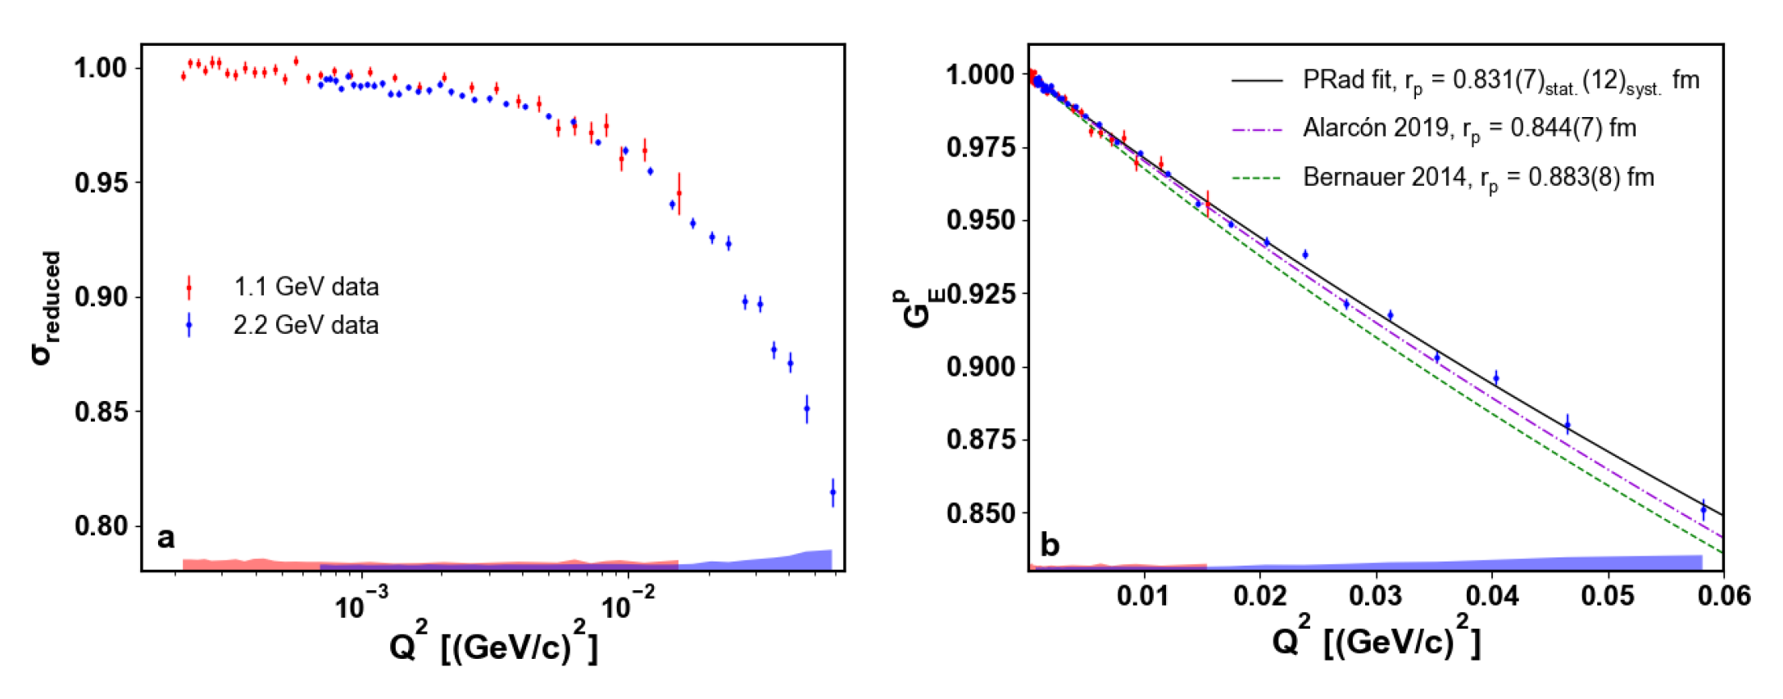
PRad Cross Section Results
W. Xiong et al., Nature 575 (2019) 147–150. https://doi.org/10.1038/s41586-019-1721-2
The horizonal line indicates the lowest Q² point of the Bernauer data of 0.00384 [(GeV/c)²]
The lowest Q² point of the PRad data is 0.000215 [(GeV/c)²]

Slide 13
PRad Cross Section Results
W. Xiong et al., Nature 575 (2019) 147–150. https://doi.org/10.1038/s41586-019-1721-2

Slide 14
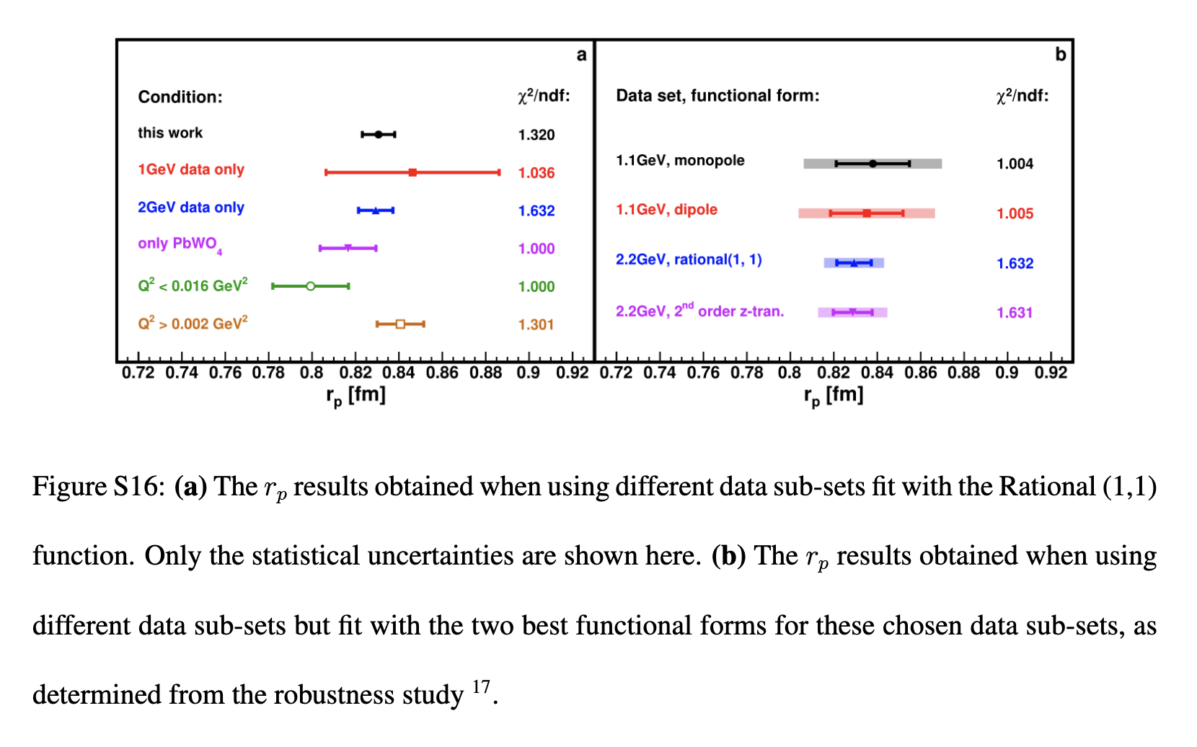
From Nature Paper Supplemental Material

Slide 15
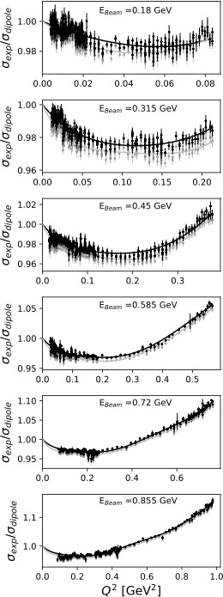
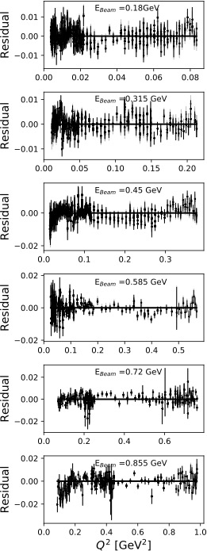
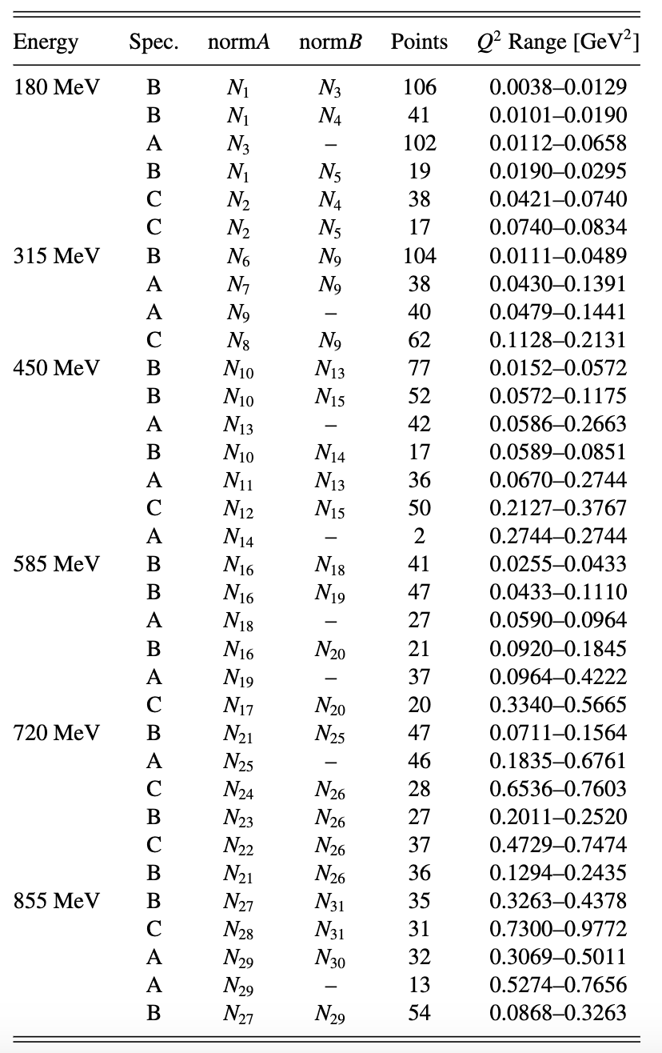
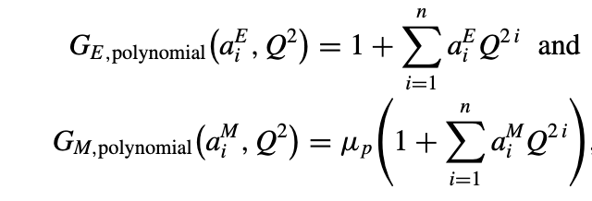
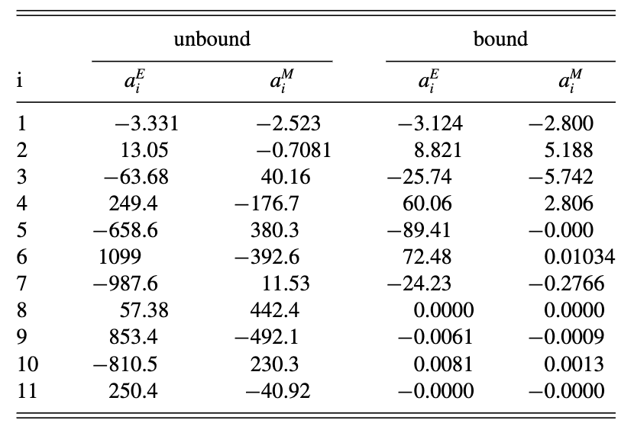
How Analytic Choices Can Affect the Extraction of Electromagnetic Form Factors from Elastic Electron Scattering Cross Section Data
https://doi.org/10.1103/PhysRevC.102.015205
https://arxiv.org/abs/1902.08185
One example in the paper shows, that with all other things fixed, changing the Mainz 1422 data point fit from an unbounded polynomial fit (results shown in light grey) to one where the polynomial parameters are forced to alternate sign (results shown in black) the normalization values to change and the charge radius changes from 0.882 fm to 0.854 fm.

Slide 16
Q² [(GeV/c)²]

Slide 17
Comparison of Form Factors
The bounded fit approximates a completely monotone function by alternating signs of terms.
Notice how the bounded fit is smoother then the unbound, but unbounded will always give the lower chi².
Scott Barcus, DH, Randall E. McClellan, https://doi.org/10.1103/PhysRevC.102.015205

Slide 18
Comparing PRad and Fit Results

Slide 19
Comparing PRad and Fit Results
And of course one can fit the sets of data simultaneously.

Slide 20
Summary and Outlook
A lot of effort has gone into understanding the proton radius puzzle
  MANY re-analysis of old and new scattering data
  PRad (no spectrometer) proton radius 0.831(7) fm
  New Atomic Lamb shift results mostly consistent with small radius
    2020 blinded analysis from Candana was consistent http://doi.org/10.1126/science.aau7807
    2017 CRÈME result also consistent with smaller value http://doi.org/10.1126/science.aah6677
    But 2018 French result still gives previous value https://doi.org/10.1103/PhysRevLett.120.183001
  MUSE, New Mainz A1 Data, MESA, Compass, PRAD-II and more still to come
From Hohler in 1976 to the Dispersively Improved Chiral Effective Field Theory of Alarcon and Weiss in 2022, conventional nuclear theory seems consistent with a smaller radius, thus it would seem the larger radius is the one that would point to new physics.
As was shown in the analytic choice paper, in complex regressions, small changes can have large impact on the results.

Slide 21
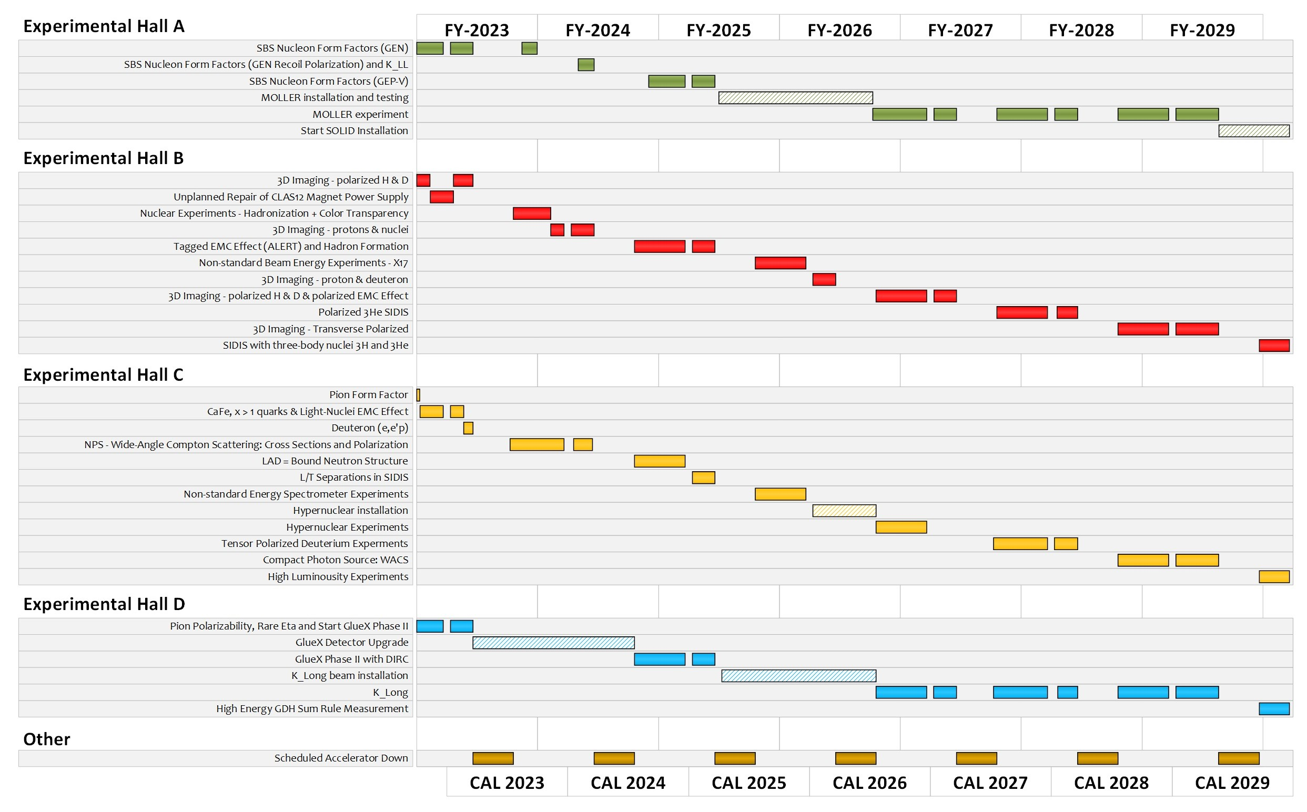
VERY TENATIVE LONG TERM SCHEDULE FOR JEFFERSON Lab

Slide 22
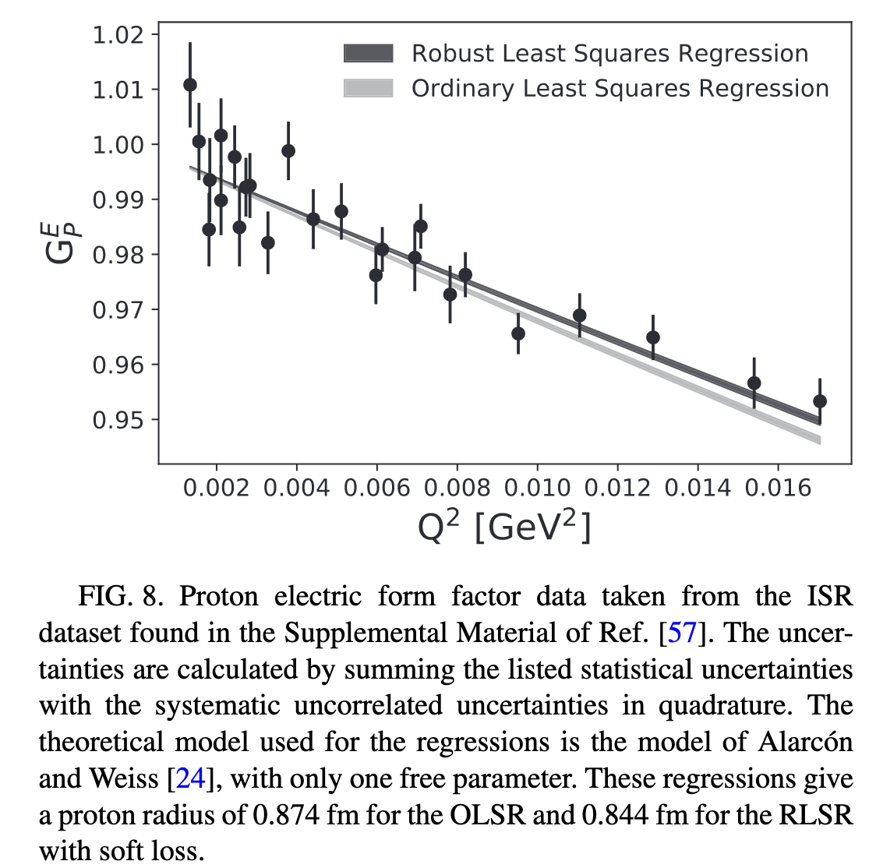
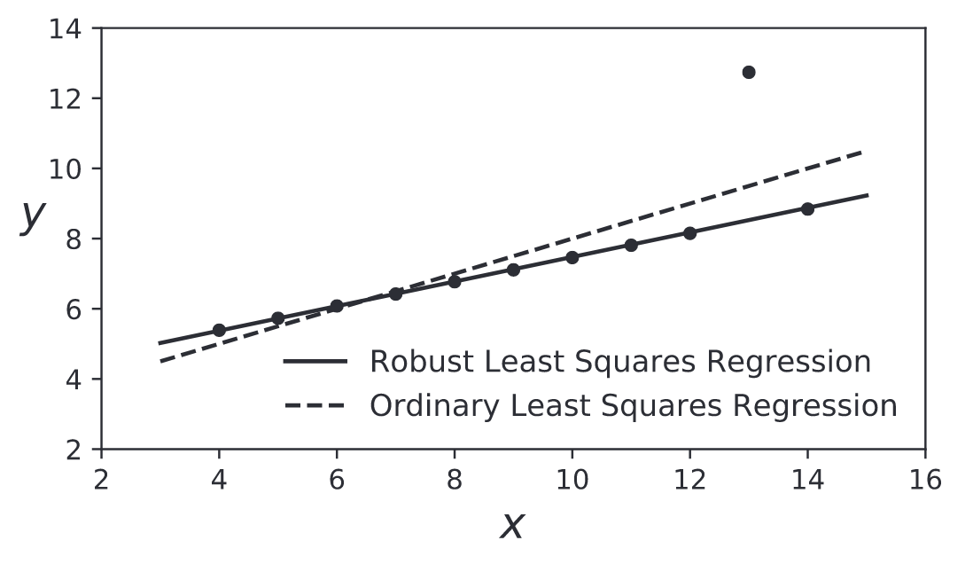
Robust Regressions https://doi.org/10.1103/PhysRevC.102.015205
Ordinary Least Squares Regressions are easily “pulled” by a single point.
Robust regressions tend to follow the global trends.

Slide 23
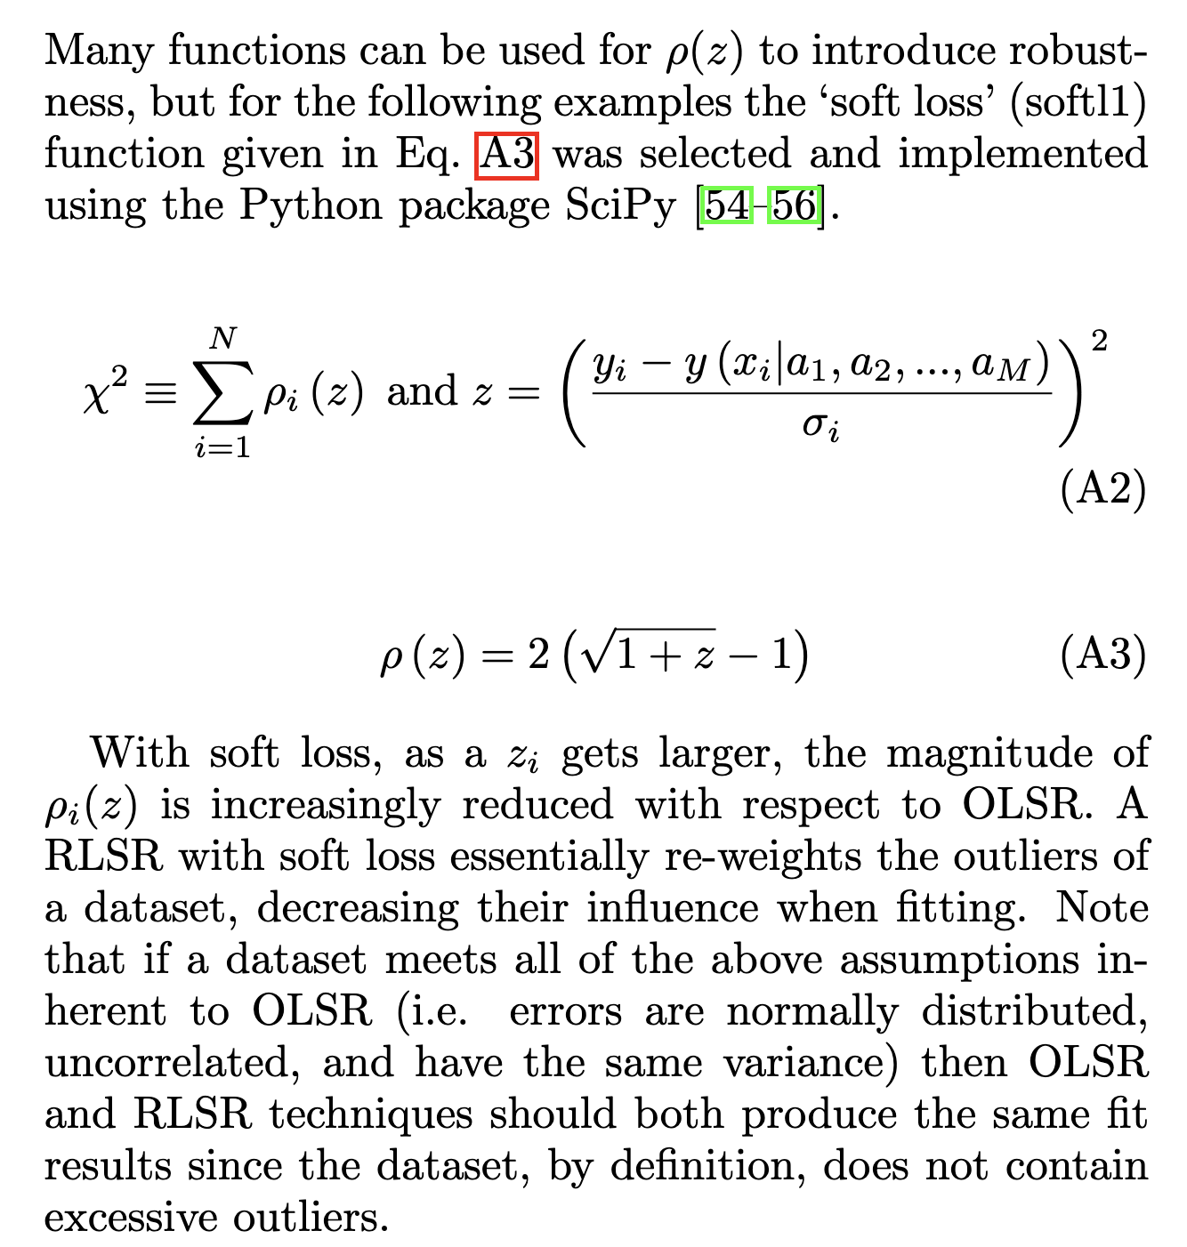
https://doi.org/10.1103/PhysRevC.102.015205

