Slide 1
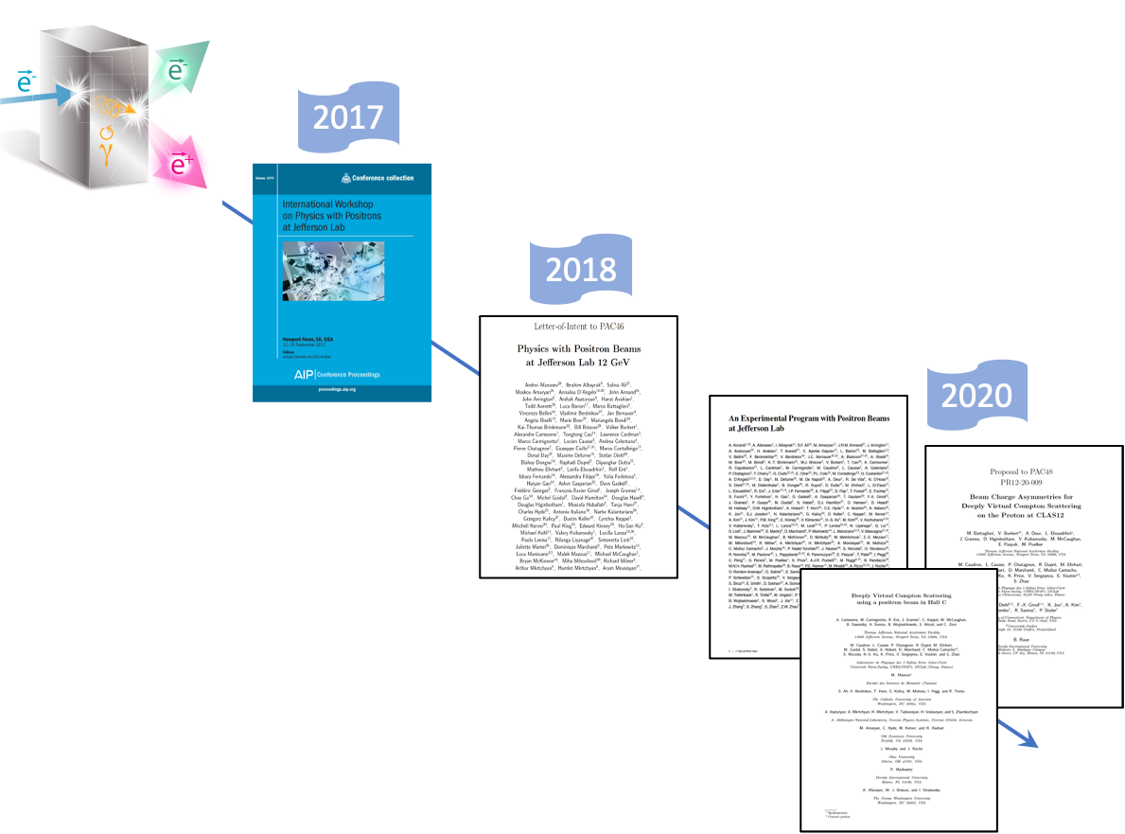



The Jefferson Lab Positron Experimental Program
e⁺@JLab
Eric Voutier and the Jefferson Lab Positron Working Group
Université Paris-Saclay, CNRS/IN2P3/IJCLab, Orsay, France
Positron White Paper
Two photon exchange
Virtual Compton scattering
Nucleon tomography
Towards e⁺ beams @ CEBAF
Positron injector concept
This project has received funding from the European Union’s Horizon 2020 research and innovation program under grant agreement Nº 824093.
2nd Workshop on Nucleon Structure at Low Q and μASTI
May 15th- 21st, 2023

Slide 2
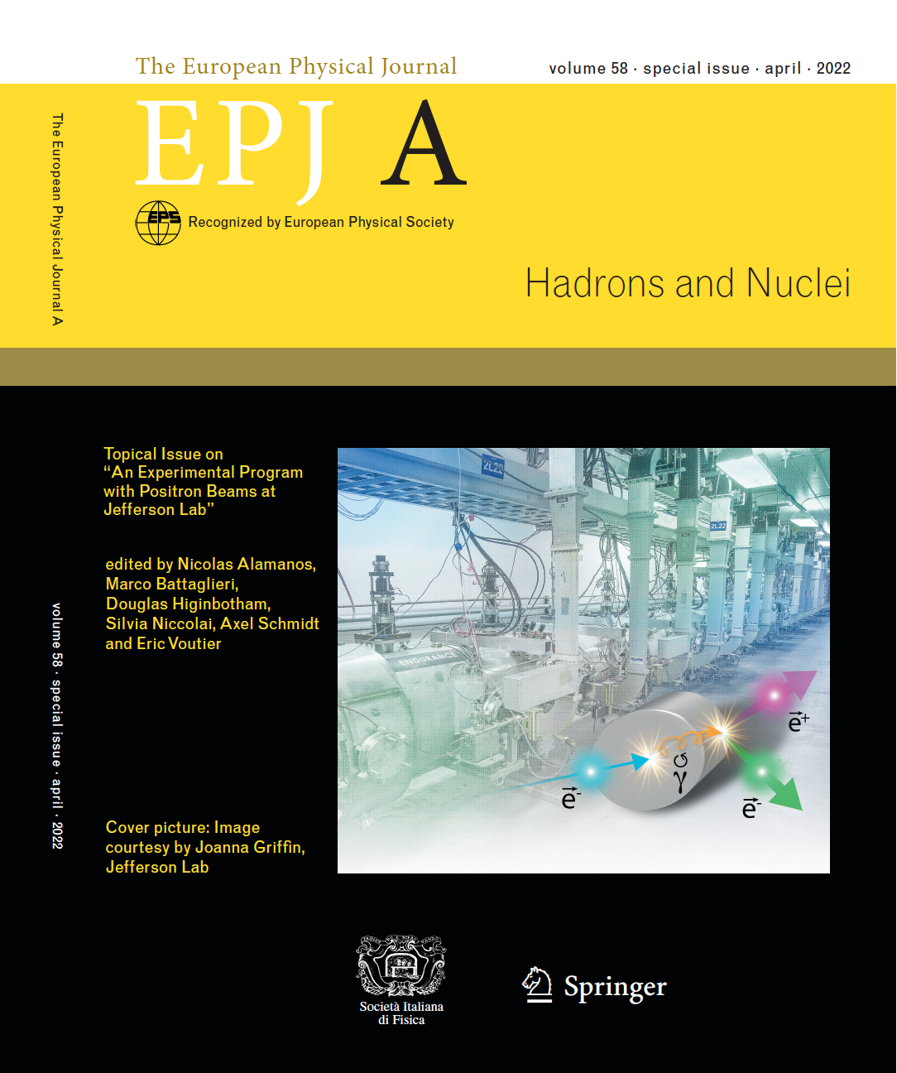

Positron White Paper
E. Voutier
The JLab Positron Working Group (PWG) developed the perspectives of an experimental program with positron beams at CEBAF in a specific EPJ A Topical.
This document constitutes the final JLab Positron White Paper, gathering 19 single contributions and a summary article, all peer-reviewed.
JLab PWG = $\sim$250 Physicists from 75 Institutions
(Jefferson Lab Positron Working Group) A. Accardi et al. EPJ A 57 (2021) 261
2/30
May 15th- 21st, 2023

Slide 3
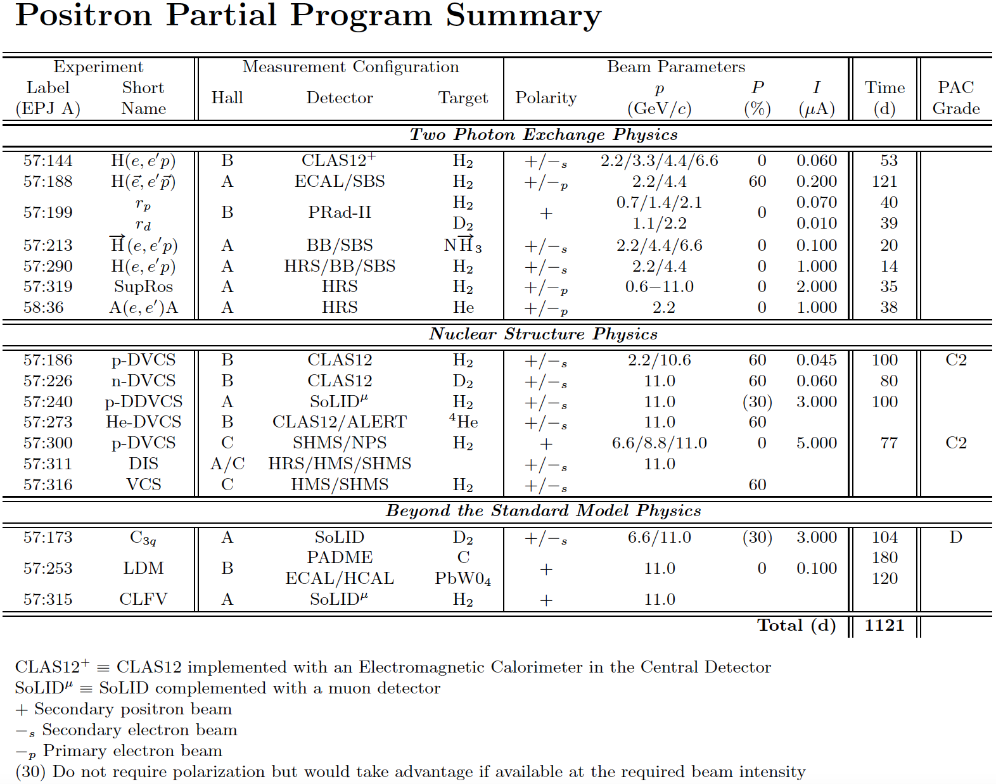
Positron White Paper
E. Voutier
TPE Physics in elastic scattering globally asks for low beam energies.
Nucleon Structure Physics and Beyond the Standard Model Physics ask for high beam energies.
There exists strong opportunities for polarized target experiments, which have not been yet explored.
3/30
May 15th- 21st, 2023

Slide 4
Positron White Paper
E. Voutier
TPE Physics in elastic scattering globally asks for low beam energies.
Nucleon Structure Physics and Beyond the Standard Model Physics ask for high beam energies.
There exists strong opportunities for polarized target experiments, which have not been yet explored.
3/30
May 15th- 21st, 2023

Slide 5
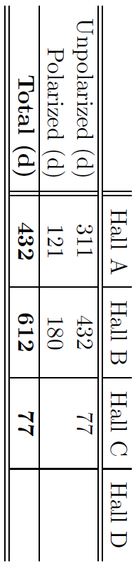
Positron White Paper
E. Voutier
Assuming
36 weeks/year of beam and
50% accelerator efficiency, this is
4.8 years of running.
Operating Hall D with a positron beam is not an issue and may also take advantage of the additional photon source from e⁺ annihilation.
4/30
May 15th- 21st, 2023

Slide 6
Positron White Paper
E. Voutier
Assuming
36 weeks/year of beam and
50% accelerator efficiency, this is
4.8 years of running.
Operating Hall D with a positron beam is not an issue and may also take advantage of the additional photon source from e⁺ annihilation.
6 Proposals and 3 Letters-of-Intent are expected for PAC51…
4/30
May 15th- 21st, 2023

Slide 7
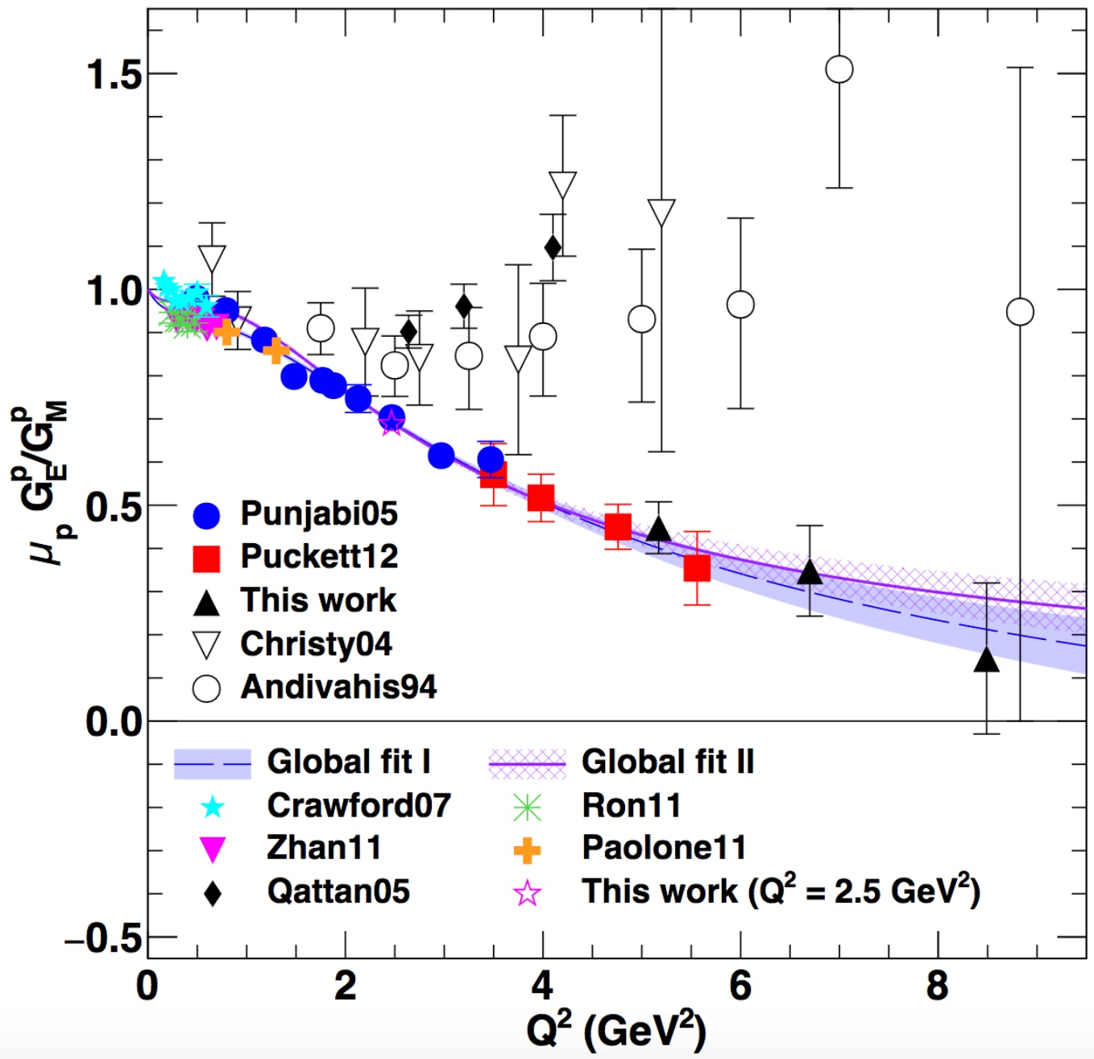
Two photon exchange
E. Voutier
P.A.M. Guichon, M. Vanderhaeghen, PRL 91 (2003) 142303 P.G. Blunden, W. Melnitchouk, J.A. Tjon, PRL 91 (2003) 142304
Measurements of polarization transfer observables in electron elastic scattering off protons question the validity of the 1γ exchange approximation (OPE) of the electromagnetic interaction.
A.J.R. Puckett et al. PRC 96 (2017) 055203
Hard two-photon exchange (TPE) may be the cause of the form factor discrepancy at high Q².
If TPE, the electromagnetic structure of the nucleon would be parameterized by 3 generalized form factors i.e. 8 unknow quantities.
TPE can only be calculated within model-dependent approaches.
Q² (GeV²)
e⁺ @ JLab have the unique opportunity to bring a definitive answer about TPE.
5/30
May 15th- 21st, 2023

Slide 8
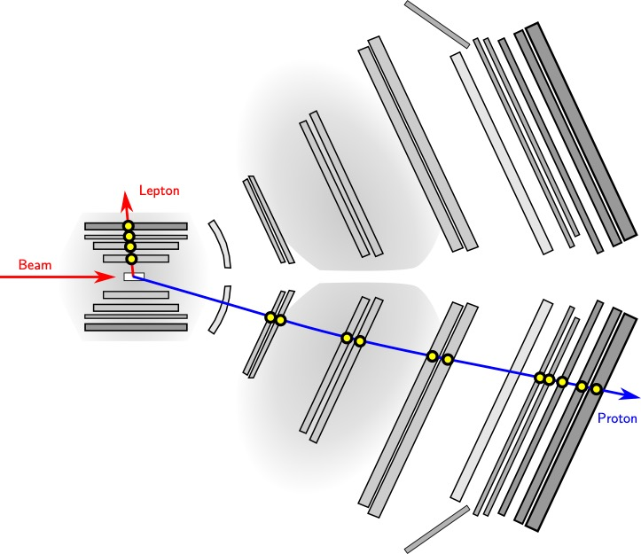
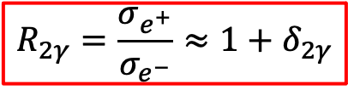
Two photon exchange
E. Voutier
TPE @ CLAS12
J.C. Bernauer, V. Burkert, A. Schmidt et al.
J.C. Bernauer, V. Burkert, E. Cline, A. Schmidt, Y. Sharabian, EPJ A 57 (2021) 144
Using the CLAS12 spectrometer, an unprecedented (Q²,ε) phase space can be covered, providing a conclusive answer about the relevance of 2γ-effects.
$$R_{2γ}=\frac{σ_{e^{+}}}{σ_{e^{−}}}≈1+δ_{2γ}$$
CLAS12 provides a big improvement over previous experiments.
Previous measurements lacked the kinematic reach to draw meaningful conclusions.
6/30
May 15th- 21st, 2023

Slide 9


Two photon exchange
E. Voutier
Expected Sensitivity
Over a run of 55 days, alternating e⁻ and e⁺ at 2.2-4.4-6.6 GeV and an intensity of 50 nA, the TPE@CLAS12 experiment will map-out two-photon exchange effects.
The CLAS12 trigger will be modified to allow lepton detection in the Central Detector and proton detection in the Forward Detector.
Courtesy of Axel Schmidt (GWU)
$Q^{2}$-dependence
$ε$-dependence
7/30
May 15th- 21st, 2023

Slide 10
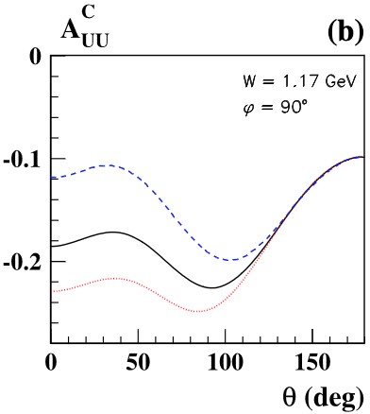
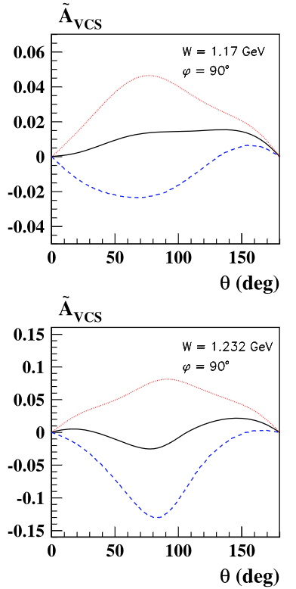
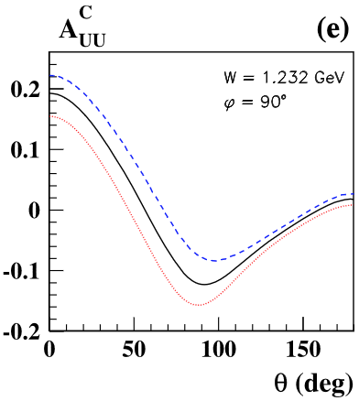
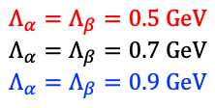
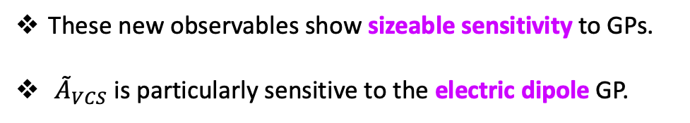
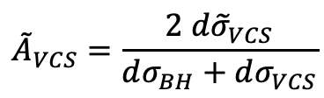
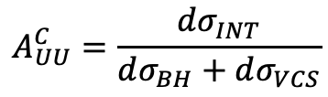
Virtual Compton scattering
E. Voutier
Experimental Observables
B. Pasquini, M. Vanderhaegen, EPJ A 57 (2021) 316
$$Λ_{α}=Λ_{β}=0.5 GeV$$
$$Λ_{α}=Λ_{β}=0.7 GeV$$
$$Λ_{α}=Λ_{β}=0.9 GeV$$
The comparison of unpolarized/polarized electrons and positrons provides an independent path to access Generalized Polarizabilities (GPs).
Q² = 0.65 GeV²
Q² = 0.65 GeV²
$${dσ}_{P}^{e}={dσ}_{BH}+{dσ}_{VCS}+Pd{\tilde{σ}}_{VCS}+e \left[{dσ}_{INT}{+ Pd\tilde{σ}}_{INT}\right]$$
$$A_{UU}^{C}=\frac{dσ_{INT}}{dσ_{BH}+dσ_{VCS}}$$
$${\tilde{A}}_{VCS}=\frac{2 d{\tilde{σ}}_{VCS}}{dσ_{BH}+dσ_{VCS}}$$
Q² = 0.65 GeV²
Q² = 0.65 GeV²
These new observables show sizeable sensitivity to GPs.
${\tilde{A}}_{VCS}$ is particularly sensitive to the electric dipole GP.
8/30
May 15th- 21st, 2023

Slide 11
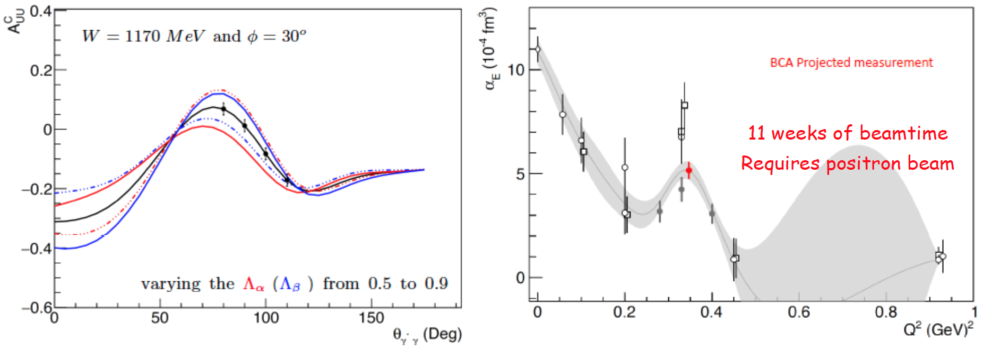
Virtual Compton scattering
E. Voutier
LoI12-23-###
N. Sparveris et al.
A new experimental project to measure unpolarized BCA in the VCS channel has been evaluated.
Courtesy of Nikos Sparveris (TU)
1 week of electron beam at 50 μA.
10 weeks of positron beam at 5 μA.
9/30
May 15th- 21st, 2023

Slide 12
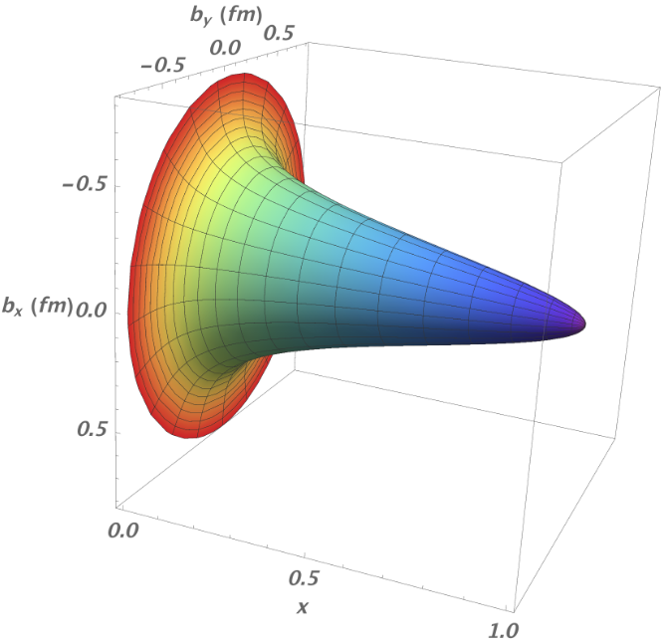
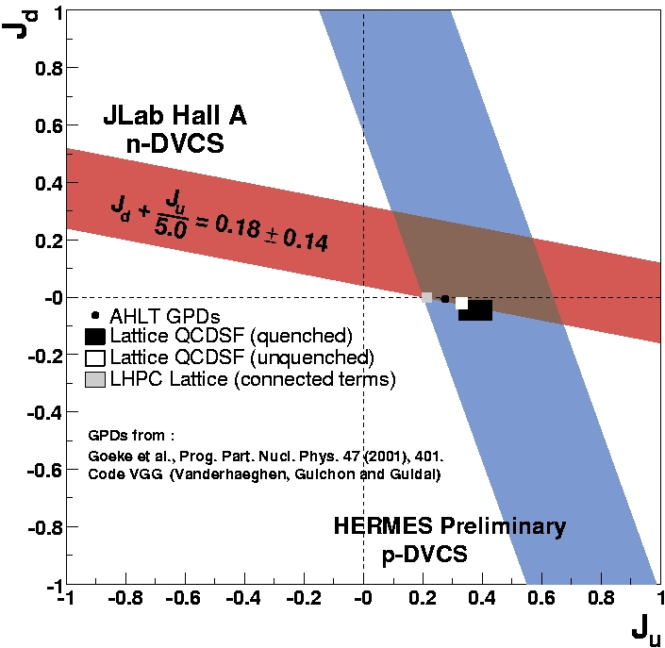
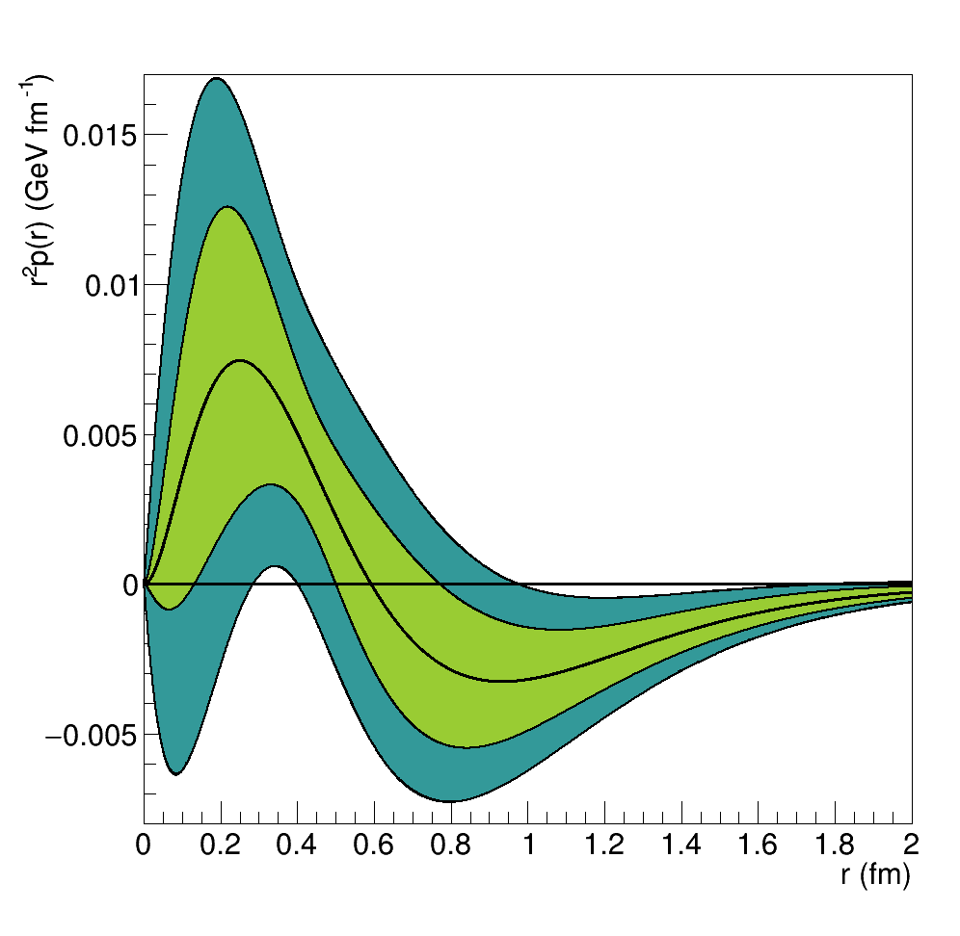
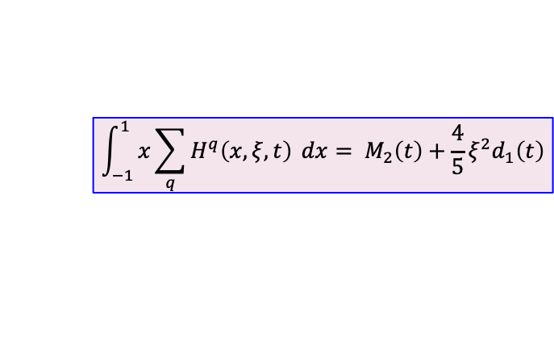
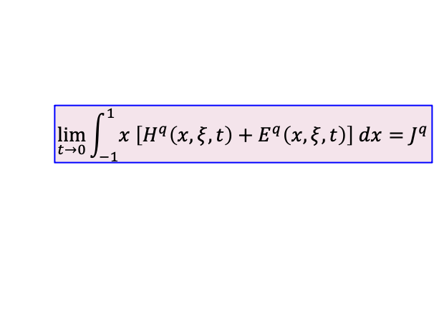
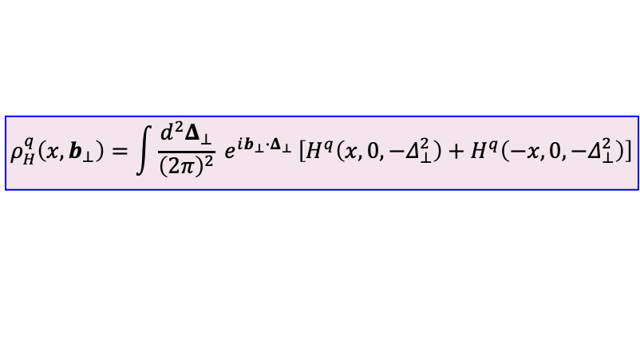
Nucleon tomography
E. Voutier
X. Ji, PRL 78 (1997) 610 M. Polyakov, PLB 555 (2003) 57 M.V. Polyakov, P. Schweitzer, IJMP A 33 (2018) 1830025
Generalized Parton Distributions (GPDs) encode the correlations between partons and contain information about the internal dynamics of hadrons which express in properties like the angular momentum or the distribution of the forces experienced by quarks and gluons inside hadrons.
$$ρ_{H}^{q}\left(x,b_{⊥}\right)=\int{\frac{d^{2}Δ_{⊥}}{{\left(2π\right)}^{2}}} e^{ib_{⊥}{∙Δ}_{⊥} }\left[H^{q}\left(x,0,−Δ_{⊥}^{2}\right)+H^{q}\left(−x,0,−Δ_{⊥}^{2}\right)\right]$$
d
$$\lim_{t→0}{\int_{−1}^{1}{x \left[H^{q}\left(x,ξ,t\right)+E^{q}\left(x,ξ,t\right)\right] dx}}=J^{q}$$
$$\int_{−1}^{1}{x\sum_{q}{H^{q}\left(x,ξ,t\right)} dx}= M_{2}\left(t\right)+\frac{4}{5}ξ^{2}d_{1}\left(t\right)$$
A.W. Thomas, PRL 101 (2008) 102003
Unpolarized e⁺ combined with unpolarized e⁻ access the real part of the Compton Form Factors.
Polarized e⁺ combined with polarized e⁻ access the imaginary part of the Compton Form Factors (CFFs) and higher twist effects.
u
M. Mazouz et. al. PRL 9 (2007) 242501 A. Airapetian et al. JHEP 06 (2008) 066 R. Dupré, M. Guidal, M. Vanderhaeghen, PRD 95 (2017) 011501 V. Burkert, L. Elouadrhiri, F.-X. Girod, Nat. 557 (2018) 396
10/30
May 15th- 21st, 2023

Slide 13
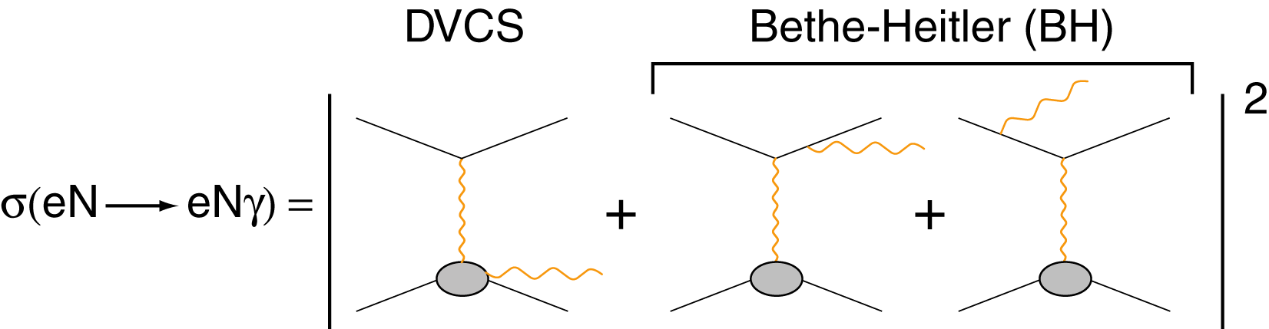
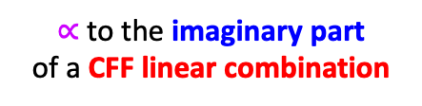
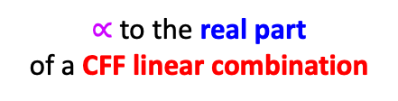


Nucleon tomography
E. Voutier
Deeply Virtual Compton Scattering
M. Diehl at the CLAS12 European Workshop, Genova, February 25-28, 2009
CFF = Compton Form Factors
$∝$ to the real part
of a CFF linear combination
$∝$ to the imaginary part
of a CFF linear combination
$${d^{5}σ}_{P0}^{e}={d^{5}σ}_{BH}+{d^{5}σ}_{DVCS}+P{ d}^{5}{\tilde{σ}}_{DVCS}−e \left[{d^{5}σ}_{INT}{+ P{ d}^{5}\tilde{σ}}_{INT}\right]$$
$∝$ to the real part
of a CFF bilinear combination
$∝$ to the imaginary part
of a CFF bilinear combination
$${d^{5}σ}_{PS}^{e}={d^{5}σ}_{P0}^{e}+S \left[{{P d}^{5}∆σ}_{BH}+\left({{Pd}^{5}∆σ}_{DVCS}+{ d}^{5}∆{\tilde{σ}}_{DVCS}\right)−e\left(P{d^{5}∆σ}_{INT}{+{ d}^{5}∆\tilde{σ}}_{INT}\right) \right]$$
Polarized electrons and positrons allow to separate the
unknown amplitudes of the cross section for electro-production of photons.
11/30
May 15th- 21st, 2023

Slide 14
Nucleon tomography
E. Voutier
Deeply Virtual Compton Scattering
M. Diehl at the CLAS12 European Workshop, Genova, February 25-28, 2009
CFF = Compton Form Factors
$∝$ to the real part
of a CFF linear combination
$∝$ to the imaginary part
of a CFF linear combination
$${d^{5}σ}_{P0}^{e}={d^{5}σ}_{BH}+{d^{5}σ}_{DVCS}+P{ d}^{5}{\tilde{σ}}_{DVCS}−e \left[{d^{5}σ}_{INT}{+ P{ d}^{5}\tilde{σ}}_{INT}\right]$$
$∝$ to the real part
of a CFF bilinear combination
$∝$ to the imaginary part
of a CFF bilinear combination
$${d^{5}σ}_{PS}^{e}={d^{5}σ}_{P0}^{e}+S \left[{{P d}^{5}∆σ}_{BH}+\left({{Pd}^{5}∆σ}_{DVCS}+{ d}^{5}∆{\tilde{σ}}_{DVCS}\right)−e\left(P{d^{5}∆σ}_{INT}{+{ d}^{5}∆\tilde{σ}}_{INT}\right) \right]$$
Polarized electrons and positrons allow to separate the
unknown amplitudes of the cross section for electro-production of photons.
11/30
May 15th- 21st, 2023

Slide 15
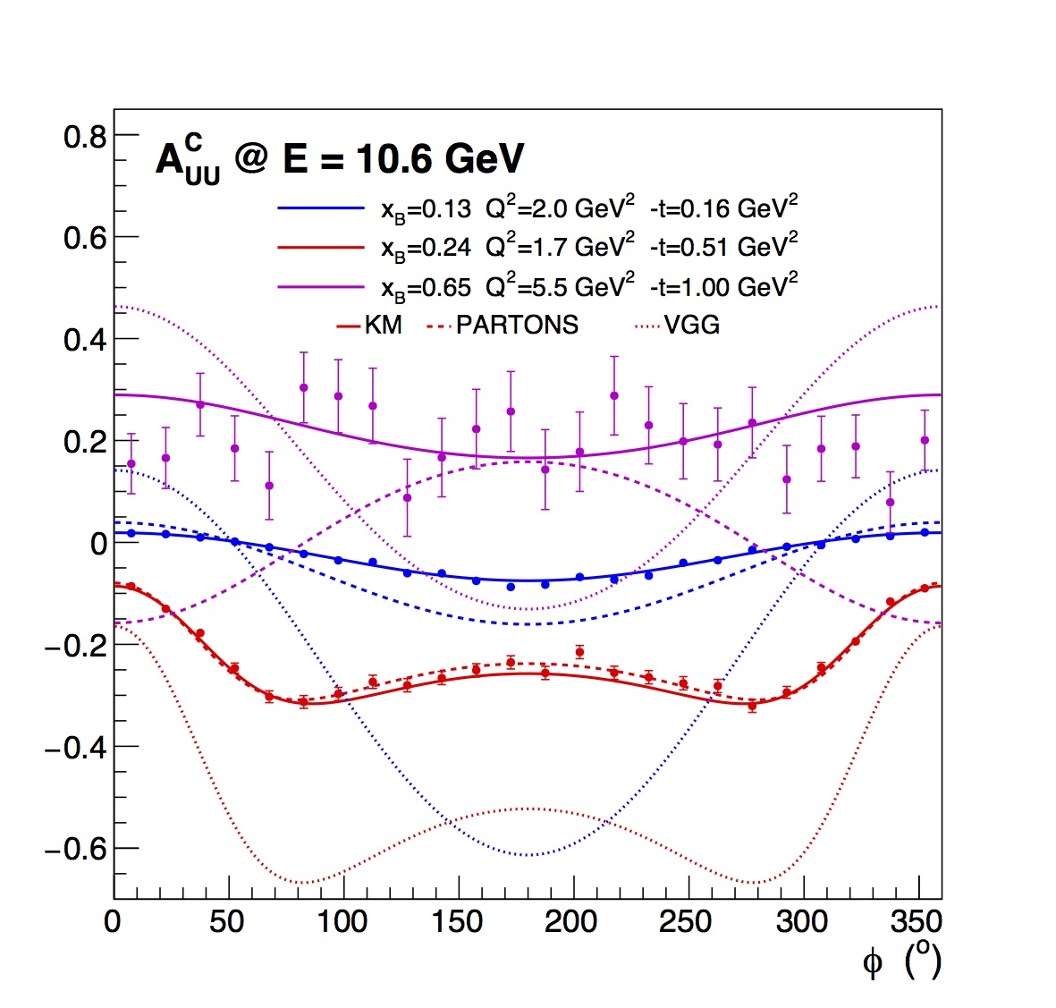
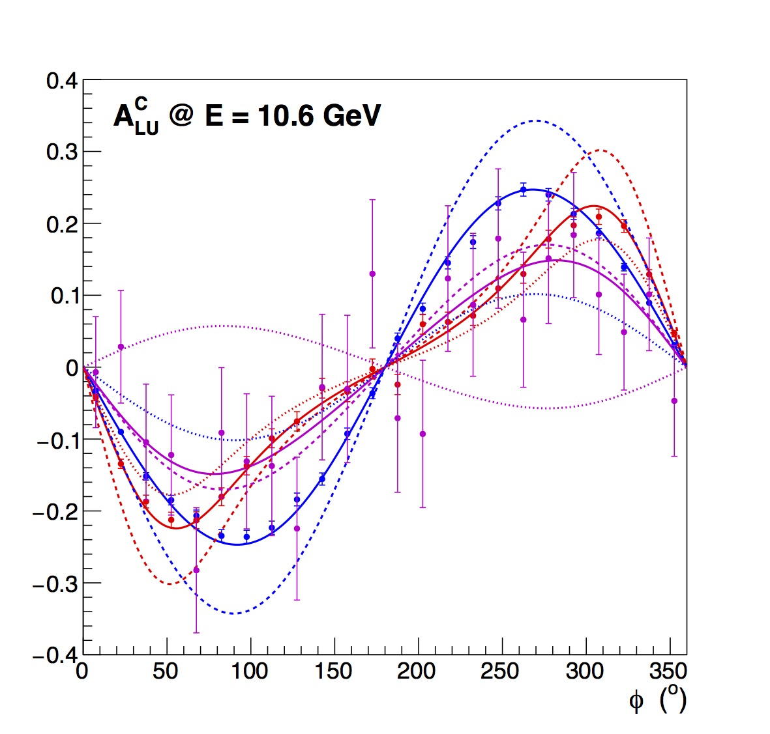


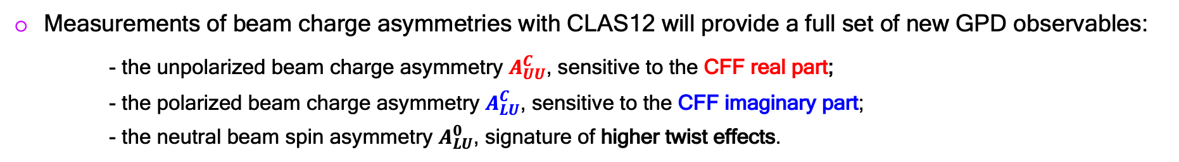
Nucleon tomography
E. Voutier
PR12-20-009
V. Burkert, L. Elouadrhiri, F.-X. Girod, S. Niccolai, E. Voutier et al.
V. Burkert et al. EPJ A 57 (2021) 186
Measurements of beam charge asymmetries with CLAS12 will provide a full set of new GPD observables:
- the unpolarized beam charge asymmetry $A_{UU}^{C}$, sensitive to the CFF real part;
- the polarized beam charge asymmetry $A_{LU}^{C}$, sensitive to the CFF imaginary part;
- the neutral beam spin asymmetry $A_{LU}^{0}$, signature of higher twist effects.
$$A_{UU}^{C}=\frac{d^{5}σ_{INT}}{{d^{5}σ}_{BH}+{d^{5}σ}_{DVCS}}$$
$$A_{LU}^{C}=\frac{d^{5}{\tilde{σ}}_{INT}}{{d^{5}σ}_{BH}+{d^{5} σ}_{DVCS}}$$
Projected data
12/30
May 15th- 21st, 2023

Slide 16
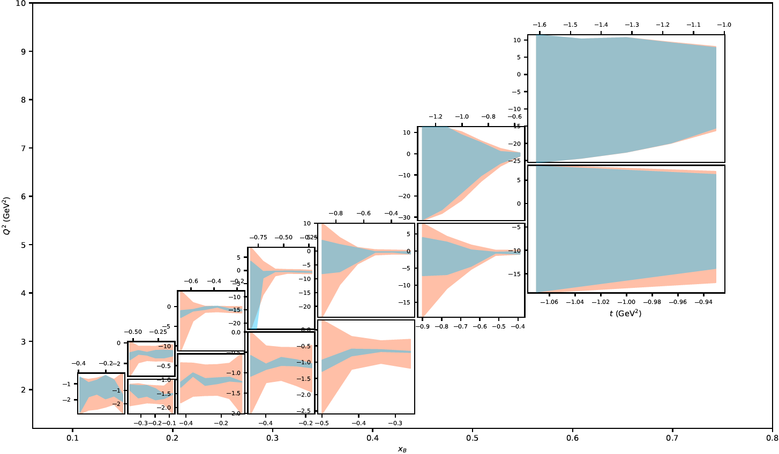
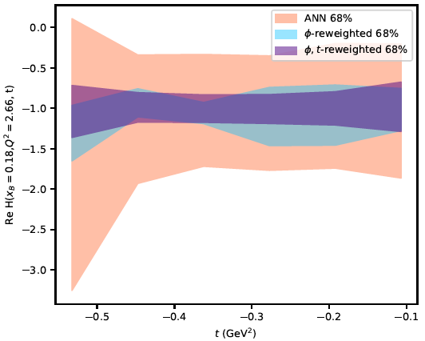
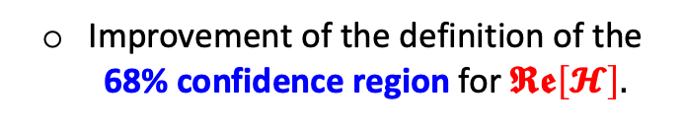

Nucleon tomography
E. Voutier
Impact of e⁺ data
H. Dutrieux, V. Bertone, H. Moutarde, P. Sznajder, EPJ A 57 (2021) 300
The existing DVCS world data set is analyzed within a global fit based on an Artificial Neural Network procedure within PARTONS to extract CFFs.
The impact of projected CLAS12 BCA data on the proton is evaluated from a Bayesian reweighting analysis of CFFs.
Improvement of the definition of the 68% confidence region for $𝕽𝖊\left[𝓗\right].$
$$𝕽𝖊\left[𝓗\right]$$
13/30
May 15th- 21st, 2023

Slide 17
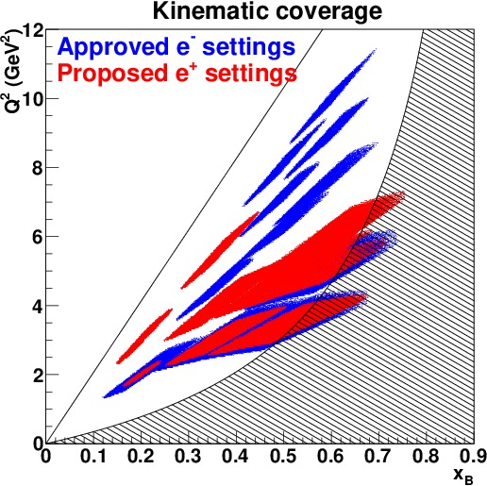
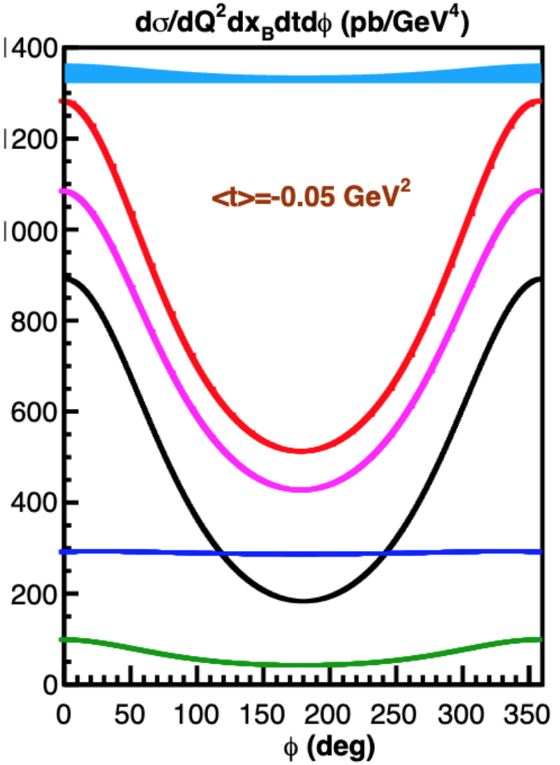
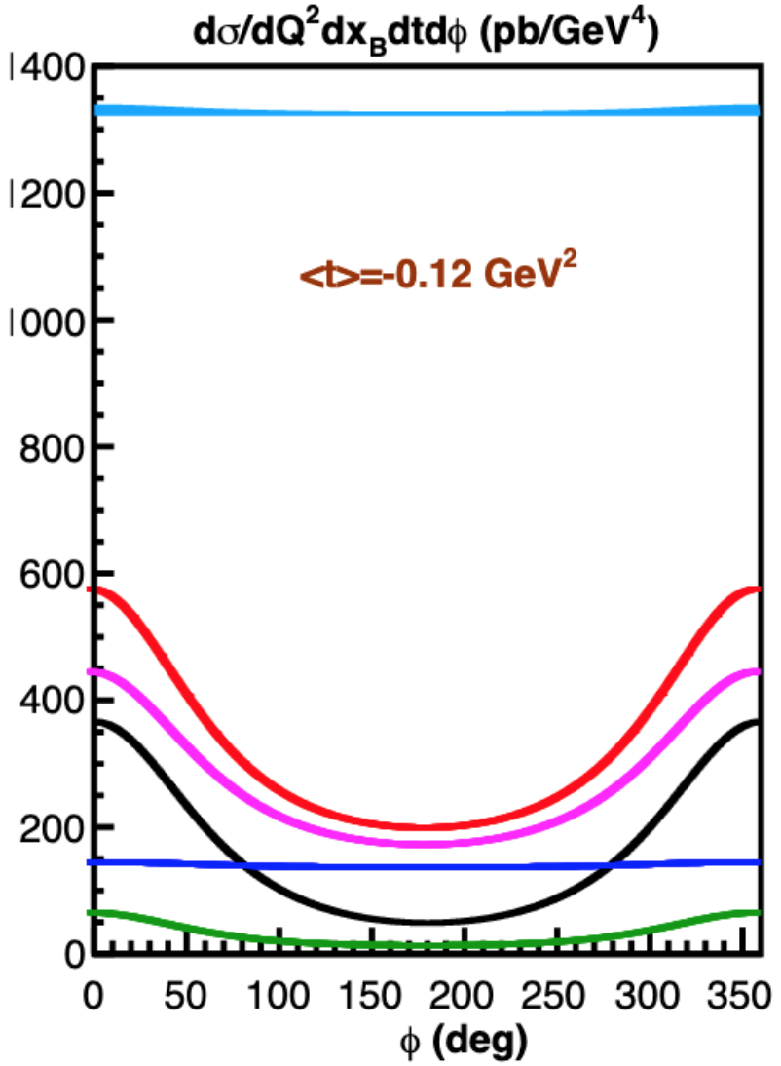
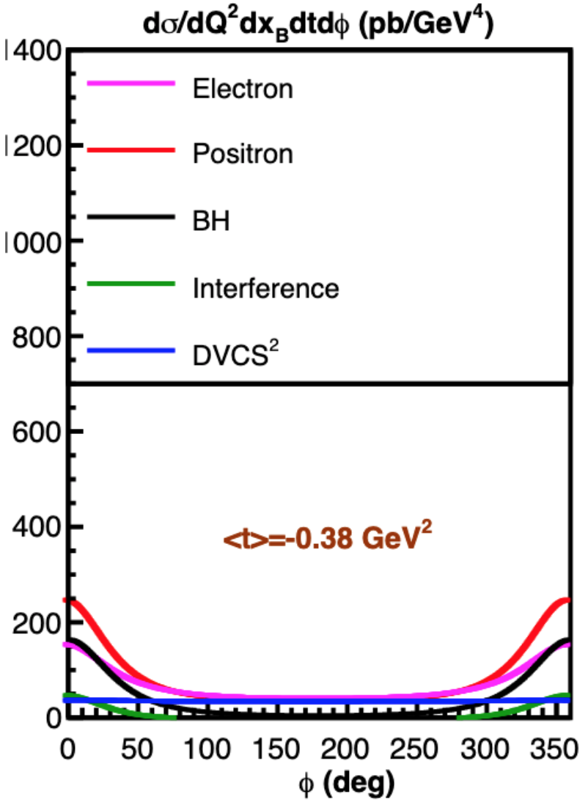
Nucleon tomography
E. Voutier
PR12-20-012
J. Grames, M. Mazouz, C. Muñoz Camacho et al.
A. Afanasev et al. EPJ A 57 (2021) 300
Combining the HMS and the NPS spectrometers, precise cross section measurements with unpolarized positron beam will be performed at selected kinematics where electron beam data will soon be accumulated.
x_{B} = 0.5 Q² = 3.4 GeV²
14/30
May 15th- 21st, 2023

Slide 18
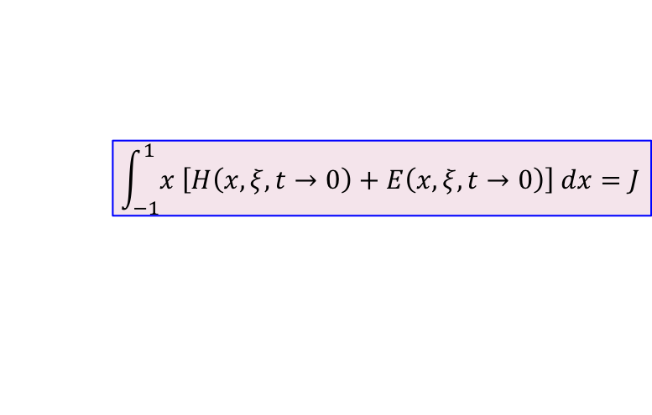

Nucleon tomography
E. Voutier
LoI12-18-004
Jefferson Lab Positron Working Group
S. Niccolai, P. Chatagnon, M. Hoballah, D. Marchand, C. Muñoz Camacho, E. Voutier, EPJ A 57 (2021) 226
Contrary to H, the GPD E flips the spin of the nucleon and is consequently not constrained by Deep Inelastic Scattering data.
X. Ji, PRL 78 (1997) 610
e⁺ and e⁻ beams
$$\int_{−1}^{1}{x \left[H\left(x,ξ,t→0\right)+E\left(x,ξ,t→0\right)\right] dx}=J$$
e⁻ beam only
$$A_{UU}^{C}∝\frac{1}{F_{2}}ℜ𝔢\left[ξ{\tilde{H}}_{n}−\frac{t}{4M^{2}}E_{n}\right]$$
The BCA on the neutron accesses the real part of the CFF E, and is sensitive to H at some kinematics.
~
15/30
May 15th- 21st, 2023

Slide 19
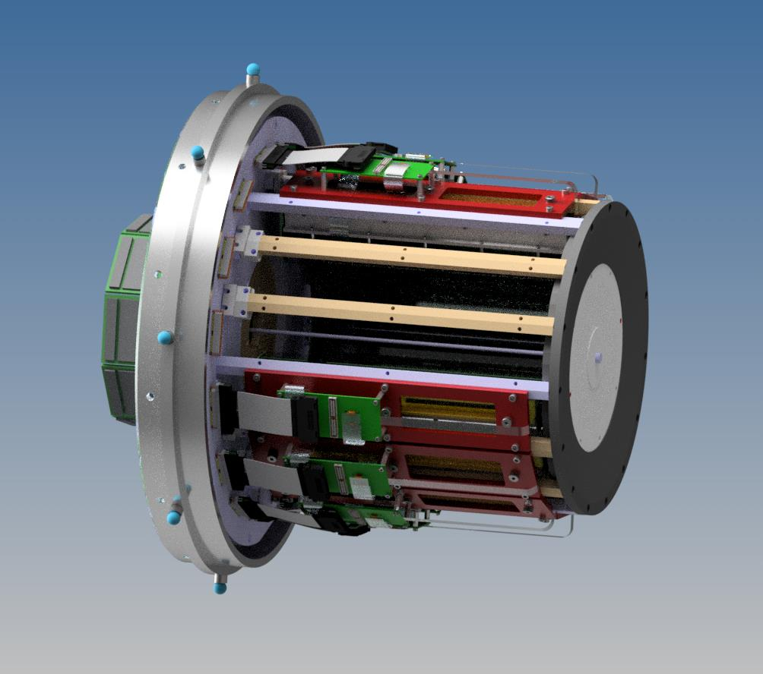
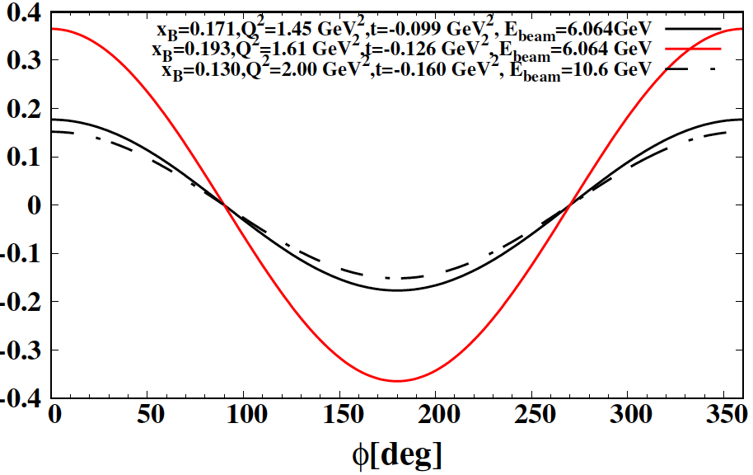
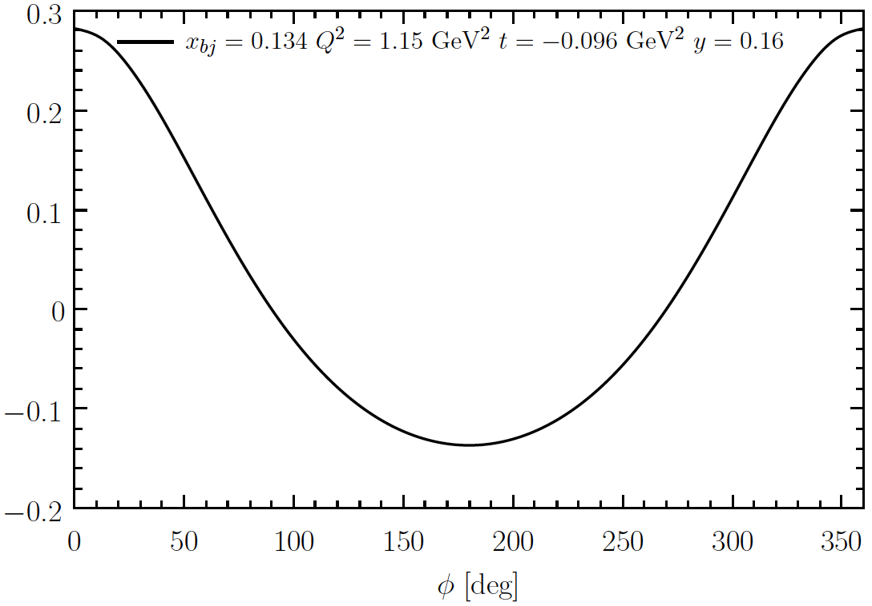
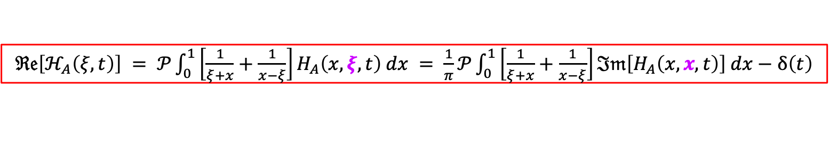
Nucleon tomography
E. Voutier
Coherent He-DVCS
M. Rinaldi, S. Scopetta, PRC 85 (2012) 062201; PRC 87 (2013) 035208
S. Fucini, M. Hattawy, M. Rinaldi, S. Scopetta, EPJ A 57 (2021) 273
The association of the ALERT recoil detector and the CLAS12 spectrometer together with high-energy electron and positron beams offer a new tool for the investigation of the nuclear force.
$ℜ𝔢\left[ℋ_{A}\left(ξ,t\right)\right] = 𝒫\int_{0}^{1}{\left[\frac{1}{ξ+x}+\frac{1}{x−ξ}\right]H_{A}\left(x,ξ,t\right) dx} = \frac{1}{π}𝒫\int_{0}^{1}{\left[\frac{1}{ξ+x}+\frac{1}{x−ξ}\right]ℑ𝔪\left[H_{A}\left(x,x,t\right)\right] dx}−δ\left(t\right)$
Courtesy of Raphaël Dupré (IJCLab)
Unpolarized Beam Charge Asymmetry
⁴He
³He
Nuclear imaging
Sensitivity to neutron GPDs
16/30
May 15th- 21st, 2023

Slide 20
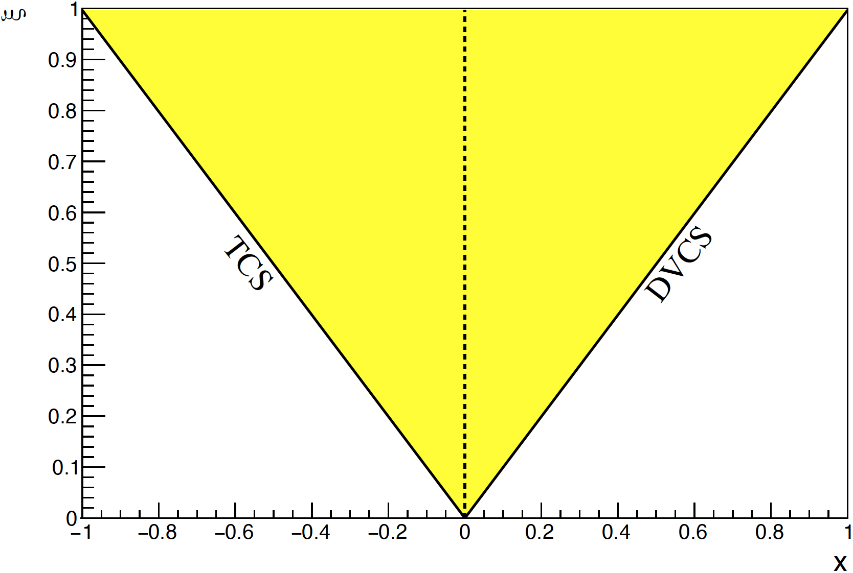
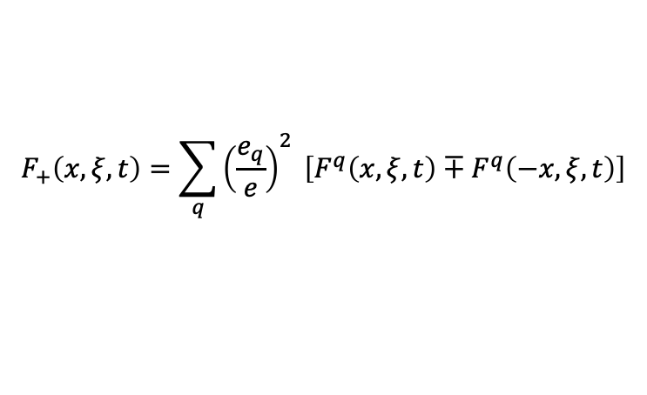
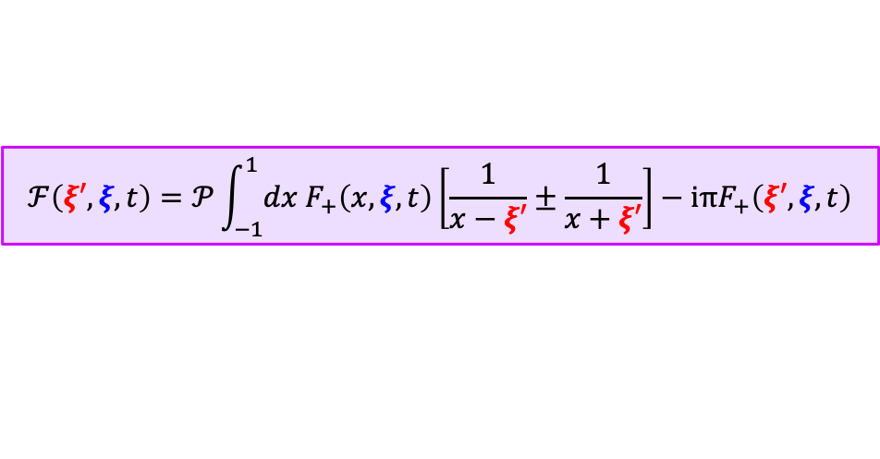
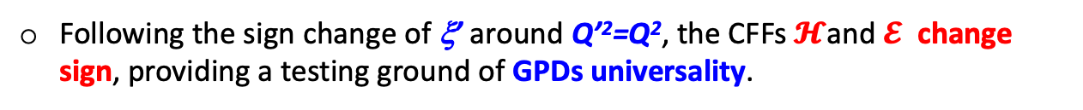
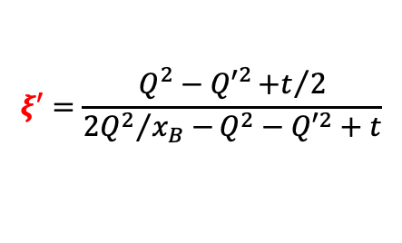
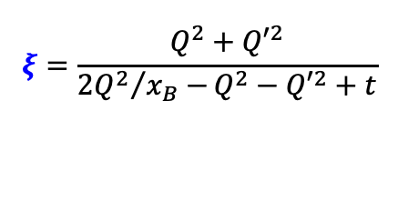
Nucleon tomography
E. Voutier
Double Deeply Virtual Compton Scattering
M. Guidal, M. Vanderhaeghen, PRL 90 (2003) 012001
A.V. Belitsky, D. Müller PRL 90 (2003) 022001; PRD 68 (2003) 116005
Because of the virtuality of the final photon, DDVCS allows a direct access to GPDs at $x≠±ξ,$which is of importance for their modeling and for the investigation of nuclear dynamics.
$$ℱ\left(ξ′,ξ,t\right)=𝒫\int_{−1}^{1}{dx F_{+}\left(x,ξ,t\right)}\left[\frac{1}{x−ξ′}±\frac{1}{x+ξ′}\right]−iπF_{+}\left(ξ′,ξ,t\right)$$
$$F_{+}\left(x,ξ,t\right)=\sum_{q}{{\left(\frac{e_{q}}{e}\right)}^{2} \left[F^{q}\left(x,ξ,t\right)∓F^{q}\left(−x,ξ,t\right)\right]}$$
$$ξ′=\frac{Q^{2}−{Q′}^{2}{+t}/2}{{2Q^{2}}/{x_{B}−}Q^{2}−{Q′}^{2}+t}$$
$$ξ=\frac{Q^{2}+{Q′}^{2}}{{2Q^{2}}/{x_{B}−}Q^{2}−{Q′}^{2}+t}$$
Following the sign change of ξ’ around Q’²=Q², the CFFs $𝓗$and $𝓔$ change sign, providing a testing ground of GPDs universality.
17/30
May 15th- 21st, 2023

Slide 21
Nucleon tomography
E. Voutier
LoI12-15-005
M. Boer, A. Camsonne, K. Gnanvo, E. Voutier, Z. Zhao et al.
S. Zhao et al. EPJ A 57 (2021) 240
The SoLID apparatus completed with muon detectors at large and forward angles, enables DDVCS measurements with both polarized electron and polarized positron beams.
L = 10³⁷cm⁻²⋅s⁻¹
The initial LoI discussed electron BSA measurements over a 50 days run parasitic to the J/Ψ approved experiment.
Completing this program with a 50 days positron beam run would provide unpolarized BCA data.
18/30
May 15th- 21st, 2023

Slide 22
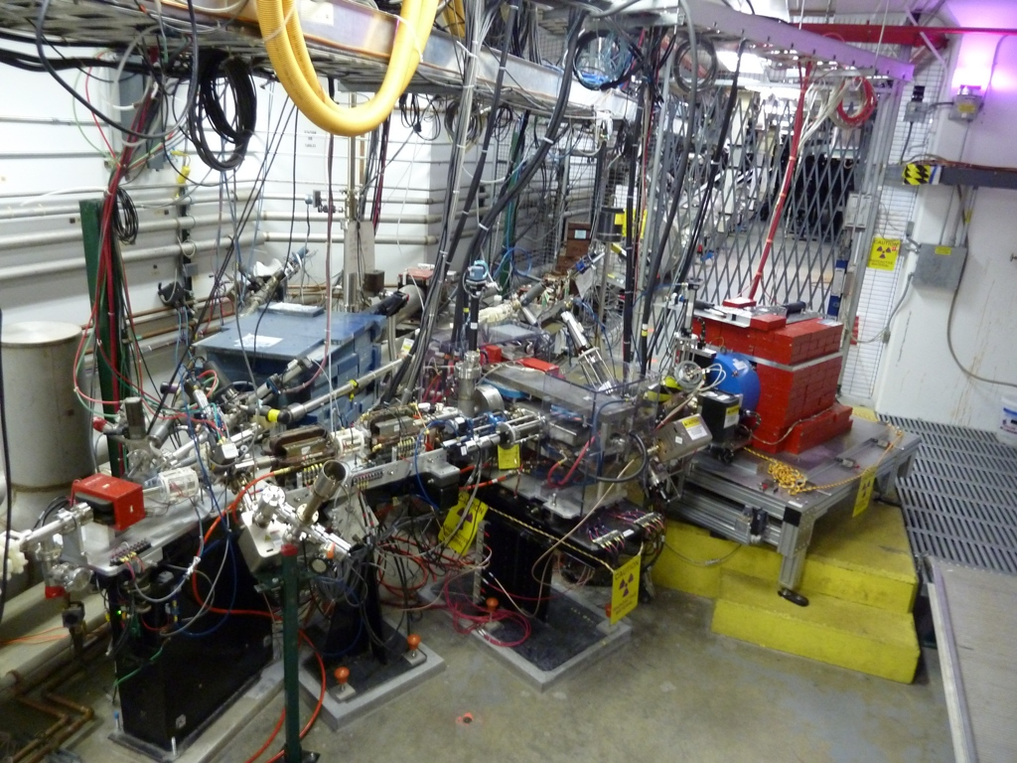
Towards e⁺ beams @ CEBAF
E. Voutier
The JLab positron source built on the PEPPo (Polarized Electrons for Polarized Positrons) experiment which demonstrated the feasibility of using bremsstrahlung radiation of MeV Polarized Electrons for producing Polarized Positrons.
p_{e} = 8.2 MeV/c P_{e} = 85% I_{e} = 1 µA t_{W} = 1 mm P < 10 W
(PEPPo Collaboration) D. Abbott et al. PRL 116 (2016) 214801
electron beam polarization
85.2 ± 0.6 ± 0.7 %
J. Grames, E. Voutier et al. JLab Experiment E12-11-105 (2011)
19/30
May 15th- 21st, 2023

Slide 23
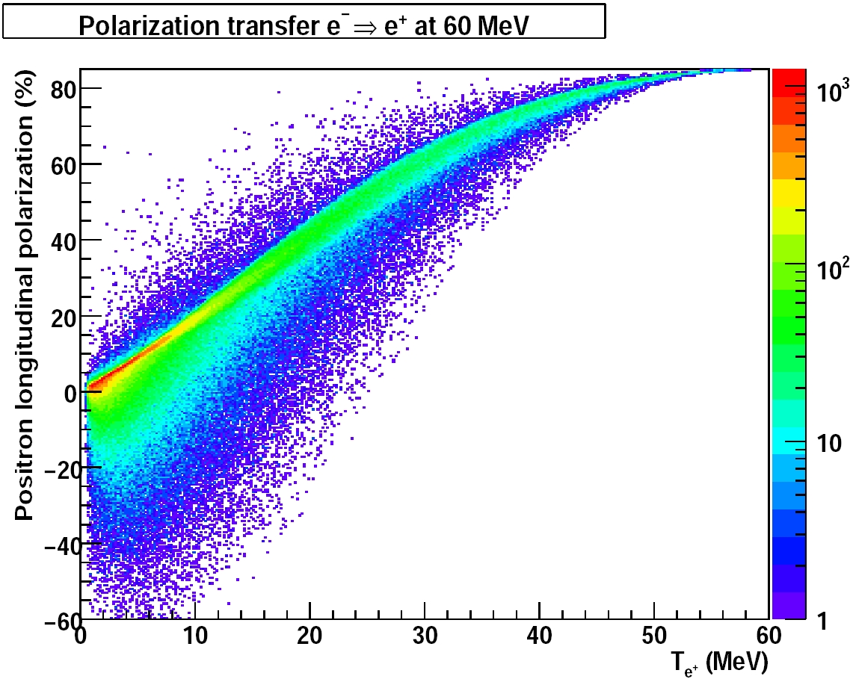
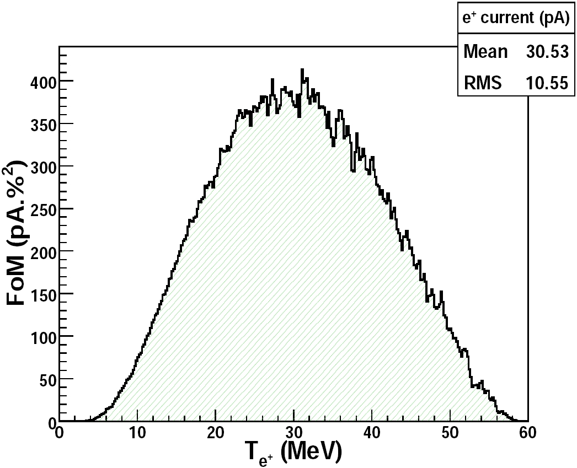
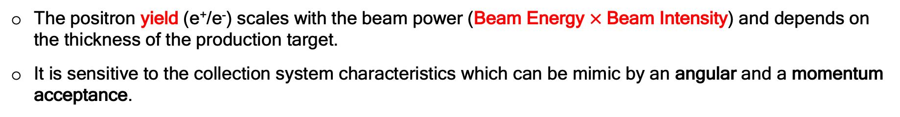
Towards e⁺ beams @ CEBAF
E. Voutier
The positron yield (e⁺/e⁻) scales with the beam power (Beam Energy $×$Beam Intensity) and depends on the thickness of the production target.
It is sensitive to the collection system characteristics which can be mimic by an angular and a momentum acceptance.
High P
Low I
- Selection of e⁺ momentum allows to operate the source from low to highly polarized modes.
Low P
High I
FoM=IP²
(Jefferson Lab Positron Working Group)
A. Accardi et al. EPJ A 57 (2021) 261
20/30
May 15th- 21st, 2023

Slide 24
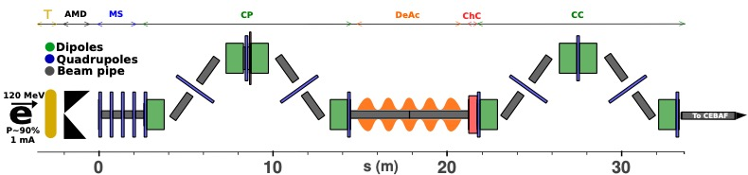
Towards e⁺ beams @ CEBAF
E. Voutier
The design of the JLab positron source evolved towards the today’s concept :
P = 120 kW
beam power
Momentum Selection
Chicane
Beam Compression
Chicane
Nominal
I_{e+} > 50 nA @ P_{e+} = 60%
I_{e+} > 1 µA @ P_{e+} = 0%
Positron Production
Target
High duty cycle, intensity, and polarization distinguish JLab positron beam from any past or existing others.
21/30
June 27th- July 1st, 2022
May 15th- 21st, 2023

Slide 25




Towards e⁺ beams @ CEBAF
E. Voutier
A FODO lattice combined with a matching section at the entrance ensure the smallest beam size and the largest momentum dispersion at the middle of the chicane where an efficient momentum collimation is achieved.
A cavity at the entrance of a magnetic chicane creates a correlation betwen the momentum dispersion and the bunch length.
The chicane is designed to feature the appropriate R₅₆ to optimally compress the bunch length (Δz).
κ = 3.81 m⁻¹
C = 23.3
R₅₆ = -0.25 m
p₀ = 60 MeV/c
Work of Sami Habet (IJCLab/JLab) and of Yves Roblin (JLab)
22/30
May 15th- 21st, 2023

Slide 26

Towards e⁺ beams @ CEBAF
E. Voutier
1/6 segment of the e⁺ target
The electron beam deposits a power of 17 kW in the 4mm W target.
The water channel with turbulent water flows at a speed of 2 m/s and a 22°C inlet temperature.
The beam spot RMS size is 1.5 mm.
The rotation speed of the target is 2 m/s.
The tungsten target will operate at an average temperature of 500°C with a peak temperature at 680°C at each rotation cycle.
What are the radiation hardness and the fatigue limits of the target material at operational conditions ?
Irradiation measurements at MAMI
Fatigue measurements at JLab
Work of Andriy Ushakov (IJCLab/JLab)
23/30
May 15th- 21st, 2023

Slide 27


Towards e⁺ beams @ CEBAF
E. Voutier
1/6 segment of the e⁺ target
The electron beam deposits a power of 17 kW in the 4mm W target.
The water channel with turbulent water flows at a speed of 2 m/s and a 22°C inlet temperature.
The beam spot RMS size is 1.5 mm.
The rotation speed of the target is 2 m/s.
The tungsten target will operate at an average temperature of 500°C with a peak temperature at 680°C at each rotation cycle.
What are the radiation hardness and the fatigue limits of the target material at operational conditions ?
MAMI - 3.5 MeV
Irradiation measurements at MAMI
Fatigue measurements at JLab
Work of Andriy Ushakov (IJCLab/JLab)
23/30
May 15th- 21st, 2023

Slide 28
Towards e⁺ beams @ CEBAF
E. Voutier
Other challenges to address :
  Reduction of beam emittance and momentum dispersion at the source;
  Polarized electron gun capable of 1 mA currents with a life time > 1 kC;
  High field (up to 2.5 T) DC solenoid in high X-ray environment;
  High energy spin rotators;
  Polarity reversal of CEBAF magnets;
  Transport of e⁺ beams to and into CEBAF;
  e⁺ beam diagnostics and polarimetry.
A pre-CDR document is due for the end of the calendar year 2023.
24/30
May 15th- 21st, 2023

Slide 29

Positron injector concept
E. Voutier
Jefferson Lab as today: high CW beam intensity, high polarization, multi-hall delivery… a powerful and worldwide unique experimental facility!
e⁻ beam injection at 123 MeV
25/30
May 15th- 21st, 2023

Slide 30
Positron injector concept
E. Voutier
Jefferson Lab as today: high CW beam intensity, high polarization, multi-hall delivery… a powerful and worldwide unique experimental facility!
e⁻ beam injection at 123 MeV
25/30
May 15th- 21st, 2023

Slide 31
Positron injector concept
E. Voutier
Taking advantage of the existing infrastructure (electric and cryogenic power supplies, shielding… ), the new positron injector would be installed at the LERF.
26/30
May 15th- 21st, 2023

Slide 32


Positron injector concept
E. Voutier
A new tunnel would transport the positron beams from the LERF to CEBAF.
The connection would occur in the arc region dealing, among others with different beam elevations at the LERF and CEBAF.
Work of Joel Dobeck (JLab)
27/30
May 15th- 21st, 2023

Slide 33
Positron injector concept
E. Voutier
A new beam transport line attached to the ceiling of the existing tunnels will guide the 123 MeV positron beam till the injection point of the entrance of the North LinAc.
Work of Denis Turner and Yves Roblin (JLab)
28/30
May 15th- 21st, 2023

Slide 34




Positron injector concept
E. Voutier
Ce⁺BAF Working Group
J. Benesch, A. Bogacz, L. Cardman, J. Conway, S. Covrig, J. Grames, J. Gubeli,
C. Gulliford, S. Habet, C. Hernandez-Garcia, D. Higinbotham, A. Hofler, R. Kazimi,
V. Kostroun, F. Lin, V. Lizarraga-Rubio, M. Poelker, Y. Roblin, A. Seryi, K. Smolenski, M. Spata, R. Suleiman, A. Sy, D. Turner, A. Ushakov, C. Valerio, E. Voutier, S. Zhang, Y. Zhang
29/30
May 15th- 21st, 2023

Slide 35
Summary
E. Voutier
A rich and high impact experimental program asking for intense CW polarized and unpolarized positron beams at JLab has been elaborated, accounting for about 5 calendar years of CEBAF running.
Such beams would be a worldwide « première ».
An R&D and construction plan is under progress, which goal is the production at the LERF of positron beams suitable for CEBAF acceleration within the 5 coming years.
Subscribe to the JLab Positron Working Group mailing list pwg@jlab.org
This project has received funding from the European Union’s Horizon 2020 research and innovation program under grant agreement Nº 824093.
30/30
May 15th- 21st, 2023

Slide 36
Summary
E. Voutier
A rich and high impact experimental program asking for intense CW polarized and unpolarized positron beams at JLab has been elaborated, accounting for about 5 calendar years of CEBAF running.
Such beams would be a worldwide « première ».
An R&D and construction plan is under progress, which goal is the production at the LERF of positron beams suitable for CEBAF acceleration within the 5 coming years.
It is now time to submit the experimental program to the evaluation of the JLab PAC.
Consider submitting proposals not only for high energy experiments at CEBAF, but also for low beam energies to be available at LERF an early stage of the project.
Subscribe to the JLab Positron Working Group mailing list pwg@jlab.org
This project has received funding from the European Union’s Horizon 2020 research and innovation program under grant agreement Nº 824093.
30/30
May 15th- 21st, 2023

Slide 37

Summary
E. Voutier
A rich and high impact experimental program asking for intense CW polarized and unpolarized positron beams at JLab has been elaborated, accounting for about 5 calendar years of CEBAF running.
Such beams would be a worldwide « première ».
An R&D and construction plan is under progress, which goal is the production at the LERF of positron beams suitable for CEBAF acceleration within the 5 coming years.
It is now time to submit the experimental program to the evaluation of the JLab PAC.
Consider submitting proposals not only for high energy experiments at CEBAF, but also for low beam energies to be available at LERF an early stage of the project.
LERF
I_{e-} > 1 mA @ P_{e+} > 90%
I_{e+} > 50 nA @ P_{e+} = 60%
I_{e+} > 1 µA @ P_{e+} = 0%
$T_{e^{±}}≤120 MeV$
Ce⁺BAF
I_{e+} > 50 nA @ P_{e+} = 60%
I_{e+} > 1 µA @ P_{e+} = 0%
Subscribe to the JLab Positron Working Group mailing list pwg@jlab.org
This project has received funding from the European Union’s Horizon 2020 research and innovation program under grant agreement Nº 824093.
30/30
May 15th- 21st, 2023

