Slide 1



A Low Q² Measurement of the Proton's Spin Structure Functions & Hyperfine Splitting Polarizability Contributions
David Ruth
Low-Q Workshop 2023
5/17/2023

Slide 2
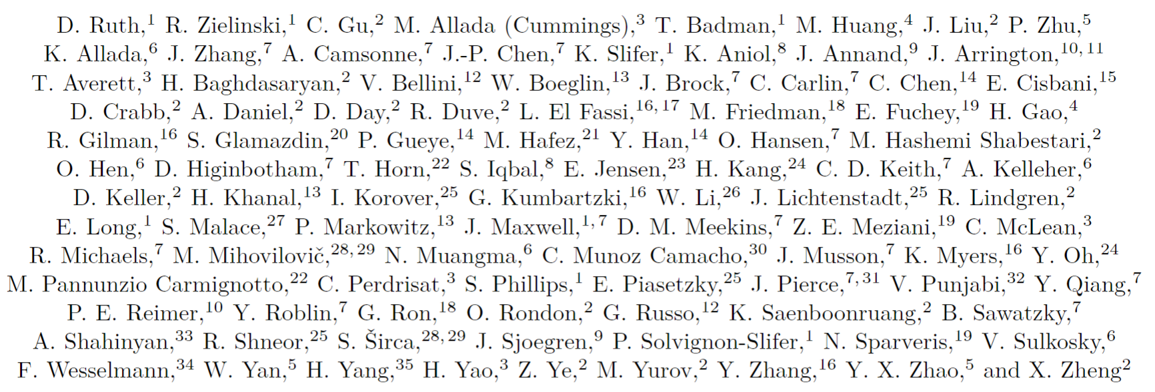
A big thanks to the whole g2p collaboration!

Slide 3
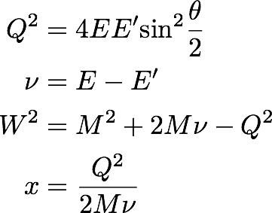
Electron-Proton Scattering Formulation
e⁻
E
E’
e⁻
Goal: study the proton’s spin structure and understand QCD in the regime where quark-gluon correlations are significant
Inclusive electron scattering measurement
γ
X
p

Slide 4
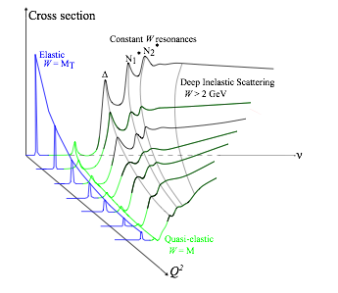
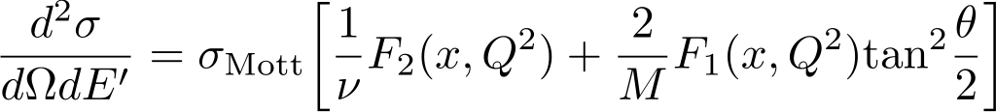
Cross section can be decomposed into Form Factors & Structure Functions
Elastic Scattering: target remains in ground state
Form factors G_{e} and G_{m} describe electric and magnetic distribution
Inelastic Scattering: target is excited by interaction
Structure functions F₁ and F₂ describe quark-gluon distribution
Inelastic Scattering with polarized beam & target:
  g₁ and g₂ describe spin distribution & quark-gluon correlations

Slide 5
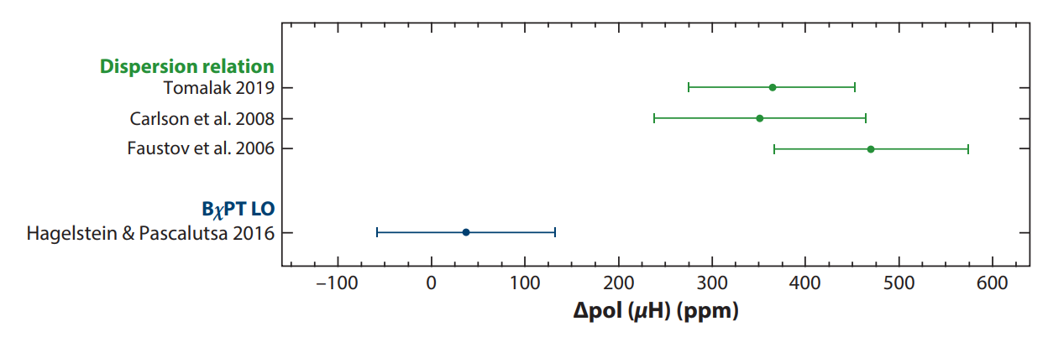

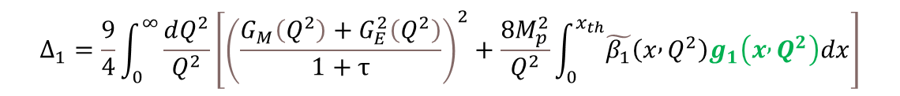
Proton Spin Structure contributes to Hyperfine Splitting of Hydrogen
See Carl Carlson’s previous talk…
Uncertainty in theoretical calculations of Hyperfine splitting is presently dominated by proton structure term
Requires experimental constraint from spin structure functions!
A. Antognini, F. Hagelstein, and V. Pascalutsa (2022)
$$E_{nS−hfs}^{2γ}=\frac{E_{F}}{n^{3}}\left(Δ_{Z}+Δ_{recoil}+Δ_{pol}\right)$$
$$Δ_{1}=\frac{9}{4}\int_{0}^{∞}{\frac{dQ^{2}}{Q^{2}}\left[{\left(\frac{G_{M}\left(Q^{2}\right)+G_{E}^{2}\left(Q^{2}\right)}{1+τ}\right)}^{2}+\frac{8M_{p}^{2}}{Q^{2}}\int_{0}^{x_{th}}{\tilde{β_{1}}\left(x , Q^{2}\right)g_{1}\left(x , Q^{2}\right)dx}\right]}$$
$$Δ_{2}=−24M_{p}^{2}\int_{0}^{∞}{\frac{dQ^{2}}{Q^{4}}}\int_{0}^{x_{th}}{\tilde{β_{2}}\left(x , Q^{2}\right)g_{2}\left(x , Q^{2}\right)dx}$$
$$Δ_{pol}=\frac{αm_{e}}{πg_{p}M_{p}}\left(Δ_{1}+Δ_{2}\right)$$

Slide 6
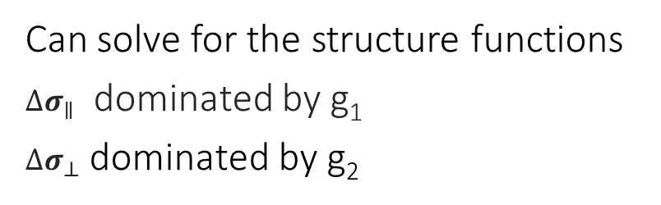


Extracting structure functions
$${∆σ}_{∥}$$
$${∆σ}_{⊥}$$
Can solve for the structure functions
${∆σ}_{∥}$ dominated by g₁
${∆σ}_{⊥}$ dominated by g₂

Slide 7
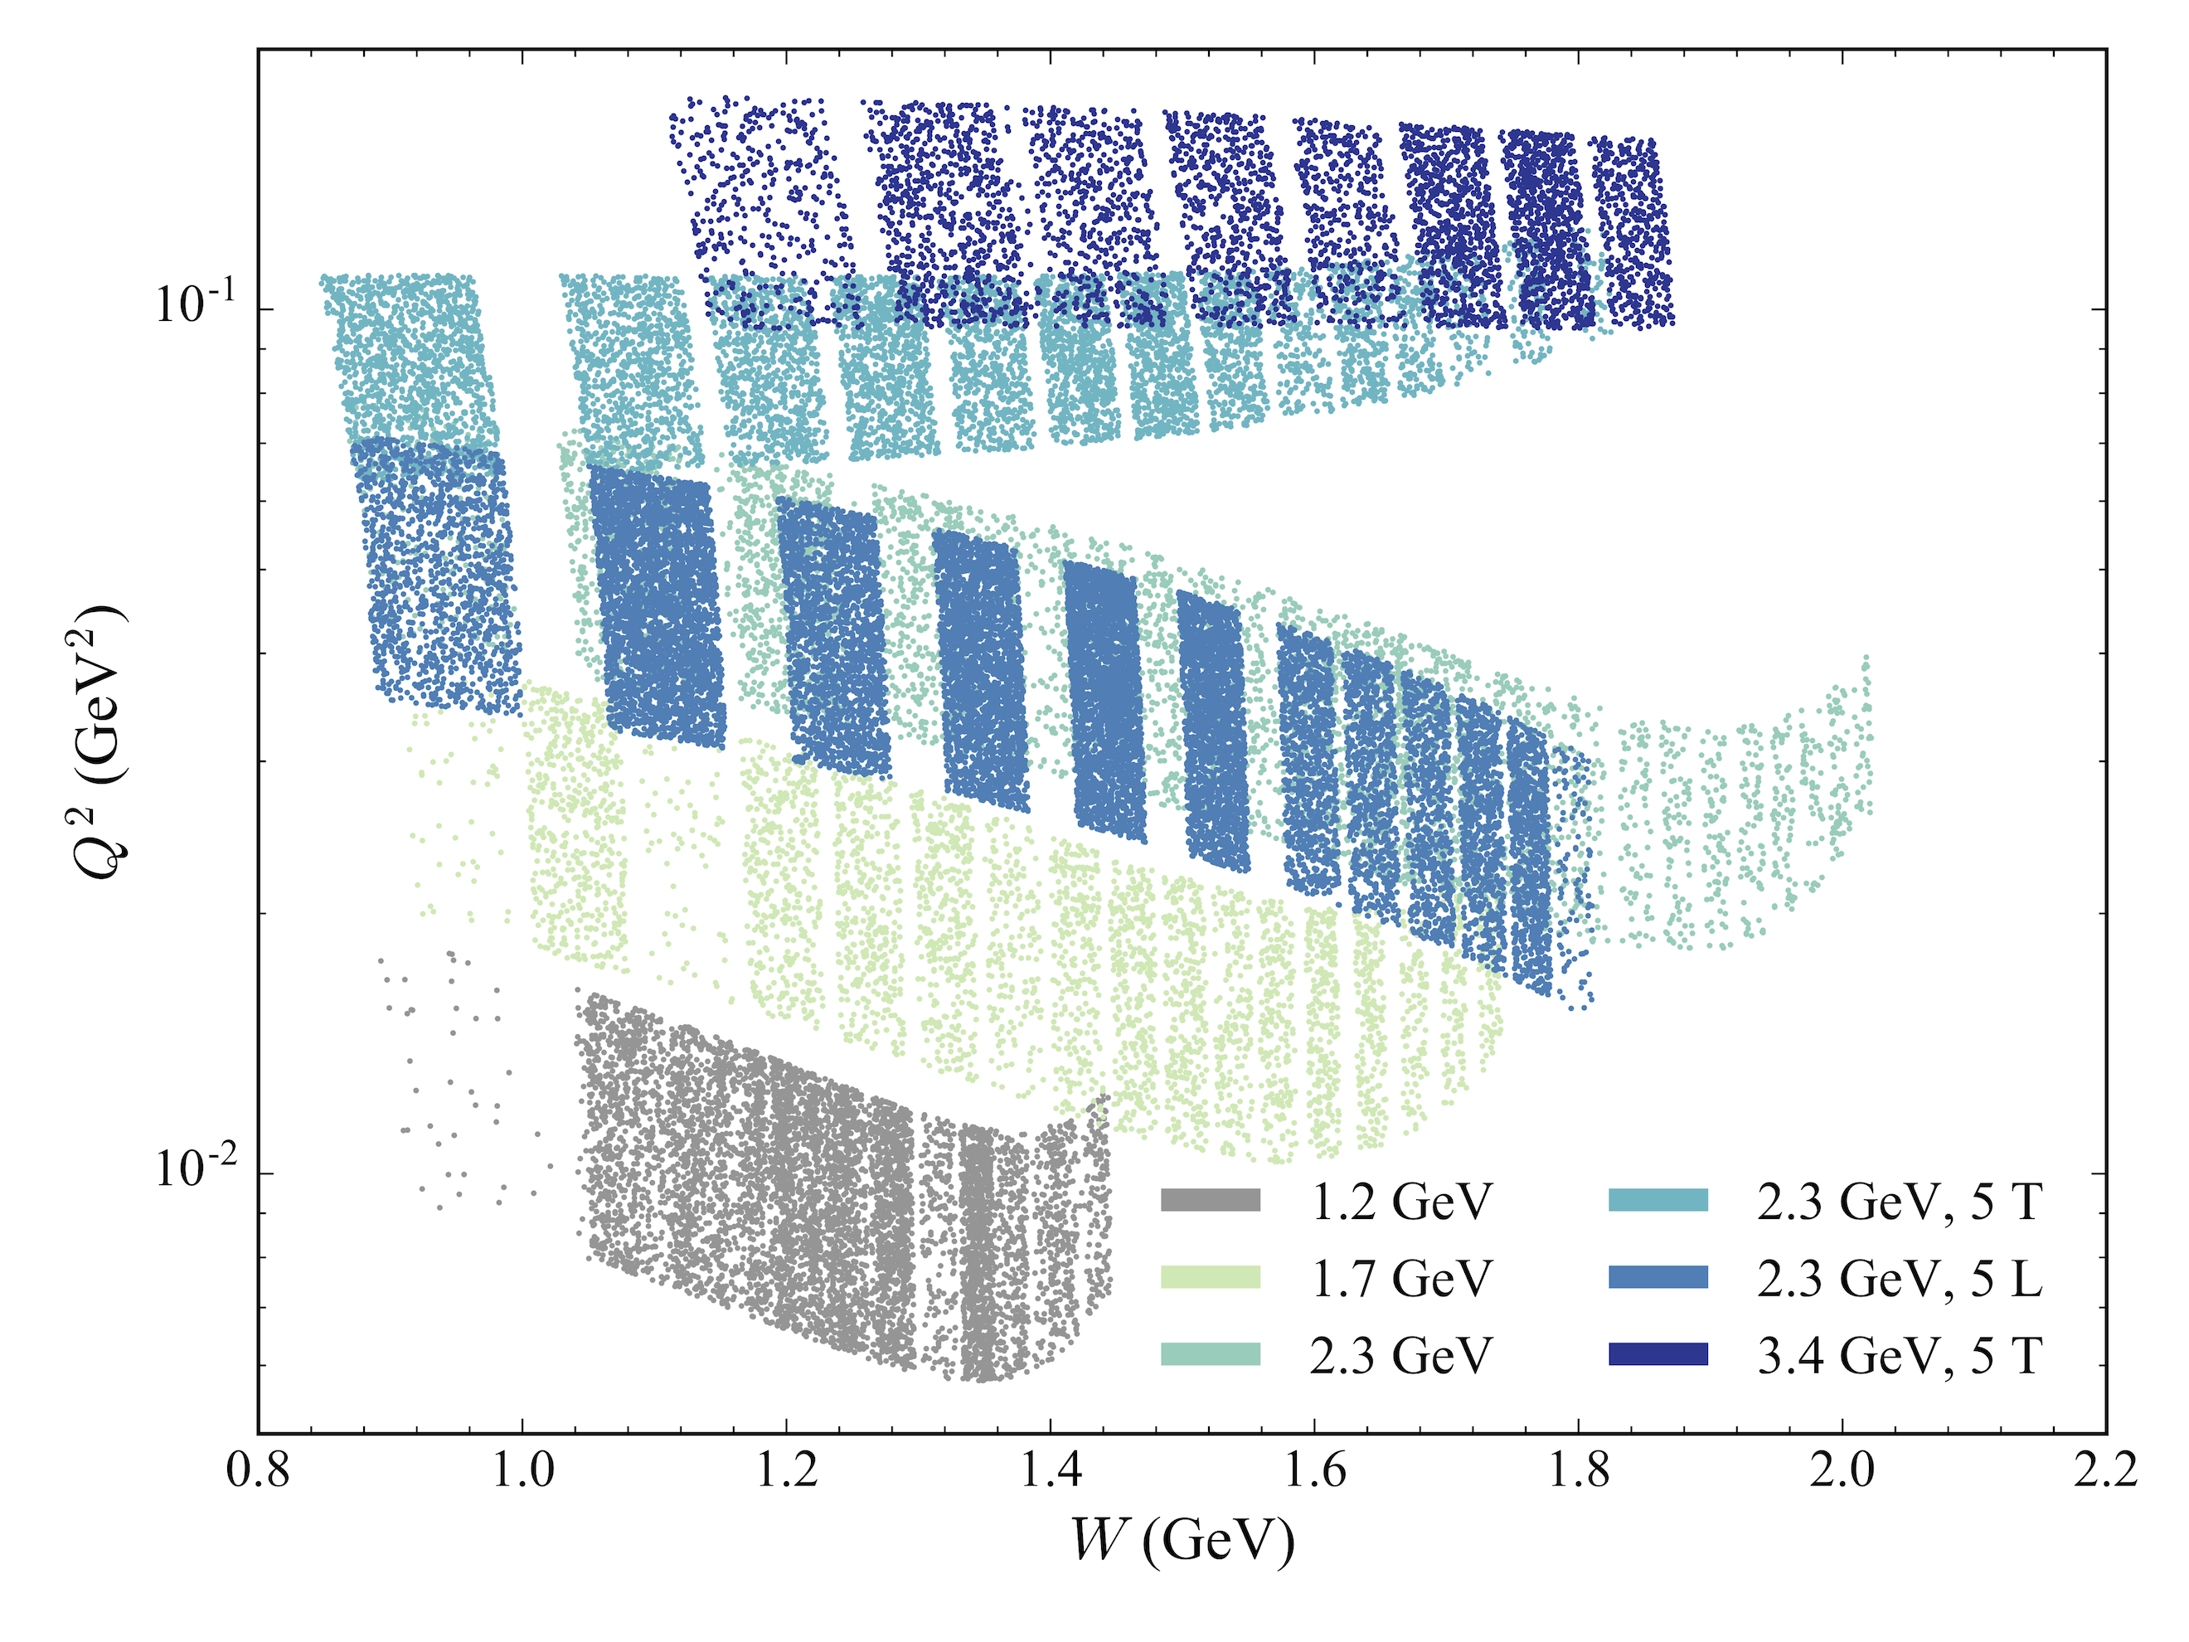
Kinematic Settings
5 Transverse settings and 1 Longitudinal setting
1.2 GeV setting only used for radiative corrections
2.2 GeV 5T Longitudinal & 2.2 GeV 2.5T Transverse fall at almost the same Q² and so can be used together

Slide 8
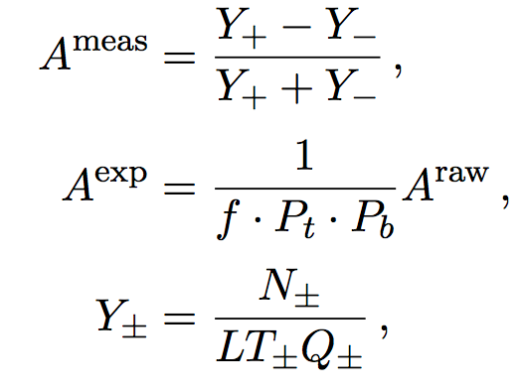



Forming polarized cross section differences
$${∆σ}_{∥} =2A_{∥}σ_{0}$$
$${∆σ}_{⊥} =2A_{⊥}σ_{0}$$
Form with an asymmetry and an unpolarized cross section
Lots of unpolarized world data for the proton, so the models are very good
Asymmetries are easy because they cancel many quantities:
$$A_{⊥} =\frac{σ^{↑⇒}−σ^{↓⇒}}{σ^{↑⇒}+σ^{↓⇒}}$$

Slide 9
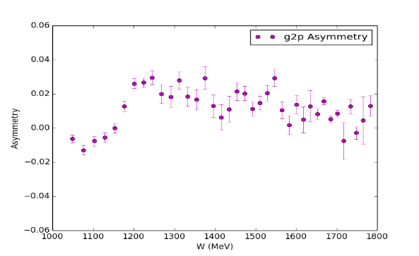
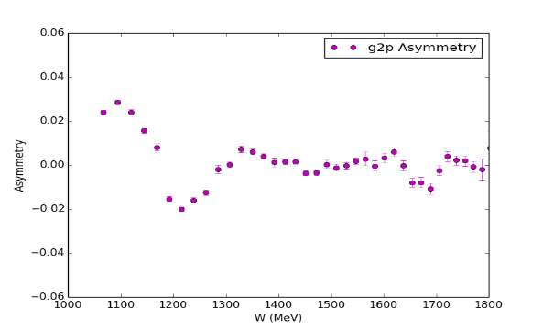
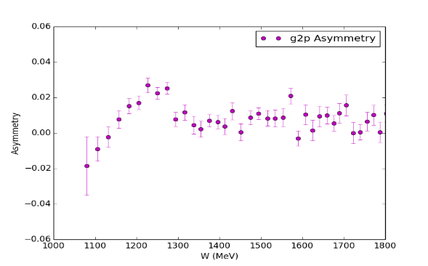
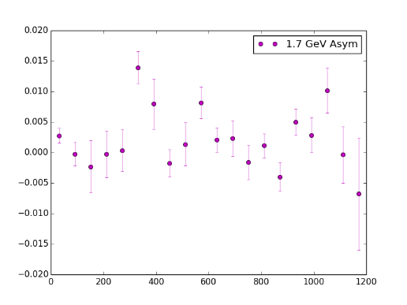
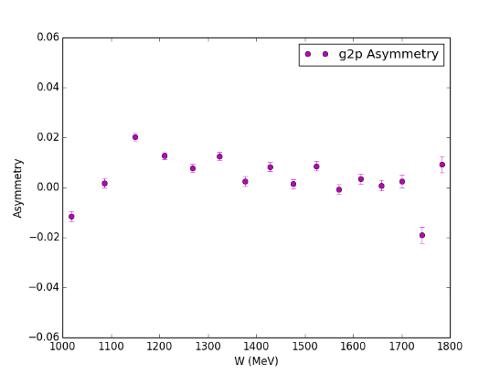
Asymmetry Results
2.2 GeV 5T Transverse
2.2 GeV 5T Parallel
3.3 GeV 5T Transverse
LHRS and RHRS combined for better statistics
2.2 GeV 2.5T Transverse
1.7 GeV 2.5T Transverse

Slide 10
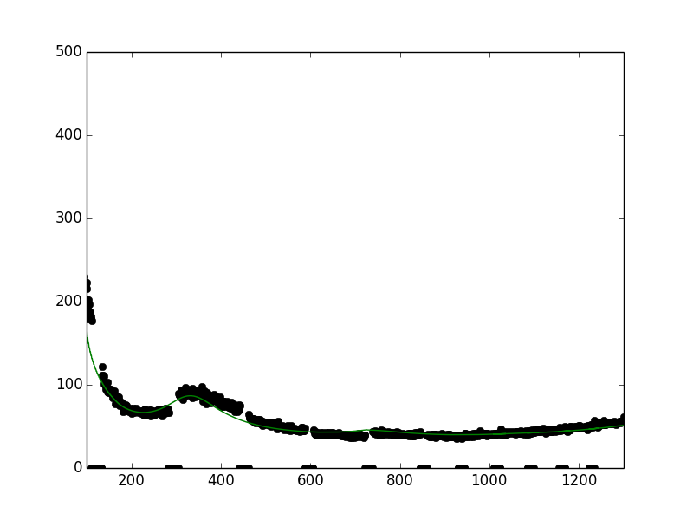

Unpolarized Cross Section
$$\frac{d2σ}{dΩdE′}=\frac{(ps)N}{N_{in}ρ(LT)ε_{det}}\frac{f}{ΔΩΔE′ΔZ}$$
Acceptance issues on the edge of transverse momentum settings made the unpolarized cross section extraction challenging, with large associated systematics
Instead, use a model unpolarized cross section
Bosted-Christy model used, shows good agreement with our longitudinal setting cross section in the resonance region
σ₀
ν (MeV)

Slide 11
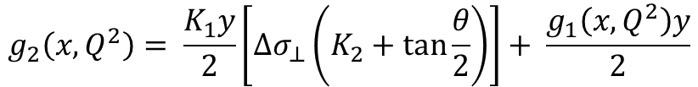
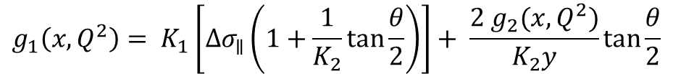
Extraction of Structure Functions
$$g_{1}\left(x,Q^{2}\right)= K_{1}\left[Δσ_{∥}\left(1+\frac{1}{K_{2}}\tan{\frac{θ}{2}}\right)\right]+ \frac{2 g_{2}(x,Q^{2})}{K_{2}y}\tan{\frac{θ}{2}}$$
Input from Hall B model
$$g_{2}\left(x,Q^{2}\right)= \frac{K_{1}y}{2}\left[Δσ_{⊥}\left(K_{2}+\tan{\frac{θ}{2}}\right)\right]+ \frac{g_{1}\left(x,Q^{2}\right)y}{2}$$
Combination of data & Bosted model
CLAS Hall B model used as g₁ input for most settings
For 0.045 GeV² setting, we have both polarized XS differences, so we can form g₁ and g₂ from data

Slide 12
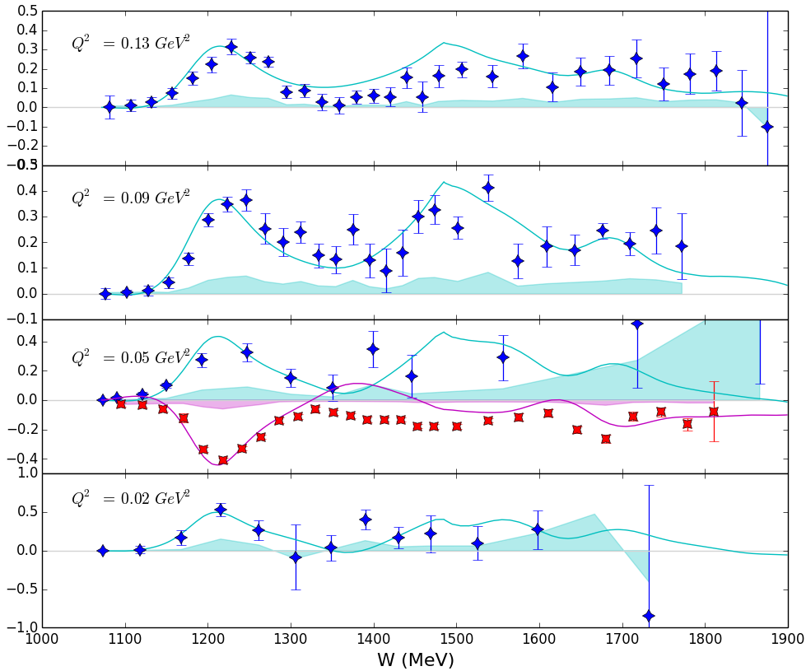
Structure Function Results
Blue stars: g₂
Red stars: g₁
g₁ data has very good statistics and goes very close to pion production threshold

Slide 13
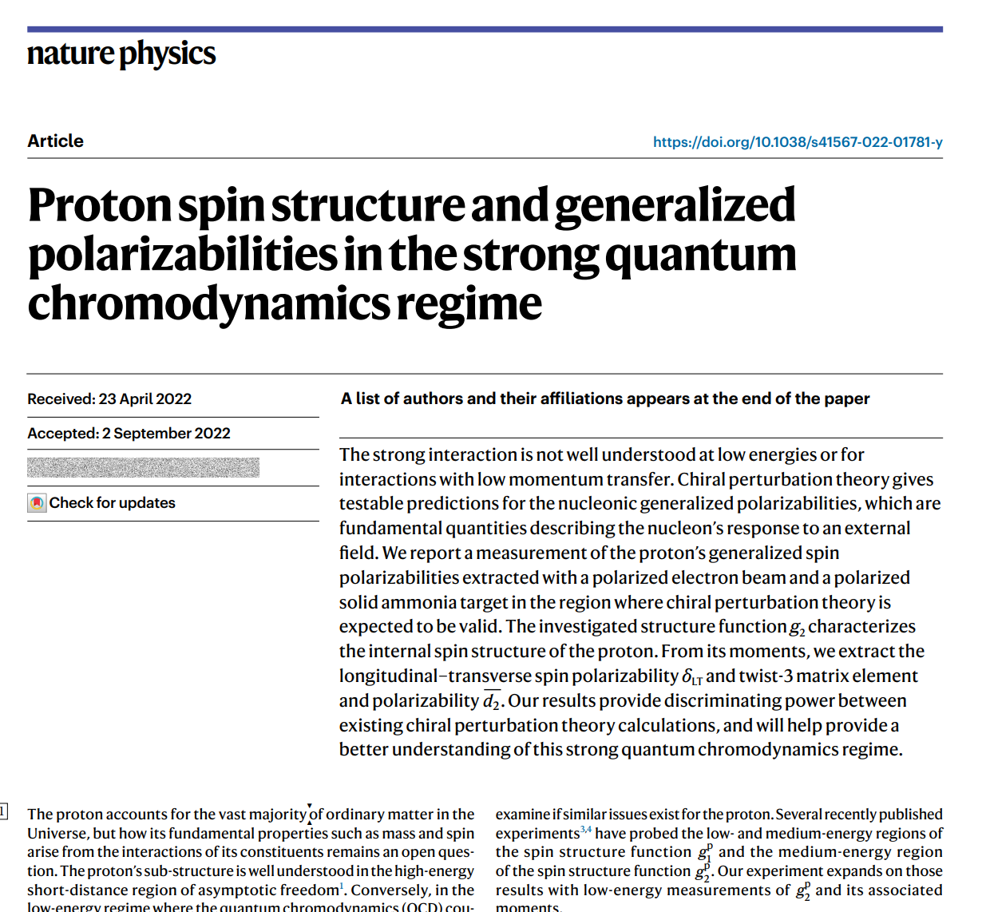
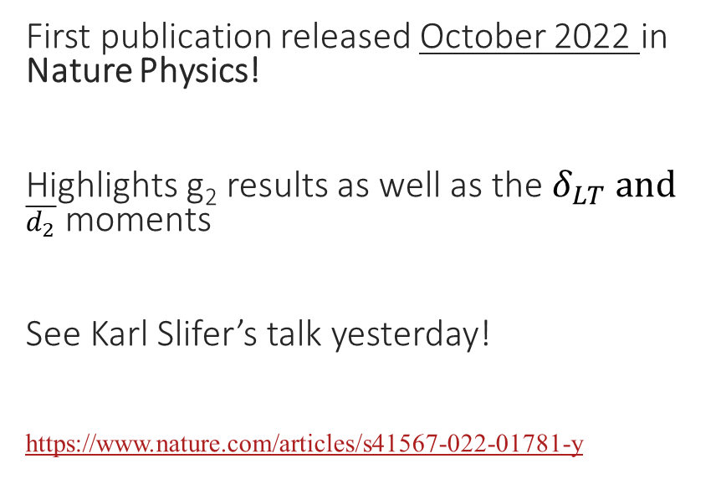
First publication released in October!
First publication released October 2022 in Nature Physics!
Highlights g₂ results as well as the $δ_{LT} and$ $\overline{d_{2}}$ moments
See Karl Slifer’s talk yesterday!
https://www.nature.com/articles/s41567-022-01781-y
Published!

Slide 14
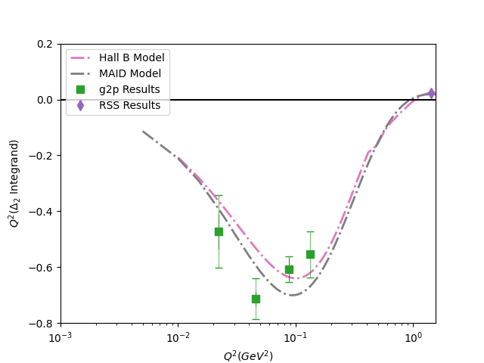
Δ₂ Results (Electronic Hydrogen)
RSS Data constructed from F. Wesselman, K. Slifer, S. Tajima et al (PRL 2007)
Preliminary
First ever experimental results for this quantity!
Q² both above and below g2p contributes strongly to Δ₂

Slide 15
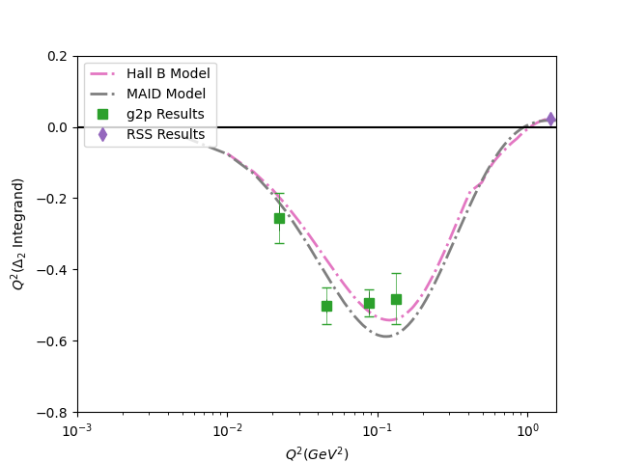
Δ₂ Results (Muonic Hydrogen)
RSS Data constructed from F. Wesselman, K. Slifer, S. Tajima et al (PRL 2007)
Preliminary
First ever experimental results for this quantity!
Q² both above and below g2p contributes strongly to Δ₂

Slide 16
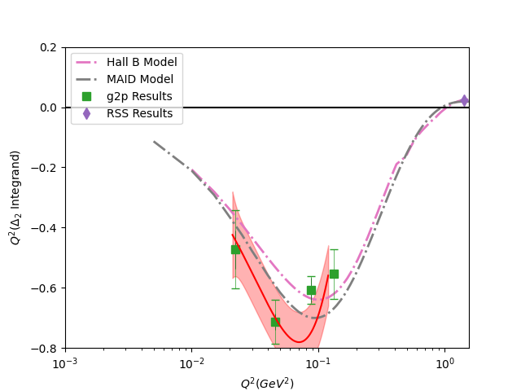
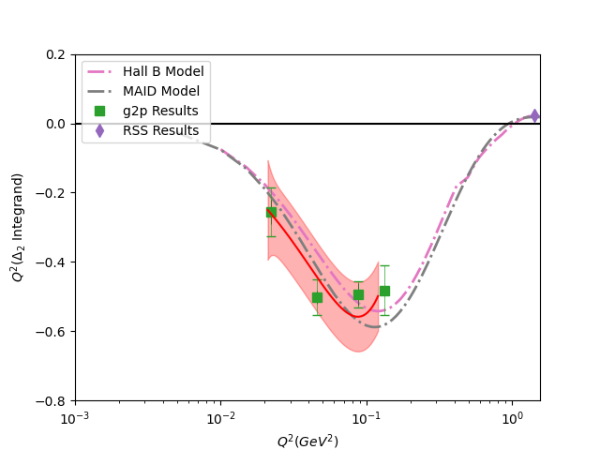
Δ₂ Results (Fits)
Preliminary
Preliminary
e
μ

Slide 17
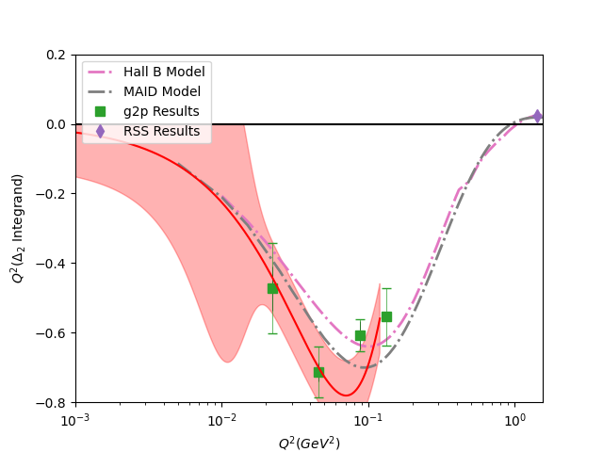
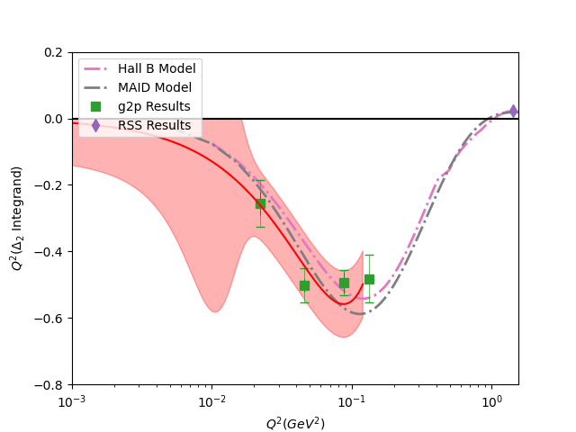
Δ₂ Results (Fits)
Preliminary
Preliminary
e
μ

Slide 18
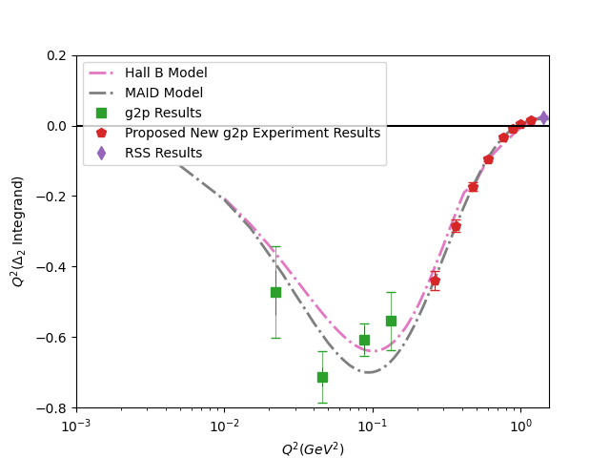
Proposal in Progress to Measure another relevant region of Δ₂
In preparation for JLab PAC deadline next week with Karl Slifer, Jian-Ping Chen, and Nathaly Santiesteban
Intend to propose transverse polarized target experiment in Hall C for
0.27 GeV² < Q² < 1.1 GeV²
Please let us know if you are interested in being part of the proposal!!
Preliminary

Slide 19
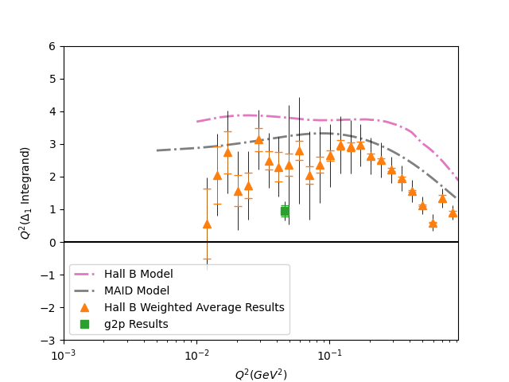
Δ₁ Results (Electronic Hydrogen)
Hall B Data constructed from EG4 and EG1b data from Jefferson Lab
See X. Zheng et al (Nature Physics 2021) and R. Fersch et al (PRC 2017)
Many thanks to Alexandre Deur for sharing the EG4 Data
Preliminary
New data from g2p and other Jefferson Lab experiments constrains Δ₁ above Q² = 0.01 GeV²

Slide 20
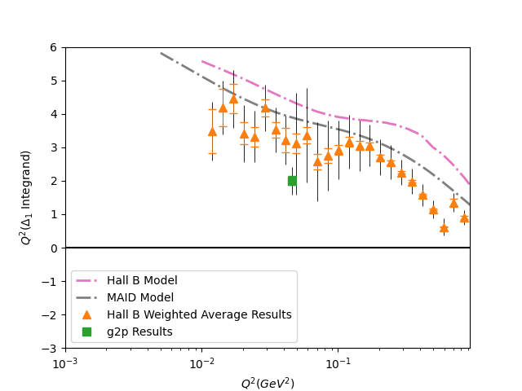
Δ₁ Results (Muonic Hydrogen)
Hall B Data constructed from EG4 and EG1b data from Jefferson Lab
See X. Zheng et al (Nature Physics 2021) and R. Fersch et al (PRC 2017)
Many thanks to Alexandre Deur for sharing the EG4 Data
Preliminary
New data from g2p and other Jefferson Lab experiments constrains Δ₁ above Q² = 0.01 GeV²

Slide 21
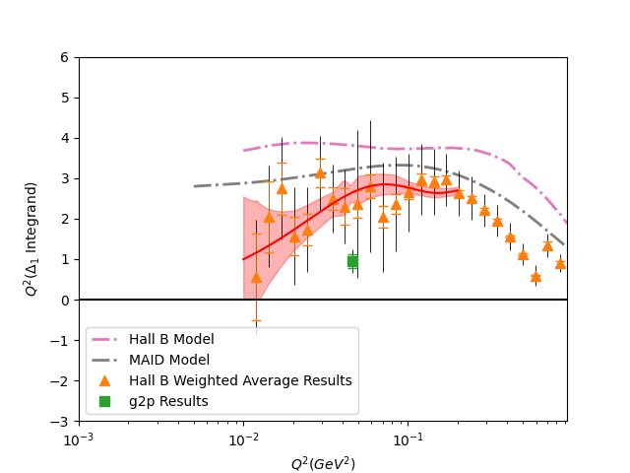
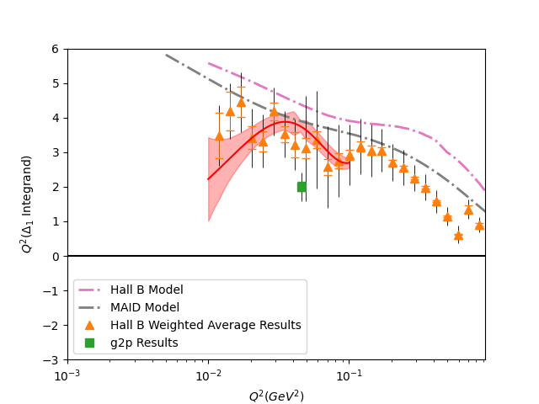
Δ₁ Results (Fits)
μ
e
Preliminary
Preliminary

Slide 22
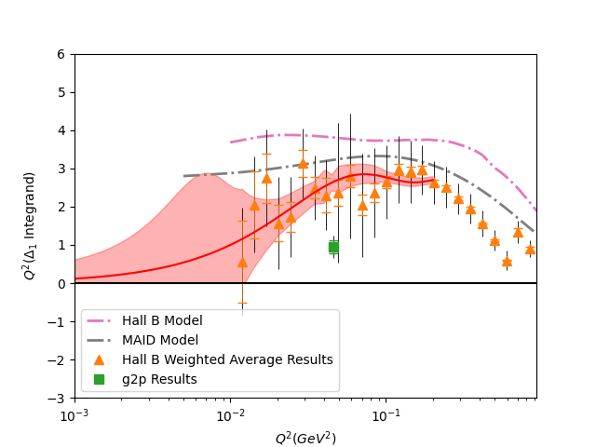
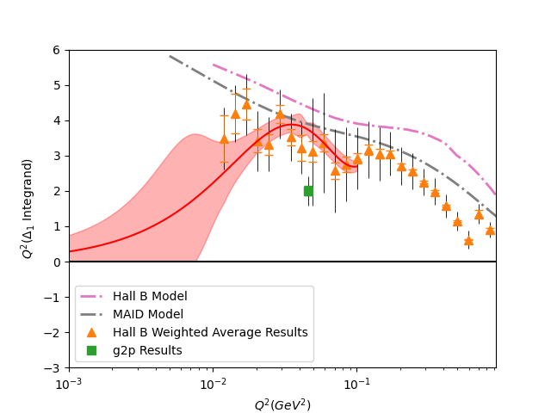
Δ₁ Results (Fits)
μ
e
Preliminary
Preliminary

Slide 23
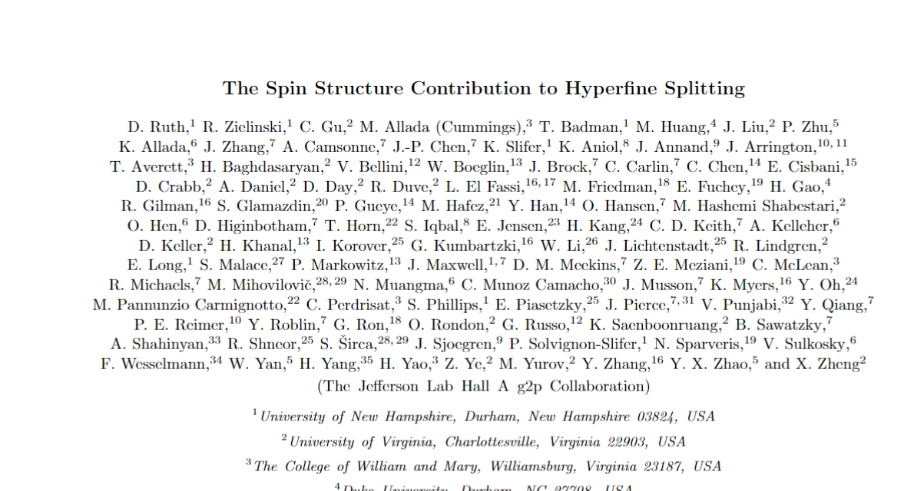
Hyperfine Structure Publication in preparataion
Paper is in preparation with the hope of submitting soon
Highlights polarizability contributions shown on previous slides
Any feedback or suggestions welcomed!!
In Preparation!

Slide 24
Acknowledgements
Spokespeople:
J.P. Chen
Karl Slifer†
Alexandre Camsonne
Don Crabb
Graduate Students:
Ryan Zielinski
Chao Gu
Toby Badman
Melissa Cummings
Min Huang
Jie Liu
Pengjia Zhu
Thanks to Jefferson Lab for funding to help me travel to this conference!
Thanks to Alexandre Deur for providing the EG4 Data!
Post-Docs:
Kalyan Allada
James Maxwell
Vince Sulkosky
Jixie Zhang
†: Corresponding Author, Email: Karl.Slifer@unh.edu

Slide 25
References
R. Zielinski, The g2p Experiment: A Measurement of the
Proton’s Spin Structure Functions, Ph.D. thesis, Univer-
sity of New Hampshire (2017), arXiv:1708.08297 [nucl-
ex].
C. Gu. The Spin Structure of the Proton at Low Q2: A Measurement of the Structure
Function g2p. PhD thesis, University of Virginia, 2016.
X. Zheng, A. Deur, H. Kang, et al., Nature Physics, 17,
736 (2021).
V. Sulkosky, C. Peng, J. Chen, et al., Nature Physics,
17, 687 (2021).
J. M. Alarcón, F. Hagelstein, V. Lensky, and V. Pasca-
lutsa, Phys. Rev. D, 102, 114026 (2020).
V. Bernard, E. Epelbaum, H. Krebs, and U.-G. Meissner,
Phys. Rev. D, 87, 054032 (2013).
M. E. Christy and P. E. Bosted, Phys. Rev. C, 81, 055213
(2010).
J. Alcorn et al. Basic Instrumentation for Hall A at Jefferson Lab. Nucl. Instrum.
Meth., A522:294–346, 2004.

Slide 26
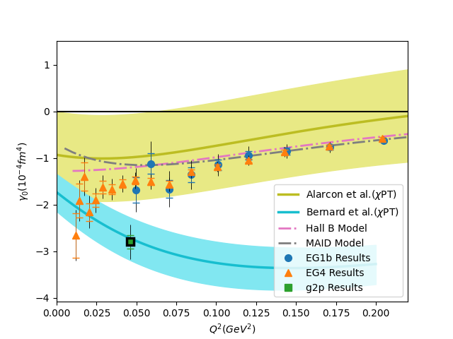
Extra Slide: Gamma0
Preliminary

Slide 27
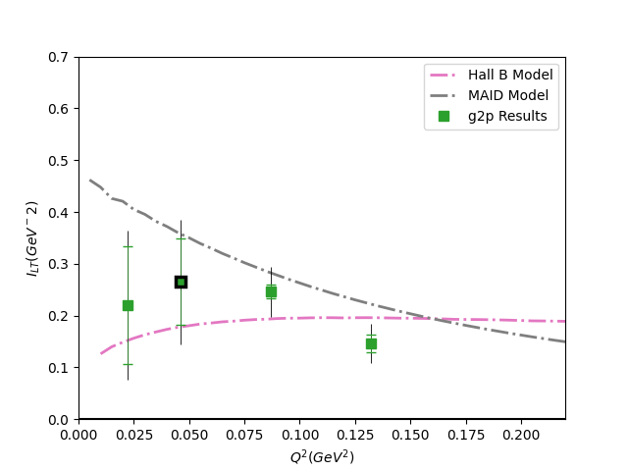
Extra Slide: Schwinger Sum Rule
Preliminary

