Slide 1
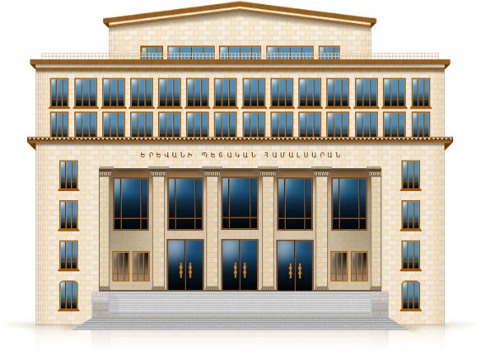


Vacuum densities for branes orthogonal
to AdS boundary
Aram Saharian
Institute of Physics, Yerevan State University
Gourgen Sahakyan Chair of Theoretical Physics
MPCS-23, 12 - 16 September, 2023
Yerevan, Armenia

Slide 2

Outline
Anti-de Sitter spacetime as a background geometry in QFT
Geometry, field and boundary conditions
Mean field squared
VEV of the energy-momentum tensor and the Casimir forces
Conclusions

Slide 3
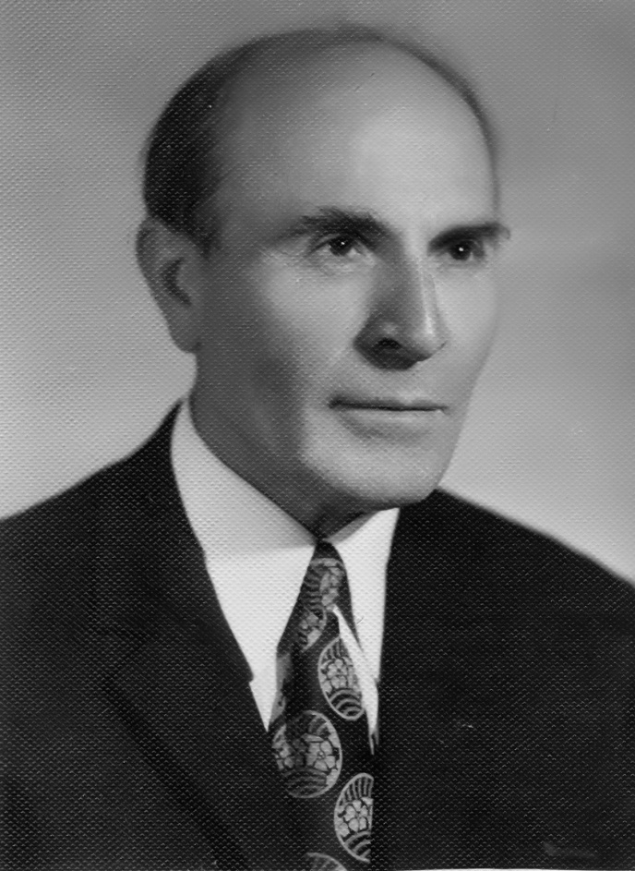

Equilibrium configurations
of degenerate gaseous masses
G.S. Sahakyan
Moscow,1972

Slide 4

It was translated into English and was issued abroad in 2 years period,
that was very short in those days.
The English edition of the monograph by G.S. published by
A Halsted Press Book
in 1974.

Slide 5
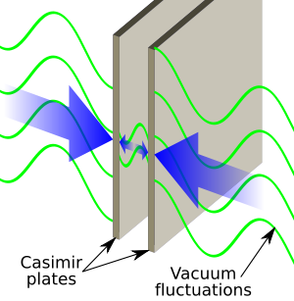
Casimir effect
Parallel metallic plates

Slide 6
Aim
We aim to consider combined effects of boundaries and gravity on the properties of quantum vacuum
Gravitational field is considered as a classical curved background
Back-reaction of quantum effects is described by Einstein equations with the expectation value of the energy-momentum tensor for quantum fields in the right-hand side
This hybrid but very useful scheme is an important intermediate step to the development of quantum gravity
Among the most interesting effects in this field are the particle production and the vacuum polarization by strong gravitational fields
As a background geometry we consider AdS spacetime

Slide 7
Importance of AdS in QFT on curved backgrounds
Because of the high symmetry, numerous problems are exactly solvable on AdS bulk and this may shed light on the influence of a classical gravitational field on the quantum matter in more general geometries
Questions of principal nature related to the quantization of fields propagating on curved backgrounds
AdS spacetime generically arises as a ground state in extended supergravity and in string theories
AdS/Conformal Field Theory correspondence: Relates string theories or supergravity in the bulk of AdS with a conformal field theory living on its boundary
Braneworld models: Provide a solution to the hierarchy problem between the gravitational and electroweak scales
Braneworlds naturally appear in string/M-theory context and provide a novel setting for discussing phenomenological and cosmological issues related to extra dimensions

Slide 8
Randall-Sundrum-type braneworlds
Original Randall-Sundrum model (RS1) offers a solution to the hierarchy problem by postulating 5D AdS spacetime bounded by two (3+1)-dimensional branes
Gravity is localized near UV or Planck brane
SM particles are localized on IR or TeV brane
AdS bulk
Branes are parallel to the AdS boundary
SM
Only graviton and some other non SM fields propagate in the bulk
UV brane
IR brane
y
Hierarchy problem between the gravitational and electroweak scales is solved for
k·distance between branes = 40
The Casimir effect has been widely investigated in braneworlds setup and provides an attractive mechanism to stabilize the interbrane distance

Slide 9
Surfaces intersecting AdS boundary and Ryu-Takayanagi conjecture
AdS/BCFT correspondence maps conformal field theory on a manifold with boundary (BCFT) to asymptotically AdS spacetime with additional boundary
Consider CFT living on the boundary of AdS spacetime
Conjecture provides a geometric interpretation of the entanglement entropy in CFT
Entanglement entropy of CFT in spatial sub-region with its complement
Ryu-Takayanagi formula
Compare with Bekenstein-Hawking formula for black hole entropy
Surface in the bulk satisfies the properties:
Has the same boundary as
Is homologous to
Extremizes the area

Slide 10
Geometry
(D+1)-dimensional AdS spacetime
New coordinate
AdS boundary z=0, horizon z=∞
Branes perpendicular to AdS boundary
Proper distance between the branes

Slide 11
Field, boundary conditions and VEVs
Scalar field with general curvature coupling parameter
Boundary conditions
Normal to the brane at
Boundary condition imposed on the field modify the spectrum of vacuum fluctuations and the VEVs of physical observables are changed
Casimir effect
We are interested in the VEVs of the field squared and of the energy-momentum tensor
Scheme of calculation:
Two-point function Mean field squared VEV of the energy-momentum tensor
Forces acting on the branes

Slide 12
Decomposition of the Wightman function
In the region between the branes the eigenvalues of the quantum number corresponding to the direction perpendicular to the branes are expressed in terms of roots of transcendental equation
In the expression of the Wightman function for summation of the series of those eigenvalues the Generalized Abel-Plana formula is used
That allows to decompose the Wightman function as:
Wightman function for the geometry without branes
Contribution corresponding to the geometry of a single brane
Wightman function
Contribution when we add the second brane to geometry of a single brane
For points away from the branes the renormalization of the local VEVs is reduced to the one in the brane-free geometry
Similar decomposition is obtained for Bulk-to-boundary propagator
among the central objects in the AdS/CFT correspondence

Slide 13
Mean field squared in the single brane geometry
Mean field squared in the region between the branes ( )
AdS boundary
branes
Notations:
VEV for the geometry without branes
VEV depends on in the form of the dimensionless ratios , and
Proper distance from the brane
Maximal symmetry of AdS spacetime

Slide 14
Mean field squared: Special cases and asymptotes
Conformally coupled massless field:
VEV in Minkowski spacetime for geometry
Dirichlet plate
Robin plates
Small distances from the brane ( ) for non-Dirichlet BC
(opposite sign for Dirichlet BC)

Slide 15
Mean field squared: Special cases and asymptotes
Points near the AdS boundary:
For points near the AdS boundary and not too close to the branes, the brane-induced part in the mean field squared tends to zero like
Points near the horizon:
Near the horizon the effects of the curvature on the brane induced VEV are weak

Slide 16
Brane induced mean field squared
=
Conformal coupling
Minimal coupling

Slide 17
Vacuum energy-momentum tensor
VEV of the energy-momentum tensor
Diagonal components
Off-diagonal component

Slide 18
Covariant conservation and trace relation
Covariant conservation equation
Trace relation

Slide 19
Vacuum energy-momentum tensor: Asymptotes
VEV of the energy-momentum tensor near branes
Minkowski limit

Slide 20
Vacuum energy density
=
Conformal coupling
Minimal coupling

Slide 21
The Casimir forces
The -th component of the force acting on the surface element of the brane at
is given by
Due to the nonzero off-diagonal stress, in addition to the normal component this force has nonzero component parallel to the brane (shear force)
AdS bulk
Minkowski bulk
Normal force
Normal force
AdS boundary
Shear force
Directions of the forces depend on the coefficients in the boundary conditions on the branes

Slide 22
Normal force
Normal force acting on the brane at :
Vacuum effective pressure
Small separations between the branes
Attractive force
At small separations the effect of gravity is weak
For non-Dirichlet BC one brane and Dirichlet BC on other:
Repulsive force

Slide 23
Normal force
The effect of gravity is essential at large separations between the branes
For non-Neumann boundary conditions on both branes
For non-Neumann BC on the brane and Neumann BC on the second brane
For Neumann BC on the brane and non-Neumann BC on the second brane
For Neumann BC on both branes

Slide 24
Casimir normal force
Minimal coupling
Neu
Dir

Slide 25
Casimir normal force
Conformal coupling
Minimal coupling

Slide 26
Shear force
The part in the shear force induced by the second brane
Shear force is zero for Dirichlet and Neumann boundary conditions on the brane regardless of boundary conditions on the second brane
Shear force is directed toward the horizon for and toward the AdS boundary for
Normal force
Toward horizon
AdS boundary
Shear force
Toward AdS boundary

Slide 27
Shear force: Asymptotes
Shear force at small separations between the branes
At small separations, the shear component of the force has opposite signs for Dirichlet and non-Dirichlet boundary conditions on the second brane
Shear force at large separations between the branes
Force has opposite signs for Neumann and non-Neumann boundary conditions on the brane

Slide 28
Shear force: Numerics
Conformal coupling
Minimal coupling

Slide 29
Shear force: Numerics
Conformal coupling
Minimal coupling

Slide 30
Conclusions
We have investigated combined effects of gravity and boundaries on local characteristics of the scalar vacuum
Near the boundaries the effects of gravity on the mean field squared, on the energy density and parallel stresses are weak
The effect of gravity is essential at distances from the brane larger than the curvature radius
Off-diagonal component of the vacuum energy-momentum tensor is induced that gives arise to shear force acting on branes
VEVs vanish on the AdS boundary and diverge on the horizon
Signs for both the normal and shear Casimir forces depend on the Robin coefficients

Slide 31
Thank you

