Slide 1
New vortices in two flavor dense quark core of compact star
Karen Shahabasyan
New diquark phase in two flavor dense quark core of compact star

Slide 2
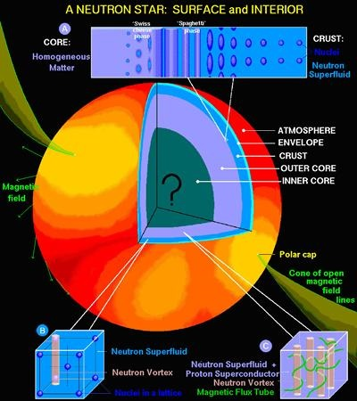
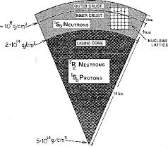
A compact star: surface and interior

Slide 3
Structure of compact star:
“Ae”-phase, “Aen”-phase, “npe”-phase, quark phase: “2SC”-phase or “CFL”-phase

Slide 4
Conceptual framework for a continuous connection between hadronic and quark phases of dense matter described by QCD was suggested in
T.Schaefer,F.Wilczek, Phys. Rev. Lett. 82, 3956,1999.
M.Alford,,J.Berges, K.Rajagopal, Nucl. Phys. B558, 1999.

Slide 5
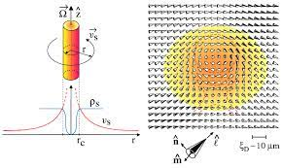
Structure of 1S0 superfluid neutron vortex

Slide 6
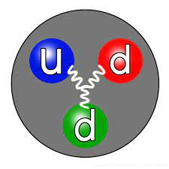
The Quark Structure of the Neutron Pair

Slide 7
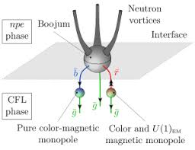
Three neutron vortices ending in a boojum at the interface
M. Cipriani, W. Vinci, M. Nitta, Phys. Rev. D 86, 121704,2012

Slide 8
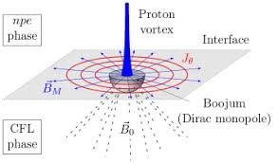
A superconducting proton vortex ending on interface
M. Cipriani, W. Vinci, M. Nitta, Phys. Rev. D 86, 121704, 2012.

Slide 9



The neutron-neutron spin-orbit interactions is generated by Lorentz scalar and vector couplings of neutrons. Phenomenological boson exchange models associate these interactions with scalar and vector boson fields, σ(x) and

Slide 10

Spin-orbit interaction favoring J=2 neutron pairing in “npe-phase
Y. Fujimoto,K.Fukushima, W. Weise, Phys. Rev. D 101, 094009,2020

Slide 11


The spin-orbit interaction between quarks can be produced by one-gluon exchange

Slide 12



Spin-orbit interactions quark quasiparticles

Slide 13
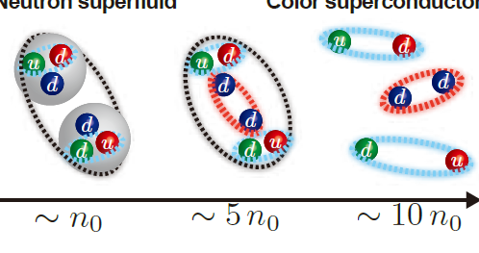
Schematic picture of quark-hadron continuity between neutron superfluid and color superconductor.
Y. Fujimoto, K. Fukushima, W. Weise,Phys. Rev. D 101,094009, 2020.

Slide 14
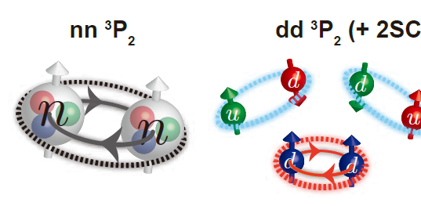
Schematic picture of quark-hadron continuity between the 3P2 neutron superfluid and the 2SC+(dd) color superconductor

Slide 15
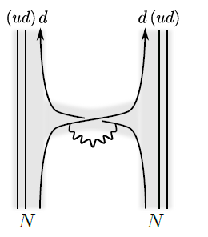
Short –range interaction between neutrons mediated by quark-gluon exchange

Slide 16


2SC+(dd) phase from quark-hadron continuity
Y. Fujimoto, M. Nitta, Phys. Rev. D103,114003, 2021 order parameter 3P2 neutron superfluid is

Slide 17



Expectations values of the order parameters in the hadronic and in the quark phases are

Slide 18
Minimal topological vortex in the “dd” phase is non abelian semi-superfluid Alice string
A. Abelian vortex. It carries a unit quantized circulation in U(1)B.

Slide 19
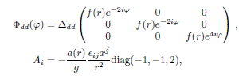


B. Pure color magnetic flux tubes for the case of 2SC and CFL phases:
K. Iida, Phys. Rev. D 71, 054011, 2005.
M. G. Alford, A. Sedrakian, J. Phys. G 37, 075202, 2010.

Slide 20
Semi-superfluid vortices in the CFL phase
A.P. Balachandran,S.Digal,T. Matsuura, Phys. Rev. D73,074009,2006.
E. Nakano,M.Nitta, T. Matsuura, Phys. Phys. Rev. D78,045002,2008.
D.M.Sedrakian,K.M.Shahabasyan,D.Blaschke,M.K.Shahabasyan,Astrophys.51,544,2008

Slide 21
Quark hadron continuity connects hadronic matter with neutron 3P2 super-fluidity and 2-flavor dense quark matter [1]. This 2-flavor quark phase consists of the coexistense of the 2SC condensate of the ud quarks and P-wave diquark condensate of d-quarks, which gives rise to color superconductivity, as well as superfluidity. Stable vortices are non-Abelian Alice strings which are superfluid vortices with fractional circulation and non-Abelian color magnetic fluxes [2].
1. Y. Fujimoto, Nucl. Phys. A 1005, 121757,2021.
2. Y. Fujimoto, M. Nitta, Phys. Rev. D 103, 054002, 2021.

Slide 22




There are also green and red Alice strings respectively:

Slide 23

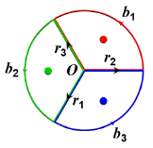

Decay of an Abelian U(1)B vortex into three non-abelian Alice strings, denoted by the red, green, blue blobs. The are the paths with angles 2 π/3 at the boundary at the spatial infinity, and denote the paths from the origin O to the spatial infinities.
Divergent tension of superfluid vortices:

Slide 24
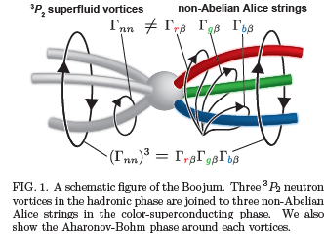
Three 3P2 neutron vortices in the “npe”-phase are joined to three non-Abelian semi-superfluid vortices in “2SC”+”dd” phase.
Y. Fujimoto, M. Nitta, Phys. Rev. D 103, 114003,2021.

Slide 25
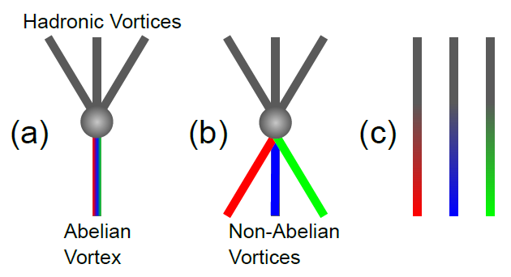
Schematic illustrations for connecting vortices.
M.G. Alford ,G. Baym,K. Fukusima,T. Hatsuda,M. Tachibana, Phys. Rev. D 99, 036004, 2019.

Slide 26
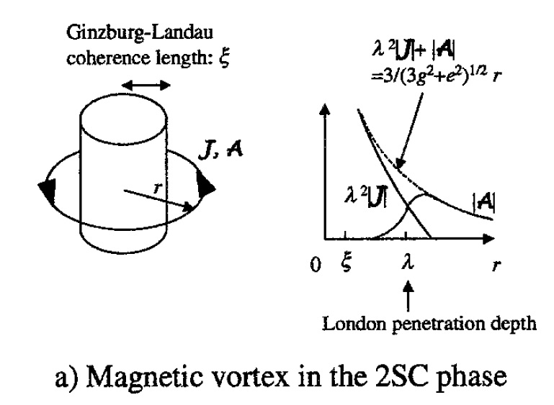
D.M. Sedrakian,D. Blaschke, nucl-th/ 0006038,
K. Iida,G. Baym, Nuclear Physics A , 718, 697, 2003.
2SC condensate is type II superconductor and magnetic field penetrates into quark core in the form of quark magnetic vortices.

Slide 27
Thank You!

