Slide 1



¹Hebrew University of Jerusalem
²Ioffe Institute
Self-similarities of Equations of State
and $M−R$ curves of Neutron Stars
Dima Ofengeim^{1,2}, P. Shternin², T. Piran¹
The Modern Physics of Compact Stars & Relativistic Gravity – 2023
12 September 2023

Slide 2
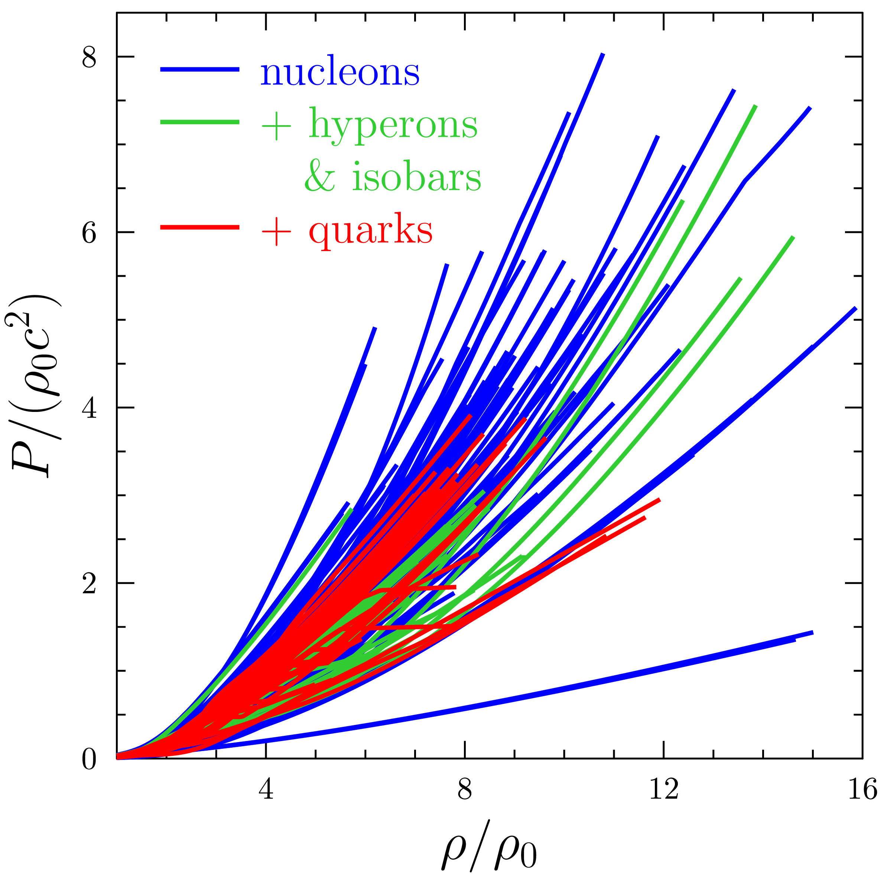

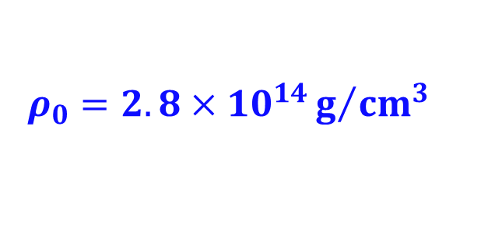
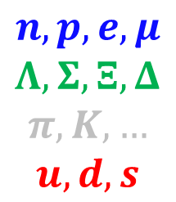





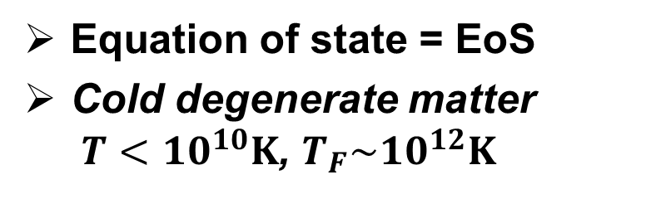
NS Equations of State
Equation of state = EoS
Cold degenerate matter
$T<10^{10}K$, $T_{F}\sim 10^{12}K$
$P\left(ρ\right), n\left(ρ\right),composition\left(ρ\right),…$
Crust
$$e,Z,n$$
Core
$$n,p,e,μ$$
$$Λ,Σ,Ξ,Δ$$
$$π,K,…$$
$$u,d,s$$
$$P\left(ρ\right)$$
$$P\left(ρ\right)$$

?
$$∼0.5ρ_{0}$$
$$ρ_{0}=2.8×10^{14}g/{{cm}^{3}}$$
$P−ρ$ and $M−R$ self-similarities

Slide 3
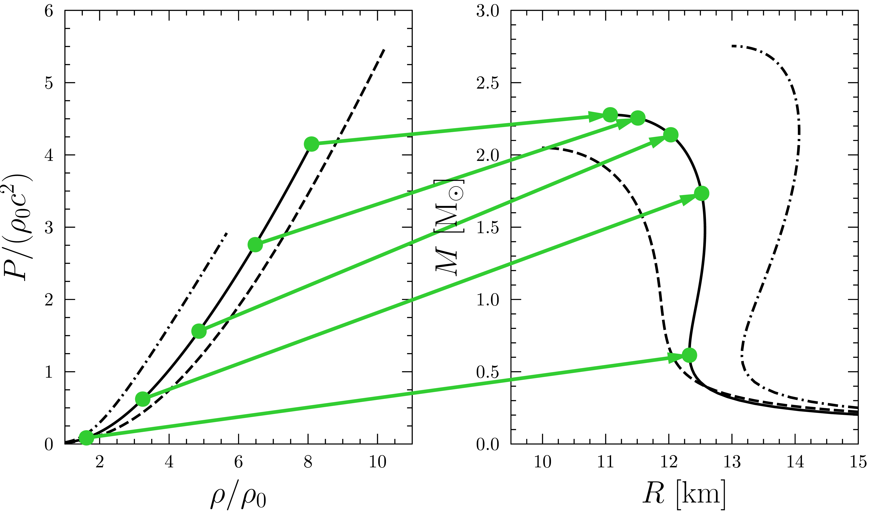
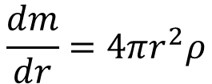
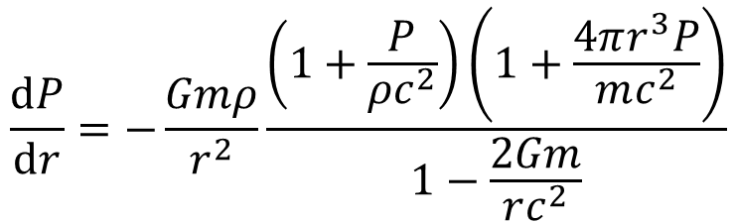

Oppenheimer-Volkoff Mapping
$$\frac{dP}{dr}=−\frac{Gmρ}{r^{2}}\frac{\left(1+\frac{P}{ρc^{2}}\right)\left(1+\frac{4πr^{3}P}{mc^{2}}\right)}{1−\frac{2Gm}{rc^{2}}}$$
GR hydrostatics
Rotation
Tolman (1939); Oppenheimer & Volkoff (1939)
$$\frac{dm}{dr}=4πr^{2}ρ$$
$$ψ_{OV}: P\left(ρ\right)↦M−R$$
$P−ρ$ and $M−R$ self-similarities

Slide 4
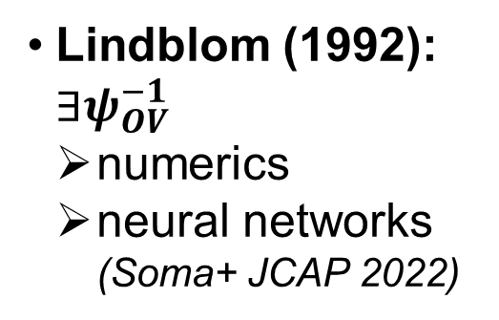

Oppenheimer-Volkoff Mapping
$$\frac{dP}{dr}=−\frac{Gmρ}{r^{2}}\frac{\left(1+\frac{P}{ρc^{2}}\right)\left(1+\frac{4πr^{3}P}{mc^{2}}\right)}{1−\frac{2Gm}{rc^{2}}}$$
GR hydrostatics
Rotation
Tolman (1939); Oppenheimer & Volkoff (1939)
$$\frac{dm}{dr}=4πr^{2}ρ$$
$$ψ_{OV}: P\left(ρ\right)↦M−R$$
$$ψ_{OV}^{−1}:M−R↦P\left(ρ\right)$$
Lindblom (1992): $∃ψ_{OV}^{−1}$
  numerics
  neural networks
  (Soma+ JCAP 2022)
$P−ρ$ and $M−R$ self-similarities

Slide 5





Oppenheimer-Volkoff Mapping
$$\frac{dP}{dr}=−\frac{Gmρ}{r^{2}}\frac{\left(1+\frac{P}{ρc^{2}}\right)\left(1+\frac{4πr^{3}P}{mc^{2}}\right)}{1−\frac{2Gm}{rc^{2}}}$$
GR hydrostatics
Rotation
Tolman (1939); Oppenheimer & Volkoff (1939)
$$\frac{dm}{dr}=4πr^{2}ρ$$
$$ψ_{OV}: P\left(ρ\right)↦M−R$$
$$ρ_{max}$$
$$R_{Mmax}$$
Lindblom (1992): $∃ψ_{OV}^{−1}$
  numerics
  neural networks
  (Soma+ JCAP 2022)
$$M_{max}$$
$$P_{max}$$
$∃ M_{max}↔ρ_{max},P_{max}$
$P−ρ$ and $M−R$ self-similarities

Slide 6







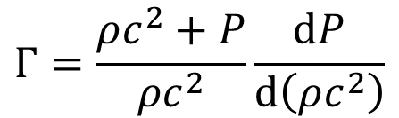

Dimension of EoS Manifold
Lindblom (2010): spectral representation
$$npeμ$$
34 «realistic» EoS
universal fit
$$npeμΛΣ$$
$$npeμΛΣuds$$
$$\ln{Γ\left(P\right)}=γ_{0}+γ_{1}\ln{P}+γ_{2}{\left(\ln{P}\right)}^{2}+γ_{3}{\left(\ln{P}\right)}^{3}+γ_{4}{\left(\ln{P}\right)}^{4}+…$$
$$rms∼3−8\%$$
$$Γ=\frac{ρc^{2}+P}{ρc^{2}}\frac{dP}{d\left(ρc^{2}\right)}$$
$$P−ρ$$
$$rms∼1−5\%$$
$$M−R$$
$$rms∼0.5−4\%$$
Lindblom (2010)
$P−ρ$ and $M−R$ self-similarities

Slide 7
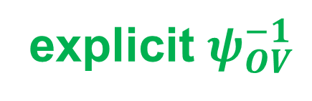
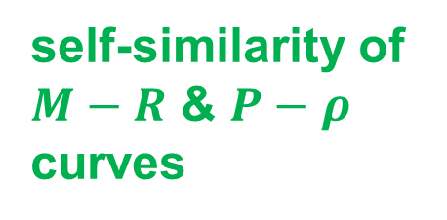


Dimension of EoS Manifold
Lindblom (2010): spectral representation
$$npeμ$$
34 «realistic» EoS
universal fit
$$npeμΛΣ$$
$$npeμΛΣuds$$
$$\ln{Γ\left(P\right)}=γ_{0}+γ_{1}\ln{P}+γ_{2}{\left(\ln{P}\right)}^{2}+γ_{3}{\left(\ln{P}\right)}^{3}+γ_{4}{\left(\ln{P}\right)}^{4}+…$$
$$rms∼3−8\%$$
$$Γ=\frac{ρc^{2}+P}{ρc^{2}}\frac{dP}{d\left(ρc^{2}\right)}$$
$$P−ρ$$
$$rms∼1−5\%$$
$$M−R$$
$$rms∼0.5−4\%$$
handful parametrization:
self-similarity of $M−R$ & $P−ρ$ curves
Idea of this work
$$M_{max},R_{Mmax}$$
explicit $ψ_{OV}^{−1}$
$$P_{max},ρ_{max}$$
$P−ρ$ and $M−R$ self-similarities

Slide 8
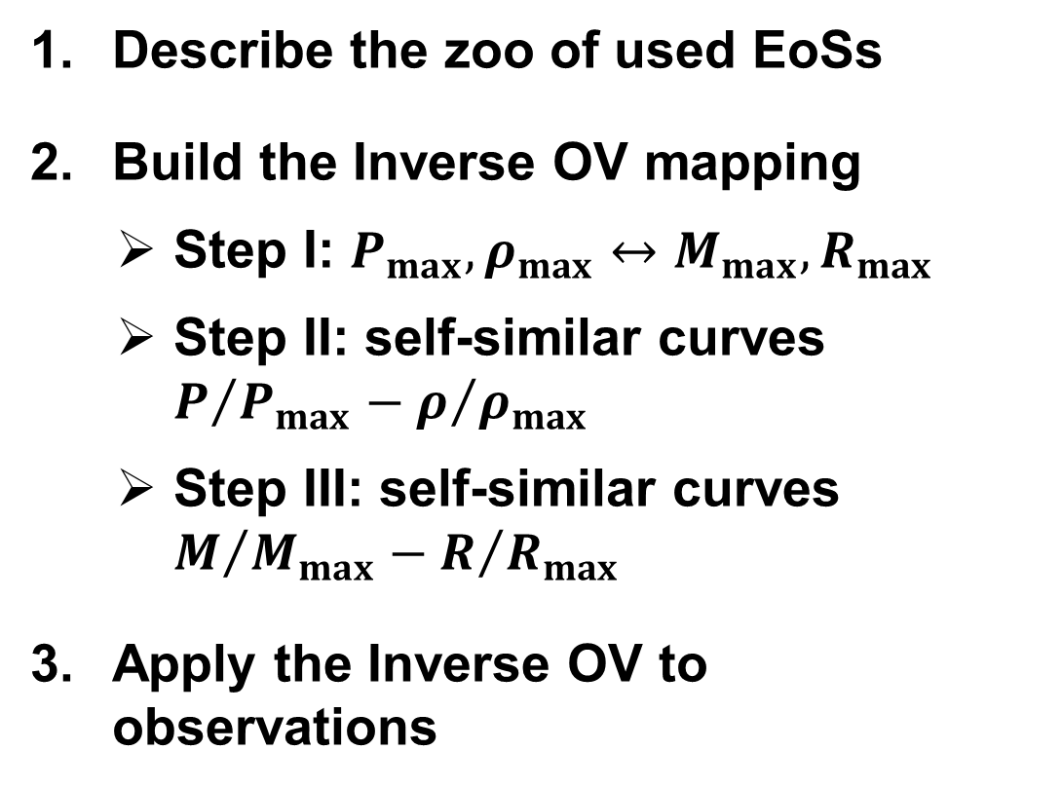
Plan of the Further Talk
Describe the zoo of used EoSs
Build the Inverse OV mapping
  Step I: $P_{max},ρ_{max}↔M_{max},R_{max}$
  Step II: self-similar curves $P/{P_{max}}−ρ/{ρ_{max}}$
  Step III: self-similar curves $M/{M_{max}}−R/{R_{max}}$
Apply the Inverse OV to observations
Universal fits
$P−ρ$ and $M−R$ self-similarities

Slide 9
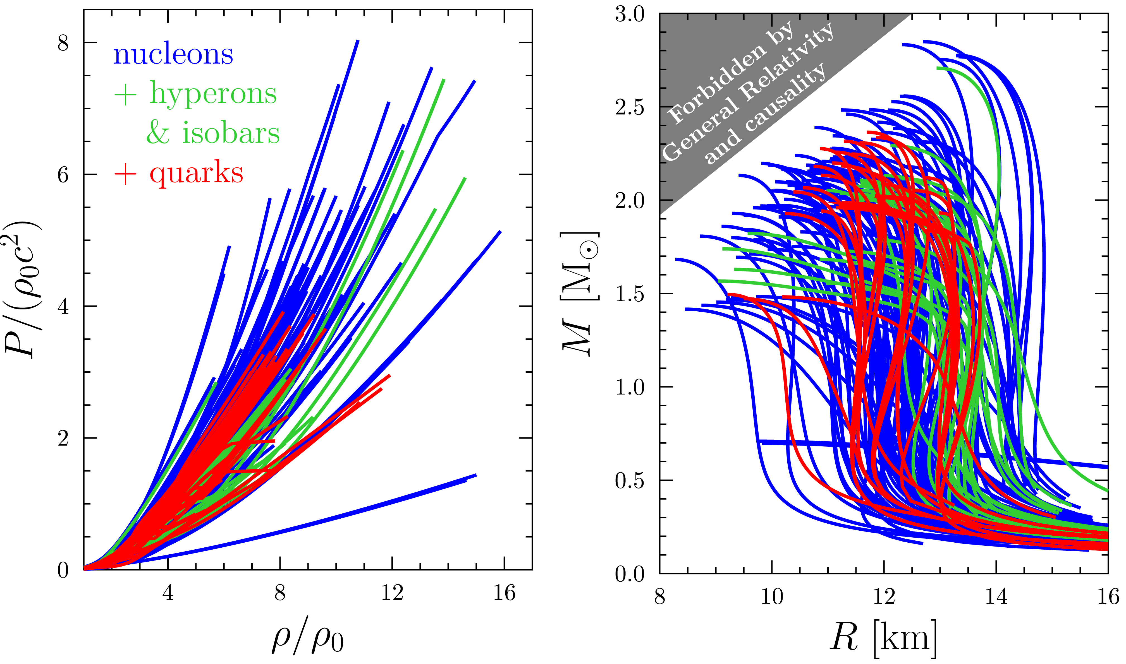


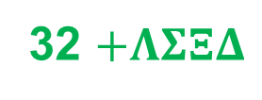
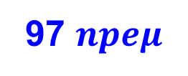
EoS Zoo
162 models
97 $npeμ$
32 $+ΛΣΞΔ$
33 $+uds$
CompOSE
https://compose.
obspm.fr/
Read+2009
$↔$Lindblom
(2010)
Ozel & Freira 2016
Gusakov, Kantor & Haensel 2014, Fortin+2017, Ofengeim+2019,…
…free $npe$, PAL, HHJ, variational, Skyrme, RMF, QMC, QHC,…
Inverse Oppenheimer-Volkoff Mapping
$P−ρ$ and $M−R$ self-similarities

Slide 10
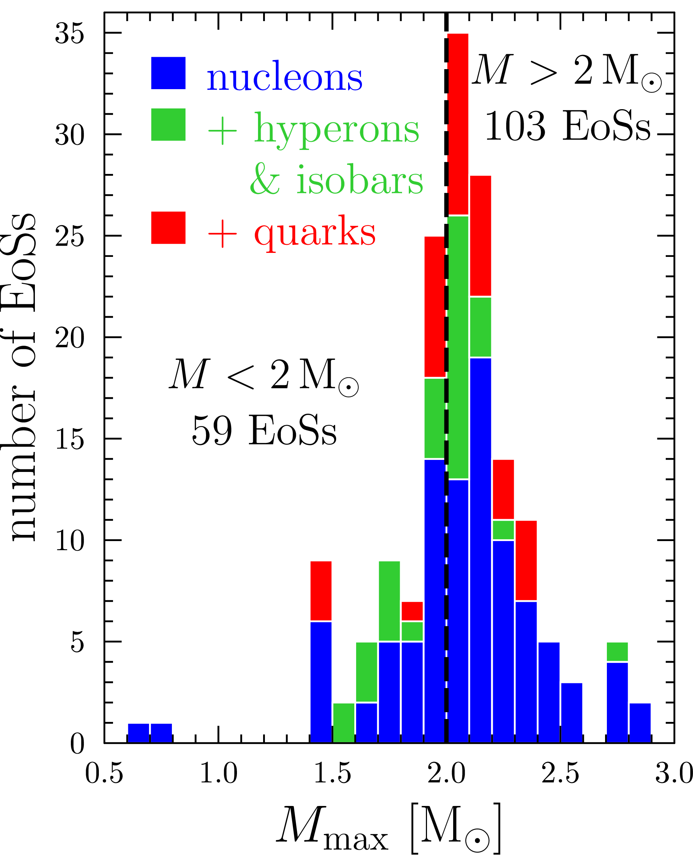
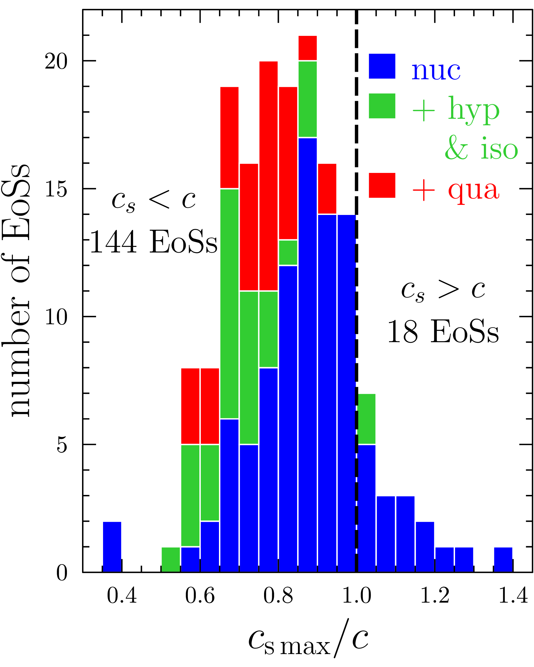
EoS Zoo
162 models
97 $npeμ$
32 $+ΛΣΞΔ$
33 $+uds$
CompOSE
https://compose.
obspm.fr/
Read+2009
$↔$Lindblom
(2010)
Ozel & Freira 2016
Gusakov, Kantor & Haensel 2014, Fortin+2017, Ofengeim+2019,…
…free $npe$, PAL, HHJ, variational, Skyrme, RMF, QMC, QHC,…
$P−ρ$ and $M−R$ self-similarities

Slide 11
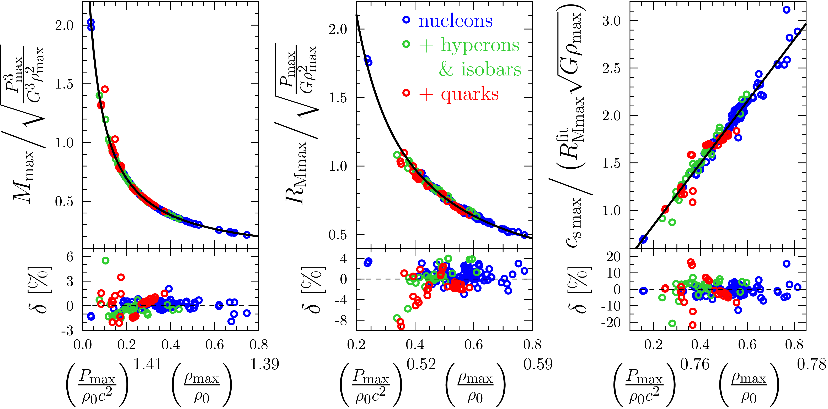

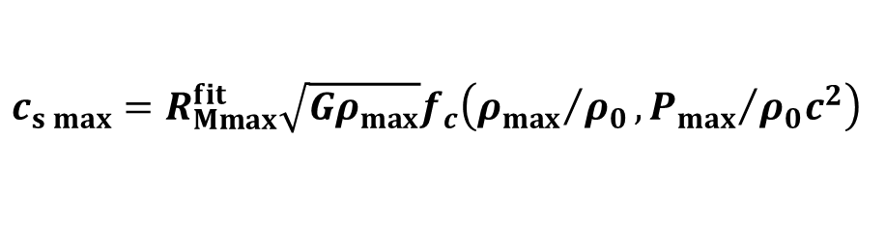
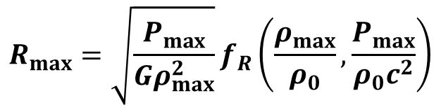
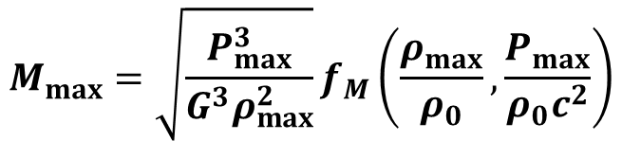
Step I: $M_{max},R_{max}↔P_{max},ρ_{max}$
$$M_{max}=\sqrt{\frac{P_{max}^{3}}{G^{3}ρ_{max}^{2}}}f_{M}\left(\frac{ρ_{max}}{ρ_{0}},\frac{P_{max}}{ρ_{0}c^{2}}\right)$$
$$R_{max}=\sqrt{\frac{P_{max}}{Gρ_{max}^{2}}}f_{R}\left(\frac{ρ_{max}}{ρ_{0}},\frac{P_{max}}{ρ_{0}c^{2}}\right)$$
$$c_{s max}=R_{Mmax}^{fit}\sqrt{Gρ_{max}}f_{c}\left({ρ_{max}}/{ρ_{0}},{P_{max}}/{ρ_{0}c^{2}}\right)$$
$P−ρ$ and $M−R$ self-similarities

Slide 12
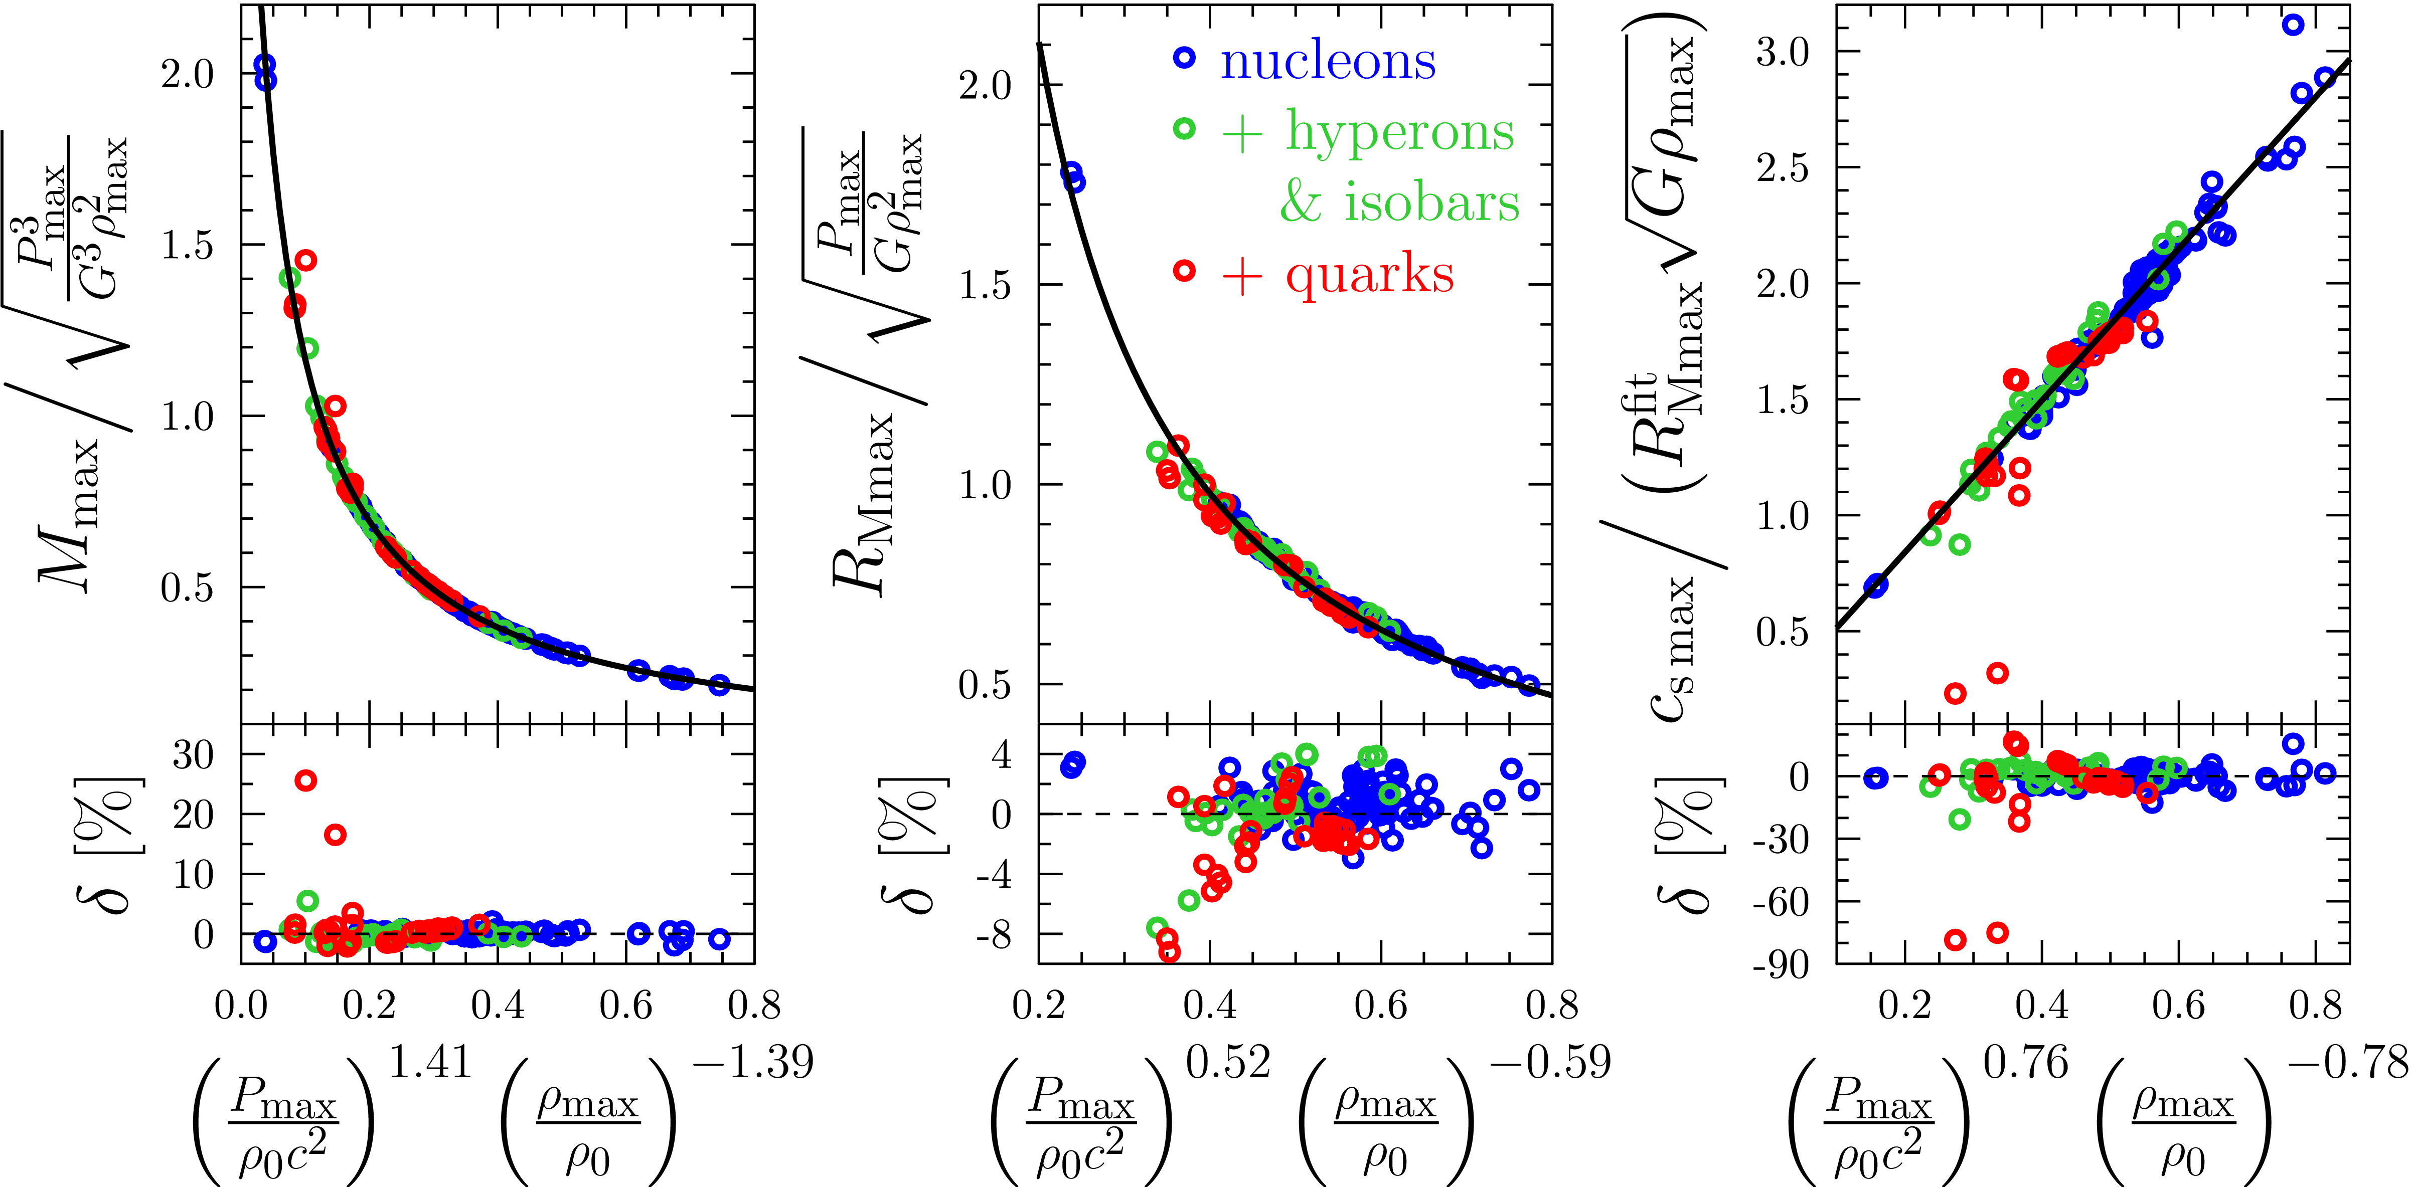
Step I: $M_{max},R_{max}↔P_{max},ρ_{max}$
$$M_{max}=\sqrt{\frac{P_{max}^{3}}{G^{3}ρ_{max}^{2}}}f_{M}\left(\frac{ρ_{max}}{ρ_{0}},\frac{P_{max}}{ρ_{0}c^{2}}\right)$$
$$R_{max}=\sqrt{\frac{P_{max}}{Gρ_{max}^{2}}}f_{R}\left(\frac{ρ_{max}}{ρ_{0}},\frac{P_{max}}{ρ_{0}c^{2}}\right)$$
$$c_{s max}=R_{Mmax}^{fit}\sqrt{Gρ_{max}}f_{c}\left({ρ_{max}}/{ρ_{0}},{P_{max}}/{ρ_{0}c^{2}}\right)$$
outliers:
$P−ρ$ and $M−R$ self-similarities

Slide 13
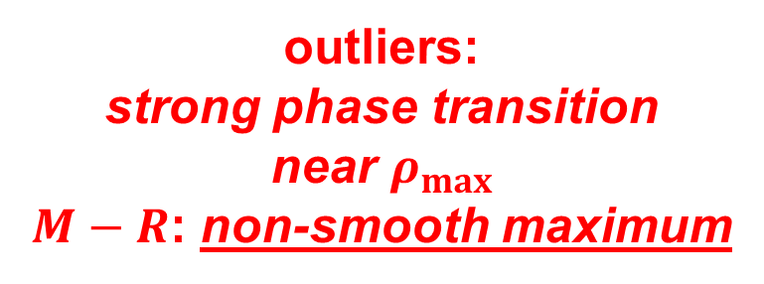
Step I: $M_{max},R_{max}↔P_{max},ρ_{max}$
$$M_{max}=\sqrt{\frac{P_{max}^{3}}{G^{3}ρ_{max}^{2}}}f_{M}\left(\frac{ρ_{max}}{ρ_{0}},\frac{P_{max}}{ρ_{0}c^{2}}\right)$$
$$R_{max}=\sqrt{\frac{P_{max}}{Gρ_{max}^{2}}}f_{R}\left(\frac{ρ_{max}}{ρ_{0}},\frac{P_{max}}{ρ_{0}c^{2}}\right)$$
$$c_{s max}=R_{Mmax}^{fit}\sqrt{Gρ_{max}}f_{c}\left({ρ_{max}}/{ρ_{0}},{P_{max}}/{ρ_{0}c^{2}}\right)$$
outliers:
strong phase transition
near $ρ_{max}$
$M−R$: non-smooth maximum
exclusions
that support the rule
$P−ρ$ and $M−R$ self-similarities

Slide 14
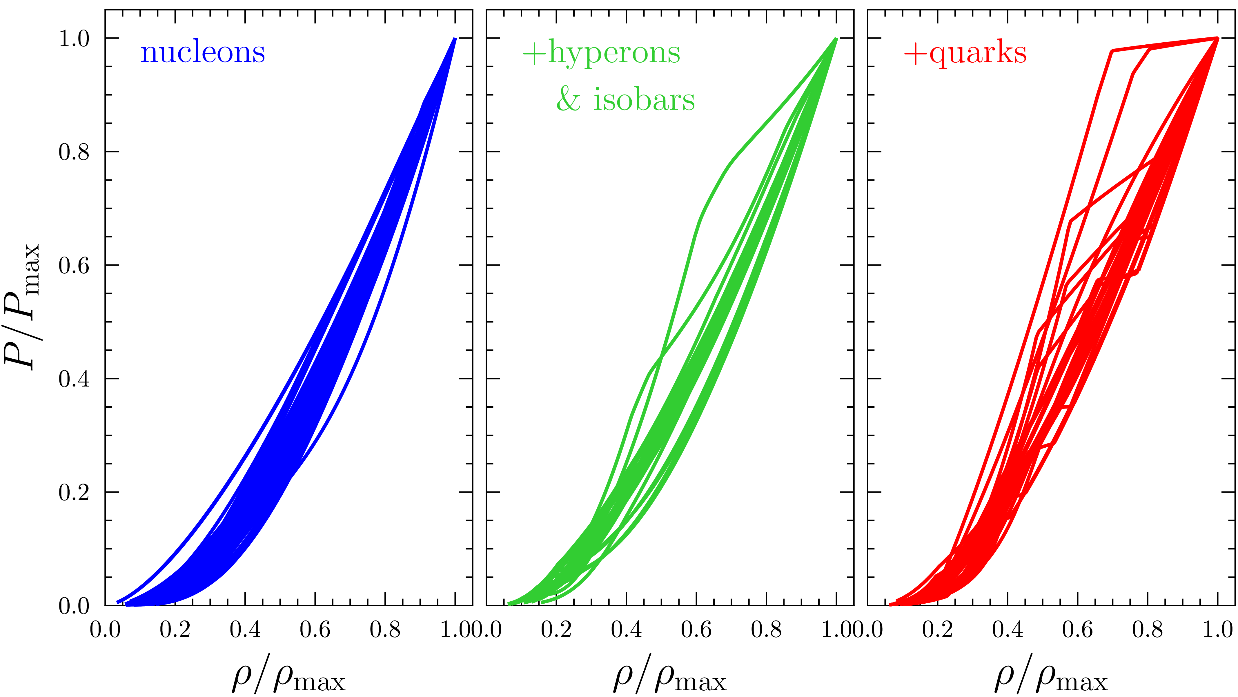
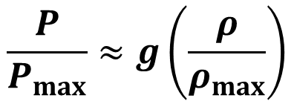


Step II: Self-similar $P\left(ρ\right)$
$$\frac{P}{P_{max}}≈g\left(\frac{ρ}{ρ_{max}}\right)$$
$$c_{sc max}$$
$P−ρ$ and $M−R$ self-similarities

Slide 15
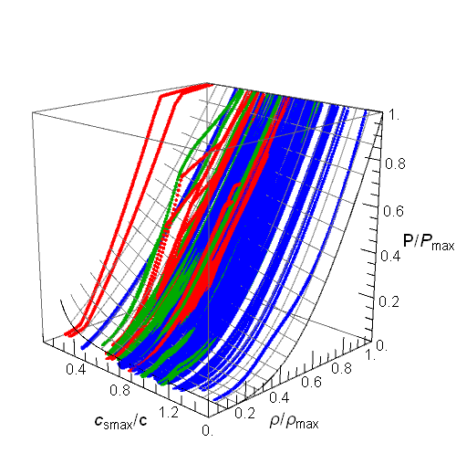
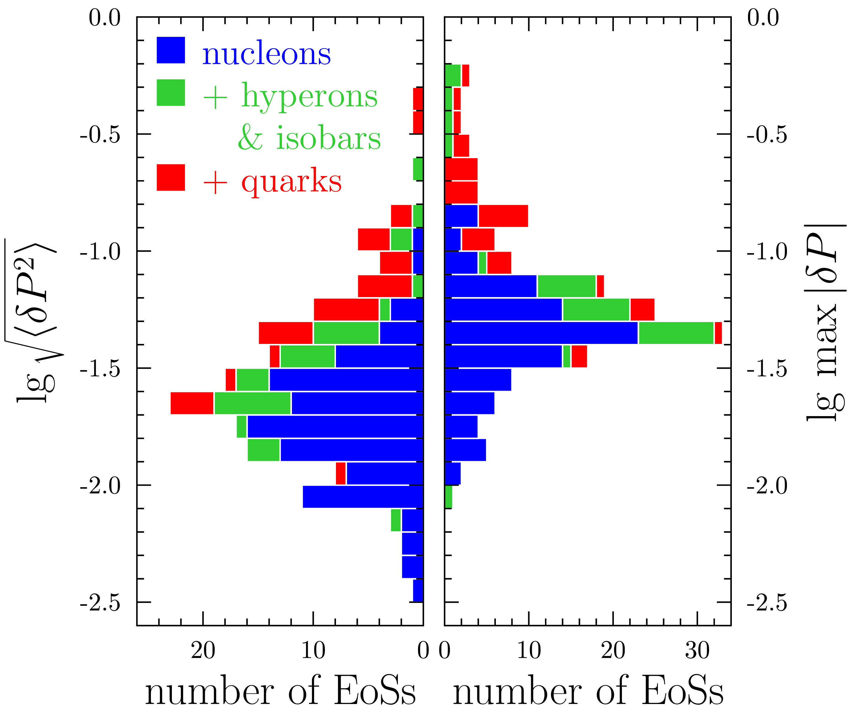


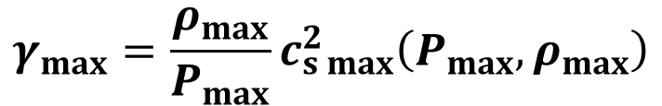

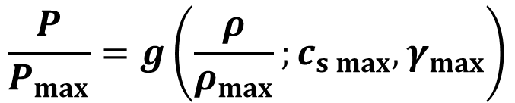
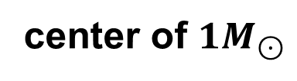
Step II: Universal Fit $P\left(ρ\right)$
$$\frac{P}{P_{max}}=g\left(\frac{ρ}{ρ_{max}};c_{s max},γ_{max}\right)$$
$$c_{s max}\left(P_{max},ρ_{max}\right)$$
$$γ_{max}=\frac{ρ_{max}}{P_{max}}c_{s max}^{2}\left(P_{max},ρ_{max}\right)$$
$$ρ≳3ρ_{0}$$
center of $1M_{⊙}$
$P−ρ$ and $M−R$ self-similarities

Slide 16
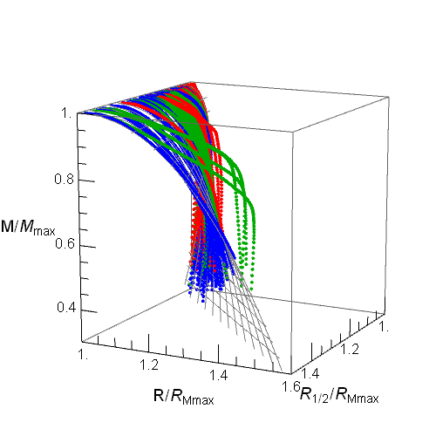
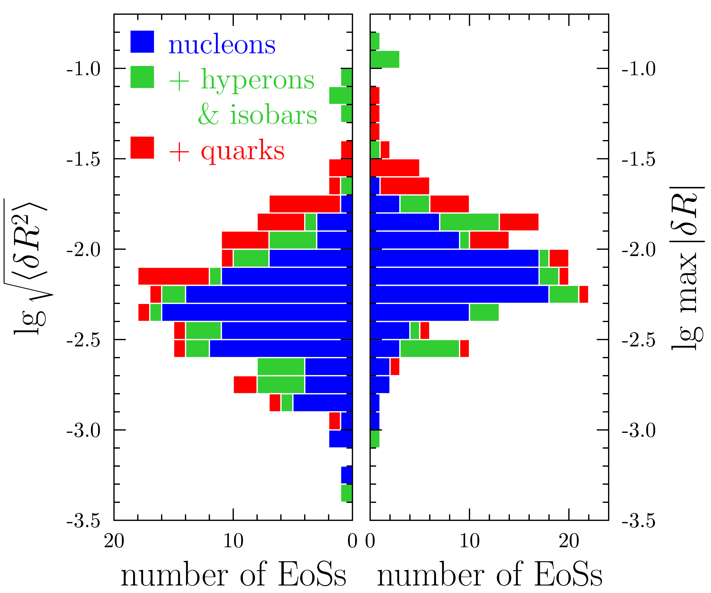



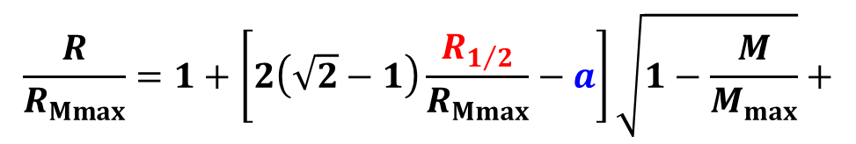
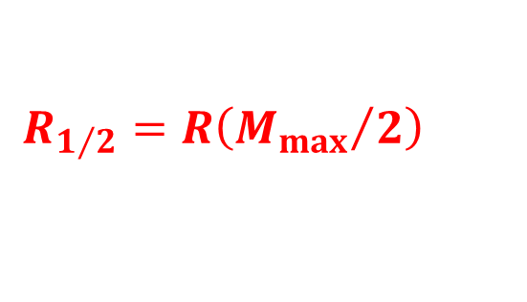
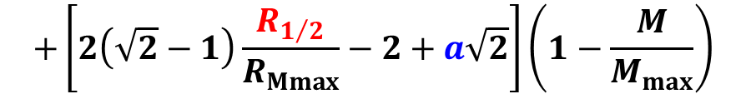
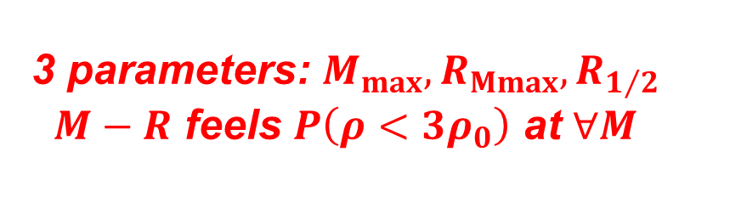
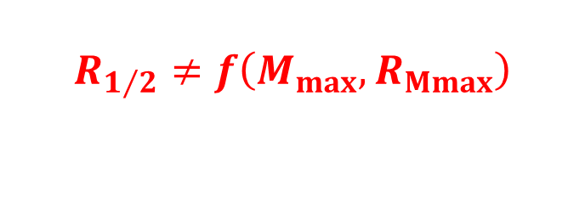
Step III: Universal Fit $R\left(M\right)$
$$\frac{R}{R_{Mmax}}=1+\left[2\left(\sqrt{2}−1\right)\frac{R_{1/2}}{R_{Mmax}}−a\right]\sqrt{1−\frac{M}{M_{max}}}+$$
$$a=0.478$$
1 fitting parameter
$$R_{1/2}=R\left({M_{max}}/2\right)$$
$$+\left[2\left(\sqrt{2}−1\right)\frac{R_{1/2}}{R_{Mmax}}−2+a\sqrt{2}\right]\left(1−\frac{M}{M_{max}}\right)$$
$$M≳1M_{⊙}$$
$$R_{1/2}≠f\left(M_{max},R_{Mmax}\right)$$
3 parameters: $M_{max},R_{Mmax},R_{1/2}$
$M−R$ feels $P\left(ρ<3ρ_{0}\right)$ at $∀M$
$P−ρ$ and $M−R$ self-similarities

Slide 17
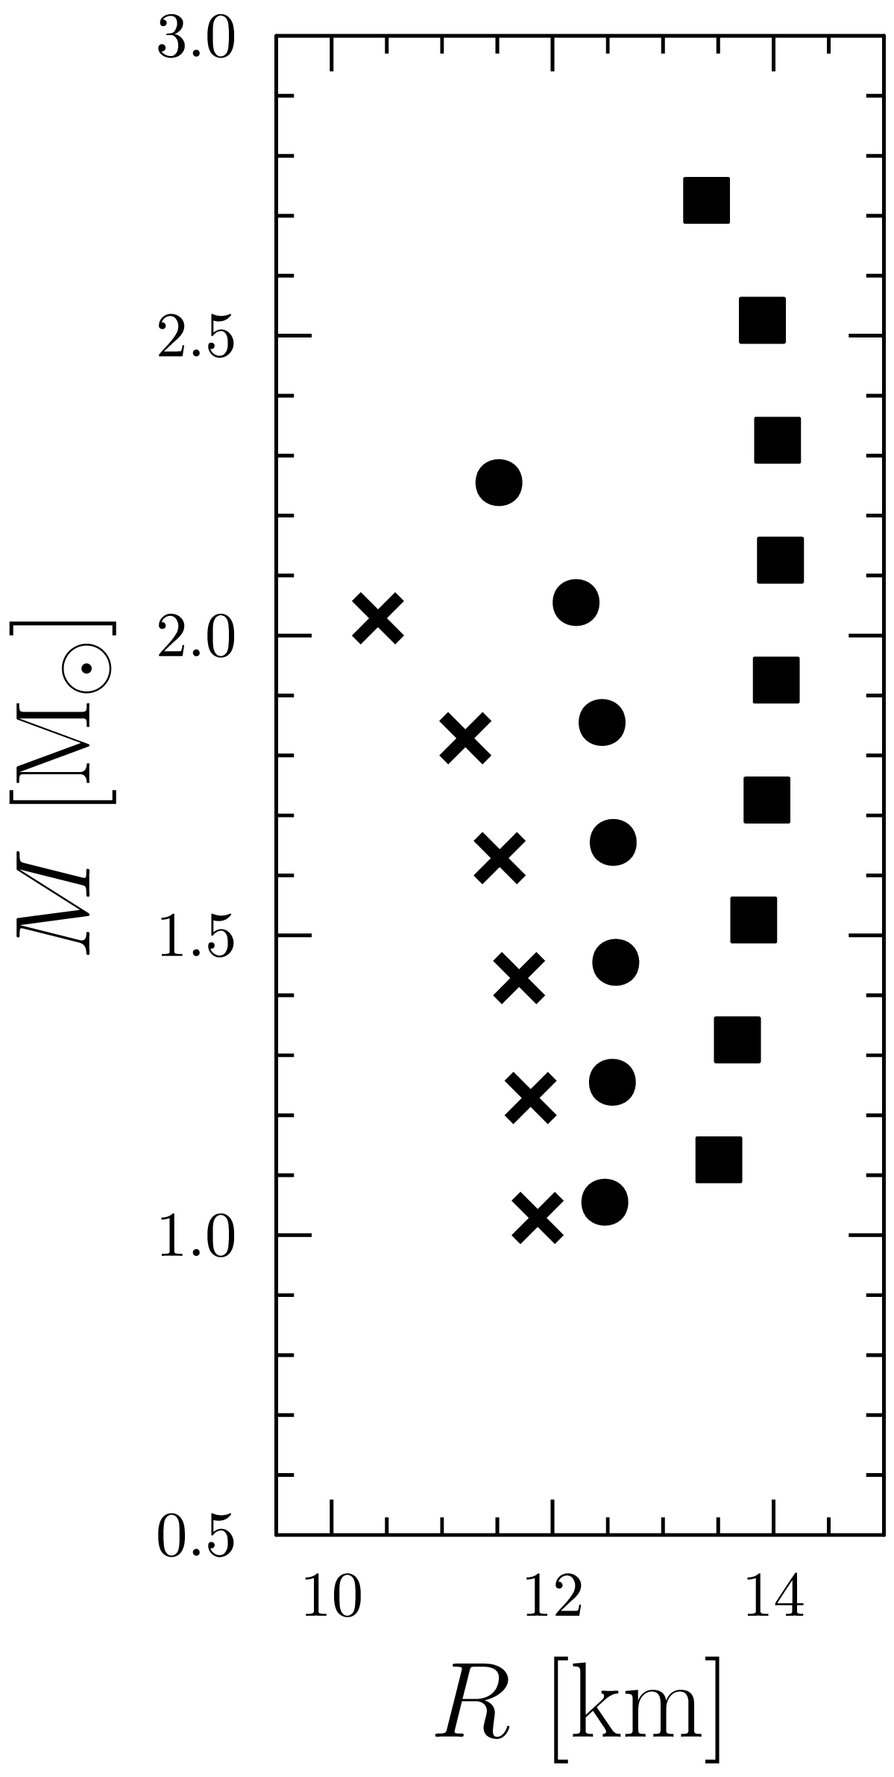
Inverse Oppenheimer-Volkoff Mapping
$P−ρ$ and $M−R$ self-similarities

Slide 18
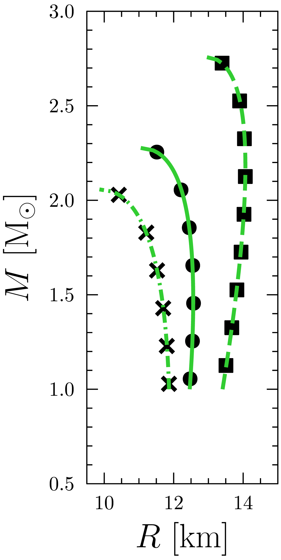

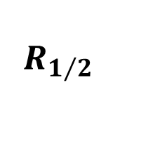


Inverse Oppenheimer-Volkoff Mapping
fit $R\left(M\right)$
$$f_{M}\left(P_{max},ρ_{max}\right)=M_{max}$$
$$f_{R}\left(P_{max},ρ_{max}\right)=R_{Mmax}$$
$$R_{1/2}$$
$P−ρ$ and $M−R$ self-similarities

Slide 19
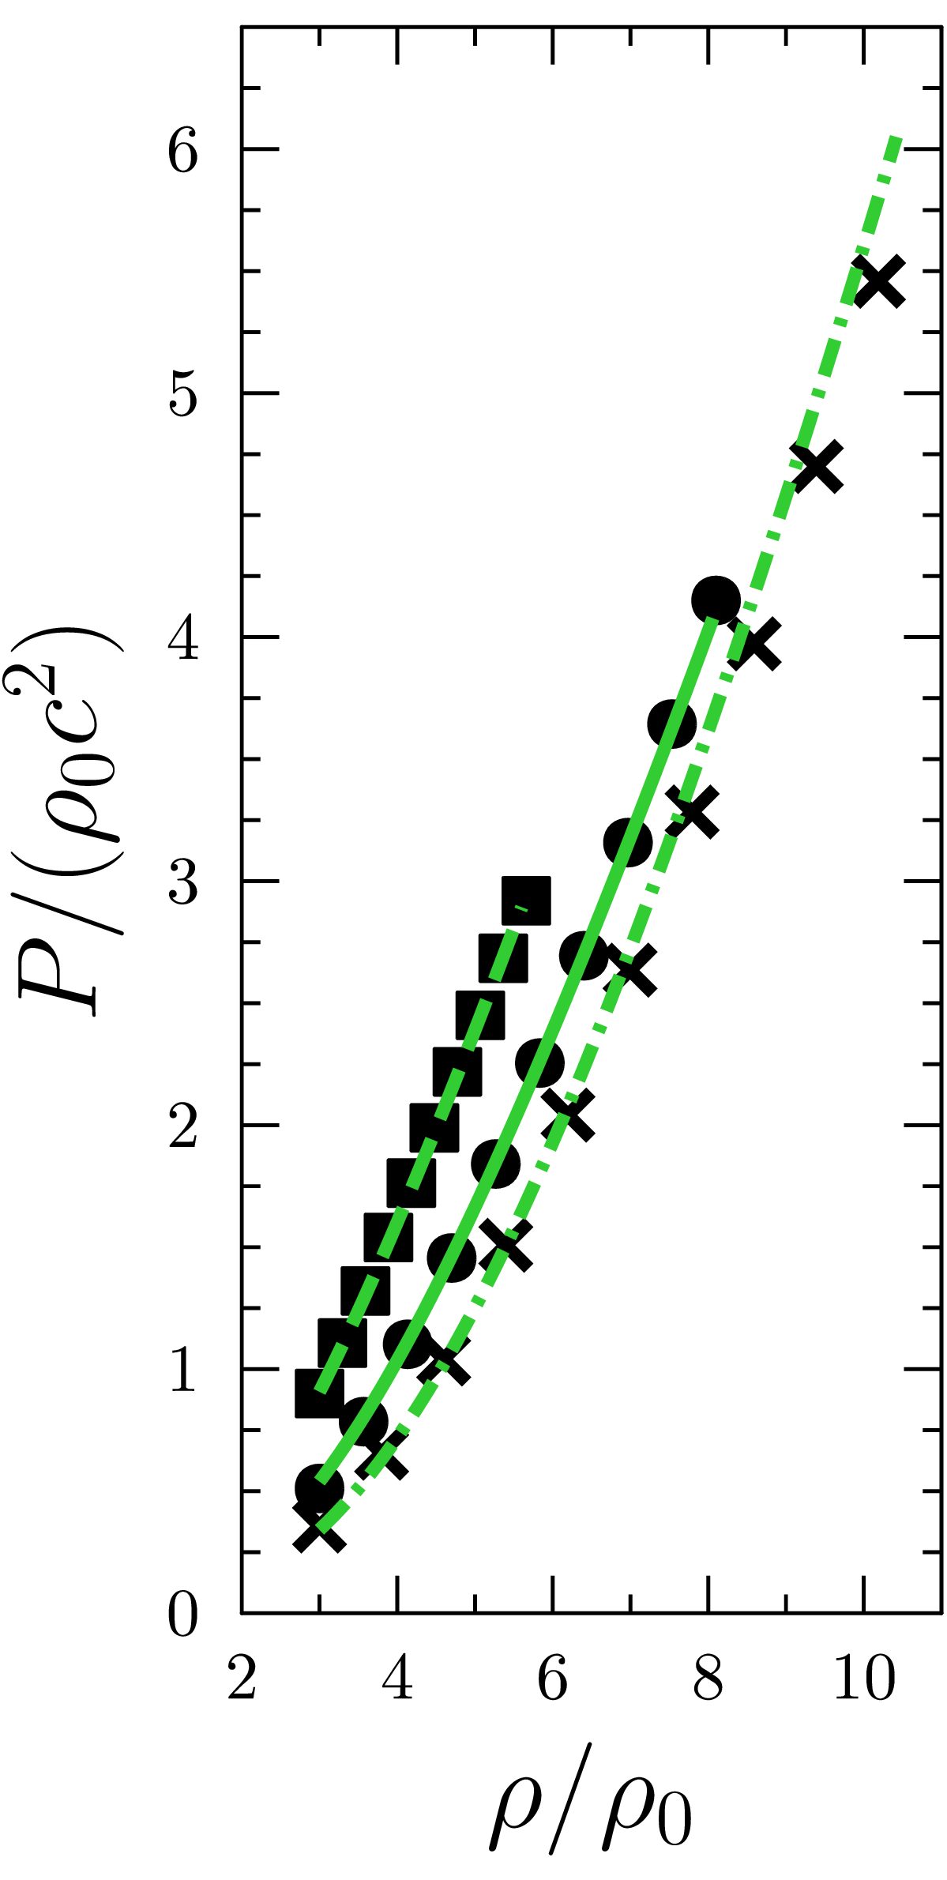
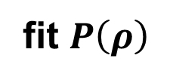
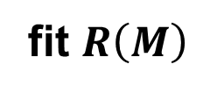
Inverse Oppenheimer-Volkoff Mapping
fit $R\left(M\right)$
$$f_{M}\left(P_{max},ρ_{max}\right)=M_{max}$$
$$f_{R}\left(P_{max},ρ_{max}\right)=R_{Mmax}$$
$$R_{1/2}$$
fit $P\left(ρ\right)$
$P−ρ$ and $M−R$ self-similarities

Slide 20
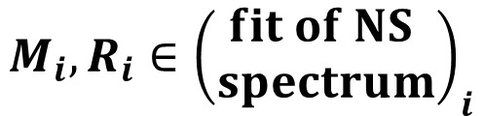

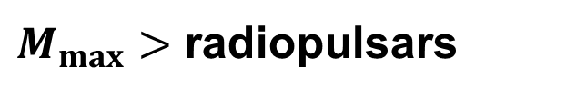
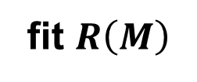

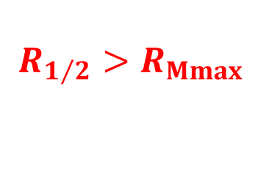
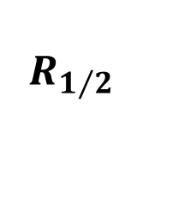


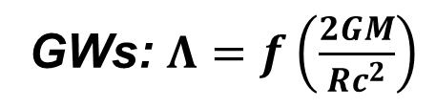
Analysis of Observations: Method
$M_{max}>$ radiopulsars
PSR J1614-2230
fit $R\left(M\right)$
PSR J0348+0432
Arzoumanian+’18;
Fonseca+’21
$$c_{s max}\left(P_{max},ρ_{max}\right)<c$$
GWs: $Λ=f\left(\frac{2GM}{Rc^{2}}\right)$
$$R_{1/2}>R_{Mmax}$$
Yagi & Younes’13,’16
GW170817
$$f_{M}\left(P_{max},ρ_{max}\right)=M_{max}$$
Abbot+’18
$$f_{R}\left(P_{max},ρ_{max}\right)=R_{Mmax}$$
$$M_{i},R_{i}∈{\left(\begin{aligned}fit of NS \\ spectrum\end{aligned}\right)}_{i}$$
$$R_{1/2}$$
PSR J0740+6620
Miller+’19; Riley+’19
?
PSR J0030+0451
fit $P\left(ρ\right)$
Miller+’21; Riley+’21
Cas A
Shternin+’23
$P−ρ$ and $M−R$ self-similarities

Slide 21












Analysis of Observations: Results
$$M_{max}−R_{Mmax}$$
$$R\left(M\right)$$
$$c_{s max}\left(P_{max},ρ_{max}\right)<c\left(+0.1c\right)$$
68%
$$P_{max}−ρ_{max}$$
90%
0740
0348
1614
$$P\left(ρ\right)$$
GW
0030
Cas A
$$M_{max}={2.29}_{−0.15}^{+0.15} M_{⊙}$$
$$P_{max}={4.1}_{−1.0}^{+1.0} ρ_{0}c^{2}$$
$$R_{1/2}={12.4}_{−0.6}^{+0.7}km$$
$$R_{max}={11.3}_{−0.6}^{+0.5} km$$
$$ρ_{max}={7.7}_{−0.8}^{+1.0} ρ_{0}$$
$P−ρ$ and $M−R$ self-similarities

Slide 22


Add More Observations
$M_{max}>$ radiopulsars
PSRs J1614-2230, J0348+0432
fit $R\left(M\right)$
+ spider PSRs
J0952−0607, J1311−3430, J1653−0158, J1810+1744
$$c_{s max}\left(P_{max},ρ_{max}\right)<c$$
Kandel&Romani’23
$$R_{1/2}>R_{Mmax}$$
GWs: $Λ=f\left(\frac{2GM}{Rc^{2}}\right)$
Yagi & Younes
’13,’16
$$f_{M}\left(P_{max},ρ_{max}\right)=M_{max}$$
GW170817
$$f_{R}\left(P_{max},ρ_{max}\right)=R_{Mmax}$$
$$M_{i},R_{i}∈{\left(\begin{aligned}fit of NS \\ spectrum\end{aligned}\right)}_{i}$$
$$R_{1/2}$$
PSRs J0740+6620, J0030+0451
?
+ X-ray bursters
Cas A
fit $P\left(ρ\right)$
4U 1702-429, 4U1724-307, SAX J1810.8-2609
$P−ρ$ and $M−R$ self-similarities

Slide 23







Results for More Observations
$$M_{max}−R_{Mmax}$$
$$R\left(M\right)$$
$$c_{s max}\left(P_{max},ρ_{max}\right)<c\left(+0.1c\right)$$
$$P_{max}−ρ_{max}$$
0952
1311
1653
1810
0740
0348
1810
1614
$$P\left(ρ\right)$$
68%
1702
1724
0030
90%
Cas A
spiders
bursters
GW
$$M_{max}={2.47}_{−0.12}^{+0.09}M_{⊙}$$
$$P_{max}={4.5}_{−0.8}^{+0.3}ρ_{0}c^{2}$$
$$R_{1/2}={12.0}_{−0.3}^{+0.3}km$$
$$R_{max}={11.5}_{−0.3}^{+0.3} km$$
$$ρ_{max}={7.3}_{−0.5}^{+0.5}ρ_{0}$$
$P−ρ$ and $M−R$ self-similarities

Slide 24

Discussion
Physics or antropology?
Extend to $ρ<3ρ_{0}$?
  Lattimer & Prakash 2001: $R_{1.4}∝P^{1/4}\left(2n_{0}\right)$
Extend to $M<1M_{⊙}$?
  Sufficient dimension of $M−R$ curves family?
Account for rotation?
  Talk by A. Konstantinou
$P−ρ$ and $M−R$ self-similarities

Slide 25

Conclusion
Maximum-mass NS – handful universal scale of hydrostatic properties of NSs
Using this scale we
  provide universal fits for $P−ρ$ and $M−R$
  derived explicit (semi)analytic inverse Oppenheimer-Volkoff mapping
This inverse OV mapping – new handful tool to gain properties of superdense matter from NS onservations
$P−ρ$ and $M−R$ self-similarities

Slide 26
Thank you!
More equations of state are welcome
$P−ρ$ and $M−R$ self-similarities

Slide 27


Comparison with Other Works
68%
90%
90% Jiang, Ecker & Rezzolla 2023
$P−ρ$ and $M−R$ self-similarities

