Slide 1
INVESTIGATIONS of REGION of EXTENDED RADIO SOURSE NGC315
Martik Hovhannisyan

Slide 2
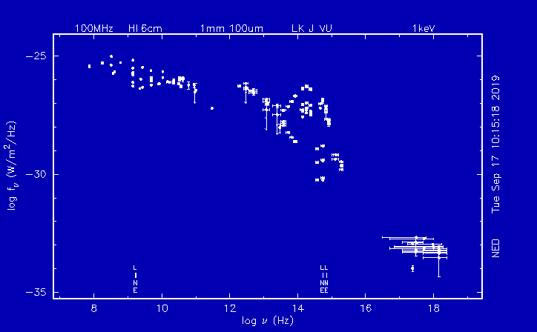

Slide 3
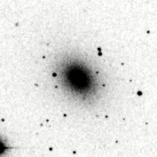

Slide 4
60 | 4 | 0.000354 | 231 | 0.044563
120 | 26 | 0.000575 | 806 | 0.017817
180 | 62 | 0.000609 | 1694 | 0.016642
240 | 111 | 0.000613 | 2929 | 0.016186
300 | 187 | 0.000661 | 4552 | 0.016099
360 | 276 | 0.000679 | 6547 | 0.016080
10’ | 15 | 0.04775 | 1 | 0.003183 | 14 | 0.044563
20’ | 33 | 0.02626 | 1 | 0.000796 | 46 | 0.036606
30’ | 57 | 0.02016 | 2 | 0.000707 | 82 | 0.029002
40’ | 86 | 0.01711 | 2 | 0.000398 | 125 | 0.017109
50’ | 132 | 0.01681 | 2 | 0.000255 | 171 | 0.021772
60’ | 179 | 0.01583 | 4 | 0.000354 | 231 | 0.020425

Slide 5
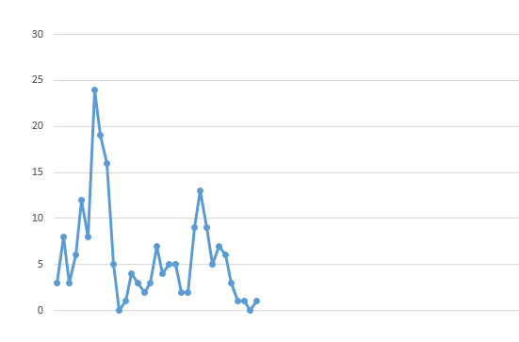
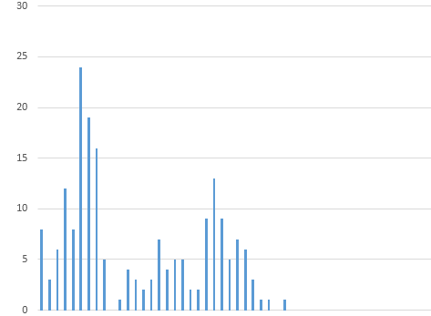

Slide 6
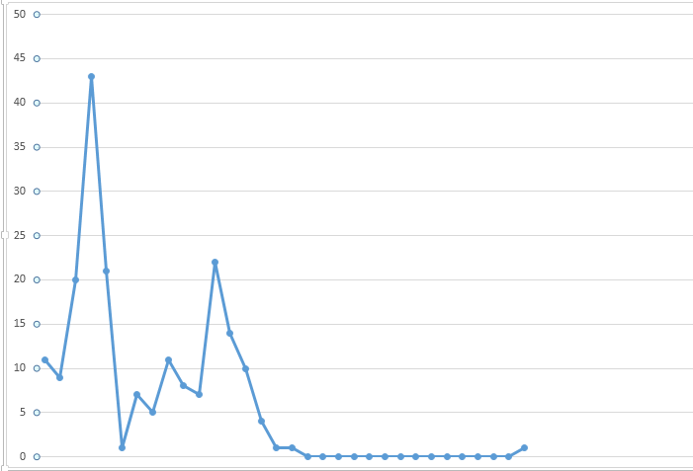
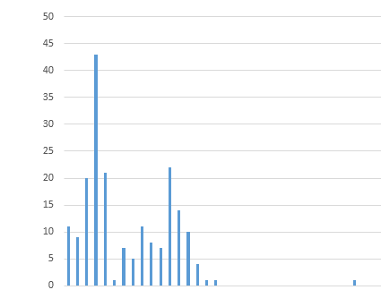

Slide 7
All data has taken from the site NASA.

Slide 8
THANK YOU

