Slide 1
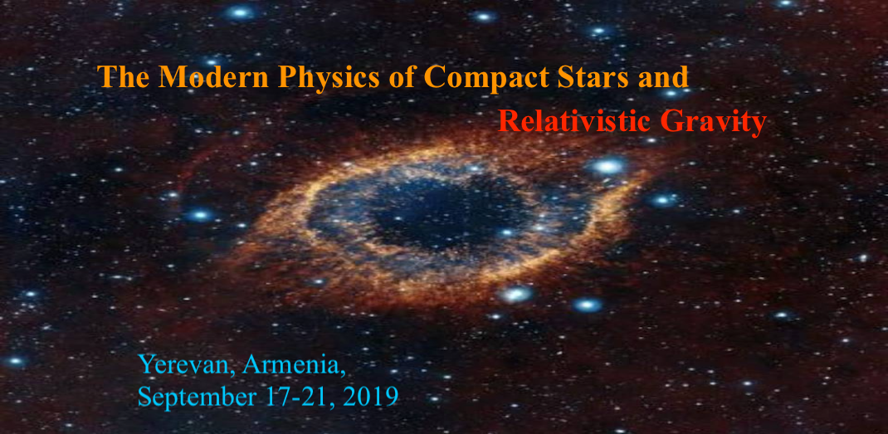


Cosmological constant induced by a bulk scalar in braneworlds with compact dimensions
A. A. Saharian, H. G. Sargsyan
Yerevan State University,
Gourgen Sahakyan Chair of Theoretical Physics

Slide 2
Outline
Motivation
Bulk and boundary geometries
The surface energy-momentum tensor
VEV and the induced cosmological constant
Conclusions

Slide 3
Models with extra dimensions
Many of high energy theories of fundamental physics are formulated in higher-dimensional spacetimes
Idea of extra dimensions has been extensively used in supergravity
Extra dimensions are predicted by string theory, at present the most promising candidate for the consistent quantum gravity theory and for a unification of fundamental interactions
Two types of models with extra dimensions
Kaluza-Klein type models: Extra dimensions are compact and they are accessible for all fields
Brane-world models: Standard model fields are localized on a hypersurface (brane). Gravity and possibly some other fields extend to all dimensions. Extra dimensions may be non-compact.

Slide 4
Boundary conditions in models with extra dimensions
In Kaluza-Klein type models the extra dimensions are compactified
Simplest example is the toroidal compactification
R¹
S¹
Topologically inequivalent configurations for fields
Untwisted field periodic boundary conditions
Twisted field antiperiodic boundary conditions
Generalized boundary conditions

Slide 5
Barneworld models: Randall-Sundrum 2-brane model
Original Randall-Sundrum model (RS1) offers a solution to the hierarchy problem by postulating 5D AdS spacetime bounded by two (3+1)-dimensional branes
Gravity is localized near UV or Planck brane
SM particles are localized on IR or TeV brane
AdS bulk
SM
Only graviton and some other non SM fields propagate in the bulk
UV brane
IR brane
y
Hierarchy problem between the gravitational and electroweak scales is solved for
k·distance between branes = 40

Slide 6
Randall-Sundrum 1-brane model
brane
Warp factor
Z₂ identification
y=0 y
Boundary condition on the brane
Constant
Normal to the brane

Slide 7
Generalized RS models with compact dimensions
Background geometry:
Topology
Background geometry contains two patches of the AdS glued by the brane and related by the -symmetry identification
Brane
Spatial geometry in the case D = 2, embedded into a 3D Euclidean space
For fields even under the reflection with respect to the brane
(untwisted scalar field) the boundary condition is of the Robin type with
, with c being the brane mass term
For fields odd with respect to the reflection (twisted fields) the boundary condition is reduced to the Dirichlet one

Slide 8
Fields
Charged scalar field with general curvature coupling
External classical gauge field
In models with nontrivial topology one need also to specify the periodicity conditions obeyed by the field operator along compact dimension
Special cases:
Untwisted fields Twisted fields
Boundary condition on the brane
normal to the brane
We assume that the gauge field is constant:
Though the corresponding field strength vanishes, the nontrivial topology gives rise to Aharonov-Bohm-like effects

Slide 9
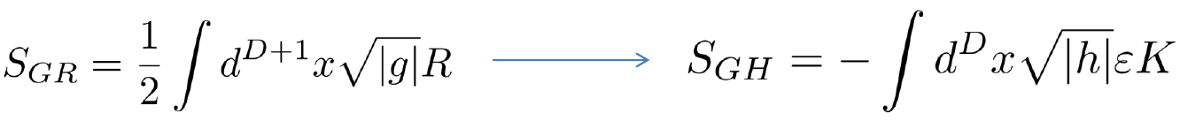
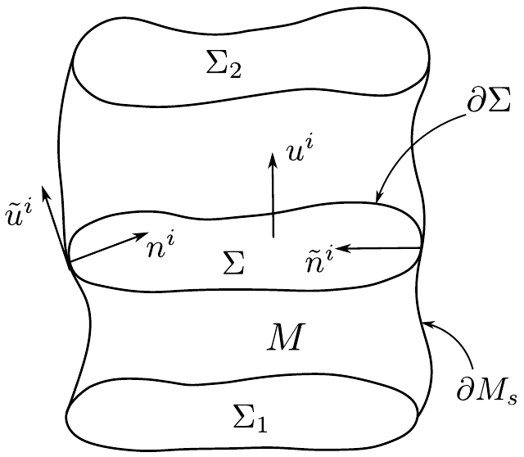
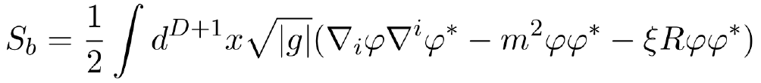
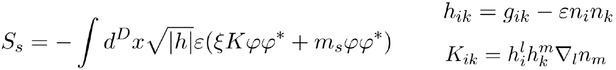
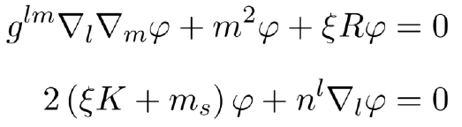
Bulk + Surface
The Gibbons-Hawking surface term in GR, in manifolds with boundaries
A complex scalar field on the background of a manifold with boundaries
The standard bulk action with
coupling (to the background curvature) constant
The surface action with the analog of Gibbons-Hawking term
and surface mass term
The equations of motion

Slide 10
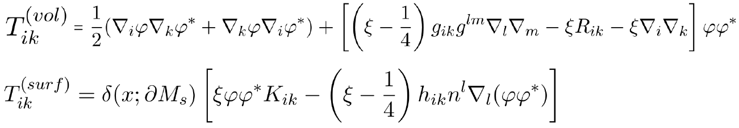
Surface energy-momentum tensor
The energy-momentum tensor
Extrinsic curvature tensor
Induced metric
Unit normal
Vacuum expectation value of the surface EMT on the brane
This corresponds to the generation of the cosmological constant on the branes by quantum effects

Slide 11
VEV of surface EMT
VEV of the surface energy-momentum tensor is expressed in terms of the VEV for field squared
VEV for the field squared is divergent and renormalization is required
We use the generalized zeta function technique

Slide 12
Cosmological constant on the brane
Renormalized vacuum energy density on the brane for
Hurwitz zeta function
Determines the magnetic flux enclosed by compact dimension

Slide 13
Cosmological constant on the brane
Cosmological constant measured in units of the AdS curvature radius
Depending on the values of the parameters the CC can be either positive or negative
Minimal coupling
Conformal coupling

Slide 14
The 2-brane model
Separation into 1-brane and 2nd brane contributions
Cosmological constant induced on the visible brane
by the hidden one

Slide 15
Conclusions
Why D≠3?
Quantum fluctuations of bulk fields induce cosmological constant on the brane
Induced cosmological constant is a periodic function of the magnetic flux enclosed by compact dimension with the period of the flux quantum
Depending on the values of the parameter the CC on the brane can be either positive or negative
If the length of the compact dimension is of the order of curvature radius for AdS, the induced energy density is of the order of dark energy driving the accelerated expansion of the Universe at recent epoch

Slide 16
Thank You!
Why D≠3?

