Slide 1
Bridging scales by modelling and replicating in silico
Computational Neuroscience at FIAS

Slide 2
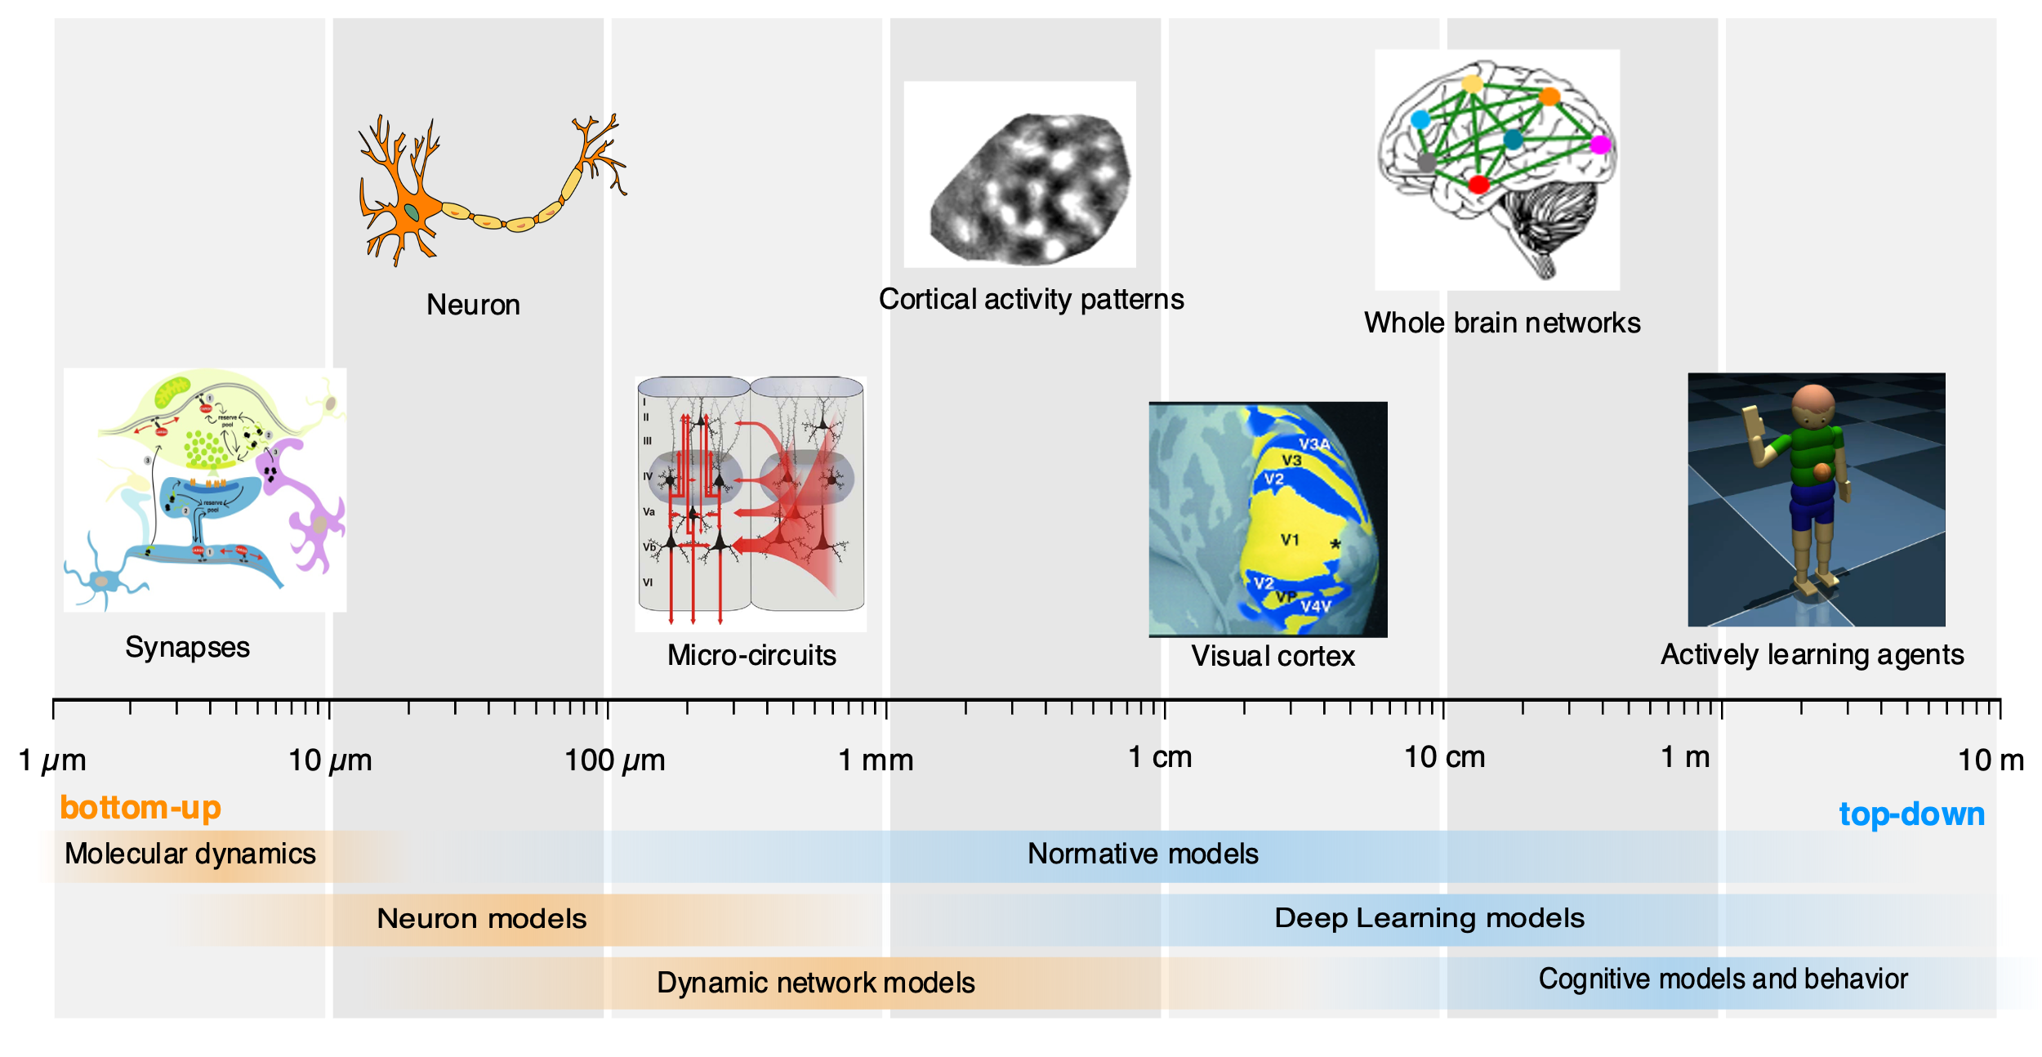
Multi-scale modelling and simulations of neural systems
Cuntz
Kaschube
Roig
Triesch
Multi-scale modelling
High-performance computing
Integration of theory and experiments

Slide 3

Computational Connectomics
DFG priority program SPP-2041
Topics
Key Results from FIAS
Who:
Scientists across Germany
FIAS participants:
J. Triesch (speaker)
M. Kaschube
T. Tchumatchenko
Automated reconstruction of brain connectivity
Curation and open-access distribution of large-scale data sets
Computational analyses of complex connectivity networks
Computational models of brain networks and their dynamics and function
Spine detection in 3D live cell imaging. Vogel, …, Triesch, …, Kaschube. Sci Rep. (2023)
V1 connectivity rules from in vivo recording. Kraynyukova, …, & Tchumatchenko. PNAS (2022)
Simulator development. Vieth, … & Triesch. Front. Neuroinform. (2021)

Slide 4
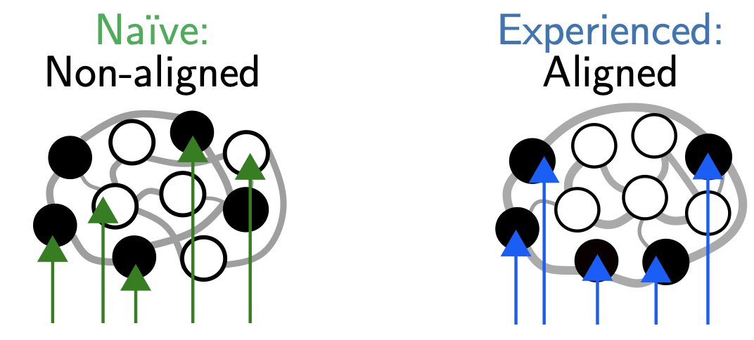
Emergence of representations during development
D-US Grants (NSF, NIH / BMBF)
Key results
Follow up work
D-US joint grants:
2016: with MPI Florida, D. Fitzpatrick
2020: with UMN Minnesota, G. Smith
2024: with UMN, G. Smith & UC Denver, B. Scholl (under review)
FIAS participants:
M. Kaschube
Highly structured spontaneous activty in infant cortex
Smith et al, Nature Neurosc. 2015, 2018
Activity structure universal across neocortex
Powel et al., PNAS 2024
Universal structure explained by
Turing-mechanism
Nature Com., in rev.
Reliable representations through feedforward-recurrent alignment: Nature Neurosc., in rev.
Visual cortex
Prefrontal cortex

Slide 5
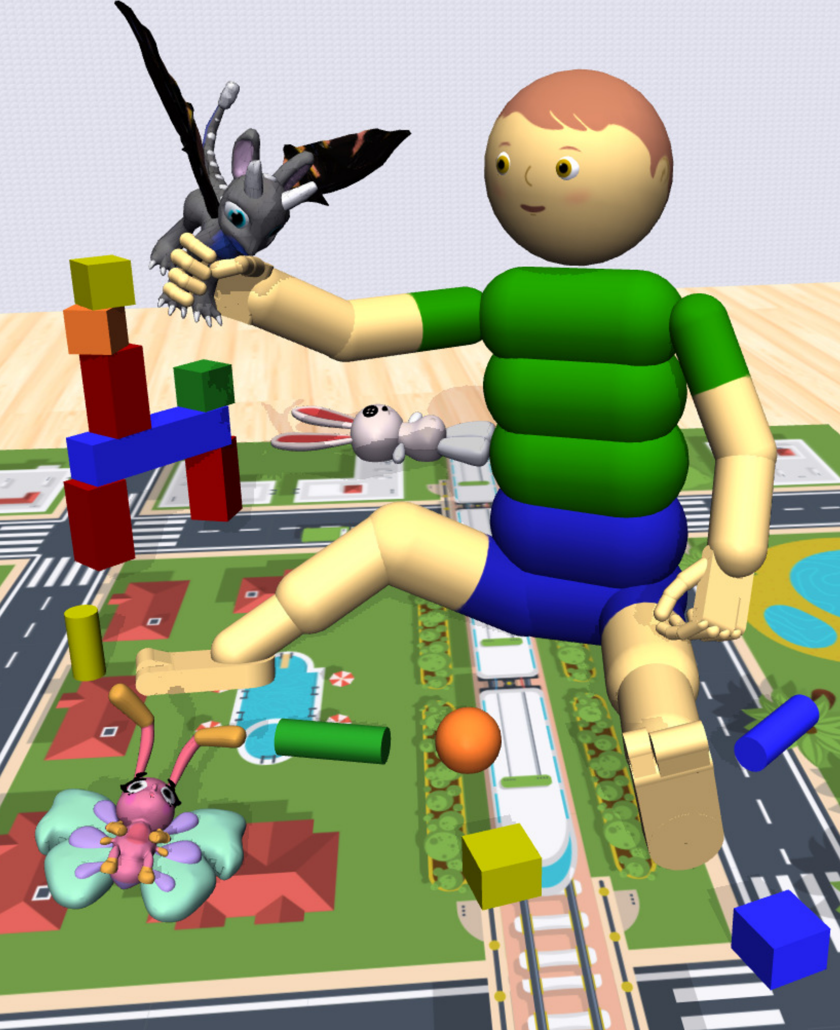
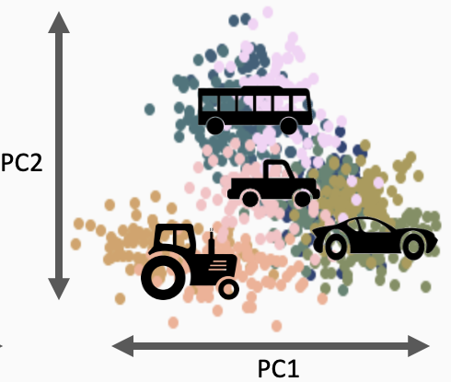
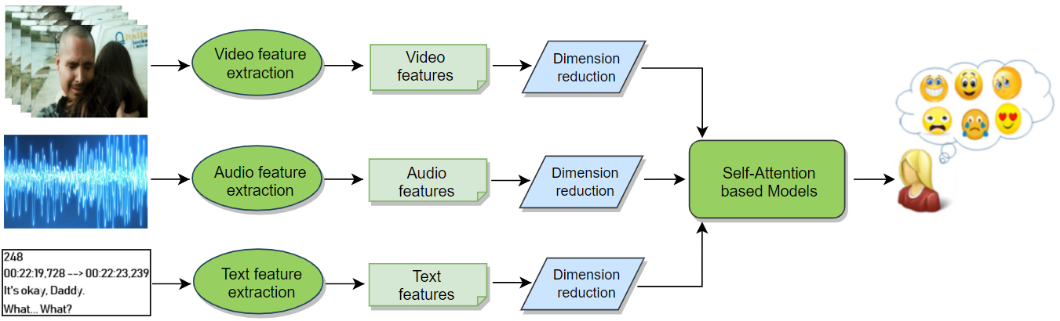
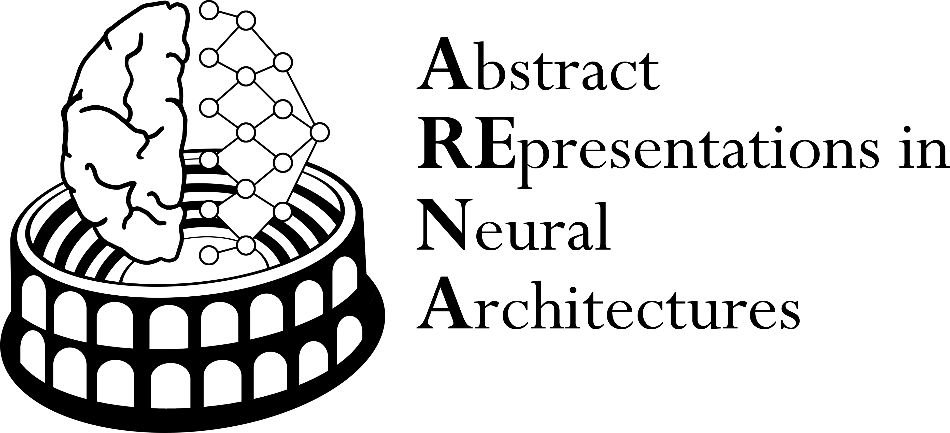
Abstract Representations in Neural Architectures
DFG FOR 5368 ARENA (2023-27)
Overall Goals
Subprojects
Who:
Psychology, Max Planck Soft. systems and FIAS scientists
FIAS participants:
J. Triesch
M. Kaschube
Gemma Roig, co-speaker
- Study principles underlying the representation of abstract knowledge in the brain
- How those emerge in the developing brain
- How abstract representations of knowledge are used for behaviors
Model in silico with AI
J. Triesch:
Active Learning
M. Kaschube:
\. Cognitive maps
G. Roig
Multimodal
learning

Slide 6
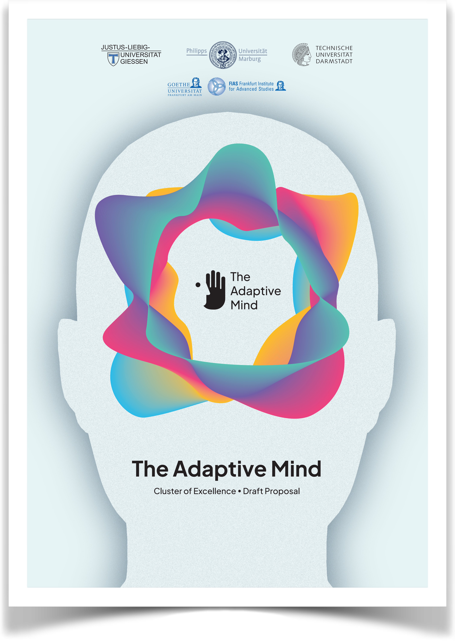
The Adaptive Mind (TAM)
Invited for an excellence initiative
Goals
System Level Research
Who:
Giessen, Marburg, Darmstadt; participating institutions: Goethe Univ.,
FIAS participants:
J. Triesch
G. Roig
Understand human perception, thought, action by uncovering how humans adapt to changing conditions.
Focus on 5 key areas:
regulation,
causality,
categorization,
prediction,
reciprocity
Cognitive Development in silico
MIMo: Multi-Modal Infant Model
Aubret et al., ICLR (2023); Mattern et al. IEEE TCDS (2024)

Slide 7

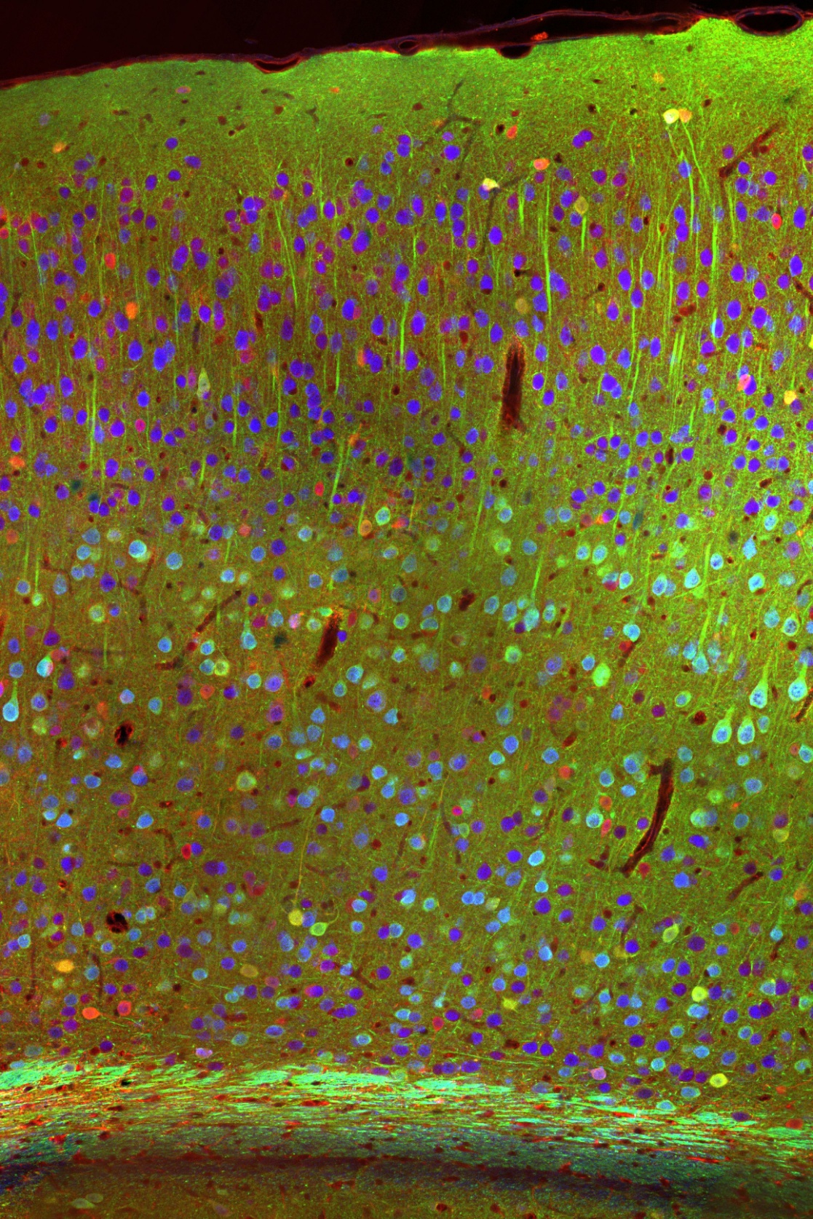
Emerging Initiatives
Circuit mechanisms of creativity
Bernstein Conference
for Computational Neuroscience
FIAS conference:
Bridging Fields in Creativity Research
Sep 11-13 2024
26 speakers
40 participants
Planned DFG FOR
In Frankfurt 2024-2026
World’s top 3
+500 participants
Notes:
Bernstein Conference 2024-2026

Slide 8
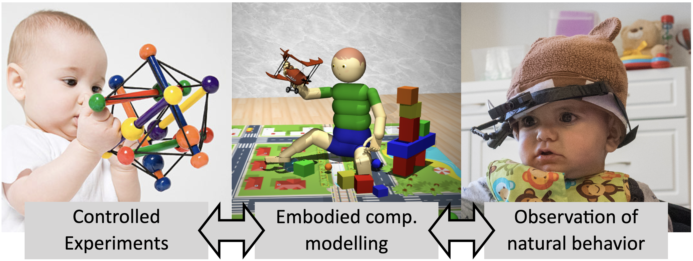
Emerging Initiatives
Consciousness in Natural and Artificial Systems
Initiatives in the Area of Mental Health
* DYNAMIC (LOEWE Center)
Topic: Psychiatric Disorders,
FIAS participants: J. Triesch, G. Roig (affiliated)
* EpiImmune (CRC/Transregio application)
Topic: Epilepsy,
FIAS participants: J. Triesch, G. Roig
* MOPRED (GRK application)
Topic: Multimodal-Processing
FIAS participants: M. Kaschube, G. Roig
What: “LOEWE Schwerpunkt“ pre-proposal selected in internal competition of Goethe University
Who: scientists from Frankfurt and Giessen; at FIAS: G. Roig, G. Pipa, J. Triesch (co-speaker)
Goals: better understand the development of different facets of consciousness; explore possibility of conscious AI systems.
Notes:
There are also initiatives where we develop machine learning techniques to improve diagnosis and treatment of mental disorders.

Slide 9
Dynamic Neural Representations Potential Research Focus
Experimental neuroscience
Research focus:
Neural mechanisms and implementation
Refinement in learning and development
Dynamic sequences for reasoning
Links to newly established brain-imaging center CoBIC
Collaborative research initiative in preparation
Long-term perspective: Top-down approach towards a digital twin of the brain
Computational neuroscience
Representational learning in AI
Foundations in ML
Cognition and Behavior
FIAS
TAM
hessian.ai
RAI

Slide 10
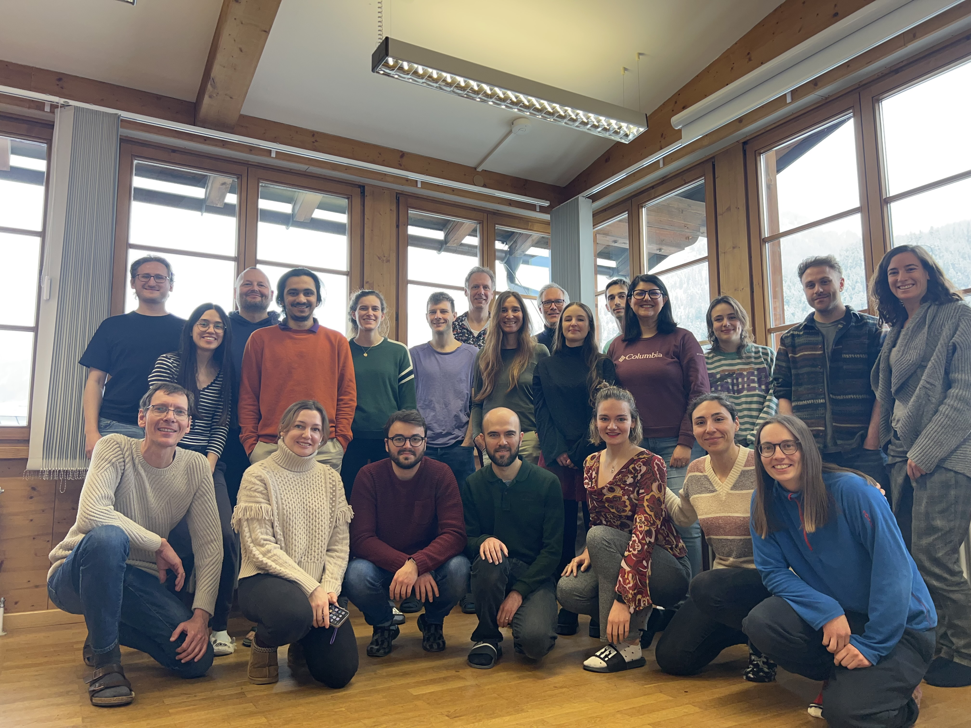
Overall summary
connectivity
activity
function
behaviour
Bridging scales and levels of understanding, modelling and replicating in silico
ARENA retreat 2024
Vibrant environment (3 Max-Planck Institutes, Ernst Strüngmann Institute, CoBIC, Hessian.AI, RMN2, ICNF)
High impact publications (Nature Communications, Nature human behaviour, Neuron, PNAS (2), Scientific Reports (3), Cell reports (3), Elife (3),
PLOS Computational Biology (6), Journal of Cognitive Neuroscience, NeurIPS (2), ICLR, NeuroImage (2), MLHC (2))
Multiple ongoing and planned collaborative initiatives

Slide 11
THANK YOU!

