Slide 1
FIAS – Status and Strategy
E Elsen
FIAS Scientific Advisory Board, March 13-14, 2024

Slide 2
FIAS SAB Membership
Frankfurt
  Prof. Dr. Ulrich Achatz
  Prof. Dr. Volker Dötsch (Chair)
  Prof. Dr. Owe Philipsen
External
  Prof. Dr. Alberta Bonanni
  Prof. Dr. Edda Klipp
  PD Dr. Aneta Koseska
  Dr. Luciano Musa
  Prof. Dr. Reinhard Schneider
  Prof. Dr. Arndt von Haeseler
Thanks for helping us with your assessment.

Slide 3


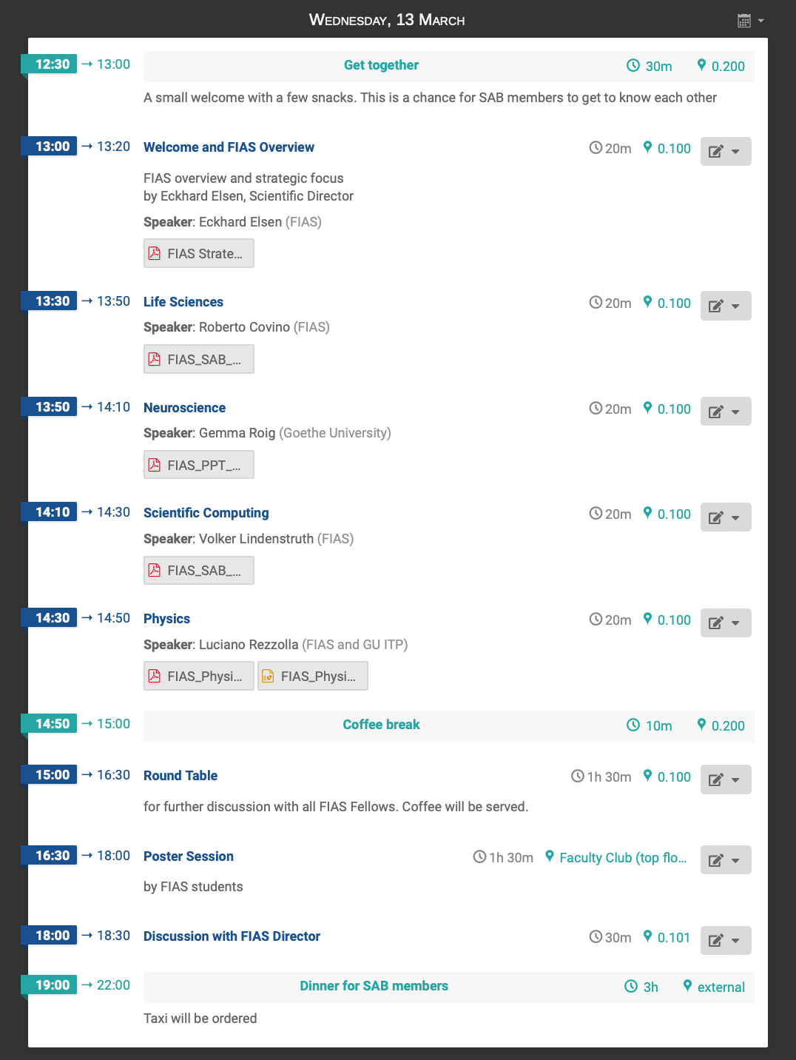
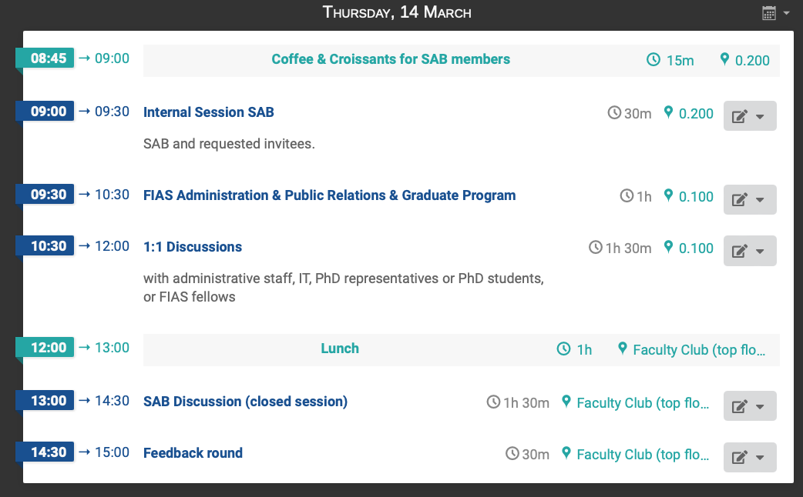
Agenda
4 topics
FIAS SAB report
Time to discuss
Questions for clarification?

Slide 4
Brief introduction to FIAS

Slide 5
20 Years of FIAS
FIAS
  founded in 2004
    Walter Greiner (Theoretical Physics)
    Wolf Singer (Neuroscience)
    Rudolf Steinberg (President GU)
with the mission to support theoretical natural science
  Relocation to new FIAS building (Giersch Foundation) in 2007
  New „constitution“ instigated by Board of Trustees (Stiftungsrat) in 2022
    „lean management“
    Change in funding structure

Slide 6
FIAS Finances – qualitatively
Base funding is provided by Goethe University. It covers
    rent
    infrastructure maintenance
    salaries of administration
    …
Project funding
    DFG, Helmholtz, EU, etc.
    donations
typical numbers only

Slide 7
Finances
After reorganisation
  FIAS almost entirely relies on grants to carry out research
  Fixed cost (rent and services) are covered by base funding from university
  Small residual assets are not recurring and need to be carefully targeted including
    risk management
    inflation
    salary increases on endowments
~500 k€

Slide 8
Positioning FIAS scientifically

Slide 9
Positioning FIAS scientifically
Given the Funding situation
  FIAS has to set itself apart from a university institute
FIAS holds a privileged position in the Frankfurt science landscape with
  Goethe University
  Max Planck Institutes
  Helmholtz Centres and Institutes
  Leibniz Institutes
  Private Research Institutions

Slide 10
Identifying (future) Scientific Topics
Faculty of Senior Fellows serves as the advisory body of the director
  Proposals for new projects are guided by ongoing projects and follow-up projects
  No established mechanism to seize new opportunities
Unsurprisingly the search for a consistent portfolio has been slow
  Stiftungsrat has been very helpful and demanding
FIAS Faculty
  H Elfner
  M L Hansmann
  G Hummer
  M Kaschube
  U Kebschull
  V Lindenstruth
  L Rezzolla
  W Singer
  H Stöcker
  J Triesch
  P Wild

Slide 11
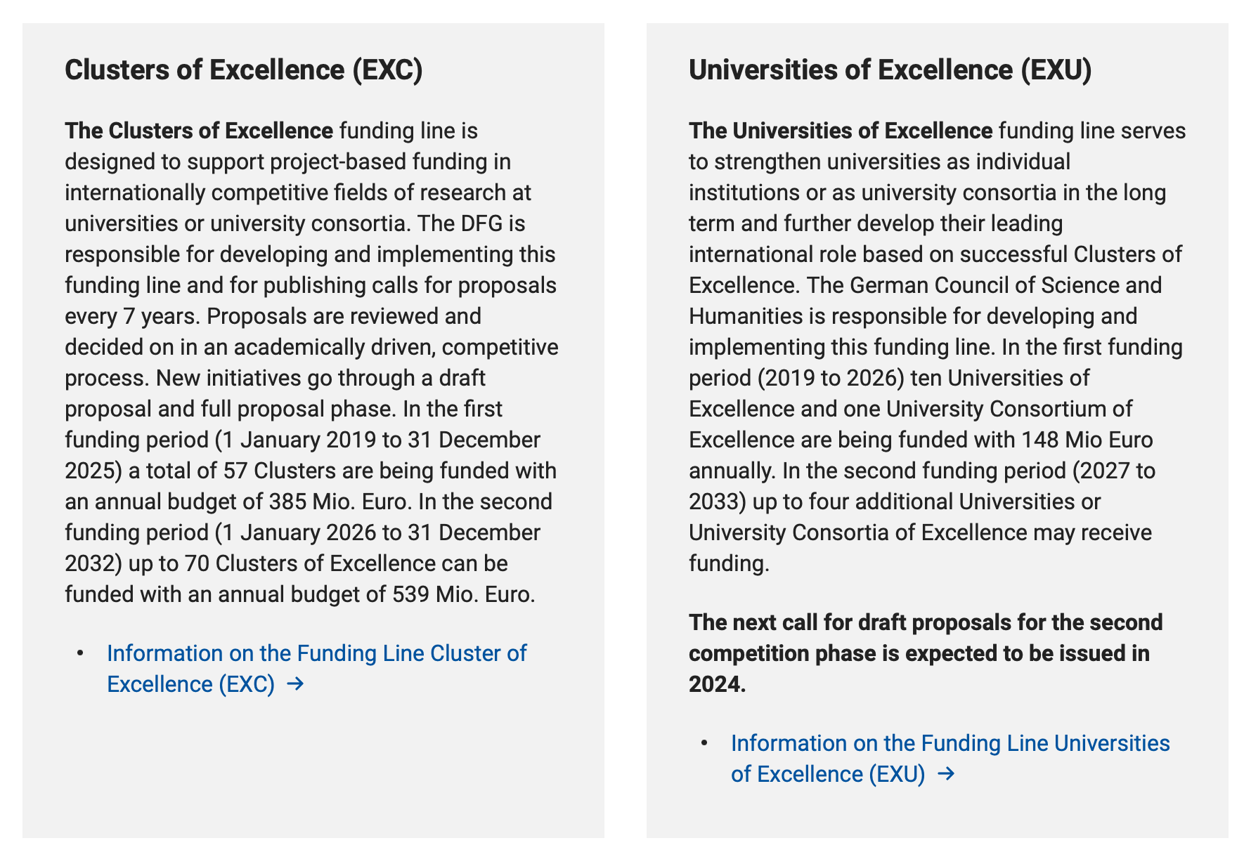

An aside – DFG Excellence Strategy for Universities
Competition of German Universities
  Additional funding for
    specific topics (EXC)
    Universities (EXU)

Slide 12
FIAS Participation in DFG Excellence Initiative
EMTHERA – Frankfurt and Mainz
  excellent support by R Covino, V Satagopam
ELEMENTS – Frankfurt and Darmstadt
  L Rezzolla, H Elfner and S Nissanke
SCALE – Frankfurt
  R Covino, G Hummer, F Matthäus, S Thallmair, T Sokolowski, V Lindenstruth
The Adaptive Mind (TAM) – Darmstadt, Gießen, Marburg
  J Triesch and G Roig
No invitation for full application
recent news from DFG
Invited to full application

Slide 13
Ongoing and future topics at FIAS

Slide 14
Thematic Opportunities
Life Science and Biophysics
  SCALE
  Multi-scale modelling of biological systems (CMMS)
  Computational bio-medicine
Neuroscience
  Multi-scale modelling of neural systems
  The Adaptive Mind (TAM), Consciousness (LOEWE)
Scientific Computing
  sustainable computing through architectures and algorithms
SCALE
TAM
NHR initiative

Slide 15
Thematic Opportunities cont'd
Physics
  Dense nuclear matter
    Heavy ion collisions, EOS in nuclear matter
  Gravitation
    Expand topic jointly with university
  Quantum
    Theoretical exploration at FIAS to complement hardware initiative at GU, i.e. quantum computer installation (T Lippert et al.)
    Engagement in initiatives (Open Quantum Initiative Geneva)

Slide 16
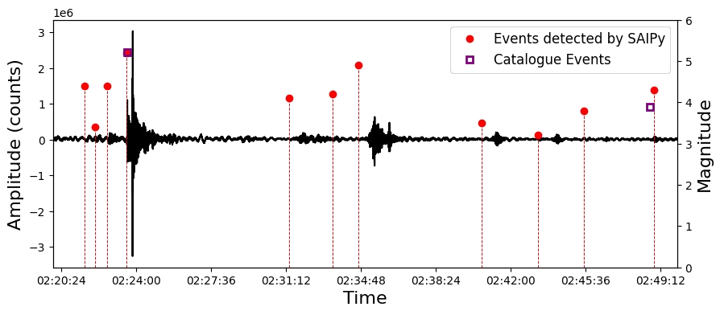
Thematic Opportunities: Sustainability
Environmental topics
  Structure of Lightnings
  Electricity network operation with widely distributed sources
  volcano eruptions, tsunamis, violent climate events
Application of AI methods
AI tools for swift recognition

Slide 17
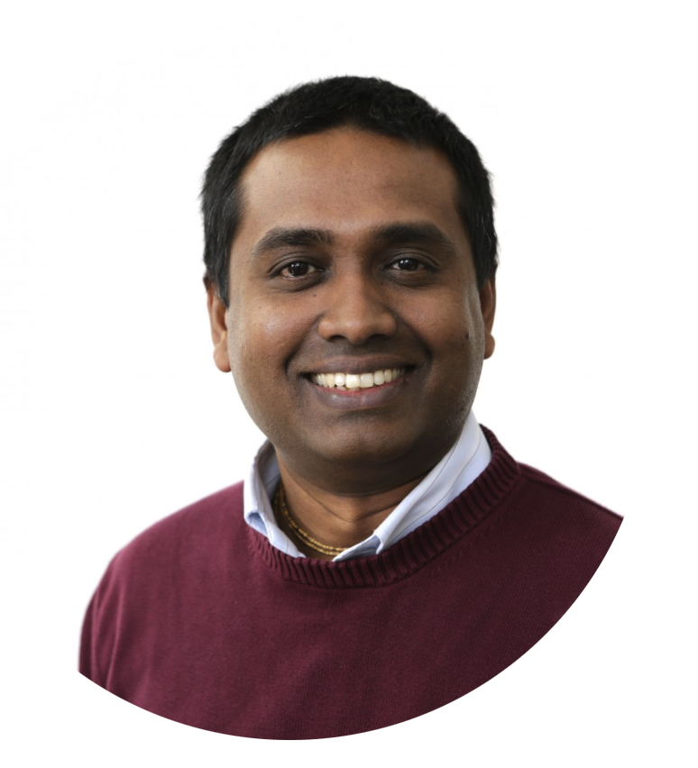
Computational Biomedicine and Therapeutics
Computational tools for biological and translational research
  responsible use of approaches from AI
  multi-scale modelling
  complex and diverse data integration and interpretation, standardisation, and ethical and legal considerations.
Existing collaboration with University of Luxemburg
  Studies on a limited cohort sets an
  excellent example
Venkata Satagopam

Slide 18
Using the Giersch Conference 2023 for soul searching

Slide 19
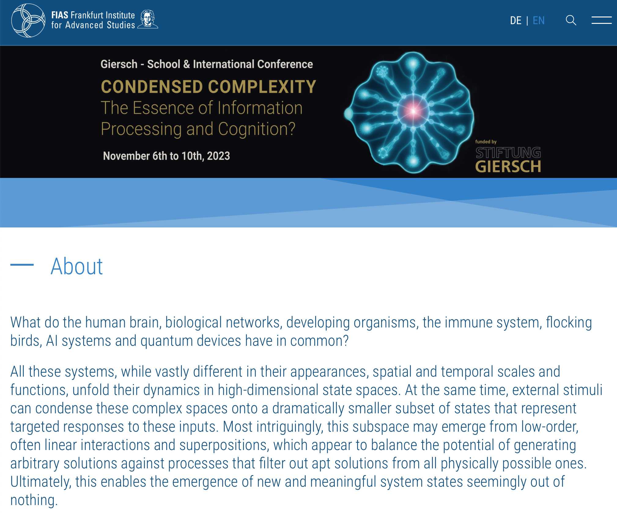
Giersch Conference 6.-10.11.2023
Graphics from OpenAI;
generated from abstract
Abstract as synthesis from discussions

Slide 20
Condensed Complexity
The Essence of Information Processing and Cognition?
What do the human brain biological networks developing organisms the immune system flocking birds AI systems and quantum devices have in common?
All these systems while vastly different in their appearances spatial and temporal scales and functions unfold their dynamics in high-dimensional state spaces. At the same time external stimuli can condense these complex spaces onto a dramatically smaller subset of states that represent targeted responses to these inputs. Most intriguingly this subspace may emerge from low-order often linear interactions and superpositions which appear to balance the potential of generating arbitrary solutions against processes that filter out apt solutions from all physically possible ones. Ultimately this enables the emergence of new and meaningful system states seemingly out of nothing. Is this the basis of knowledge cognition and information processing in general? And if so can we identify common principles and relevant differences by comparing such systems across different realms and disciplines?
This conference will bring together experts from neuroscience molecular and developmental biology simulation and machine learning and quantum computing and sensing. It will explore fundamental commonalities across systems from these distinct fields at the same time highlighting their peculiarities and how material and temporal constraints may have shaped them.

Slide 21
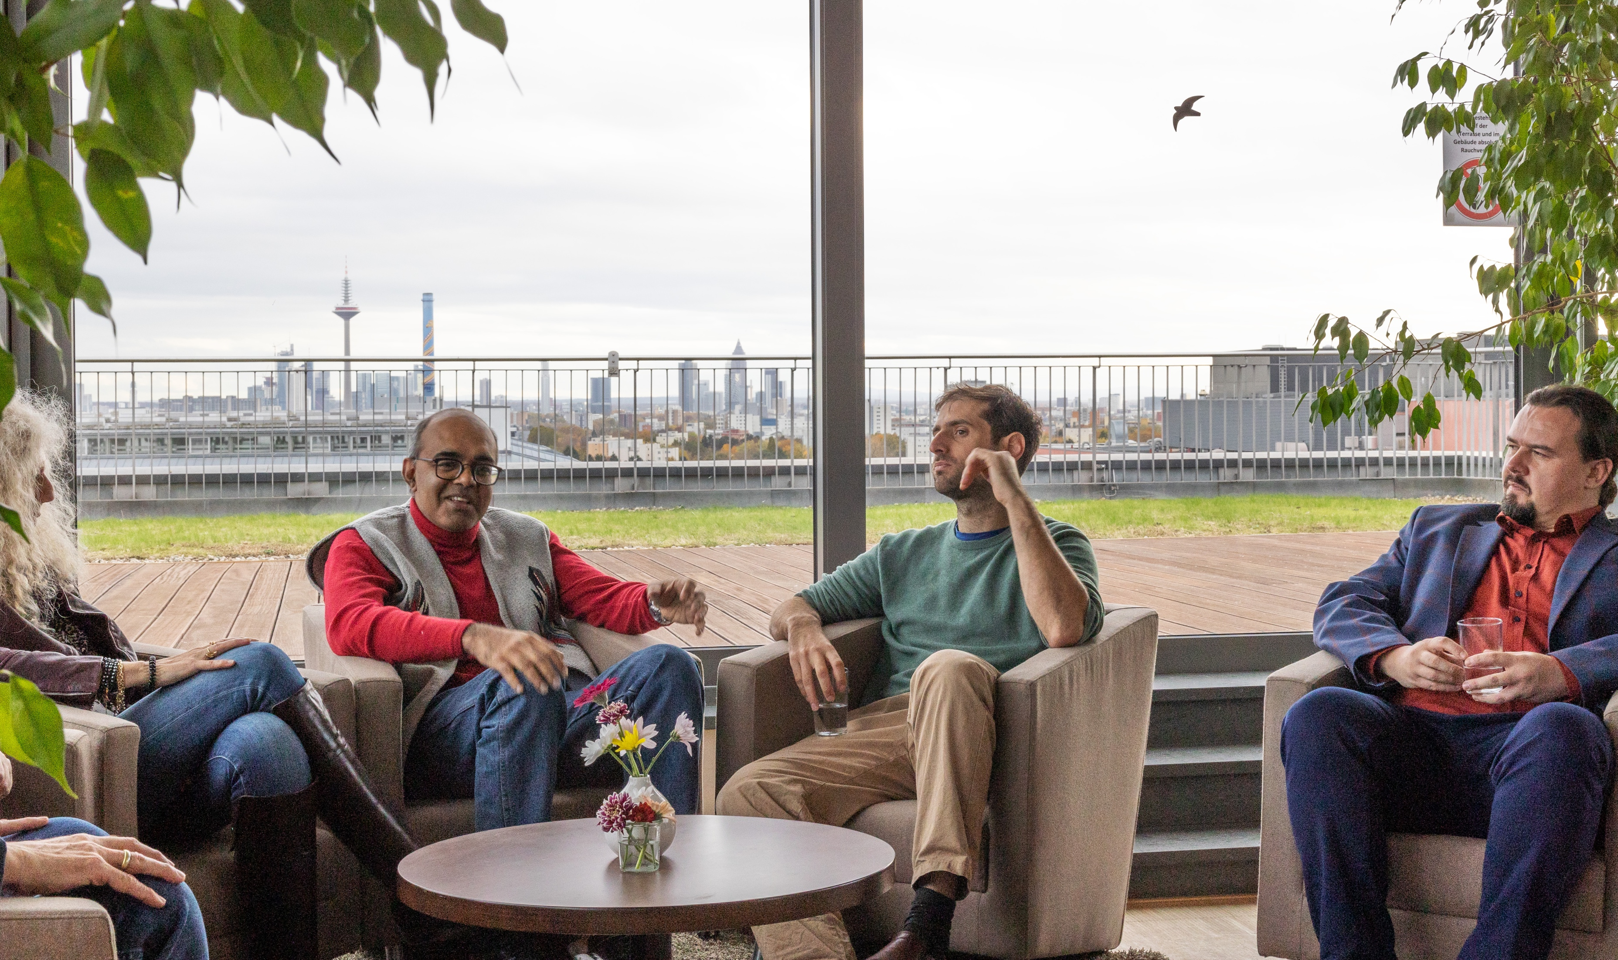
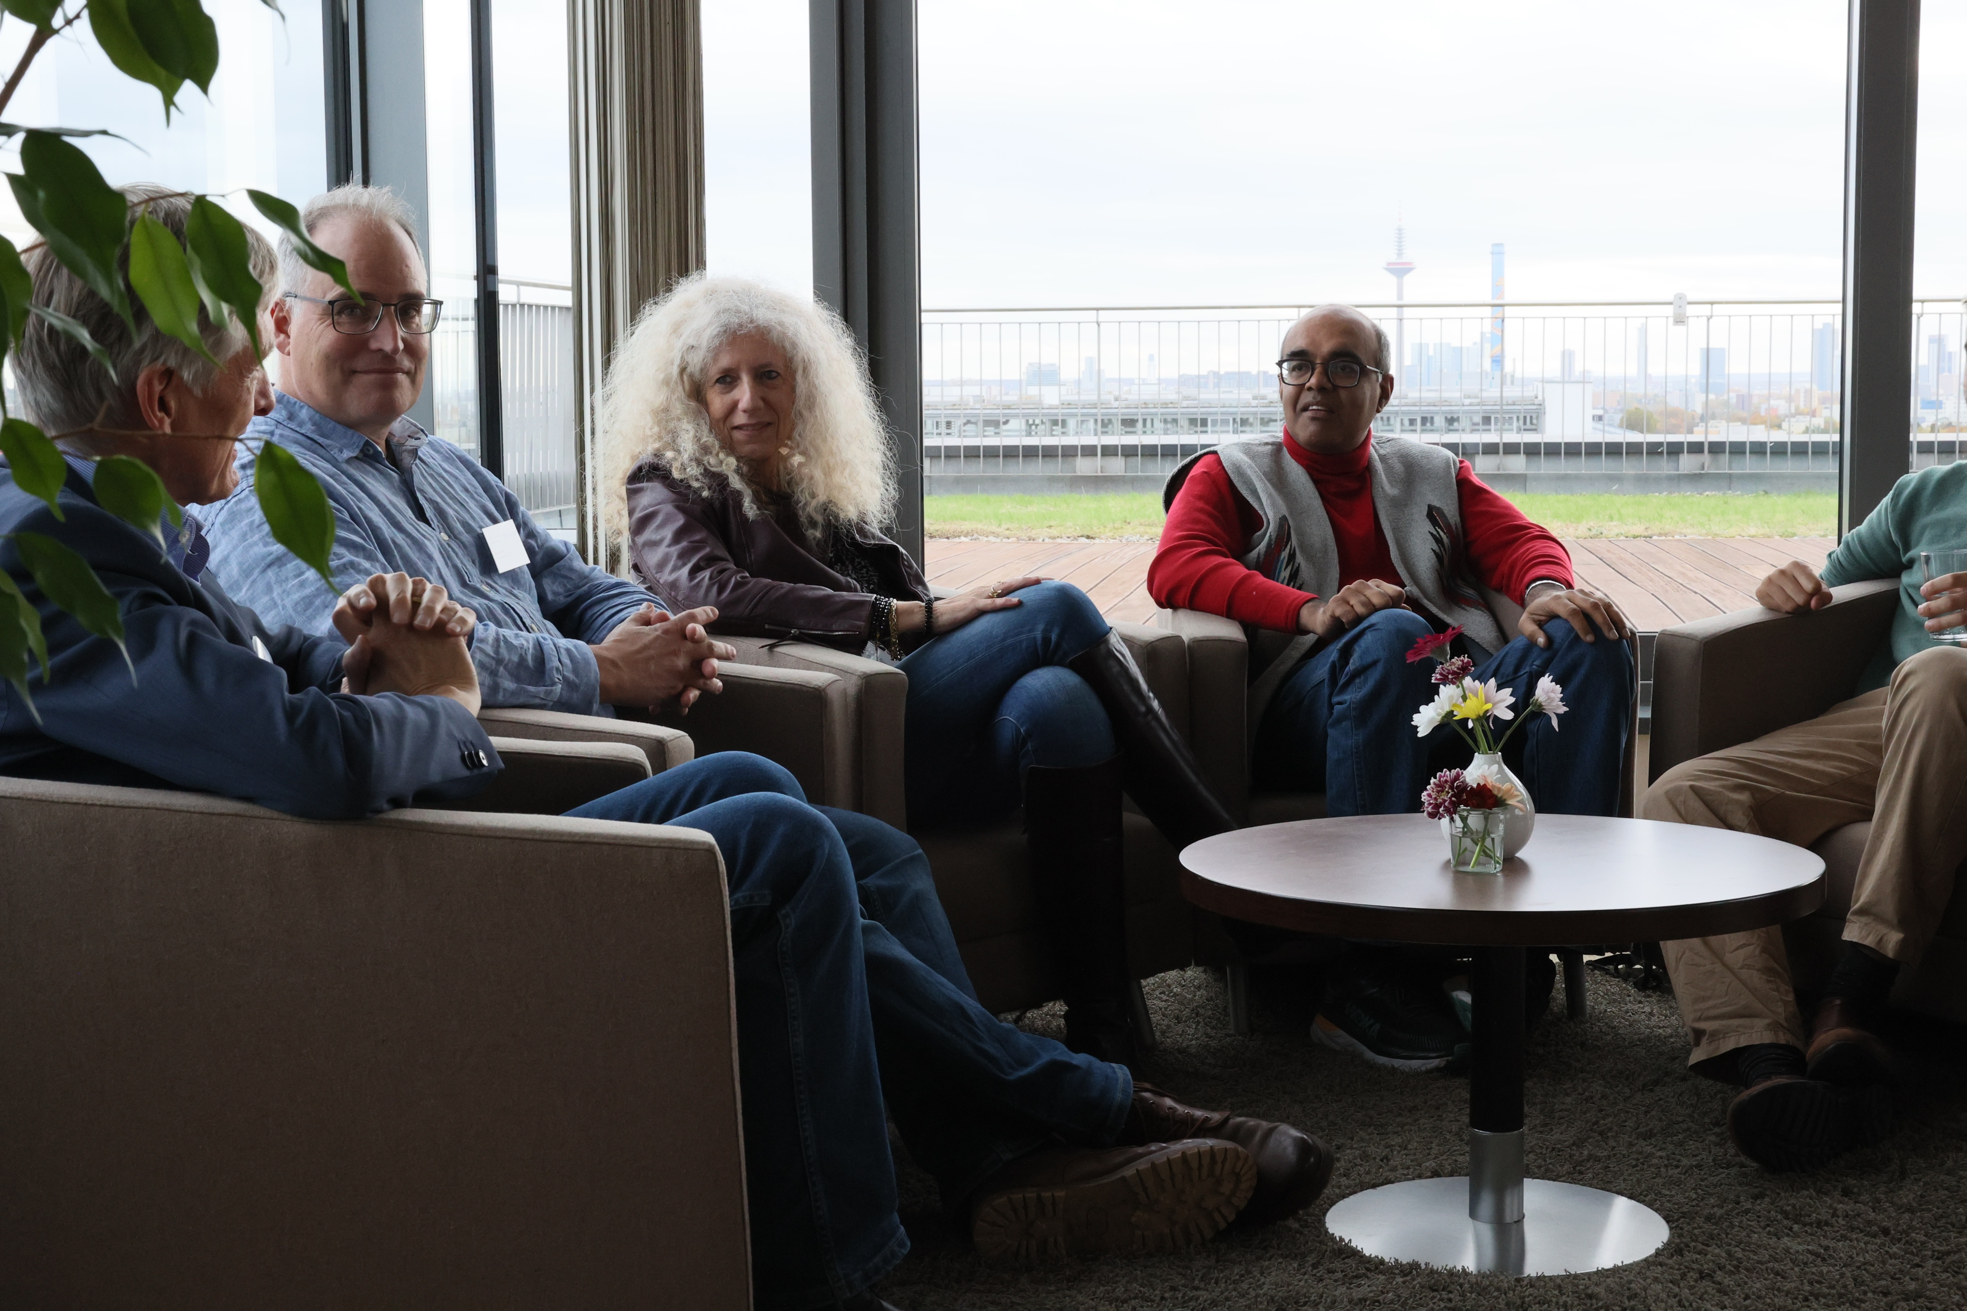
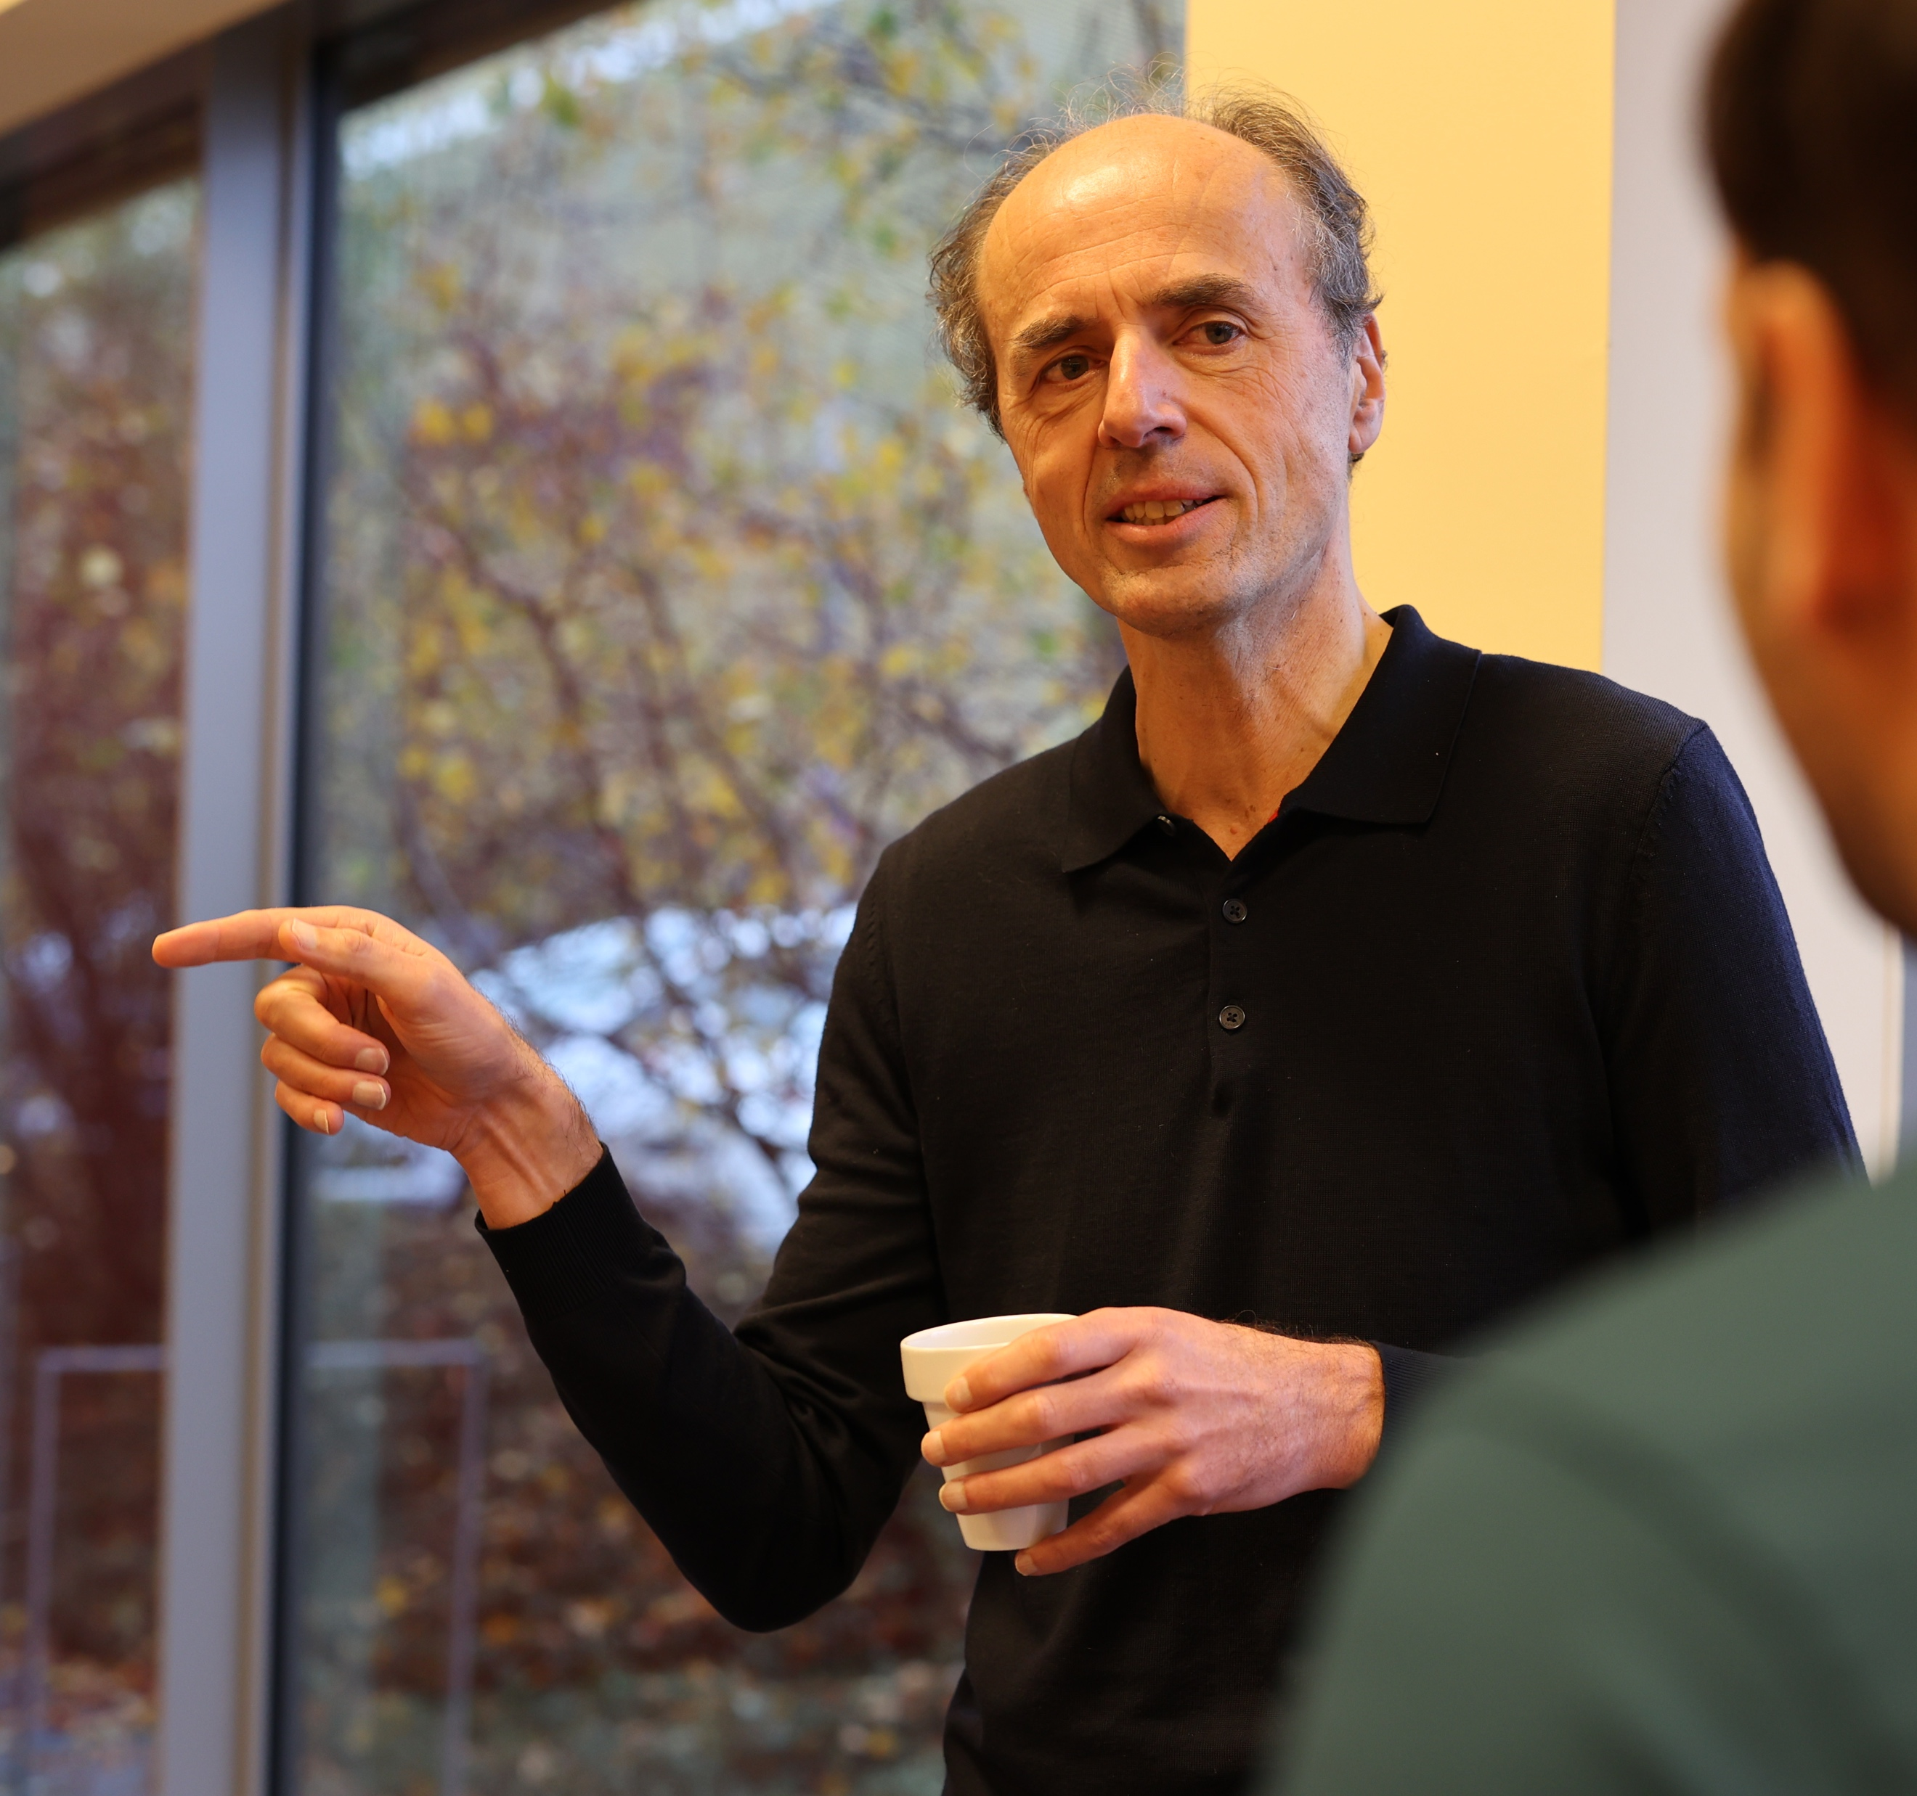
Impressions
Thanks for organising this conference. I enjoyed it tremendously - it gave a lot of inspiration! And it was all very well organized.
– Pieter Rein ten Wolde (AMOLF Amsterdam)

Slide 22
Emerging conclusion

Slide 23
Common interests
All topics revolve around a common method
  Digital Twin
    A simulation of reality to a detail that can be interrogated with respect to external stimuli and guide developments and interpretations
    using
      theory inspired modelling
      AI methods for optimisation
  Refine the methods; profit from the progress in neighbouring fields
  Scientific understanding is a vital element

Slide 24
Topics presented today
  Life Sciences – Roberto Covino
  Neuroscience – Gemma Roig
  Scientific Computing – Volker Lindenstruth
  Physics – Luciano Rezzolla
There are many more activities and some will hardly be mentioned. Please refer to Annual Report and Poster Session to learn more on the details.
  We will use the Round Table to discuss and to explore strategic aspects. Please do not hesitate to ask.

Slide 25
Charge to SAB

Slide 26
Roles of FIAS
Identify new and future research topics with high potential
  not yet established in research centres or universities
  avail themselves for rapid implementation and test
    transferrable to research centres and universities once successful
  suitable for attracting funds or donations in order to finance themselves
Attract high level researchers temporarily – sabbatical, detailed studies
Collaboration with GU and other research centres
Foster international collaboration

Slide 27
Charge – your comments to:
Are we fulfilling these roles?
  Selection of topics
    New opportunities
  Comments on available expertise
    Fellows
    Topics
Management approach
  Establish themes before acquiring grants
    Less (thematic breadth) may be more – in establishing the FIAS brand
FIAS SAB report
Strategic evaluation

Slide 28
Thank you!

