Slide 1
Radiative corrections
Andrea Bressan

Slide 2
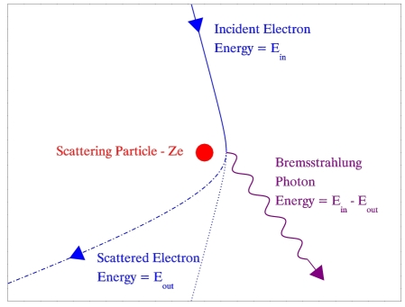
Radiative Events
In scattering experiments, a photon may be emitted by a charged particle due to Bremsstrahlung radiation.
This type of radiation is due to the deceleration of a charged particle as it approaches the culombic field of another.
Bremsstrahlung radiation
Only the scattered lepton is measured during the event, while the radiated photon usually evades detection. Therefore, there is a loss of energy in the system which is not accounted for.

Slide 3
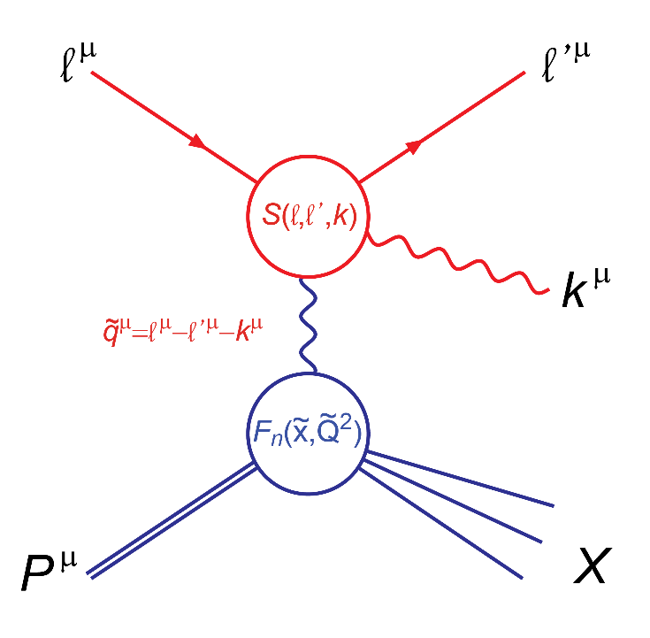
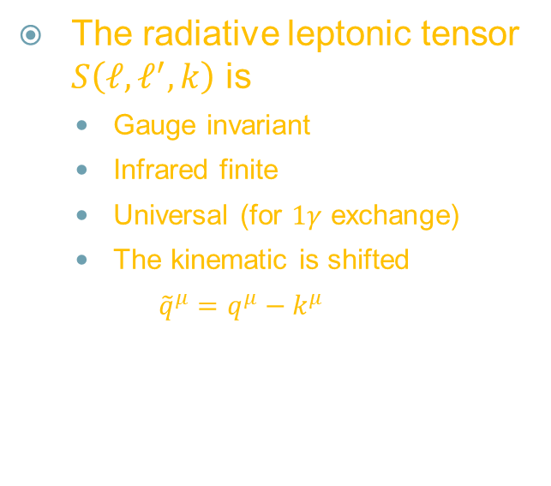
RADIATIVE CORRECTIONS
The radiative leptonic tensor $S\left(ℓ, ℓ^{′},k\right)$ is
  Gauge invariant
  Infrared finite
  Universal (for $1γ$ exchange)
  The kinematic is shifted
  $${\tilde{q}}^{μ}=q^{μ}−k^{μ}$$

Slide 4
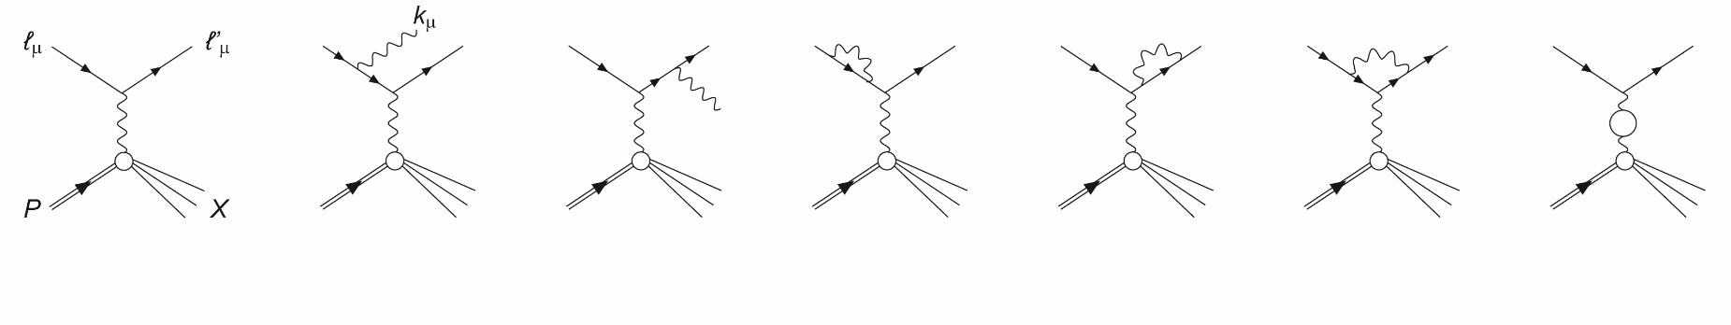
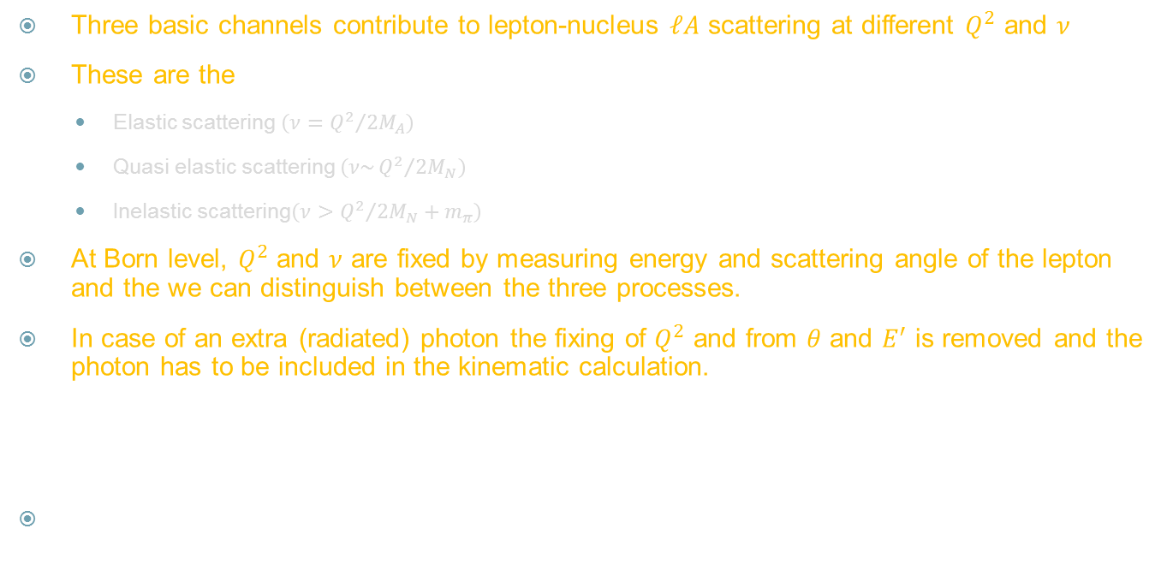
RADIATIVE CORRECTIONS
Three basic channels contribute to lepton-nucleus $ℓA$ scattering at different $Q^{2}$ and $ν$
These are the
  Elastic scattering $\left(ν={Q^{2}}/{2M_{A}}\right)$
  Quasi elastic scattering $\left(ν\sim {Q^{2}}/{2M_{N}}\right)$
  Inelastic scattering$\left(ν>{Q^{2}}/{2M_{N}}+m_{π}\right)$
At Born level, $Q^{2}$ and $ν$ are fixed by measuring energy and scattering angle of the lepton and the we can distinguish between the three processes.
In case of an extra (radiated) photon the fixing of $Q^{2}$ and from $θ$ and $E^{′}$ is removed and the photon has to be included in the kinematic calculation.

Slide 5
Codes for RC in ep-scattering
POLRAD 2.0 FORTRAN code for the RC procedure of experimental data in polarized inclusive and semi-inclusive DIS. The iteration procedure based on MINUIT fitting the data is included. Estimation of higher order and electroweak corrections is done.
DIFFRAD FORTRAN code for RC calculation in the processes of electroproduction of vector mesons. Versions with Monte Carlo and numerical integrations are available. Monte Carlo code allows to estimate RC to the quasi-real photoproduction case (i.e., the final electron is not detected)
HAPRAD FORTRAN code for RC calculation in the processes of semi-inclusive hadron electroproduction. Versions with Monte Carlo and numerical integrations are available.
ESFRAD (Authors: A. Afanasev, I. Akushevich, N. Merenkov) FORTRAN code for RC calculation in the processes of elastic, inelastic and deep inelastic scattering using the method of electron structure functions.
ELARADGEN (Authors: A. Afanasev, I. Akushevich, A. Ilychev, B. Niczyporuk) Monte Carlo generator of radiative events in the kinematics of elastic ep-scattering measurements.
MASCARAD FORTRAN code for RC calculation in elastic electron-nucleon scattering with a polarized target and/or recoil polarization. The experimental acceptances are accounted for.
EXCLURAD (Authors: A. Afanasev, I. Akushevich, V. Burkert, K. Joo) FORTRAN code for RC calculation in the process of exclusive pi electroproduction on a nucleon.

Slide 6
AVAILABLE Monte Carlo CODES
RADGEN (I.Akushevich, H.Boettcher, D.Ryckbosch, arXiv:hep-ph/9906408) Monte Carlo generator of radiative events in the DIS on polarized and unpolarized targets. Can be applied for RC generation in inclusive, semi-inclusive and exclusive DIS processes.
HERACLES and DJANGOH (Bohm, Hollik, Hubert Spiesberger): Monte Carlo generator of radiative events in DIS lepton-nucleon scattering including both QED and QCD radiative effects.

Slide 7
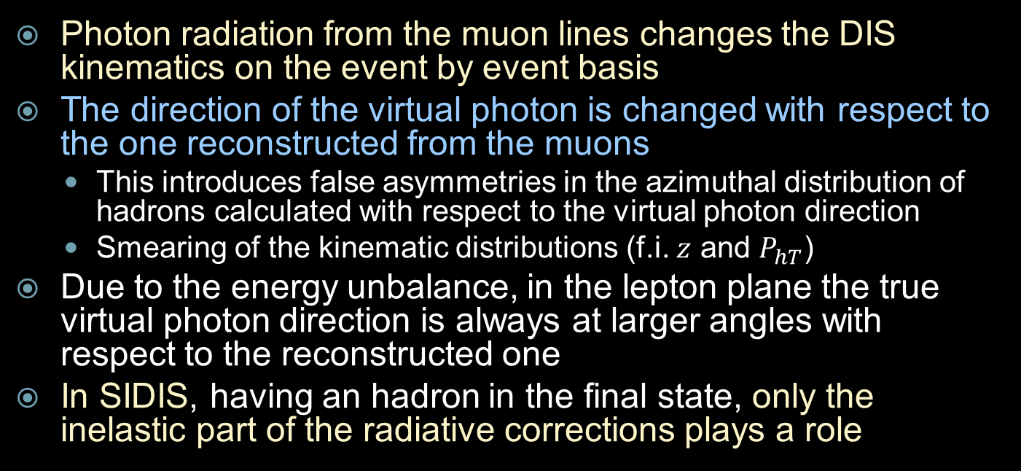
The problem for SIDIS
Photon radiation from the muon lines changes the DIS kinematics on the event by event basis
The direction of the virtual photon is changed with respect to the one reconstructed from the muons
  This introduces false asymmetries in the azimuthal distribution of hadrons calculated with respect to the virtual photon direction
  Smearing of the kinematic distributions (f.i. $z$ and $P_{hT}$)
Due to the energy unbalance, in the lepton plane the true virtual photon direction is always at larger angles with respect to the reconstructed one
In SIDIS, having an hadron in the final state, only the inelastic part of the radiative corrections plays a role

Slide 8
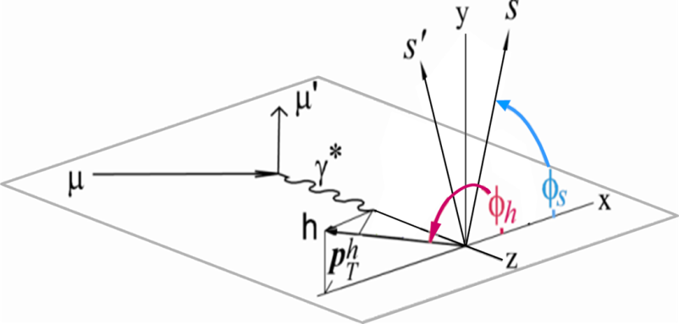
Azimuthal asymmetries in SIDIS

Slide 9
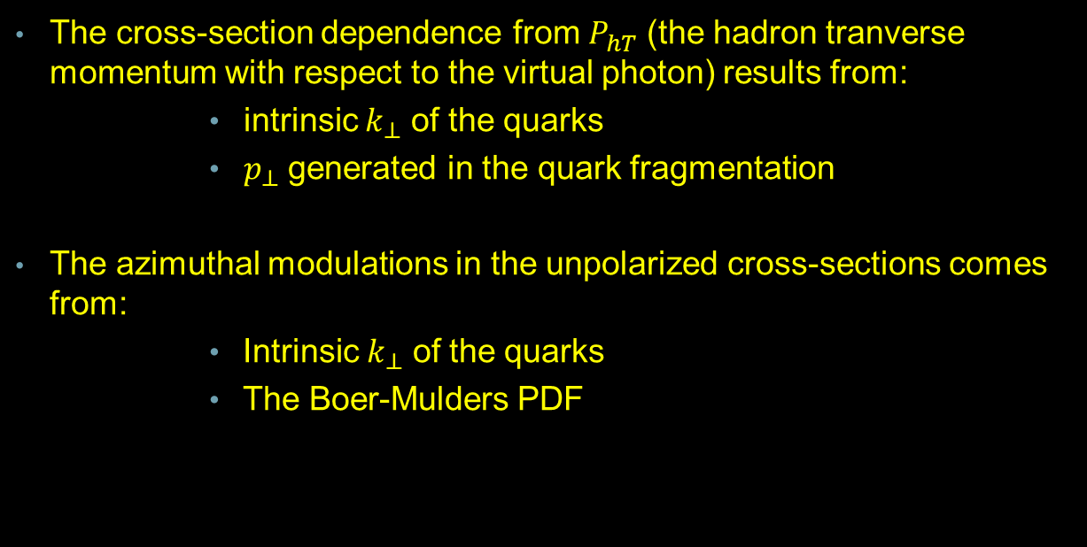
Unpolarized TMDs
The cross-section dependence from $P_{hT}^{}$ (the hadron tranverse momentum with respect to the virtual photon) results from:
  intrinsic $k_{⊥}$ of the quarks
  $p_{⊥}$ generated in the quark fragmentation
The azimuthal modulations in the unpolarized cross-sections comes from:
  Intrinsic $k_{⊥}$ of the quarks
  The Boer-Mulders PDF

Slide 10

Measured cross-section
The measured cross section $σ_{obs}$ is not the Born, $1γ$, cross section $σ_{1γ}$; typically:
$$\frac{d^{2}σ_{obs}}{dydQ^{2}}=δ_{R}\left(E_{min}^{γ}\right)\left(1+δ_{vertex}+δ_{vacum}+δ_{i.r}\right)\frac{d^{2}σ_{1γ}}{dydQ^{2}}+$$
$$\frac{d^{2}σ_{add}}{dydQ^{2}}\left(E_{min}^{γ}\right)+\frac{d^{2}σ_{el}}{dydQ^{2}}+\frac{d^{2}σ_{q}}{dydQ^{2}}+\frac{d^{2}σ_{in}}{dydQ^{2}}\left(E_{min}^{γ}\right)$$
where $E_{min}^{γ}$ defines the minimum energy needed to detect the radiated photon by the experimental setup:
Then a term $σ_{add}\left(E_{min}^{γ}\right)$ is used to take into account the approximation that the photon energy is considered to be small $\left(E_{γ}<E, E′\right)$ for $E_{γ}<E_{min}^{γ}$

Slide 11
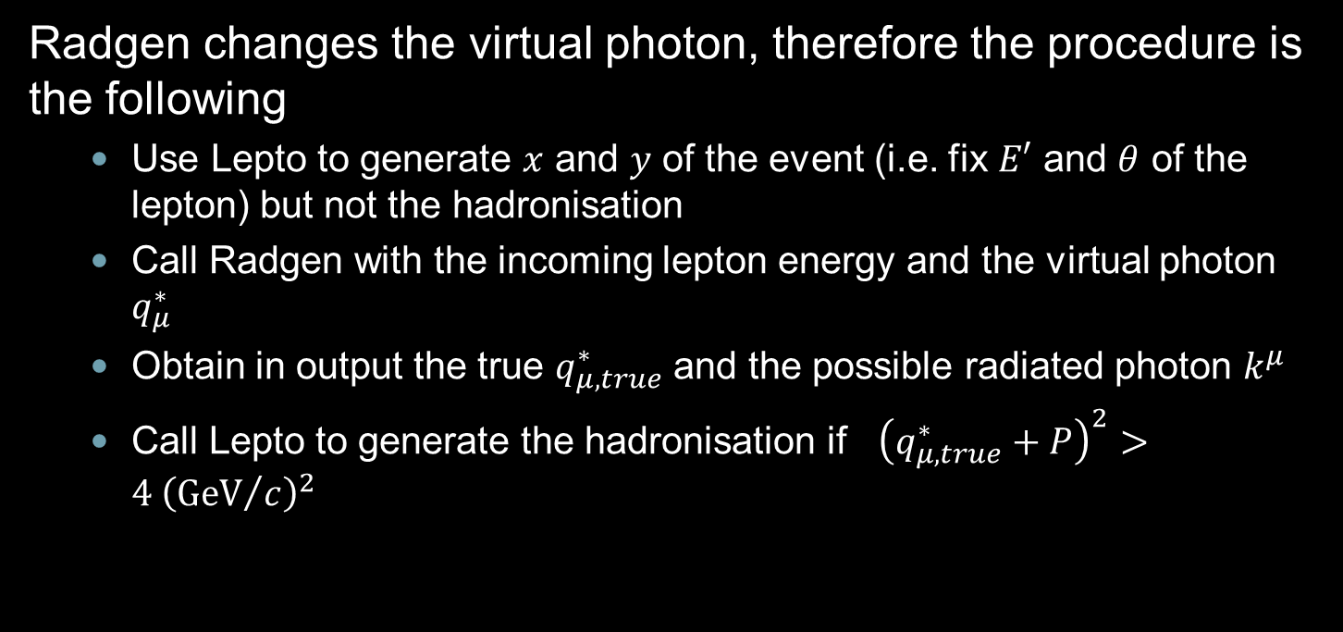
RADGEN+LEPTO
Radgen changes the virtual photon, therefore the procedure is the following
  Use Lepto to generate $x$ and $y$ of the event (i.e. fix $E′$ and $θ$ of the lepton) but not the hadronisation
  Call Radgen with the incoming lepton energy and the virtual photon $q_{μ}^{∗}$
  Obtain in output the true $q_{μ, true}^{∗}$ and the possible radiated photon $k^{μ}$
  Call Lepto to generate the hadronisation if ${\left(q_{μ, true}^{∗}+P\right)}^{2}>4 {\left({GeV}/c\right)}^{2}$

Slide 12
HERACLES + DJANGOH
DJANGOH is an interface to HERACLES and LEPTO 6.5.1:
  The use of HERACLES allows to take into account the complete one-loop electroweak radiative corrections and radiative scattering.
  The LUND string fragmentation as implemented in the event simulation program JETSET is used to obtain the complete hadronic final state.
  At low hadronic mass, SOPHIA is used instead of LEPTO.
  Several routines of LEPTO modified both for cross section calculations and to kinematic generation
  No weights, events are generated accordingly to the full cross section (Born+RC)

Slide 13
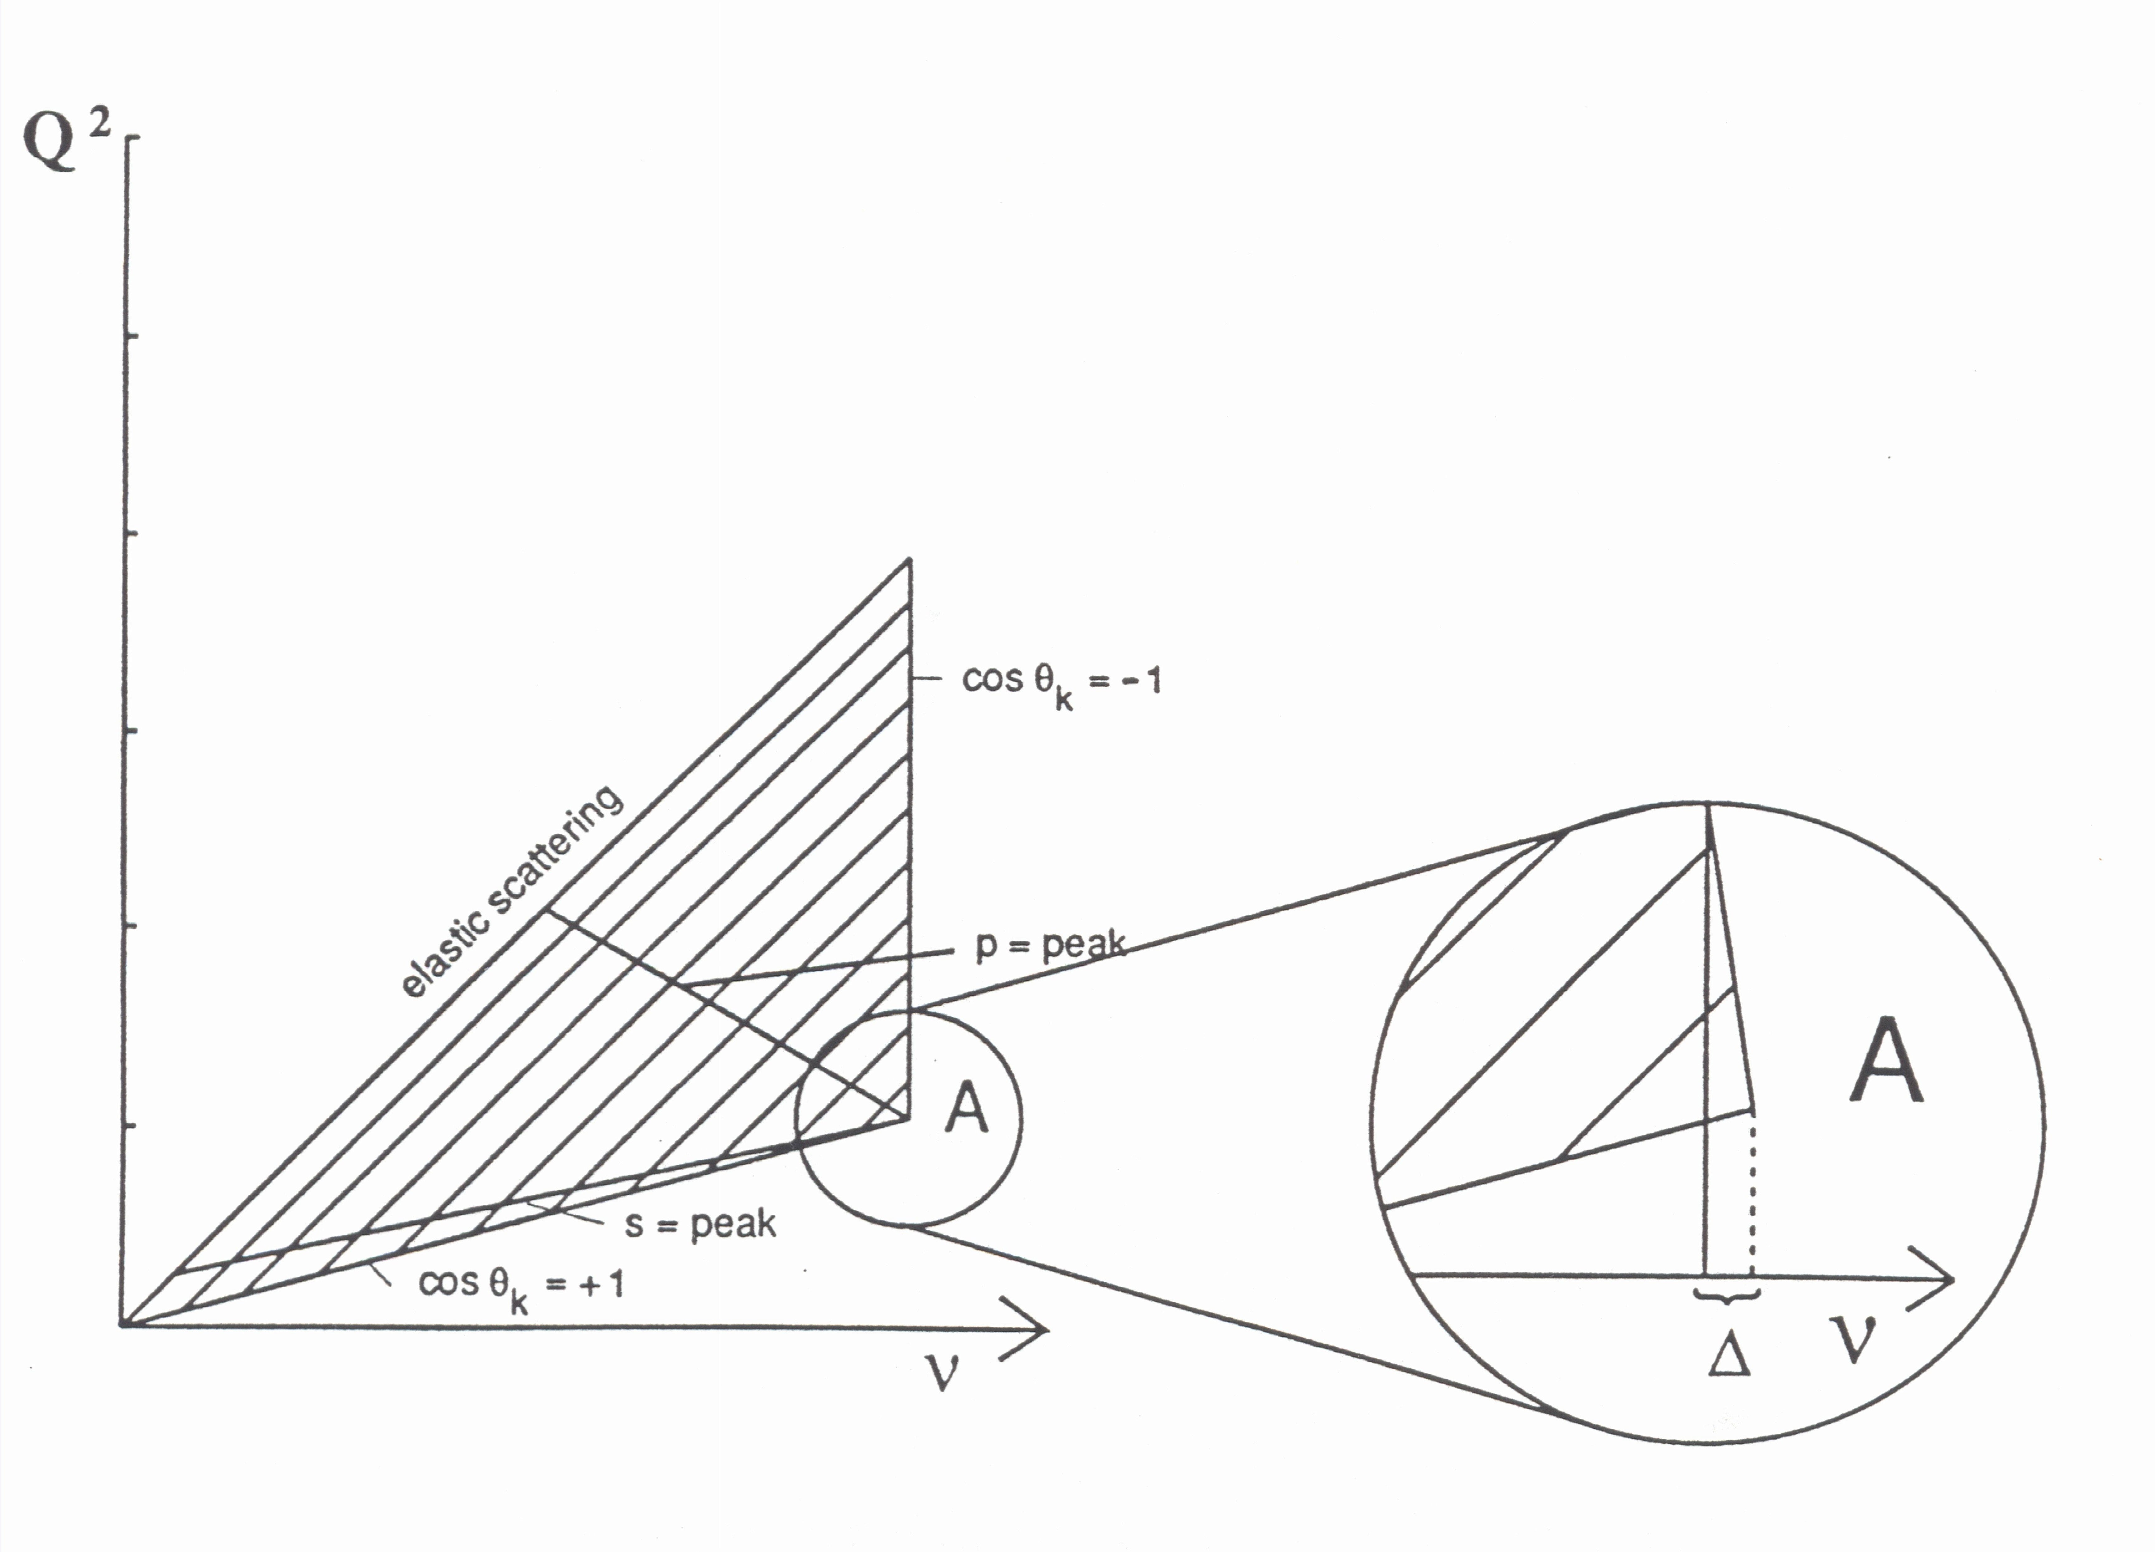
Inputs to RC Calculations
^{σ}meas ^{= vσ}1γ ^{+ σ}tails ^{= vσ}1γ ^{+ σ}inel ^{+ σ}el ^{+ σ}qel
v – virtual corrections + soft photon emission.
Range of kinematical variables from which the radiative tails contribute to the cross section measured at the point A(Q², ν); parallel lines: W = const
Even if we measure at DIS, information on
F1, F2 (or R, F2) needed down to Q² =0!
Badelek, Bardin, Kurek, Scholz, Z. Phys. C66 (1995) 591

Slide 14

Inputs for RC calculations
The following inputs for the full cross section calculation have to be known for
$$x_{meas}<x<1$$
$$0<Q^{2}<Q_{MAX}^{2}$$
Spin independent structure function F₂(x, Q²) (nucleon, nuclei)
Spin independent structure function R(x, Q²)
Spin dependent structure function g₁(x, Q²)
Quasielastic suppression factors (Q²) (nuclei)
Elastic form factors (Q²) (nucleon, nuclei)
TMDs…GPDs?

Slide 15
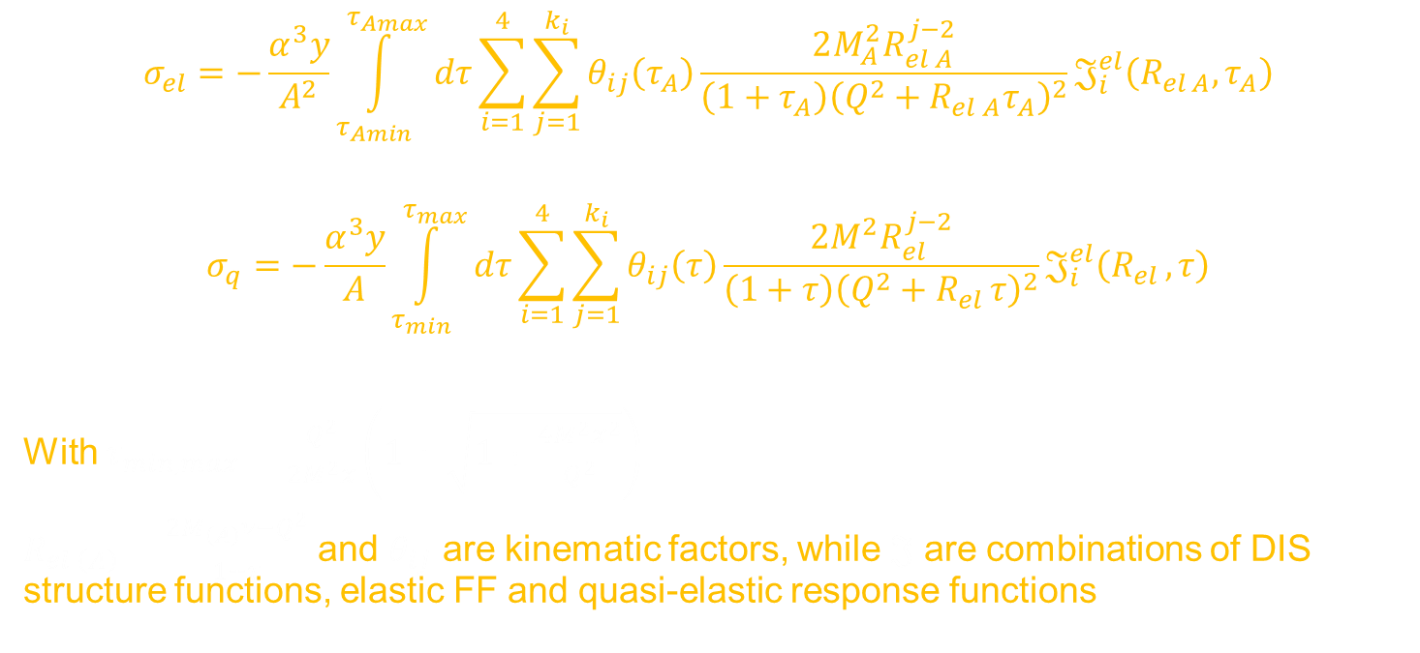
X SECTIONS of RADGEN
$$σ_{el}=−\frac{α^{3}y}{A^{2}}\int_{τ_{Amin}}^{τ_{Amax}}{dτ}\sum_{i=1}^{4}{\sum_{j=1}^{k_{i}}{θ_{ij}\left(τ_{A}\right)\frac{2M_{A}^{2}R_{el A}^{j−2}}{{\left(1+τ_{A}\right)\left(Q^{2}+R_{el A}τ_{A}\right)}^{2}}𝔍_{i}^{el}\left(R_{el A},τ_{A}\right)}}$$
$$σ_{q}=−\frac{α^{3}y}{A}\int_{τ_{min}}^{τ_{max}}{dτ}\sum_{i=1}^{4}{\sum_{j=1}^{k_{i}}{θ_{ij}\left(τ\right)\frac{2M^{2}R_{el }^{j−2}}{{\left(1+τ\right)\left(Q^{2}+R_{el }τ\right)}^{2}}𝔍_{i}^{el}\left(R_{el },τ\right)}}$$
With $τ_{min, max}=\frac{Q^{2}}{2M^{2}x}\left(1±\sqrt{1+\frac{4M^{2}x^{2}}{Q^{2}}}\right)$
$R_{el \left(A\right)}=\frac{2M_{\left(A\right)}ν−Q^{2}}{1+τ}$ and $θ_{ij}$ are kinematic factors, while $𝔍$ are combinations of DIS structure functions, elastic FF and quasi-elastic response functions

Slide 16
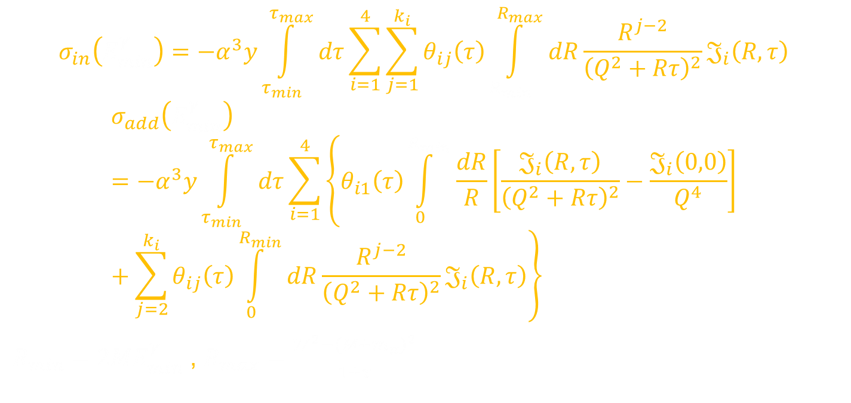
X SECTIONS of RADGEN
$$σ_{in}\left(E_{min}^{γ}\right)=−α^{3}y\int_{τ_{min}}^{τ_{max}}{dτ}\sum_{i=1}^{4}{\sum_{j=1}^{k_{i}}{θ_{ij}\left(τ\right)\int_{R_{min}}^{R_{max}}{dR\frac{R^{j−2}}{{\left(Q^{2}+Rτ\right)}^{2}}𝔍_{i}\left(R,τ\right)}}}$$
$$σ_{add}\left(E_{min}^{γ}\right)=−α^{3}y\int_{τ_{min}}^{τ_{max}}{dτ}\sum_{i=1}^{4}{\left\{θ_{i1}\left(τ\right)\int_{0}^{R_{min}}{\frac{dR}{R}\left[\frac{𝔍_{i}\left(R,τ\right)}{{\left(Q^{2}+Rτ\right)}^{2}}−\frac{𝔍_{i}\left(0,0\right)}{Q^{4}}\right]}+\sum_{j=2}^{k_{i}}{θ_{ij}\left(τ\right)\int_{0}^{R_{min}}{dR\frac{R^{j−2}}{{\left(Q^{2}+Rτ\right)}^{2}}𝔍_{i}\left(R,τ\right)}}\right\}}$$
$R_{min}=2ME_{min}^{γ}$ , $R_{max}=\frac{W^{2}−{\left(M+m_{π}\right)}^{2}}{1+τ}$

Slide 17

Corrections for azimuthal asym.s:
For each multimensional bin in $x, Q^{2},z,P_{hT}$and $φ$ used for the analysis one has to look at the ratio
$$\frac{{N\left(x, Q^{2},z,P_{hT},φ\right)}_{MCEG+RC}}{{N\left(x, Q^{2},z,P_{hT},φ\right)}_{MCEG}}$$

Slide 18
Some kinematic distribution for events with radiation
All shown at generator level

Slide 19
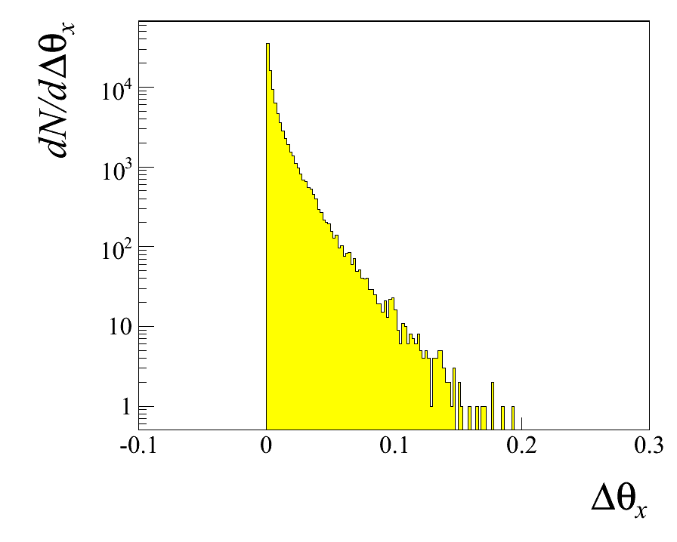
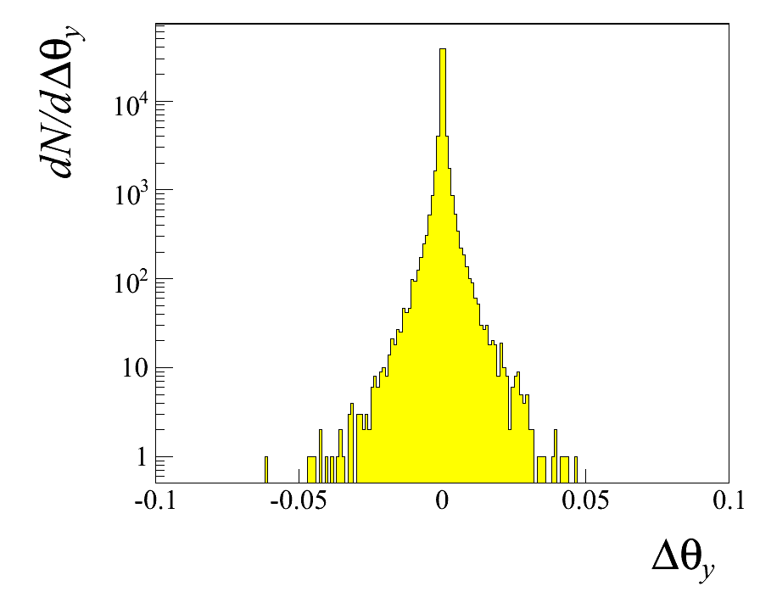
Virtual photon Δ’s (Θ_{true}-Θ_{m})
XZ is the lepton scattering plane
YZ is the off-lepton scattering plane

Slide 20
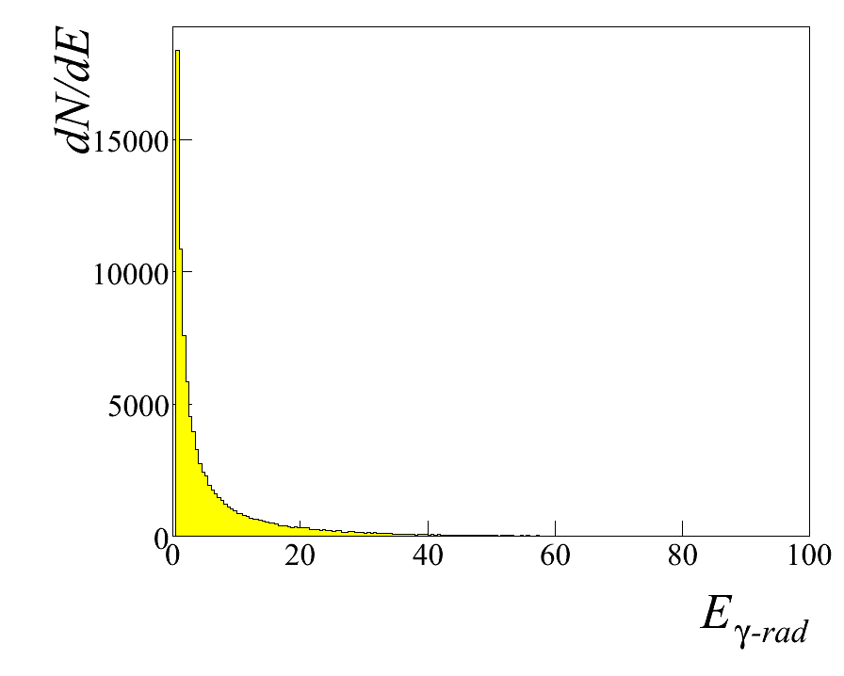
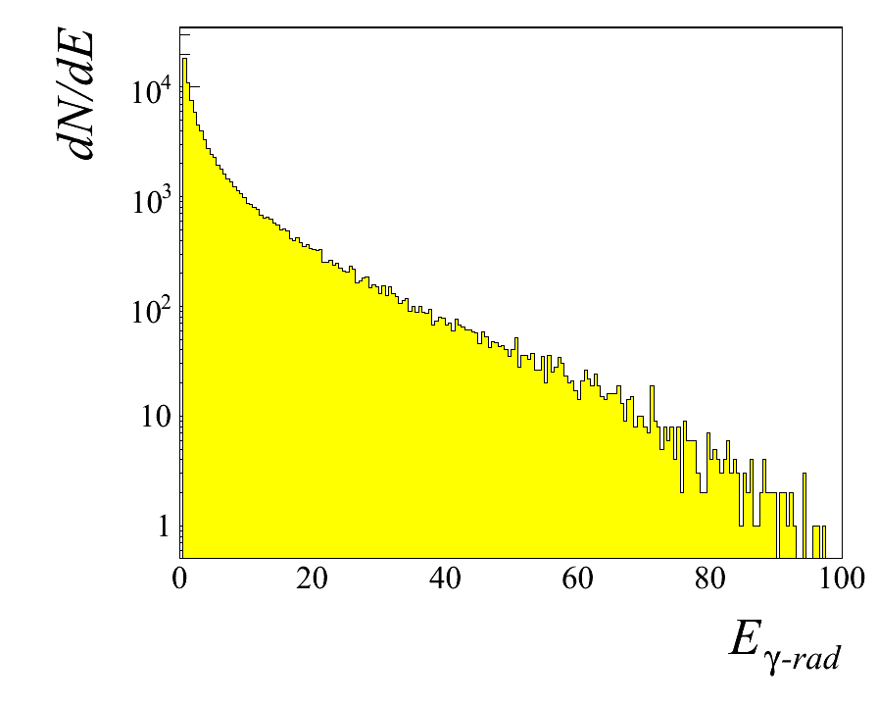
Radiated Photon: Energy

Slide 21
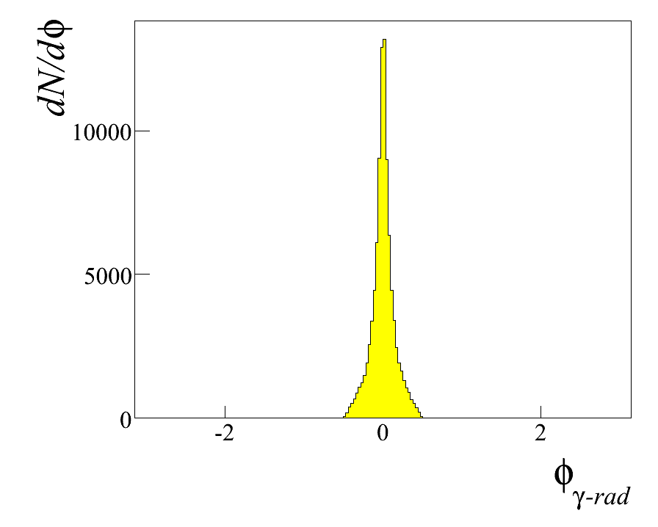
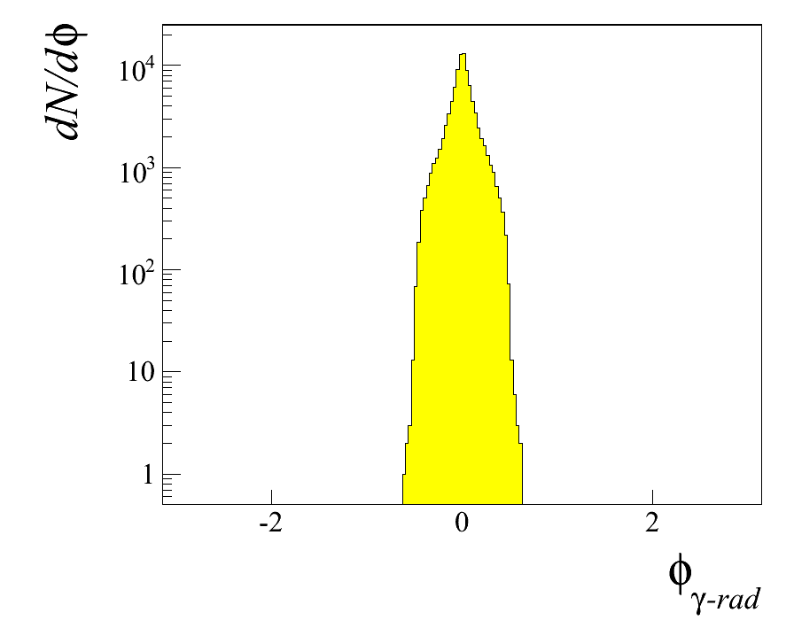
Radiated Photon: Azimuthal angle in GNS

Slide 22
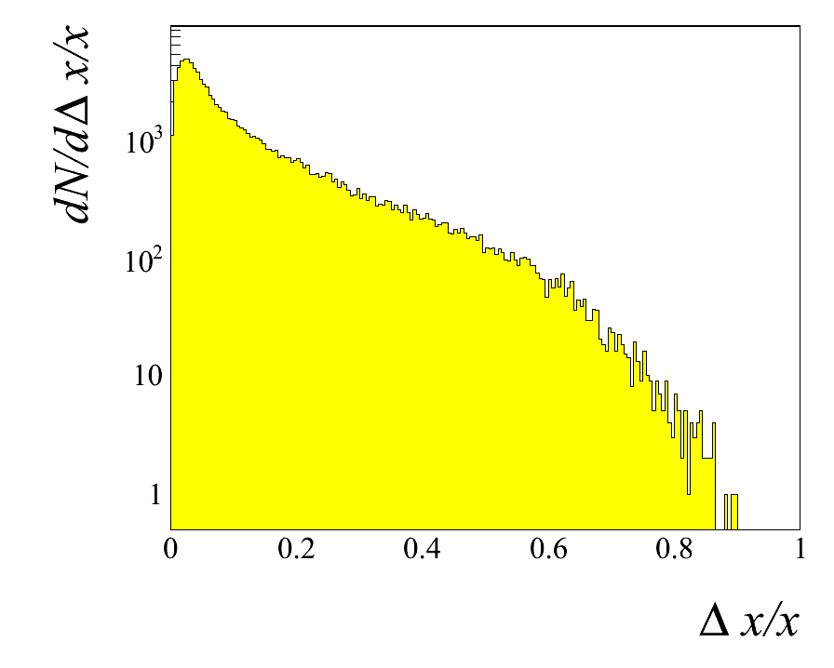
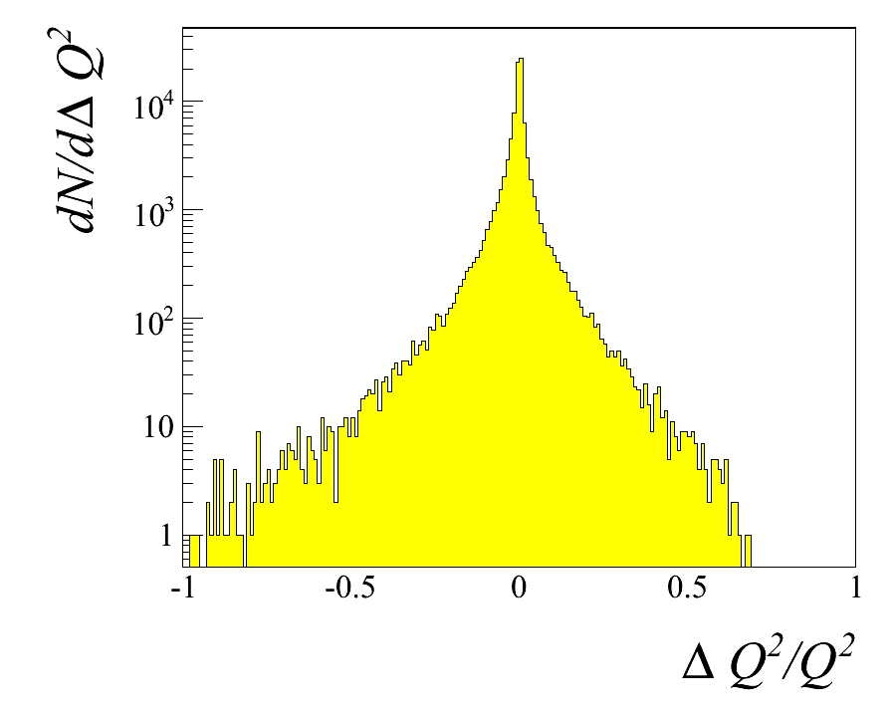
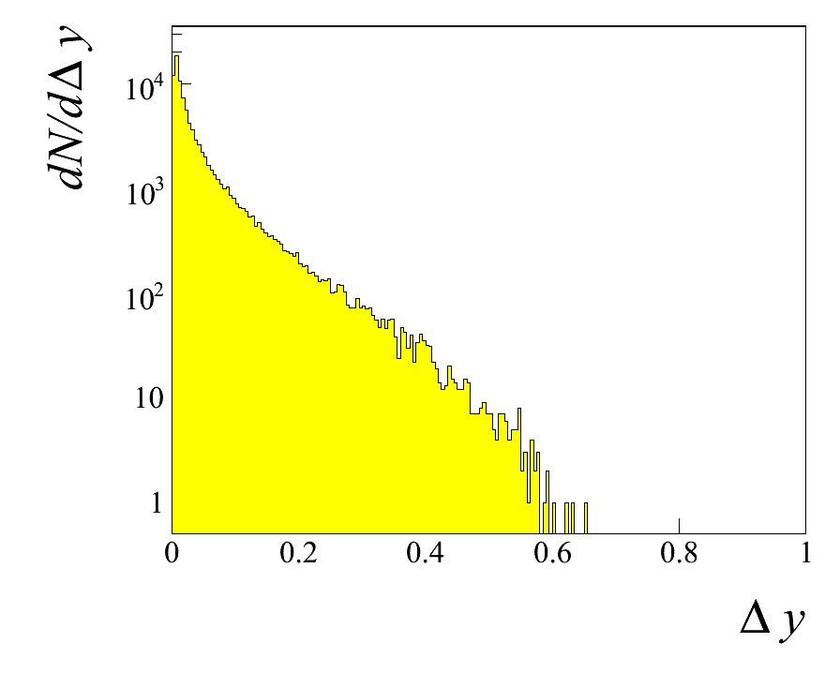
Projections:

Slide 23
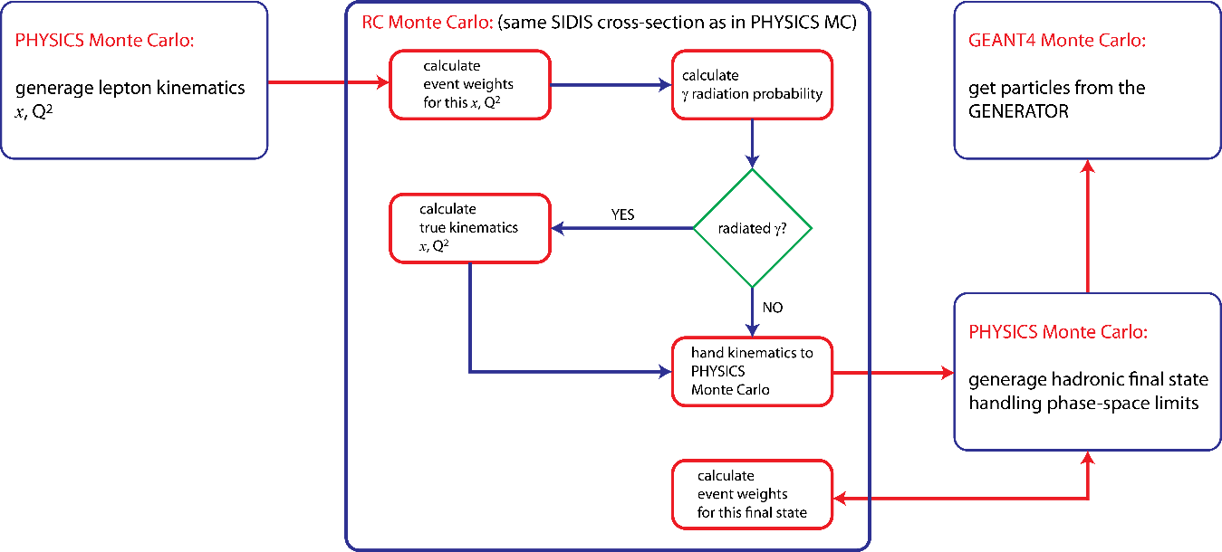
Interfacing with modern MCEG

Slide 24

PYTHIA 6
Steps:
  Cross section calculation (LO, NLO)
  Full cross section including radiative corrections (NNLO in QED)
  Generate according to cross section
  Final steps in Pythia using $γ^{∗}N$ interactions

Slide 25

PYTHIA 8
$γ^{∗}N$ not available in PYTHIA 8
Use of PDF:lepton? Can be used for initial/final state radiations from lepton lines (not for loops, Compton peak)
Modification of the cross-section calculation for the multiplicative parts?
Use of MadGraph5?
  Adv: MadGraph output the results of a matrix-element calculation as a set of PYTHIA 8 C++ classes, that can then be linked and used within Pythia.

Slide 26
Use of MadGraph5?
Can generate hard processes, including higher order QED

Slide 28
QED=4 is missing

Slide 29
END

