Slide 1
Wigner, Husimi, and GTMD distributions for nucleon tomography
Yoshitaka Hatta
(Yukawa institute, Kyoto U.)

Slide 2
Outline
Phase space distributions in QCD
Connection to orbital angular momentum
Accessing Wigner/GTMD in experiment
Entropy of the nucleon?

Slide 3
Wigner distribution in 2012 EIC white paper
Almost no account.
Only briefly mentioned in two places.
Although there is no known way to measure
Wigner distributions for quarks and gluons,
they provide a unifying theoretical framework
for the different aspects of hadron structure.
A lot of progress since then!

Slide 4
5D tomography:
Wigner distribution— the “mother distribution”
Belitsky, Ji, Yuan (2003);
Lorce, Pasquini (2011)
TMD
GPD
Form factor
PDF
charge

Slide 5
Generalized TMD (GTMD)
Meissner, Metz, Schlegel (2009)
Off-forward generalization of TMD
Fourier transform of Wigner
(Rather, Wigner is the Fourier transform of GTMD.)
More basic object, more directly related to experiments.

Slide 6
Husimi distribution
Gaussian smearing of Wigner in the minimal uncertainty region
Husimi distribution is positive definite!
coherent state
Probabilistic interpretation possible. Well known in quantum optics.
4th excited state of
1D harmonic oscillator
Wigner
Husimi

Slide 7
QCD Husimi distribution
Hagiwara, YH (2014)
Off-diagonal matrix element (relativistic effect).
Positivity not proven. But it is positive in all the models studied so far.
Wigner and Husimi of a quark at 1-loop.
Husimi
Wigner
Wigner Husimi

Slide 8
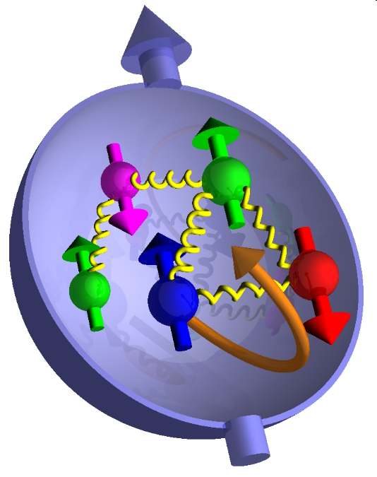
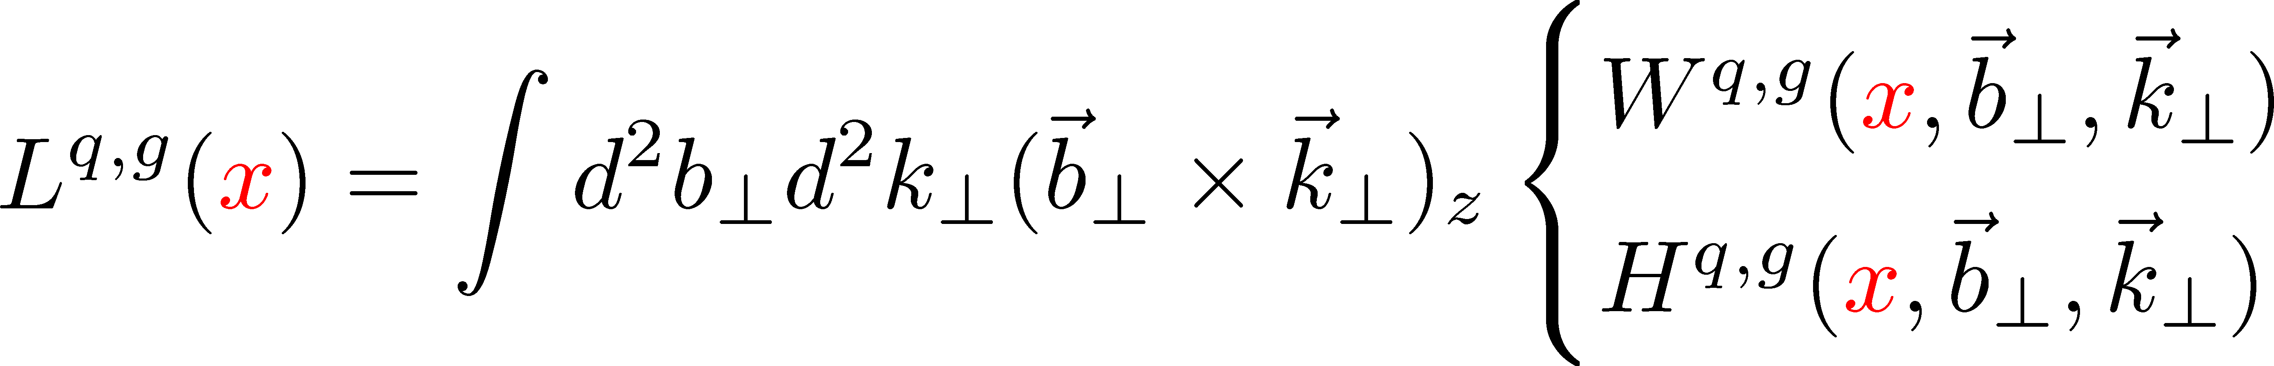
Wigner distribution and orbital angular momentum
Jaffe-Manohar decomposition
Quarks’ helicity
Canonical Orbital angular momentum
Gluons’ helicity
Lorce, Pasquini, (2011);
YH (2011)
Lorce, Pasquini, Xiong, Yuan
`PDF’ for OAM

Slide 9
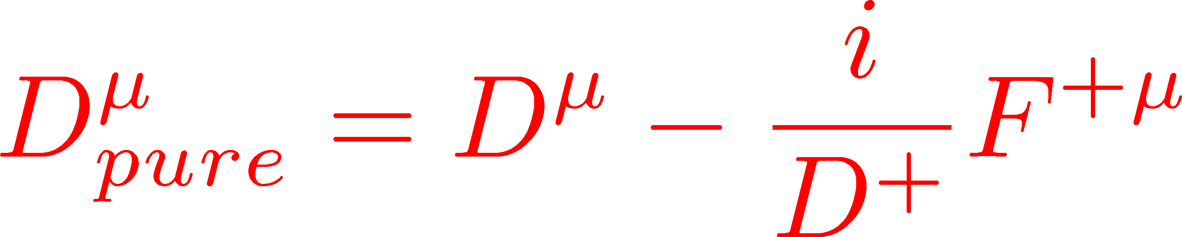
Canonical vs. kinetic orbital angular momentum
Canonical (Jaffe-Manohar) OAM from the light-cone Wilson line
YH (2011)
Kinetic (Ji’s) OAM from the straight Wilson line
Ji, Xiong, Yuan (2012)
The difference numerically significant.
Engelhardt (2017)

Slide 10
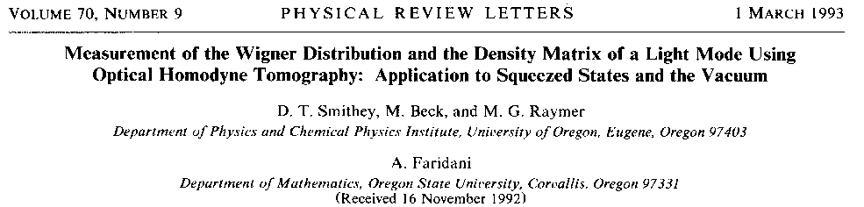
Wigner distribution: Is it measurable?
In quantum optics, yes!

Slide 11
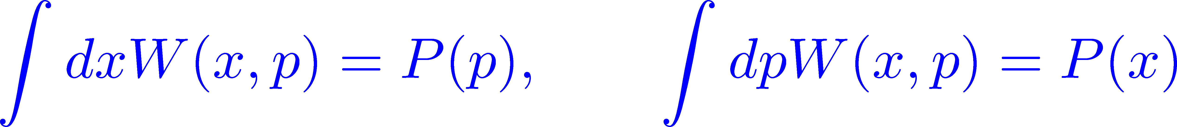
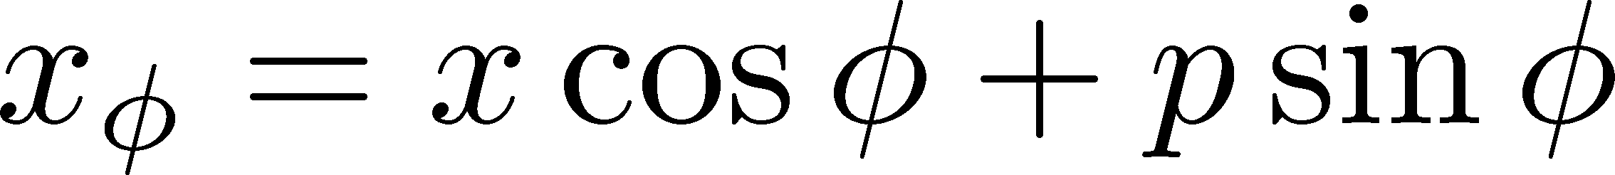
Homodyne Detection
Projection of Wigner : probability distribution
Difference in photon counts at detectors C,D
Reconstruct Wigner via
the inverse Radon transform
cf. computed tomography (CT)
(coherent state, phase )
What about in QCD?
Higher-dimensional distribution → More exclusive process.
Tag at least three particles in the final state (e.g., dijet + recoiling proton)

Slide 12
Gluon Wigner distribution
There are two ways to make it gauge invariant
Bomhof, Mulders (2008)
Dominguez, Marquet, Xiao, Yuan (2011)
Dipole distribution
Weizsacker-Williams (WW) distribution

Slide 13
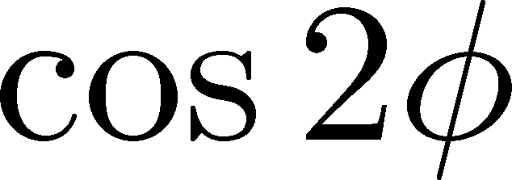
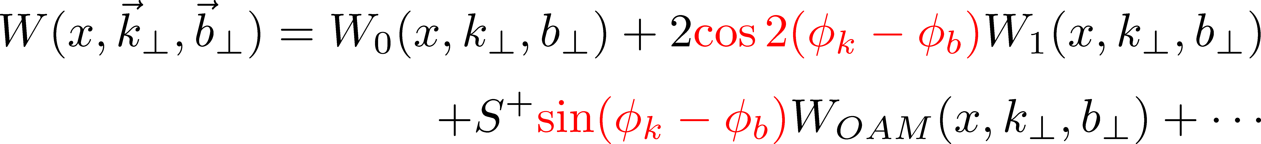
Dipole gluon Wigner distribution at small-x
YH, Xiao, Yuan (2016)
Simply related to the dipole S-matrix at small-x
correlation expected
``Elliptic Wigner”
NB: Dependence on longitudinal spin drops out in this approximation.

Slide 14

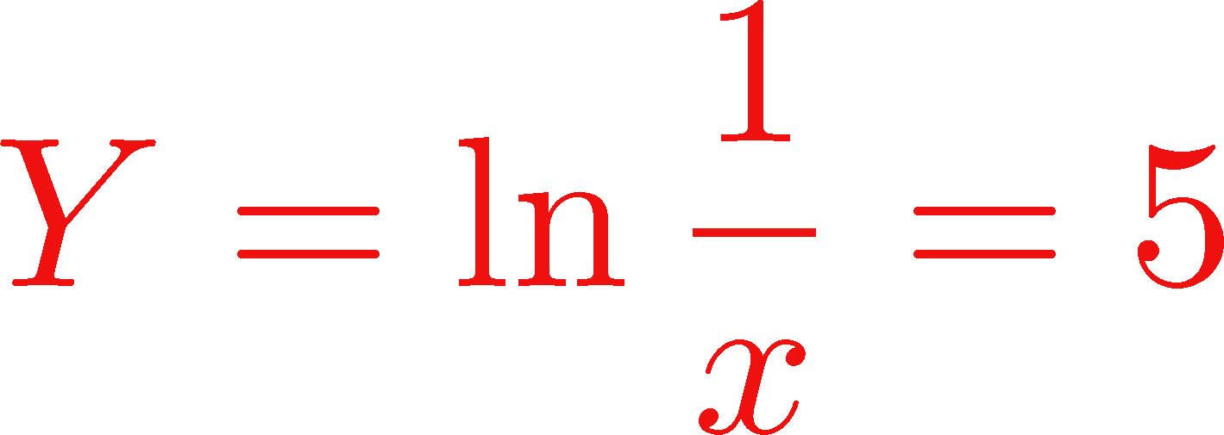


Dipole Wigner from Balitsky-Kovchegov equation
Hagiwara, YH, Ueda (2016)
Peak at the saturation momentum
Elliptic part small in magnitude (a few percent effect). No geometric scaling.

Slide 15
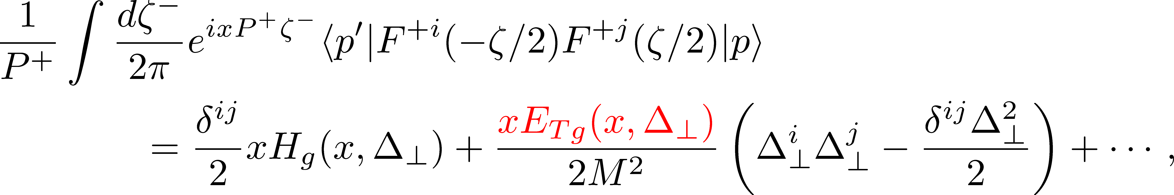
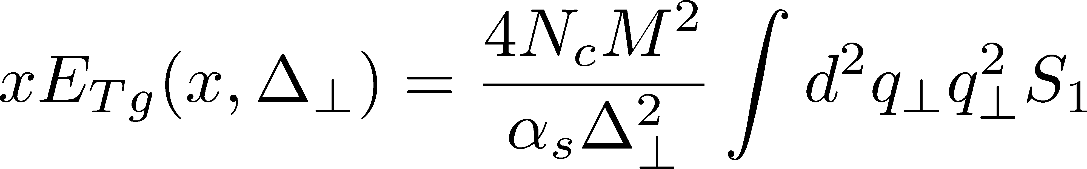
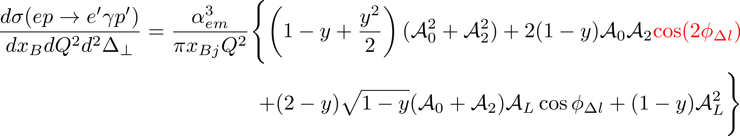
Elliptic Wigner in DVCS
YH, Xiao, Yuan (2017)
Gluon transversity GPD
Elliptic Wigner (GTMD)

Slide 16
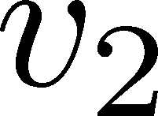
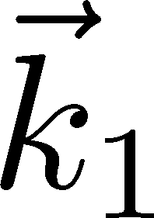
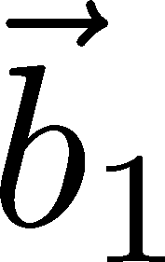
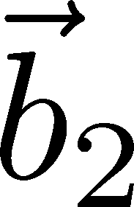
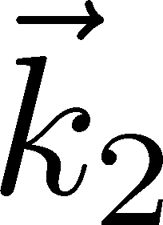
Elliptic Wigner in high-multiplicity pp and pA
Kopeliovich et al. (2008),
Levin Rezaeian (2011),
Hagiwara, YH, Xiao, Yuan (2017)
Elliptic flow observed in
high-multiplicity pp and pA.
Initial state or final state effect?
1509.04776
Double parton scattering + elliptic Wigner = elliptic flow

Slide 17

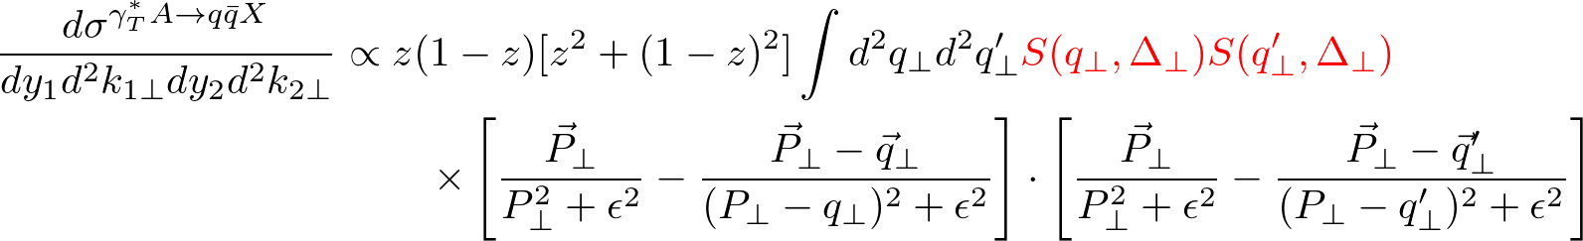
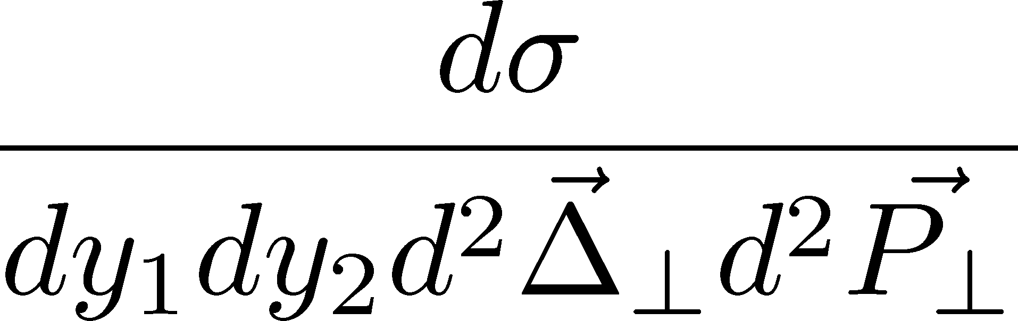
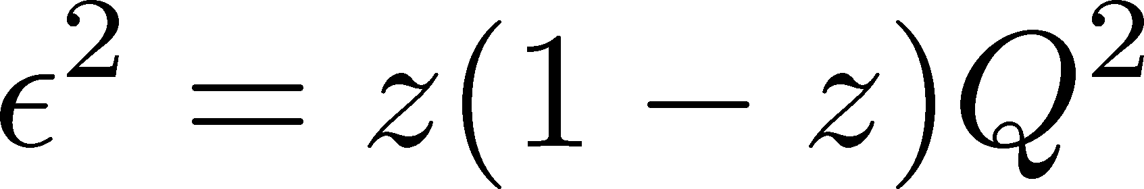

Probing Wigner (GTMD) in diffractive dijet production in ep
YH, Xiao, Yuan (2016), see also Braun, Ivanov (2005)
Altinoluk, Armesto, Beuf, Rezaeian (2015)
NLO calculation by Boussarie et al. (2016)
Jet 1
Jet 2
$$e^{−}$$
GTMD (dipole S-matrix)

Slide 18


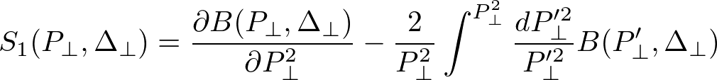
Probing dipole Wigner in ultra-peripheral pA collisions
Hagiwara, YH, Pasechnik, Tasevsky, Teryaev (2017)
preferably small
Use the Weiszacker-Williams photons in UPC!
photon flux

Slide 19
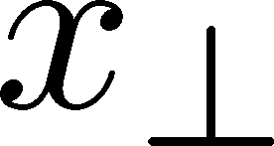
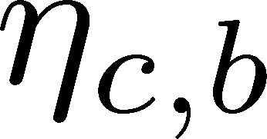

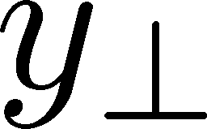
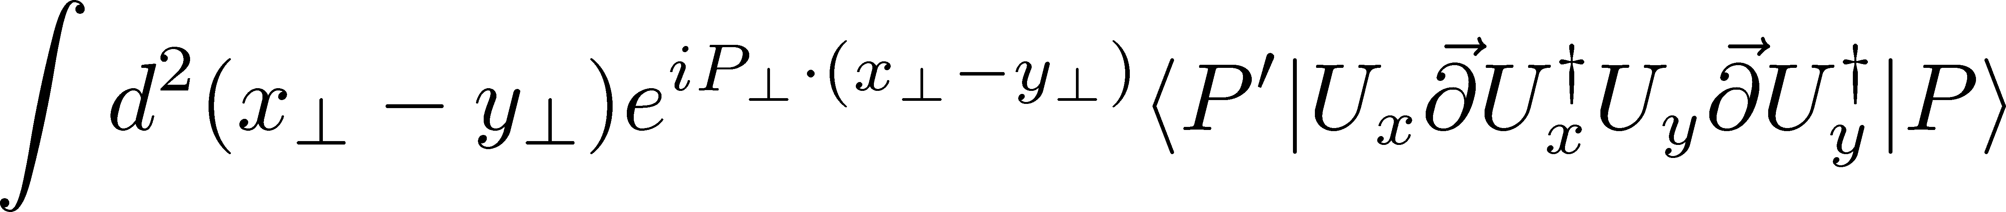
Probing the gluon WWW in pp
Boussarie, YH, Xiao, Yuan, in preparation
Amplitude proportional to
Similar idea by
Bhattacarya, Metz, Ojha, Tsai, Zhou 1802.10550

Slide 20
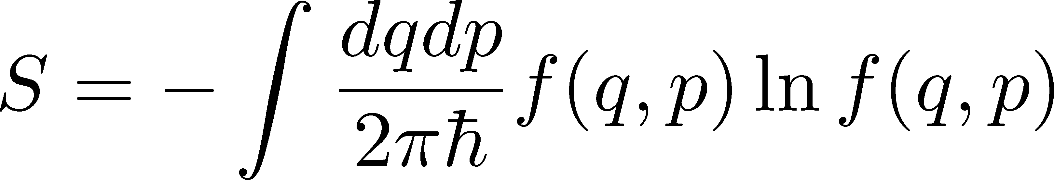
`Entropy’ of partons?
A hadron in its ground state is a pure state → vanishing von Neumann entropy
Experiments probe only a part of the hadron wavefunction → entanglement entropy?
Recent interest in defining an (entanglement) `entropy’ of partons
in the hadron wavefunction
Remember, classically entropy is defined via the phase space distribution.
→ Talks by Lublinsky and Florechinger

Slide 21
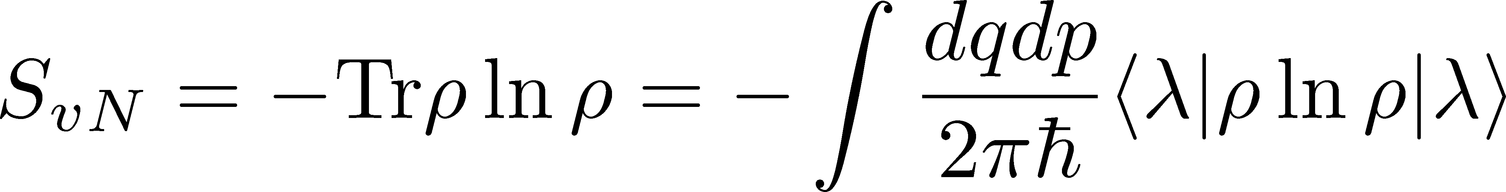
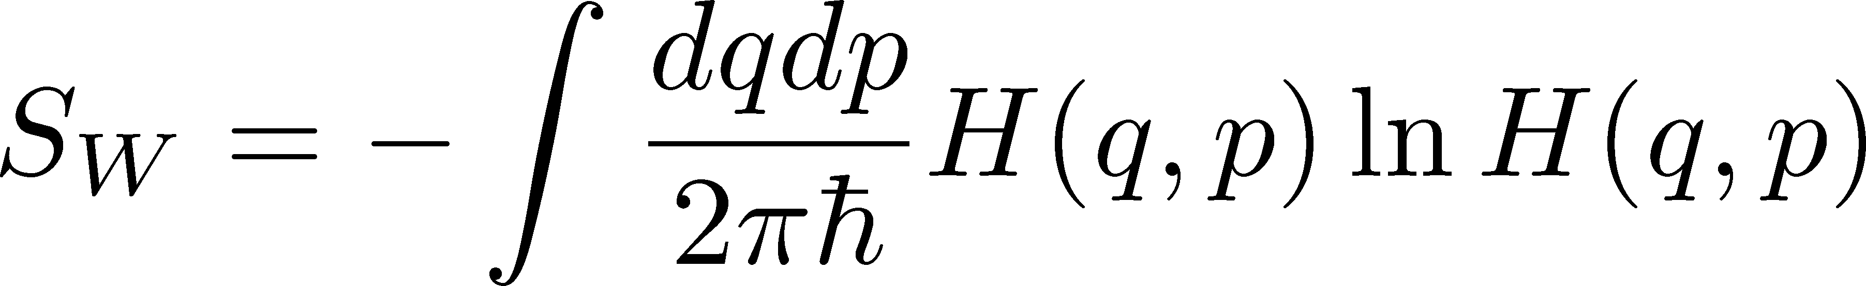
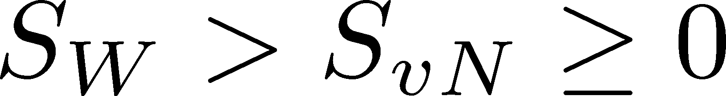
Wehrl entropy in quantum mechanics
von Neumann entropy
coherent state
Replace
Husimi distribution
Wehrl entropy
Nonvanishing even for a pure state because

Slide 22
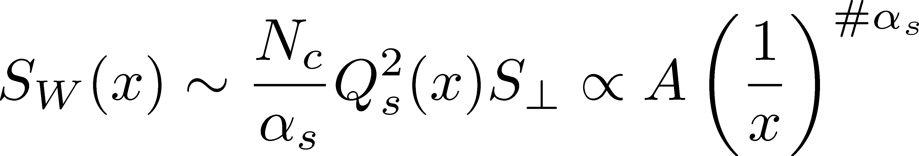
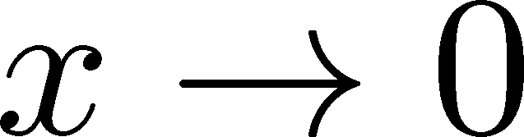
Wehrl entropy for the nucleon
Hagiwara, YH, Xiao, Yuan (2018)
Use the QCD Husimi distribution to define
cf. Wehrl entropy for QGP; Kunihiro, Muller, Ohnishi, Schafer (2008)
Parametrically the same result as in Kutak; Peschanski; Kovner-Lublinsky
Measure of `complexity’ of the multiparton system.
Proportional to the final state multiplicity?
Saturation of entropy due to the Pomeron loop effect?

Slide 23
Conclusions
Let’s get 5 dimensional. Even richer physics than TMD and GPD combined. A lot of progress since the 2012 EIC white paper.
Wigner/GTMD measurable in ep, pp, pA, including the elliptic part and spin-dependent part (connection to OAM).
Experimentally challenging, but possible at the EIC!
Phase space distributions naturally define an `entropy’ of nucleon. Communicate with other fields of physics
Bhattacharya, Metz, Zhou
Ji, Yuan, Zhao
YH, Nakagawa, Xiao, Yuan, Zhao

