Slide 1
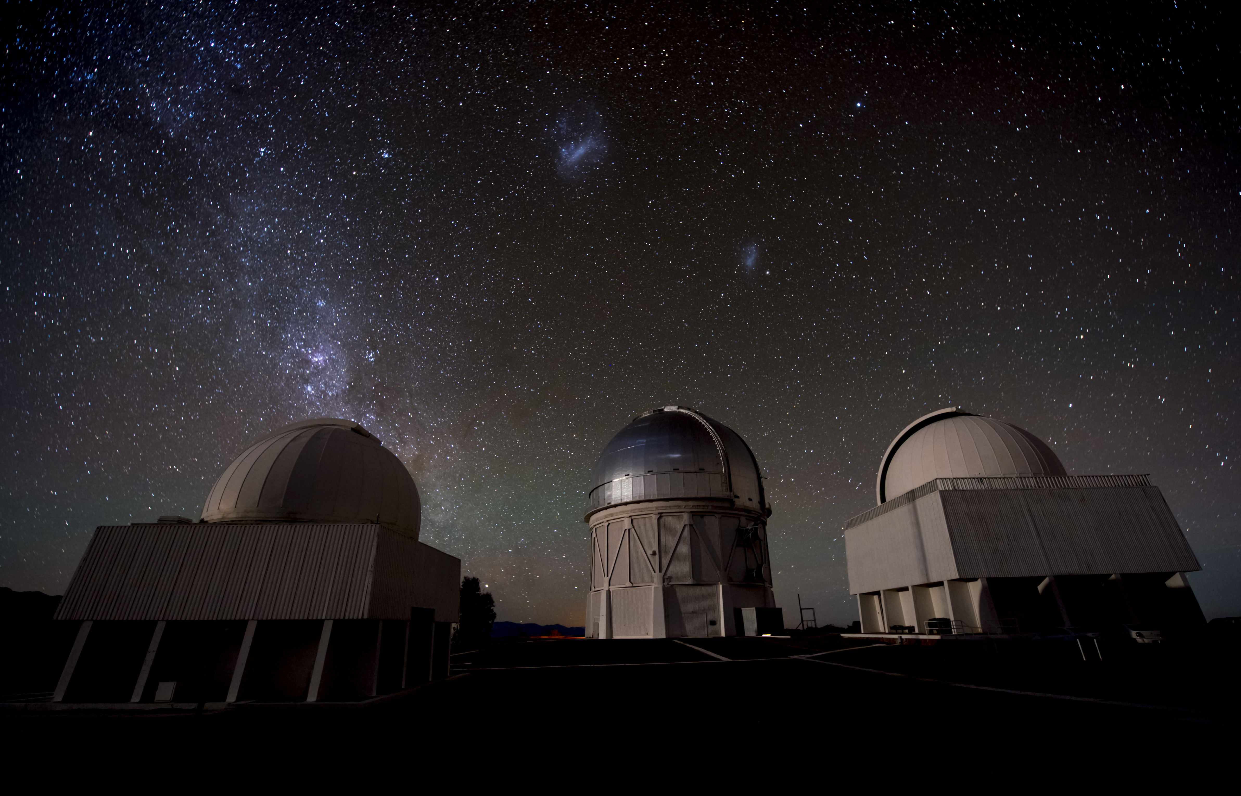
Is Dark Energy Evolving?
Josh Frieman
U. Chicago, SLAC
UCLA Dark Matter Conference
March 24, 2025

Slide 2
Dark Energy
Josh Frieman
U. Chicago, Fermilab
UCLA Dark Matter Conference
March 29, 2023

Slide 3
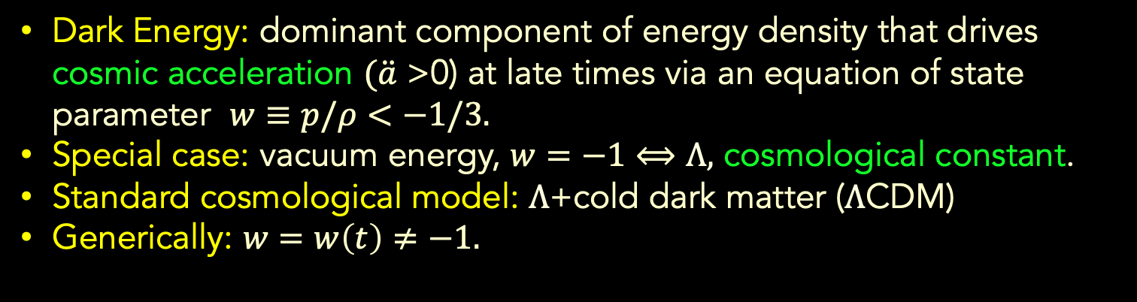
Cosmological Dynamics
Friedmann
Equation from
General Relativity
Dark Energy: dominant component of energy density that drives cosmic acceleration $(\ddot{a}$ >0) at late times via an equation of state parameter $w≡p/ρ<−1/3.$
Special case: vacuum energy, $w=−1⟺Λ,$ cosmological constant.
Standard cosmological model: $Λ$+cold dark matter ($Λ$CDM)
Generically: $w=w\left(t\right)≠−1.$
Notes:
In our Newtonian derivation of cosmology, we implicitly assumed that the energy content of the Universe was dominated by the rest-mass of the particles, i.e., that the particles are slowly moving: non-relativistic. In Einstein’s General Relativity, stress-energy, e.g., pressure, gravitates, and it becomes significant in the relativistic regime. In order to drive accelerated expansion, there must be a component with negative pressure comparable to the energy density: this is the defining feature of Dark Energy.

Slide 4
How do we probe Dark Energy?
JF, Turner, Huterer
Growth of
Density
Perturbations
Geometry: Distances, Expansion rate vs. Redshift
Expansion History Growth of Structure
Type Ia Supernovae
Baryon Acoustic Oscillations
Weak Lensing
Galaxy Clustering
Cluster Abundance
Redshift Space Distortions

Slide 5
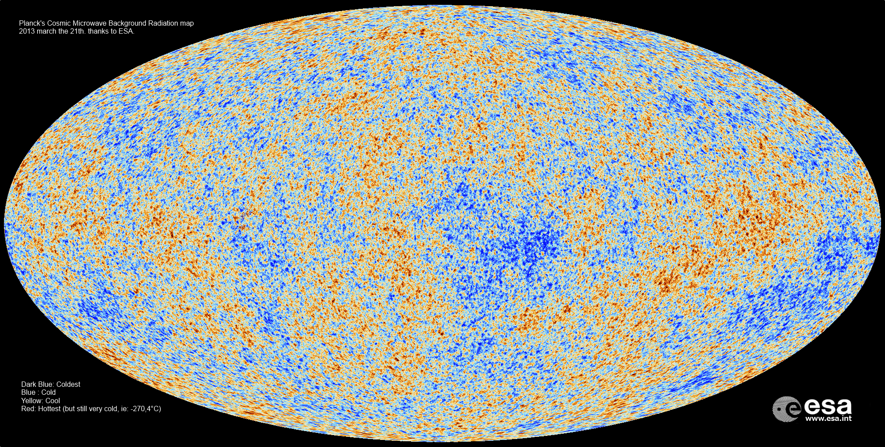
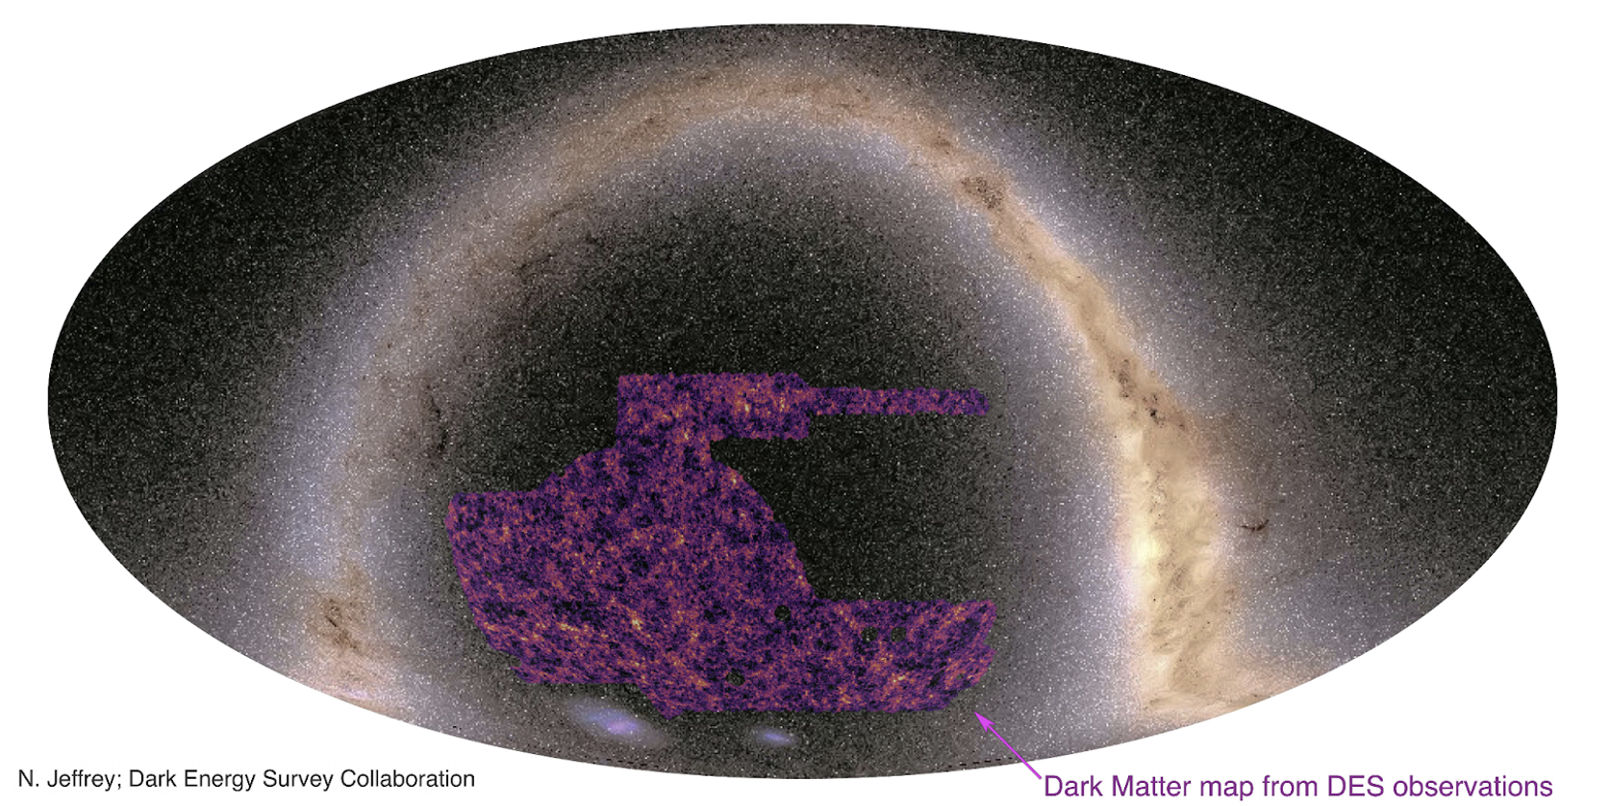
Growth of Structure
Planck Cosmic Microwave Background (CMB) map of temperature anisotropies. Snapshot of the Universe at z~1000.
Dark Energy Survey weak lensing map of large-scale structure today. Perturbations have grown by factor 10³ on large scales.

Slide 6
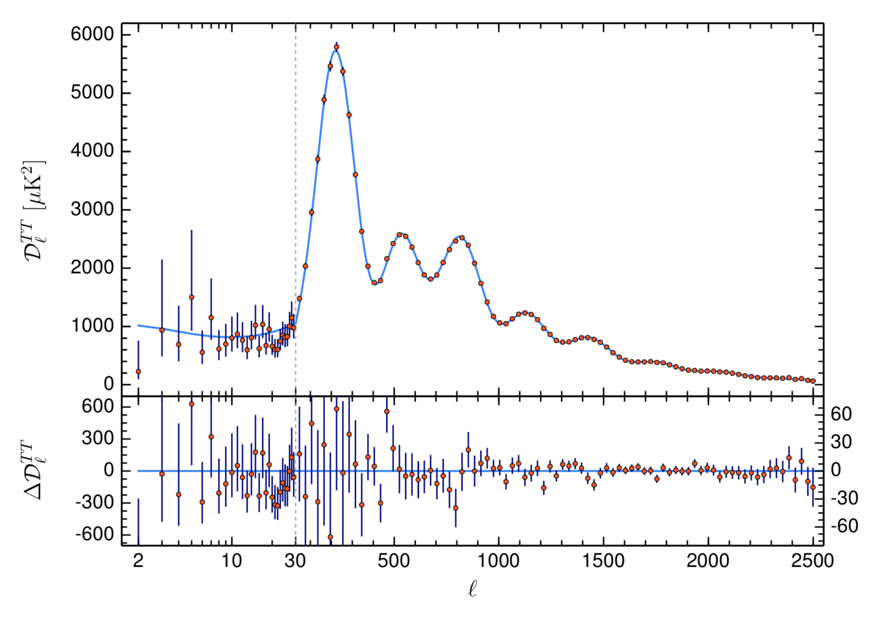
Planck 2018 CMB Results
6-parameter ΛCDM fit:
Ω_{Λ}=0.685±0.007
Ω_{m}=0.315±0.007
n_{s}=0.965±0.004
H₀=67.4±0.5 km/sec/Mpc
σ₈=0.811±0.006
Ω_{b}h²=0.02237±0.00015
(TT,TE,EE+lowE+lensing)
Angular power spectrum
Angular multipole

Slide 7
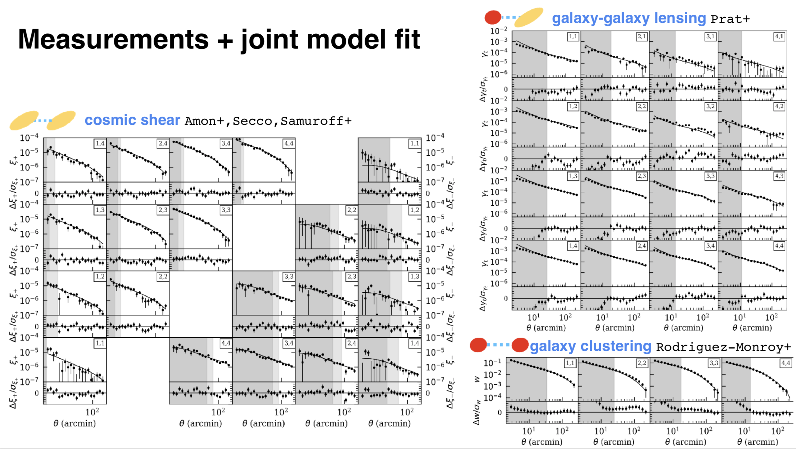
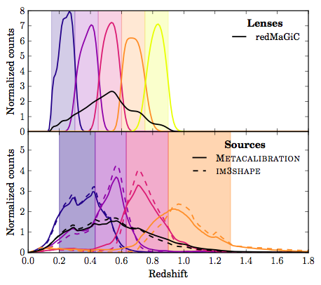
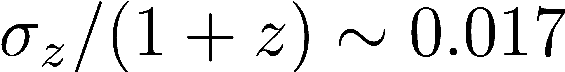

DES Y3 3x2pt Measurements
DES Collaboration 2021
660,000 redMaGiC galaxies with excellent photo-z’s:
26 million source galaxies for weak lensing
For cosmology probes, we need true n(z) distribution in each photo-z bin.
For DES Y1, cosmology results insensitive to shape of n(z): we just need true mean redshift for each photo-z bin.
$Λ$CDM
+26 nuisance parameters
Each panel shows (cross-)correlation between photometric redshift bins.

Slide 8
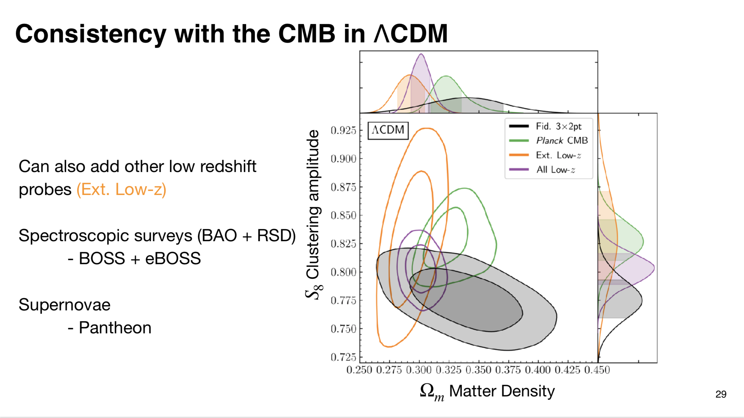
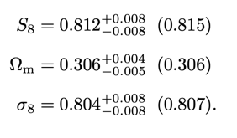

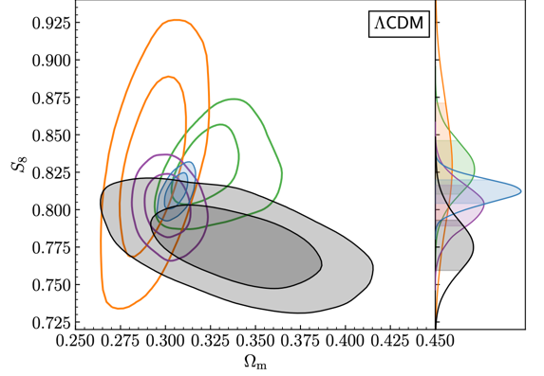
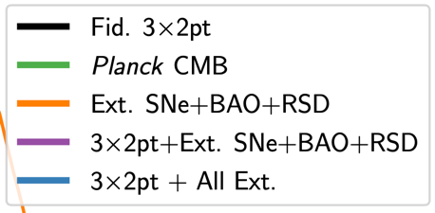
Combined Constraints: ΛCDM
DES Collaboration 2021
All data sets combined:
DESY3 3x2 + Ext. Low-z + Planck
:
CMB
DES

Slide 9
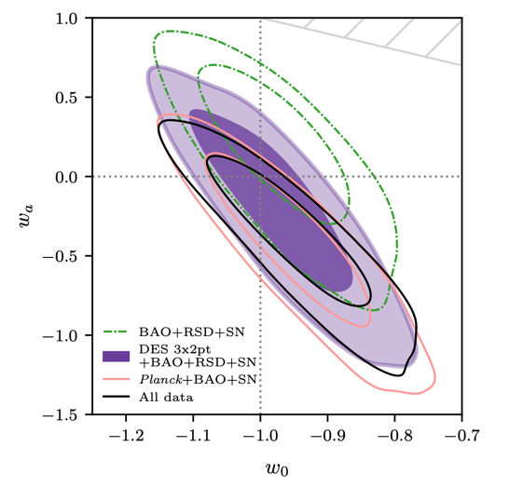


Combined Constraints: w₀w_{a}CDM
Evolving Dark Energy
model:
$$w\left(a\right)=w_{o}+(1−a)w_{a}$$
consistent with $Λ$CDM
$$(w_{0}=−1, w_{a}=0)$$
Amplitude of clustering
$$Λ$$
Density of matter
DES Collaboration 2022
DES Y3 3x2 + Pantheon SN + SDSS BAO + CMB

Slide 10
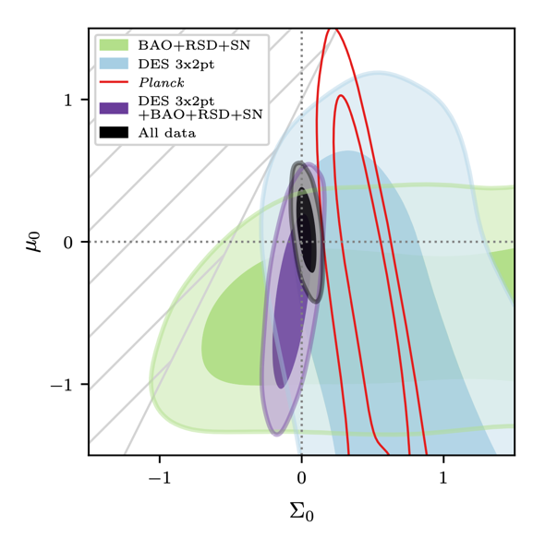
Dark Energy & Modified Gravity
DES Collaboration 2022
Data are consistent with cosmological constant and GR. But still room for surprises/discoveries (new physics).

Slide 11
Dark Energy & Modified Gravity
Freezing models
Thawing models
DES Collaboration 2022
Data are consistent with cosmological constant and GR. But still room for surprises/discoveries (new physics).

Slide 12

What’s changed in the last 2 years?
Improved Expansion History Constraints:
  New Supernova Ia Data from DES (DES-SN5YR)
  New BAO Data from DESI (Y1 and Y3) and DES (DES-Y6)
Coming soon: improved Growth of Structure Constraints:
  DES Year-6 Lensing+Clustering+Clusters

Slide 13
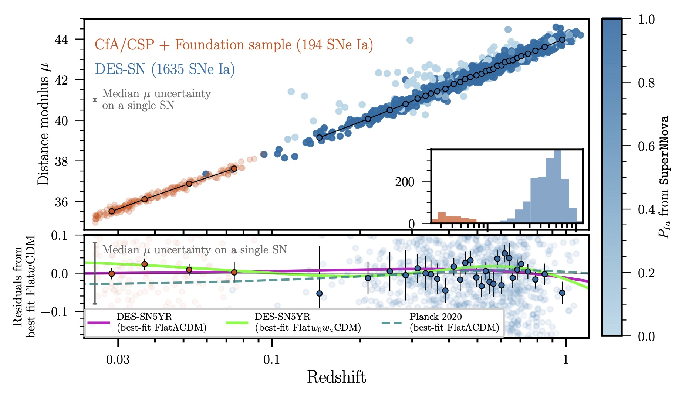
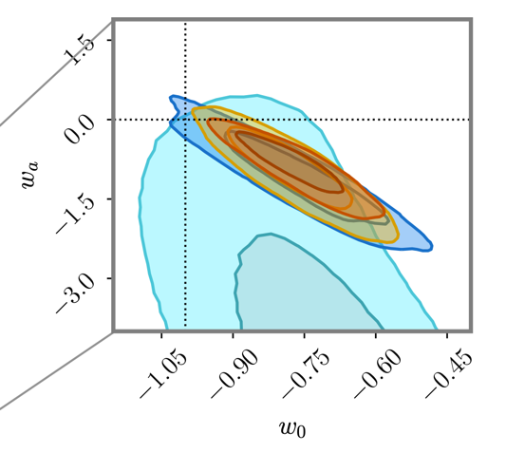




DES 5-Year Supernova Results (DES-SN5YR)
$$Λ$$
Pantheon+: 1550 SNe
DESY5 SN 2024
Distance modulus
JLA: ~750 SNe Ia
redshift
Using DES-SN5YR+ SDSS (Pre-DESI)
BAO+CMB+
DES 3x2pt
Combined constraints:
$$w_{0}=−{0.773}_{−0.067}^{+0.075}$$
$w_{a}=−{0.83}_{−0.42}^{+0.33}$
DES 2024, Jan. 2024
$\sim 3σ$from $Λ$CDM

Slide 14

Supernovae: Pantheon → DES-SN5YR
Efstathiou 2024
Geometry: Distances, Expansion rate vs. Redshift
Vincenzi+ 2025
High-z SNe at given redshift appear relatively closer than in $Λ$CDM, a signature of $w>−1$.
Pantheon→DES-SN5YR: much more high-z data, improved modeling of SN intrinsic scatter and host galaxy effects.

Slide 15
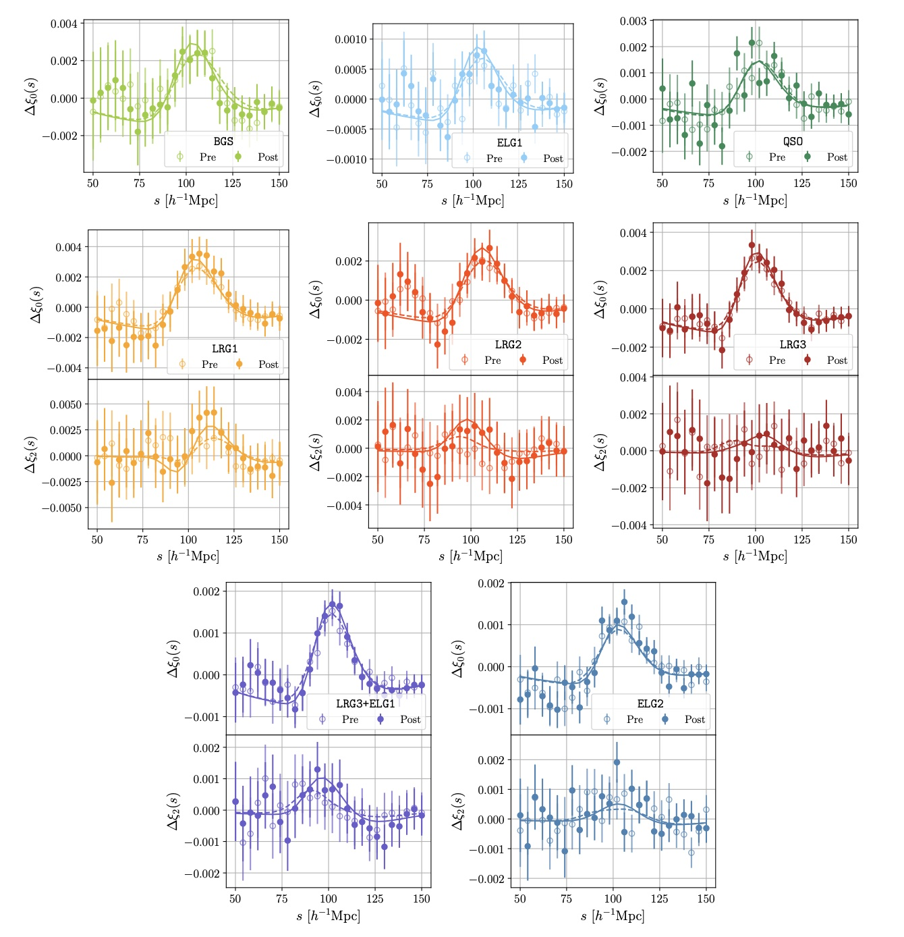
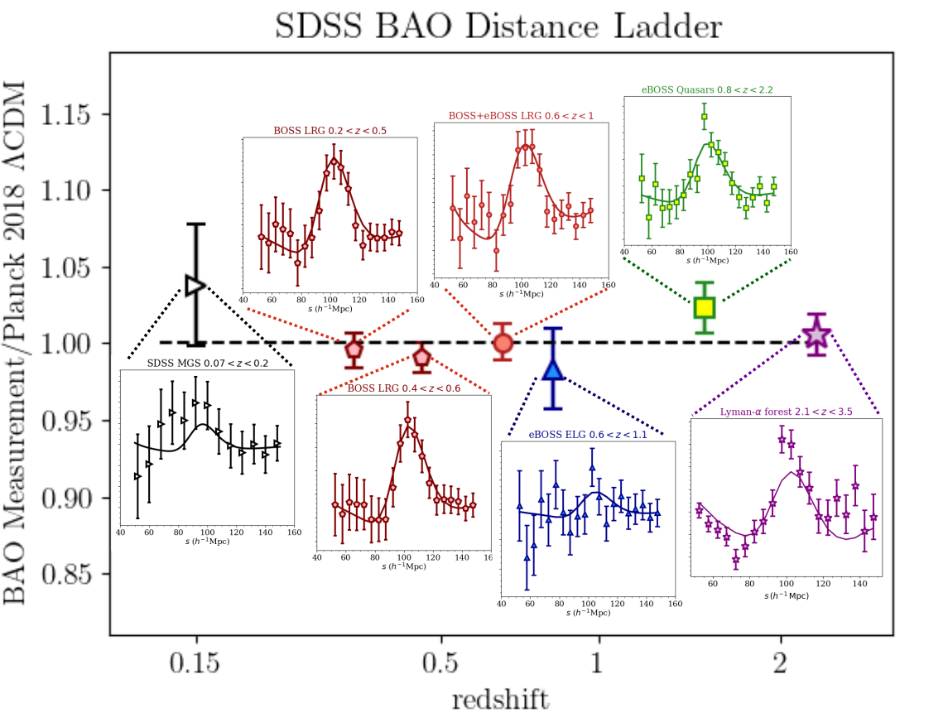
Baryon Acoustic Oscillations:
SDSS → DESI-Y1
Geometry: Distances, Expansion rate vs. Redshift
SDSS: Alam+ 2021
DESI VI (April 2024)

Slide 16
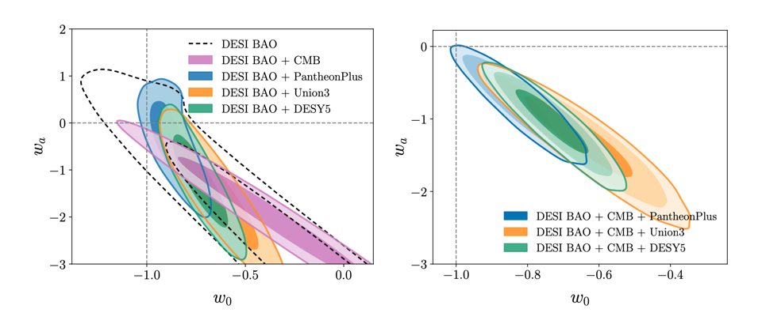
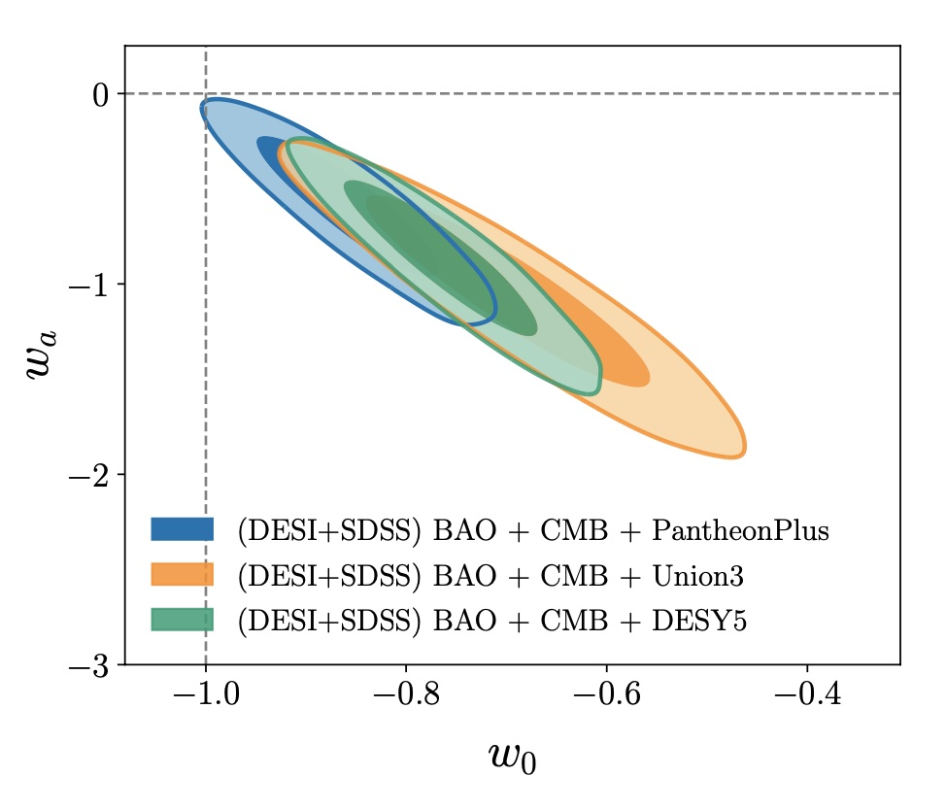
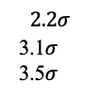

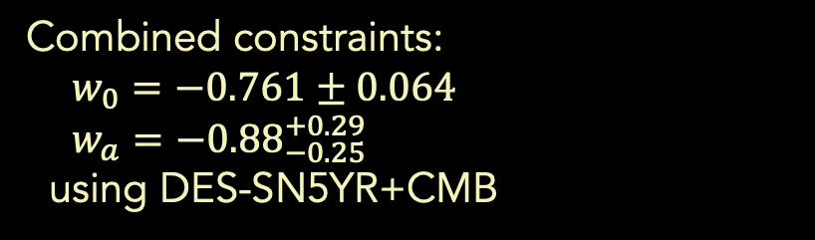
SDSS+DESI-Y1 BAO+CMB+DES-SN5YR: April 2024
$$2.6σ$$
Pantheon+: 1550 SNe
Distance modulus
$$2.2σ$$
3.1$σ$
3.5$σ$
JLA: ~750 SNe Ia
redshift
$$3.5σ$$
from $Λ$CDM
Combined constraints:
$w_{0}=−0.761±0.064$
$w_{a}=−{0.88}_{−0.25}^{+0.29}$
using DES-SN5YR+CMB
DESI VI, 2024

Slide 17
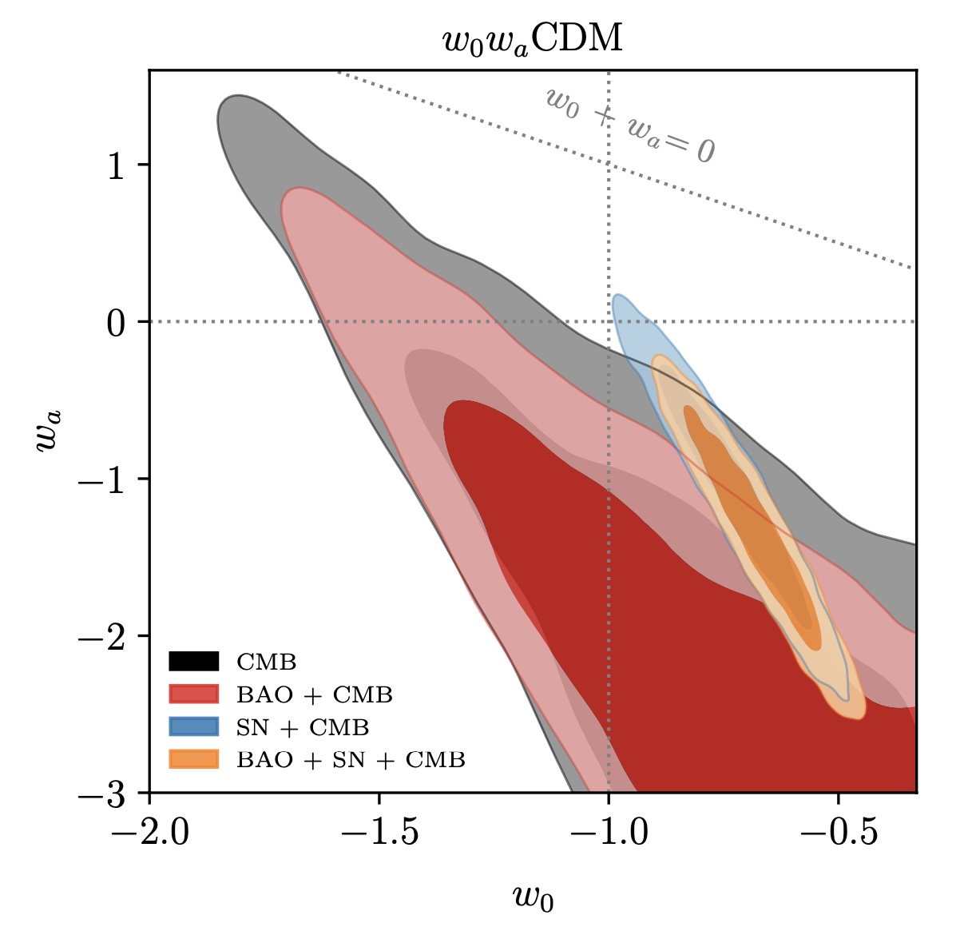
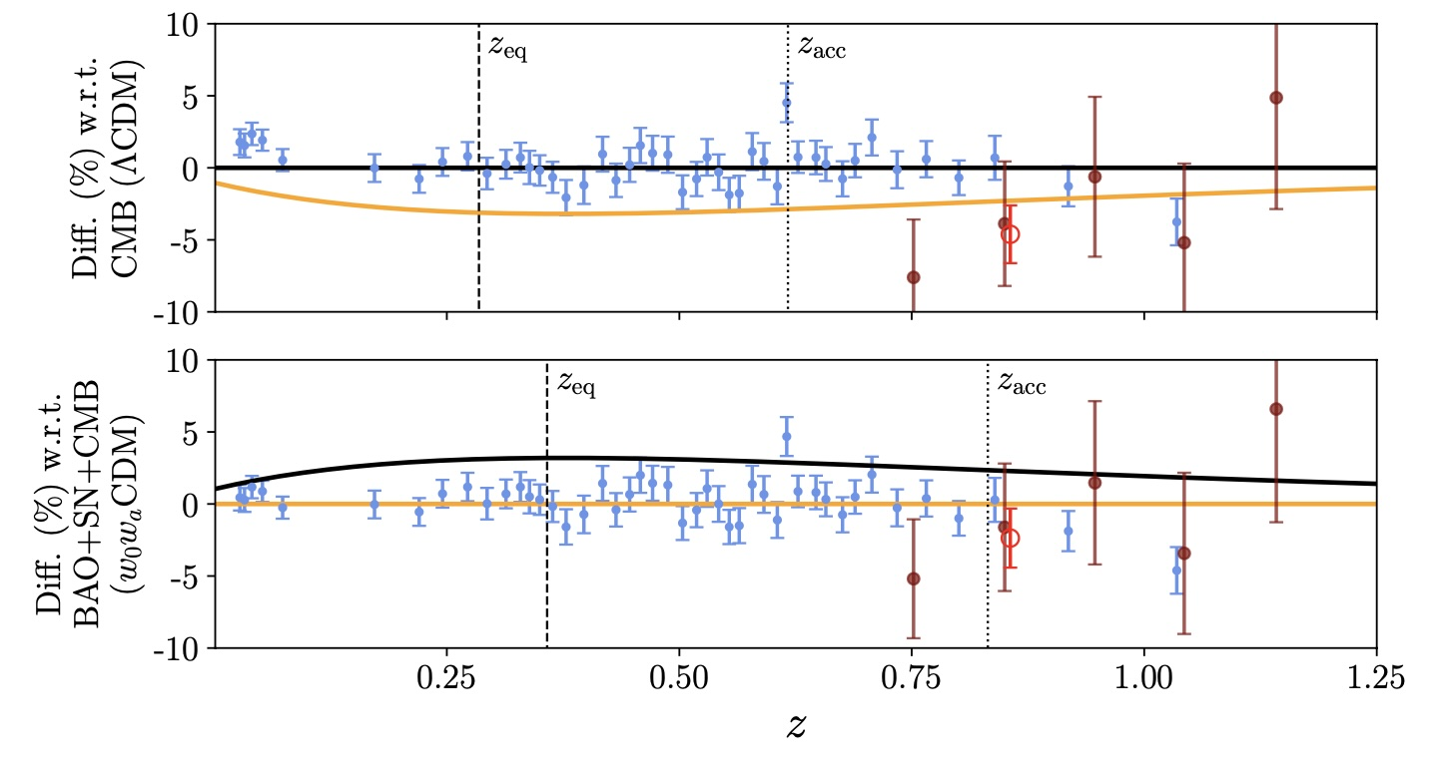
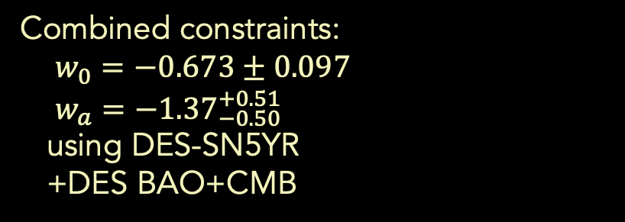

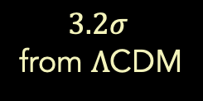
CMB+DES-SN5YR+DES-Y6 BAO:
early March 2025
Results robust to BAO data set
Thawing models
$$2.6σ$$
Distance modulus
$$2.2σ$$
3.1$σ$
3.5$σ$
redshift
Combined constraints:
$w_{0}=−0.673±0.097$
$w_{a}=−{1.37}_{−0.50}^{+0.51}$
using DES-SN5YR
+DES BAO+CMB
$$3.2σ$$
from $Λ$CDM
DES, 2025

Slide 18
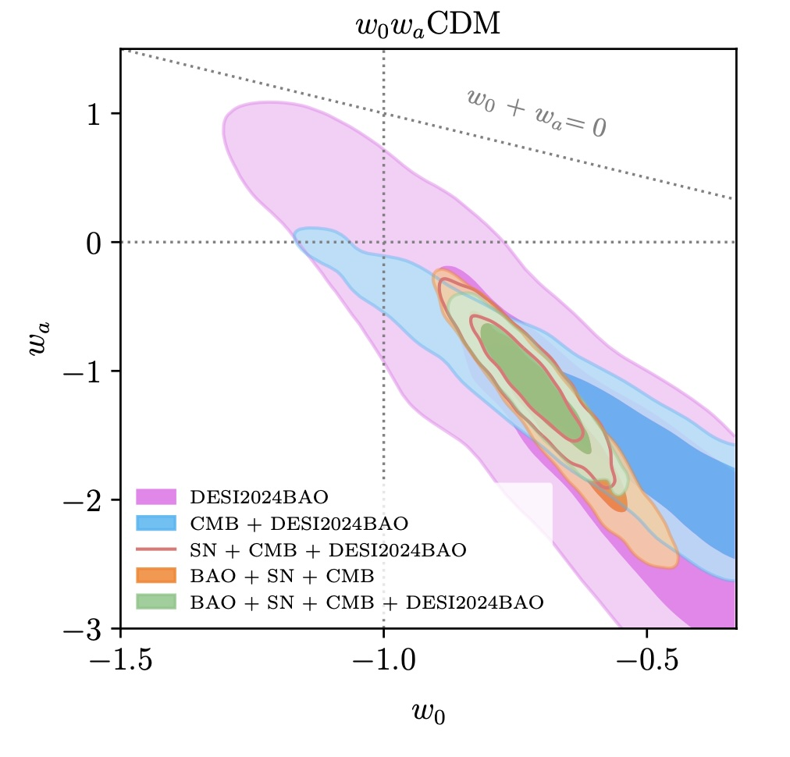
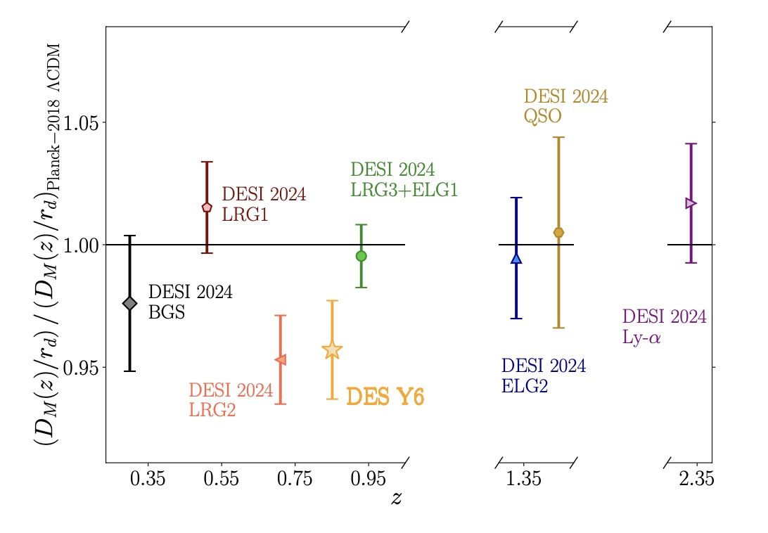
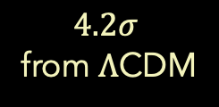
CMB+DES-SN5YR+DES-Y6 BAO+DESI-Y1 BAO: early March 2025
Results robust to BAO data set
Thawing models
$$2.6σ$$
Distance modulus
$$2.2σ$$
3.1$σ$
3.5$σ$
redshift
$$4.2σ$$
from $Λ$CDM
DES 2025

Slide 19
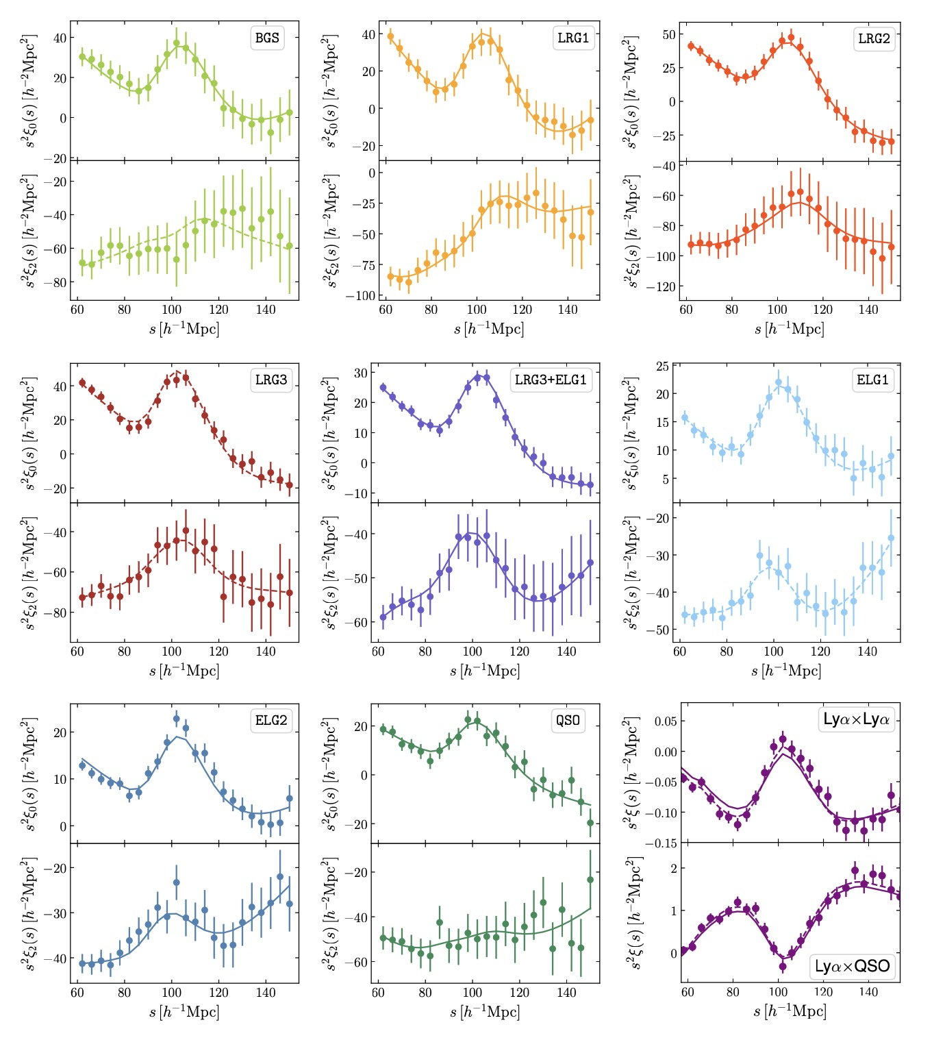
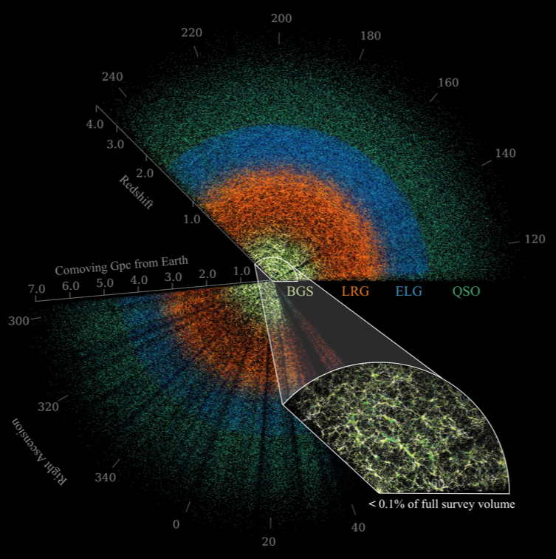
DESI DR2 BAO: March 2025
Thawing models
$$2.6σ$$
Distance modulus
$$2.2σ$$
3.1$σ$
3.5$σ$
redshift
DESI DR2 (Y3), 2025

Slide 20
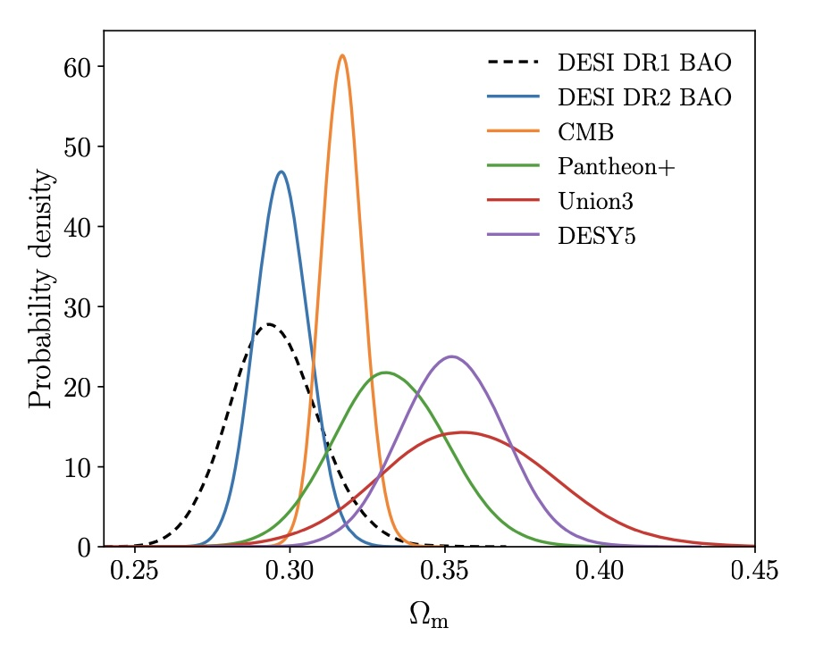
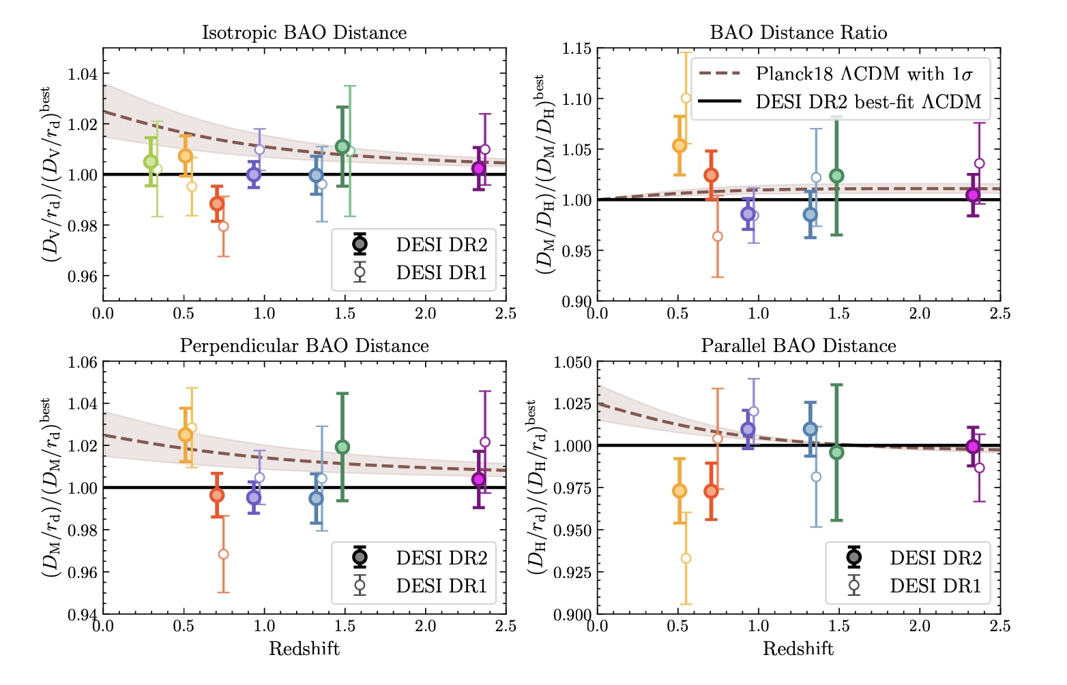

DESI DR2 BAO vs CMB, SN: $Λ$CDM
Tension: the same $Λ$CDM model doesn’t fit all the data.
Distance modulus
$$2.2σ$$
3.1$σ$
3.5$σ$
redshift
DESI DR2, 2025
See also DES 2025

Slide 21
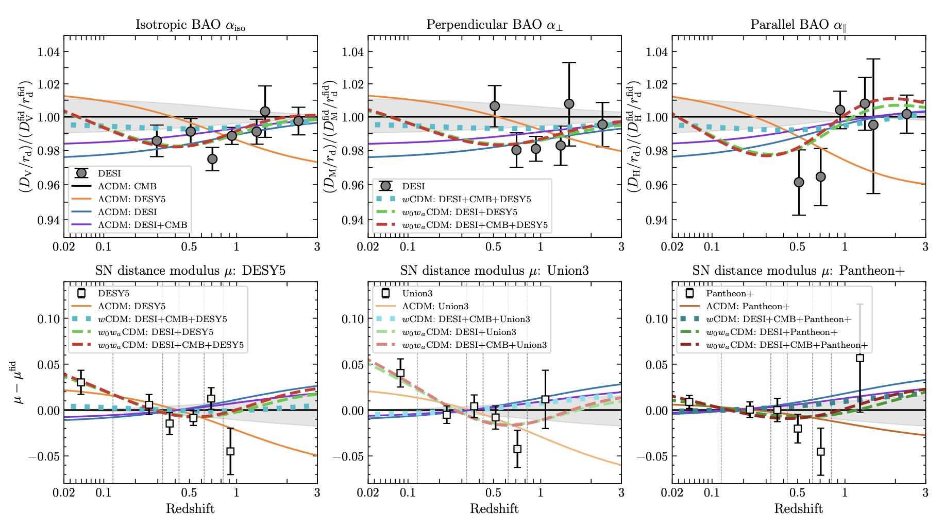

DESI DR2 BAO vs CMB, SN
Tension: the same $Λ$CDM model doesn’t fit all the data. Evolving Dark Energy model has enough flexibility.
Distance modulus
$$2.2σ$$
3.1$σ$
3.5$σ$
redshift
DESI DR2, 2025

Slide 22
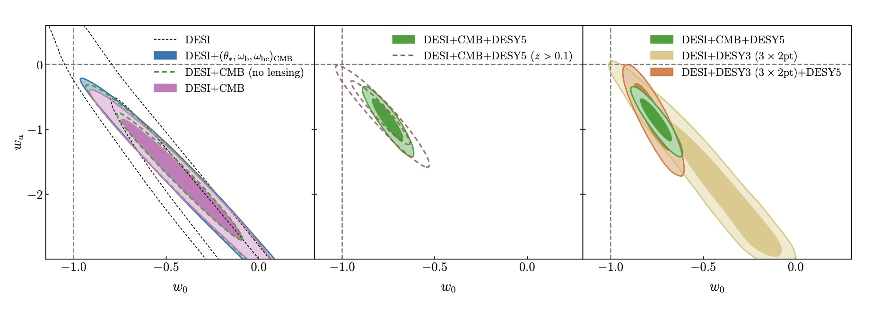
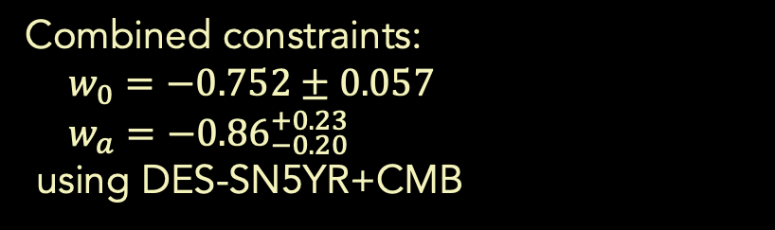

DESI DR2 BAO+CMB+DES-SNY5
Results robust to dropping individual legs of the strategic triad.
Thawing models
$$2.6σ$$
No low-z SNe
No CMB
No SNe
Distance modulus
$$2.2σ$$
3.1$σ$
3.5$σ$
redshift
Combined constraints:
$w_{0}=−0.752±0.057$
$w_{a}=−{0.86}_{−0.20}^{+0.23}$
using DES-SN5YR+CMB
$$4.2σ$$
from $Λ$CDM
DESI DR2, 2025

Slide 23






Summary of Recent Results
$$Ω_{m }{ w}_{0 }{ w}_{a} Nσ$$
DES-SN+DESY3 3x2+SDSS BAO+CMB
DES-SN+[SDSS+DESI-Y1] BAO+CMB
DES-SN+DESI-Y3 BAO+CMB
DES-SN+DESY3 3x2+DESI-Y3 BAO
$0.325±0.008$ ${−0.773}_{−0.067 }^{+0.075} { −0.83}_{=0.42}^{+0.33}$
$$\sim 3$$
1/24
4/24
3/25
3/25
$$−0.761±0.064 {−0.88}_{−0.25}^{+0.29}$$
$$3.5$$
$$0.3191±0.0056 −0.752±0.057 −{0.86}_{−0.20}^{+0.23}$$
$$4.2$$
$0.3239±0.0092$ $−0.771±0.068 { −0.82}_{=0.32}^{+0.38}$
$$\sim 3$$
Parameter values have remained remarkably stable since Jan. 2024.

Slide 24
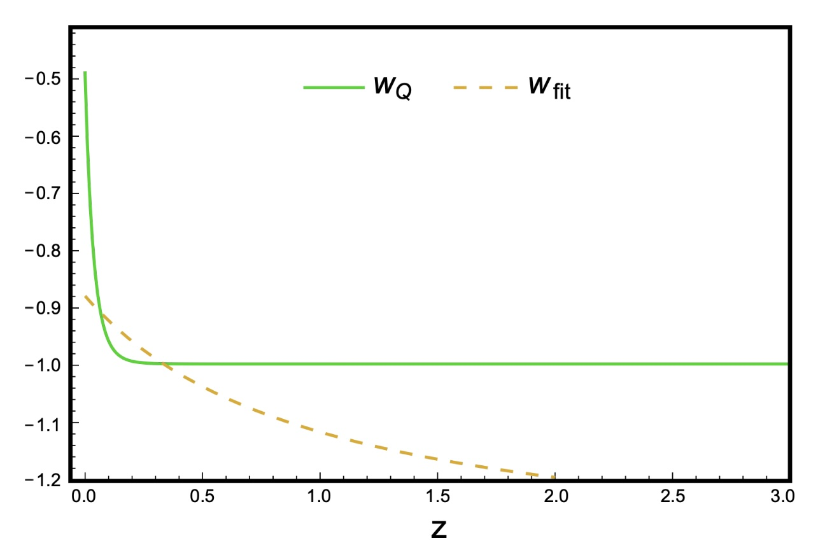


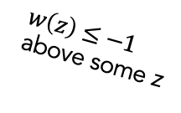




Issues with $w_{0}w_{a}$ parametrization
Chevallier & Polarski 2001, Linder 2003
$$w_{0}w_{a}$$
These 2 models have the same D(z), H(z).
$$w\left(z\right)≥−1$$
$w\left(z\right)≤−1$
above some z
$$w(z)$$
Pantheon+: 1550 SNe
$w\left(z\right)≤−1$
above z=0.35
NEC
Distance modulus
NEC
JLA: ~750 SNe Ia
redshift
Shlivko and Steinhardt 2024
Data naively violate Null Energy Condition (NEC) $(w\left(z\right)≥−1 ∀z)$for $w_{0}w_{a}$ parametrization.
But mapping from BAO, SN observables to $w\left(z\right)$ is not unique: NEC-preserving models not described by $w_{0}w_{a}$ fit data equally well.
We should not draw model conclusions from the $w_{0}w_{a}$ fit.

Slide 25
Scalar Field Dark Energy
Dark Energy could be due to a very light scalar field φ(x,t), slowly evolving in a potential, V(φ):
Density & pressure:
Slow roll:
V(ϕ)
ϕ

Slide 26
Scalar Field Dark Energy Models
Freezing models
Thawing models
V
V
e.g., e^{–φ} or φ^{–n}
e.g., m²φ²
M_{Pl}
ϕ
ϕ
Runaway potentials
DE/matter ratio constant
(Tracker Solution)
Pseudo-Nambu Goldstone Boson
Low mass protected by symmetry
(Cf. axion)
Ratra & Peebles 1988
Steinhardt, Wang, Zlatev 1999
JF, Hill, Stebbins, Waga 1995
Coble, Dodelson, JF 1997

Slide 27
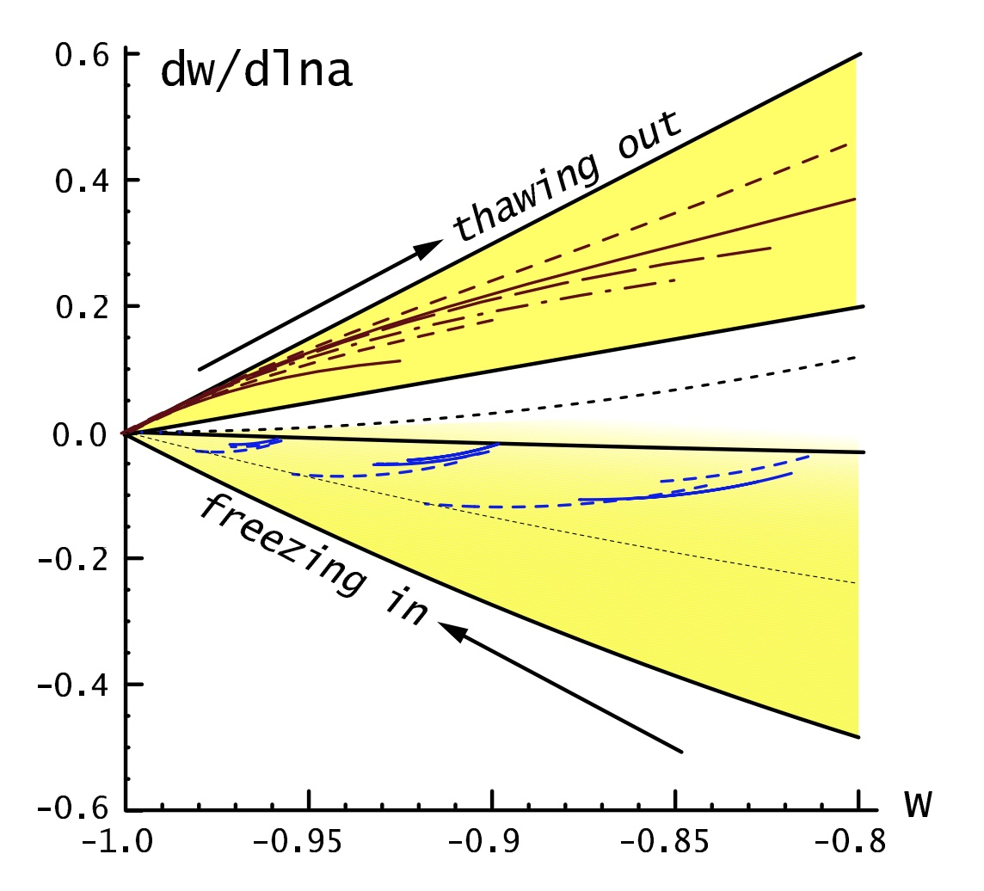



Constraining w Evolution Can Distinguish between Models
$$w_{0}$$
Freezing models
$$w_{a}$$
Geometry: Distances, Expansion rate vs. Redshift
$$Λ$$
Thawing models
PNGB
w(a)=w₀+w_{a}(1-a)
Data
Caldwell and Linder 2005

Slide 28
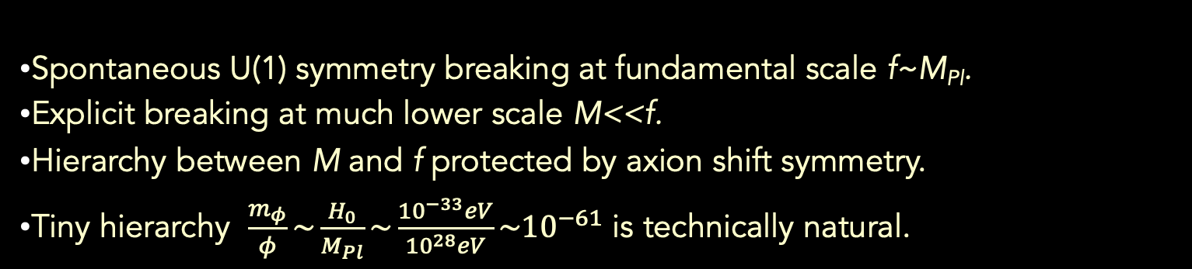
PNGB Model of Thawing Dark Energy
(aka Ultra-light Axion or Natural Quintessence)
JF, Hill, Stebbins, Waga 1995
M⁴
f
Spontaneous U(1) symmetry breaking at fundamental scale f~M_{Pl}.
Explicit breaking at much lower scale M<<f.
Hierarchy between M and f protected by axion shift symmetry.
Tiny hierarchy $\frac{m_{φ}}{φ}\sim \frac{H_{0}}{M_{Pl}}{\sim \frac{{10}^{−33}eV}{{10}^{28}eV}\sim 10}^{−61}$ is technically natural.

Slide 29
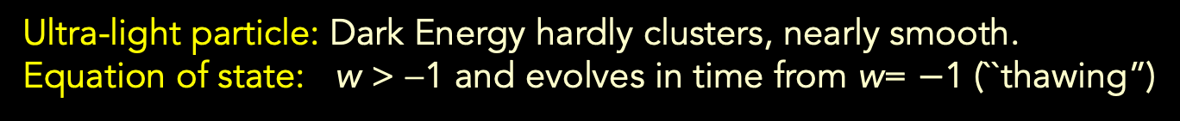
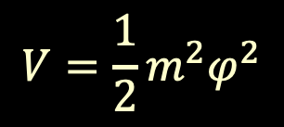

Worked Example: Free, Massive Scalar
Damped Harmonic Oscillator:
Field frozen until $H\left(t\right)\sim m$, then rolls
(`viscosity’ falls as universe expands).
For $w<0$, field still overdamped: require $m<3H_{0}\sim {10}^{−33}$ eV, so $φ$ rolls on timescale $Δt\sim H_{0}^{−1}$.
$$H_{0}^{2}\sim VM_{Pl}^{−2}\sim m^{2}{\left(\frac{φ^{2}}{M_{Pl}^{2}}\right)\sim H_{0}^{2}\left(\frac{φ^{2}}{M_{Pl}^{2}}\right)}^{ }$$
$$V=\frac{1}{2}m^{2}φ^{2}$$
V(ϕ)
(3x10^{–3} eV)⁴
ϕ
10²⁸ eV
Ultra-light particle: Dark Energy hardly clusters, nearly smooth.
Equation of state: w > −1 and evolves in time from w= $−$1 (``thawing”)

Slide 30

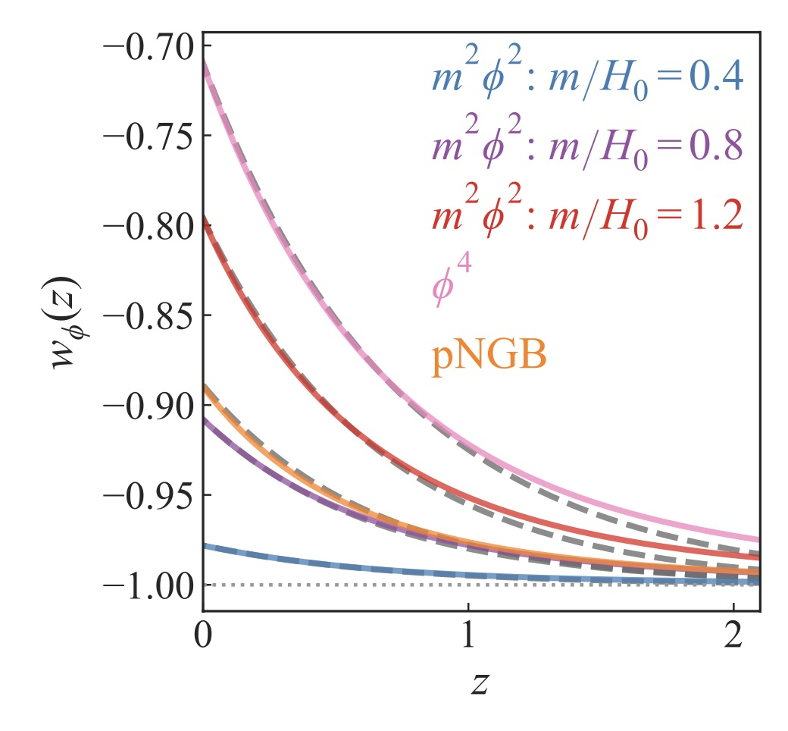
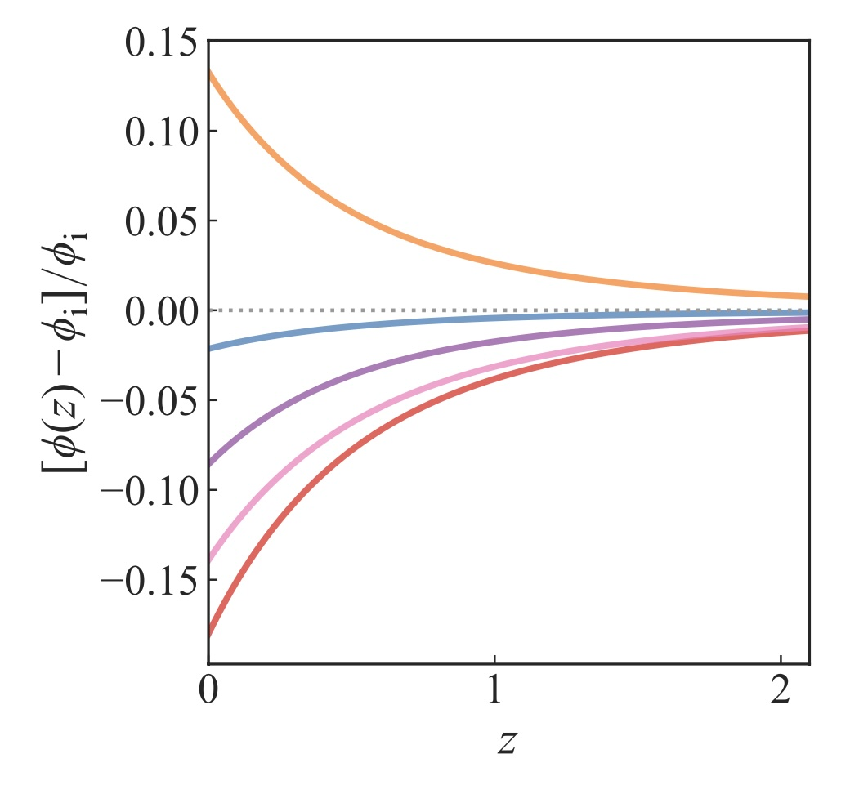






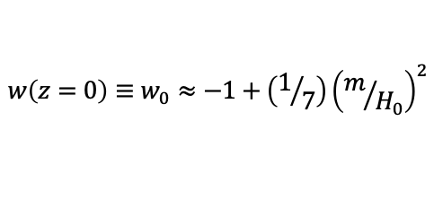



Thawing Scalar Field Evolution: $w_{φ}$CDM
Quasi-universal behavior parametrized by $w\left(z=0\right)≡w_{0}$
$$V=\frac{1}{2}m^{2}φ^{2}$$
For $Ω_{φ}=0.7,$
$\frac{m}{H_{0}}\frac{φ_{0}}{M_{Pl}}$ $≈0.44$
For $Ω_{φ}=0.7,$
$\frac{m}{H_{0}}\frac{φ_{0}}{M_{Pl}}$ $≈0.4$
$$\frac{m}{H_{0}}=0.4, \frac{φ_{i}}{M_{Pl}}=1.1$$
$$\frac{m}{H_{0}}=0.8, \frac{φ_{i}}{M_{Pl}}=0.55$$
$$\frac{m}{H_{0}}=1.2, \frac{φ_{i}}{M_{Pl}}=0.4$$
$$w\left(z=0\right)≡w_{0}≈−1+\left(1/7\right){\left(m/{H_{0}}\right)}^{2}$$
Shajib, JF 2025
See also Abreu+Turner 2025

Slide 31
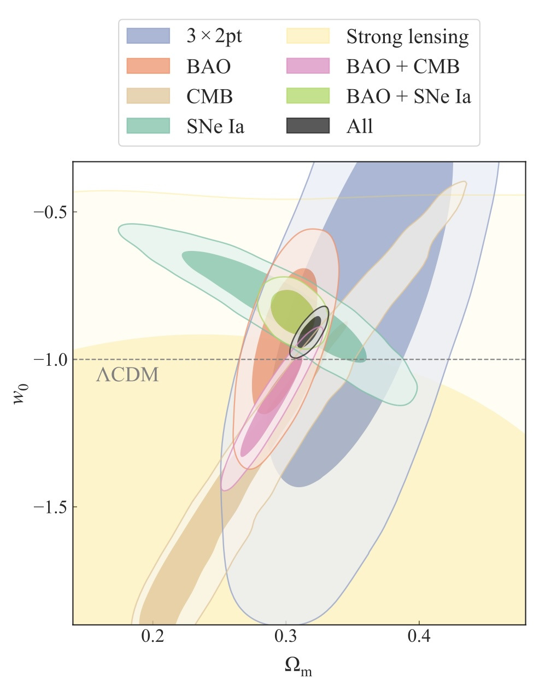


Observational Constraints on $w_{φ}$CDM Models
DES-SN5YR+CMB+DESI-Y1 BAO+DES Y3 3x2pt
Best fit parameters:
$w_{0}=−0.908±0.035$
$Ω_{m}=0.318±0.006$
Best-fit scalar field mass $m=0.8H_{0}=1.1×{10}^{−33}$ eV, $φ_{i}/M_{Pl}$=0.55 and has changed by 8% to today.
$2.6σ$ from $Λ$CDM, but favored by Bayesian evidence ratio.
See also Camilleri+ 2024, Lodha+2024
Shajib, JF 2025

Slide 32


Observational Constraints on $w_{φ}$CDM Models
SN+CMB+DESI-Y3 BAO
Best-fit scalar field mass $m=2.3×{10}^{−33}$ eV using DES-SN5YR
pNGB Model
Lodha+ 2025

Slide 33



Distinguishing $w_{φ}$CDM Models from Planck $Λ$CDM
Shajib, JF 2025

Slide 34


Distinguishing $w_{φ}$CDM Models from Planck $Λ$CDM
Forecast constraints for DESI extension plus LSST.
$σ(w_{0}$) reduced from 0.035 to 0.01.
Current best-fit thawing model will be 9.2$σ$ from $Λ$CDM.
Shajib, JF 2025

Slide 35

Is Dark Energy Evolving?
$Λ$CDM tensions between probes are getting stronger: evidence for Evolving DE growing as data sets become more precise.
Evidence for evolving DE also becoming robust to removal of individual probes and substitution of data sets.
Evolving models fit ``better enough” than $Λ$CDM to justify added model complexity (Bayesian evidence, etc).
But Evolving DE remains a hint, not a discovery.
If the current hints are real, DESI extension+LSST will nail it at very high significance (3→9 sigma for thawing models) in several years.
Geometric probes have strongest DE constraining power (BAO, SN), but structure growth becoming competitive (3x2, clusters, RSD).
Standard $w_{0}w_{a}$ prescription not physically motivated: we’re now at the point where we should be testing physical DE models.
Thawing models are an example: ultra-light axion PNGB with mass $m\sim H_{0}$ fits current data better than $Λ$CDM.

