Slide 1
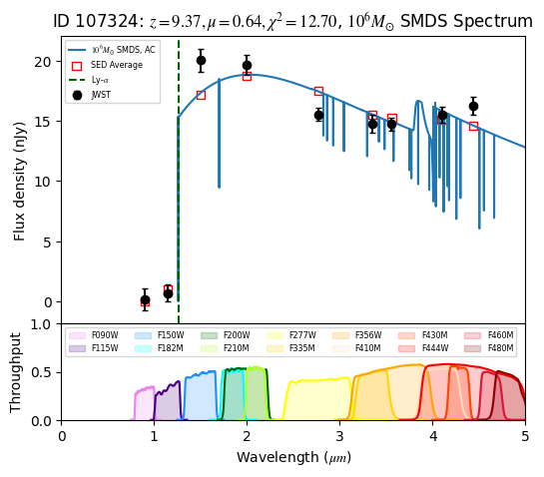
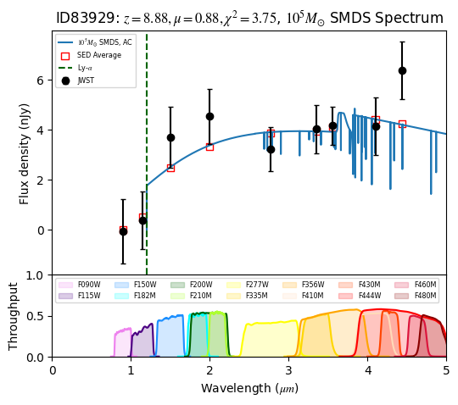
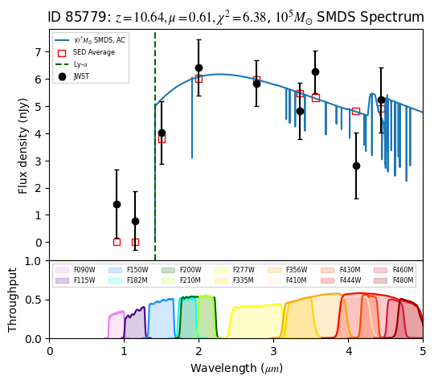
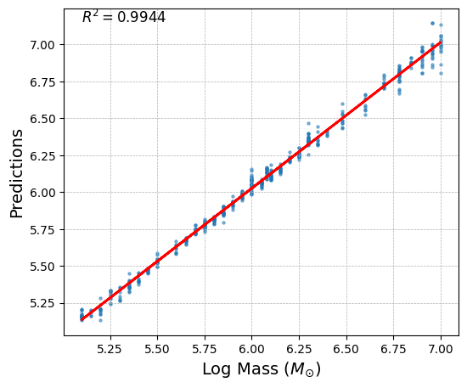
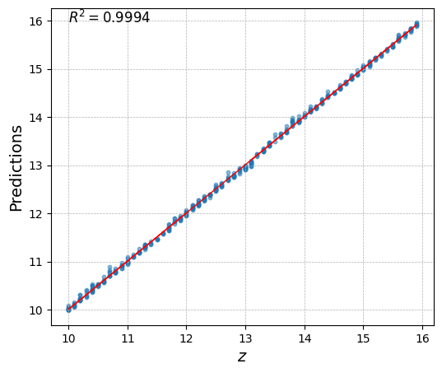
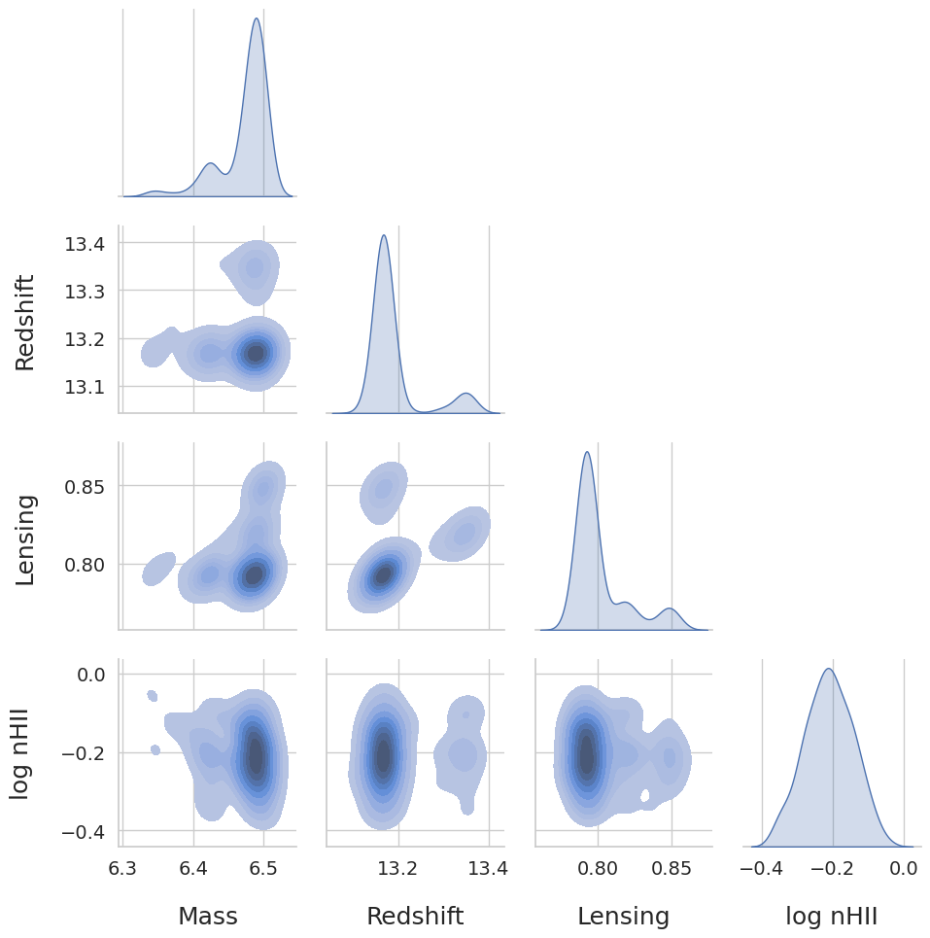
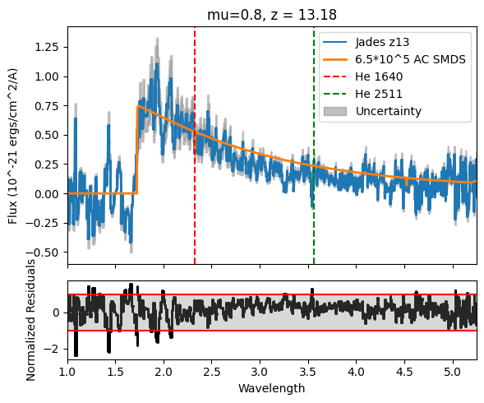
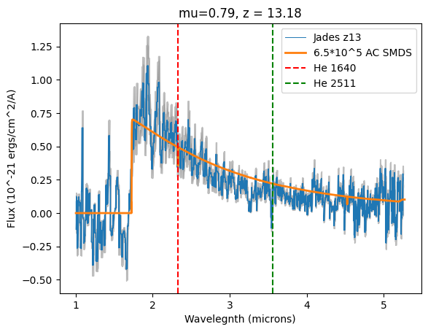
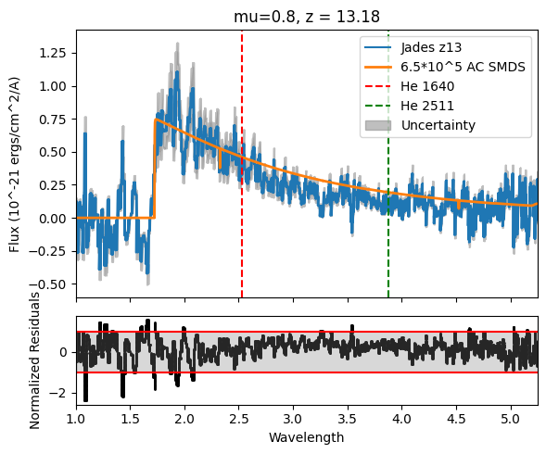
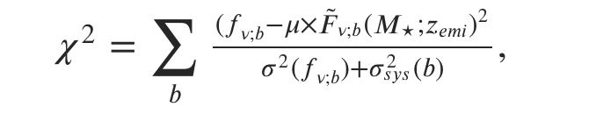
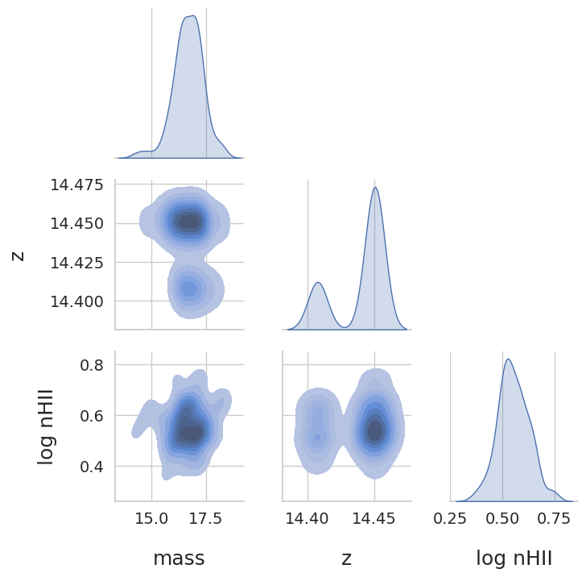
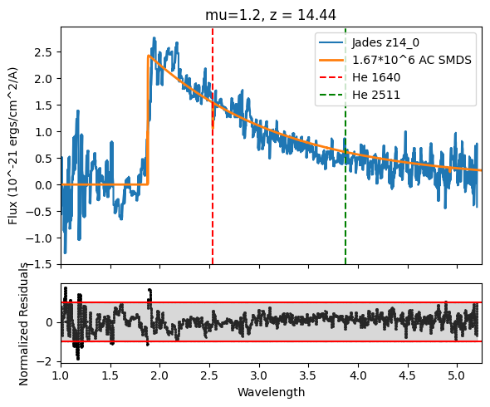
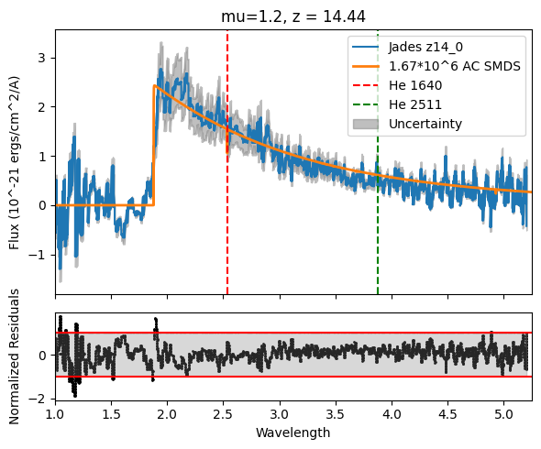
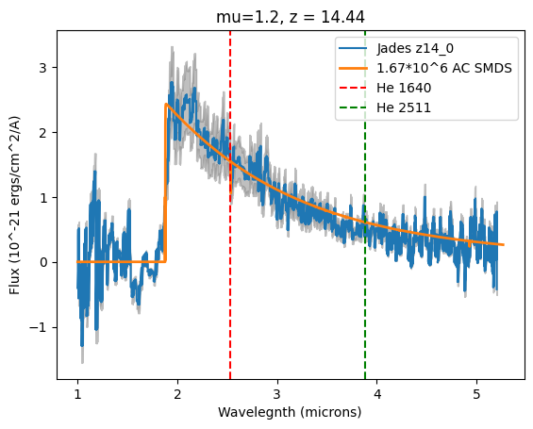
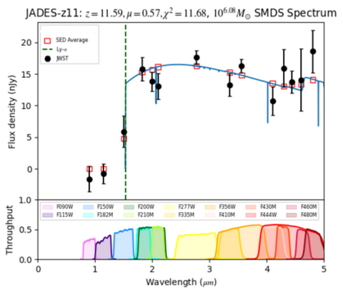
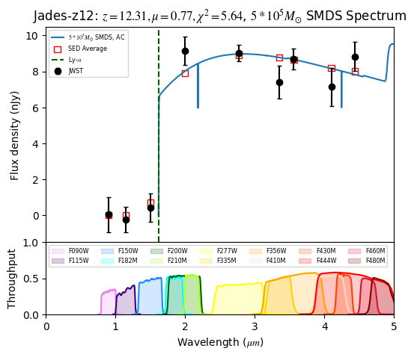
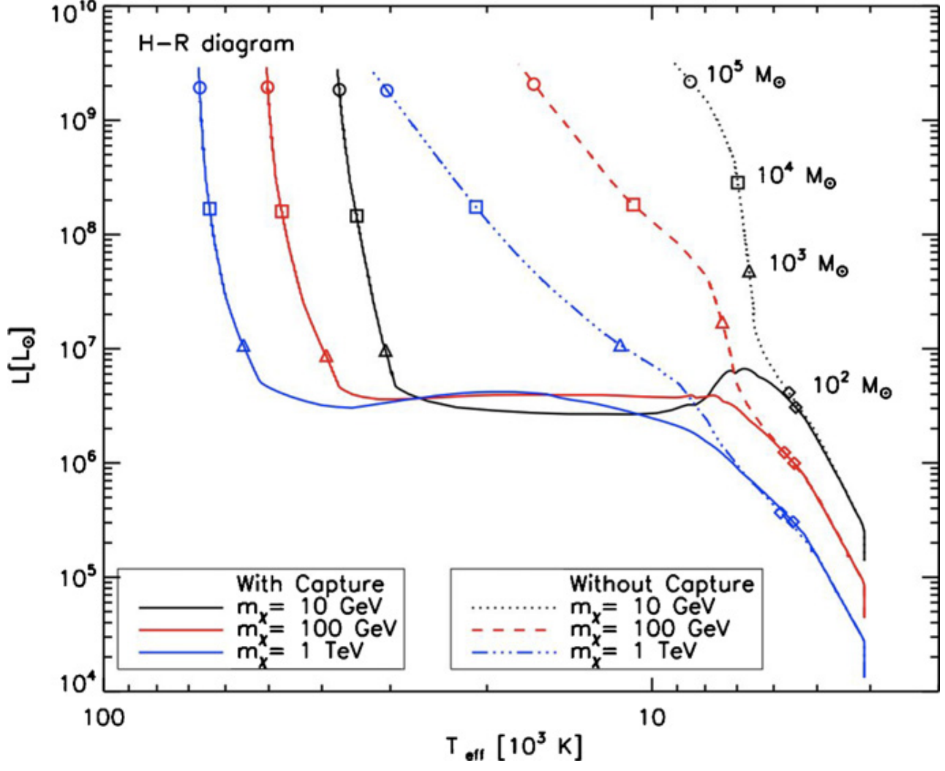
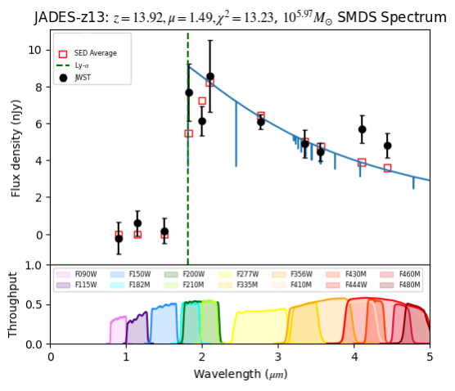
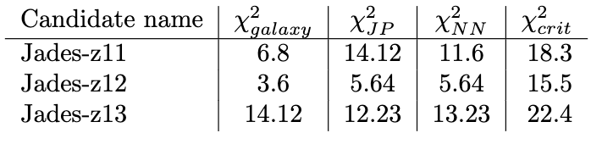
Using Neural Networks to Detect Dark Star Candidates from JWST Data
Sayed Shafaat Mahmud, Adiba Amira Siddiqa, Cosmin Ilie
Dark Matter Research Group, Colgate University
What are Dark Stars?
Dark Stars, hypothesized to have formed during the cosmic dawn era, are unique stellar objects that utilize dark matter annihilation as their primary source of energy against gravitational collapse. These stars can reach immense sizes, growing to millions of times the mass of our Sun, and possess luminosities on the order of trillion times that of the Sun. Dark Stars, powered by dark matter, have limited lifespans and may ultimately evolve into supermassive black holes. As such, Supermassive Dark Stars can be the precursors to the many observed supermassive black holes at high redshift, which remains an open question, many years after their discovery.
Neural Network Performance
We design 3 neural networks one of which takes in photometric data of JWST and outputs whether the candidate resembles AC or Capture, the others predict the Mass, redshift and gravitational lensing of the DS based on its classification as an AC or capture dark star. The NNs are a standard feed forward NN with 3 hidden layers each with 128, 64 and 32 nodes and relying on relu activation function.
More Candidates…
Spectral Analysis
The Goal
We compare Dark Star spectra generated by Tlusty to photometric data of galaxy candidates z>8 and perform a chi-squared goodness of fit of observed data to our model.
Dark Star Candidates
In order to validate our method we first independently identify previously detected DS candidates from Ilie 2023 et. al. For all the objects we find our model to have chi–squared values below the critical value.
Generating Data for Neural Network
Interpolation of Mass grid of DS from Fresse 2010 et.al. to generate TLUSTY spectra
Shifting SED flux as a function of gravitational lensing parameter and redshift.
Conversion of SED data to photometric data as would be seen by JWST.
Generating ~100,000 SED for capture and adiabatic cases each.
References
[1] Ilie, Cosmin, Jillian Paulin, and Katherine Freese. 2023. “Supermassive Dark Star Candidates Seen by JWST” 120 (30). https://doi.org/10.1073/pnas.2305762120. ‌[2] Freese, Katherine, Tanja Rindler-Daller, Douglas Spolyar, and Monica Valluri. 2016. “Dark Stars: A Review.” Reports on Progress in Physics 79 (6): 066902.

