Slide 1
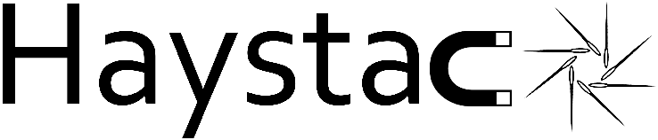

New Results from HAYSTAC's Search for Dark Matter Axions
Michael Jewell
Yale University
UCLA Dark Matter, March 2025

Slide 2
Talk Outline
Introduction to HAYSTAC Experiment
Recent Results from Phase II Operations
Plans for HAYSTAC Phase III and Beyond

Slide 3
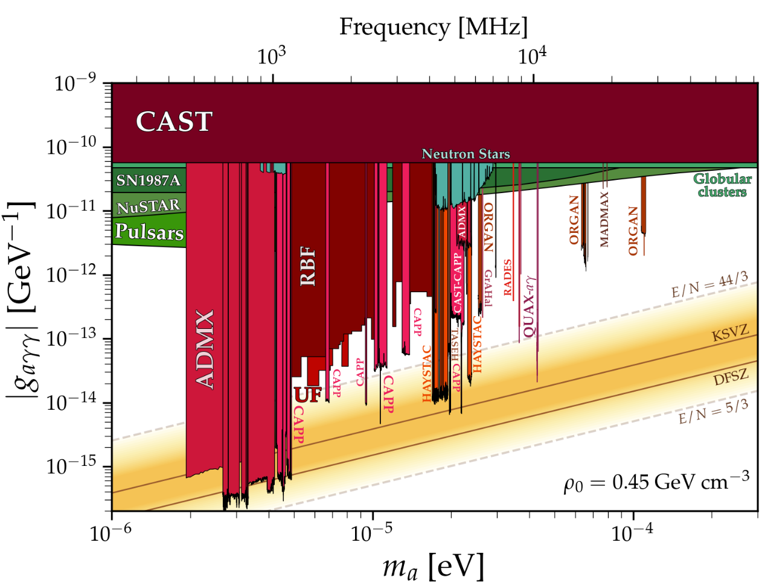
Axion Dark Matter
Axions solve CP Problem + Dark Matter
https://cajohare.github.io/AxionLimits/docs/ap.html

Slide 4
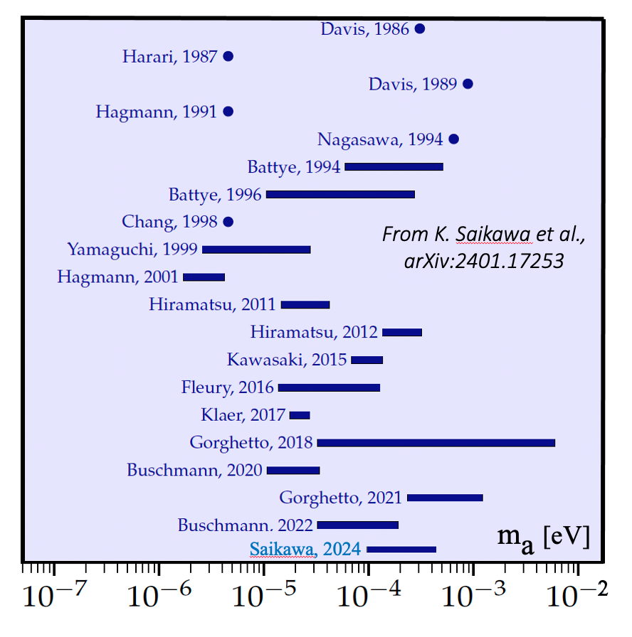
Axion Dark Matter
Axions solve CP Problem + Dark Matter
Post inflation models >10 μeV
https://cajohare.github.io/AxionLimits/docs/ap.html

Slide 5



High Frequency Challenge
Fridge
B-Field
AMP
Cavity
Rod
Solenoid
Axion
$$γ_{E}$$
$$γ_{B}$$

Slide 6

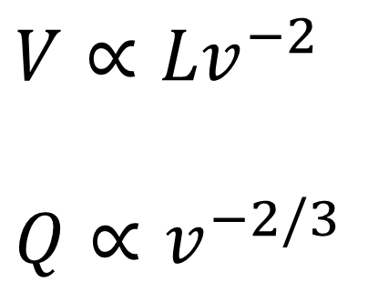
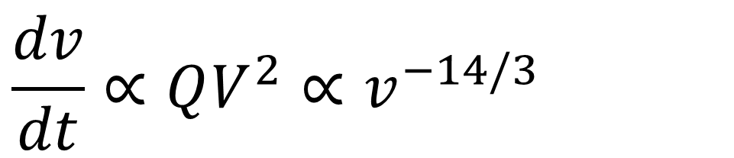
High Frequency Challenge
$$r$$
Fridge
B-Field
AMP
$$V∝{Lv}^{−2}$$
$$Q∝v^{−2/3}$$
Cavity
Rod
Solenoid
Axion
$$γ_{E}$$
$$γ_{B}$$
$$\frac{dv}{dt}∝QV^{2}∝v^{−14/3}$$

Slide 7
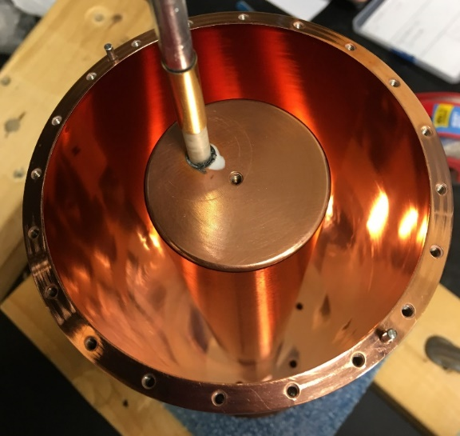
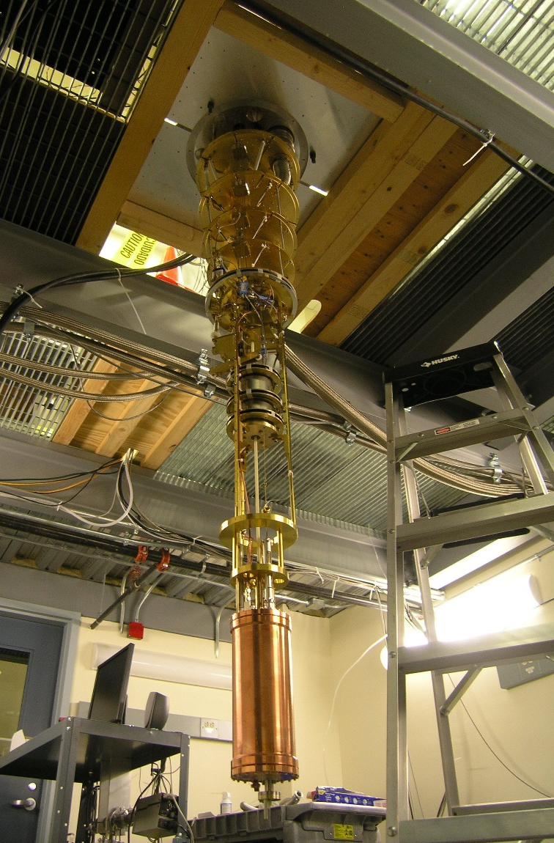
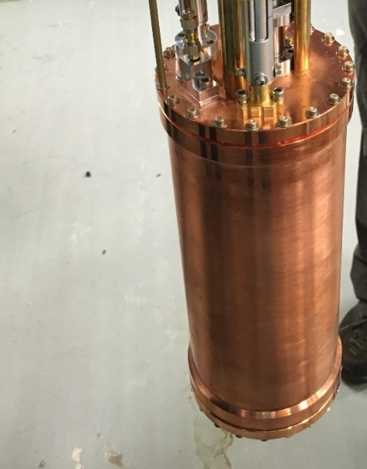
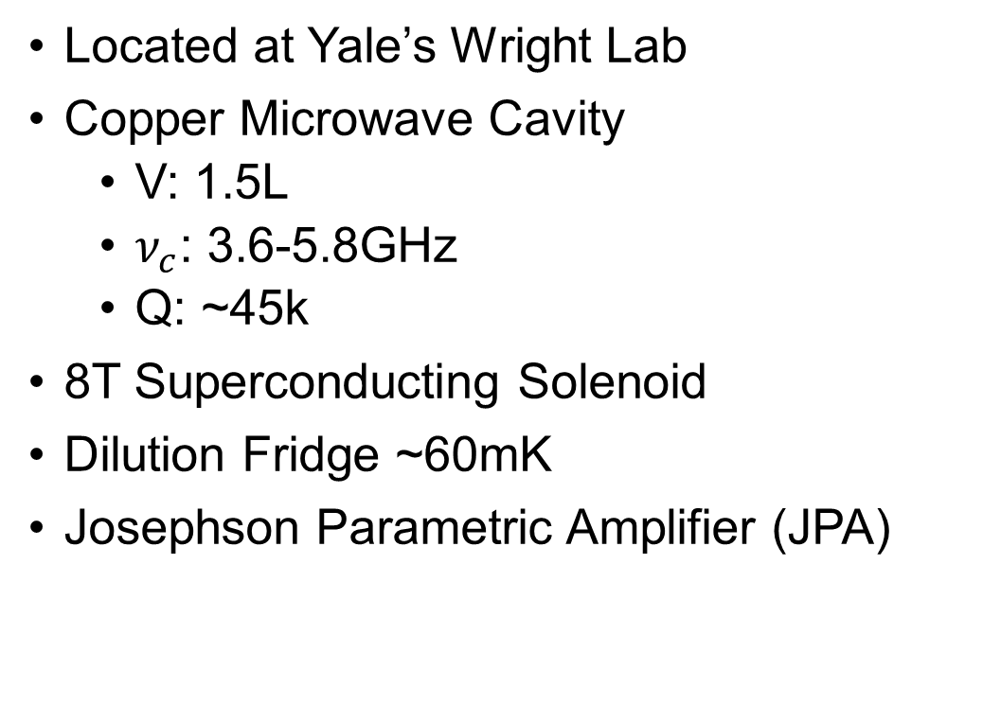
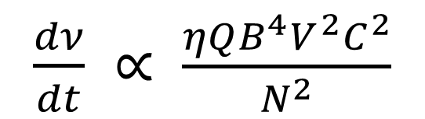
HAloscope at Yale Sensitive To Axion CDM
Located at Yale’s Wright Lab
Copper Microwave Cavity
  V: 1.5L
  $ν_{c}$: 3.6-5.8GHz
  Q: ~45k
8T Superconducting Solenoid
Dilution Fridge ~60mK
Josephson Parametric Amplifier (JPA)
Tuning Rod
$\frac{dν}{dt} ∝ \frac{ηQB^{4}V^{2}C^{2}}{N^{2}}$
Cavity

Slide 8
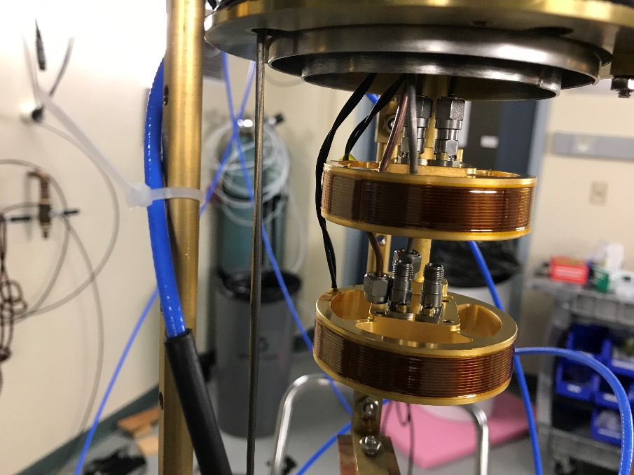
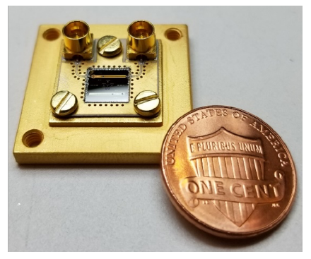
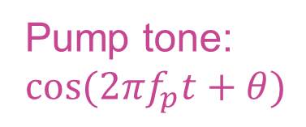
Josephson Parametric Amplifier (JPA)
Tunable LC Resonator
Phase sensitive amplifiers
Allow for manipulation of squeezed states
Pump tone:
$$cos({2πf}_{p}t+θ)$$

Slide 9

Squeezed State Receiver (SSR)
Pump
$$φ=\frac{π}{2}$$
SQ
AMP
Vacuum
Squeezed Vacuum
+ Cavity Noise
(+Axion Signal)
Amplify SQ Quad

Slide 10
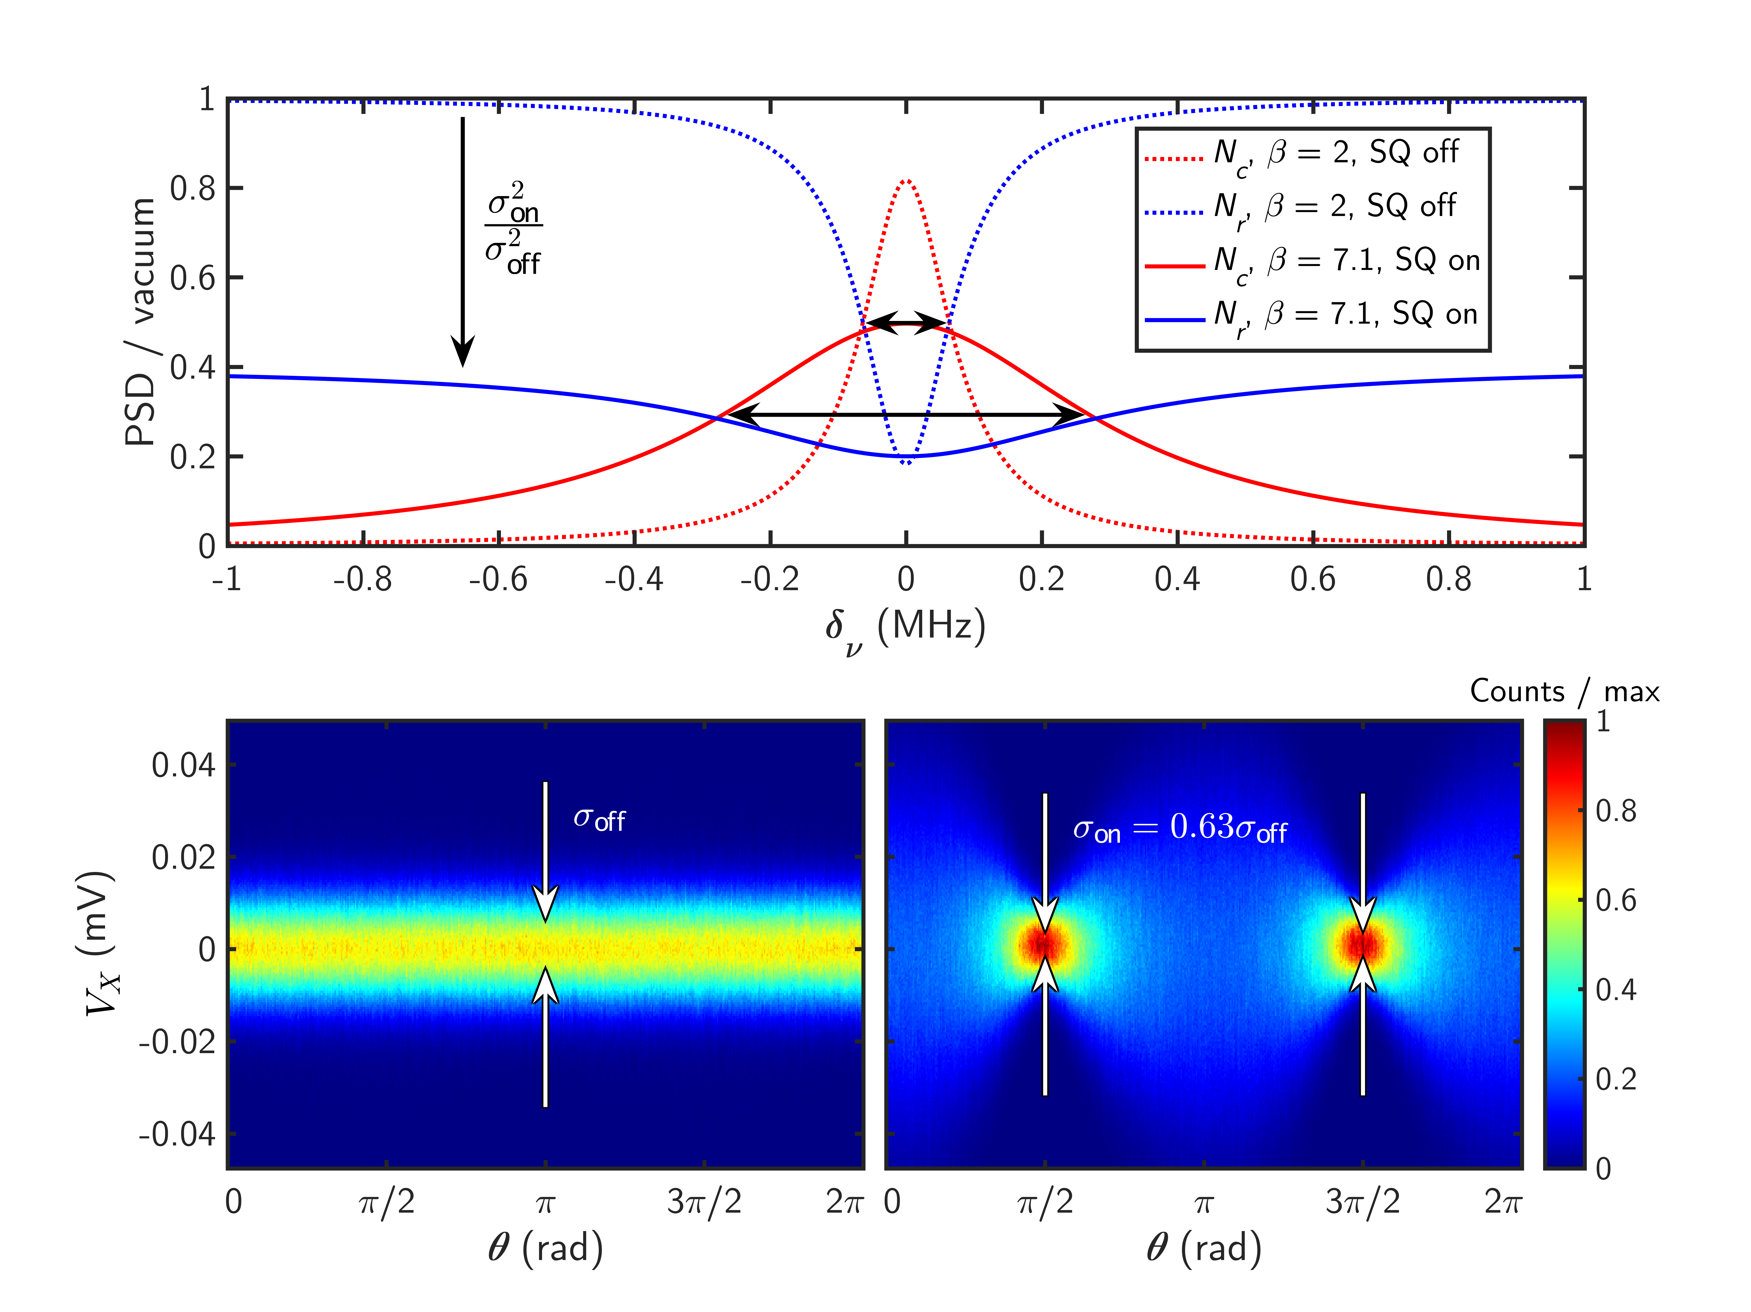
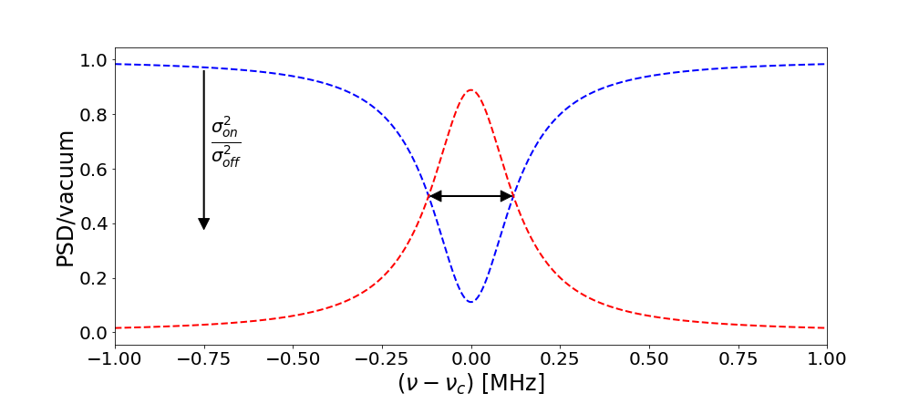
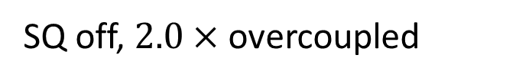
Bandwidth Enhancement
SQ off, $2.0×$ overcoupled
cavity noise
reflected noise

Slide 11
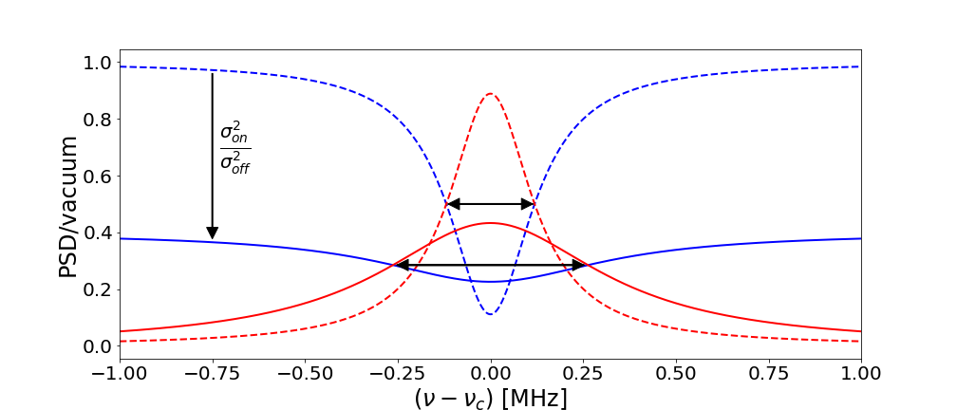
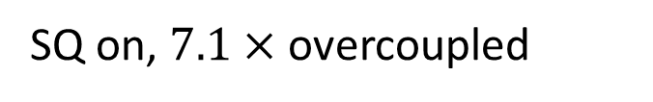
Bandwidth Enhancement
SQ off, $2.0×$ overcoupled
SQ on, $7.1×$ overcoupled
cavity noise
cavity noise
reflected noise
reflected noise

Slide 12
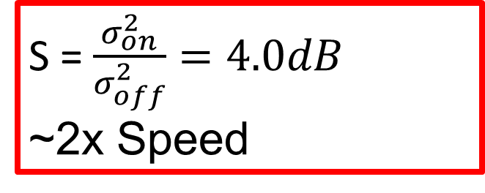
Bandwidth Enhancement
SQ off, $2.0×$ overcoupled
SQ on, $7.1×$ overcoupled
cavity noise
cavity noise
reflected noise
reflected noise
S = $\frac{σ_{on}^{2}}{σ_{off}^{2}}=4.0dB$
~2x Speed
M. Malnou et al., Phys.Rev.X 9 (2019)
K.M. Backes et al Nature 590 (2021)

Slide 13

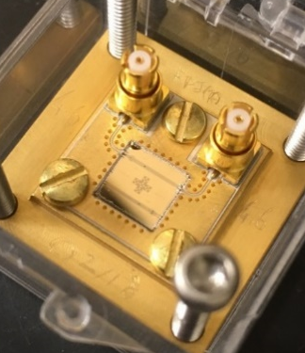
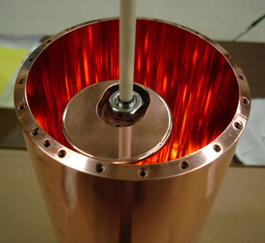
Design/Construction
Phase I (Single JPA)
Phase II (SSR)
2015
2016
2017
2018
2019
2020
2021
2022
2023
2012
2013
2014
2024
2025

Slide 14
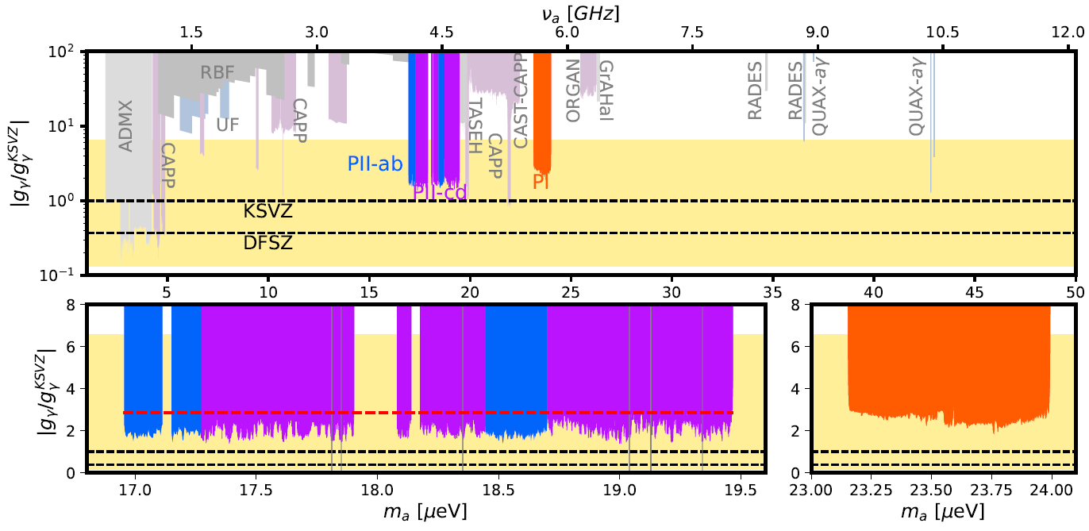
Design/Construction
Phase I (Single JPA)
Phase II (SSR)
2015
2016
2017
2018
2019
2020
2021
2022
2023
2012
2013
2014
2024
2025
PRL 118 (2017)
PRD 97 (2018)

Slide 15
Design/Construction
Phase I (Single JPA)
Phase II (SSR)
2015
2016
2017
2018
2019
2020
2021
2022
2023
2012
2013
2014
2024
2025
Nature 590 (2021)
PRD 107 (2023)
arXiv:2409.08998 (2024) – Accepted to PRL
PRL 118 (2017)
PRD 97 (2018)

Slide 16
Talk Outline
Introduction to HAYSTAC Experiment
Recent Results from Phase II Operations
Plans for HAYSTAC Phase III and Beyond

Slide 17
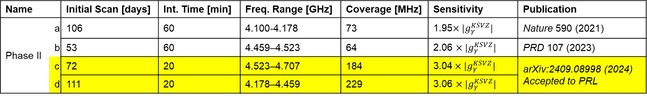
New HAYSTAC Data
Roughly 3x previous Phase II coverage
Name |  | Initial Scan [days] | Int. Time [min] | Freq. Range [GHz] | Coverage [MHz] | Sensitivity | Publication
Phase II | a | 106 | 60 | 4.100-4.178 | 73 | 1.95$×|g_{γ}^{KSVZ}|$ | Nature 590 (2021)
 | b | 53 | 60 | 4.459–4.523 | 64 | 2.06 $×|g_{γ}^{KSVZ}|$ | PRD 107 (2023)
 | c | 72 | 20 | 4.523–4.707 | 184 | 3.04$×|g_{γ}^{KSVZ}|$ | arXiv:2409.08998 (2024) Accepted to PRL
 | d | 111 | 20 | 4.178–4.459 | 229 | 3.06 $×|g_{γ}^{KSVZ}|$
New Data

Slide 18
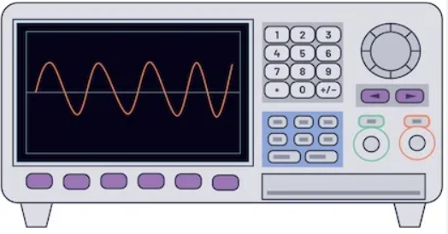
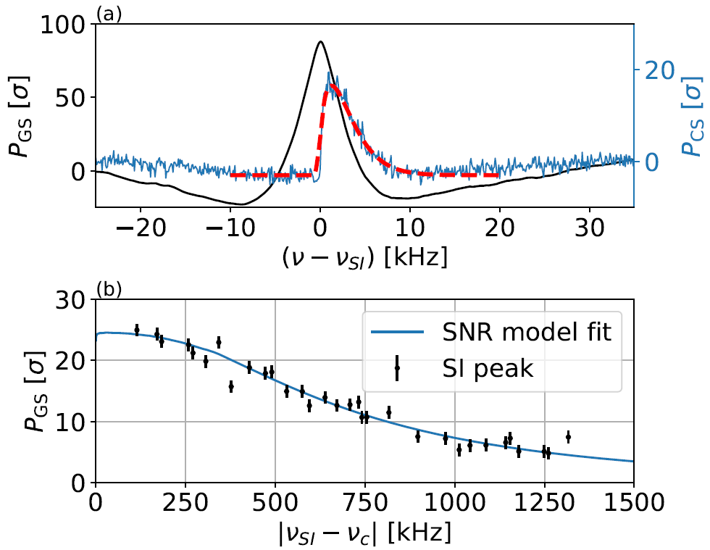
Mock Axion Signal Injection
Axion expected to have Maxwell Boltzman lineshape
Frequency hopping used to mimic this shape
6 injections during Phase IIc/d
All signals recovered
Observed power follows expected SNR
Weak/tx port
Antenna/rfl port
Cavity
Y. Zhu, et. al, RSI, 10.1063/5.0137870 (2023)
Axion Model
Data (CS)
Data (GS)

Slide 19
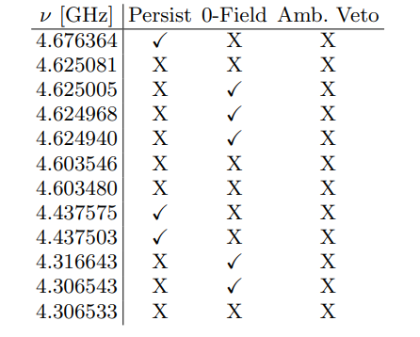
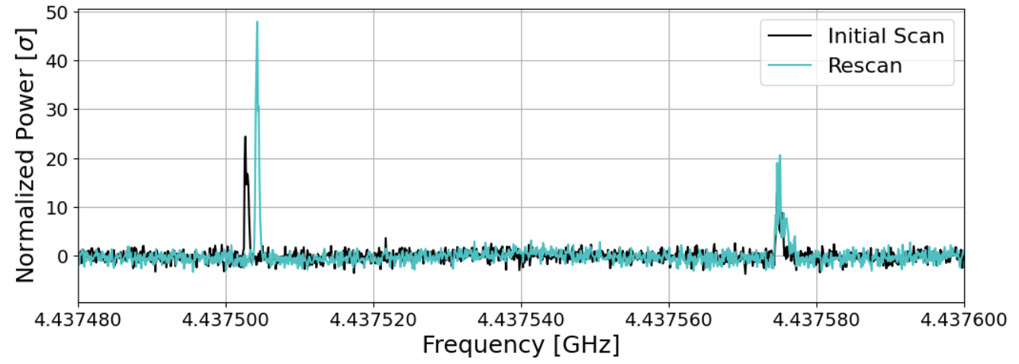
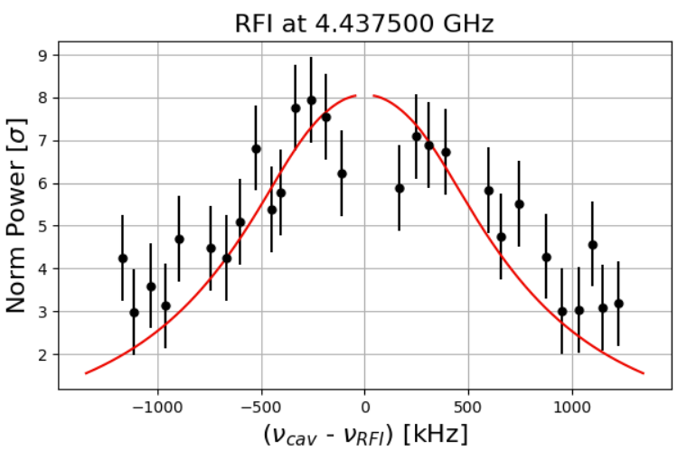
Environmental RFI
12 RF large signals detected
  Large (> 5sigma)
  Filtered by Cavity Profile
  Some persisted upon rescan
  Very narrow (<1kHz)
  Many exhibited transient behavior
~80kHz

Slide 20
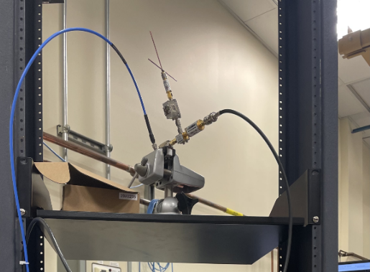
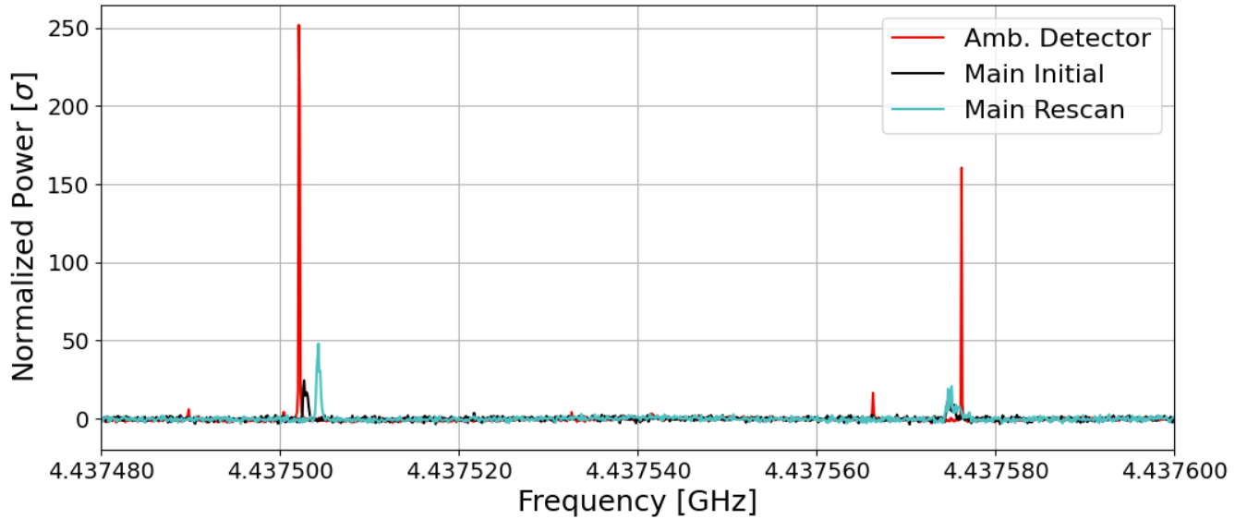
Identification of RFI
RF “veto” receiver deployed in lab
All 12 had corresponding signal
Likely man made RFI
  4-5GHz is popular communication band
RF
IF
LO

Slide 21

Results from Phase II
Phase II covered 550MHz of unexplored parameter space
  With 413MHz covered in new data
  Remaining gaps are inaccessible due to mode crossings
No evidence of an axion signal
90% Aggregate exclusion ${|g}_{γ}|>2.86 |g_{γ}^{KSVZ}|$over all Phase II
PIIa/b
PIIc/d (new data)
Joint
Aggregate

Slide 22
Final Exclusion
Combined with Phase I we have covered ~750 MHz in the 4-6GHz mass range
Accepted to PRL
arXiv:2409.08998 (2024)

Slide 23
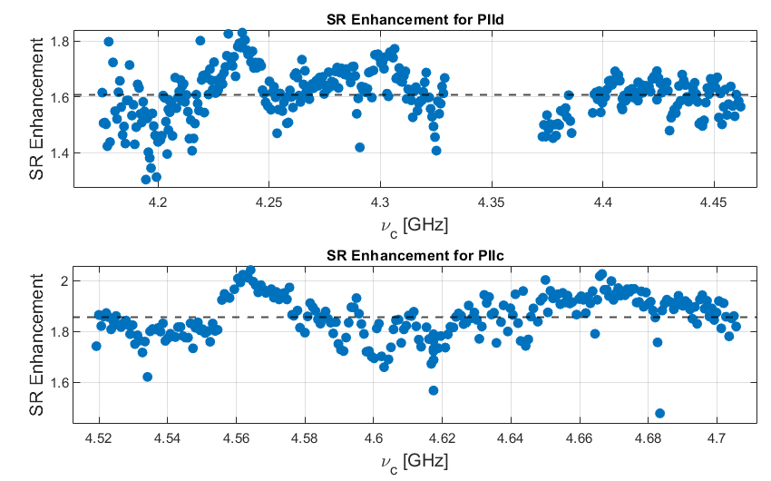
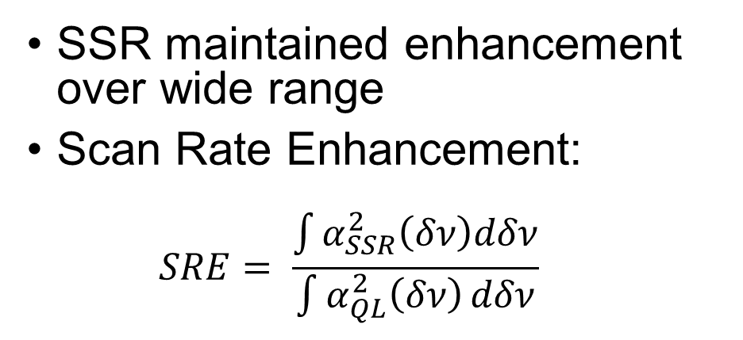
Squeezing Performance
Expected SRE ~2.0x given losses
  Average Enhancement of 1.7x
  Some regions with ~1.3x
SSR maintained enhancement over wide range
Scan Rate Enhancement:
  $$SRE= \frac{\int{α_{SSR}^{2}\left(δν\right)dδν}}{\int{α_{QL}^{2}\left(δν\right)}dδν}$$

Slide 24
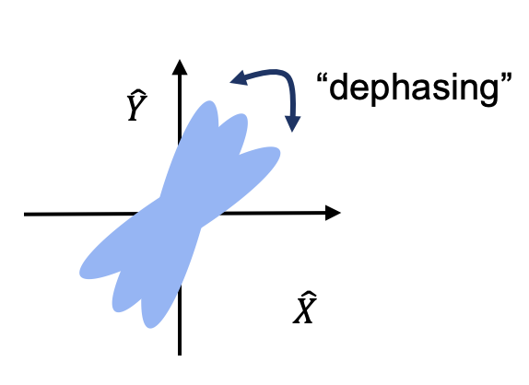
Vibrational Noise
Pump
$$φ=\frac{π}{2}$$
SQ
AMP
Cavity vibrations can cause “dephasing” of squeezed state
Can reduce squeezing if effect is large enough
Vacuum
Squeezed Vacuum
+ Cavity Noise
(+Axion Signal)
Amplify SQ Quad

Slide 25

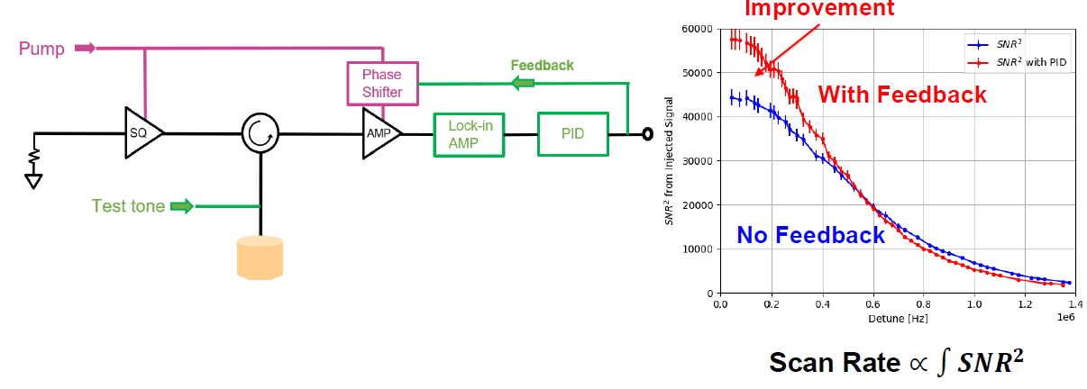
Mitigating Vibrations & Phase II Details
Xiran Bai: Recent Results and Status of HAYSTAC Phase III Upgrades

Slide 26
Talk Outline
Introduction to HAYSTAC Experiment
Recent Results from Phase II Operations
Plans for HAYSTAC Phase III and Beyond

Slide 27
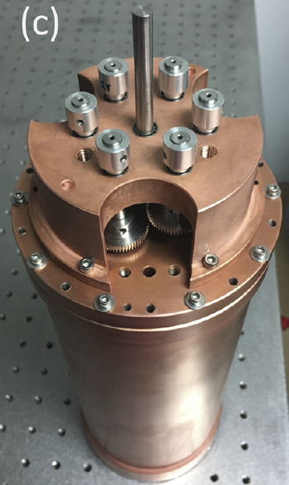
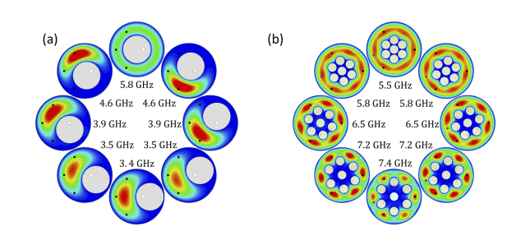
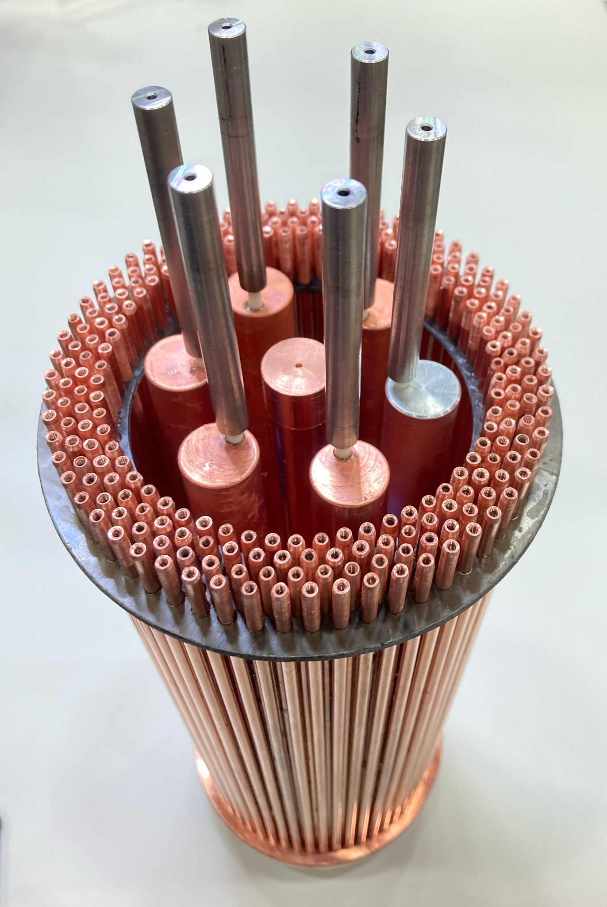
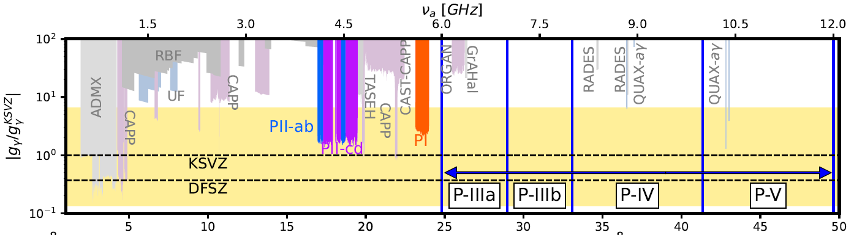
Beyond Phase II
P-IIIa
P-IIIb
Rev.Sci.Instrum. 92 (2021)
arXiv:2411.18914 (2024)

Slide 28
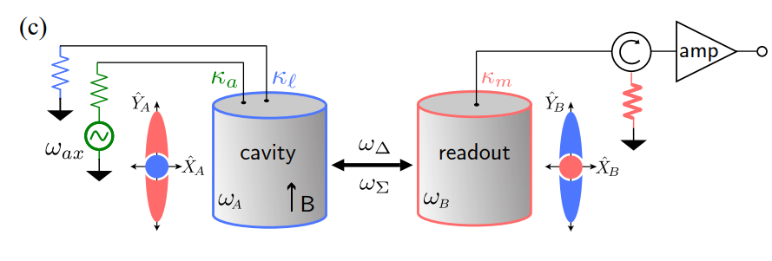
Beyond Phase II
P-IIIa
Lehnert Group:
Y. Jiang et al., PRX Quantum 4 (2024)
P-IIIb
P-IV
Rev.Sci.Instrum. 92 (2021)
arXiv:2411.18914 (2024)

Slide 29
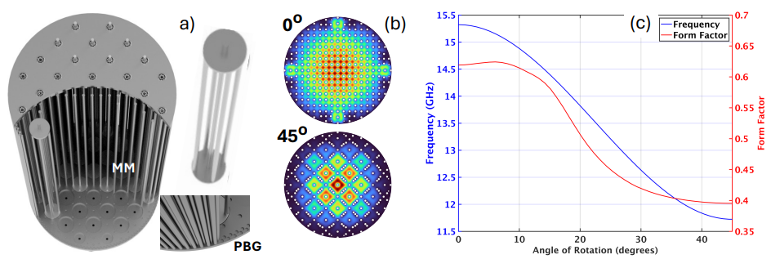
Beyond Phase II
P-IIIa
van Bibber Group
Lehnert Group:
Y. Jiang et al., PRX Quantum 4 (2024)
P-IIIb
P-IV
P-V
Rev.Sci.Instrum. 92 (2021)
arXiv:2411.18914 (2024)

Slide 30
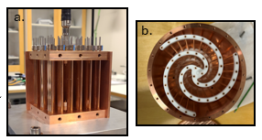

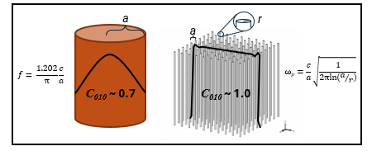
ALPHA Experiment
Claire Laffan: Current Status of ALPHA's Search for Dark Matter Axions Between 10-20GHz

Slide 31
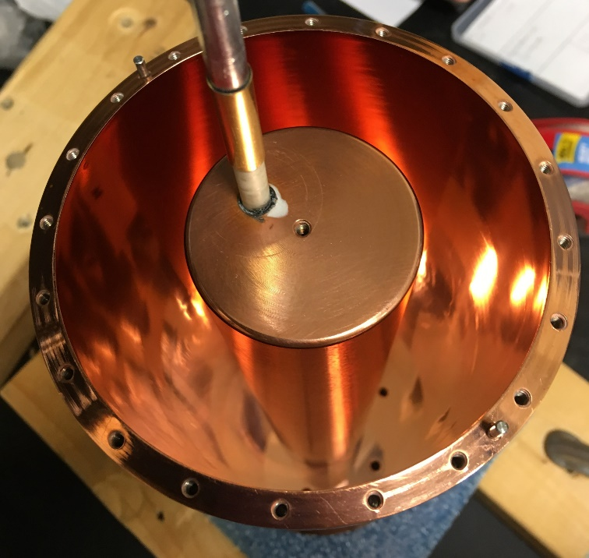

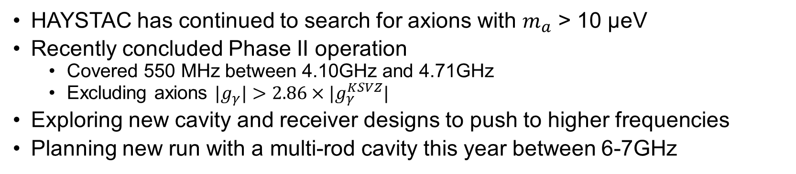
Conclusion
HAYSTAC has continued to search for axions with $m_{a}$ > 10 μeV
Recently concluded Phase II operation
  Covered 550 MHz between 4.10GHz and 4.71GHz
  Excluding axions ${|g}_{γ}|>2.86×|g_{γ}^{KSVZ}|$
Exploring new cavity and receiver designs to push to higher frequencies
Planning new run with a multi-rod cavity this year between 6-7GHz

Slide 32
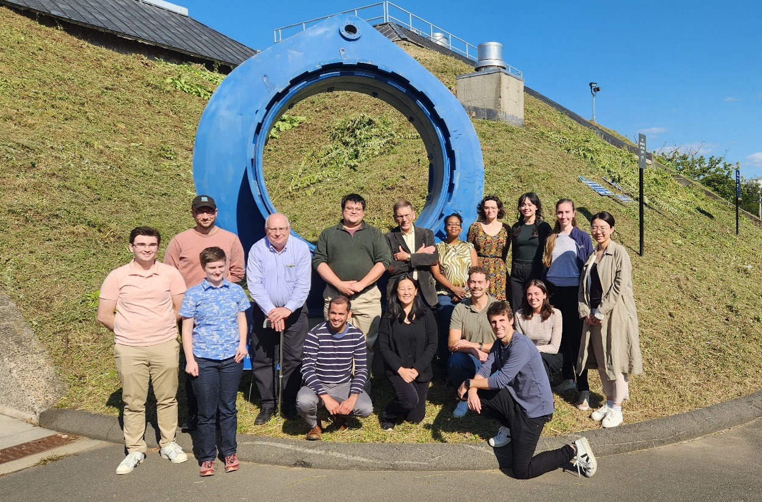






Thanks

Slide 33
Backups

Slide 34
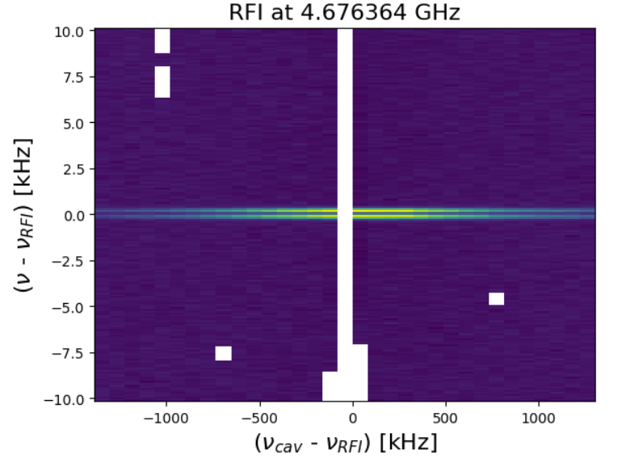
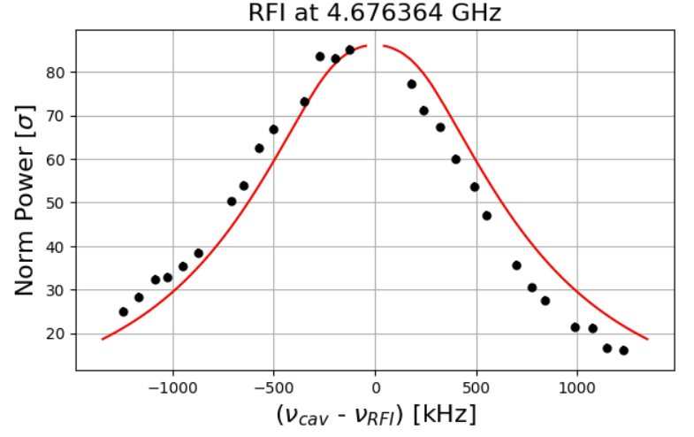
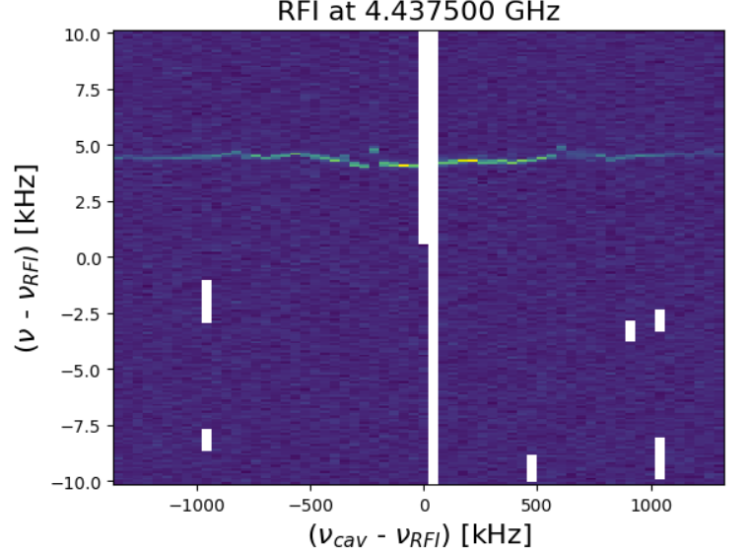
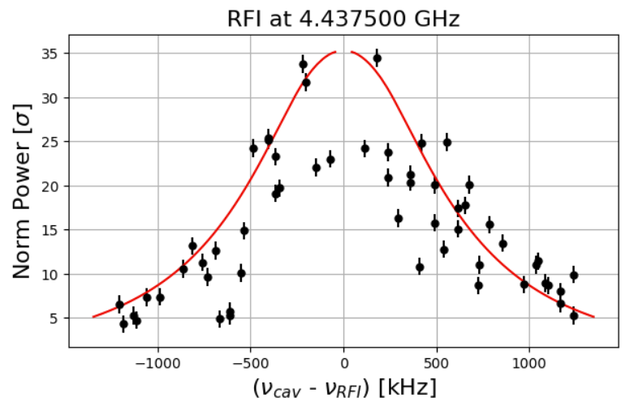
RFI Veto

Slide 35


Rescan Candidate Summary

Slide 36


RF Deficits
A handful of “deficits” are observed
Power Excess > 5.1 sigma but negative
Unknown source but none have persisted upon rescan
f. [KHz]
f. [KHz]

Slide 37

PIIIa: Multi-Rod Cavities
7-Rod Cavity gives higher TM010 frequency in same volume
Maintains high figure of merit
M. Simanovskaia, et al., Rev. Sci. Instrum. 92 (2021)

Slide 38


PIIIb: Photonic Band Gap (PBG)
Intruder TE modes removed
TM010 mode confined still
With PBG
Without PBG
D. Goulart et al. , arXiv:2411.18914 (2024)

Slide 39


Limiting Factor
SSR is limited by loss between two JPAs
  Loss is dominated by triple junction circulator
  4dB of Squeezing is roughly best we can do currently
SQ
AMP
Vacuum
Squeezed Vacuum
+ Cavity Noise
+ Vacuum
Amplify SQ Quad
M. Malnou et al., Phys. Rev. X 9, 021023 (2019)

Slide 40
PIV: New Receiver Designs
Cavity Entanglement And Swapping Experiment For Improved Readout Efficiency (CEASEFIRE)
Solves the problem of loss between JPAs
Scan Rate Enhancement >8x quantum limited searches
SQ
AMP
Y. Jiang et al., PRX Quantum 4 (2024)

Slide 41
PV: Meta-Material Cavities
Use Wire Array Meta-Materials to decouple resonant frequency from physical size

Slide 42






Quantum Limit for Haloscopes
$$\left[\hat{X}, \hat{Y}\right]=\frac{i}{2}$$
$$\hat{H}=\frac{hν_{c}}{2}({\hat{X}}^{2}+{\hat{Y}}^{2})$$
Cavity Hamiltonian:
$$N_{v}≥\frac{1}{2}hν_{c}$$
Vacuum Fluctuations:
AMP
$$N_{A}≥\frac{1}{2}hν_{c}$$
Linear Amplifier:
$$\hat{H}$$
Total SQL:
$$N_{total}≥hν_{c}$$
C. M. Caves. Phys. Rev. D, 26 1817-1839, (1982)
H. A. Haus and J. A. Mullen. Phys. Rev., 128 2407-2413, Dec 1962.

Slide 43



Josephson Parametric Amplifier (JPA)
Phase Sensitive Amplifier
Can operate in Phase Insensitive Mode
  Near Quantum limited amplifiers
Phase sensitive mode can produce “Squeezed” States
$$\hat{H}=\frac{hν_{c}}{2}({\hat{X}}^{2}+{\hat{Y}}^{2})$$
$$\left[\hat{X}, \hat{Y}\right]=\frac{i}{2}$$
AMP
$$\hat{H}$$
Pump tone:
$$cos({2πf}_{p}t+θ)$$

Slide 44

Axion Classifications
Pre-inflation axion – wide range of viable masses. “GUT-scale” axion.
Mass: 20 peV – 1 μeV
Typical Measurement: Lumped element detectors
Post-inflation axion: theoretically calculable from string production mechanisms.
Mass: 1 μeV – 1 meV
Typical Measurement: Cavity haloscopes
Ciaran O'Hare, Axion Limits, https://cajohare.github.io/AxionLimits/

Slide 45



JPAs in HAYSTAC
JPA
JPA Shield
JPA Coils

Slide 46

JPAs in HAYSTAC
Frequency [GHz]
JPA Shield
coil current [mA]

Slide 47

HAYSTAC Timeline
Two Phases
  Phase I: Single JPA, Phase-Insensitive Measurement
  Phase II: Two JPAs, Phase-Sensitive Measurement
Name |  | Amplifier | Dates | Freq. Range | Sensitivity | Publication
Phase I |  | Phase Insensitive | Jan. 2016 – Jan. 2017 | 5.6–5.8 GHz | 2.70$×|g_{γ}^{KSVZ}|$ | Phys. Rev. D 97 (2018)
Phase II | a | Phase Sensitive | Sept. 2019 – April 2020 | 4.100-4.178 GHz | 1.95$×|g_{γ}^{KSVZ}|$ | Nature 590 (2021)
 | b |  | July 2021 – Nov. 2021 | 4.459–4.523 GHz | 2.06 $×|g_{γ}^{KSVZ}|$ | PRD 107 (2023)
 | c |  | Sept 2022 – May 2023 | 4.523–4.707 GHz | 3.04$×|g_{γ}^{KSVZ}|$ | arXiv:2409.08998 (2024)
 | d |  | June 2023 – Aug. 2024 | 4.178–4.459 GHz | 3.06 $×|g_{γ}^{KSVZ}|$

Slide 48







Tuning with SSR
Pump 2 $ν_{c}$
Five parameter optimization
JPAs tuned to match Cavity Resonance
  $I_{sz}$: Squeezer Flux Bias
  $I_{AMP}$: Amplifier Flux Bias
Amplifiers share same Pump Source
  $P_{P}$: Amplifier Gain
  A: Squeezer Gain
  $θ$: Phase difference
$$P_{P}$$
$$θ$$
A
SQ
AMP
$$I_{sz}$$
$$I_{Amp}$$
$$ν_{c}$$

Slide 49

Tuning with SSR
Pump 2 $ν_{c}$
$$P_{P}$$
Five parameter optimization
$$θ$$
A
SQ
AMP
$$I_{sz}$$
$$I_{Amp}$$
$$ν_{c}$$

Slide 50

Improvements for Phase IIb
Higher Frequency JPAs
New pair of JPAs to extend frequency above 4.2GHz
Reduced DAQ Deadtime
Improved DAQ routine to reduce deadtime from in-situ processing (1.6x speed up)
SQZ JPA
AMP JPA
 | Fractional Time [%]
 | Phase IIa | Phase IIb
DAQ | 40 | 10
Tuning | 12 | 8
Livetime | 48 | 82

Slide 51



Detector Calibration

Slide 52

System Diagram

Slide 53


First Demonstration
S = $\frac{σ_{on}^{2}}{σ_{off}^{2}}=4.5dB$
2.1x Speed
Demonstration by Colorado Group
SSR speed up for “Fake” Axion signal
M. Malnou et al., Phys. Rev. X 9, 021023 (2019)

