Slide 1
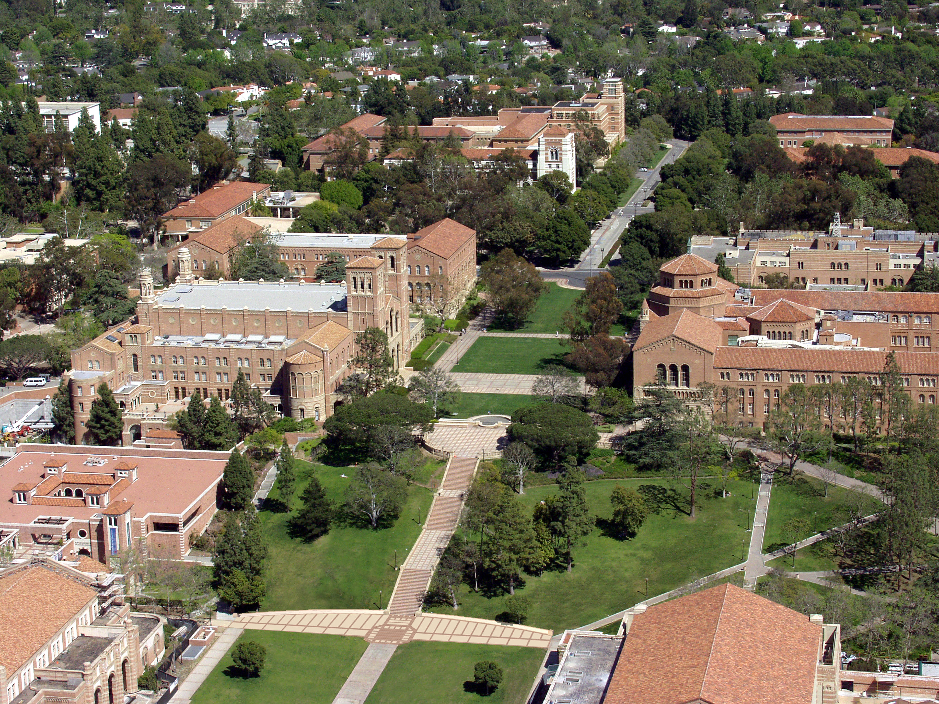
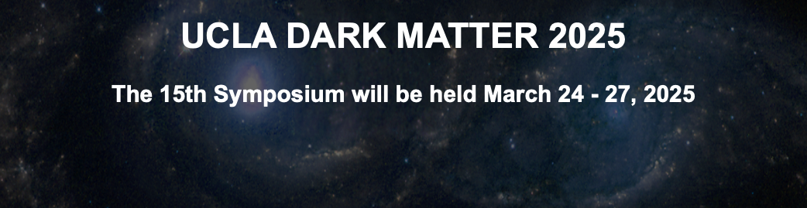
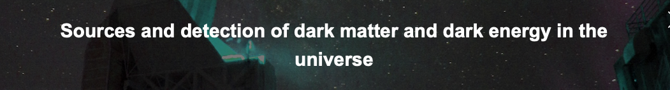
Introduction, preview and overview
Where do we go from here?
24 March 2025
Michael S. Turner
UCLA and KICP at the University of Chicago

Slide 2
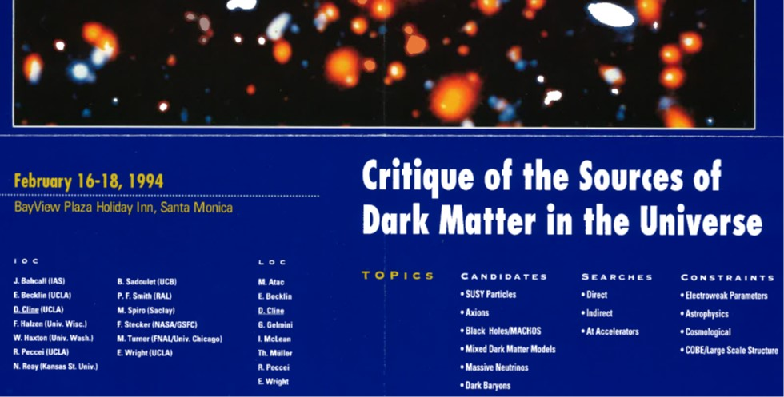
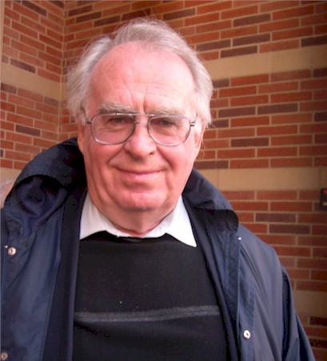


1st UCLA Dark Matter Meeting

Slide 3
UCLA Dark Matter: a back story

Slide 4
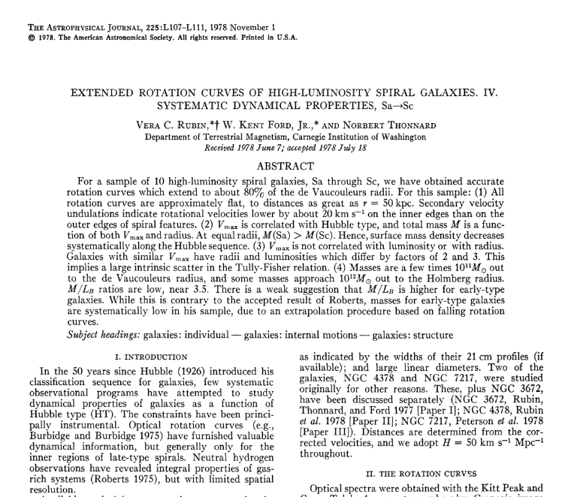
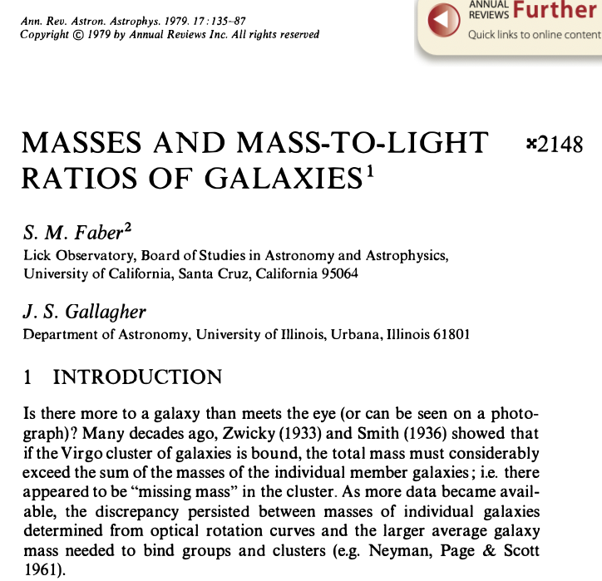
Flat rotation curves and dark matter

Slide 5
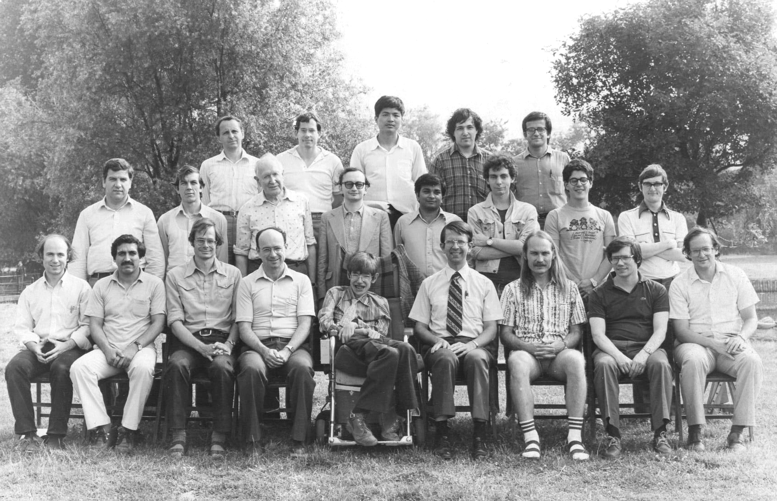
Nuffield 1982: Birth of slow-roll inflation

Slide 6

(K)ITP Workshop 1983: birth of modern CDM

Slide 7
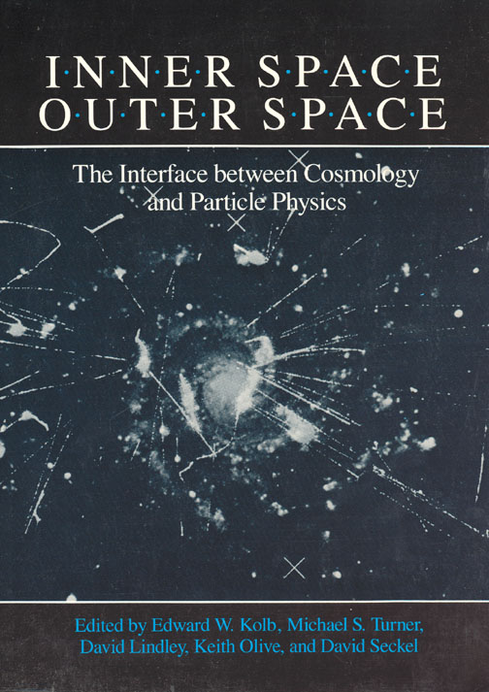
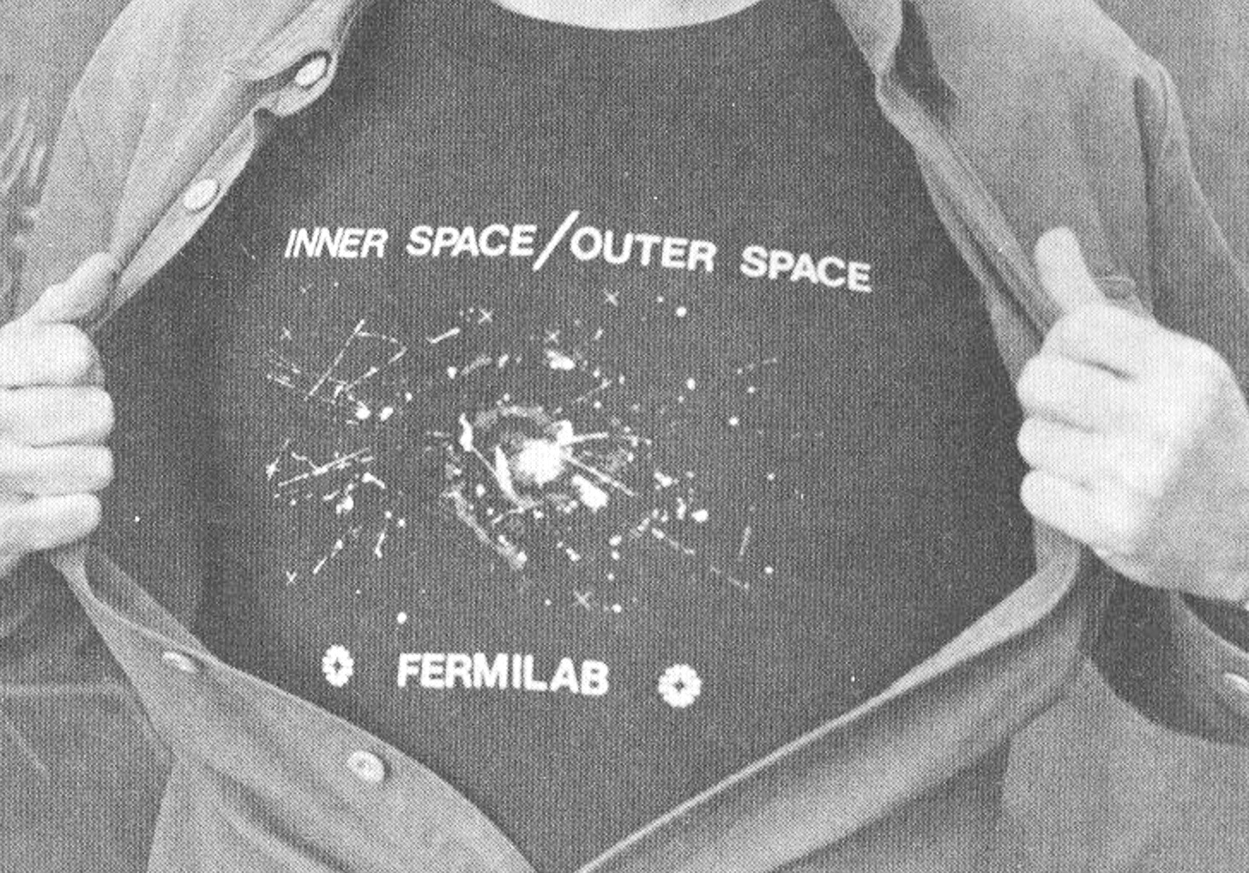
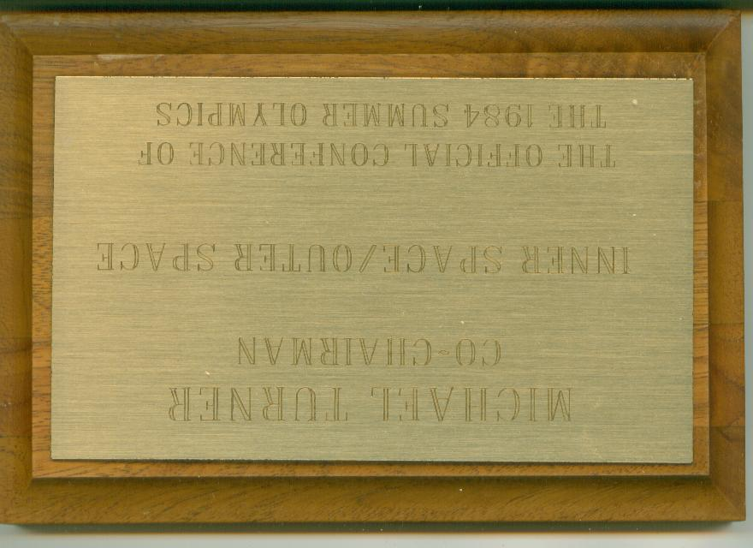
Fermilab 1984: Inner Space/Outer Space

Slide 8
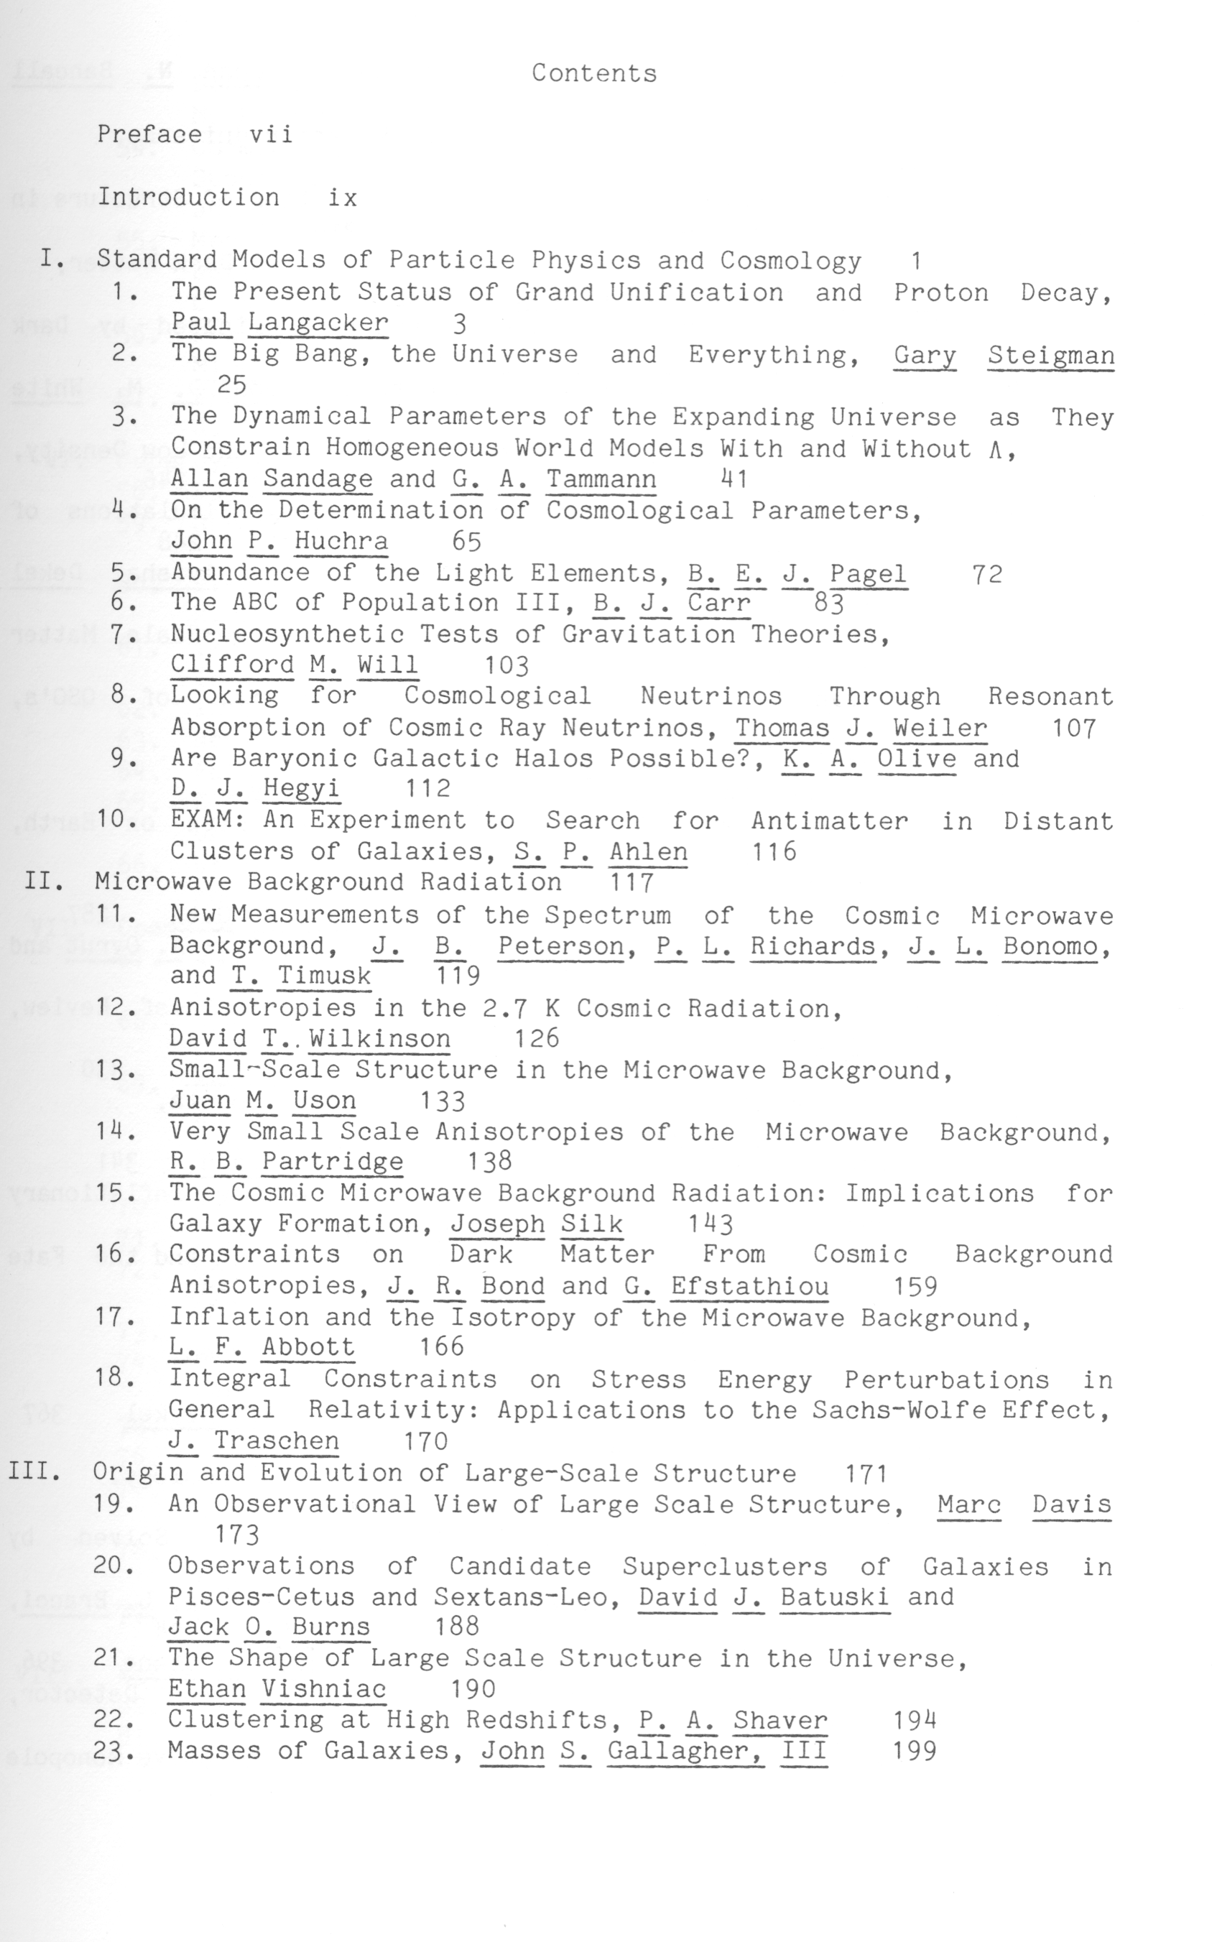
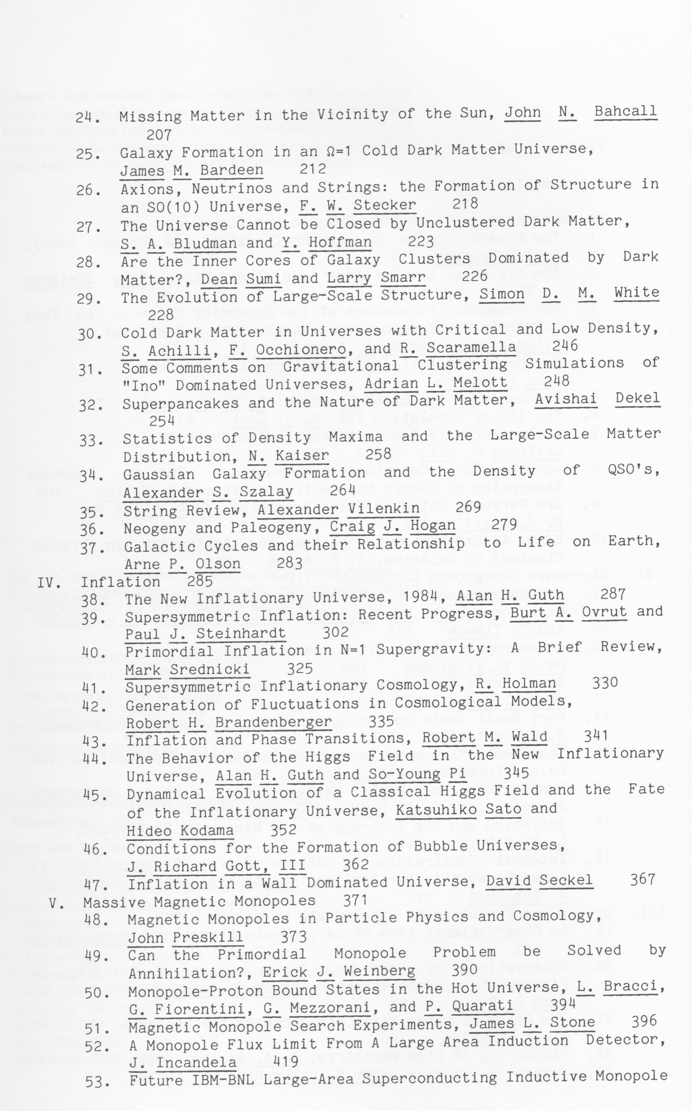


Slide 9
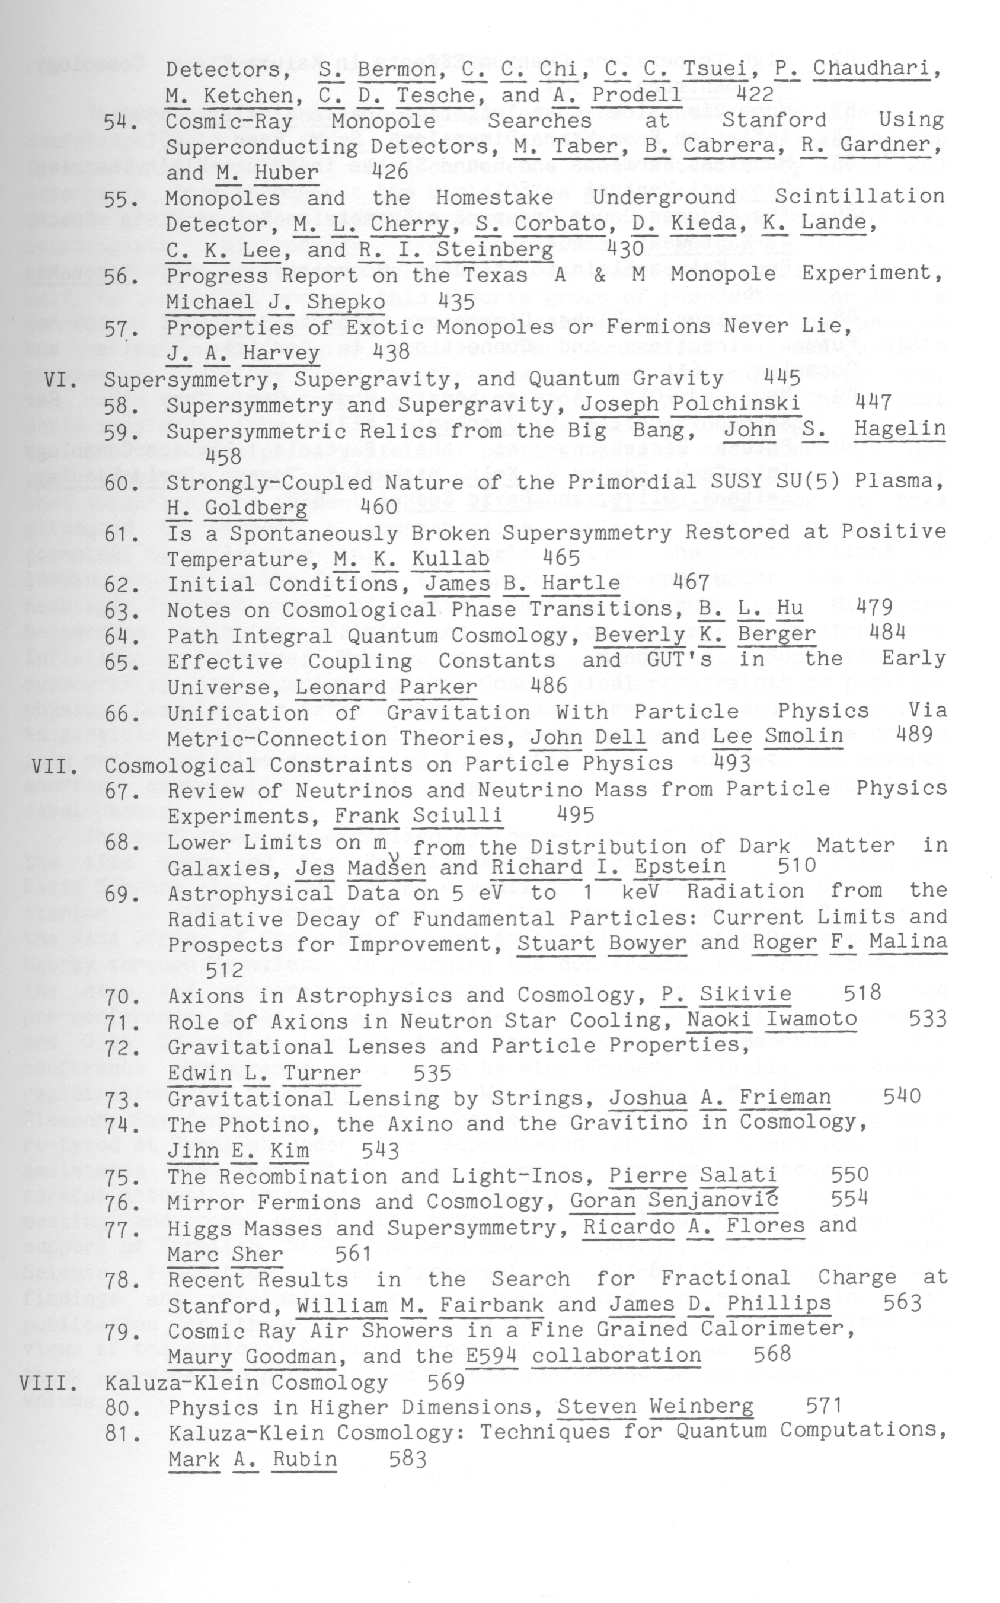
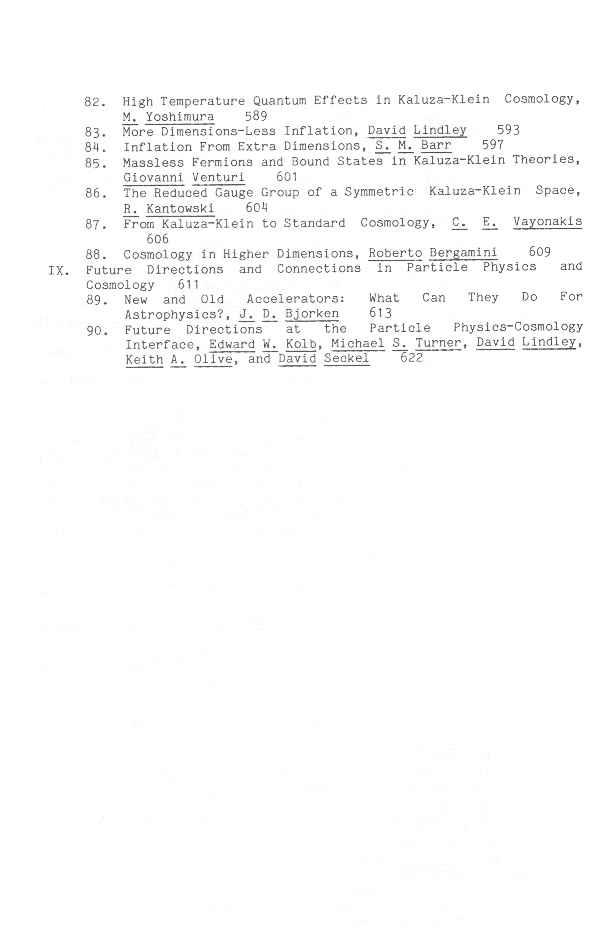


Slide 10
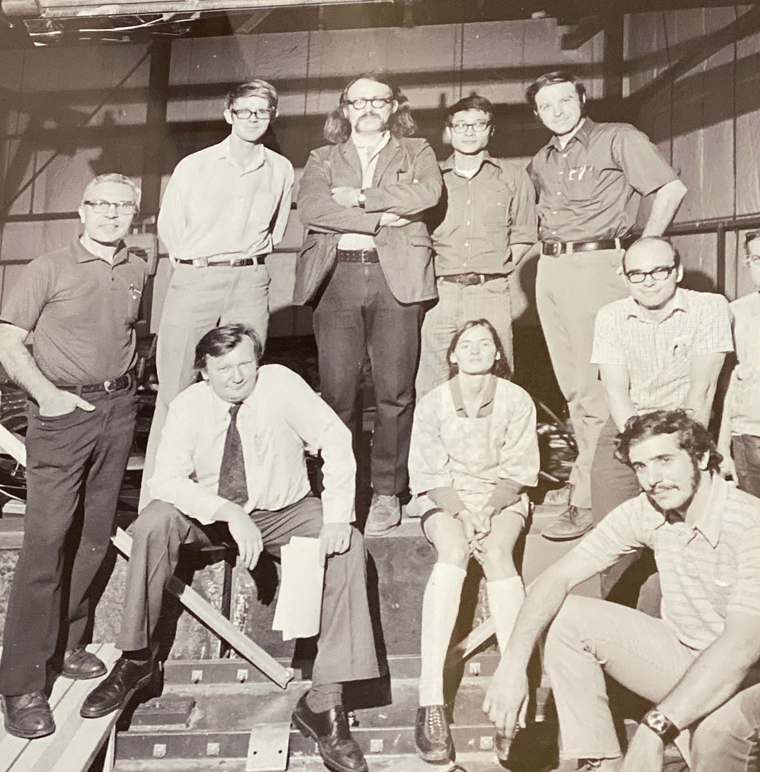

1986 David Cline moves to UCLA
David Cline at UCLA
1979: HPW Proton Decay Detector (Park City, Utah)

Slide 11
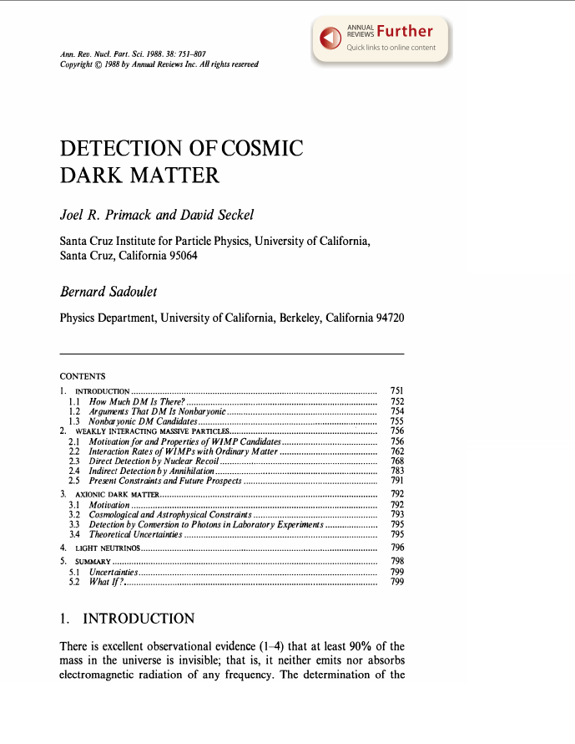
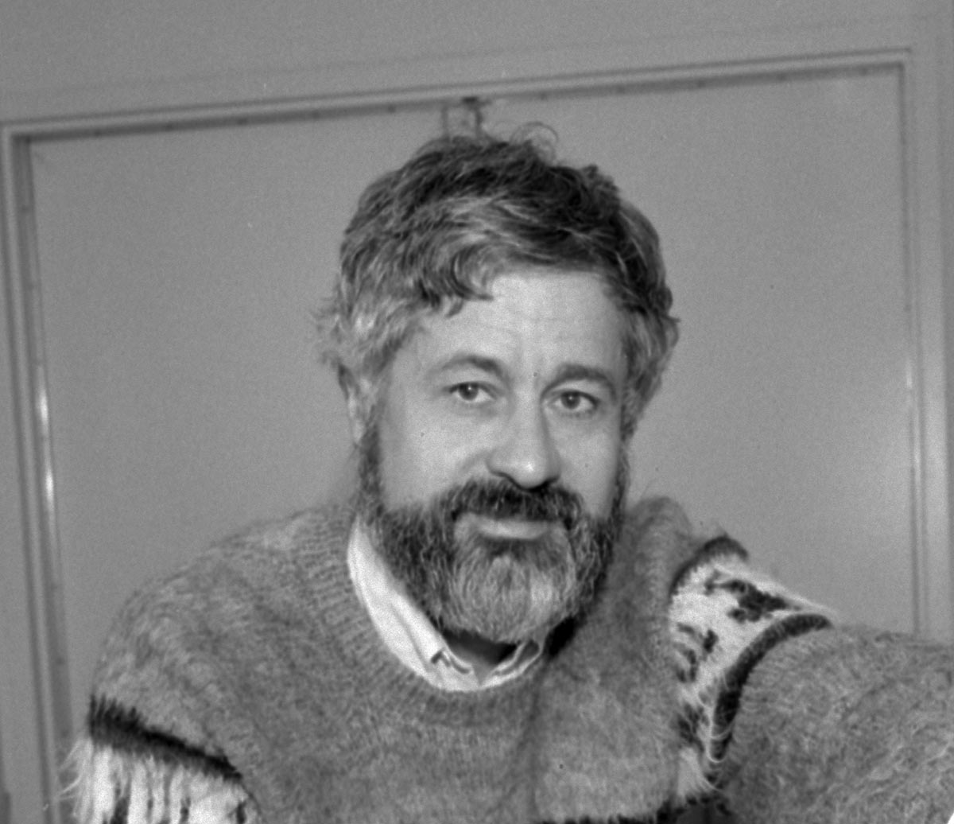
1989 – 2001 : Center for Particle Astrophysics

Slide 12
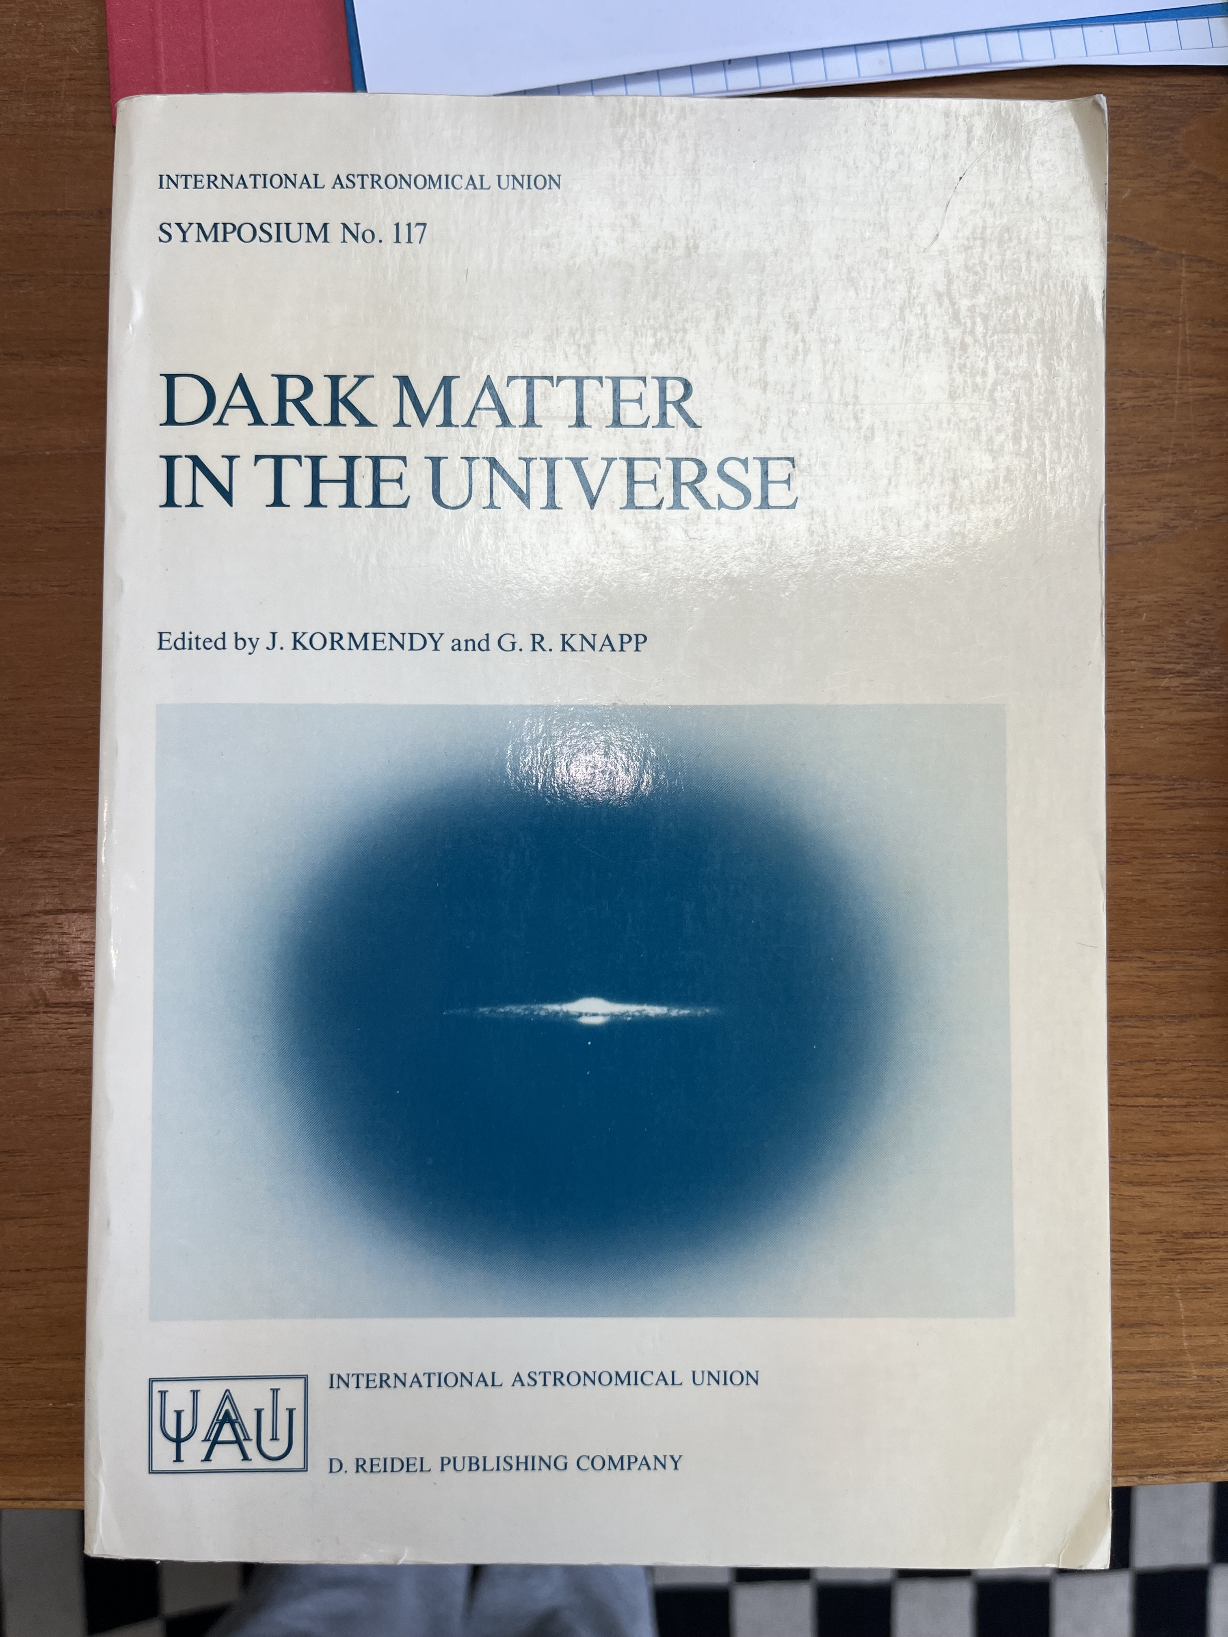
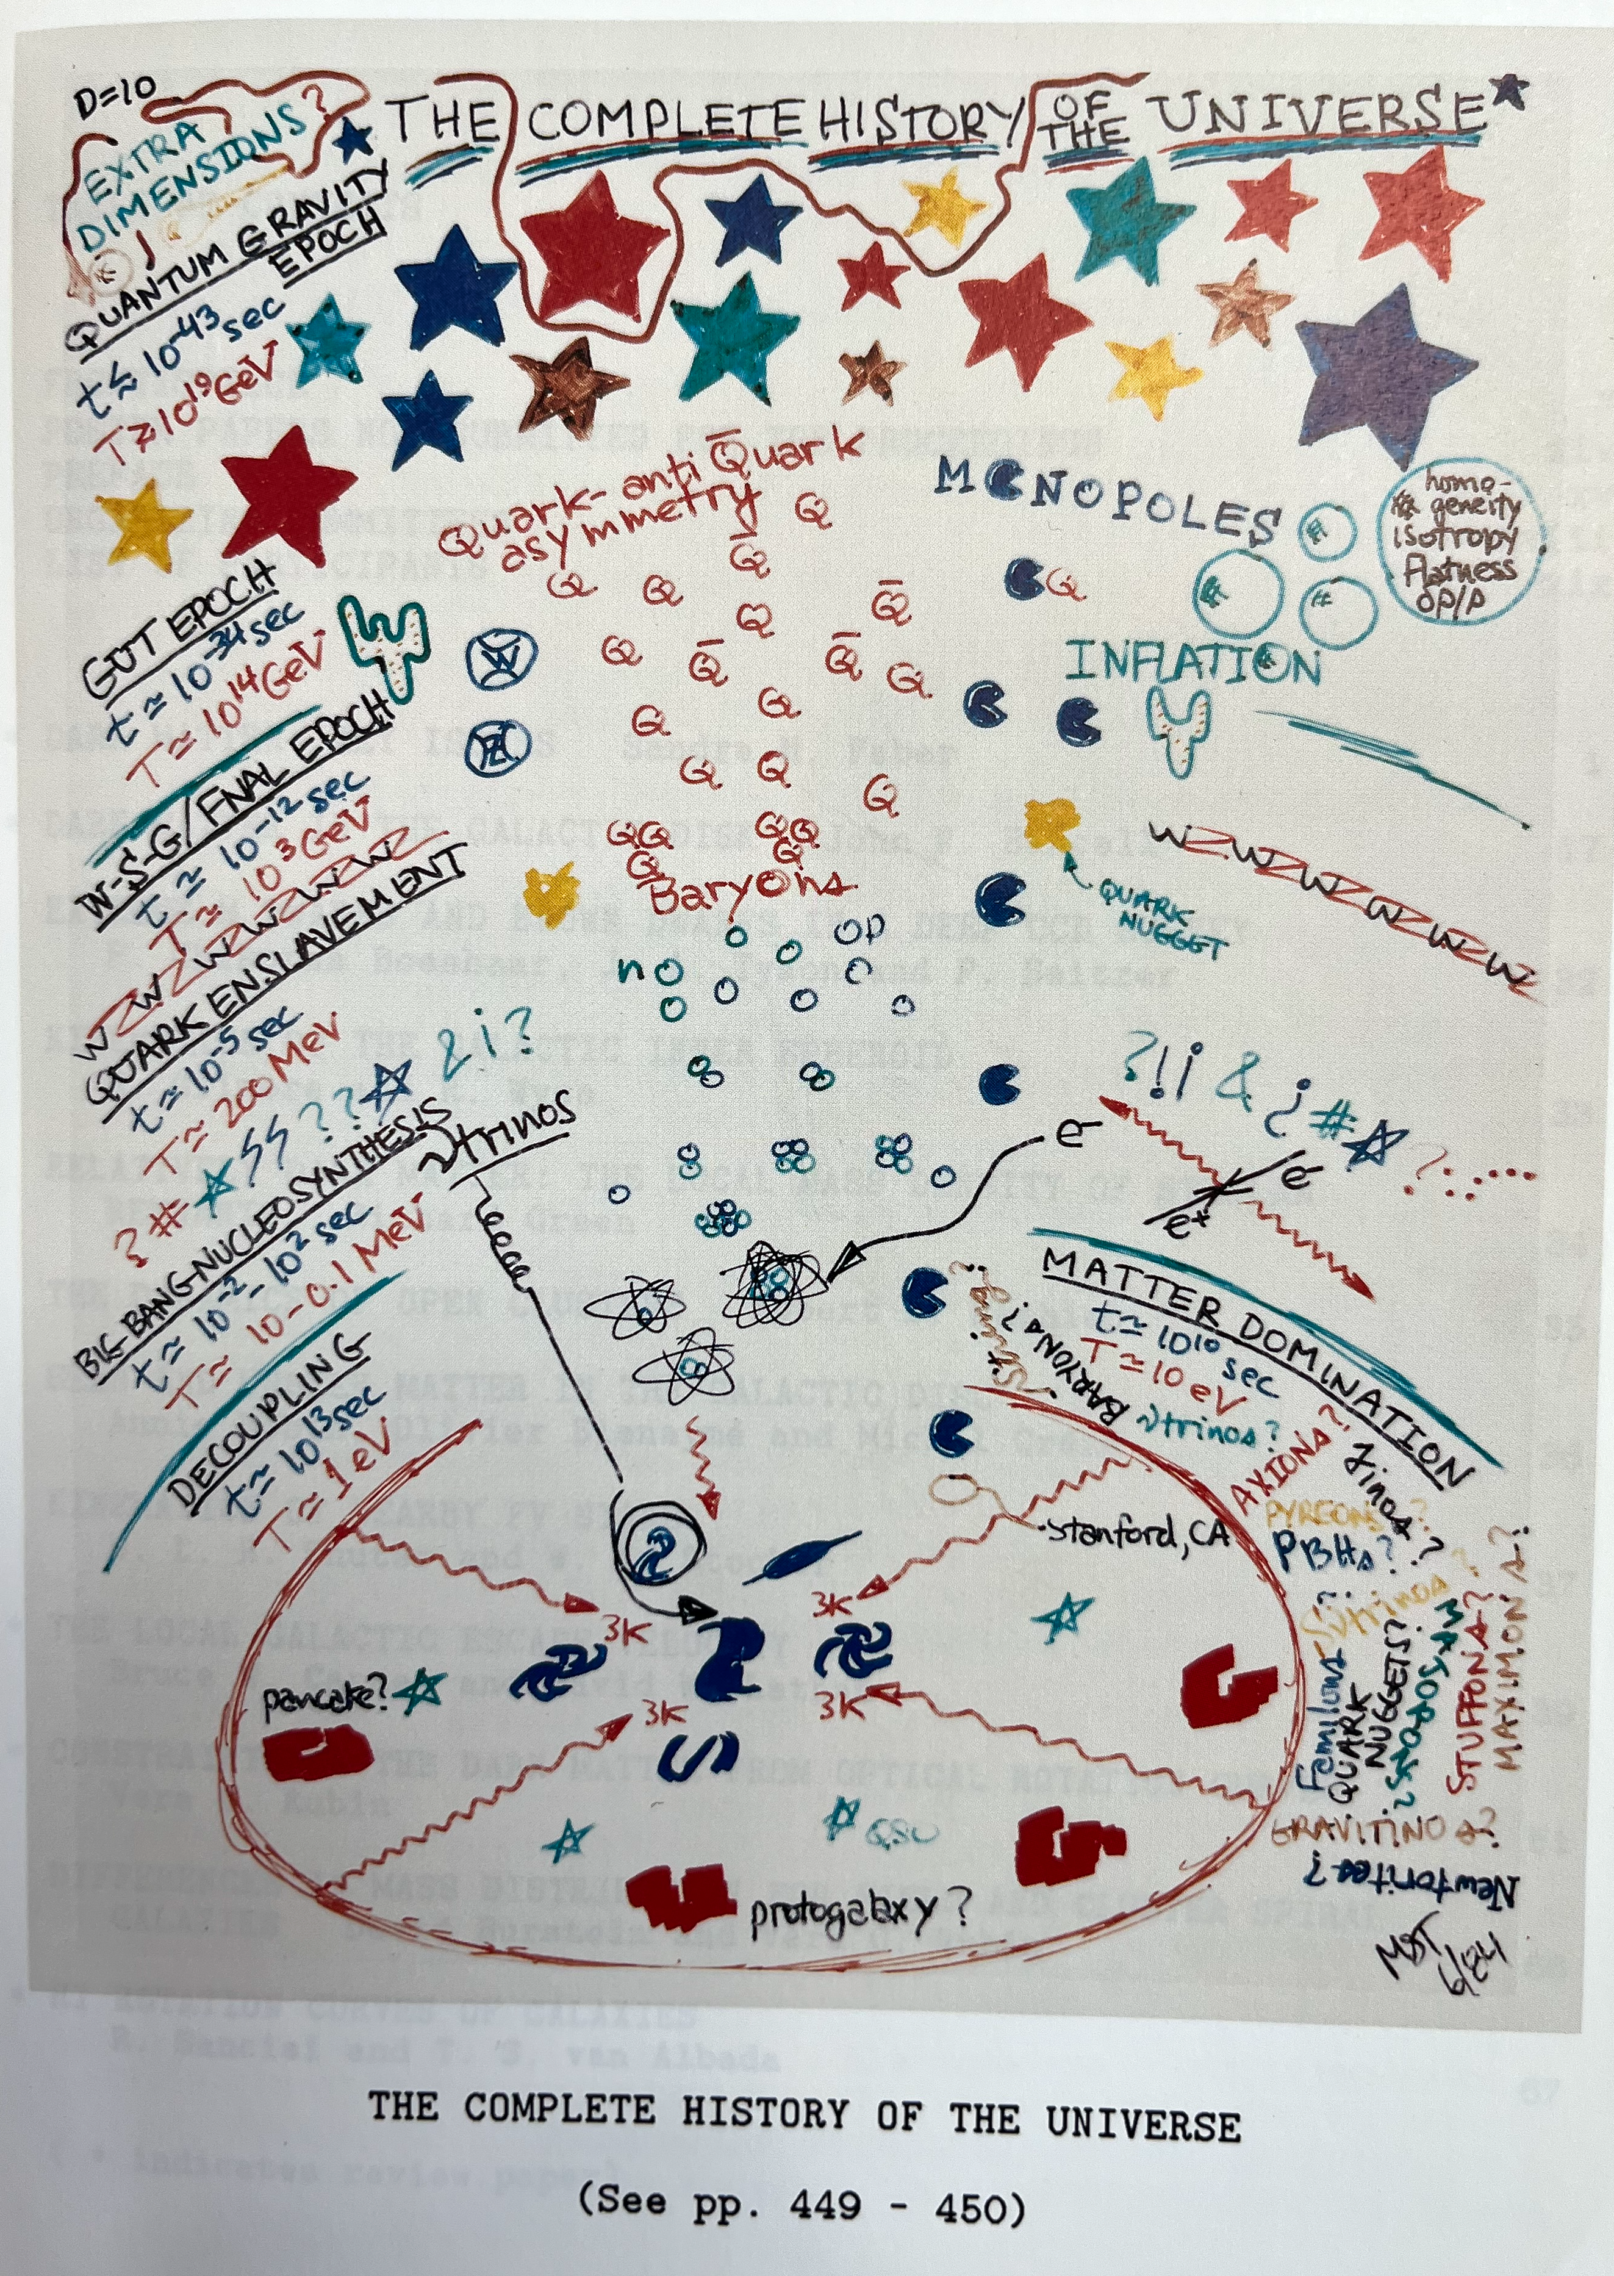
1985 Princeton: Dark Matter is officially an astronomy thing

Slide 13

1984 – 1992: drifting

Slide 14


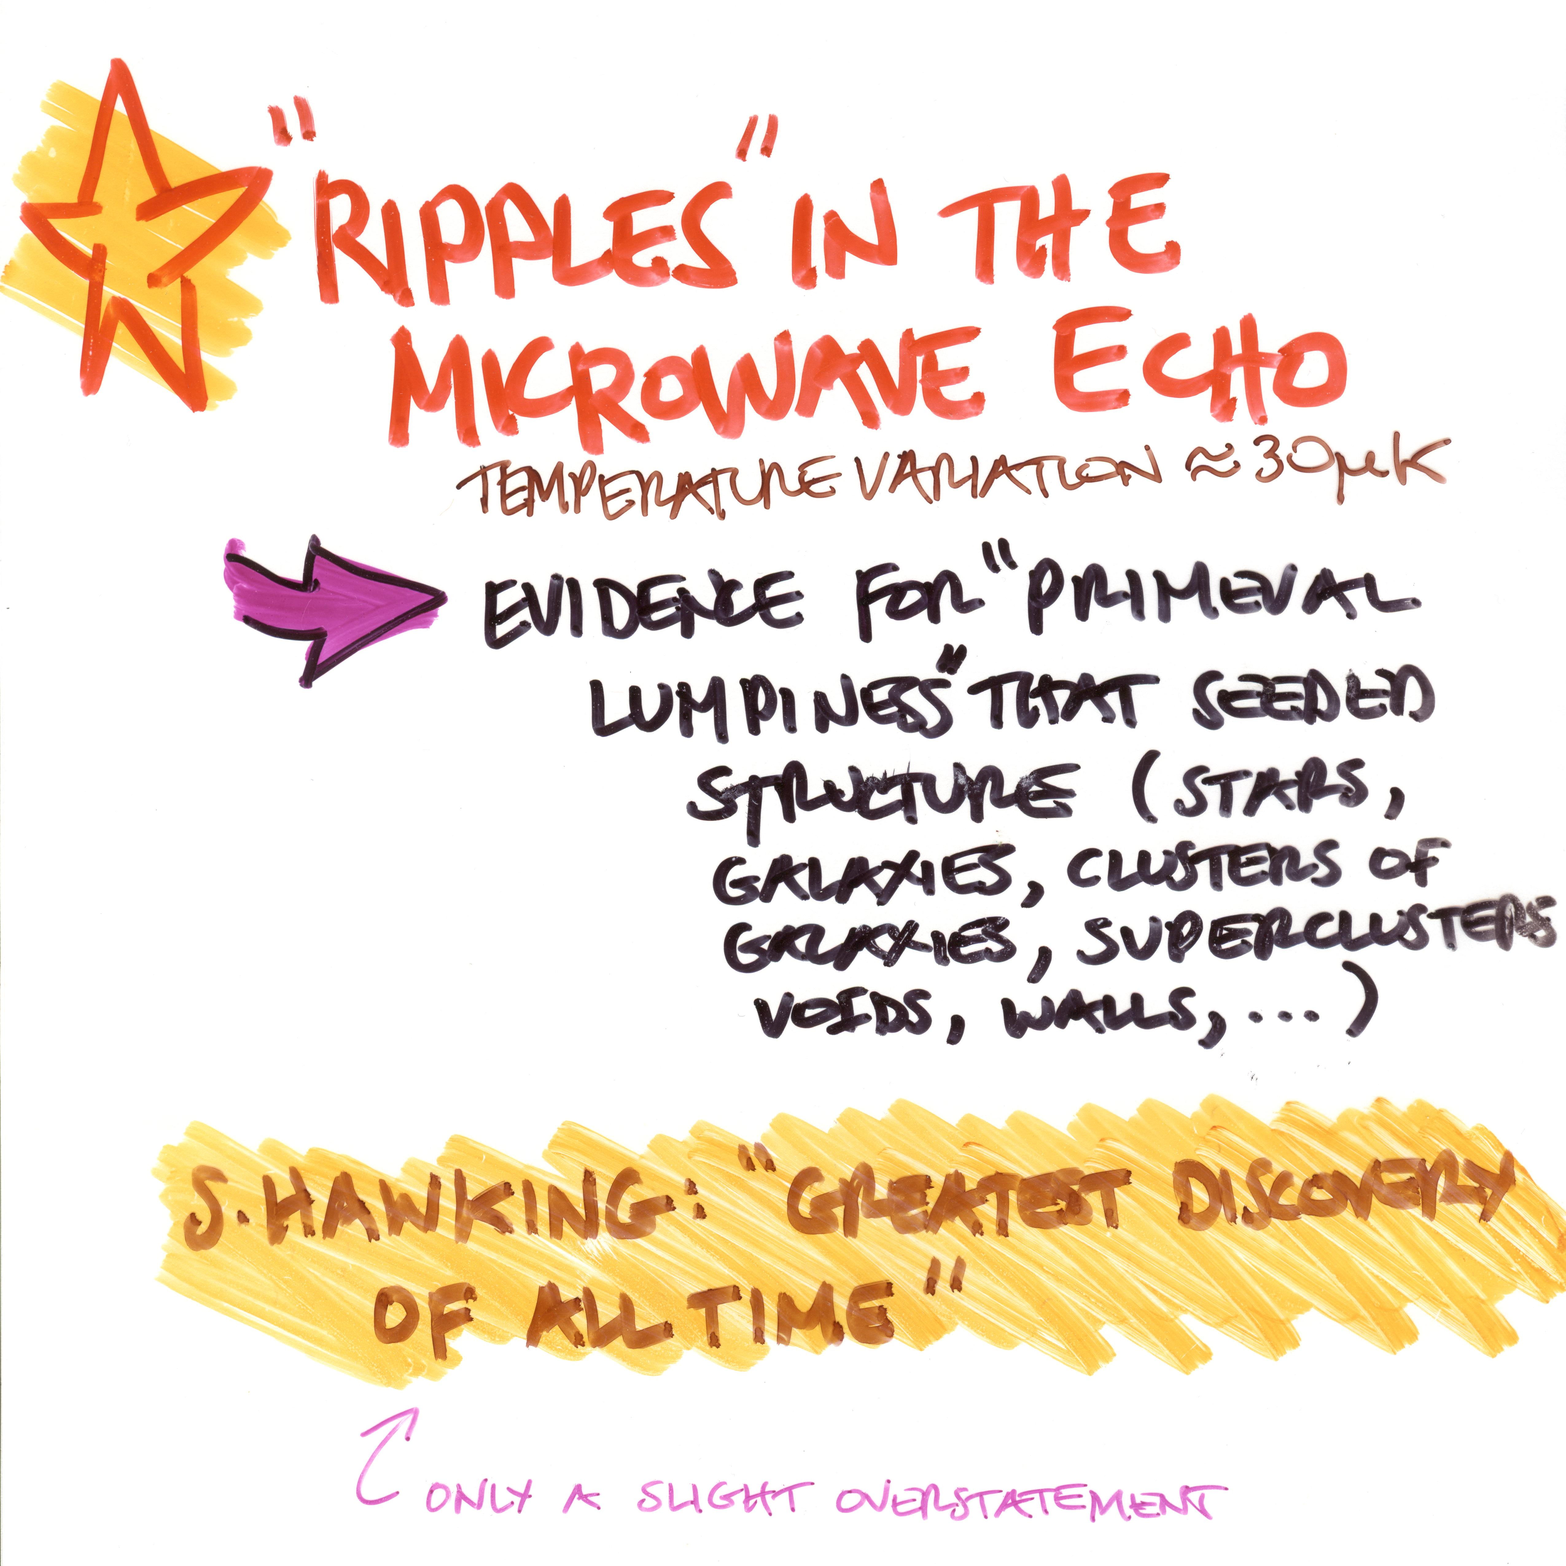
1992: COBE DMR and the birth of precision cosmology!

Slide 15
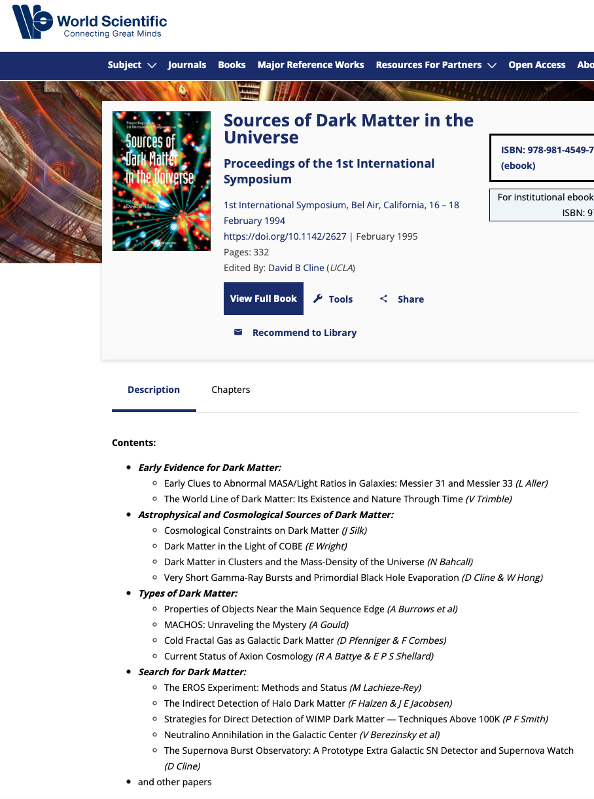
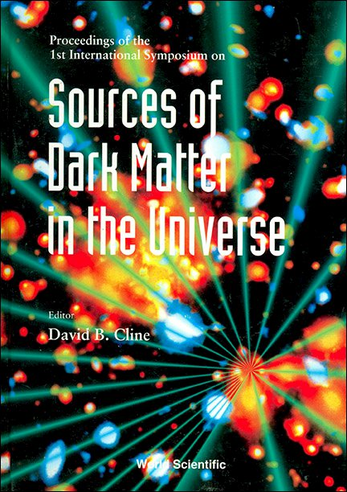
My talk: “The case for particle dark matter”

Slide 16
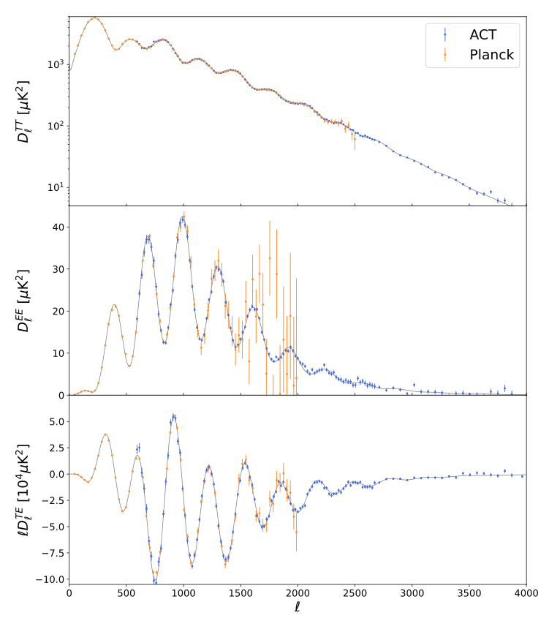
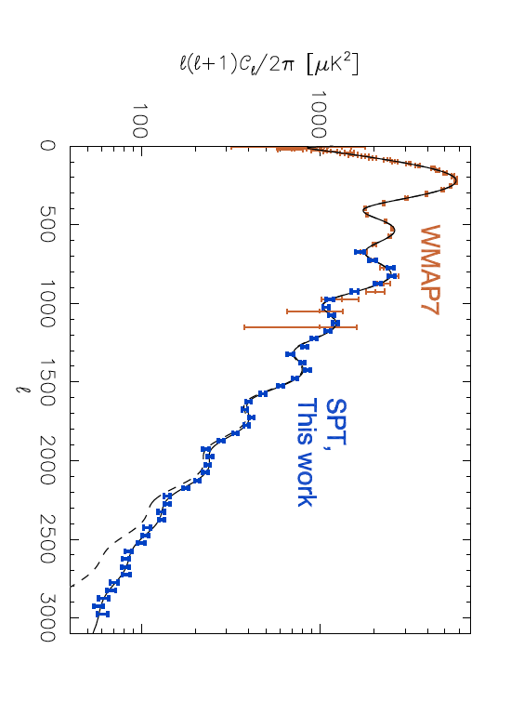
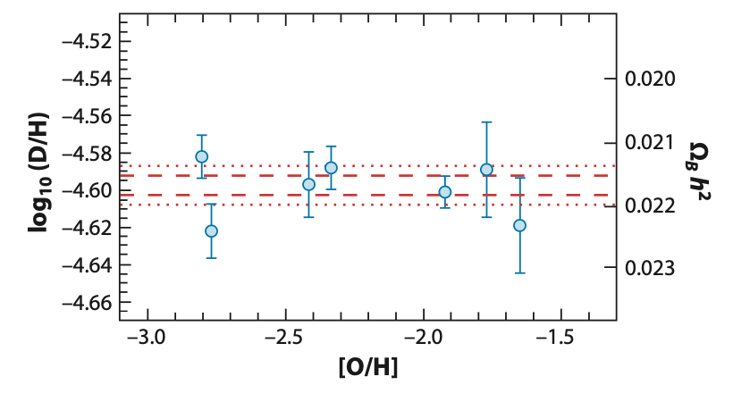
Today: airtight evidence for nonbaryonic DM (or a big problem)
ACT DR6
CMB & BBN
Ω_{B}h² = 0.0226 ± 0.0001
vs.
CMB/SDSS/DES/BOSS
Ω_{M}h² = 0.141 ± 0.0008
> 100 σ discrepancy

Slide 17

The Plan
Produce DM at LHC
Detect halo DM particles
Detect DM annihilations

Slide 18
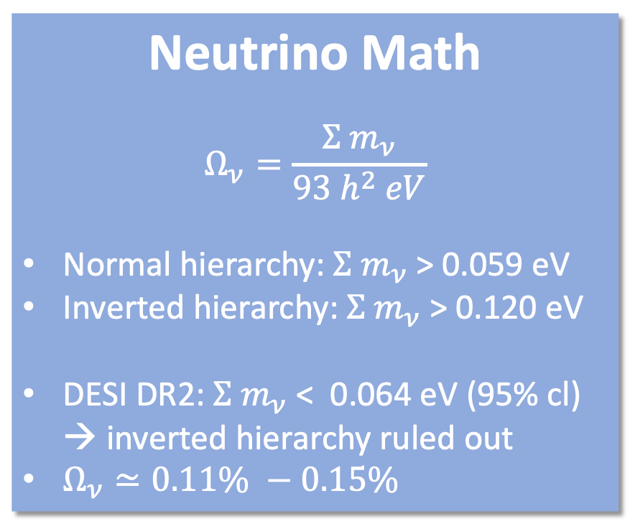
Neutrino Math
$$Ω_{ν}=\frac{{Σ m}_{ν}}{93 h^{2} eV}$$
Normal hierarchy: ${Σ m}_{ν}$ > 0.059 eV
Inverted hierarchy: ${Σ m}_{ν}$ > 0.120 eV
DESI DR2: ${Σ m}_{ν}$ < 0.064 eV (95% cl) → inverted hierarchy ruled out
$Ω_{ν}≃0.11\% −0.15\%$
Neutrinos contribute 0.11% - 0.15%

Slide 19
Full Court Press!!
Produce at LHC
Detect particles in our halo
Detect annihilation products
But where is the WIMP?
Neutrinos contribute 0.11% to 0.15%

Slide 20

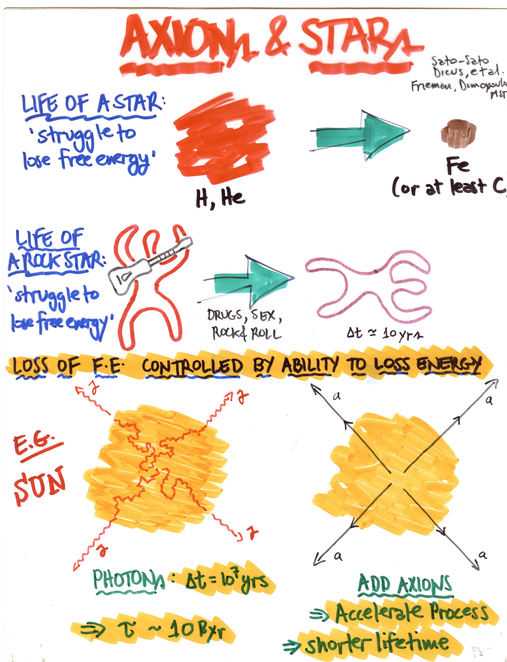

Slide 21
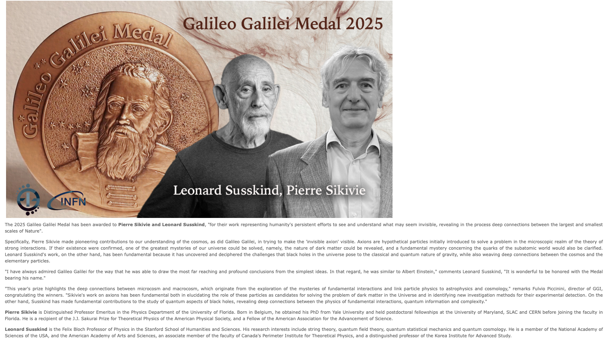

Slide 22
Dark Matter coda*
Rock solid evidence for non-baryonic dark matter (that includes PBHs – Stefano) – crisis if we don’t find it
Powerful experiments searching for WIMPs, axions and other particles
Plenty of new ideas for candidates (sorting please!) and how to detect them
Other big questions
  How cold is the DM? (lensing, streams, ... – Risa)
  How many dark matter particles?
  What are their names?
  Cross checks; e.g., interactions → relic abundance
*Path forward (Quo vadis?) – Hitoshi

Slide 23
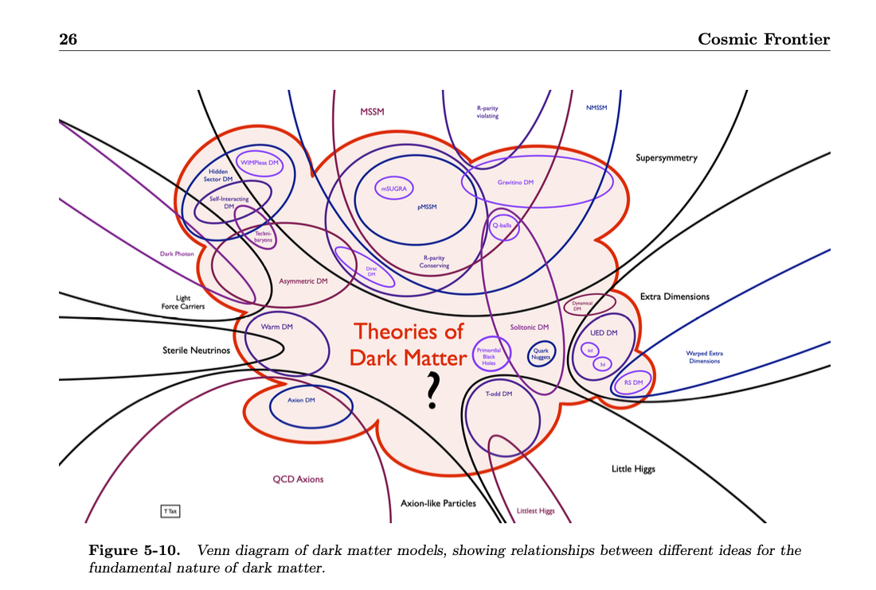
Tait

Slide 24
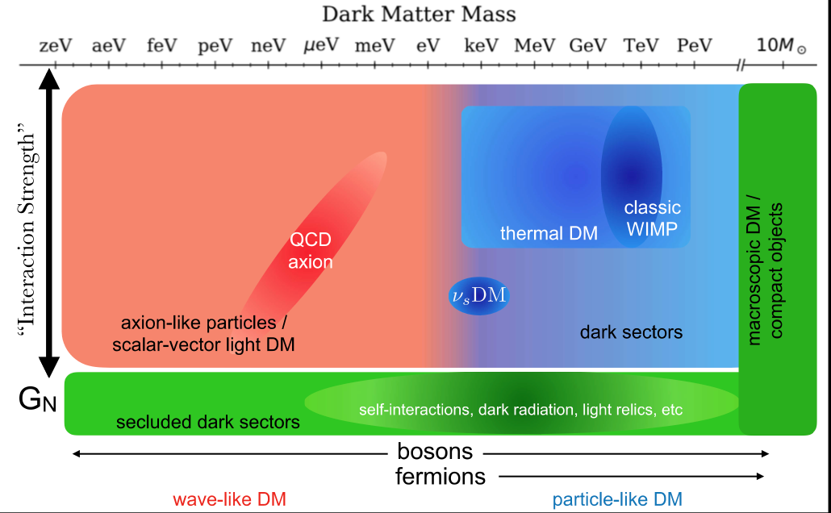
Tait

Slide 25
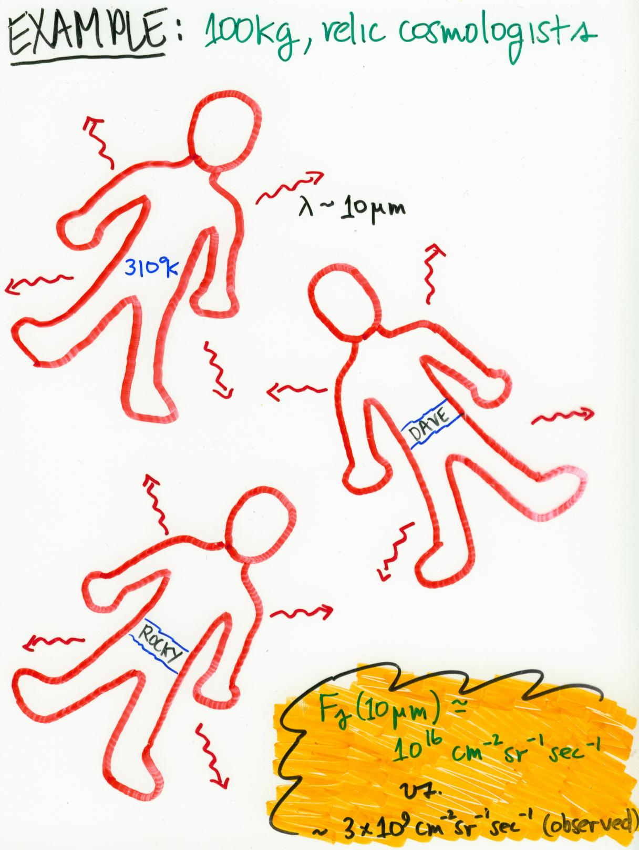

Slide 26
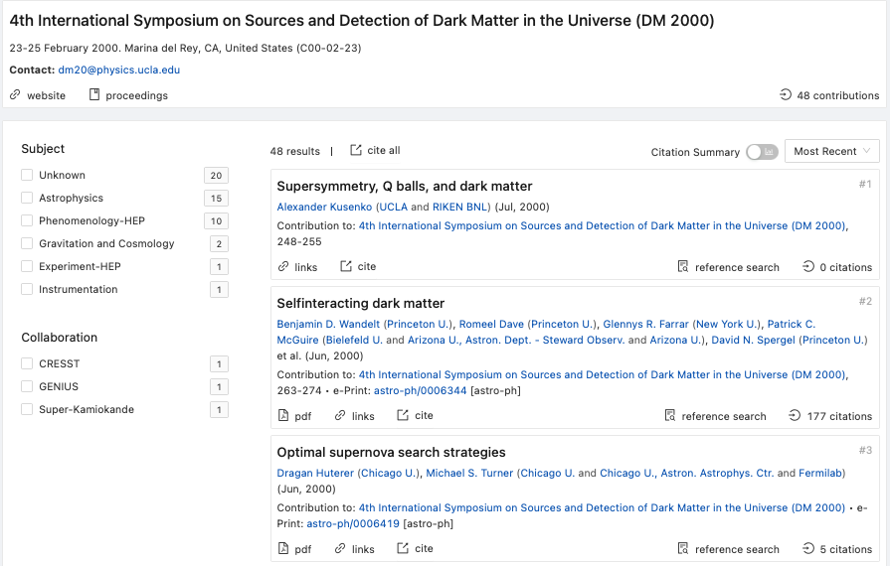
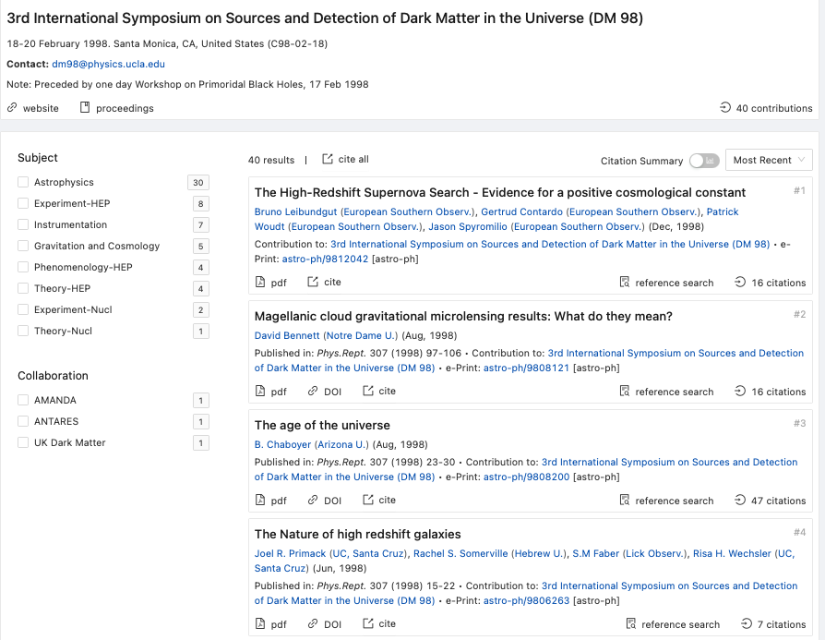
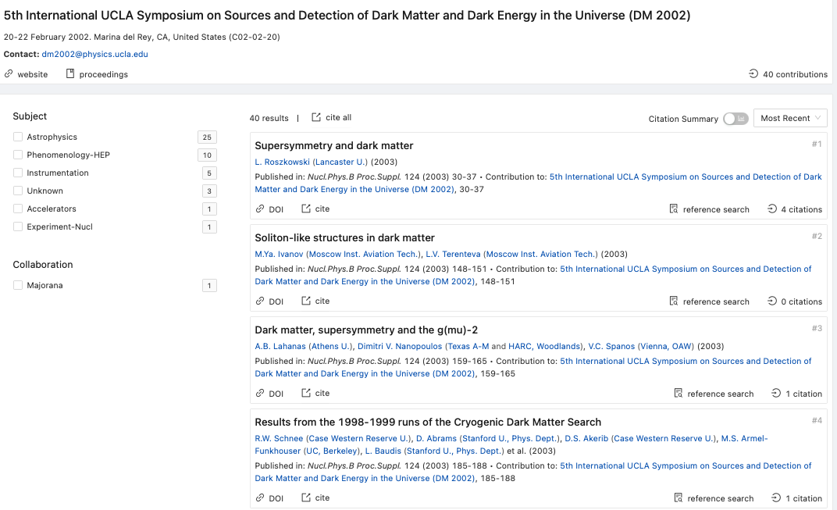

1998: Dark Energy!

Slide 27
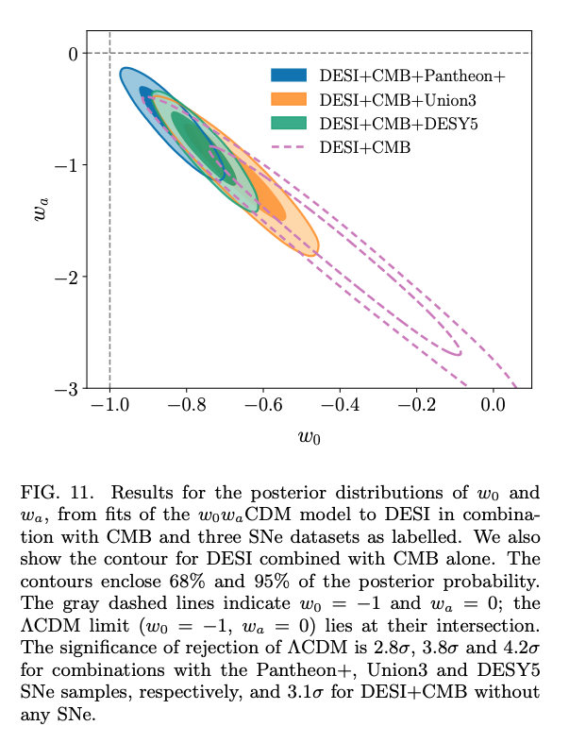
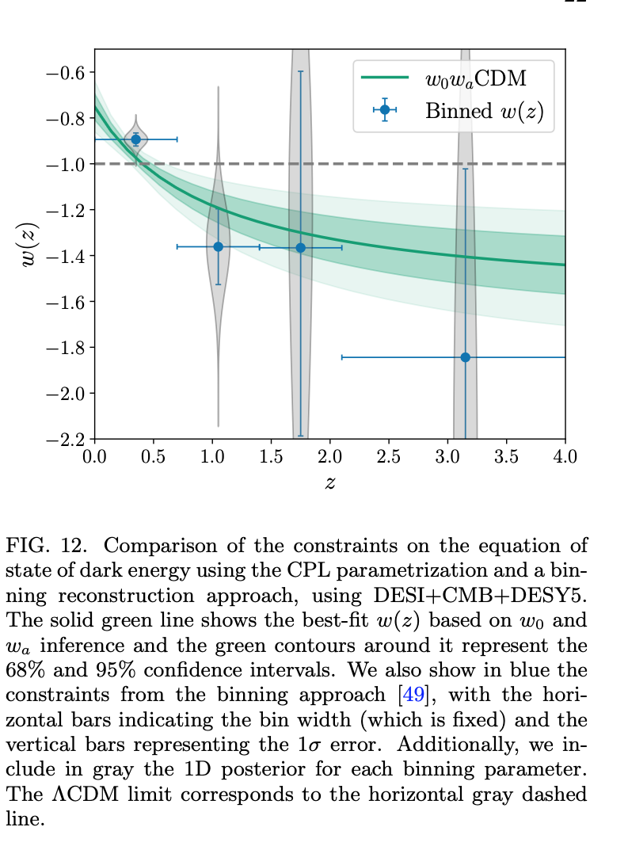
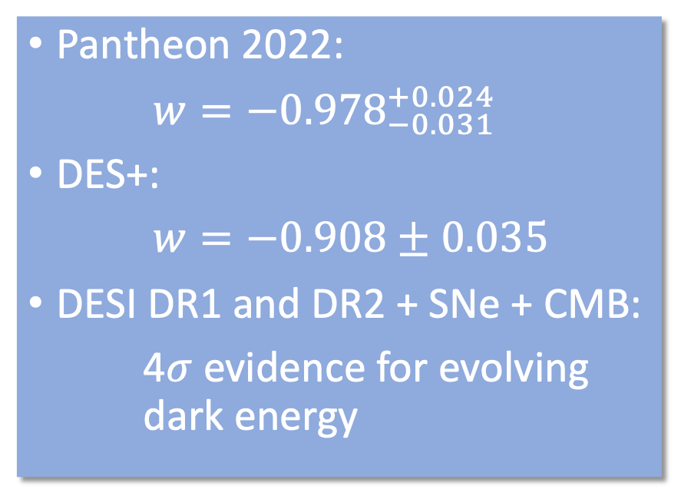

What we know about dark energy
Pantheon 2022:
$w=−{0.978}_{−0.031}^{+0.024}$
DES+:
$w=−0.908±0.035$
DESI DR1 and DR2 + SNe + CMB:
4$σ$ evidence for evolving dark energy
$$w\left(z\right)=w_{0}+{z w}_{a}/(1+z)$$

Slide 28
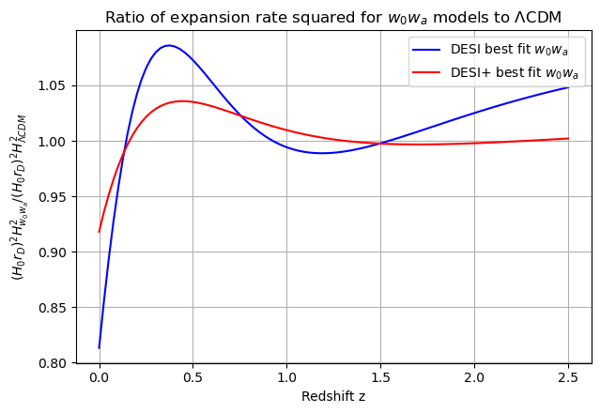
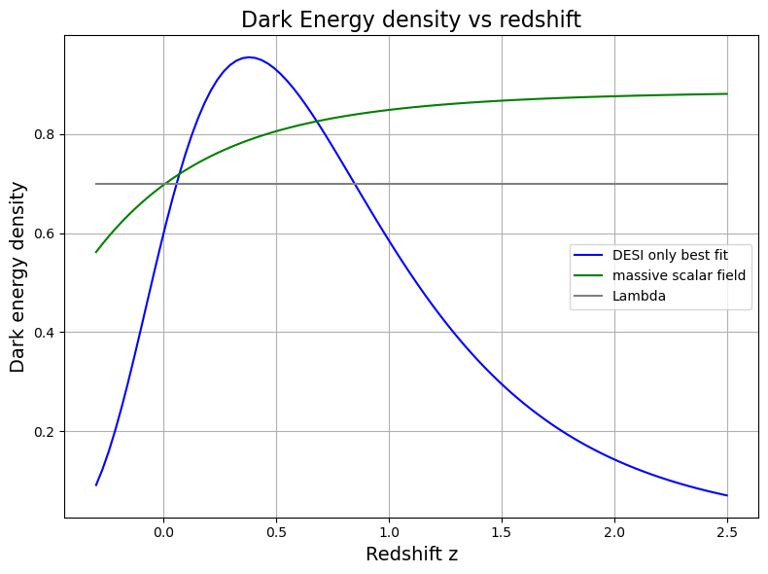
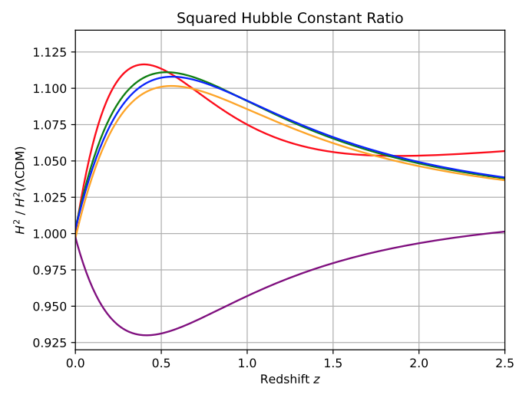
Head scratcher!#? It is a bump that DESI wants. Yikes!
Abreu & Turner, arXiv:2502.08876
Scalar fields

Slide 29
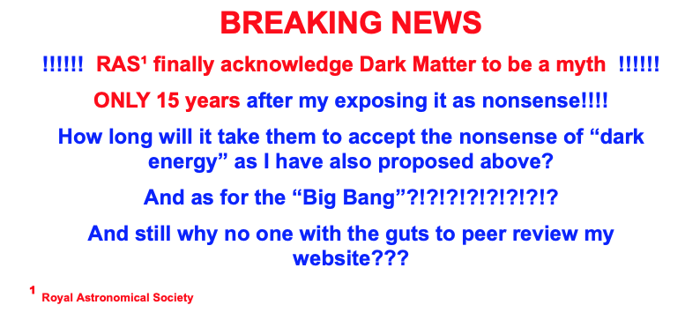
Dark Energy coda*
Strong evidence for at least two epochs of cosmic acceleration: today and inflation
Is the Hubble tension resolved by a third? (ACT says no)
What has DESI/DES found? Is it evolving dark energy? An effective description of a tangle of sources of mass/energy (E. Linder)?
The new “dark energy” questions: how many times has the expansion sped up, when, and how? Are they connected?
*More from Josh
Ask Josh Frieman, RAS

Slide 30
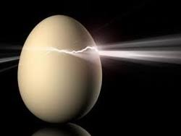
Looking for cracks in the cosmic egg

Slide 31
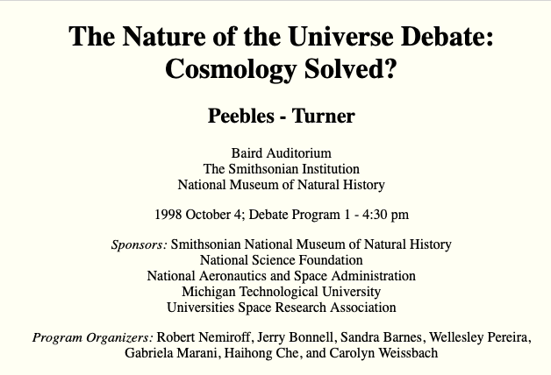
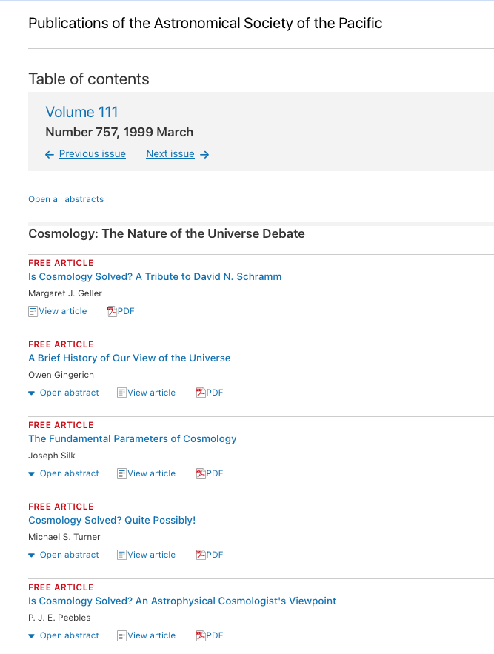
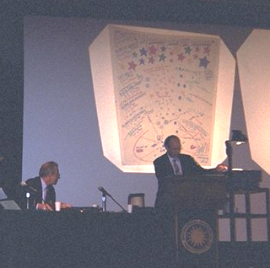
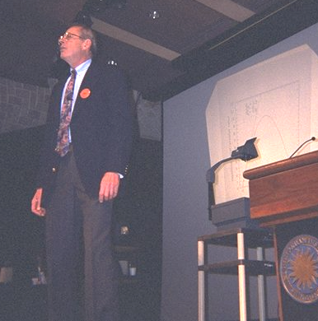
1998: The coming out party for ΛCDM
27 years later still going strong

Slide 32

ΛCDM cosmology
DARK MATTER
DARK ENERGY
INFLATION
rests upon three mysterious pillars
that involve new physics and are inter-related

Slide 33
ΛCDM connects all the pieces
Dark matter, dark energy and inflation are the three pillars of ΛCDM
All involve “new physics” and are the windows to a deeper understanding of “quarks” and “the cosmos”
It is difficult to discuss each of the three separately
UCLA Dark Matter 2027: Sources and detection of dark matter, dark energy and inflation?
“The inter-connected tensions”

Slide 34
LCDM: the tensions (my ranking)
Hubble tension – more from Lloyd
Evolving dark energy – or not
“Sigma-8”
The basket full of CDM ailments: cusps, satellites, early galaxies, early SMBHs
Resolving the tensions/addressing the big questions
JWST, CMB (SO, SPT, CMB-S4/5, Litebird, …)
DESI, LSST, … , SPEC-5
LHC, DUNE, …
Dark Matter experiments

Slide 35
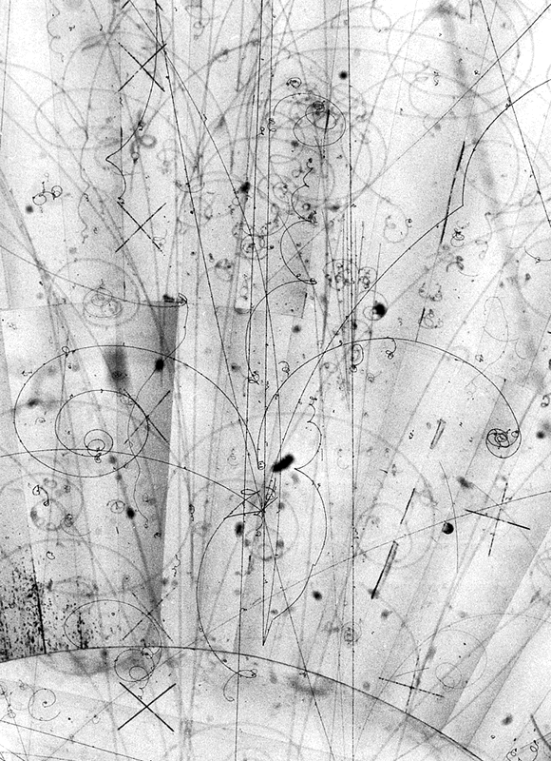
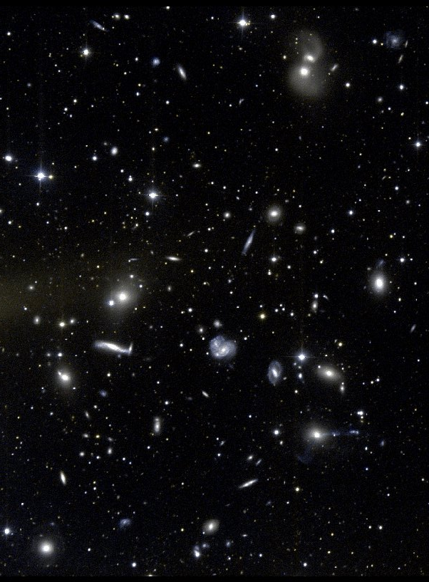
The pieces on the table
Dark matter
Inflation
Dark Energy
Baryon asymmetry
Eternal inflation/multiverse
The mix
Standard model, gravity
Unified gauge theory
“Stringy ideas”*
Holography
Duality, extra dims
Landscape
Emergence
* The collection of powerful ideas formerly known as String Theory
NB: probably some missing pieces

Slide 36

Dark Matter: this?
Stars
The dark matter particle
WIMPs or axions

Slide 37
Dark Matter: or that?
Dark Matter
The dark sector

Slide 38
Precision Cosmology!
Powerful tool
Team sport: theorists, builders and analysts
Precision Cosmology
is Hard
Accurate Cosmology
is even Harder!
H₀ again!

Slide 39
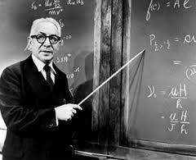
A complicated Universe
Atoms : Democritus to 1964
+ photons: 1964
+ neutrinos (e, μ): 1967
+ exotic dark matter: 1981
+ CDM: 1983/4
+ massive neutrinos: 1998
+ dark energy: 1998
+ τ neutrino: 2000
Done? Not likely!
Why is Ω_{CDM}/Ω_{B} ≈ 5?
I.I. Rabi
Who ordered that?
How much room for more:
UR: ~0.2ρ_{CMB}
NR: ~0.1ρ_{crit}
Other leftovers: ??

Slide 40

Combinations of fundamental constants?
Similar asymmetries and masses?
Accident?
cf. Milgrom’s Law (DM “kicks in” at a = cH₀) or CMB energy vs. stellar free energy

Slide 41

Precision cosmology – once an oxymoron – with its large, high quality datasets is now probing dark matter and dark energy in unprecedented ways
A word from your sponsor:
Annu. Rev. Nucl. Part. Sci. 72, 1-35 (2022)

Slide 42


Names matter: from Dark Energy to Cosmic Acceleration
1998

