Slide 1
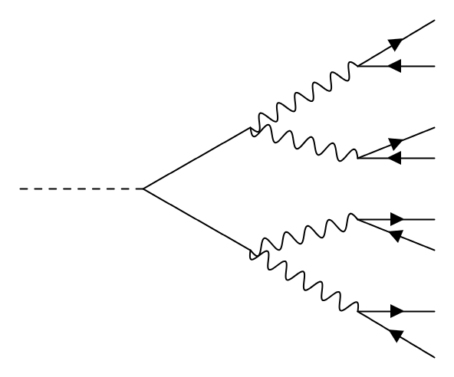
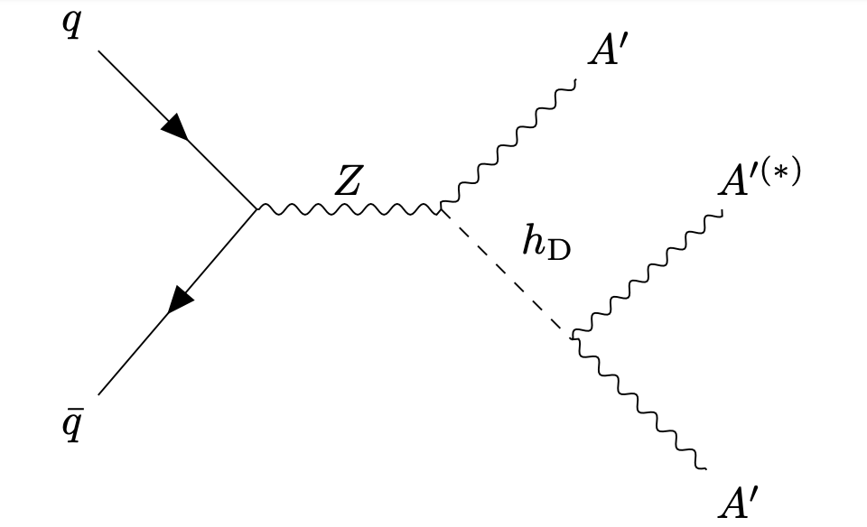

Exploring Dark Sectors Using Dilepton Resonances
Probing exotic Higgs decays using multilepton signatures
Rabia Husain in collaboration with Junyi Cheng, Lingfeng Li, and Matthew Strassler
f
f
V
f
A
h
V
f
V
f
A
f
V
f
f

Slide 2
2306.07413

Slide 3
We have put limits below 10⁻⁴ on the signal H $→$ A A $→$ V V V V
f
V
f
A
f
preliminary
h
V
f
A
V
f
f
V
f
f

Slide 4
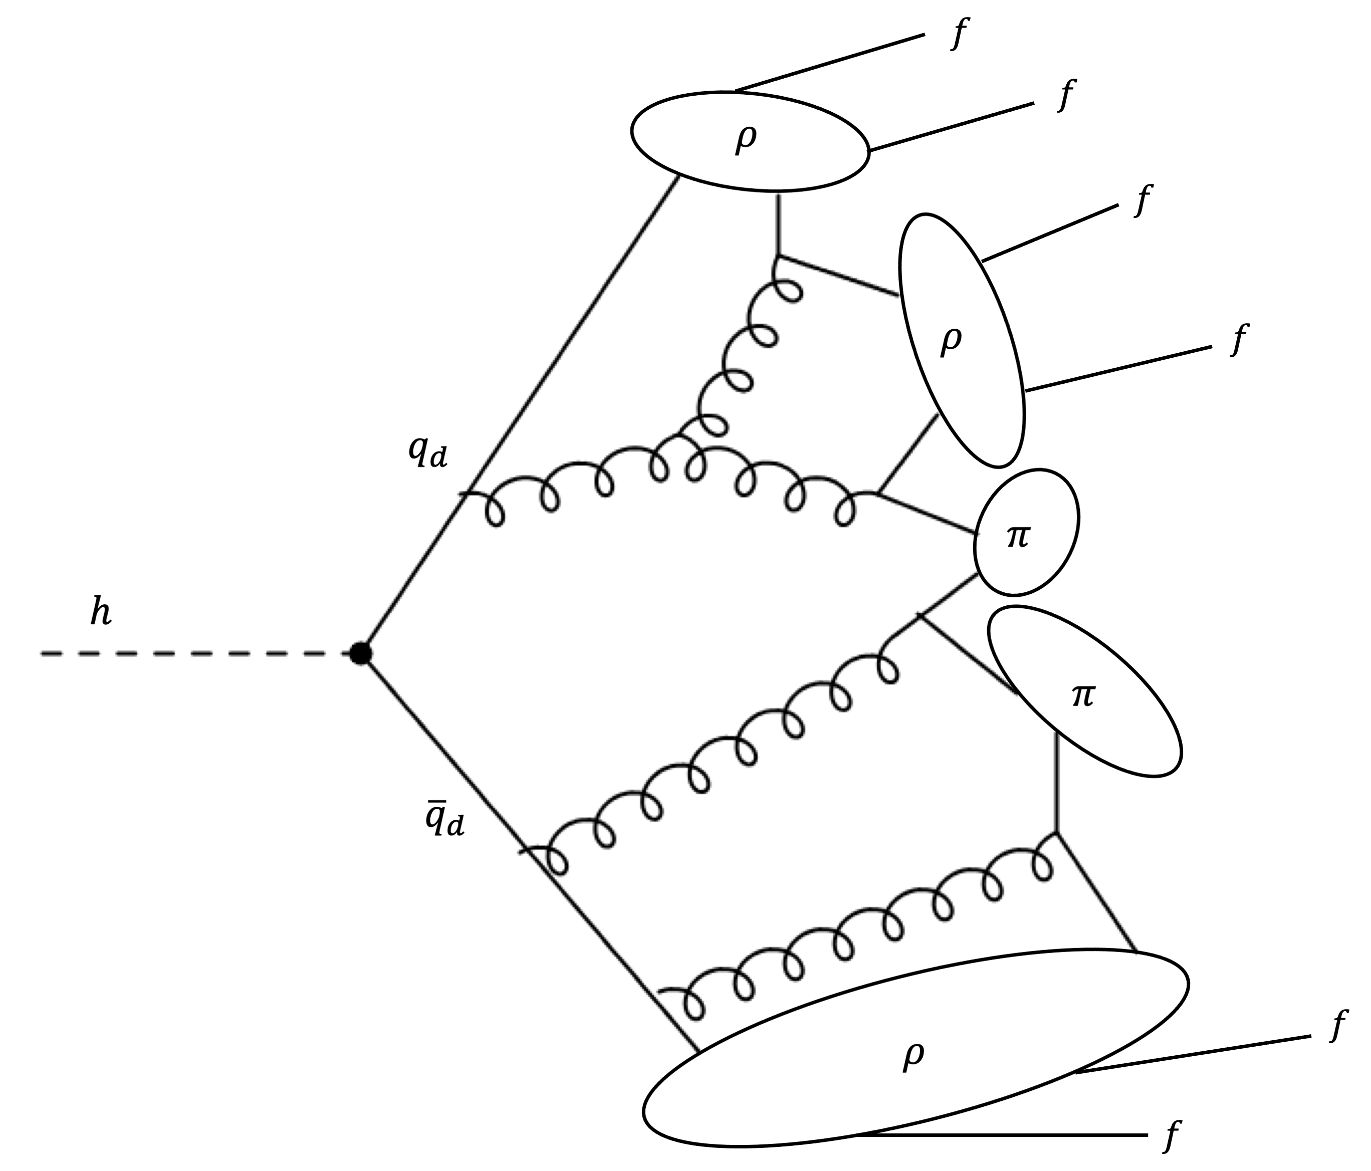
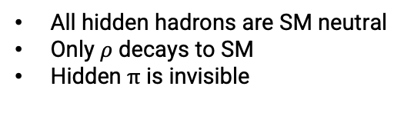
All hidden hadrons are SM neutral
Only $ρ$ decays to SM
Hidden $π$ is invisible
Figure modified from
1907.04346

Slide 5

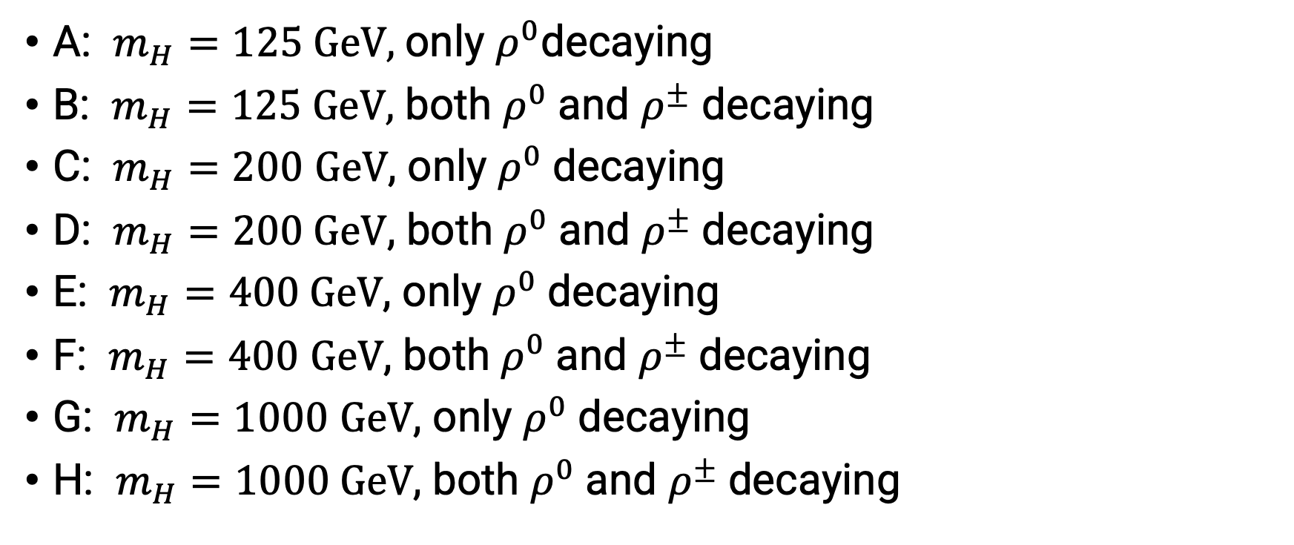
Hidden Valley Models
$±$ labels hidden isospin
A: $m_{H}=125 GeV,$only $ρ^{0}$decaying
B: $m_{H}=125 GeV,$ both $ρ^{0}$and $ρ^{±}$ decaying
C: $m_{H}=200$ $GeV$, only $ρ^{0}$decaying
D: $m_{H}=200 GeV$, both $ρ^{0}$and $ρ^{±}$decaying
E: $m_{H}=400 GeV$, only $ρ^{0}$decaying
F: $m_{H}=400$ $GeV$, both $ρ^{0}$and $ρ^{±}$decaying
G: $m_{H}=1000$ $GeV$, only $ρ^{0}$decaying
H: $m_{H}=1000 GeV$, both $ρ^{0}$and $ρ^{±}$decaying

