Slide 1
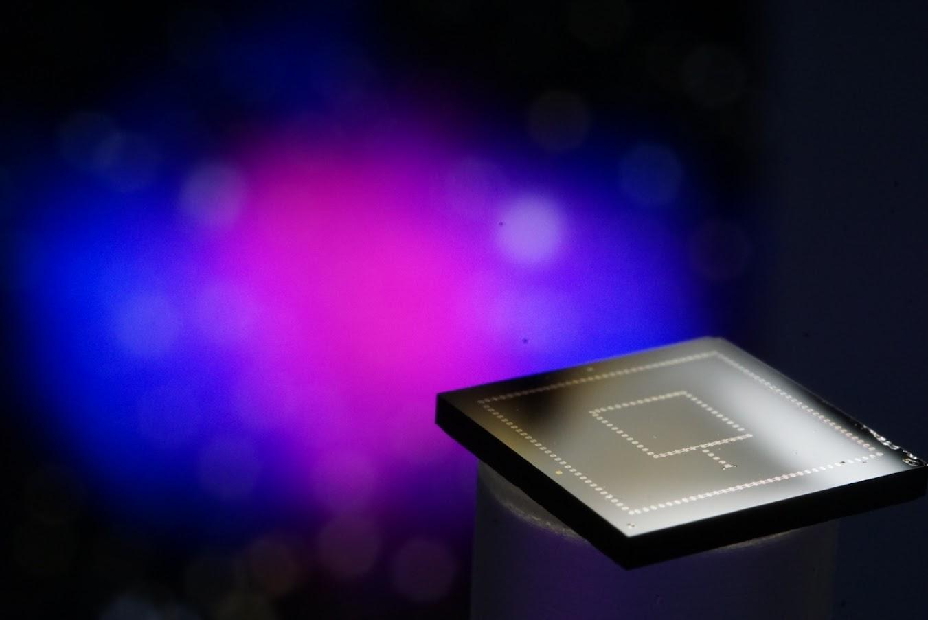


Development of Ultra-sensitive, Low Background Detector Technology for 10meV to GeV Dark Matter
Matt Pyle
Nobel Symposium on Dark Matter
8/25/23

Slide 2
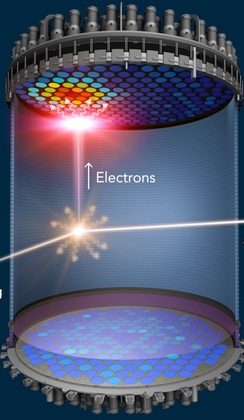
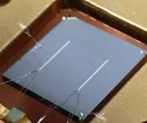
Don’t Put All Your Eggs in One Basket: Broaden the Search
10⁻²² eV
keV
10 GeV
10¹⁹ GeV
Dark Sectors: DM w/ New Mediators
WIMPS
This Talk
We’re still searching for high
mass WIMPs with noble gas
TPCs
Well motivated theoretical
models at other mass scales
US Cosmic Visions: New Ideas in Dark Matter: 1707.04591

Slide 3
Light Mass DM Direct Detection
Design Drivers

Slide 4
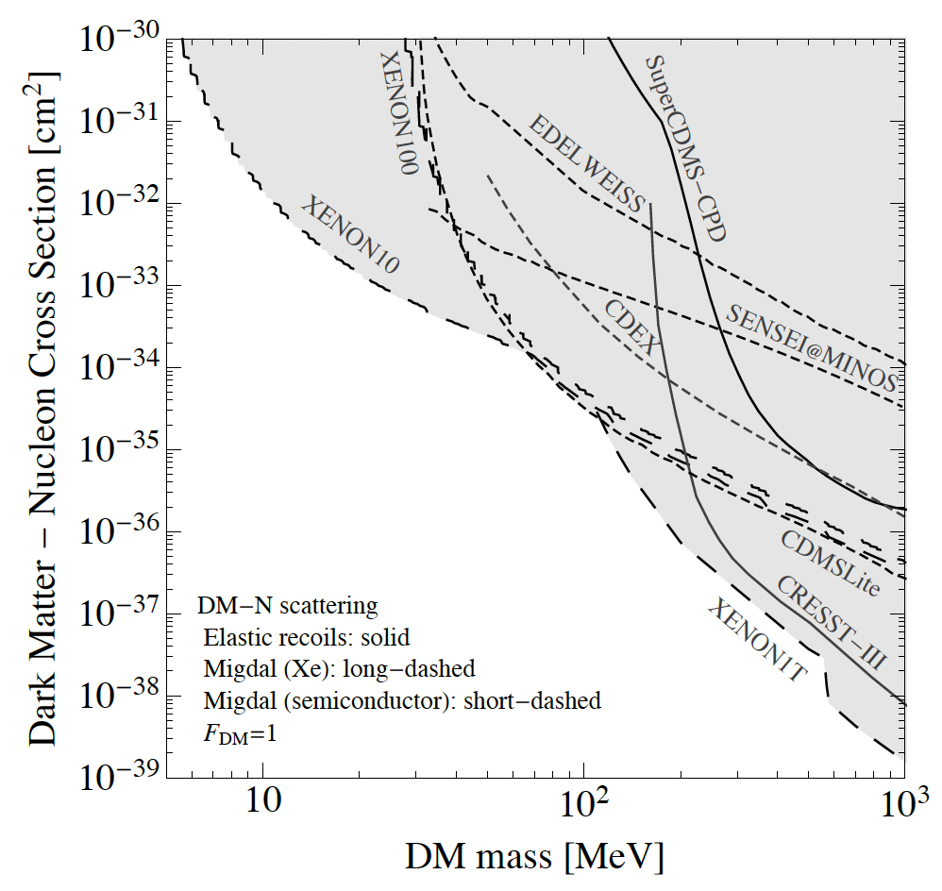
Light Mass DM: Nuclear Recoil Direct Detection Constraints
?
There are basically no Direct Detection constraints. Why?
Typical Neutrino cross section
2203.08297

Slide 5
Light Mass DM Design Drivers: Exposure
?
Interaction Rate scales with 1/M_{DM}
Light Mass Dark Matter Search experiments are tabletop and have small project cost scales: <10M

Slide 6
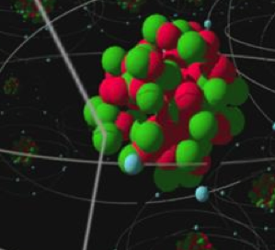
Kinematics: 2 Body Elastic Nuclear Scattering
DM
When M_{n}>> M_{DM}
Transfer of DM kinetic energy to nucleus is really inefficient for elastic 2 Body Scatters when M_{n} >> M_{DM}

Slide 7
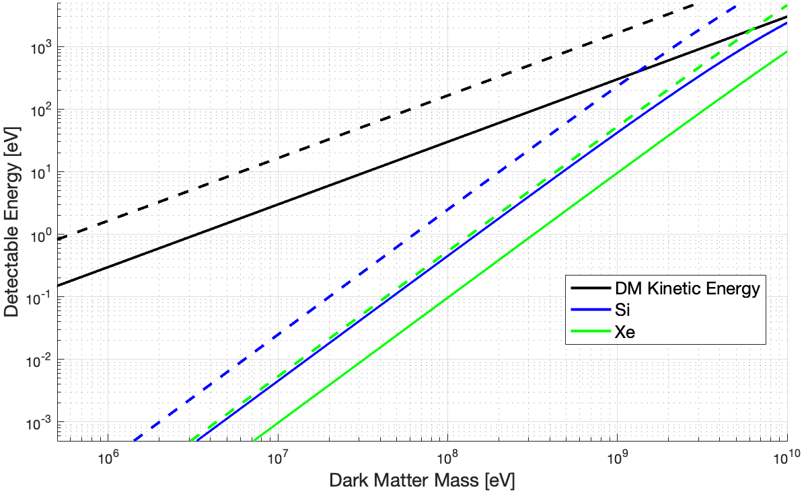
Light Mass Dark Matter: Elastic Nuclear Scattering
<v> -
V_{esc} --
1 meV
Design Driver #1: Energy Sensitivity

Slide 8
It’s not quite this daunting …

Slide 9
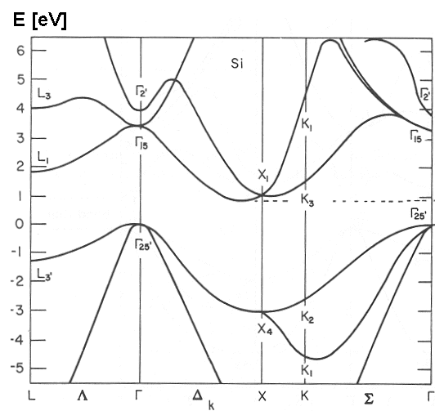
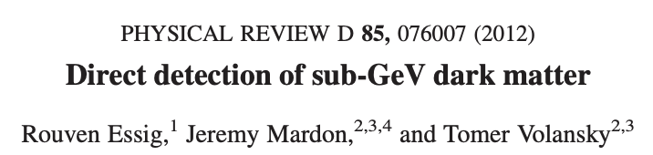
Inelastic e⁻ Recoils in Semiconductors
Band Diagram for Si
Crystal e- Momentum and Energy Scales Match MeV DM perfectly
Energy [eV]
DM
Momentum
4.5x10⁻¹⁰ m
3 keV/c

Slide 10
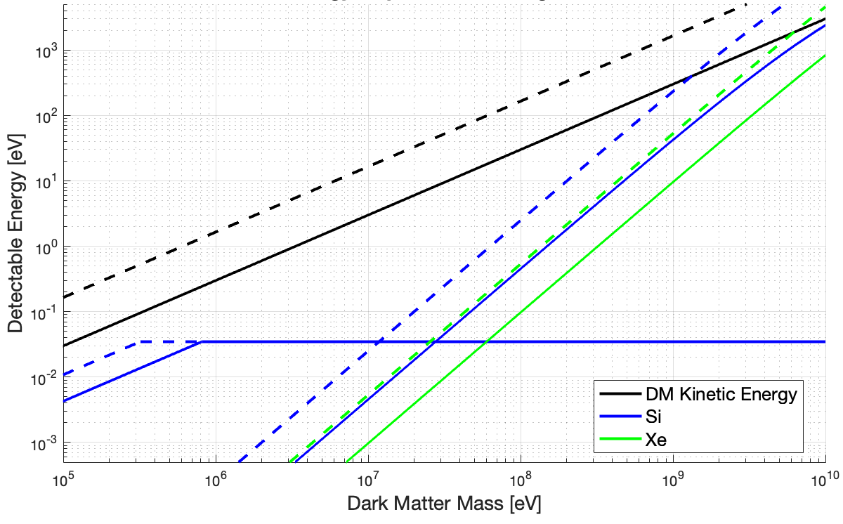
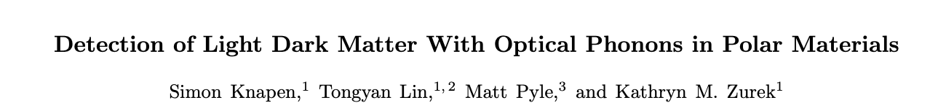
DM- Coherent Vibrational Interactions
For DM interactions with small momentum and energy transfers, we need to start thinking about DM interactions producing coherent crystal excitations!
<v> -
V_{esc} --
Multiphonon
Regime
2205.02250
Coherent Vibrational Excitations in Si
Single Phonon Regime
1712.06598

Slide 11
Light Mass DM: Detector Design Driver #1: Energy Sensitivity
1. Energy Sensitivity
Typical Neutrino cross section
2203.08297

Slide 12


Athermal Phonon Detectors
TES (W or IrPt)
Athermal Phonon Collection Fins (Al)
Crystal (Si,Ge,GaAs,SiO₂,Al₂O₃)
1 cm
$$ε_{collect}$$
1 cm
$$ε_{sensor}$$
1 cm
To increase TES sensitivity, lower T_{c} and volume

Slide 13
The Challenge: Environmental Noise
Lowering Tc and decreasing V_{tes,} doesn’t just increase sensitivity to DM, it drastically increases sensitivity to all environmental power sources
To increase your sensitivity by x10, you need to decrease your susceptibility to environmental DC backgrounds by x100!

Slide 14
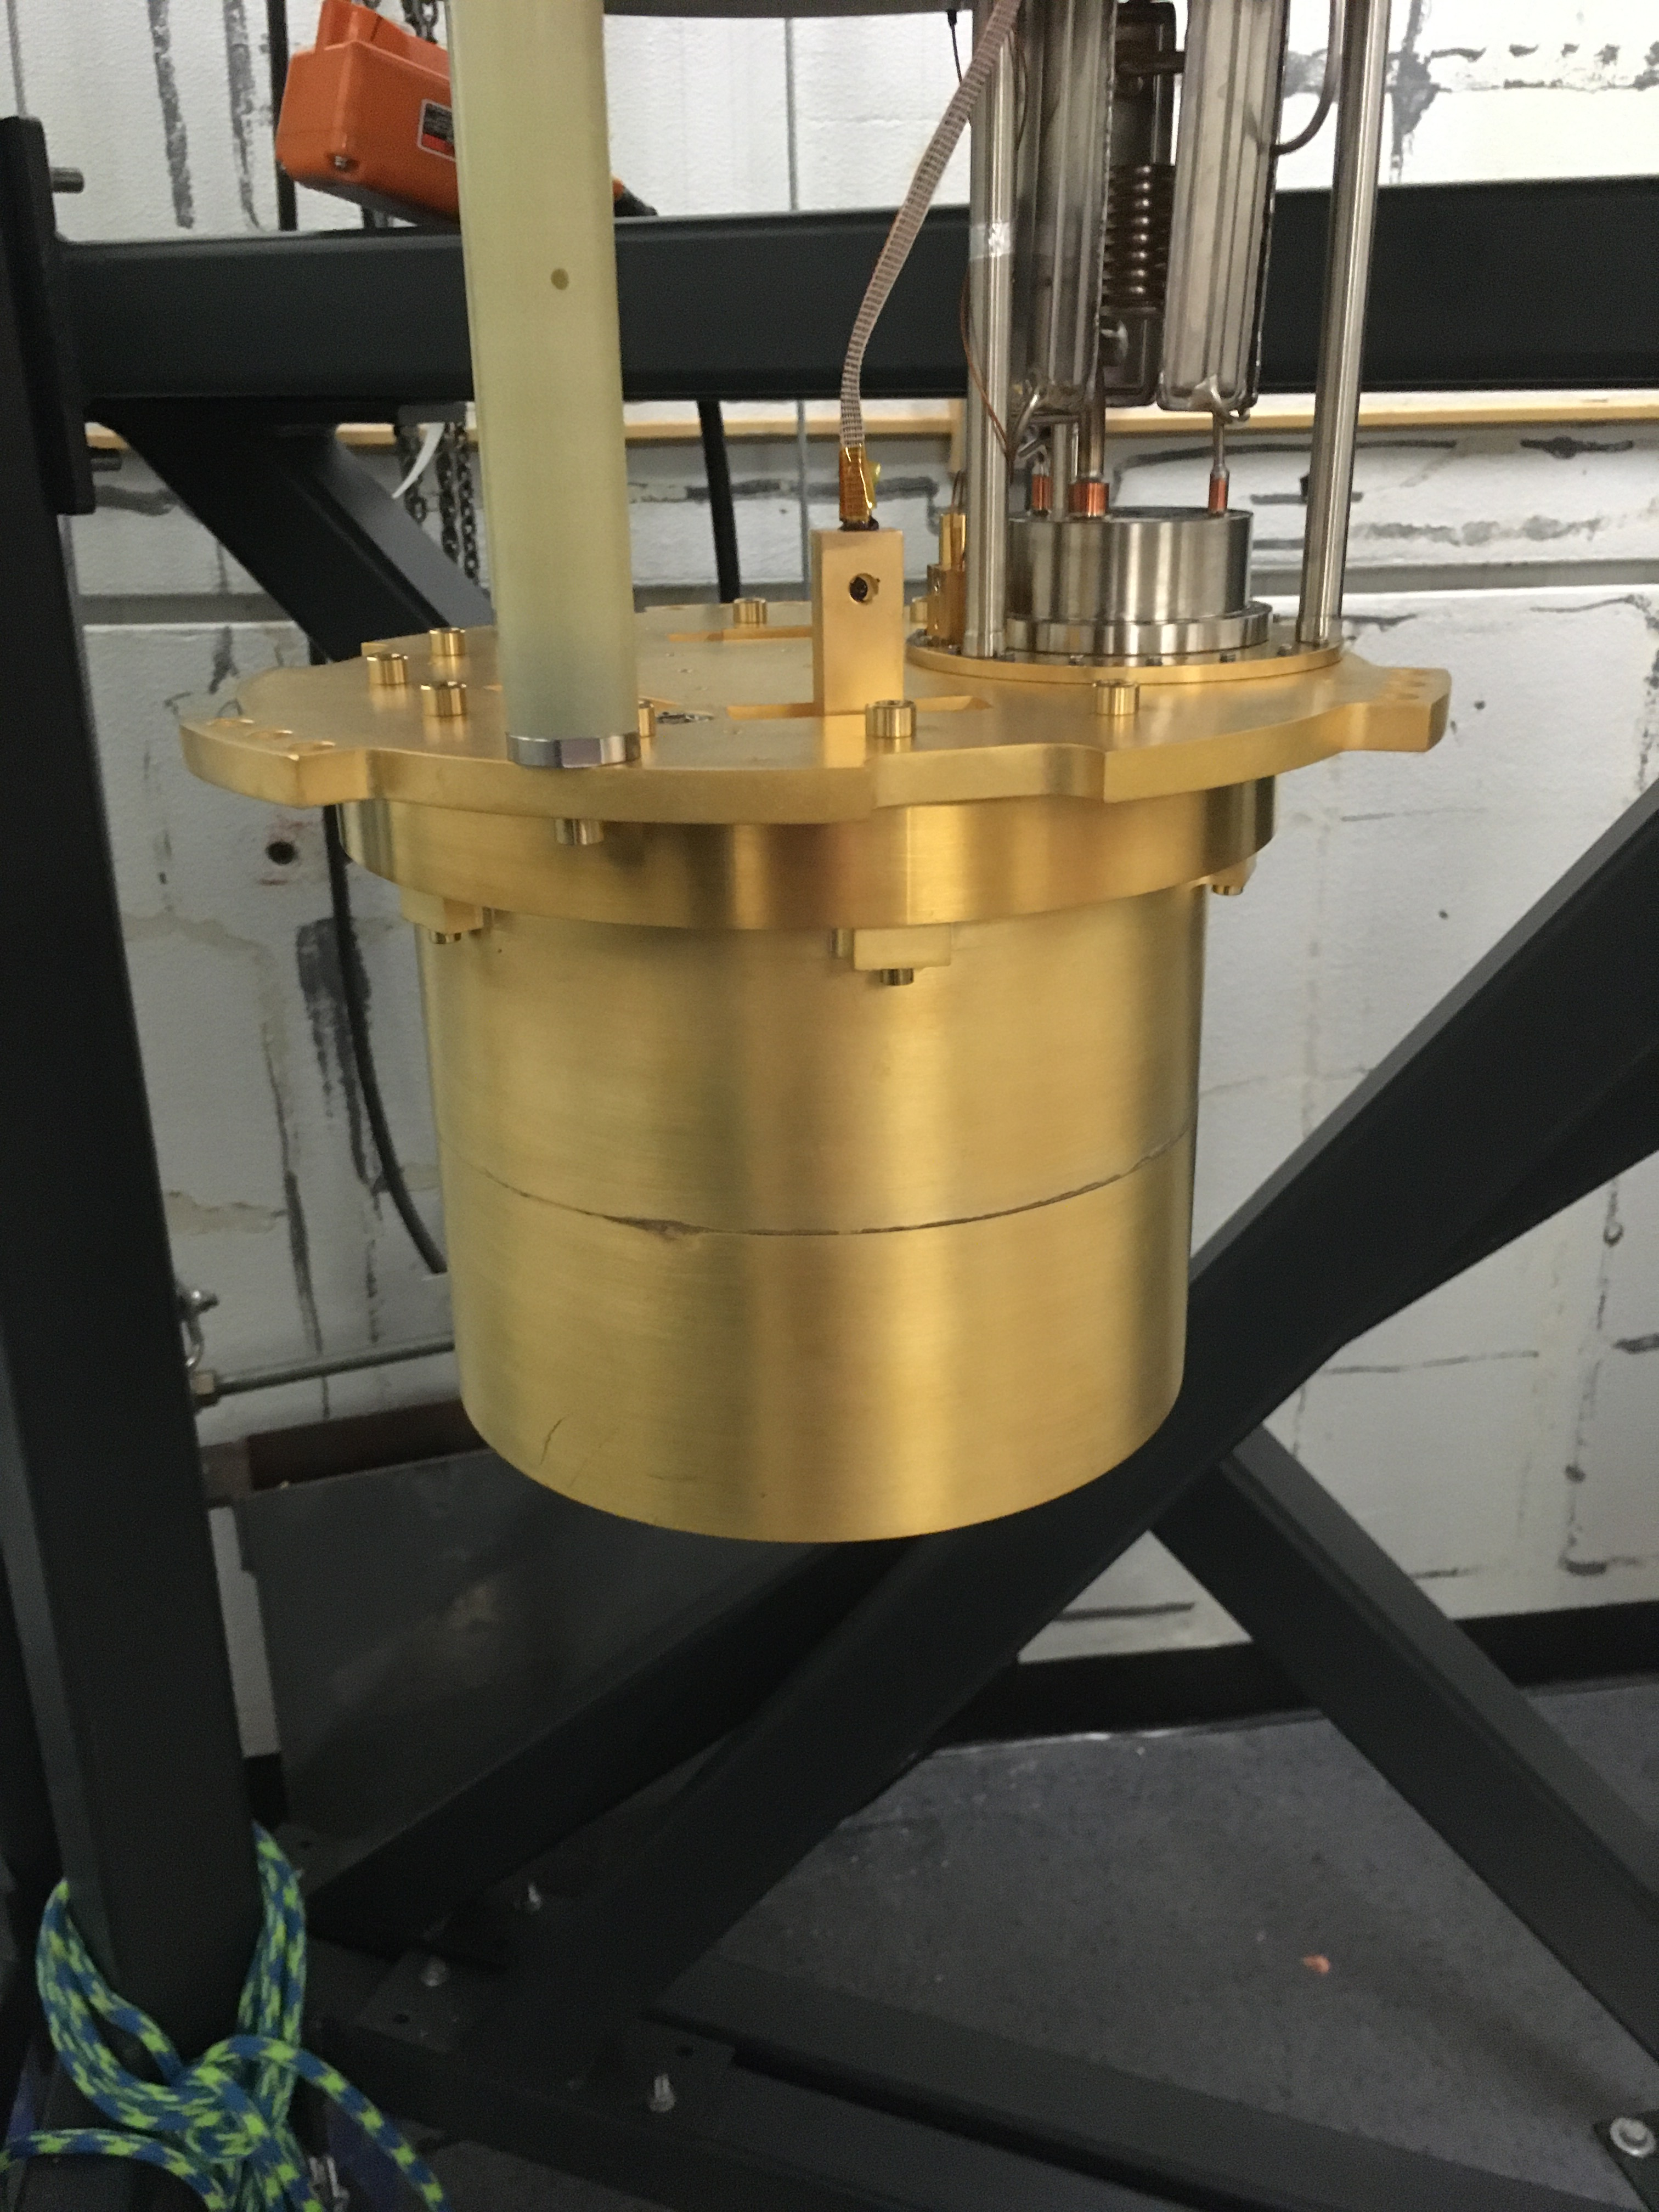
Environmental Upgrades: IR
Bias Power vs Still temperature
TES bias power decreased as we heated the still … we had an IR leak
Bias Power [fW]
Still Temperature [mK]
x20 improvement with the addition of a 2nd IR tight can
Future: redesigning both cans for further IR tightness

Slide 15
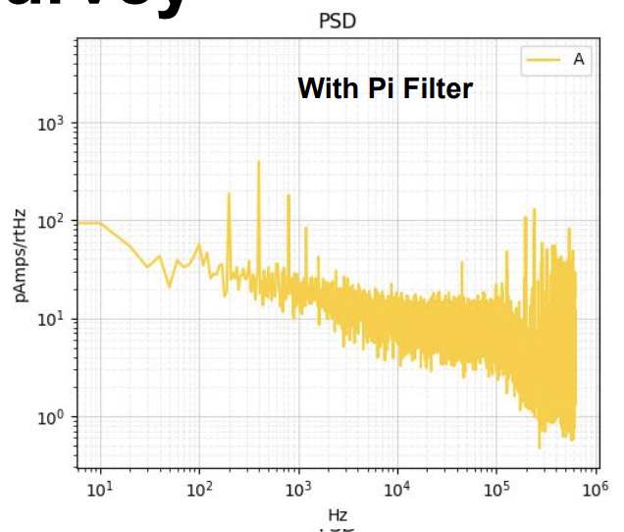
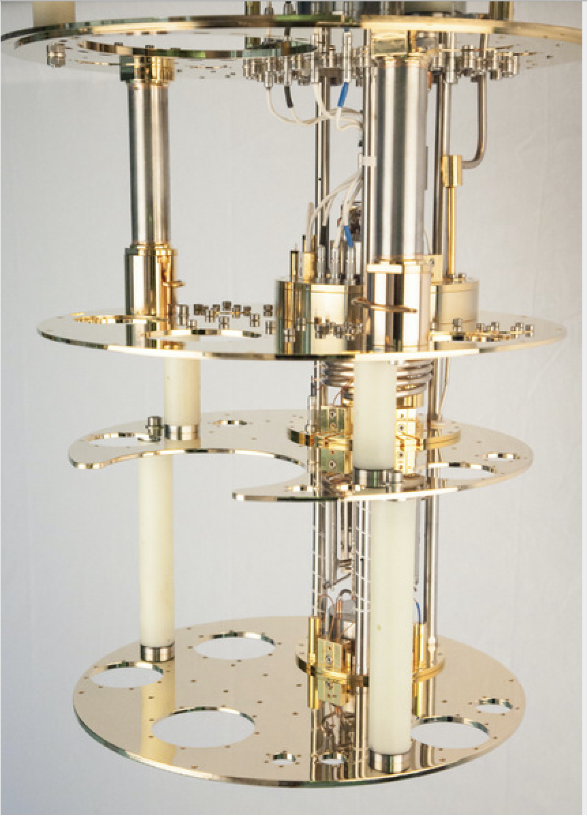
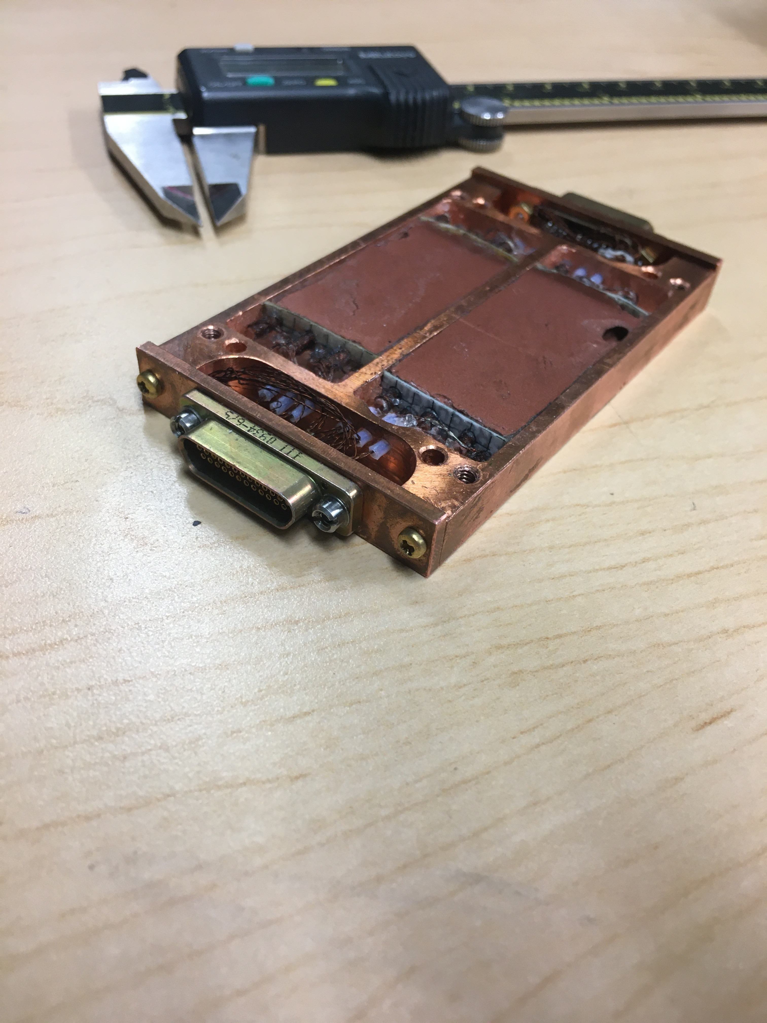
Environmental Upgrades: EMI Mitigation
Measure EMI shielding effectiveness with 200Hz modulation of 800MHz EMI leakage seen
~x20 decrease in external GHz scale radiation susceptibility by tightening 300K faraday cage (just 2 weeks ago)
200Hz amplitude modulation of 800MHz EMI
Steal copper powder filter from Martinis, Devoret, Clarke (PRB 35.4682 1987) for the 4K and still stages. Currently in Fabrication. Test performance improvements in a few months.
By 2024, we’ll be largely finished with EMI upgrades

Slide 16
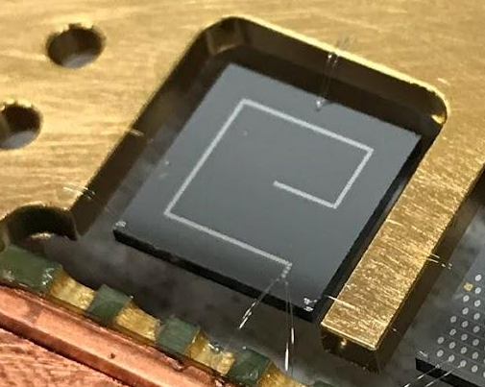
Current Detector Performance
Prototype 1cm²x1mm Si pixel athermal phonon detector for HeRALD Superfluid He dark matter search
1% of surface covered with TES based athermal phonon detectors
Wirebond support structure
  Mechanical vibration decoupler
  No frictional rubbing at interface between clamp and detector
  Minimal stress structural support
T_{c} ~50mK (not the lowest Tc device)

Slide 17
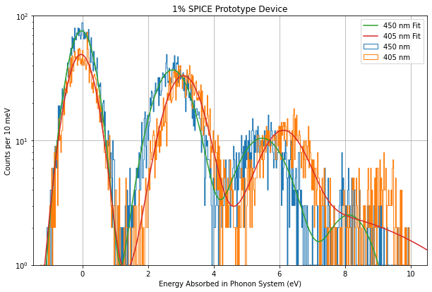
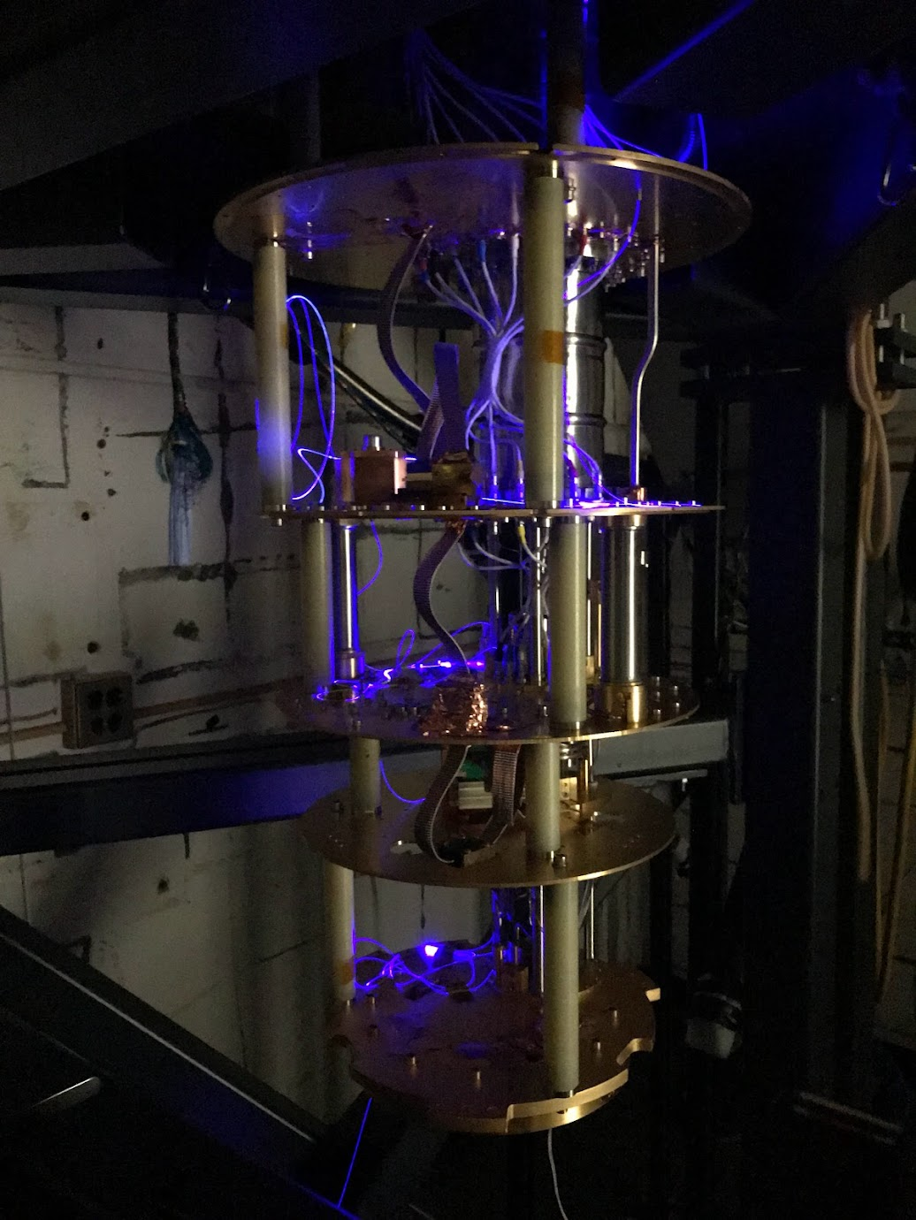
Single Optical Photon Calibration
Calibrate detector with 405nm and 450nm
Photon bunches delivered by fiber
SPICE/HeRALD Preliminary
2212.12513
First time to see optical photon quantization in macroscopic phonon detectors without Luke-Neganov Gain

Slide 18
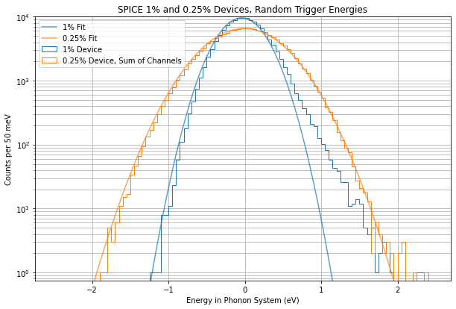
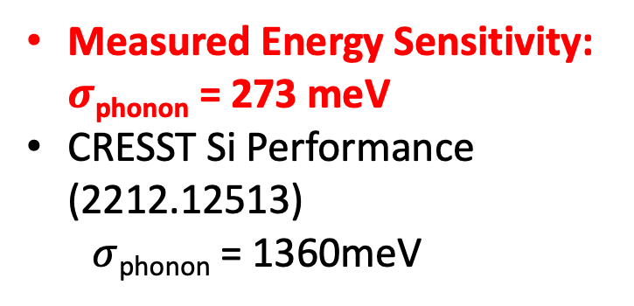
1) Achieved Energy Sensitivity
Measured Energy Sensitivity: $σ$_{phonon} = 273 meV
CRESST Si Performance (2212.12513)
  $σ$_{phonon} = 1360meV

Slide 19
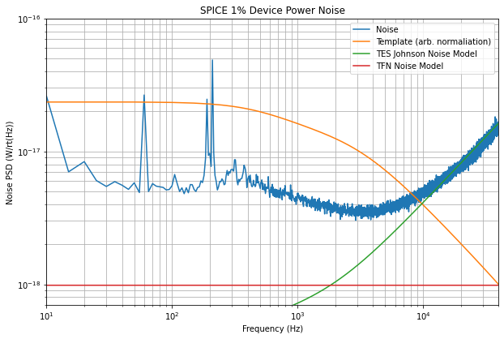
Significant Sensitivity Improvement Possible
Completely dominated in signal band by an unknown broadband power noise source
x5 Excess Noise

Slide 20
Light Mass DM: Detector Design Drivers
1. Energy Sensitivity
2. Backgrounds
& Discrimination
Typical Neutrino cross section
2203.08297

Slide 21
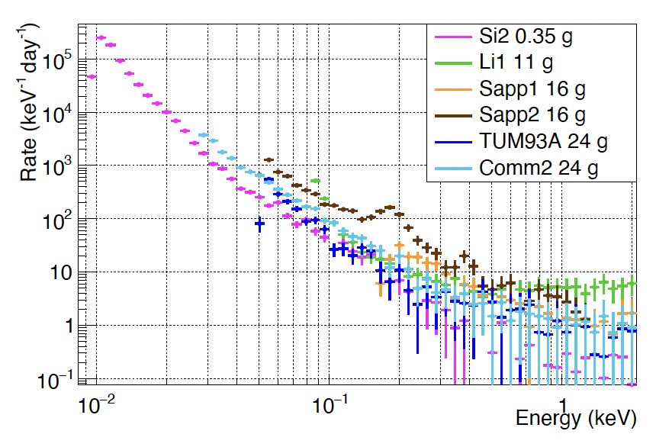
Mysterious Low Energy Excess
CRESST Background Studies
2207.09375
SiO₂ 0.35g
LiAlO₂ 11g
Al₂O₃ 16g
Al₂O₃ 16g
CaWO₄ 24g
CaWO₄ 24g
?
Expected Radiogenic Backgrounds
Seen in all calorimeter experiments to varying degree

Slide 22
1. Doesn’t vary with crystal mass or type
CRESST Background Studies
2207.09375
SiO₂ 0.35g
LiAlO₂ 11g
Al₂O₃ 16g
Al₂O₃ 16g
CaWO₄ 24g
CaWO₄ 24g
What does it scale with? Surface area? Sensor Volume?

Slide 23
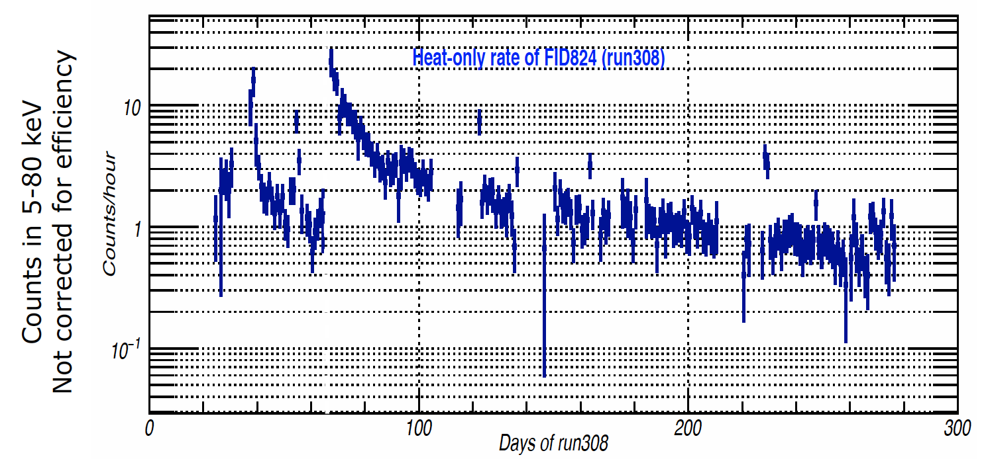
2. Variation with time since cooldown
Warm up to 11K and 19K due to fridge issues
E. Queguiner
Thesis

Slide 24
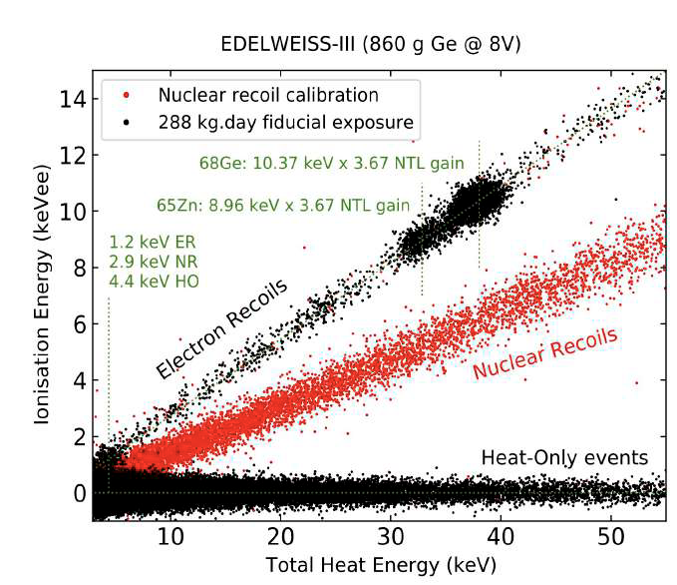
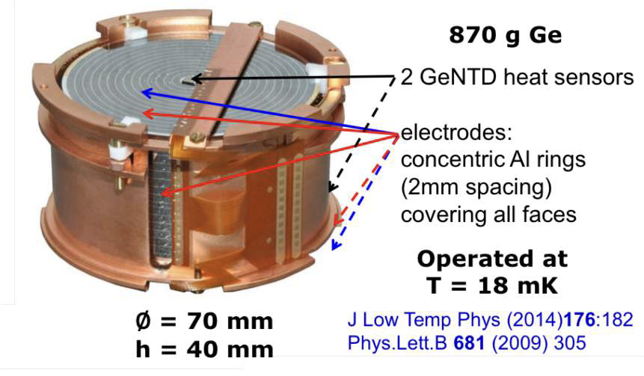
3) Low Energy Excess is Non-Ionizing
EDELWEISS interleaved detectors measure both phonons (NTD) and ionization production
Large no ionization background of unknown origin out to pretty high energies
From J. Gascon /EDELWEISS

Slide 25
Low Energy Excess Fact Summary
 | SPICE/CDMS | EDELWEISS | CRESST
1) Doesn’t vary with crystal volume/ type |  |  | Yes
2) Variation with time since cooldown (and/or time since fabrication) | Yes | Yes | Yes
3) Non-Ionizing | Yes | Yes
4) Same above /below ground | mostly | mostly
These facts are incredibly restrictive

Slide 26
Stress Induced Microfractures?
Detector
Detector
Detector under stress due to thermal contraction,manufacturing, etc.
Detector relaxes releasing phonon energy
arXiv:physics/0504151

Slide 27
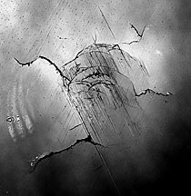
Stress Related Microfractures:
High Energy Evidence
CRESST had a sapphire ball support structure that tightened due to thermal contraction
Not an exact match to low energy excess:
  Events 100keV –MeV scale
  Non-poissonian rate distribution
Change in support structure mitigated events
arXiv:physics/0504151

Slide 28
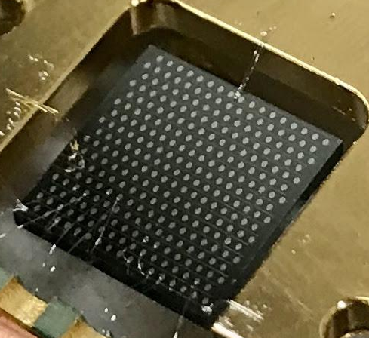
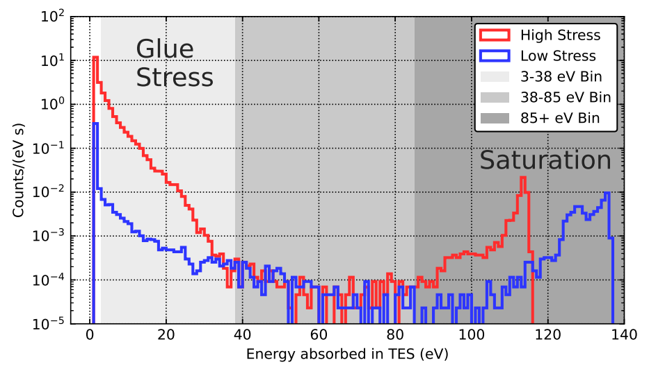
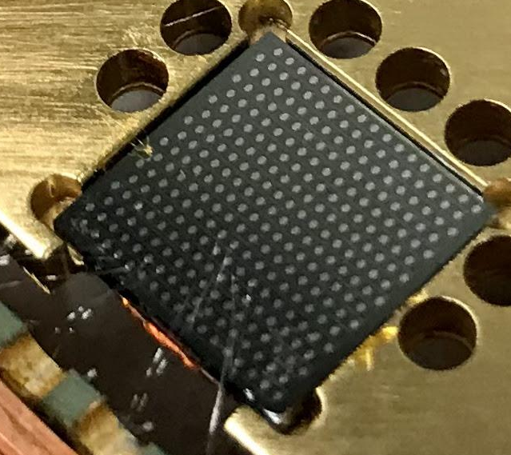
Stress Related Microfractures:
1st Low Energy Evidence
Hanging (low stress)
2208.02790
2 orders of magnitude difference in rate between high stress (glued) and low stress (hanging) device
Glued Down with GE varnish
(High Stress)

Slide 29
Mitigation for Stress Induced Microfracture Events:
GET RID OF ALL STRESS
Support Structure
Sensor Films
Stress on “Bare” Crystal Surface

Slide 30
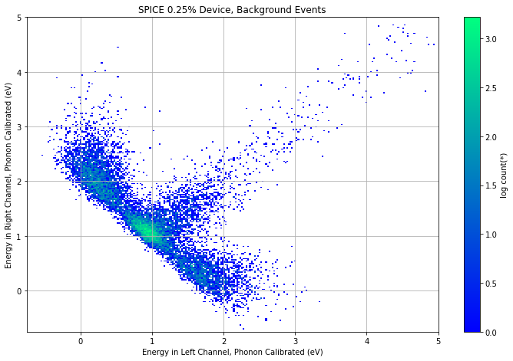

Understanding Source of Relaxation Events:
2 Channel Devices
0.25% 2 Channel Device
Energy in Channel 2 [eV]
Energy in Channel 1 [eV]
Microfractures in metal films should have assymmetric energy collection
Microfractures from bare surface/bulk should have symmetric energy collection
We see both symmetric and assymmetric relaxation events

Slide 31
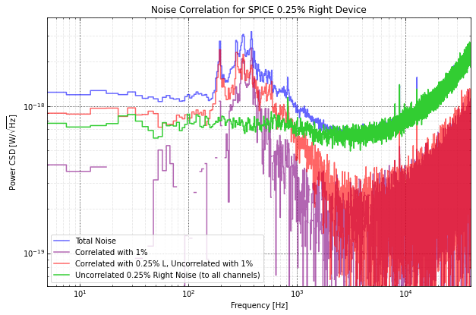
Noise in 2 Channel Device
We have both correlated and uncorrelated noise between the 2 channels

Slide 32
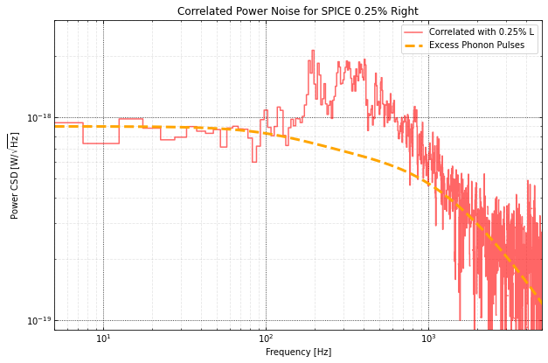
Correlated Noise: Phonon Origin
Excess correlated noise has phonon collection pole
Peaks:EMI, microphonics…

Slide 33
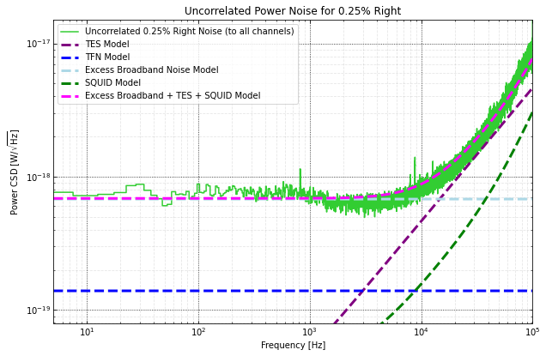
Uncorrelated Noise: Sensor Fluctuations
Noise event in TES/QET

Slide 34
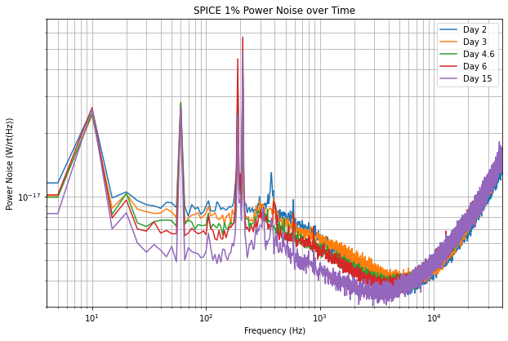
Excess Noise decreases with time
Excess noise is just shot noise from below threshold relaxation events!

Slide 35
Low Energy Excess Summary
We see 2 classes of relaxation event excess both above and below threshold (shot noise)
Noise event in TES/QET
Next Step: understand the precise source of each background and mitigate

Slide 36
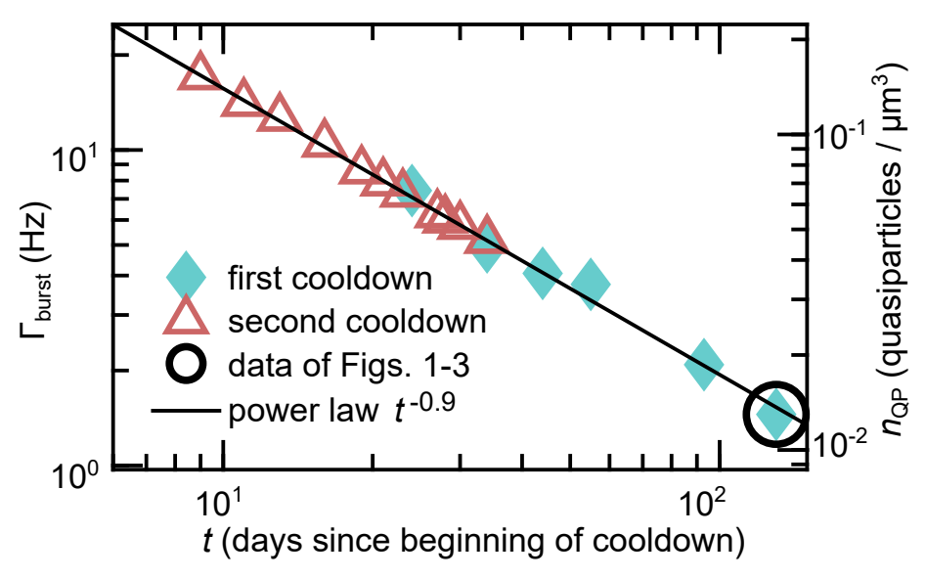
Quantum Computing: Quasiparticle Poisoning
Superconducting quantum circuits (qubits) see anomalously short decoherence times partially due to high density of quasiparticles (QP, broken Cooper pairs)
  Lots of sources of excess QPs: radioactivity, muons, IR…
  In 2102.00484, excess quasiparticle density decreased as a function of time
This behaves identically to the low energy excess
Solve excess QP problem, allow quantum computers to make big step forward
arXiv: 2102.00484
Mannila et. al.

Slide 37
Can one discriminate between relaxation backgrounds and Dark Matter Interactions?
Julien’s talk

Slide 38
Conclusions
Light Mass Dark Matter Design Drivers
  Energy sensitivity
  Relaxation Backgrounds
Below threshold relaxation backgrounds dominate our noise
Future:
  We are really close to precisely understanding the source of relaxation backgrounds
  Significant filtering upgrades will be implemented this coming year

Slide 39
Backup

Slide 40
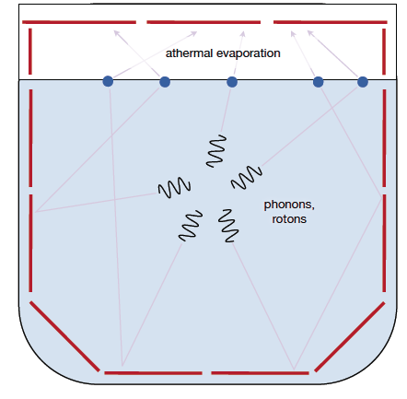
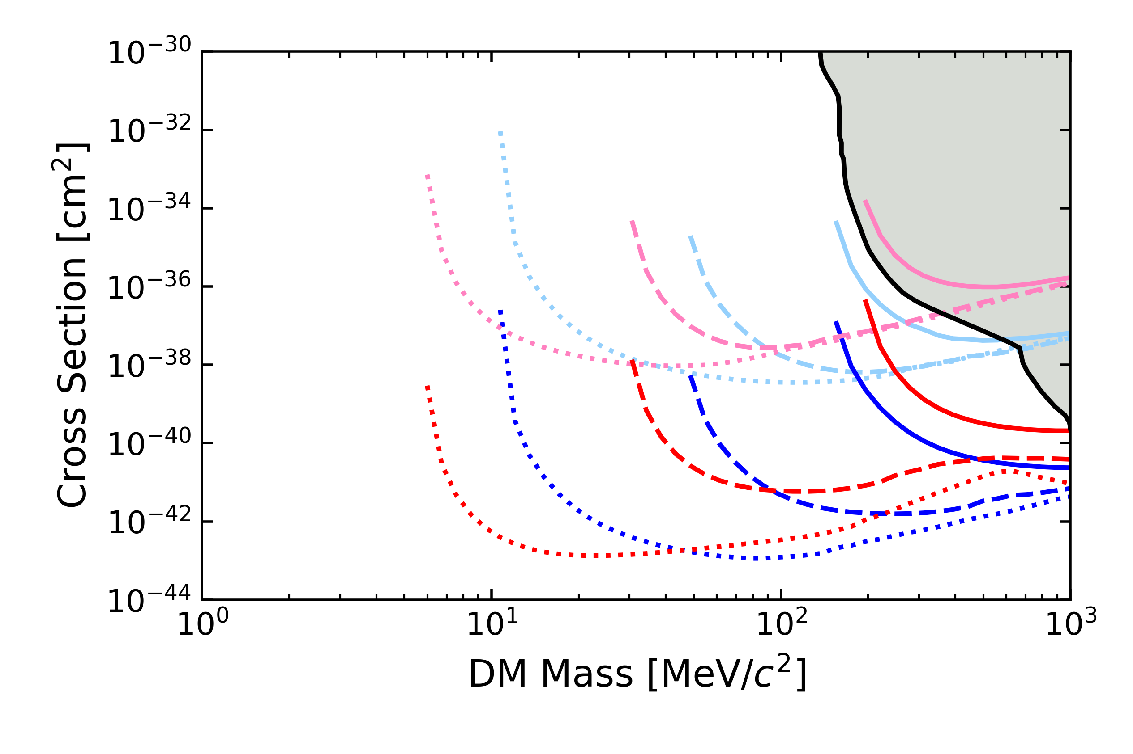
TESSERACT Discrimination: Superfluid Helium
Superfluid Helium: it’s a liquid … no stress microfractures
Multiple Pixel Coincidence for He DM events discriminates DM from pixel microfractures
Pulse Shape Discrimination: Helium is slow!
Al₂O₃
He
Design Driver #2:
Mitigation plan
Discrimination plan
Surface
Required
Goal
Stretch
Goal
Underground

Slide 41
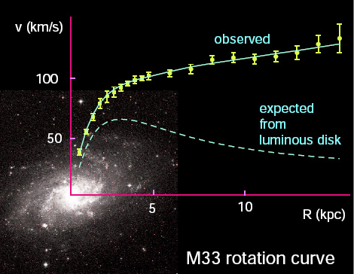
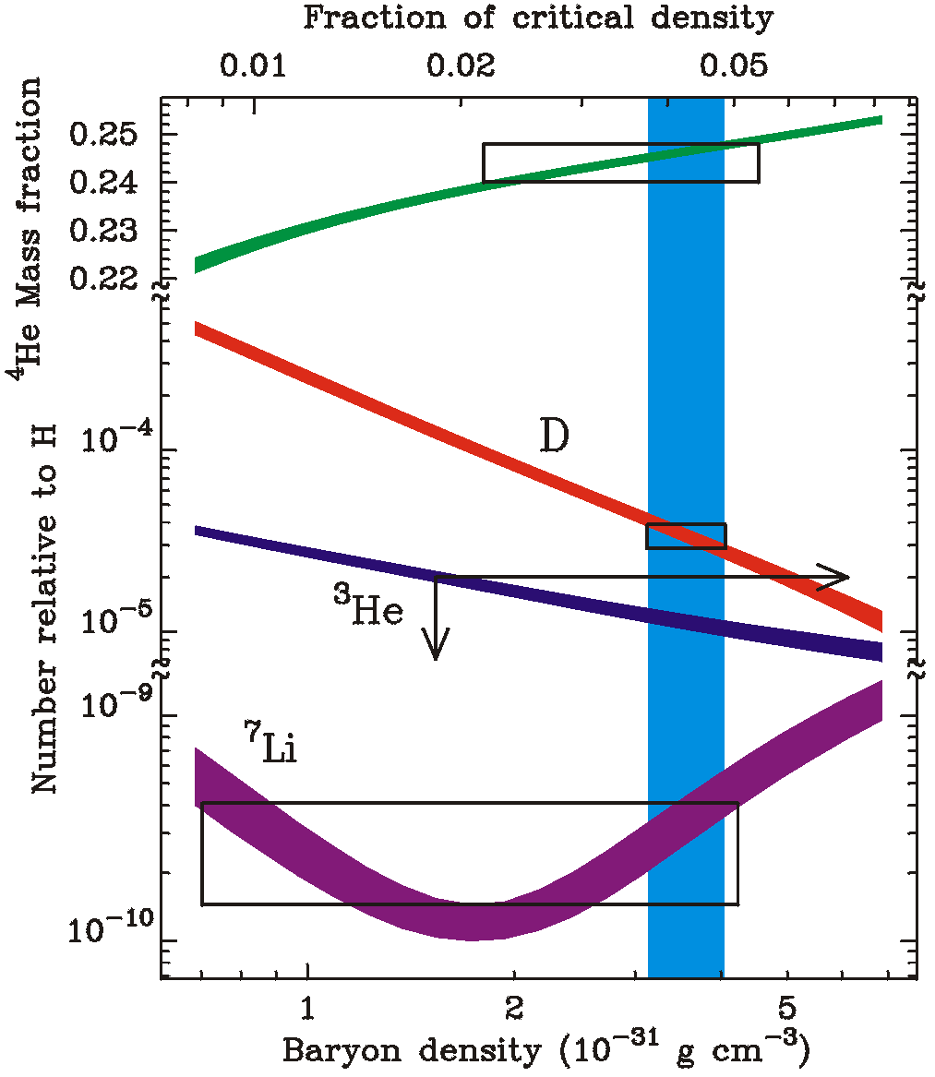
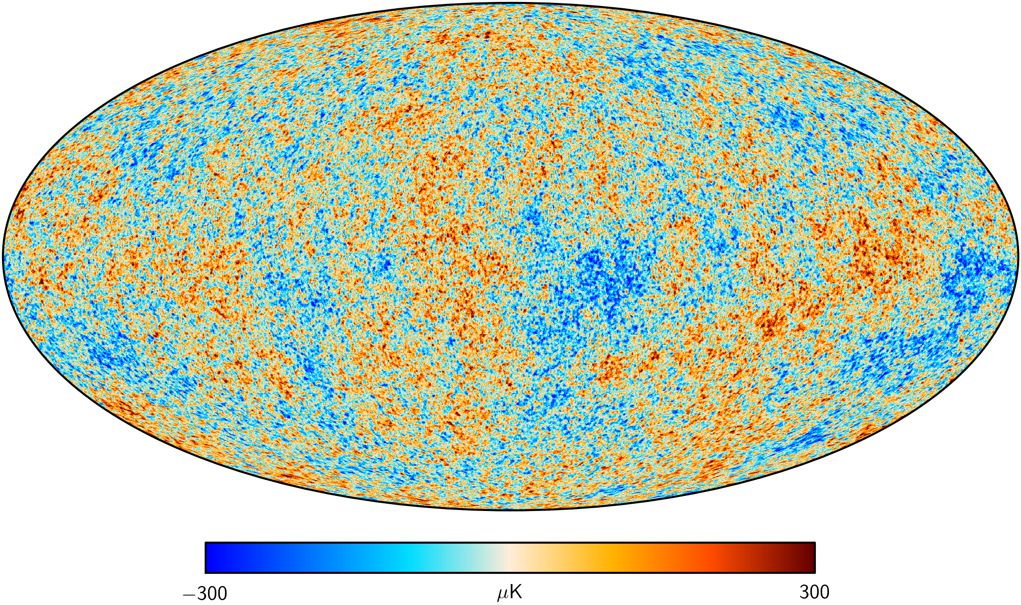
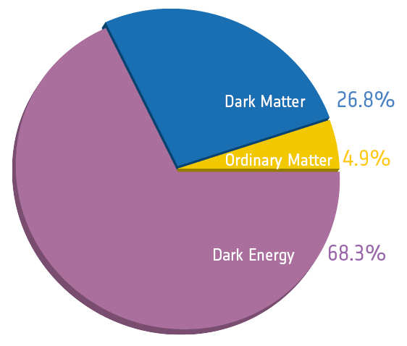
Observational Evidence for Dark Matter
Notes:
Main Idea: 1 slide showing all the observational evidence for dark matter

Slide 42
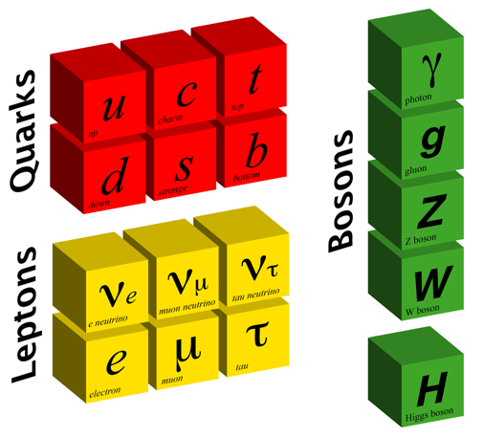

Dark Matter & Particle Physics
What are its properties?
  mass
  Is it charged under a new force(s)?
  How was it generated?
Can this knowledge help us understand the laws of physics at high energies?
Dark Sector
Visible Sector
?
?
Quarks
Portal
Bosons
?
?
?
Leptons
?
?
?
US Cosmic Visions: New Ideas in Dark Matter: 1707.04591

Slide 43
Midgal and Ionization

Slide 44
Ionization Production in eV Scale Nuclear Recoils
NR Ionization << ER ionization
Xenon
?
Si
?
No Ionization expected from elastic nuclear recoils for
M_{DM} < O(200MeV) in Si
M_{DM} < O(GeV) in Xe
<v> -
V_{esc} --
𝛳=180

Slide 45
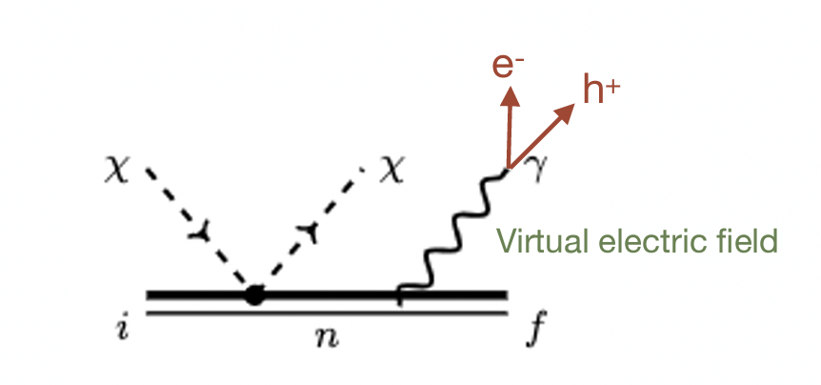
Midgal Ionization
Si
Xe
Search for DM using NR interactions that share momentum and energy between nucleus and e⁻
Knapen

Slide 46
Midgal Ionization: Signal Suppression
x10⁶ Penalty in Signal
Knapen
Midgal, like all processes with off-shell particles, will have significantly suppressed signal rates
x10⁶ greater exposure needed if exposure limited
x10⁶ less backgrounds needed if background limited

Slide 47
Developing Ultra-Sensitive Detector Technology

Slide 48
100meV Excitation Sensitivity -> Low Temperature Detectors
300K = 26meV
To sense 100meV excitations we’ll need to cool the detector down to near absolute zero
Use superconducting detector technology
  Transition Edge sensors
  MKIDs
  SNSPD (only for photon applications)
  Quantum Capacitors / QUBIT (THIS IS YOU GUYS)

Slide 49

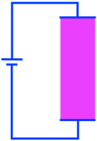
The Simplest Thermal Calorimeter
R
T
Transition Edge Sensor (TES): A superconducting metal film (W) that is externally biased so as to be within its superconducting/normal transition

Slide 50
TES Sensitivity
~ Intrinsic Thermal Noise of Calorimeters

Slide 51
TES Scaling Laws & Optimization
Minimize Temperature
  Dilution Refrigerators can cool detectors to 5mK
  T_{c} -> 1.5x T_{bath}
Minimize Heat Capacity
  Small Volume

Slide 52
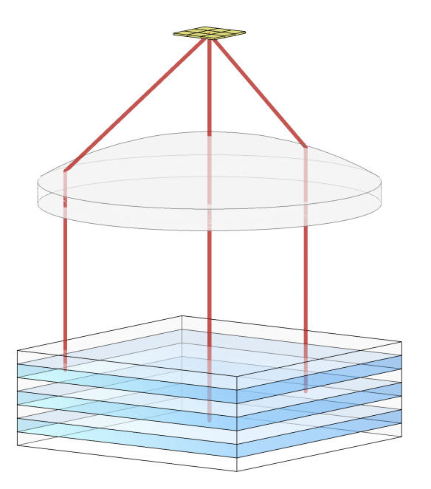
100meV Threshold TES are really small!
𝜎_{theory} ~ 20meV
T_{c} = 20mK
V = 275umx275umx40nm
= 3 x10⁻⁹ cm³
= 60ng
1 gram of active target mass -> 15M channels
TES can only be used by themselves when photon collecting over a very small area (true for MKIDs and most other sensor technology too)

Slide 53
2nd most simple thermal calorimeter
Couple the sensor to a large volume insulator -> low heat capacity

Slide 54
Problem: Decoupling between the Sensor and Absorber
Kapitza boundary conductance scale as as T³
e⁻/phonon thermal conductance scales as T⁴
As T is decreased, it’s harder and harder to keep the sensor thermally coupled to the absorber
Energy leaks out of the absorber through G_{ab} before its measured
TES sensitive to power fluctuations through G_{tb}
Physical clamps that support the absorber

Slide 55
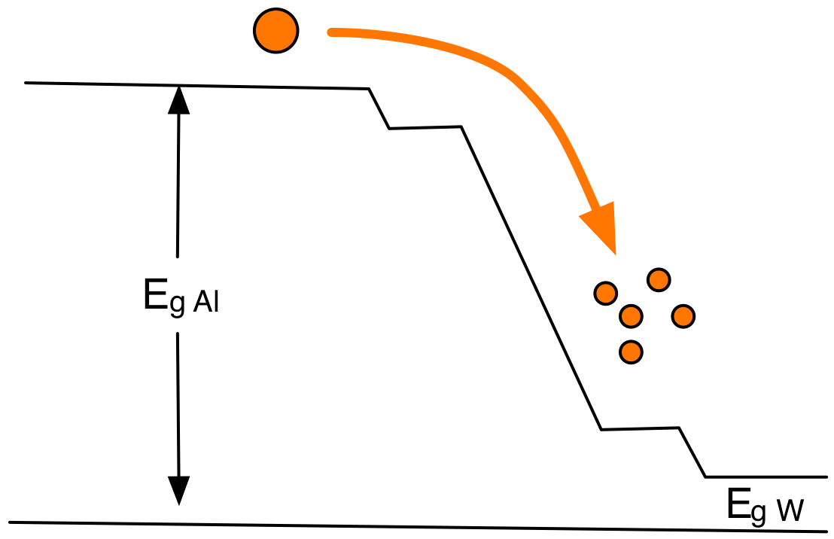
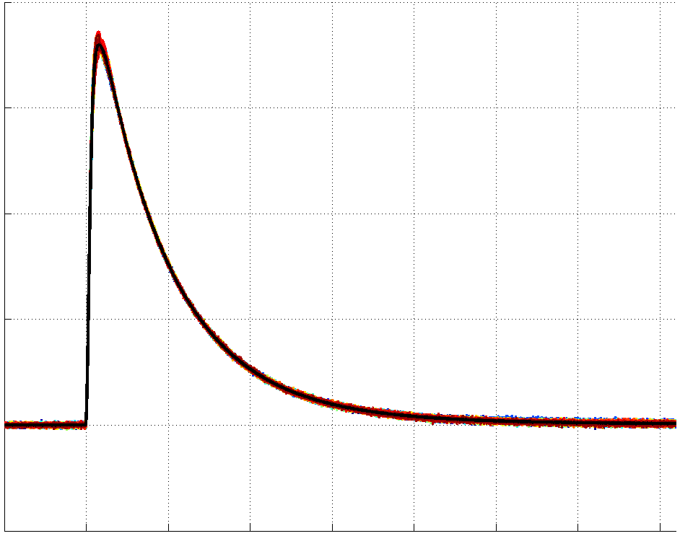
Athermal Phonon Sensor Technology
Collect and Concentrate Athermal Phonon Energy into Sensor
R
T

Slide 56
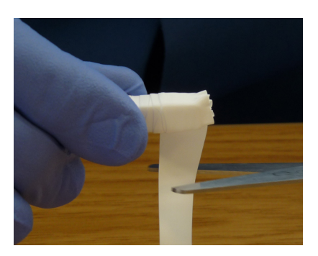
Excitation Detectors & Volume Scaling
Scintillator
PMT
Scintillator
Reflector
PMT
Will these detectors have the same energy sensitivity?
Yes, if:
Lifetime of the athermal excitation (photon) is really long
Excitation absorption dominated by sensor

Slide 57
Optimizing the Athermal Phonon Excitation Detectors
Absorber
Absorber
TES
TES
Minimize the number/volume of the TES sensors instrumented on the surface to the point that you begin to see the bare surface thermalization rate

Slide 58

Athermal Phonon Sensor Sensitivity Scaling
Power Noise for various G
Phonon Power Noise [W/rtHz]
Lower 𝑣_{sensor} (lower T_{c}) if 𝑣_{signal} < 𝑣_{sensor}
Lower 𝑣_{signal} (decrease Al coverage) if 𝑣_{signal} > 𝑣_{sensor}
$$ω∝G/C$$
G
You can always say on VT_{c}³ scaling (in principle)
45mK-> 10mK: 2eV -> 20meV

Slide 59
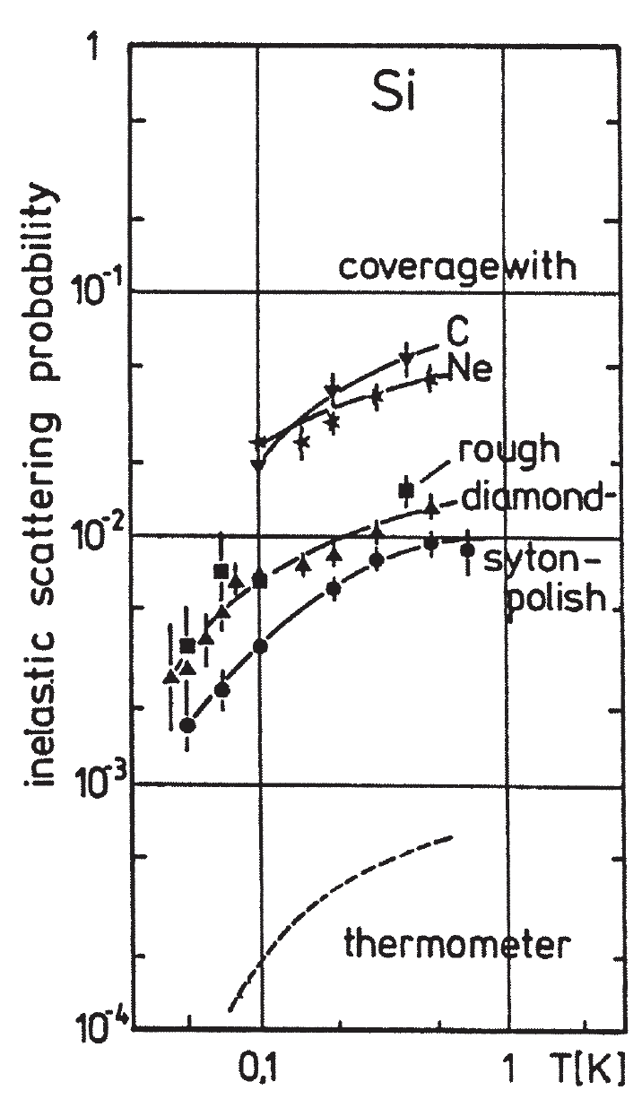
Athermal Phonon Thermalization at Surfaces
Athermal phonon surface thermalization probability found to depend upon
  Crystal
  Surface roughness
  Surface cleanliness
(W. Knaak et al, Phonon Scattering in Condensed Matter V,1986)
0.1%-1% of the crystal surface covered with athermal phonon sensors … 1/1000-1/100 thermalization probability needed
Si, Ge -> ok

Slide 60
Quantum Sensor?
The basic concepts of the athermal phonon detector are sensor agnostic
  ballistic bouncing of athermal phonons for long times
  Concentration and collection of QP
Just replace the TES
Quantum Sensor

Slide 61
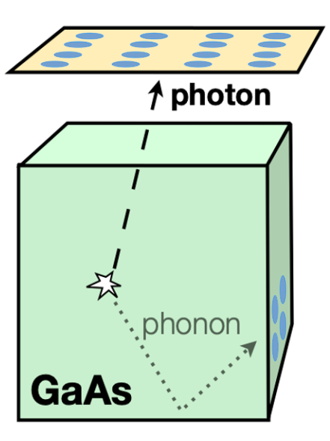
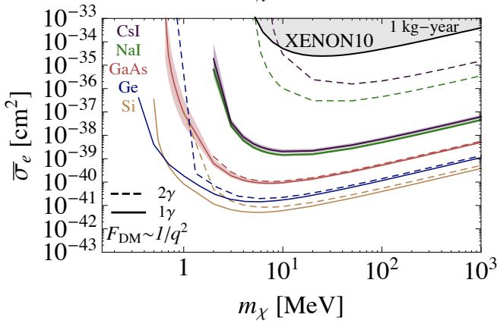
TESSERACT Discrimination: GaAs
To discriminate zero charge phonon only events in GaAs ER DM detector, one can require photon+phonon coincidence
Design Driver #2 (Backgrounds)
  Mitigation Plan
  Discrimination Plan
Scattering via Light Dark Photon

Slide 62

TESSERACT Discrimination: Polar Crystal
DM
Film OQLEE
Dark Matter
1
Energy Channel 2
2
DM
Film 0QLEE
Energy Channel 1
If stress is occurring in phonon sensor films, energy will preferentially deposited in a single channel
Design Driver 2 (Backgrounds)
  Plan to mitigate
  Plan to discriminate

Slide 63
NRDM Search Sensitivity @ Surface
Al₂O₃
He
Surface
Stretch
Goal
Goal
Required
Underground
Achieving pre-project energy threshold goals leads to world leading science @ surface

Slide 64

Nearly everything the same
Having multiple targets with complementary DM science (NRDM, ERDM, Absorption) and orthogonal risks doesn’t increase cost (time & money) significantly since almost everything is identical (phonon sensor development, wiring, electronics, DAQ, data handling, processing, and analysis software) except the substrate.

Slide 65

1) HeRALD:Helium Roton Apparatus for Light Dark matter
Surface
Required
Goal
Underground
Stretch
 | Required Threshold | Goal Threshold | Stretch Goal Threshold
Si 4cmx4cm | 6.7eV | 900 meV | 12 meV
He | 21 eV | 570 meV | 24meV
#1 Design Driver for Light Mass Dark Matter Searches: Energy Sensitivity

Slide 66

2) SPICE: GaAs ERDM
“CRESST for ERDM”
Scattering via Light Dark Photon
Ge
1kgyr
No Backgrounds
1607.01009
 | Required (5 $σ$) | Goal (5 $σ$) | Stretch Goal (5 $σ$)
Ge | 2.3 eV (3 $γ$) | 300 meV ($1 γ$) | 12 meV
GaAs | 4.6 eV | 600 meV | 24meV
~35meV
Optical
~600meV
900meV
ERDM
NR
GaAs
1meV 10meV 100meV 1eV 10eV

Slide 67



3) SPICE: Sub-ev Polar Interactions Cryogenic Experiment
Scattering via Light Dark Photon
In ionic crystals, optical phonons are oscillating electric dipoles! Couple strongly to dark photons!
Required
Stretch
Goal
1kgyr
No Backgrounds
1910.10716
/SiO₂
60meV
149meV
 | Required Threshold (5 $σ$) | Goal Threshold (5 $σ$) | Stretch Goal Threshold (5 $σ$)
SiO₂ | 3.5eV | 350 meV | 20meV
Al₂O₃ | 3.5eV | 350 meV | 20meV
Optical
Phonon/ER
SiO₂
Al₂O₃
60meV
90meV
NR
10meV 100meV 1eV 10eV 100eV

