Slide 1



New aspects of
Cosmic Inflation
Konstantinos Dimopoulos
Lancaster University

Slide 2
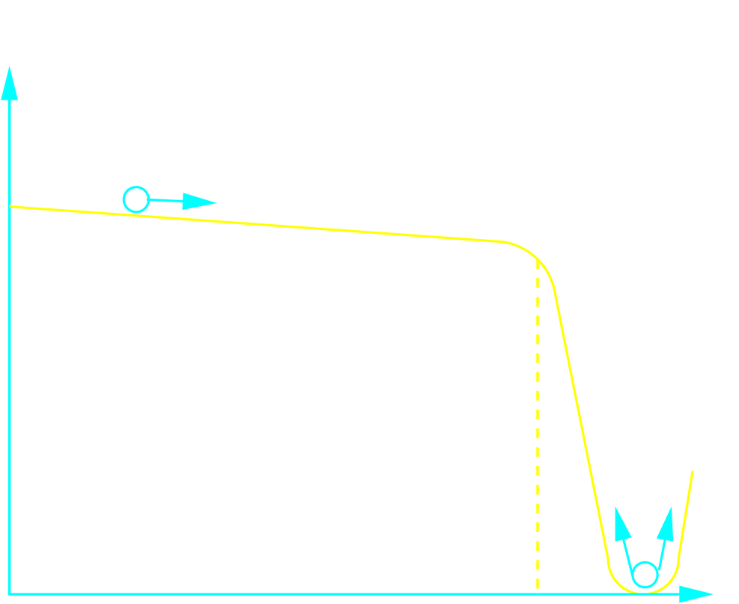

Cosmic Inflation
The history of the Universe requires special initial conditions
Which are arranged by cosmic inflation
Cosmic Inflation: Period of accelerated expansion in the Early Universe
Inflation produces a Universe large and uniform
Inflationary Paradigm: Τhe Universe inflates when dominated by the potential energy density of a scalar field (inflaton field)
Equation of motion:
V (φ)
Inflaton field slow-rolls down the potential plateau
Inflation ends when the potential becomes steep and curved
INFLATIONARY PLATEAU
After the end of inflation, the infaton particles decay into the primordial plasma (reheating)
φ_{end}
φ

Slide 3
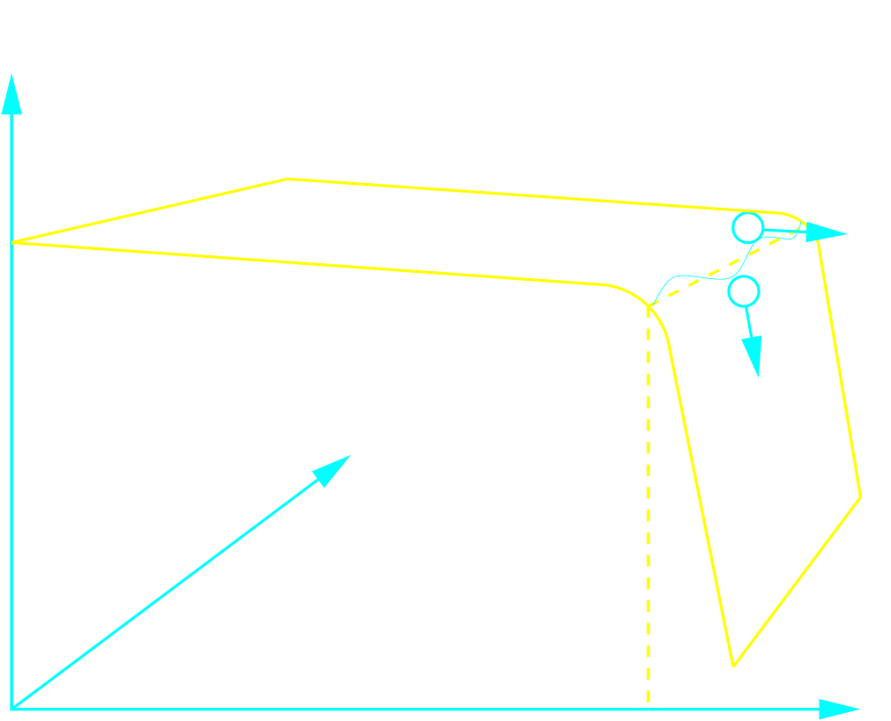
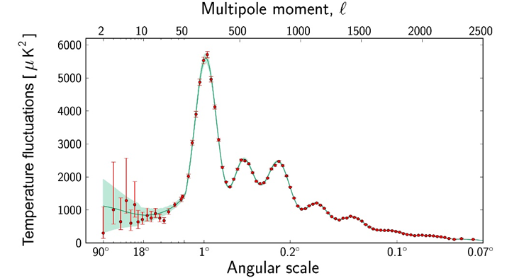
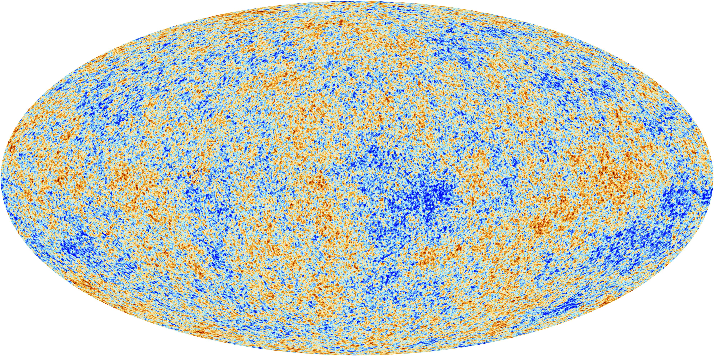
Cosmic Inflation
In order for galaxies to form, initial perturbations in the density are needed
Inflation generates the Primordial Density Perturbations
Superluminal expansion amplifies the quantum fluctuations of the inflaton field to classical perturbations
Consequently, inflation continues a little bit more in some locations than in others ⇒ Primordial Density Perturbations
⇒ CMB Temperature Perturbations (Sachs-Wolfe ) ∼ 10⁻⁵
V (φ)
Impressive agreement with observations
x
Primodial Density Perturbations:
>> Adiabatic
>> Gaussian
φ
>> Scale-invariant
φ_{end}

Slide 4
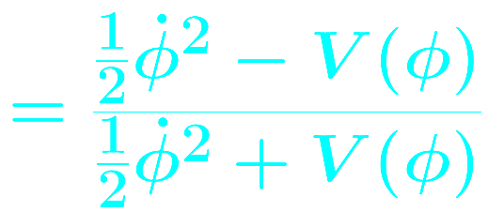
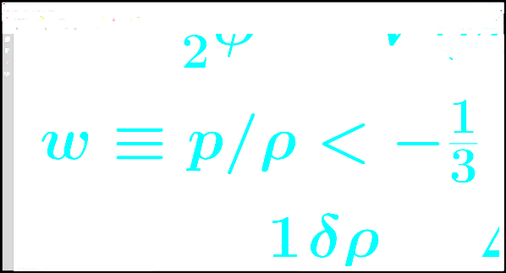
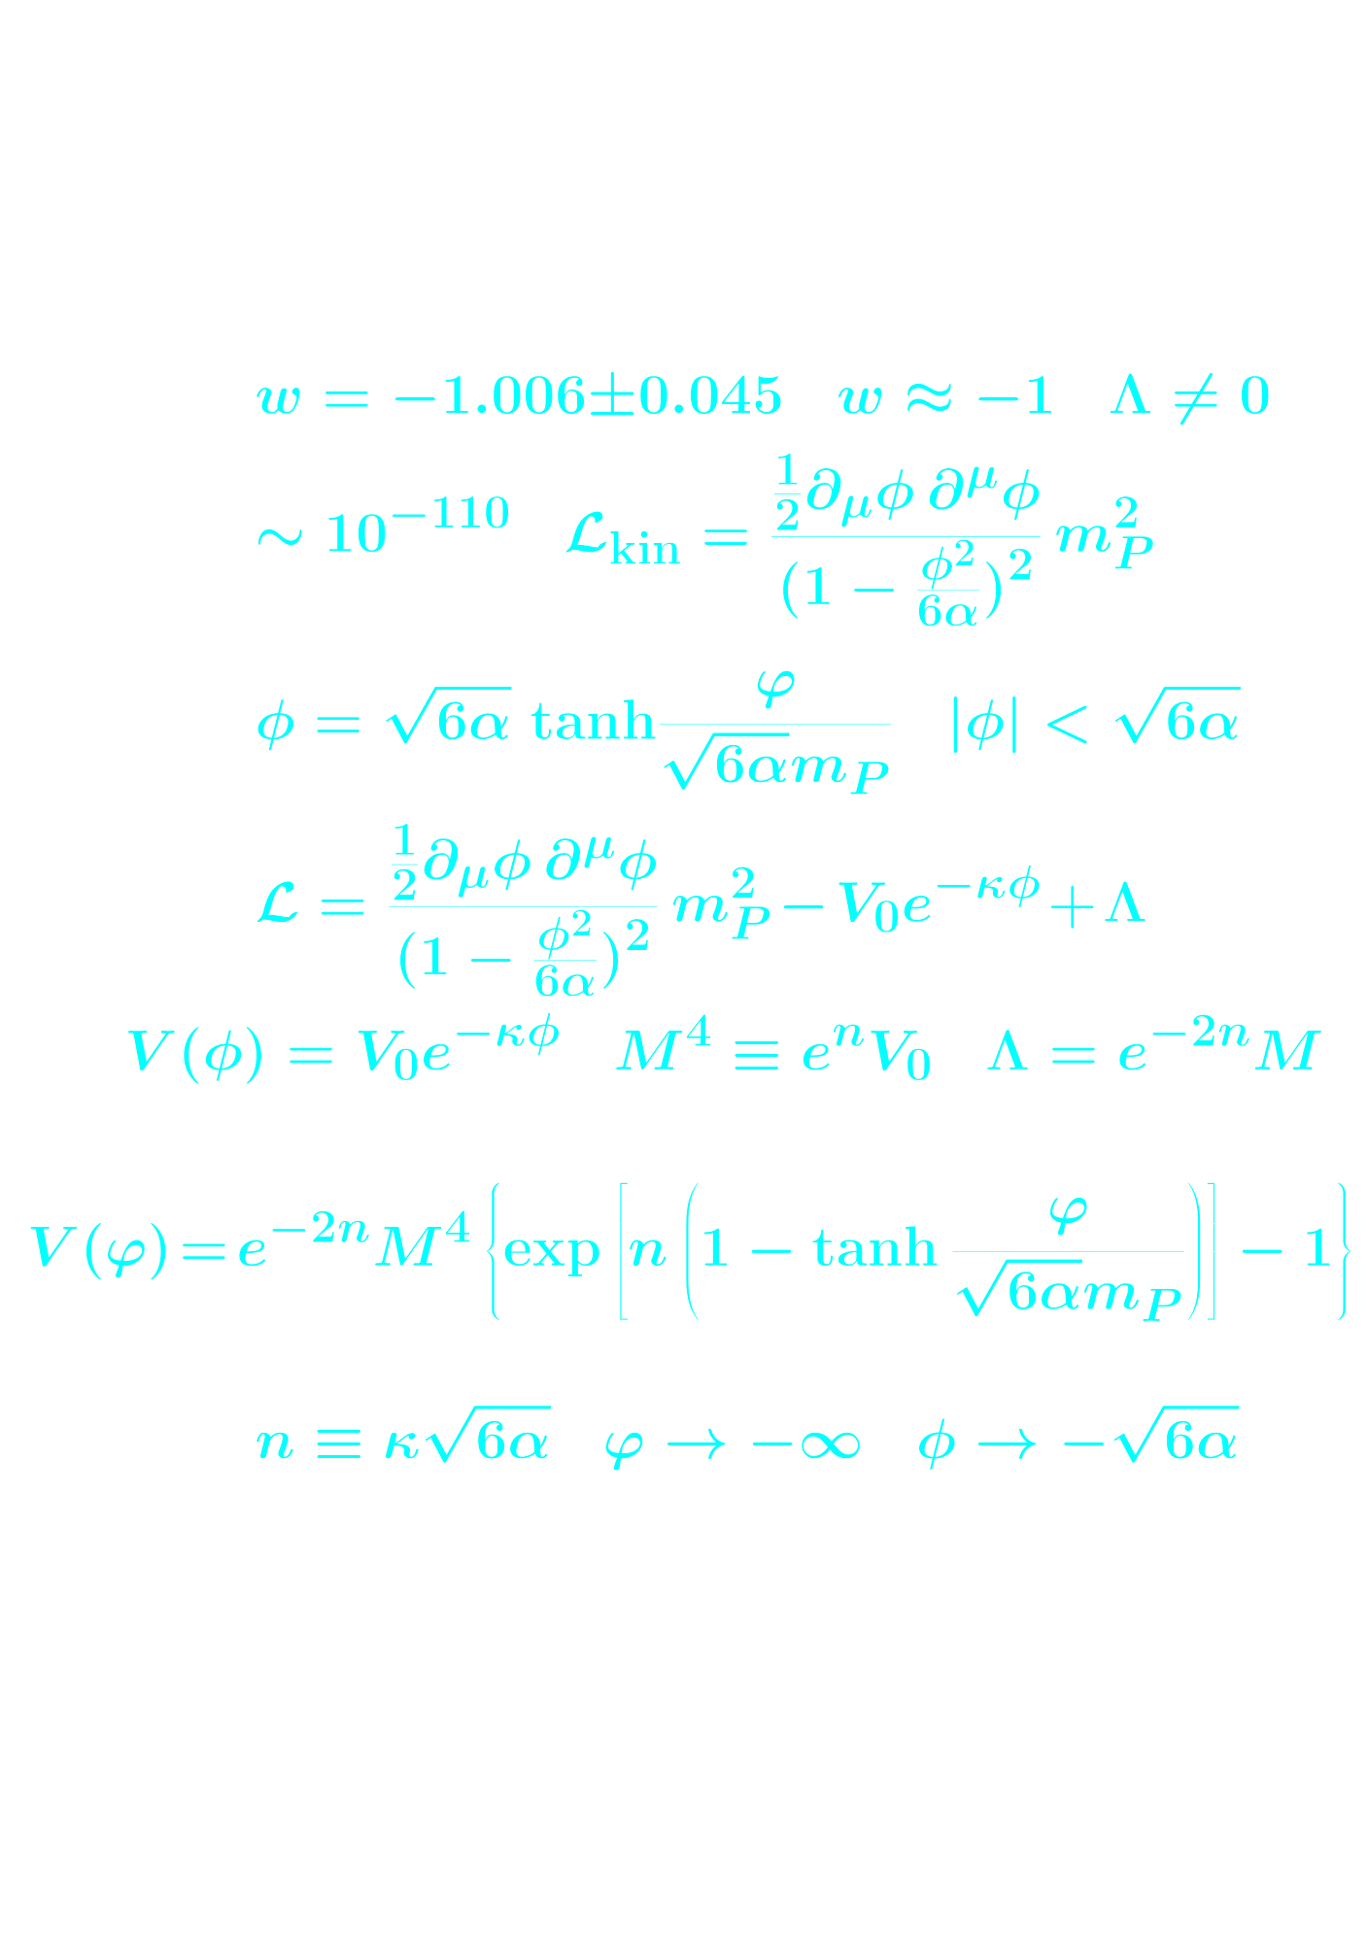
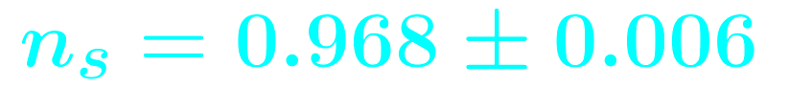
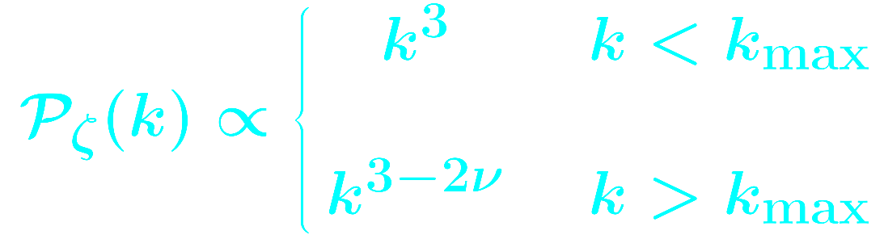
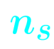
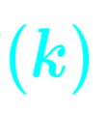
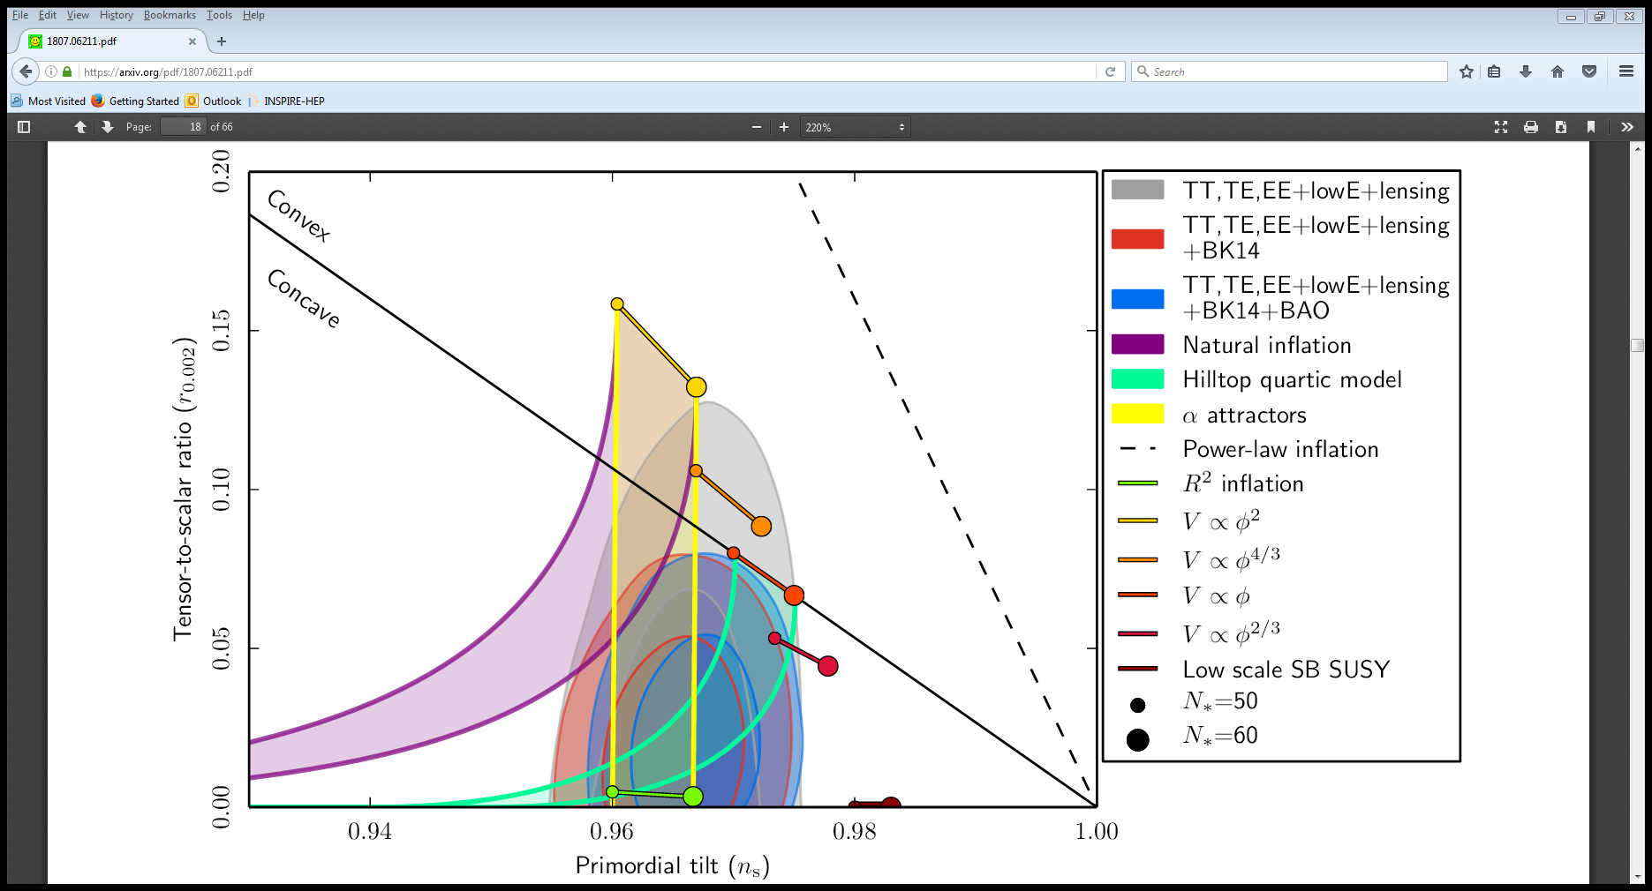
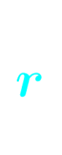
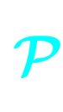
Cosmic Inflation
(Approximate) scale-invariance: Inflation is quasi-de Sitter: ρ ≅ constant
Potential density domination ⇒ barotropic parameter:
Perturbations discriminate between models
Spectral index: tensor-to-scalar ratio: r < 0.036
Spectrum of scalar
perturbations
t
t
Spectrum of tensor
perturbations

Slide 5

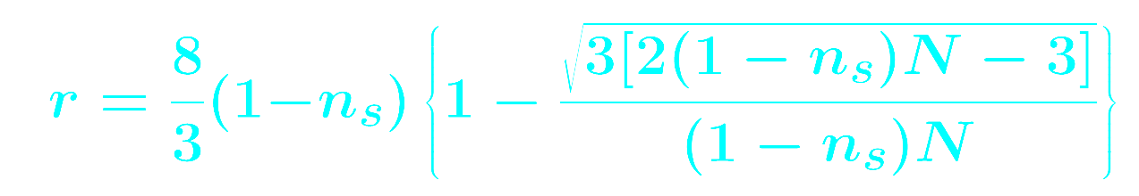
Quartic Hilltop Inflation
Potential:
Boubekeur & Lyth 2005
Inflation requires:
KD 2020
N : number ( ) of exponential expansions (efolds) of remaining inflation corespondoing to cosmological scales
Super-Planckian VEV: purturbative orgin of the potential not trustworty

Slide 6
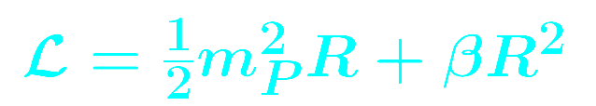
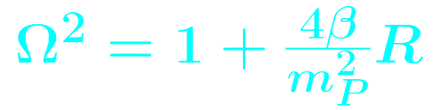

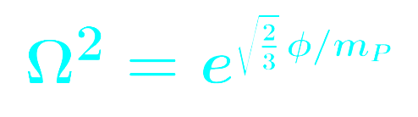
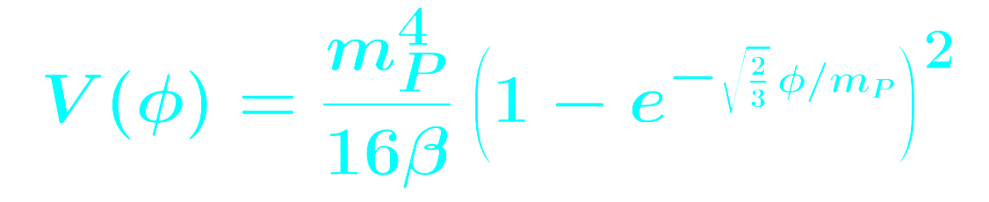
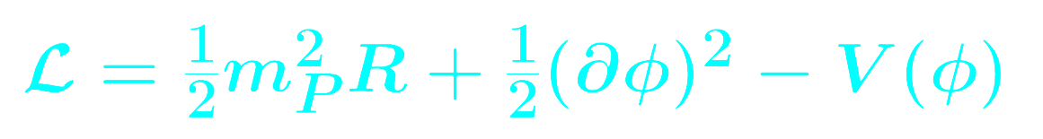
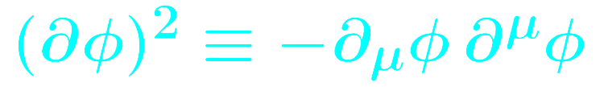
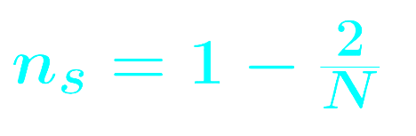
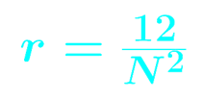
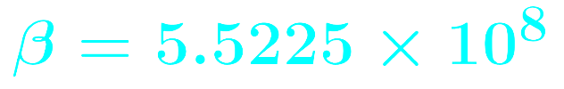
Starobinsky Inflation
Lagrangian:
Jordan frame
Starobinsky 1980
Quadratic gravity introduces additional degree of freedom (scalaron field)
Conformal Xmation:
Einstein frame
Non-perturbative coefficient

Slide 7
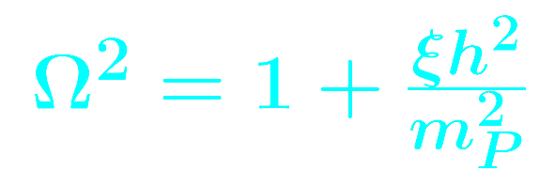
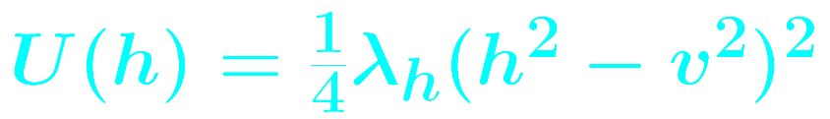
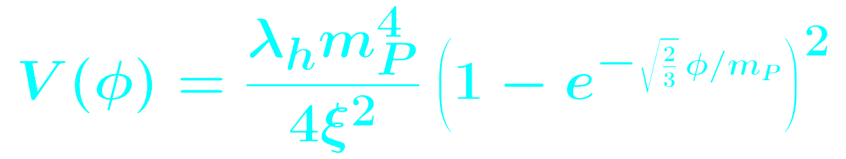
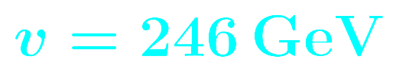
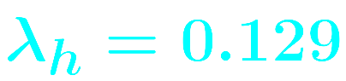
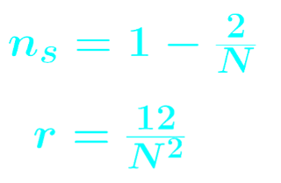
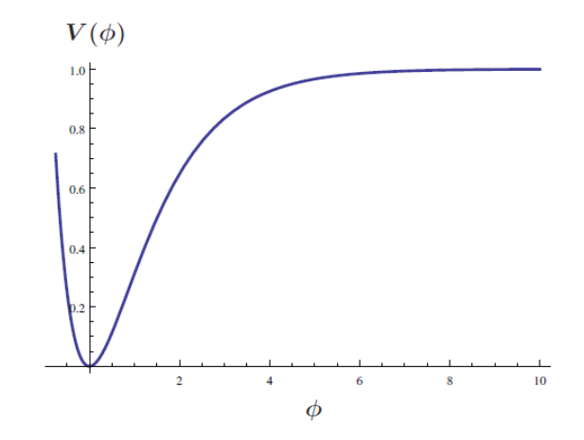
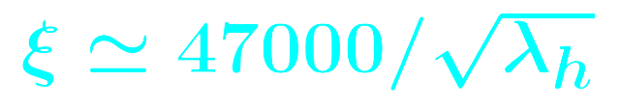
Higgs Inflation
Bezrukov & Shaposhnikov
2008
Jordan frame
Lagrangian:
Conformal transformation:
Einstein frame
Non-perturbative coefficient
EW Higgs as inflaton ⇒ decays to SM known

Slide 8
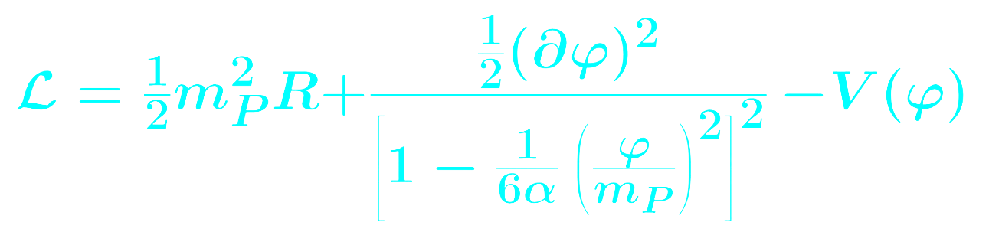
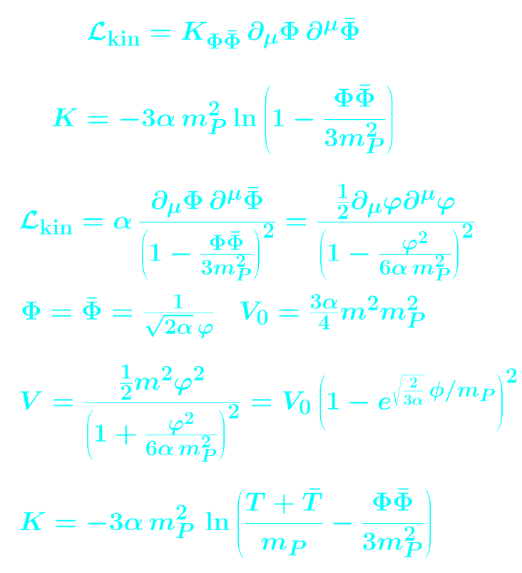
α-attactors
Kinetic poles:
Kallosh, Linde & Roest 2013

Slide 9
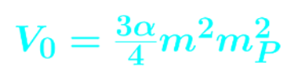
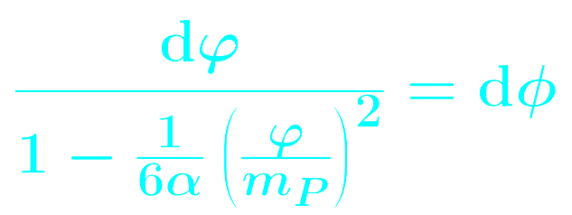
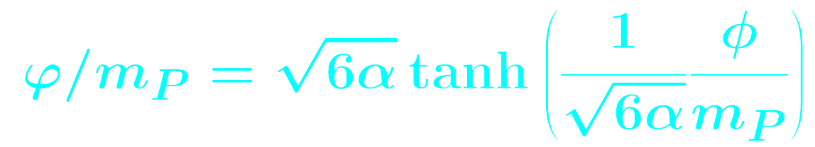
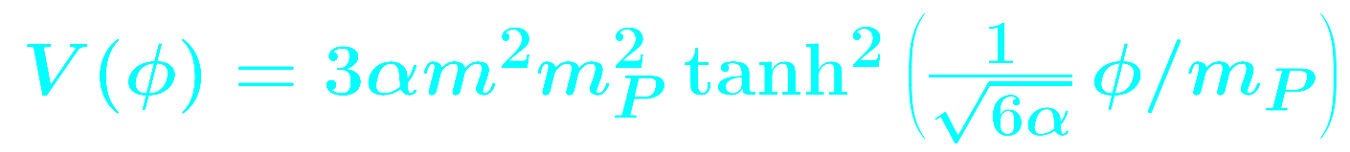
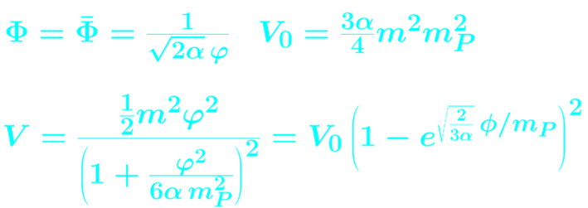
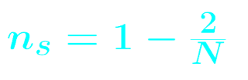
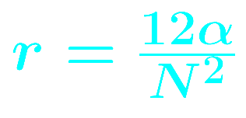
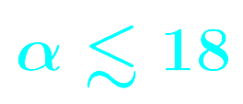
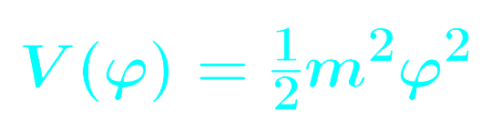
α-attactors
Kinetic poles:
non-
canonical
Starobinsky
canonical
E-model:
T-model:

Slide 10
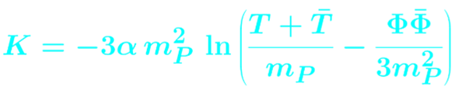
No-scale supergravity & α-attactors
Kinetic poles:
Ellis, Nanopoulos
& Olive 2013
E-model:
T-model:

Slide 11
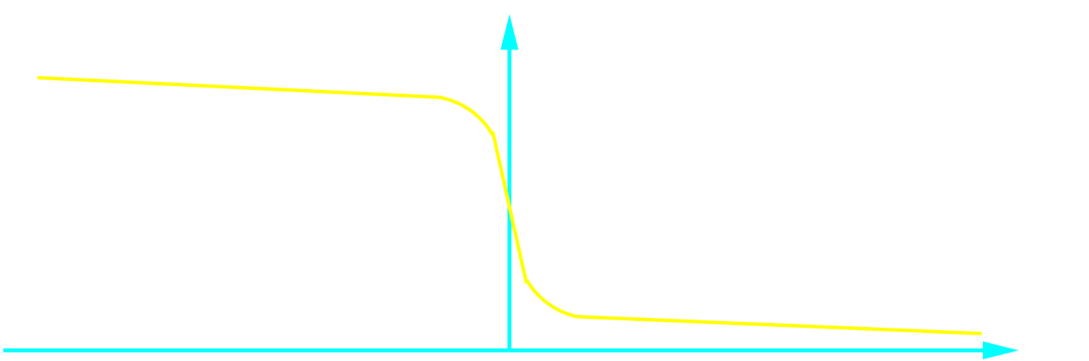
Non-oscillatory Inflation
Non-oscillatory inflation is characterised by a runaway inflaton potential with the minimum displaced at infinity
Non-oscillatory models are used in quintessential inflation which unifies early and late acceleration of the Universe expansion
Peebles & Vilenkin 1999
Inflaton field survives until the present to become quintessence and explain Dark Energy
Reheating occurs without the decay of the inflaton field
V (φ)
INFLATIONARY PLATEAU
QUINTESSENTIAL TAIL
φ

Slide 12
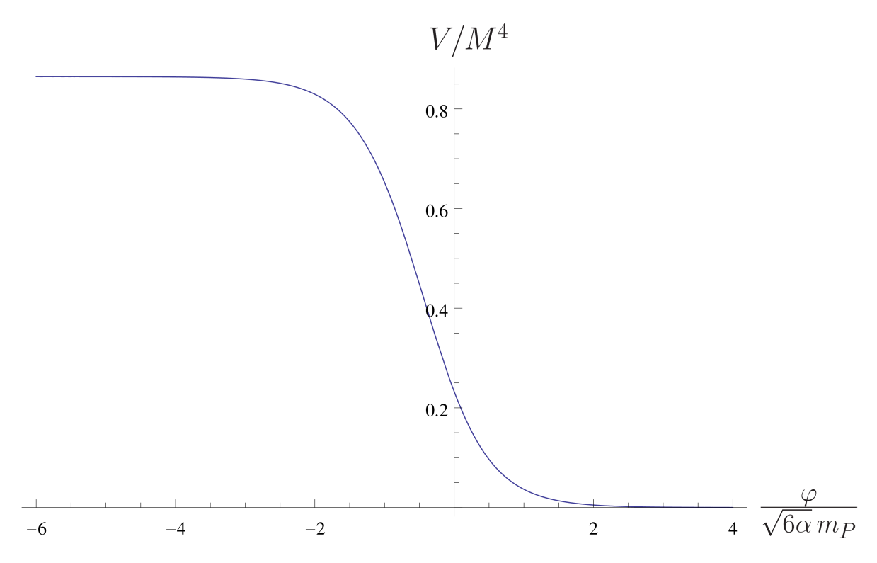
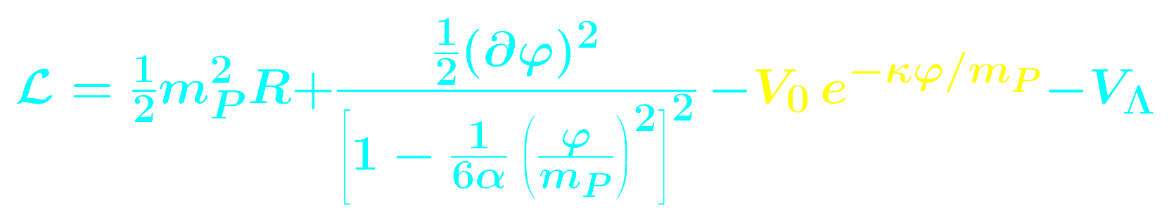
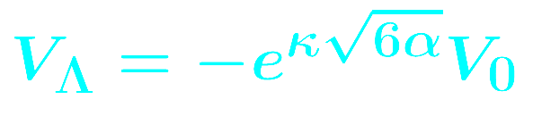
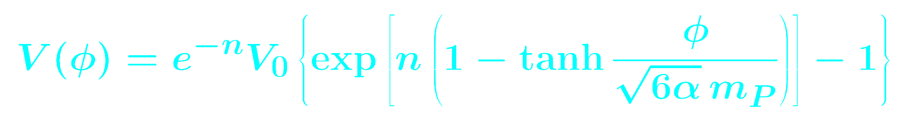

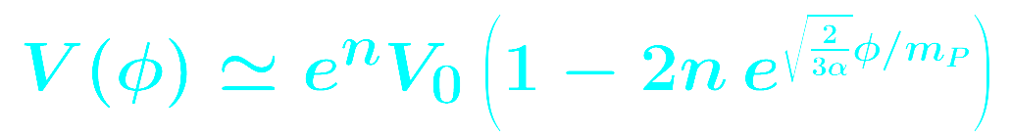



Quintessential inflation with α-attractors
Lagrangian:
KD & Owen 2017
non- canonical
canonical
works
when
Inflation:
Quintessence:

Slide 13





Quintessential inflation in Palatini gravity
Lagrangian:
KD & Sánchez López 2021
Jordan frame
Conformal Xmation:
Einstein
frame
For large V the potential density is constant:
Inflation is successful if:
For small V the field becomes canonical.
If V is runaway ⇒ thawing quintessence

Slide 14






Quintessential inflation in Palatini gravity
Lagrangian:
KD, Karam, Sánchez López & Tomberg (2021 & 2022)
Jordan frame
Conformal Xmation:
Einstein frame
Inflationary plateau:
See talk of Sánchez López
When V canonical ⇒ quintessence:

Slide 15










Kination
Kination: After inflation kinetic energy density dominates
► Inflaton oblivious of potential
► Field rolls down to quintessential tail
Reheating: Radiation eventually dominates
► Field rolls for a while but eventually freezes
► Residual density ≈ Dark Energy today
Frozen field:
V (φ)
KD & Owen 2017
Large roll for small reheating efficiency
φ

Slide 16


Kination and Gravitational Waves
Inflation generates a scale-invariant superhorizon spectrum of primordial tensor perturbations (gravitational waves - GW)
Primordial GW are scale-invariant only if they re-enter the horizon during radiation domination because ρ_{GW}/ρ_{γ} = constant
During kination ρ_{GW}/ρ_{kin} ≠ constant so the GW spectrum is a spike
The longer kination is the bigger the spike
The most inneficient reheating leads to the longest kination possible, which challenges BBN
&

Slide 17



Kination and Gravitational Waves
If stiff period were milder from kination proper, then it could be extended to observable frequencies without disturbing BBN
Observable primordial gravitational waves when: with reheating temperature:
Figueroa & Tanin 2019
Toy-model augmenting Hybrid Inflation with α-attractors produces the desired stiff period with w ≈ 1/2 and waterfall vev M ≈ 2m_{P}
KD 2022
&

Slide 18

Conclusions
Cosmic Inflation determines the initial conditions of the history of the Universe and leads to a large and uniform Universe
Inflation also generates the primordial density perturbations which seed galaxy formation and are reflected on the primordial CMB anisotropy
Observations suggest that inflation is driven by a single scalar field slowly-rolling down a flat patch of its scalar potential (inflationary plateau)
Typically, after inflation the inflaton field oscillates around its VEV and then decays into the thermal bath of the Hot Big Bang (reheating)
In non-oscillatory (NO) inflation, the inflaton VEV is displaced at infinity
Reheating in NO inflation does not occur through the decay of the inflaton
NO inlation is used to model Quintessential Inflation which explains both inflation and Dark Energy.
Palatini gravity is a natural framework for model-building quintessential inflation because it “flattens” a runaway potential to generate the inflationary plateau
NO inflation is typically followed by a stiff period (kination), which generates a spike of primordial gravitational waves, potentially observable by LISA

Slide 19


My book!

Slide 20

Reheating in quintessential inflation
Alternative mechanisms for reheating without the decay of the inflaton:
>> Gravitational Reheating
Ford 1987
All light ( m < H ) non-conformal fields undergo particle production during inflation ⇒ subdominant thermal bath with density: ρ_{γ} ∼ Η⁴
But too inefficient: Spike in GWs challenges BBN
>> Instant Preheating
Felder, Kofman & Linde 1999
Interaction with another scalar converts a fraction of the inflaton’s kinetic energy density to radiation:
But requires appropriate ESP in inflaton trajectory
>> Curvaton Reheating
Bueno Sánchez & KD 2007
Decay of another spectator field.
But requires tuned initial conditions, which determine reheating efficiency
>> Ricci Reheating
KD & Markkanen 2018
Spectator field with non-minimal coupling: (natural). Based on the fact that R = 3(1-3w)H² changes sign after inflation
>> Warm Quintessential Inflation
KD & Donaldson-Wood 2019
Dissipation of inflaton’s kinetic energy density during inflation creates subdominant radiation, which eventually takes over after inflation

