Slide 1


Anomalies in Particle Physics
Andreas Crivellin
PSI & UZH
PASCOS 2022, Heidelber, 29.07.2022
Work supported by

Slide 2
Outline
Introduction
Status of the anomalies
  b→sµµ
  b→cτν
  a_{µ}
  Cabibbo Angle Anomaly
  Non-resonant di-leptons
  EW fit: W mass and Z→bb
Explanations of the Flavour anomalies
Common Explanations
Conclusions
Andreas Crivellin

Slide 3
Physics Beyond the Standard Model
Dark Matter existence established at cosmological scales
  New weakly interacting particles
Neutrinos not exactly massless
  Right-handed (sterile) neutrinos
Matter anti-matter asymmetry
  Additional CP violating interactions
writescience.wordpress.com
The SM must be extended!
What is the underlying fundamental theory?
Andreas Crivellin

Slide 4
Discovering New Physics
Cosmic Frontier
  Cosmic rays and neutrinos
  Dark Matter
  Dark Energy
Energy Frontier
  LHC
  Future colliders
Intensity Frontier
  Flavour
  Neutrino-less double-β decay
  Test of fundamental symmetries
  Proton decay
Energy
Frontier
Dark
Matter
NP
NP
Intensity
Frontier
Cosmic
Frontier
writescience.wordpress.com
Dark
Matter
Andreas Crivellin

Slide 5
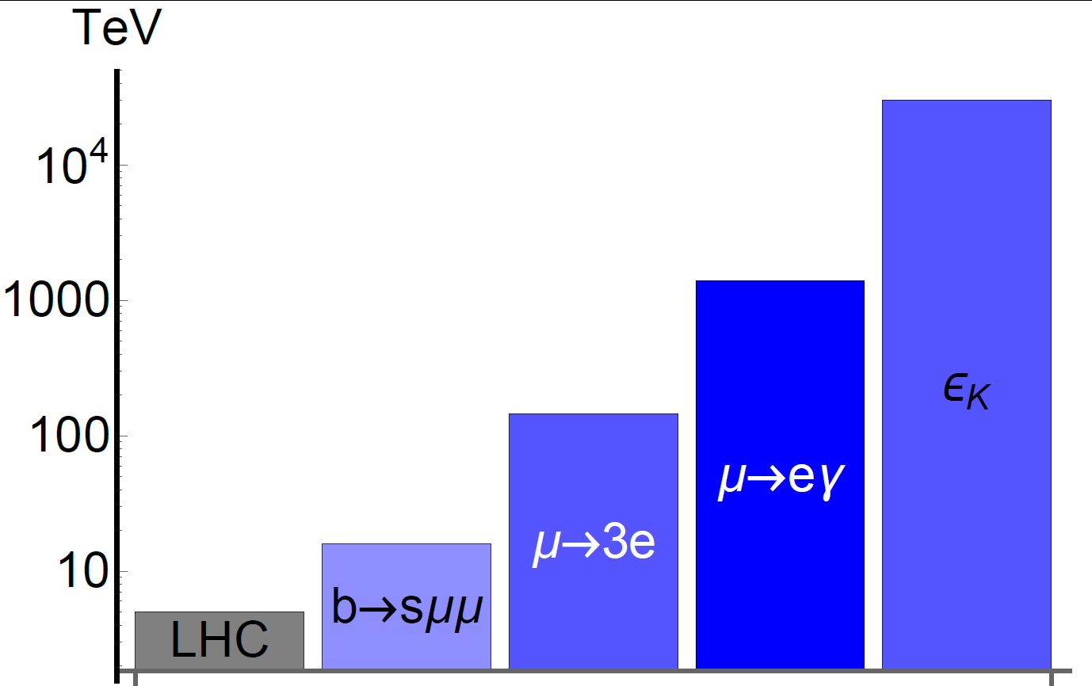
Indirect Searches for New Physics
Perfrom high-statistics measurements to search for the quantum effects of new particles
Experiment
Flavour observables
Standard Model
Direct searches
New Physics
PSI
PSI
Flavour observables can be sensitive to higher energy scales than collider searches
Andreas Crivellin

Slide 6
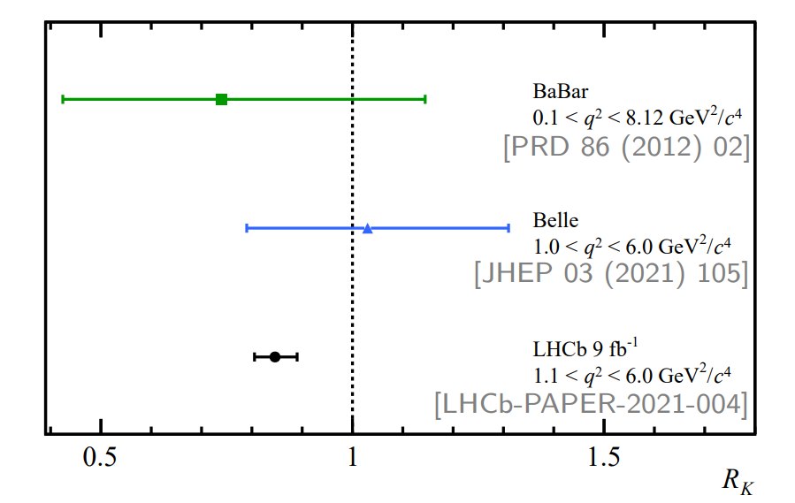
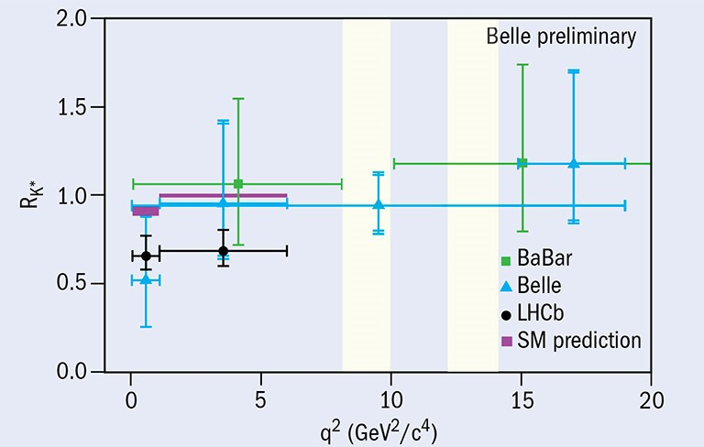
LFUV in b→sℓ⁺ℓ⁻
Muon and electron masses can be neglected
Clean prediction
Supported by
LFUV in B decays >4σ

Slide 7
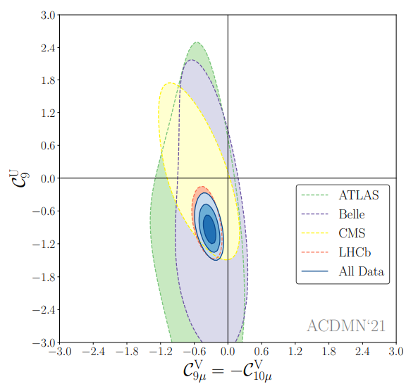
Global Fit to b→sμ⁺μ⁻ Data
Perform global model independent fit to include all observables (≈180)
Several NP hypothesis
give a good fit to data
significantly preferred
over the SM
hypothesis
arXiv:2104.08921
Fit is >7 σ better than the SM

Slide 8
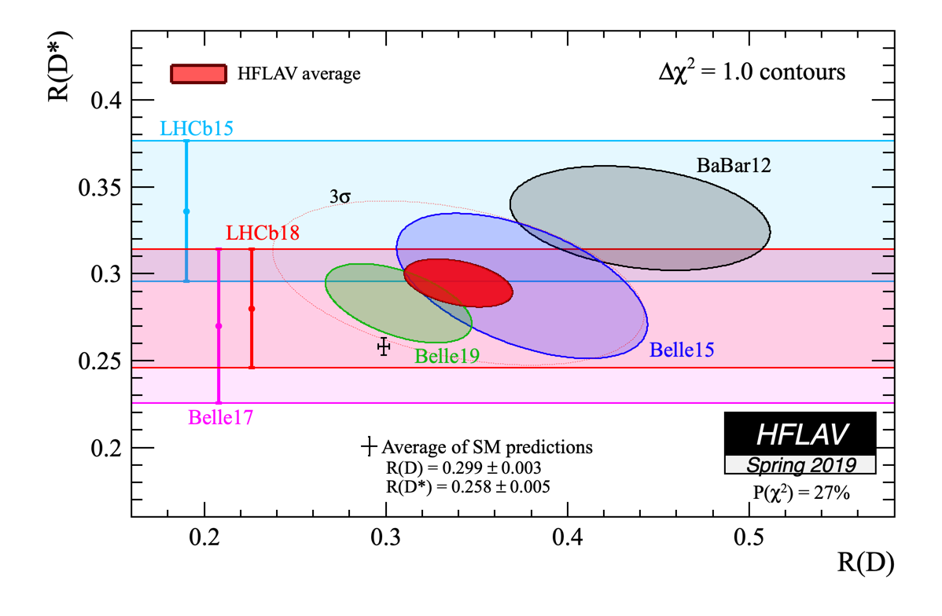
b→cτν
All measurements above the SM prediction
O(10%) constructive effect at 3σ preferred

Slide 9
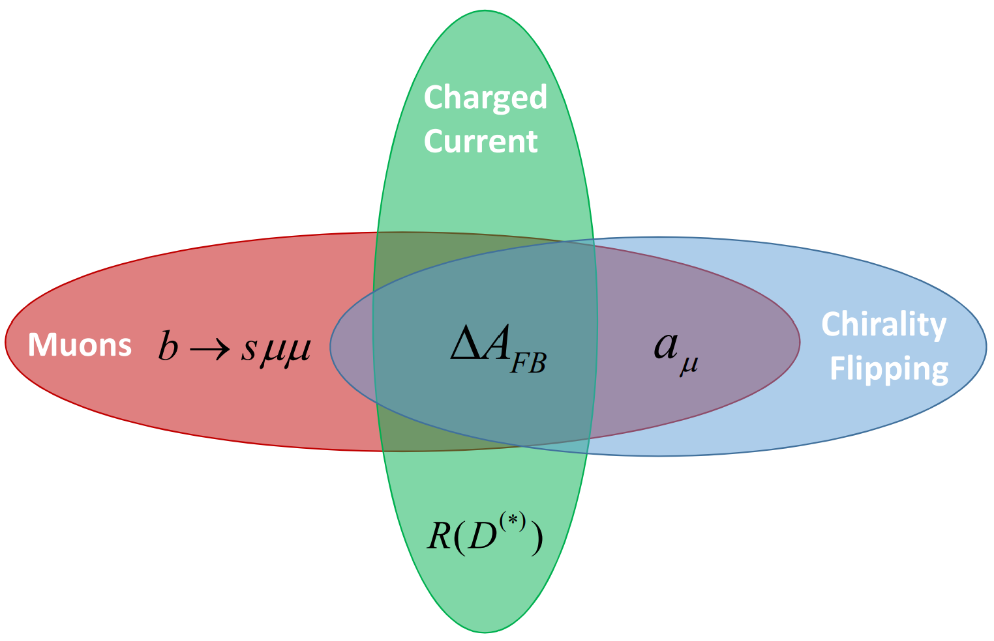
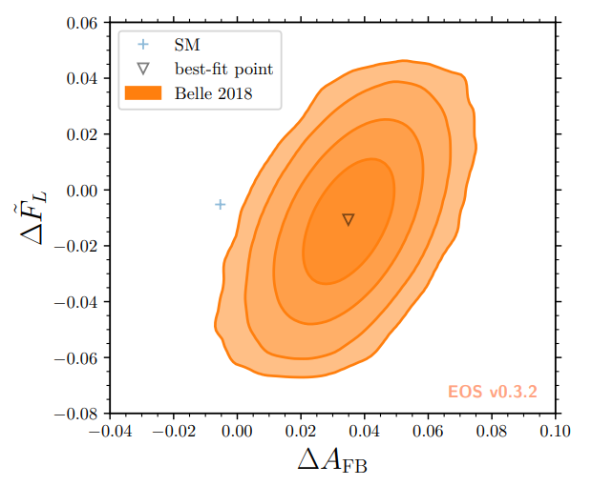
ΔA_{FB} in B→D*lν
4σ deviation found
by 2104.02094
based on BELLE
data 1809.03290
Scalar and/or
tensor operators
required for an
angular asymmetry
g-2 and b→sµµ
motivate new physics
related to muons
2104.02094
Hint for scalar/tensor NP in b→cµν

Slide 10
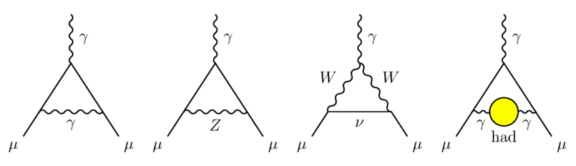
Muon Anomalous Magnetic Moment
Theory prediction challenging (hadronic effects)
Need NP of the order of the SM EW contribution
Chiral enhancement necessary for heavy NP
Soon more experimental results from Fermilab
Vanishes for m_{μ}→0 measure of LFUV
T. Aoyama et al., arXiv:2006.04822
4.2σ deviation from the SM prediction

Slide 11
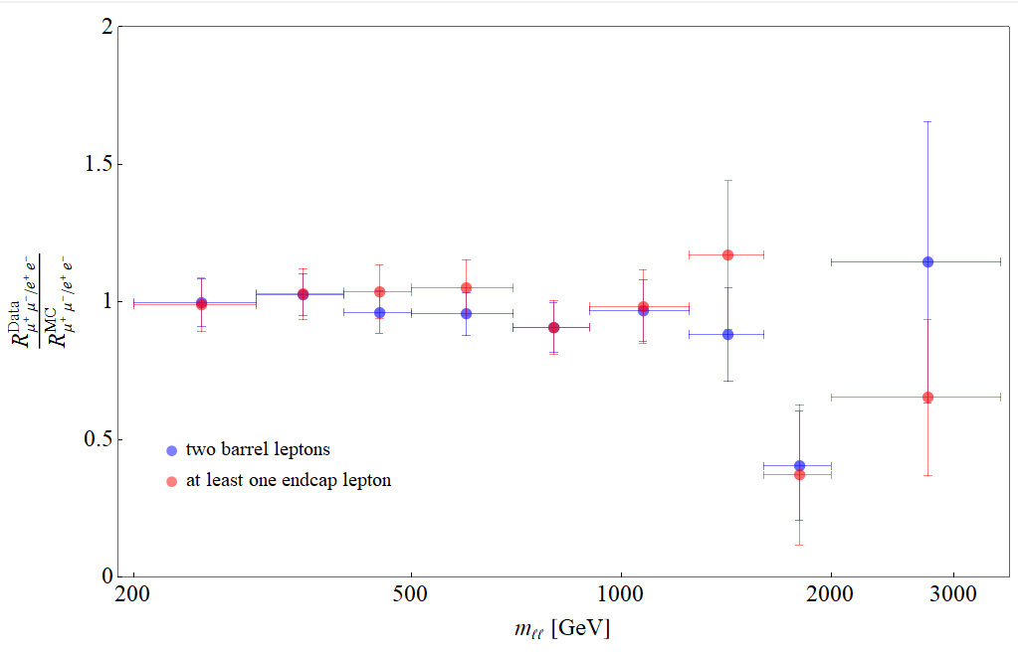
Non-Resonant Di-Leptons
Excess in
di-electrons at
m_{ee}>1800GeV
Observed:
44 events
Expected
29.2 ± 3.6 events
Also ATLAS (2006.12946) and HERA (1902.03048) observe slightly more electrons than expected.
No excess in muon data
CMS: arXiv:2103.02708
≈3σ hint for LFUV

Slide 12
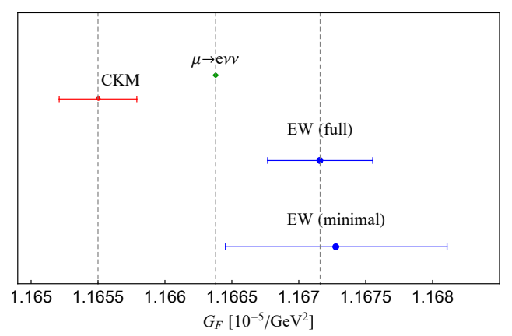
Cabibbo Angle Anomaly (CAA)
Deficit in first row and first column CKM unitarity
NP in the determination
of from beta decays
needed
Can be interpreted as
  NP in beta decays
  NP in the Fermi constant
  LFUV (modified Wµν coupling)
AC, Hoferichter, Manzari, PRL 127 (2021)
3σ tension, can be interpreted as LFUV

Slide 13
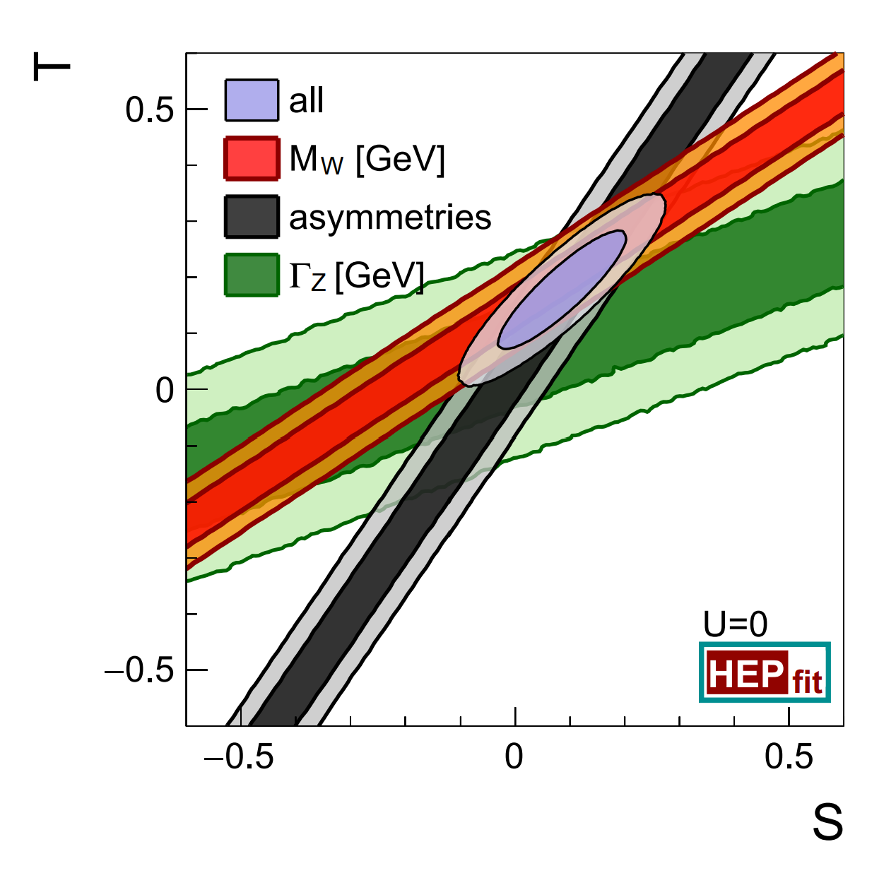
EW fit: W mass and Z→bb,
3.7 σ tension
in the W mass
using a
conservative
error
combination
2 σ tension
in Z→bb
from LEP
2204.04204
Related to LFUV?

Slide 14
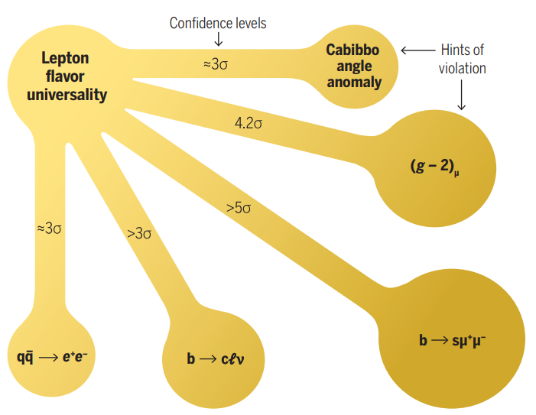
Hints for New Physics
EW observables
LFUV
AC, M. Hoferichter, Science 374 (2021)
m_{W}
≈3-4σ
Z→bb
Direct searches
γγ
ττ
4b
bbττ
Andreas Crivellin

Slide 15
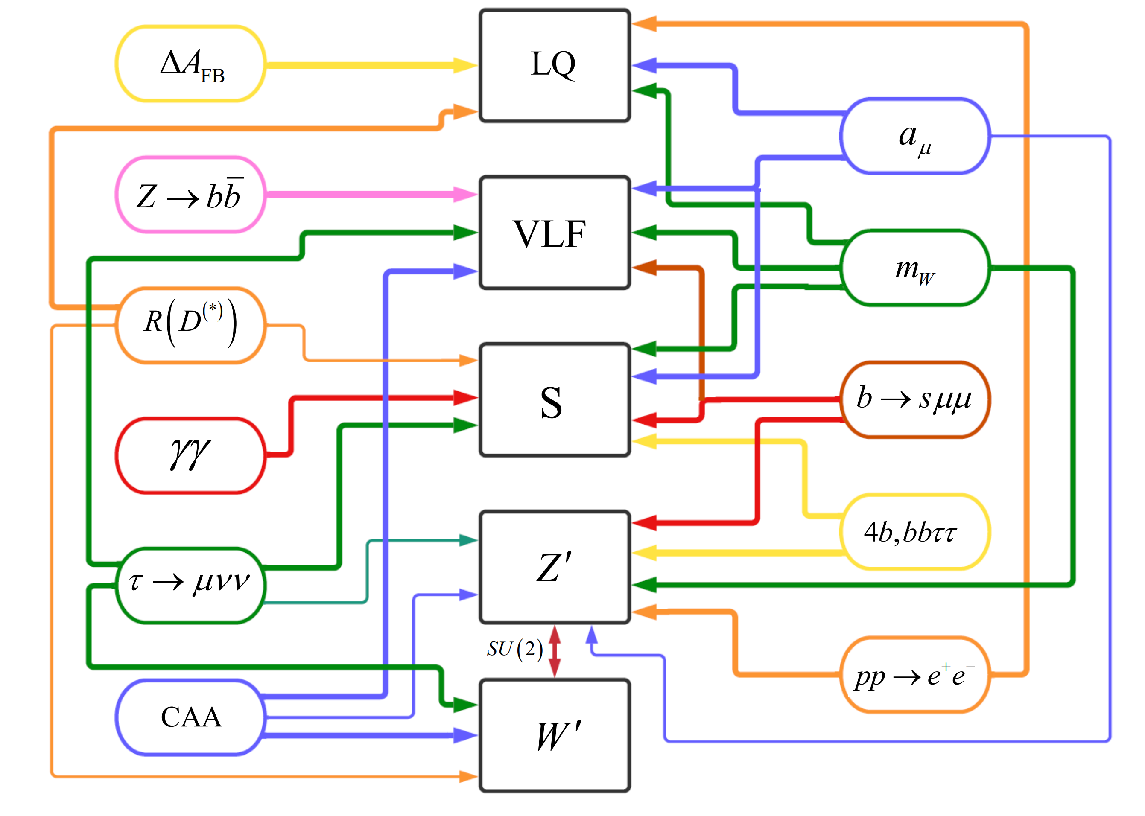
Expanations

Slide 16
Simultaneous Explanations

Slide 17
Vector Leptoquark SU(2) Singlet
Left-handed effect in b→sμμ
Left-handed vector current in R(D) and R(D*)
No effect in b→sνν
No proton decay
Contained within the Pati-Salam model
Massive vector bosons
  Non-renormalizable without Higgs mechanism
  Pati Salam not possible at the Tev scale because of K_{L}→μe and K→πμe
Good solution, but difficult UV completion

Slide 18
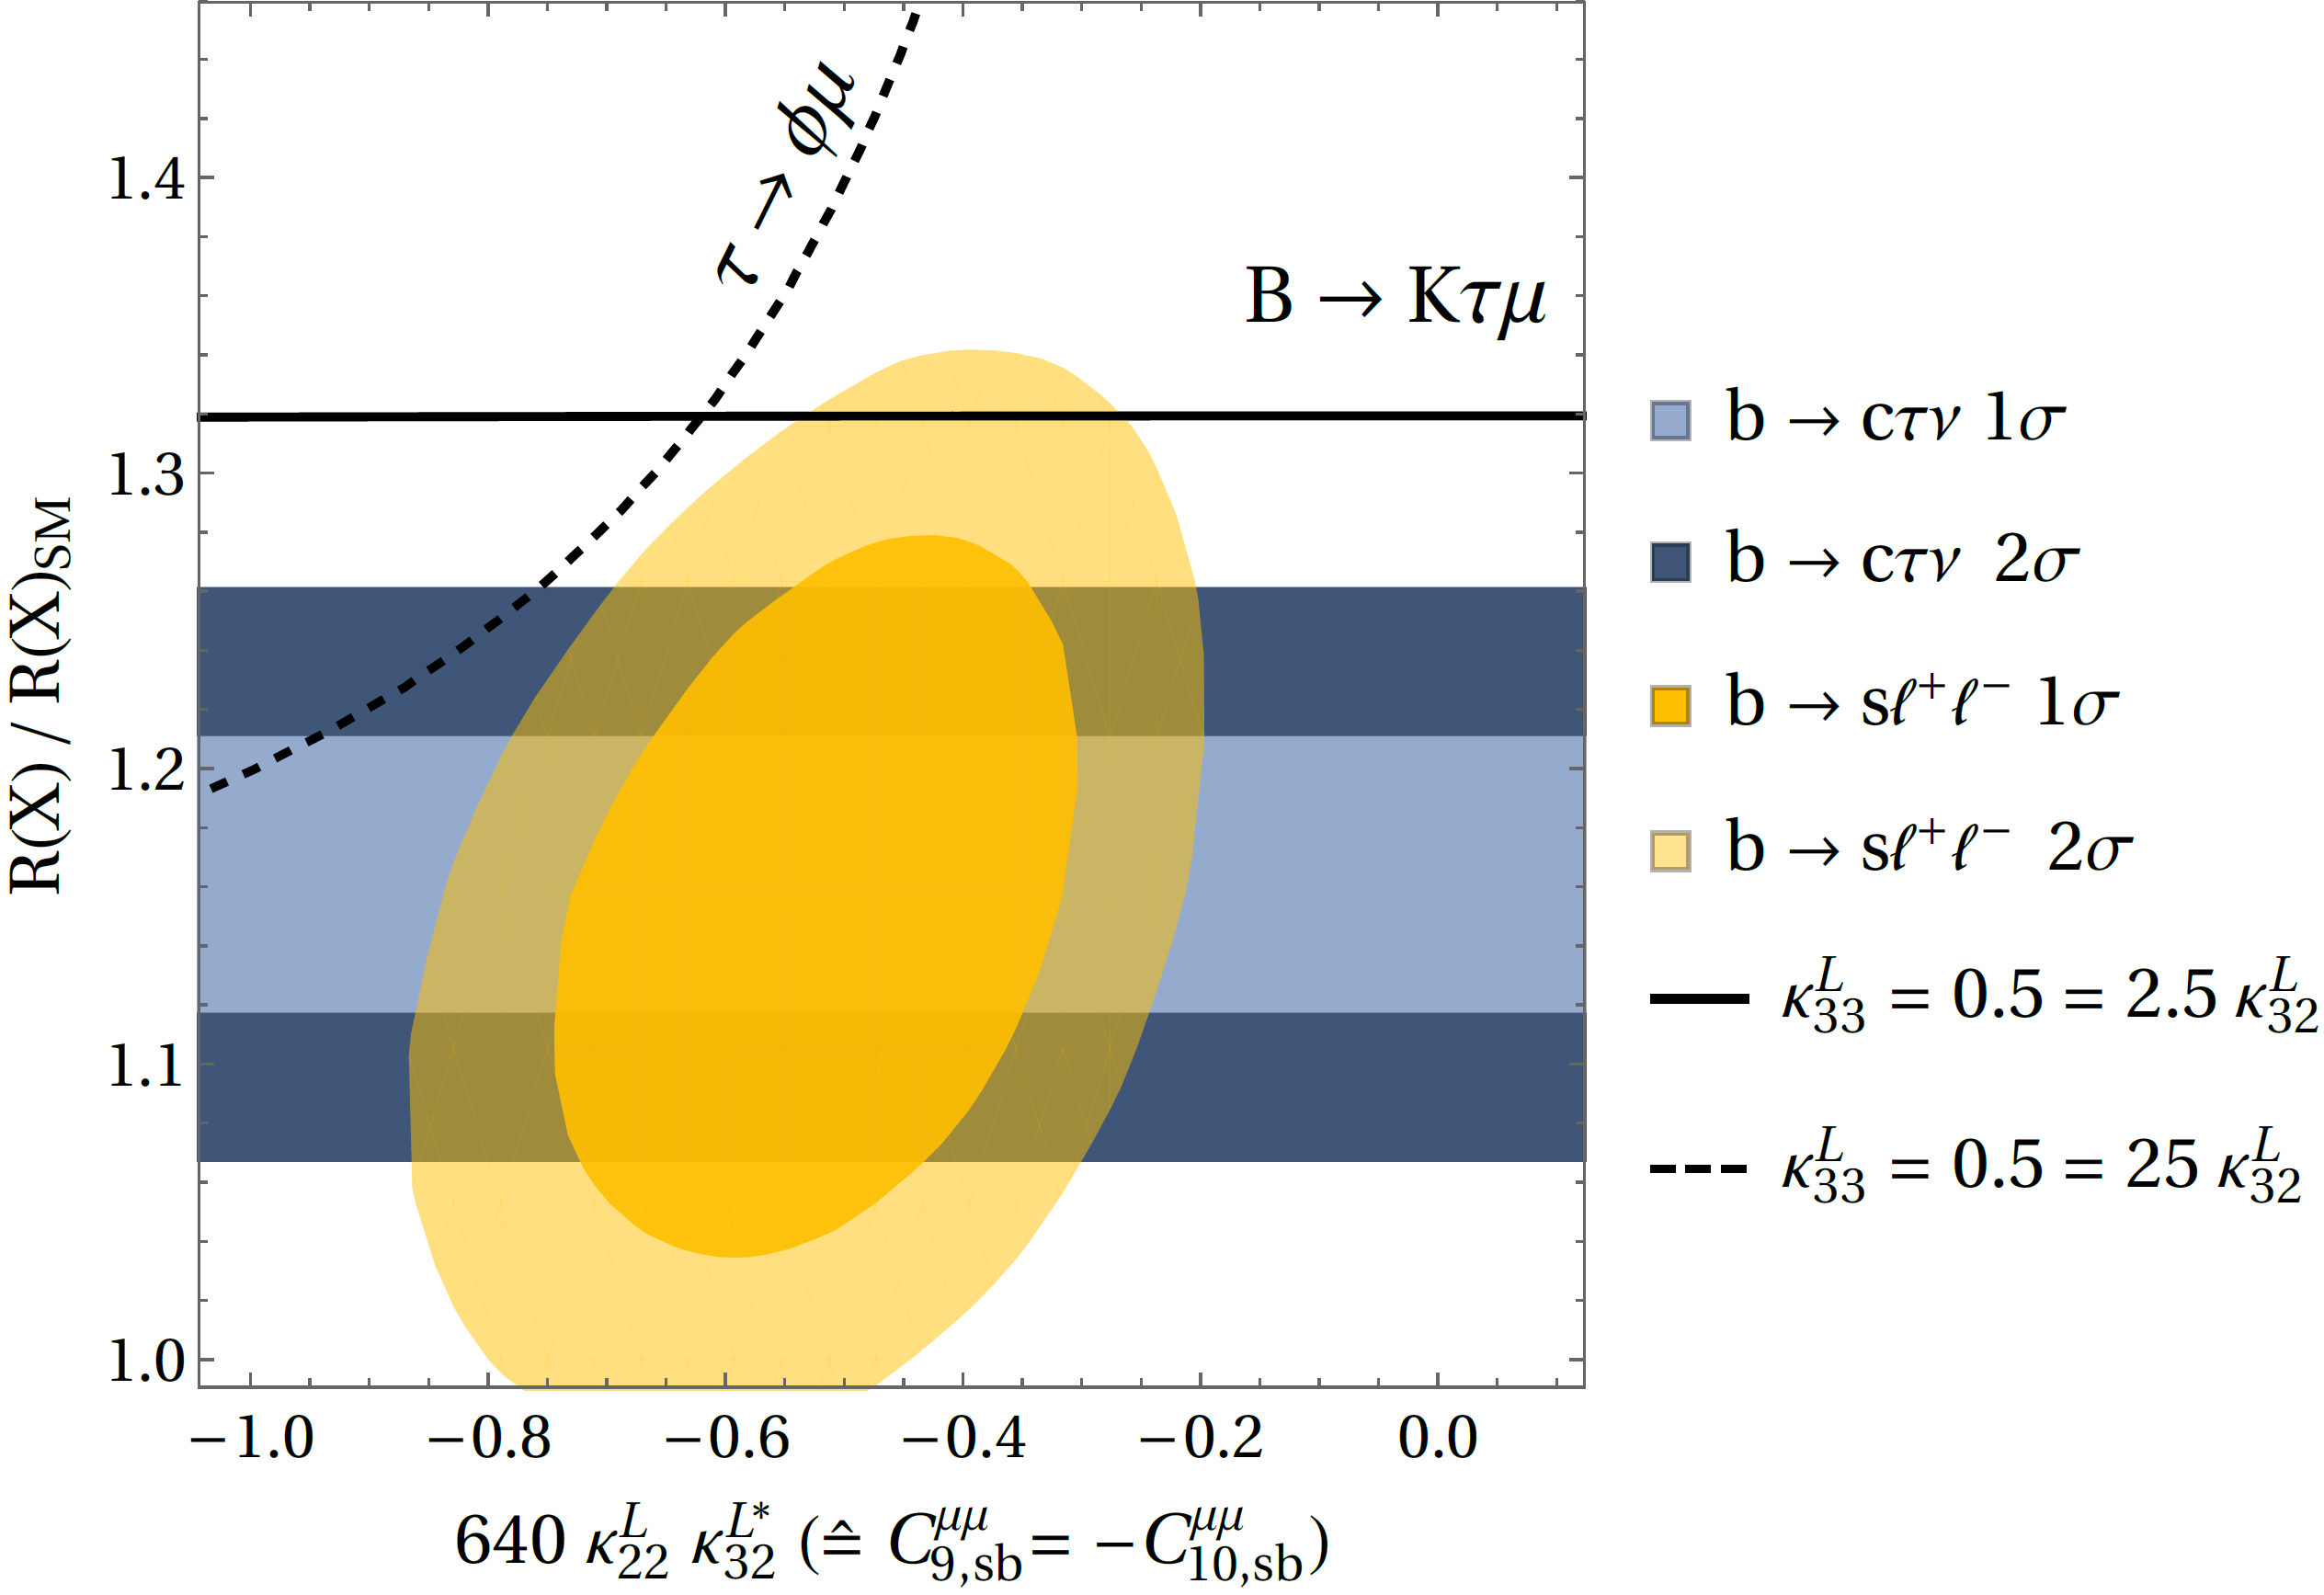
Perfect agreement with data
AC, C. Greub, D. Müller,
F. Saturnino, PRL 2018
Pati-Salam LQ can explain the flavour anomalies

Slide 19
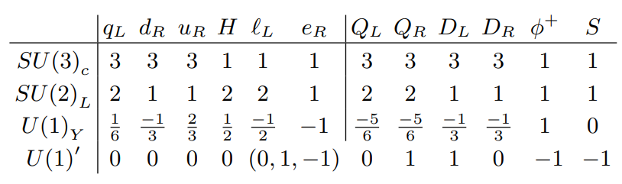
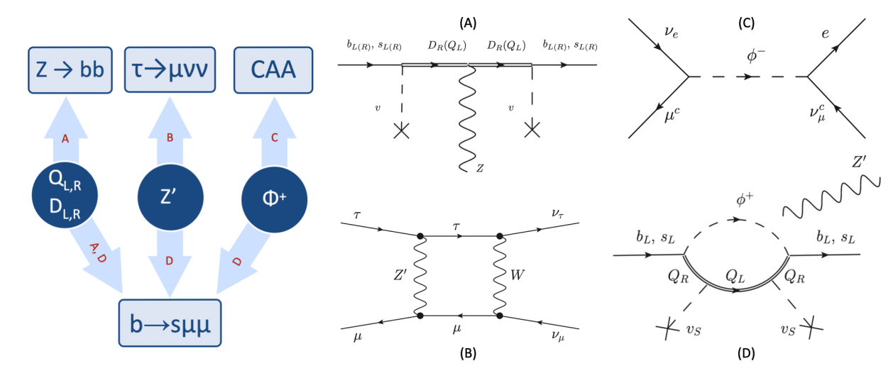
Model for b→sℓℓ, CAA, Z→bb & τ → μνν
L_{µ}-L_{τ} model with
vector-like quarks
AC, C.A. Manzari et al. PRL 127 2021
Simple model provides combined explanation
8

Slide 20
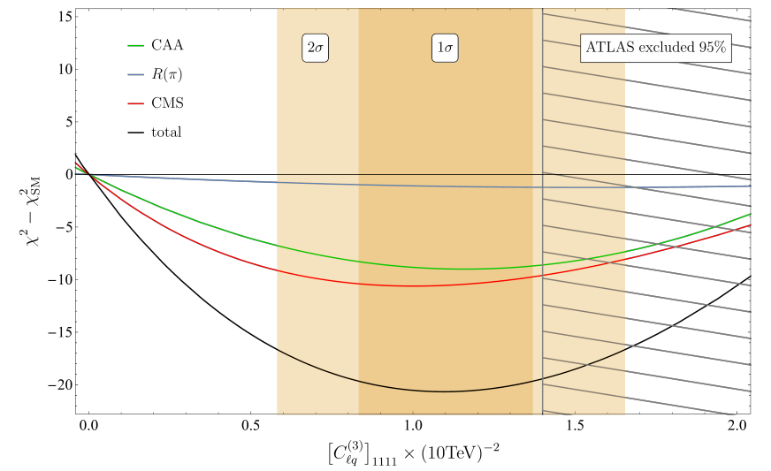
CAA and Non-Resonant Di-Leptons
AC, C. Manzari, M. Montull, 2103.12003
4.5σ better than SM, prediction for R(π)

Slide 21
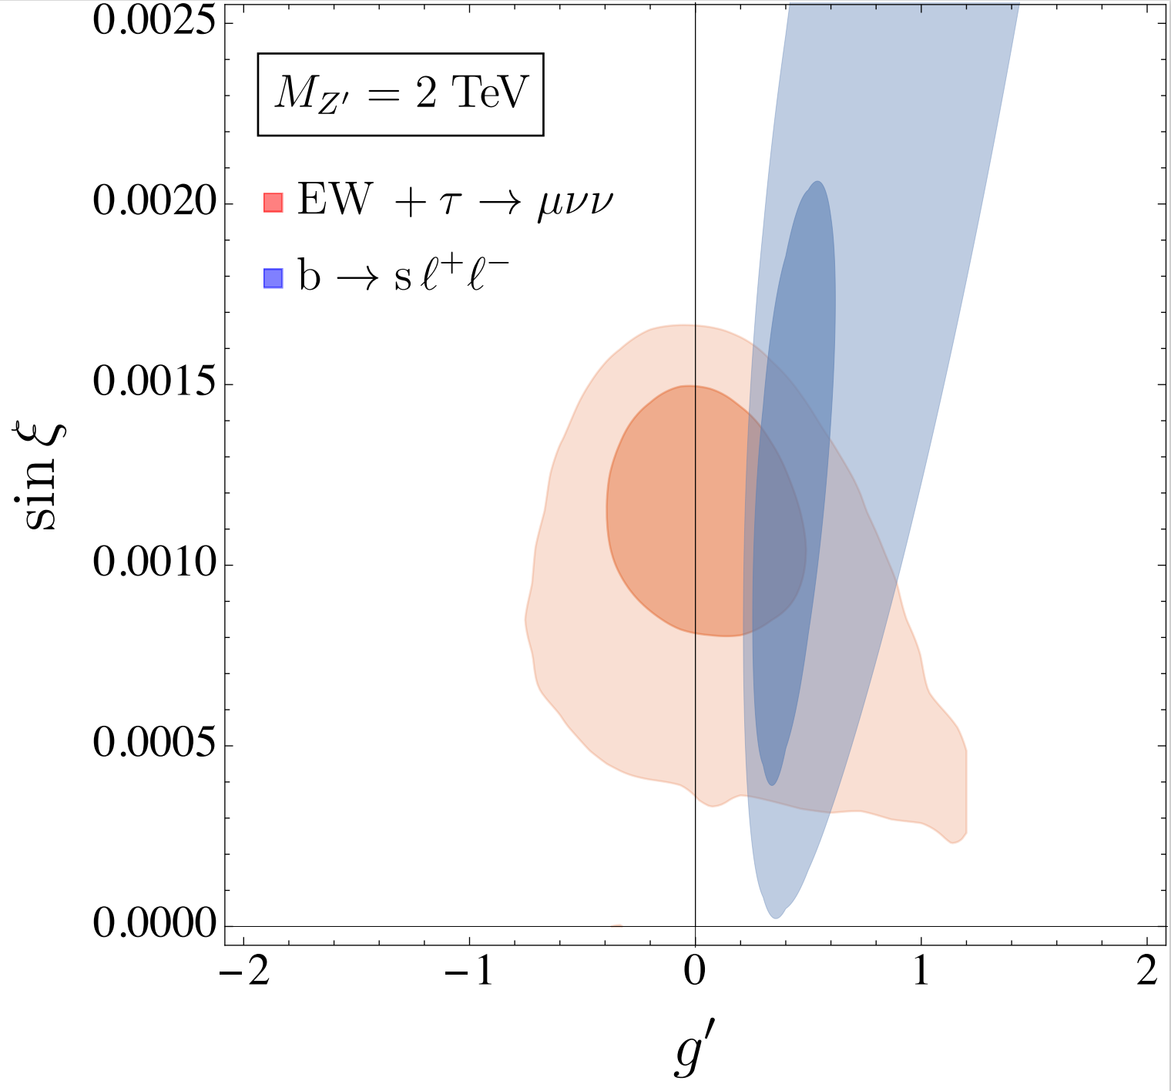
b→sℓℓ, W mass and Z’ mixing
Z-Z’ mixing can leads to a shift in the predictions of
the W mass and
can explain the
tension in
the EW fit
LFU effect
in b→sℓℓ
AC, M. Alguero,
C.A. Manzari,
J. Matias
2201.08170
Interesting correlations between b→sℓℓ and the EW fit
8

Slide 22
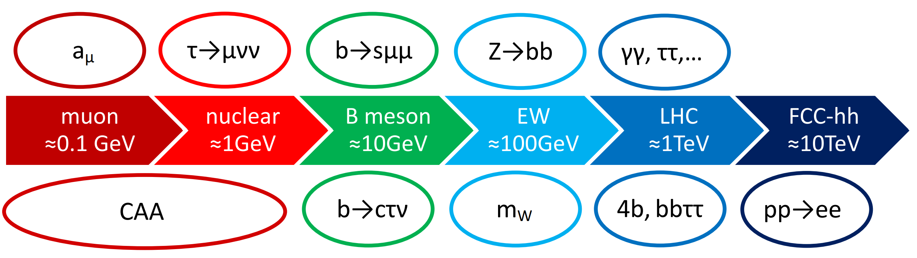
Conclusions
Many intriguing anomalies emerged in the last years:
  LFUV
  EW observables
  Direct LHC searches
The Standard Model is crumbling

Slide 23
Backup

Slide 24
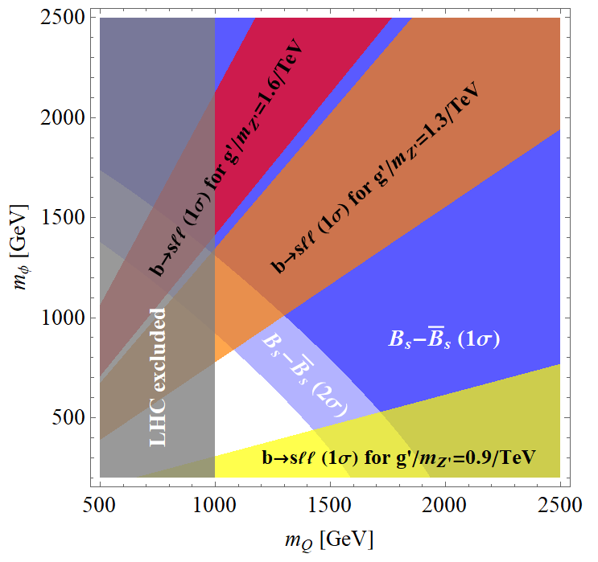
Model for b→sℓℓ, CAA, Z→bb and τ → μνν
Z → bb
τ→μνν
CAA
Zbb
box
Tree-level
Q_{L,R}
D_{L,R}
Z’
Φ⁺
Z’ penguin
Zsb coupling
Z’ penguin
Z’ penguin
Z’ penguin + modified Zsb
coupling give very
good fit to b→sll data
b→sμμ
Simple model provides combined explanation
8

Slide 25
Implications for FCC-ee
pp→e⁺e⁻
ΔA_{FB}
Z→bb
R(D⁽*⁾)
e⁺e⁻→ff
1.5x10¹²
b
5x10¹²
Z
3x10¹¹
τ
VLQ, VLL
LQ
W’
Z’, loop
VLL
CAA
b→sμμ
a_{μ}
τ →µνν
Andreas Crivellin

Slide 26
Outlook: Physics at Future Colliders
Flavour Anomalies require NP at the TeV scale
This new particles in general also affect EW precision observables
Flavour is directly linked
to the Higgs boson
Direct Searches at HL-LHC, HE-LHC, FCC-pp
2006.10758
Z decays at CLIC
and FCC-ee
LQ in Higgs decays
CLIC, FCC
Flavour Anomalies (if confirmed) strengthen the physics case for future colliders significantly
Andreas Crivellin

Slide 27
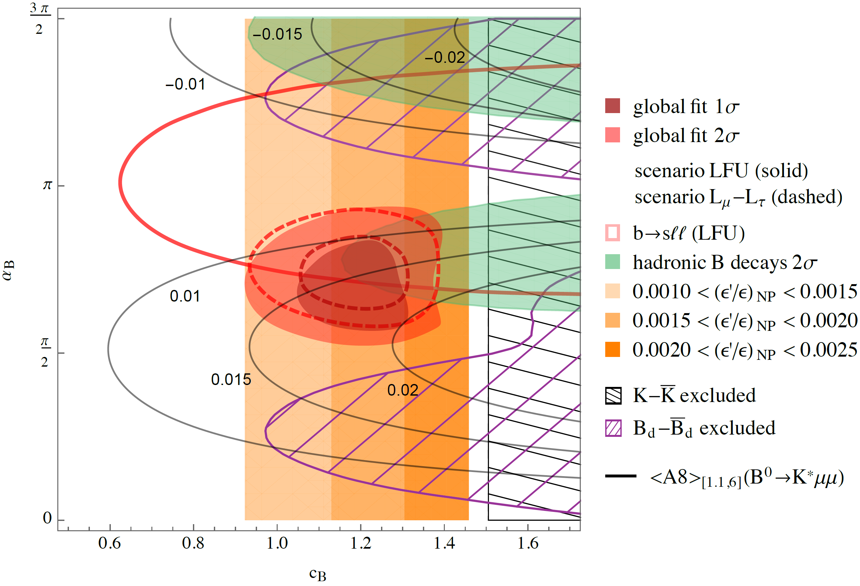
Z’ model with U(2) flavour
L. Calibbi, AC, F. Kirk, C. A. Manzari, L. Vernazza.
arXiv:1910.00014
Common explanation possible

Slide 28
CP violation in Kaon decays: ε‘/ ε
ε: indirect CP violation in Kaon decays
  K_{L} and K_{S} are not CP eigenstates due to mixing
ε': direct CP violation in Kaon decays
Buras et al.
Measurement ≈3σ above the SM prediction

Slide 29
Hadronic B decays
L. Hofer, D. Scherer, L. Vernazza, arXiv:1011.6319 [hep-ph]
Longstanding B→πK Puzzle
More observables like
CP and
isospin
violation
needed
Similar
picture
in D decays
Global fit to data: 2-3σ

Slide 30
ε‘/ ε explanations
W_{R} coupling
Z’ (also for ΔA_{CP})
MSSM
V. Cirigliano, et al. arXiv:1612.03914
A. Buras, et al.
arXiv:1507.08672
A. Buras and F. De Fazio,
arXiv:1512.02869
T. Kitahara, U. Nierste,
P. Tremper, arXiv:1604.07400
M. Endo, et al. arXiv:1608.01444
A. Crivellin, G. D'Ambrosio,
T. Kitahara and U. Nierste,
arXiv:1703.05786

Slide 31
QCD corrections to the Matching
Perform matching
Correct for 4-dimensional Fierz identities

Slide 32
Results
J. Aebischer, AC, C. Greub, 1811.08907
Slightly weaker LHC constraints

Slide 33
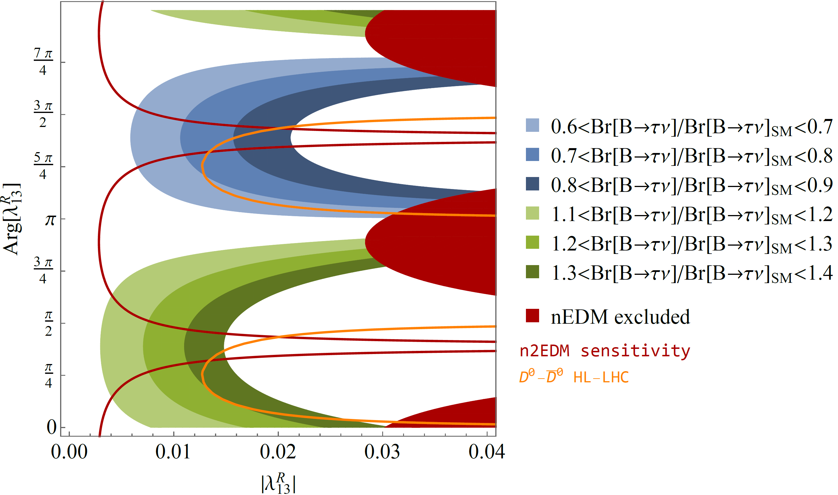
Correlations the neutron EDM with S1
W. Dekens, J. de Vries, M. Jung,
K. K. Vos, arXiv:1809.09114
AC, F. Saturnino
arxiv:1905:08257
1905:08257
J. Aebischer, AC, F. Saturnino, 1905.xxx
Effect in B predicts measurable nEDM effect

Slide 34
R(D⁽*⁾), b→sνν with 2 Scalar LQs

Slide 35
Model with new vector-like leptons
AC, M. Hoferichter, P. Schmidt-Wellenburg, arXiv:1807.11484
Works for a_{e} but tension with a_{μ}

Slide 36
Hadronic Vacuum Polarization
New BMWc lattice QCD result
A.C. M. Hoferichter, C. Manzari, M. Montull 2003.04886
Up to 4σ tension in EW fit

Slide 37
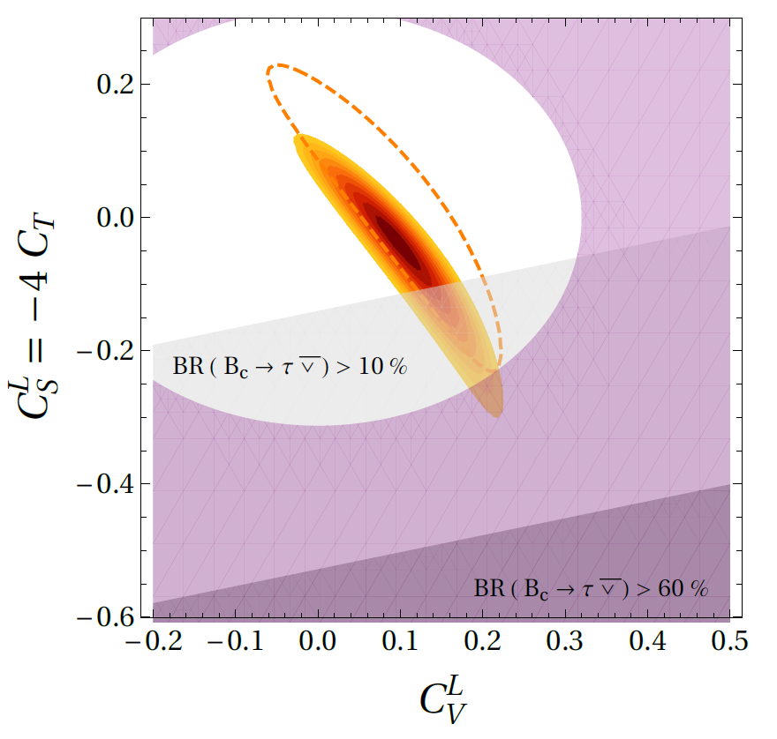
b→cτν Global Fit
M. Blanke,
A.C.,
T. Kitahara,
M. Moscati,
U. Nierste,
I. Nišandžić, 1905.08253
Pure scalar-tensor
explenations in
tension
with the B_{c}
lifetime
Pure left-handed
vector, i.e. contribution
to the SM operator
gives good fit
1905.08253
Global fit give up to 4σ preference for NP

Slide 38
Scalar
Leptoquarks

Slide 39
Two Scalar Leptoquarks
AC, D. Mueller, T. Ota
arxiv:1703.09226
scalar leptoquark singlet with Y=-2/3
scalar leptoquark triplet with Y=-2/3
Constructive in R(D⁽*⁾)
Destructive in b→sμμ

Slide 40
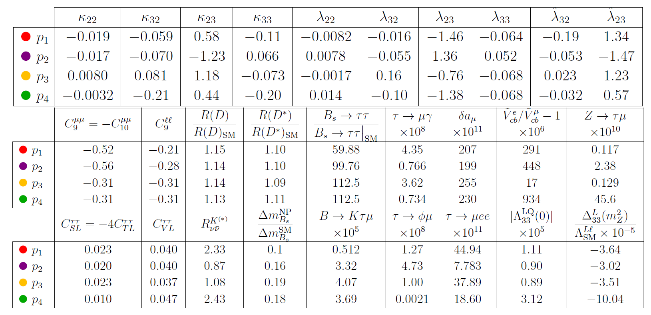
R(D⁽*⁾), b→sll and a_{µ}
4 benchmark points
AC, D. Mueller, F. Saturnino
arxiv:1912.04224
Common explanation possible

Slide 41
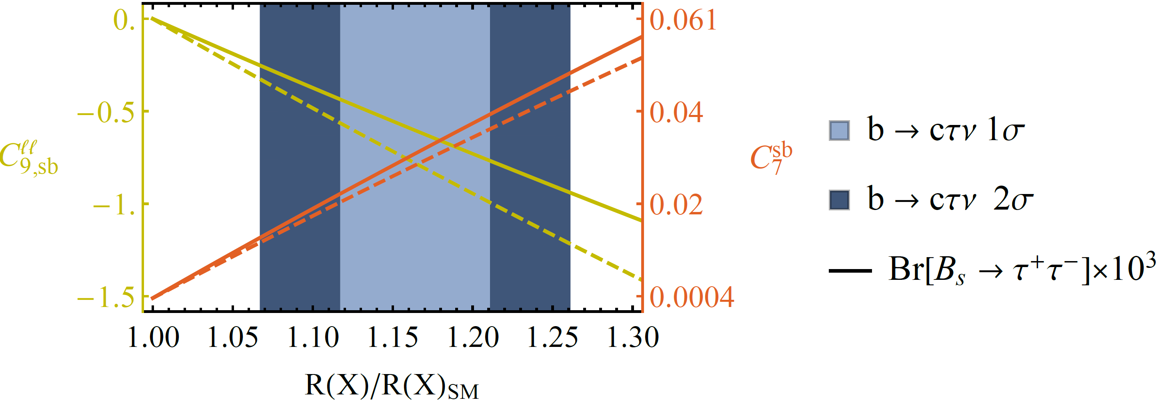
Important Loop-Effects
Explanation of b→cτν requires large bτ and sτ couplings (follows from SU(2) invariance)
AC, C. Greub, D. Müller,
F. Saturnino, PRL 2018
Large loop effects in b→sμμ

Slide 42
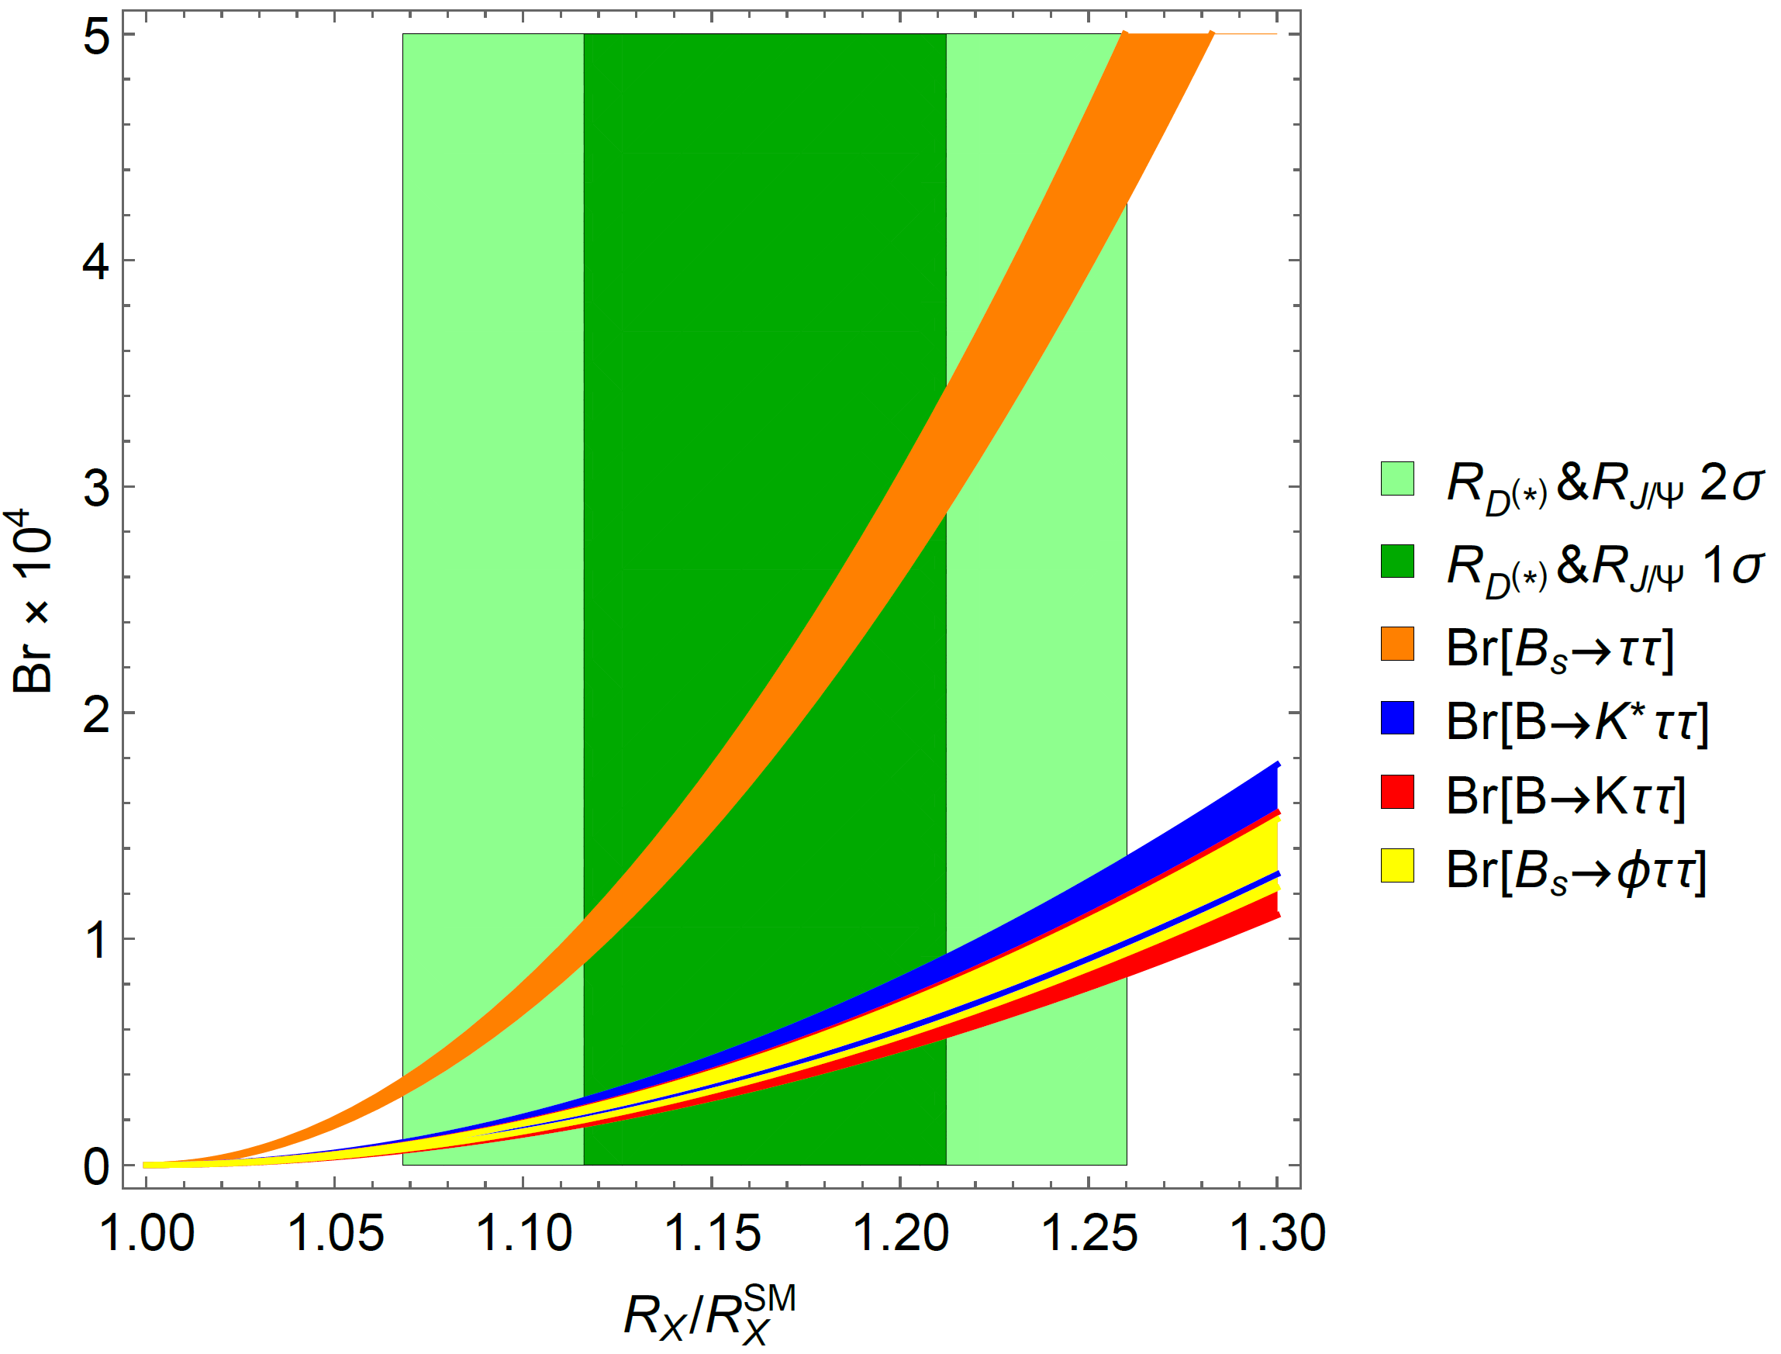
R(D⁽*⁾) and b→sττ
Large couplings to the second generation
b→sττ
very strongly enhanced
B. Capdevila, AC, S. Descotes-Genon, L. Hofer and J. Matias, PRL.120.181802

Slide 43
Important Loop-Effects
Explanation of b→cτν requires large LQ-bτ and LQ-c-ν_{τ} couplings
Via SU(2) invariance this
leads to large effects in
b→sττ processes
Closing the tau-loop gives a LFU
effect in b→sll
Effect goes in the right direction
AC, C. Greub, D. Müller,
F. Saturnino, PRL 2018
M. Algueró, B. Capdevila, S. Descotes-Genon, P. Masjuan, J. Matias, PRD, 2019
Explanation of b→cτν leads to
loop effects in b→sμμ

Slide 44
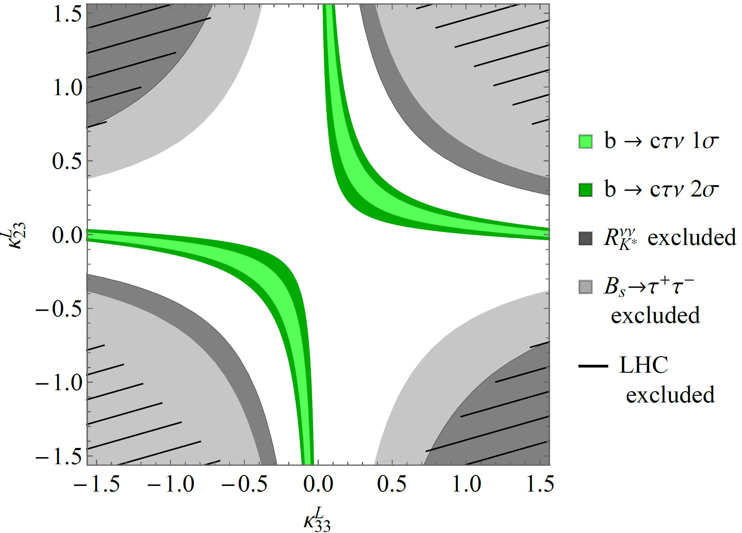
Vector LQ Phenomenology
Compatible with constraints for generic couplings

Slide 45
Possible UV completions
SU(4)×SU(3)’×SU(2)_{L}×U(1)_{Y} + Vector-like fermions
L. Di Luzio, A. Greljo, M. Nardecchia, arXiv:1708.08450
SU(4)×U(2)_{L}×SU(2)_{R} + Vector-like fermions
L. Calibbi, AC, T. Li, arXiv:1709.00692
SU(4)×SU(4)×SU(4)
M. Bordone, C. Cornella, J. Fuentes-Martin, G. Isidori, arXiv:1712.01368
SU(4)×SU(2)_{L}×SU(2)_{R} including scalar LQs and
light right-handed neutrinos
J. Heeck, D. Teresi, arXiv:1808.07492
SU(8) might even explain ɛ’/ɛ
S. Matsuzaki, K. Nishiwaki and K. Yamamoto, arXiv:1806.02312
SU(4)×SU(2)_{L}×SU(2)_{R} in RS background
M. Blanke, AC, arXiv:1801.07256
Good solution, but challenging UV completion

Slide 46
Pati-Salam RS Phenomenology
M. Blanke, AC, PRL 2018
Model well motivated + limited but sizable effect

Slide 47
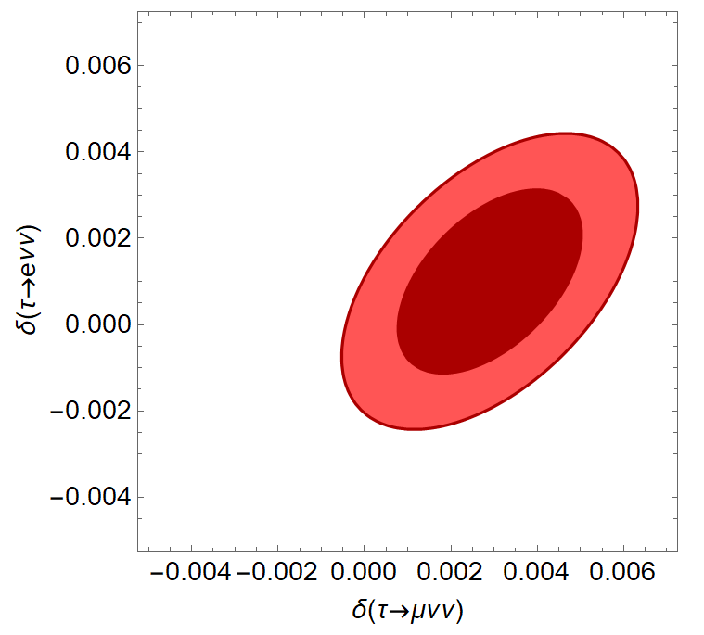
τ→μνν
Ratios of leptonic
tau decays
NP in muon decay too
constrained from EW data
≈2σ hint for LFUV in tau decays

Slide 48
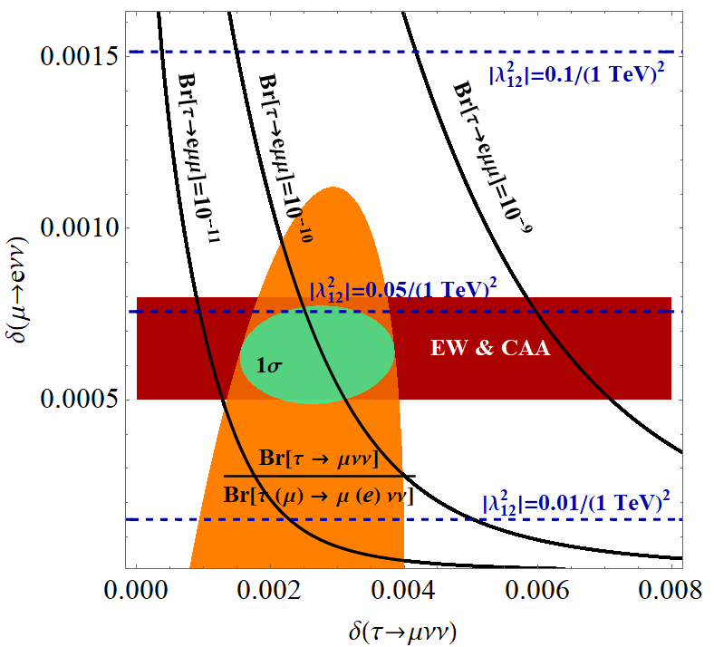
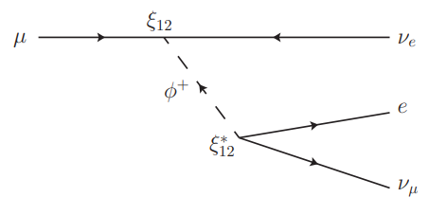
τ→μνν
L_{μ}-L_{τ} Z‘ (box diagrams)
LFV violating Z‘
Modified Wlν couplings
W‘
Singly charged scalar
Singly charged scalar
A.C., F. Kirk, C. Manzari, L. Panizzi, arXiv:2012.09845
4σ hint for modified neutrino couplings

Slide 49
W’ Explanation of CAA
W’ effects in LFU and EW observables
Z’ effects in LHC di-jet and di-lepton tail searches
R(V_{us}) can be explained by a left-handed W’
8

Slide 50
Vector Triplet in R(V_{us}) & b→sll
Region preferred by
EW fit overlaps with
b→sll region
Correlations
between
e.g. π→μν/π→eν
and R(K⁽*⁾) are
predicted
Global fit significantly
improved
Common explanation possible
8

Slide 51
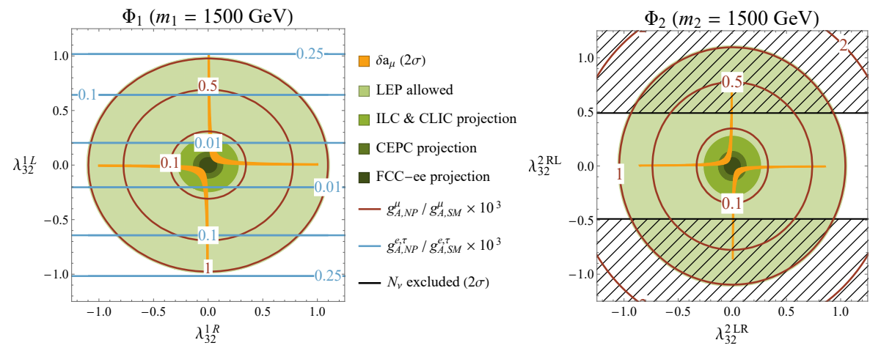
a_{μ} vs Z→μμ
Chirally enhanced effects via top-loops
Left-, right-handed muon-top coupling
E. Leskow, A.C., G. D'Ambrosio,
D. Müller 1612.06858
A.C, C. Greub, D. Müller, F.Saturnino, 2010.06593
Z→μμ at future colliders
8

Slide 52
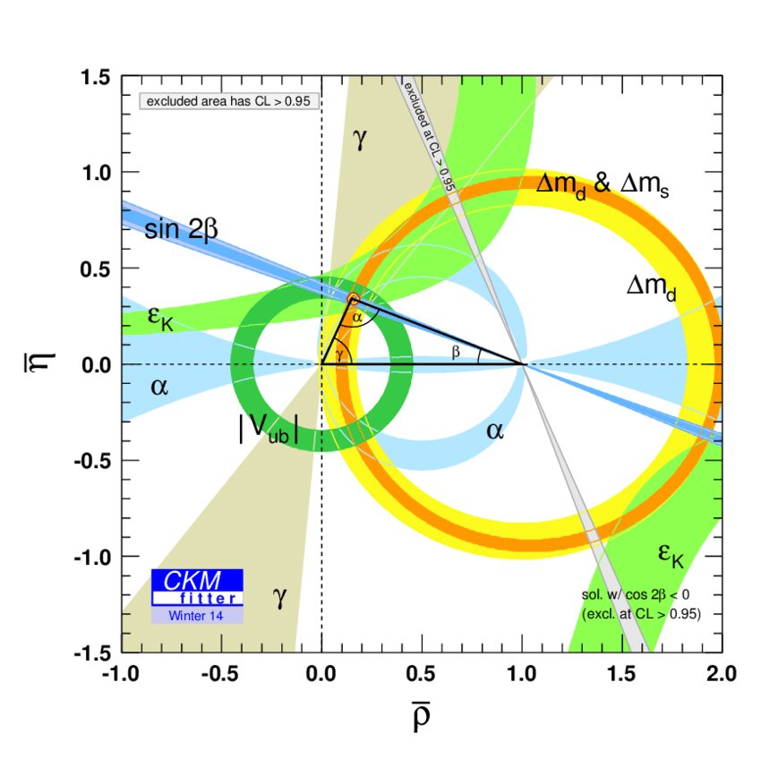
Global Fit to the CKM Matrix
Tree-level determinations of CKM elements (with light leptons) agree with ΔF=2 processes
Picture of CKM Flavour violation established, but sub leading NP possible
Still room for New Physics effects of O(10%)
Andreas Crivellin

