Slide 1

Kink-antikink scattering in a quantum vacuum
George Zahariade
E. Sfakianakis, M. Mukhopadhyay, T. Vachaspati, GZ, JHEP 04 (2022) 118
July 27th 2022

Slide 2
Motivation
Topological defects
Topological defects: classical field theory solutions topologically distinct from the trivial vacuum; localized energy density; stability; shape preservation
Produced e.g. during phase transitions when some symmetry is spontaneously broken
Relevant for early universe cosmology
Classified by their dimensionality as well as the type of broken symmetry
  Dimension 0: Monopoles (broken SO(3) symmetry)
  Dimension 1: Strings (broken U(1) symmetry)
  Codimension 1: Domain walls or kinks in d=1 (broken discrete symmetry)
Topological defects interact in complex ways with each other

Slide 3

Motivation
Topological defects
Topological defects: classical field theory solutions topologically distinct from the trivial vacuum; localized energy density; stability; shape preservation
Produced e.g. during phase transitions when some symmetry is spontaneously broken
Relevant for early universe cosmology
Classified by their dimensionality as well as the type of broken symmetry
  Dimension 0: Monopoles (broken SO(3) symmetry)
  Dimension 1: Strings (broken U(1) symmetry)
  Codimension 1: Domain walls or kinks in d=1 (broken discrete symmetry)
Topological defects interact in complex ways with each other

Slide 4

Motivation
Topological defects
Topological defects: classical field theory solutions topologically distinct from the trivial vacuum; localized energy density; stability; shape preservation
Produced e.g. during phase transitions when some symmetry is spontaneously broken
Relevant for early universe cosmology
Classified by their dimensionality as well as the type of broken symmetry
  Dimension 0: Monopoles (broken SO(3) symmetry)
  Dimension 1: Strings (broken U(1) symmetry)
  Codimension 1: Domain walls or kinks in d=1 (broken discrete symmetry)
Topological defects interact in complex ways with each other

Slide 5

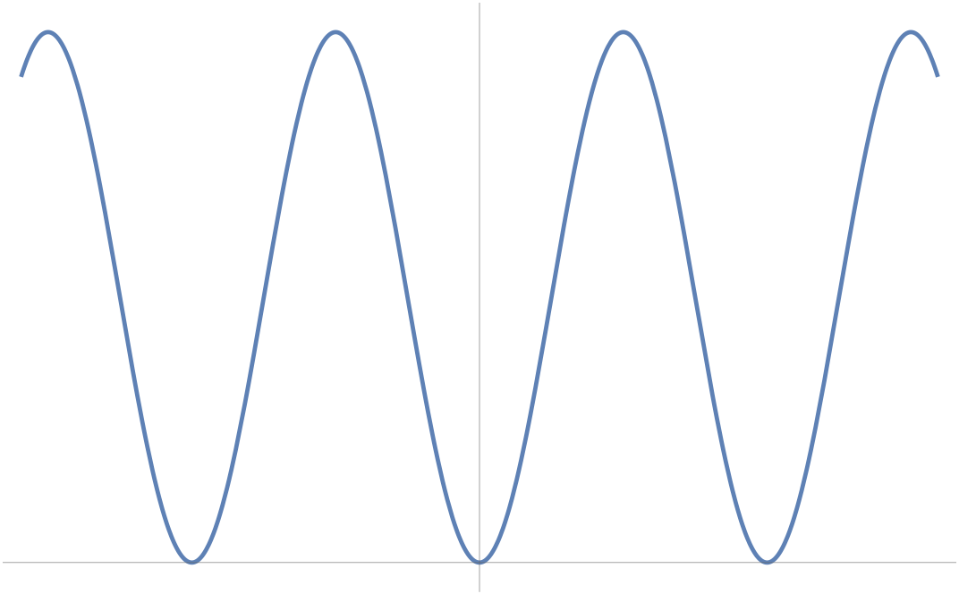

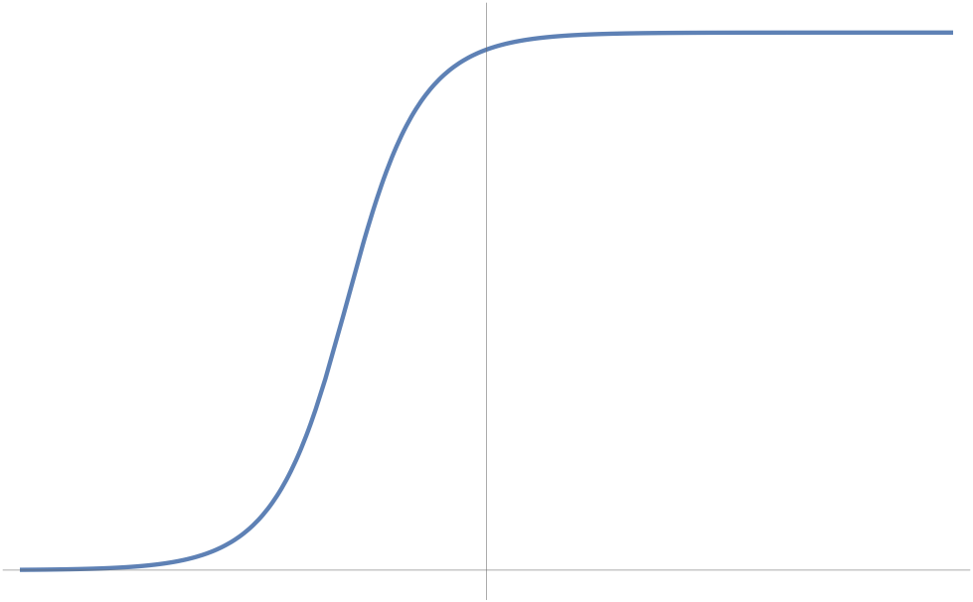
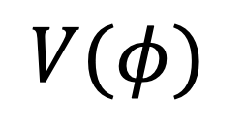
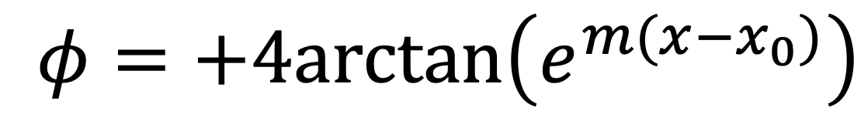
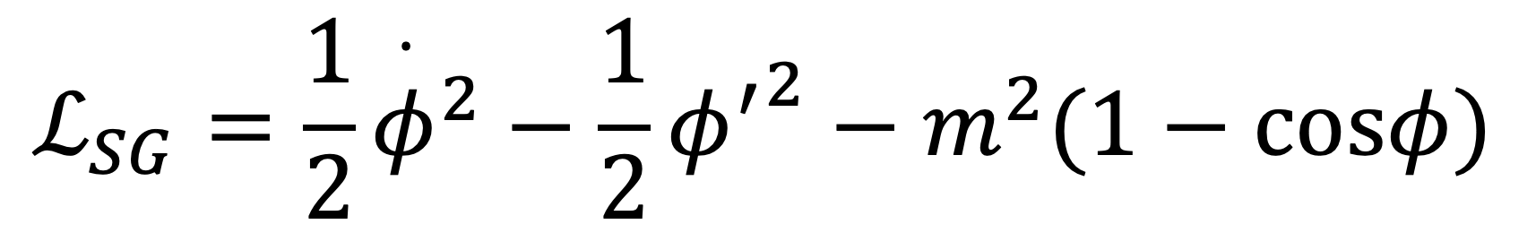
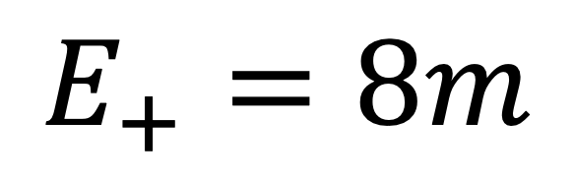

Laboratory: sine-Gordon model
Elementary zoology
$$ℒ_{SG}=\frac{1}{2}{\overset{·}{φ}}^{2}−\frac{1}{2}{φ^{′}}^{2}−m^{2}(1−cosφ)$$
$$V(φ)$$
Kink
$$φ=+4arctan\left(e^{m(x−x_{0})}\right)$$
$$E_{+}=8m$$
$$φ$$

Slide 6
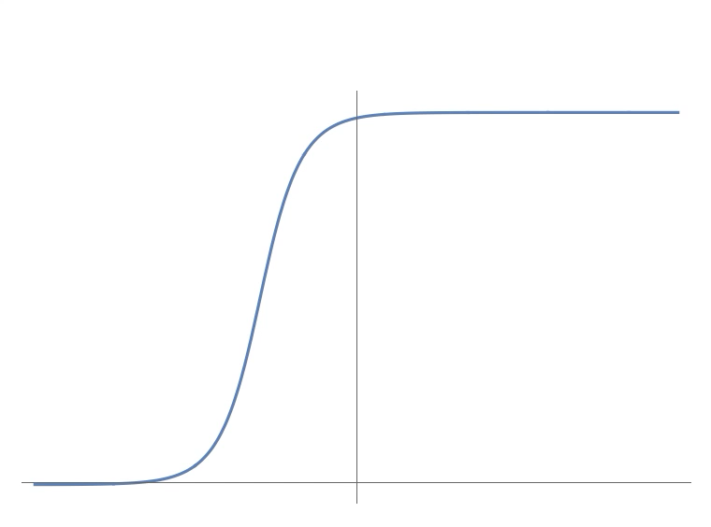

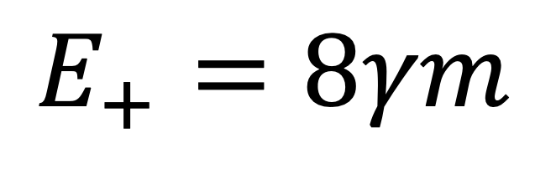
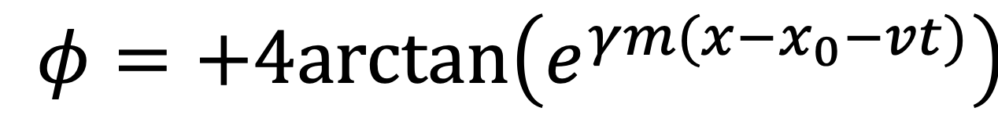
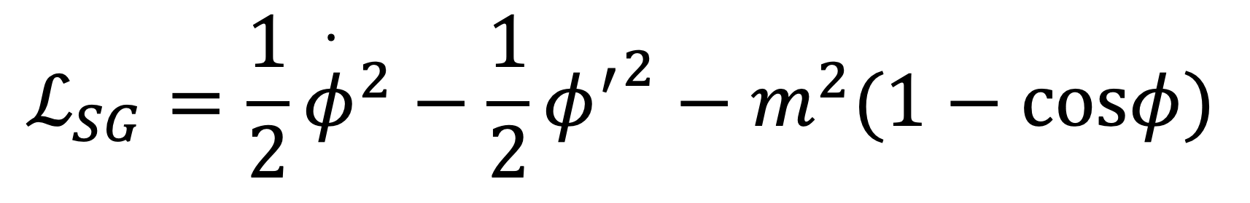
Laboratory: sine-Gordon model
Elementary zoology
$$ℒ_{SG}=\frac{1}{2}{\overset{·}{φ}}^{2}−\frac{1}{2}{φ^{′}}^{2}−m^{2}(1−cosφ)$$
$$V(φ)$$
Kink
$$φ=+4arctan\left(e^{γm(x−x_{0}−vt)}\right)$$
$$E_{+}=8γm$$
$$φ$$

Slide 7

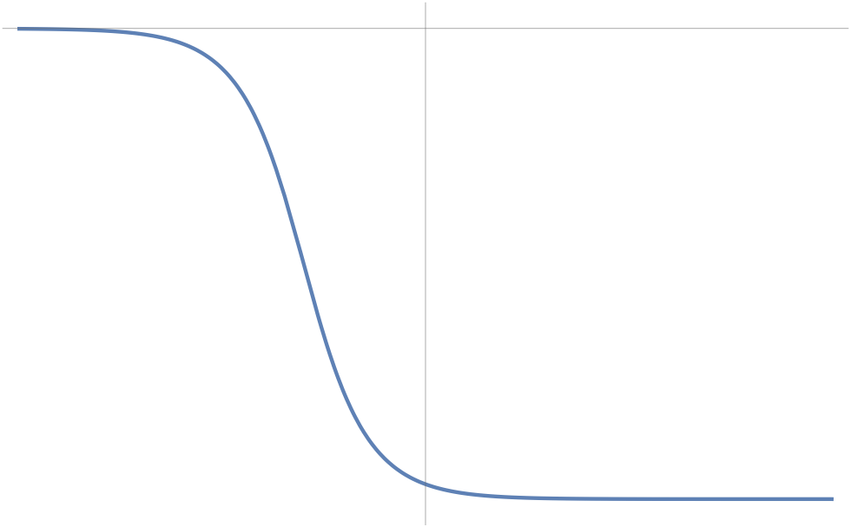
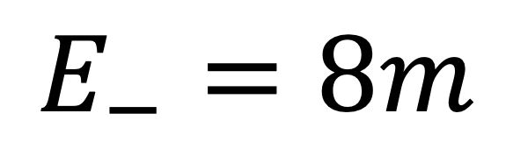
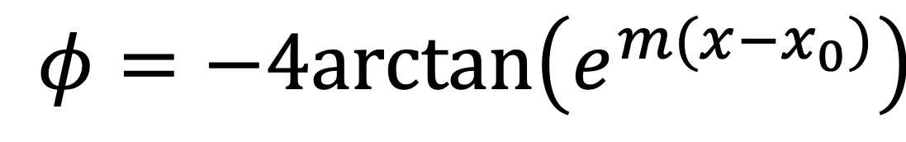
Laboratory: sine-Gordon model
Elementary zoology
$$ℒ_{SG}=\frac{1}{2}{\overset{·}{φ}}^{2}−\frac{1}{2}{φ^{′}}^{2}−m^{2}(1−cosφ)$$
Antikink
$$φ=−4arctan\left(e^{m(x−x_{0})}\right)$$
$$V(φ)$$
$$E_{−}=8m$$
$$φ$$

Slide 8
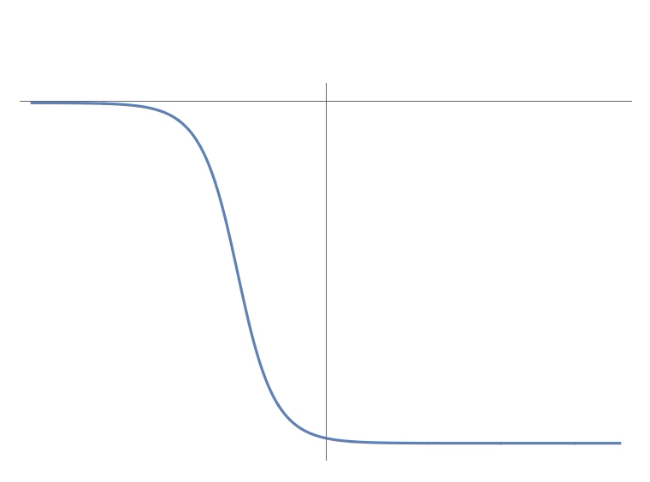
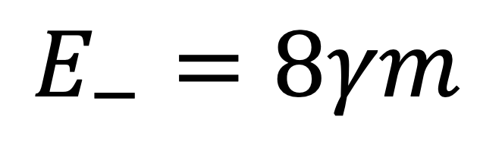
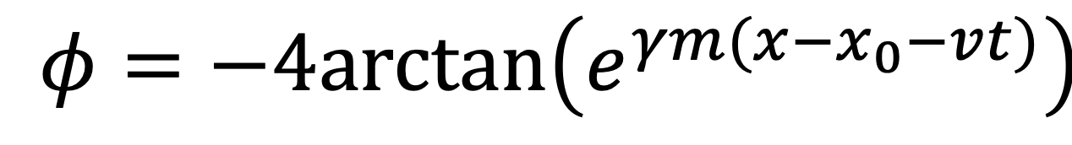
Laboratory: sine-Gordon model
Elementary zoology
$$ℒ_{SG}=\frac{1}{2}{\overset{·}{φ}}^{2}−\frac{1}{2}{φ^{′}}^{2}−m^{2}(1−cosφ)$$
Antikink
$$φ=−4arctan\left(e^{γm(x−x_{0}−vt)}\right)$$
$$V(φ)$$
$$E_{−}=8γm$$
$$φ$$

Slide 9

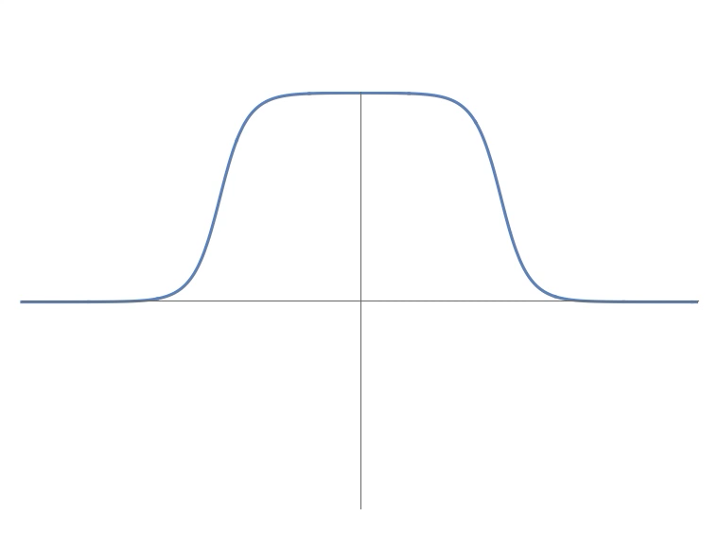
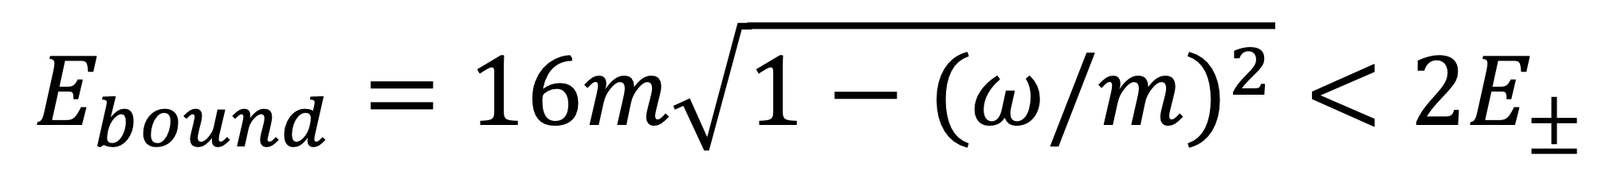
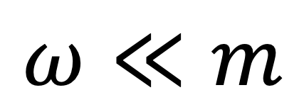
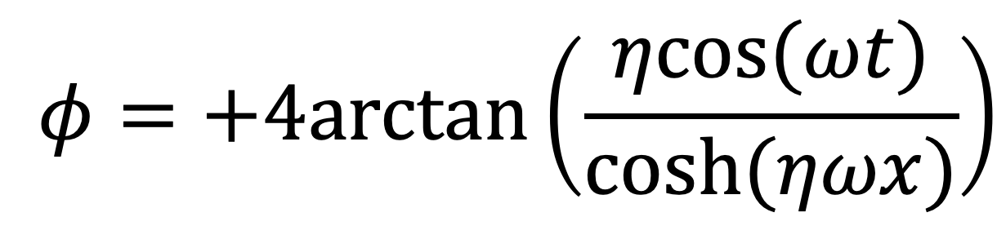
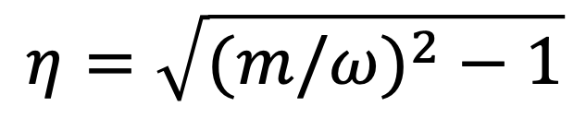
Laboratory: sine-Gordon model
Elementary zoology
$$ℒ_{SG}=\frac{1}{2}{\overset{·}{φ}}^{2}−\frac{1}{2}{φ^{′}}^{2}−m^{2}(1−cosφ)$$
$$η=\sqrt{(m/ω)^{2}−1}$$
Kink-antikink bound state
$$φ=+4arctan\left(\frac{ηcos(ωt)}{cosh(ηωx)}\right)$$
$$V(φ)$$
$$ω≪m$$
Large breather
$$φ$$
$$E_{bound}=16m\sqrt{1−(ω/m)^{2}}<2E_{±}$$

Slide 10
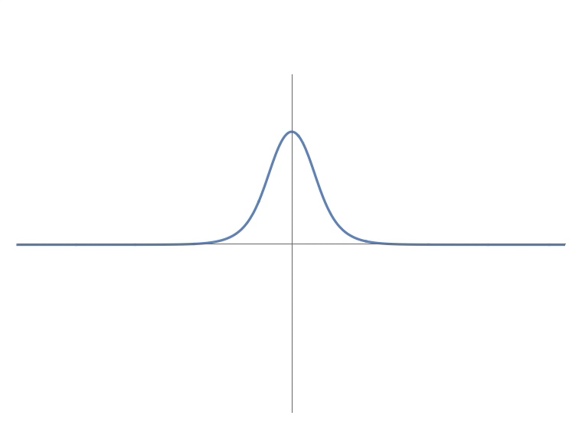
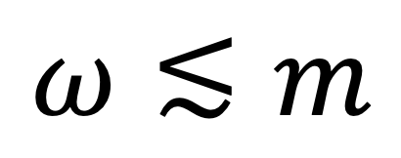
Laboratory: sine-Gordon model
Elementary zoology
$$ℒ_{SG}=\frac{1}{2}{\overset{·}{φ}}^{2}−\frac{1}{2}{φ^{′}}^{2}−m^{2}(1−cosφ)$$
$$η=\sqrt{(m/ω)^{2}−1}$$
Kink-antikink bound state
$$φ=+4arctan\left(\frac{ηcos(ωt)}{cosh(ηωx)}\right)$$
$$V(φ)$$
$$ω≲m$$
Small breather
$$φ$$
$$E_{bound}=16m\sqrt{1−(ω/m)^{2}}<2E_{±}$$

Slide 11
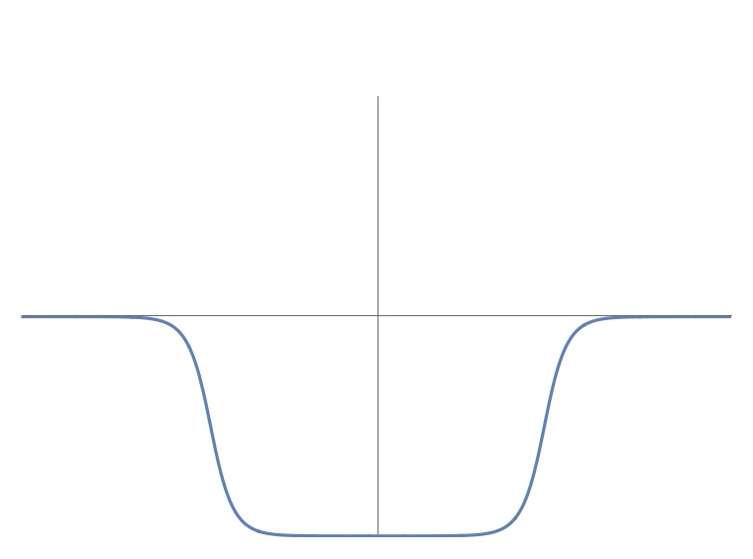
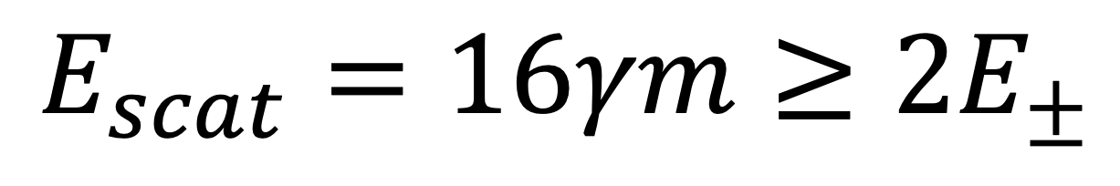
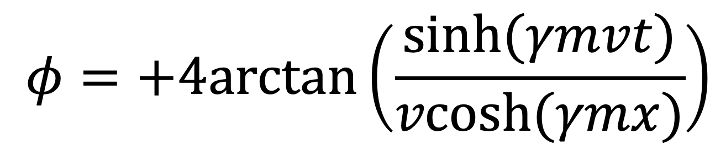
Laboratory: sine-Gordon model
Elementary zoology
$$ℒ_{SG}=\frac{1}{2}{\overset{·}{φ}}^{2}−\frac{1}{2}{φ^{′}}^{2}−m^{2}(1−cosφ)$$
Kink-antikink scattering state
$$φ=+4arctan\left(\frac{sinh(γmvt)}{vcosh(γmx)}\right)$$
$$V(φ)$$
$$φ$$
$$E_{scat}=16γm≥2E_{±}$$

Slide 13
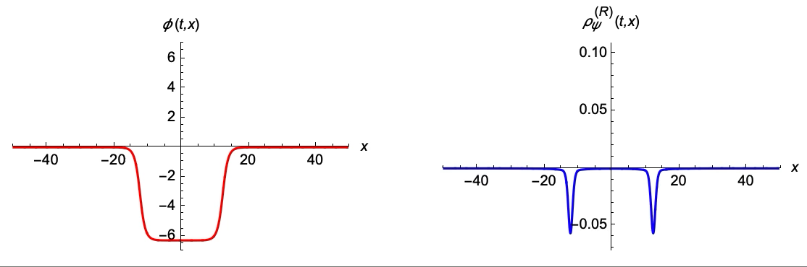



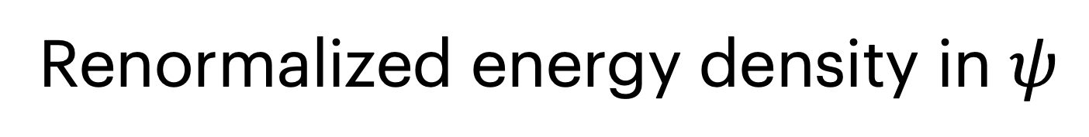
Quantum radiation: no backreaction
$$v=0.1,λ=0.3,μ=0.1$$
Given by exact sG solution
Renormalized energy density in $ψ$

Slide 14

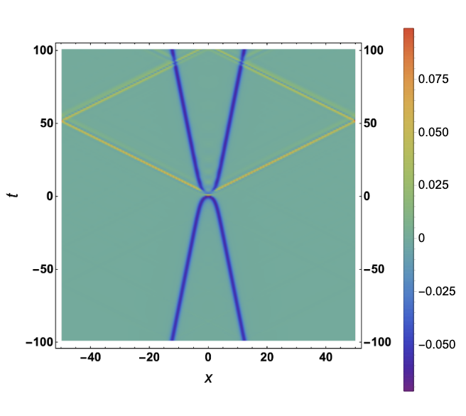
Quantum radiation: no backreaction
Given by exact sG solution
Renormalized energy density in $ψ$

Slide 16
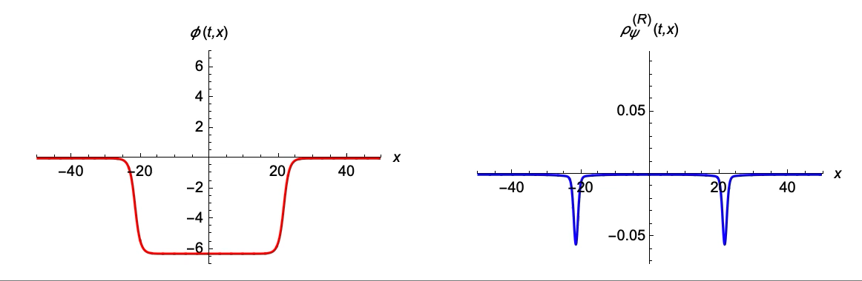

Quantum radiation: with backreaction
$$v=0.2,λ=0.3,μ=0.1$$
Given by backreacted sG solution
Renormalized energy density in $ψ$

Slide 17

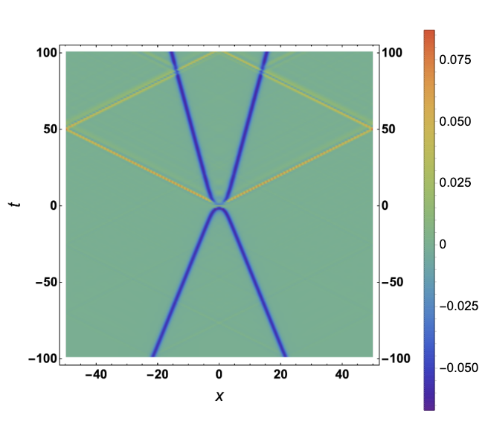
Quantum radiation: with backreaction
$$v=0.2,λ=0.3,μ=0.1$$
Given by backreacted sG solution
Renormalized energy density in $ψ$

Slide 18

Quantum radiation: with backreaction
$$v=0.2,λ=0.3,μ=0.1$$
Given by backreacted sG solution
Renormalized energy density in $ψ$

Slide 19
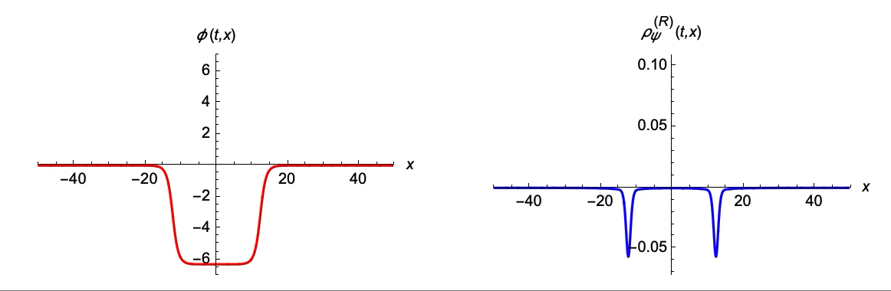
Quantum radiation: with backreaction
$$v=0.1,λ=0.3,μ=0.1$$
Given by backreacted sG solution
Renormalized energy density in $ψ$

Slide 20
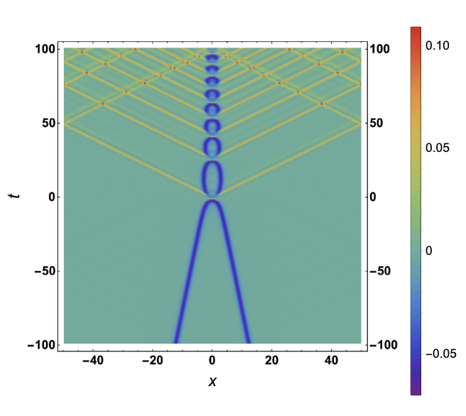
Quantum radiation: with backreaction
$$v=0.1,λ=0.3,μ=0.1$$
Given by backreacted sG solution
Renormalized energy density in $ψ$

Slide 21

Quantum radiation: with backreaction
$$v=0.1,λ=0.3,μ=0.1$$
Given by backreacted sG solution
Renormalized energy density in $ψ$

Slide 22
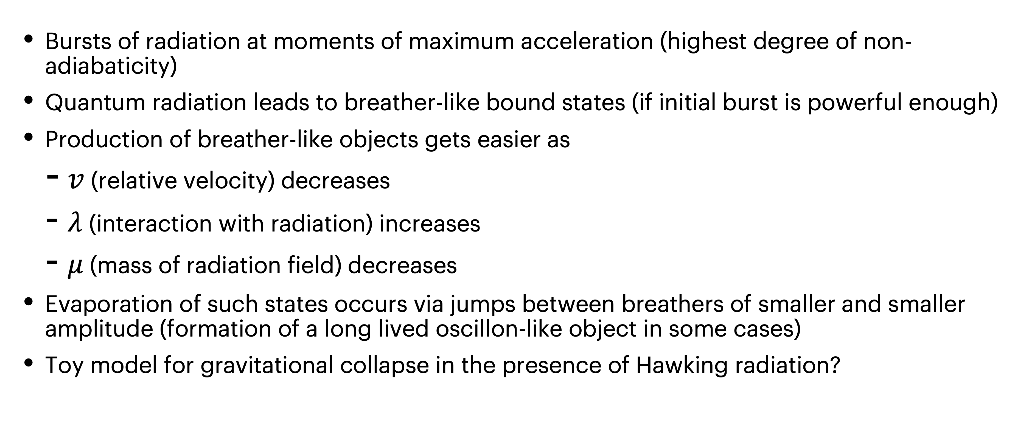
Takeaway
Kink-antikink scattering is inelastic in the presence of quantum radiation
Bursts of radiation at moments of maximum acceleration (highest degree of non-adiabaticity)
Quantum radiation leads to breather-like bound states (if initial burst is powerful enough)
Production of breather-like objects gets easier as
  $v$ (relative velocity) decreases
  $λ$ (interaction with radiation) increases
  $μ$ (mass of radiation field) decreases
Evaporation of such states occurs via jumps between breathers of smaller and smaller amplitude (formation of a long lived oscillon-like object in some cases)
Toy model for gravitational collapse in the presence of Hawking radiation?

Slide 23


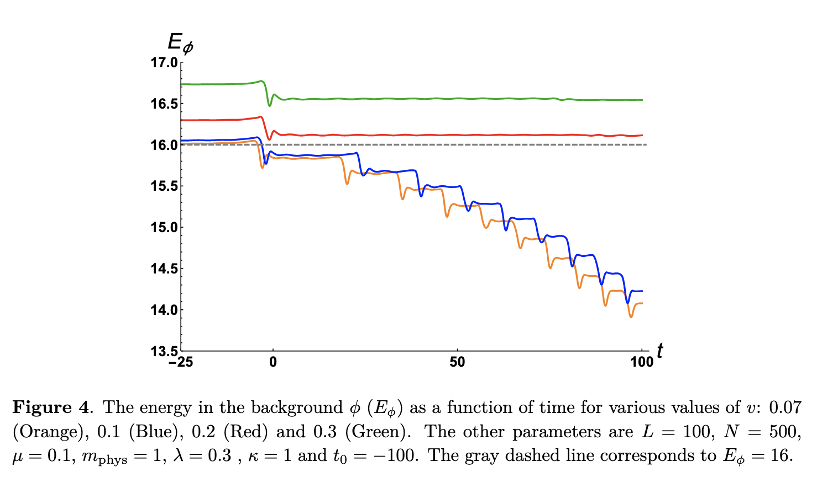
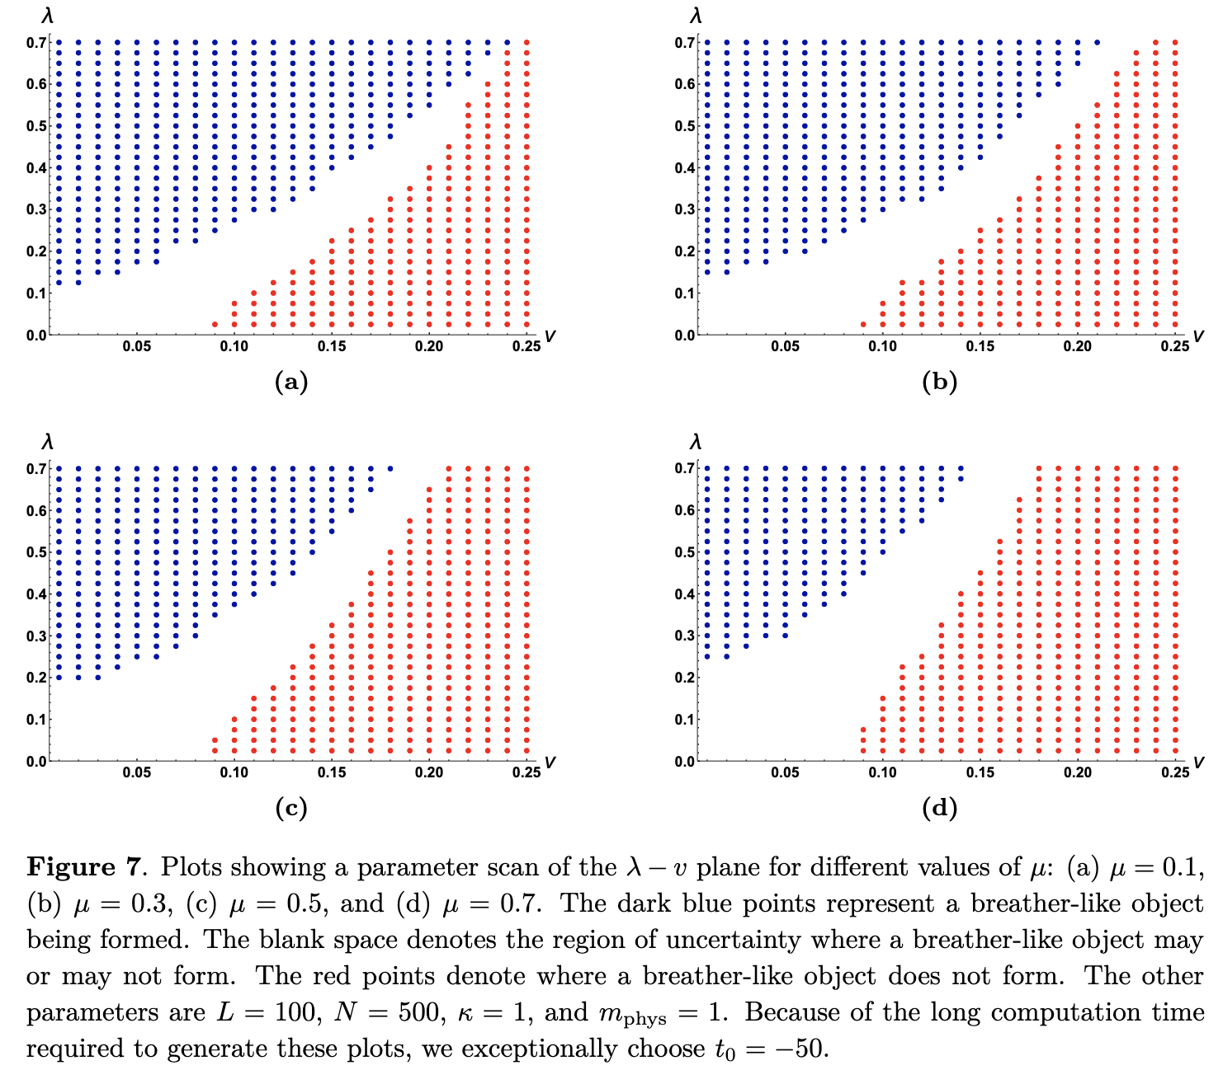

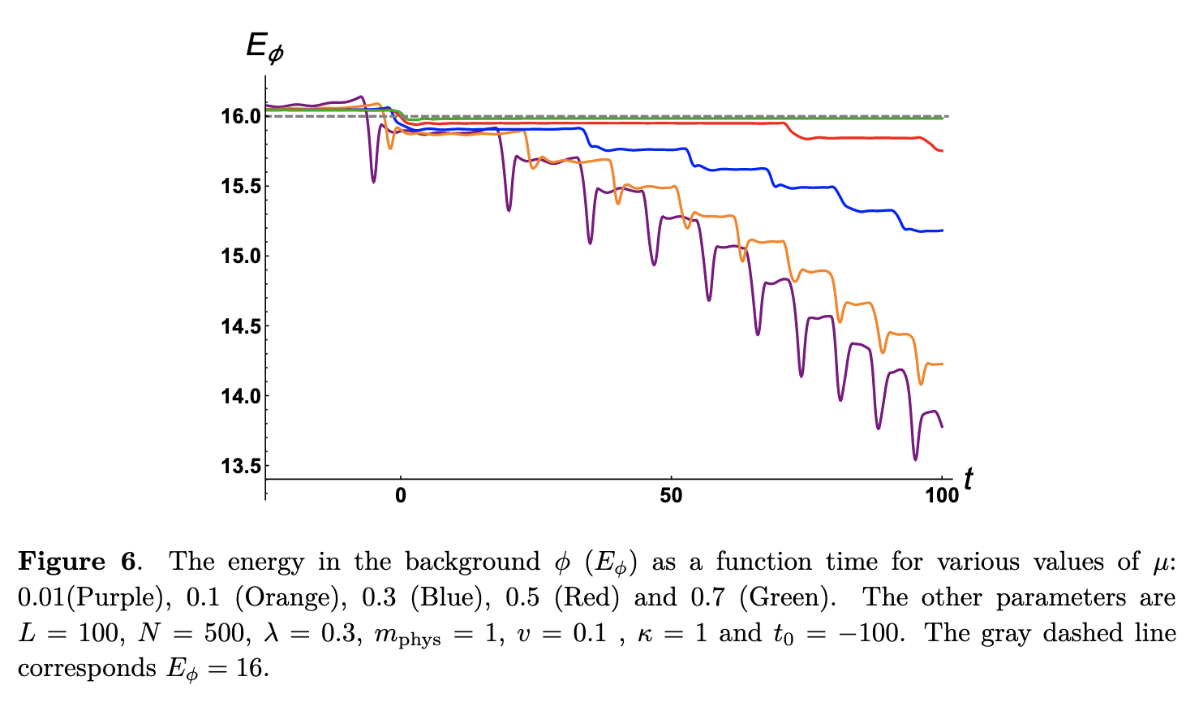

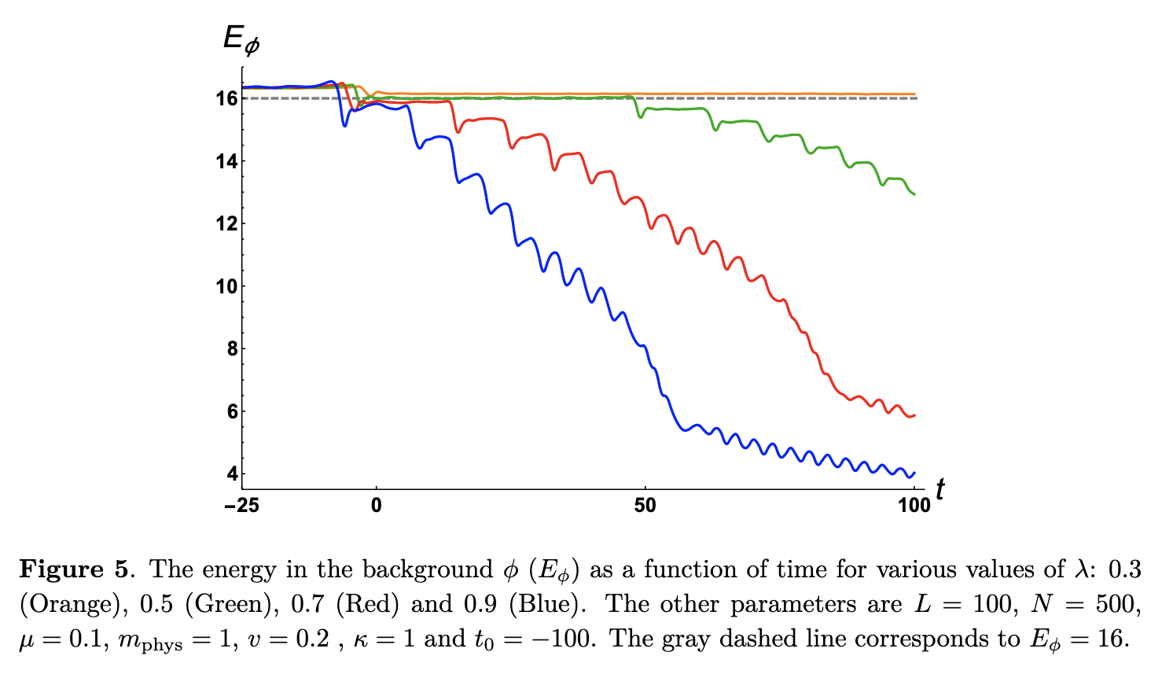
Additional slide: decay or not decay?

Slide 24

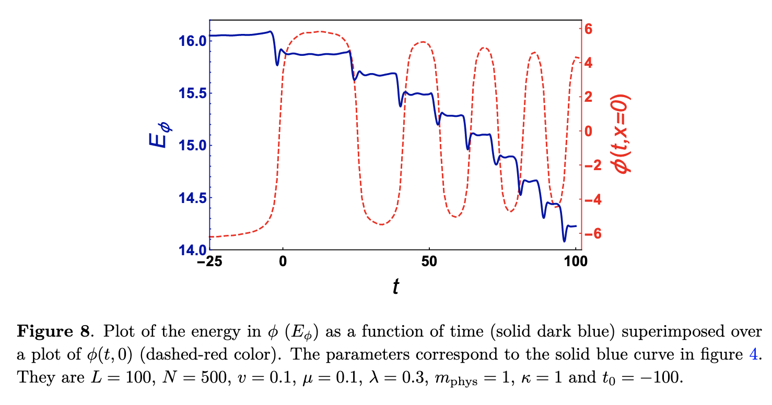

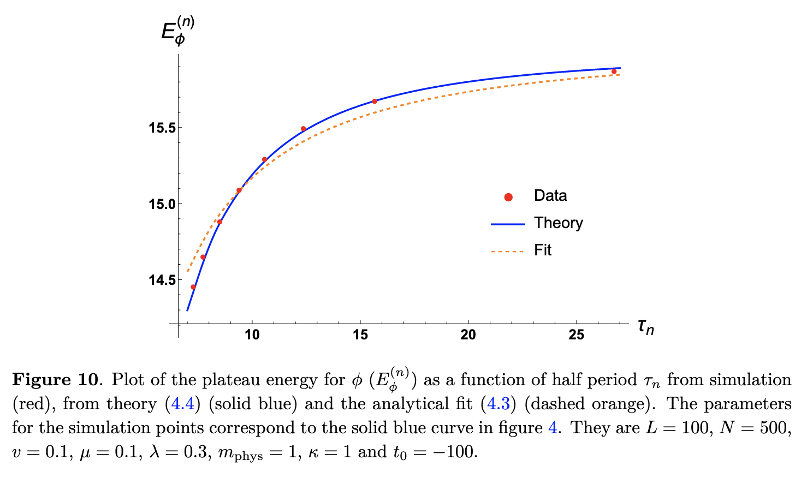
Additional slide: from breather to breather

