Slide 1

The Big Bang in the Lab:
Table Top Experiments of Reheating After Inflation
Jonathan Braden
Canadian Institute for Theoretical Astrophysics
[in prep]
Related work :
JHEP 07 (2018) 014
JHEP 10 (2019) 174
PASCOS 2022 @ Heidelberg, July 25, 2022

Slide 2
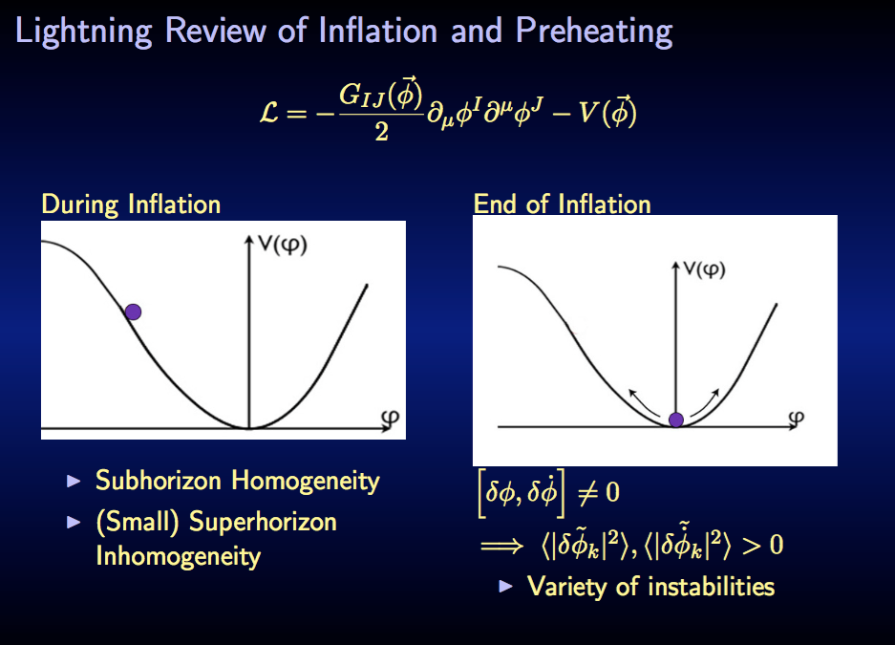


Slide 3
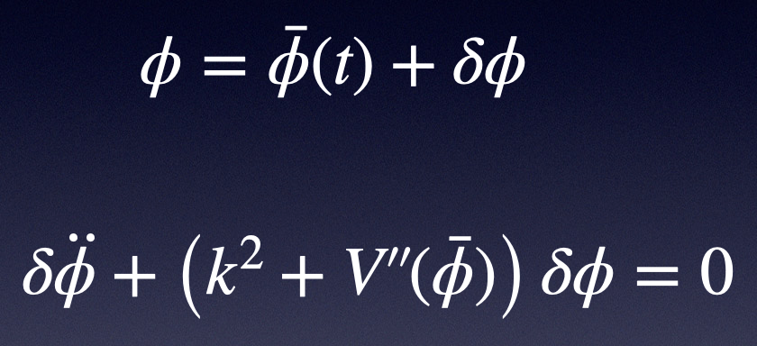
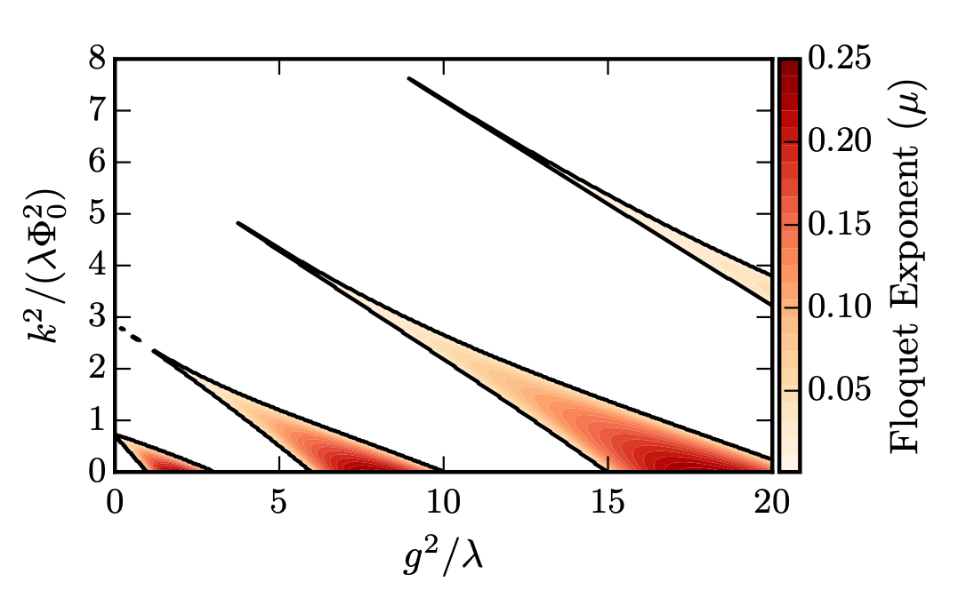


Preheating (linear theory)
[e.g. Traschen, Bradendberger /
Kofman, Linde, Starobinski]
$$V(φ)=\frac{λ}{4}φ^{4}$$
$$\overline{φ}$$
In linear theory,
acts as an external driver
for the fluctuations
Full treatment includes backreaction and rescattering

Slide 4
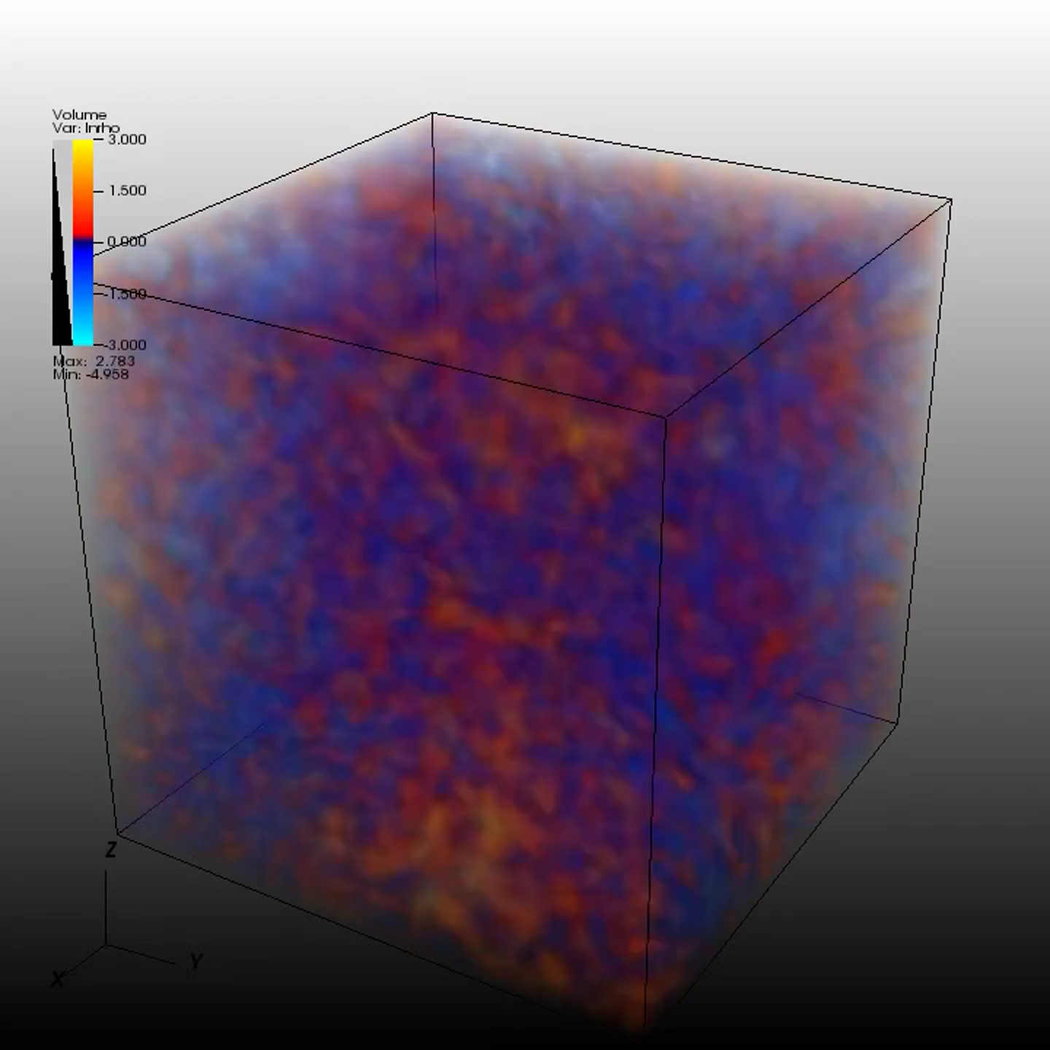

Slide 5
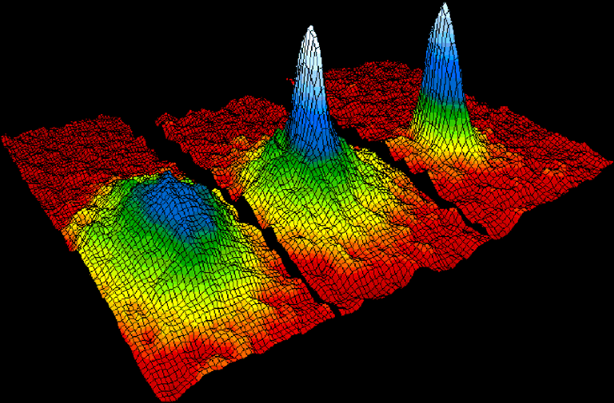
Analogue Systems?

Slide 6

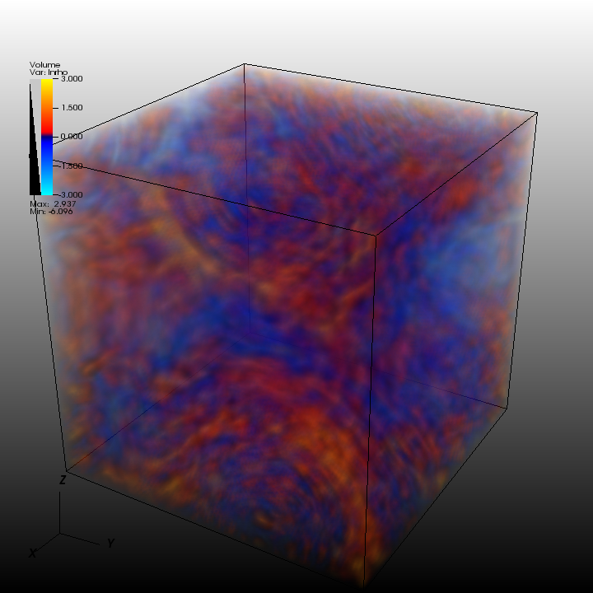

Finite number effects
Trapping Potential
Finite Temperature
This Talk

Slide 7
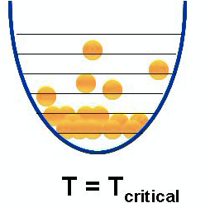
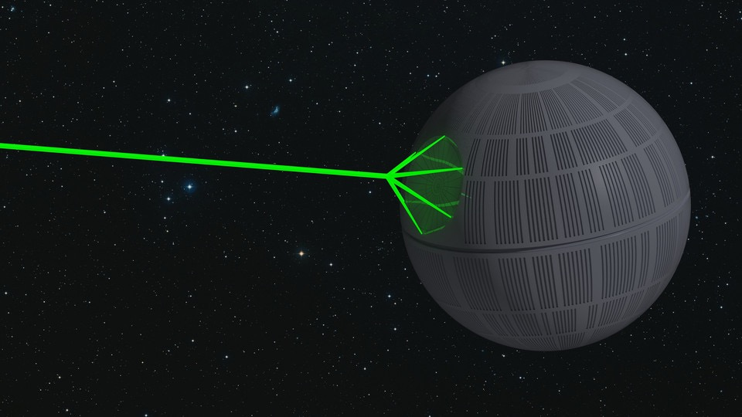
Building an Analogue System
[Fialko, Opanchuk, Sidorov, Drummond, and Brand]
[JB, Johnson, Peiris, Weinfurtner]
[Billam, Gregory, Michel, and Moss]
Important Scale : Healing Length
Crossover between wave and
particle dispersion relationship

Slide 8

Modelling BEC Dynamics
KE
PE
S-wave
Conversion

Slide 9



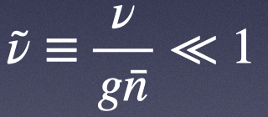


BECs and Relativity
Can. Momentum
(Particle density)
Can. Position
(Complex phase)
Assumptions
Useful limit
1) Homogeneous
2) Small
First Hint: Relativistic Dispersion for $k<k_{heal}$
$$ℏ^{2}ω^{2}=m^{2}+c^{2}k^{2}\left(1+\frac{k^{2}}{k_{heal}^{2}}\right)$$
$$k_{heal}^{2}=\frac{4mg\overline{n}}{ℏ^{2}}=4\frac{m}{g\overline{n}}\frac{g^{2}{\overline{n}}^{2}}{ℏ^{2}}$$

Slide 10


Small Density Fluctuations

Slide 11


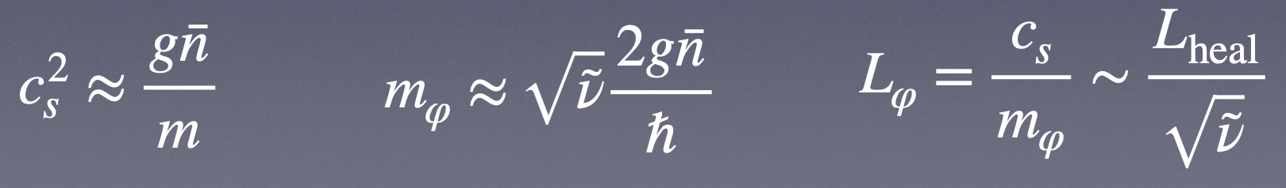


Small Density Fluctuations
A convenient variable is
$$φ=φ_{2}−φ_{1}$$
Integrate out fluctuations in number density
Relative phase governed by sine-Gordon model
$$ℒ_{eff}∼\frac{{\overset{·}{φ}}^{2}}{2}−c_{s}^{2}\frac{(∇φ)^{2}}{2}+νΛcosφ+…$$

Slide 12
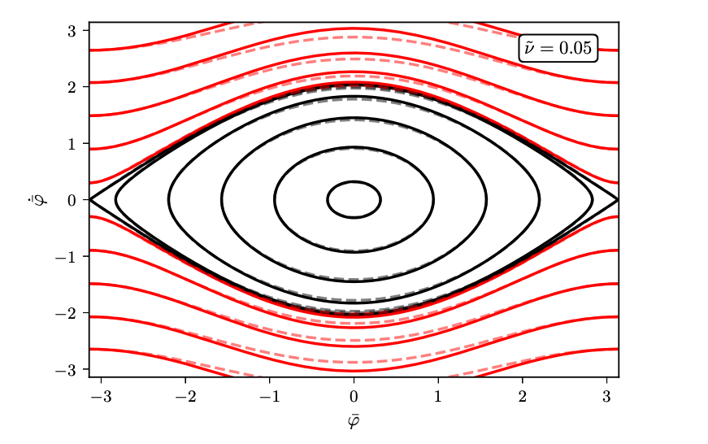
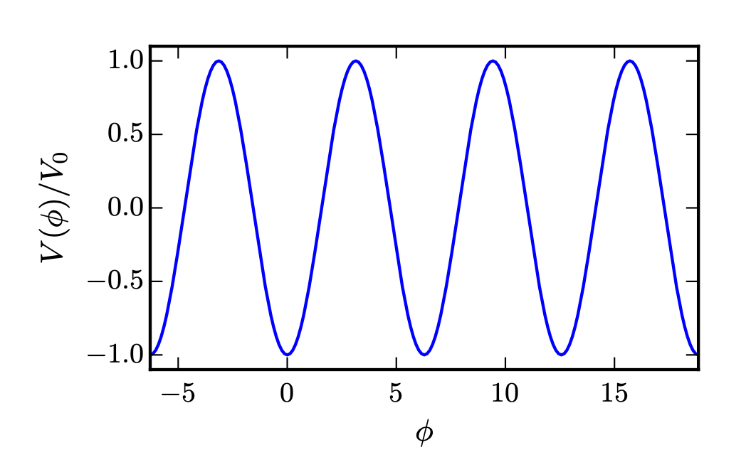
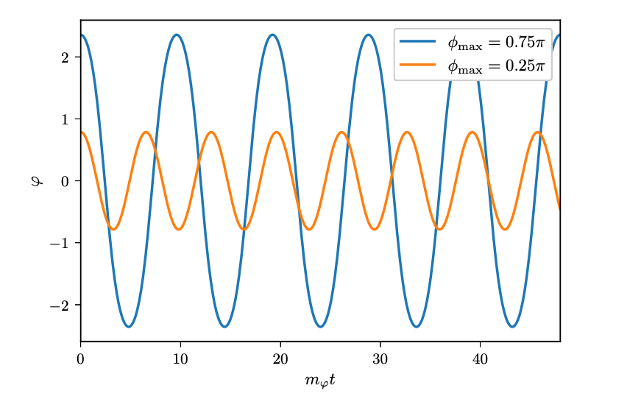
Homogeneous Background Evolution
Two periodic motion types
Black - single minimum
Red - scan minima

Slide 13
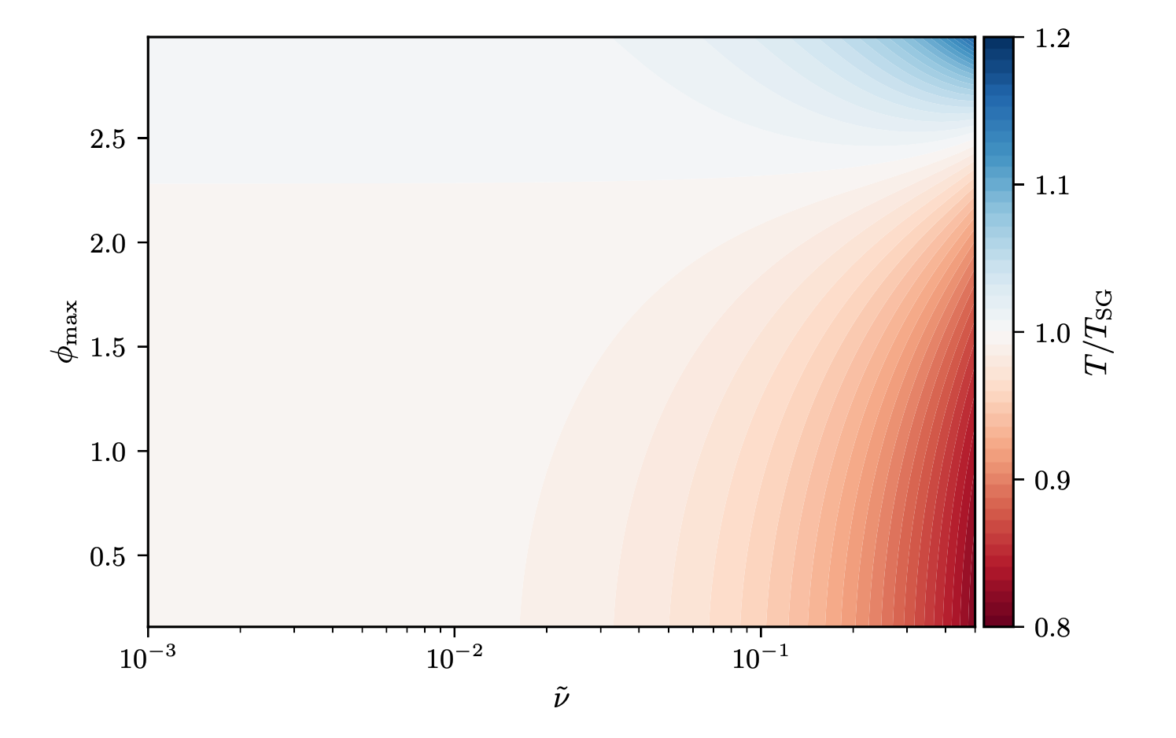

Background Period
Period matches SG for

Slide 14
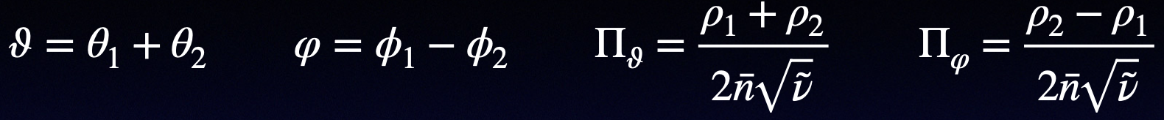
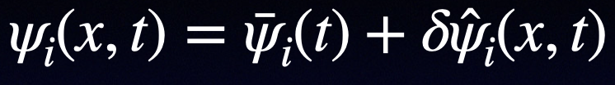
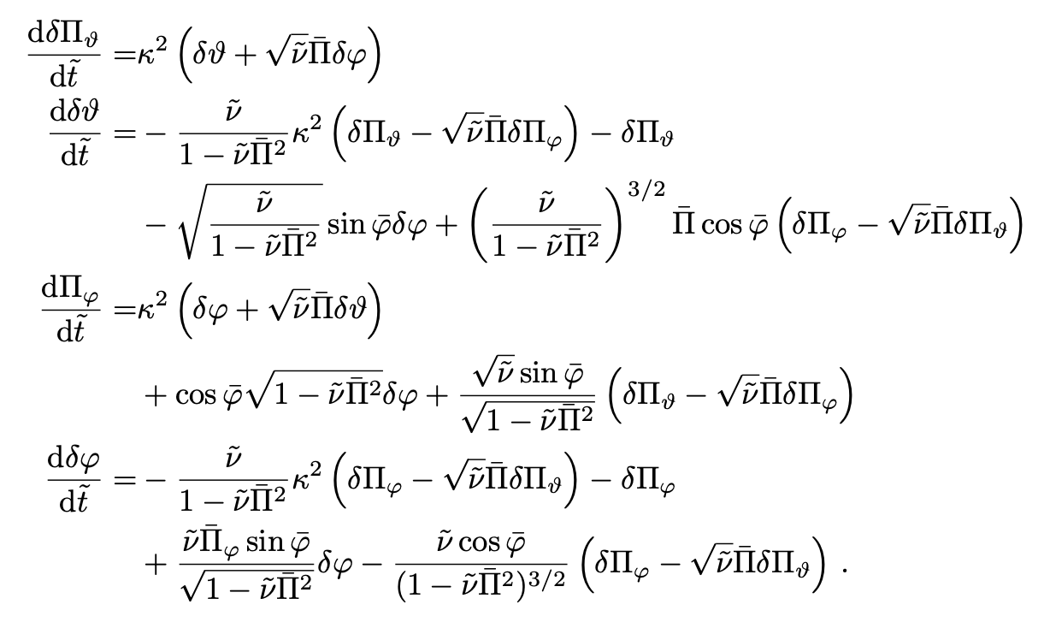
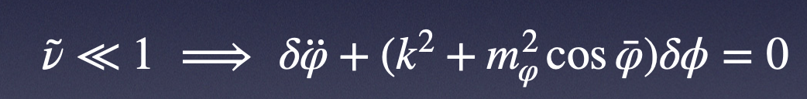



Perturbation Equations
$$\frac{dy}{dt}=L(t)y$$
$$L(t+T)=L(t)$$
Our old friend the sine-Gordon model
Positive real part
=> exponential growth
Periodic $\overline{φ}$ and ${\overline{Π}}_{φ}$ $⟹$solutions $δy=P(t)e^{μt}$

Slide 15
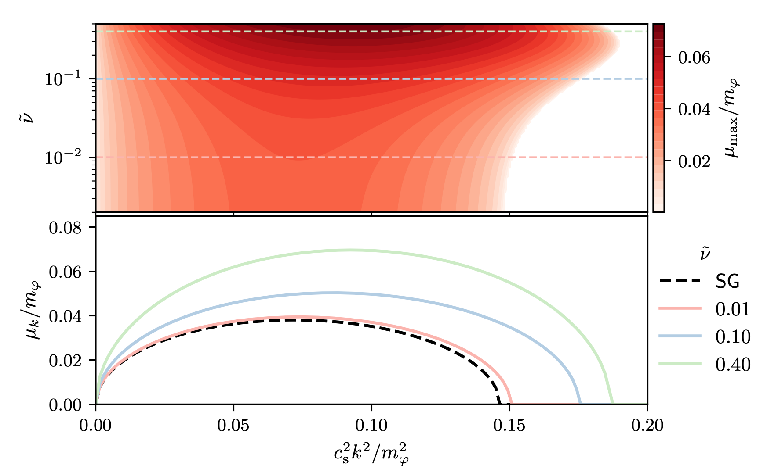

Linear Instability ($φ_{max}=0.25π$)

Slide 16
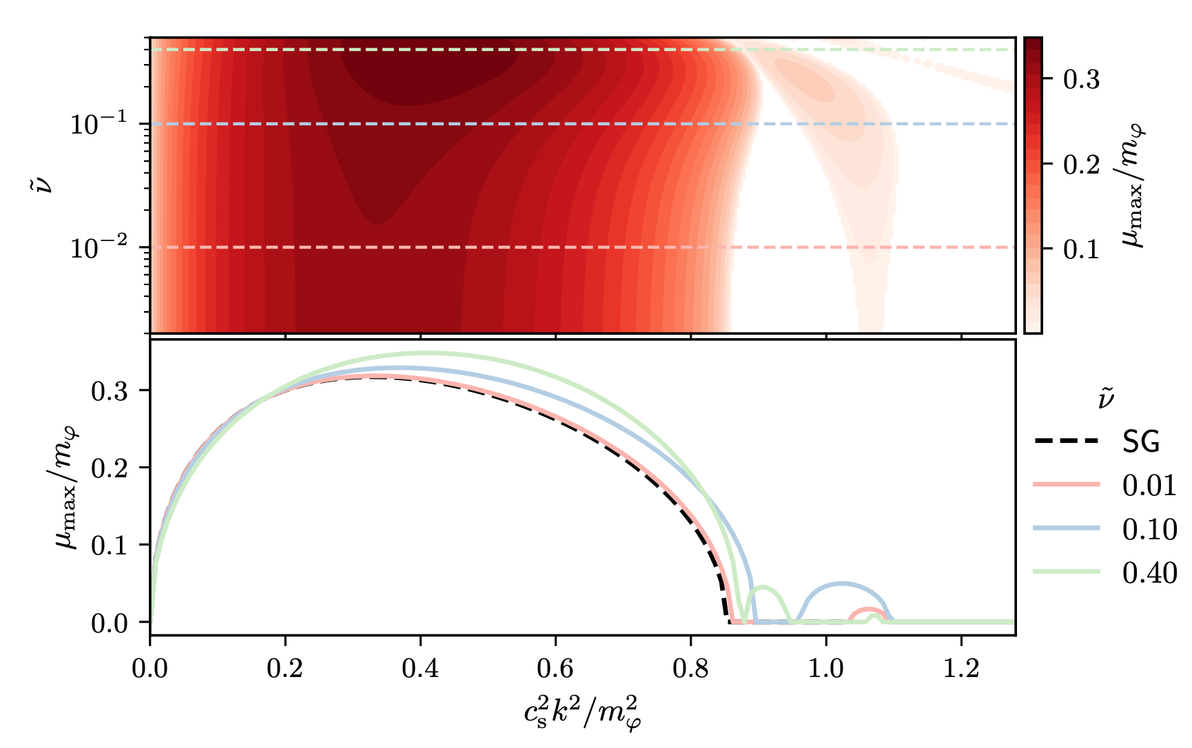

Linear Instability ($φ_{max}=0.75π$)

Slide 17
What About Nonlinearity

Slide 18
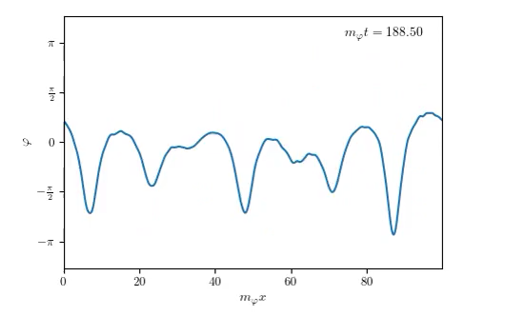
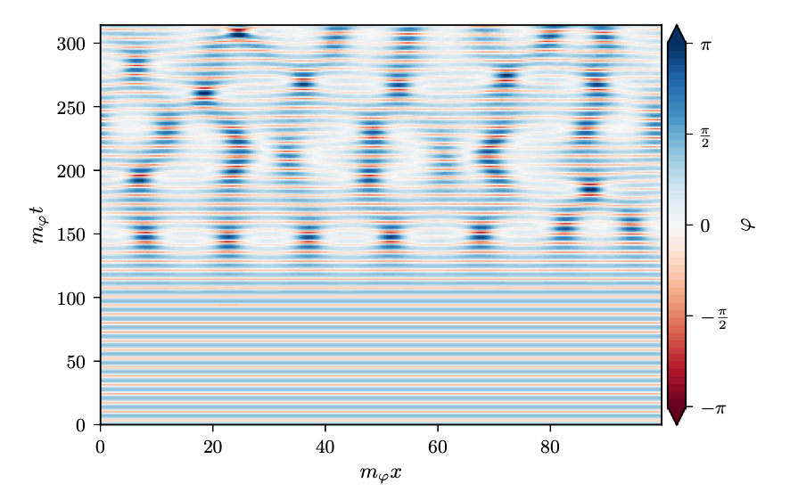
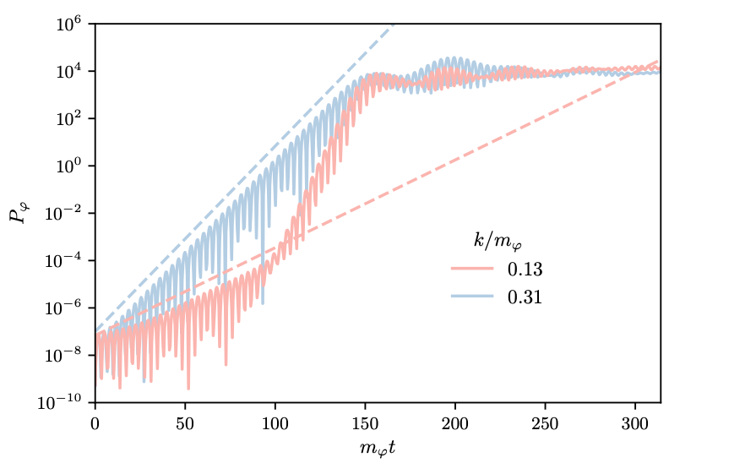
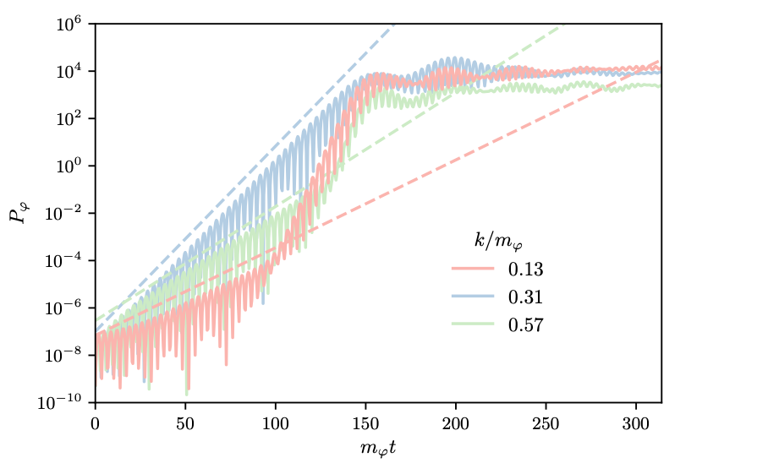
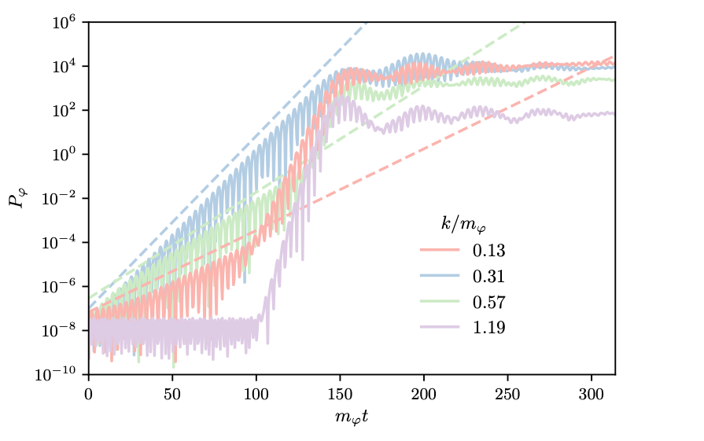
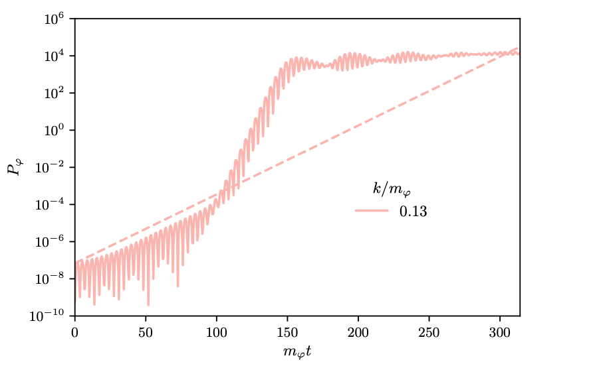
1D Analog Preheating
Early : Linear (Floquet) theory
Intermediate : Rescattering
Late : Solitary waves

Slide 19
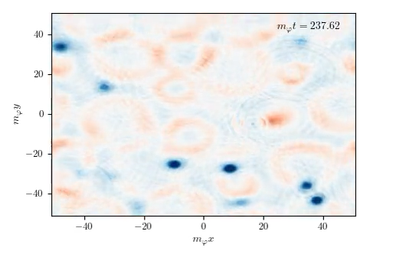

3D Analog Preheating
Field Momentum $\overset{·}{φ}$ with mean removed

Slide 20
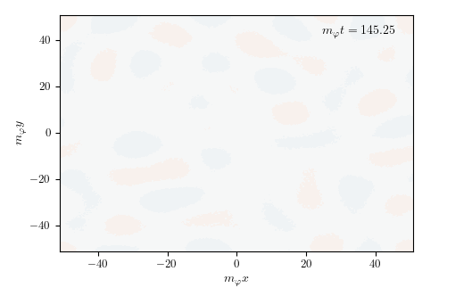
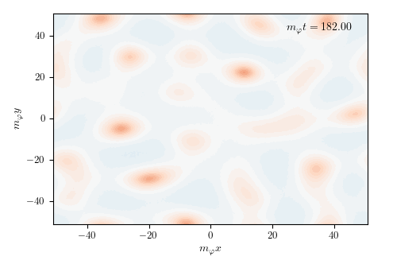
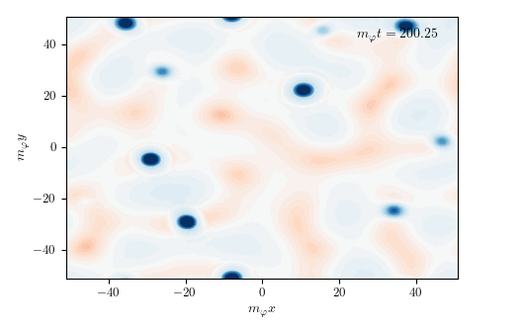
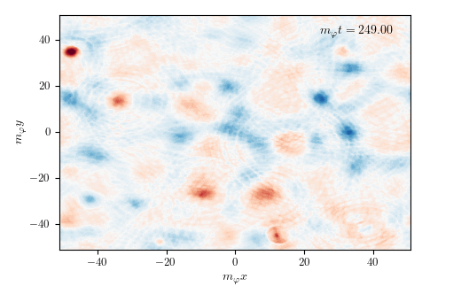

3D Analog Preheating
Field Momentum $\overset{·}{φ}$ with mean removed

Slide 21
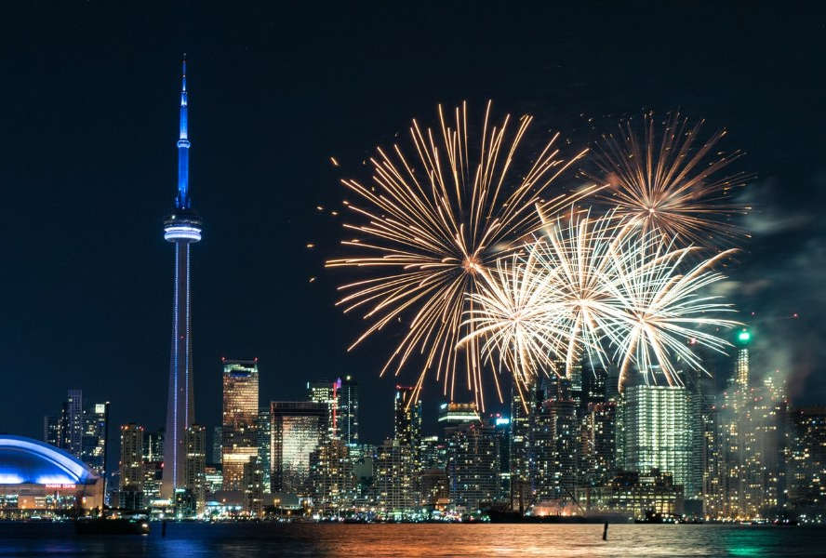
BUT …

Slide 22
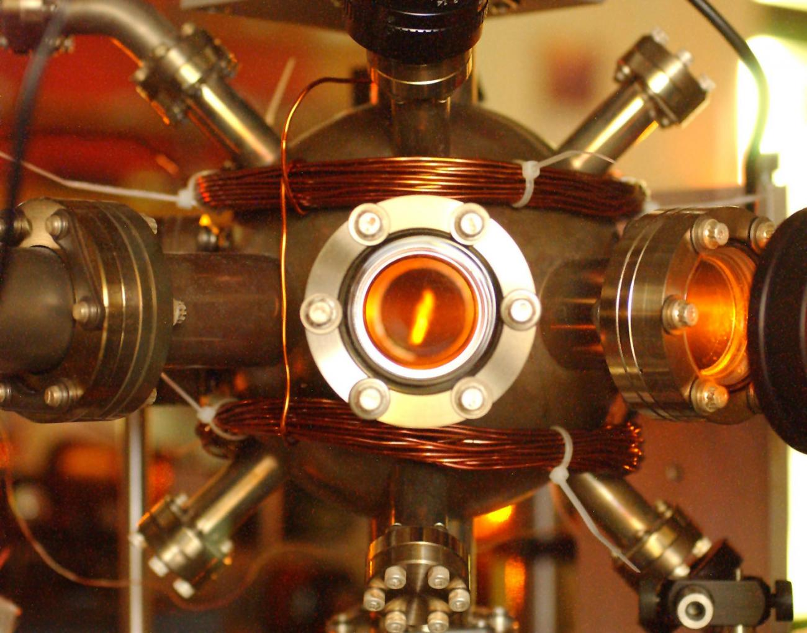
… Real BECs are Trapped
$V(x)$=0 homogeneous: $\overline{ψ}$ $→V(x)≠0$ inhomogeneous $\overline{ψ}(x)$
Does parametric resonance still work?

Slide 23
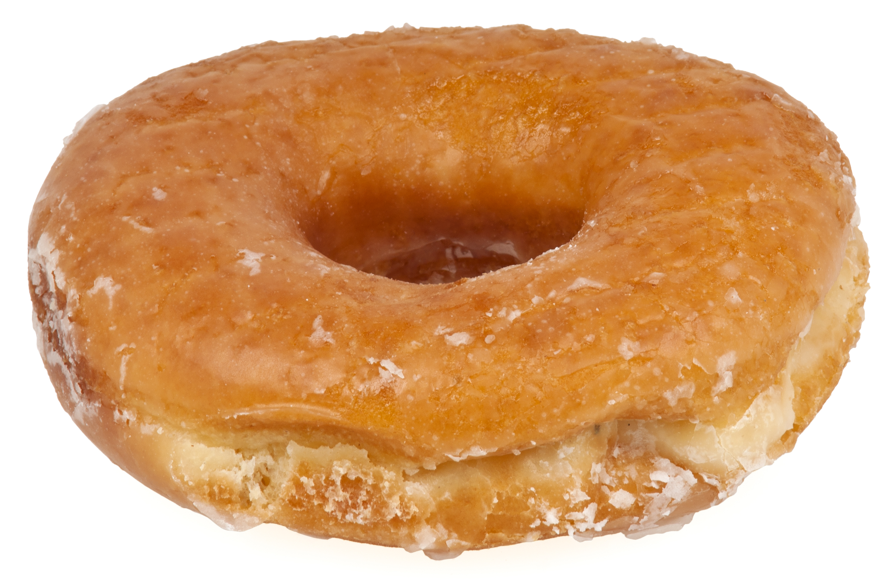
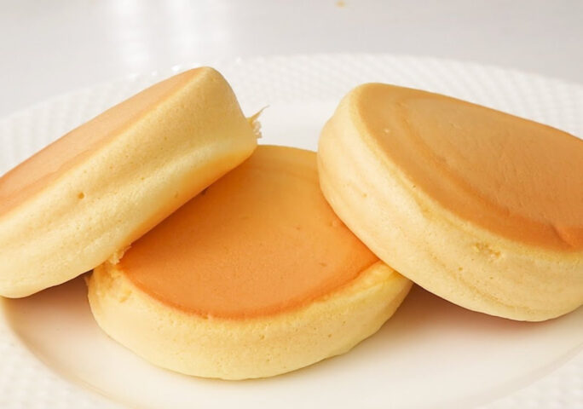
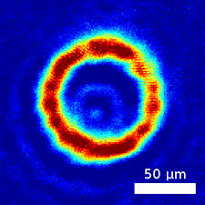
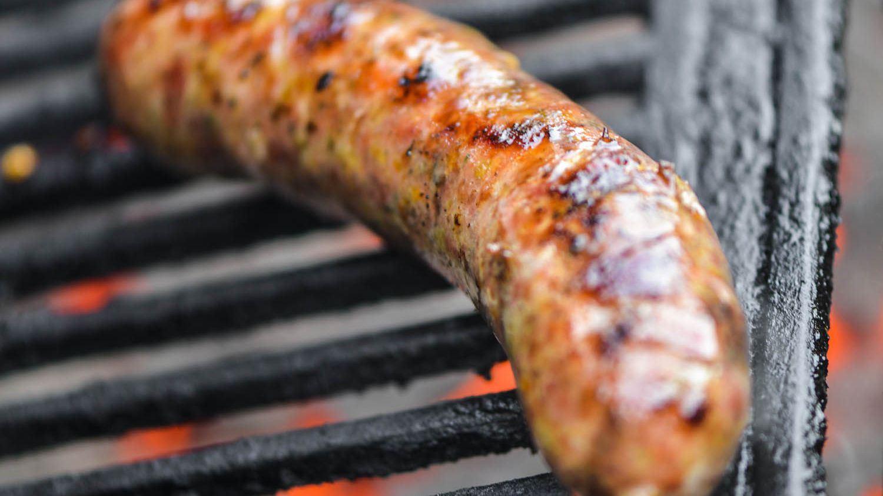
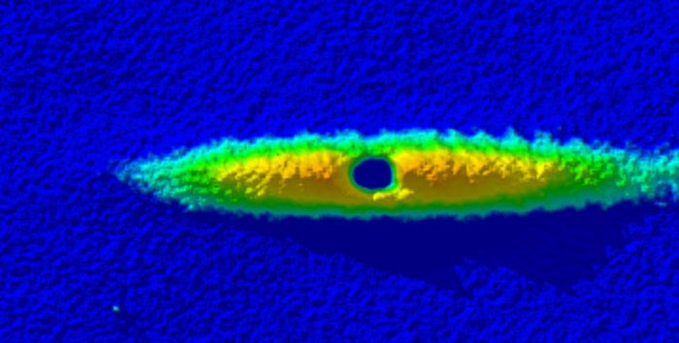
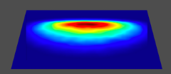


Dimensional Reduction
Idea : Integrate out trapped directions
Pancake Trap
Cigar Trap
Ring Trap
$$\frac{g^{D−1}}{g^{D}}=\frac{1}{L_{⊥}}=\frac{∫dx_{⊥}n^{2}}{∫dx_{⊥}n}=\frac{∫dx_{⊥}|ψ_{⊥}|^{4}}{∫dx_{⊥}|ψ_{⊥}|^{2}}$$

Slide 24
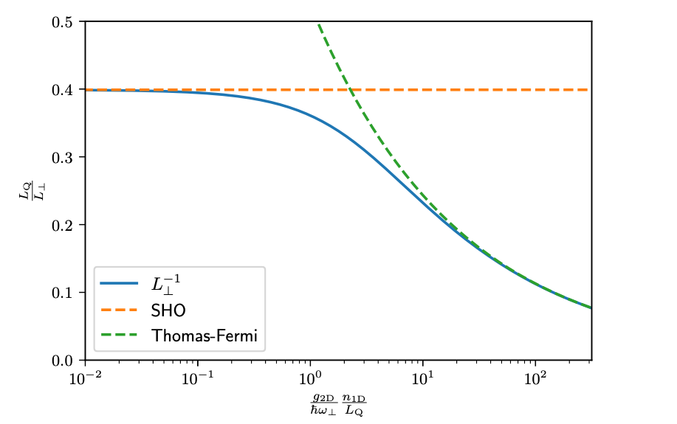
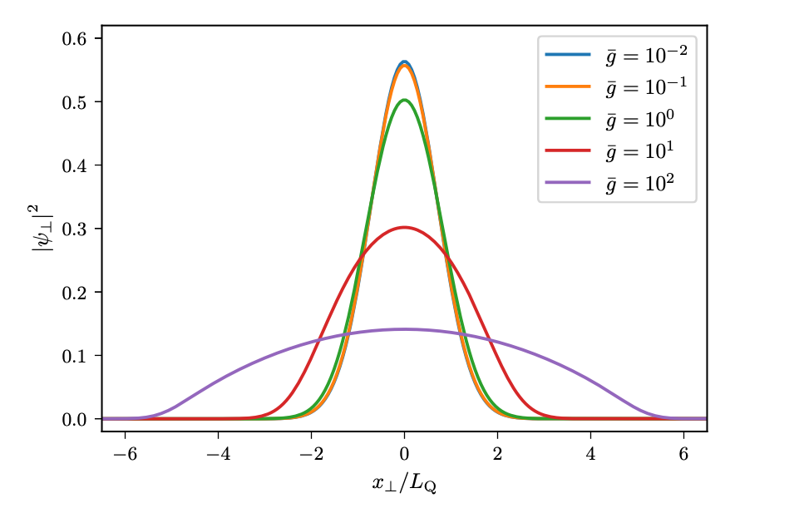
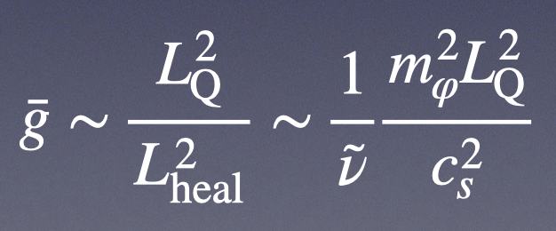



Harmonic Trap
$$V(x_{∥},x_{⊥})=\frac{1}{2}mω_{⊥}^{2}x_{⊥}^{2}$$
$$L_{Q}^{2}=\frac{ℏ}{mω_{⊥}}$$
$$μψ_{⊥}=\left[−\frac{ℏ^{2}}{2m}∇_{⊥}^{2}+V_{trap}(x_{⊥})+g^{D}{\left|ψ_{⊥}\right|}^{2}\right]ψ_{⊥}$$

Slide 25
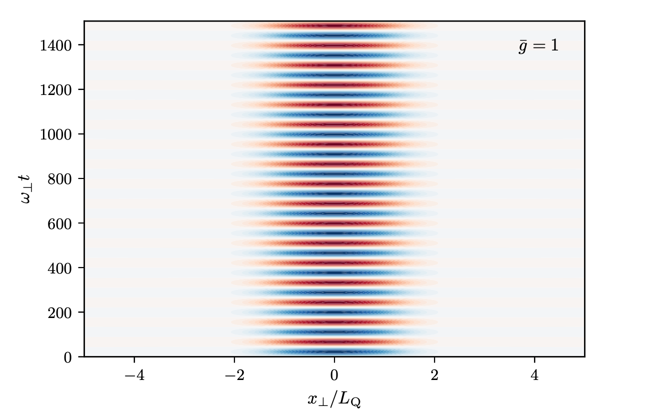
Background Evolution
Evolution matches dimensionally reduced simulations
Is trapping maintained with parametric resonance?

Slide 26
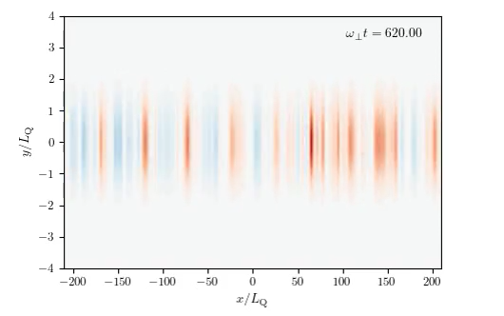
Preheating in a Trap
Trapping Direction

Slide 27
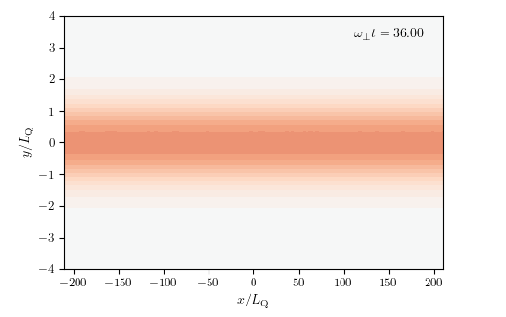
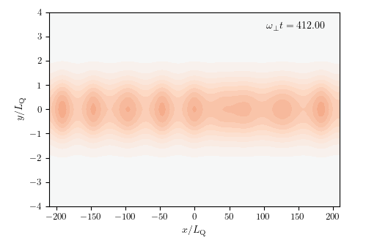
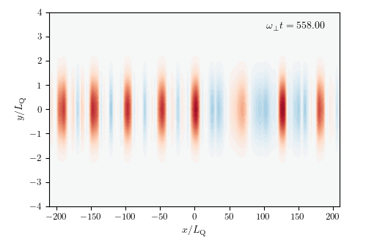
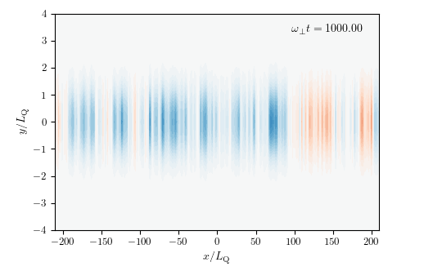
Preheating in a Trap
Trapping Direction

Slide 28
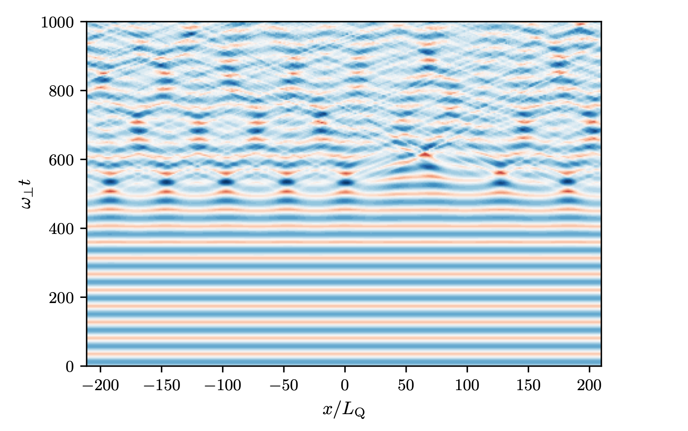
Effective 1D Field Evolution

Slide 29
Summary
Coupled dilute gas Bose-Einstein condensates can behave as relativistic fields
Setups exist to mimic end-of-inflation
(self-induced parametric resonance -> nonlinearity)
Linear theory : BEC and cosmological calculation match, deviations controlled by tunable parameter
Solitary waves in nonlinear regime
Persists in more realistic case of trapped BEC

Slide 30
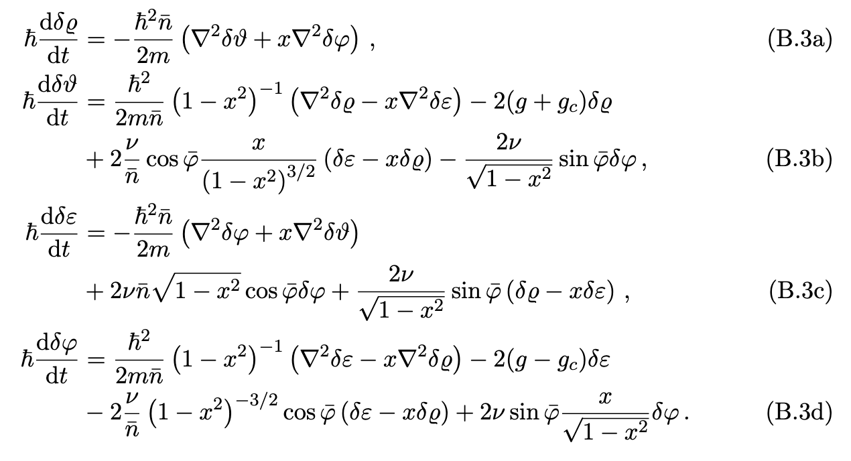

Slide 31

Full realizations in nonlinear simulations

