Slide 1

Multi-Field Oscillons
A complicated, but relevant phenomenon
Fabio van Dissel, 27/07/2022
PASCOS 2022 Parallel session C

Slide 2
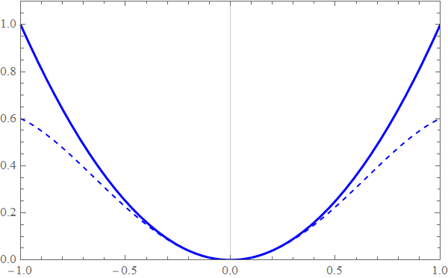
Introduction: Oscillons
Localized configurations in classical scalar field theories
Oscillating
Attractive
Unstable (Albeit Long-Lived)
Requirement: A Potential
“Shallower than Quadratic”
Potential
Field

Slide 3
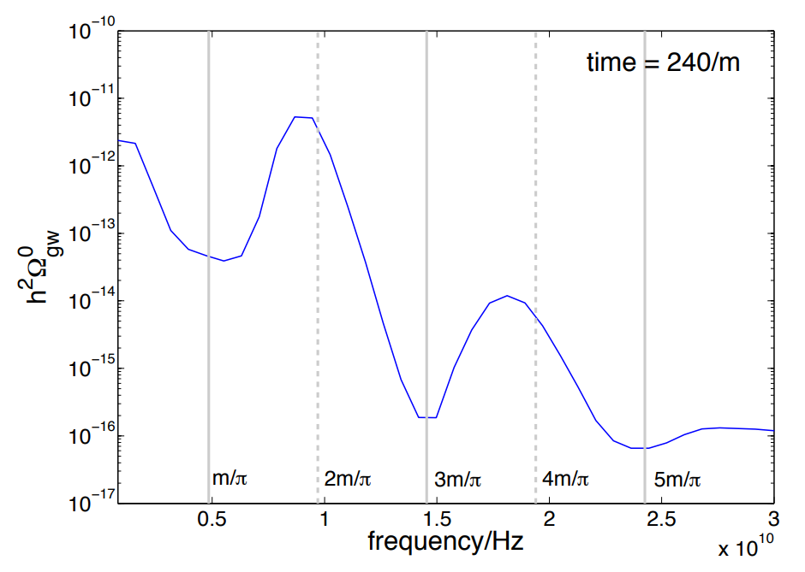
Introduction: Relevance
Relevance in Cosmology
Dark Matter [arXiv:1906.06352 Ollé et al.]
Gravitational Waves [arXiv:1304.6094 Copeland et al.]
Relevance in Spectroscopy
The QCD Sector of SM (short lifetimes) [arXiv:9805382 Hormuzdiar et al.]

Slide 4
The Case For Multi-Field
String- and Supersymmetric theories
Axiverse
Supersymmetric Scalar partners
General Phenomenology
What are their signatures?

Slide 5

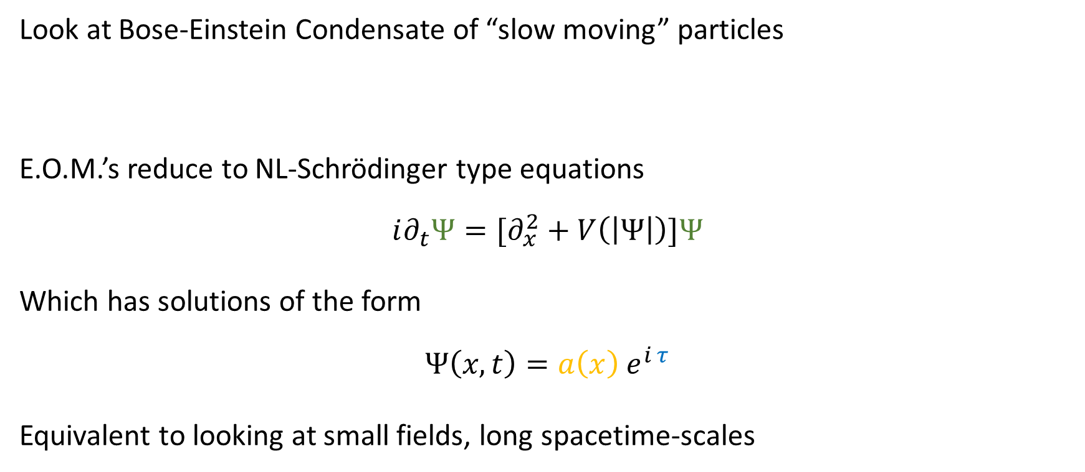
The Nonrelativistic Limit
Look at Bose-Einstein Condensate of “slow moving” particles
E.O.M.’s reduce to NL-Schrödinger type equations
$$i∂_{t}Ψ=[∂_{x}^{2}+V\left(\left|Ψ\right|\right)]Ψ$$
Which has solutions of the form
$$Ψ\left(x, t\right)=a\left(x\right) e^{i τ}$$
Equivalent to looking at small fields, long spacetime-scales
$$φ\left(x, t\right)≈e^{−imt} Ψ\left(x, t\right)+c.c.$$

Slide 6
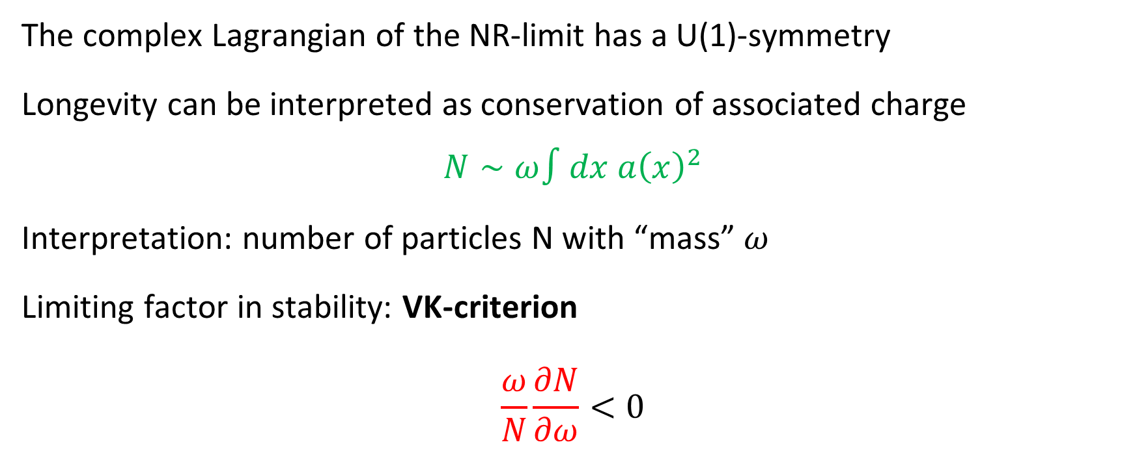
The “Conserved” Charge
The complex Lagrangian of the NR-limit has a U(1)-symmetry
Longevity can be interpreted as conservation of associated charge
$$N∼ω∫dx a{\left(x\right)}^{2}$$
Interpretation: number of particles N with “mass” $ω$
Limiting factor in stability: VK-criterion
$$\frac{ω}{N}\frac{∂N}{∂ω}<0$$

Slide 7
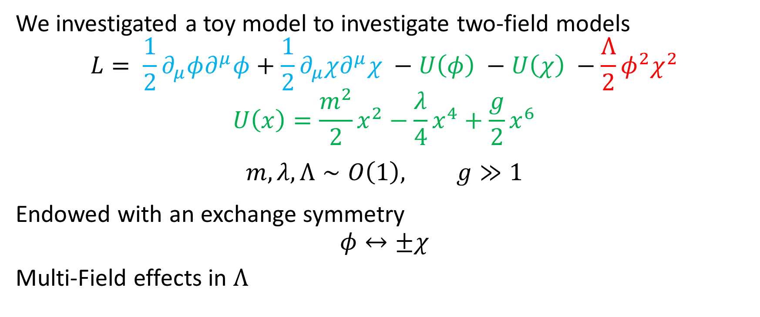
A Simple Model
We investigated a toy model to investigate two-field models
$$L= \frac{1}{2}∂_{μ}φ∂^{μ}φ+\frac{1}{2}∂_{μ}χ∂^{μ}χ −U\left(φ\right) −U\left(χ\right) −\frac{Λ}{2}φ^{2}χ^{2}$$
$$U\left(x\right)=\frac{m^{2}}{2}x^{2}−\frac{λ}{4}x^{4}+\frac{g}{2}x^{6}$$
$$m, λ, Λ∼O\left(1\right), g≫1$$
Endowed with an exchange symmetry
$$φ↔±χ$$
Multi-Field effects in $Λ$

Slide 8
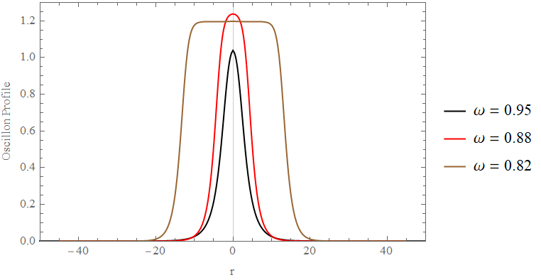
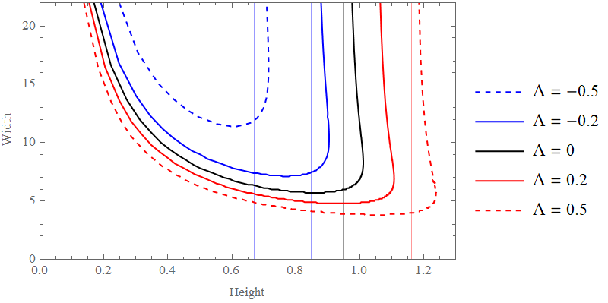

A Simple Model
$$Λ=0.5$$

Slide 9
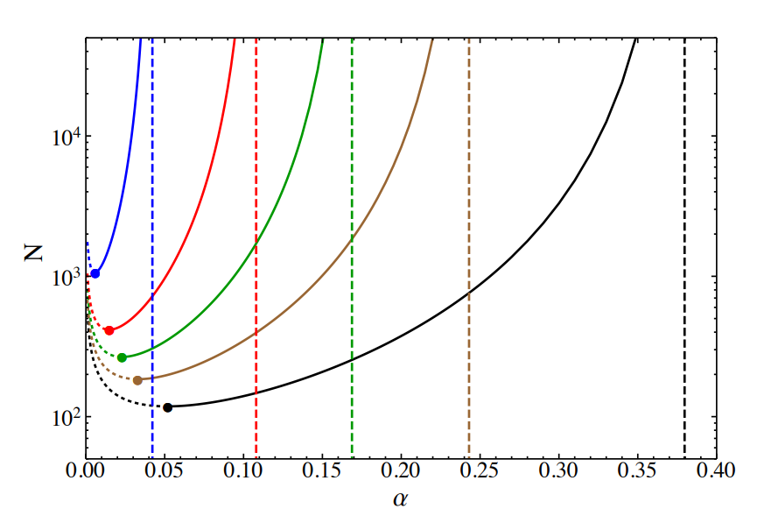
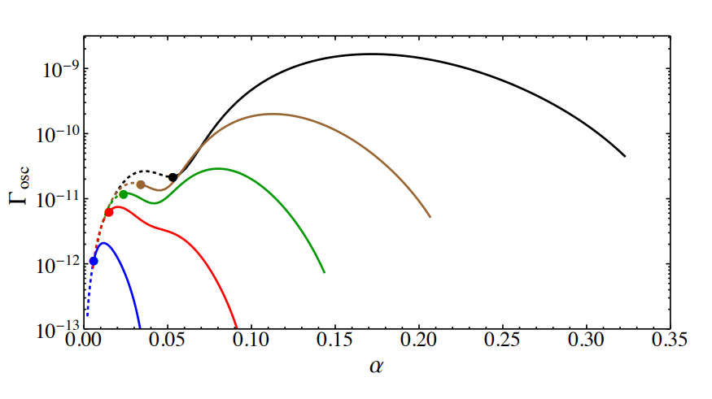

A Simple Model
Stability Lifetime
$$ω=\sqrt{1−αε^{2}}$$

Slide 10
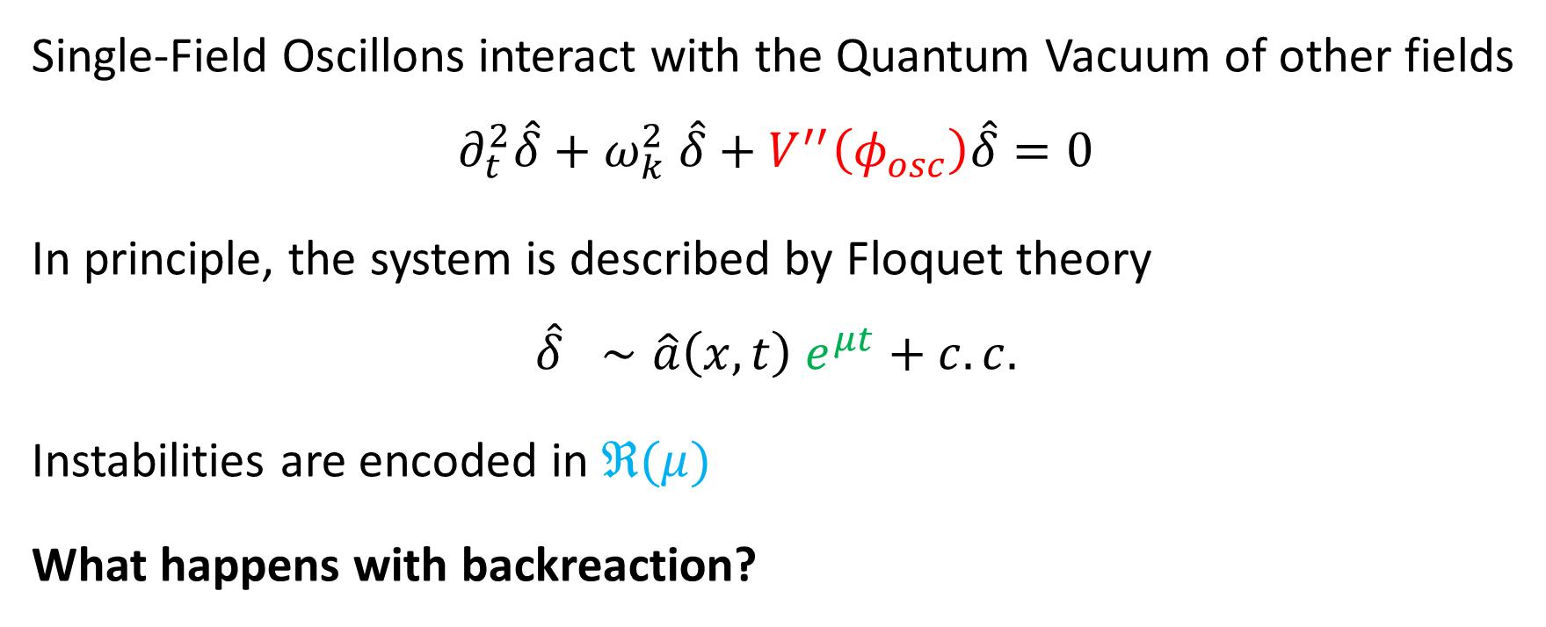
Semiclassical Instability
Single-Field Oscillons interact with the Quantum Vacuum of other fields
$$∂_{t}^{2}\hat{δ}+ω_{k}^{2} \hat{δ}+V^{′′}\left(φ_{osc}\right)\hat{δ}=0$$
In principle, the system is described by Floquet theory
$$\hat{δ} ∼\hat{a}\left(x, t\right) e^{μt}+c.c.$$
Instabilities are encoded in $ℜ(μ)$
What happens with backreaction?

Slide 11
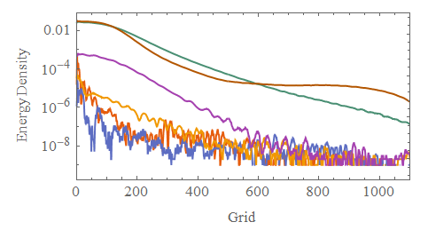
Emergence
Search for unstable modes
Initialize with Classical Fluctuations

Slide 12
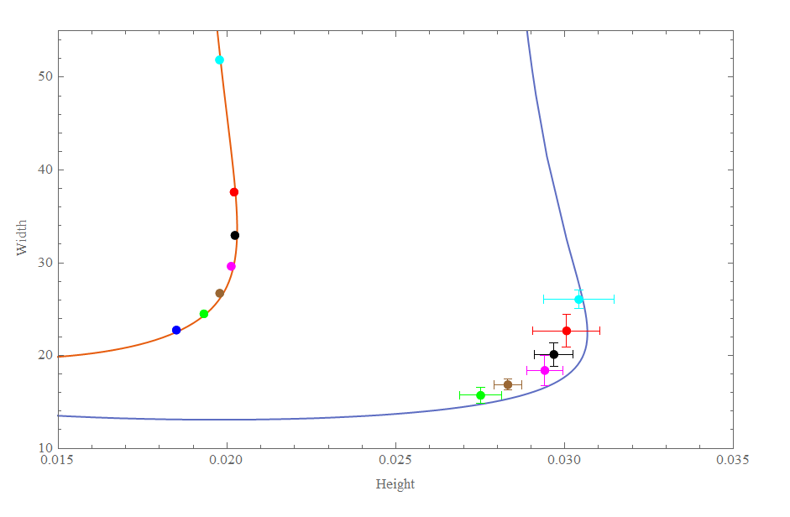
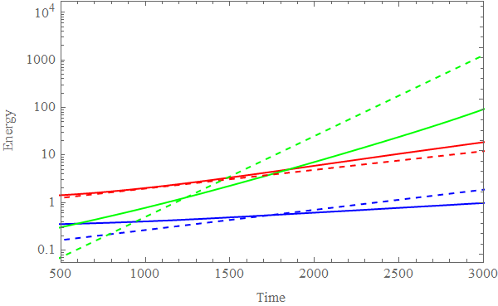
Emergence
Exponential Growth and Multi-Field Oscillon Formation
Different Colors = Different Frequency

Slide 13
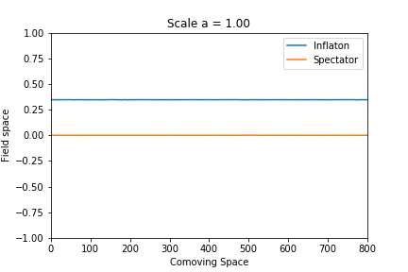
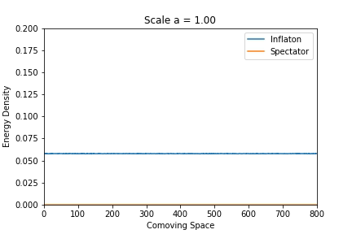


Emergence: Preheating
Field Fragmentation in Preheating: New Scenario
$$Fields φ, χ$$
$$Energy Density ρ$$

Slide 14
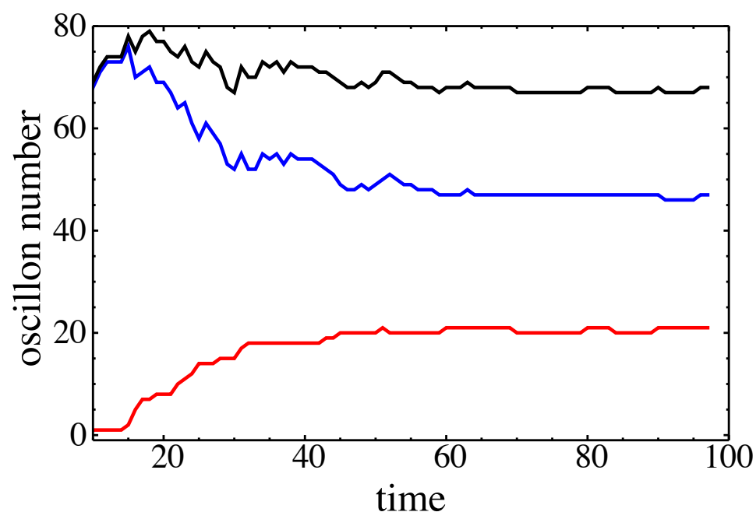
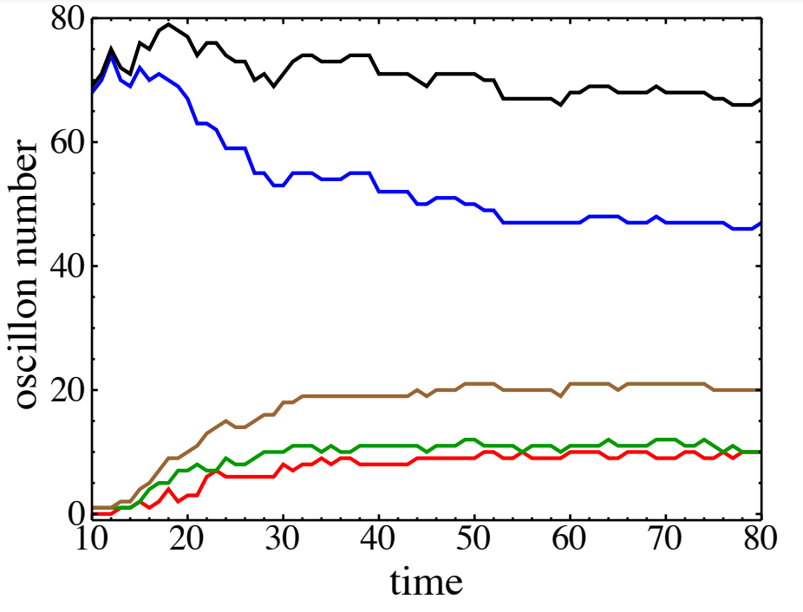
Emergence: Preheating
In this scenario the fragmentation occurs in four distinct phases
Fragmentation of the Inflaton
Inflaton settles into Single-Field oscillons
The Single-Field oscillons (sometimes) excite instabilities in the spectator field
Composite oscillons are formed
Total
Single Component
Total Multi
Three Component
Two Component
Total
Single Component
Two Component
1 Spectator
2 Spectators

Slide 15
Novel Effects?
Instabilities in the Vacuum alter Single Field predictions
  Extra Linear Radiation Channel otherwise [arXiv:1003.3459 Hertzberg]
In some cases the full nonlinear theory will support multi-component oscillons
  Preheating singatures (GW)?

Slide 16
Conclusions
Oscillons have provided promising probes of scalar theories
Understanding their Multi-Component Nature could reveal new aspects of BSM theories where scalars are prevalent
Here I highlighted some novel effects using a toy model focusing on the effects of vacuum instabilities and how multi-field oscillons could emerge naturally during preheating

Slide 17
Thank You!

Slide 18

Computing Radiation
The oscillon expansion is not closed and higher harmonics obey radiation boundary conditions
We can write an approximate EOM for radiation
$${\ddot{δ}}_{rad}+∇^{2}δ_{rad}+δ_{rad}=S_{3}\left(φ_{osc}\right)+S_{5}(φ_{osc})$$
We can find the solution for $δ_{rad}$ numerically
From this
$$FLUX=T_{0r}=\dot{δ}∂_{r}δ$$
And Finally
$$Γ_{osc}=\frac{\overline{4 π r^{2} T_{0r}}}{E_{osc}}$$

Slide 19
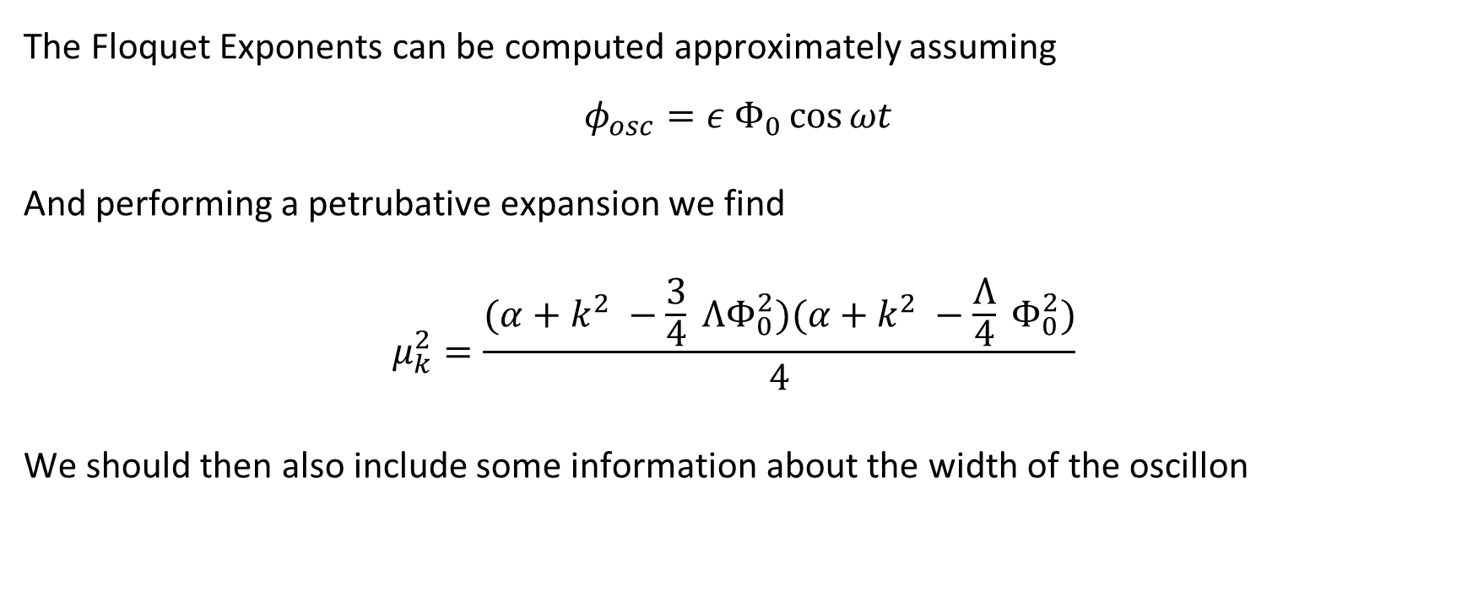
Floquet Approximation
The Floquet Exponents can be computed approximately assuming
$$φ_{osc}=ε Φ_{0}\cos{ωt}$$
And performing a petrubative expansion we find
$$μ_{k}^{2}=\frac{(α+k^{2} −\frac{3}{4} ΛΦ_{0}^{2})(α+k^{2} −\frac{Λ}{4} Φ_{0}^{2})}{4}$$
We should then also include some information about the width of the oscillon

Slide 20
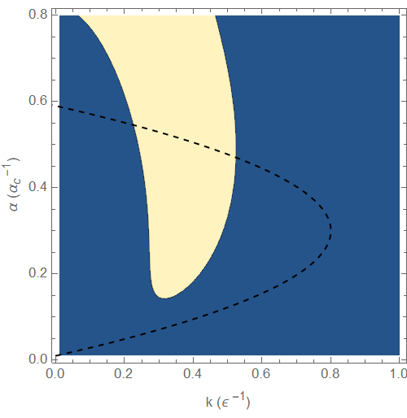
Floquet Approximation

