Slide 1
How Special are Black Holes?:
Black Hole-Saturon Correspondence
Juan Sebastián Valbuena Bermúdez
In collaboration with:
Prof. Dr G. Dvali, O. Kaikov
MPP & LMU
PASCOS 2022
Based on: Phys. Rev. D 105, 056013 (2022)
See talk by M. Zantedeschi

Slide 2
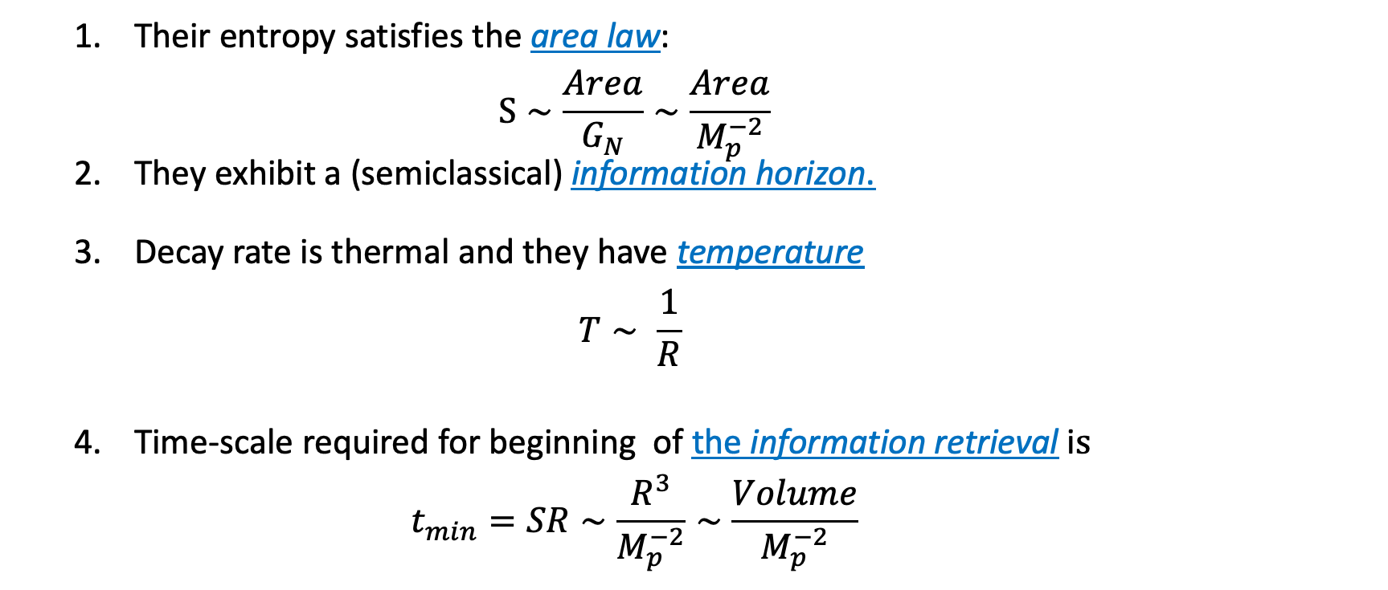
How Special Are Black Holes?
  Their entropy satisfies the area law:
  $S∼\frac{Area}{G_{N}}∼\frac{Area}{M_{p}^{−2}}$
  They exhibit a (semiclassical) information horizon.
  Decay rate is thermal and they have temperature
  $T∼ \frac{1}{R}$
  Time-scale required for beginning of the information retrieval i$s$
  $t_{min}=SR∼\frac{R^{3}}{M_{p}^{−2}}∼\frac{Volume}{M_{p}^{−2}}$
S. W. Hawking, Commun. Math. Phys. 43, 199 (1975).
D. N. Page, Phys. Rev. Lett. 71, 3743 (1993).

Slide 3
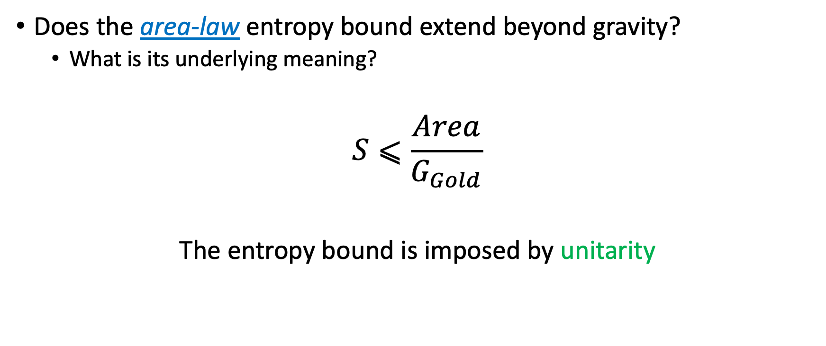
How Special Are Black Holes?
Does the area-law entropy bound extend beyond gravity?
  What is its underlying meaning?
$$S⩽\frac{Area}{G_{Gold}}$$
The entropy bound is imposed by unitarity
G. Dvali, JHEP03(2021) 126, arXiv:2003.05546.
G. Dvali, PTRS A, arXiv:2107.10616

Slide 4

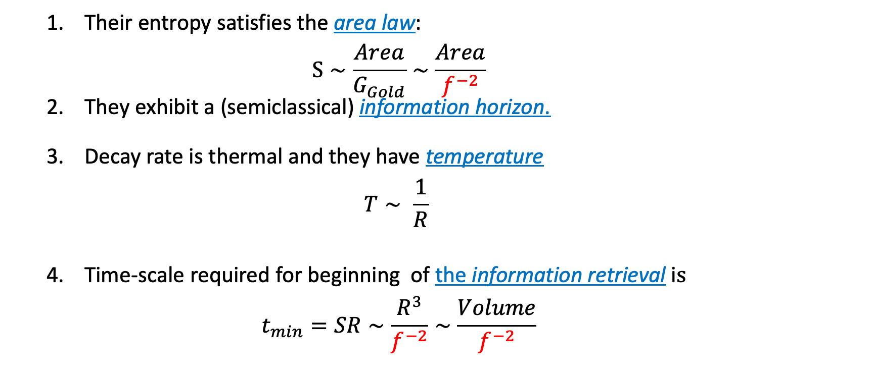
Saturons
  Their entropy satisfies the area law:
  $S∼\frac{Area}{G_{Gold}}∼\frac{Area}{f^{−2}}$
  They exhibit a (semiclassical) information horizon.
  Decay rate is thermal and they have temperature
  $T∼ \frac{1}{R}$
  Time-scale required for beginning of the information retrieval i$s$
  $t_{min}=SR∼\frac{R^{3}}{f^{−2}}∼\frac{Volume}{f^{−2}}$
$G_{Gold}≡f^{−2}$ Goldstone Coupling

Slide 5
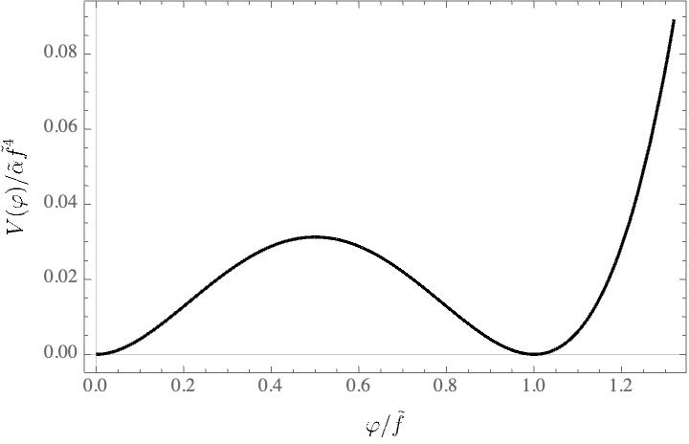
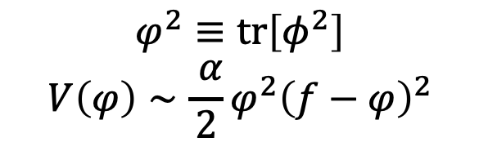
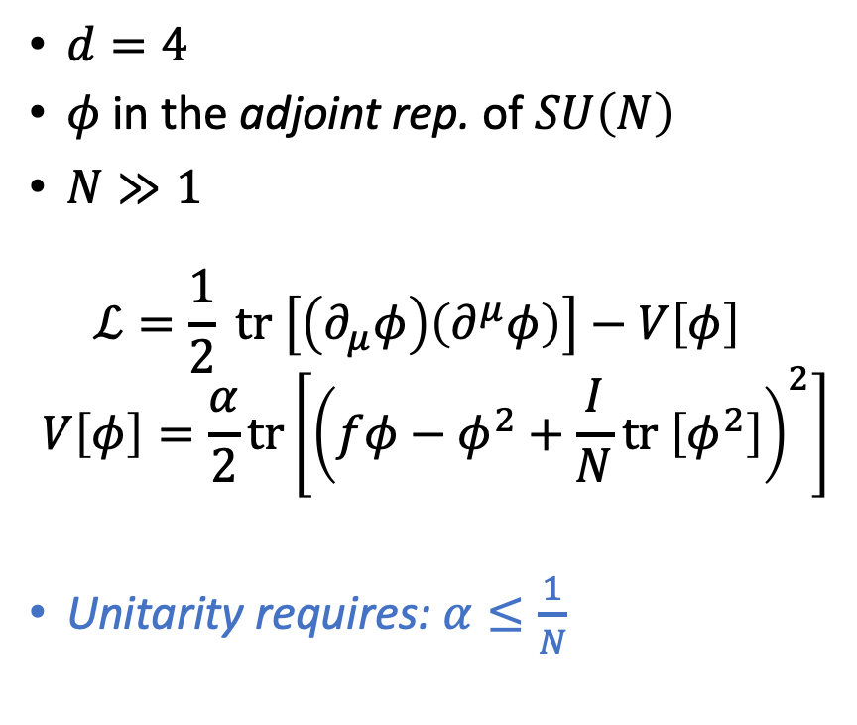
Model of a Saturon as a Vacuum Bubble
$d=4$
$φ$ in the adjoint rep. of $SU\left(N\right)$
$N≫1$
$ℒ=\frac{1}{2} tr \left[\left(∂_{μ}φ\right)\left(∂^{μ}φ\right)\right]−V\left[φ\right]$
$$V\left[φ\right]=\frac{α}{2}tr\left[{\left(fφ−φ^{2}+\frac{I}{N}tr \left[φ^{2}\right]\right)}^{2}\right]$$
Unitarity requires: $α≤\frac{1}{N}$
$$φ^{2}≡tr\left[φ^{2}\right]$$
$$V\left(φ\right)∼\frac{ α}{2}φ^{2}{\left(f−φ\right)}^{2}$$

Slide 6
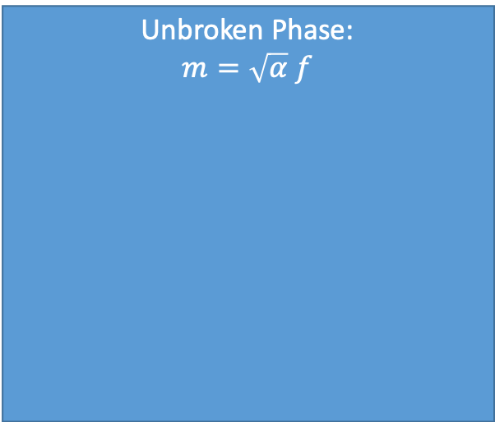
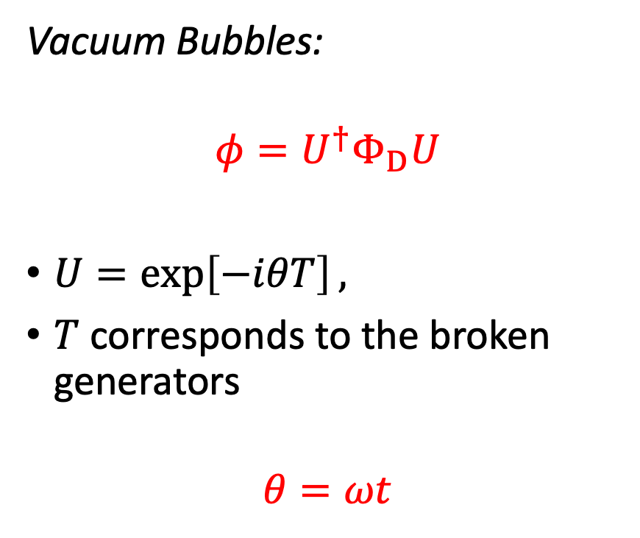
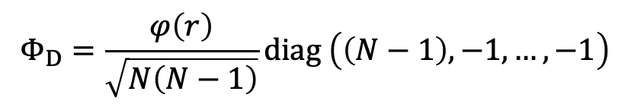

Model of a Saturon as a Vacuum Bubble
Vacuum Bubbles:
$$φ=U^{†}Φ_{D}U$$
$U=\exp\left[−iθT\right],$
$T$ corresponds to the broken generators
$$θ=ωt$$
$$Φ_{D}=\frac{φ\left(r\right)}{\sqrt{N\left(N−1\right)}}diag \left(\left(N−1\right),−1,…,−1\right)$$
Unbroken Phase:
$$m=\sqrt{α} f$$
Broken Phase:
$N_{Gold}$ massless Goldstones
$$SU\left(N\right)→SU\left(N−1\right)×U\left(1\right),$$

Slide 7


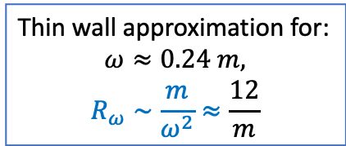
Vacuum Bubbles Stabilization:
$$\dot{θ }=0$$
$$\dot{θ }=ω$$
Thin wall approximation for:
$$ω≈0.24 m,$$
$$R_{ω}∼\frac{m}{ω^{2}}≈\frac{12}{m}$$

Slide 8
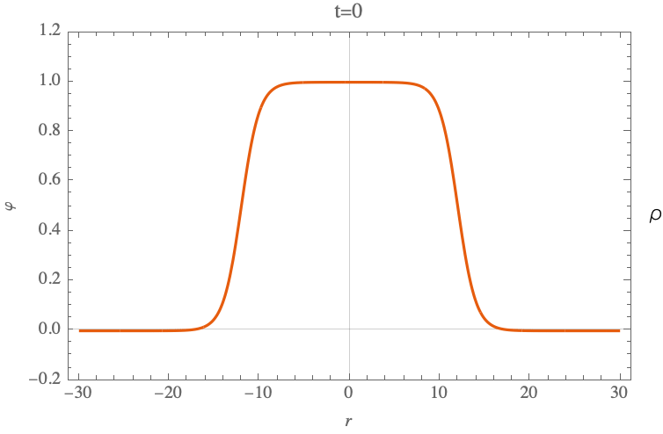

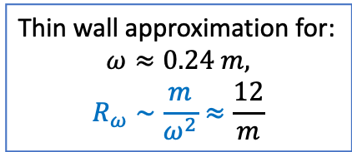
Vacuum Bubbles Stabilization:
$$\dot{θ }=0$$
$$\dot{θ }=ω$$
Thin wall approximation for:
$$ω≈0.24 m,$$
$$R_{ω}∼\frac{m}{ω^{2}}≈\frac{12}{m}$$

Slide 9
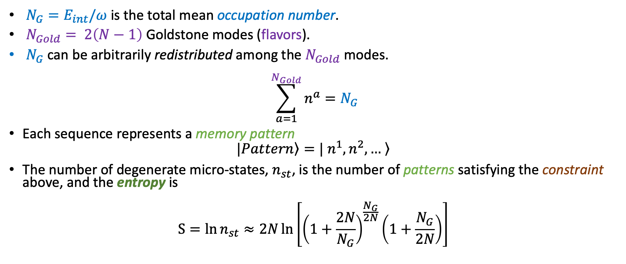
Vacuum Bubbles Microstates
$N_{G}=E_{int}/ω$is the total mean occupation number.
$N_{Gold}= 2\left(N−1\right)$ Goldstone modes (flavors).
$N_{G}$ can be arbitrarily redistributed among the $N_{Gold}$ modes.
$$\sum_{a=1}^{N_{Gold}}{n^{a}}=N_{G}$$
Each sequence represents a memory pattern
$$|\left.Pattern\right\rangle =\left.| n^{1},n^{2},… \right\rangle$$
The number of degenerate micro-states, $n_{st}$, is the number of patterns satisfying the constraint above, and the entropy is
$$S=\ln{n_{st}}≈2N\ln\left[{\left(1+\frac{2N}{N_{G}}\right)}^{\frac{N_{G}}{2N}}\left(1+\frac{N_{G}}{2N}\right)\right]$$

Slide 10
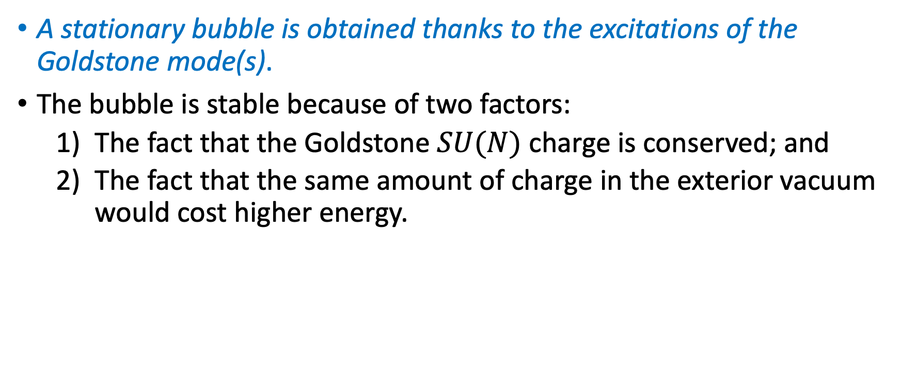
Vacuum Bubbles Stabilization:
Quantum picture of classical stability
A stationary bubble is obtained thanks to the excitations of the Goldstone mode(s).
The bubble is stable because of two factors:
  The fact that the Goldstone $SU(N)$ charge is conserved; and
  The fact that the same amount of charge in the exterior vacuum would cost higher energy.
G. Dvali, JHEP03 (2021) 126, arXiv:2003.05546.
G. Dvali, arXiv:1810.02336.
G. Dvali, L. Eisemann, M. Michel, and S. Zell, JCAP03 (2019) 010, arXiv:1812.08749.

Slide 11

Saturon as a Vacuum Bubble
Thick wall Bubbles correspond to Saturons
$$ω∼m$$
$$m^{−1}∼R$$
$$N_{G}∼\frac{1}{α}∼N∼N_{Gold}$$
$$S∼S_{max}∼\frac{1}{α}∼E_{Bubble}R$$
J. D. Bekenstein Phys. Rev. D23no. 2 (1981), 287-298.47

Slide 12
Information Horizon
Saturons in semiclassical limit

Slide 13
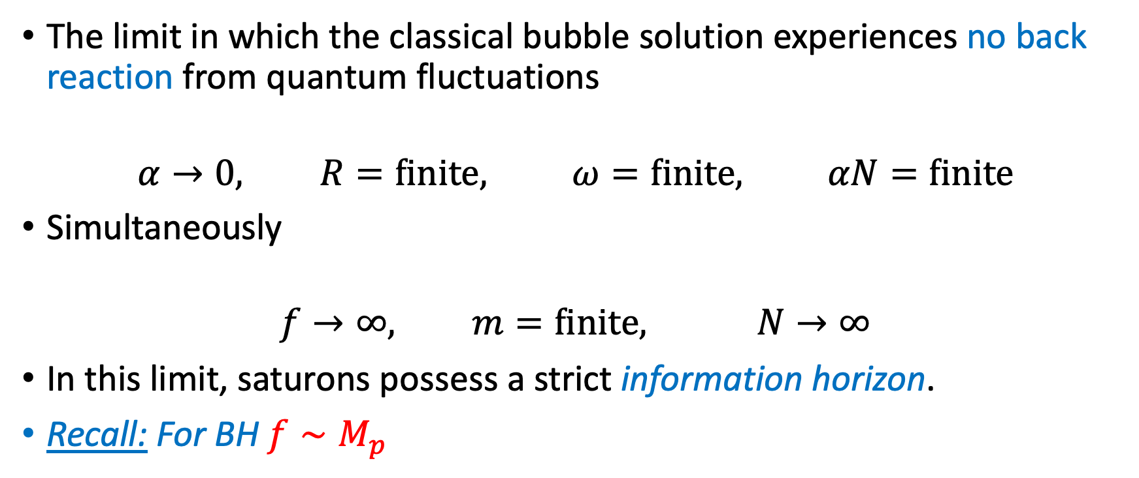
Semi-classical Limit
The limit in which the classical bubble solution experiences no back reaction from quantum fluctuations
$$α→0, R=finite, ω=finite, αN=finite$$
Simultaneously
$$f→∞, m=finite, N→∞$$
In this limit, saturons possess a strict information horizon.
Recall: For BH $f∼M_{p}$

Slide 14
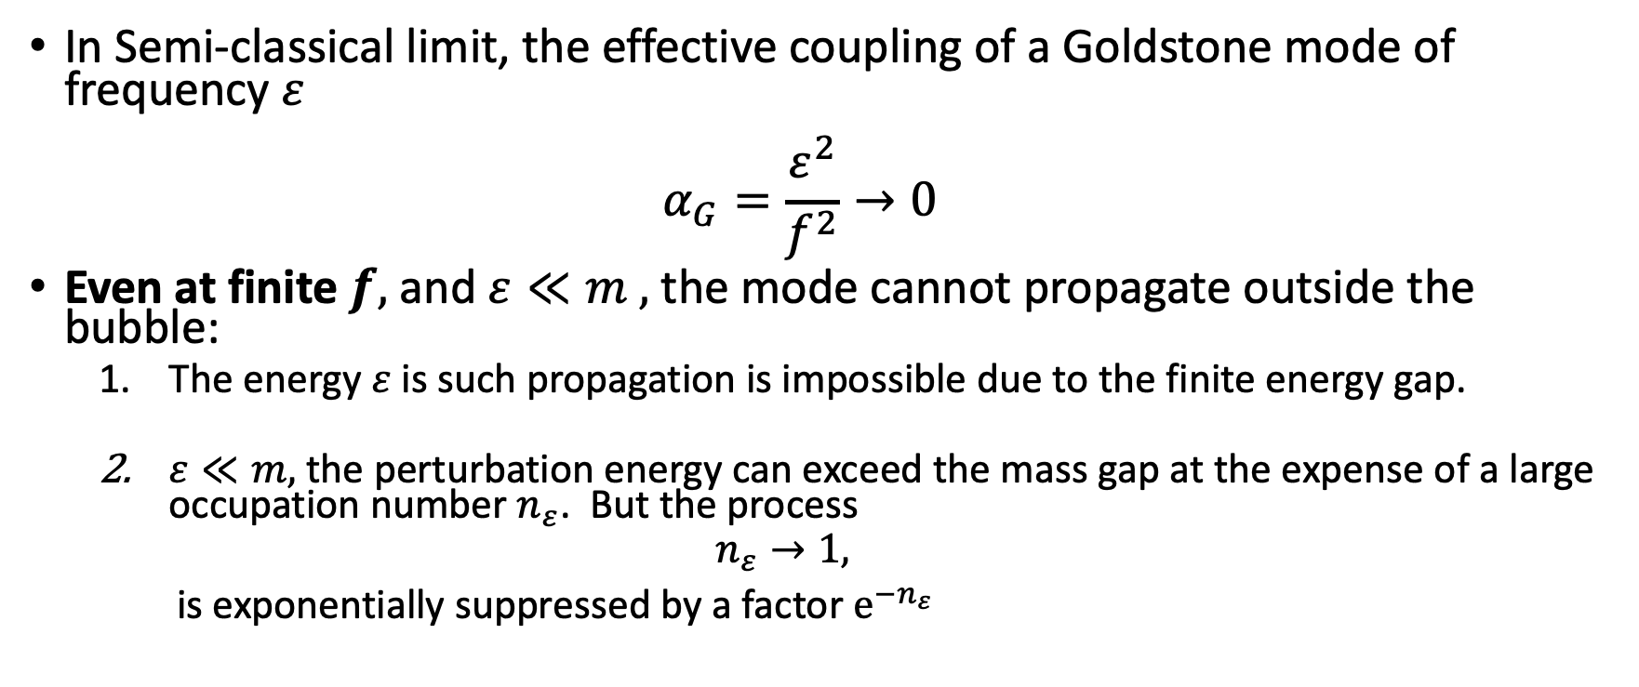
Semi-classical Limit
In Semi-classical limit, the effective coupling of a Goldstone mode of frequency $ε$
$α_{G}=\frac{ε^{2}}{f^{2}}→0$
Even at finite $f,$ and $ε≪m ,$the mode cannot propagate outside the bubble:
  The energy $ε$ is such propagation is impossible due to the finite energy gap.
  $ε≪m,$ the perturbation energy can exceed the mass gap at the expense of a large occupation number $n_{ε}$. But the process
  $$n_{ε}→1,$$
  is exponentially suppressed by a factor $e^{−n_{ε}}$
G. Dvali, PTRS A, arXiv:2107.10616

Slide 15
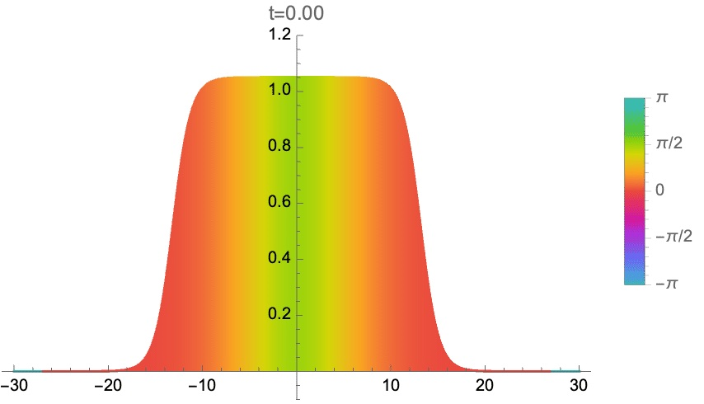
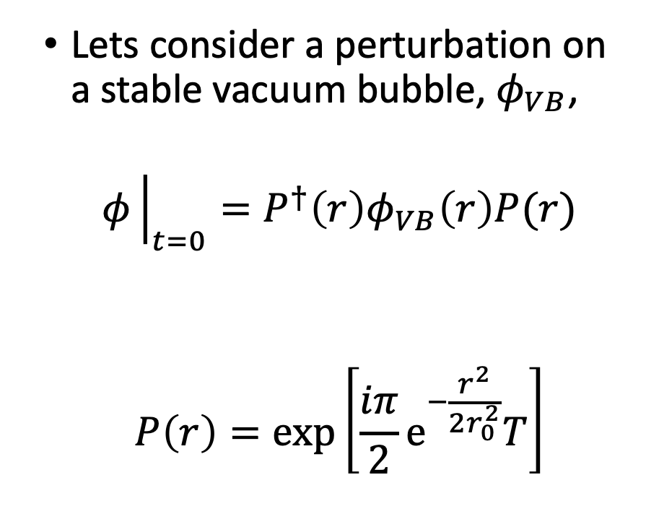
Goldstone Horizon: An Example
Lets consider a perturbation on a stable vacuum bubble, $φ_{VB}$,
$$φ{\left.​\right|}_{t=0}=P^{†}\left(r\right)φ_{VB}\left(r\right)P(r)$$
$$P\left(r\right)=\exp\left[\frac{iπ}{2}e^{−\frac{r^{2}}{2r_{0}^{2}}}T\right]$$

Slide 16
Goldstone Horizon: An Example

Slide 17

Goldstone Horizon: An Example

Slide 18
Correspondence to Black Holes

Slide 19
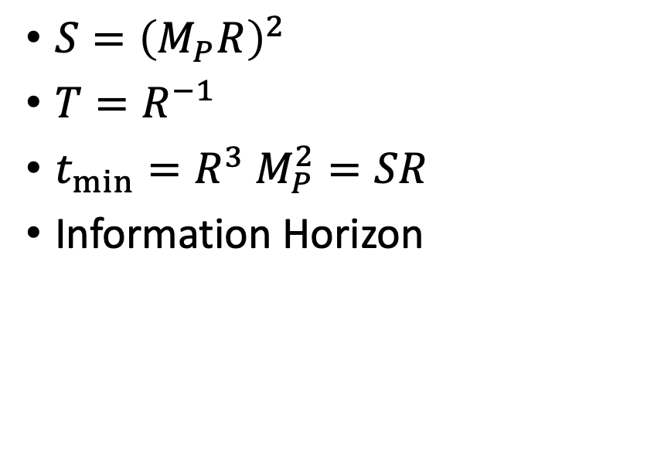
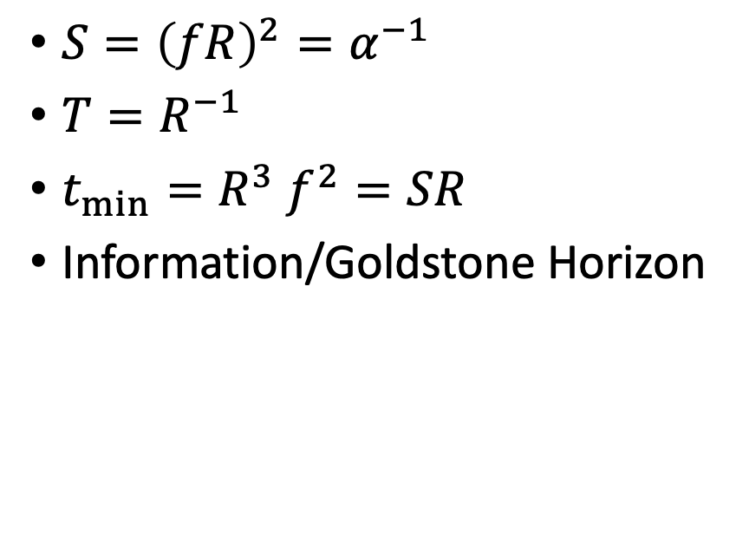
Correspondence to Black Holes
Saturons
Black Holes
$S={\left(fR\right)}^{2}=α^{−1}$
$T=R^{−1}$
$t_{min}=R^{3} f^{2}=SR$
Information/Goldstone Horizon
$S={\left(M_{P}R\right)}^{2}$
$T=R^{−1}$
$t_{min}=R^{3} M_{P}^{2}=SR$
Information Horizon

Slide 20
Conclusions and outlook
Black Holes are certainly special but not unique. They belong to a larger class of objects: Saturons, which saturate the entropy bound.
We have shown an explicit example of a Saturon as a Vacuum Bubble.
Vacuum Bubbles exhibit a goldstone horizon, analog to the information horizon of saturons.
G. Dvali, JHEP03(2021) 126, arXiv:2003.05546, arXiv:2107.10616
G. Dvali and O. Sakhelashvili, PRD 105 (2022) 6, 065014arXiv:2111.03620.
G. Dvali, R. Venugopalan, PRD 105 (2022) 5, 056026

Slide 21
Conclusions and outlook
Departures from semi-classical behavior can become observable for BH that are relatively old and close to their half-decay time.
The light Primordial Black Holes, provided they exist, can be within a potentially interesting window.
Possible observational consequences for rotating black holes.
G. Dvali, F. Kühnel and M. Zantedeschi, hep-th/2112.08354.

Slide 22
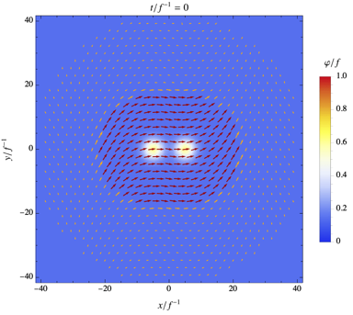
Outlook

Slide 23
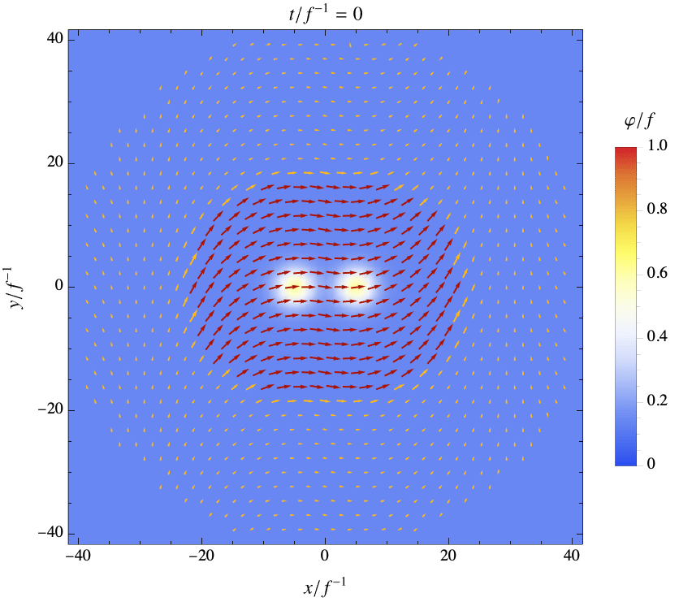
Outlook

Slide 24
Thank you

Slide 25
Entropy Bound

Slide 26
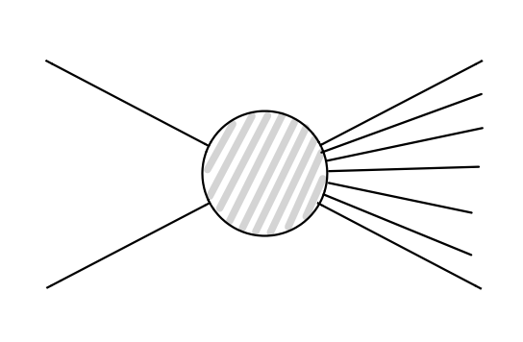
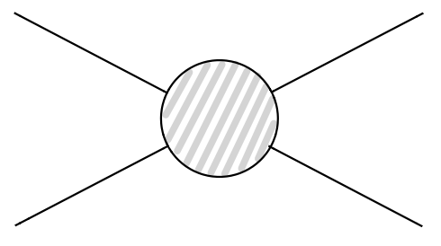

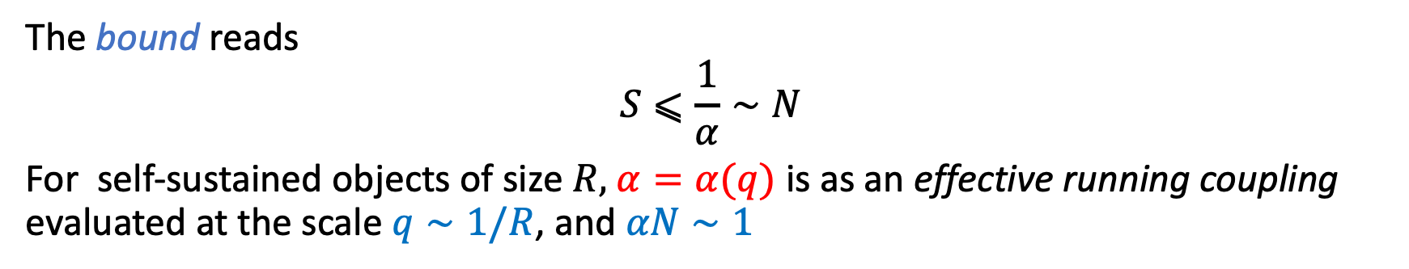

Entropy Bound Imposed by Unitarity
Cross-section:
$$σ_{2→2}∼α$$
$$\text{Cross}\text{−}\text{section}\text{: }$$
$$σ_{2→N} n_{st}∼α^{N}N!n_{st}$$
The bound reads
$$S⩽\frac{1}{α}∼N$$
For self-sustained objects of size $R,$ $α=α(q)$ is as an effective running coupling evaluated at the scale $q∼1/R$, and $αN∼1$
G. Dvali, JHEP03(2021) 126, arXiv:2003.05546.
G. Dvali, PTRS A, arXiv:2107.10616

Slide 27

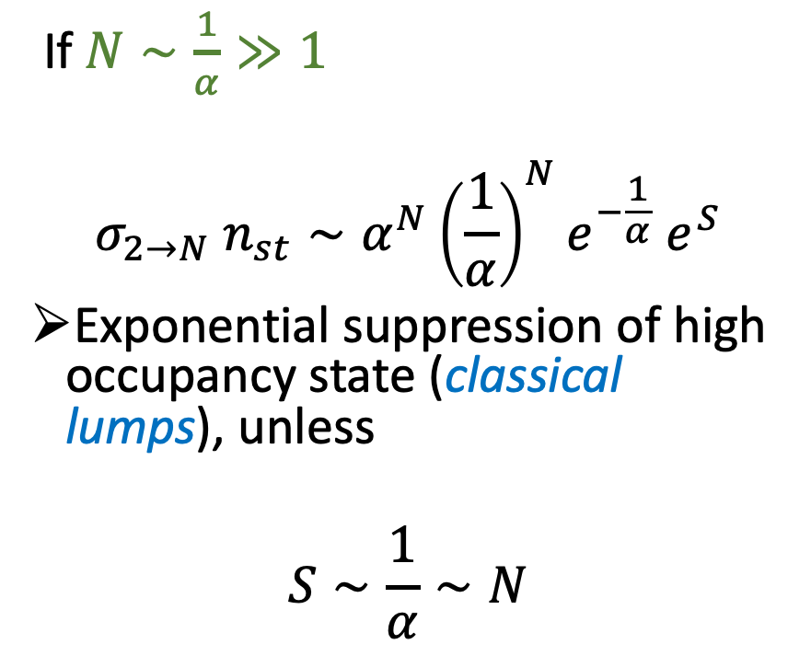
Saturation of Unitarity
If $N∼\frac{1}{α}≫1$
$$σ_{2→N} n_{st}∼α^{N}{\left(\frac{1}{α}\right)}^{N}e^{−\frac{1}{α}} e^{S}$$
Exponential suppression of high occupancy state (classical lumps), unless
$$S∼\frac{1}{α}∼N$$
$$σ_{2→N} n_{st}∼α^{N}N!n_{st}$$

Slide 28
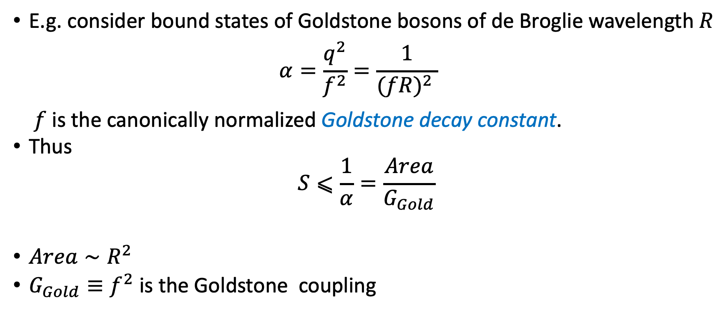
Entropy Bound Imposed by Unitarity
E.g. consider bound states of Goldstone bosons of de Broglie wavelength $R$
$α=\frac{q^{2}}{f^{2}}=\frac{1}{{(fR)}^{2} }$
$f$ is the canonically normalized Goldstone decay constant.
Thus
$$S⩽\frac{1}{α}=\frac{Area}{G_{Gold}}$$
$Area∼R^{2}$
$G_{Gold}≡f^{2}$ is the Goldstone coupling

Slide 29
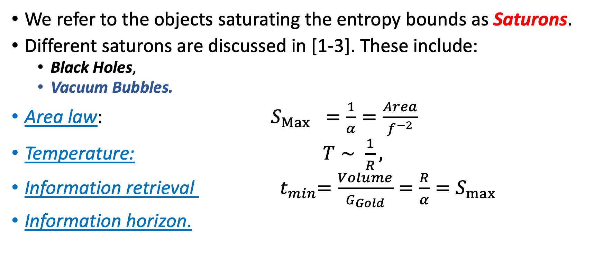
Saturons
We refer to the objects saturating the entropy bounds as Saturons.
Different saturons are discussed in [1-3]. These include:
  Black Holes,
  Vacuum Bubbles.
Area law: $S_{Max} =\frac{1}{α}=\frac{Area}{f^{−2}}$
Temperature: $T∼ \frac{1}{R},$
Information retrieval ${ t}_{min}=\frac{Volume}{G_{Gold}}=\frac{R}{α}=S_{max}$
Information horizon.
  Classical lumps, Instantons, Monopoles…
  Color Glass Condensates
G. Dvali, JHEP03(2021) 126, arXiv:2003.05546, arXiv:2107.10616
G. Dvali and O. Sakhelashvili, PRD 105 (2022) 6, 065014arXiv:2111.03620.
G. Dvali, R. Venugopalan, PRD 105 (2022) 5, 056026

Slide 30
Vacuum Bubbles Microstates
Towards Entropy Saturation

Slide 31
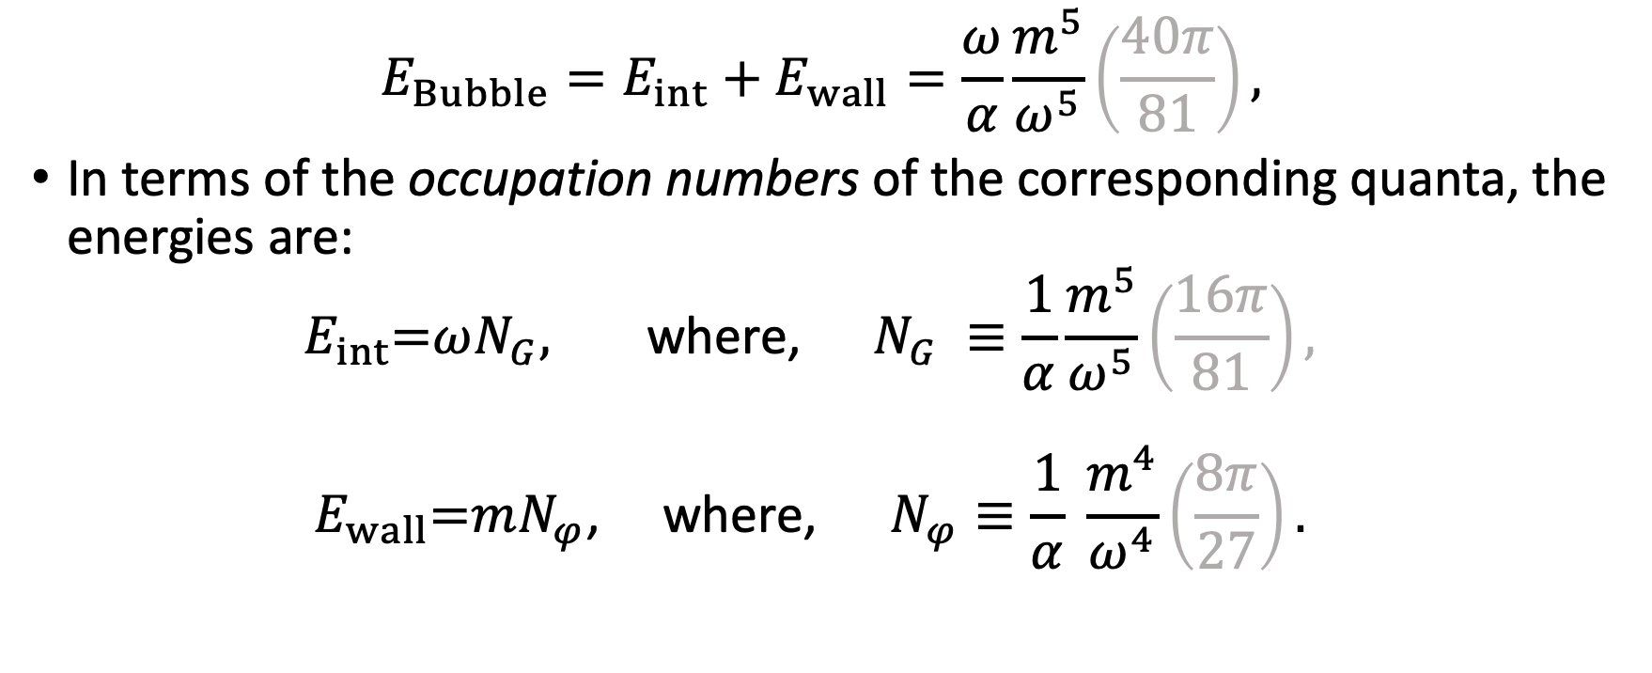
Vacuum Bubbles Stabilization:
Quantum picture of classical stability
$$E_{Bubble}=E_{int}+E_{wall}=\frac{ω}{α}\frac{m^{5}}{ω^{5}}\left(\frac{40π}{81}\right),$$
In terms of the occupation numbers of the corresponding quanta, the energies are:
$E_{int}\text{=}ωN_{G}\text{, }\text{where}\text{,} N_{G} ≡\frac{1}{α}\frac{m^{5}}{ω^{5}}\left(\frac{16π}{81}\right),$
$E_{wall}\text{=}mN_{φ}\text{,} \text{where}\text{, } N_{φ}≡\frac{1}{α} \frac{m^{4}}{ω^{4}}\left(\frac{8π}{27}\right).$

Slide 32
Vacuum Bubbles Stabilization:
Quantum picture of classical stability
A stationary bubble is obtained thanks to the excitations of the Goldstone mode(s).
The bubble is stable because of two factors:
  The fact that the Goldstone $SU(N)$ charge is conserved; and
  The fact that the same amount of charge in the exterior vacuum would cost higher energy.
G. Dvali, Entropy Bound and Unitarity of Scattering Amplitudes, JHEP03 (2021) 126, arXiv:2003.05546.
G. Dvali, A Microscopic Model of Holography: Survival by the Burden of Memory, arXiv:1810.02336.
G. Dvali, L. Eisemann, M. Michel, and S. Zell, Universe’s Primordial Quantum Memories, JCAP03 (2019) 010, arXiv:1812.08749.

Slide 33
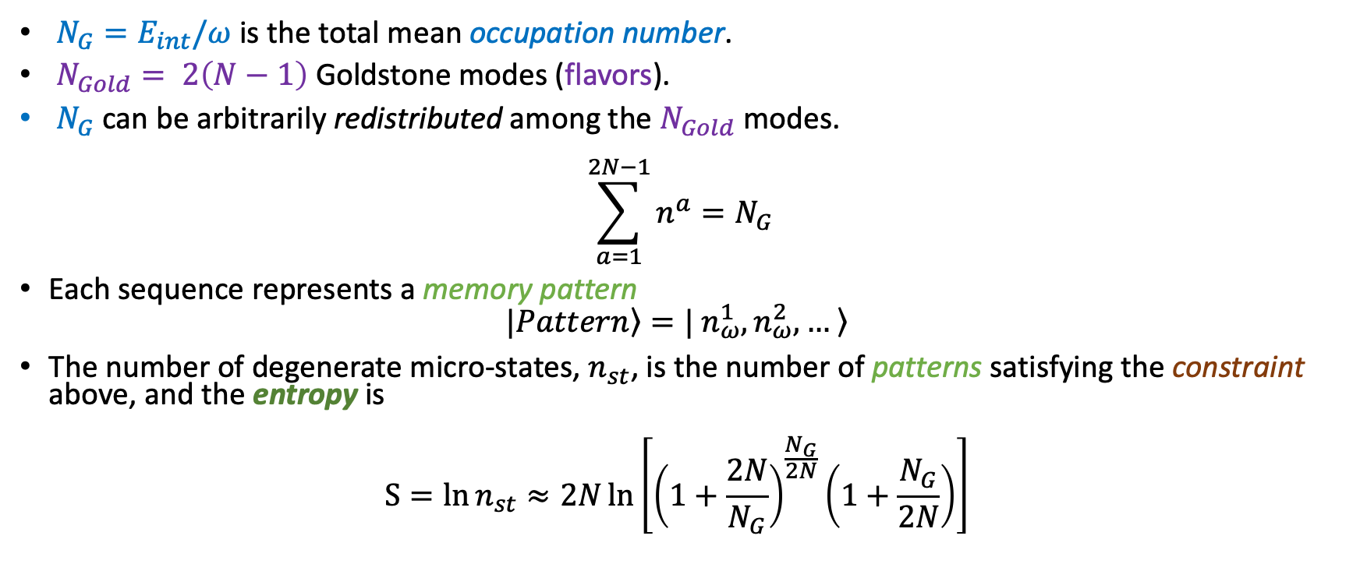
Vacuum Bubbles Microstates
$N_{G}=E_{int}/ω$is the total mean occupation number.
$N_{Gold}= 2\left(N−1\right)$ Goldstone modes (flavors).
$N_{G}$ can be arbitrarily redistributed among the $N_{Gold}$ modes.
$$\sum_{a=1}^{2N−1}{n^{a}}=N_{G}$$
Each sequence represents a memory pattern
$$|\left.Pattern\right\rangle =\left.| n_{ω}^{1},n_{ω}^{2},… \right\rangle$$
The number of degenerate micro-states, $n_{st}$, is the number of patterns satisfying the constraint above, and the entropy is
$$S=\ln{n_{st}}≈2N\ln\left[{\left(1+\frac{2N}{N_{G}}\right)}^{\frac{N_{G}}{2N}}\left(1+\frac{N_{G}}{2N}\right)\right]$$

Slide 34
Memory Burden
Effect
Large amount of Memory patterns
Slowdown of the system’s evolution
Vaccum Bubbles
Stabilization
Large amount of Bubble micro-states
Excitations of the Goldstone modes
Stored quantum information.
Slowdown of bubble's decay
Notes:
In its essence, this effect can be explained in the following way:
The core statement of the memory burden effect is that a large amount of quantum information stored in a memory pattern slows down the system’s evolution.
The bubble micro-states are analogous to the memory patterns.
Excitations of the Goldstone modes preventing the bubble from collapsing or expanding.

Slide 35
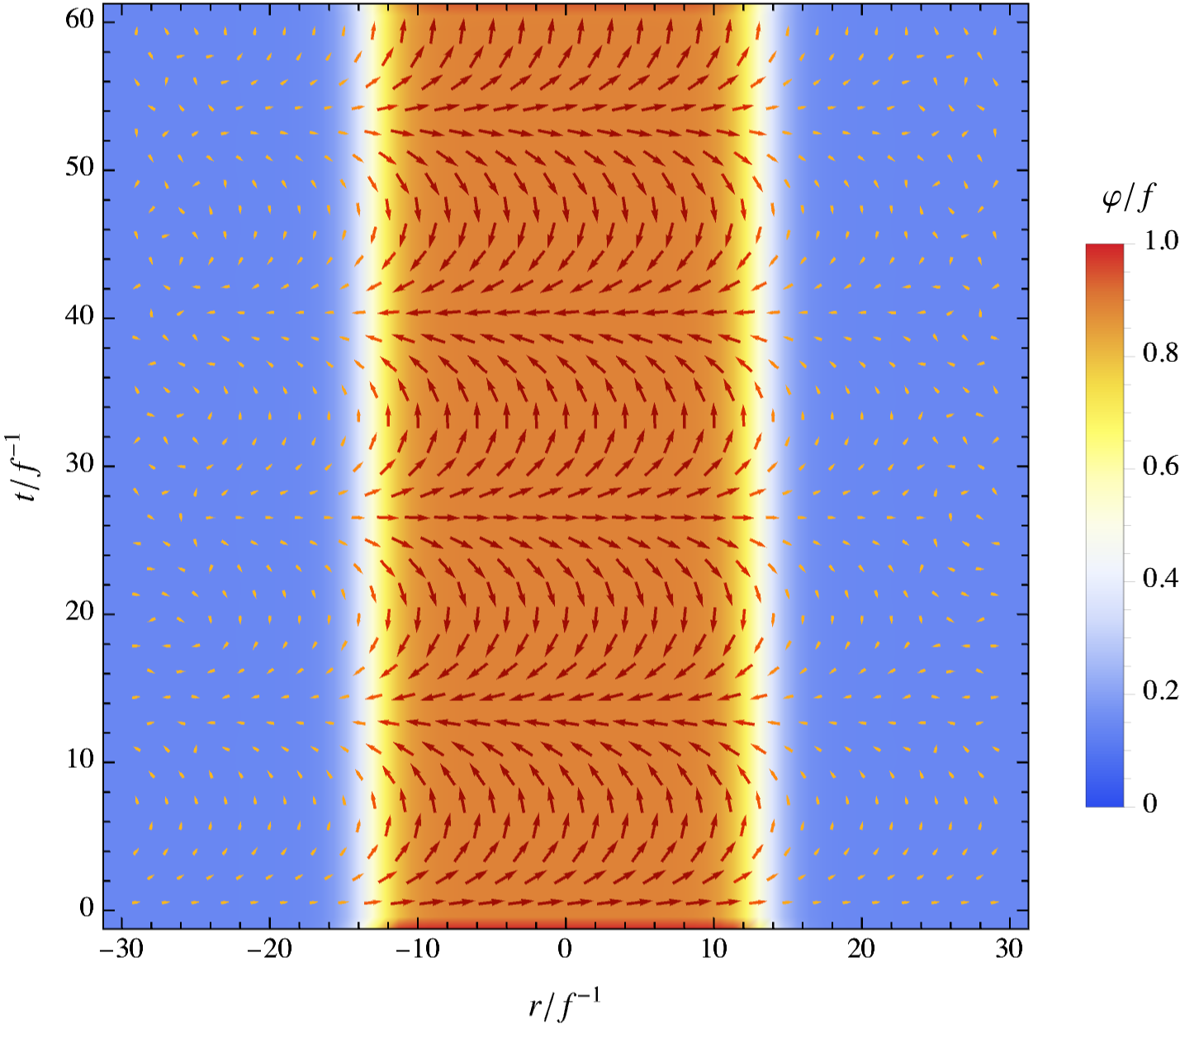
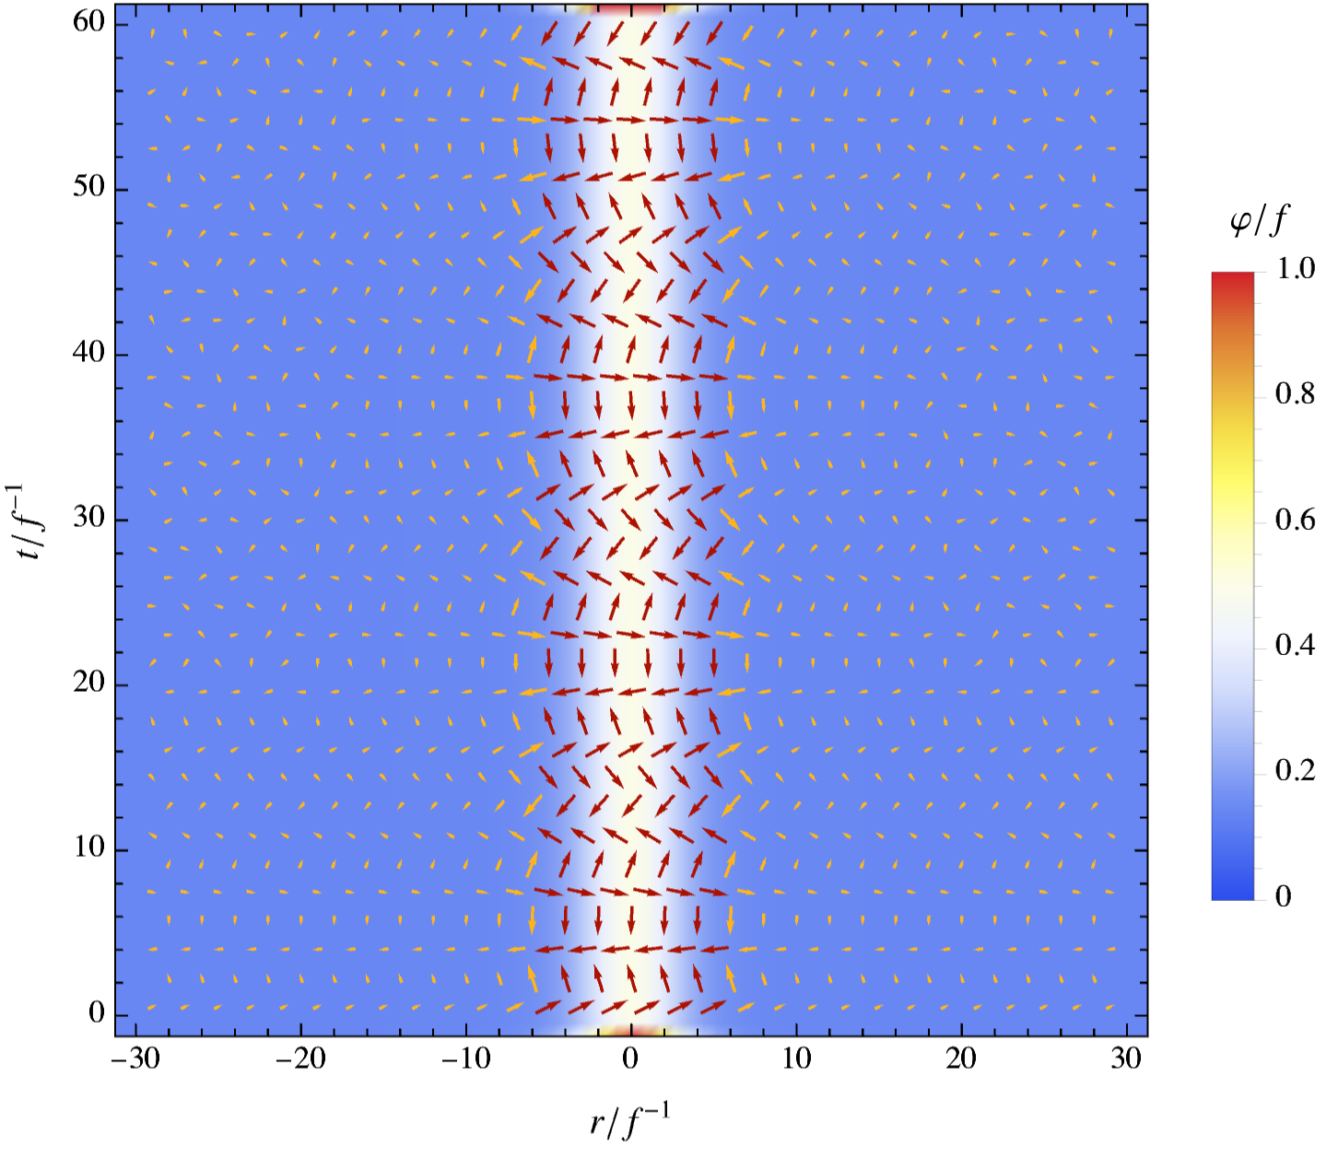


Vacuum Bubbles Stabilization
Large Bubbles
$R∼12m^{−1}$
Small Bubbles
$$R∼1.02m^{−1}$$

Slide 36
Hawking Evaporation

Slide 37
Hawking Evaporation: Temperature

Slide 38
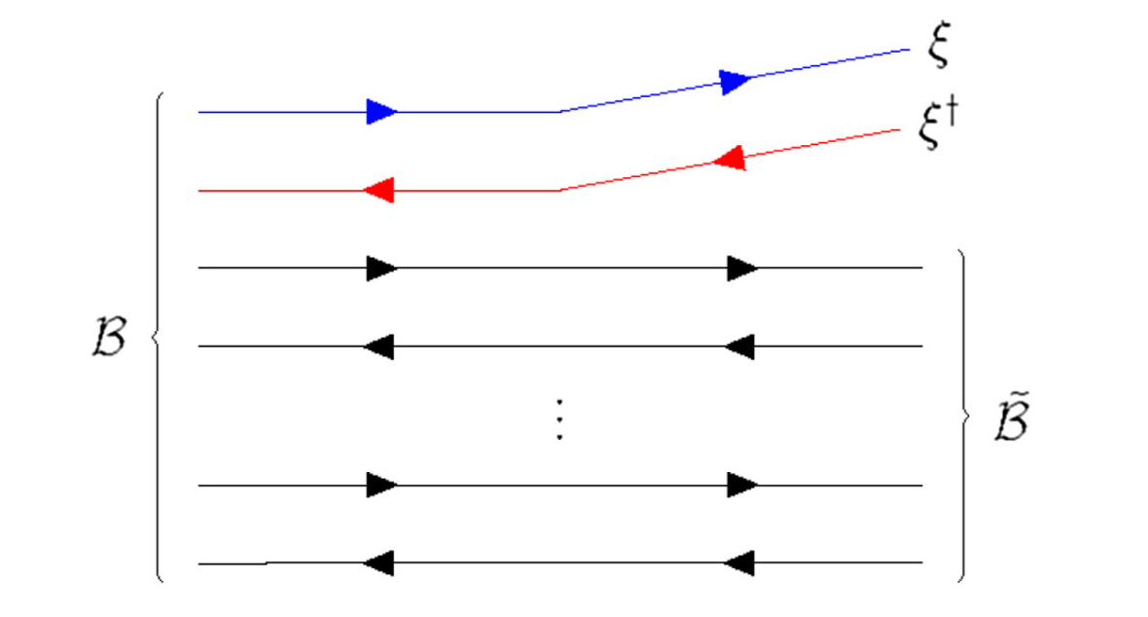
Hawking Evaporation: Temperature

Slide 39
Spectrum

Slide 40
Spectrum

Slide 41
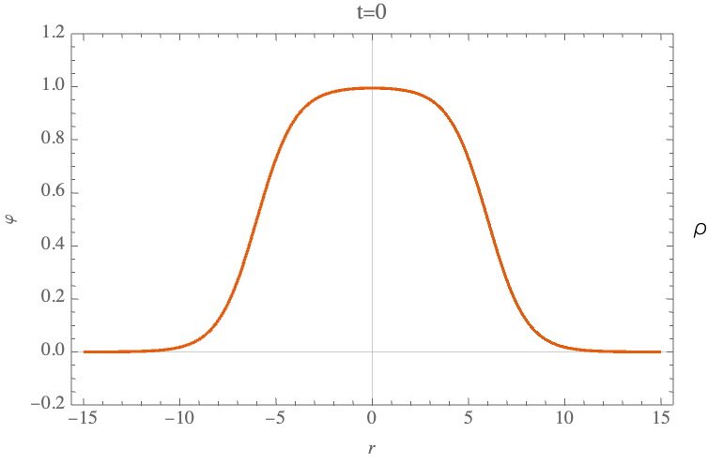
1+1 Dim

