Slide 1



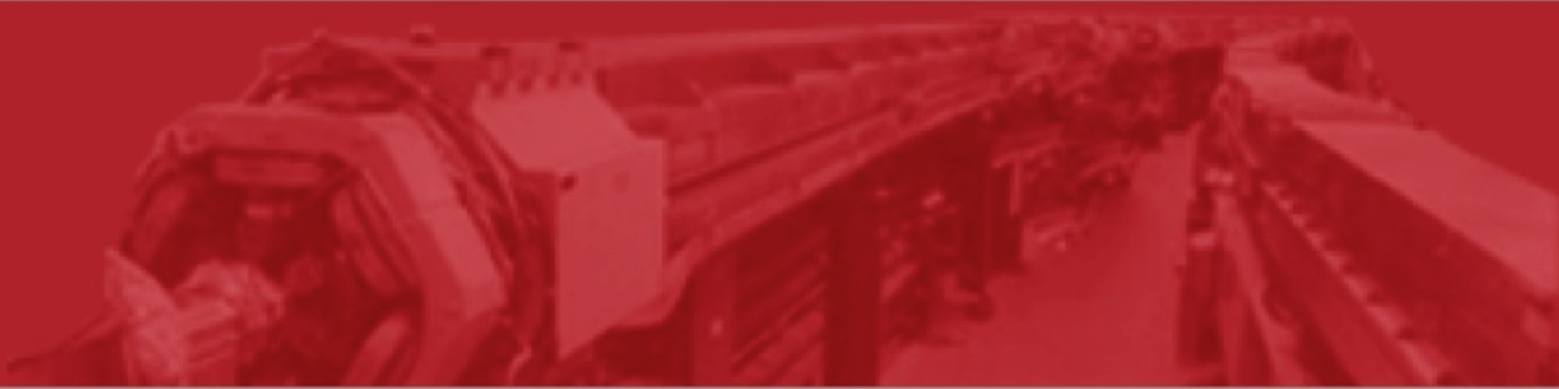


HOM considerations for Energy Recovery Linacs and other high-current, CW SRF accelerators
Georg Hoffstaetter (Cornell) for the SRF and CBETA team
Cavity design and construction for high BBU current
Beam-pipe HOM absorber design and construction
HOM testing with and without beam
Beam limits from HOM heating
BBU limits for multi-turn ERLs with realistic HOM
High Order Modes in Superconducting Cavities
HOMSC16, 22 – 23 August, 2016

Slide 2
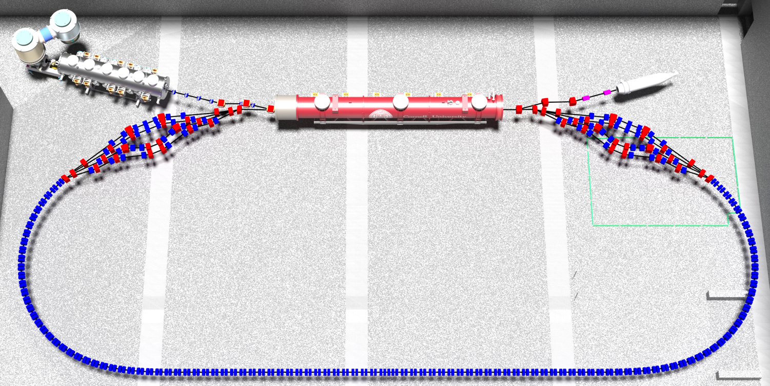
Cornell’s ERL for eRHIC prototyping and beam experiments
Cornell DC gun
100mA, 6MeV SRF injector (ICM)
600kW beam dump
100mA, 6-cavity SRF CW Linac (MLC)
Existing components at Cornell
6 MeV
6 MeV
+/- 36 MeV
Electron Current up to 320mA in the linac
Bunch charge Q of up to 2nC
Bunch repetition rate 1.3GHz/N
Beams of 100mA for 1 turn and 40mA for 4 turns
42, 78, 114, 150 MeV

Slide 3
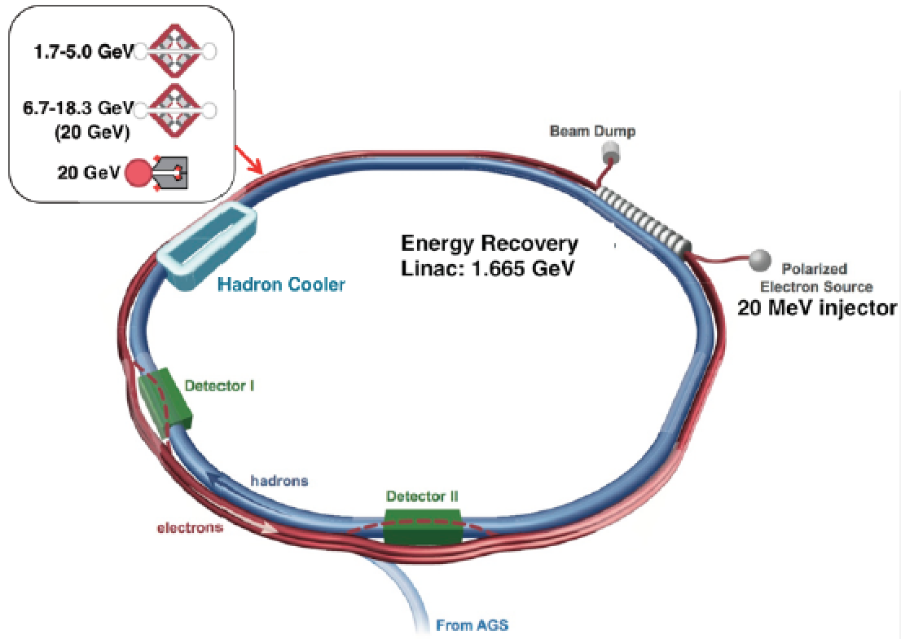
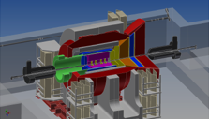
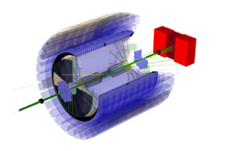
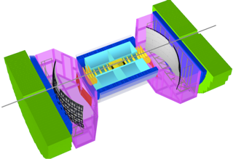
eRHIC Design – need for an ERL
ePHENIX
eSTAR
BeAST
1.7 × 10³³ cm⁻² s⁻¹ for √s = 127 GeV (15.9 GeV e↑on 255 GeV p↑)
× 10 luminosity with modest improvements (coating of RHIC vacuum chamber)
× 100 luminosity with shorter bunch spacing (ultimate capability)
courtesy Thomas Roser

Slide 4
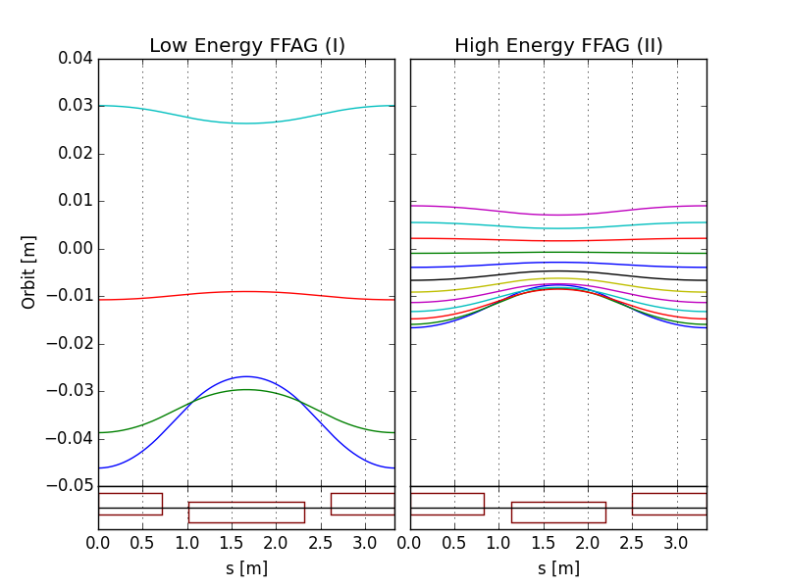
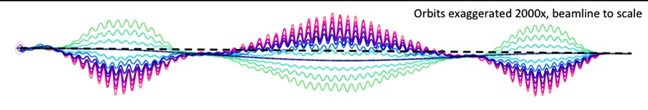
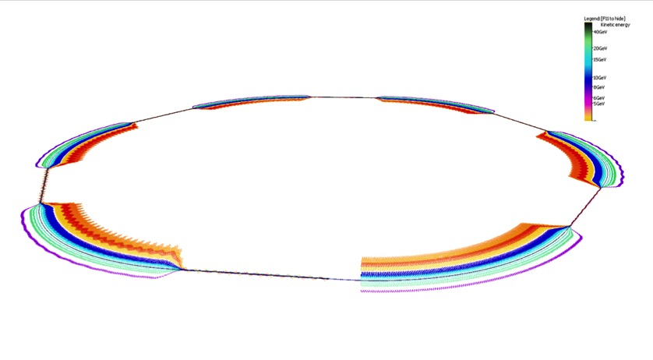
eRHIC ERL – 12 turns in only 2 NS-FFAG arcs
eRHIC uses two FFAG beamlines to do multiple recirculations.
(FFAG-I: 1.7-5.0 GeV, FFAG-II: 6.7-18.3 GeV, 20 GeV)
All sections of a FFAG beamline is formed using a same FODO cell. Required bending in different sections is arranged by proper selection of the offsets between cell magnets (or, alternatively, with dipole field correctors).
Permanent magnets can be used for the FFAG beamline magnets (no need for power supplies/cables and cooling).
E=5.0 GeV
E=18.3 GeV
E=6.7 GeV
E=1.7 GeV
BD
QF
@S.Brooks, D.Trbojevic
Orbits in Detector bypass section
Quad offsets evolve adiabatically
Orbits in Transition section
Each of two eRHIC FFAGs contain 1066 FFAG cells

Slide 5
CBETA for risk drivers of eRHIC
Some of the most important risk items for eRHIC:
FFAG loops with a factor of 4 in momentum aperture.
  Precision, reproducibility, alignment during magnet and girder production.
  Stability of magnetic fields in a radiation environment.
  Matching and correction of multiple simultaneous orbits.
  Matching and correction of multiple simultaneous optics.
  Path length control for all orbits.
Multi-turn ERL operation with a large number of turns.
  HOM damping.
  BBU limits.
  LLRF control and microphonics.
  ERL startup from low-power beam.

Slide 6
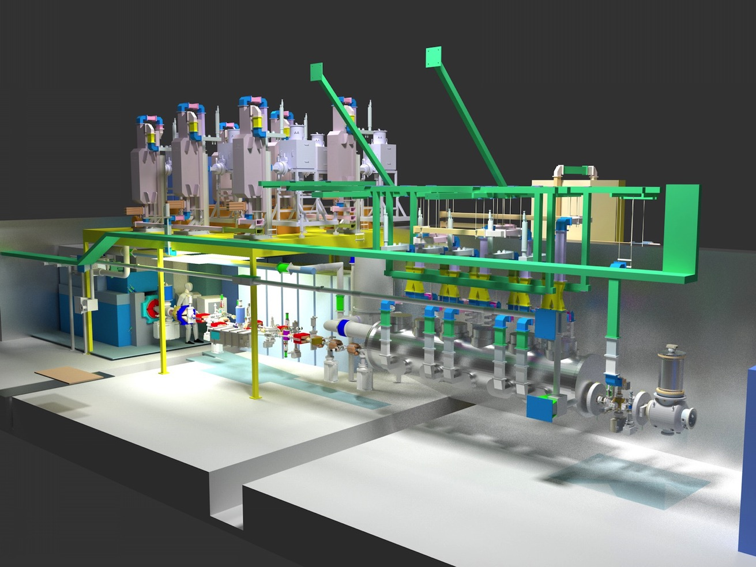
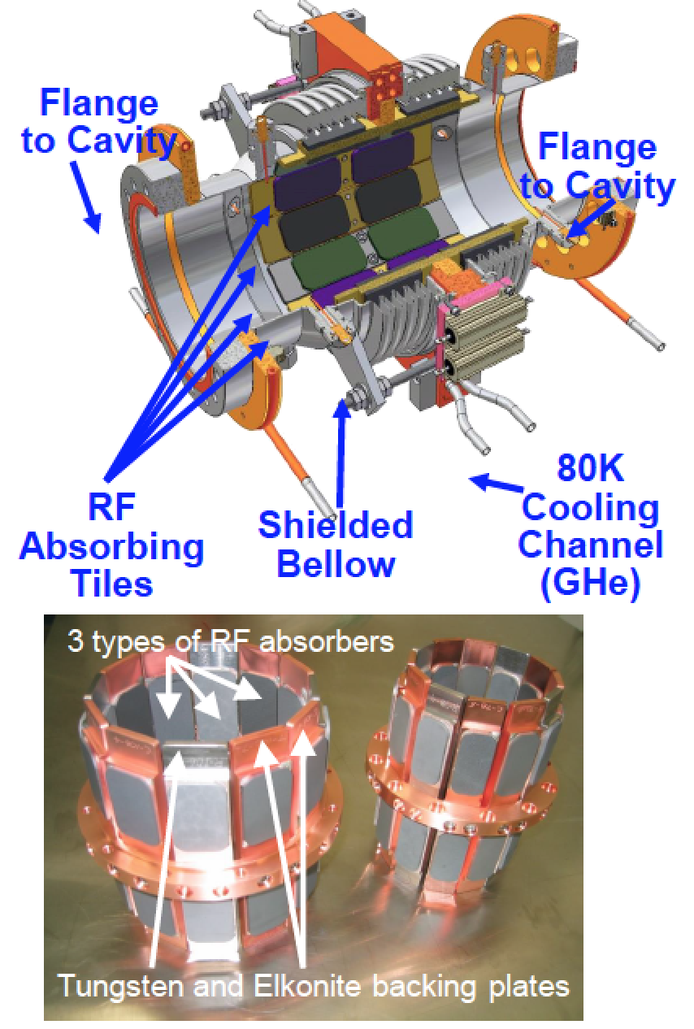
ERL injector at Cornell
SC injector
Dump
Diagnostics
Cavities, couplers,
HOM absorbers
Source

Slide 7
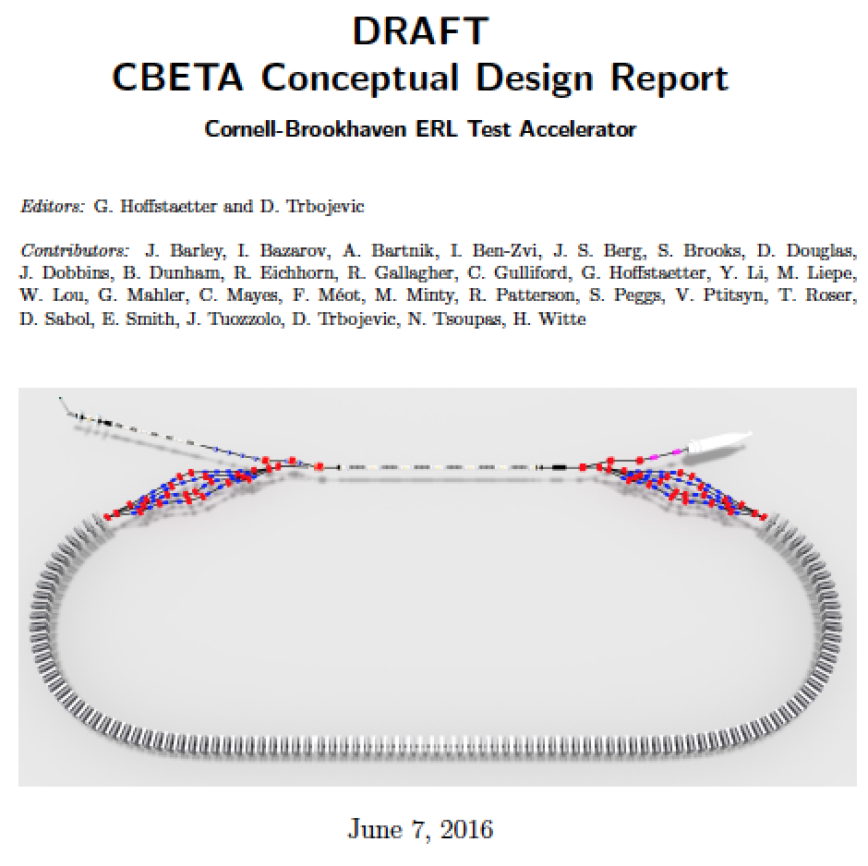
The CBETA CDR
Background for CDR
Wrote PDDR for hard X-ray ERL at Cornell in 2012.
Start of CBETA July 2014 White paper December 2014
CDR scheduled for magnet prototypes.
Planed for completion of optics and layout for CDR.
Scheduled this Review to include advise on CDR.
Plan to include committee advise by the end of July.

Slide 8
Why is CBETA at Cornell
Track Record:
ERL injector with world-record current (10 times more than the next)
ERL injector with world-record emittance (5 times less than the next)
SRF cavity shape for high current (30 times more than the next)
SRF R&D for ERL Light Sources with world-record low energy loss
High Brightness Beam Physics (first full hard x-ray ERL design)
Facilities and Capabilities:
About 120 accelerator-related employees with decades of experience in accelerator building and operation at the worlds forefront.
Facilities and experience for building full SRF accelerators and DC guns.
Space for a 100mA, > 36MeV per turn ERL.

Slide 9
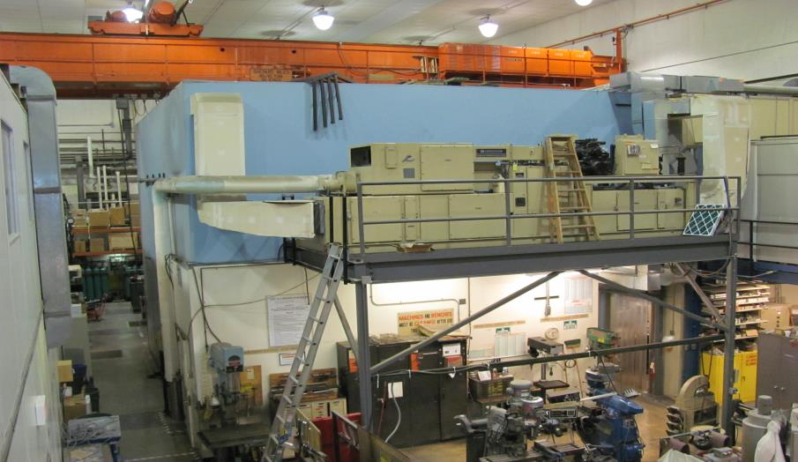
Hall L0E before CBETA
L0E contained approximately 7,000 square feet of Lab and Shop space

Slide 10
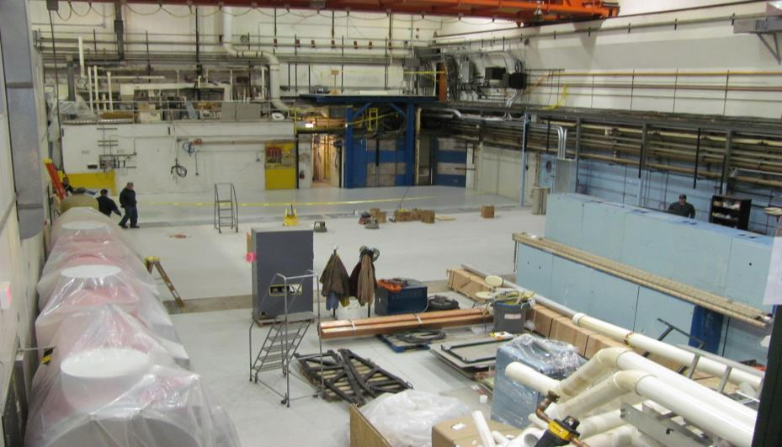
Spring 2015
70% of the existing technical-use space was removed for the initial phase

Slide 11
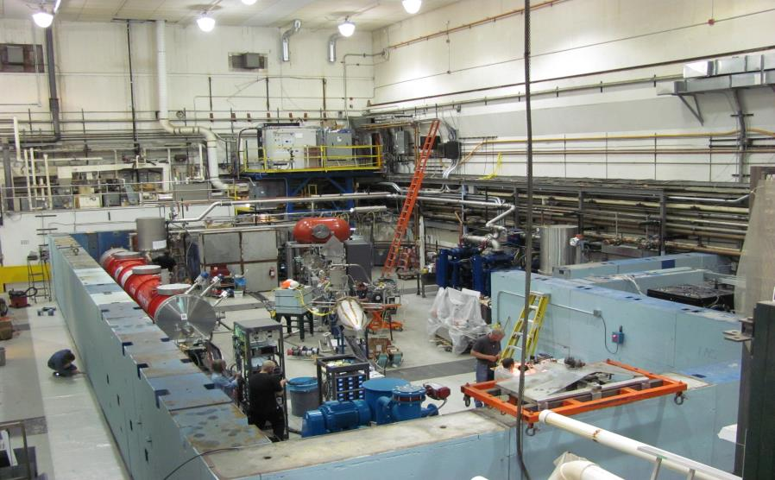
Fall 2015
The initial installation was completed for the MLC and ERL beamline

Slide 12
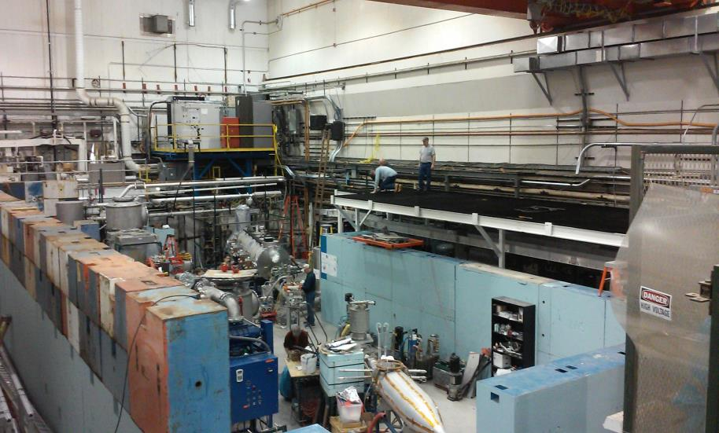
Spring 2016
The second phase will accommodate the new loop-layout

Slide 13
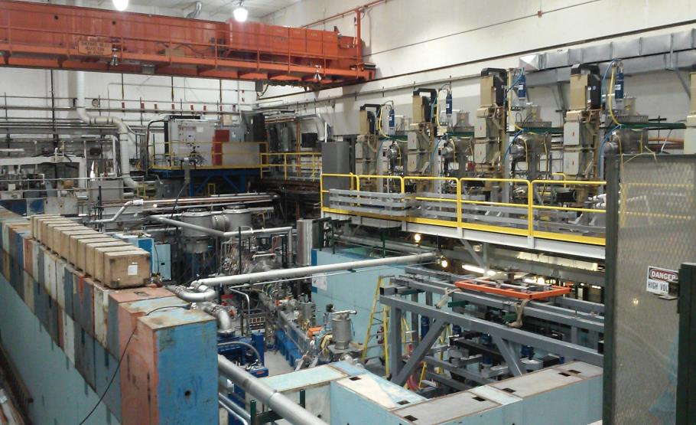
Summer 2016
The second phase is almost complete

Slide 14
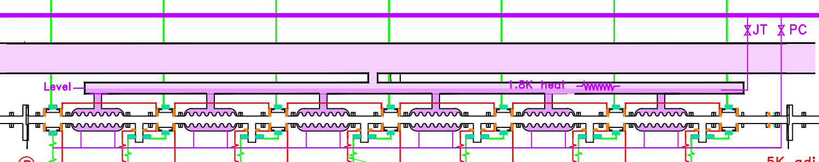
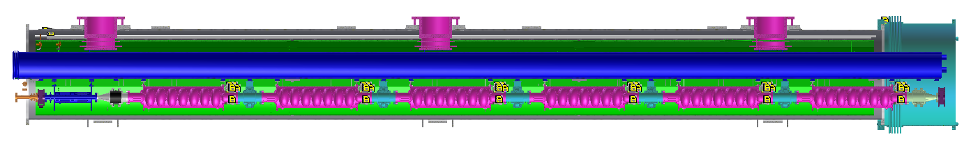
Prototype Main Linac Cryomodule
MLC
the chimney on 2K2P line to HGRP
JT-valve
HGRP
2K-2phase
Cavity string and Rad monitor notes
Pre-cool
Cavity#1
Cavity#2
Cavity#3
Cavity#4
Cavity#5
Cavity#6
six packages of 7-cell cavity/Coupler/tuner
a SC magnets/BPMs package (magnet not installed)
five regular HOMs/two taper HOMs
JT-valve
SC magnets & BPMs
7-cell cavity
Beamline HOM absorber
nominal length: 9.8 m
Intermodule unit

Slide 15
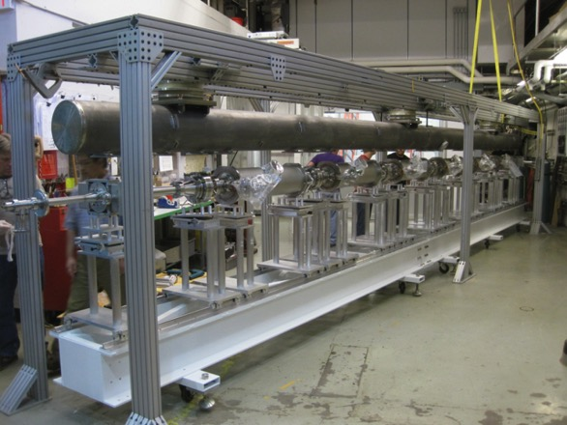
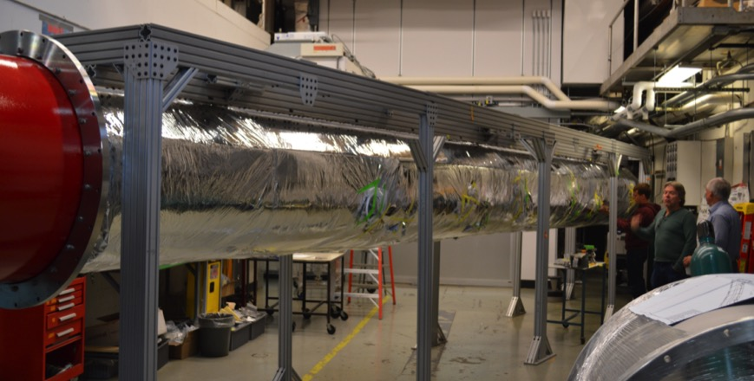
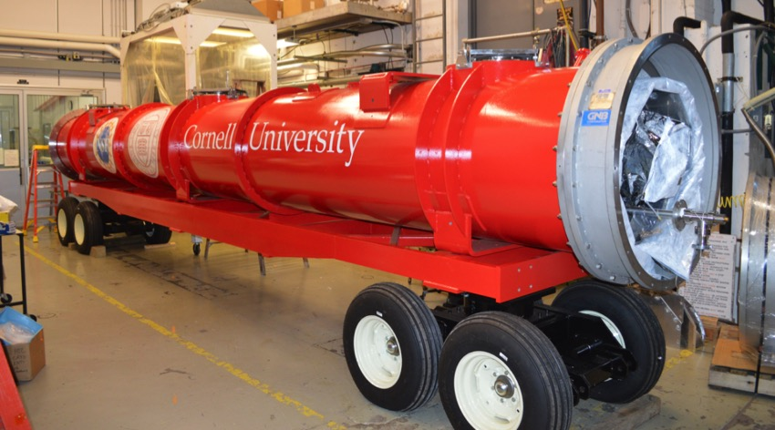
Main linac cryomodule assembly for CW beams
MLC assembly was completed
Cooled down fall 2015, field, Q, and microphonics tested.
Further cold studies will start August 2016

Slide 16
High Current Cavity Design Strategy
Central focus: Maximize threshold current through ERL
Optimization over ~100 degrees of freedom
  Center cell geometry
  End cell geometry
  Beam line HOM absorbers
Simulate ERL performance with realistically shaped cavities
Notes:
Say what realistic shapes mean

Slide 17
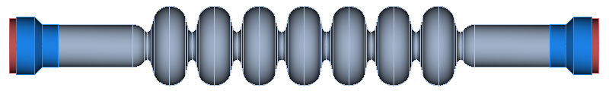
Accelerating Structure Overview
Goal: Maximize I_{th} > 100 mA (under constraints)
Center cells
  Geometries are (nominally) identical
  Responsible for general properties of HOM spectrum
    Controls frequencies of HOM passbands and dispersion relations
    Determines cell-to-cell coupling and how sensitive HOM spectrum is to variation in cell shape

Slide 18
Accelerating Structure Overview
Goal: Maximize I_{th} > 100 mA (under constraints)
Center cells
  Geometries are (nominally) identical
  Responsible for general properties of HOM spectrum
    Controls frequencies of HOM passbands and dispersion relations
    Determines cell-to-cell coupling and how sensitive HOM spectrum is to variation in cell shape
End cells
  Asymmetric design helps prevent trapped modes
  Responsible for coupling HOMs to HOM absorber
    Directly controls quality factors of HOMs

Slide 19
Accelerating Structure Overview
Goal: Maximize I_{th} > 100 mA (under constraints)
Center cells
  Geometries are (nominally) identical
  Responsible for general properties of HOM spectrum
    Controls frequencies of HOM passbands and dispersion relations
    Determines cell-to-cell coupling and how sensitive HOM spectrum is to variation in cell shape
End cells
  Asymmetric design helps prevent trapped modes
  Responsible for coupling HOMs to HOM absorber
    Directly controls quality factors of HOMs
Beam Pipe
  Should be short to improve linac fill factor but long enough to avoid dissipating too much power from the fundamental mode

Slide 20
Accelerating Structure Overview
Goal: Maximize I_{th} > 100 mA (under constraints)
Center cells
  Geometries are (nominally) identical
  Responsible for general properties of HOM spectrum
    Controls frequencies of HOM passbands and dispersion relations
    Determines cell-to-cell coupling and how sensitive HOM spectrum is to variation in cell shape
End cells
  Asymmetric design helps prevent trapped modes
  Responsible for coupling HOMs to HOM absorber
    Directly controls quality factors of HOMs
Beam Pipe
  Should be short to improve linac fill factor but long enough to avoid dissipating too much power from the fundamental mode
HOM load
  Absorber material properties determine specific mode losses.

Slide 21
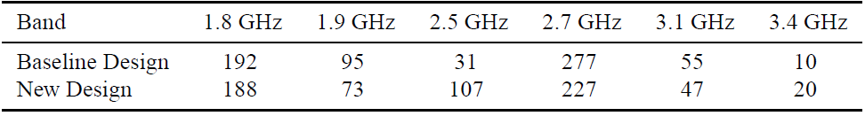
Center Cell Optimization
Baseline Center Cells
Enhanced cell-to-cell coupling
BBU Parameter
BBU Parameter
o HOM properties with no fabrication variation
x HOM properties with 1/16 mm variation

Slide 22
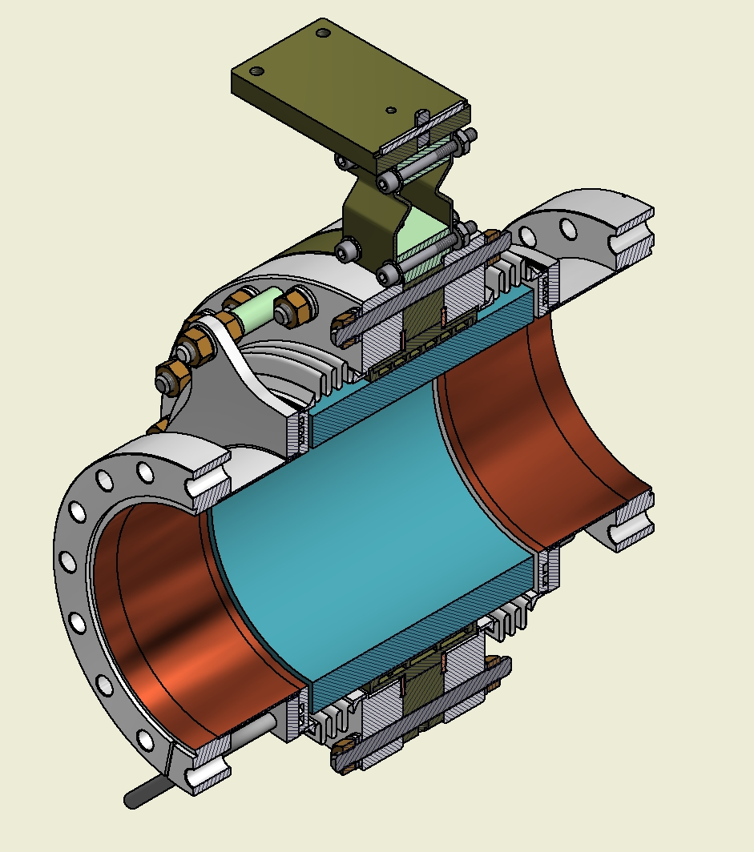
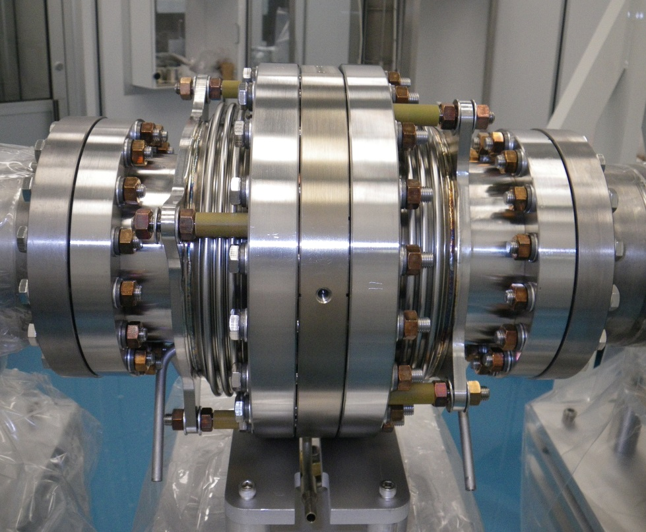
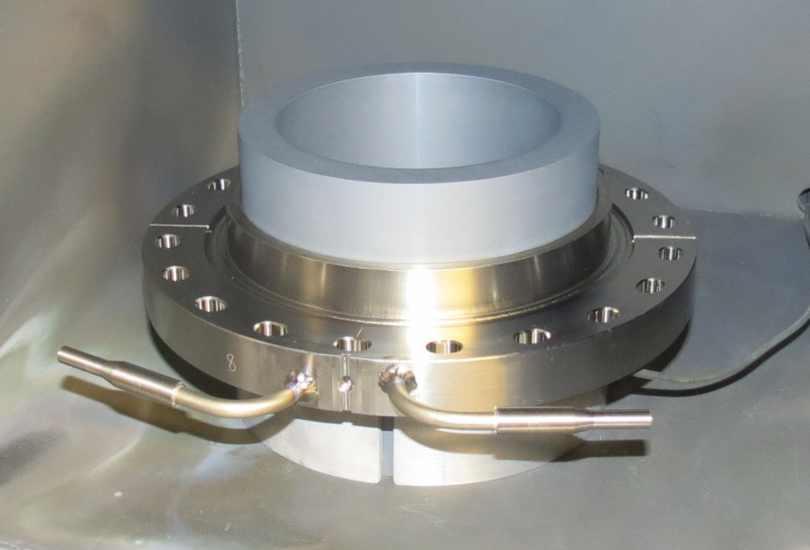
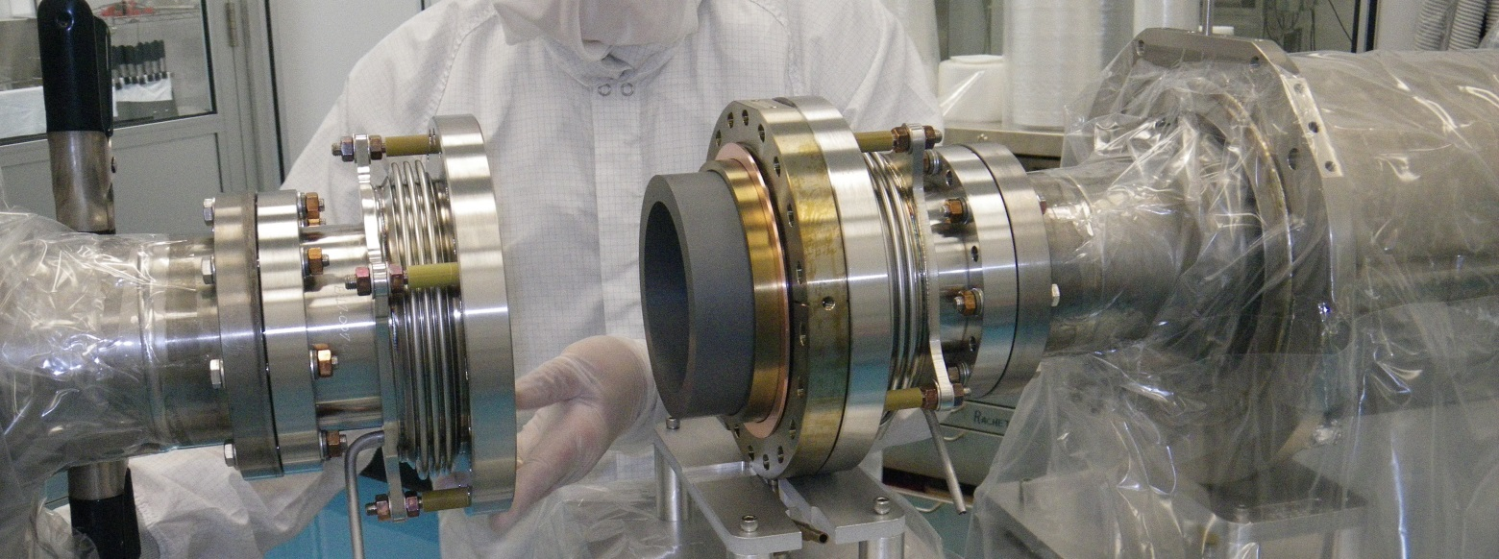
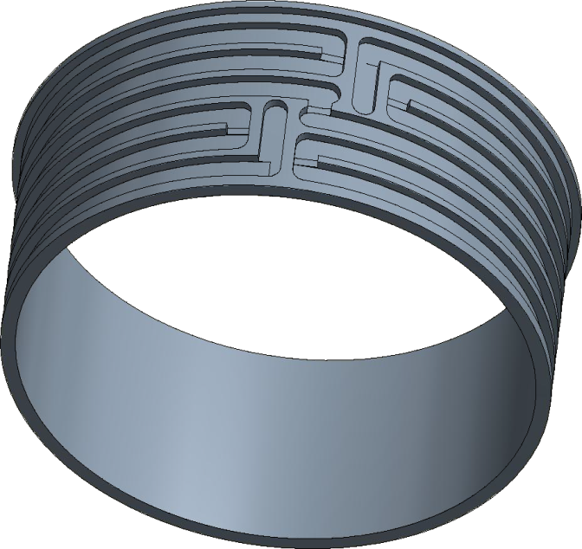
Cornell HOM Beamline Absorbers
Absorbing Material:
Doped SiC (SC-35 from Coorstek
Cooling Passage Configuration of 80K Cooling Jacket
The HOMSC workshop series started in 2010 with a call to discuss development of this HOM absorber.

Slide 23
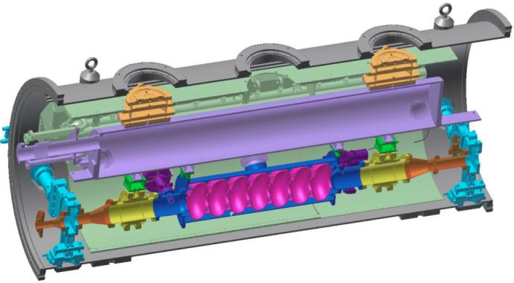
Horizontal Test Cryostat (HTC) with 1st ERL cavity
80K shield
HGRP
Much better Q0 than the ERL spec.
Increased state of the art expectations for other projects, e.g. LCLS-II.
Became essential for high-Q cavity research, incl. for N-doped cavities.
HOM load
cavity
HOM load
Gate valve
Horizontal Test Cryostat:
16MV/m, 1.8K: Q₀ = 2.E10
(reached with coupler)
Q₀ = 3.5E10 without coupler
Q₀ = 6E10 with coupler and HOM absorbers (held the world record)

Slide 24
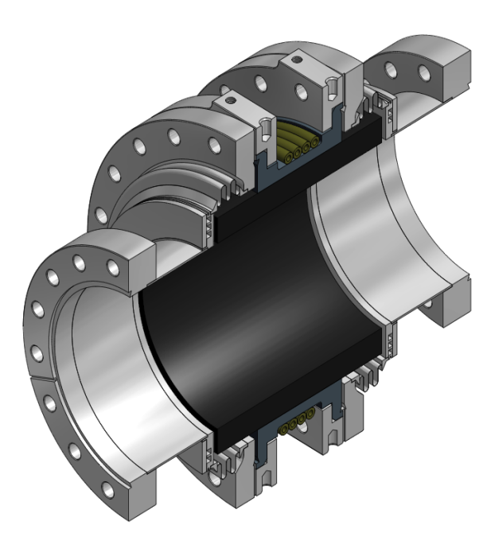
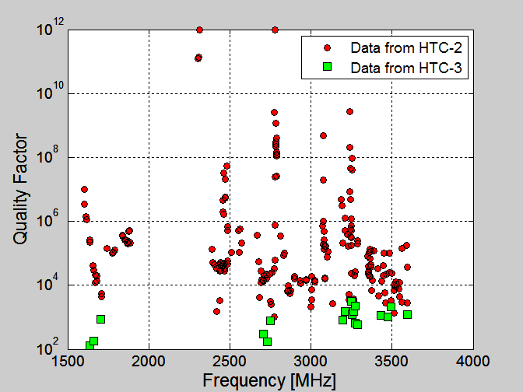
HTC HOM damping
Flange for disassembly
HTC-2: No HOM Absorbers
HTC-3: With HOM Absorbers
40 to 80K intercept
5K intercept
Flange to cavity
SiC absorber ring
Shielded bellow
Beamline HOM absorbers strongly damp dipole HOMs to under Q ~ 10⁴
Ralf Eichhorn | CLASSE | Cornell University ERL Workshop 2015 | Stony Brook| 06/10/15 24

Slide 25
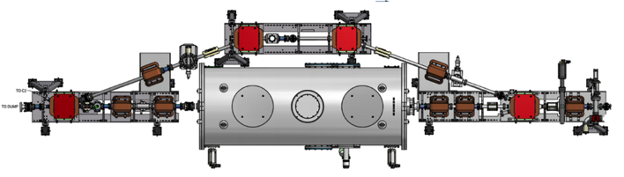
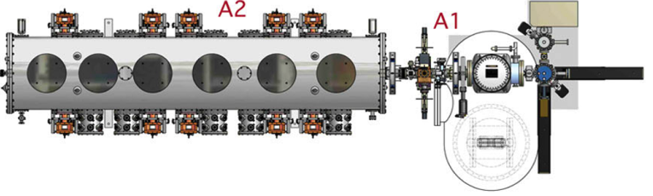
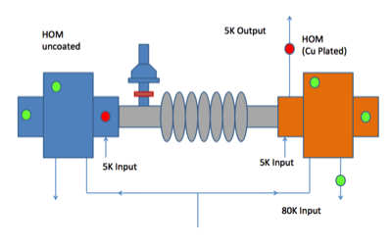
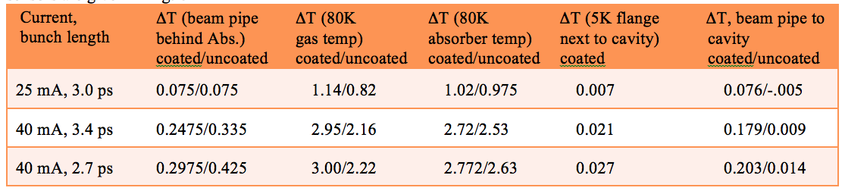
HOM measurements with beam
BPM
7-cell cavity in cryostat
gun
No charge-up of the HOM absorber observed.
HOM heating was less than expected, limits to 400mA total ERL current.
This establishes the current limit of 40mA for the 4-turn CBETA ERL

Slide 26
Main linac cryomodule (MLC) achieved accelerating gradients
Limit.
Admin.
Admin.
Admin.
Quench
Admin.
FE
*FE processed out.
5 of 6 cavities had achieved design gradient of 16.2MV/m at 1.8K in MLC.
Cavity#4 is limited by quench so far, no detectable radiation during test.
Enough Voltage for 76MeV per ERL turn (where 36MeV are needed)

Slide 27
Main linac cryomodule (MLC) achieved surface losses (Q0)
*Q₀ at 14MV/m, FE started.
Target Qo 2.0e10 at 1.8K
*Q₀ after FE processed out.
*Q₀ at 16.2MV/m with severe FE.
*Q₀ after many quench.
1.8K
4 of 6 cavities had achieved design Q₀ of 2.0E+10 at 1.8K.
Q₀ of Cavity#6 had severe FE at 16MV/m.
Enough cooling for 73MV per ERL turn (where 36MeV are needed)

Slide 28
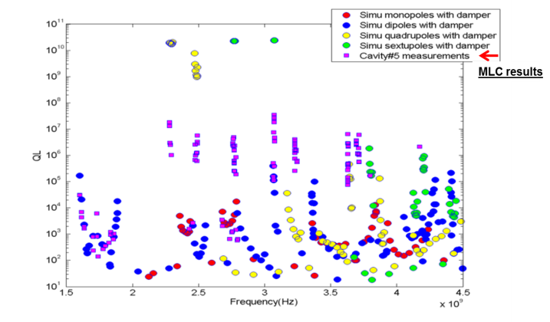
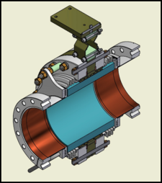
Current limits from HOMs
Dipole HOMs on MLC were strongly damped below Q~10⁴.
Consistent with HTC and simulation results.
HTC results were:
HOM heating: currents are limited to < 40mA in CBETA
BBU no HOM limits BBU to below 100mA in one turn

Slide 29
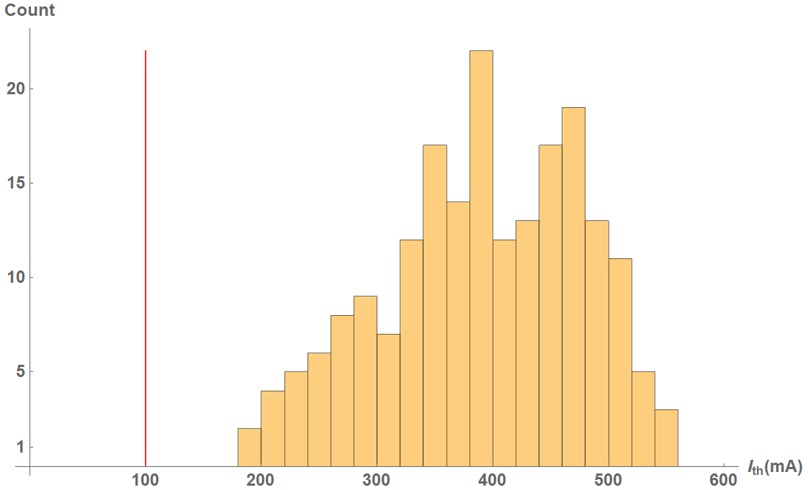
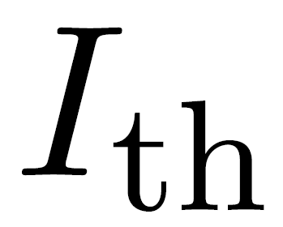
BBU for 1 pass in CBETA
CBETA 1-pass
Cavity shape error: 125 μm
100% of simulations have > 100mA

Slide 30
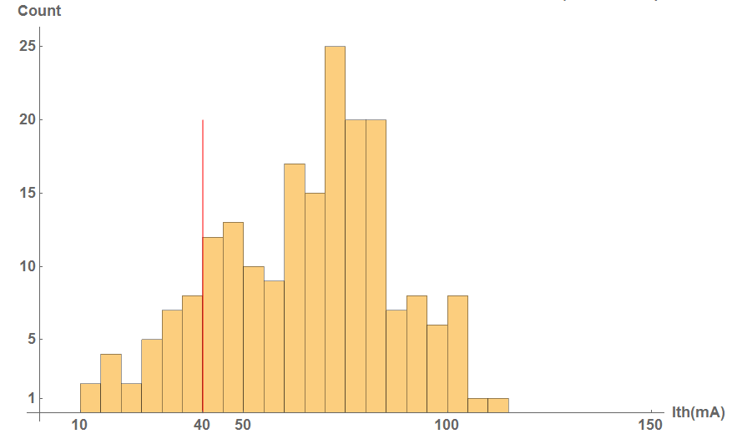
BBU for 4 passes in CBETA
CBETA 4-pass
Cavity shape error: 125 μm
x/y coupling is simulated to increase the threshold significantly
100% of simulations have > 100mA
86% of simulations have > 40mA

Slide 31
CBETA: FFAG-ERL
Cornell DC gun
100mA, 6MeV SRF injector (ICM)
600kW beam dump
100mA, 6-cavity SRF CW Linac (MLC)
Existing components at Cornell
6 MeV
6 MeV
+/- 36 MeV
Electron Current up to 320mA in the linac
Bunch charge Q of up to 2nC
Bunch repetition rate 1.3GHz/N
Beams of 100mA for 1 turn and 40mA for 4 turns
42, 78, 114, 150 MeV

Slide 32
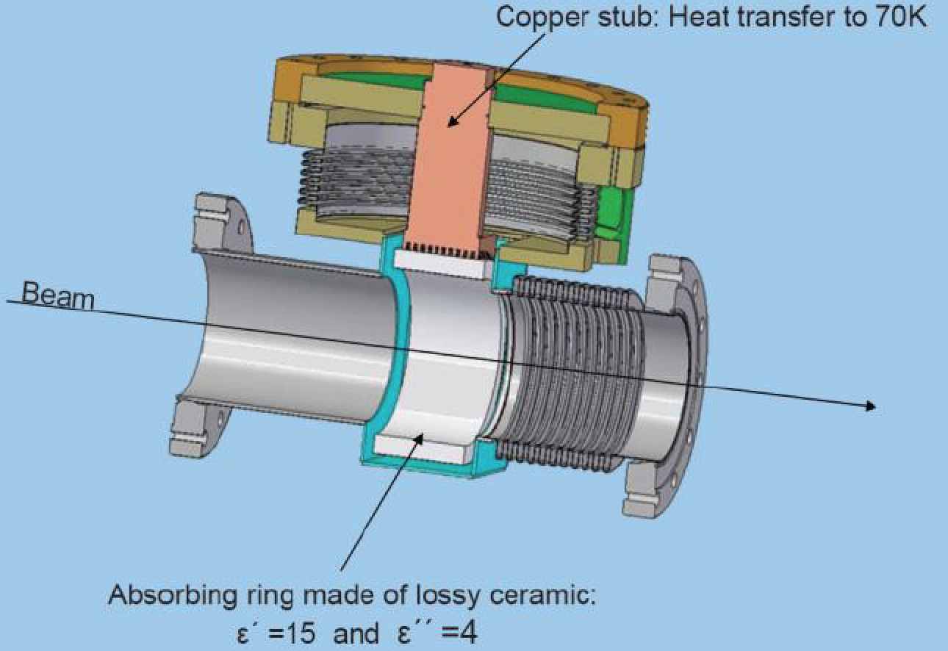
Summary
Cornell is building a 4-turn Energy Recovery Linac (ERL) with a beam current limited by HOMs through
HOM heating
The Beam-Breakup (BBU) instability
Cornell has already built the Injector Cryomodule (ICM) and the Main Linac Cryomodule (MLC) with beam-pipe HOM absorbers.
The ICM has accelerated 75mA CW without HOM-heating problems.
The cavity arrangement of the MLC with HOM absorbers has been tested with beam.
HOM-absorber heating limits to 320mA in the MLC, or 40mA for a 4-turn ERL beam.
HOM measurements with and without beam indicate the a 1-turn ERL with 100mA should be possible.
BBU calculations: 100mA one-turn ERL is possible, 40mA, 4-turn ERL may be possible
To operate accelerators CW linacs with larger
currents, HOM absorption at room temperature
become advisable. Designs for this should be
developed.

Slide 33
The END
Questions
Discussion
?

