Slide 1

Study on HOM Damping Effects in SRF Cavities of BESSY VSR Project
Tsakanian# , H. W. Glock, A. Velez , J. Knobloch
Helmholtz-Zentrum Berlin, Albert-Einstein-Str. 15, 12489 Berlin
International ICFA Mini-Workshop on
High Order Modes in SC Cavities
22 - 24 August 2016
Rostock-Warnemünde, Germany

Slide 2
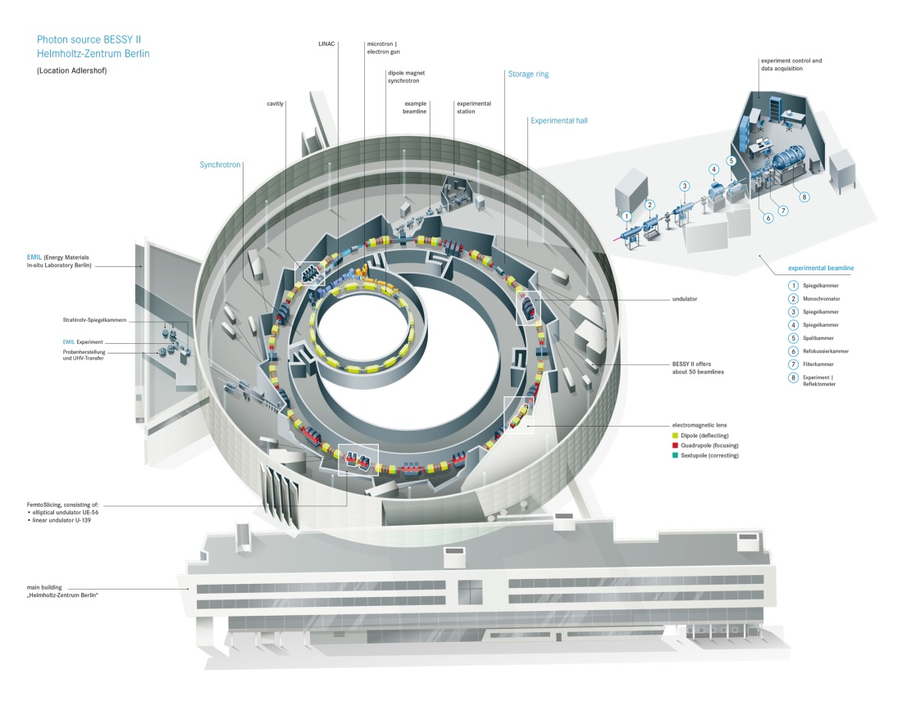
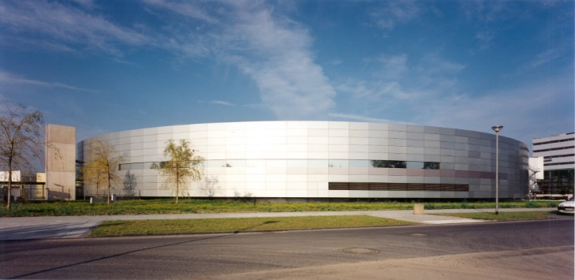

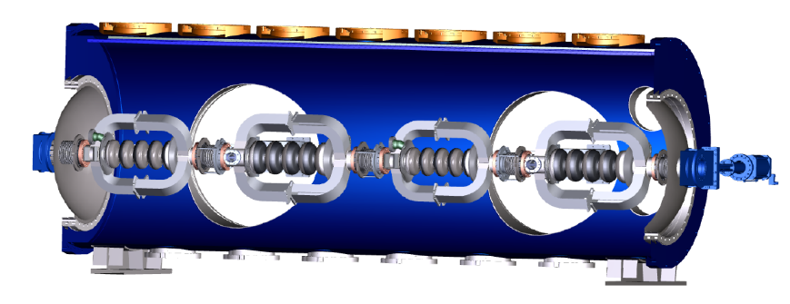
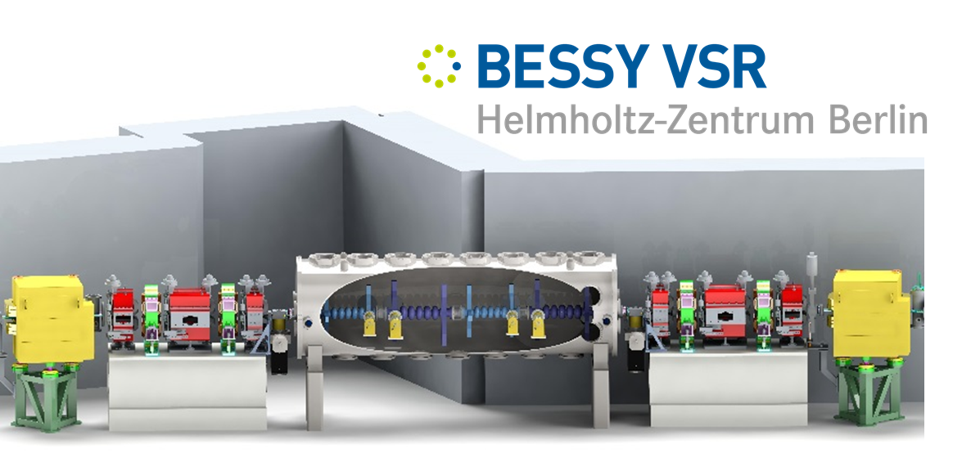
BESSY II SC Upgrade
BESSY II is a 1.7 GeV synchrotron radiation source operating for 20 years in Berlin
Core wavelength in the range from Terahertz region to hard X rays
SC Upgrade
Variable pulse length Storage Ring
BESSY II Parameters
Lattice | DBA
Circumference | 240 m
Energy | 1.7 GeV
Current | 300 mA
RF Frequency | 500 MHz
RF Voltage | 1.5 MV
Bunch Length | 15 ps
Emmitance | 6 nm rad
SRF SYSTEM: 2@1.5 GHz & 2@1.75 GHz
CHALLANGES
CW operation @ high field levels E=20MV/m
High beam current (Ib=300mA),
Cavity HOMs must be highly damped (CBIs)
Exotic cavity design (damping end-groups)
2

Slide 3
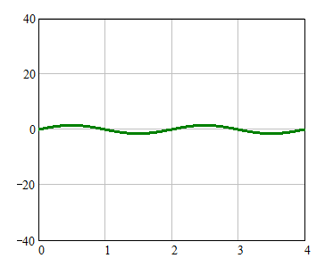
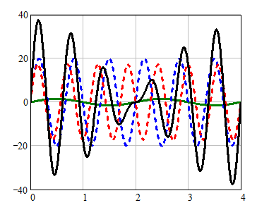

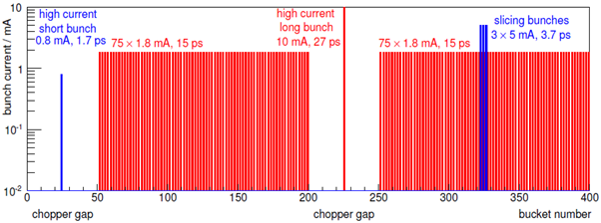
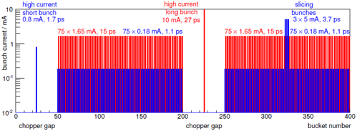
BESSY II, SC Upgrade – BESSY VSR
Present
BESSY VSR
SC Upgrade
Voltage: 1.5 MV @ 0.5 GHz
Long Bunch
G.Wüstefeld et al.
„Simultaneous long and short electron bunches in the BESSY II storage ring“
IPAC2011
15 ps bunch
Voltage / MV
1.5GHz and 1.75GHz ---- RF beating
(modulate RF focusing)
Odd (voltage cancelation, 15 ps bunches)
Even (voltage addition, 1.1 ps)
Voltage / MV
Short Bunch
Time [ ns ]
Time [ ns ]
BESSY VSR Filling Patterns
Baseline
Extended
3

Slide 4
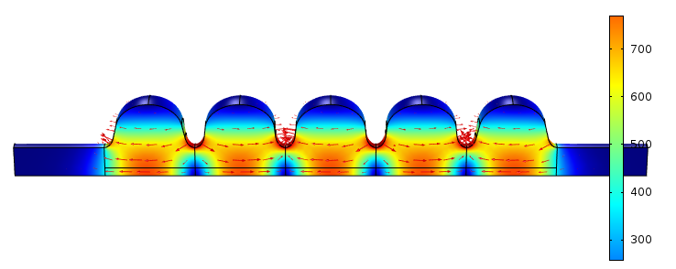
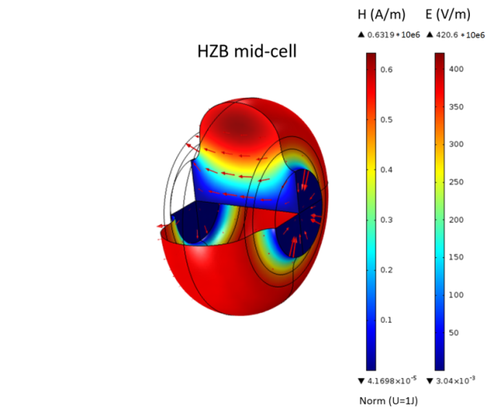
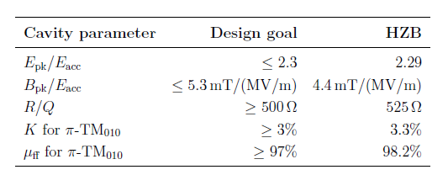

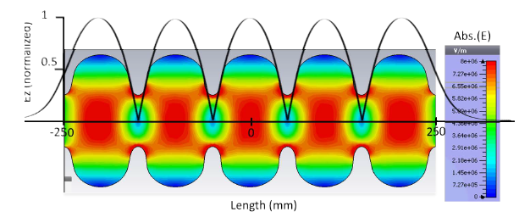
BESSY VSR 1.5GHz SRF Cavity Design
Stage 1: Cavity geometry
1.5 GHz design
Base models
Cornell 1.3 GHz (escaled)
Jlab 1.497 GHz
Big iris diameter for high cell-cell coupling
SRF Specifications fullfilled
Φ=71.34mm
HZB optimized model
Operation problems derived from high field values prevented
Stage 2: HOM damping
Analyze HOM in relation to beam spectrum
Provide strong HOM damping in order to avoid CBIs
Courtesy of A. Velez
4

Slide 5
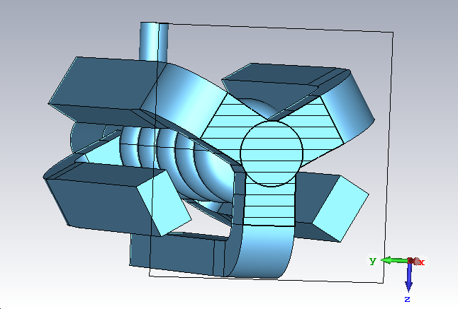
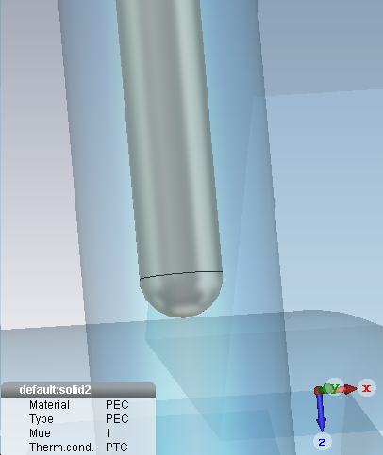
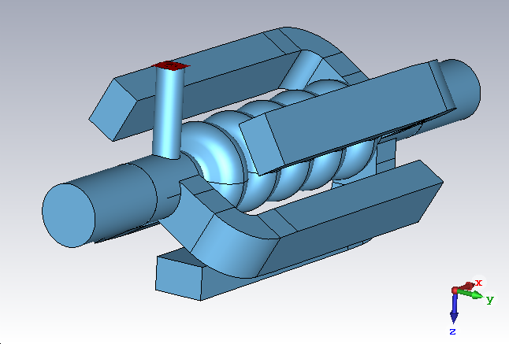
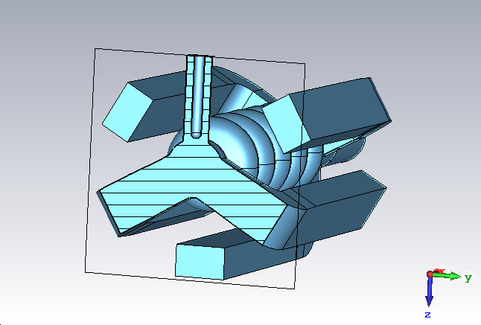
BESSY VSR 1.5GHz SRF Cavity
Cavity Model
WG_Tapered – 88-91-95mm
BmP Diam. – 110 mm
End-Group Down Stream
FPC – Coax. diam.: 20 x 49mm
End-Group Up Stream
5- HOM damping Waveguides
Large beampipe radius – better HOM propagation
Goal
Expected HOM power evolution for BESSY VSR Beams.
  HOM load capabilities.
  Power flowing thru beampipes

Slide 6

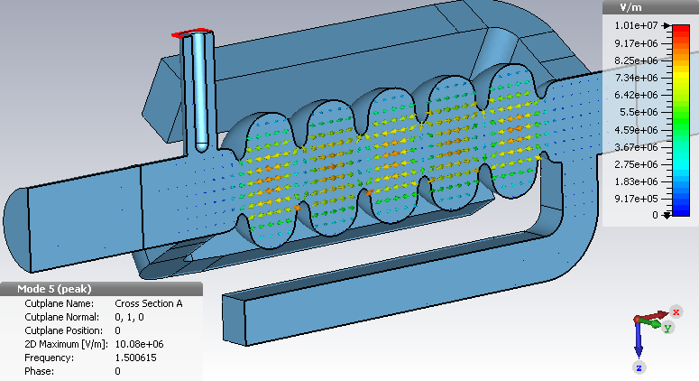
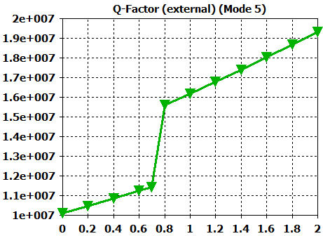
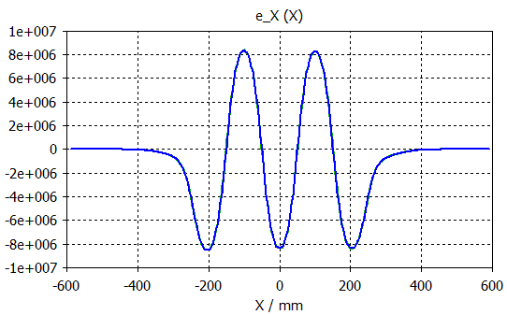
BESSY VSR 1.5GHz SRF Cavity
Num. Tune of FPC to Q_{ext}~10⁷
working point
EG-UpS
EG-DnS
FPC inner cyll. position from BmP [mm]
HOM high damping => Large Beampipes
Deeper penetration of fundamental acc. mode into the beampipes.

Slide 7
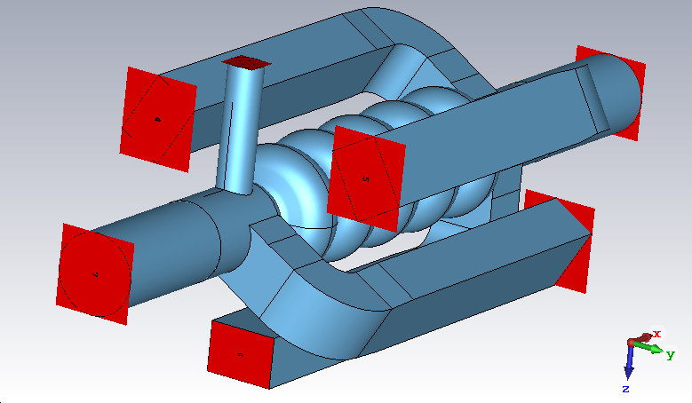
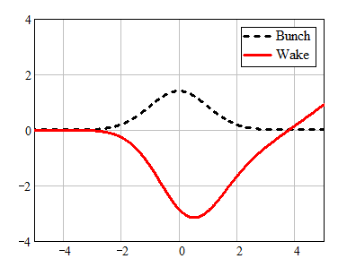
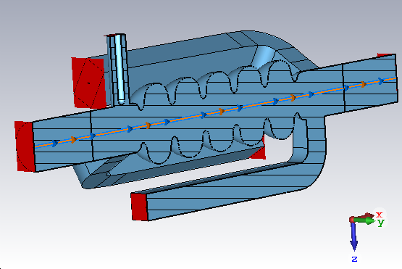
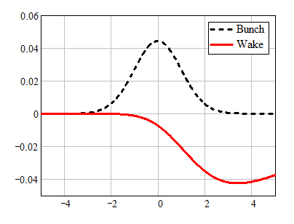

BESSY VSR 1.5GHz SRF Cavity
Shot Range Wakes
$$Simulated Bunch=9mm ⇒f_{max}\sim 12GHz$$
K_{loss}= 2.26 V/pC
W// [ V/pC ]
Setup Wakefield Solver
  5 x WG ports – 15 mode
  FPC port – 10 mode
  2 x Bmp – 40 mode
s / σ_{b}
Simulation Consistency
Energy loss in all ports ~ 1.46 µJ < 2.26 µJ (bunch loss).
About 35% of EM energy steel remains in fundamental mode.
W_{z} [ V/pC ]
The vertical kick of fundamental-power-coupler can be compensated by 180 degree rotation of second 1.5GHz Cavity.
Horizontal kick is 10K times smaller than vertical.
s / σ_{b}

Slide 8
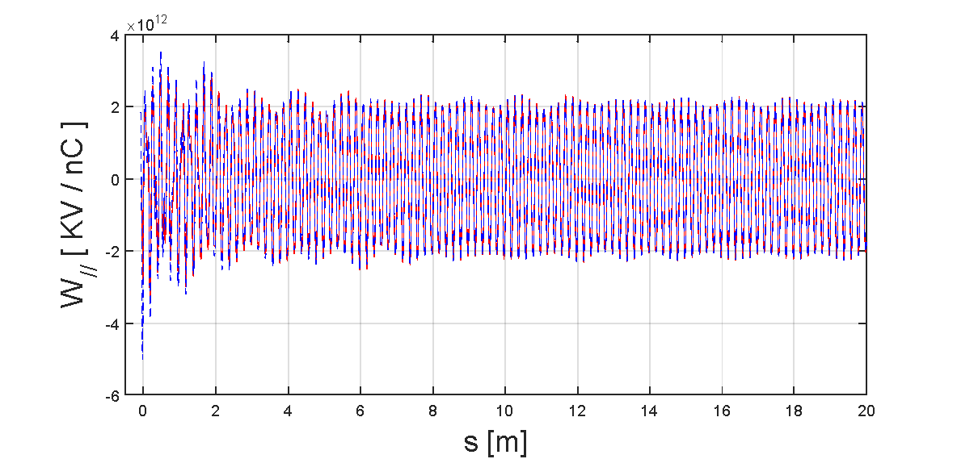
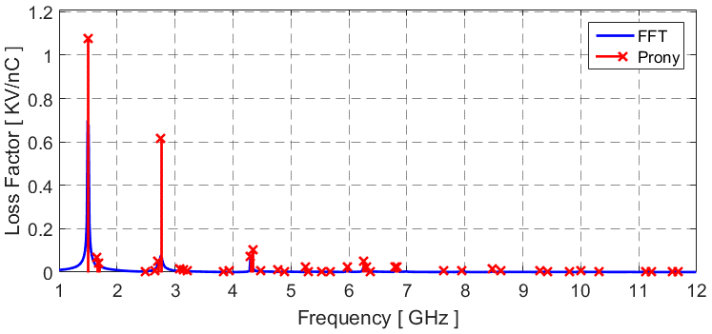
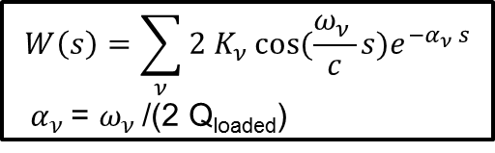
BESSY VSR 1.5GHz SRF Cavity
Cavity Long Range Wakes
Bunch Gauss 1nC, σ = 9mm
$$W\left(s\right)=\sum_{ν}{2 K_{ν }cos⁡(\frac{ω_{ν }}{c}s)e^{−α_{ν }s}}$$
$α_{ν }$= $ω_{ν }$/(2 Q_{loaded})
Prony-Pisarenko Fit
K_{loss}~2.266 KV/nC
Energy ~ 2.266µJ
Simulated
Prony- Fit
Freq. [GHz] | K_{loss} [KV/nC] | Q_{loaded}
1.500 | 1.078 | 1.85e6
1.651 | 0.068 | 60
1.685 | 0.042 | 34
2.705 | 0.049 | 364
2.757 | 0.62 | 73
4.301 | 0.070 | 3.25e3
4.343 | 0.102 | 201
6.251 | 0.052 | 1.1e3

Slide 9
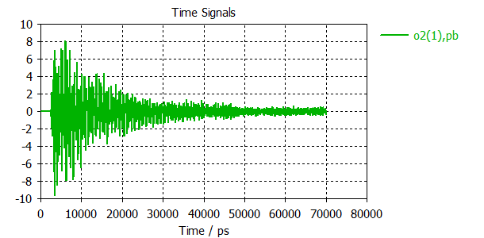
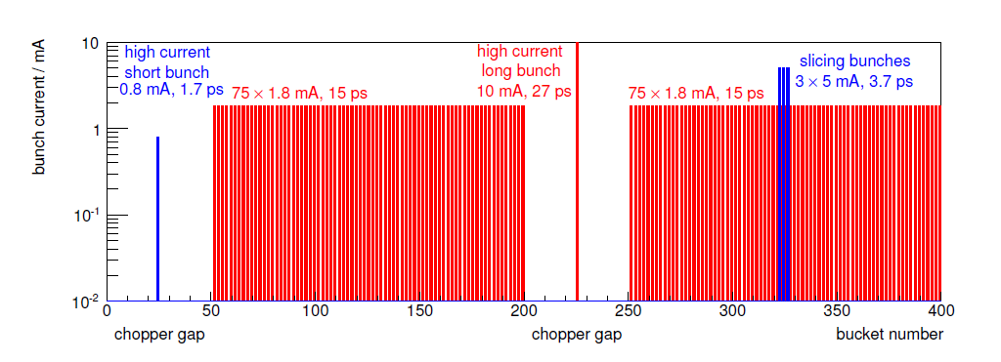
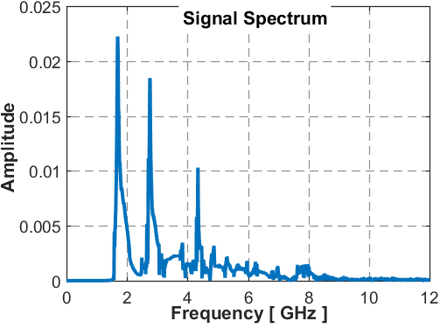
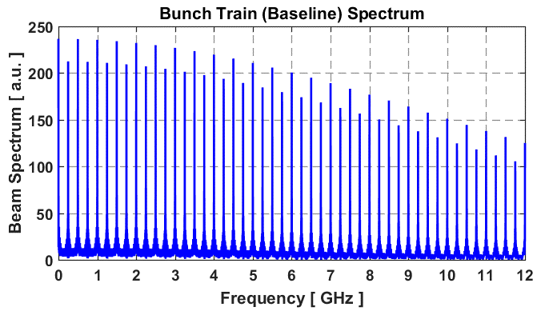
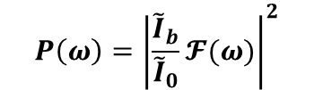
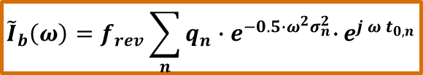

BESSY VSR 1.5GHz SRF Cavity
Bunch Train - Baseline
Bunch Current [ mA ]
Bucket Number
$${\tilde{I}}_{b}\left(ω\right)=f_{rev}\sum_{n}{q_{n}{∙e}^{−0.5∙ω^{2}σ_{n}^{2}}∙}e^{j ω t_{0,n}}$$
FFT
Spectral weighting of port signal & Power per freq. bins (FFT)
∆f =250 MHz
$$P\left(ω\right)={\left|\frac{{\tilde{I}}_{b}}{{\tilde{I}}_{0}}𝓕(ω)\right|}^{2}$$
${\tilde{I}}_{0}$ - Simulated single bunch

Slide 10
BESSY VSR 1.5GHz SRF Cavity
Power Balance of Propagating HOMs
=== Coherent ====
Port Baseline Extended Single
FPC - 1 , 44.12 38.72 26.47
2 , 189.71 154.08 93.00
3 , 189.70 154.08 93.00
WGs 4 , 297.71 217.95 127.65
5 , 297.71 217.95 127.65
6 , 289.96 215.72 124.31
BmP - 7 , 470.14 413.57 127.19
BmP - 8 , 531.85 406.03 165.03
====
Total = 2310.89 1818.10 884.31
---------------
Baseline >>> FPC = 44.12 W, HOMs = 1264.79 W, BmP = 1001.99 W
1.91 % , 54.73 % , 43.36 %
=== None-Coherent ====
Baseline >> FPC = 40.05 W, HOMs = 705.83 W, BmP = 595.65 W, Total = 1341.54 W
2.99 % , 52.61 % , 44.40 %
Original Data >> FPC = 0.05 W, HOMs = 1.12 W, BmP = 0.64 W, Total = 1.81 W
3.02 % , 61.66 % , 35.32 %
Max Power in WG (Baseline) = 381.83 W
About 1.3 KW RF power should be damped in 5 HOM loads
(Broadband & Multimode RF load design)
1KW flowing out thru beampipes (cavity concatenation issues)
Power in FPC need to be analyzed in terms of coax. modes
(RF window heating issues )

Slide 11
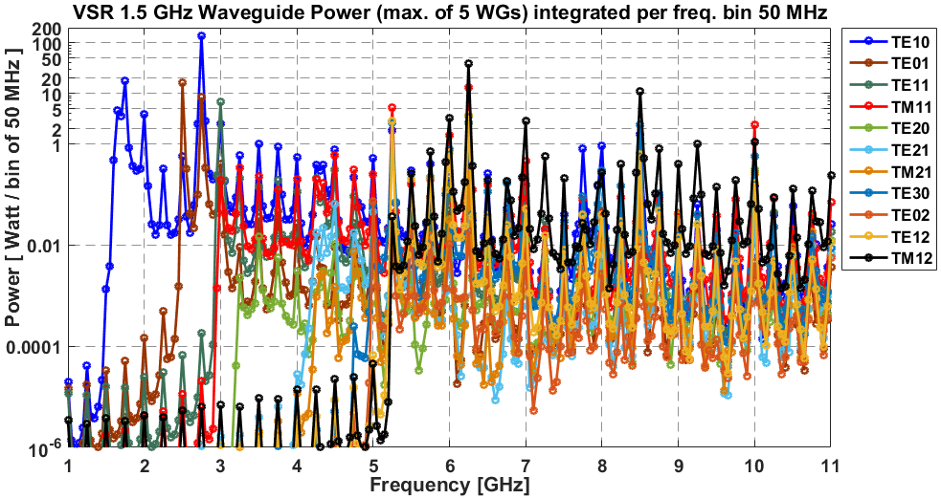
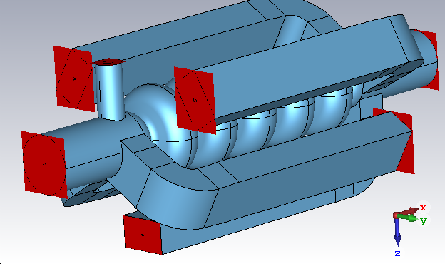
BESSY VSR 1.5GHz SRF Cavity
Wakefield Simulation
Bunch – 9 mm (~ 21h)
Power Balance - Baseline (Total ~ 2311 W)
FPC = 44.12 W, HOMs = 1264.79 W, BmP = 1001.99 W
1.91 % , 54.73 % , 43.36 %
Max. expected power in each load ~ 400 Watt
FPC – Coax. diam.: 49 x 20mm
Model – 2
Tapered WGs: 60 x 88-91-95mm

Slide 12
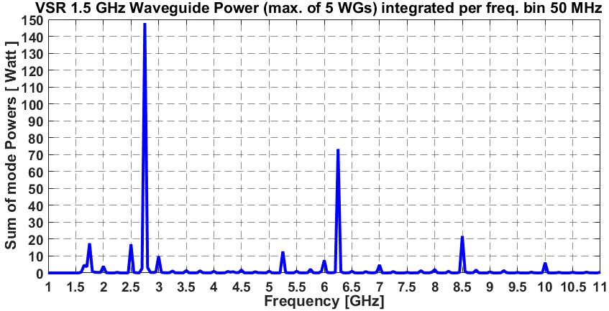
BESSY VSR 1.5GHz SRF Cavity
2.75 GHz
6.25 GHz
f[GHz] TE10 TE01 TE11 TM11 TE20 TE21 TM21 TE30 TE02 TE12 TM12 TE31 TM31 TE22 TM22
1.75 17.5654 0.0001 0.0000 0.0000 0.0000 0.0000 0.0000 0.0000 0.0000 0.0000 0.0000 0.0000 0.0000 0.0000 0.0000
2.00 3.9692 0.0001 0.0000 0.0000 0.0000 0.0000 0.0000 0.0000 0.0000 0.0000 0.0000 0.0000 0.0000 0.0000 0.0000
2.25 0.3279 0.0005 0.0000 0.0000 0.0000 0.0000 0.0000 0.0000 0.0000 0.0000 0.0000 0.0000 0.0000 0.0000 0.0000
2.50 0.5653 16.3865 0.0001 0.0000 0.0000 0.0000 0.0000 0.0000 0.0000 0.0000 0.0000 0.0000 0.0000 0.0000 0.0000
2.75 139.4482 8.4237 0.0002 0.0000 0.0000 0.0000 0.0000 0.0000 0.0000 0.0000 0.0000 0.0000 0.0000 0.0000 0.0000
3.00 2.5146 0.4105 6.7323 0.1913 0.0000 0.0000 0.0000 0.0000 0.0000 0.0000 0.0000 0.0000 0.0000 0.0000 0.0000
5.25 1.8647 0.0183 0.0234 5.2666 0.0188 0.0123 0.0055 2.6393 0.0122 2.8285 0.0361 0.0000 0.0000 0.0000 0.0000
6.00 0.2217 0.0485 0.1854 1.5223 0.0328 0.0051 0.0315 0.7723 0.0105 0.6730 3.2767 0.1159 0.5661 0.0267 0.0001
6.25 0.7545 0.2357 2.6704 12.8974 0.0690 0.0353 0.3234 3.5270 0.0193 3.6989 38.3787 2.7692 7.7731 0.0278 0.1526
7.00 0.4585 0.0092 0.1519 0.4567 0.0128 0.0054 0.0211 0.0358 0.0075 0.0524 2.8254 0.0368 0.5964 0.0168 0.0466
8.50 1.5918 0.0726 0.6425 0.6142 0.0611 0.0495 0.1014 2.4145 0.0091 0.6241 10.8408 0.3525 4.2869 0.0135 0.1529
P>20W
P<20W
P<5W
Sum=73W
At high frequencies (for example 6.25GHz), it is difficult to distinguish the bend effect from coupled mode excitation at cavity & HOM waveguide connection point (WG – 60x88mm).

Slide 13
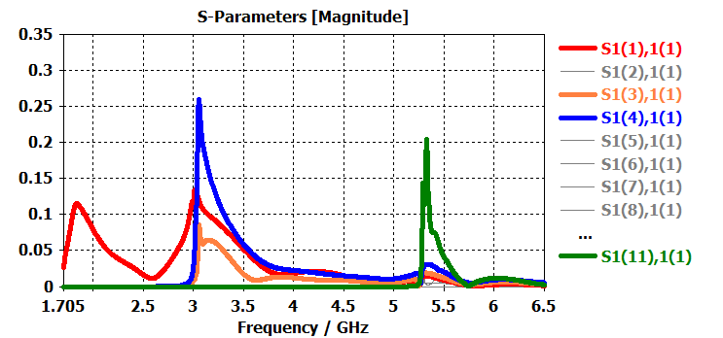
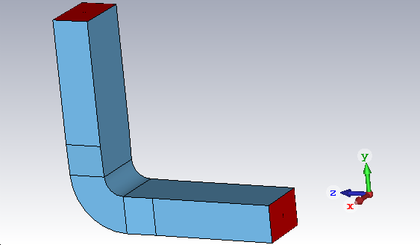
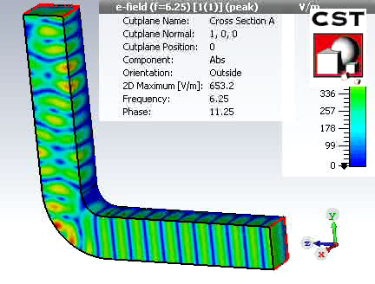
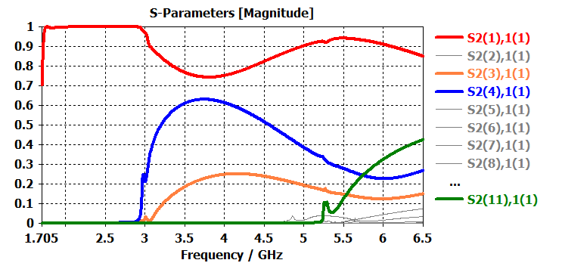
Waveguide Bend Broadband Characteristics
Transmission & Reflection Broadband Behavior for TE10 Mode
WG Tapered 60 x 88_91_95mm
TE10
60x95mm
TE11
TM11
Incident (TE10) Port,
60x88mm
Taper 91-95
Taper 88-91
TM12
R_{bend}=30mm
TE10 - 6.25 GHz
R_{bend}=30mm
TE10 mode couples into different modes after bend: TE10, TE11, TM11…, depending on excitation frequency & the cutoff of each WG mode !
At high frequencies the TE10 is scattered from the bend into several modes, i.e. acts as mode mixer.
At optimized 30mm inner bending radius the reflection is minimal in broadband frequency sense.

Slide 14
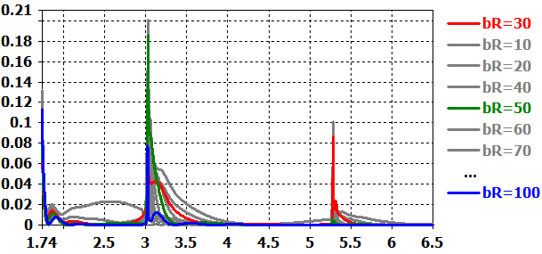
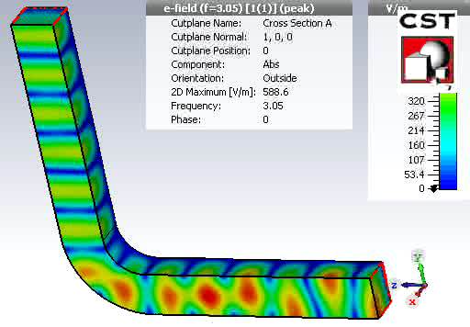
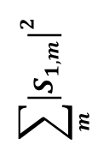
Waveguide Bend Broadband Characteristics
Bending Radius Optimization for WG-Bend Low Reflection
WG Tapered 60 x 88_91_95mm
Port modes -18
$$\sum_{m}{{\left|S_{1,m}\right|}^{2}}$$
TE10 - 3.05 GHz
R_{bend}=50mm
Frequency [ GHz ]
Low reflection (broadband) from the WG bend is for bending radius = 30mm or bR ≥ 100mm.

Slide 15
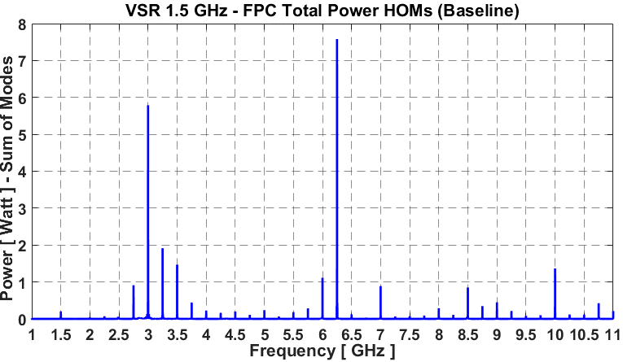
BESSY VSR 1.5GHz SRF Cavity
Fundamental-Power-Coupler
TEM – 1.4W
TE11 – 2.85W
Mode5 – 3.3W
Total - 44 W
TE11 – 5.7W
Mode | Power
1 – TEM | 8.07 W
3 – TE11 | 25.22 W
5 – TE | 6.18 W
7 – TE | 3.49 W
8 – TM | 1.09 W
18 %
6.25 GHz
57 %
14 %
7.9 %
Coax Diam. – 42 x 18mm
2.5 %
Cutoff Frequency
FPC-TE11: 3.248 GHz
About 25 W of HOM power is propagation in FPC as TE11 mode.
FPC RF window heating issues.

Slide 16



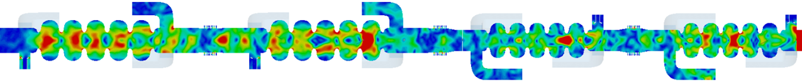
Summary
The technique for calculation of RF power propagation of HOMs excited by the circulating beam in SRF cavities.
Long Range Wake computation (single bunch).
Bunch train - Spectral weighting of port signals.
This class of simulations are very expensive – time consuming & comp. resource.
Single Cavity
HOM power balance estimation & RF Load Specification (spectrum up to 20GHz possible).
Estimate changes in RF Load capabilities from short bunch !
Available resources for 5mm(~15ps) smallest bunch length and long range 20m (~ 1 Week) . For 9mm ~21h
But smallest VSR bunch is 1.1ps~330µm (standart opt.) !!!
Challenging task – HOMs above 20GHz.
Collaborations
SRF module - 4 x Cavity chain (Concatenation Study)
First test with CST – 9mm bunch possible ~2Week.
Cavity cross talk – Do we expect considerable HOM power increase at one of the local loads ?
Confirm HOM load specifications.
Validate Impedance budget.
Tune bellow transitions.
Thank You for Your Attention !

