Slide 1

Higher Order Modes Based Beam Phase Study:
Simulations and Measurements
ICFA Mini Workshop on High Order Modes in Superconducting Cavities 2016
Presenter: L. Shi (U. Manchester / CI / DESY)
Members: N. Baboi (DESY), R.M. Jones (U. Manchester), T. Wamsat (DESY),
U. Mavric (WUT)
The work is supported partly by EuCARD² with Grant No. GA 312453

Slide 2
Outline
  A brief introduction to the European XFEL and Higher Order Modes
  Principle of beam phase determination
  Simulations with circuit model
  Measurements with a broadband setup
  Summary and Outlook

Slide 3
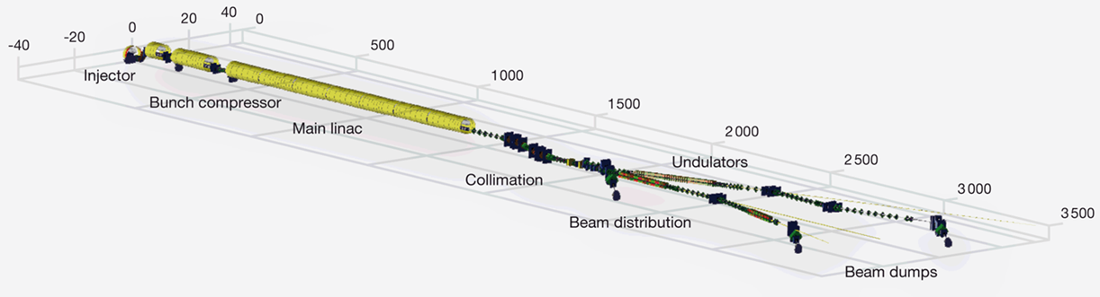
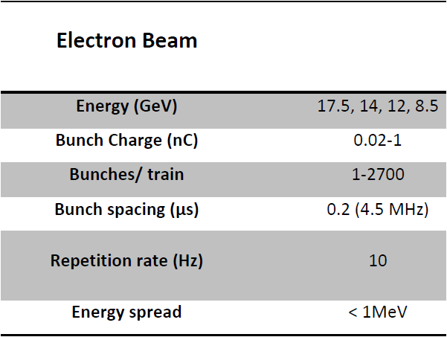
Introduction to the European XFEL
Commissioning of the European XFEL Injector, Frank Brinker, IPAC2016, PP1044
Notes:
No additional space.

Slide 4
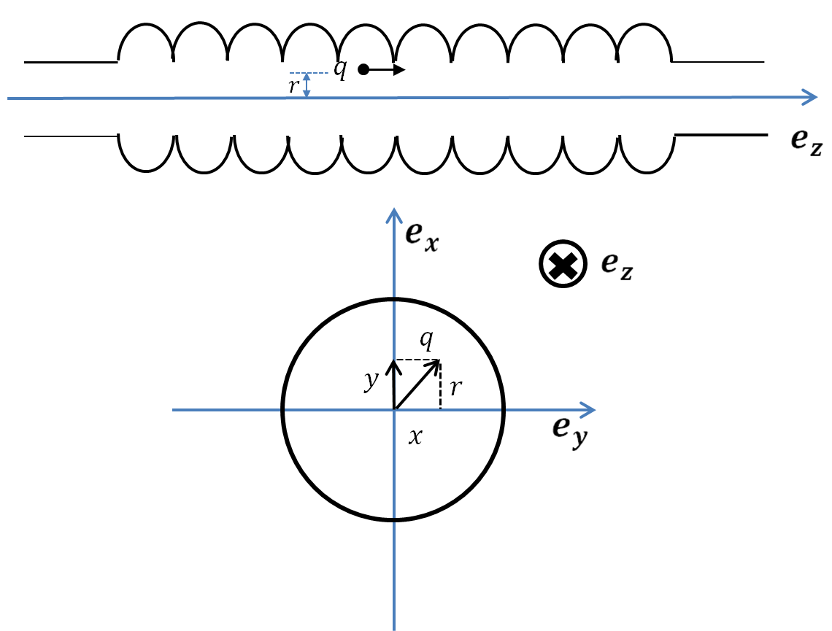
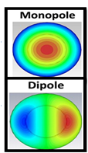
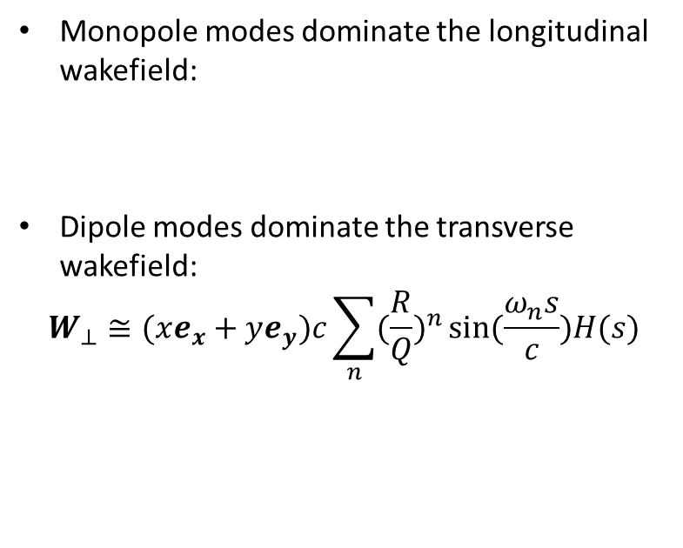


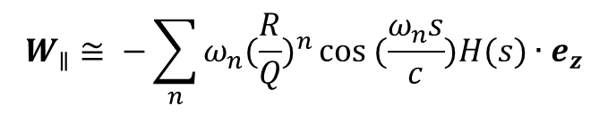
Introduction to Higher Order Modes (HOM)
When beam transverses a cavity, wakefields
are excited. These fields are classified into monopole, dipole, quadrupole modes etc.
Monopole modes dominate the longitudinal wakefield:
Dipole modes dominate the transverse wakefield:
$$W_{⊥}≅(xe_{x}+ye_{y})c\sum_{n}{({\frac{R}{Q})}^{n}}sin(\frac{ω_{n}s}{c})H(s)$$
$$W_{∥}≅ −\sum_{n}{ω_{n}({\frac{R}{Q})}^{n}}cos (\frac{ω_{n}s}{c})H(s)∙e_{z}$$
Measured Quantity  $q⋅\frac{R}{Q}$
Bunch charge
Measured Quantity  $q⋅r⋅\frac{R}{Q}$
R. Wanzenberg, TESLA 2001-33, 2001.
Bunch offset

Slide 5
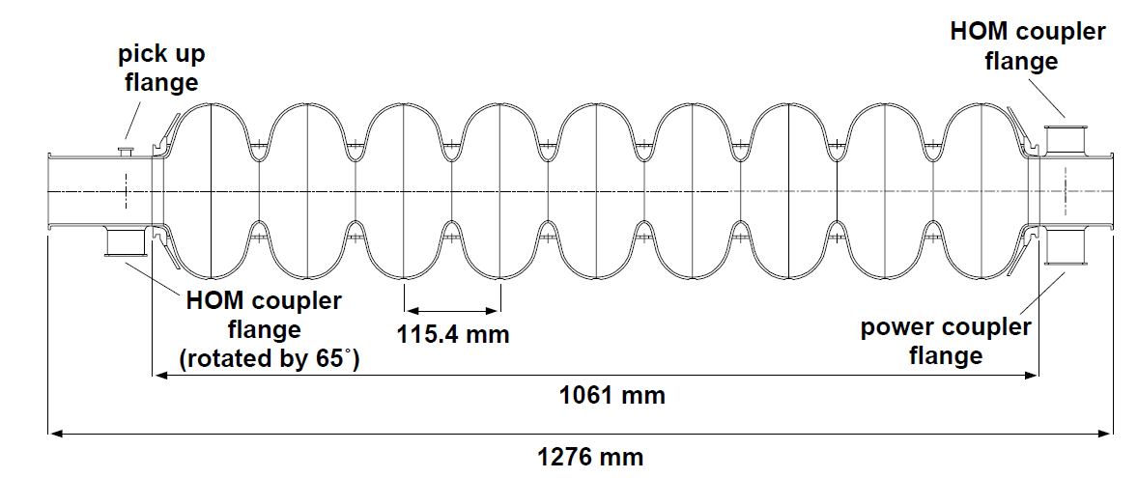
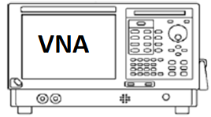
TESLA Cavity and HOM spectrum
TESLA Cavity (1.3 GHz)
HOM Spectrum
Monopole modes
Monopole band occupies ~ 2.4 GHz with 70 MHz (2.38-2.45 GHz) bandwidth. The last two modes are with higher R/Q
(~ 70 Ω).
B. Anue, Phys. Rev. ST Accel. Beams 3, 092001.

Slide 6
  Introduction
  Principle of beam phase determination
  Simulation with circuit model
  Measurements with a broadband setup
  Summary and Outlook

Slide 7
Field Control inside a cavity
FEL operation requires high stability of RF amplitude and phase. Requirements are derived from beam properties:
  Energy spread
  Emittance
  Bunch length
  Arrival time
 | Amp | Phase
FLASH | 0.01% | 0.01 degree
E-XFEL | 0.01% | 0.01 degree
Phase 0 is defined as on crest.
C. Schmidt, IPAC 2013, WEPME009

Slide 8
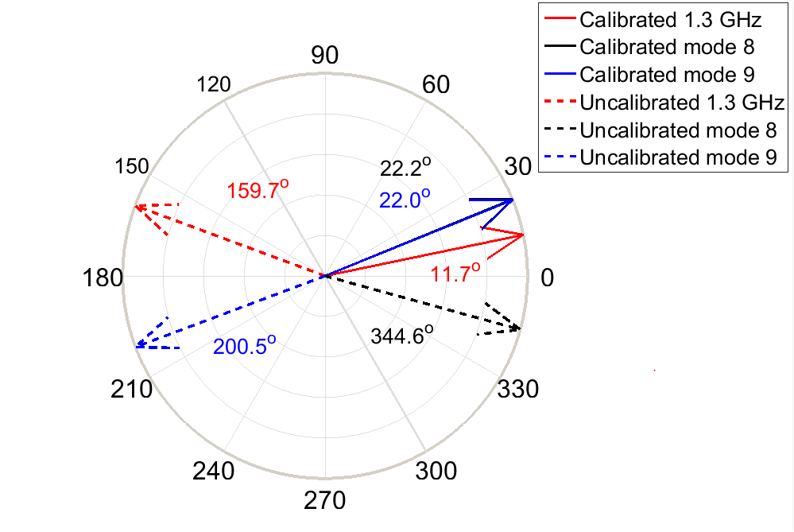
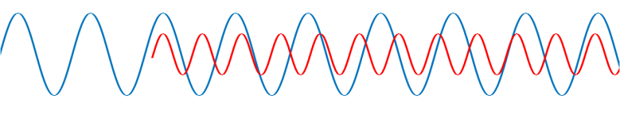
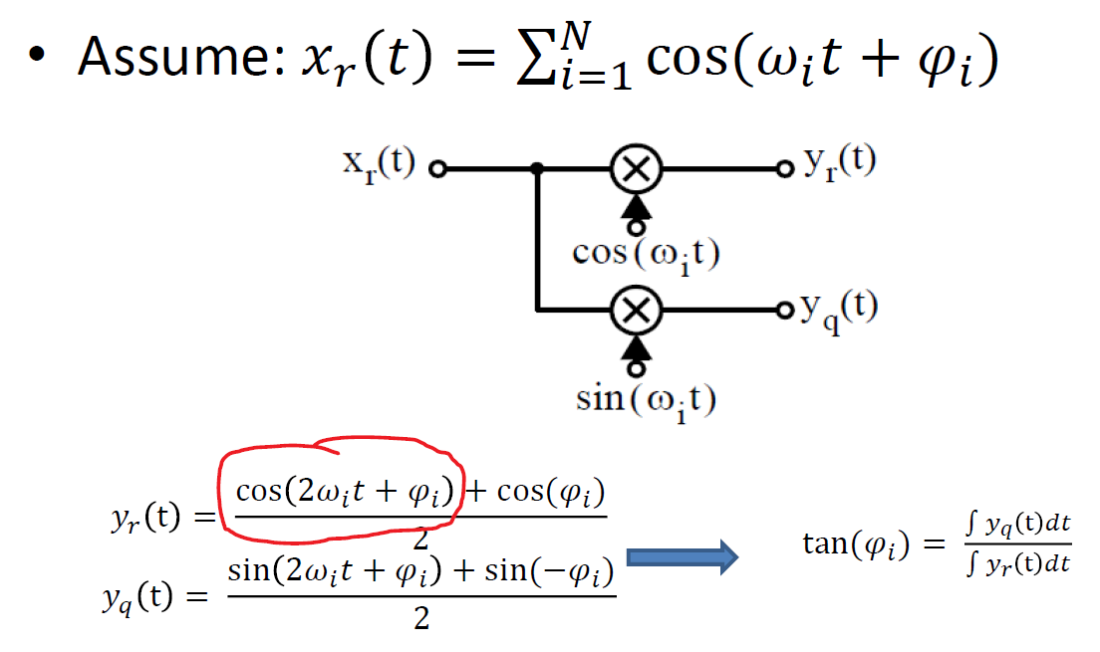


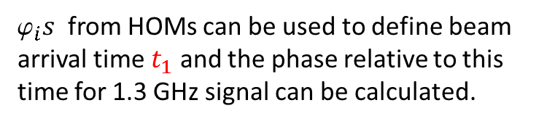





How to determine the beam phase?
$${RF}_{t0}$$
${RF}_{t1}= {RF}_{t0}+V_{b}$
$$t_{0}$$
$$t_{1}$$
Flat top of RF field inside cavity
${RF}_{t0}:1.3 GHz$ signal
$$V_{b}:\sim 2.4 GHz beam induced signal$$
${RF}_{t1}:1.3+2.4 GHz$ signal
$_{i}s$ from HOMs can be used to define beam
arrival time $t_{1}$ and the phase relative to this
time for 1.3 GHz signal can be calculated.

Slide 9
Signal strength estimation
Assume the gradient is 20 MV/m and 0.5 nC bunch charge
  Beam induced fundamental mode: 2*0.5nC*2.08V/pC = 2080 V;
  Beam induced high order monopole mode 2*0.5nC*0.6V/pC = 600 V;
  Direct measurement of the fundamental mode (induced from klystron and beam) needs a large dynamic range.
  The fundamental mode signals from HOM couplers are comparable to that of damped higher order modes.
Mode | Loss factor
Pi (1.3 GHz) | 2.08 V/pC
TM011 (2.4499GHz) | 0.08 V/pC
TM011 (2.4419GHz) | 0.60 V/pC
TM011 (2.4539GHz) | 0.57 V/pC
TESLA cavity simulation

Slide 10
  Introduction
  Principle of beam phase determination
  Simulation with circuit model
  Measurements with a broadband setup
  Summary and Outlook

Slide 11
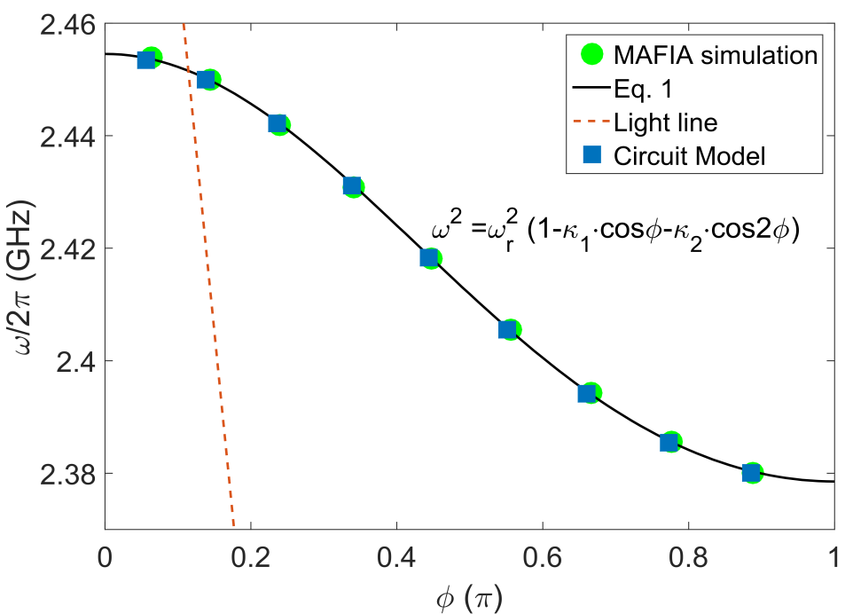
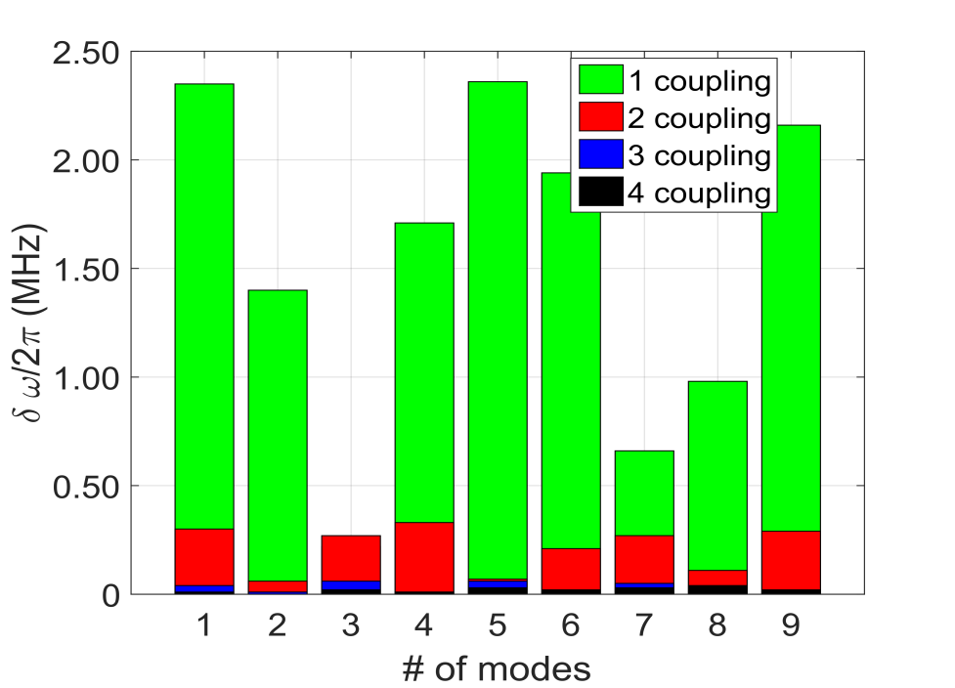


A single chain coupled circuit model
A single chain of coupled parallel LC circuit is used to facilitate the beam phase monitor development.
1
(1)
$$κ_{1}=−3.2\%$$
$$κ_{2}=−0.2\%$$
|CM – MAFIA|

Slide 12
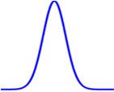
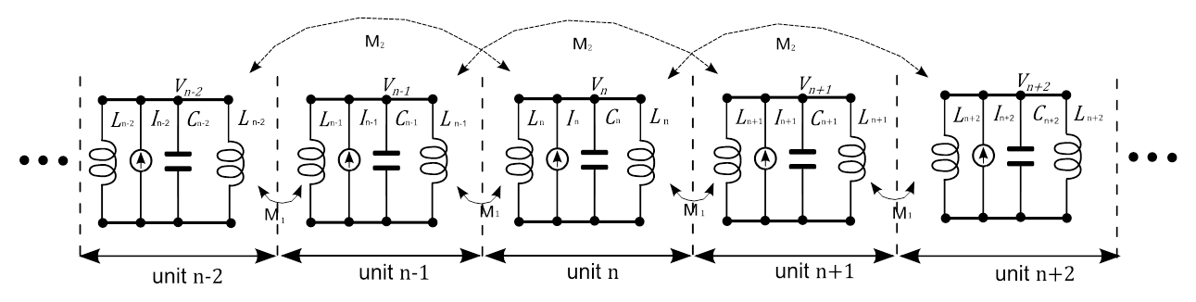
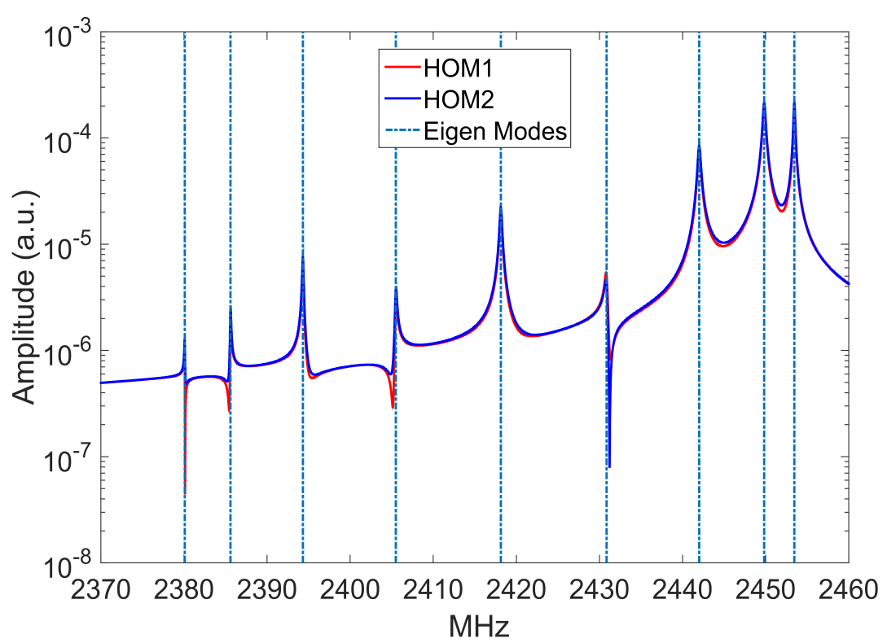

Beam driven circuit model
$$t_{0}=\frac{1}{2}⋅\frac{1}{1.3}ns$$
Mode 8
Mode 9
Circuit is truncated to nine cells.
It is then driven with delayed Gaussian pulses.
The last two modes are excited strongly, and are used for beam phase calculation.
Notes:
Add beam Gaussian pulse

Slide 13
Resolution study - Circuit model
Vary the sampling frequency, while keeping other parameters constant
Vary the noise level, while keeping other parameters constant
By comparing phases calculated from two HOM couplers, resolution can be estimated.
The resolution clearly depends exponentially on the noise present in the system.
The resolution also depends on the sampling frequency.
In order to meet the 0.01 degree requirement, the SNR is at least 35 dB
0.01°

Slide 14
  Introduction
  Principle of beam phase determination
  Simulation with circuit model
  Measurements with a broadband setup
  Summary and Outlook

Slide 15
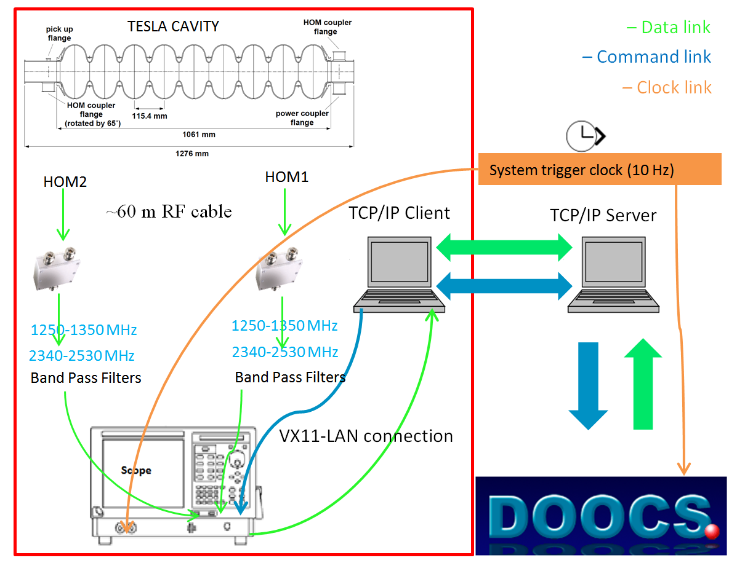
Experimental Setup
  HOM signals are available from HOM Patch panel.
  A fast scope (TDS6604B) with 20 GS/s, 6 GHz bandwidth is connected for two channels for HOM signals.
  A 10 Hz external clock is used to synchronize the measurement.
  The data from DOOCS and from scope are combined at TCP/IP Client
  Each triggered event takes
  ~ 20s

Slide 16
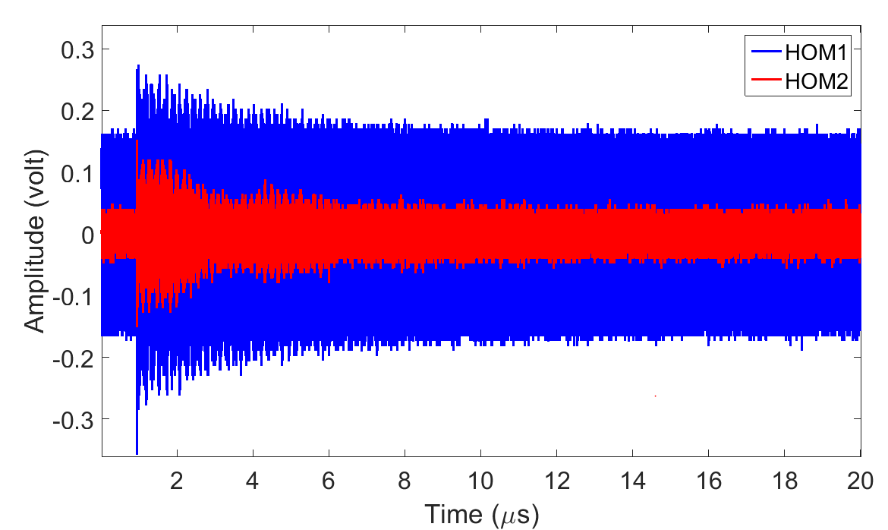
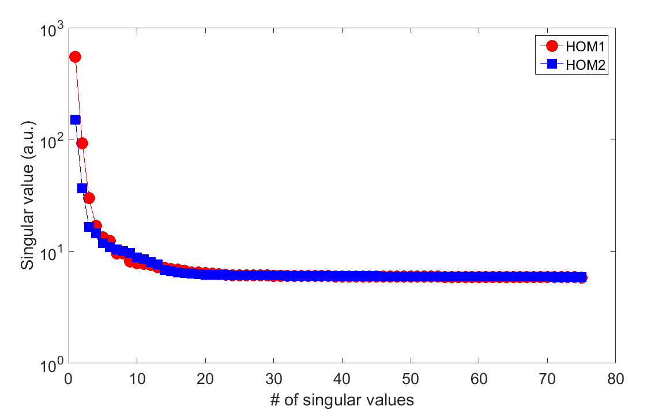
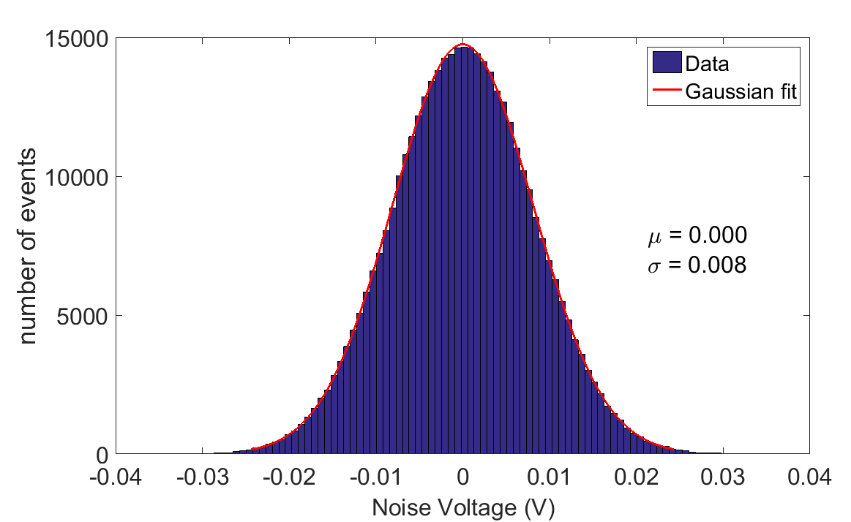
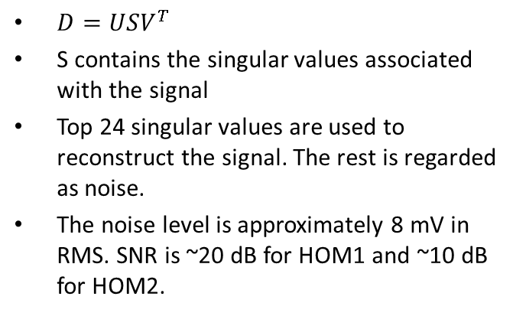
  Estimation of Noise based on SVD
$D=USV^{T}$
S contains the singular values associated with the signal
Top 24 singular values are used to reconstruct the signal. The rest is regarded as noise.
The noise level is approximately 8 mV in RMS. SNR is ~20 dB for HOM1 and ~10 dB for HOM2.

Slide 17
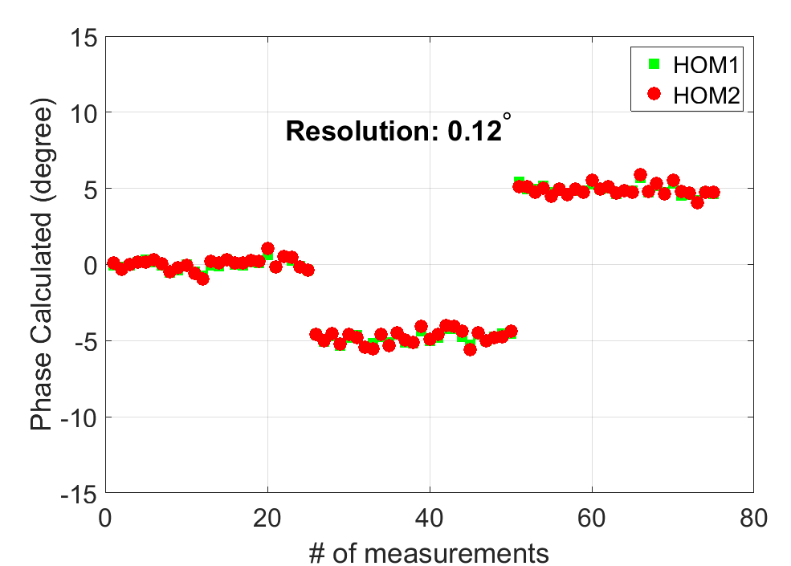
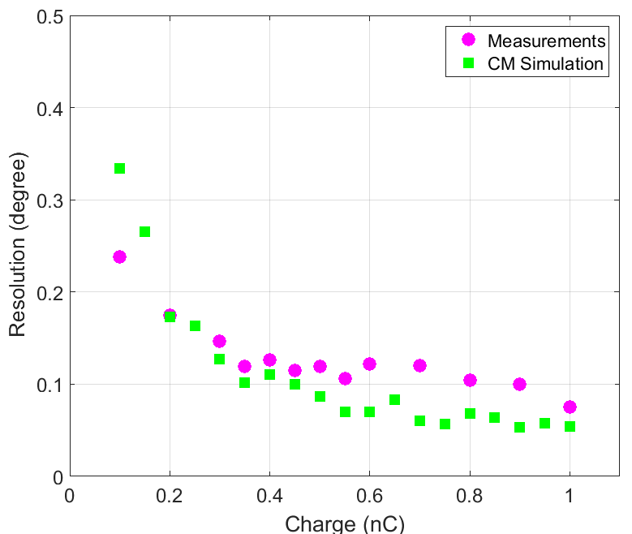
Resolution over charge
The beam charge was varied from 0.1 to
1 nC with a step of 0.1 nC
The simulation data was scaled with real measurements.
Experiment（20 GS/s）@22MV/m, 0.5 nC
Beam phase is varied at 0, -5, and 5 degree from DOOCS.

Slide 18
HOM Phase vs LLRF result
RMS error is 0.4 degree
RMS error is 0.3 degree
Phase was changed from -10 to 10 degree with a step of 1 degree.
Up to a calibration offset, the probe phase agrees with the phase from HOM.
Note the measurement system is not fully synchronized.

Slide 19
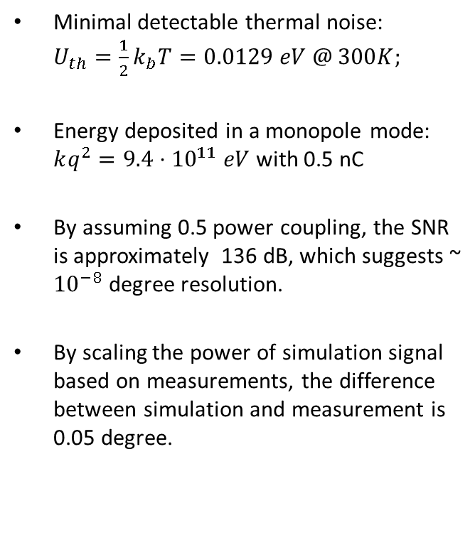
Resolution limit estimation
Simulation data with 0.5 nC and 20 GS/s
Minimal detectable thermal noise: $U_{th}=\frac{1}{2}k_{b}T=0.0129 eV @ 300K;$
Energy deposited in a monopole mode: $kq^{2}=9.4⋅{10}^{11} eV$ with 0.5 nC
By assuming 0.5 power coupling, the SNR is approximately 136 dB, which suggests ~ ${10}^{−8}$ degree resolution.
By scaling the power of simulation signal based on measurements, the difference between simulation and measurement is 0.05 degree.

Slide 20
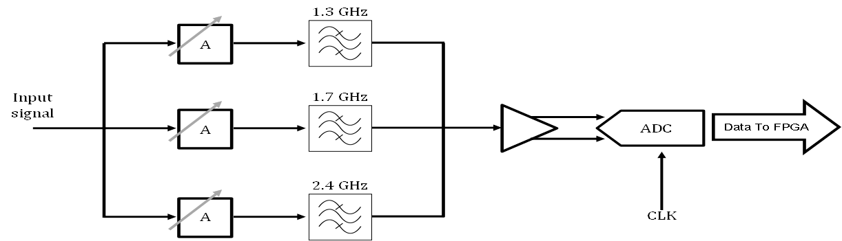
Electronics of HOM based Beam Phase Monitor
1290-1310 MHz
1690-1710 MHz
2400- 2460MHz
The electronics are compact and can be used for beam phase and beam position
measurements.
It fully complies with MicroTCA.4 standard.
Notes:
A

Slide 21
Possible topologies of final system
Process at the front end and transmit the results over long distance.
Transmit the signal over long distance and process in the middle
+ Less influence from the intermediate units
- Radiation protection
Accelerator Module
Process unit
BKR
Vicinity of the module
Accelerator Module
Process unit
BKR
+ No need for radiation protection.
- Signal integrity issue
Longer cable
to different site

Slide 22
Summary and Outlook
Circuit model aided the development of beam phase monitor.
At least 35 dB SNR is required to achieve 0.01 degree resolution.
SVD method is used to estimate noise level. Simulation and measurements agree well with each other.
Beam phase based on HOM is consistent with the phase from LLRF.
Signal power optimization is required to further improve the resolution.
The hardware development for the beam phase monitor is ongoing.
It is promising to integrate the monitor into LLRF system.

Slide 23
Thank you for your attention!

