Slide 1
Electromagnetic Modeling and Eigenfield Analysis of SC Cavities
W. Ackermann, H. De Gersem, T. Weiland
Institut für Theorie Elektromagnetischer Felder, Technische Universität Darmstadt
HOMSC 2016
August 22, 2016
Warnemünde, Germany

Slide 2
Outline
Motivation
Computational model
  Fundamental equations
  Volume discretization methods
  Boundary conditions
  Eigenvalue calculation
Numerical examples
  TESLA 1.3 GHz cavity and TESLA 3.9 GHz module
Summary and Outlook

Slide 3
Outline
Motivation
Computational model
  Fundamental equations
  Volume discretization methods
  Boundary conditions
  Eigenvalue calculation
Numerical examples
  TESLA 1.3 GHz cavity and TESLA 3.9 GHz module
Summary and Outlook

Slide 4
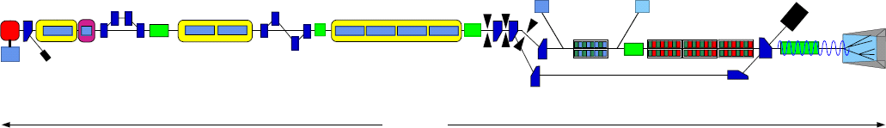
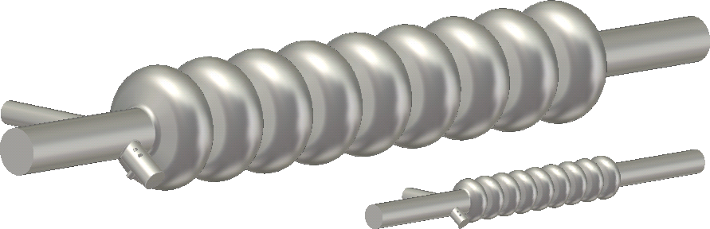
Motivation
Particle accelerators
  FLASH at DESY, Hamburg
  Cavities
RF Gun
Diagnostics
Accelerating Structures
sFLASH
Undulators
Bunch
Compressor
Bunch
Compressor
FEL
Experiments
Laser
Collimator
Bypass
315 m
http://www.desy.de
TESLA 1.3 GHz
TESLA 3.9 GHz

Slide 5
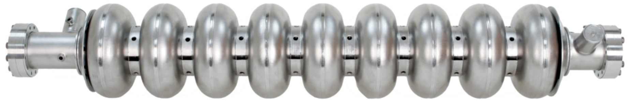
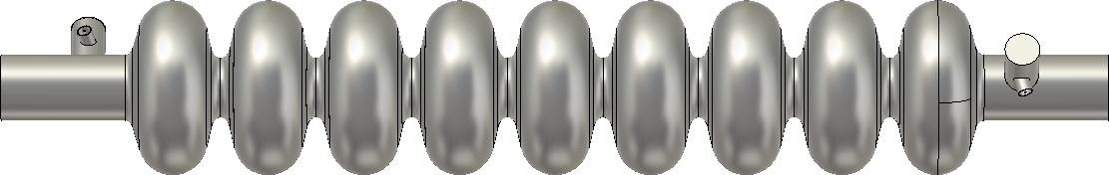
Motivation
Modeling of individual cavities
  Photograph
  Numerical model
http://newsline.linearcollider.org
upstream
downstream
CST Studio Suite 2016

Slide 6
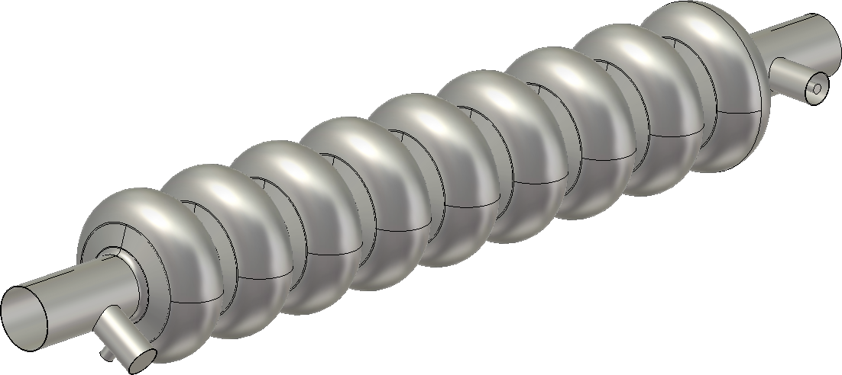
Motivation
Superconducting resonator
Downstream
Higher Order Mode Coupler
9-Cell Cavity
Input Coupler
Beam
Tube
High precision
cavity simulations
Geometry
(cell and coupler)
Material
Boundary conditions
Upstream
Higher Order Mode Coupler

Slide 7
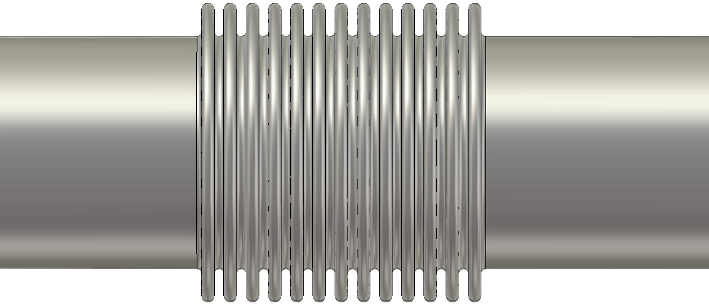
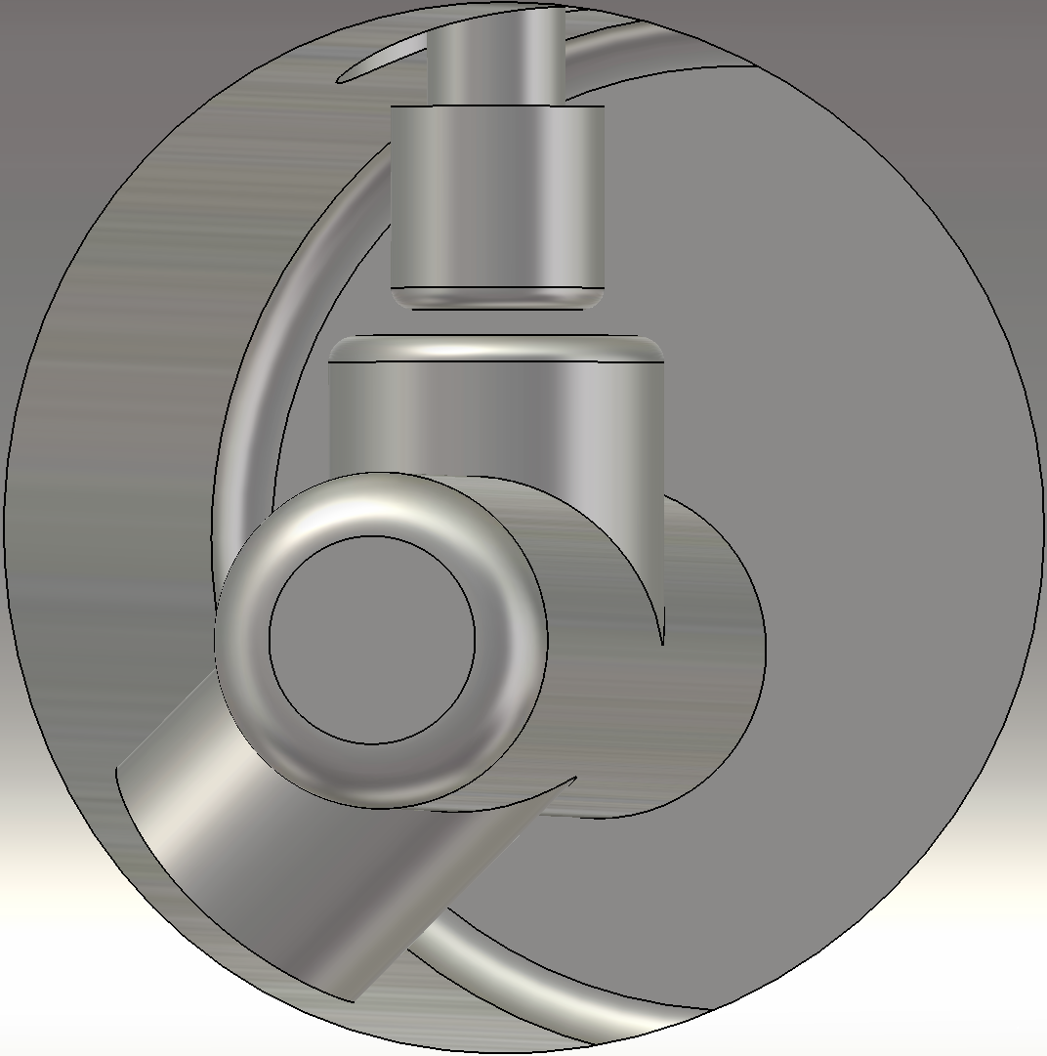
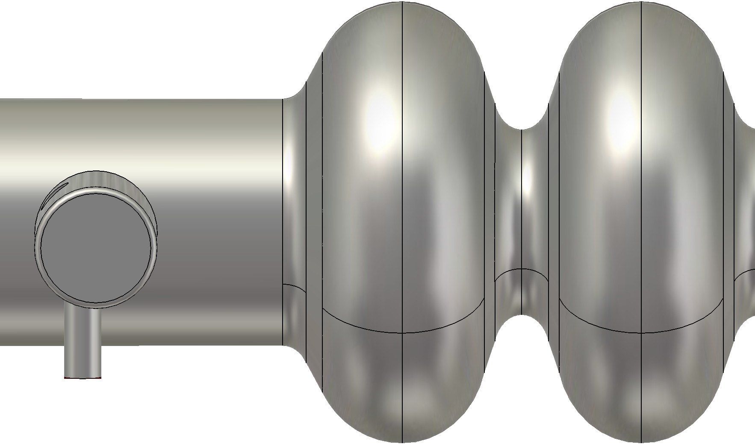
Motivation
Modeling of detailed structures
2.2 mm
40 mm
0.5 mm
Advantageous:
Local mesh refinement
Unstructured grid (simple)
Exact geometric modeling
71.574 mm
TESLA 3.9 GHz structure

Slide 8
Motivation
Modeling of entire modules
  Geometric details
    Cavities and bellows
    Input coupler
    HOM coupler
  Material
  Ports
Bellow
9-cell cavity
HOM coupler
Beam pipe
Input coupler
TESLA 3.9 GHz module

Slide 9
Outline
Motivation
Computational model
  Fundamental equations
  Volume discretization methods
  Boundary conditions
  Eigenvalue calculation
Numerical examples
  TESLA 1.3 GHz cavity and TESLA 3.9 GHz module
Summary and Outlook

Slide 10
Computational Model
Problem formulation
  Time domain
    Efficient algorithms available (explicit method)
    Field excitation with imposed current or individual particles possible
    Separation of tightly clustered modes difficult (long simulation time)
  Frequency domain (driven problem)
    Efficient algorithms available (fast frequency sweep)
    Field excitation may influence modal field distribution
    Separation of tightly clustered modes difficult (many frequency samples)
  Frequency domain (eigenmode formulation)
    Expensive algorithms
    Field distributions without distortions available
    Localized mode patterns (with weak coupling) naturally included
ü
ü
û
ü
û
û
û
ü
ü

Slide 11
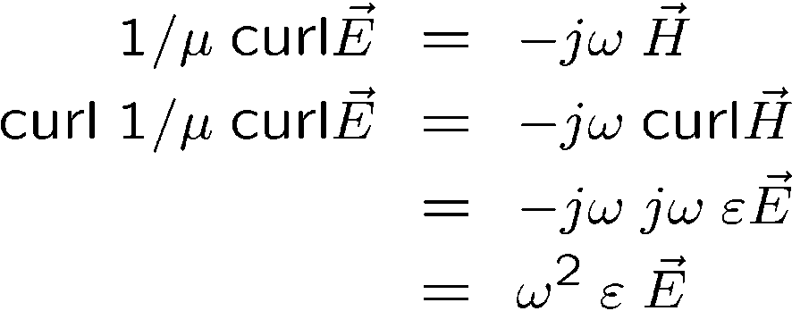
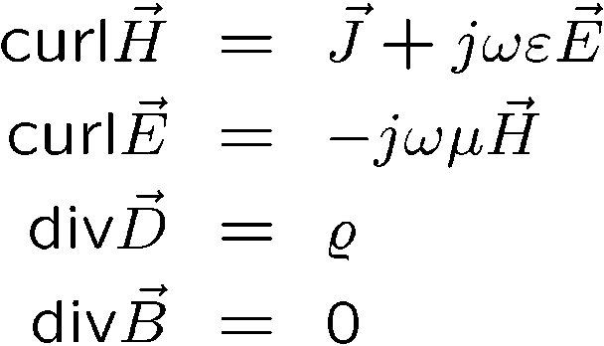
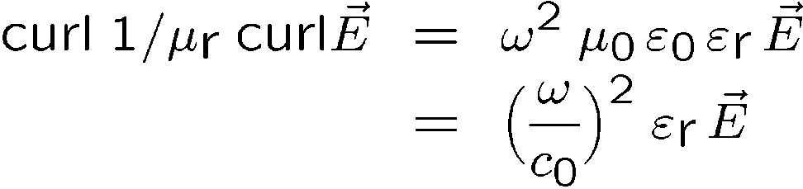
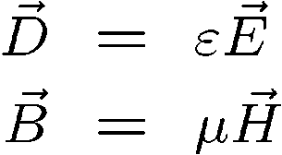

Computational Model
Fundamental equation
  Maxwell
  Material relation
0
0
no sources taken into account
fundamental equation

Slide 12
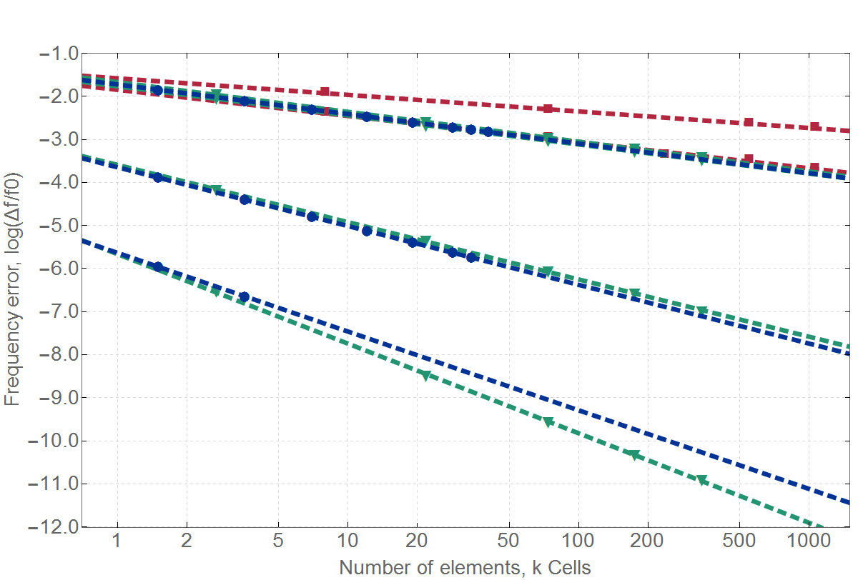
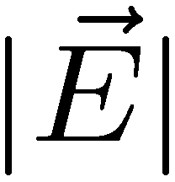
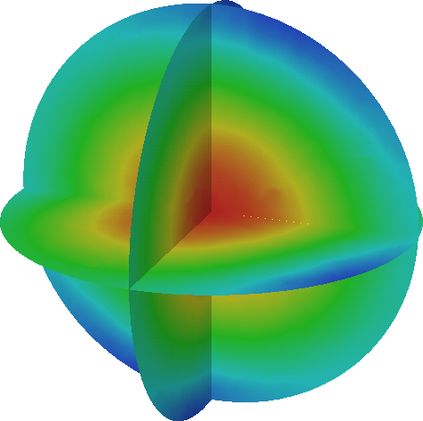
Computational Model
Numerical method comparison
TM 011: f₀ = 184.662 MHz
FIT-FPBA: 1.15
FIT-PBA: 1.82
IGA-O1C0: 2.06
FEM-O1G1: 2.07
FEM-O2G1: 2.02
Spherical resonator
R = 0.5 m
IGA-O2C1: 4.09
FEM-O2G2: 3.99
IGA-O3C1: 5.48
FEM-O3G4: 6.24
IGA analysis: courtesy of Jacopo Corno

Slide 13
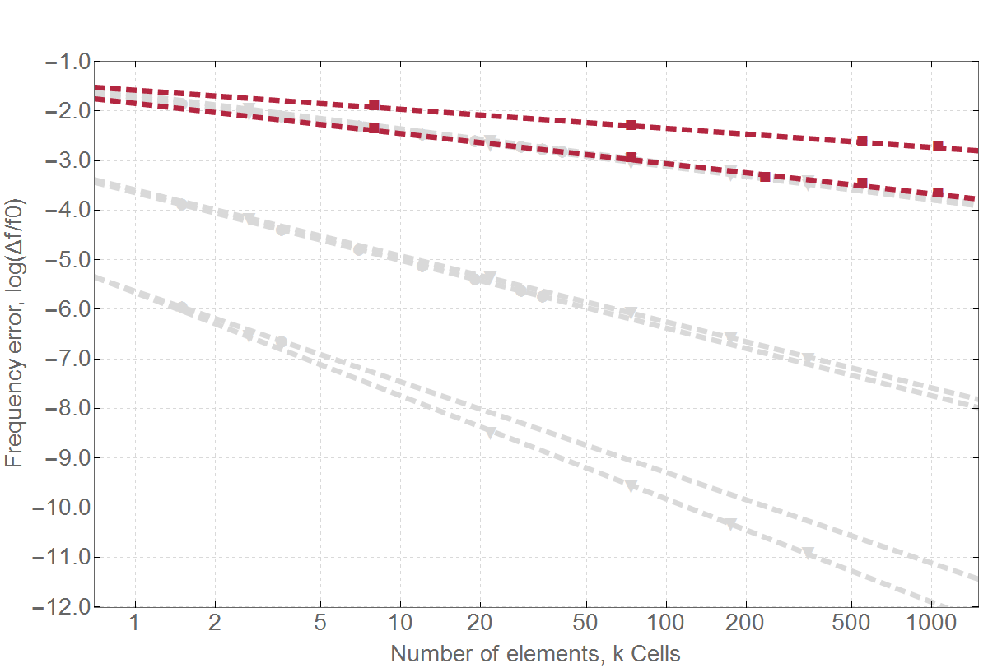
Computational Model
Numerical method comparison
TM 011: f₀ = 184.662 MHz
FIT-FPBA: 1.15
FIT-PBA: 1.82
IGA-O1C0: 2.06
FEM-O1G1: 2.07
FEM-O2G1: 2.02
Spherical resonator
R = 0.5 m
IGA-O2C1: 4.09
FEM-O2G2: 3.99
IGA-O3C1: 5.48
FEM-O3G4: 6.24

Slide 14
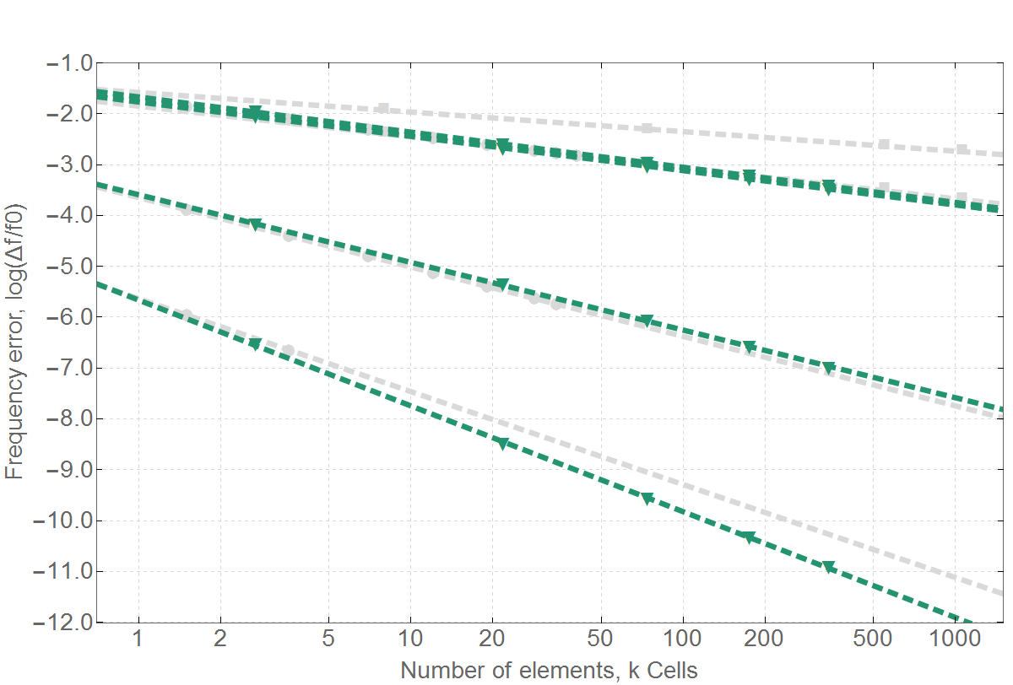
Computational Model
Numerical method comparison
TM 011: f₀ = 184.662 MHz
FIT-FPBA: 1.15
FIT-PBA: 1.82
IGA-O1C0: 2.06
FEM-O1G1: 2.07
FEM-O2G1: 2.02
Spherical resonator
R = 0.5 m
Geometry!
IGA-O2C1: 4.09
FEM-O2G2: 3.99
IGA-O3C1: 5.48
FEM-O3G4: 6.24

Slide 15
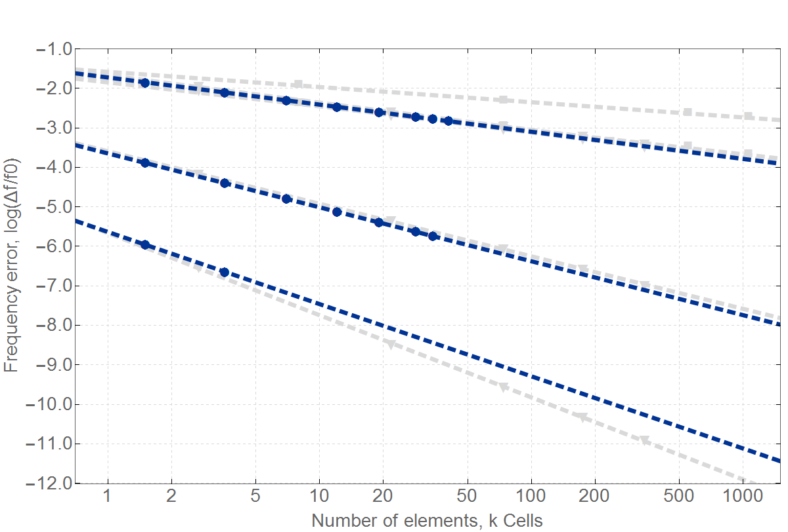
Computational Model
Numerical method comparison
TM 011: f₀ = 184.662 MHz
FIT-FPBA: 1.15
FIT-PBA: 1.82
IGA-O1C0: 2.06
FEM-O1G1: 2.07
FEM-O2G1: 2.02
Spherical resonator
R = 0.5 m
IGA-O2C1: 4.09
FEM-O2G2: 3.99
IGA-O3C1: 5.48
FEM-O3G4: 6.24
IGA analysis: courtesy of Jacopo Corno

Slide 16
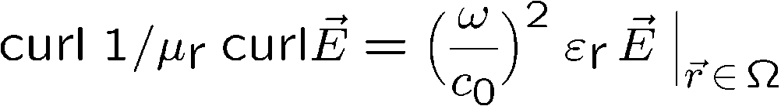
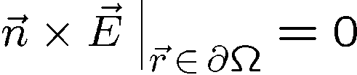

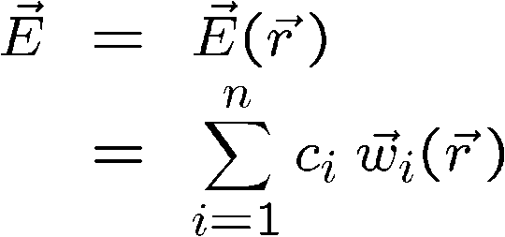
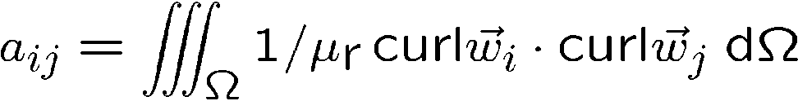

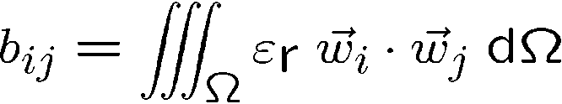

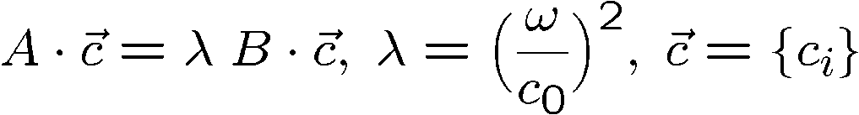
Computational Model
FEM formulation
  Local Ritz approach
continuous eigenvalue problem
Galerkin testing
of the fundamental equation
vectorial function
scalar coefficient
global index
number of DOFs
discrete eigenvalue problem

Slide 17









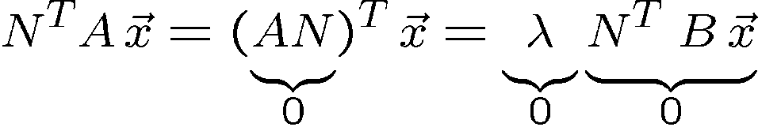


Computational Model
Eigenvalue calculation
  Problem definition
  Important properties
for proper chosen scalar and vecor basis functions
or
static
dynamic

Slide 18
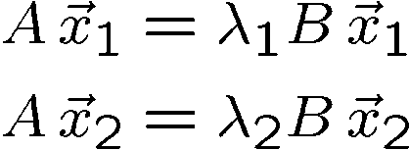

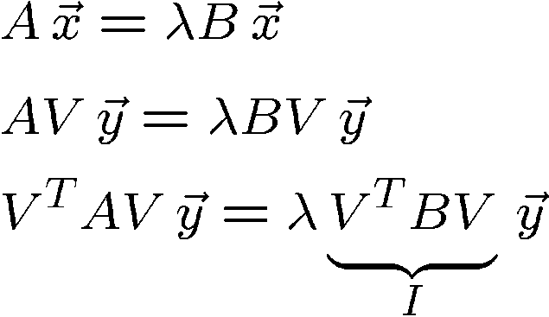

Computational Model
Eigenvalue calculation
  Orthogonality
  Projected system
If eigenvalues are not degenerated eigenvectors are B-orthogonal.
It is therefore advantageous to set up a seach space using B-othogonal vectors.
Very small system
(dimension: 10 - 20),
can be easily solved
LAPACK

Slide 19





Computational Model
Eigenvalue calculation
  Residuum
  Advanced search space expansion methods
The residuum is othogonal with respect to the search space . It seems to
make sense to expand the search space in this direction KRYLOV
But the final residuum is not B-othogonal with respect to the search space.
Expand in the direction with:
to get !
Orthogonal expansion
DAVIDSON
JACOBI-DAVIDSON
correction equation

Slide 20
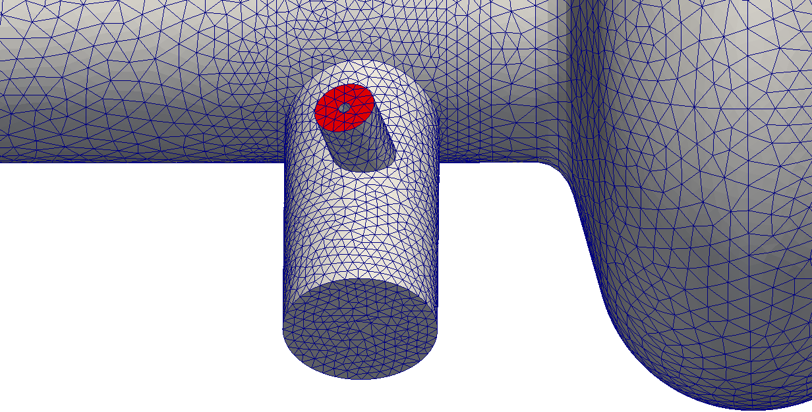
Computational Model
Port boundary condition
Port face, HOM coupler

Slide 21
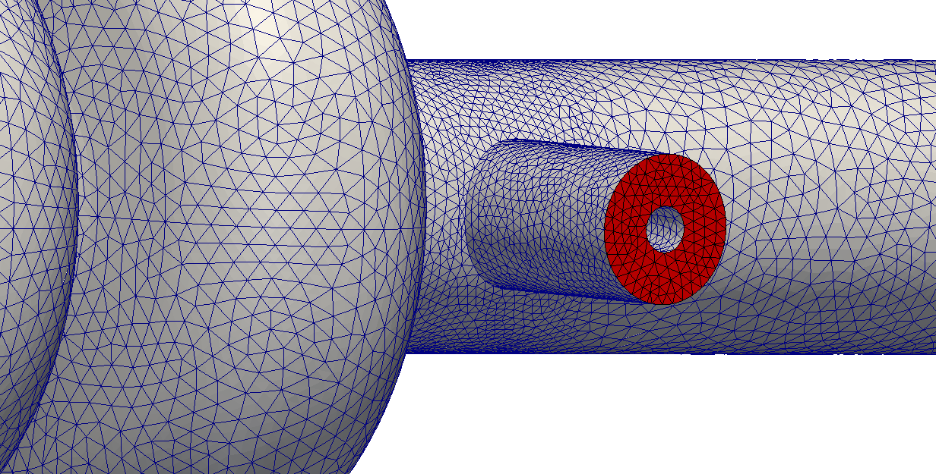
Computational Model
Port boundary condition
Port face, fundamental coupler

Slide 22
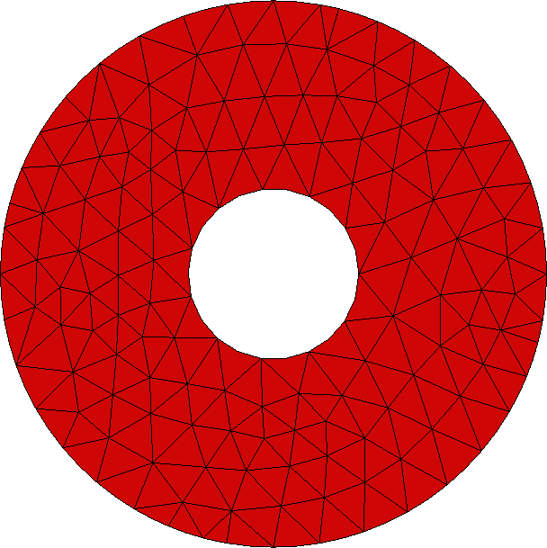
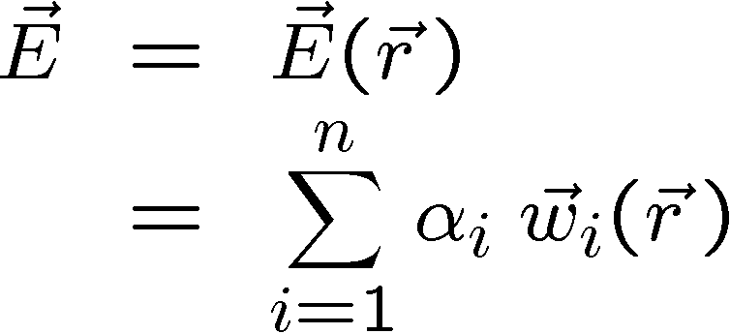


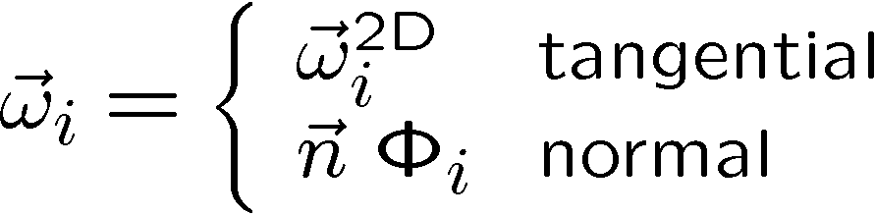

Computational Model
Problem formulation
  Local Ritz approach
Port face
vectorial function
scalar coefficient
Mixed 2-D vector and scalar basis
global index
number of DOFs

Slide 23
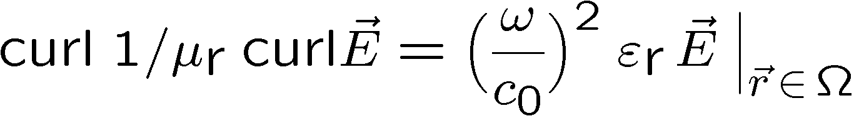
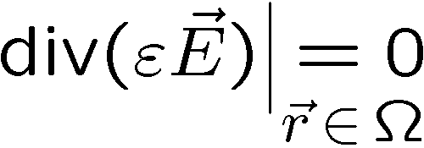
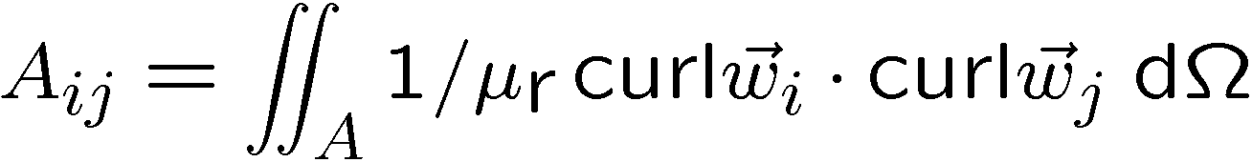
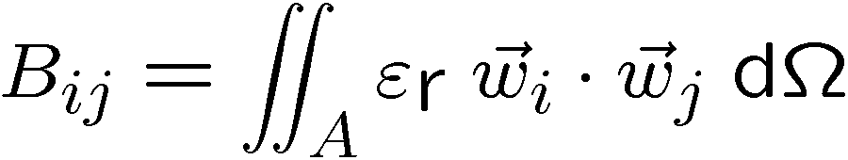
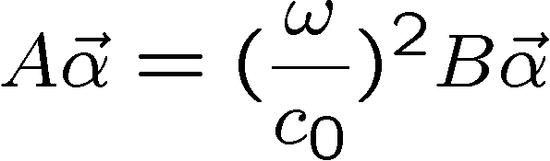
Computational Model
Problem formulation
  Local Ritz approach
+ boundary conditions
continuous eigenvalue problem, loss-free
Galerkin
vectorial function
scalar coefficient
global index
number of DOFs
discrete eigenvalue problem

Slide 24
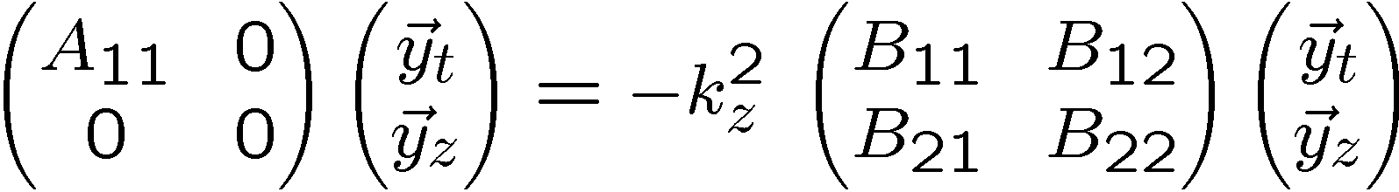
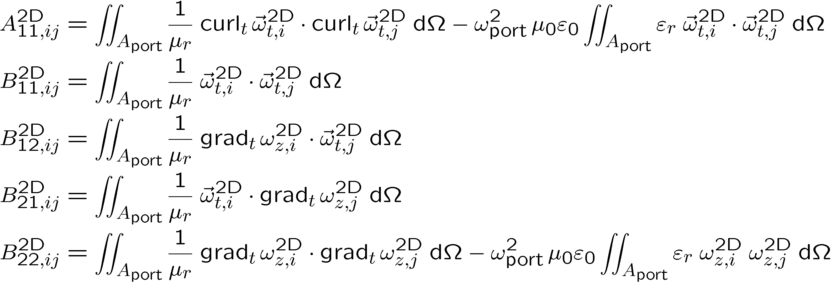
Computational Model
Problem formulation
  Determine propagation constant for a fixed frequency
eigenvector
and
eigenvalue
algebraic eigenvalue problem
Provides connection
between k_{z} and ω_{port}.

Slide 25

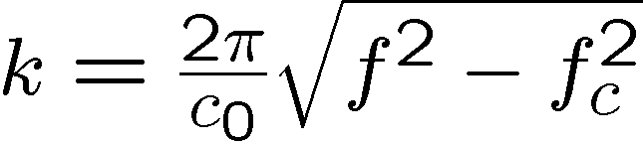



Computational Model
Wave propagation in the applied coaxial lines
  Main coupler
  HOM coupler
f₀ = 1.3 GHz
60.0 mm
TEM
Dispersion relation
12.5 mm
TE₁₁
TE₂₁
propagation
f₀ = 1.3 GHz
16.0 mm
TEM
3.4 mm
damping
TE₁₁
TE₂₁

Slide 26
Computational Model
Boundary conditions
Main Coupler: Port ü
HOM Coupler: Port ü
HOM Coupler: Port ü
SC Cavity: PEC ü
Main Coupler: Port ü
Beam Pipe: PEC ü (below cutoff), û (above cutoff)
PMC ü (below cutoff), û (above cutoff)
Port ü
”Cavity boundary condition” ü (How to realize this?)

Slide 27
Computational Model
Boundary conditions
HOM Coupler: Number of port modes?
HOM Coupler: Length of line?
Main Coupler: Length of line?
Main Coupler: Number of port modes?

Slide 28
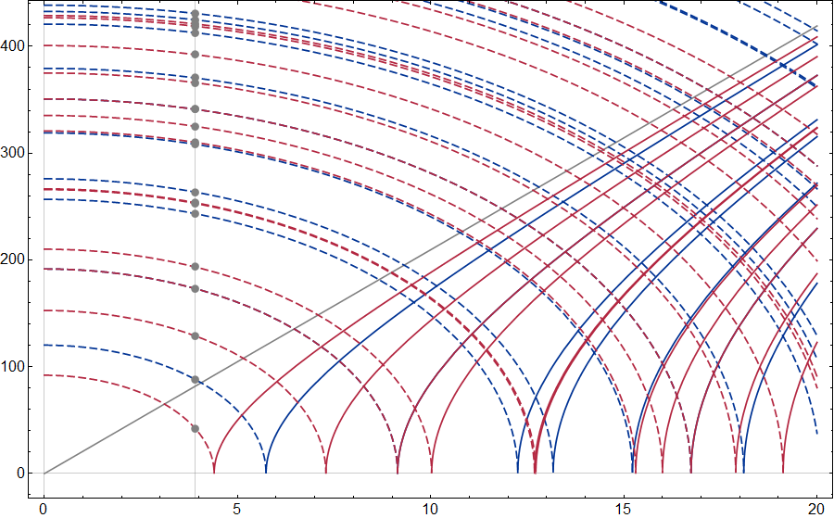
Computational Model
Dispersion Diagram for Modes in the Beam Tube
Mode Type Index
Propagation Constant in 1/m
TE
TM
3.9
Frequency in GHz

Slide 29
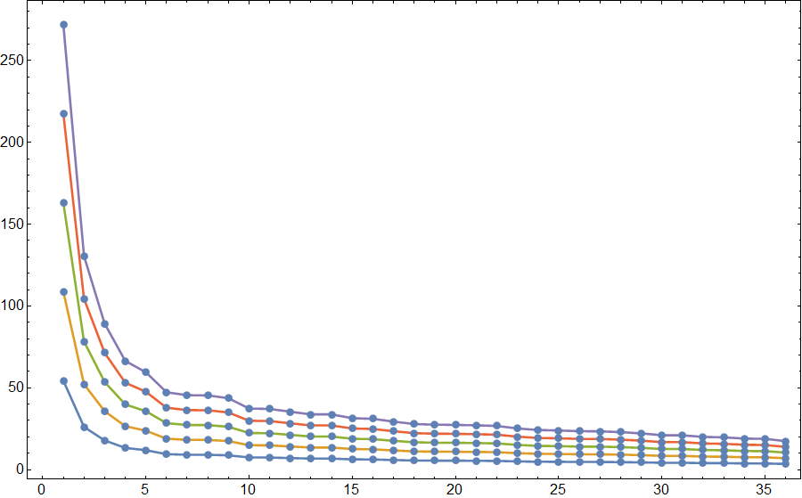
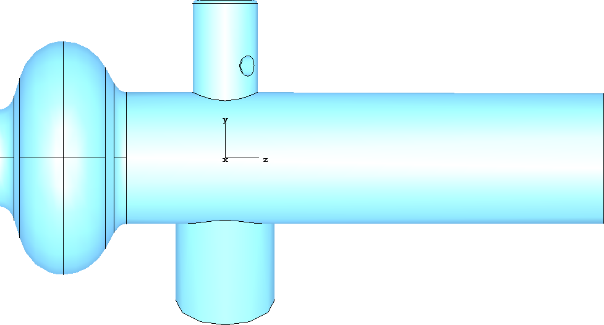
Computational Model
Modeling of the Beam Tube
10⁻⁵
Evaluation Frequency = 3.9 GHz
10⁻⁴
First mode should be sufficiently damped if PEC has been applied.
Visualization: 100 mm
10⁻³
PEC
Waveguide Length in mm
Waveguide
Length
10⁻²
used for visualization
Degenerated modes and modes with
different polarizations are represented only once!
10⁻¹
Mode Type Index

Slide 30
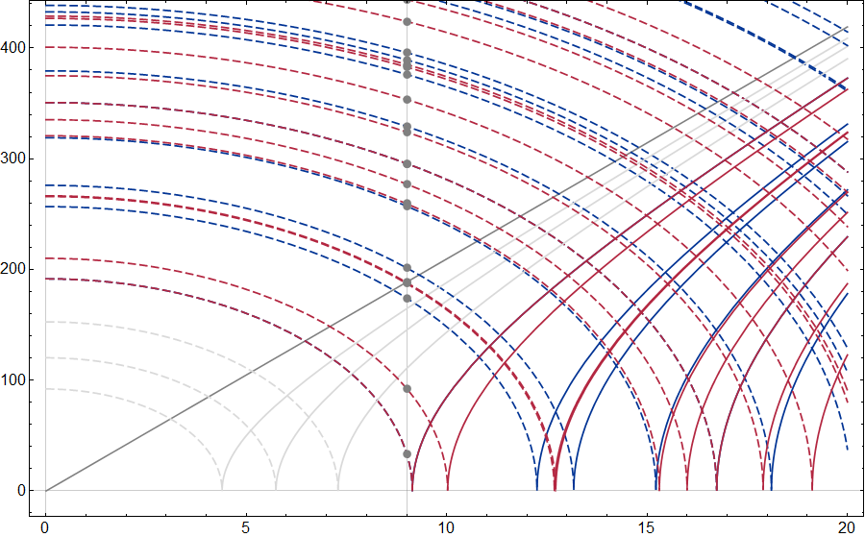
Computational Model
Dispersion Diagram for Modes in the Beam Tube
Mode Type Index
Propagation Constant in 1/m
TE
TM
Three propagating mode types
9
Frequency in GHz

Slide 31
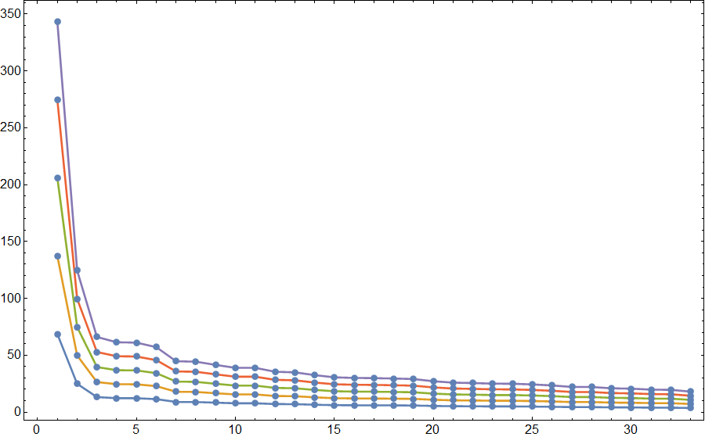
Computational Model
Modeling of the Beam Tube
10⁻⁵
Cavity length = 345.9 mm
Evaluation Frequency = 9.0 GHz
10⁻⁴
Visualization: 100 mm
PORT
3 mode types
10⁻³
Waveguide Length in mm
Waveguide
Length
10⁻²
Degenerated modes and modes with
different polarizations are represented only once!
10⁻¹
Mode Type Index

Slide 32
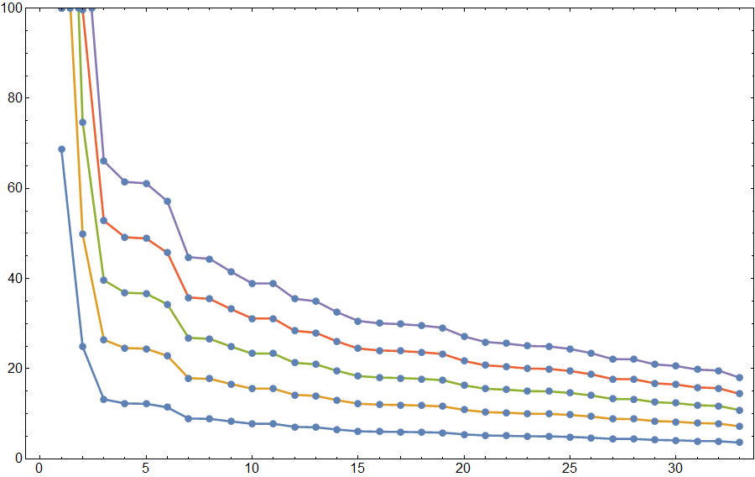
Computational Model
Modeling of the Beam Tube
Evaluation Frequency = 9.0 GHz
Port
Port
10⁻⁵
Waveguide Length in mm
10⁻⁴
15 mm
45.3 mm
10⁻³
10⁻²
22.65 mm
10⁻¹
7.5 mm
Mode Type Index

Slide 33
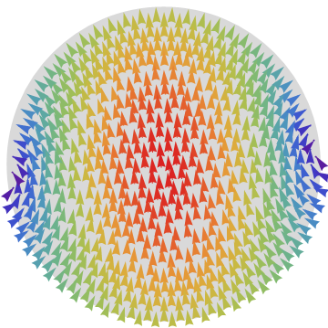
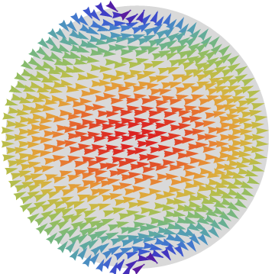
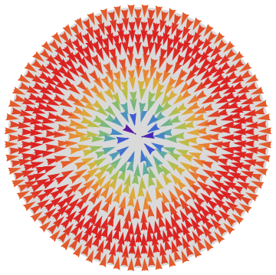
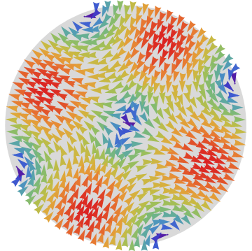






Computational Model
Transverse electric field pattern of 2D beam pipe modes
Type 1
Type 2
Type 3
TE
TM
TE
Mode 1
Mode 2
Mode 3
Mode 4
Mode 5
Type 4
Type 5
Type 6
TE
TM
TE
Mode 6
Mode 7
Mode 8
Mode 9
Mode 10

Slide 34



Computational Model
Modeling of the Beam Tube
Multipole Magnitude
Mode Index

Slide 35



Computational Model
Modeling of the Beam Tube
Multipole Magnitude
Mode Index

Slide 36


Computational Model
Modeling of the Beam Tube
Multipole Magnitude
Mode Index

Slide 37
Computational Model
Boundary conditions
HOM Coupler:
Length = 12.5 mm
Number of port modes = 3
Beam Tube:
Length = 60 mm
Number of port modes = 8
Main Coupler:
Length = 34 mm
Number of port modes = 7

Slide 38
Outline
Motivation
Computational model
  Fundamental equations
  Volume discretization methods
  Boundary conditions
  Eigenvalue calculation
Numerical examples
  TESLA 1.3 GHz cavity and TESLA 3.9 GHz module
Summary and Outlook

Slide 39







Numerical Examples
Simulation results
  Accelerating mode (#9, monopole mode)
  Higher-order mode (#37, dipole mode)

Slide 40


Numerical Examples
Simulation results
Accelerating mode
(#9, monopole mode)
Higher-order mode
(#37, dipole mode)
Beam tube
Beam tube
Coaxial line
Coaxial
input coupler
Coaxial
input coupler
HOM coupler
HOM coupler

Slide 41



Numerical Examples
Controlling the Jacobi-Davidson eigenvalue solver
  Evaluation in the complex frequency plane
  Select best suited eigenvalues in circular region around user-specified complex target
Real and imaginary part of the complex frequency

Slide 42

Numerical Examples
Quality factor versus frequency
TESLA 1.3 GHz
Mesh: 3.081.614
DOF: 19.177.820
Calculations kindly performed by Cong Liu

Slide 43




Numerical Examples
Field distribution of the first 194 modes
  Characteristic data summarized in a DESY publication
E
B
E
B

Slide 44


Numerical Examples
TESLA 3.9 GHz module
  14 Ports
    7 modes per main coupler
    3 modes per HOM coupler
    8 modes per beam pipe
  4 Main coupler
  8 HOM coupler
  4 Cavities
  3 Bellows
zoom
Mesh:
922.455 tetrahedrons
5.502.084 DOF

Slide 45
Numerical Examples
Field distribution in the TESLA 3.9 GHz structure
  Field localized in individual cavities (below cutoff beam pipe)
  Weakly coupled fields
  Strongly coupled fields

Slide 46
Numerical Examples
Field distribution in the TESLA 3.9 GHz structure
  Fields located between cavities

Slide 47
Outline
Motivation
Computational model
  Fundamental equations
  Volume discretization methods
  Boundary conditions
  Eigenvalue calculation
Numerical examples
  TESLA 1.3 GHz cavity and TESLA 3.9 GHz module
Summary and Outlook

Slide 48
Summary / Outlook
Summary:
  Precise eigenvalue calculations based on FEM analysis available for “open” resonators with external couplings
  FEM eigenvalue formulation adopted from classical frequency-domain approach with proven reliability
  Parallel implementation applicable to real-life structures
Outlook
  Suitable impedance boundary condition has to be made accessible to the user to model lossy material

