Slide 1
HOM Characterization for Beam Diagnostics at the
European XFEL
N. Baboi, DESY (for the HOM team)
HOMSC2016, Warnemünde, 22 Aug. 2016
Notes:
How to edit the title slide
Upper area: Title of your talk, max. 2 rows of the defined size (55 pt)
Lower area (subtitle): Conference/meeting/workshop, location, date,
your name and affiliation, max. 4 rows of the defined size (32 pt)
Change the partner logos or add others in the last row.

Slide 2
Contents
HOM-based diagnostics in SC accelerating cavities
  Principle
  Experience at FLASH
The European XFEL
  Spectra of 1.3 GHz cavities in the E-XFEL
  Beam measurements in 1.3 GHz cavities in the E-XFEL injector
Summary

Slide 3
Contents
HOM-based diagnostics in SC accelerating cavities
  Principle
  Experience at FLASH
The European XFEL
  Spectra of 1.3 GHz cavities in the E-XFEL
  Beam measurements in 1.3 GHz cavities in the E-XFEL injector
Summary

Slide 4
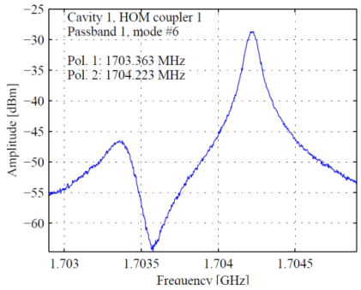
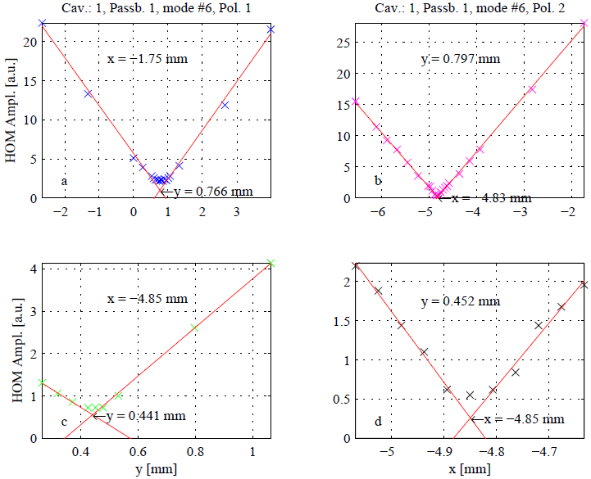
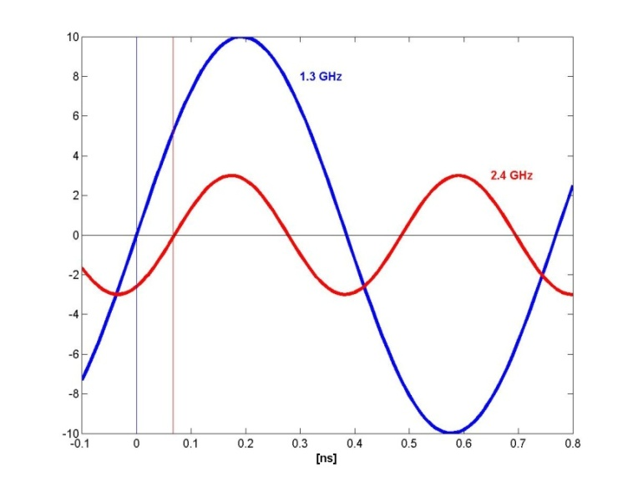
HOM-based Beam Diagnostics in SC Cavities:
Principle
HOMs carry information about the beam properties
⇒ they can be used to monitor the beam
  The strength of the excited dipole modes depends linearly on the beam charge and position: q∙r∙(R/Q)
  The timing of excited modes depend on beam arrival time (beam phase)
accelerating RF field
beam excited
HOM
×
Phase difference
Beam offset [mm]

Slide 5
HOM-based Beam Diagnostics in SC Cavities:
Benefits
Align the beam based on the signals which can damage beam quality, therefore reduce the (long-range) wakes
Measure the transverse beam position
Measure the transverse cavity alignment in the cryo-module
Direct, on-line measurement of beam phase wrt RF phase
Does not require additional vacuum components, therefore relatively cheap

Slide 6
Contents
HOM-based diagnostics in SC accelerating cavities
  Principle
  Experience at FLASH
The European XFEL
  Spectra of 1.3 GHz cavities in the E-XFEL
  Beam measurements in 1.3 GHz cavities in the E-XFEL injector
Summary

Slide 7
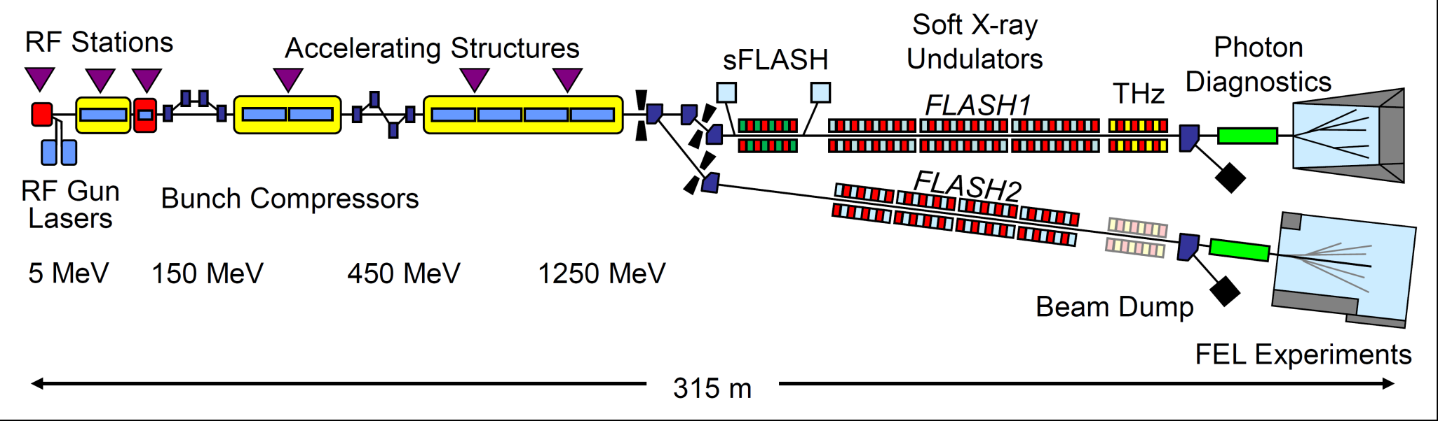
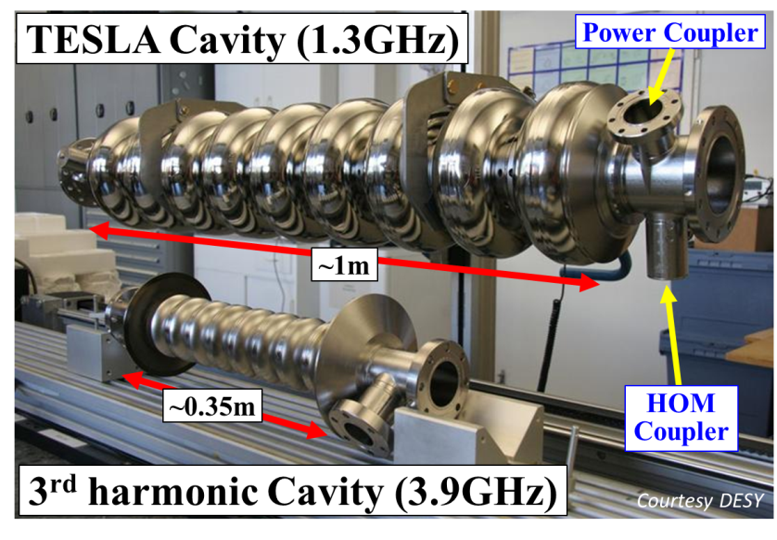
HOM-based Beam Diagnostics in SC Cavities:
Experience at FLASH
TESLA (1.3 GHz) cavities
3rd harmonics (3.9 GHz) cavities

Slide 8
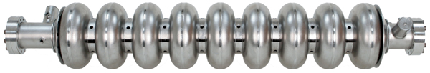
Experience at FLASH: 1.3 GHz cavities
Bandpass
Filter
1.7 GHz
20 MHz BW
Mixer
Digitizer
HOM couplers
LO 1.68 GHz
Clock 108 MHz
  HOM electronics installed in
  5 cryo-modules in FLASH
Joe Frisch, SLAC

Slide 9
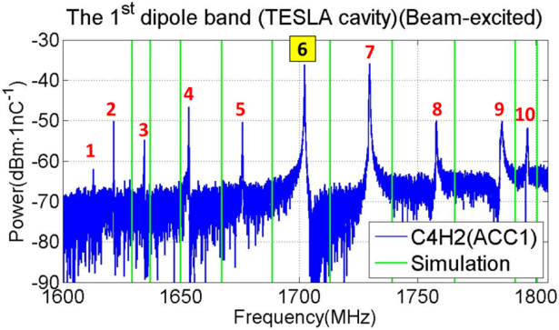
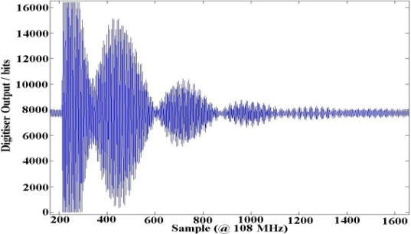
Experience at FLASH: 1.3 GHz cavities
Showed resolution
< 10um rms
Bandpass
Filter
1.7 GHz
20 MHz BW
Mixer
Digitizer
LO 1.68 GHz
Clock 108 MHz
9

Slide 10
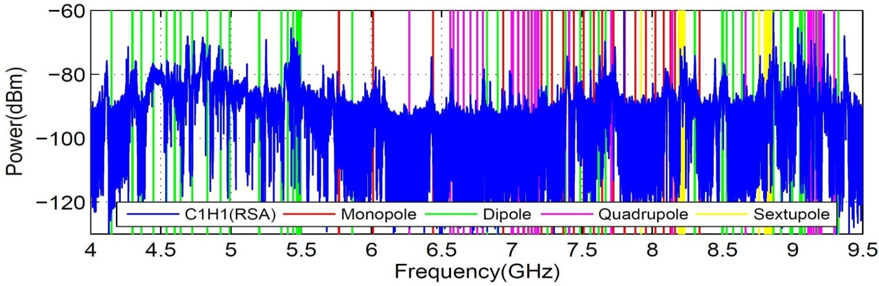
Experience at FLASH: 3.9 GHz cavities
Use propagating and trapped modes
Concept based on extensive
studies within EuCARD
(UMAN, UROS, DESY)
Nathan Eddy, FNAL
Bandpass
Filter
5.4 or 9 GHz
100 MHz BW
Mixer
Digitizer
LO
Clock 108 MHz
10
Pei Zhang, DESY (now IHEP)

Slide 11
Contents
HOM-based diagnostics in SC accelerating cavities
  Principle
  Experience at FLASH
The European XFEL
  Spectra of 1.3 GHz cavities in the E-XFEL
  Beam measurements in 1.3 GHz cavities in the E-XFEL injector
Summary

Slide 12
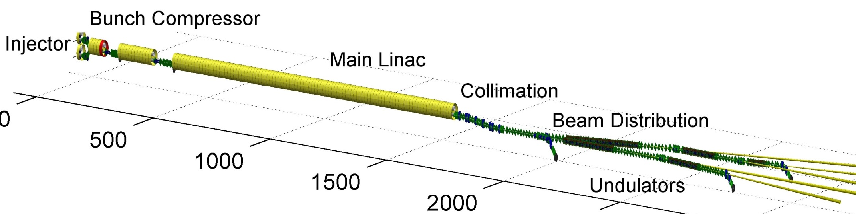
The European XFEL:
Overview
17.5 GeV; up to 2700 Bunches/RF Pulse @ 10 Hz; 0.02-1 nC
101 TESLA modules
One 3rd harmonic module with 8 cavities
Injector started operation in Dec. 2015
First beam through linac expected before end of 2016

Slide 13
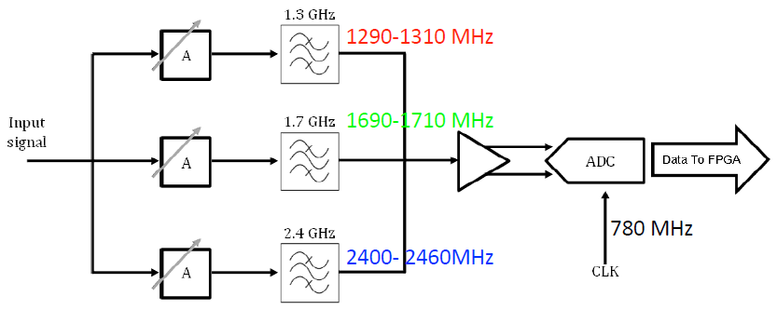
E-XFEL: Plans for HOM-based Beam Diagnostics in 1.3 GHz cavities
Electronics under design
Multiple filter
  selects 1.3 and 2.4 GHz monopole modes from spectrum
  Also 1.7 GHz dipole mode for beam position monitoring
Direct sampling: No downconversion
500

Slide 14
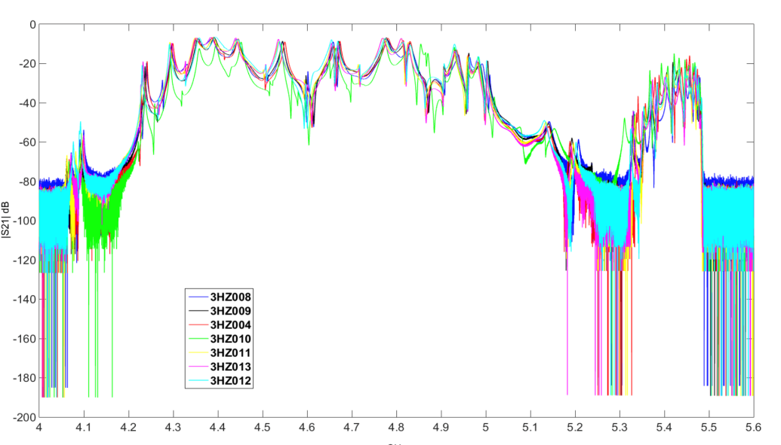
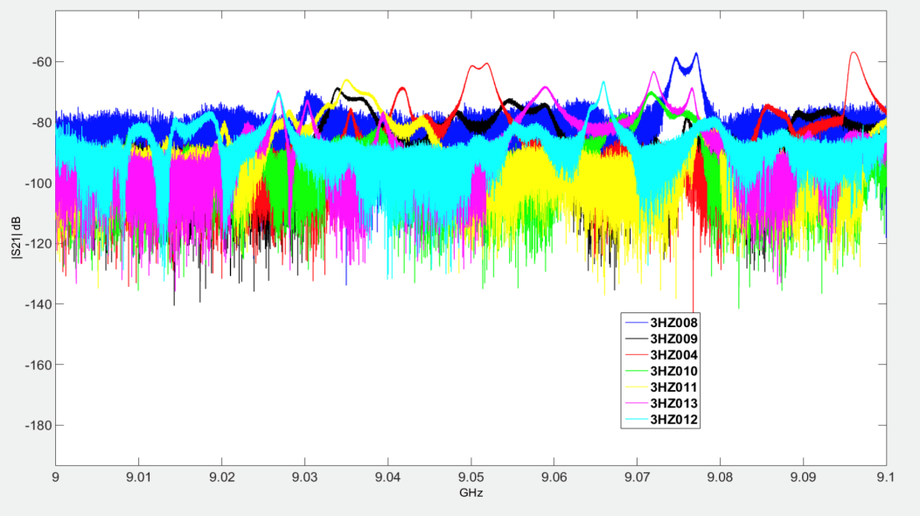
E-XFEL: Plans for HOM-based Beam Diagnostics in 3.9 GHz cavities
Electronics under design: same principle as in FLASH
HOM-BPMs at 3.9 GHz cavities at the E-XFEL more challenging mainly due to
  8 coupled cavities (4 at FLASH)
  Different orientation of cavities
Object of task within EuCARD-2 (UMAN, UROS, DESY)
2nd Dipole Band
5th Dipole Band
Liangliang Shi, DESY

Slide 15
Contents
HOM-based diagnostics in SC accelerating cavities
  Principle
  Experience at FLASH
The European XFEL
  Spectra of 1.3 GHz cavities in the E-XFEL
  Beam measurements in 1.3 GHz cavities in the E-XFEL injector
Summary

Slide 16
Spectra of E-XFEL 1.3 GHz cavities:
First 5 Cryo-modules
Check modes of interest
  Dipole modes at ca. 1.7 GHz ± 10MHz
  for beam position measurement
  Monopole modes at between ca. 2.435 and 2.465
  for beam phase measurement
Data from cavity database

Slide 17
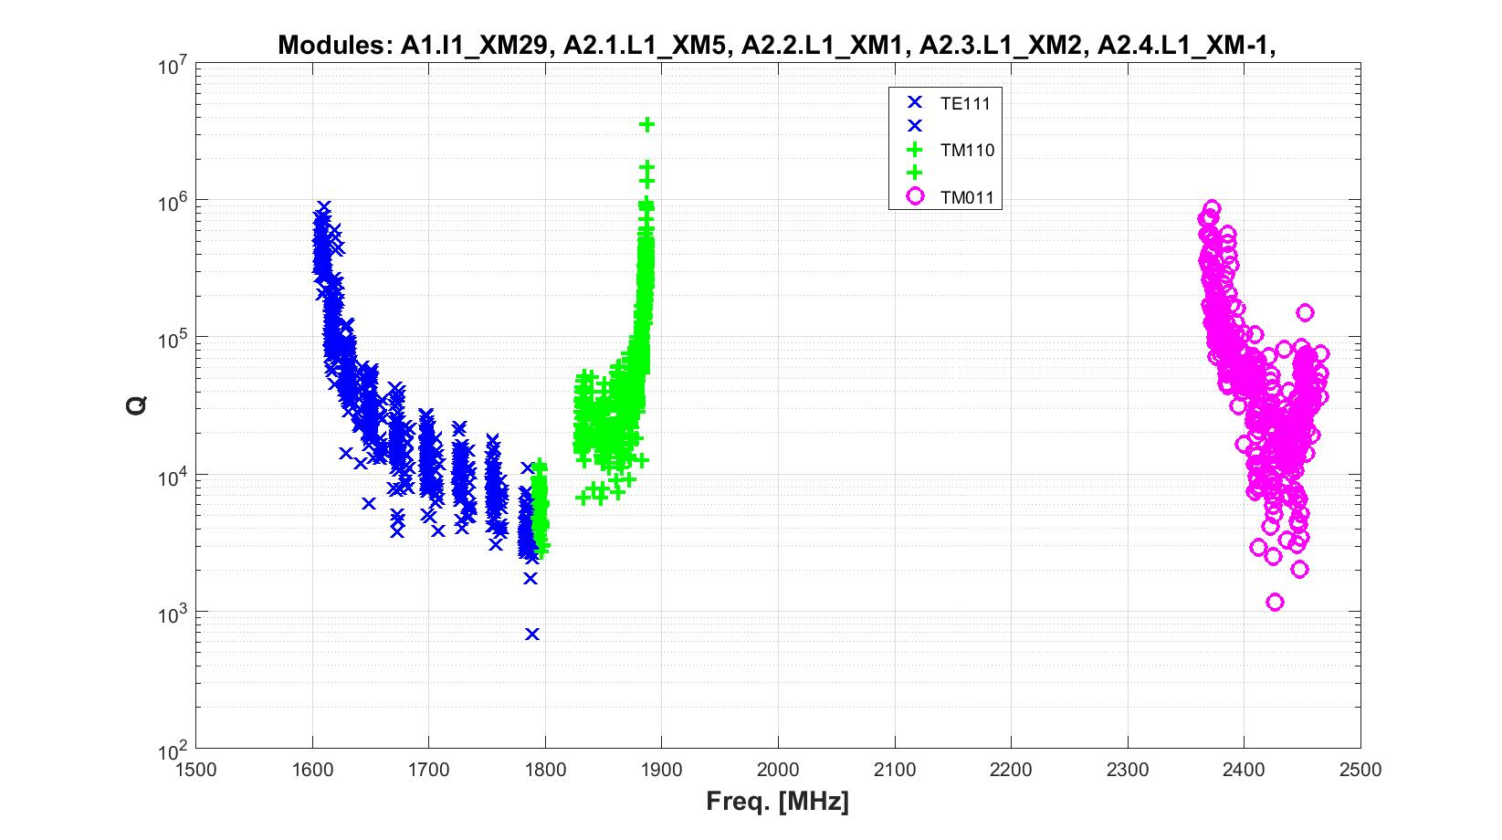
Spectra of E-XFEL 1.3 GHz cavities:
First 5 Cryo-modules: Q vs. Frequency

Slide 18
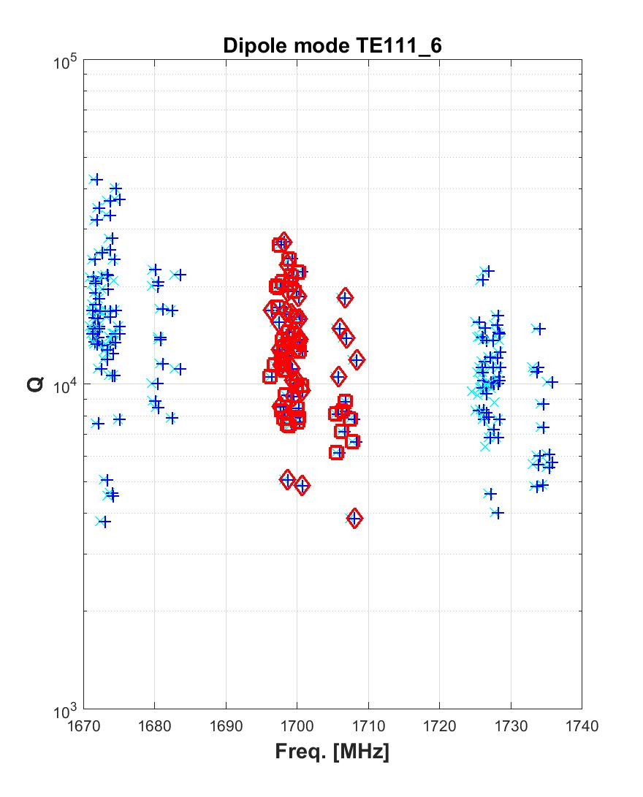
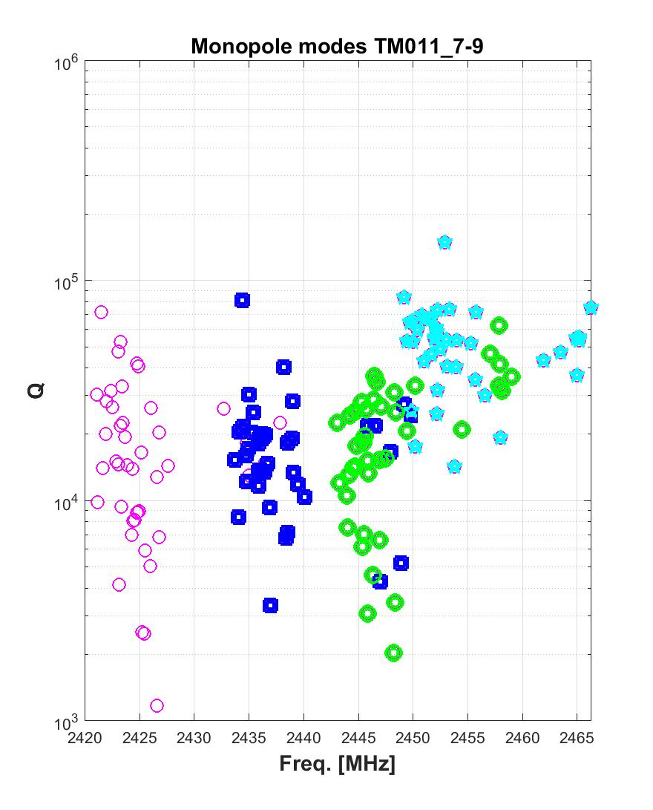
First 5 E-XFEL Modules:
Q vs. Frequency: TE111-6 and TM011-7 to 9

Slide 19
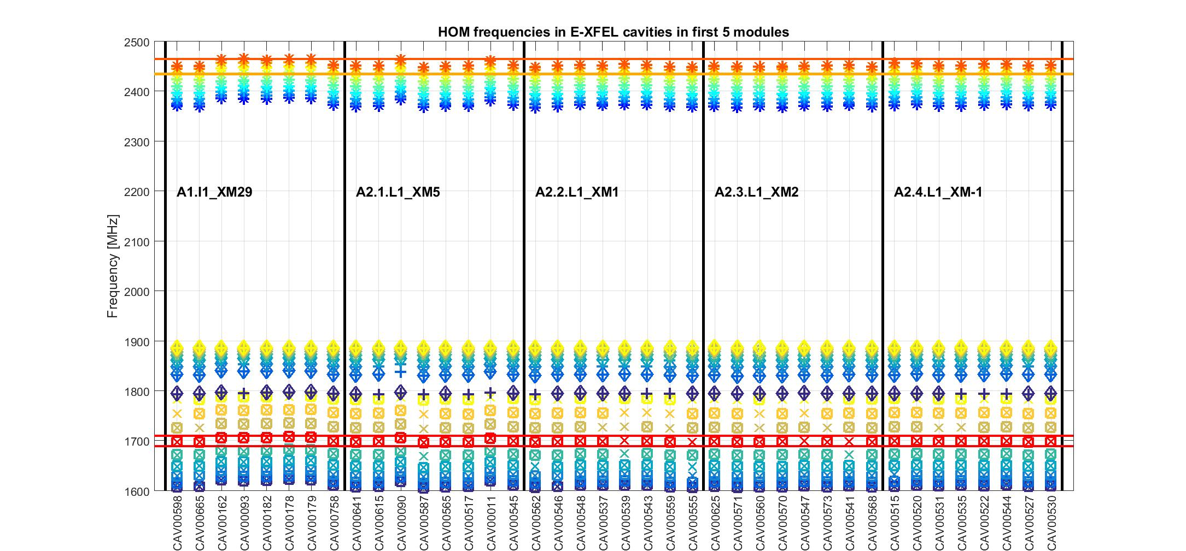
First 5 E-XFEL Modules:
Frequency vs. Cavity

Slide 20
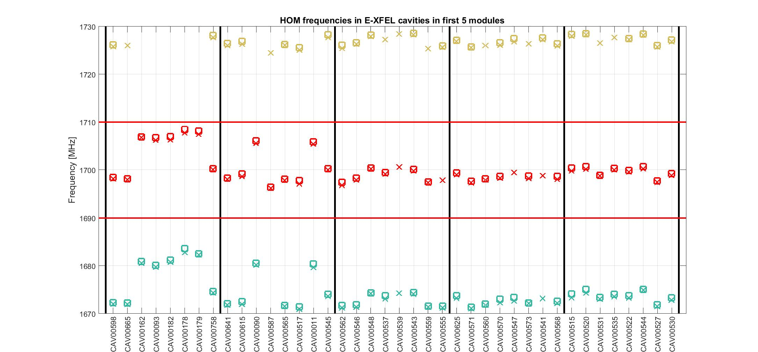
First 5 E-XFEL Modules:
Frequency vs. Cavity: TE111-6

Slide 21
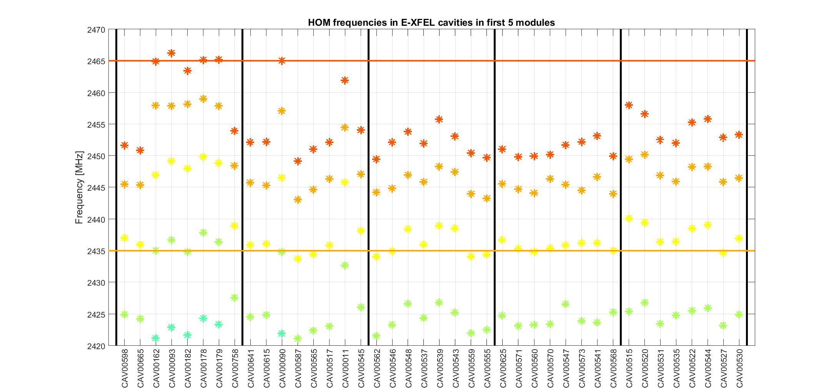
First 5 E-XFEL Modules:
Frequency vs. Cavity: TM011-7 to 9

Slide 22
Spectra of E-XFEL 1.3 GHz cavities:
First 5 E-XFEL Modules: Conclusions
Spectra of several cavities shifted
Cavities were produced by 2 companies
All cavities with shifted spectra are from one company
Nevertheless still within filter of HOM electronics

Slide 23
Contents
HOM-based diagnostics in SC accelerating cavities
  Principle
  Experience at FLASH
The European XFEL
  Spectra of 1.3 GHz cavities in the E-XFEL
  Beam measurements in 1.3 GHz cavities in the
  E-XFEL injector
Summary

Slide 24
Beam measurements in the E-XFEL injector:
1.3 GHz Cavities
Measured spectra of 8 cavities of the 1.3 GHz cryo-module in the first E-XFEL injector
Measured their dependency on the beam position
Used a Tektronik Real-Time Spectrum Analyzer (RSA)

Slide 25
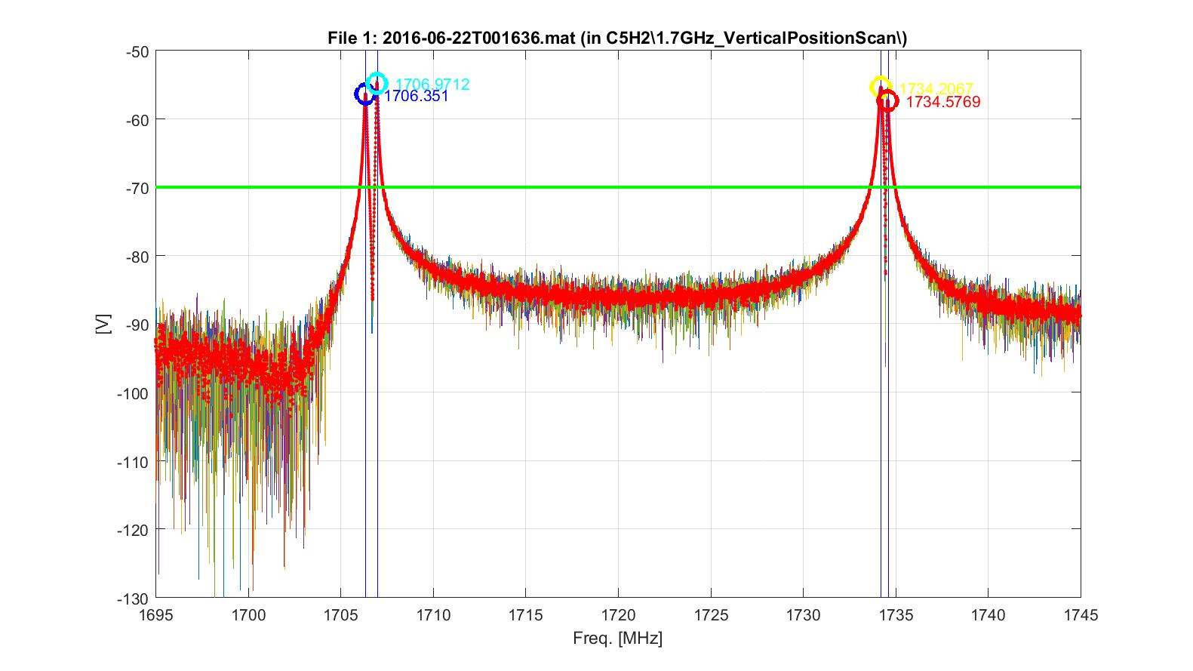
Beam measurements in the E-XFEL injector:
HOM Spectra

Slide 26
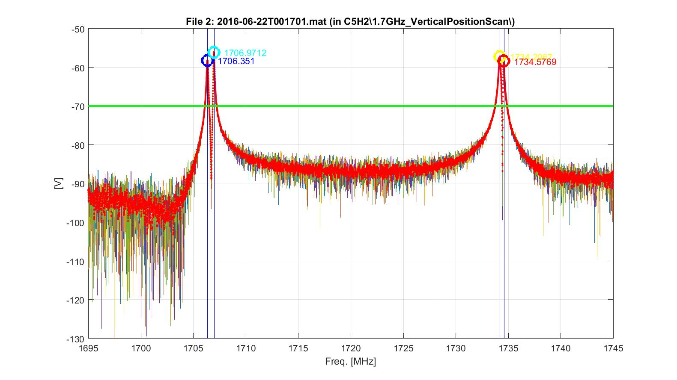
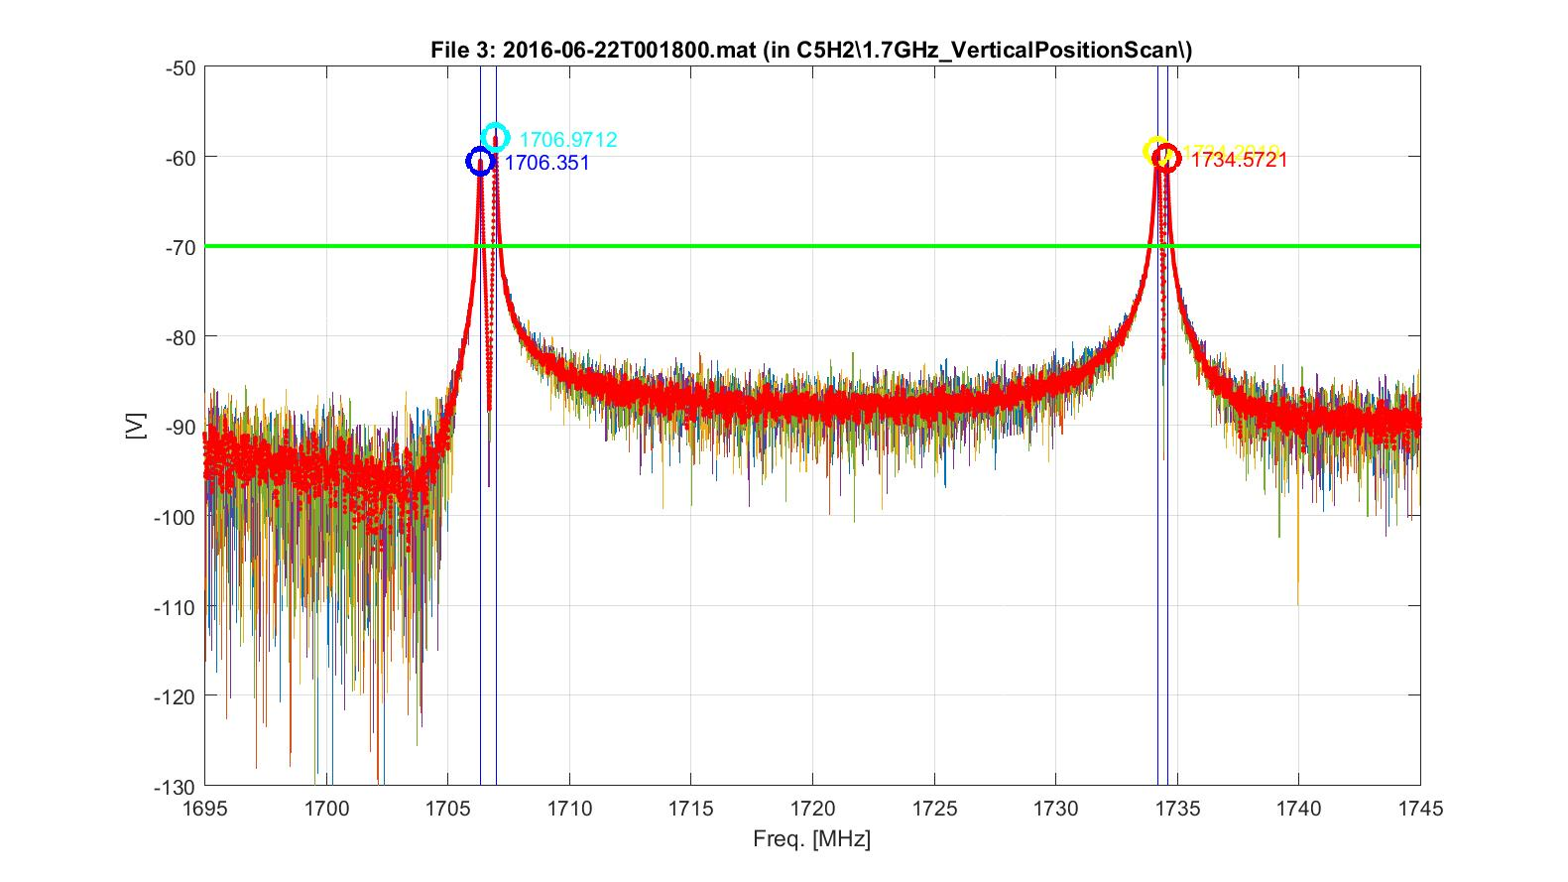
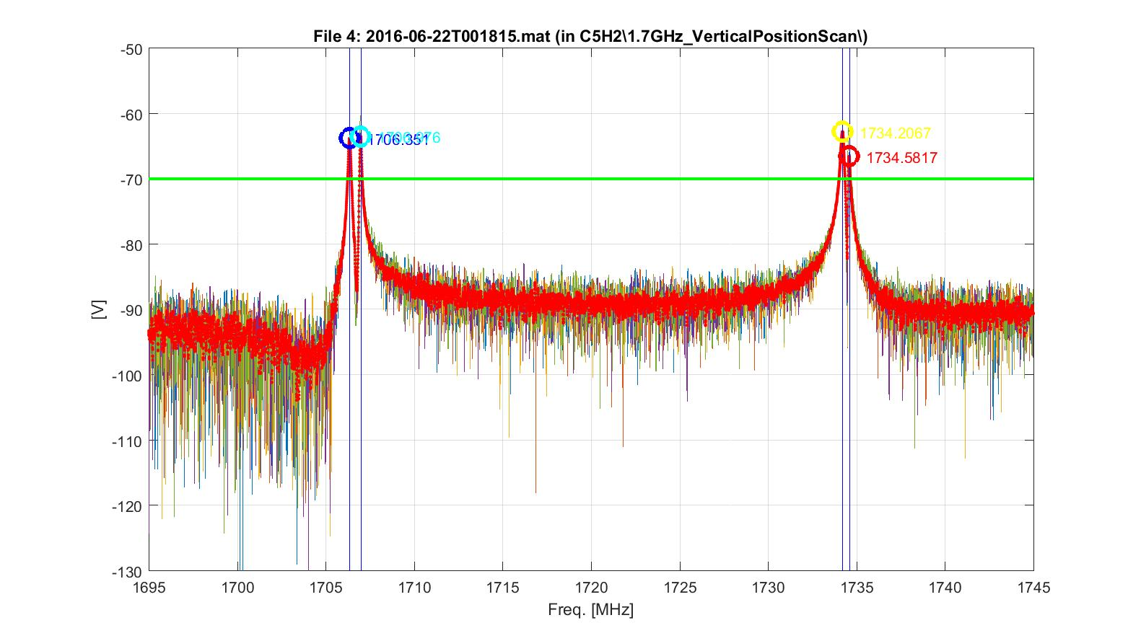
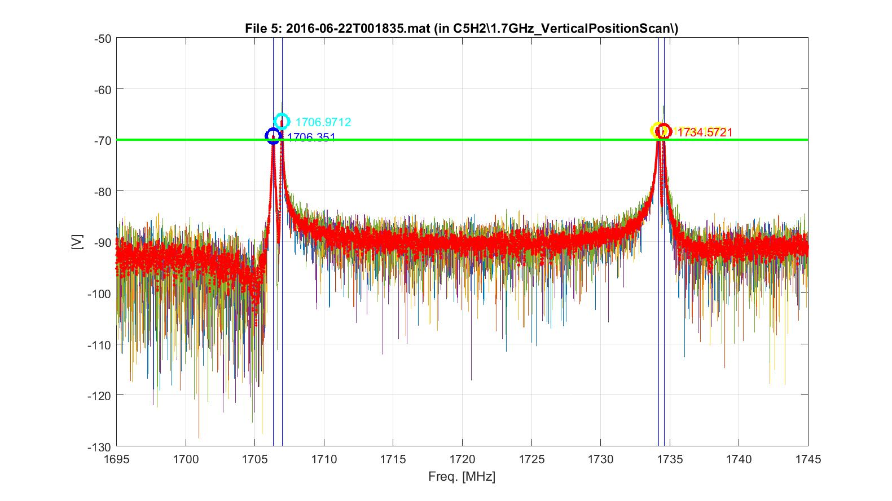
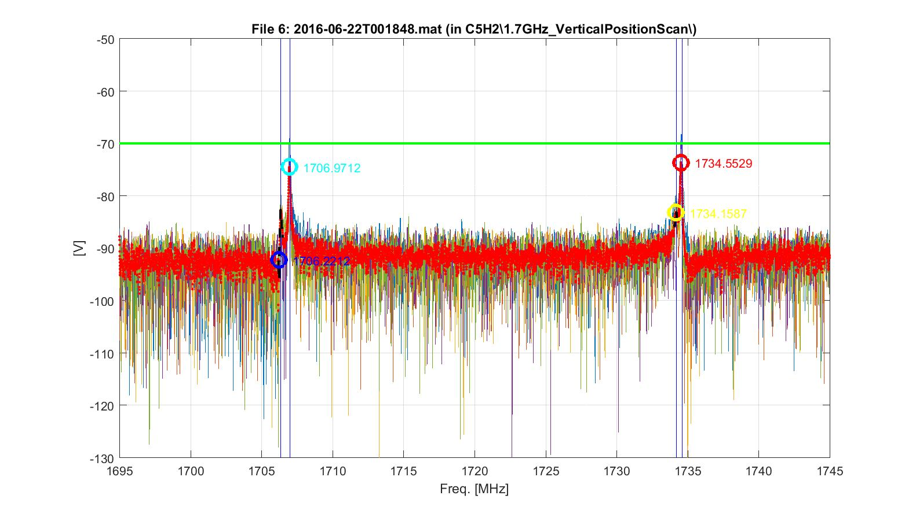
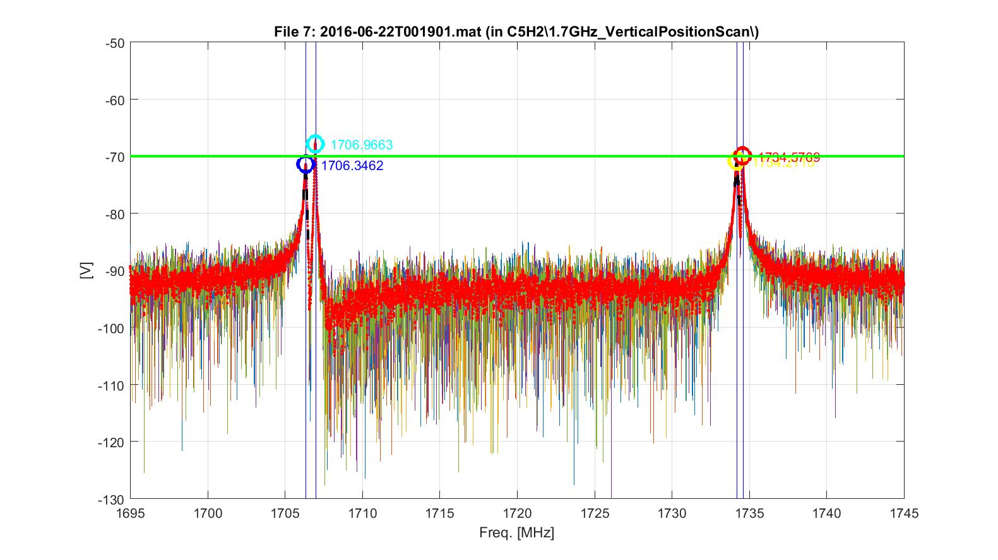
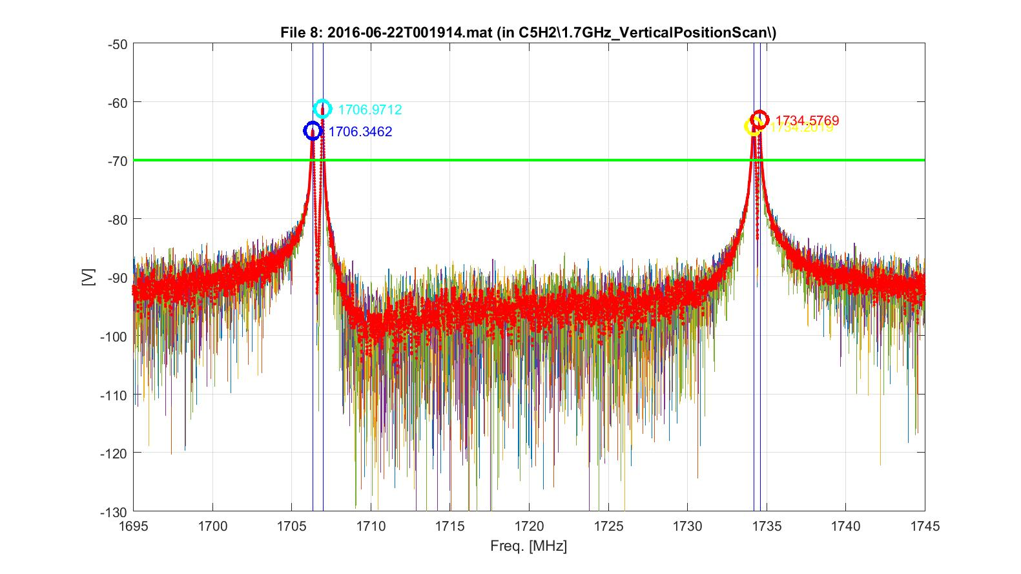
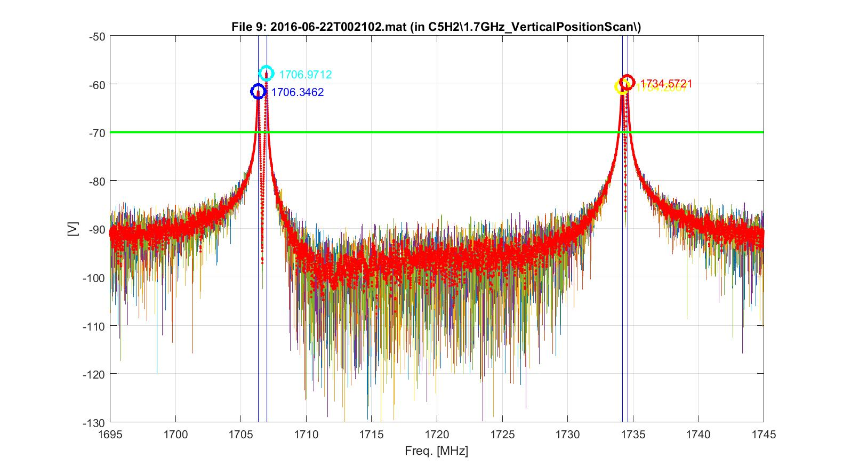
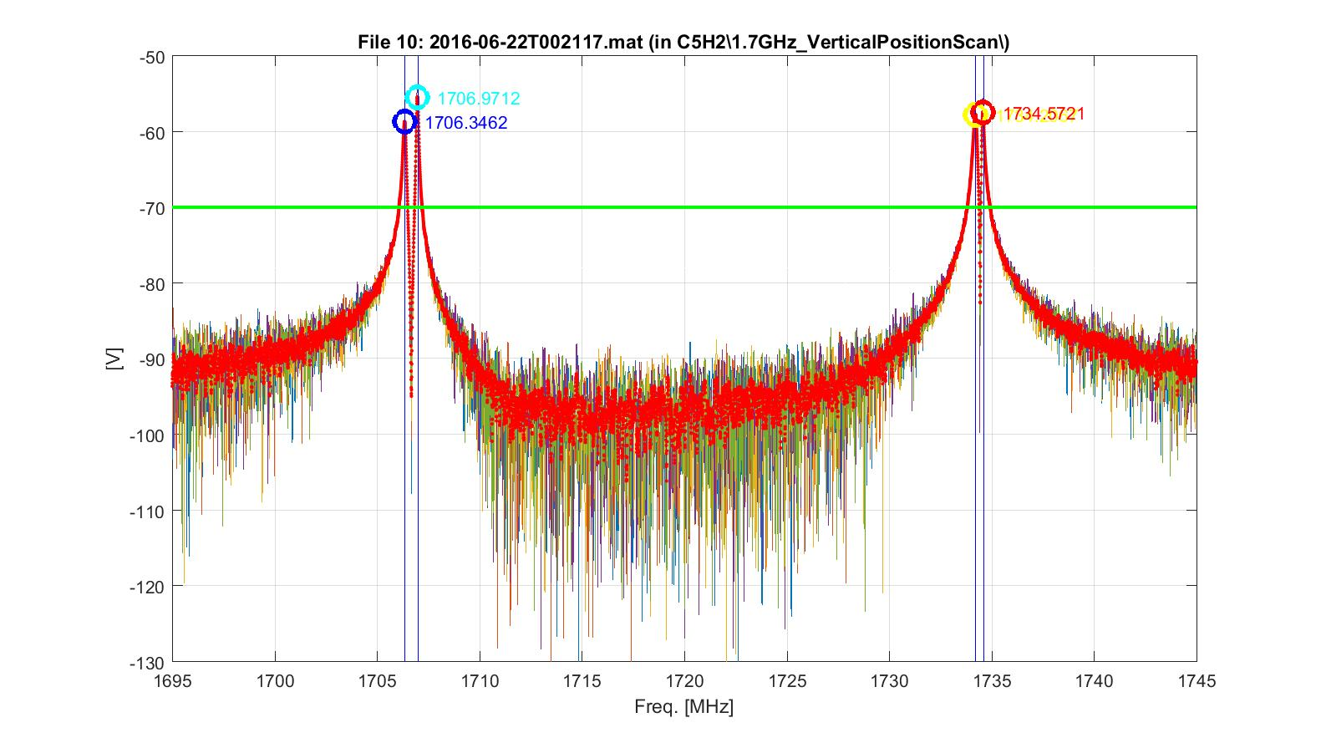
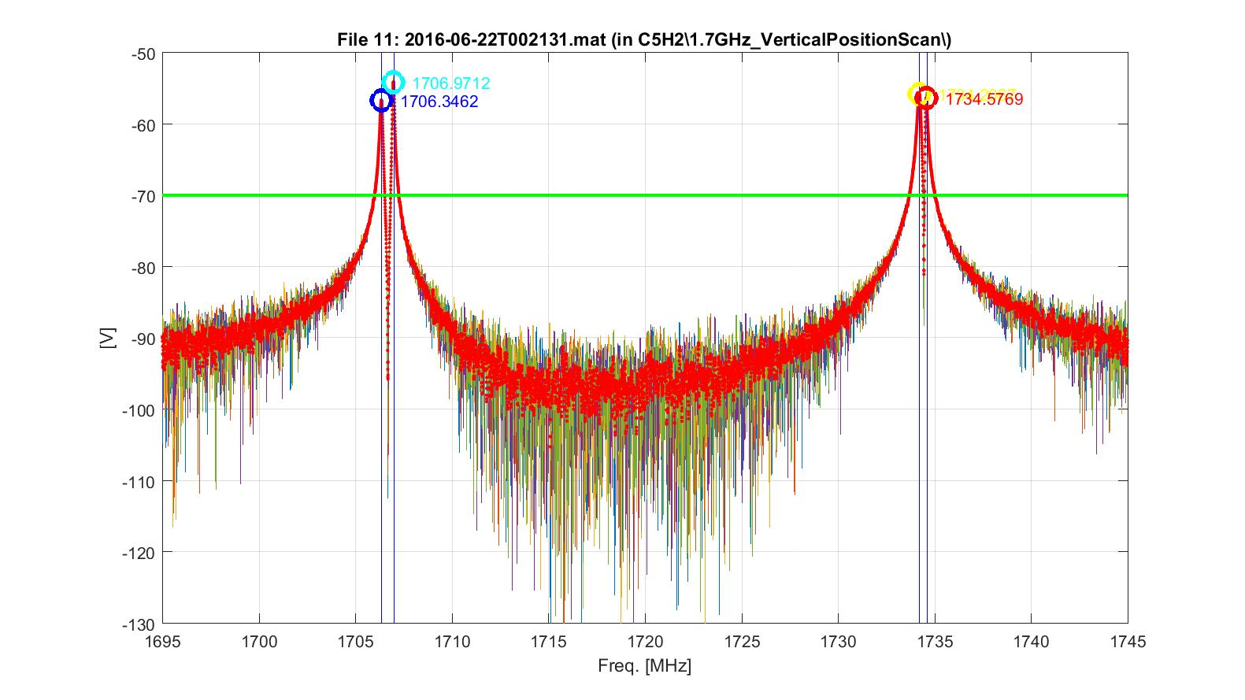
Beam measurements in the E-XFEL injector:
HOM Spectra Variation with Beam Position

Slide 27
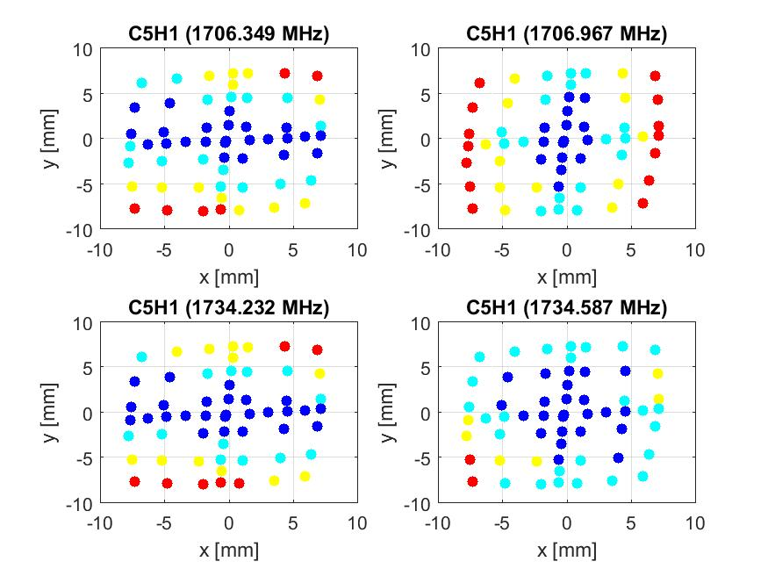

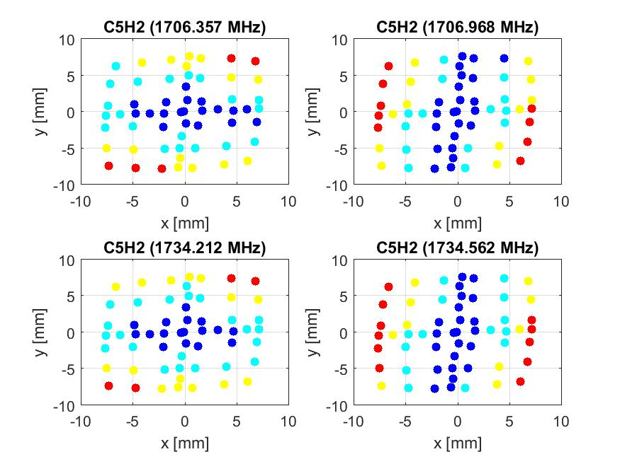
Beam measurements in the E-XFEL injector:
2D-Scan: Cavity 5, both HOM Couplers

Slide 28
Beam measurements in the E-XFEL injector:
2D-Scan: Cavity 5, both HOM Couplers

Slide 29
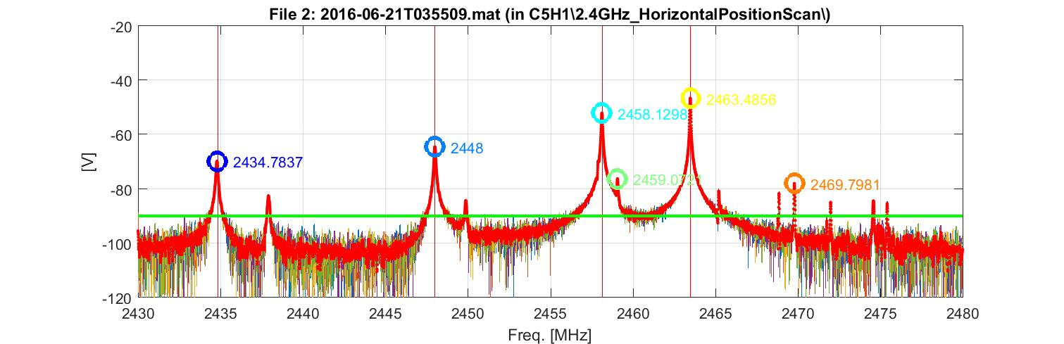
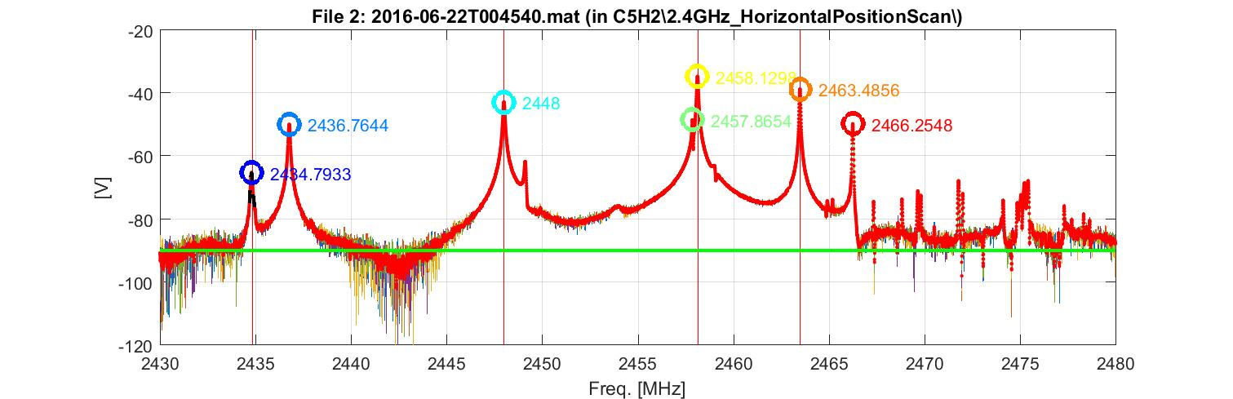
Beam measurements in the E-XFEL injector:
Monopole Modes
C5H1
C5H2

Slide 30
Beam measurements in the E-XFEL injector:
Conclusions
Based on dipole signals can
  Align the beam
    Reduce excited dipole modes and therefore reduce their effect on the beam
  Measure the beam position
  Measure the cavity alignment in the cryo-module
Monopole modes
  Unidentified peaks observed, with no dependence on beam position

Slide 31
Summary
HOM-based beam diagnostics planed at the E-XFEL based on experience at FLASH
Spectra of first 5 E-XFEL 1.3 GHz modules
  Some cavities have systematic shift of spectra
Beam measurements in 1.3 GHz Cavities
  Data recorded for all 8 cavities of the injector
  Linear variation of dipole modes with beam position
  Plans to calculate cavity alignment
    Talk by Thorsten Hellert (for FLASH)
First measurements on beam phase
    Talk by Liangliang Shi

Slide 32
Acknowledgement
Talk based on work of many people from several institutes
  SLAC, CEA, FNAL, University of Rostock, University of Manchester, Cockcroft Institute, DESY
Part of the work is currently made under EuCARD-2, Grant Agreement 312453
  WP12 RF Technologies; Task 12.4 HOM-based Diagnostics
    University of Manchester/Cockcroft Institute, Rostock University, DESY

Slide 33
Thank you for your attention!

