Slide 1
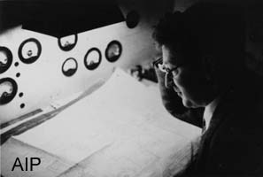

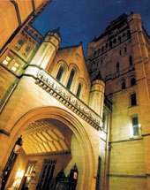
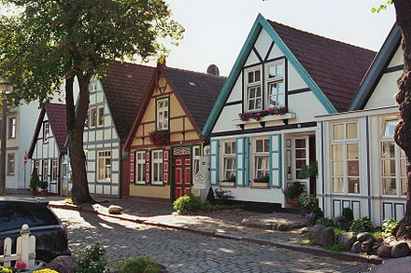
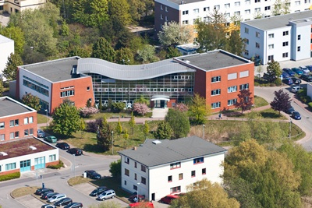
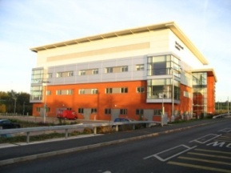

Conspectus of HOMS in SC Cavities:
BPMs and Damping
Roger M. Jones
University of Manchester/Cockcroft Inst.
http://tinyurl.com/jz3yuzz

Slide 2
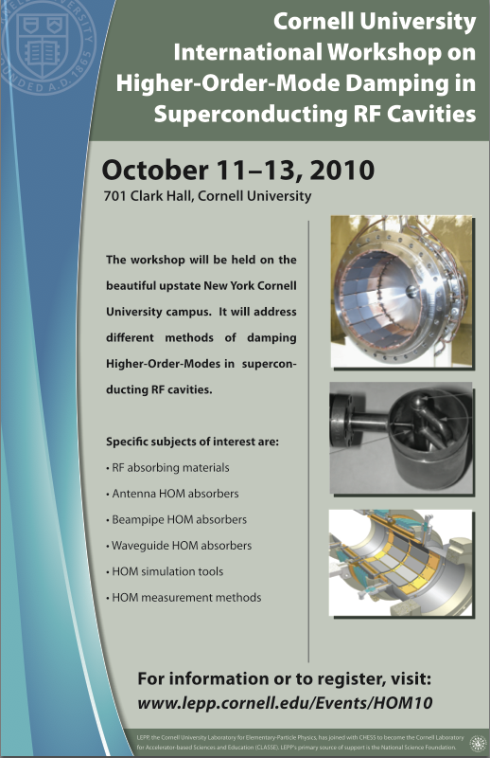
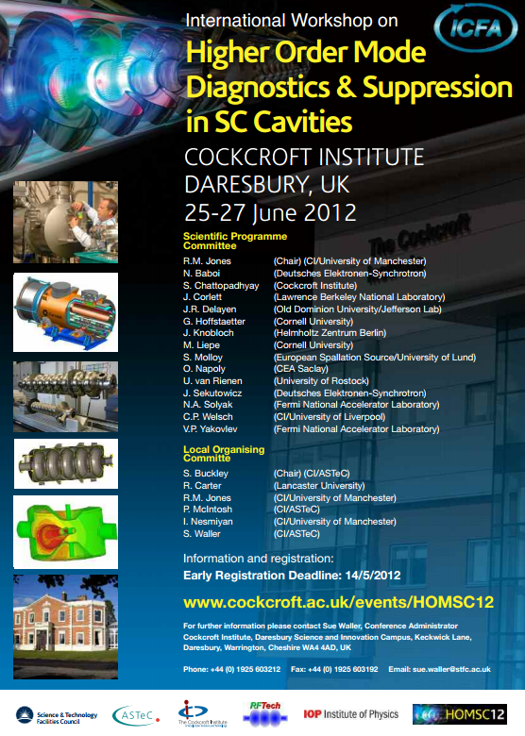
Inaugural & Continuing…
37 registered –by invitation only
Papers published in HOMSC14 Phys Proc. Special Is
37 registered –open registration
http://tinyurl.com/grqb7qq
58 registered –open registration
(26 UK, 14 Europe, 11 USA, 3 Asia)
Published in HOMSC12 NIMA Special Issue

Slide 3

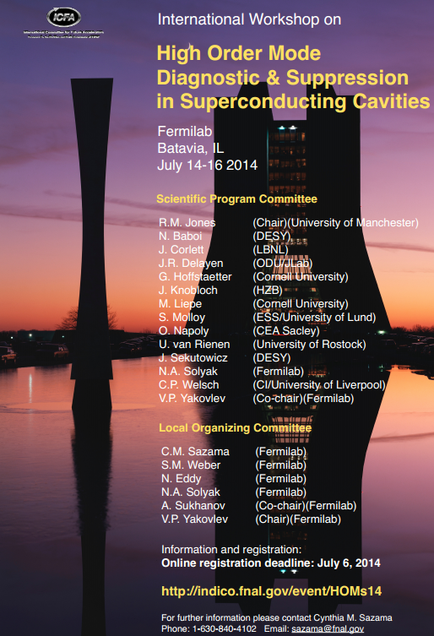
Inaugural & Continuing…
37 registered –by invitation only
Papers published in HOMSC14 Phys Proc. Special Issue
36 Registered –open registration
HOMSC16 Proc. Publications online + +PRAB Special Issue

Slide 4
HOMSC16 Workshop -Overview
Light Sources & LCs
HOM BPM diagnostics and measurement methods
HOM couplers and influence of FP couplers
Novel HOM suppression in TEM and other cavity shapes
Special considerations in third harmonic, deflecting and crab cavities
RF absorbing materials
Beam-pipe HOM absorbers
Waveguide HOM absorbers
HOM simulation tools and models

Slide 5
HOMSC16 Workshop –Broad Overview
Facilities: Planned Light Sources, Colliders, and Specialised Cavities: CEPC, EUV, XFEL, FLASH, Project-X, Novel Crab Cavities, LL cavities, ESS, LCLS-II
Diagnostics: FLASH/XFEL
Simulations on HOMS, Beam Dynamics (Emittance Preservation), and Simulations of RF Loads

Slide 6
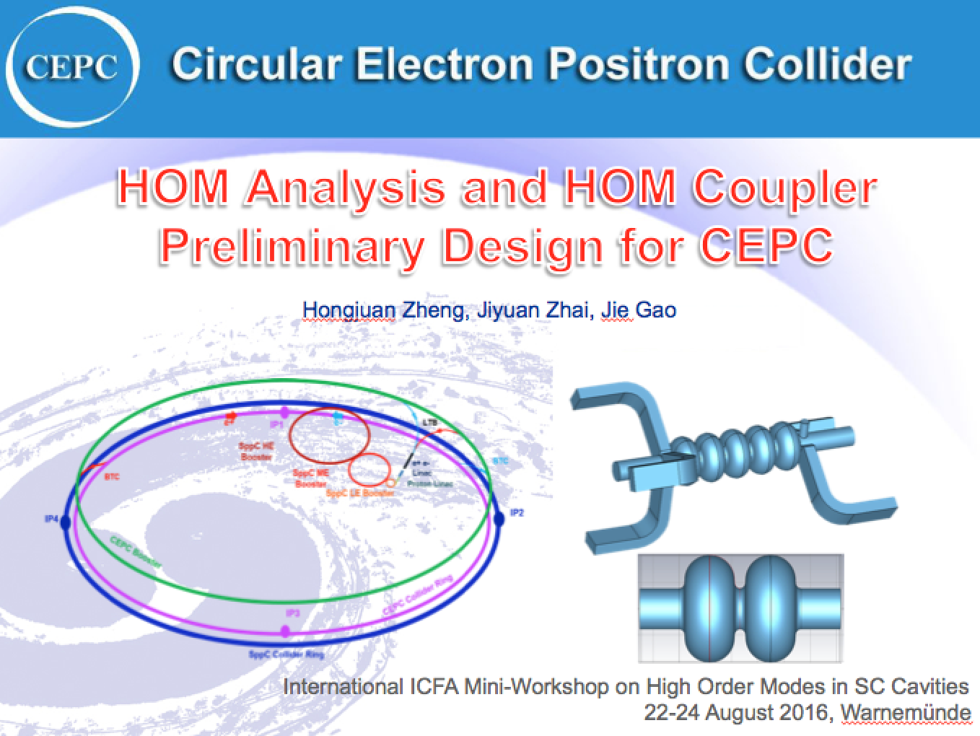
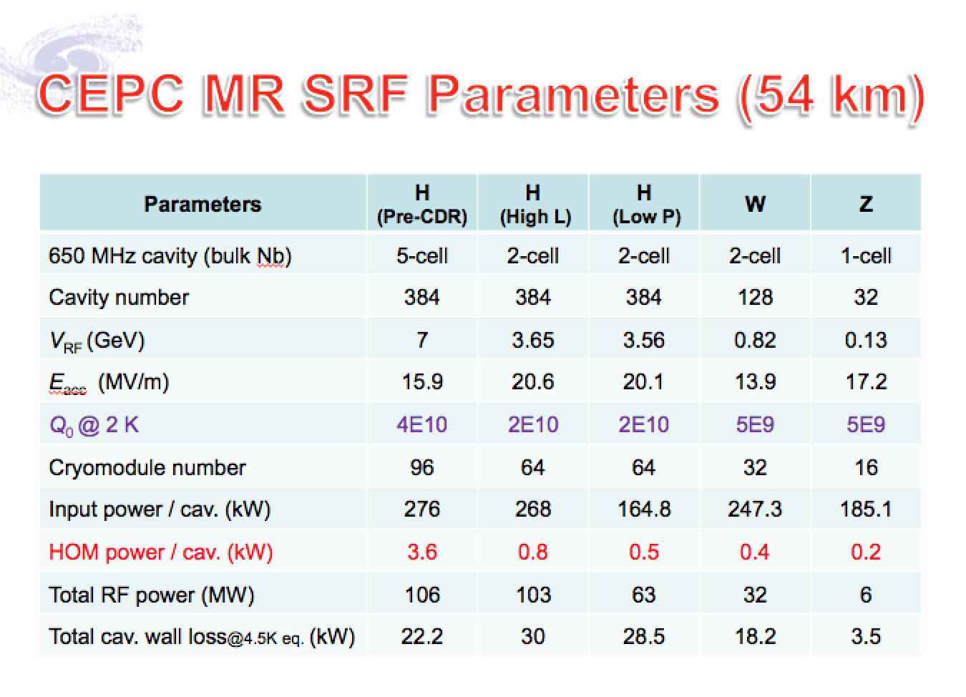
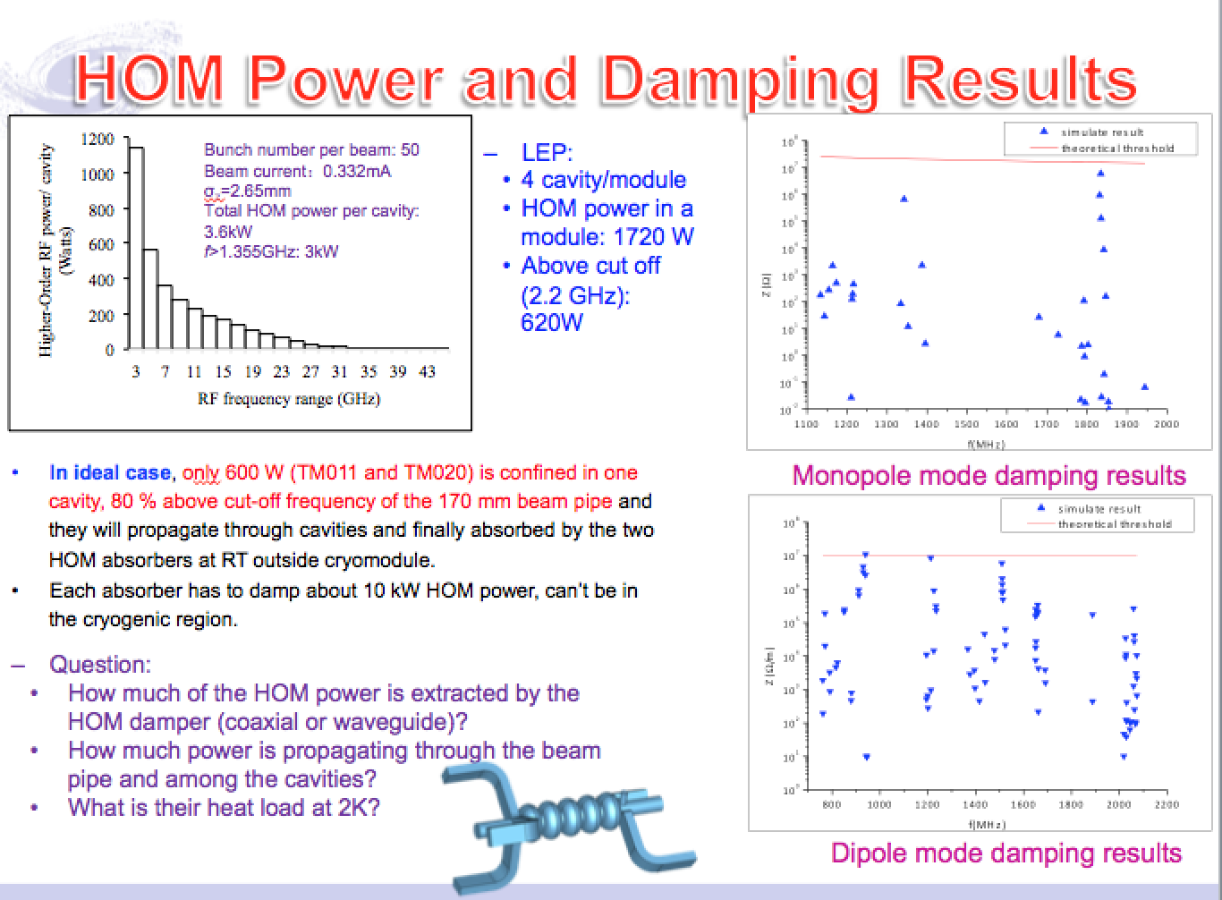
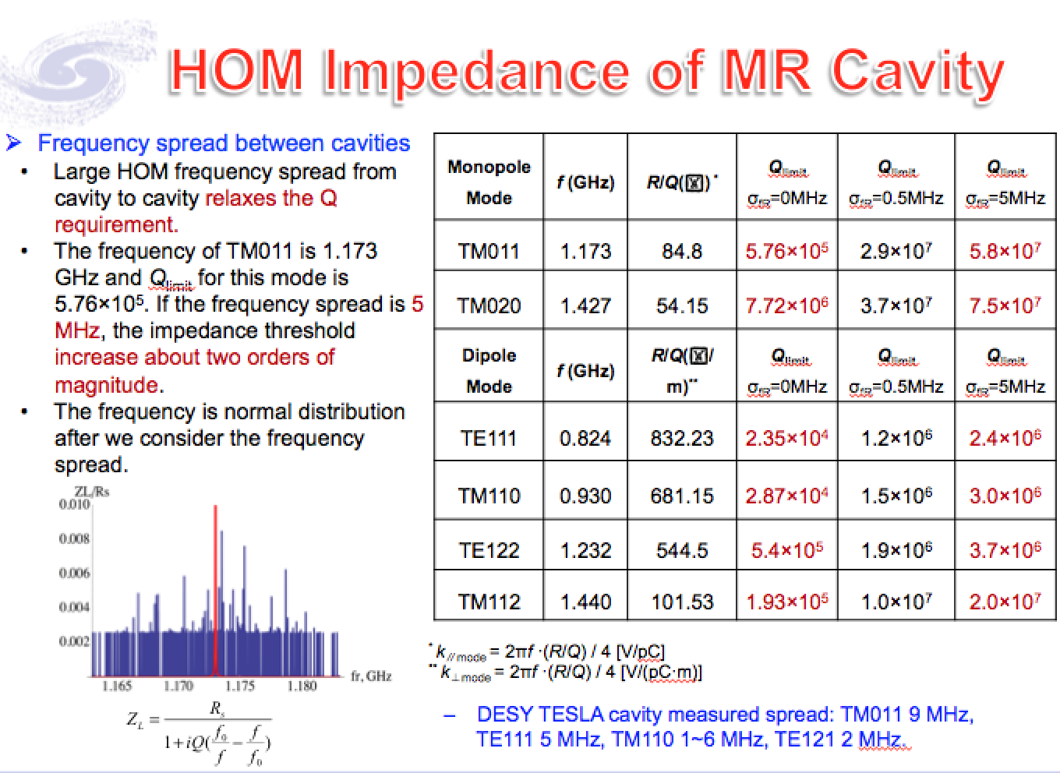
Colliders: CEPC
See talk by –H. Zheng, J. Zhai, J. Gao

Slide 7
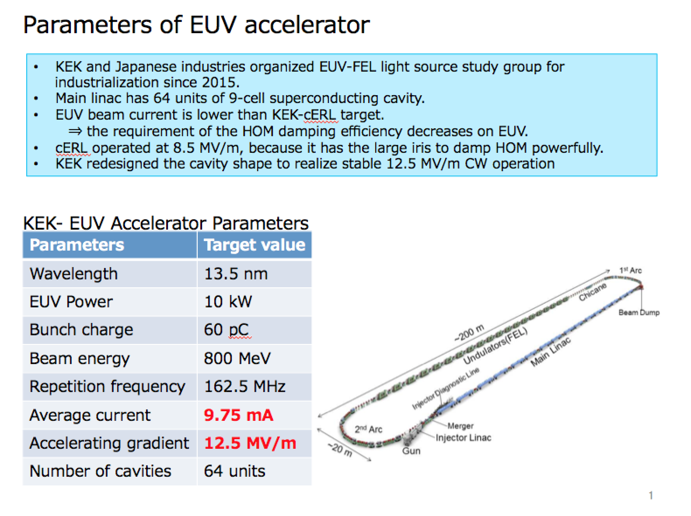
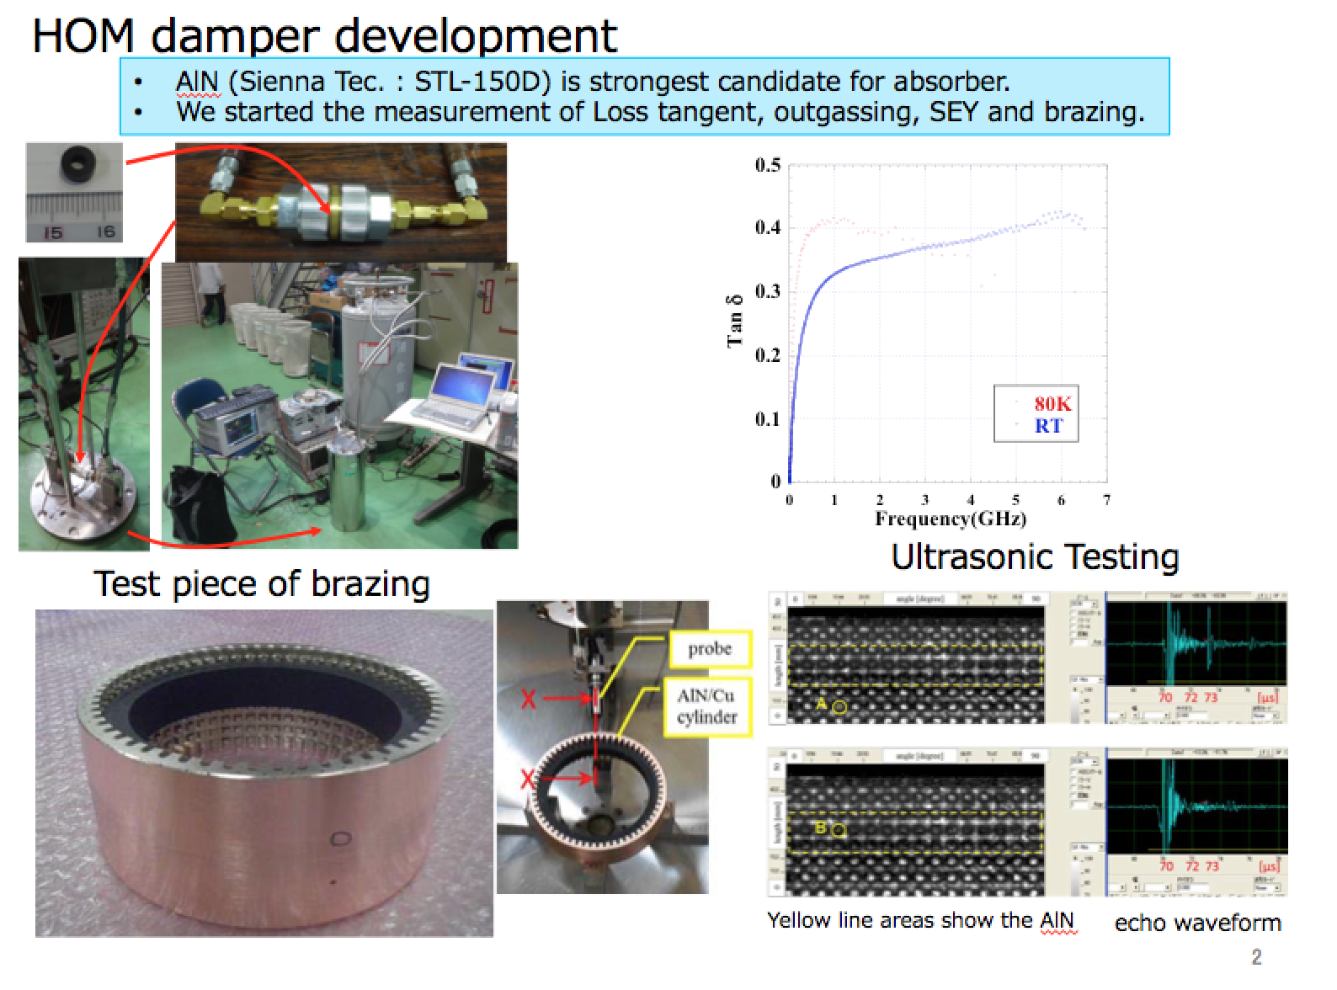
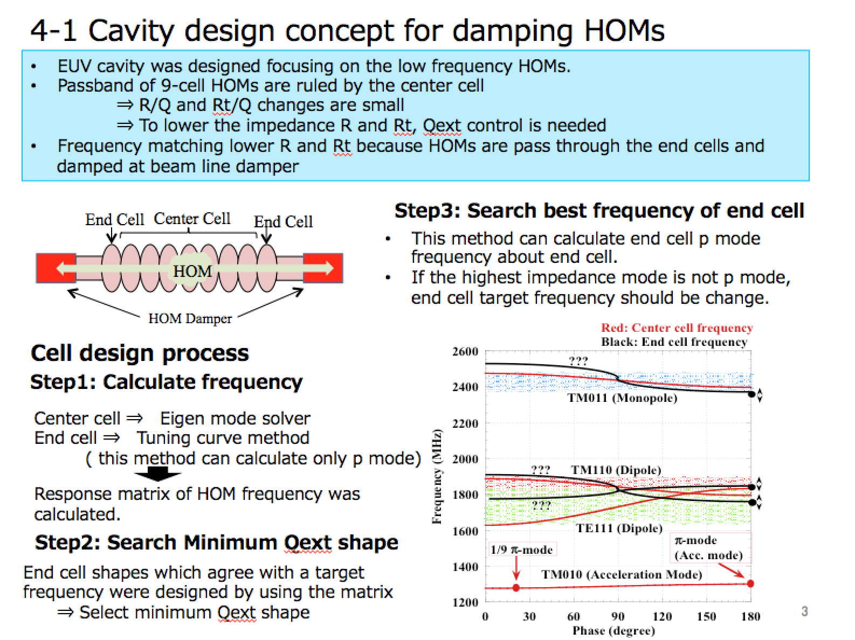
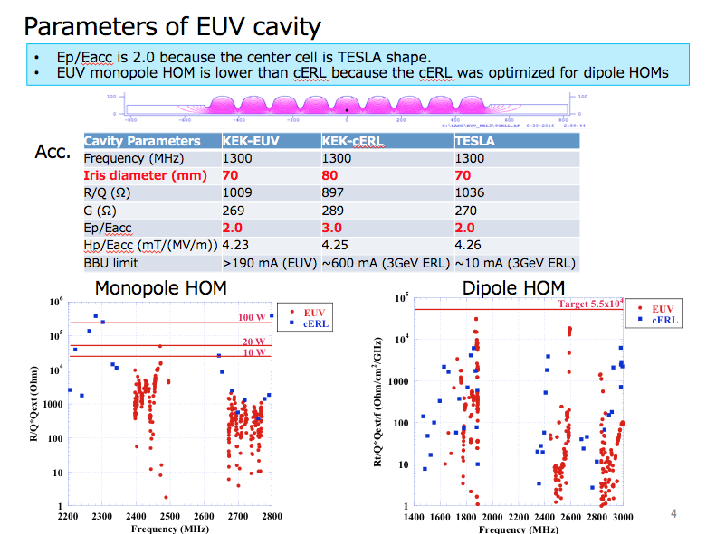
Light Sources: EUV Based on ERL
See talk by –T. Konomi

Slide 8
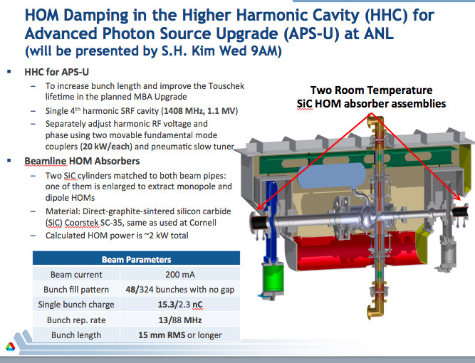
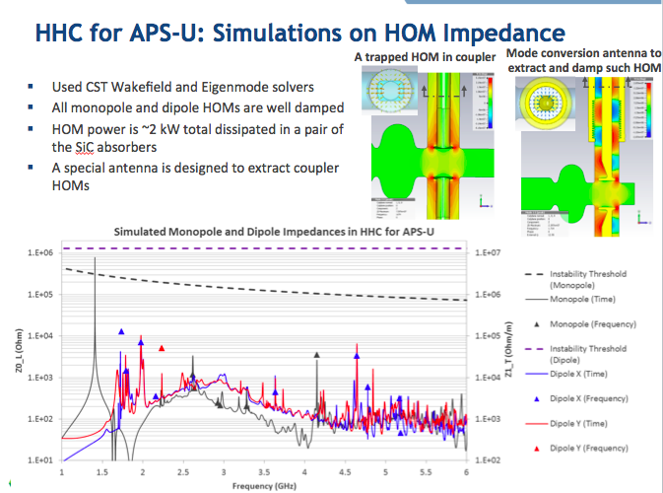
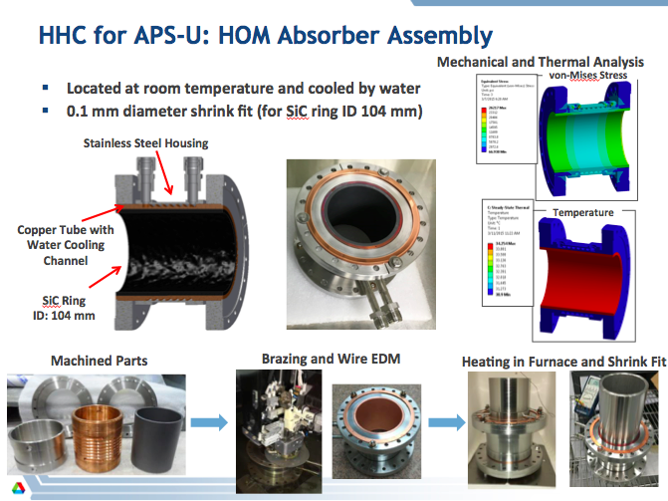
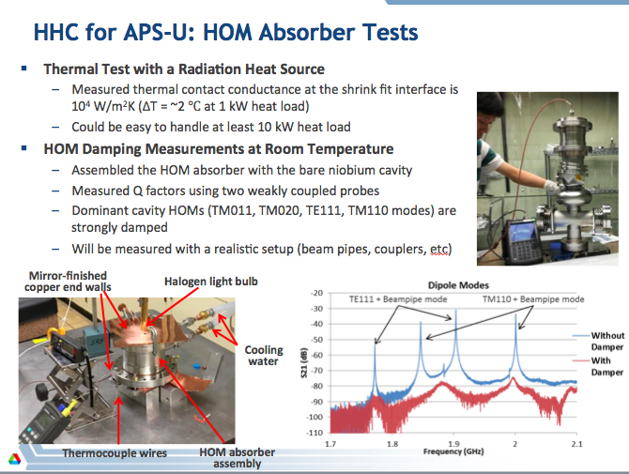
HOM Suppression: HHC for APS Upgrade
See talk by -S.H. Kim

Slide 9
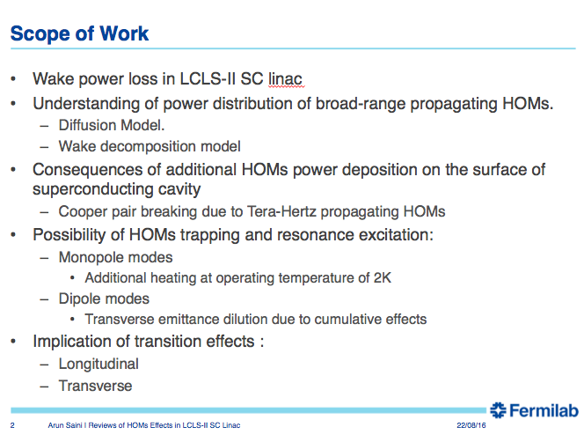
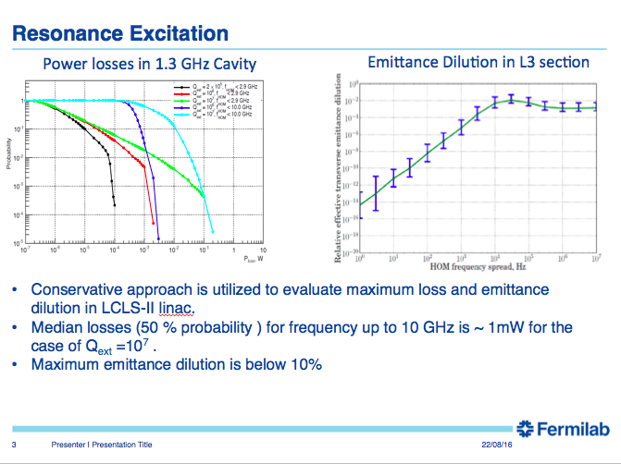
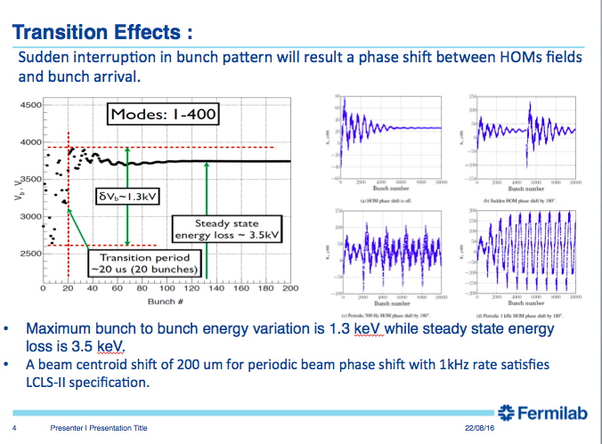
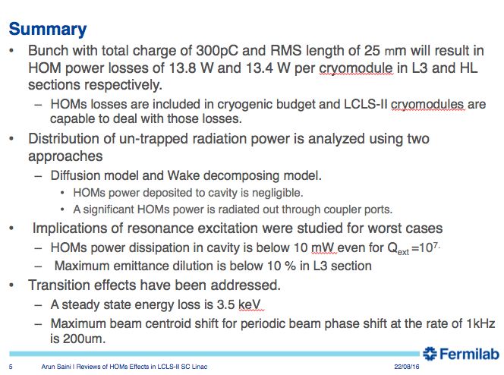
HOMs in LCLS-II
See talk by –A. Saini

Slide 10
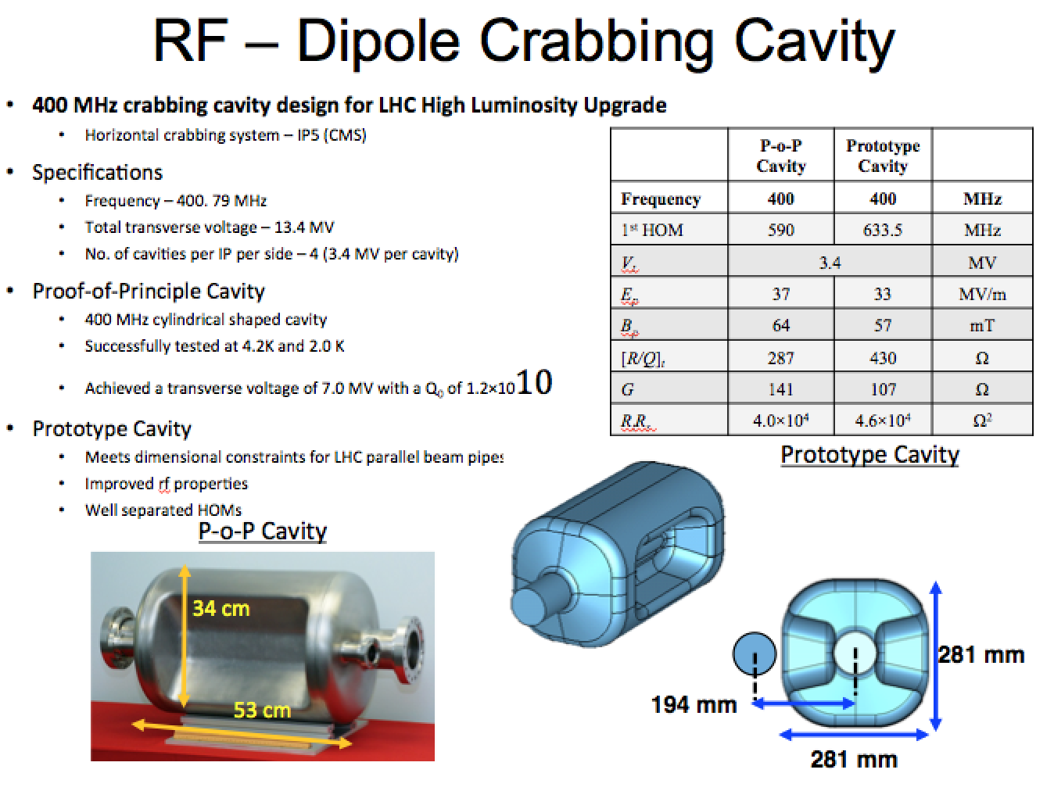
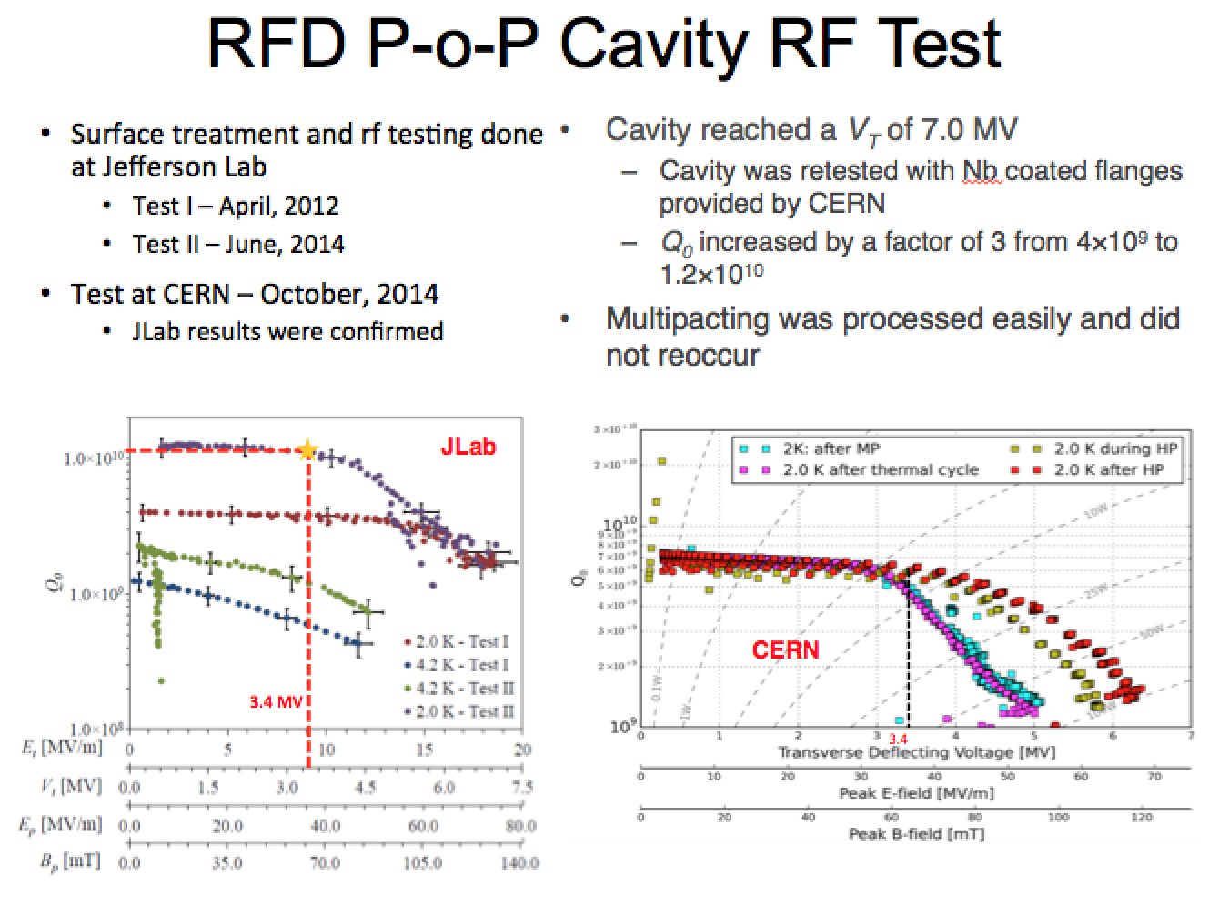
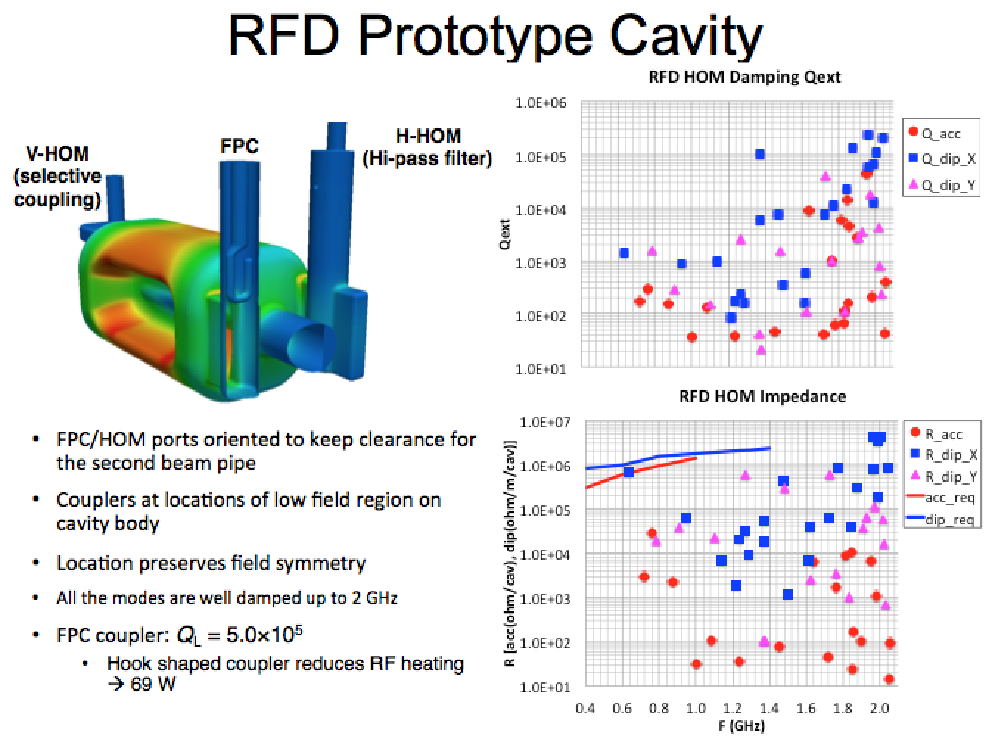
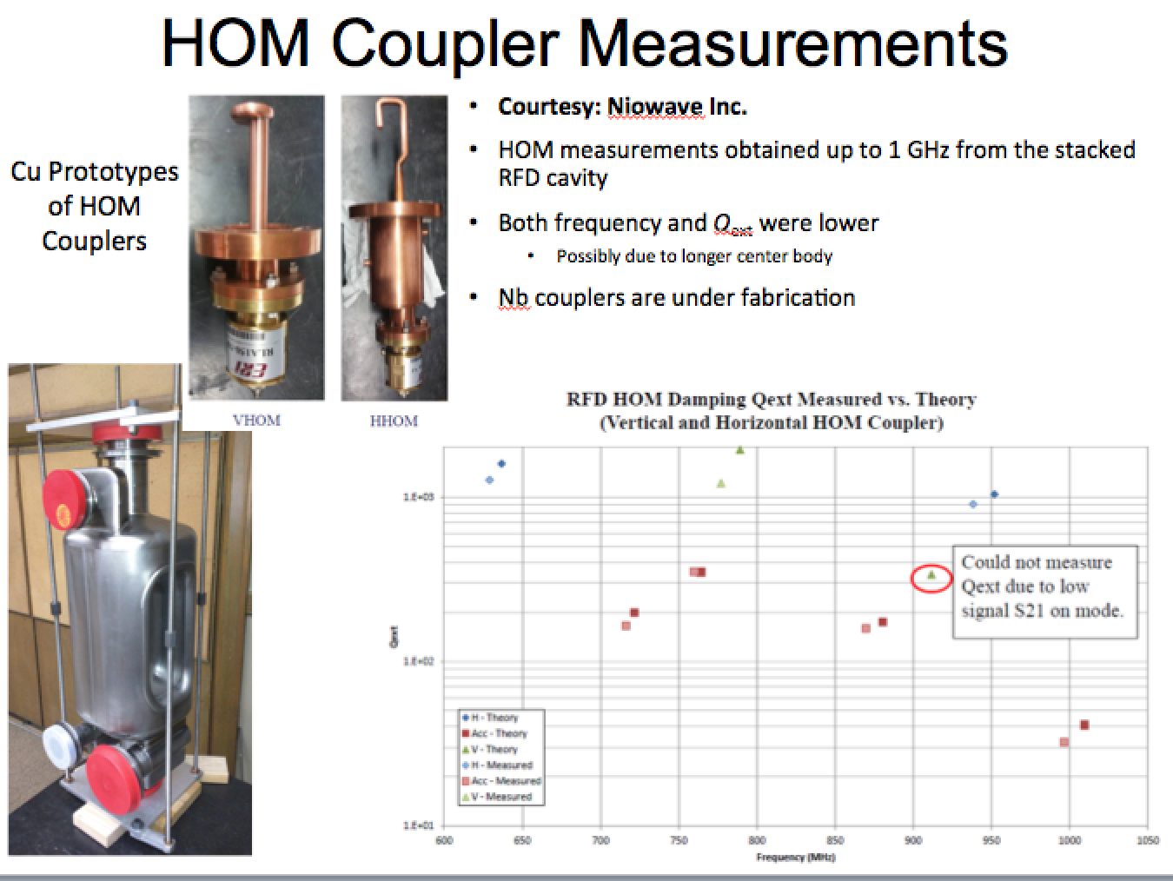
Novel Crabbing Cavities: LHC
See talk by -S. De Silva, J. Delayen
Notes:
Slide 1:
P-o-P cavity was completed in 2012 to prove the concept of using TE11 like cavity as deflecting and crabbing cavities
The cavity design went through several design iterations was finalized into this current shape
He prototype cavity was reshaped into a square shaped cavity to meet the LHC dimensional specifications
Two prototype cavities are currently being fabricated in collaboration with Niowave Inc. and USLARP
Slide 2:
P-o-P cavity was successfully tested first at JLab and then at CERN
Cavity achieved at transvers kick of twice the design specifications
Multipacting levels were easily processed an did not reappear in the following tests
The Q₀ at CERN test was low due to lack of magnetic field compensation. A magnetic field of 3 µT was present during the test
Slide 3:
Current prototype cavity is designed for the SPS cryomodule
Cavity has only two HOM couplers: Horizontal and Vertical HOM couplers
Damping meets the current impedance budget
Slide 4:
Set of Cu HOM couplers are also fabricated by Niowave Inc., and Nb HOM couplers are under fabrication
Measurements are in agreement with the simulations

Slide 11
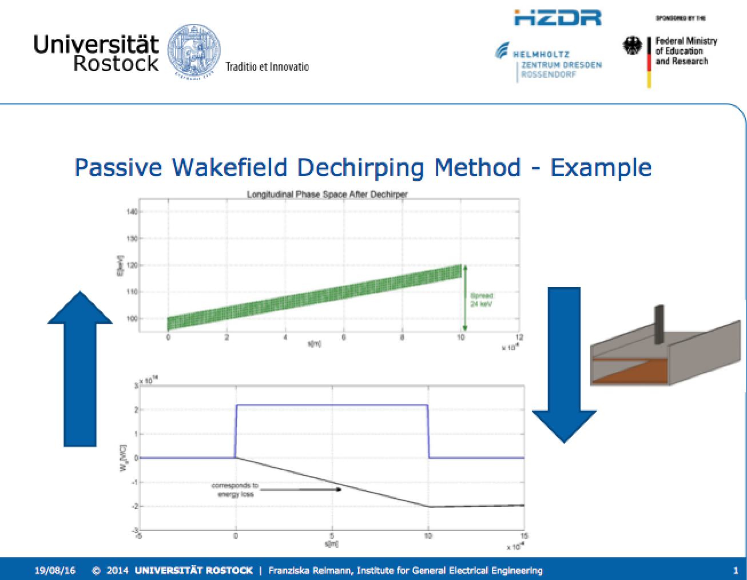
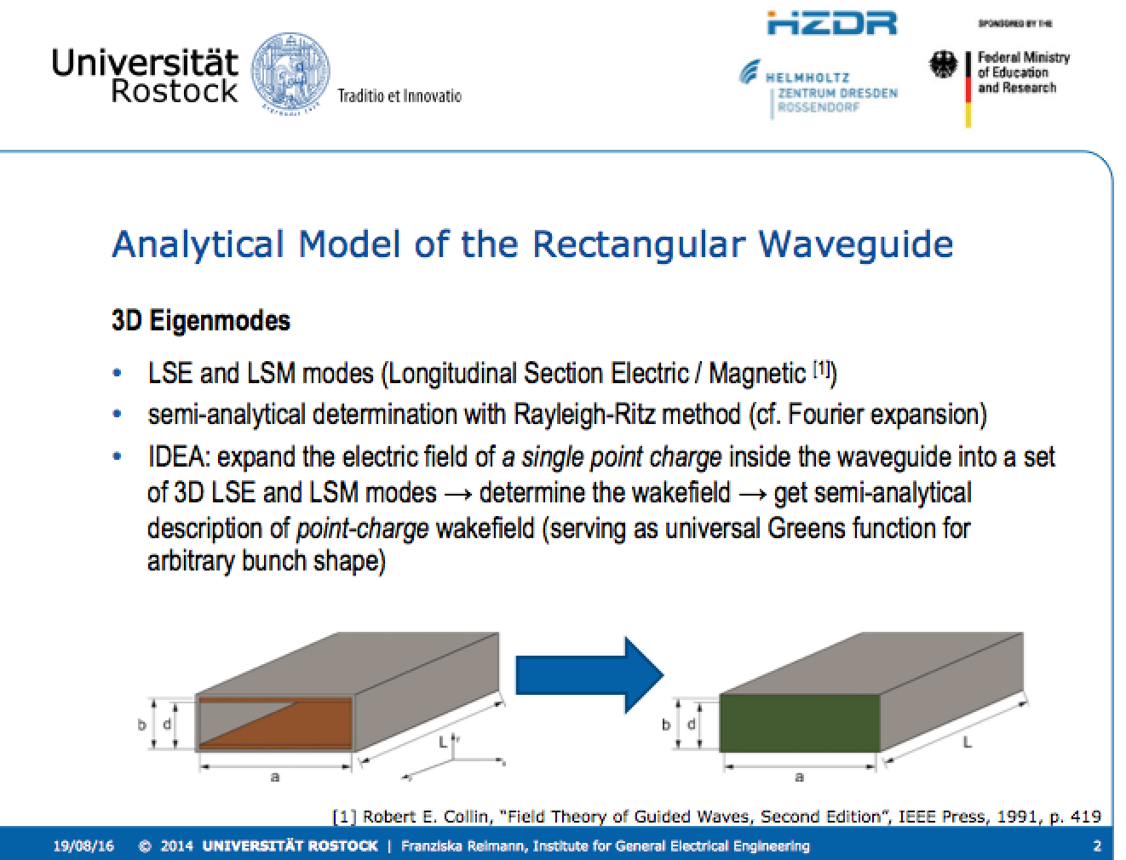
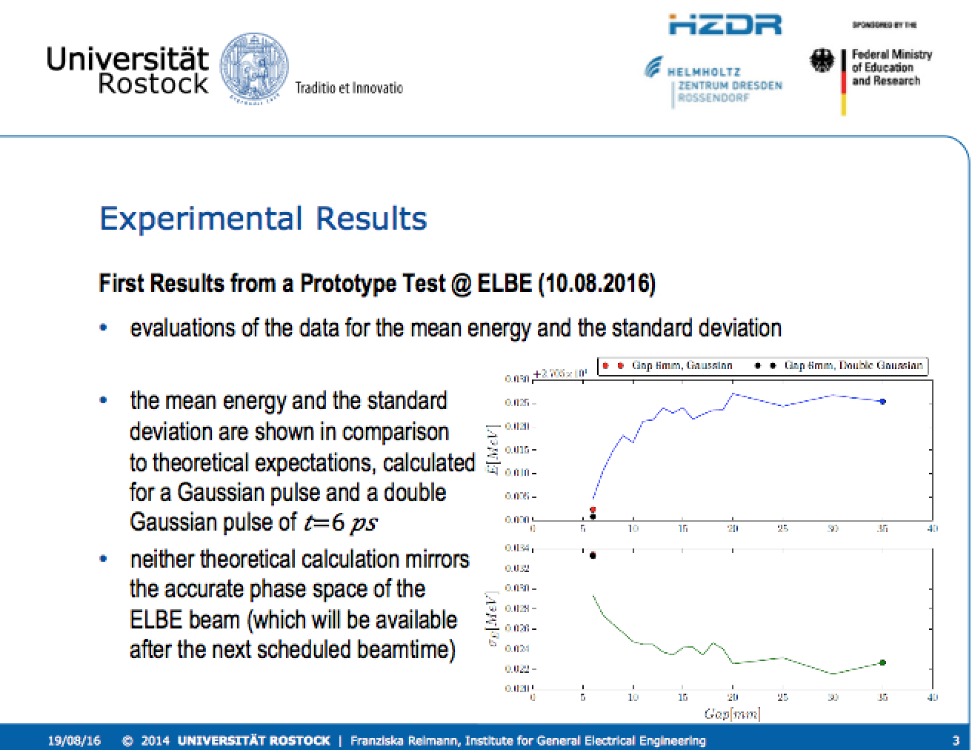
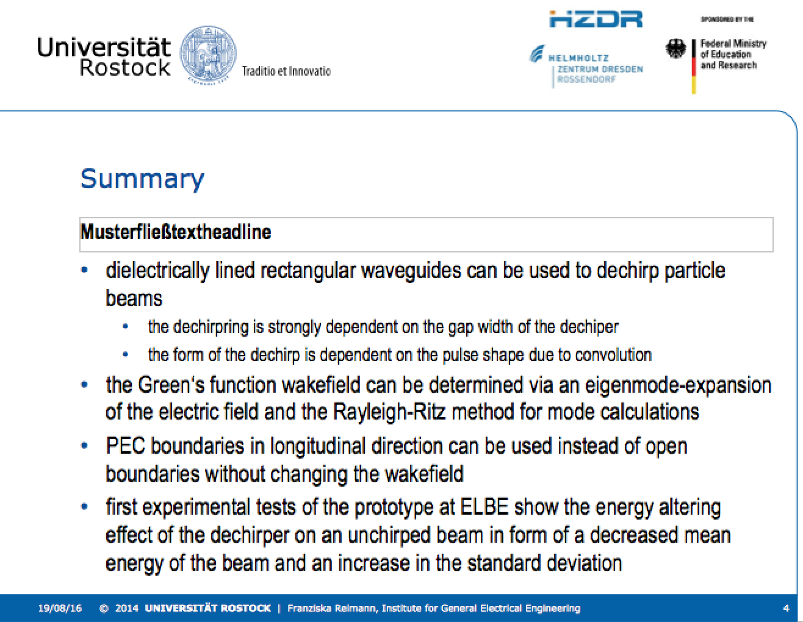
Novel Methods: Dechirping
See talk by –F. Reimann

Slide 12
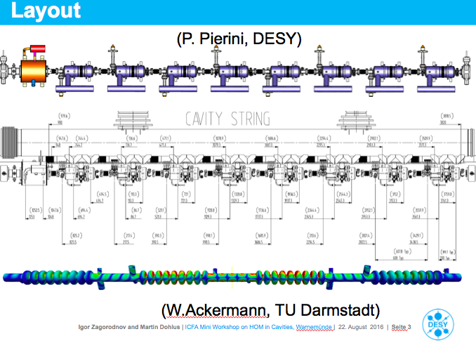
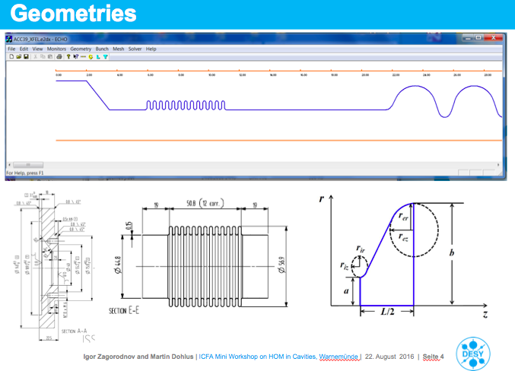
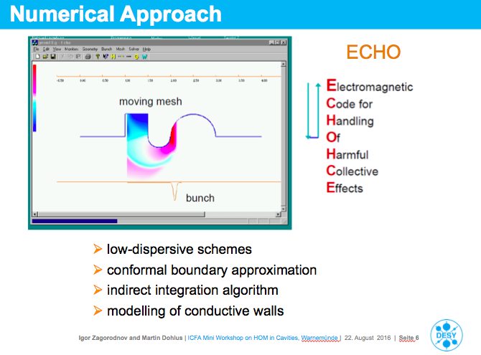
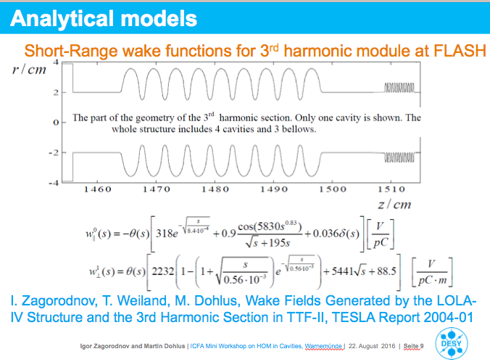
Novel Methods & Codes: ECHO2D/ECHO3D
See talk by –I. Zagorodnov and M. Dohlus

Slide 13
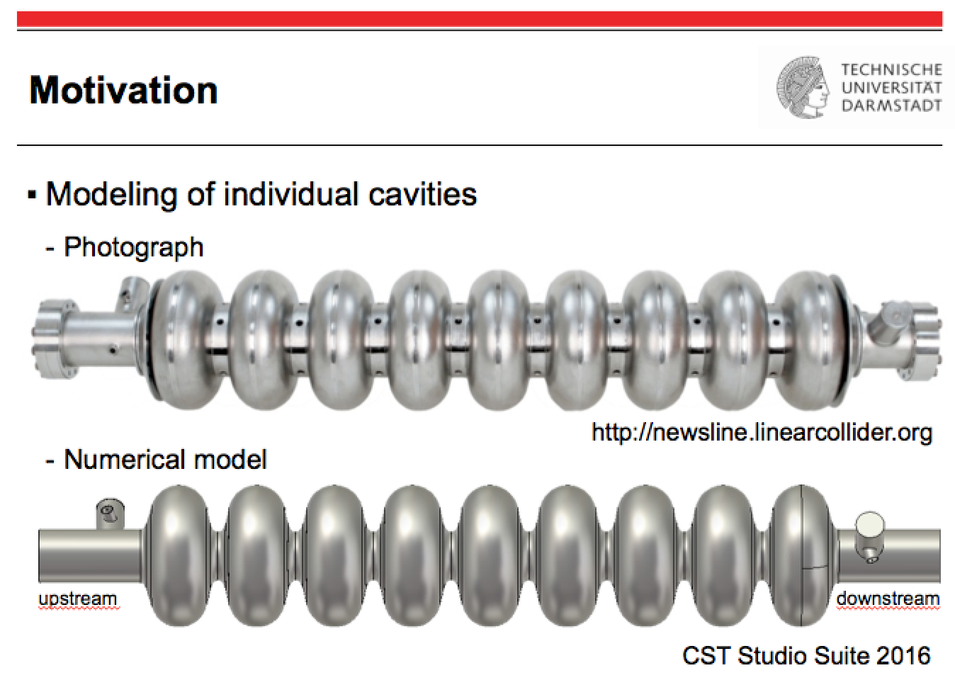
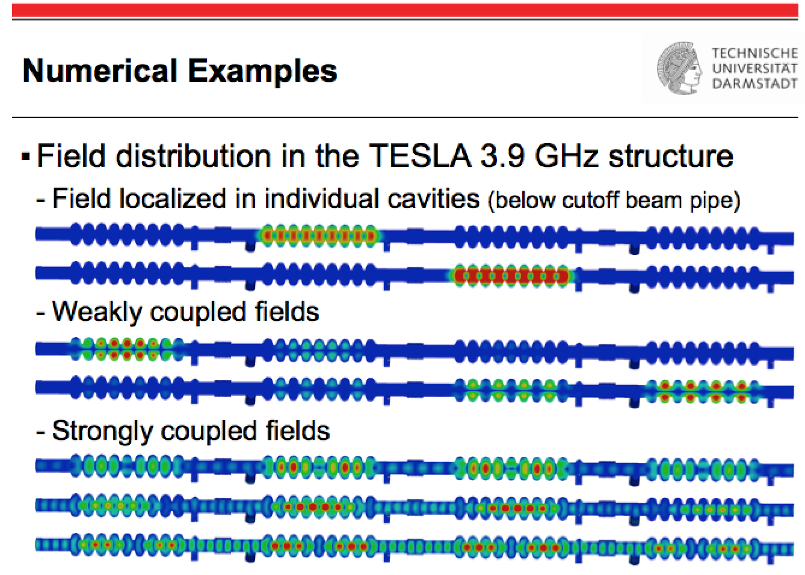
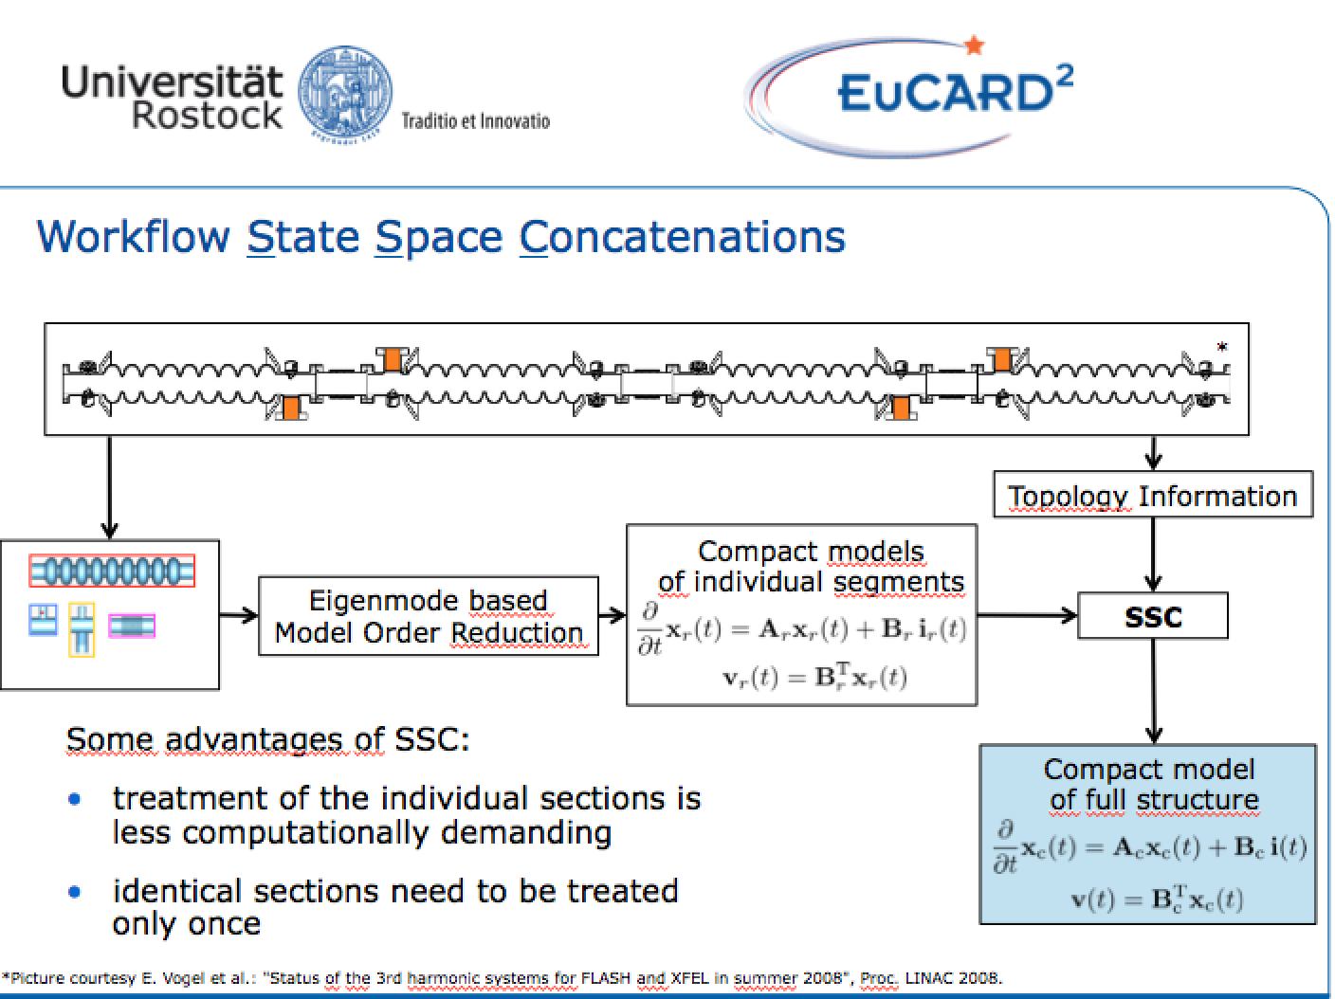
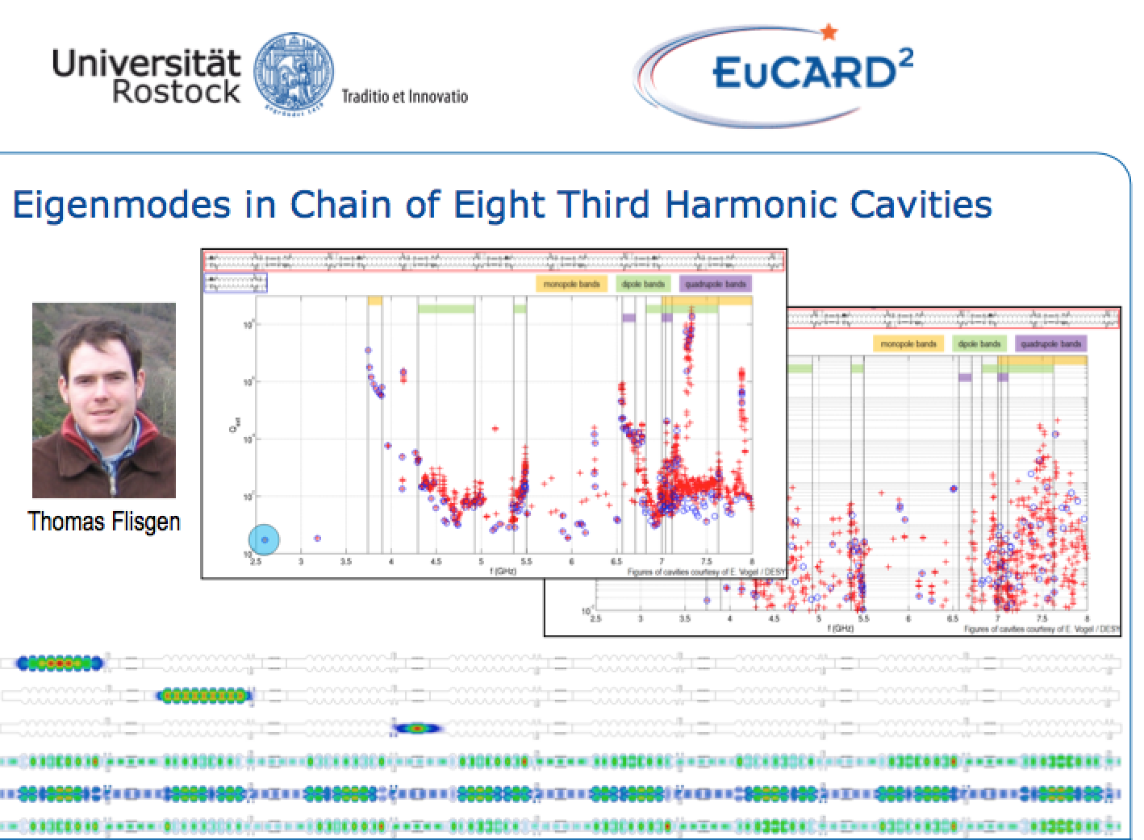
Novel Methods: Multi-Cavity Simulations
See talk by -W. Ackermann & T. Flisgen

Slide 14
Highlights
XFEL/FLASH (HOM Diagnostics & Simulation, Beam Dynamics)
ESS (HOMs and Beam Dynamics)

Slide 15
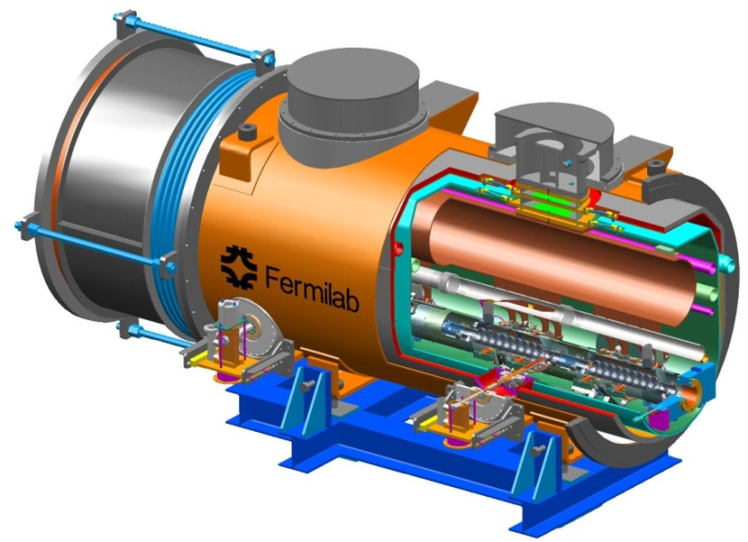
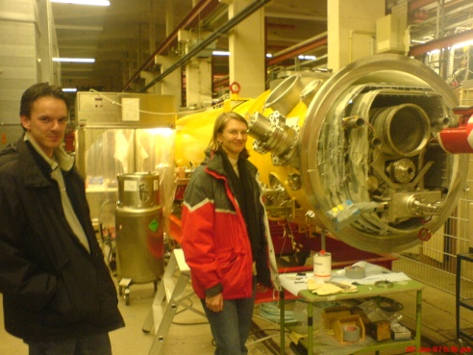
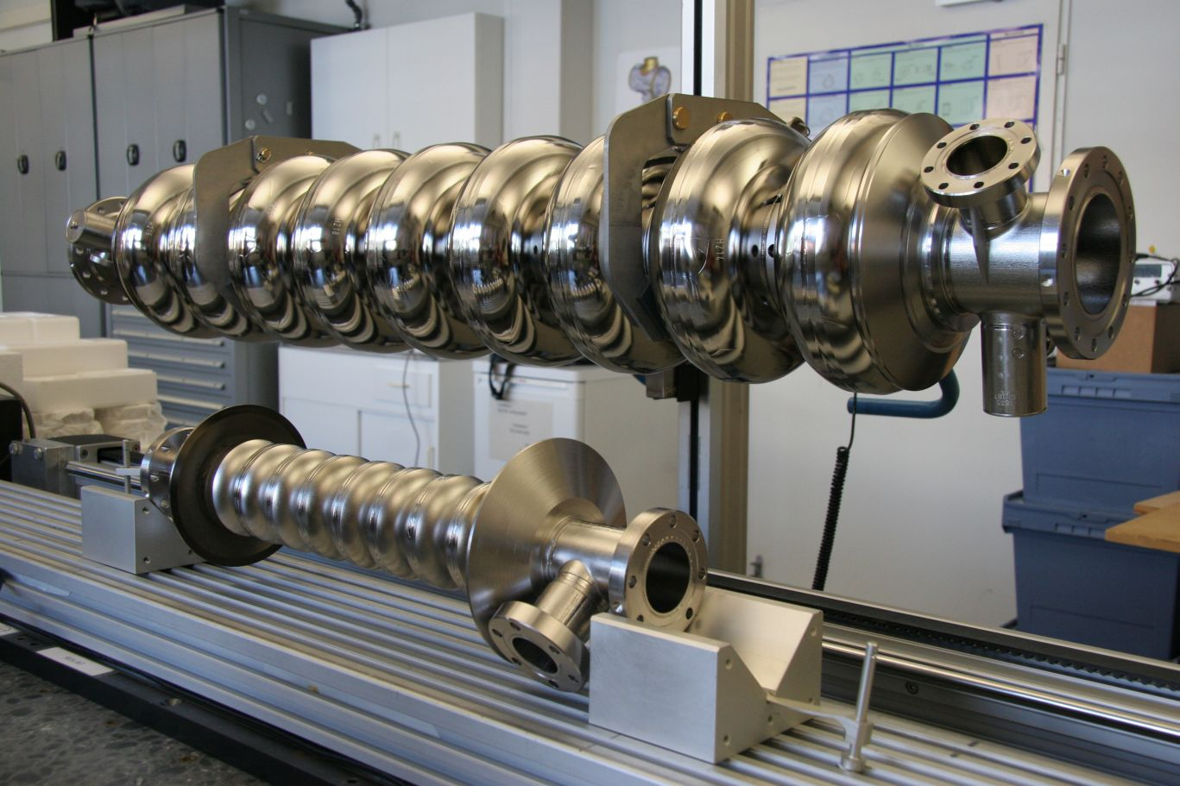
1. XFEL/FLASH

Slide 16

1.HOM Diagnostic in 3rd Harmonic Cavities at FLASH
Fermilab has constructed a third harmonic accelerating (3.9GHz) superconducting module and cryostat for a new generation high brightness photo-injector.
This system compensates the nonlinear distortion of the longitudinal phase space due to the RF curvature of the 1.3 GHz TESLA cavities prior to bunch compression.
The cryomodule, consisting of four 3.9GHz cavities, have been installed in the FLASH photoinjector downstream, of the first 1.3 GHz cryomodule (consisting of 8 cavities).
Four 3.9 GHz cavities provide the energy modulation, ~20 MV, needed for compensation.

Slide 17
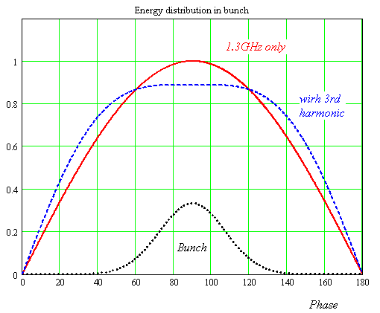
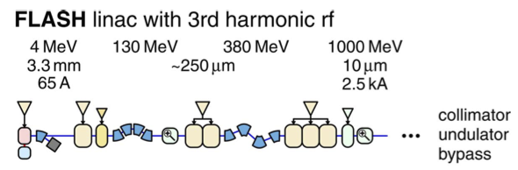
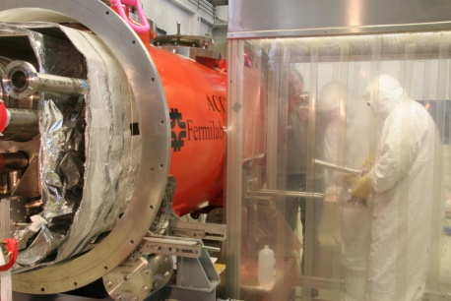
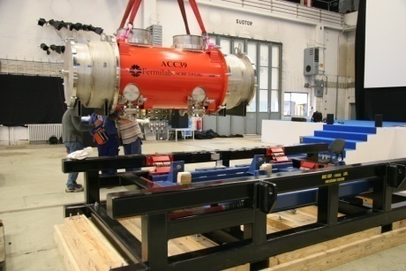
1. Third Harmonic (3.9 GHz) Parameters
Illustrative energy (not to scale)
Number of Cavities | 4
Active Length | 0.346 meter
Gradient | 14 MV/m
Phase | -179º
R/Q [=U²/(wW)] | 750 Ω
E_{peak}/E_{acc} | 2.26
B_{peak} (E_{acc} = 14 MV/m) | 68 mT
Q_{ext} | 1.3 X 10⁶
BBU Limit for HOM, Q | <1 X 10⁵
Total Energy | 20 MeV
Beam Current | 9 mA
Forward Power, per cavity | 9 kW
Coupler Power, per coupler | 45 kW
Adding harmonic ensures the 2nd derivative at the max is zero for total field (could use any of the harmonics in the expansion, but using the lowest freq. ensures the transverse wakefields ~ ω³ are minimised).
The third harmonic system (3.9GHz) compensates nonlinear distortion of the longitudinal phase space due to cosine-like voltage curvature of 1.3 GHz cavities.
It linearises the energy distribution upstream of the bunch compressor thus facilitating a small normalized emittance ~1.10⁻⁶ m*rad.
See talk by N. Baboi et al.

Slide 18
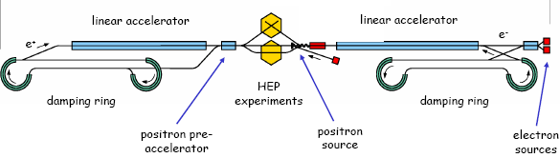
1.I HOMs in SCRF Cavities
Schematic of International Linear Collider (ILC)
~11km
~11km
http://www.linearcollider.org
Used at XFEL and FLASH. Baseline design for main accelerators in ILC.
TESLA cavity (1.3 GHz)
FPC Coupler
~1m
Used at XFEL and FLASH in order to flatten the field profile and reduce energy spread.
HOM Coupler
3rd harmonic cavity (3.9 GHz)

Slide 19
1.I Minimising Emittance Dilution and HOMBPMs
Source of Emittance Dilution
W_{t} , transverse wakefields for radial offset r :W_{t} ~ (r/a)³ (a iris aperture)
Stronger in 3.9 GHz than in 1.3 GHz cavities (each iris is a ~ 15 mm compared to 35 mm for TESLA).
Utilise Wakefields as Diagnostic
Sample HOMs to ascertain beam position (HOMBPM).
Move beam to minimise impact on itself and to align to electrical axis.
  Can also be used for measuring beam charge, phase etc.
See talk by N. Baboi et al.
Notes:
~ eight times larger…

Slide 20
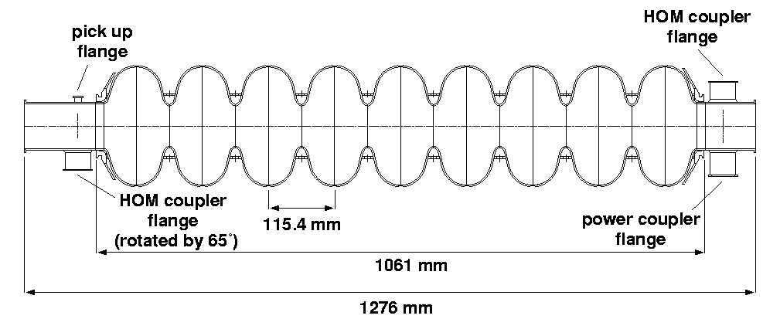
1.I XFEL/FLASH HOMs in SCRF Cavities
Task:
  Develop, build, test electronics for 3.9 GHz cavities
  Interpret signals and integrate in control system
  Measure cavity alignment
HOM-couplers
  At end of each cavity
  Enable monitoring the
  HOMs excited by beam
HOM-couplers (pick-ups)
TESLA cavity Illustrated
(similar features present in 3.9 GHz cavity)
See talk by N. Baboi et al.

Slide 21
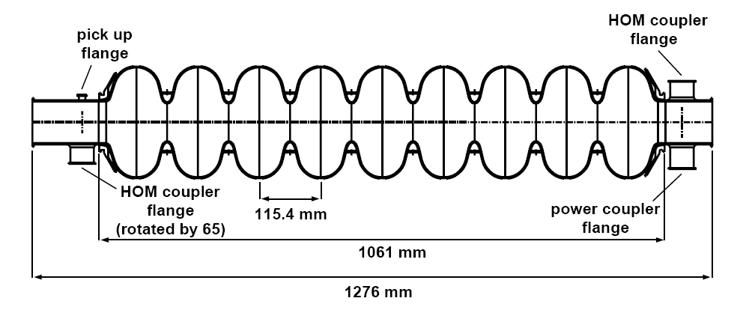

bunch compressors
bypass line
gun
undulators
FEL beam
ACC39
4 cavities within
3.9GHz Module
collimator section
dump
5 accelerating modules
with 8 cavities each
1.3GHz SC, typically 450-700MeV, 1 nC charge for FLASH/XFEL
HOMs generated in accelerating cavities must be damped.
Monitored HOMs facilitate beam/cavity info
Forty cavities exist at FLASH.
-Couplers/cables already exist.
-Electronics enable monitoring of HOMs (wideband and narrowband response).
Based on 1.3 GHz (CEA/SLAC/FNAL/DESY) Diagnostics –redesigned for ACC39 as part of EuCARD
See talk by N. Baboi et al.

Slide 22


1.I Response of HOM Modes to Beam
See talk by N. Baboi et al.

Slide 23


1.I Extant Work at 1.3 GHz:
HOM-BPMs in TESLA Cavities
HOM-BPMs at 1.3GHz cavities
  Use dipole mode at 1.7 GHz
  Installed in 5 accelerating
  modules (40 cavities)
  Calibration: with SVD technique
    problem: unstable in time
Beam Alignment in Modules
  Now routinely used in FLASH
Other studies
  Cavity alignment in cryo-module
  Beam phase measurement with monopole modes at ~2.4GHz
XFEL Plans:
  Install in some 1.3 GHz and in all 3.9 GHz cavities (8 per module)
See talk by N. Baboi et al.

Slide 24
1.I Analysis of Narrowband Signals –
Beam Position (Previous 1.3 GHz Study)
Resolution of position measurement.
  Predict the position at cavity 5 from the measurements at cavities 4 and 6.
  Compare with the measured value.
X resolution
  ~9 μm
Y resolution
  ~4 μm
See talk by N. Baboi et al.

Slide 25




1.I FLASH and ACC39
Free-electron LASer in Hamburg (FLASH)
Photo courtesy E. Vogel & DESY
See talk by N. Baboi et al.
Page 25

Slide 26


1.I ACC39 Spectra Measured in CMTB:
Focused on Dipole and Other Bands
For comparison: dipole band in TESLA cavity
Transmission matrix measurements made on all 4 cavities within ACC39.
See talk by N. Baboi et al.

Slide 27



1.I Band Structure
5th dipole band
Potential HOM Diagnostic Candidates (2nd band)
Potential HOM Diagnostic Candidates (5th band)
Resolution Issues
2nd Band consists of multi-cavity modes – provides resolution along module
5th Band modes are trapped – provides resolution along cavity (but with reduced overall resolution ~ R/Q)
See talk by N. Baboi et al.
Page 27

Slide 28


1.I FLASH S₂₁ Exp vs Simulations
Transmission through single cavity in chain.
Transmission through complete chain.
See talk by T. Flisgen & U. Van Rienen

Slide 29






5th Dipole Cavity Band
1.I 5th Dipole Cavity Band
localized!
hor. move
hor. move
vert. move
vert. move
† I.R.R. Shinton, et al., “Mode Distribution …”, CI Internal Note
See talk by N. Baboi et al.

Slide 30






1. XFEL S₂₁ Exp vs Simulations
S-parameters measured on 8-cavity chain module installed in the injector section, in superconducting state.
Input port: HOM-1 port on first cavity
Output measured at HOM-2 ports of Cavity-1 to Cavity-8.
Frequency step size 5kHz (Experiment), 500 kHz (simulation, 50kHz in narrow peak regions.)
Systematic shift observed and included in comparison together with additional amplitude loss of 10 dB observed in experiment (attributed to additional cable loss in experimental setup)
See talk by
–N. Joshi
VNA
P1
C1
P7F
C2
P6
P8
C3
P13F
C4
P12
P14
C5
P19F
C6
P18
P20
C7
P25F
C8
P24
P4
P2
P5
P10F
P9
P11
P15
P22F
P21
P23
P26
P3F
P16

Slide 31
1. XFEL/FLASH Remarks on HOMs
ACC1 HOM diagnostics successful & ACC39 linearises beam –HOM diagnostics ongoing as part of EuCARD2.
Third harmonic ACC39 module at FLASH consists of 4 coupled cavities (XFEL 8) within a module. Many of these modes propagate through the modules –a suite of simulations is being used to characterise the coupling and sensitivity to geometrical perturbations. Challenging to simulate accurately. Nonetheless, simulations of transmission is in good agreement with measurement (see T. Flisgen/U. Van Rienen talk).
HOM electronics at XFEL continue tests in 3.9 GHz cavities 2016 –for both beam phase and position measurement

Slide 32



2. ESS
European Spallation Source (ESS) is a collaboration of more than 17 countries
Experiment is based in Lund Sweden –2 GeV, 5 MW beam
At the forefront of neutron flux
Anticipated first beam in 2019
ESS is planned to be “green” - the energy used to power the machine will be recovered using on-site renewable energy sources

Slide 33



2. ESS –HOM Dispersion Curves and k_{loss}
β= 0.86 Elliptical Cavities (86 in Linac)
First 6 Monopole
Dispersion Curves
Banded Modal Loss Factors
In dispersion curves (left): blue points correspond to full cavity (model), and red to infinite periodic results (single cell)
Loss factor (right) are modal values
Focus on the 2 modes close to the synchronous point
These have the potential to be resonantly excited from random errors in fabrication -as they are within 2 MHz of the bunch frequency

Slide 34


2. ESS –Beam Dynamics Simulations
Q=10⁸
Q=10⁸
Utilising R. Ainsworth python code, subject the cavities to an RMS error of 2 MHz (expected from manufacturing) and track beam down complete linac whilst monitoring the emittance dilution (%) due to a single monopole HOM (1.410 GHz left, 2.465 GHz)
A single modal component is included in one cavity along the linac
Its frequency is shifted to be a multiple of the bunch frequency
Worst case regime –at present damping provided by fundamental mode couplers is not determined.

Slide 35


2. ESS –Beam Dynamics Simulations
R/Q
Q=10⁸
R/Q
Q=10⁸
Q=10⁶
Q=10⁶
Utilising R. Ainsworth python code, subject the cavities to an RMS error of 2 MHz (expected from manufacturing) and track beam down complete linac whilst monitoring the emittance dilution (%) due to a single monopole HOM (1.410 GHz left, 2.465 GHz)
A single modal component is included in one cavity along the linac
Its frequency is shifted to be a multiple of the bunch frequency
Worst case regime –at present damping provided by fundamental mode couplers is not determined.
Adding further damping manages the dilution but it is still significant –suggesting that cavities must be tuned to better than 2 MHz

Slide 36
Final Remarks
HOMs are still issues in LC and developing light sources.
HOMs in SC cavities is an active and vibrant field!
Based on earlier HOM-based measurements at FLASH (routinely used by operators), there is potential for implementation at XFEL –3rd harmonic cavities coupled in a module and initial simulations are encouraging.
ESS operation close to harmonic of HOM bunch prompts attention to tuning and manufacturing tolerances –further studies in progress to pin down the tolerances.
Improved understanding of HOM damping materials –both simulation & measurement

Slide 37
Acknowledgments
In addition to several ongoing collaborations , I am pleased to acknowledge direct contributions from S.H. Kim, H. Zheng, J. Zhai, J. Gao, S. De Silva, J. Delayen, T. Konomi, I. I. Zagorodnov , M. Dohlus, F. Reimann, W. Ackermann, T. Flisgen, N. Joshi, N. Baboi , T. Flisgen, U. Van Rienen

Slide 38

Thank you for your attention!
HOMSC16, ICFA Mini Workshop, Rostock-Warnemünde, 22th- 24th August 2016

Slide 39
Extra Slides

Slide 40


ESS Linac
Beam power (MW) | 5
Beam current (mA) | 62.5
Linac energy (GeV) | 2
Beam pulse length (ms) | 2.86
Repetition rate (Hz) | 14
Low energy section of the Linac is normal conducting taking the beam to 90 MeV
Superconducting Linac takes the beam to the final energy of 2 GeV
Three families of SC cavities working across a range of velocities
 | Num. of CMs | Num. of cavities
Spoke | 13 | 26
Medium β (6-cell) | 9 | 36
High β (5-cell) | 21 | 84
At 352.2 MHz bunch spacing means 1 Million bunches
Notes:
Early stages NC
Latter stages have three familier of SC Cavity
Focus on the SC section with example cavity as the high beta cavity

Slide 41




Direct Linear Regression
Direct Linear Regression
RSA
2nd dipole cavity band
Direct Linear Regression (DLR)
A: spectra matrix
B: beam position matrix
See talk by N. Baboi et al.

Slide 42




Singular Value Decompostion
RSA
Calib.
2nd dipole cavity band
Two steps
Valid.
See talk by N. Baboi et al.

Slide 43


