Slide 1
Reviews of Higher Order Modes Effects in LCLS-II Superconducting Linac
Arun Saini
ICFA Mini Workshop on High Order Modes in Superconducting Cavities
22-24 August 2016

Slide 2
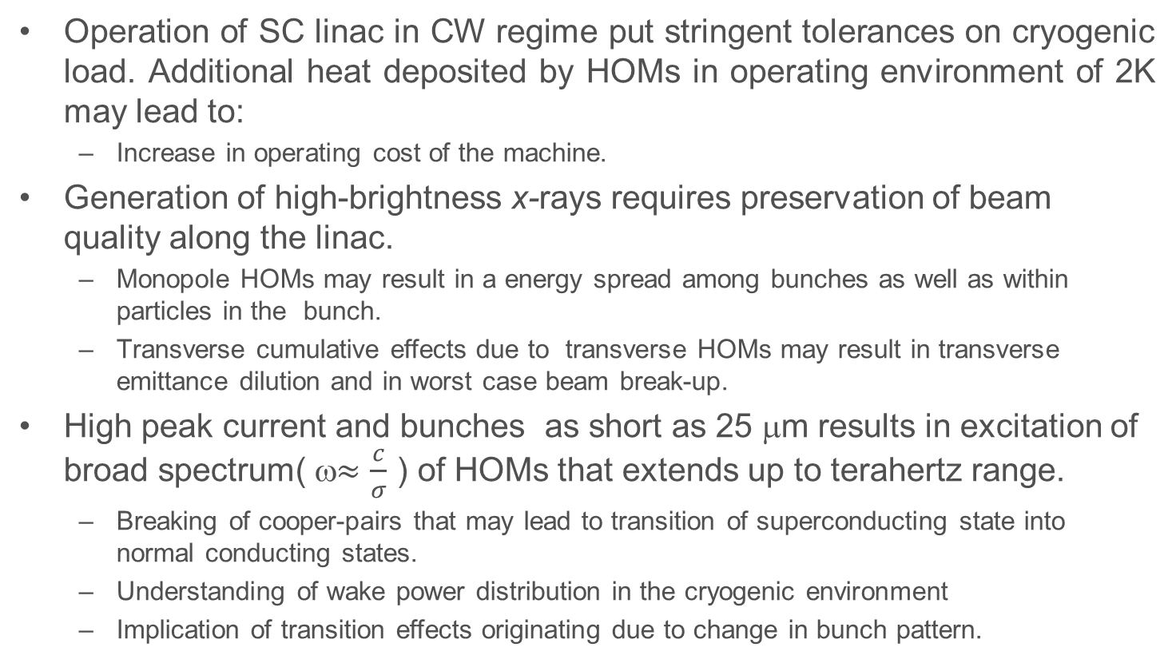
Motivation
Operation of SC linac in CW regime put stringent tolerances on cryogenic load. Additional heat deposited by HOMs in operating environment of 2K may lead to:
  Increase in operating cost of the machine.
Generation of high-brightness x-rays requires preservation of beam quality along the linac.
  Monopole HOMs may result in a energy spread among bunches as well as within particles in the bunch.
  Transverse cumulative effects due to transverse HOMs may result in transverse emittance dilution and in worst case beam break-up.
High peak current and bunches as short as 25 μm results in excitation of broad spectrum( ω$≈\frac{c}{σ}$ ) of HOMs that extends up to terahertz range.
  Breaking of cooper-pairs that may lead to transition of superconducting state into normal conducting states.
  Understanding of wake power distribution in the cryogenic environment
  Implication of transition effects originating due to change in bunch pattern.

Slide 3
Scope of Work
Wake power loss in LCLS-II SC linac
Understanding of power distribution of broad-range propagating HOMs.
  Diffusion Model.
  Wake decomposition model
Consequences of additional HOMs power deposition on the surface of superconducting cavity
  Cooper pair breaking due to Tera-Hertz propagating HOMs
Possibility of HOMs trapping and resonance excitation:
  Monopole modes
    Additional heating at operating temperature of 2K
  Dipole modes
    Transverse emittance dilution due to cumulative effects
Implication of transition effects :
  Longitudinal
  Transverse

Slide 4
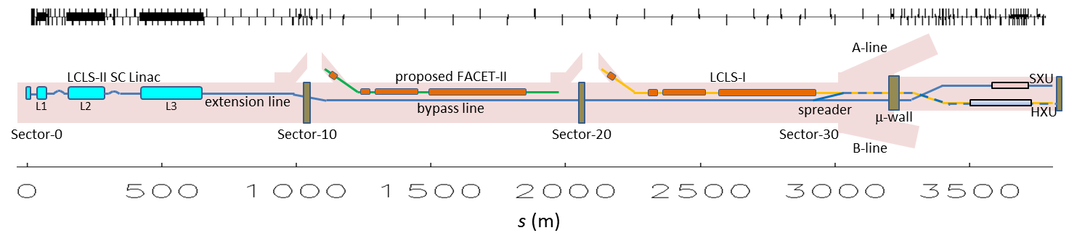
Linac Coherent Light Source-II
LCLS-I Linac
Undulators (LCLS-I & -II)
The Linac Coherent Light Source –II (LCLS-II) is a proposed fourth generation x-ray light source facility under construction at SLAC.
It is based on a new superconducting radio frequency linac that will operate in continuous wave (CW) mode and will deliver a 4GeV electron beam.
The SCRF linac will employ XFEL/ILC technology and will use 1.3 GHZ 9-cell SCRF cavity for beam acceleration.

Slide 5
LCLS-II SCRF Linac Architecture
PRD: LCLSII-2.4-PR-0041
On the basis of RF parameters and intermediate warm regions, LCLS-II SCRF Linac is mainly segmented into several sections.
All sections except HL are composed of 9-cell 1.3 GHz accelerating cavity. One cryomodule comprise eight cavities.
HL section is employed to compensate non-linearity in longitudinal phase space and composed of 3.9 GHz 9-cell cavity.
Section | V_{o} (MV) | Φ (deg) | Acc.Grad (MV/m) | CMs
L0 | 100 | ~0 | 16.3 | 1
L1 | 211 | -12.7 | 13.6 | 2
HL | -64.7 | -150 | 12.5 | 2
L2 | 1446 | -21.0 | 15.5 | 12
L3 | 2206 | 0 | 15.7 | 18
Lf | 202 | +/- 34 | 15.7 | 2

Slide 6
LCLS-II Linac Baseline Parameters
LCLSII-1.1-PR-0133, LCLS-II Parameters
Parameter | symbol | nominal | range | units
Electron Energy | E_{f} | 4.0 | 2.0 - 4.14 | GeV
Bunch Charge | Q_{b} | 100 | 10 - 300 | pC
Bunch Repetition Rate in Linac | f_{b} | 0.62 | 0 - 0.93 | MHz
Average e⁻ current in linac | I_{avg} | 0.062 | 0.0 - 0.3 | mA
Avg. e⁻ beam power at linac end | P_{av} | 0.25 | 0 - 1.2 | MW
Norm. rms slice emittance at undulator | γε_{⊥-s} | 0.45 | 0.2 - 0.7 | μm
Final peak current (at undulator) | I_{pk} | 1000 | 500 - 1500 | A
Final slice E-spread (rms, w/heater) | σ_{Es} | 500 | 125 - 1500 | keV
RF frequency | f_{RF} | 1.3 | - | GHz
Avg. CW RF gradient (powered cavities) | E_{acc} | 16 | - | MV/m
Avg. Cavity Q0 | _{Q0} | 2.7e10 | 1.5 - 5e10 | -
Photon energy range of SXR (SCRF) | E_{phot} | - | 0.2 - 1.3 | keV
Photon energy range of HXR (SCRF) | E_{phot} | - | 1 - 5 | keV
Photon energy range of HXR (Cu-RF) | E_{phot} | - | 1 - 25 | keV

Slide 7
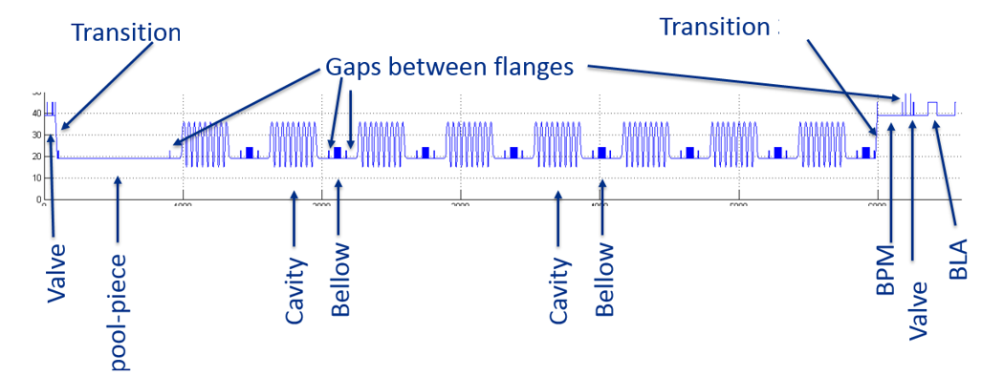
HOMs power generated in LCLS-II Linac
Schematic of Cryomodule consisting 8 nine-cell cavities
A cryomodule (CM) in the LCLS-II linac is composed of eight 9-cell SC cavities and quadrupole magnet. A beam line absorber (BLA) is also placed b/w two cryomodules.
When beam traverses through a CM in linac, its wake energy is radiated into modes that are much above cut-off frequency. They are named as un-trapped radiation.
Primary source of excitation of un-trapped radiation in the LCLS-II SC linac is irises of 9-cell cavities. Interconnecting bellows and beam pipe transitions also contributes in this process.
HOM power generated by beam is:
In LCLS-II, maximum HOMs power is generated for the case Q_{b}= 300pC and f_{rep} = 1MHz.

Slide 8
Steady State Wake Losses
LCLS-II TN-13-04: K. Bane et al
Loss factor (k_{loss} ) is estimated for L1, L2 and L3 sections using :
where s₀ =1.74 mm. Longitudinal bunch distribution is considered Gaussian.
For RMS bunch length of 1 mm, 0.25 mm, and 0.25 μm in L1, L2 and L3, loss factor is 86, 119 and 154 V/pC per cryomodule respectively. Loss factor in HL section is 151.6 V/pC per cryomodule.
HOM power generated for Q_{b}= 300pC and f_{rep} = 1MHz is 7.7, 10.7 and 13.8 W/CM in L1, L2 and L3 respectively.
HOM power generated in HL section is 13.6 W/CM .
In this presentation we address worst cases i.e. L3 section and HL section.

Slide 9
HOM power spectrum(1)
In order to understand distribution of power among the modes, HOM power spectrum calculated.
Wake potential is given as:
Analytically estimated wake potential is fitted to wake potential computed numerically (ECHO) by adjusting wake function.
Wake function for 1.3 GHz CM :
Wake function for 3.9 GHz CM :
* I. Zagorodnov, T. Weiland, “Wake Fields Generated by the LOLA-IV Structure and the 3rd Harmonic Section in TTF-II”, TESLA Report 2004-1

Slide 10
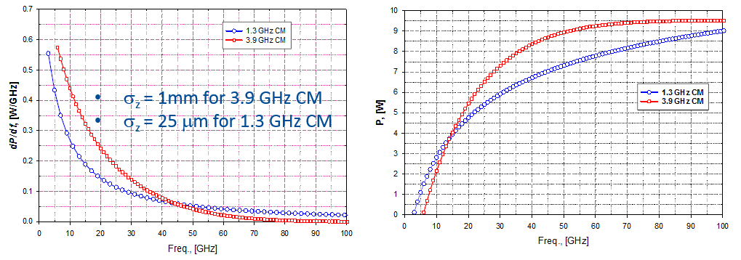
HOMs power spectrum(2)
Differential Power
Integrated Power
Propagating/un-trapped HOM power
HOMs power comprised in propagating/un-trapped modes is 12.8 W/CM and 9.5 W/CM for 1.3 GHz cryomodule in L3 section and 3.9 GHz cryomodule respectively.
In order to estimate total cryogenic heat load, a good understanding of power distribution of propagating modes is required.

Slide 11
Distribution of Un-trapped radiation
Power below cut off frequency is extracted by HOMs coupler
HOMs above cut-off propagates along the linac make several reflection on the surface of beamline elements.
Numerical estimation of propagating HOMs power (spectrum ranging up to tera-Hertz) is unfeasible.
A diffusion model is prepared to understand power distribution of propagating HOMs in LCLS-II linac.
Model is based on assumption that HOMs above cut-off frequency can be treated as photons gas uniformly distributed in a cryomodule..
It is also assumed that total wake power generated in a cryomodule is dissipated inside cryomodule.
  Assumption is valid in long cryostring arrangement.

Slide 12
Diffusion Model
Power absorption is proportional to impedance of element.
  S_{i}: Surface area of i^{th} element, i is type of element such as cavity, bellows, beam pipe etc; n: no of elements, ω :angular frequency, dP(ω)/dω :HOM spectral power, Re(Z_{i}(ω)) : real part of surface impedance.
Power absorbed by i^{th} type element is
Total Power losses in a cryomodule is P_{cryo} = 12.8 W for L3 section and 9.5 W for HL section .

Slide 13
Surface Impedance of Elements
BCS surface resistance is :
  Assuming surface impedances of cavity operating at 1.3 GHz at 2K is 5 nΩ
Surface impedance of steel is computed using:
  κ is electrical conductivity. We used κ = 1Ε+06 1/ Ωm for stainless steel.
Copper exhibits anomalous effects at 4K at higher frequencies.
  A = 3.3E-10 (W sec^{2/3}).

Slide 14
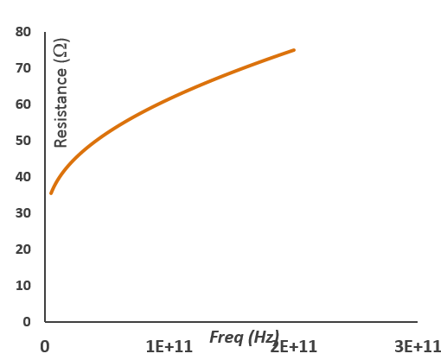
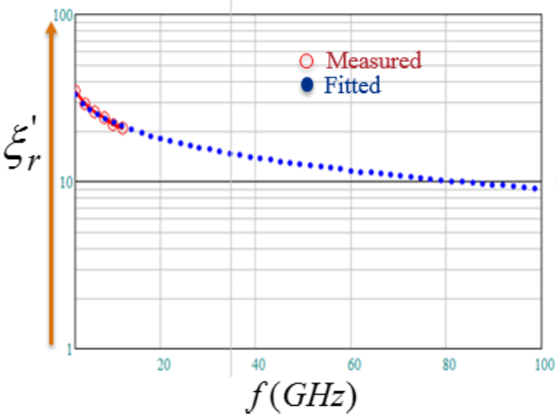
Surface Impedance of Absorber
Attenuation coefficient (α) in lossy medium is:
  where , are real and imaginary part of relative electrical permittivity and
  is relative permeability.
  STL-150D aluminum nitride ceramic is chosen for absorber material. Loss tangent for this material is >0.4 and < 30.
Absorber Impedance

Slide 15
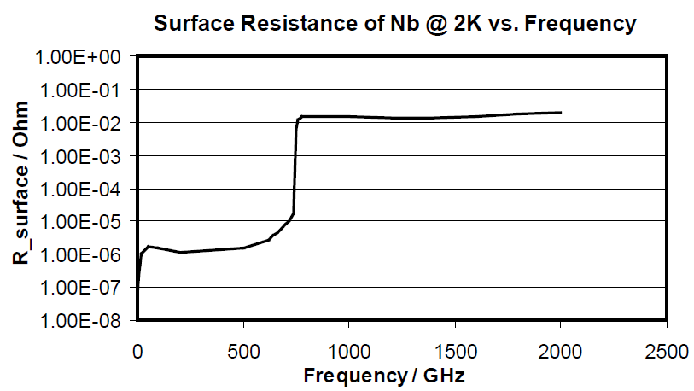
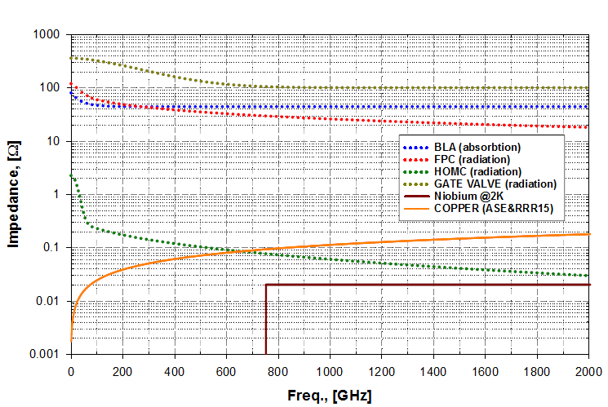
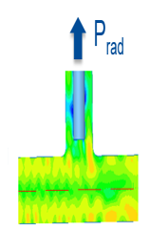
Variation in Surface Impedance with Frequency
Cavity Impedance
Impedance of other Elements
*Tesla2000-07, R. Brinkmann et al
Surface impedance of cavity is much smaller at frequency < 750 GHz.
A fraction of power is also radiated out through coupler port and gate valves. Their contributions are included and corresponding impedances are used in model for power loss distribution.

Slide 16
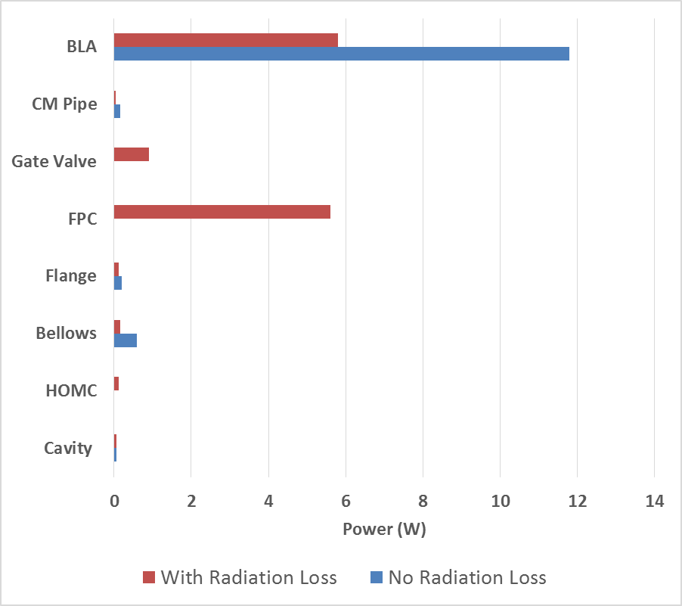
Distribution of Untrapped radiation in 1.3 GHz CM
  2 K : Cavities, Bellows, Flanges, Gate Valve, Cryomodule Beam pipes
  70 K: Absorbers,
 | P_{Cavity} | P_{HOMC} | P_{FPC} | P_{Bellows} | P_{Flange} | P_{BLA} | P_{GV} | P_{CM pipe}
n | 8 | 16 | 8 | 9 | 22 | 1 | 2 | 1
 | 0.07 | 0.13 | 5.6 | 0.16 | 0.2 | 5.8 | 0.9 | 0.05
Distribution of power losses (Watt) in Cryomodule
Power dissipation at 2K ( inside the cavity) is negligible.
If no radiation loss to the coupler ports and HOMs are considered, most of HOM power is deposited to the absorber at 70 K.
Power is uniformly distributed between fundamental power coupler (FPC) and absorber if radiation losses were included.
Most of power going to coupler is absorbed outside the operating environment.

Slide 17
Distribution of unstrapped radiation in 3.9 GHz section
Baseline layout of 3rd Harmonic section.
Third harmonic section consists of two 3.9 GHz cryomodules.
Each cryomodule consists of eight 9-cell 3.9GHz cavities.
Wake power loss per cryomodule is 13.6 W. Contribution of untrapped radiation is 9.4 W.
Un-trapped radiation will leak out from cryomodule ends.
  Diffusion model based on assumption that total HOMs power dissipated in CM provide overestimation.
Distribution of un-trapped radiation is estimated using two approach
  Modified diffusion model that assumed total wake power will be lost in the section.
  S-matrix based wake decomposition model.
CM1
BLA
CM2
BLA
SS Beam Pipe (L=2.5m)

Slide 18
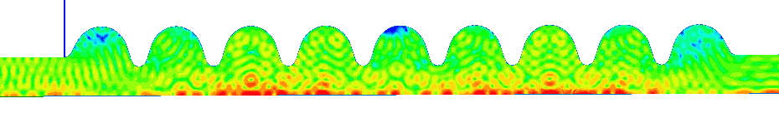
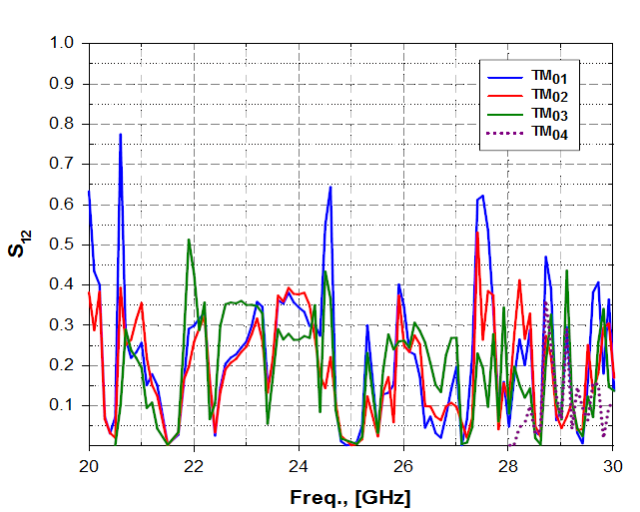
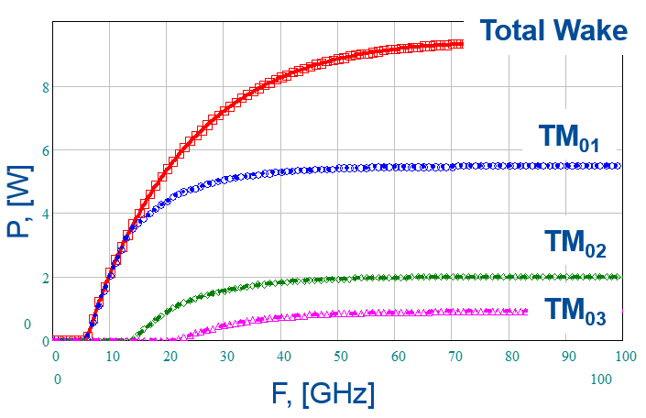
Wake decomposition model(1):
Model is based on the fact that wake fields can be decomposed into propagating modes.
  Assumed only monopole modes are excited by beam.
P_{inp} TM₀₁
P_{rad}
Wake power at a given frequency is expressed as:
  where N is no of propagating modes.
Most of the total wake power in 3.9 GHz CM is contained in first few modes.
Transformation of 20 GHzTM₀₁ mode passing through 3.9 GHz Cavity

Slide 19
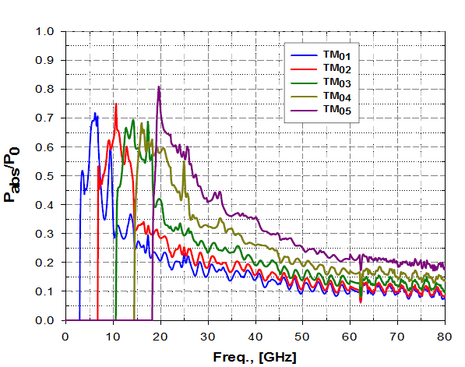
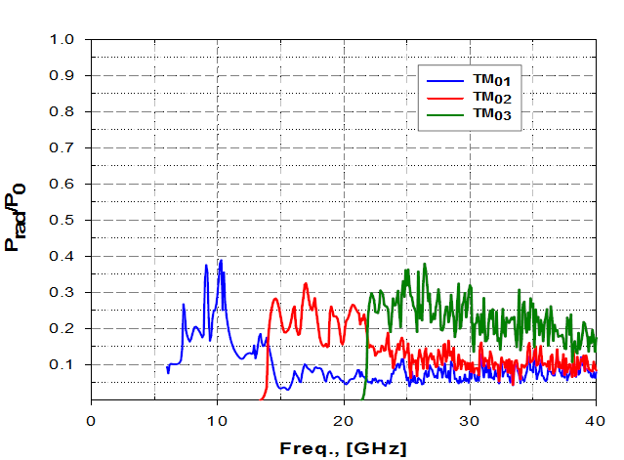
Wake Decomposition Model(2): Single Pass Absorption
Fraction of power absorbed by a element in a single pass of un-trapped radiation is
Single pass losses are computed numerically using HFSS for all elements in Cryomodules.
Beam Line Absorber
Fundamental Power Coupler
Component | BLA | FPC | Gate Valve | HOMC | Bellows (Cu-plated) | End Pipe (2.5 m, SS) |  | End Pipe (Ø32 mm, rad.)
1-pass loss, [%] | 42 | 23 | 2.7 | 1.6 | 0.2 |  | 11 | 41

Slide 20
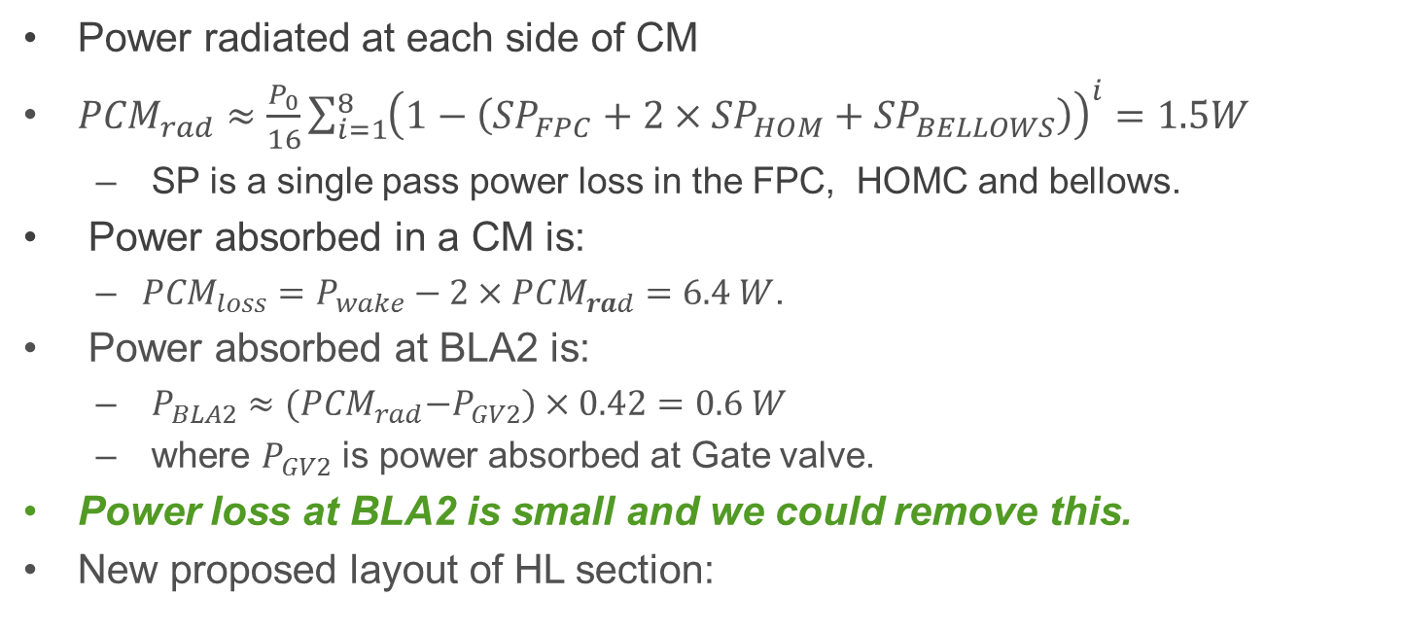
Wake Decomposition Model (3): Power loss in Cryomodule
CM1
BLA1
CM2
BLA2
SS Beam Pipe (L=2.5m)
Power radiated at each side of CM
${PCM}_{rad}≈\frac{P_{0}}{16}\sum_{i=1}^{8}{{\left(1−\left({SP}_{FPC}+{2×SP}_{HOM}+{SP}_{BELLOWS}\right)\right)}^{i}=1.5W}$
  SP is a single pass power loss in the FPC, HOMC and bellows.
Power absorbed in a CM is:
  ${PCM}_{loss}=P_{wake}−{2×PCM}_{rad}=6.4 W$.
Power absorbed at BLA2 is:
  $P_{BLA2}≈{(PCM}_{rad}−P_{GV2})×0.42=0.6 W$
  where $P_{GV2}$ is power absorbed at Gate valve.
Power loss at BLA2 is small and we could remove this.
New proposed layout of HL section:
CM1
BLA
CM2
SS Beam Pipe (L=2.5m)

Slide 21
Un-trapped Radiation Distribution in Third Harmonic Section
CM1
BLA1
CM2
BLA2
SS Beam Pipe (L=2.5m)
Components | # | Surface Area, [mm²] | Power Deposition, [W]
 |  |  | Wake Decomposition | Diffusion
BLA | 2 | 1.4e4 | 3.6 | 11.5
End Pipe (SS) | 1 | 6.2e5 | 0.12 | 0.6
End Pipe (Rad) | 2 | 804 | 1.1 | -
Bellows (Cu&SS) | 18 | 3.7e4 | 0.12 | 0.12
Gate Valve | 4 | 2.0e2 | 0.4 | 1.1
Spool Pipe (Cu) | 1 | 1.0e5 | 0.01 | 0.01
HOMC | 32 | 3.1e2 | 1.6 | 0.6
FPC | 16 | 7.1e2 | 12.0 | 5.0
Total Wake Power |  |  | 18.9 | 18.9
Wake decomposition model predicts a small fraction of power loss to BLA.
Most of power is intercepted before it reaches to BLA.
~1W power is leaked out from section.
Analysis allows to get rid of BLA2.

Slide 22
Implications of un-trapped radiation : Cooper Pair Breaking
Additional HOM power deposited on surface of superconducting cavity will result in an increase in wall losses
  Increase in Surface temperature (small ~ mK)
  Increase in fraction of unpaired electrons.
Cooper pairs are basis of superconducting state. In nominal conditions, number of Cooper pairs in penetration depth δ ~100 nm are:
where ΔE = 1.55x10⁻³ is band gap of niobium, Fermi energy, E_{f} =5.35 V, surface area of cavity S_{cav}=0.8m². n_{e} is density of normal conducting electrons = 2.3x10^{30 .} It yields N_{cooper} = 2.3x10¹⁹
Interaction of photons with Cooper pair at frequency above Cooper pair breaking threshold frequency, f_{cbp} = 750 GHz results in breaking of Cooper pairs.

Slide 23
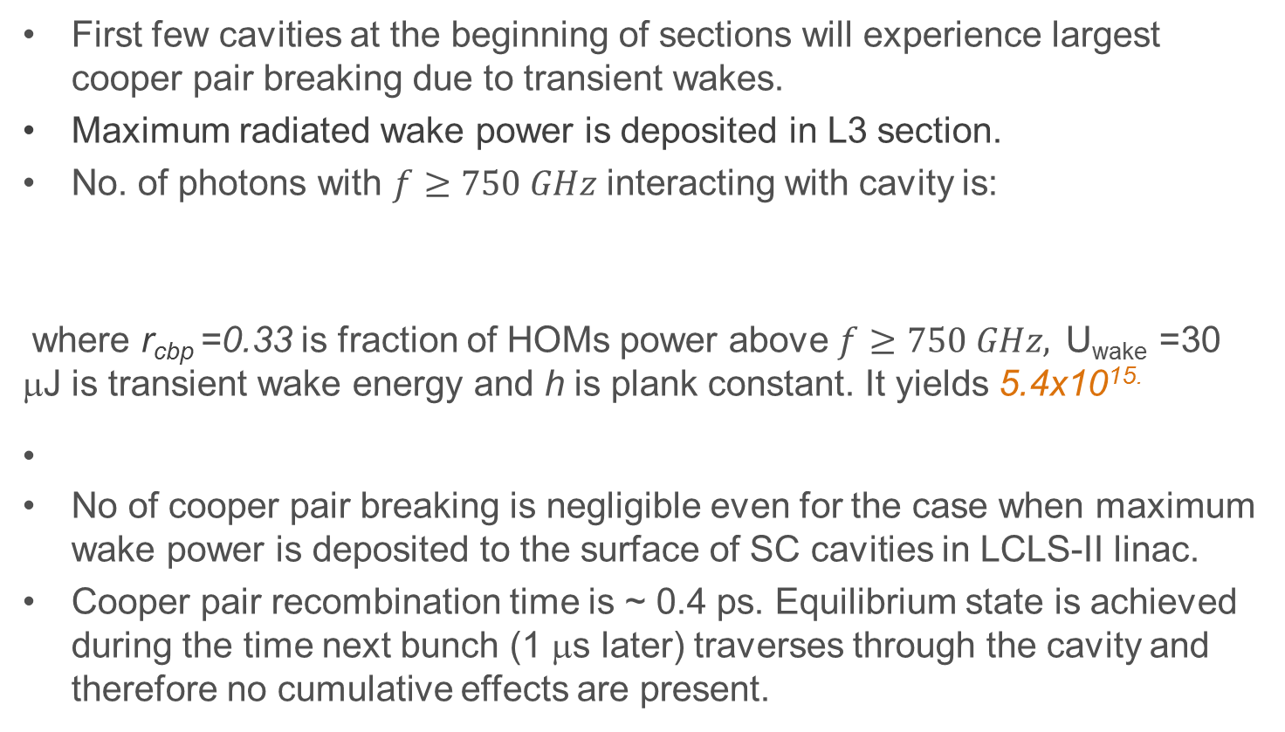
Cooper Pair Breaking(2)
First few cavities at the beginning of sections will experience largest cooper pair breaking due to transient wakes.
Maximum radiated wake power is deposited in L3 section.
No. of photons with $f≥750 GHz$ interacting with cavity is:
where r_{cbp} =0.33 is fraction of HOMs power above $f≥750 GHz,$U_{wake} =30 μJ is transient wake energy and h is plank constant. It yields 5.4x10^{15.}
No of cooper pair breaking is negligible even for the case when maximum wake power is deposited to the surface of SC cavities in LCLS-II linac.
Cooper pair recombination time is ~ 0.4 ps. Equilibrium state is achieved during the time next bunch (1 μs later) traverses through the cavity and therefore no cumulative effects are present.
Implications of Cooper pair breaking is minimum in LCLS-II SC linac

Slide 24
HOMs trapping and Resonance Excitation
HOMs Heating
Emittance Dilution
HOMs Modes below 12 GHz are considered.

Slide 25
Resonance Excitation and Trapping: HOMs Heating:
Total power dissipated at surface of the cavity due to HOMs excited by beam harmonics is given as:
I_{n} and ω_{n} : amplitude and frequency of beam harmonic.
ω_{p} : Angular frequency of p^{th} mode.
Q_{L} : Loaded quality factor for p^{th} mode.
Q₀: Cavity quality factor for p^{th} mode.
Power dissipated if the p^{th} mode is close to frequency of beam harmonic:
In order to estimate maximum power loss due to HOMs we use following approach:
  Maximum (R/Q) is computed by creating mode trapping conditions.
  A random RMS frequency spread of 1MHz in HOMs is introduced from cavity to cavity.

Slide 26
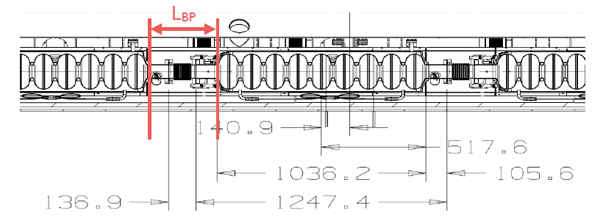
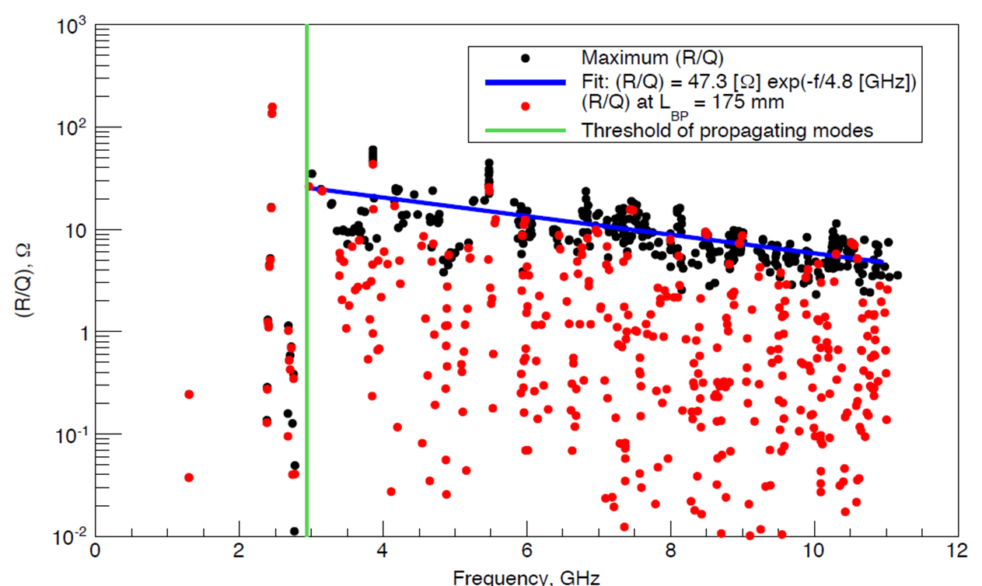
Maximum (R/Q) Estimation:
Propagating HOMs may form standing wave in a periodic arrangement of cavities and get trapped.
In order to find trapped modes, length of beam pipe connecting neighboring cavities is varied.
  Monopole modes up to 11 GHz are computed for 1.3 GHz 9-cell cavity
  A linear fit is obtained for maximum (R/Q) for respective modes.
  Those values are used for power loss estimation.

Slide 27
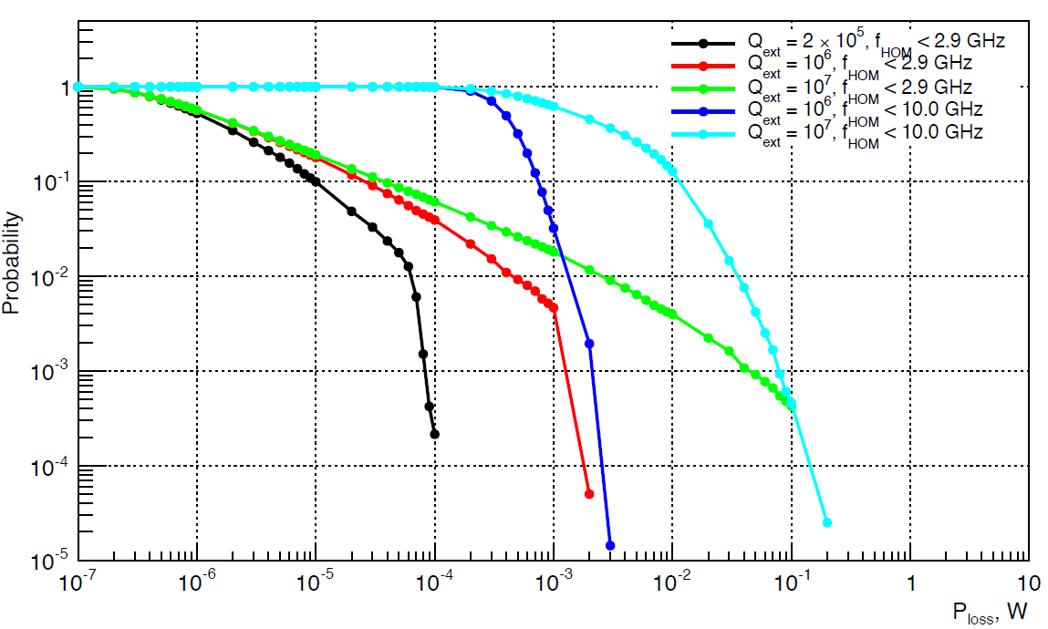
Power losses on surface of 1.3 GHz Cavity
Study is performed for 10^{5.} RMS frequency spread of 1MHz is applied cavity to cavity.
Results is presented in terms of complimentary cumulative distribution function.
Median losses (50 % probability ) for frequency up to 10 GHz is ~ 1mW for the case of Q_{ext} =10⁷ .

Slide 28
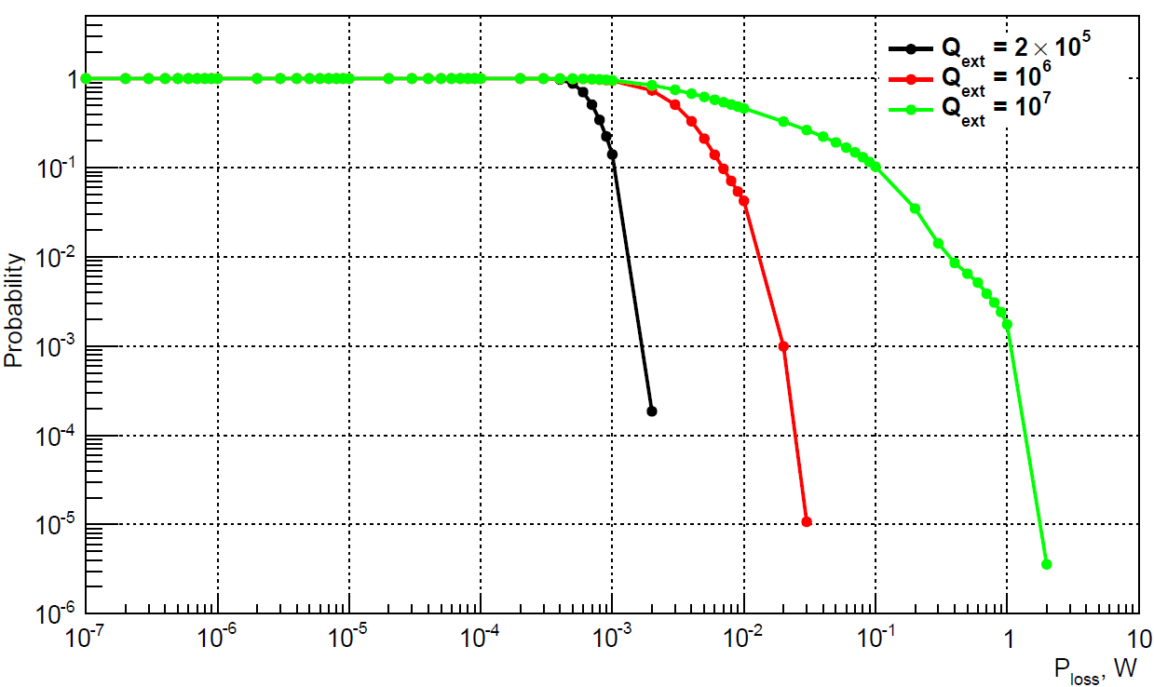
Power Losses on surface of 3.9 GHz Cavity
Similar approach is used to estimate power losses in 3.9 GHz cavity.
Median losses (50 % probability ) for frequency up to 10 GHz is ~ 10mW for the case of Q_{ext} =10⁷ .

Slide 29
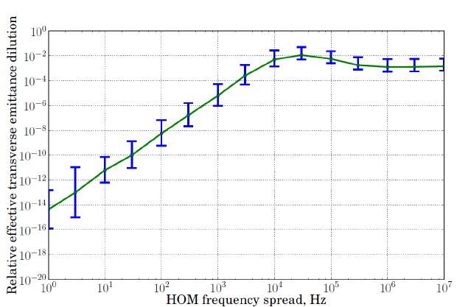
Dipole Modes Excitation: Cumulative Effects
A bunch passing through the cavity with an offset excites the dipole modes in cavity.
Dipole modes result in a transverse kick to the following bunches. Offset bunches further excites dipole.
Similar approach is used and study is performed to analyze maximum emittance dilution.
Emittance Dilution in L3 section
Maximum (R/Q) for dipole modes are computed by creating trapped mode conditions.
Cavity RMS misalignment of 0.5 mm is applied.
An RMS frequency spread of 1MHz in HOMs is introduced from cavity to cavity.
NO significant Impact in framework of LCLS-II SC Linac

Slide 30
Transition Effects:
Sudden interruption in bunch pattern will result a phase shift between HOMs fields and bunch arrival.
  Implication on
    Longitudinal dynamics
    Transverse dynamics
Switching from one undulator section to another and time to time beam delivery to diagnostic section will disturb regular bunch pattern in LCLS-II linac and therefore will result in the transition effects

Slide 31
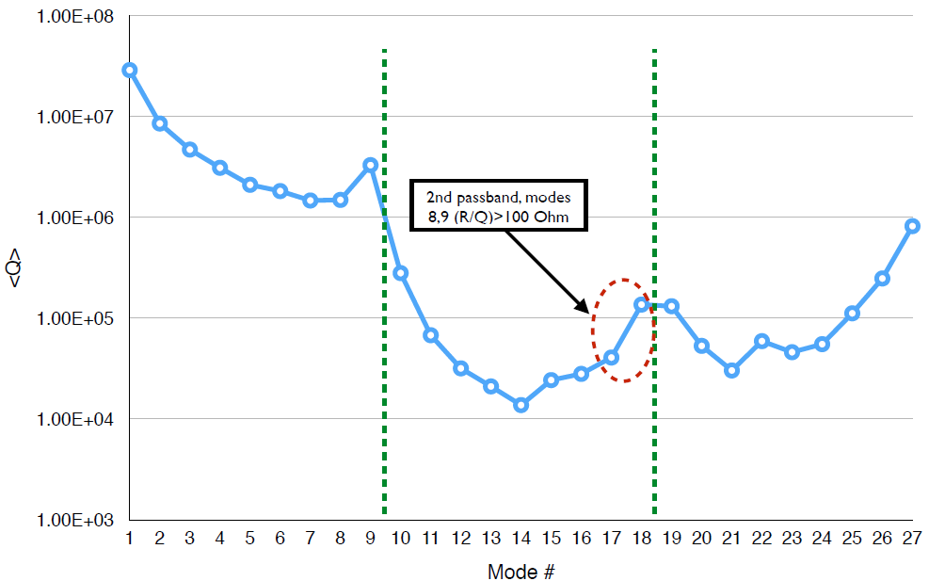
Transition Effect: Longitudinal
Voltage corresponds to i^{th} mode in a cavity is given as:
N^{th} bunch passing through the cavity see voltage:
Total voltage seen by Nth bunch can be obtained by summing over all excited modes.
400 modes are used in studies.
Quality factors for first three monopole passbands were measured at Fermilab.
Rest of modes we use Q_{ex,i}=10⁵

Slide 32
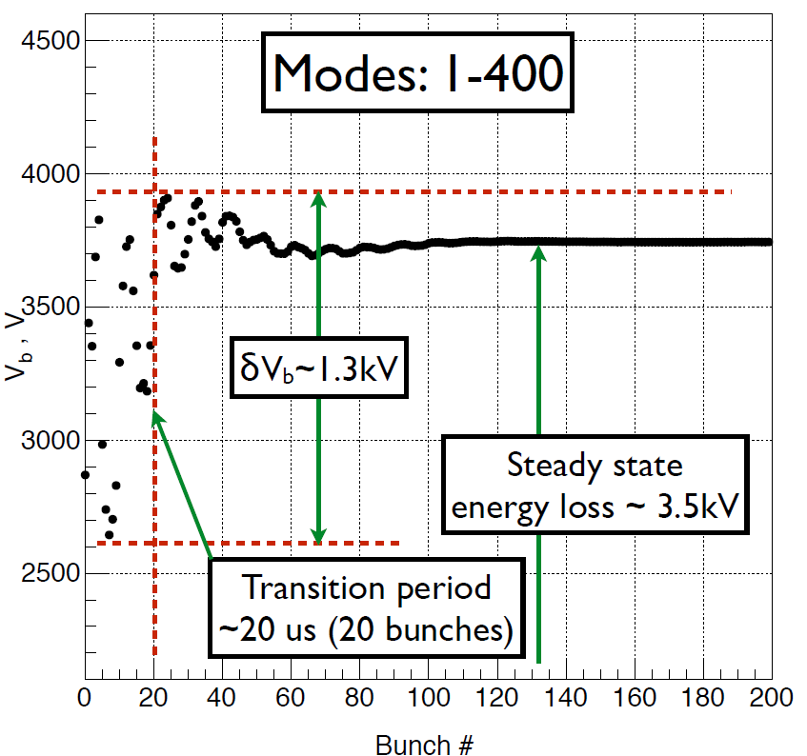
Transition Effects on Longitudinal Beam Dynamics
Energy variations among the 200 bunches at the end of L3 section are computed for first 400 modes in 1.3 GHz cavity.
Maximum bunch to bunch energy variation is 1.3 keV.
Steady state energy loss is 3.5 keV.
Laser Heater introduces RMS energy spread of 20 keV.
Bunch to bunch energy spread is within specification

Slide 33
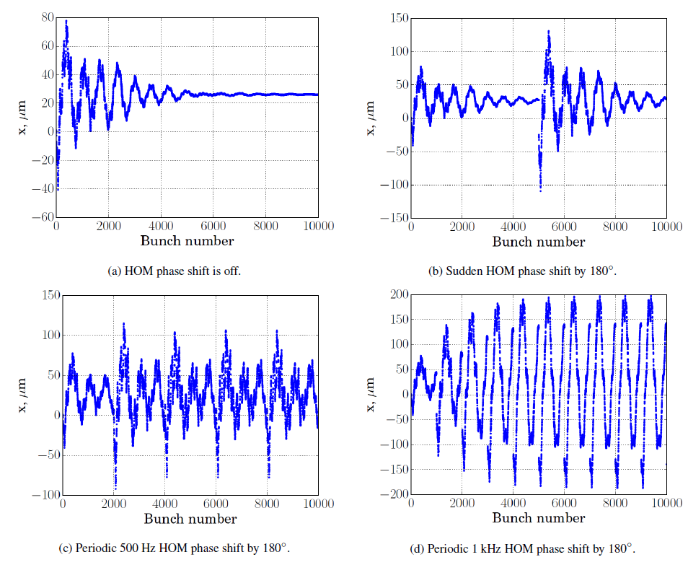
Transition Effects on Transverse dynamics
RF deflector operates at 325 MHz.
Beam phase is shifted by
  180⁰ at 325 MHz during switching to undulator section.
  360⁰ at 325 MHz for beam diagnostic.
A steady state is achieved with residual beam centroid shift in case of
  No beam phase shift
  Beam phase shift interval is longer (5ms).
Fast periodic beam phase shift results in
  Beam centroid oscillation with large amplitude die to correlation in transition effects from each shift.
A beam centroid shift of 200 um for periodic beam phase shift with 1kHz rate satisfies LCLS-II specification.
Transverse beam centroid of bunches
Beam centroid shift as large as 5 mm can be corrected using steering correctors:
LCLSII-TN-14-03, A.Saini et al, Studies of Misalignment Tolerances for SC Linac of LCLS-II.

Slide 34
Summary
Bunch with total charge of 300pC and RMS length of 25 μm will result in HOM power losses of 13.8 W and 13.4 W per cryomodule in L3 and HL sections respectively.
  HOMs losses are included in cryogenic budget and LCLS-II cryomodules are capable to deal with those losses.
Distribution of un-trapped radiation power is analyzed using two approaches
  Diffusion model and Wake decomposing model.
    HOMs power deposited to cavity is negligible.
    A significant HOMs power is radiated out through coupler ports.
Implications of resonance excitation were studied for worst cases
  HOMs power dissipation in cavity is below 10 mW even for Q_{ext} =10^{7.}
  Maximum emittance dilution is below 10 % in L3 section
Transition effects have been addressed.
  A steady state energy loss is 3.5 keV
  Maximum beam centroid shift for periodic beam phase shift at the rate of 1kHz is 200um.

Slide 35
Acknowledgement
A. Lunin, A. Sukhanov, N. Solyak, V. Yakovlev and entire LCLS-II SRF Team

Slide 36
Back-up Slides

Slide 37
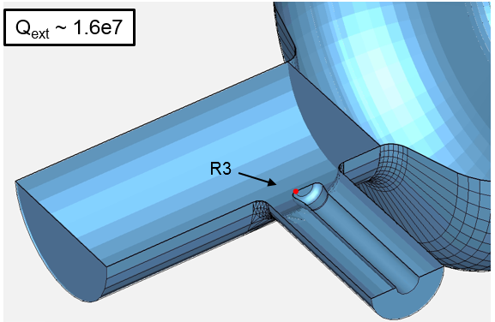
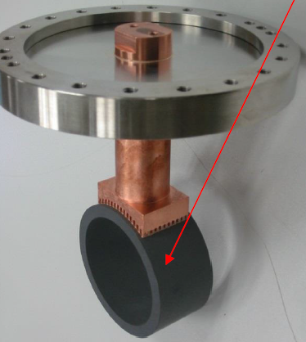
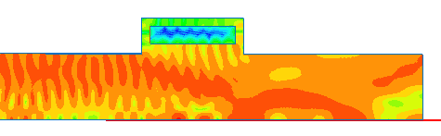
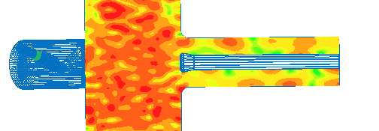
Wake transmission (single pass) through beam line components
FPC wake loss is ~ 9%
BLA wake loss is ~ 42%
HFSS Driven Modal (20 GHz)
P_{rad}
P_{inp} TM₀₁
P_{inp} TM₀₁

Slide 38
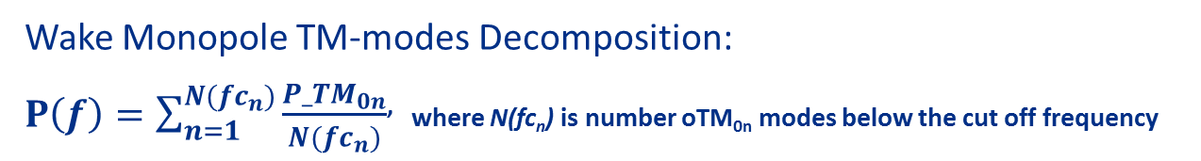
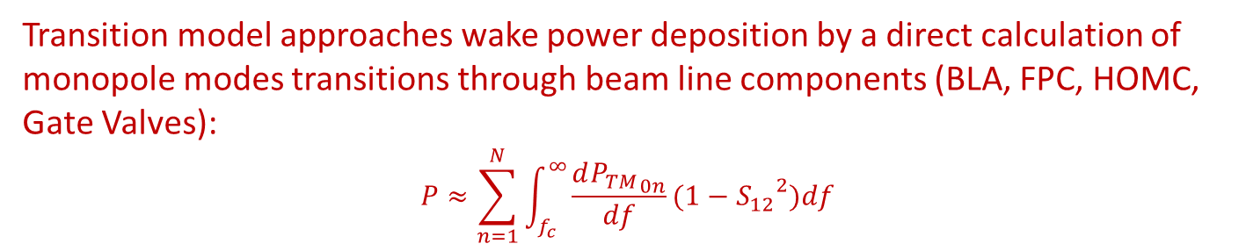
Wake Power Deposition (Transition Model)
Total Wake
dP/df, [W/GHz]
P, [W]
TM₀₁
TM₀₂
TM₀₃
F, [GHz]
Wake Monopole TM-modes Decomposition:
$P\left(f\right)=\sum_{n=1}^{N({fc}_{n})}{\frac{{P_TM}_{0n}}{N({fc}_{n})}}$, where N(fc_{n}) is number oTM_{0n} modes below the cut off frequency
F, [GHz]
Transition model approaches wake power deposition by a direct calculation of monopole modes transitions through beam line components (BLA, FPC, HOMC, Gate Valves):
$$P≈\sum_{n=1}^{N}{\int_{f_{c}}^{∞}{\frac{d{P_{TM}}_{0n}}{df}(1−{S_{12}}^{2})df}}$$

Slide 39

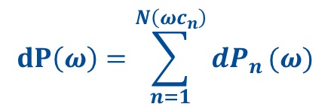
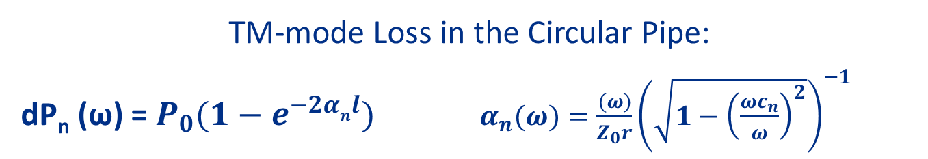
Wake Power Deposition (Diffusion Model)
TM-mode Loss in the Circular Pipe:
dP_{n} (ω) = $P_{0}(1−e^{−2αnl})$ ${ α}_{n}(ω)=\frac{(ω)}{Z_{0}r}{\left(\sqrt{1−{\left(\frac{{ωc}_{n}}{ω}\right)}^{2}}\right)}^{−1}$
HFSS Simulations
$$dP\left(ω\right)=\sum_{n=1}^{N\left({ωc}_{n}\right)}{{dP}_{n}}(ω)$$
$$2πrl_{n}=S_{n}$$
where, S_{n} is the area of lossy (radiating) surface and l_{n} is the length of a beam pipe with an equivalent impedance Z(ω)
We can derive the equivalent surface impedance Z(ω) for beam line components !

Slide 40
Wake Power Deposition in the 1.3 GHz Cryomodule (Diffusion Model)
Components | # | Surface Area, [mm²] | Power Deposition, [W/CM]
 |  |  | Cu Bellows | SS Bellows
BLA | 1 | 1.4e4 | 5.8 | 5.1
Cavity (Nb) | 8 | 9e5 | 0.07 | 0.04
Flanges (SS) | 18 | 2.4e3 | 0.13 | 0.12
Bellows (Cu&SS) | 9 | 6.4e4 | 0.16 | 1.7
Gate Valve | 2 | 2.0e2 | 0.9 | 0.8
Spool Pipe (Cu) | 1 | 2.2e5 | 0.05 | 0.04
HOMC | 16 | 1.3e3 | 0.13 | 0.12
FPC | 8 | 1.3e3 | 5.6 | 4.9
Total Wake Power |  |  | 12.8 | 12.8
Non-plated SS bellows intercept < 2 W/CM of wakefield power
About 43% of wake power is radiated to FPC & HOMC couplers!

Slide 41
Power Losses Distribution in One 3.9 GHz Cryomodule
Total Power Deposition: 9.5 W

Slide 42
Wake Power Deposition (Diffusion Model)
Wake Loss in the 3rd harmonic section
Components in 2 CM’s | Power Deposition, [W]
 | A (baseline) |  | B | C
 | w/o HOM&PC | with HOM&PC | with HOM&PC | with HOM&PC
BLA (1 or 2) | 16.2 (per 2) | 13.5 | 10.5 | 14.5
SS end-pipe 2.5m (1) | 1.65 | 1.4 | 2.2 | 0.07
Bellows (17) | 0.36 | 0.3 | 0.4 | 0.27
Gate Valve (4) | 0.6 | 0.45 | 0.7 | 0.5
Spool Pipe (2) | 0.02 | 0.02 | 0.03 | 0.02
HOMC (32) | 0 | 0.5 | 0.75 | 0.5
FPC (16) | 0 | 2.7 | 4.1 | 2.8
Total power | 18.8

Slide 43
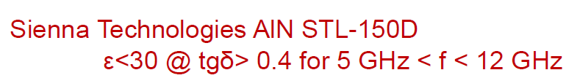
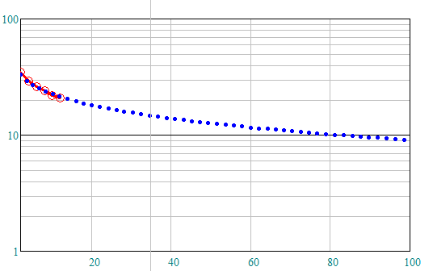


Beam Line Absorber properties
$$ε.re\left(f\right)≈73e^{−0.66f^{0.25}}$$
$$\tan\left(∆\right)=0.4=const$$

Slide 44
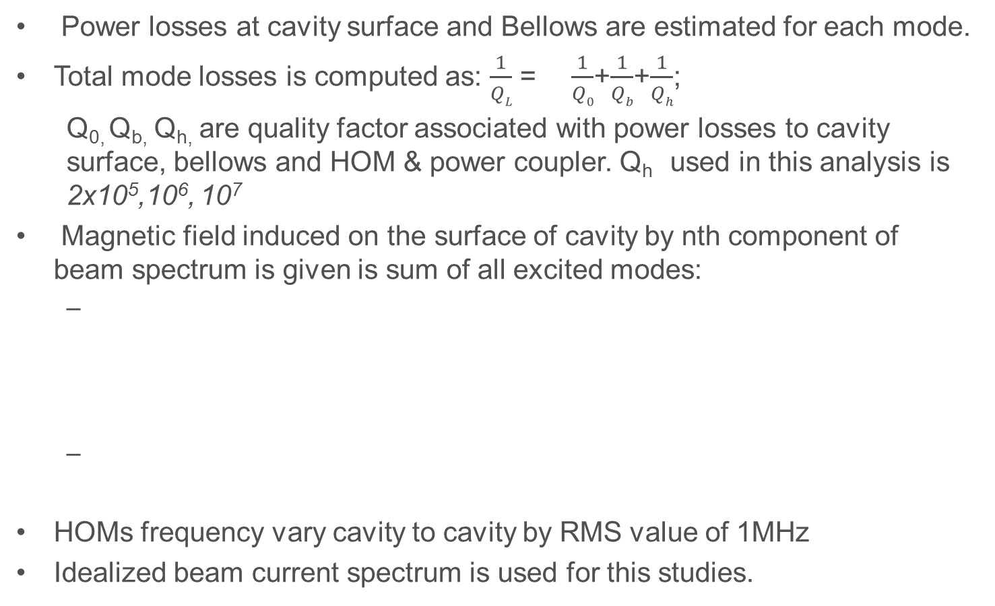
Model for HOMs Trapping and Resonance Excitation in LCLS-II SC linac(2)
Power losses at cavity surface and Bellows are estimated for each mode.
Total mode losses is computed as: $\frac{1}{QL}$ = $\frac{1}{Q0}$+$\frac{1}{Qb}$+$\frac{1}{Qh}$;
  Q_{0,} Q_{b,} Q_{h,} are quality factor associated with power losses to cavity surface, bellows and HOM & power coupler. Q_{h} used in this analysis is 2x10⁵,10⁶, 10⁷
Magnetic field induced on the surface of cavity by nth component of beam spectrum is given is sum of all excited modes:
HOMs frequency vary cavity to cavity by RMS value of 1MHz
Idealized beam current spectrum is used for this studies.
: is simulated magnetic field for pth mode.
I_{n} and ω_{n} : amplitude and frequency of beam harmonic.
W_{p} :is energy stored in cavity.

Slide 45
Maxodel for HOMs Trapping and Resonance Excitation in LCLS-II SC linac(1)
RF Simulation is performed using SuperLANS to compute (R/Q) and fields corresponding to particular mode.
  Monopole modes up to 11 GHz are computed for 1.3 GHz 9-cell cavity
    Cut-off frequency of monopole modes is 2.94 GHz
Propagating HOMs may form standing wave in a periodic arrangement of cavities and get trapped.
In order to find trapped modes, length of beam pipe connecting neighbouring cavities is varied.
In order to find worst case, maximum (R/Q) is used to estimate power losses.

Slide 46
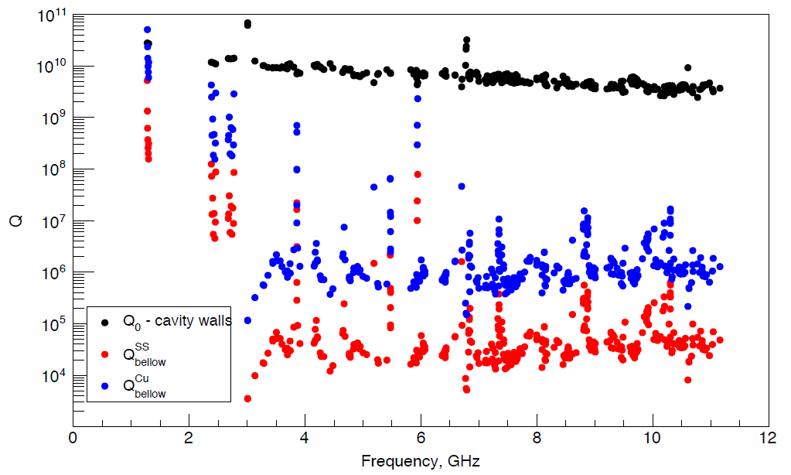
Quality factor of cavity and bellows for modes ~11GHz

Slide 47
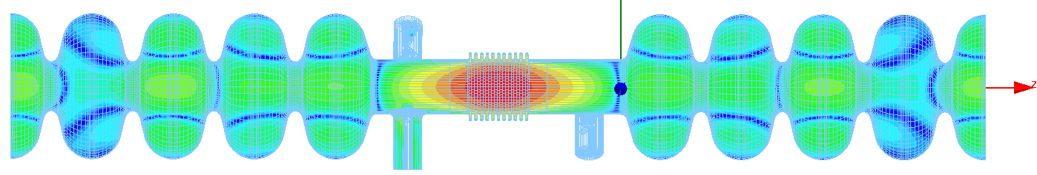
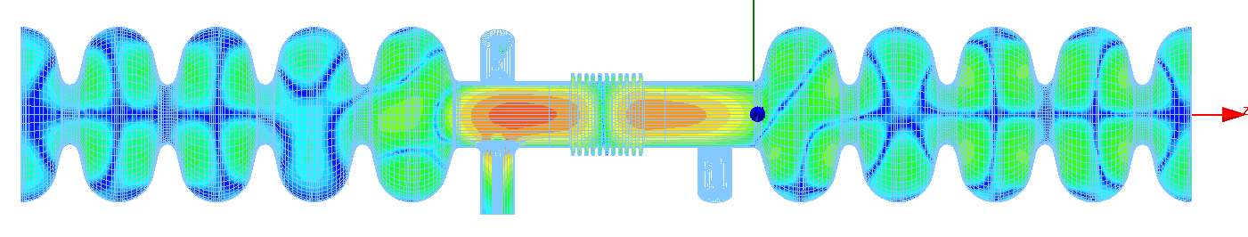
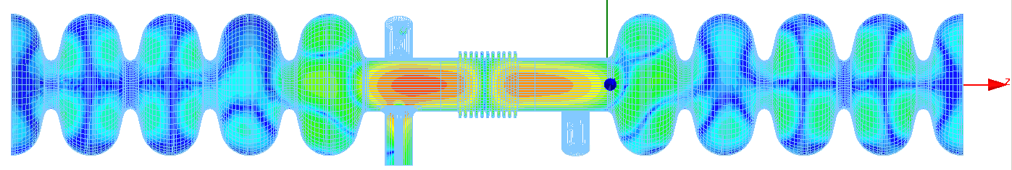
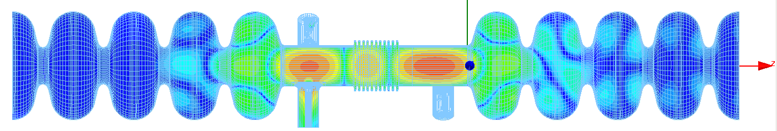
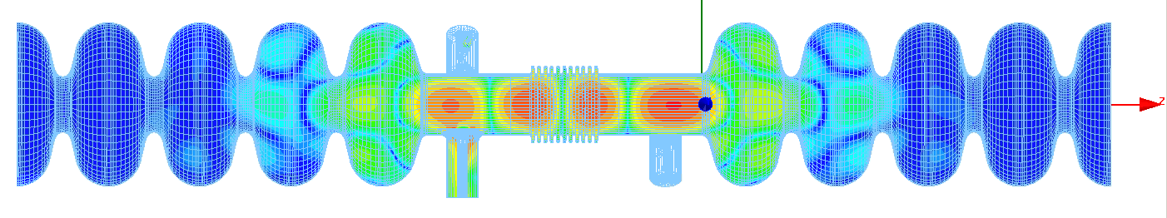
Resonant Losses in bellows due to Monopole HOMs
# | Freq. [GHz] | R/Q , [Ω]* | Q_{ext} | Resonant P_{loss} [mW]
1 | 2.737 | 1.5 | 3.2e4 | 4.8e-3
2 | 2.9682 | 1.6 | 1.8e4 | 2.9e-3
3 | 2.9683 | 1.5 | 1.7e4 | 2.6e-3
4 | 3.044 | 1.2 | 2.0e4 | 2.4e-4
5 | 3.169 | 2.7 | 8.0e3 | 2.2e-4
Trapped Monopole HOMs in bellows (3D)
#1
#2
#3
In a worse case one can estimate R/Q < 10 Ω and Q_{ext} < 1e5, then the max possible coherent RF loses are: P_{max} = R/Q*Q*I ≈ 10*1e5*1e-7 ≈ 0.1 W
Losses from operating mode (16MV/m) P_{bellow_SS} = ω*W/Q_{bellow_SS} ≈ 0.2 W P_{bellow_Cu} = ω*W/Q_{bellow_SS} ≈ 0.002 W
#4
#5

Slide 48
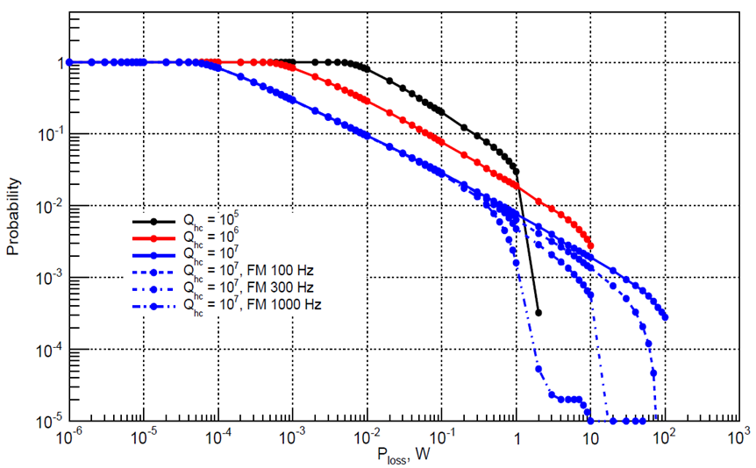
Maximum RF power in HOM coupler
1.3 GHz Cavity
3.9 GHz Cavity
Median P <5W
Only Non-propagating modes (f<2.9 GHz)
Random variation of HOM frequencies with 1 MHz R.M.S.

