Slide 1
Acceleration of Graph Neural Networks using compiler-supported high-level synthesis tools
Shen Shao
Supervisor: Prof. Dr.-Ing Dr. h. c. Jürgen Becker

Slide 2

Shen Shao
Major: ETIT
Email: urtoy@student.kit.edu

Slide 3
Goal:
use Hardware to accelerate GNNs
Graph data Structure
Common HLS tools:
HLS4ML for DNN/Edge Classifier
FINN for DNN
small functional modules
3. Compiler-based HLS-Tools （ScaleHLS)

Slide 4
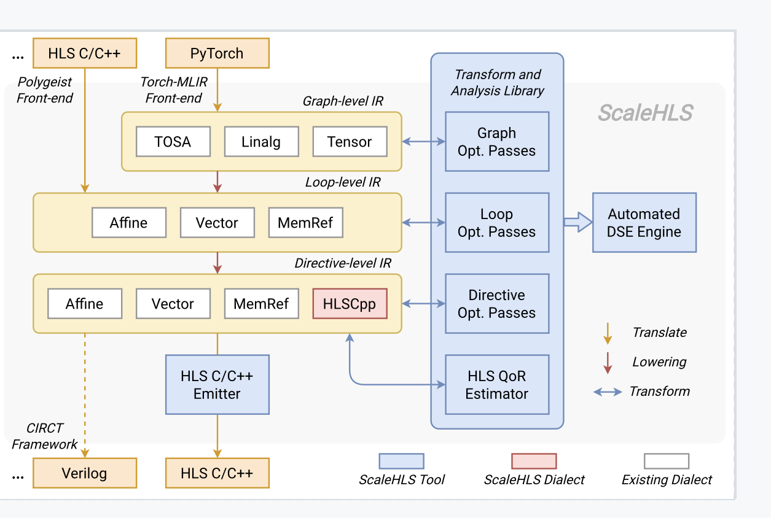
ScaleHLS
On top of a multi-level compiler infrastructure called MLIR
(Multi-Level Intermediate Representation)
Library: solve the optimization problems at the suitable levels.
DSE: generate optimized HLS designs automatically
Performance significantly imporvoed

Slide 5
Edge_classifier.py
Error: mlir transformation fails
Torch-MLIR
Error:
failed to convert python type“inspectpr“ to Torchscript
Interaction_Network.py
Torch-geometric
Relationalmodel
Objectmodel
MLP, works well
Get o1.cpp, r1.cpp, r2.cpp

